Slide 1
ExaCT Co-Design Center
Jacqueline Chen
Director
Sandia National Laboratories
Livermore, CA
ASCAC Meeting
American Geophysical Union, Washington D.C.
March 5-6, 2013

Slide 2
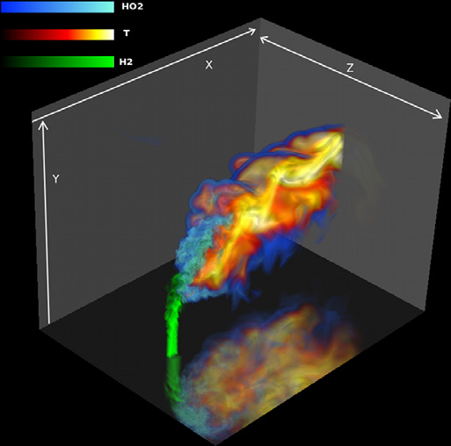
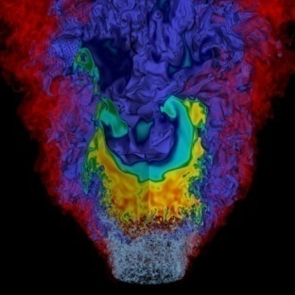
Why Combustion
83% of U.S. energy comes from combustion of fossil fuels
National goals
  Reduce greenhouse gas emissions by 80% by 2050
  Reduce petroleum usage by 25% by 2020
New generation of high-efficiency, low emission combustion systems
  New designs for IC engines such as HCCI
  Fuel flexible turbines for power generation
Rapidly evolving fuel streams
  Biodiesel for transportation
  Syngas from gasification processes
  Alcohols
These factors significantly increase the design space for new combustion technologies
Nitrogen-diluted hydrogen jet in crossflow
NOx emissions from a low swirl injector fuels by H2
Notes:
Reformat

Slide 3

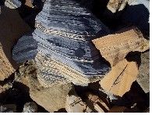

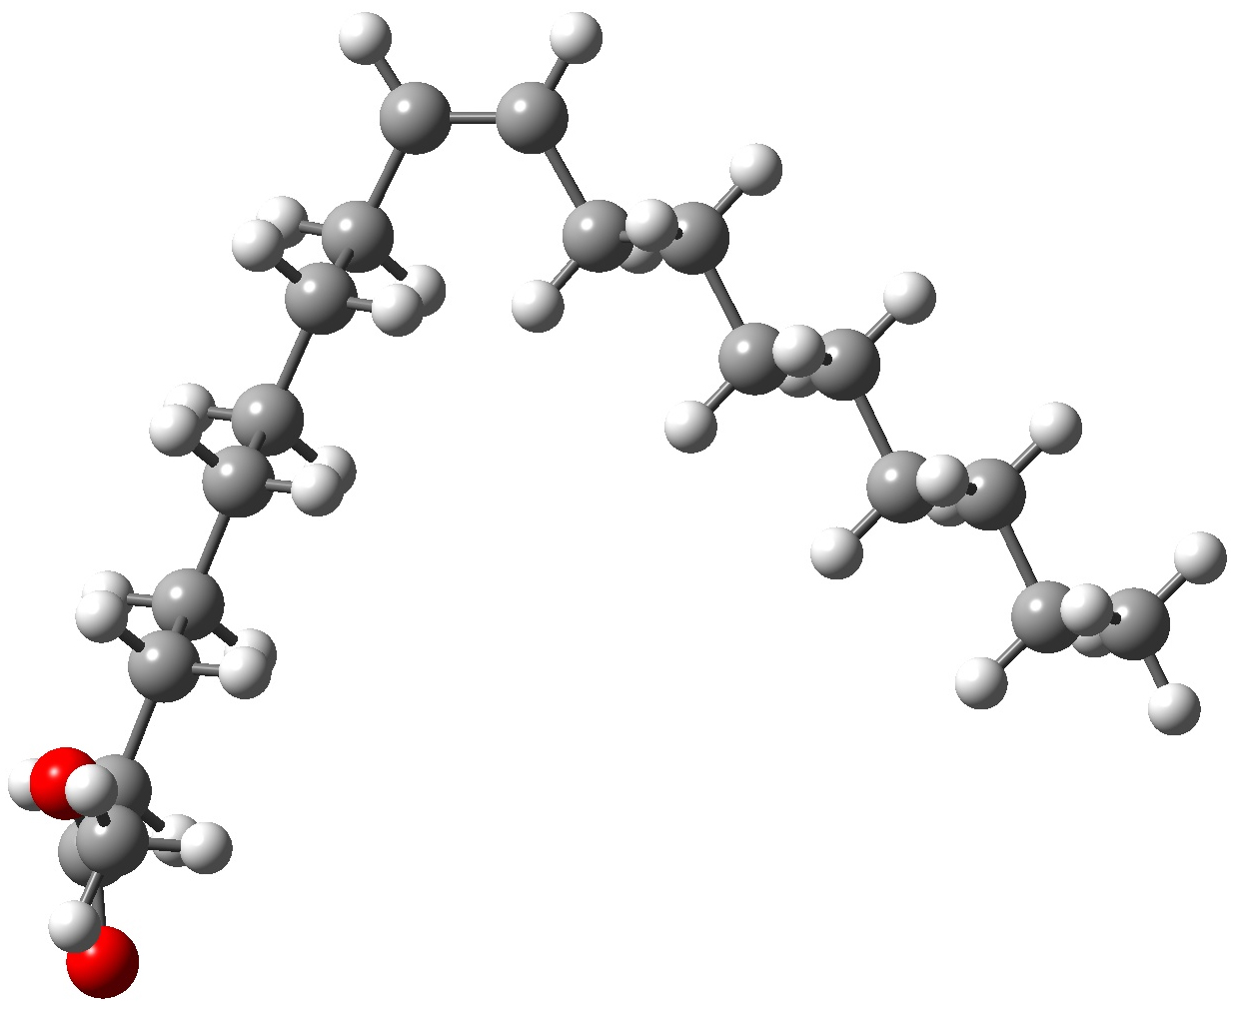

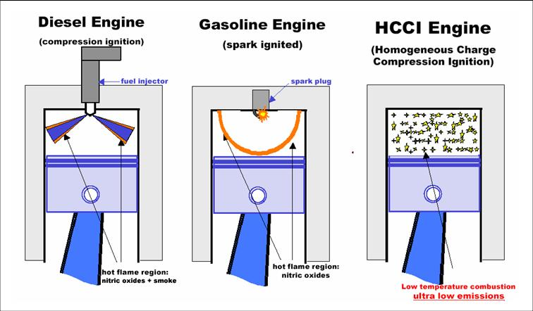
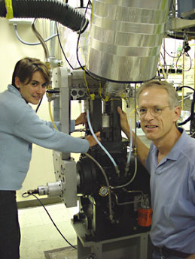
Why Exascale
Current design methodologies are largely phenomenological
  Combustion models based on simplified theory
  Global-step simple chemical kinetics
Significant increase in computational capability will dramatically reduce design cycle for new combustion technologies and new fuels
  Simulations with higher physical fidelity, particularly chemistry at high pressure
  More predictive science-based turbulence/ chemistry interaction models
    Address new mixed-mode regimes driven by efficiency and emissions
    Differentiate effects of alternative fuels
Co-design center is focusing on direct numerical simulation methodologies
  Science base for novel fuels at realistic pressures
  Not addressing complexity of geometry in engineering design codes
  D
Notes:
Reformat

Slide 4
ExaCT Goal
Goal of combustion exascale co-design is to consider all aspects of the combustion simulation process from formulation and basic algorithms to programming environments to hardware characteristics needed to enable combustion simulations on exascale architectures
  Interact with vendors to help define hardware requirements for combustion simulation at the exascale
  Interact with vendors and DOE CS community (X-stack) on requirements for programming environment and software stack needed for combustion simulation
  Interact with applied mathematics community on mathematical issues related to exascale combustion simulation
Combustion is a surrogate for a much broader range of multiphysics computational science areas

Slide 5
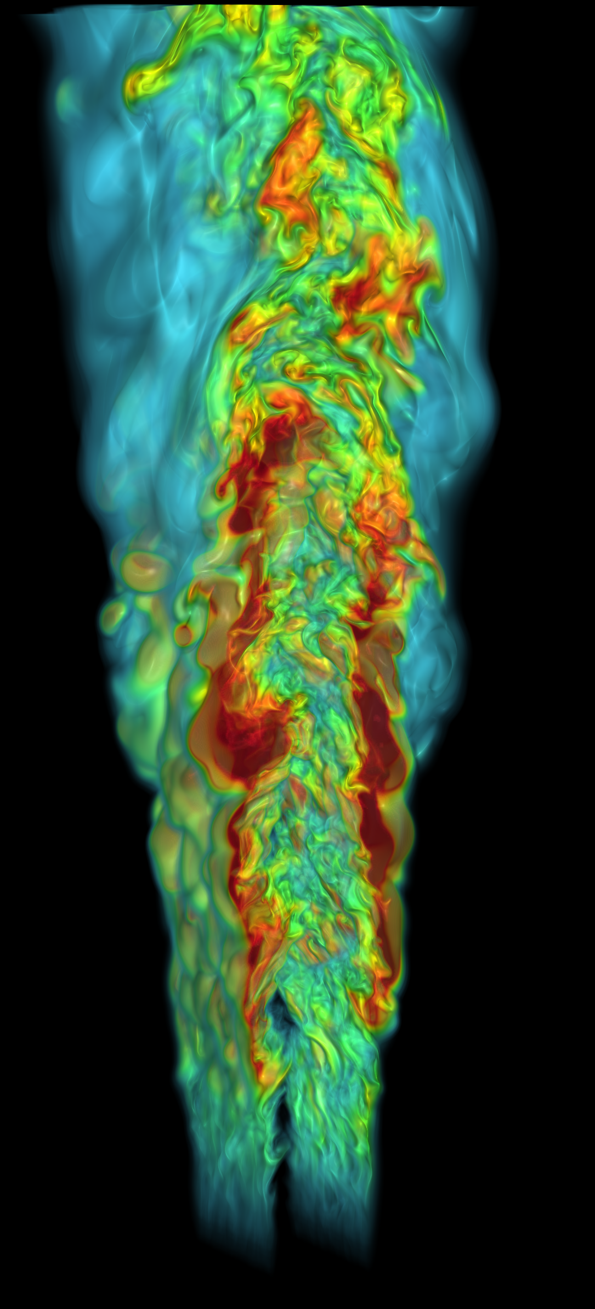
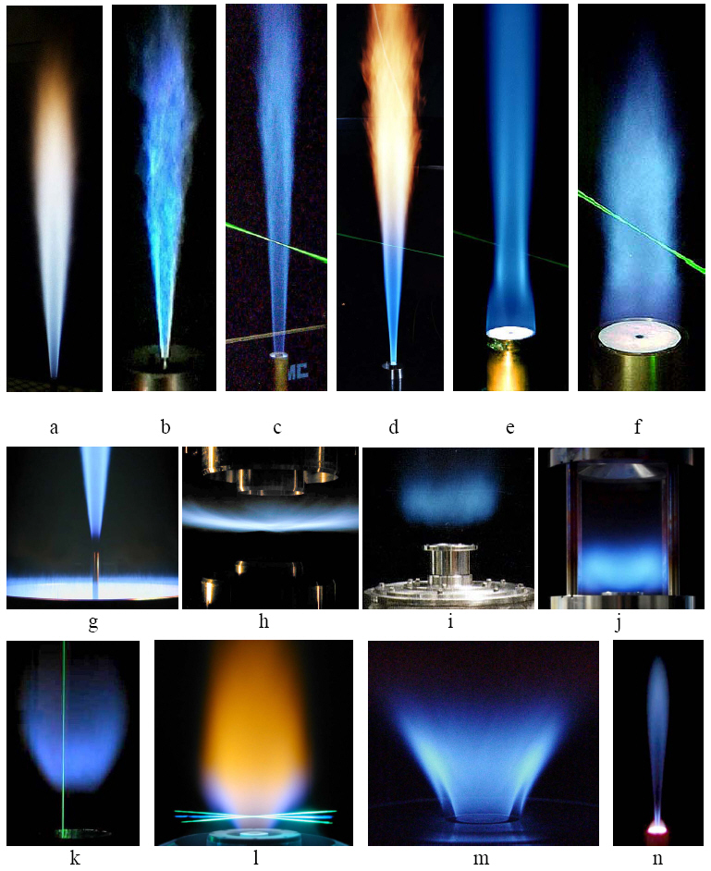
Petascale codes provide starting point for co-design process
S3D
  Compressible formulation
  Eighth-order finite difference discretization
  Fourth-order Runge-Kutta temporal integrator
  Detailed kinetics and transport
  Hybrid parallel model with MPI + OpenMP
  OpenACC pragmas for GPU’s (Titan CAAR)
LMC
  Low Mach Number model that exploits separation of scales between acoustic wave speed and fluid motion
  Second-order projection formulation
  Detailed kinetics and transport
  Block-structure adaptive mesh refinement
  Hybrid parallel model with MPI + OpenMP
Expectation is that exascale will require new code base
S3D simulation of HO₂ ignition marker in lifted flame
Laboratory scale
flames
LMC simulation of NOx emissions from a low swirl injector
Notes:
S3D is a comprssible reacting flow DNS code. It is based on high order finite difference method of lines approach. It supports detailed kinetics and transport and is
implemented in a hybrid parallel model that combines MPI + OpenMP
We can target lab-scale flames but to have impact on design of engines in future we need to simulate at engine relevant conditions.

Slide 6
Petascale codes provide starting point for co-design process
S3D
  Compressible formulation
  Eighth-order finite difference discretization
  Fourth-order Runge-Kutta temporal integrator
  Detailed kinetics and transport
  Hybrid parallel model with MPI + OpenMP
LMC
  Low Mach Number model that exploits separation of scales between acoustic wave speed and fluid motion
  Second-order projection formulation
  Detailed kinetics and transport
  Block-structure adaptive mesh refinement
  Hybrid parallel model with MPI + OpenMP
Expectation is that exascale will require new code base
S3D simulation of HO₂ ignition marker in lifted flame
Target computational capability at exascale:
  High-fidelity physics
    Detailed chemical kinetics
    Multicomponent species transport
  Supports both compressible and low Mach number formulations
  Block-structured adaptive mesh refinement
  Higher-order spatial discretizations
  Higher-order temporal integration
  Support for embedded UQ
  In situ analytics
Laboratory scale
flames
LMC simulation of NOx emissions from a low swirl injector
Notes:
S3D is a comprssible reacting flow DNS code. It is based on high order finite difference method of lines approach. It supports detailed kinetics and transport and is
implemented in a hybrid parallel model that combines MPI + OpenMP
We can target lab-scale flames but to have impact on design of engines in future we need to simulate at engine relevant conditions.

Slide 7
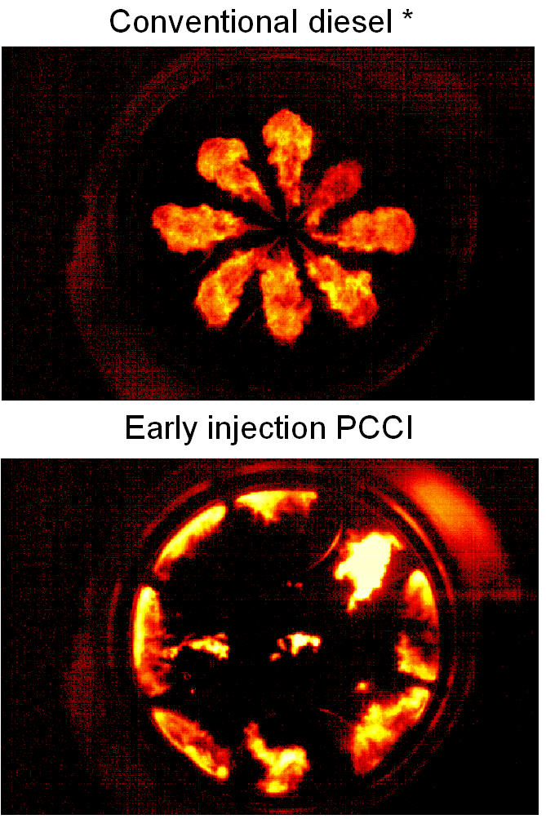

Exascale Target: Advanced Engine Combustion Regimes
2.0
Equivalence Ratio
Conventional Diesel
1.5
Soot
1.0
High Efficiency
Clean Regime
PCCI
Spark
ignited
0.5
Cylinder Temperature [K]
HCCI
NOx
CO
HCCI
0.0
1400
1600
1800
2000
2200
2400
PCCI/HCCI – load limitations
Requires precise charge preparation and combustion control mechanisms
(for auto-ignition and combustion timing)
UNIVERSITY OF WISCONSIN - ENGINE RESEARCH CENTER
7
Notes:
7
Model validated.
Future Work:
Engine Exp’t
Stratification on combustion
AIS with piston geometry design (single spray angle)

Slide 8
Exascale Target: Advanced Engine Combustion Regimes
2.0
Conventional Diesel
Equivalence Ratio
1.5
Soot
Relevant turbulence, pressure, temperature (Re_{t} = 4300, 30-60 atm, 750-2000K)
Domain and grid size: 5cm³, 5 micron grid,
Size of state: 10¹² grids x 100 dof x 8 bytes/dof ~ 1 PB
High water memory use: ~ 3 x (size of state) ~ 3 PB
Number of time steps: 6 ms/5 ns timesteps = 1.2e6 steps
Total run time: 1380e-06 s/time step/grids x 1.2e6 time steps x 10¹² grids / 3600s/hr = 0.46e¹² cpu-hrs (20 days at billion way concurrency)
Total amount of data for analysis: 1.0 exabyte
1.0
High Efficiency
Clean Regime
Spark
ignited
PCCI
0.5
Cylinder Temperature [K]
HCCI
NOx
CO
HCCI
0.0
1400
1600
1800
2000
2200
2400
PCCI/HCCI – load limitations
Requires precise charge preparation and combustion control mechanisms
(for auto-ignition and combustion timing)
UNIVERSITY OF WISCONSIN - ENGINE RESEARCH CENTER
8
Notes:
8
Model validated.
Future Work:
Engine Exp’t
Stratification on combustion
AIS with piston geometry design (single spray angle)

Slide 9
Petascale Workflow Model Won’t Scale
Performing the simulation is not enough – need to analyze results
combustion simulation
Synchronous I/O
O(1-10 EB)/run
O(1B) cores
O(1 PB)/dump every
30 min (1 min)
Synchronous I/O
Analysis
Visualization
I/O bandwidth constraint make it infeasible to save all raw simulation data to persistent storage
  ➔ Integrate simulation and analysis !!!!
Challenge: co-design a workflow that supports smart placement of analyses, visualization and UQ, tracking large graphs, reducing checkpointing size with in situ analytics
Potential to reduce amount of data by 1000-fold
Notes:
Current combustion practice is to write data to persistent disk and then read data later for
analysis. This approach is unlikely to scale well to the exascale and we anticipate a need to integrate analysis and visualization with the simulation. Consequently, as part of the co-design process, we are considering not only the simulation but also a more comprehensive view of the required workflow. These use cases, including analysis and visualization, therefore provide a focus to defining the requirements of an exascale ecosystem needed for effective combustion simulation.
One of the primary challenges in exascale computing is the widening gap between computational power and
machine memory compared to the available I/O bandwidth. If current projections hold true, the classical
paradigm of simulation followed by post-processing will become infeasible. At exascale, simulation codes
will not be able to write a sufficient number of time steps to permanent storage to ensure a reliable analysis.
Therefore, we anticipate that much of the current analysis will need to be integrated with the simulation
codes into a comprehensive combustion workflow

Slide 10
Overall Workflow and Characterization of Solvers/Analytics/UQ Captured Through Proxy Apps
Exascale Machine
Write to Disk
Compressible and Low-Mach Reacting Flow Solvers
Descriptive Statistics Visualization Topological Analysis UQ
Reduced Checkpoints
Reduced Data (downstream analysis and sharing)
Proxy Apps
SMC
SSA
Streaming Statistics
CNS
Compressible solver
Meta-skeletal workflow proxy app
LMC
PVR
Parallel Volume Rendering
Multi-grid
Chemistry
Low Mach AMR
New UQ + topology proxy for adjoint solution data flow
RTC
Reduced Topology
UQ
Notes:
For the solver area, the current proxy apps fall within two main areas: uniform grid compressible flow solvers and low Mach number AMR solvers. For the analytics area, we currently have three proxy apps that represent the main areas of feature extraction and tracking, data statistics, and visualization. These proxy apps will evolve over time as they are modified to reflect changes in hardware and software that arise as part of the co-design process.
We are also planning to develop several additional proxy apps. In particular, we will develop a richer
set of AMR-based proxys and a number of additional analytic- and UQ-focused algorithms. Our initial
development of UQ proxy apps will focus on computational kernels typical of embedded UQ applications.
Special proxy apps for analytics will be developed to test their effectiveness when tightly integrated with
other components, for example to share data structures with the solvers or to select reduced regions of interest
for the UQ computations. To evaluate the entire workflow in conjunction with evolving requirements,
we are also creating an automatic workflow skeleton generator. This skeleton will use the data movement
operators from analysis and visualization proxies to provide a model of the data flow for the entire workflow.
Combined with an emulation of the compute characteristics, this will allow us to provide a platform
for better understanding the entire workflow. In addition, we fully expect to create custom proxy apps as
needed to address specific issues that arise in our interactions within the Center and with vendors and other
research projects.

Slide 11
Proxy Applications - Solver
Uniform grid compressible flow proxies
  SMC – Multicomponent, reacting, compressible Navier-Stokes
    Detailed chemistry and transport
    Eighth-order in space, low storage third-order Runge Kutta in time
    Fully explicit -- Time step limited by acoustics / chemical time scales
    Hybrid implementation with MPI + OpenMP
  CNS – Same stencil operations as SMC
    SMC without species
    Acoustic time step limitation
Low Mach number + AMR
  LMC – Exploit separation of scales between different processes when appropriate
    Projection-based discretization strategy
    Second-order in space and time
    Semi-implicit treatment of advection and diffusion
    Time step based on advection velocity
    Stiff ODE integration methodology for chemical kinetics
    Hybrid implementation with MPI + OpenMP
  Multigrid solver -- > 50% of time in LMC
  Chemical kinetics integration –14% of time in LMC
SMC
CNS
LMC
Chem
Multigrid

Slide 12
Proxy Machines
 |  | Hopper | exaNode1 | exaNode2 | exaPIM
Memory BW | TB/s/node (chip) | 0.05 | 1 | 4 | TBD (higher)
Memory Size | GB/node (chip) | 32 | 256 | 32 | TBD (lower)
Flops | TF/node (chip) | 0.03 | 10 | 10 | 10
# of Cores | Cores/chip | 6 | ~1k | ~1k | TBD
# of Chips | Chips/node | 4 | 1-2 | 1-2 | TBD
Cache (last L) | $/core (MB) | 1 | 32 | 32 | NA
Cache L1 | $/core (KB) | 64 | 16-64 | 16-64 | NA
NIC BW | GB/s | 1 | 100 | 400 | TBD
NIC Latency | microseconds | 1 | 0.4 | ~0 | TBD
Registers | KB/chip
exaNode1 and 2 are many core architectures
exaNode1 uses commodity NIC and memory technology
exaNode2 uses custom on-board NIC and faster memory technology
exaPIM: Processing Near Memory or Processor In Memory
Notes:
An initial cut at the machine proxies for the processors and memory on an exascale node is shown here.
Fix animation of boxes in this slide

Slide 13
Co-Design Methodology
Measurement alone is not sufficient
  Gives performance of today’s algorithms on today’s hardware using today’s software stack
  Difficult to make precise extrapolations
  Difficult to assess algorithm variations
Analytic performance model
  Algorithm variations
  Architectural features
  Identify critical parameters
  Predict trends
Validate performance with hardware simulators / measurements
  Confirm key predictions
  Model what can’t be predicted analytically
Algorithms
Exascale
Application
Performance
Hardware
Software
Notes:
John: What points do you want to make? The next 5-6 slides are on tools/methods for co-design. Is there a way to condense this?

Slide 14
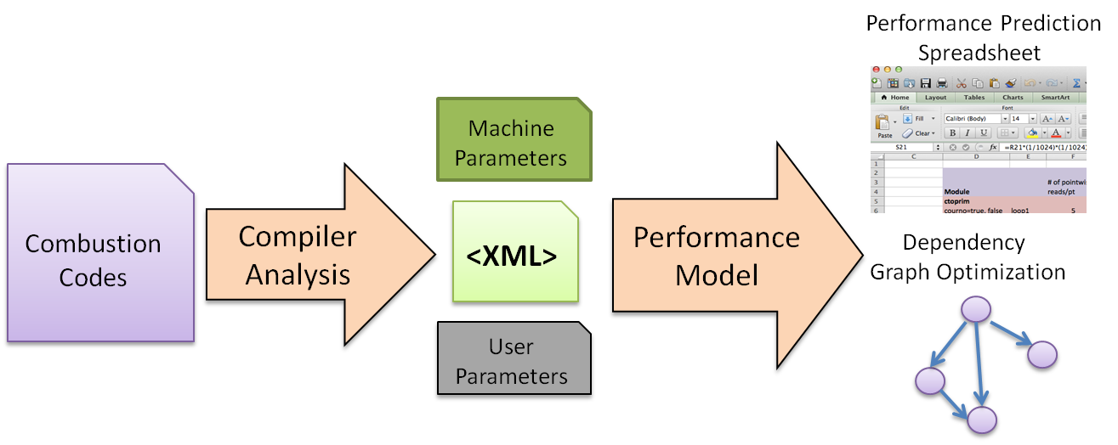
Performance Modeling Tool Chain
Automatically predict performance for many input codes and software optimizations
Predict performance under different architectural scenarios
Much faster than hardware simulation and manual modeling
Includes cache model to capture the working set reuse
Notes:
Performance analysis + prediction
Under different arhcitectural snerioc
How the algorithm formulated?

Slide 15
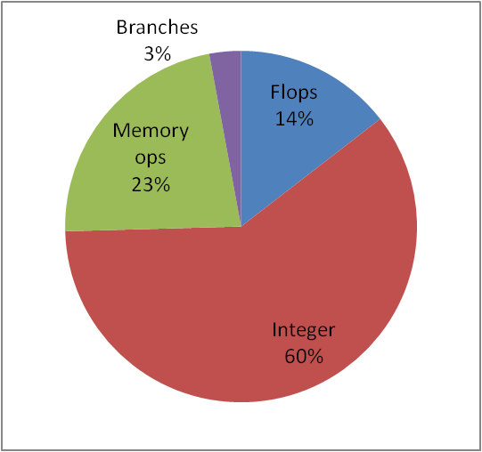
Leveraging the Compiler as a Co-Design Tool
Leveraging compiler infrastructure allows us to:
  Characterize aspects of codes in a hardware independent and customized fashion tailored to co-design questions/goals
  Drive modeling and architecture analysis and more effective communication with the broad co-design team (including vendors)
  Explore characteristics in significantly less time than relying on architecture simulation (especially for large/complex code)
SMC Characterization
Topology Proxy Characterization
Optimization
details
Static information
Code generation
details
Compiler
Algorithm Design &
Development
Performance
Modeling
Vendors &
Architectures
Notes:
To the best of my knowledge, this is a unique aspect of how we are approaching co-design activities within ExaCT.
The compiler toolchain can provide us with a set of leverage points as we proceed from the source-level details
all the way down to details such as architecture-centric optimizations and code generation. Our goal is to use
an associated suite of tools across the Center (solves, SDMA, etc) to help us address questions not only provided
to us by the vendors but also within the cross-discipline teams within ExaCT.
John’s (solvers) talk has already highlighted some of these tools being used and we’ll dive a bit more into the details
in this talk.

Slide 16
Example: Byfl – Compiler-Driven Dynamic Software Performance Counters
Compiler
front end
Intermediate
Representation
Code Analysis
&
Insertion
Code
generation
Source
  architecture
Analysis
Byfl implemented as a language and architecture independent middle-stage compiler pass
  Analyzes code and inserts targeted software-counters into code
  Supports Fortran, C, C++ (via any GNU toolchain frontend)
  Builds upon LLVM -- a common intermediate representation (IR)
Providing answers (estimates) to some initial questions from the vendors:
  What is the memory bandwidth/flop?
  What is the instruction mix?
  What is the read/load to write/store ratio of data?
LLVM web site: http://llvm.org
Open source: http://github.com/losalamos/Byfl
Notes:
The Byfl tool (originally funded by DOE NNSA ASC) takes the approach of leveraging the full compiler toolchain to help
implement software-based performance counters. In this case we operate on an intermediate representation of the
program and walk code structure (functions, loops, basic blocks) and add software-based performance counters that
measure various details that are difficult for hardware performance counters to capture (data type specific operations,
loads vs. stores, instruction mix, etc.).
A key component of our approach is the LLVM infrastructure (adopted by many for production compiler tools: Apple,
AMD, NVIDIA, Intel, Cray, etc.). This gives us a production-quality infrastructure for our work that is already targeted
cross architectures.
ExaCT has extended upon the ASC efforts and will likely continue to do so to further address co-design related needs and
Questions.
Scott Pakin, Pat McCormick (LANL)

Slide 17
Hardware/Software Co-Design Questions
Computational Throughput
  What is the instruction mix, and should we utilize chip area for vector units for special functions?
Registers
  How many registers are needed to capture scalar variables to avoid cache spills?
Memory Bandwidth
  How sensitive is the application to the memory bandwidth?
Cache
  To what extent can on-chip memory (cache) filter memory bandwidth?
  Can software optimizations change the memory bandwidth requirements?
Memory Capacity
  What is the memory footprint of the application, and can NVRAM be used to increase memory capacity?
Network Interface
  How sensitive is the application to network interface (NIC) characteristics in terms of latency and injection bandwidth?
Interconnect Topology
  Which interconnect topologies offer the highest performance for the lowest cost (fat-tree, dragonfly, tori)
  How does job placement affect performance?
Notes:
Initial cut of
John:
What special function?
What does it mean to ‘filter’ memory bandwidth?
What points do you make with this slide?

Slide 18
Basic Characterization of SMC Proxy
Even though transcendentals and division ops might be low in count, they can dominate the CPU time
Notes:
John: How was this characterization done, with BYfl? Or other tools? What is dynamics, everything else but chemistry?

Slide 19
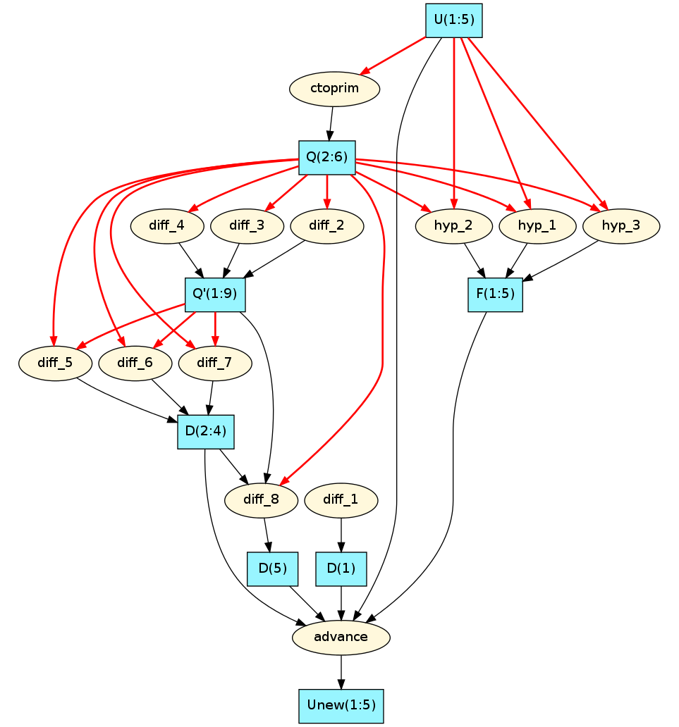
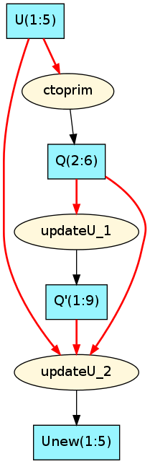
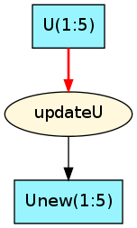
CNS Dependency Graph
Aggressive
Fusion
0.5 GB/sweep (–84%)
0.28 Bytes/Flop
Simple Fusion
1.5 GB/sweep (–45%)
0.93 Bytes/Flop
Baseline
2.8 GB/sweep
1.72 Bytes/Flop
Notes:
John: What does the 2.8 GB/sweep (is this total memory needed per sweep?) vs 1.72 bytes/flop (Is this memory traffic/floating point operations?) represent?
Does exanode 1 imply memory bw/flops is 0.1 and exanode2, 0.4? With aggressive fusion reach exanode 2 bw/flop ratio requirements, but this takes knowledge of data dependences which isn’t provided by compiler, and needs to be exposed to programmer?
Describe loop fusion: merging the bodies of two loops so that they are in the same loop nest. This saves the memory traffic cost for 1) streaming common input arrays into cache multiple times, and 2) streaming temporary arrays in and out of memory (eliminate the arrays).
Simple fusion: compiler may figure out the fusion, no data dependency
Aggressive fusion: very hard to do with compiler,
If we determine aggressive fusion is important , new programming contruct, how can we make it visible to the programmer?
We are looking at this
Baseline
Flops:byte
Baseline 0.58
Simple : 1.07
Aggressive 3.54

Slide 20
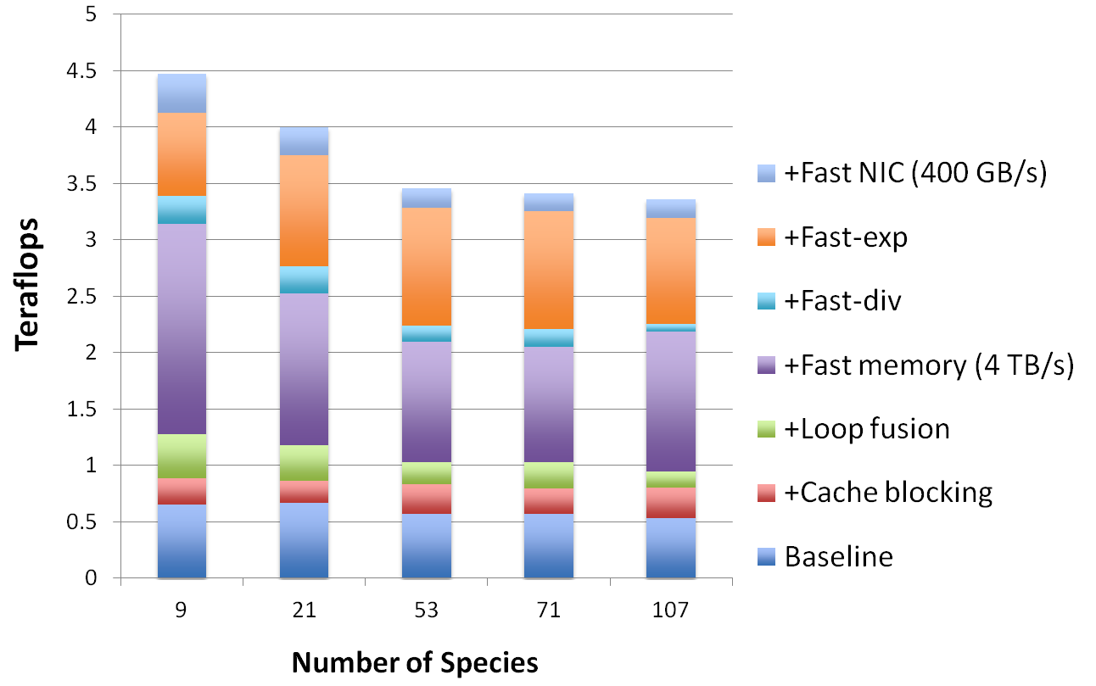
Estimated performance improvements
Neither software optimizations alone nor hardware optimizations alone will not get us to the exascale, we have to apply both.
Notes:
John: Are the hardware optimizations fast memory (bandwidth), fast exp, fast div, and fast NIC?
Why does fast memory benefit larger numbers of species?
What is the size of the problem tested? How many grids per patch and is it 1 patch/node? Should the performance be compared against the 10 Tflop peak? 128^3 1 patch/node, working set size
It would seem that fast memory bandwidth and fast exp are biggest wins.

Slide 21
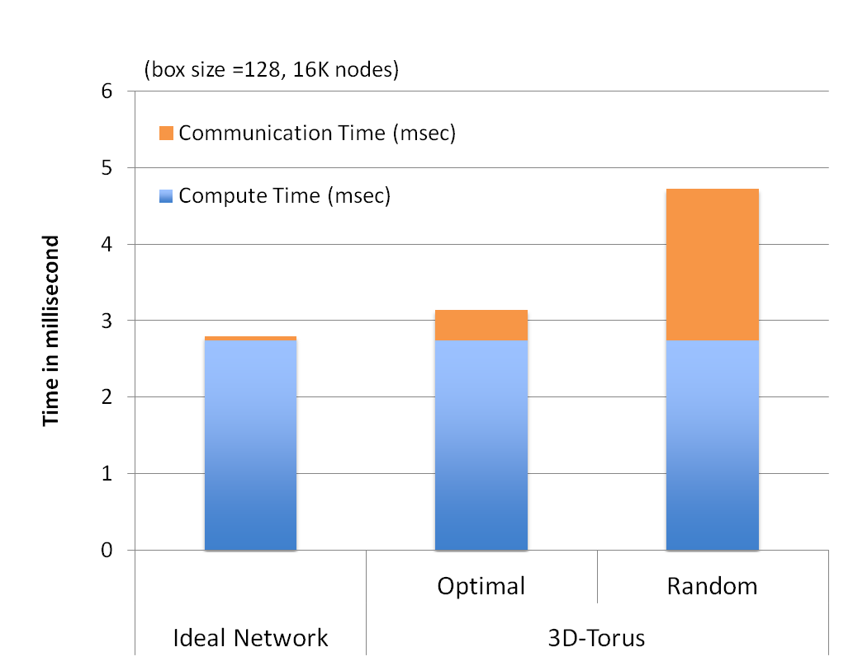
Impact of Data Layout on Performance
Previous analysis assumes ideal network behavior
Use SST macro to model contention on realistic network
Results illustrate importance of locality on performance
  Internode data placement needs to be topology aware
Notes:
John: what is box size 128 and only tested this on 16K nodes, other counts of nodes?
Only tested for 3D torus?

Slide 22
Domain-Specific Languages for Co-Design
A domain-specific language (DSL) is a language of reduced expressiveness targeted at developers in a specific, focused problem domain
Perfect fit for co-design.
  Influenced and driven by both the domain and architecture
  Contributes directly as an enabling technology that insulates applications from the complexity of the architecture. Specialized software that works well with the co-designed hardware.
Starting points:
  Team has previous experience in DSLs via ASC PSAP (Stanford) – unstructured CFD, DSL with LLVM (LANL)
  LLVM Common IR for vendor toolchain interactions and supporting infrastructure (not building compiler from scratch). Using as FastForward interface for code generation (with AMD and NVIDIA). Intel? IBM?
  Orion Stencil DSL
  Memory-hierarchy-aware programming model and runtime (Legion – leveraging initial DARPA funding)
  Terra Language (DSL building blocks)
Source
DSL
Compiler
Common
IR
Runtime
Auto-tune
Vendor
Code Gen
  architecture
Notes:
A key point here is that DSLs themselves to contribute to co-design directly. They are an
enabling technology that allows application programmers to be insulated from the complexity
of highly optimized machines. And like co-design, which often proposes specialized hardware
Functionality, DSLs allow for specialized software that works well with the specialized hardware.
Reduced language expressiveness allow us to reduce the complexity of not only coding in the domain but also
compiling/optimizing in comparison to general-purpose languages (i..e. addresses part of the problems we have
today in getting compilers to fully optimize general-purpose languages).
There have always been concerns about the co-design center tackling this – we’re leveraging a lot of existing
software for these parts of our effort (that have/had funding from other efforts). In addition, our leveraging of
LLVM IR gives us a nice connection to the vendor’s tool chains (for those who are playing along) and also a
modular, production-quality infrastructure (primarily to help reduce complexity and level of effort).

Slide 23
Legion: Programming Locality and Independence
Programming based on logical regions to hierarchically describe organization of data
  Legion tasks operate on logical regions, specifying required privileges (read-only, read-write, reduction) and coherence (exclusive, atomic, etc.)
  Mapping of tasks and regions onto processors and memories. Programmable from both domain and architecture points of view
All Cells
*
All Shared Cells
All Private Cells
Boundary Cells
*
*
*
Ghost
Owned
*
*
L3$
*
L2$
Notes:
Locality – data close to computation
Independence – computations operating on disjoint data (finding parallelism)
Legion tasks operate on logical regions, specifying required privileges (read-only, read-write, reduction) and coherence (exclusive, atomic, etc.)
Mike Bauer, Sean Treichler, Alex Aiken (Stanford)
Start with a slightly modified version the first two bullets from Pat's slide:
* Programming based on logical regions to hierarchically describe organization of data
* Legion tasks operate on logical regions, specifying required privileges (read-only, read-write, reduction) and coherence (exclusive, atomic, etc.)
and a small version of the region tree from Pat's slide (although you can probably get away with cropping the bottom two layers of the tree).
Then I'd include a very-scaled down version of the dataflow graph I sent you - it won't be readable, but that helps make the following points:
* Tasks are coded in familiar sequential style (subtasks look like function calls).
* Legion runtime uses region information to _automatically_ extract parallelism and map tasks using the same data
together to benefit from locality.
* Current S3D fortran has no task parallelism and interleaves 3 inter-node transfers at a time.
* Straightforward port of code to Legion:
- results in identification of 100's of independent tasks by runtime
- allows interleaving of up to 100's of inter-node transfers to hide communication latencies.
- has a code structure that is very similar to current Fortran code
I'm often chastised for putting too much text on my slides, so some of that may be better left as talking points. The key is that the parallelism and locality are already there in most apps, and with a little help from the programmer to specify which "regions" of data they're accessing, the runtime can do the busywork needed to actually extract the parallelism and make use of the locality.
- Sean

Slide 24
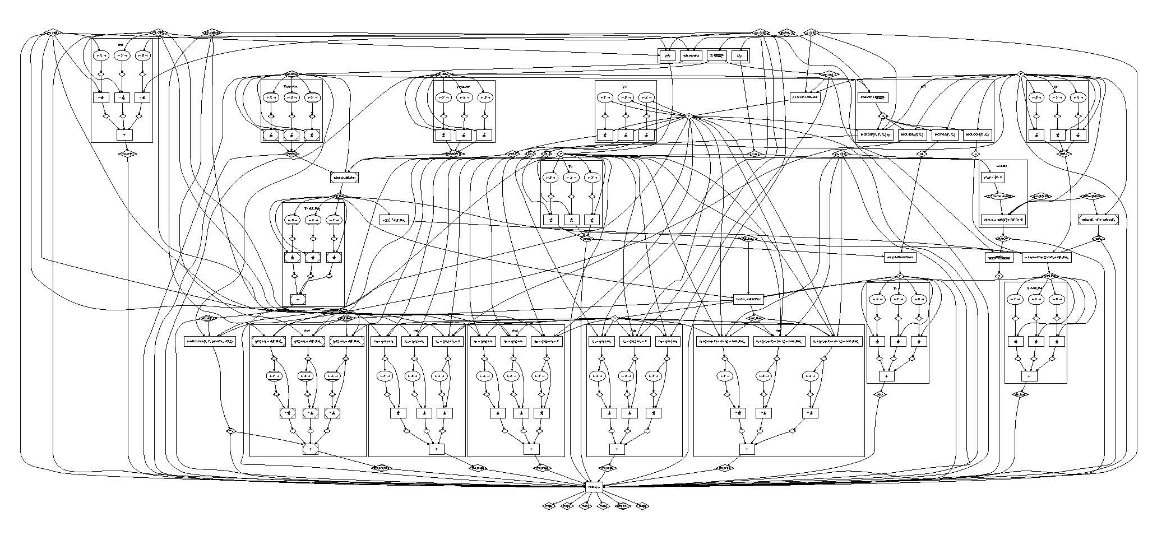
Exposing Locality and Expressing Parallelism in S3D
Tasks are coded in familiar sequential style (subtasks look like function calls).
Legion runtime uses region information to automatically extract parallelism and map tasks using the same data together to benefit from locality.
Current S3D Fortran has no task parallelism (interleaves 6 inter-node transfers at a time.
Straightforward port of S3D to Legion:
  Results in identification of 100's of independent tasks by runtime
  Allows interleaving of up to 100's of inter-node transfers to hide communication latencies.
  Has a code structure that is very similar to current Fortran code
S3D Data Flow Graph in Legion
Notes:
The 100's of internode transfers are the ones used for all the spatial derivatives for various intermediate gradient calculations and all the final rhs terms. In the Fortran code, there are up to 6 (not 3, like I initially said) interleaved: the X+, X-, Y+, Y-, Z+, Z- for a single gradient/derivative, and this is done with some ugly transformations to the Fortran code. In Legion, the independence of those 6 transfers for a given derivative, as well as the independence of the transfers for all the other derivatives, is determined automatically.
The 100's of independent tasks again come from all the stencil operations as well as any other computations that operate on different data (e.g. computation of the stress tensor vs. computation of heat flux). The work Mike has been doing on getrates is further increasing the parallelism by breaking the monolithic getrates call into several subtasks which are independent by construction, and will be run in parallel by the Legion runtime.

Slide 25
At exascale, the model of compute first, analyze later will be infeasible: SDMA challenges at exascale
The widening gap between compute power and available I/O rates will make it infeasible to save all necessary data for post processing
  Data analysis and/or data triage must be performed on the fly
  “On-system” workflow architectures must be explored
Analysis codes have markedly different characteristics compared to simulation codes challenging current hardware and software stacks
  Can require data-dependent computations and global communications, which are difficult/expensive to scale
Understanding and modeling interaction / coordination behaviors of end-to-end workflows will be critical to co-design
  Empirical evaluations must be used, along with analytic models to explore the complete co-design space

Slide 26
Approach to Characterize SDMA Requirements
Develop proxy / skeletal applications for a representative set of data analyses methods and characterize machine independent characteristics, e.g. memory access patterns, communication patterns, etc.
Define and characterize relevant workflow architectures and map (formally and empirically) the machine independent information to specific architectural choices
Integrate analytics and simulation proxies to understand end-to-end performance characteristics of the combustion workflow & express this using the meta-skeleton abstraction

Slide 27
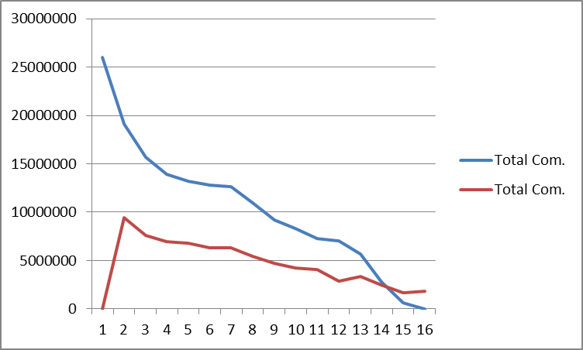
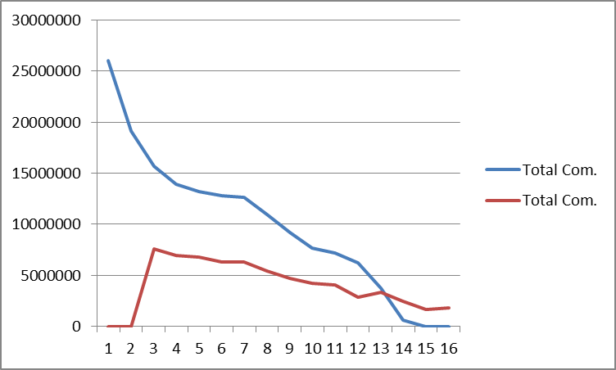
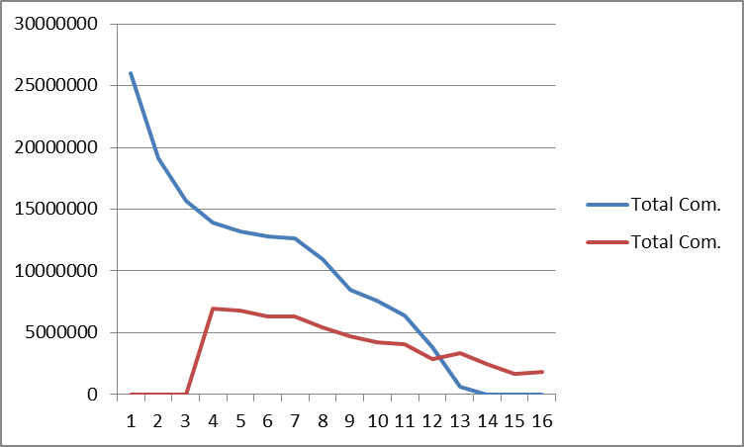
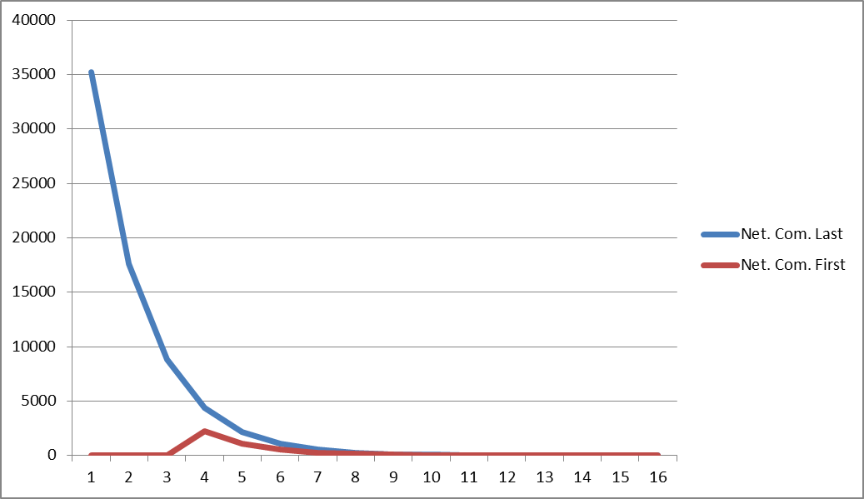
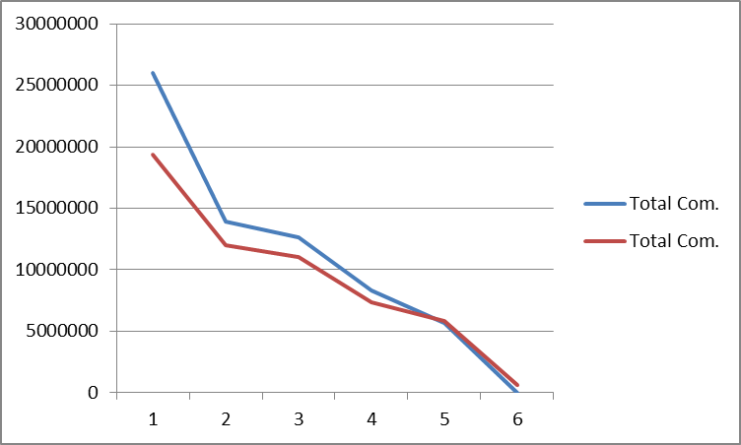
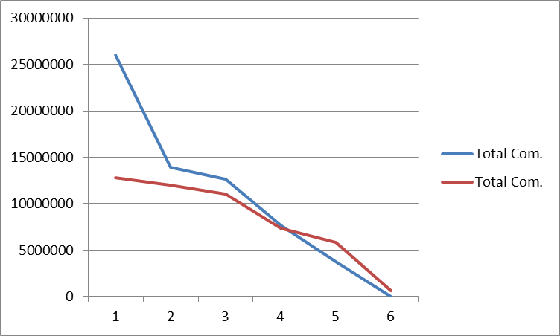
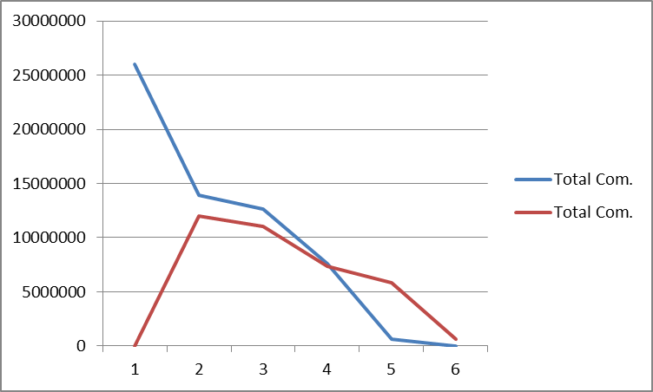
Initial lessons show highly heterogeneous behaviors and requirements
2-cores per node
4-cores per node
8-cores per node
binary merge
Total Communication
8-way merge
Merge stages
Analytics instruction mixes cover a wide range of behaviors
Algorithms range from Flop-free to having more Flops than solver
Mapping machine independent characterizations onto future workflow architectures is important
Algorithms can have a cross-over in communication costs for different workflow architectures
Notes:
Valerio: explain figure on the right

Slide 28
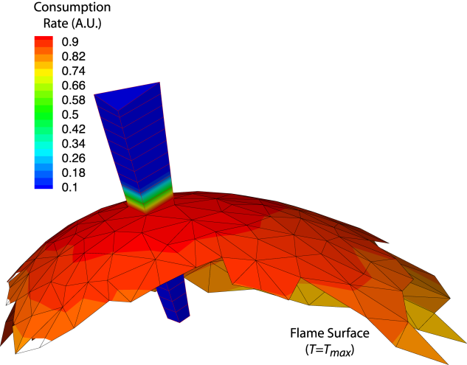
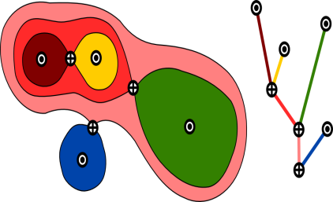
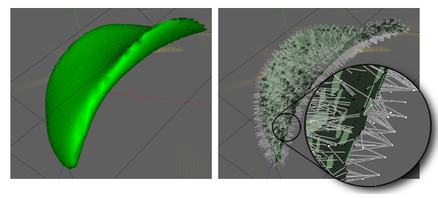
Extracting Knowledge from Simulation Requires Range of Analysis With Different Instruction Mixes
Visualization (PVR)
  In situ multi-variate volume and particle rendering
  Lagrangian particle querying and analysis
Topological Segmentation and Flame/Flow Geometry (RTC)
  Topological segmentation:
    Contour trees
    Morse-Smale complex
    Time tracking
    Scalar field comparison
  Distance field (level set)
  Shape analysis
Statistics (SSA)
  Filtering and averaging (spatial and temporal)
  Statistical moments (conditional)
  Statistical dimensionality reduction (joint PDFS)
  Spectra (scalar, velocity, coherency)
Flame-centric control volume analysis
Analytics instruction mixes cover a wide range of behaviors
Algorithms range from Flop-free to having more Flops than solver

Slide 29
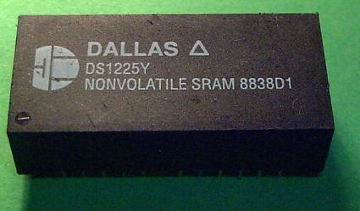
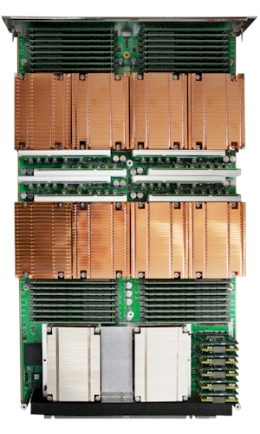
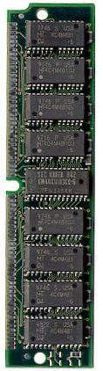
Rich Design Space of Workflows at Exascale
Location of analysis compute resources
  Same cores as the simulation (in-situ)
  Dedicated cores on the same node (in-situ)
  Dedicated nodes on the same machine (in-transit)
  Dedicated nodes on external resource (in-transit)
Synchronization and scheduling
  Execute synchronously with simulation every n^{th} simulation time step
  Execute asynchronously
Data access, placement, and persistence
  Shared memory access via hand-off / copy
  Shared memory access via non-volatile near node storage (NVRAM)
  Data transfer to dedicated nodes or external resources
simulation
analysis
network communication
shared cores
dedicated separate nodes
dedicated cores on same node
…
synchronous
time
…
asynchronous
time
dram hand-off/copy
non-volatile shared memory
data transfer to dedicated nodes

Slide 30
An empirical study demonstrates hybrid workflow architectures show promise for minimizing impact to the simulation
Primary resources: execute main simulation & in situ computations
Secondary resources: staging area for in transit computations
}
Minimal impact
Profound impact reduction for non-scalable algorithms
}
Significant impact
Simulation size: 1600x1372x430
All measurements: per simulation time step
4896 cores total: 4480 in situ /
256 in transit / 160 scheduling

Slide 31
Meta-Skeleton Abstraction for Co-Design of Overall Workflow
End-to-end workflow comprises heterogeneous components
  Individual proxy & skeletal apps are per component characterizations
  The Meta-Skeleton models the dynamic interaction between components
Meta-skeleton abstraction supports cross-layer co-design
  Proxy apps, skeletal apps and kernels characterize components
  Programming models provide abstractions to couple the components
  Simulators map workflow onto future architectures
Characterize how workflow influences hardware design choices
Characterize how hardware design constraints influence the workflow
Notes:
I don’t think Analytical is a good word here.

Slide 32
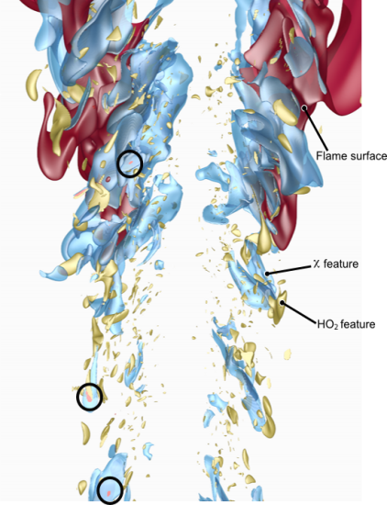
Intrusive Uncertainty Quantification - Chemistry Models are Source of Error in DNS:
Motivation: Inform chemical kineticists and chemical engineers in the fuels industry (BP, Exxon) on what chemical properties need to be pinned down more accurately for optimal utilization of a given fuel
Embedded chemistry model source of uncertainty
  Reaction rates
  Missing reactions
  Transport coefficients
Combustion intermittency characterized by space-time localized phenomena of interest, tractable for UQ
Solve adjoint equations backward in time: need the primal state at all times (data management opportunity for co-design)
Notes:
Combustion intermittency characterized by space-time locality, dependent on local turbulence scales, and this bounds regions of interest for in situ UQ
Effective, robust UQ methods for long-time, chaotic systems open research question.
Space/Time localized phenomena of interest more tractable for current UQ methods(Extinction, Ignition)
Embedded chemistry models inherent source of uncertainty
Reaction rates
Missing/under-modeled processes/reactions
Species concentrations, initial profiles
Expression/reduction of basic science/prediction goals to mathematical UQ framework.
Leads to tractable and relevant set of UQ problems
Helps catalog varying sources of uncertainty
What is the uncertainty in reaction rates characterizing intermittent combustion events that control fuel efficiency and emissions with respect to uncertainties in input parameters: elementary chemical rates and species transport properties
Leads to optimization over:
Available fast/slow memory
Costs of using slow(er) storage
Forward state recomputation(checkpointing)
Adjoint state(and resulting sensitivities) computation accuracy

Slide 33
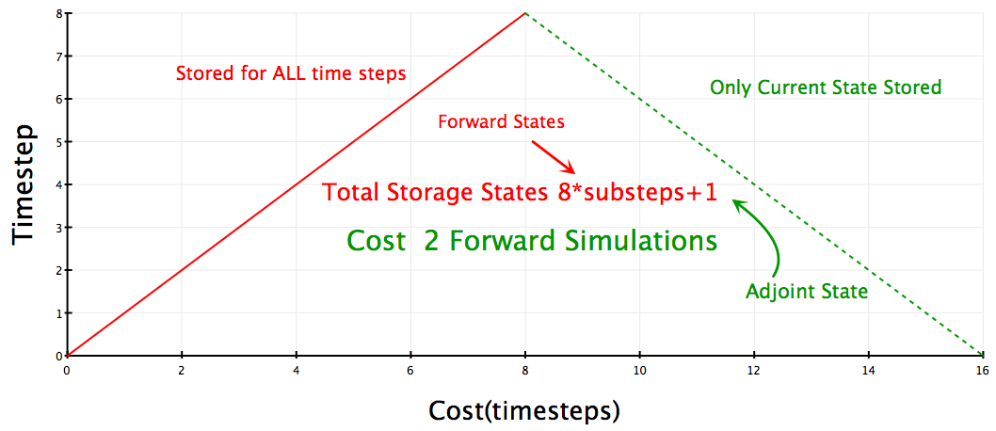
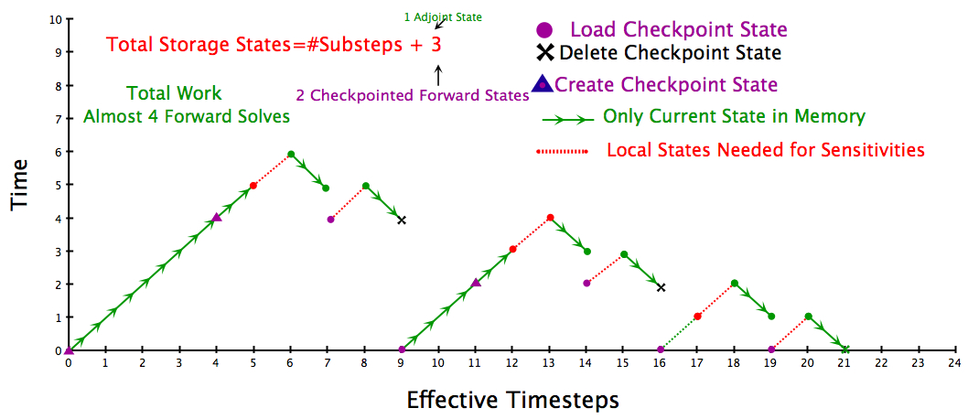
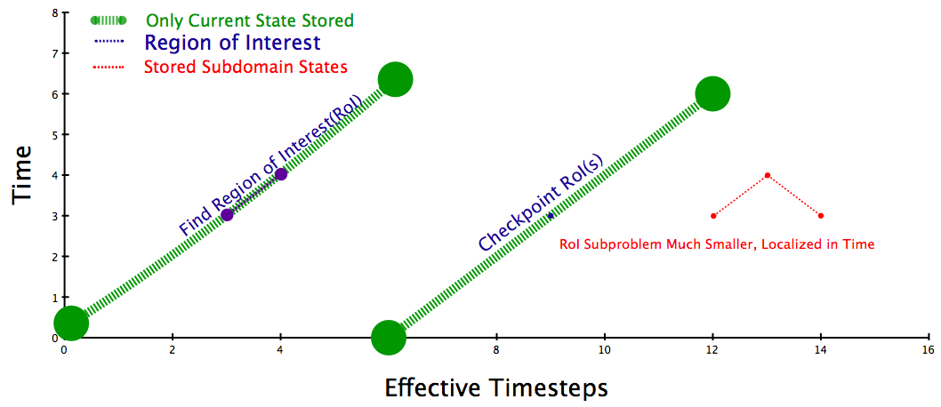
Intrusive UQ poses a co-design challenge:
How to effectively manage the work and data flow
Storing entire primal state is infeasible: 5ZB
Recomputation reduces storage costs: 4 EB
Adjoint UQ Proxy App available to explore trade-offs in the adjoint work & data flows
Focusing computation to regions of interest (ROI) : 500PB/ROI
Notes:
Research of UQ impact on SDMA parallels proxy app thrust
Adjoint-based Sensitivity Analysis
Computation of adjoint requires solution access on all of a space-time domain “near” the phenomena of interest.
Leads to optimization over:
Available fast/slow memory
Costs of using slow(er) storage
Forward state recomputation(checkpointing)
Adjoint state(and resulting sensitivities) computation accuracy
Proposed adjoint solution process involves many functions
Identifying interesting events (in-situ analytics)
Checkpointing primal solution in RoIs
Interleaving primal recompute with adjoint solution
Managing data flow
Analyzing adjoint solution (in-situ)
Explore impact of hardware configurations and how they are used
Explore tradeoff between storage, data movement and recomputing
Building proxy application(s) to represent the adjoint work and data flow
Build on BoxLib data structures
Flexible expression of computing and data management tasks

Slide 34
Future Directions
Develop more complete models for exascale combustion simulation
  Architecture aware AMR algorithms
    Incorporate interconnect topology into AMR data layout
    Dynamic load-balancing that incorporates communication costs, data movement and dynamic machine behavior
  Capture model for complete work flow
    Encapsulate all aspects of analysis into performance model
Explore hardware tradeoffs with vendors and CS collaborators
  Refined analysis of node architectures
  Analysis of network behavior for AMR at scale
  Explore tradeoffs for machine balance
Focused interaction with programming environment community to ensure that future programming models will support effective expression of methodology needed for combustion simulation

Slide 35
Contact
www.exactcodesign.org
jhchen@sandia.gov

Slide 36
Integrating UQ into the combustion workflow introduces unprecedented challenges
Goal: Evaluate sensitivities of quantities of interest with respect to
  chemistry model parameters
  modeled fields (e.g. reaction rate fields)
The classical approach to solving this problem requires solving P+1 forward simulations, where P is the number of sensitivity evaluations
  P can be very large (>> 1000) making this classical approach infeasible
Adjoint approach: solve one auxiliary problem, the adjoint problem
  Linearized about the primal solution
Need the primal (forward) solution to solve the adjoint problem
  Catch: adjoint problem has reverse causality
Notes:
The Problem: Evaluate sensitivities of quantities of interest (QoIs) with respect to chemistry model parameters, or modeled fields (e.g. reaction rate fields)
The classical approach to solving this problem requires solving
P+1 forward simulations, where P is the number of sensitivity evaluations
P can be very large (>> 1000) makes classical approach infeasible
Adjoint approach: solve one auxiliary problem, the adjoint problem, which is linearized about the primal solution.
Need the primal (forward) solution to solve the adjoint problem.
The catch: the adjoint problem has reverse causality.
What is possible for UQ?
Adjoin – reverse causality – solve nbackward in time

Slide 37
Adjoint solutions pose a co-design challenge:
How to effectively manage the work and data flow
Storing entire primal state is infeasible: 5ZB
Recomputation reduces storage costs: 4 EB
Proxy apps are being developed to explore trade-offs in the adjoint work & data flows
Focusing computation to regions of interest (ROI) : 500PB/ROI
Notes:
Proposed adjoint solution process involves many functions
Identifying interesting events (in-situ analytics)
Checkpointing primal solution in RoIs
Interleaving primal recompute with adjoint solution
Managing data flow
Analyzing adjoint solution (in-situ)
Explore impact of hardware configurations and how they are used
Explore tradeoff between storage, data movement and recomputing
Building proxy application(s) to represent the adjoint work and data flow
Build on BoxLib data structures
Flexible expression of computing and data management tasks

Slide 38
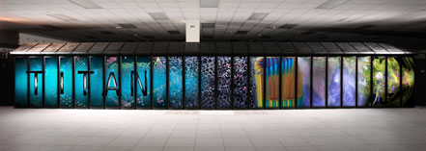
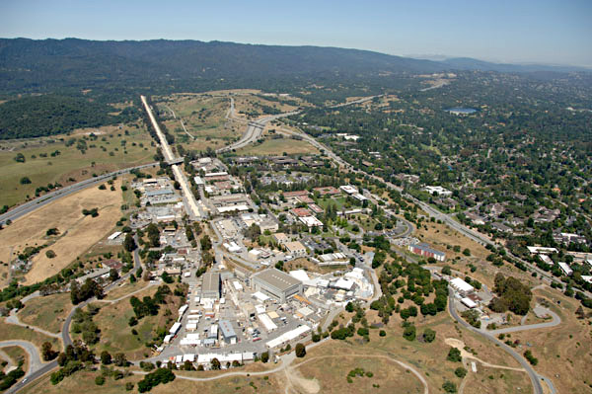
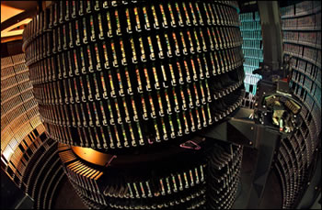
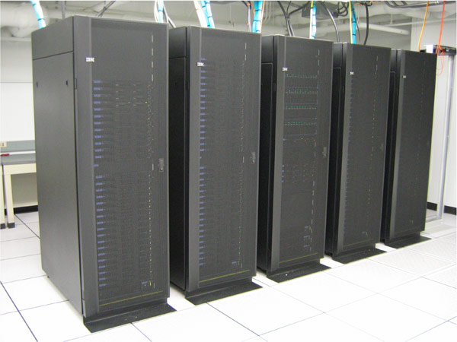
Current big compute and high-throughput experimental workflows are similar
Big Compute
Experimental
Simulate
Experiment
Need to verify experimental workflow
Store
Store
Analyze
Analyze

Slide 39
Both big compute and high-throughput experimental workflows face big data challenges
Both big compute and high-throughput workflows will generate too much data to be stored directly
Future workflows will move analysis closer to both simulations and experiments
  Either full analysis or data reduction performed in situ
  Secondary computational resources finish time-sensitive computations for computational steering
  Reduced data stored for down-stream analysis
Co-design is needed to identify the architectural designs that result in global optimized performance

Slide 40
Backup slides

Slide 41
Synchronous I/O at exascale is expensive
Combustion simulation
Synchronous I/O
O(400 PB)/run
O(1M) cores
1 PB/dump
every 30 minutes
Synchronous I/O
Storage space requirements
  35 disks for each dump (No RAID)
  1.5 KW/live dump
Performance requirements
  5% overhead, ~1M disks, >40 MW
  10% overhead, ~500K disks, >20 MW
  50% overhead, ~100K disks, >4 MW
Analysis
Visualization
Downstream Analytics
Notes:
Examples of Analysis/Viz/Downstream tasks?

Slide 42
Asynchronous I/O is also expensive
Combustion simulation
Asynchronous I/O
O(400 PB)/run
O(1M) cores
1 PB/dump
every 30 minutes
Synchronous I/O
Storage space requirements
  35 disks for each dump (No RAID)
  1.5 KW/live dump
Performance requirements (absorb output in 30 minutes)
  ~1500 disks, 60 KW
Analysis
Visualization
Downstream Analytics
Notes:
Examples of Analysis/Viz/Downstream tasks?

Slide 43
UQ Impact: Turbulent Combustion
Effective, robust UQ methods for long-time, chaotic systems open research question.
Space/Time localized phenomena of interest more tractable for current UQ methods(Extinction, Ignition)
Embedded chemistry models inherent source of uncertainty
  Reaction rates
  Missing/under-modeled processes/reactions
  Species concentrations, initial profiles
Expression/reduction of basic science/prediction goals to mathematical UQ framework.
  Leads to tractable and relevant set of UQ problems
  Helps catalog varying sources of uncertainty

Slide 44
UQ Challenges: Nodal Proxy Apps
Two Classes of Intrusive UQ Proxy Apps
Adjoint-based Sensitivity Proxy App
  Allows efficient sensitivity analysis for large number of parameters
  Requires solution of adjoint problem, backwards in time.
  Implementation impacts available fast-memory(need state(s), adjoint state).
  Increases need for low-storage, high-order time integrator
  CNS Sensitivity Proxy App available now.
Polynomial Chaos(PC) Proxy App
  Even “S3D-like” implementation requires access to distinct realizations of solution state.
  Increased memory access influences stencil, time-integrator, and parallel decomposition choices.
  Proxy app allows exploration of different multirate time integration/operator split choices at the “realization”/PC coefficient level.
  PC Proxy App available 5/12.

Slide 45
UQ Challenges: Data Management
Research of UQ impact on SDMA parallels proxy app thrust
Adjoint-based Sensitivity Analysis
  Computation of adjoint requires solution access on all of a space-time domain “near” the phenomena of interest.
  Leads to optimization over:
    Available fast/slow memory
    Costs of using slow(er) storage
    Forward state recomputation(checkpointing)
    Adjoint state(and resulting sensitivities) computation accuracy
Intrusive, Polynomial Chaos enabled UQ.
  “S3D-like” implementation can result in significant data movement
  AMR, multi-level methods, implicit time integration lead to even greater data challenges

Slide 46
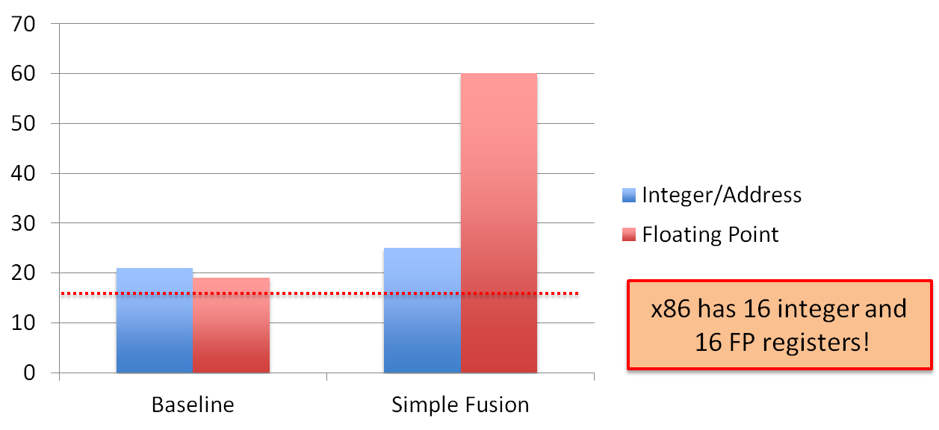
Register State Estimates
These estimates are for state variables only and do not include registers needed for arithmetic
If there are not enough registers available, state variables spill into the L1 cache, increasing cache traffic and possibly affecting performance

Slide 47
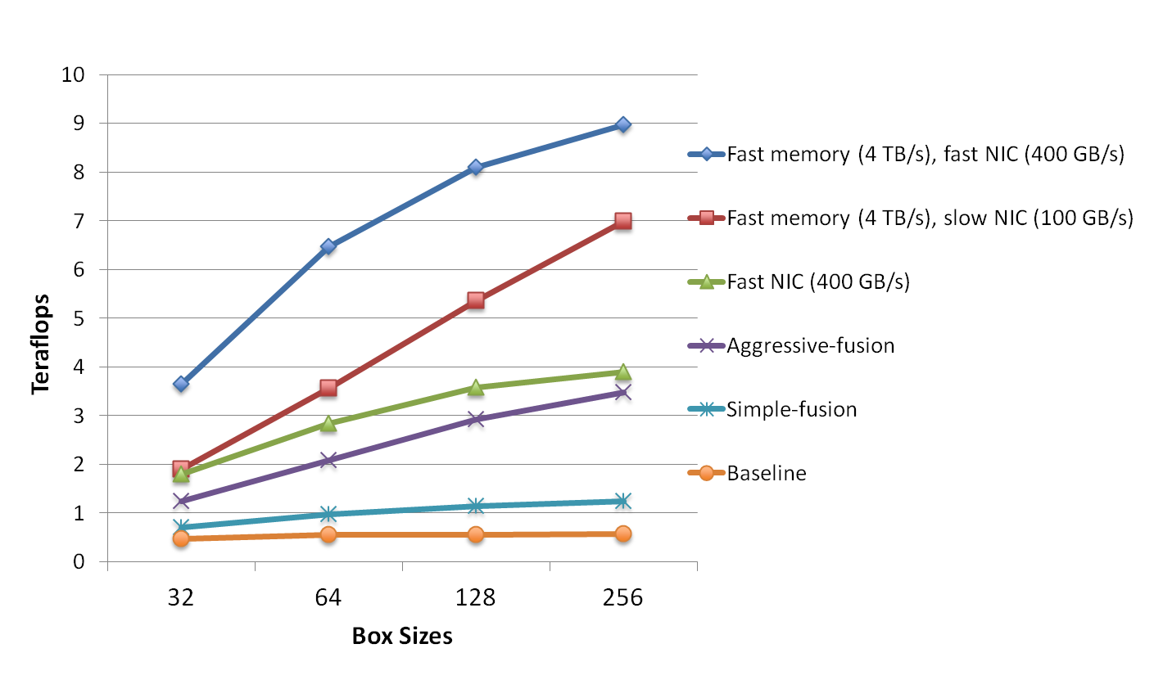
Impact of Exascale Node Characteristics on CNS Performance
Aggressive loop fusion improves performance
Fast memory doubles performance – but limits memory per node
Network
  High bandwidth network not significant for slow memory
  High bandwidth network is significant with faster memory bandwidth
  Latency not that important except for very small box sizes

Slide 48
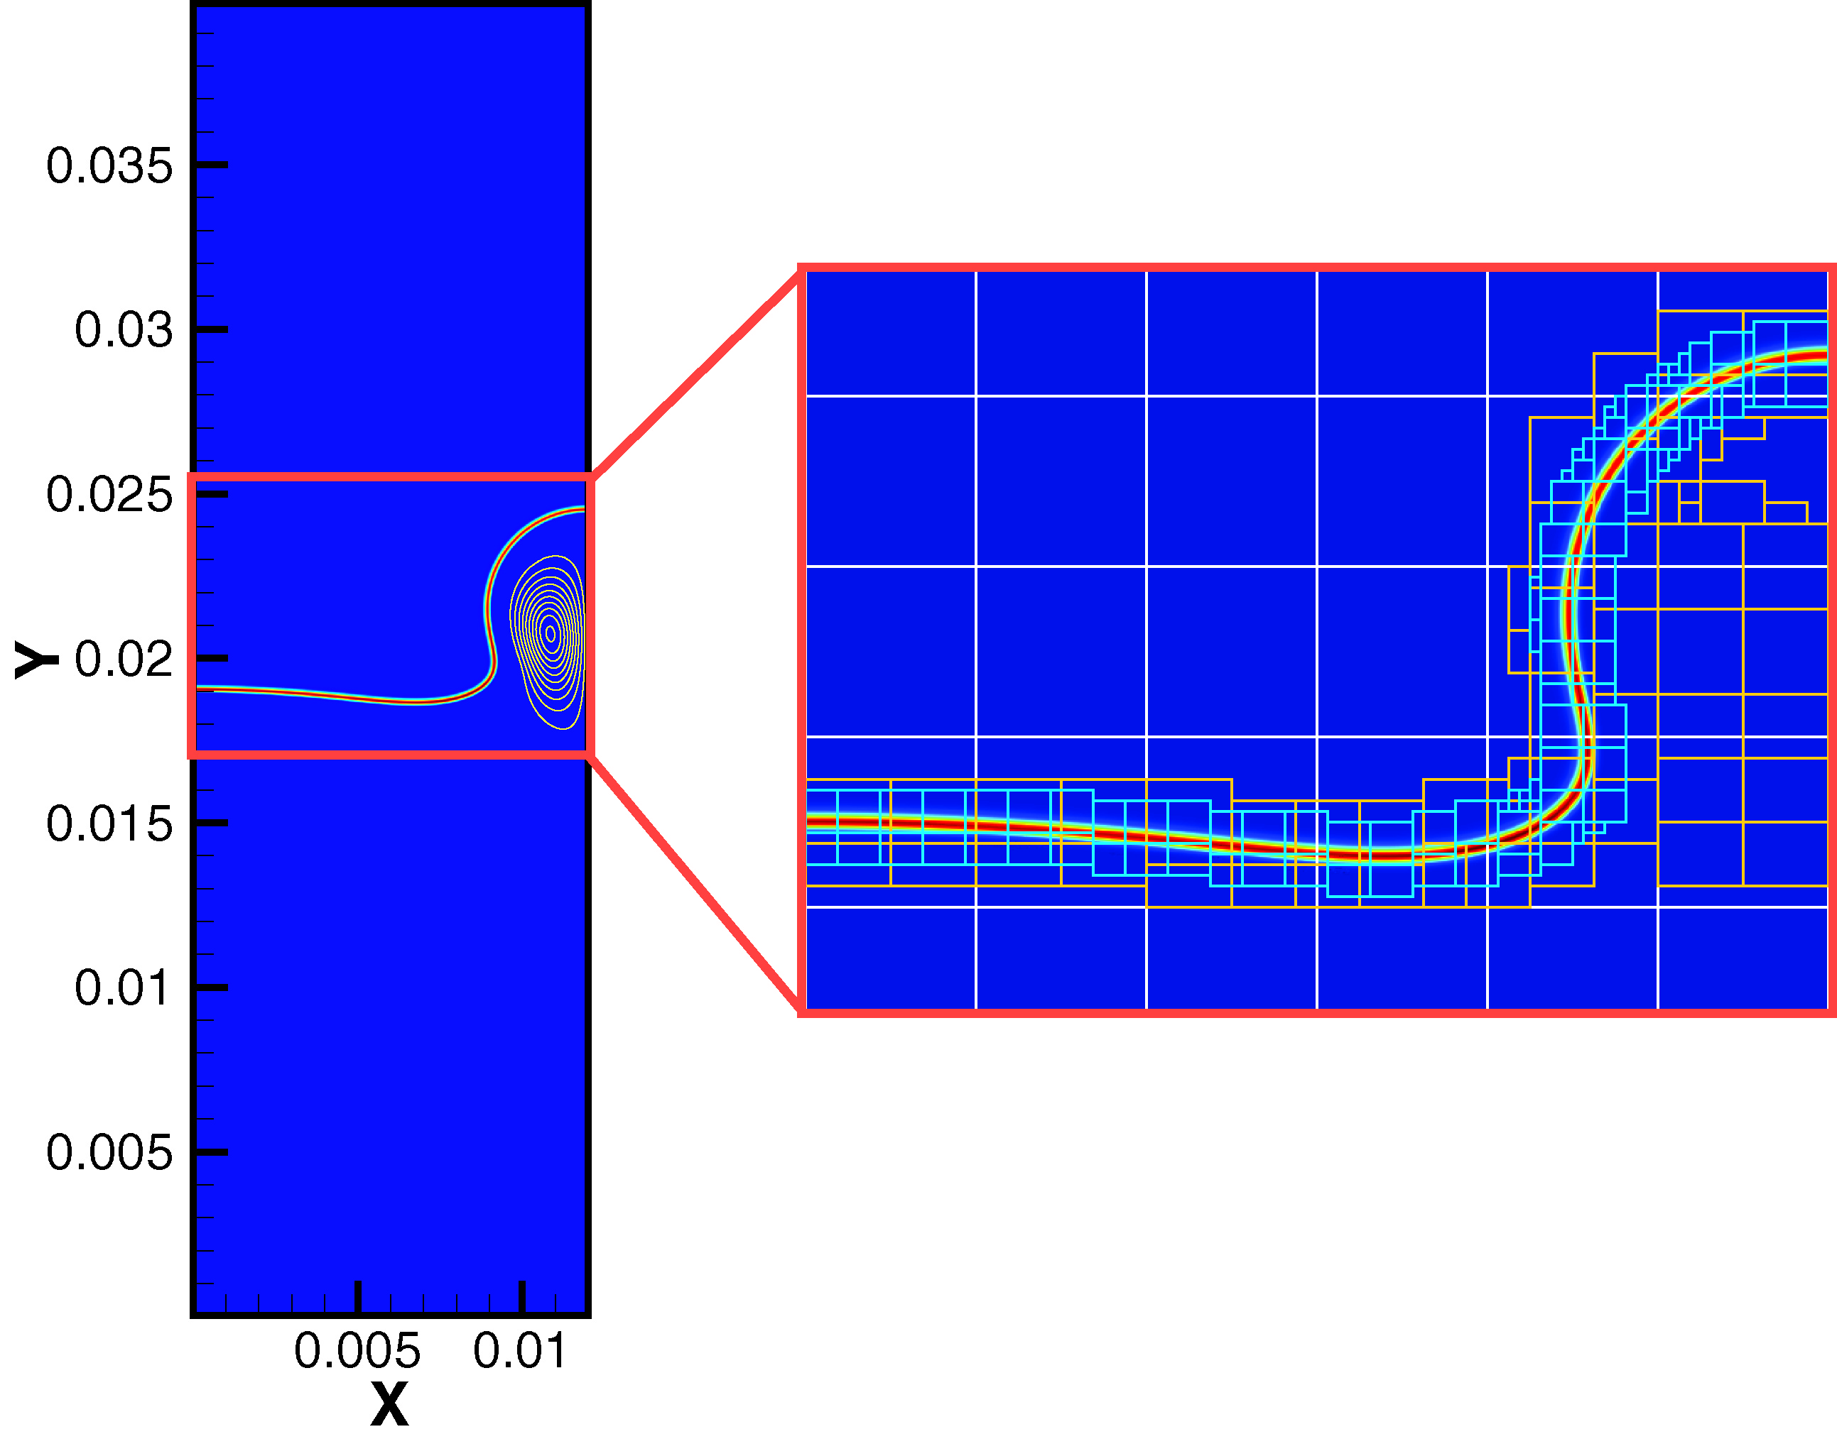
Adaptive Mesh Refinement
Need for AMR
  Reduce memory
  Reduce computation
Block-structured AMR
  Data organized into logically-rectangular structured grids
  Amortize irregular work
  Good match for multicore architectures
AMR introduces extra algorithm issues not found in static codes
  Metadata manipulation
  Regridding operations
  Dynamic communication patterns
Structured grid AMR used in a wide range of DOE applications
  Astrophysics
  Climate
  Cosmology
  Defense science
  Materials science
  Subsurface flow

Slide 49
SMC Characterization using BYFL
SMC – 8th order finite difference
  Compact 2nd derivatives
  Iterate 8th order first derivative – S3D-like
  Trades Flops for communication
Bytes to flops – 11.4 w/o cache
Operation breakdown
  14% Flops
  23% Memory ops (loads and stores)
  60% Integer
  3% Branch
Bulk of loads and stores are double precision floating point
Significant data reuse
Exp() plays a significant role in the floating point work
Communication characteristics
  9.9% Iterated
  2.8% Compact

Slide 50
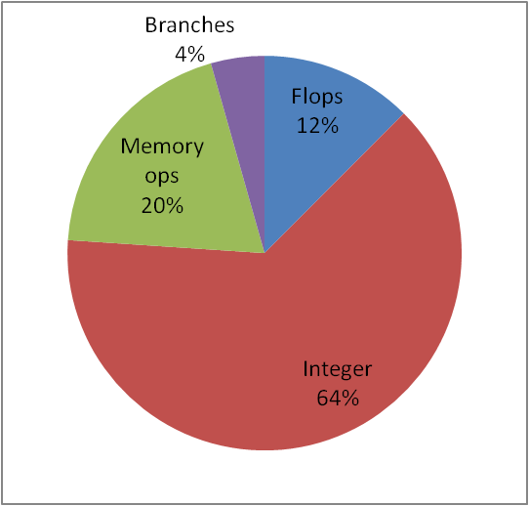
LMC characterization using BYFL
Bytes to flops – 11.4 w/o cache
Operation breakdown
  12% Flops
  20% Memory ops (loads and stores)
  64% Integer
  4% Branches
Loads and stores
  Double precision floating point still largest
  Integer and pointer/address loads are significant (AMR feature)
Data reuse much less than explicit codes
Exp() plays a significant role in the floating point work
  No other single routine carries a significant fraction of the work
Communication characteristics – 20-25%

Slide 51
Multigrid Communication Characterization
Look at how multigrid communication patterns are affected by network characteristics
PFMG
  Structured algebraic multigrid method
  Preserve stencil size
  One of the options used in Boxlib
Model communication in a PFMG cycle on 2 different networks (torus and fat tree) for a 7-point and a 27-point stencil
  Includes latency, bandwidth and cost of additional hops
  Results here for 27-point
  Surrogate for higher-order stencils
smooth
form residual
prolong to
level i-1
restrict to
level i+1
smooth

Slide 52
Methodology
Create proxy machine models to represent exascale node architectures
  Configurable machine parameters (cache size, memory bw)
Develop proxy applications to represent exascale combustion codes
  CNS and SMC codes by J. Bell’s group
Design a performance modeling framework to estimate performance of proxy apps on proxy machines
  ExaSAT framework:
    static compiler analysis + performance model

Slide 53
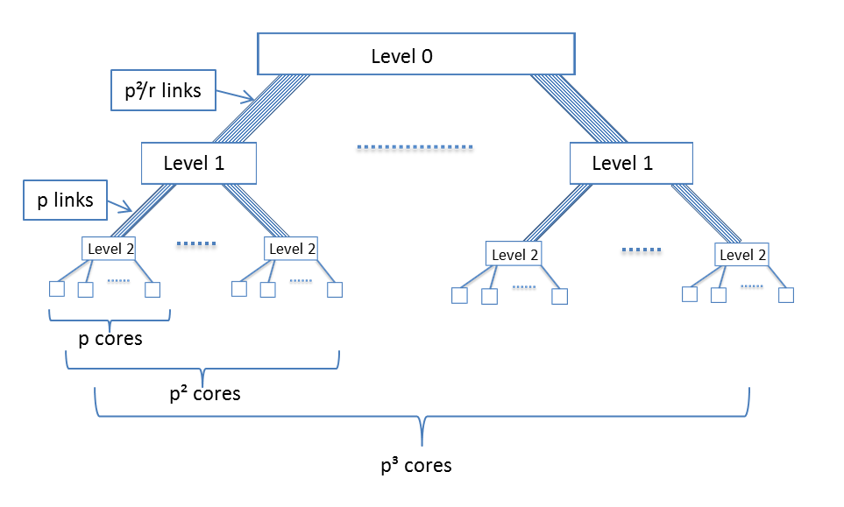
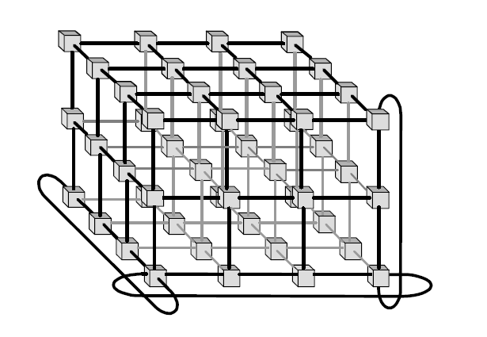
Networks considered
3D-Torus
3-Level Fat tree
p³ cores (or end stations)
Both networks have same number of links, i.e. 3p³, but fat tree needs longer links
Tapering will reduce number of links for fat tree, and with it cost!

Slide 54
Parameters used in multigrid study
p = 48³ corresponding to 110,952 nodes
Effect of bandwidth given latency
  400 ns latency
  20 ns latency
Effect of latency given bandwidth
  100 GB / s
  400 GB / s
Level of tapering at top level of the fat-tree
  r = 1 (no tapering) -> 2308 links from level 0 to level 1
  r = 3 -> 768 links
  r = 9 -> 256 links
Simple model for contention

Slide 55
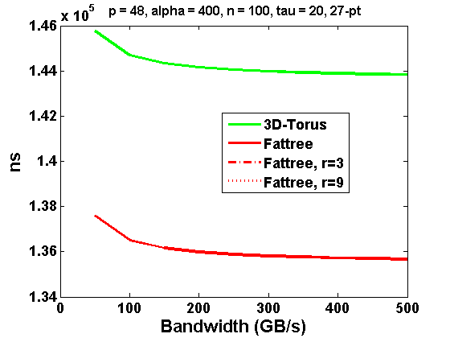
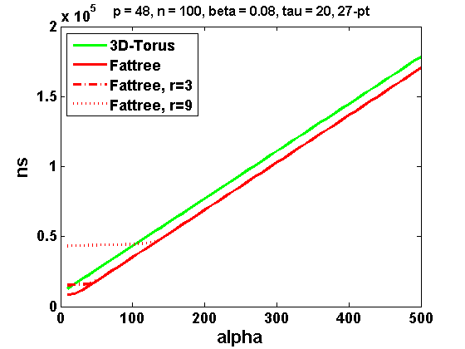
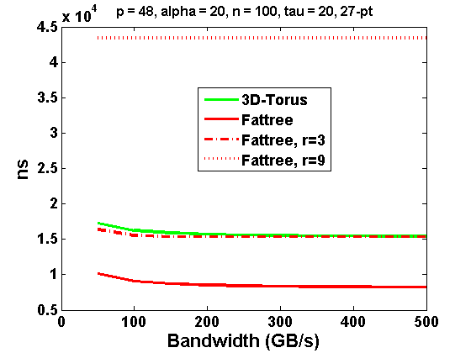

Multigrid communication costs – 27 point stencil
400 ns
latency
100 GB / s
bandwidth
20 ns
latency
400 GB / s
bandwidth

Slide 56
Summary – Results in Solver Area
Characterization of baseline methodology
  Instruction mix
  Floating point intensity
  Communication
  Breakdown of execution time
Developed initial suite of proxy apps
  Compressible Navier Stokes without species
  Generalization to multispecies with reactions
  LMC
  Multigrid algorithm – 7 and 27 point stencils
  Chemical integration
  Coming soon
    Embedded UQ kernels
    Additional AMR proxy apps
Methodology for co-design
  Algorithm description – code analysis or algorithm specification
  Performance measurement
  Analytic performance modeling
  Judicious application of simulator
Initial application to co-design equations with CNS and multigrid proxies

Slide 57
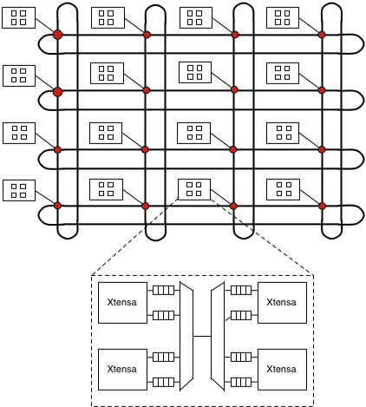
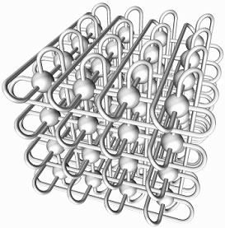
A Toy (parameterized) abstract machine model
(the full range of design choices for a machine)
Chip Scale
Node Scale
System Scale
Cores (many simple cores)
  Flat clock rate
  Multithreaded (n-threads)
  SIMD (n-slots)
  Fat+Thin cores (ratio)
NoC
  Constrained Topology (2D) torus, mesh, ring
Cache Hierarchy (size, type, assoc)
  Automatic caches
  Scratchpad/software managed
  NVRAM
  Alternative coherency methods
Non-uniform memory access (NUMA) between cores and memory channels
  Topology may be important
  Or perhaps just distance
Memory
  Increased NUMA domains
  Intelligence in memory (or not)
Fault Model for node
  FIT rates, kinds of faults, granularity of faults/recovery
Interconnect
  Constrained Topology (Torus, Tapered Dragonfly)
  Bandwidth/latency/overhead for communication
Primitives for data movement/sync
  Global Address Space or messages only
  Memory fences
  Transactions / remote atomics

Slide 58
Measured Performance and Lower Bounds
Measure performance of simplest proxy app – CNS
Manually produced a Roofline model for each loop nest in CNS code
  Red is CNS running on Hopper.
  Green is lower bound for moving data
Loops with large cache working set dramatically underperforms the roofline
ctoprim( )
hypterm( )
diffterm( )
Roofline model defines intersection of limits to performance from hardware elements
Notes:
What software changes can be made to close the gap?
Software optimization to get closer to the bound
Automated performance analysis and prediction tool to improve productivity
Any modification of the code requires manual update on the performance bounds.
Actual performance exceeds the hardware bound because of capacity traffic
The main cause of
discrepancy is capacity misses
not capturing working set
We want to an automated process to improve productivity
Add cache model to capture the working set
Any modification of the code requires manual update on the model.
It is predictive it is bound
We added cache model to capture the working set
Get more accurate predictions for real architectures

Slide 59
Optimization of Hypterm
Consider one particularly underperforming function: hypterm()
Roofline bounds performance to an 8x speedup over the original version
What optimizations can be applied?
  Vector-like semantics to
  improve prefetcher
  behavior
  Loop fusion
  Cache blocking
  Buffering (for $bypass
  & conflict misses)
  Task-like parallelization
  Blocked data layout
  (instead of flat arrays)
  SIMDization
Overall, attained a 6.5x speedup
Analysis needs to reflect realizable performance
Notes:
8X is the roofline
Yellow : loop interchanges, source code
Green: SIMDization, cache by pass, data structure reorganization
Vector-like : oppposite of fusion, multiple
$blocking : cache blocking for all the components
Task-based : j, k tasks, enumarate list of tasks, two adjacent task share working set, includes components
Task are entire value of i.threads are computing compoWhen enumerating blocks, I chose component-major, then j, and finally k
components in parallel
Data layout: 4^3.
Note, the three columns on the right all include loop fusion

