Slide 1
Mathematical Multifaceted Integrated Capability Centers (MMICCs)
Sandy Landsberg
Advanced Scientific Computing Research
Office of Science
Department of Energy
March 6, 2013

Slide 2
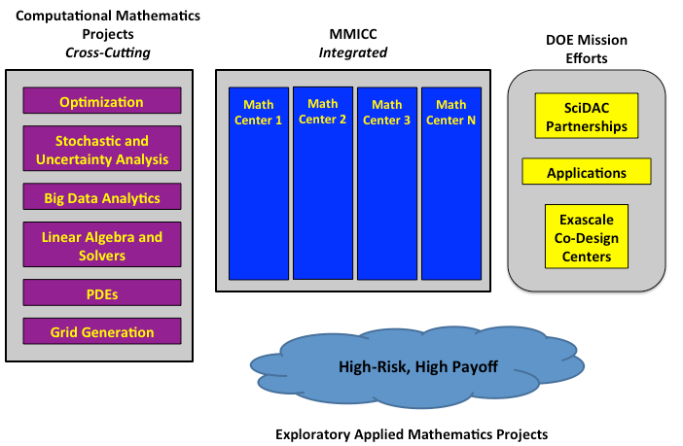
DOE Applied Mathematics
Support the research and development of applied mathematics models, methods and algorithms for understanding natural and engineered systems related to DOE’s mission … Support ASCR Challenge: Discover new applied mathematics, computer science, and networking tools for the ultra-low power, multicore-computing future and data-intensive science
Long-term goals:
Mathematics research that 5-10+ years out will impact DOE mission efforts: DOE Applications, SciDAC Program, and Exascale Co-Design
New Mathematical Multifaceted Integrated Capability Centers (MMICCs) directly enhances impact of applied math on DOE mission
Multiscale Methods
Exploratory Research
Cross-cutting computational mathematics projects: addresses foundational, algorithmic and extreme-scale mathematical challenges
Exploratory Research: new mechanism to bring in highly innovative research

Slide 3
Mathematical Multifaceted Integrated Capability Centers (MMICCs)
FY12 solicitation for Mathematical Multifaceted Integrated Capability Centers. Proposals must:
Address the long-term mathematical challenges for one or more DOE grand challenges and that require new integrated, iterative processes across multiple mathematical disciplines.
Identify a set of interrelated mathematics research challenges that represent abstractions of the grand challenges. These abstractions would then be optimally addressed through a multifaceted, integrated approach.
Have impact to the DOE mission in the 5-10+ year timeframe

Slide 4
MMICCs Solicitation Summary
Three Centers awarded:
  Multifaceted Mathematics for Complex Energy Systems (M2ACS), Director: Mihai Anitescu (ANL)
  Collaboratory of Mathematics for Mesoscopic Modeling of Materials (CM4), Director: George Karniadakis (PNNL)
  DiaMonD: An Integrated Multifaceted Approach to Mathematics at the Interfaces of Data, Models, and Decisions, Co-Directors: Omar Ghattas (UT Austin) and Karen Willcox (MIT)
Broad DOE mission relevance:
  Anitescu: Complex energy systems such as power grid and renewables integration
  Karniadakis: Mesoscale modeling applicable to materials, chemistry, and biofuels
  Ghattas & Willcox: Multiscale, multiphysics challenges related to subsurface flows and materials for energy storage
Lab and University Comparison
  Anitescu ($3.5M/year): $2,600K lab (74%), $900K university subcontract (26%)
  Karniadakis ($3M/year): $1,975K lab (66%), $1,025K university (34%)
  Ghattas & Willcox ($2.5M/year): $265K lab (10%), $2,235K university (90%)
  Total ($9M/year): $4,840K lab (54%), $4,160K university (46%)

Slide 5
What’s unique about these MMICCs projects?
Integration of mathematical sub-disciplines:
  Allow applied mathematics researchers to take a broader view of the problem as a whole, and devise solution strategies that attack the problem in its entirety by building fundamental, multidisciplinary mathematical capabilities and tools
  Requires applied mathematics researchers to work together in large, collaborative teams to more effectively address grand challenge problems
Careful balance with DOE applications
  Motivated by DOE grand challenge problems, but this does not have tight coordination and application-focus of SciDAC Partnership efforts
A 5-year research roadmap:
  Annual individual research goals and integration goals with metrics of success
Annually reviewed by program manager and external review committee:
  Evaluate technical progress against 5-year roadmap
  Evaluate effectiveness of integration toward long-term challenge problems
Outreach to research community
  Serve as entry points for external researchers to more readily understand the mathematical challenges of DOE-relevant problems.

Slide 6
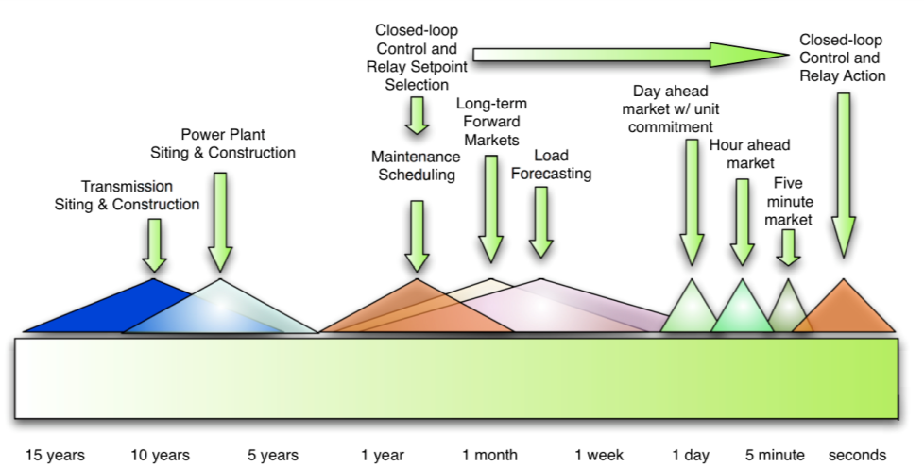
Multifaceted Mathematics for Complex Energy Systems (M2ACS)
Project Director: Mihai Anitescu, Argonne National Lab
Goals:
By taking a holistic view, develop deep mathematical understanding and effective algorithms to remove current bottlenecks in analysis, simulation, and optimization of complex energy systems.
Address the mathematical and computational complexities of analyzing, designing, planning, maintaining, and operating the nation's electrical energy systems and related infrastructure.
  Integrated Novel Mathematics Research:
Predictive modeling that accounts for uncertainty and errors
Mathematics of decisions that allow hierarchical, data-driven and real-time decision making
Scalable algorithms for optimization and dynamic simulation
Integrative frameworks leveraging model reduction and multiscale analysis
Long-Term DOE Impact:
Development of new mathematics at the intersection of multiple mathematical sub-domains
Addresses a broad class of applications for complex energy systems, such as :
  Planning for power grid and related infrastructure
  Analysis and design for renewable energy integration
Multifaceted Mathematics for Complex Energy Systems
Representative decision-making activities and their time scales in electric power systems. Image courtesy of Chris de Marco (U-Wisconsin).
Team: Argonne National Lab (Lead), Pacific Northwest National Lab,
Sandia National Lab, University of Wisconsin, University of Chicago

Slide 7
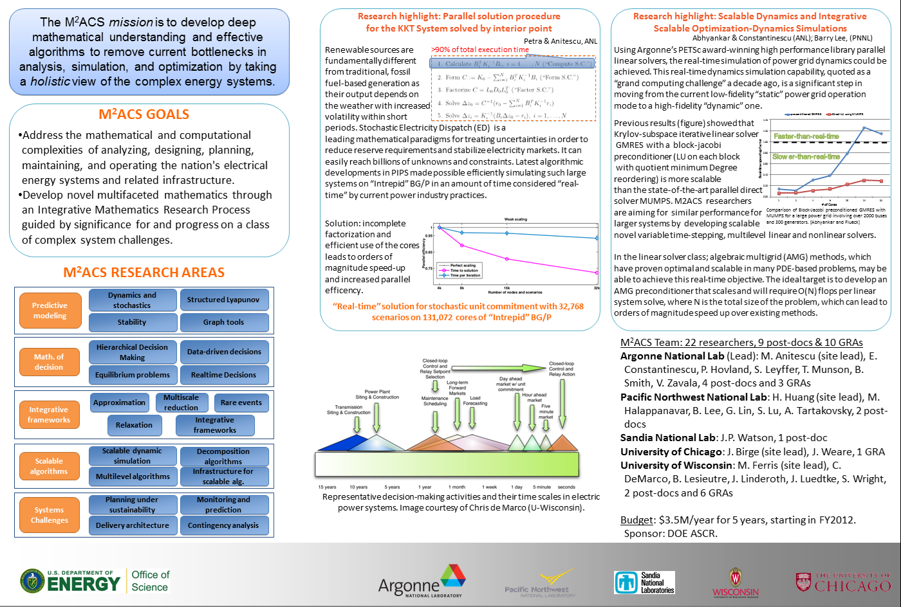
Multifaceted Mathematics for Complex Energy Systems (M2ACS)
Project Director: Mihai Anitescu, Argonne National Lab
Notes:
Parallel Interior-Point Solver for Stochastic Programming (PIPS).

Slide 8
M2ACS Integration Challenge #1:
Temporal Multiscale Modeling for Critical Energy Devices
Application Motivation: Simulation of critical devices, such as High-Voltage Direct Current (HVDC) substations , which are extremely expensive, in the accurate dynamic range of the rest of the system.
Technical Challenge: To achieve this, need to run simulations on microsecond time scale for the device, but impossible for the entire grid. Need to formulate multi-time-scale model.
Math Question: Can we define consistent multiscale-in-time mathematical models and derive efficient solvers for it in this application space?
Possible plan forwards: Leverage the comprehensive intellectual resources and capabilities of M2ACS.
  Year 1: Analysis of multiscale in time coupling equations : well-posedness and properties (Tartakovsky, Anitescu,Lu)
  Year 1: Multiscale Data Analysis for Determining Fluctuations Models (Lin,Lu)
  Year 2: Derive a new multi-rate partitioned implicit-explicit time stepping scheme and the attached linear algebra (Constantinescu, Smith)
  Year 2: Derive new nonlinear solvers with scalable linear algebra (Lee, Smith)
  Year 2: Inclusion of Dynamics Features in PyOmo, to support decision that also accounts for maintenance costs of HVDC. (Watson)
Notes:
The Python Optimization Modeling Objects (Pyomo) package is an open source tool for modeling optimization applications in Python.

Slide 9
M2ACS Integration Challenge #2:
Probabilistic Modeling for Complex Energy Infrastructure
Application Motivation: The number of energy states in energy infrastructure is too large to ever have enough information to know it exactly.
Technical Challenge: To predict in this environment, we need to replace deterministic (point) estimates with probability distributions . Need to formulate novel probabilistic frameworks.
Math Question: Can we define probabilistic models consistent with the system and provably accurate statistical tests to validate those for such complex systems?
Possible plan forwards: Leverage the comprehensive intellectual resources and capabilities of M2ACS.
  Year 1: Multiscale Data Analysis . Identify multiscale spatio-temporal probabilistic structure from high resolution data (Lin,Lu)
  Year 2: Data-driven decisions. Scalable algorithms for data analysis with complex multiscale correlation structure (Wright, Anitescu)
  Year 2: Dynamics and stochastics. New closure approaches for probability density function evolution derived from the nonlinear differential algebraic system equations (Tartakovsky).
  Year 3: Graphs. New metrics for probability-driven weighing schemes for graph generation for efficient probabilistic contingency representation (Halappanavar, Hogan)
  Year 4: Real-Time decision. Fast and scalable algorithms for stochastic state and probability estimation (Huang, Zavala, Leyffer)

Slide 10
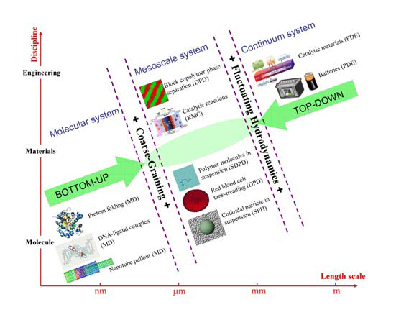
Collaboratory of Mathematics for Mesoscopic Modeling of Materials (CM4)
Project Director: George Karniadakis, Pacific Northwest National Lab
Goals:
Develop mathematical foundations for understanding and control of fundamental mechanisms in mesoscale processes.
  Accurate multiscale simulations require understanding the formal relation between different length and time scales
  Mathematical challenges include the development of (1) system reduction, (2) sampling, (3) filtering and (4) projection techniques
  Integrated Novel Mathematics Research:
Computational approaches at mesoscale:
  Particle-based methods (bottom-up)
  Grid-based methods (top-down)
  Stochastic methods for modeling randomness and for UQ at all scales
Concurrent couplings to provide descriptions across scales.
Use Mori-Zwanzig formulation to derive new governing equations for coarse-graining.
Long-Term DOE Impact:
Develop a hierarchy of mathematical models and numerical approaches to seamlessly model and simulate a system from the molecular to the macroscopic scale.
Addresses a broad class of applications such as control of chemical reactions in combustion and catalysis, reactive flow in complex liquids, and the formation of new energy storage materials.
Sketch illustrating the range of mesoscale phenomena and their connection to molecular and continuum-based description.
Team: Pacific Northwest National Lab (Lead), Sandia National Lab, Brown University, University of Minnesota, Princeton University, Stanford University, UC Santa Barbara , Pennsylvania State University

Slide 11
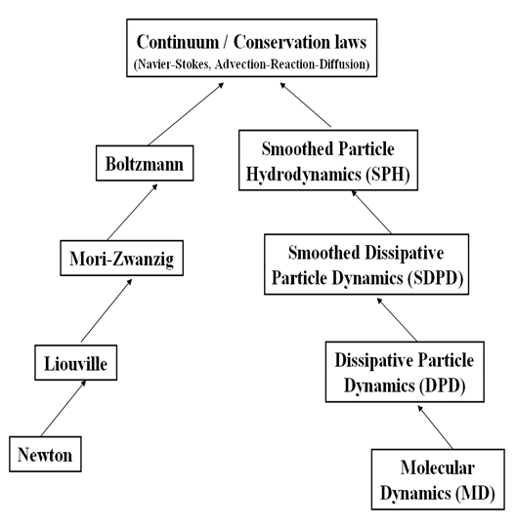
CM4: A Hierarchy of Mathematical and Numerical Models

Slide 12
Collaboratory of Mathematics for Mesoscopic Modeling of Materials (CM4)
Project Director: George Karniadakis, Pacific Northwest National Lab
The CM4 mission is to develop mathematical foundations for understanding and control of fundamental mechanisms in mesoscale processes addressing to a broad class of applications such as control of chemical reactions in combustion and catalysis, reactive flow in complex liquids, and the formation of new energy storage materials.
Team (22 researchers plus 8 post-docs & 8 GRAs) :
$3.0M /year for 5 years
Pacific Northwest National Lab (Lead)
  G. Karniadakis (site lead), G. Lin, K. Jarman, G. Schenter, T.P. Straatsma plus 5 staff researchers and 3 post-docs
Sandia National Lab
  M. Parks (site lead), P. Bochev, J. Hu, C. Siefert plus 1 post-doc & 1 GRA
Brown University
  M. Maxey, B. Caswell plus 1 post-doc
    and 1 GRA
University of Minnesota
  P. Stinis plus 1 post-doc and 1 GRA
Princeton University
  Weinan E plus 1 post-doc and 1 GRA
Stanford University
  E. Darve plus 1 GRA
UC Santa Barbara
  P. Atzberger plus 1 post-doc & 2 GRAs
Penn State University
  J. Xu, X. Hu, plus 1 GRA

Slide 13
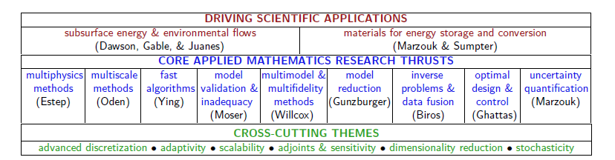
DiaMonD: An Integrated Multifaceted Approach to Mathematics at the Interfaces of Data, Models, and Decisions
Project Directors: Omar Ghattas (UT-Austin) and Karen Willcox (MIT)
Goals:
Addresses the mathematical challenges of end-to-end modeling and simulation for complex DOE problems by considering multi-scale, multi-physics methods, uncertainty quantification, optimization and design, inverse problems and data fusion.
  Nine core applied mathematics research thrusts and six cross-cutting themes identified.
  Integrated Novel Mathematics Research:
  Ultimate goal of supporting decision-making includes integrated approach to:
    Solving an inverse problem
    Solving an optimal design problem
    Solving a control problem
    Quantifying uncertainties from data to model inference to prediction and finally to optimal design and control.
Long-Term DOE Impact:
Mathematics addresses a broad class of applications such as subsurface flows, including both CO2 sequestration and contaminant transport, and materials for energy storage and conversion, e.g. fuel cells.
Team: University of Texas at Austin (Co-Lead), MIT (Co-Lead), Colorado State University, Florida State University, Stanford, Los Alamos National Lab, Oak Ridge National Lab

Slide 14
DiaMonD: An Integrated Multifaceted Approach to Mathematics at the Interfaces of Data, Models, and Decisions
The DiaMonD mission is to develop advanced integrated mathematical methods and analysis for multimodel, multiphysics, multiscale problems motivated by DOE applications such as subsurface energy and environmental flows and advanced materials for energy storage.
$2.5M /year for 5 years
Team (20 researchers plus 12 post-docs & 11 GRAs) :
UT Austin (Co-Lead)
  O. Ghattas (site lead), T. Oden, R. Moser, G. Biros, C. Dawson plus 6 post-docs, 6 GRAs and 3 research staff
Florida State University
  M. Gunzburger (site lead), J. Peterson, J. Burkhardt plus 1 post-doc & 1 GRA
Colorado State University
  D. Estep plus 1 post-doc
    and 1 research staff
MIT (Co-Lead)
  K. Willcox (site lead), Y. Marzouk, R. Juanes plus 2 post-docs and 3 GRAs
Stanford University
  L. Ying plus 1 GRA
Los Alamos National Laboratory
  C. Gable and M. Vesselinov plus 1 post-doc
Oak Ridge National Laboratory
  B. Sumpter plus 1 post-doc

Slide 15
Enhancing the impact of Applied Mathematics
on the DOE mission
Computational Mathematics
Cross-Cutting Projects
Mathematical Multifaceted Integrated Capability Centers
Integrated Projects
DOE Mission
Efforts
Optimization
Multifaceted Mathematics for Complex Energy Systems
Collaboratory of Mathematics for Mesoscopic Modeling of Materials
DiaMonD: An Integrated Multifaceted Approach to Mathematics
at the Interfaces of Data, Models, and Decisions
Future
Collaboratory
Math Projects
SciDAC
Partnerships
PDEs
Stochastics and Uncertainty Analysis
DOE Applications
Big Data Analytics
Exascale
Co-Design
Centers
Linear Algebra &
Scalable Solvers
Multiscale Math
Exploratory Applied Mathematics Research

Slide 16
Thank you.

