Slide 1
INCITE Overview
March 5, 2013
Julia C. White, INCITE Manager
whitejc@DOEleadershipcomputing.org

Slide 2
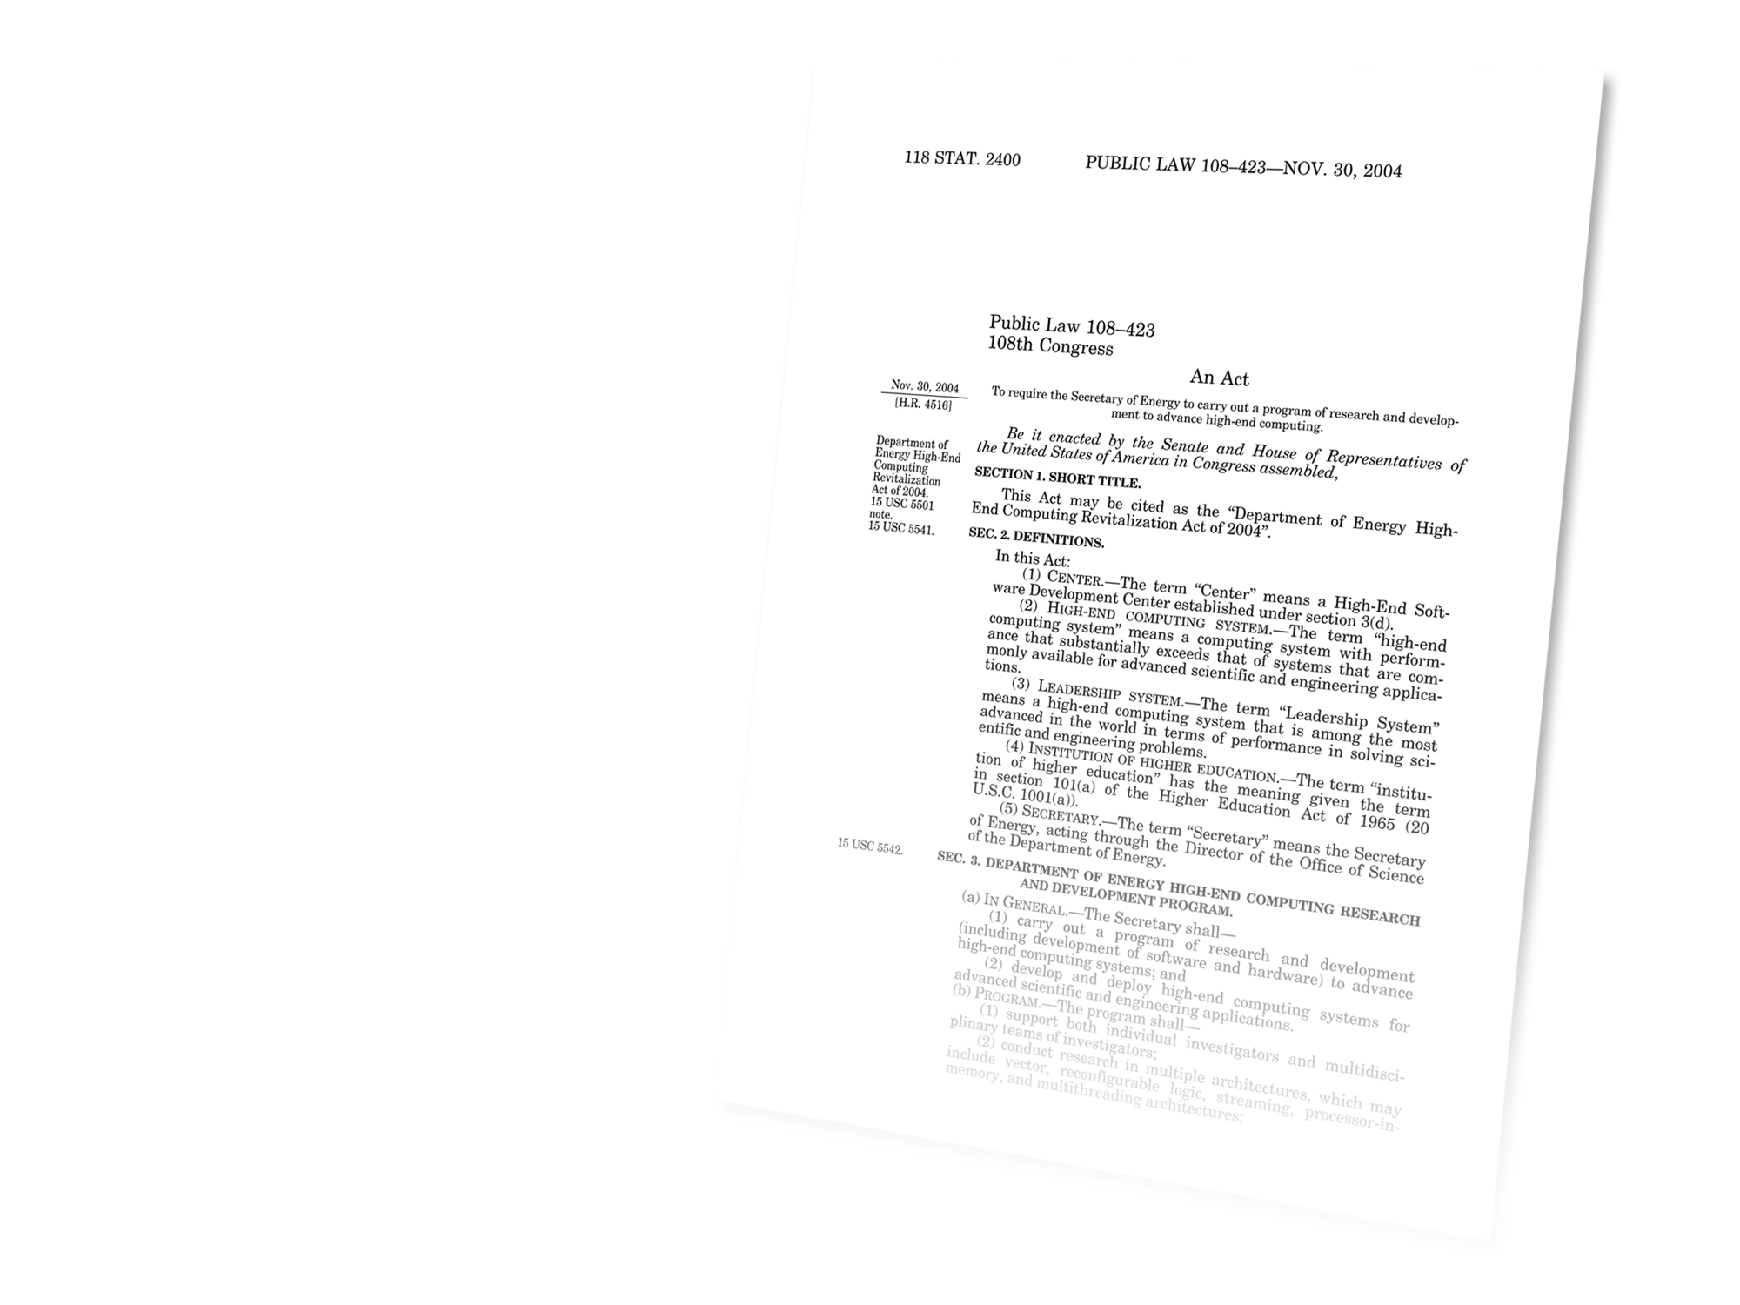
Origin of Leadership Computing Facility
Department of Energy High-End Computing Revitalization Act of 2004 (Public Law 108-423):
The Secretary of Energy, acting
through the Office of Science, shall
Establish and operate
Leadership Systems Facilities
Provide access [to Leadership Systems Facilities]
on a competitive, merit-reviewed basis to researchers
in U.S. industry, institutions of higher education, national laboratories and other Federal agencies
Notes:
The High-End Computing Revitalization Task Force (HECRTF) was chartered under the National Science and Technology Council (NSTC) to develop a plan for undertaking and sustaining a robust Federal high-end computing program to maintain U.S. leadership in science and technology. The Plan includes:
Leadership Systems: the leading-edge high-capability computers that will enable breakthrough science and engineering results for a select subset of challenging computational problems. These are problems that have been unsolvable with currently available computing resources.
Build and operate Leadership Systems for the Federal science and technology community.

Slide 3
Separation of selection processes for Leadership-class computing and
DOE capability computing
2008 ASCAC Committee of Visitors Recommendation 1
“The selection processes for leadership class and DOE capability class computing should be separated. A significant portion … of computational resources should be allocated to high-end DOE capability-class computing using a similar INCITE-type process.”

Slide 4


Leadership Computing Facility systems
 | Argonne LCF | Argonne LCF | Oak Ridge LCF
System | IBM Blue Gene/P | IBM Blue Gene/Q | Cray XK7
Name | Intrepid | Mira | Titan
Compute nodes | 40,960 | 49,152 | 18,688
Node architecture | PowerPC, 4 cores | PowerPC, 16 cores | AMD Opteron, 16 cores NVIDIA Kepler GPU
Processing Units | 163,840 Cores | 786,432 Cores | 299,008 x86 Cores + 18,688 GPUs
Memory per node, (gigabytes) | 2 | 16 | 32 + 6
Peak performance, (petaflops) | 0.557 | ~10 | ~27

Slide 5
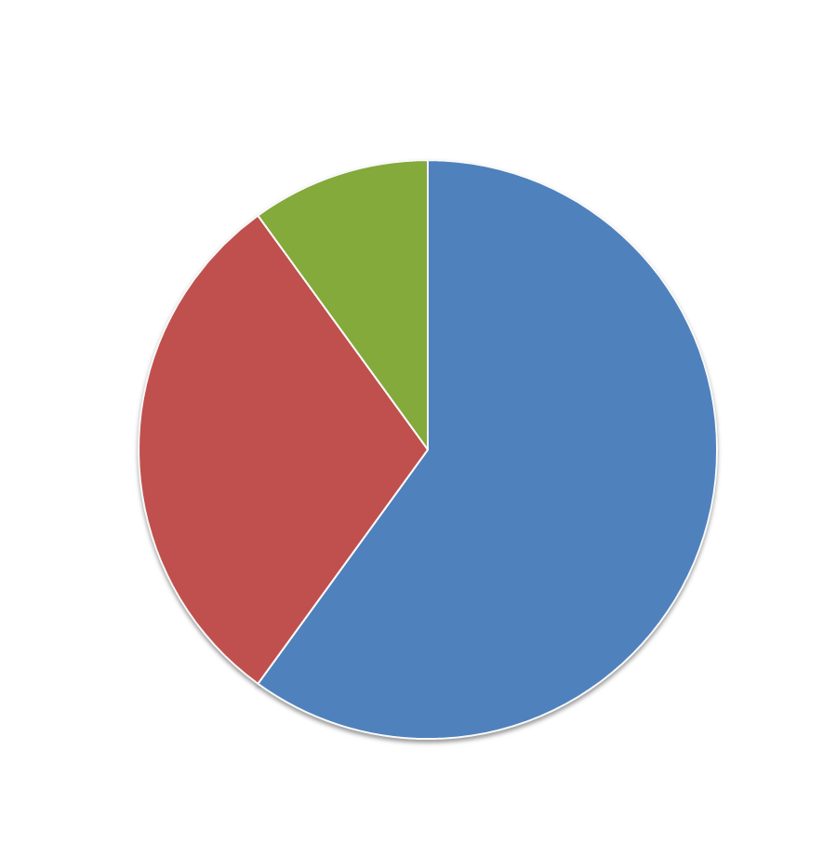
Three primary ways for access to LCF
Distribution of allocable hours
Leadership-class computing
10% Director’s Discretionary
60% INCITE
4.7 billion core-hours in CY2013
Up to 30% ASCR Leadership Computing Challenge
DOE/SC capability computing

Slide 6

What is INCITE?
Innovative and Novel Computational Impact
on Theory and Experiment
INCITE promotes transformational advances in science and technology through large allocations of computer time, supporting resources, and data storage at the Argonne and Oak Ridge Leadership Computing Facilities (LCFs) for
computationally intensive,
large-scale research
projects.

Slide 7
INCITE seeks high-impact research campaigns
Examples of previous successful INCITE applications that advance the state of the art
across a broad range of topics and different mission priorities
• Glimpse into dark matter
• Supernovae ignition
• Protein structure
• Creation of biofuels
• Replicating enzyme functions
• Global climate
• Accelerator design
• Carbon sequestration
• Turbulent flow
• Propulsor systems
• Membrane channels
• Protein folding
• Chemical catalyst design
• Plasma physics
• Algorithm development
• Nano-devices
• Batteries
• Solar cells
• Reactor design
• Nuclear structure

Slide 8
INCITE breakthroughs since inception
A few of the many science and engineering advances
Hours requested vs. allocated:
~2X per year
~3X per year
Hours allocated | 4.9M | 6.5M | 18.2M | 95M | 268M | 889M | 1.6B | 1.7B | 1.7B | 5B
Projects | 3 | 3 | 15 | 45 | 55 | 66 | 69 | 57 | 60 | 61
2004
2005
2006
2007
2008
2009
2010
2011
2012
2013
Researchers solved the 2D Hubbard model and presented evidence that it predicts HTSC behavior
Phys. Rev. Lett 2005
NIST proposes new standard reference materials from LCF concrete simulations
Modeling of molecular basis of Parkinson’s disease named #1 computational accomplishment
Breakthroughs 2008
Calculation of the number of bound nuclei in nature, Nature (2012)
Largest simulation of a galaxy’s worth of dark matter, showed for the first time the fractal-like appearance of dark matter substructures. Nature (2008), Science (2009)
New method to rapidly determine protein structure, with limited experimental data Science (2010), Nature (2011)
World’s first continuous simulation of 21,000 years of Earth’s climate history. Science (2009)
OMEN breaks the petascale barrier using more than 220,000 cores, Proceedings SC10
Largest-ever LES of a full-sized commercial combustion chamber used in an existing helicopter turbine
Unprecedented simulation of magnitude-8 earthquake
over 125-square miles, Proceedings, SC10

Slide 9
INCITE program organization
Susan Coghlan, ALCF Deputy Division Director
Arthur Bland, OLCF Project Director
Leadership Computing Facility
INCITE Program
Julia White, Manager
ALCF
Michael Papka
OLCF
James Hack
Directors of Science
Jack Wells, OLCF
Paul Messina, ALCF
Science Panel Reviewers
Chair works with INCITE manager to identify and invite reviewers
Computational Readiness
Review Leaders
Bronson Messer, OLCF
James Osborn, ALCF
Access and
Monitoring Leaders
Ashley Barker, OLCF
Richard Coffey, ALCF

Slide 10
INCITE criteria
“access on a competitive, merit-reviewed basis”*
1 | Merit criterion
 | Research campaign with the potential for significant domain and/or community impact
2 | Computational leadership criterion
 | Computationally intensive runs that cannot be done anywhere else: capability, time-to-solution, architectural needs
3 | Eligibility criterion
 | Grant allocations regardless of funding source (*see DOE High-End Computing Revitalization Act of 2004: Public Law 108-423) Non-US-based researchers are welcome to apply

Slide 11


INCITE twofold review
 | Peer Review INCITE Panels | Computational Readiness LCF Centers
New Proposal Assessment | Scientific and/or technical merit and originality Appropriateness of proposal method, milestones given Team qualifications Reasonableness of requested resources | Reasonableness and appropriateness of the request for the computational resources Technical readiness (optimization, scaling, method for hardware) Clarity of proposal and readiness of project Appropriateness of plans for new hardware
Renewal Assessment | Change in scope Met scientific milestones On track to meet future milestones | Same Technical progress toward milestones Use of resource

Slide 12
INCITE annual timeline
Access and monitoring
Access and Monitoring
Access processing
Selection and Awards
Awards
Selection
Solicitation and Review
Panel
Peer Review
Computational
Readiness Review
Solicitation
(new and renewals)
Mar
Apr
May
Jun
Jul
Aug
Sept
Oct
Nov
Dec
Jan

Slide 13
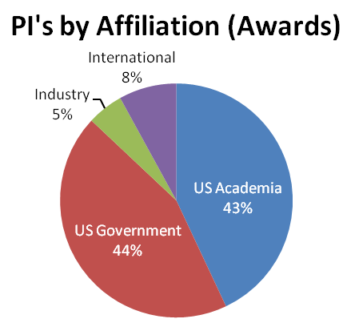
2013 INCITE statistics
Request for Information helped attract new projects
Call closed June 27th, 2012
Total requests ~15 billion core-hours, 3x more than the 5 billion core-hours requested last year
Number of proposals submitted increased nearly 20%
Awards of ~5 billion core-hours for CY 2013
61 projects awarded of which 20 are renewals
Acceptance rates
Contact information
Julia C. White, INCITE Manager
whitejc@DOEleadershipcomputing.org
33% of nonrenewal submittals and 100% of renewals

Slide 14
2013 award statistics, by system
 | Jaguar | Titan | Mira | Intrepid
 | 2012 INCITE | 2013 INCITE | 2013 INCITE | 2012 INCITE | 2013 INCITE
Number projects* | 35 | 32 | 27 | 31 | 27
Average Project | 27M | 58M | 78M | 24M | 27M
Median Project | 23M | 49.5M | 45M | 20M | 25M
* Totals of 32 projects at the OLCF, 37 projects at the ALCF (many of the ALCF projects received time on both Mira and Intrepid)
 | Titan | Mira | Intrepid
Total Awards (Hrs in CY2013) | 1.84B | 2.11B | 0.721B

Slide 15
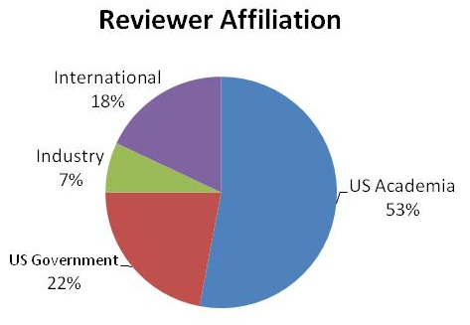
2013 INCITE panel peer reviewers
> 50% (e.g. more than 40) of the reviewers are:
— Society fellows (AAAS, APS, SIAM, IEEE, etc),
— Agency awardees (ex. NSF Early Career),
— Laboratory fellows,
— National Academy members,
— National Society presidents
41% participated in the
2012 INCITE review
83 science experts participated in the 2013 INCITE panel review.

Slide 16
2013 INCITE Panel questionnaire
Response rate >80% of science panel reviewers
*Scores range from 1 to 5 where 1 is "strongly disagree" and 5 is "strongly agree."
Questionnaire* | 2013
The INCITE proposals discussed in the panel represent some of the most cutting-edge computational work in the field. | 4.5
The proposals were comprehensive and of appropriate length given the award amount requested. | 4.1
The science panel was sufficiently diverse to assess the range of research topics being considered. | 4.3
Please rate your overall satisfaction with the 2013 INCITE Science Panel review process. (ranging from 1-"very dissatisfied" to 5-"very satisfied) | 4.6

Slide 17
Awards decision-making
The INCITE solicitation and review seeks grand-challenge-scale proposals and carries out a rigorous peer review to identify those of the highest potential impact.
LCF involvement from the solicitation through final award provides holistic guidance, checks, and balances

Slide 18
Awards decision-making (cont.)
The INCITE Awards Committee, composed of the LCF
management teams, identifies top-ranked proposals by:
  peer-review panel rating and reports
  additional considerations, such as the desire to promote use of
  HPC resources by underrepresented communities
Individual project allocations are determined in order to:
  Ensure that each awarded project has sufficient allocation to enable
  all or part of the proposed scientific or technical achievements
  Maximize the scientific support provided to each INCITE project
  Allocate all of the available INCITE hours at each site

Slide 19
Examples of 2013 INCITE awards
Project Description | Award
Michael Klein of Temple University to model the human skin barrier. | 65 M
Priya Vashishta of the University of Southern California to simulate formation of tiny cracks in highly stressed regions of materials used in energy and nuclear technologies. | 240 M
Tom Evans and colleagues of the Consortium for Advanced Simulation of Light-Water Reactors to model the interior of a nuclear reactor and gain information to aid design of next-generation reactors and improve the safety and performance of current reactors. | 21 M
Dario Alfe of University College London to create an extensive database of energy benchmarks for non-covalent forces, setting new standards and breaking new ground in examining ubiquitous weak bonding paradigms. | 95 M
Boris Kozinsky of the Robert Bosch Corp. to discover and optimize new classes of solid, inorganic lithium-ion electrolytes with properties necessary for electrical energy storage. | 48 M
Umesh Paliath of GE to gain a physics-based understanding of factors that affect the efficiency of jet engines and noise generation in wind turbines. | 105 M
Complete list at http://www.doeleadershipcomputing.org/awards/2013INCITEFactSheets.pdf

Slide 20
New PI’s in INCITE
A “new” PI has never previously led an INCITE submittal
32% of the nonrenewal projects are led by new PI’s
  41 new projects awarded, 13 led by new PI’s
INCITE actively engages with new research teams through outreach such as workshops, email distributions, and individual networking.

Slide 21
Request a start up account
Director’s Discretionary Proposals considered year-round
Award up to millions of hours
Allocated by LCF center directors
Director’s Discretionary (DD) requests can be submitted anytime
DD may be used for porting, tuning, scaling in preparation for an INCITE submittal
Submit applications at least 2 months before INCITE Call for Proposals closes
Argonne DD Program:
www.alcf.anl.gov/getting-started/apply-for-dd
Oak Ridge DD Program:
www.olcf.ornl.gov/support/getting-started/olcf-director-discretion-project-application/

Slide 22

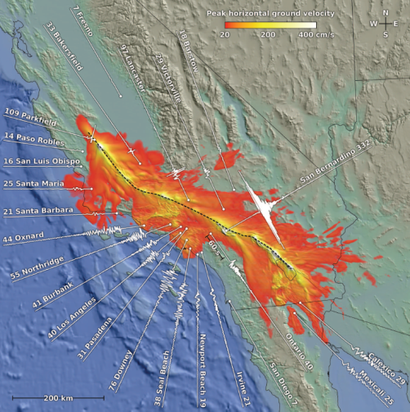

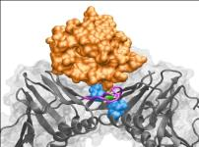

Innovative and Novel Computational Impact on Theory and Experiment
INCITE is an annual, peer-review allocation program that provides unprecedented computational and data science resources
5 billion core-hours to be awarded for 2014 on the 27-petaflops Cray XK7 “Titan” and the
10-petaflops IBM BG/Q “Mira”
Average award: 50+ million core-hours
Individual awards will be up to several hundred million core-hours
INCITE is open to any science domain
INCITE seeks computationally intensive, large-scale research campaigns
Call for Proposals
The INCITE program seeks proposals for high-impact science and technology research challenges that require the power of the leadership-class systems. Allocations will be for calendar year 2014.
April 15 – June 28, 2013
Contact information
Julia C. White, INCITE Manager
whitejc@DOEleadershipcomputing.org
Notes:
The INCITE program is jointly managed by the Oak Ridge and Argonne Leadership Computing Facility centers. The combined INCITE awards for 2013 were nearly 5B hours for 61 projects.

