Slide 1
Exascale Update
SC14 - ASCAC
Bill Harrod
Office of Science
November 20, 2014

Slide 2
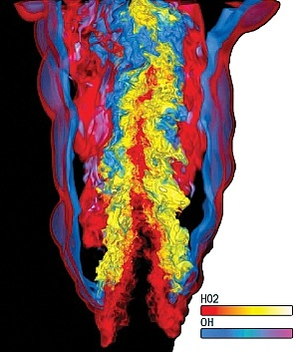
Mission: Extreme Scale Science
Next Generation of Scientific Innovation
DOE's mission is to push the frontiers of science and technology to:
  Enable scientific discovery
  Provide state-of-the-art scientific tools
  Plan, implement, and operate user facilities
The next generation of advancements will require Extreme Scale Computing
  1,000X capabilities of today's Petaflop computers with a similar size and power footprint
Extreme Scale Computing, however, cannot be
achieved by a “business-as-usual” evolutionary
approach
Extreme Scale Computing will require major novel advances in computing technology – Exascale Computing
Exascale Computing Will Underpin Future Scientific Innovations
1
Notes:
The Need: DOE needs exascale computing to continue to fulfill its mission into the next generation of scientific breakthroughs. This includes multi-physics, multi-scale simulations with increasingly high spatial and temporal resolution, scientific discovery from experimental and other data, …
Our future will be determined, driven, and (if we fail) restricted by how we form and employ HPC at exascale
Extreme scale science = next generation of scientific breakthroughs
These breakthroughs are critical to future progress in all areas of our lives
But, … these breakthroughs won't happen without Exascale computing
And, … Exascale computing won't happen via business as usual – there are no easy fixes, no magic bullets left, no low hanging fruit
Need major re-thinking of computing technology
We've done numerous studies to identify requirements, and have determined that exascale computing is challenging but feasible

Slide 3
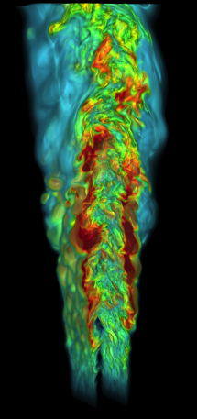
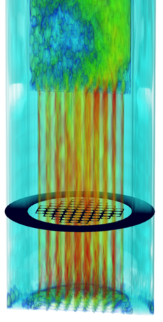
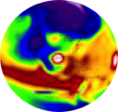
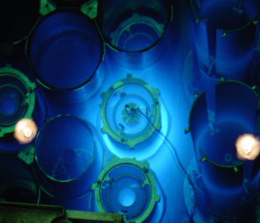

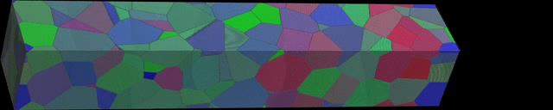

Exascale Applications Respond to DOE Missions in Discovery, Design, and National Prosperity
Scientific Discovery
  Mesoscale materials and chemical sciences
  Improved climate models with reduced uncertainty
  Plasma physics for fusion energy systems
Engineering Design
  Nuclear power reactors
  Advanced energy technologies
  Resilient power grid
National Prosperity
  Energy Technologies
  Advanced manufacturing
  Health Care
  Transportation
Notes:
Segue to the broad range of S&E applications that exascale will address
These are but a few examples in scientific discovery, engineering design, and national security
We will next address four of these important DOE mission areas…

Slide 4

Exascale Challenges and Issues
Four primary challenges must be overcome
  Parallelism / concurrency
  Reliability / resiliency
  Energy efficiency
  Memory / Storage
Productivity issues
  Managing system complexity
  Portability
  Generality
System design issues
  Scalability
  Efficiency
  Time to solution
  Dependability (security and reliability)
  must be integrated at all levels of the design

Slide 5
Exascale Strategy
Exploit co-design process, driven by the full application workflow
Develop exascale software stacks
Partner with and fund vendors to transition research to product space
Collaborate with other government agencies and other countries, as appropriate

Slide 6
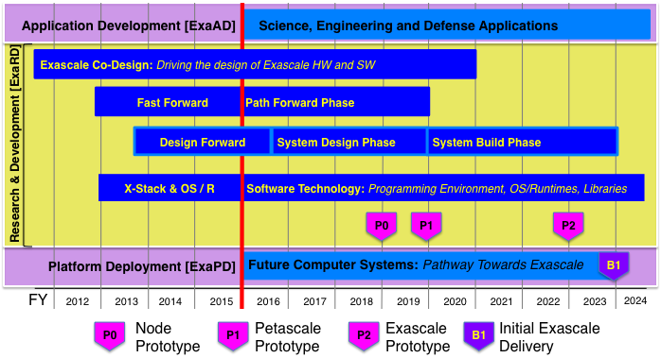
Exascale Project Schedule
Exascale Funding ?

Slide 7
Fast Forward and Design Forward Programs
Fast Forward Program
  Jointly funded by SC & NNSA
  Phase 1: Two year contracts, started July 1, 2012, Phase 2: Two year contracts, starting Fall 2014
Project Goals & Objectives
  Initiate partnerships with multiple companies to accelerate the R&D of critical node technologies and designs needed for extreme-scale computing.
  Fund technologies targeted for productization in the 5–10 year timeframe.
Design Forward Program
  Jointly funded by SC & NNSA
  Phase 1: Two year contracts, started Fall 2013, Phase 2: Two year contracts. Starting Fall 2014
Project Goals & Objectives
  Initiate partnerships with multiple companies to accelerate the R&D of interconnect architectures and conceptual designs for future extreme-scale computers.
  Fund technologies targeted for productization in the 5–10 year timeframe.
Notes:
All of the efforts listed above are looking at some aspect of the hardware requirements for energy efficient processing; reduction in data transport energy; and rapid, efficient memory and storage.
For example, Intel is looking at low-power, highly efficient memory hierarchies, and how next generation memory architectures, combined with processing power, provide optimal, energy-efficient performance.

Slide 8
FastForward 2 Projects
AMD will conduct research for an integrated exascale node architecture. Particular areas of emphasis include near-threshold-voltage logic and other low-power computing technologies. AMD will investigate a new standardized memory interface
Cray Inc. will explore alternative processor design points, including ARM microprocessor designs.
Intel will use this award to continue to advance research in energy efficient node and system architectures, including software targeted at developing extreme-scale systems.
NVIDIA will build on its work in FastForward 1, with a strong focus on energy efficiency, programmability, and resilience.
IBM will investigate next-generation standardized memory interface.

Slide 9
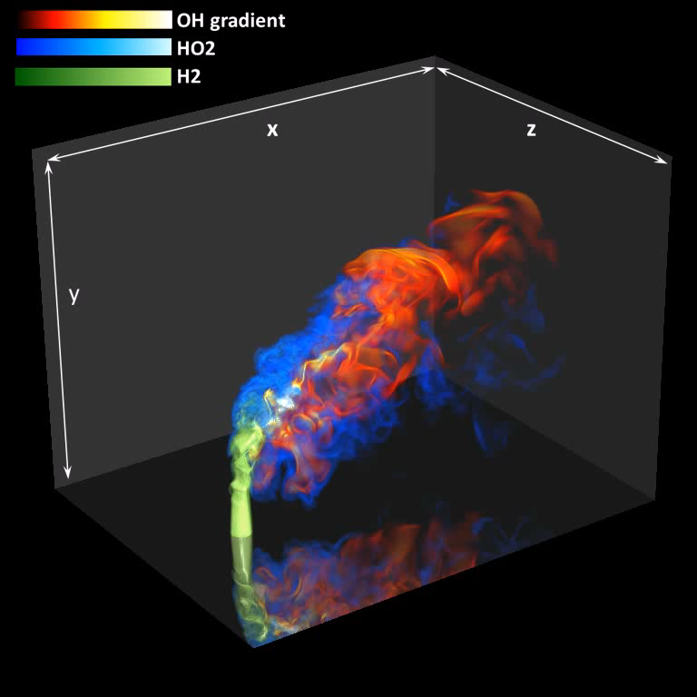
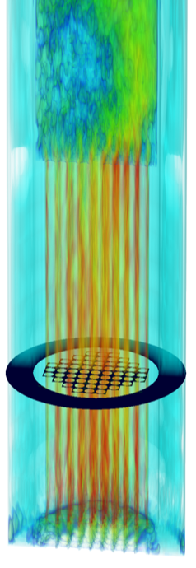
First steps on a Path Towards Exascale:
Three Exascale Co-Design Centers
Exascale Co-Design Center for
Materials in Extreme
Environments (ExMatEx)
  Director: Timothy Germann (LANL)
  http://www.exmatex.org
Center for Exascale Simulation of
Advanced Reactors (CESAR)
  Director: Andrew Siegel (ANL)
  https://cesar.mcs.anl.gov
Center for Exascale Simulation of Combustion in Turbulance (ExaCT)
  Director: Jacqueline Chen (SNL)
  http://exactcodesign.org
Notes:
We funded three exascale co-design centers. Mission critical applications are:
ExMatEx Goal: Develop algorithms, system software, and hardware that will enable pervasive embedding of microscopic behavior modeling and simulation into meso- and macro-scale materials simulations at the Exascale, for the simulation and modeling of materials subjected to extreme mechanical environment.
CESAR Goal: Enable predictive modeling and simulation for advanced nuclear reactor design at the Exascale by integrating three distinct software components -- weakly compressible hydrodynamics, particle transport, and structural mechanics -- into one code environment, TRIDENT, for detailed analysis of next-generation reactors
ExaCT Goal: Simultaneously redesign all aspects of the combustion simulation process, from algorithms to programming models to hardware architecture, to enable detailed modeling and simulations at realistic operating conditions at the Exascale for transportation and energy production applications.
Attached is an animation of a reactive syngas turbulent jet flame in a cross-stream of heated air from a petascale Direct Numerical Simulation (DNS – Navier-Stokes equations w/out turbulence) performed on Jaguar. The simulation is important to understanding safety issues in fuel injection processes in gas turbines for electricity generation using syngases for pre-combustion carbon capture and storage relevant to industry (GE, Alstom, Siemens). The DNS provide details into the chemistry and turbulent mixing needed to understand the mechanism of flame anchoring (or not) in the pre-mixer section of a gas turbine.
Combustion: The Center for Exascale Simulation of Combustion in Turbulence (“ExaCT”) sees its scientific challenge in reducing the design cycle cost for new combustion technologies and new fuels. Exascale computing will allow for improved direct numerical simulation capabilities, especially in the fidelity of the reactive chemistry models. What you are seeing is a reactive syngas turbulent jet flame in a cross-stream of heated air, from a petascale simulation performed on Jaguar. The simulation shows some of the turbulence and chemistry details in the flame and is important to understanding safety issues in fuel injection processes in gas turbines for electricity generation.
CESAR's application focus is predictive simulations of the operations of new, advanced nuclear reactors, not only to reduce costs associated with the and testing of a new nuclear reactor, but also to provide independently verification to safety margins needed by regulatory agencies to certify the new design. Understanding safety scenarios with confidence will require exascale computing resources. What you are seeing is a simulation of water flow past a bundle of reactor fuel rods in a scaled-down, experimental version of an actual small modular reactor (SMR) design being considered. There are experimental data available with this test reactor, thus the simulations may be validated. The picture represents a volume rendering of the velocity in the lower half of the reactor. The colors represent the speed (red is high, blue is low). The flow goes down laterally in the outer annular cylinder and upward in the inner rod bundle representing the core. While flowing through the core the flow is accelerated and heated.
Materials: Understanding how materials deform in various extreme environments is one of the scientific challenges of the ExMatEx Center. An example shown here is what happens to a nanocrystalline sample of a metal being shocked. As the shock wave passes through the sample, the crystal grains respond to compression by forming line defects (points on surface of crystal) and by reorienting themselves (regions changing to a different color). Our experimental facilities, such as the light sources at Argonne and at Stanford, will soon be probing these phenomena with ultrahigh space and time resolutions converging with the length and time scales of such simulations.

Slide 10
ASCR Exascale Co-Design
Status
Notable Successes
Informed & influenced vendors node designs by providing “proxy apps”, codes derived from actual applications, that go beyond the traditional math kernels
Re-examined current algorithms and made changes so that they take advantage of anticipated exascale architectures
Explored programming models and environments that are suitable for the data layout of the applications
Lessons Learned
Interdisciplinary teams discover key issues that could not have been discovered within the boundary of any one disciplinary - and find solutions that are “co-designed”
Bandwidth for interactions: personnel in Co-Design Centers in high-demand, as the Centers provide the only “application use case” for testing research results from computer science, applied math, and hardware architectures
Horizontal integration: need to create opportunities for the Centers to leverage each other
Notes:
Examples:
FF (NDA)
Gremlins & ASPEN in ExMatEx
Monte Carlo transport in CESAR
TiDA for patch-based AMR in ExaCT

Slide 11
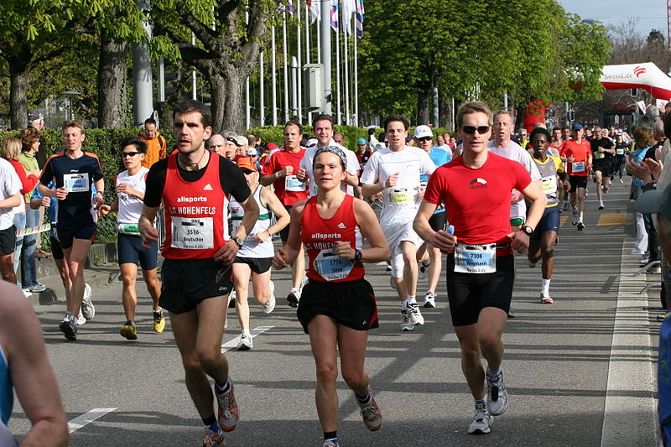

Exascale Programming Models
X-Stack Goals
New Programming Models: approaches to managing parallelism and data movement through innovations in interfaces
Dynamic Runtime Systems: adapt to changing application goals and system conditions
Locality-aware and Energy-efficient Strategies: manage locality and minimize energy consumption
Interoperability: facilitate interoperability across different HPC languages and interfaces, as well as cross-cutting execution models
Notes:
he X-Stack program was initiated to get a head start on the critical complex, intertwined software issues.

Slide 12
Exascale Programming Models
Observations & Lessons Learned
Computations and communications will be irregular due to heterogeneous processors characteristics, deep memory hierarchies, and much higher rate of faults than current platforms.
Exascale system will have deep memory hierarchy: generating optimized code will be very challenging.
Using DSLs, application code size can be reduced by 100x, and the code generated and optimized has about 3x faster execution time.
Unprecedented parallelism, asynchrony, and irregular computations and communications are well matched to task/thread-oriented dataflow programming models.

Slide 13
Status
Meetings with
  Secretary of Energy
  SEAB
  OMB
  OSTP
  Congressional Meetings
  Other agencies
  Project Design Planning
  Develop preliminary version of project design document, involving lab researchers and DOE/NNSA program managers.
  Held “Red Team” review of document
  Held external review of document (federal employees from other agencies)
  Updated project design document
  Initiated New Programs
  FastForward 2 and DesignForward 2, Resilience, Analytical Modeling for Extreme-Scale Computing Environments, Scientific Data Management, Analysis and Visualization at Extreme Scale

Slide 14
Preliminary Conceptual Design for the
Exascale Computing Initiative Document
This document presents a preliminary strategy and contains limited descriptions of project management details.
A preliminary list of proposed projects is provided
Table of Contents
Executive Summary
1 Introduction
2 Project Background
Justification of Mission Need
4 Barriers to Achieving Exascale Computing
5 Technical Approach
Project Management
Integrated Baseline
External Stakeholders
Appendix 1

Slide 15
Technical Approach
Project Components
Exascale Research, Development and Deployment (ExaRD):
  Exascale Co-Design Centers and Beyond Exascale, exploratory research to co-design hardware and software architecture
  Software Technology Research and Development, aimed at specific hardware and software technologies;
  Vendor Research and Development, aimed at developing exascale node and system architectures;
Exascale Application Development (ExaAD):
  Readiness to Use Capable Exascale Systems, initiating the development of a suite of exascale applications software packages that will be operational in 2023 to ensure maximal scientific and engineering impact of the exascale systems
Exascale Platform Deployment (ExaPD):
  Coordinated Acquisition Strategy for exascale platforms, including long-lead site preparations and system platforms

Slide 16
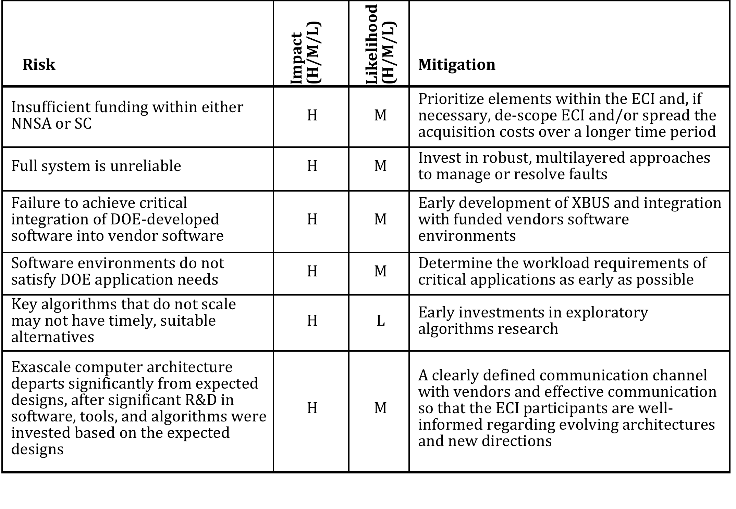

Slide 17
Software Technology Projects
Appendix 1
1 Application Foundations
1.1 Co-Design (CD)
1.2 Applied Mathematics (AM)
1.3 Data Analytics and Visualization (DV)
2 User Experiences (UE)
2.1 Productivity (PR)
2.2 Collaborative Environment (CE)
2.3 Resilience (RE)
2.4 Application Integrity
2.5 Cybersecurity (CS)
Software Stack (SS)
Performance Execution (PE)
Data Management (DM)
Hardware Architecture (HA)
System Engineering and Integration

Slide 18
Delivering on the Exascale Promise
Exascale computing systems are essential for the scientific fields that will transform the 21st Century global economy
  Energy
  Biotechnology
  Nanotechnology
  Materials science
Goal: Lead computational sciences and HPC to continue to develop and deploy HPC hardware and software systems through exascale platforms
DOE ASCAC subcommittee identifies top 10 technology advancements
  Critical to making productive, economically viable exascale systems
  Innovations beyond anticipated conventional practices and their incremental extensions

Slide 19
Technical Approaches
The Top Ten Exascale Challenges, with Technical Approaches
Energy efficiency
Interconnect technology
Memory Technology
Scalable System Software
Programming systems
Data management
Exascale Algorithms
Algorithms for discovery, design, and decision
Resilience and correctness
Scientific productivity

