Slide 1
Next Generation Networking for Science
Program Update
NGNS Program Managers
Richard Carlson
Thomas Ndousse
ASCAC meeting 11/21/2014

Slide 2
NGNS Program Mission
The Goal of the program is to research, develop, test and deploy advanced network and middleware technologies critical to DOE’s science mission
A unique focus is the end-to-end aspect of the high-performance, high-capacity network and middleware technologies needed to provide secure access to distributed science facilities, high-performance computing resources and large-scale scientific collaborations.

Slide 3
NGNS Budget Trend
Funding in $K

Slide 4
FY14 Funding Distribution
Funding in $K

Slide 5
NGNS Program Management
Regular calls and interactions with PI’s
Workshops to gather new requirements
Annual PI meetings
  URL’s to last 3 PI meetings
    https://indico.bnl.gov/conferenceDisplay.py?confId=489
    https://indico.bnl.gov/conferenceDisplay.py?confId=566
    https://www.orau.gov/ngnspi2014/agenda.htm
  2014 PI meeting highlights
    7 sessions for 24 projects
    3-4 speakers gave 15 minute talks per session
    45-60 minute discussion per session
    Poster session

Slide 6
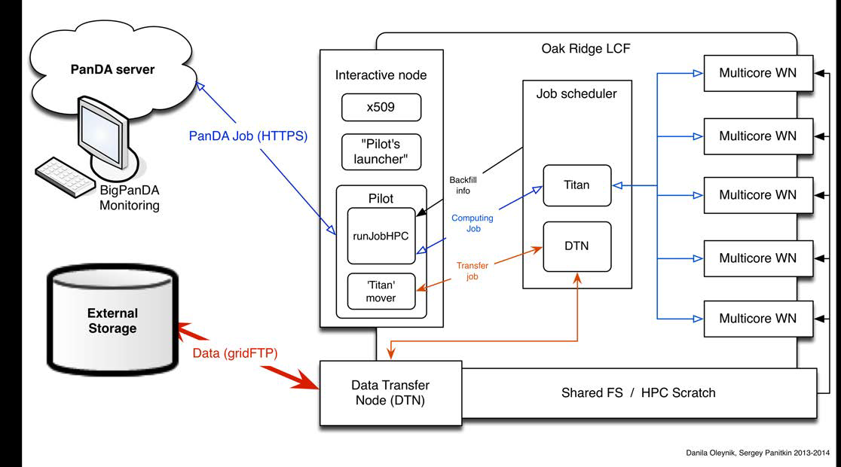
WP2 PanDA architecture for Titan
Pilot(s) executes on HPC interactive node
Pilot interact with local job scheduler to manage job
Data, produced on HPC automatically moves to external storage
Started Integration work with NERSC using the same architecture

Slide 7
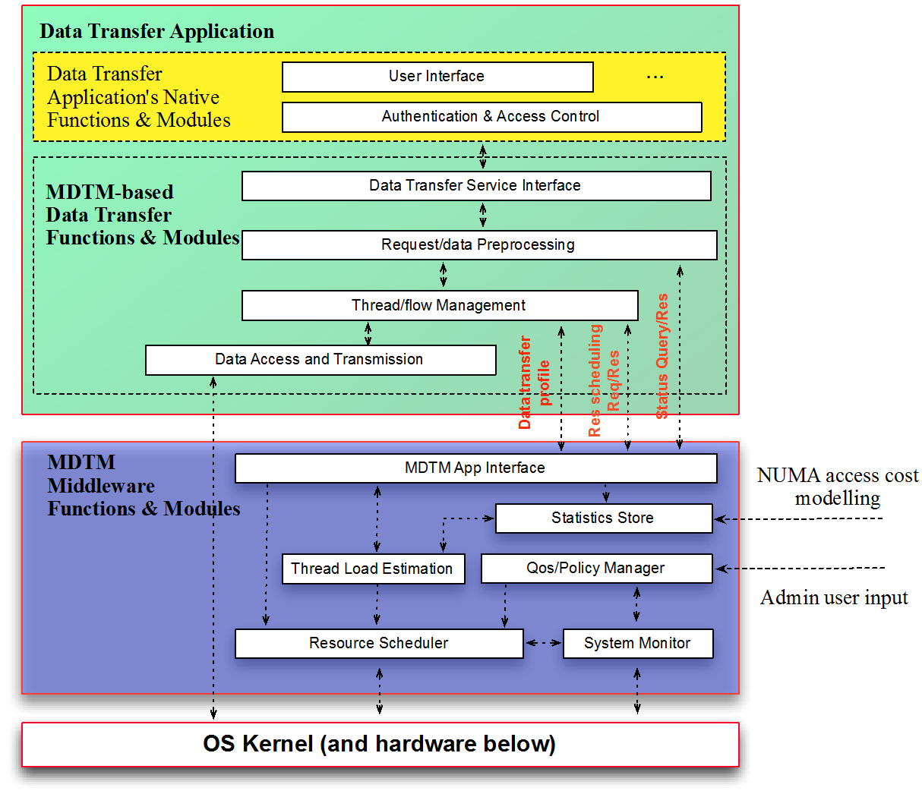


Multicore-aware Data Transfer Middleware
I/O-Centric architecture
Parallel data transfer
Data layout preprocessing
Data flow-centric scheduling
NUMA-awareness scheduling
I/O Locality optimization
Maximizing Parallelism

Slide 8
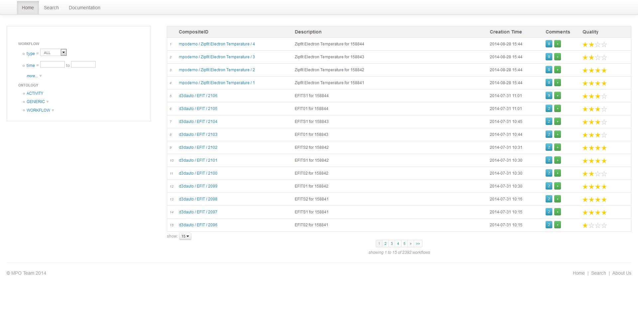
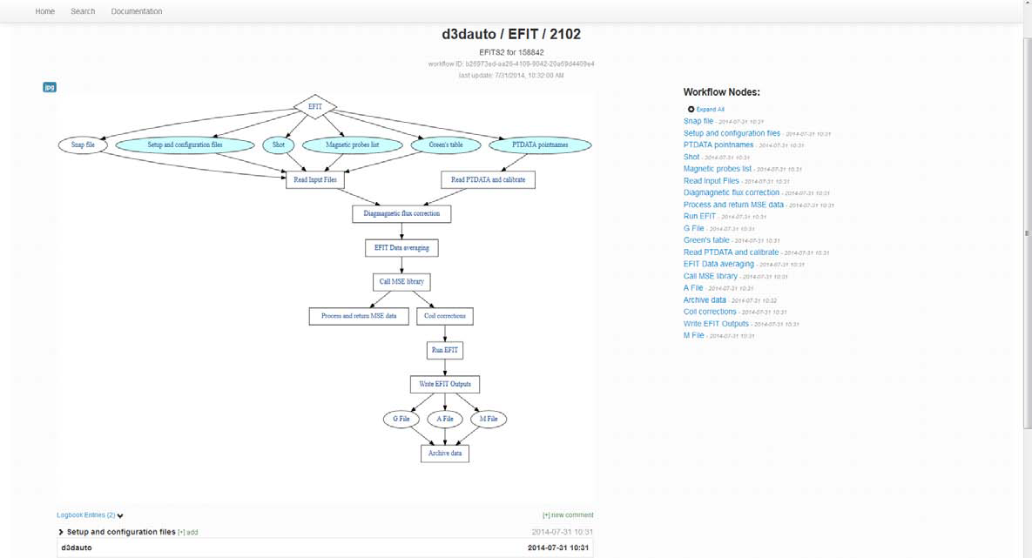


Automated Metadata, Provenance Cataloging and Navigable Interfaces
Notes:
Web service based tool to automatically document workflow and data provenance from any tool that processes data
Co-funded with FES program office

Slide 9

Distributed Computing Design Study
Two year ‘Design Study’ to create a roadmap for distributed computing
  Deep analysis of expected future for scientific distributed computing
  Identify markers and signposts that indicate the roadmap is correct
  Update Magellan cloud computing activity

Slide 10
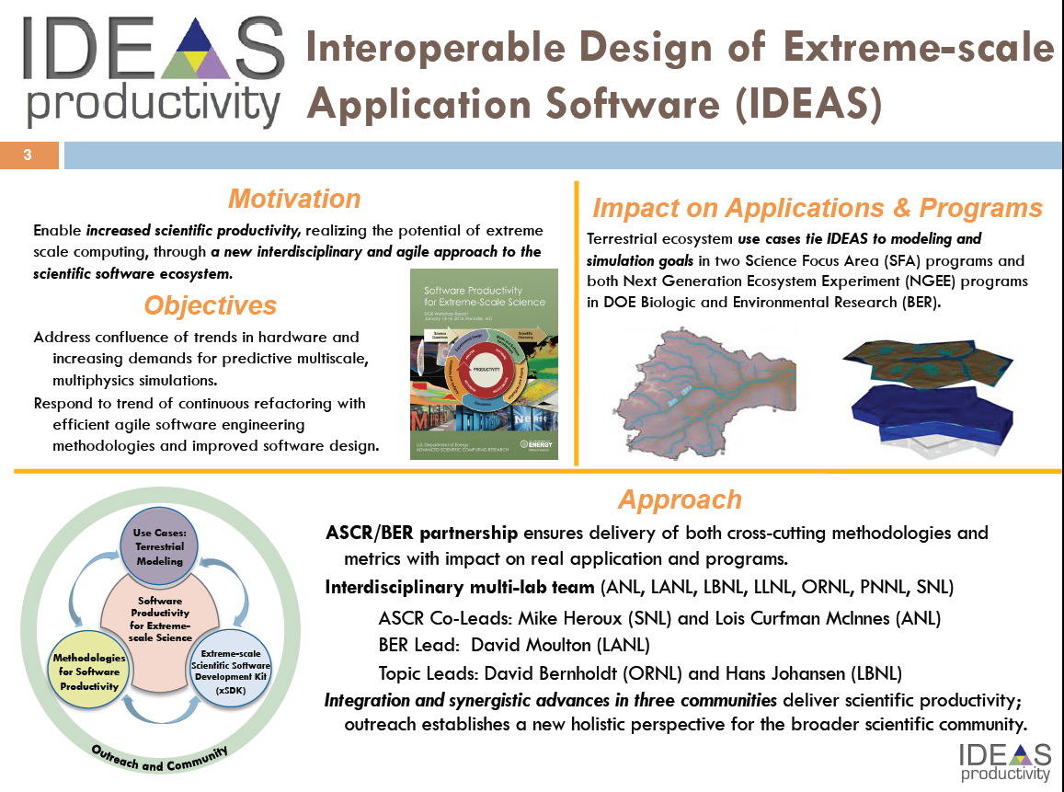

Slide 11
Analytical Modeling for Distributed Computing
Significantly enhance our ability to predict how scientific workflows perform and to explain workflow behavior on distributed extreme-scale infrastructures
Specific tasks include
  Workflow component analytical models.
  Integrated end-to-end models.
  Experimental validation and verification.
  Simple to use tools.
Start of a larger program in modeling and simulation for DOE science

Slide 12
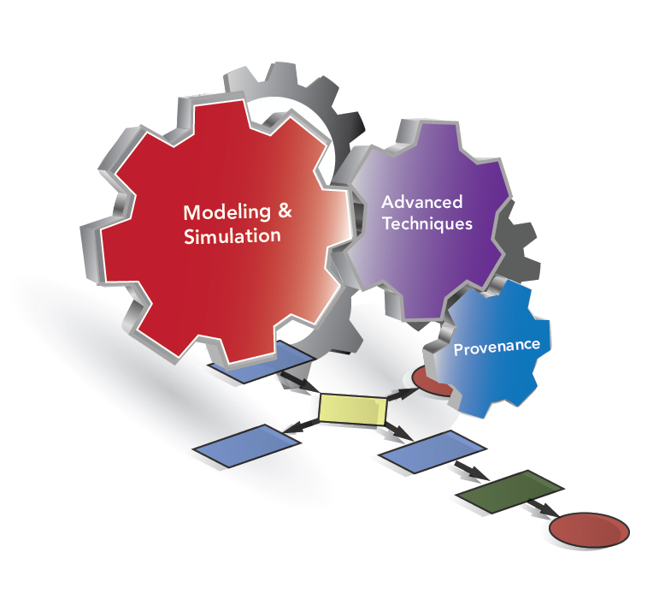

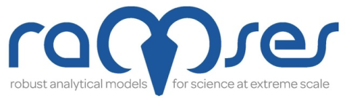

Analytical Modeling for Extreme-Scale Computing Environments
Four large projects started in FY14
  IPPD: Integrated End-to-End Performance Prediction and Diagnosis for Extreme Scientific Workflows – Kerbson, et.al. (PNNL)
  Panorama: Predictive Modeling and Diagnostic Monitoring of Extreme Science Workflow – Deelman, et.al. (USC/ISI)
  Ramses: Robust analytical models for science at extreme scales – Foster, et.al. (ANL)
  X-Swap: Extreme-Scale Scientific Workflow Analysis and Prediction – Strohmaier, et.al. (LBNL)
http://science.energy.gov/ascr/research/next-generation-networking/am-projects/

Slide 13
Proposed Activities
Workshops
  Joint NGNS/CS on workflow science (Science Automation)
  Explore optical networking from computers to networks
  What else
Potential areas
  SDN-Enabled Terabit Optical Network for Extreme-scale Science
    Explore the potential of network programmability in the design of a new generation of federated intelligent terabit optical networks
  Dynamic Distributed Resource Management
    A mixture of applied and basic research to support complex computationally intensive and data intensive science experiments

Slide 14
Conclusions
NGNS program continues to support both applied and basic research in networking and scientific collaborations
Existing programs augmented by new areas of research
  Software Productivity
  Analytical Modeling of scientific workflows
Future programs being developed to address challenges emerging from current work
  What is the top question your current research motivates you to now ask?

Slide 15
Supplemental Slides

Slide 16
Existing NGNS Programs
FY11 – Networking (8 funded)
  Innovative approaches to develop federated terabit network tools and services that address DOE’s emerging network challenges
FY12 – Collaboration (10 funded)
  Transformative approaches to understanding and/or enabling scientific collaborations at a scale not possible with today’s knowledge or using current Internet-based services and tools
  http://science.energy.gov/ascr/research/next-generation-networking/extremescalecollaboration/
FY13 – Networks (7 funded)
  Conduct research on terabit data-aware network technologies and storage system management to address scientific Big Data infrastructure challenges
  Explore innovative theoretical frameworks, network-aware data management concepts, and storage system performance optimization models

Slide 17
FY14 New Starts
Design Study
Software Productivity
Analytical Modeling of Science Workflows

Slide 18
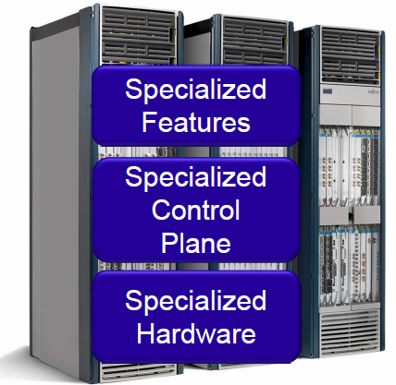
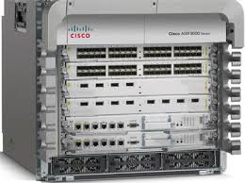

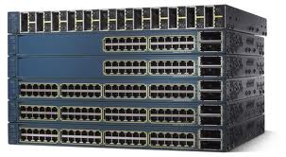
SDN-Enabled Terabit Optical Network For Extreme-scale Science
Focus Ares
Current Approach
SDN-Enabled Internet
SDN-Enable Science Networking
Internet Apps
Science
Apps
Science
Apps
Science
Apps
Network Intelligence
Workflow interface
Internet
Function
Internet
Function
Terabits
HPC-Networking
Function
Terabits
HPC-Networking
Function
Open Interfaces
Open Interfaces
Network Operating System
Control Plane
Network Operating System
Control Plane
Open Interfaces
Open Interfaces
Data Plane
Multi-layers Data Plane
Current Networking trends:
Network Control and traffic (data) flows are hardwired into a proprietary hardware
Emerging SDN paradigm;
Separation of network Control and traffic (data) forwarding
SDN-Enabled Science Terabit Networking
Adaptation and extension of SDN to distributed data-intensive science application

