Slide 1
Applications Readiness Plan
Briefing to ASCAC, November 21, 2014
Straatsma: ALCF, NERSC, OLCF Application Readiness Collaboration
Antypas: Challenges and Strategies for Portability
Williams: Planning of Joint Activities

Slide 2
ALCF, NERSC and OLCF Application Readiness Collaboration

Slide 3
ALCF, NERSC, OLCF Application Readiness Collaboration
The three ASCR sites feel that the close collaboration on application readiness and performance portability activities that has been initiated at the September 2014 joint meeting will result in better programming activities, higher value for the ultimate users of the ported applications, and a natural way to avoid duplication of effort by leveraging each other’s efforts.
The outlined collaboration on application readiness and portability does not simply address the next-generation systems that will be coming to ALCF, NERSC, and OLCF, but is also on the vendors’ paths to exascale architectures. Using appropriate abstractions to get portability and performance on these pre-exascale systems provides a path to be continued toward exascale.

Slide 4
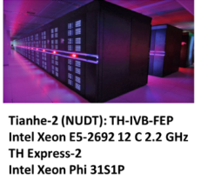


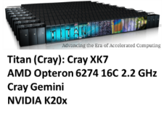
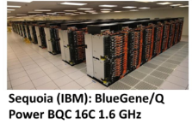
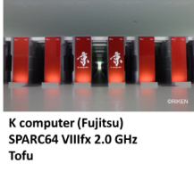


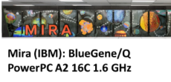

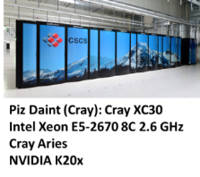

Two Tracks for Future Large Systems
Many Core
10’s of thousands of nodes with millions of cores
Homogeneous cores
Multiple levels of memory – on package, DDR, and non-volatile
Unlike prior generations, future products are likely to be self hosted
Cori at NERSC
Self-hosted many-core system
Intel/Cray
9300 single-socket nodes
Intel® Xeon Phi™ Knights Landing (KNL)
16GB HBM, 64-128 GB DDR4
Cray Aries Interconnect
28 PB Lustre file system @ 430 GB/s
Target delivery date: June, 2016
Summit at OLCF
Hybrid CPU/GPU system
IBM/NVIDIA
3400 multi-socket nodes
POWER9/Volta
More than 512 GB coherent memory per node
Mellanox EDR Interconnect
Target delivery date: 2017
ALCF-3 at ALCF
TBA
Target delivery date: 2017-18
Hybrid Multi-Core
CPU / GPU Hybrid systems
Likely to have multiple CPUs and GPUs per node
Small number of very fat nodes
Expect data movement issues to be much easier than previous systems – coherent shared memory within a node
Multiple levels of memory – on package, DDR, and non-volatile
Edison (Cray): Cray XC30
Intel Xeon E%-2695v2 12C 2.4 GHz
Aries

Slide 5
Synergy between Application Readiness Efforts
Application Developer Team involvement
Knowledge of the application
Work on application in development “moving target”
Optimizations included in application release
Early Science Project
Demonstration of application on real problems at scale
Shake-down on the new system hardware and software
Large-scale science project is strong incentive to participate
Vendor support is crucial
Programming environment often not mature
Best source of information on new hardware features
Access to multiple resources, including early hardware
Joint training activities
Portability is a critical concern
Experience benefits other developers and users
Coverage of scientific domains
Coverage of algorithmic methods and programming models
Persistent culture of application readiness
More computational ready applications available
Experience of science liaisons and catalysts for user programs
Synergy with libraries and tools projects

Slide 6
Getting Ready: Application Readiness Programs
NESAP at NERSC
NERSC Exascale Science Application Program
Call for Proposals – June 2014
20 Projects selected
Partner with NERSC Application Readiness Team
8 Postdoctoral Fellows
Criteria
An application’s computing usage within the DOE Office of Science
Representation among all 6 Offices of Science
Ability for application to produce scientific advancements
Ability for code development and optimizations to be transferred to the broader community through libraries, algorithms, kernels or community codes
Resources available from the application team to match NERSC/Vendor resources
CAAR at OLCF
Center for Accelerated Application Readiness
Call for Proposals – November 2014
8 Projects to be selected
Partner with OLCF Scientific Computing group and IBM/NVIDIA Center of Excellence
8 Postdoctoral Associates
Criteria
Anticipated impact on the science and engineering fields
Importance to the user programs of the OLCF
Feasibility to achieve scalable performance on Summit
Anticipated opportunity to achieve performance portability for other architectures
Algorithmic and scientific diversity of the suite of CAAR applications.
Optimizations incorporated in master repository
Size of the application’s user base
ESP at ALCF
Early Science Program
Call for Proposals
10 Projects to be selected
Partner with ALCF Catalyst group and ALCF Vendor Center of Excellence
Postdoctoral Appointee per project
Criteria
Science Impact
Computational Readiness
Proposed science problem of appropriate scale to exercise capability of new machine
Confidence code will be ready in time
Project code team appropriate
Willing partner with ALCF & vendor
Diversity of science and numerical methods
Samples spectrum of ALCF production apps

Slide 7
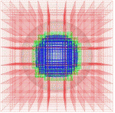
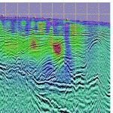
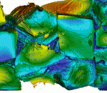
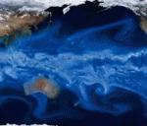
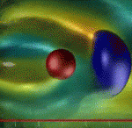
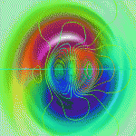
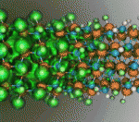
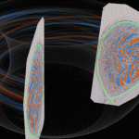
NERSC Exascale Science Applications Program (NESAP)
Advanced Scientific Computing Research
Almgren (LBNL) – BoxLib AMR Framework
Trebotich (LBNL) – Chombo-crunch
High Energy Physics
Vay (LBNL) – WARP & IMPACT
Toussaint(Arizona) – MILC
Habib (ANL) – HACC
Nuclear Physics
Maris (Iowa St.) – MFDn
Joo (JLAB) – Chroma
Christ/Karsch
(Columbia/BNL) – DWF/HISQ
Basic Energy Sciences
Kent (ORNL) – Quantum Espresso
Deslippe (NERSC) – BerkeleyGW
Chelikowsky (UT) – PARSEC
Bylaska (PNNL) – NWChem
Newman (LBNL) – EMGeo
Biological and Environmental Research
Smith (ORNL) – Gromacs
Yelick (LBNL) – Meraculous
Ringler (LANL) – MPAS-O
Johansen (LBNL) – ACME
Dennis (NCAR) – CESM
Fusion Energy Sciences
Jardin (PPPL) – M3D
Chang (PPPL) – XGC1

Slide 8
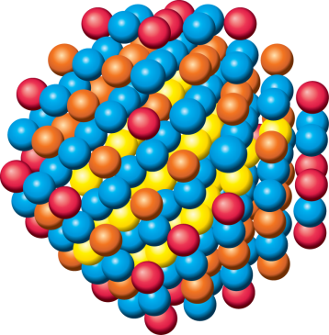
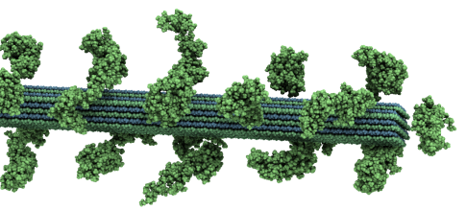
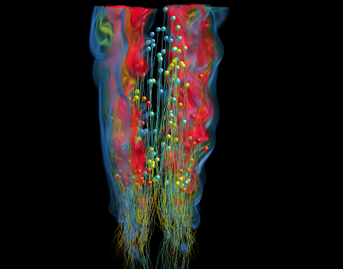
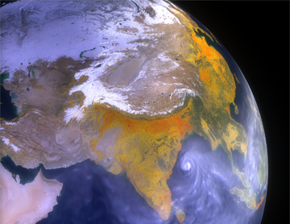
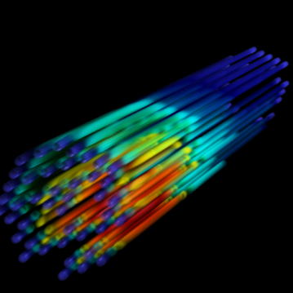
OLCF-3 Center for Accelerated Application Readiness (CAAR)
WL-LSMS
Illuminating the role of material disorder, statistics, and fluctuations in nanoscale materials and systems.
LAMMPS
A molecular description of membrane fusion, one of the most common ways for molecules to enter or exit living cells.
S3D Understanding turbulent combustion through direct numerical simulation with complex chemistry.
CAM-SE
Answering questions about specific climate change adaptation and mitigation scenarios; realistically represent features like precipitation patterns / statistics and tropical storms.
NRDF
Radiation transport – important in astrophysics, laser fusion, combustion, atmospheric dynamics, and medical imaging – computed on AMR grids.
Denovo
Discrete ordinates radiation transport calculations that can be used in a variety of nuclear energy and technology applications.

Slide 9
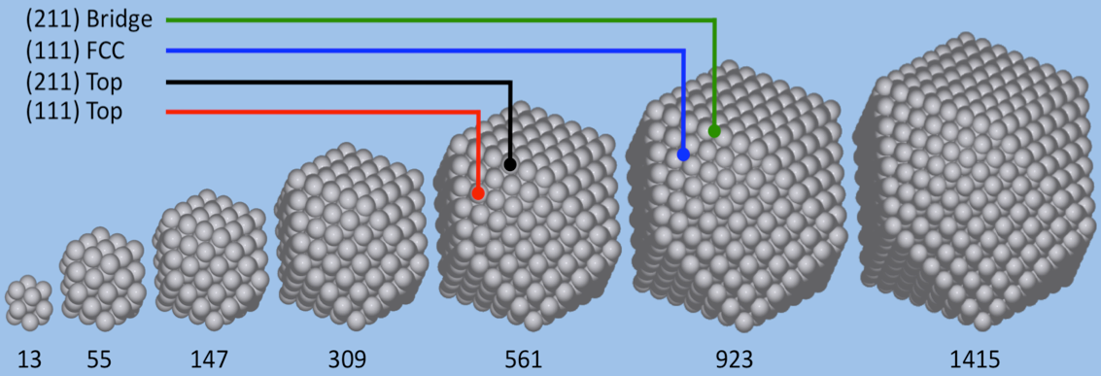
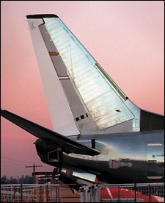
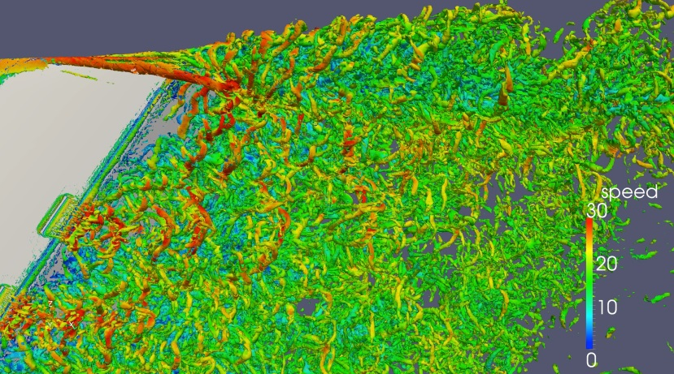
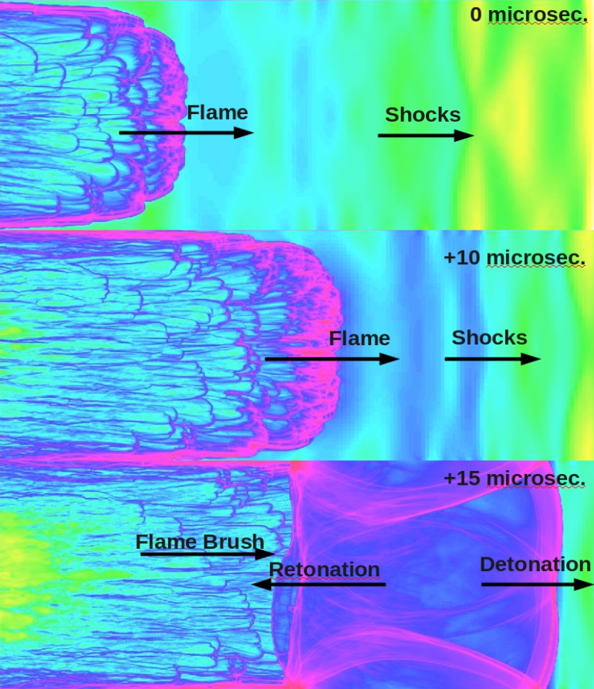
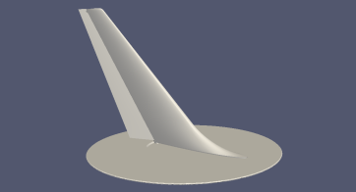
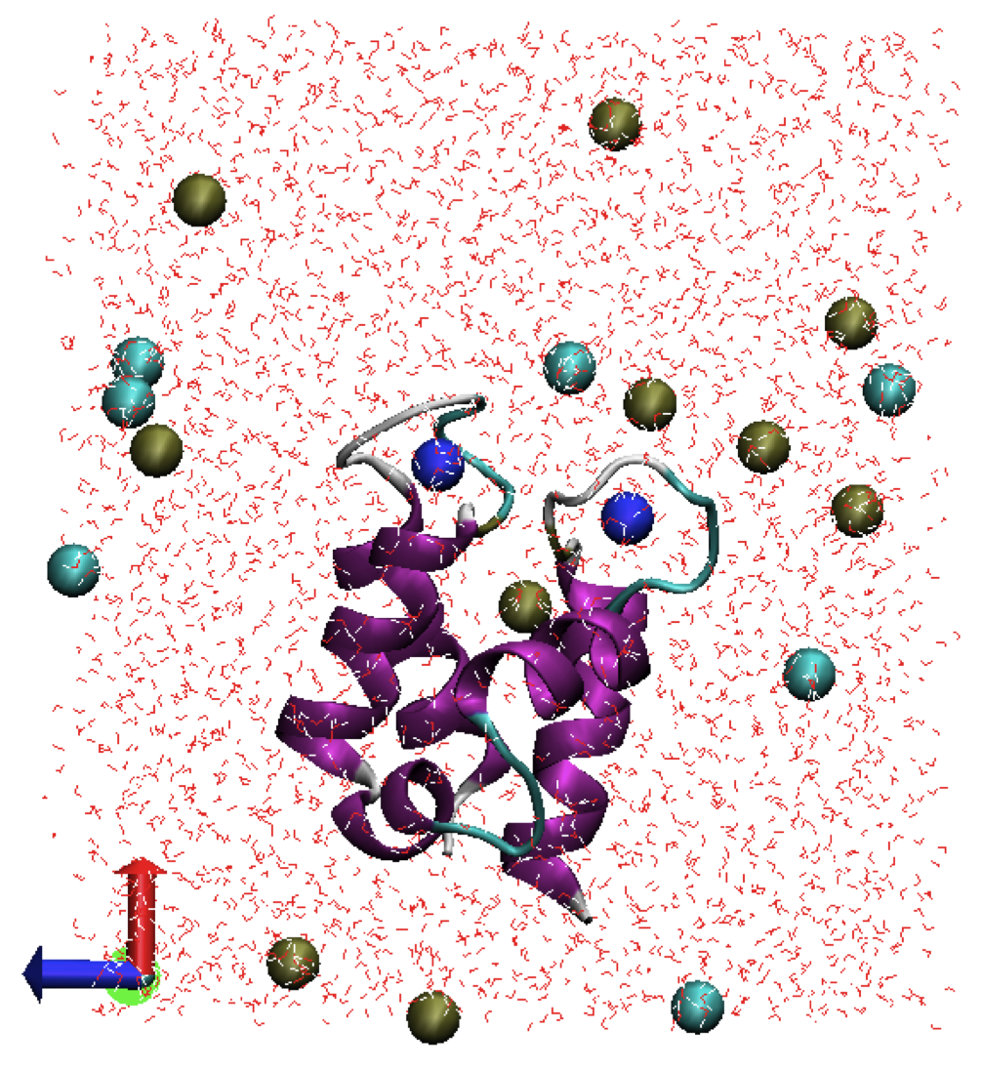
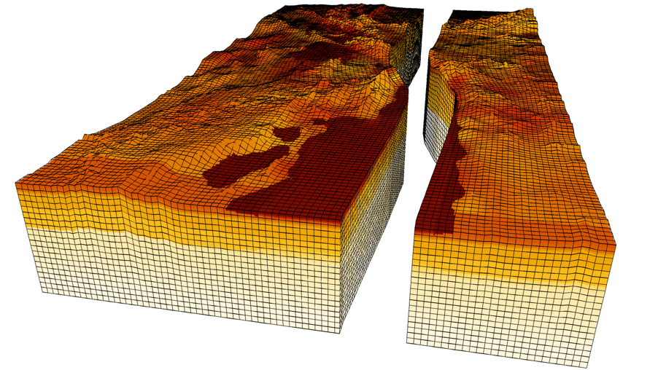
ALCF-2 ESP (Mira)
Energy Storage Materials and Catalysis
Quantum Monte Carlo simulations of platinum metal nanoparticles as catalysts for key reactions (QMCPACK).
Active Aerodynamic Flow Control
Tiny synthetic jet actuators dramatically improve effectiveness of aerodynamic control surfaces such as rudders. (PHASTA).
Biomolecular Science
Highly accurate microscopic model of proteins and complexes—polarizable force field (NAMD).
CAD
Earthquake Genesis
Realistic 3D fault rupture simulation (SORD).
High Speed Combustion and Detonation
Direct numerical simulation of shock tube experiments (ALLA/FTT).
Notes:
QMCPACK: Cuboctahedra platinum clusters, ranging from 13 to 1415 atoms.
NAMD:Figure (from Lyna): Yes, the "two-lobed object" is D9k, whit its secondary structure shown in the cartoon mode. It's a double helix-loop-helix (also called EF-hand) structure.
The blue balls represent two calcium ions bound in two binding loops.
The bulk part is shown in red dots in a rectangular box. Potassium ions and chloride ions in solvent are shown in grey balls and green balls respectively. Here are some figures of one benchmark system (Calbindin D9k) for performing Hamiltonian replica exchange 2 dimensional umbrella sampling methods on BG/P and BG/Q. Calbindin D9k, is a small protein possessing a pair of EF-hands that binds two calcium ions in a cooperative fashion. It is an excellent model system for studying the molecular mechanism of cooperativity. Binding free energy of Calcium ions is characterized in terms of a potential of mean force (PMF). The PMF is calculated using a novel two-dimensional replica-exchange molecular dynamics (MD) umbrella sampling scheme, which is developed and implemented in the program CHARMM and NAMD2.9 to increase the configuration space sampling. The algorithm is extremely scalable on the massively distributed Blue Gene/P supercomputing architecture.
ALLA/FTT: DDT in 2H2+)2 at 1 atm initial pressure (pseudo-schlieren visualization)

Slide 10
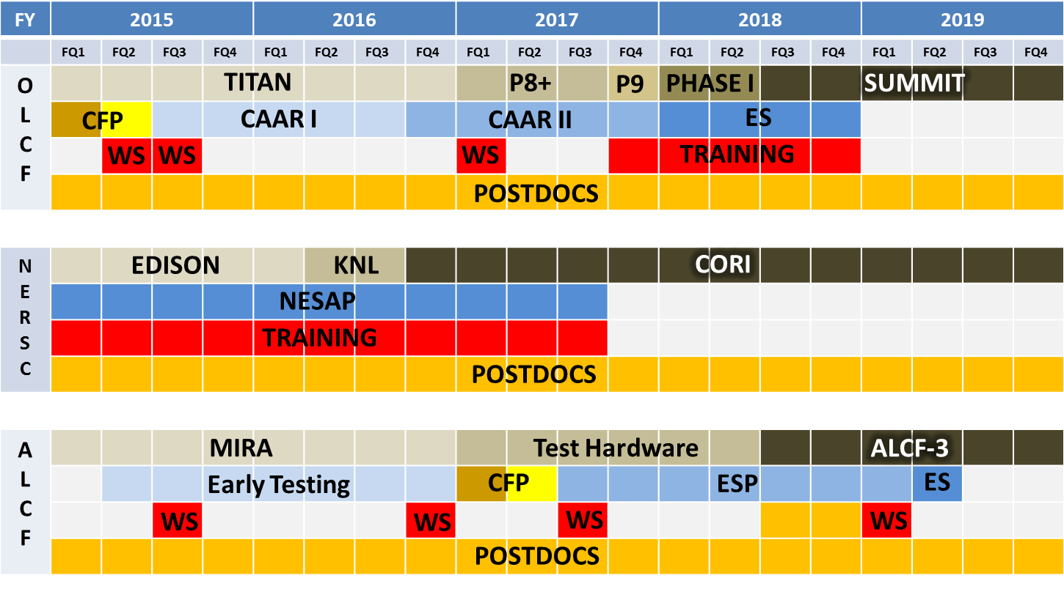
Application Readiness Programs Tentative Timeline

Slide 11
Drivers for Portability
Application portability among NERSC, ALCF and OLCF architectures is critical concern of ASCR
Application developers target wide range of architectures
Maintaining multiple code version is difficult
Porting to different architectures is time-consuming
Many Principal Investigators have allocations on multiple resources
Applications far outlive any computer system
Primary task is exposing parallelism and data locality
Challenge is to find the right abstraction:
MPI + X (X=OpenMP, OpenACC)
PGAS + X
DSL
…

Slide 12
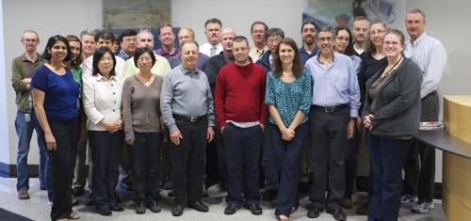
ALCF, NERSC, OLCF Collaboration
March 2014: Meeting to discuss common applications, POCs
September 2014: ALCF, OLCF participated in NESAP proposal reviews
September 2014: Meeting to discuss application readiness and architectural and performance portability:
How will we coordinate our application readiness efforts, particularly when more than one center chooses the same application for early access and readiness?
What guidance and tools can we provide users to encourage application development that will be portable across different architectures?
What mechanisms and allocations can we provide to all of our early science teams so that they can test and run their applications on different architectures?

Slide 13
Postdoctoral Associate Programs
The ASCR facilities are hosting Distinguished Postdoctoral Associates programs with the overarching objective of training the next generation of computational scientists. To achieve this goal, the postdoctoral associates programs have the specific goals of providing:
Challenging scientific campaigns in critical science mission areas
Experience in using ASCR computing capabilities
Training in software development and engineering practices for current and future massively parallel computer architectures
Central to achieving these goals is access to leadership computing resources, availability of computational domain scientists to provide adequate mentoring and guidance, and facilities’ association with universities with strong computational and computer science programs.
NERSC: https://www.nersc.gov/users/announcements/featured-announcements/nersc-exascale-science-postdoctoral-fellowships/
OLCF: https://www.olcf.ornl.gov/summit/olcf-distinguished-postdoctoral-associates-program/
ALCF: https://www.alcf.anl.gov/about/careers

Slide 14
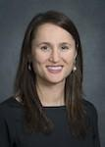
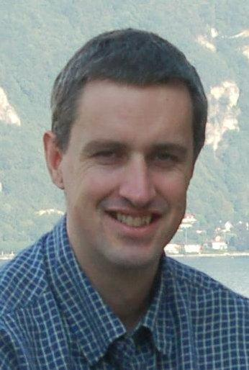
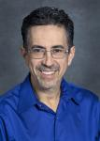
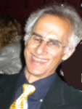
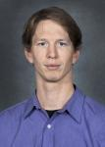

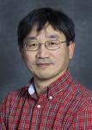






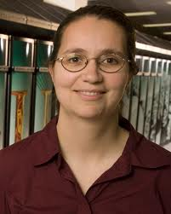
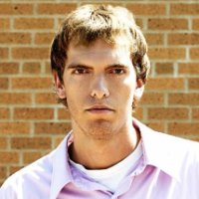
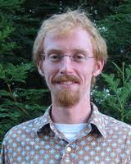
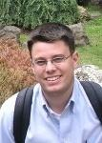












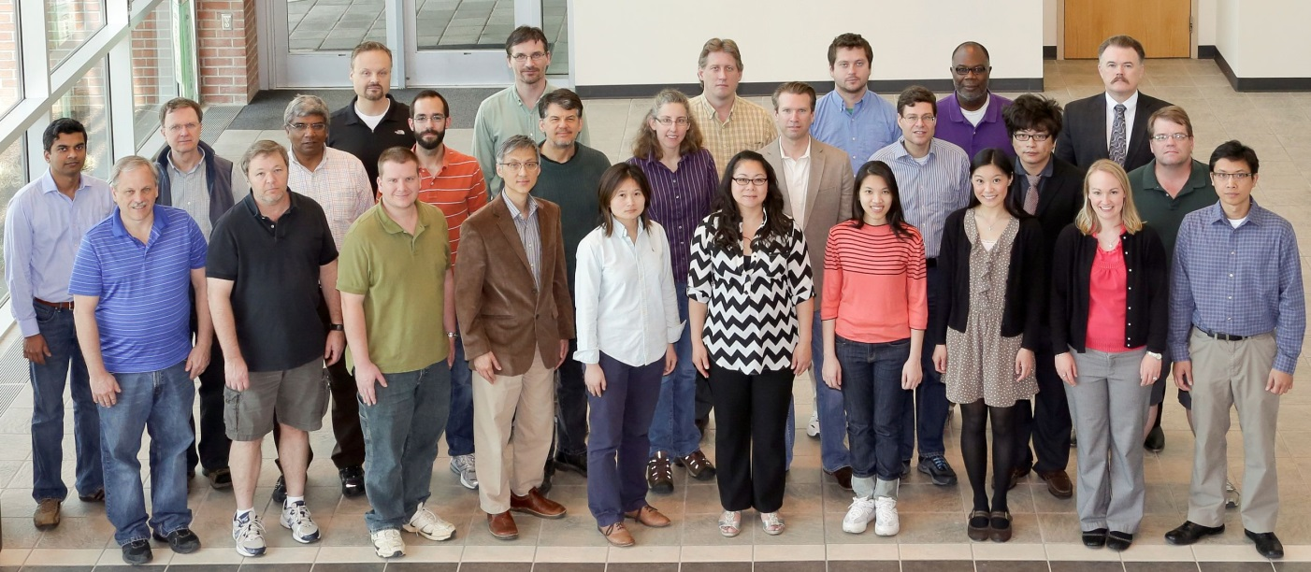
Application Readiness Staff
NERSC Application Readiness Team
ALCF Application Readiness Team
Katie Antypas
Nick Wright
Richard Gerber
Harvey Wasserman
Brian Austin
Zhengji Zhao
Woo-Sun Yang
Katherine Riley
Nichols Romero
Yuri Alexeev
Anouar Benali
Kalyan Kumaran
Ray Loy
Graham Fletcher
Rebecca
Hartman-Baker
Jon Rood
(IPCC postdoc)
Scott French
Jack Deslippe
Helen He
Matt Cordery
Hal Finkel
Marta Garcia Martinez
Wei Jiang
Vitali Morozov
Scott Parker
OLCF Application Readiness Team
James Osborn
Alvaro Vazquez-Mayagoitia
Timothy Williams
Venkatram Vishwanath
Not Pictured: Ramesh Balakrishnan, Christopher J. Knight, Adrian Pope, William Scullin, and Emily R. Shemon
Left to right: Ramanan Sankaran, Mike Matheson, George Ostrouchov, Duane Rosenberg, Valentine Anantharaj, Bronson Messer, Mark Berrill, Matt Norman, Ed D’Azevedo, Norbert Podhorski, Wayne Joubert, JJ Chai (postdoc, now in CSM), Judy Hill, Mark Fahey, Hai Ah Nam, Jamison Daniel, Dmitry Liakh, Supada Loasooksathit (postdoc), Markus Eisenbach, Arnold Tharrington, Ying Wai Li, Mingyang Chen (postdoc), Peyton Ticknor, Tjerk Straatsma, Dave Pugmire and Jan-Michael Carrillo (postdoc, now at SNS).

Slide 15
Portability Challenges and Strategies

Slide 16
How should we define performance portability?
Community is just coming to terms with the language and definition.
From a recent FASTMath meeting two definitions of performance portable emerged:
Same piece of code (from the user perspective) runs on different architectures with ‘good’ performance
A relatively small amount of effort is needed to make a change to get good performance within advertised (algorithmic or performance) tolerances across both current and future architectures

Slide 17
The dominant programming model at centers is MPI, sometimes +X
MPI only
MPI+OpenMP
MPI+OpenACC/CUDA
Programming Model GPU usage on Titan
Notes:
Get breakdown from OLCF, ALCF
Add different shade of blue

Slide 18

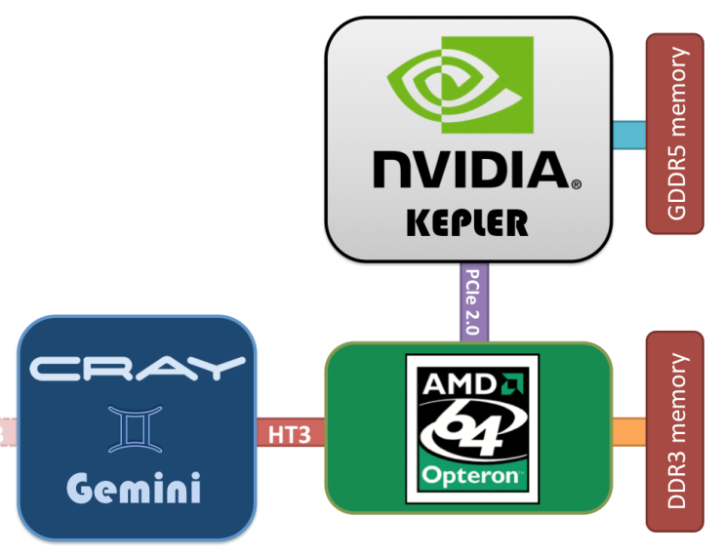
Portability challenge: Deepening memory hierarchies
Knight’s Landing Architecture
ASCR facility architectures will have memory hierarchies, each with “faster” and “slower” memory that differ by:
Ratios of fast and slow memory bandwidths
Sizes of fast and slow memories
Attributes of fast and slow memories
APIs into fast and slow memories
Number of NUMA domains
Near Memory
Near Memory
Far Memory
HBW In-Package Memory
HBW In-Package Memory
DDR
HBW In-Package Memory
KNL CPU
HBW In-Package Memory
DDR
Cache
. . .
. . .
. . .
HBW In-Package Memory
HBW In-Package Memory
DDR
PCB
Source:Intel
Titan Node Architecture
Notes:
We’ve had different layers of cache before, but now users have option to explicitly manage memory

Slide 19
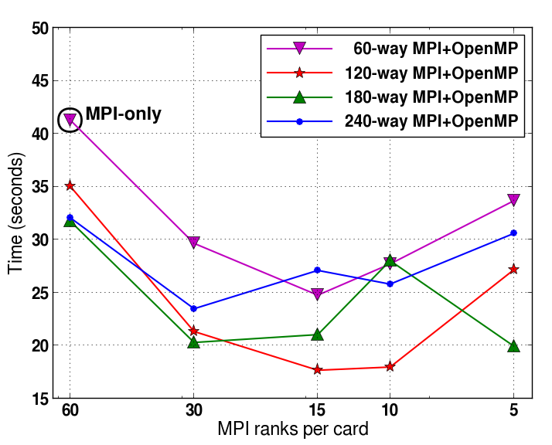
Portability challenges: Thread Scaling and Management
FLASH Code thread scaling study
Single Knight’s Corner Card
Increasing number of threads
Challenges scaling threaded performance
Different numbers of threads on each architecture
Different scheduling policies
Different levels of coarse and fine parallelism
Lower is Better
Source: Chris Daley
Notes:
OpenACC assumes light weight threads – OpenMP assumes significant thread overhead. OpenMP assumes uniform memory. OpenACC exposes memory management.
Add title 1 – KNC card. Add what code – FLASH.

Slide 20
Strategy: Improve data locality and thread parallelism
Preparing codes for GPUs or manycore architectures will improve performance on all architectures
Codes exposing finer grained parallelism will more easily transition between architectures
Applications designed with data locality in mind will also see improved portability
Source: Jack Deslippe

Slide 21
Strategy: Use portable libraries
Many applications spend significant amounts of time in libraries
Assumption is that library developers will handle portability challenges
Differences in ASCR architectures could push users to libraries rather than rolling their own -- If libraries are supported and high performing
Notes:
Add slide on library usage

Slide 22
Strategy: MPI + OpenMP 4.0 could emerge as a common programming model
OpenMP 4.0 has new capabilities that make it more attractive for use on accelerators
“Target” construct allows offloading of data and computation to accelerators
SIMD construct supports more portable vectorization
Improved task affinity
Significant work still necessary
For high performance on accelerator architectures
For explicitly managing on-package memory
All 3 centers joining the OpenMP standards committee
Notes:
For people using OpenACC not that far fetched to go to OpenMP 4.0

Slide 23
Strategy: Abstract portability challenges from users
A number of frameworks that abstract architecture details away from the user can provide portability
KOKKOS
TIDA
Gridtools
Dash
hStreams
Domain specific languages (DSLs)
It is important that we work closely with the research community to address performance portability challenges
Notes:
Stella, HIPA, OP2

Slide 24
Strategy: Encourage portable and flexible programming
Use open and portable programming models where possible
Try to avoid architecture specific models like:
Intel Thread Building Blocks
NVIDIA CUDA
Where necessary, encapsulate vendor specific code into library or swappable code module
Good coding practices
Use parameters for the amount of threading and placements of threads
Allow data structures can be flexibly allocated to different memory spaces
Allow task level flexibility so work can be allocated on different computing elements (GPU & CPU)

Slide 25
Planning of Joint Activities

Slide 26
SC Centers Roles
ADVOCATE portability
FOCUS
apps efforts
SHARE
best practices
TRAIN developers
GRANT
hardware access

Slide 27
TRAIN Developers
Center staff
Multiplatform development
Apps-readiness code teams
Platform deep dive
Audience
Topic
Library developers
Science domain specific
General user community
Broader software engineering

Slide 28
Upcoming Training
Common apps readiness approach
ORNL Jan. 2015
Spring Portability Workshops
Mar. 2015
2015
Jan
Mar
Apr
May
Jul
Sep
Oct
Scientific software engineering
ANL Feb. 2015
ALCF-3 architecture training
ANL Jun. 2015
Extreme Scale Computing
ANL Aug. 2-14 2015
Notes:
1st workshop last week of January 3 days: for our staffs
Portability workshops: F2F, hands-on: staff and apps teams members; includes OpenMP 4.0 training (right?)

Slide 29
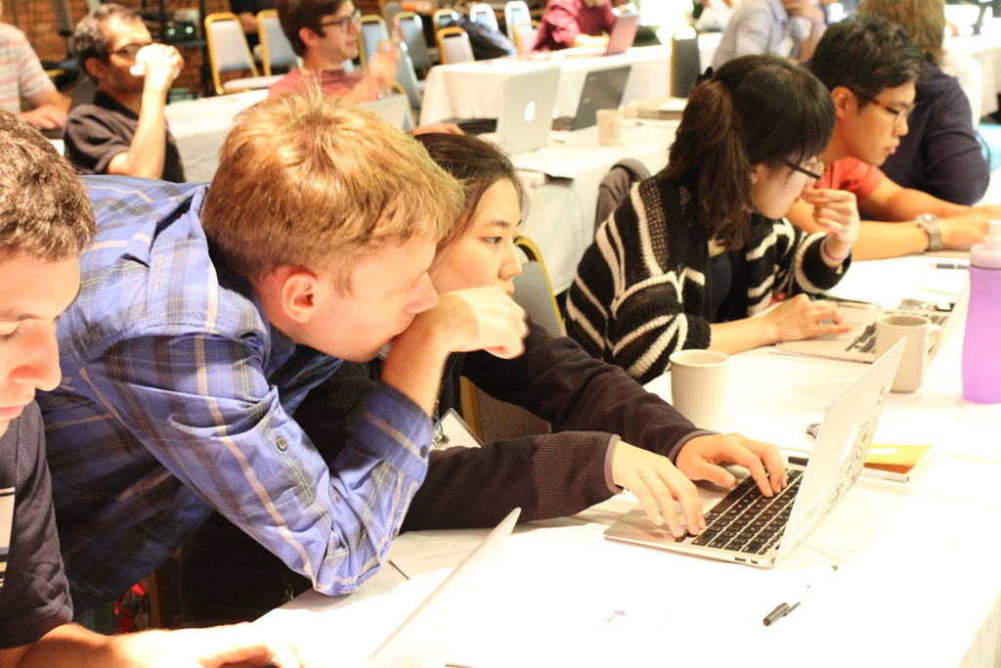
More Training
Intel Dungeon sessions (NERSC)
Vendor workshops (ORNL)
NESAP training (NERSC)
ESP hands-on workshops (ANL)
Hackathons (ORNL)
Ongoing scientific software engineering workshops (ANL)
OpenMP 4.0 training
Where appropriate, shared training events
In all training, advocate and instruct on portability
Notes:
Hackathons: week or more, attendees on one project

Slide 30
FOCUS Apps Efforts: Application Readiness Program Coordination
Joint participation in project review, selection
Representatives from other centers including CORAL and APEX (NERSC & Trinity) partners
NERSC did this in its NESAP proposal review
ESP and CAAR proposal forms ask about proposals to other centers’ programs
Annual meetings of ESP, NESAP, CAAR project teams
Share best practices
Template for presentations
Tools and Libraries readiness
Companions to and components of apps readiness
ESP
CAAR
NESAP

Slide 31
Tools and Libraries
Companions to/components of ESP, NESAP, CAAR
Example: Argonne Early Performance project (K. Kumaran)
Kokkos
Trilinos
HPC Toolkit
HDF
Chombo
PETSc
Scalasca
NetCDF
Charm++
LAPACK
TAU
ADIOS
Global Arrays
SCALAPACK
PAPI
FFTW
Open|Speedshop
P3DFFT

Slide 32
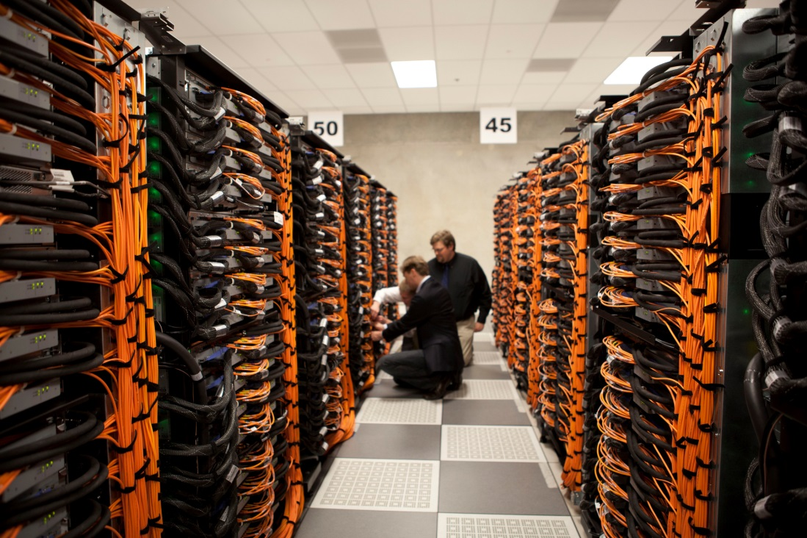
GRANT Hardware Access
For center staff: Director’s Discretionary or equivalent allocation at other centers
For learning, testing
ESP, NESAP, CAAR projects
Next-generation hardware simulators
Access to next-generation hardware as early as possible (centers/vendors)
Large allocation of pre-production time for early science runs (ALCF-3, Cori, Summit)
Time on current systems for interim development
ALCC proposal

Slide 33
Management and Planning of SC Centers Efforts
Semiannual meetings of cross-labs applications readiness staff
Tools and libraries working group (W. Joubert)
Cross-lab training committee (F. Foerttner)
Shared calendar
Shared training events
Manage nondisclosure, export control challenges
CORAL partners
APEX partners (NERSC & Trinity)
March 2014 Meeting
Apps readiness coordination
~15 representatives
September 2014 Meeting
Apps Portability
Apps readiness coordination
~25 representatives

Slide 34
ALCF, NERSC, OLCF Application Readiness Collaboration
The three ASCR sites feel that the close collaboration on application readiness and performance portability activities that has been initiated at the September 2014 joint meeting will result in better programming activities, higher value for the ultimate users of the ported applications, and a natural way to avoid duplication of effort by leveraging each other’s efforts.
The outlined collaboration on application readiness and portability does not simply address the next-generation systems that will be coming to ALCF, NERSC, and OLCF, but is also on the vendors’ paths to exascale architectures. Using appropriate abstractions to get portability and performance on these pre-exascale systems provides a path to be continued toward exascale.

