Slide 1
CORAL Acquisition Update:
OLCF-4 Project
Buddy Bland
OLCF Project Director
Presented to:
Advanced Scientific Computing Advisory Committee
November 21, 2014
New Orleans

Slide 2
Oak Ridge Leadership Computing Facility (OLCF)
Mission: Deploy and operate the computational resources required to tackle global challenges
  Providing world-leading computational and data resources and specialized services for the most computationally intensive problems
  Providing stable hardware/software path of increasing scale to maximize productive applications development
  Providing the resources to investigate otherwise inaccessible systems at every scale: from galaxy formation to supernovae to earth systems to automobiles to nanomaterials
  With our partners, deliver transforming discoveries in materials, biology, climate, energy technologies, and basic science

Slide 3
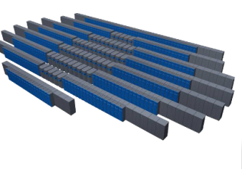
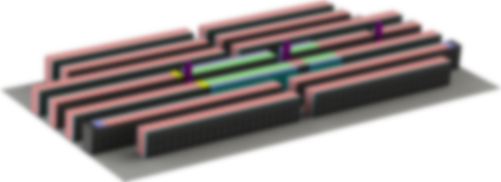
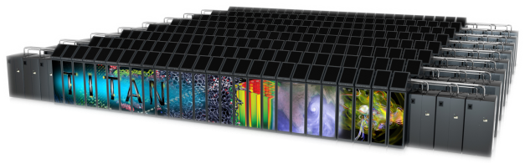
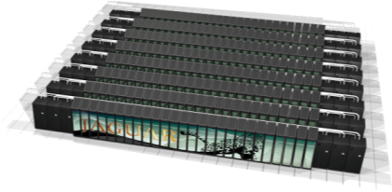
Our Science requires that we continue to advance OLCF’s computational capability over the next decade on the roadmap to Exascale.
Since clock-rate scaling ended in 2003, HPC performance has been achieved through increased parallelism. Jaguar scaled to 300,000 cores. | Titan and beyond deliver hierarchical parallelism with very powerful nodes. MPI plus thread level parallelism through OpenACC or OpenMP plus vectors
OLCF5: 5-10x Summit
~20 MW
Summit: 5-10x Titan
Hybrid GPU/CPU
10 MW
Titan: 27 PF
Hybrid GPU/CPU
9 MW
Jaguar: 2.3 PF
Multi-core CPU
7 MW
CORAL System
2010
2012
2017
2022

Slide 4
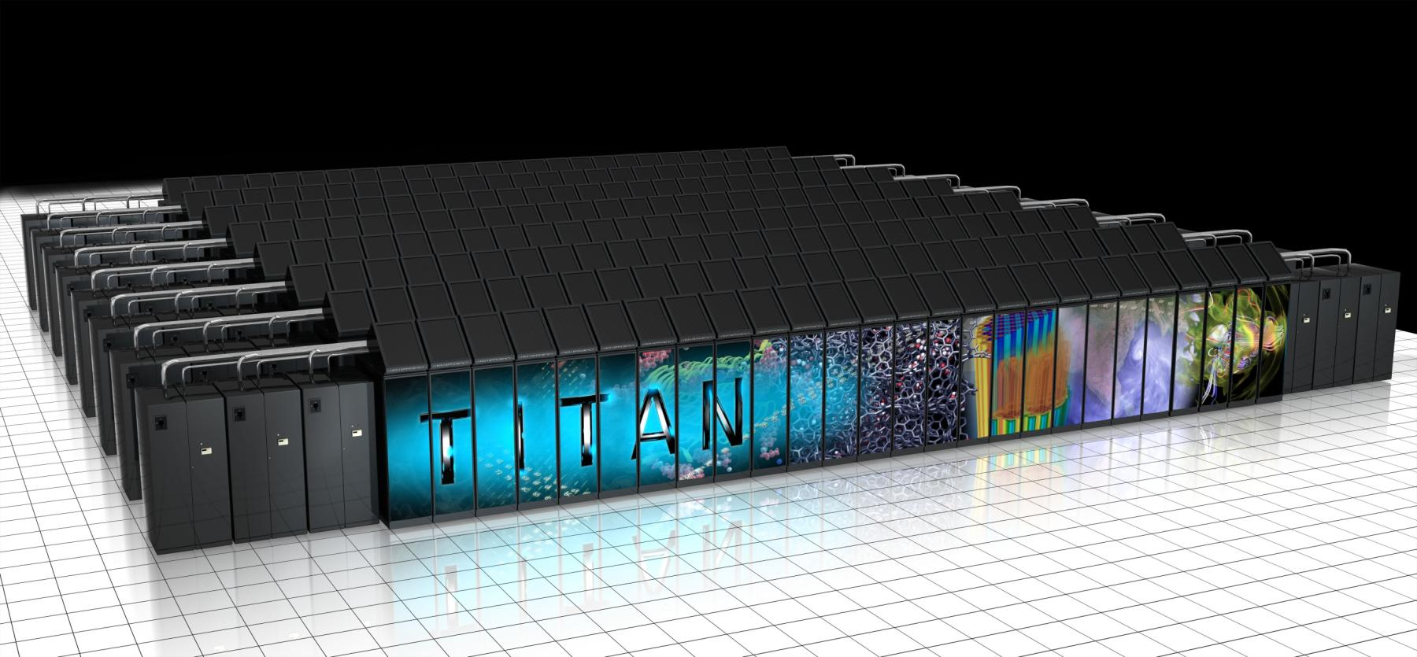
Today’s Leadership System - Titan
Hybrid CPU/GPU architecture, Hierarchical Parallelism
Vendors: Cray™ / NVIDIA™
27 PF peak
  18,688 Compute nodes, each with
  1.45 TF peak
  NVIDIA Kepler™ GPU - 1,311 GF
    6 GB GDDR5 memory
  AMD Opteron™- 141 GF
    32 GB DDR3 memory
  PCIe2 link between GPU and CPU
  Cray Gemini 3-D Torus Interconnect
32 PB / 1 TB/s Lustre® file system

Slide 5
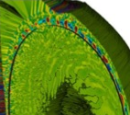
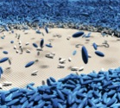
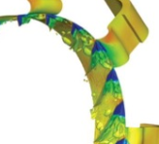
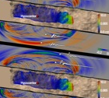
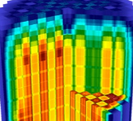
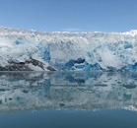
Scientific Progress at all Scales
Fusion Energy
A Princeton Plasma Physics Laboratory team led by C.S. Chang was able to simulate and explain nonlinear coherent turbulence structures on the plasma edge in a fusion reactor by exploiting
increased performance of the Titan architecture.
Liquid Crystal Film Stability
ORNL Postdoctoral fellow Trung Nguyen ran unprecedented
large-scale molecular dynamics
simulations on Titan to model the beginnings of ruptures in thin
films wetting a solid substrate.
Turbomachinery
Ramgen Power Systems is using the Titan system to significantly reduce time to solution in the optimization of novel designs based on aerospace shock wave compression technology for gas compression systems, such as carbon dioxide compressors.
Earthquake Hazard Assessment
To better prepare California for large seismic events SCEC joint researchers have simulated earthquakes at high frequencies allowing structural engineers to conduct realistic physics-based probabilistic seismic hazard analyses.
Nuclear Reactors
Center for the Advanced Simulation
of Lightwater Reactors (CASL) investigators successfully performed full core physics power-up simulations of the Westinghouse AP1000 pressurized water reactor core using their Virtual Environment for Reactor Application code that has been designed on Titan architecture.
Climate Science
Simulations on OLCF resources recreated the evolution of the climate state during the first half of the last deglaciation period allowing scientists to explain the mechanisms that triggered the last period of Southern Hemisphere warning and deglaciation.
Notes:
Fusion Energy: In a recent accomplishment a team from Princeton Plasma Physics Laboratory and ORNL was able to effectively model from first-principles the turbulence along the edge of the plasma in the DIII-D tokamak reactor at the General Atomics facility in San Diego. Now, for the first time, researchers have verified the existence and modeled the collective behavior of edge turbulence using a gyrokinetic code (or one that uses the most fundamental plasma kinetic equations, with analytic treatment of the fast gyrating particle motions) and the DIII-D geometry. This same first-principles approach also revealed the divertor heat load footprint. The divertor will extract heat and helium ash from the plasma, acting as a vacuum system and ensuring that the plasma remains stable and the reaction ongoing. (https://www.olcf.ornl.gov/2014/02/14/the-bleeding-edge-of-fusion-research/)
Turbomachinery: Ramgen Power Systems—a small research and development company in Bellevue, Washington that specializes in energy-related applications of supersonic aircraft technology—is using the Titan supercomputer managed by the Oak Ridge Leadership Computing Facility (OLCF) at Oak Ridge National Laboratory to optimize novel designs based on aerospace shock wave compression technology for gas compression systems, such as carbon dioxide compressors. Their goal is to commercialize new turbo compressor technology that will dramatically reduce the cost of carbon dioxide sequestration
In order to evaluate Ramgen’s computational fluid dynamic models used for the purpose of company R&D, Grosvenor and the team conducted open science test cases that validated the accuracy of their CFD models against real-world data. Additionally, the open science test cases further the scientific community’s understanding of fundamental aerodynamic phenomenon.
“Stage 67” is a transonic fan stage prototype designed and built by NASA Glenn Research Center in 2004. The fan stage includes rotor blades and stationary stator vanes, which work together to transfer energy to the fluid entering the fan. Uniquely, Stage 67 also includes a tip injection flow control for the purpose of delaying stall. Tip injection recirculates gas flow from downstream of the stage through injectors (there are eight injectors in the test case design) mounted on the casing at the front of the rotor blades. Using the FINE/Turbo code developed by Numeca, the team modeled a total of 1.5 billion grid cells that comprised Stage 67 with blades rotating at 16,043 rpm. Efficient parallel performance of commercial code FINE/Turbo to 1.5 billion grid cells (148 million per rotor passage) running up to 5,000 cores.
The results of the study have been published in conjunction with the Proceedings of the ASME Turbo Expo 2014 in the paper “High Resolution RANS NLH Study of Stage 67 Tip Injection Physics.” The authors include Allan Grosvenor, Gregory S. Rixon, and Logan M. Sailer of Ramgen; Michael A. Matheson of the OLCF; David P. Gutzwiller and Alain Demeulenaere of Numeca USA; Mathieu Gontier of Numeca International; and Anthony J. Strazisar of AJS Aero Incorporated
https://www.olcf.ornl.gov/2014/06/13/ramgen-takes-turbomachine-designs-for-a-supersonic-spin-on-titan/
Nuclear Reactors: Generate high-fidelity neutronics solution for code comparison of solutions for predicting reactor startup and physics testing. AP1000 model created and results generated for reactor criticality, rod worth, and reactivity coefficients. Some of the largest Monte Carlo calculations ever performed (1 trillion particles) have been completed using over 230,000 Titan cores. Extremely fine-mesh calculations, which leverage Titan’s GPU accelerators, are under way
Liquid Crystal Film Stability: investigating the Mechanism of Rupture of Liquid-Crystal Thin Films
Liquid-crystal thin films are in today’s flat-panel electronic displays and hold promise in tomorrow’s nanoscale coatings, optical and photovoltaic devices, biosensors, etc. For rational design of thin films with desirable properties, researchers want to better understand the driving force for film rupture. Theory said only two mechanisms could explain formation of holes in the film (a process called dewetting) and that the two mechanisms could not coexist. But experiment showed the mechanisms in many cases coexist.
The ORNL researchers proposed a hypothesis to solve the controversy and brought it to life with a simulation that validated the experimental results. The image (created by OLCF visualization staff) was used on the cover of a high-impact journal and depicts simulation of liquid-crystal “mesogens,” represented by blue units, which make up a thin film placed on a substrate, whose units are shown in white. Over time the thin film forms large holes as mesogens redistribute to regions of lower energy—a process called dewetting—until the film ruptures.
T. D. Nguyen, J.-M. Y. Carrillo, M. A. Matheson and W. M. Brown, “Rupture mechanism of liquid crystal thin films realized by large-scale molecular simulations,” Nanoscale 6 (2014): 3083–3096.
Simulation of movement of up to 26 million liquid-crystal mesogens on a substrate used up to 4,900 nodes of the Titan Cray XK7, which contained GPUs to accelerate LAMMPS sevenfold. The study took around 3 months but would have taken approximately 2 years on a CPU-only architecture (e.g., Cray XE6). ORNL staff developed the simulation model, and software necessary for visualization and analysis of huge systems of liquid crystals. The project consumes 20 TB for storage. The researchers had to dump out the data in parallel during the simulation, and analyzed the data from the disk also in parallel. The analyzed data is then processed and visualized by optimized in-house code.
The simulation, the first of liquid-crystal thin films at experimental length and time scales, produced dewetting patterns that were in remarkable agreement to images captured during experiments. Two mechanisms (spinodal dewetting and thermal nucleation) indeed coexist (as observed in experiment): Spinodal dewetting prevails in very thin films while thermal nucleation dominates in thicker films. The study is the first to identify that the driving force for the disintegration of thin films is liquid-crystal molecules seeking lower-energy and higher-entropy conditions they would have in a bulk state.
Earthquake Hazard Assessment: Goal of the work was to calculate forward deterministic ground motion up to 10 Hz, relevant to building engineering design. Also coupled reciprocity-based probabilistic seismic hazard analysis (PSHA) simulations with engineering models of the built environment to calculate a California-wide CyberShake seismic hazard model using the Uniform California Earthquake Rupture Forecast.
The application exploited scalable and efficient GPU-accelerated code with 2.3 PF sustained performance on 16,384 Titan nodes for a realistic 0-10 Hz earthquake ground motion simulation. Performance improvement factor of 3.7 on XK7 compared to the CPU performance only on XE6 (Blue Waters). Speedup by a factor of 110 on Titan in key strain tensor calculations critical to PSHA.
Results produced deterministic 3D ground motion simulations for Los Angeles region with maximum simulated frequencies up to 10 Hz.
The first 0-0.5Hz PSHA hazard curves for sites in the Los Angeles region were created from suites of simulations comprising approximately 108 seismograms. Calculations on Titan are milestones in use of this new GPU code in the work toward higher frequency (1.0Hz+) CyberShake Hazard maps
Climate Science:
A large team led by researchers at Harvard, Oregon State University, and the University of Wisconsin used a global dataset of paleoclimate records and OLCF resources to show that solar radiation impinging on the Northern Hemisphere led to a reduced ocean current, the combination of which gradually warmed the Southern Hemisphere. Their work explained a scientific mystery: what caused a disproportionate warming of the Southern Hemisphere at the beginning of the last deglaciation. Orbital variation led to Greenland’s warming, and the meltwater slowed the Atlantic Meridional Ocean Circulation, a key component of the ocean conveyor belt.
This trapped heat in the Southern Hemisphere that melted back sea ice and freed a southern ocean carbon sink that contributed to a warming of the whole planet. This IPCC-class modeling simulation required 14 million processor hours from the INCITE Program run continuously for more than 4 years and a large repository for the simulation data, currently just under 300TB.
As summarized by the Nature Editor: Carbon dioxide is the force behind deglaciation where changes in ocean circulation are the most plausible explanation for the early Southern Hemisphere deglacial warming and its lead over Northern Hemisphere temperature.
“The simulation reproduces the Southern Hemisphere proxy temperature records beautifully. A good model is the result of many people’s efforts,” – Feng He, Assistant Scientist, Center for Climatic Research, Nelson Institute for Environmental Studies, University of Wisconsin-Madison
Related Publications
J. Shakun, P. Clark, F. He, S. Marcott, A. Mix, Z. Liu, B. Otto-Bliesner, A. Schmittner, E. Bard 2012. “Global Warming Preceded by Increasing Carbon Dioxide Concentrations during the Last Deglaciation.” Nature 484, No. 7392, 49–54. DOI 10.1038/nature10915.
Z. Liu, B. Otto-Bliesner, F. He, E. C. Brady, R. Tomas, P. U. Clark, A. E. Carlson, J. Lynch-Stieglitz, W. Curry, E. Brook, D. Erickson, R. Jacob, J. Kutzbach, J. Cheng. “Transient Simulation of Last Deglaciation with a New Mechanism for Bølling-Allerød Warming.” Science Vol. 325, 310-314 , 49–54. DOI: 10.1126/science.1171041 .

Slide 6
Two Architecture Paths for
Today and Future Leadership Systems
Power concerns for large supercomputers are driving the largest systems to either Hybrid or Many-core architectures
Hybrid Multi-Core (like Titan)
CPU / GPU hybrid systems
Likely to have multiple CPUs and GPUs per node
Small number of very powerful nodes
Expect data movement issues to be much easier than previous systems – coherent shared memory within a node
Multiple levels of memory – on package, DDR, and non-volatile
Many Core (like Sequoia/Mira)
10’s of thousands of nodes with millions of cores
Homogeneous cores
Multiple levels of memory – on package, DDR, and non-volatile
Unlike prior generations, future products are likely to be self hosted

Slide 7
Where do we go from here?
Provide the Leadership computing capabilities needed for the DOE Office of Science mission from 2018 through 2022
  Capabilities for INCITE and ALCC science projects
CORAL was formed by grouping the three Labs who would be acquiring Leadership computers in the same timeframe (2017).
  Benefits include:
    Shared technical expertise
    Decreases risks due to the broader experiences, and broader range of expertise of the collaboration
    Lower collective cost for developing and responding to RFP

Slide 8
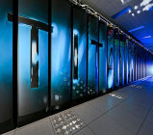
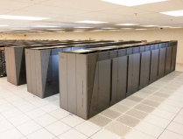
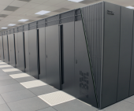


CORAL Collaboration ORNL, ANL, LLNL)
Objective - Procure 3 leadership computers to be sited at Argonne, Oak Ridge and Lawrence Livermore in 2017. Two of the contracts have been awarded with the Argonne contract in process.
Current DOE Leadership Computers
Titan (ORNL)
2012 - 2017
Sequoia (LLNL)
2012 - 2017
Mira (ANL)
2012 - 2017
Leadership Computers RFP requests >100 PF, 2 GB/core main memory, local NVRAM, and science performance 4x-8x Titan or Sequoia
Approach
Competitive process - one RFP (issued by LLNL) leading to 2 R&D contracts and 3 computer procurement contracts
For risk reduction and to meet a broad set of requirements, 2 architectural paths will be selected and Oak Ridge and Argonne must choose different architectures
Once Selected, Multi-year Lab-Awardee relationship to co-design computers
Both R&D contracts jointly managed by the 3 Labs
Each lab manages and negotiates its own computer procurement contract, and may exercise options to meet their specific needs
Understanding that long procurement lead-time may impact architectural characteristics and designs of procured computers

Slide 9
CORAL Evaluation Process
A buying team consisting of the management, technical, and procurement leadership of the three CORAL labs met to select the set of two proposals that provided the best value to the government
Evaluation Criteria:
  DOE mission requirements - the best overall combination of solutions
  Technical proposal excellence; projected performance on the applications is the single most important criterion
  Feasibility of schedule and performance
  Diversity
  Overall Price
  Supplier attributes
  Risk evaluation

Slide 10

Results of CORAL Procurement
Two Diverse Architecture Paths
NRE contract
OLCF Lab computer contract
LLNL computer contract
IBM with
NVIDIA &
Mellanox
RFP
NRE contract
ALCF computer contract
To be announced soon

Slide 11

2017 OLCF Leadership System
Hybrid CPU/GPU architecture
Vendor: IBM (Prime) / NVIDIA™ / Mellanox Technologies®
At least 5X Titan’s Application Performance
Approximately 3,400 nodes, each with:
Multiple IBM POWER9 CPUs and multiple NVIDIA Tesla® GPUs using the NVIDIA Volta™ architecture
CPUs and GPUs completely connected with high speed NVLink™
Large coherent memory: over 512 GB (HBM + DDR4)
  all directly addressable from the CPUs and GPUs
An additional 800 GB of NVRAM, which can be configured as either a burst buffer or as extended memory
over 40 TF peak performance
Dual-rail Mellanox® EDR-IB full, non-blocking fat-tree interconnect
IBM Elastic Storage (GPFS™) - 1TB/s I/O and 120 PB disk capacity.

Slide 12
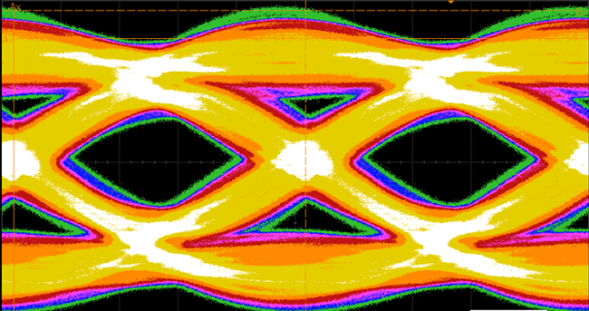
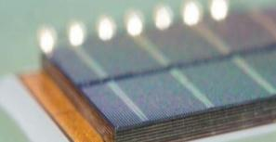
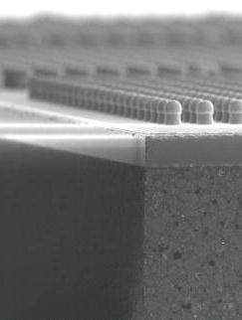
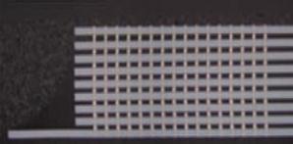

Introducing NVLINK and Stacked Memory
Transformative Technology for 2016 with POWER 8+ ®, And Beyond
NVLINK
GPU high speed interconnect
5X-12X PCI-E Gen3 Bandwidth
Planned support for POWER® CPUs
Stacked (HBM) Memory
4x Higher Bandwidth (~1 TB/s)
3x Larger Capacity
4x More Energy Efficient per bit
Slide courtesy of NVIDIA

Slide 13
Summit Key Software Components
System
  Linux®
  IBM Elastic Storage (GPFS™)
  IBM Platform Computing™ (LSF)
  IBM Platform Cluster Manager™ (xCAT)
Programming Environment
  Compilers supporting OpenMP and OpenACC
    IBM XL, PGI, LLVM, GNU, NVIDIA
  Libraries
    IBM Engineering and Scientific Subroutine Library (ESSL)
    FFTW, ScaLAPACK, PETSc, Trilinos, BLAS-1,-2,-3, NVBLAS
    cuFFT, cuSPARSE, cuRAND, NPP, Thrust
  Debugging
    Allinea DDT, IBM Parallel Environment Runtime Edition (pdb)
    Cuda-gdb, Cuda-memcheck, valgrind, memcheck, helgrind, stacktrace
  Profiling
    IBM Parallel Environment Developer Edition (HPC Toolkit)
    VAMPIR, Tau, Open|Speedshop, nvprof, gprof, Rice HPCToolkit

Slide 14
How does Summit compare to Titan
Feature | Summit | Titan
Application Performance | 5-10x Titan | Baseline
Number of Nodes | ~3,400 | 18,688
Node performance | > 40 TF | 1.4 TF
Memory per Node | >512 GB (HBM + DDR4) | 38GB (GDDR5+DDR3)
NVRAM per Node | 800 GB | 0
Node Interconnect | NVLink (5-12x PCIe 3) | PCIe 2
System Interconnect (node injection bandwidth) | Dual Rail EDR-IB (23 GB/s) | Gemini (6.4 GB/s)
Interconnect Topology | Non-blocking Fat Tree | 3D Torus
Processors | IBM POWER9 NVIDIA Volta™ | AMD Opteron™ NVIDIA Kepler™
File System | 120 PB, 1 TB/s, GPFS™ | 32 PB, 1 TB/s, Lustre®
Peak power consumption | 10 MW | 9 MW

Slide 15
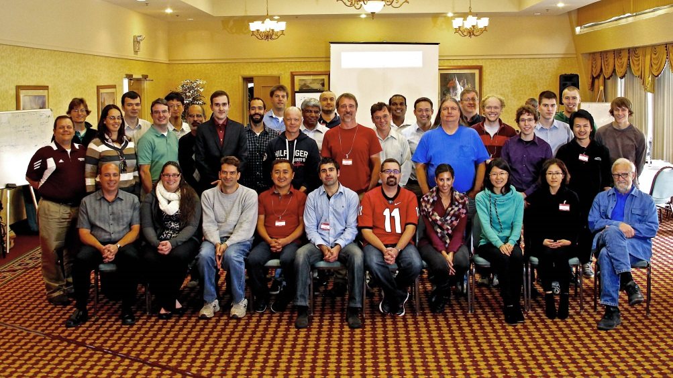
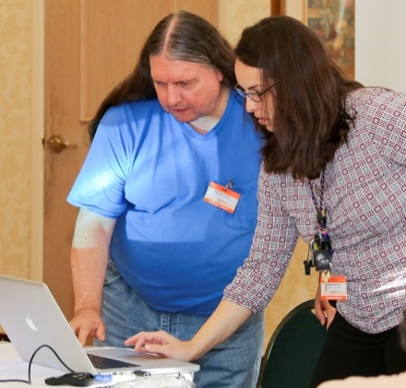

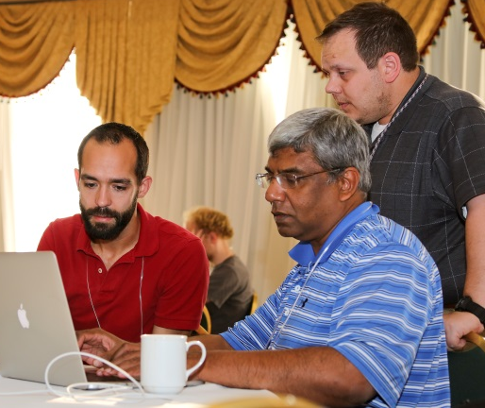
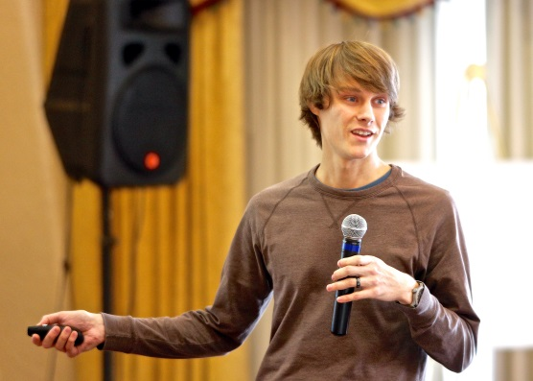
Questions?AS@ornl.gov
GPU Hackathon October 2014
This research used resources of the Oak Ridge Leadership Computing Facility, which is a DOE Office of Science User Facility supported under Contract DE-AC05-00OR22725

