Slide 1
ASCAC Subcommittee on Workforce Development Needs
Prepared by
Dr. Barbara Chapman
University of Houston
Subcommittee Chair
DOE ASCAC Subcommittee Report
November 21, 2014

Slide 2
The Charge
identify disciplines that need more workforce training at grad student or postdoc level for DOE Office of Science mission needs.
Things to consider:
Disciplines not well represented in academic curricula;
Disciplines in high demand, nationally and/or internationally, resulting in difficulties in recruitment and retention;
Disciplines where the DOE labs may play a role in providing needed workforce development;
Specific recommendations for programs at the graduate student or postdoc levels to address discipline-specific workforce development needs.
Letter report on findings and recommendations by June 30

Slide 3
The Subcommittee
Name | Affiliation
Barbara Chapman | University of Houston (ASCAC) (Chair)
Henri Calandra | Total SA
Silvia Crivelli | Lawrence Berkeley National Lab and University of California Davis
Jack Dongarra | University of Tennessee (ASCAC)
Jeffrey Hittinger | Lawrence Livermore National Lab
Chris Johnson | University of Utah
Scott A. Lathrop | NCSA, University of Illinois Urbana-Champaign
Vivek Sarkar | Rice University (ASCAC)
Eric Stahlberg | Advanced Biomedical Computing Center
Jeffrey S. Vetter | Oak Ridge National Laboratory
Dean Williams | Lawrence Livermore National Lab (ASCAC)
Notes:
Thanks to commttee

Slide 4
Interpretation of Charge
ASCAC disciplines needed for DOE mission do not fit neatly into traditional academic categories
  Some positions require multidisciplinary training
We coined term Computing Sciences for this report
  Includes: Algorithms; Applied Mathematics; Data Analysis, Management and Visualization; Cybersecurity; Software Engineering and High Performance Software Environments; and High Performance Computer Systems.
Committee decided to take a broader perspective
  in order to address workforce challenges identified, more than a program is needed

Slide 5
Limitations of Report
Information on the disciplines (and multidisciplinary expertise) needed to support DOE mission is not readily available
  No clear fit within traditional boundaries of academic disciplines
Data and information obtained usually covers some part of the Computing Sciences
HR data typically not available for this range of subjects
  E.g. some positions are categorized in area of domain expertise
Hence our findings cannot be conclusive

Slide 6
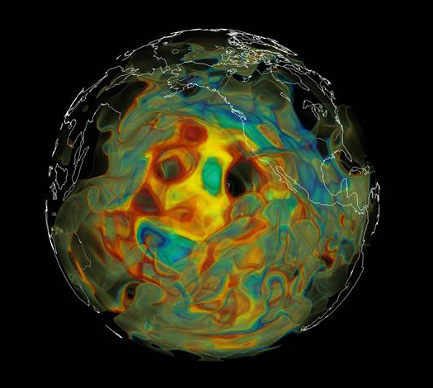
Role of Advanced Scientific Computing at DOE/SC
Scientific computation is at core of much of Office of Science R&D.
ASCR facilities, experts in their utilization are essential
  To all areas of scientific activity in the DOE national laboratories.
  Physics, chemistry, astrophysics, energy,…
ASCR provides critical technology that enables DOE’s world leadership in scientific computation

Slide 7

Need for Skilled DOE Workforce in Computing Sciences
Breadth of expertise required to effectively deploy tools increasing.
Maintaining a sufficient workforce is this area is critical
  To enable research outcomes
  Amortize significant investment in ASCR facilities

Slide 8
Workforce Recruitment/Retention Challenges
Labs invited to provide information on areas where they experience recruitment / retention difficulties
Areas in Computing Sciences figured prominently in responses, especially in large labs
For Computing Sciences, labs reported:
  Low number of qualified applicants, many of which are foreign nationals
  Takes a long time to fill positions
  Labs spend significant effort on recruiting in this area
Additional information solicited from larger labs to quantify problem
  No uniform method for recording information; not all labs provided data
  Takes labs twice as long as industry to fill positions in computing sciences
  About 4 times as long when security clearance does not permit foreigner
  Acceptance and retention rates mostly favorable
Notes:
Increasing reliance on foreign nationals. E.g. Jefferson lab had position in computational science with just 1 applicant, a foreigner. ORNL reported that over 75% of qualified applicants in comp biology staff position are foreigners, as are qualified applicants for postdoc positions in computer vision are foreign nationals

Slide 9
Competencies | National Laboratories
Advanced computing architectures | LLNL, ORNL
Applied mathematics (including advanced modeling and methods) | ANL, LBNL, LLNL, ORNL
Computational sciences/simulation; scientific software | ANL, BNL, INL, LBNL, LLNL, ORNL, SNL
Cyber security | INL, LLNL, ORNL, SNL
Data acquisition software | FNAL, ORNL
Data informatics (data mining, machine learning, big data, statistical techniques) | ANL, LBNL, LLNL, ORNL, PNNL
Dynamic mesh algorithms | LLNL
HPC /extreme-scale/exascale computing | ANL, INL, LANL, LBNL, LLNL, ORNL, PNNL, SNL
Performance analysis of HPC applications | LBNL, ORNL
Software quality assurance | LLNL, ORNL
Solvers | LBNL, LLNL
Storage systems | LBNL, ORNL
Uncertainty quantification | LLNL, ORNL
Visualization and scientific data analysis | LLNL, ORNL
Notes:
As stated, although more subcategories of applied mathematics

Slide 10
Recruitment/Retention at Labs
Lab | # Open Posns | Ave. Time To Fill (Days) | Total Tech- nical Staff | % Foreign Nationals | Declined Job Offers | Attrition Rate (%)
LANL | 148* | 263* | 1903* | 5.4* | 21/173* | 4.9*
LBNL¹ | 56 | 112 | 206 | 38.4 | 2/39 | 8.0
LLNL² | 146 | 311 | 2094* | 7.4* | 7/36 | 4.8*
ORNL³ | 87 | 110 | 379 | 38 | 11/73 | 7.6
PNNL⁴ | 44 | 107 | 1113* | 16* | 16/50 | 8.9**
* Data for all scientific and engineering disciplines, M.S. and Ph.D. level
** Data for all scientific and engineering disciplines, all degree levels
¹ LBNL data for “all scientists and engineers on the Computer Science curve”
² LLNL data based on best attempt to identify positions in the Computing Sciences; time-to-fill may be skewed by indefinite postings; attrition rate corrected for voluntary separation program
³ ORNL data for “lab-wide computing/computational science” positions; attrition rate corrected to account for voluntary separation program (37% of terminations)
⁴ PNNL attrition rate is uncorrected for voluntary separation program; historical rate is 4-5%; total number of job offers is estimated.
Notes:
Strong demand for MS and PhD level employees, in comp scie esp at LBNL and ORNL: number of open positions are ca. 25% of staff in Computing Sciences. Difficulty in filling: 100 days at SC lab, twice that at NNSA lab

Slide 11
Workforce Recruitment/Retention Challenges
Strong demand for M.Sc, Ph.D.-level Computing Sciences positions
  Especially at LBNL and ORNL where open positions are ca. 25% of total staff in Computing Sciences
Labs take longer than industry to fill positions in Computing Sciences
  On average ca. 100 days to fill an Office of Science position
  More than 200 days for NNSA lab positions
  Industry needs 39 days on average for Computer and Mathematical occupations (all degrees)
  48-50 days on average for M.Sc., Ph.D. positions in STEM
Attrition rates compare favorably with industry
  10% in industry, 5% NNSA labs, ca. 8% SC labs
  Warrants further study, since loss of expertise can be catastrophic
FINDING: The multidisciplinary national labs face workforce recruiting and retention challenges in Computing Sciences
Notes:
Difficulty of recruiting correlates strongly with ability to hire foreigners: Large number of foreign national employees at LBNL, ORNL
Increasing reliance on foreign nationals. E.g. Jefferson lab had position in computational science with just 1 applicant, a foreigner. ORNL reported that over 75% of qualified applicants in comp biology staff position are foreigners, as are qualified applicants for postdoc positions in computer vision are foreign nationals

Slide 12
Multidisciplinary Education
Computational Science disciplines taught in:
Computer Science
Computer Engineering
Information Science
Also in interdisciplinary studies:
Computational Science and Engineering
2005 PITAC report described difficulties establishing these
From PITAC Report, 2005

Slide 13
Multidisciplinary Education
Interdisciplinary Computational Science and Engineering (CS&E) studies emerging
  Domain sciences, applied mathematics, numerical analysis, computer science
  Problem-solving methodologies, science and engineering tools
  Degree program, an area of specialization or a certificate
  Cannot impart complexities of field, do not provide full skillset needed by DOE
Insufficient number of graduates
http://www.siam.org/students/resources/report.php has SIAM’s 2014 listing of CS&E programs
Notes:
Students don’t get to work with real-world apps

Slide 14
Number of PhDs in CS and CE
PhD Specialty | 2010 | 2011 | 2012 | 2013 | Total
Artificial Intelligence | 181 | 193 | 203 | 171 | 748
Databases/Info Retrieval | 99 | 106 | 122 | 125 | 452
Graphics/Vis | 87 | 111 | 99 | 99 | 396
HW/Architecture | 78 | 70 | 92 | 91 | 329
High Performance Computing | 29 | 37 | 49 | 60 | 175
Networks | 150 | 140 | 147 | 152 | 589
Operating Systems | 59 | 55 | 66 | 55 | 235
Scientific/Numerical Computing | 33 | 27 | 32 | 29 | 121
Software Engineering | 126 | 147 | 149 | 140 | 562
Taulbee Survey 2014

Slide 15
Disciplines in Academia
Fewer graduates in fields related to Computing Sciences in Computer Science (CS), Info Science, Computer Engineering (CE)
  Than in traditional areas
NSF taskforce (2011): Universities not teaching essential skills for applying CS&E in the field, not preparing students to harness powerful new supercomputing
Interdisciplinary Data Science education beginning to emerge, but not likely to satisfy demand
FINDING: Insufficient educational opportunities are available at academic institutions in areas of the Computing Sciences most relevant to the DOE mission.
Notes:
NSF – ACCI
Shortage of data scientists reported. New M.Sc. Programs emerging

Slide 16
Workforce Demand
Huge demand for graduates with computing expertise
  Taulbee survey reports very low unemployment in US for computing graduates ( under 1%)
  Large majority of graduates enter industry (70%)
Retirement of current workforce is expected to grow workforce gap over coming decade
Labs cannot compete with industry compensation
Awareness of lab careers among graduates low
Conference travel restrictions impede recruitment
  Also decrease attractiveness of jobs
Council on Competitiveness: HPC is a proven game-changing technology
Notes:
Growth in computing jobs variously articulated, expected to be strong
Only 13% took government jobs
Expect many people in 50s, so big retirement wave about to come
Generic, but our graduates are highly skilled and get good jobs elsewhere, e.g. Google

Slide 17
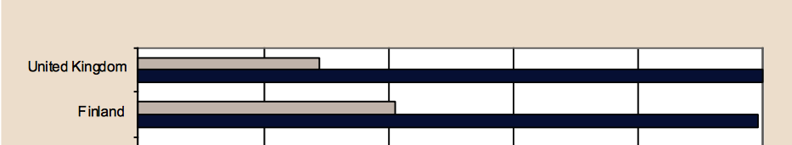

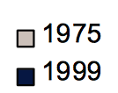
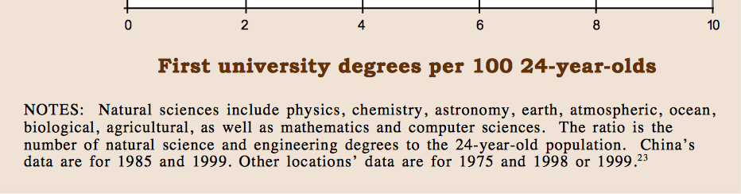
Ratio of NS&E First University Degrees to 24-year-old Population, 1975 and 1999
…
National Science Board: The Science and Engineering Workforce. Realizing America’s Potential. August 2003

Slide 18
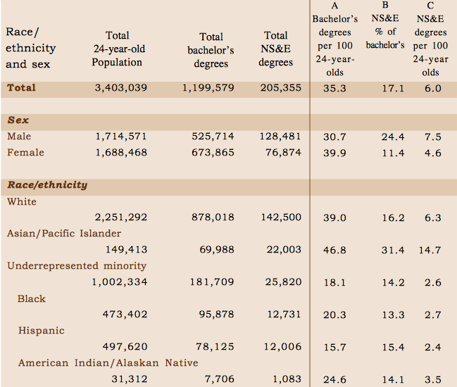
An Incomplete Talent Pool
Lack of diversity in US graduates in CS and CE is a major contributing factor in national shortage:
US citizens among graduates are mostly white male
African American / Hispanic graduates very low (ca. 1% each)
Percentage of females among graduates is declining
Participation Rate in Natural Sciences and Engineering Bachelor’s Degrees in 1998
Notes:
Under 18% of Coputer Sicnec and Computing Science degrees for women; under 2% for Hispanics and African Americans
58% are foreigners

Slide 19
Demographic Trends in Industry

Slide 20
Demographic Trends in Industry

Slide 21
US Citizens / Permanent Residents as Percentage of PhDs in CS, CE Areas
PhD Specialty | Citizens, Permanent Residents | % of Total
Artificial Intelligence | 439 | 58.7%
Databases/Info Retrieval | 203 | 44.9%
Graphics/Vis | 228 | 57.6%
HW/Architecture | 147 | 44.7%
High Performance Computing | 78 | 44.6%
Networks | 205 | 34.8%
Operating Systems | 108 | 46.0%
Scientific/Numerical Computing | 78 | 64.5%
Software Engineering | 328 | 58.4%
Figures accumulated over past 4 years; Taulbee Report, 2014
Notes:
Over past 4 years

Slide 22
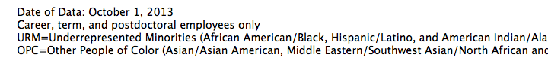
LBNL Demographics in STEM
Types of Jobs at Berkeley Labs | TTL | Women | % | URM | % | OPC | %
Scientists and Engineers (Conducting Research) | 640 | 100 | 15.6% | 29 | 4.5% | 131 | 20.5%
Postdoctoral Scientists | 486 | 133 | 27.4% | 26 | 5.3% | 209 | 43.0%
Engineers (Information, Mechanical, and Electrical) | 483 | 102 | 21.1% | 51 | 10.6% | 118 | 24.4%
Research Support (Non S&Es in programmatic divisions) | 907 | 390 | 43.0% | 145 | 16.0% | 207 | 22.8%
Ops Support (Non S&Es in Operational Divisions) | 677 | 324 | 47.9% | 161 | 23.8% | 117 | 17.3%
Totals | 3193 | 1049 | 32.9% | 412 | 12.9% | 782 | 24.5%
Data from DOE labs reflect national demographics
  Also indicate retention problem for female postdocs
Notes:
Retention challenge

Slide 23
Workforce Demand
% of foreign nationals in graduate population growing steadily
    58% of graduates in Computing Sciences are now foreign nationals
Lack of diversity in US graduates in CS and CE is a major contributing factor in national shortage
  Current US citizens among graduates are mostly white male
  African American / Hispanic graduates very low (ca. 1% each)
  Percentage of females among graduates is declining
Data from DOE labs reflect national demographics
  Also indicate retention problem for female postdocs
Lack of STEM diversity widely acknowledged, not addressed
FINDING: There is a growing demand for graduates in Computing Sciences that far exceeds the supply. A larger workforce gap and continued underrepresentation of minorities and females are expected.

Slide 24
DOE Workforce Development
Office of Science
Workforce Development Training Program
Science Undergraduate Laboratory Internships (SULI)
Community College Internships (CCI)
DOE Office of Science Graduate Fellowship (SCGSF) Program
Albert Einstein Distinguished Educator Fellowship (AEF) Program
Visiting Faculty Program (VFP) at DOE Laboratories
DOE National Science Bowl (NSB)
STEM Resources for K-12 Educators
See http://science.energy.gov/wdts

Slide 25
Existing Workforce Training
DOE CSGF program established 1991; jointly funded by ASCR and NNSA
Trains graduate students to meet national workforce needs in computational sciences, including those of DOE
Provides practical work experiences at DOE labs; improves collaboration between labs and academia; raises visibility of careers in computational sciences
Effective elements
  Interdisciplinary program of study
  Research practicum at DOE laboratories
  Annual review that enables networking
  Careful selection process
Notes:
Acceptance rate? Very selective. Down to 40-50 and every one of them is well qualified. So could take many more, easily double

Slide 26
CSGF Applicants’ Quantitative Measures for 2002-2011
Year | Average UGPA | Avg. Percentile GRE Verbal | Avg. Percentile GRE Quantitative
2002 | 3.51 | 74 | 87
2003 | 3.60 | 75 | 85
2004 | 3.62 | 75 | 82
2005 | 3.59 | 73 | 83
2006 | 3.61 | 75 | 82
2007 | 3.68 | 75 | 85
2008 | 3.64 | 78 | 87
2009 | 3.60 | 79 | 86
2010 | 3.59 | 77 | 84
2011 | 3.64 | 77 | 85

Slide 27
CSGF Awardee Quantitative Measures for 2002-2011
Year | Average UGPA | Avg. Percentile GRE Verbal | Avg. Percentile GRE Quantitative
2002 | 3.72 | 77 | 90
2003 | 3.86 | 86 | 90
2004 | 3.90 | 83 | 88
2005 | 3.73 | 80 | 88
2006 | 3.92 | 85 | 89
2007 | 3.87 | 86 | 89
2008 | 3.80 | 86 | 91
2009 | 3.86 | 85 | 92
2010 | 3.81 | 87 | 91
2011 | 3.88 | 90 | 90

Slide 28
Breakdown of CSGF Applicants by Major Field of Study for Years 2002-2011
Area | 2002 | 2003 | 2004 | 2005 | 2006 | 2007 | 2008 | 2009 | 2010 | 2011
Bio & Bioeng | 13 | 40 | 43 | 49 | 66 | 72 | 64 | 60 | 80 | 108
Math & CS | 41 | 90 | 76 | 74 | 108 | 71 | 69 | 76 | 113 | 115
Engineering | 65 | 113 | 116 | 133 | 149 | 150 | 152 | 125 | 194 | 243
Physical Sci | 27 | 58 | 74 | 71 | 69 | 92 | 76 | 73 | 119 | 134
Social Sci | 1 | 1 | 1 | 1 | 3 | 1 | 1 | 1 | 3 | 1
Did Not Report | 12 | 16 | 12 | 10 | 15 | 10 | 9 | 14 | 21 | 27
Total | 159 | 318 | 322 | 338 | 410 | 396 | 371 | 349 | 530 | 628
Notes:
Review of CSGF, ASCAC 2011

Slide 29
Breakdown of CSGF Awardees by Major Field of Expertise for Years 2002-2011
Area | 2002 | 2003 | 2004 | 2005 | 2006 | 2007 | 2008 | 2009 | 2010 | 2011
Bio & Bioeng | 3 | 1 | 1 | 3 | 3 | 5 | 6 | 3 | 2 | 3
Math & CS | 3 | 3 | 3 | 2 | 5 | 1 | 2 | 2 | 5 | 3
Engineering | 15 | 8 | 4 | 7 | 3 | 5 | 6 | 6 | 6 | 4
Physical Sci | 3 | 3 | 6 | 4 | 8 | 4 | 4 | 5 | 7 | 7
Social Sci | 0 | 0 | 1 | 0 | 0 | 0 | 0 | 0 | 0 | 0
Did Not Report | 1 | 1 | 0 | 0 | 1 | 1 | 0 | 0 | 0 | 0
Total | 25 | 16 | 15 | 15 | 20 | 16 | 18 | 16 | 20 | 17

Slide 30
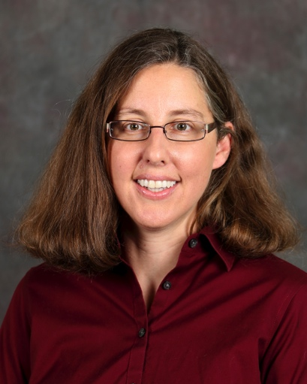
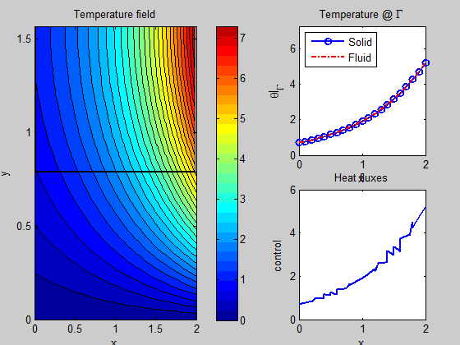

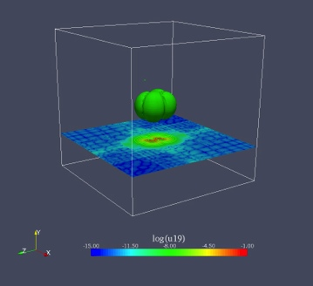
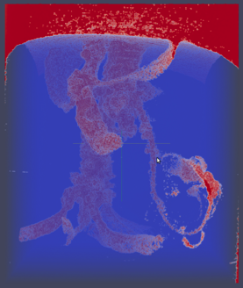
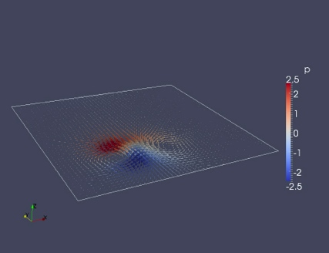
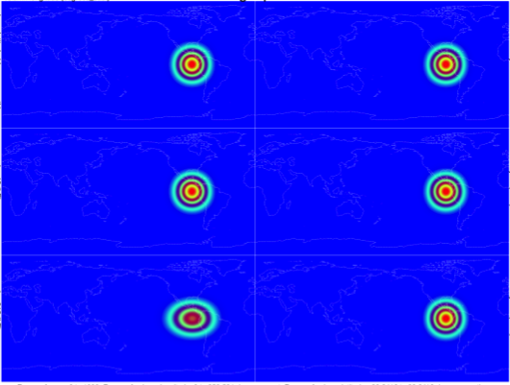


Judith Hill (CSGF Fellow, ’99-’03)
Computational Scientist and Liaison Task Lead
Oak Ridge Leadership Computing Facility
Oak Ridge National Laboratory
  Research Interest – Numerical methods enabling the effective use of HPC resources
  Inverse problems; PDE-constrained optimization,
  Multiphysics coupling using optimal control
  Pseudo-spectral methods with multiwavelet bases
  Deferred correction methods for time integration
  Applications ranging across fluid dynamics, climate, nuclear physics, plant biology and chemistry
Initial
Day 12
Day 912
Existing
Deferred Correction
Method
“The CSGF program of study encouraged me to pursue a career that was more computationally focused than I originally planned… These experiences directly influenced my choice of a career as a computational scientist in the DOE Laboratory system..”
Notes:
Statement of CSGF Impact:
As a CSGF fellow, the CSGF program of study encouraged me to pursue a career that was more computationally focused than I originally planned and the practicum experience at Sandia-Livermore exposed me to the multi-disciplinary and collaborative research environment that epitomize the National Laboratories. These experiences directly influenced my choice of a career as a computational scientist in the DOE Laboratory system. In the years since I was a Fellow, I’ve had the opportunity to mentor several CSGF Fellows during their practicums at ORNL and collaborate with fellow CSGF alums from diverse research areas on problems of mutual interest. In every case, these interactions have energized me intellectually, each of us providing viewpoints from our respective areas of expertise but finding common ground in our shared language of mathematics and numerical methods.
The CSGF program is unique amongst fellowship programs in that it’s impact wasn’t limited to my time spent as a Fellow, but the program and the community of Fellows, Alums, and Friends of the Program that has been created continues to intersect and influence my post-graduate career.

Slide 31
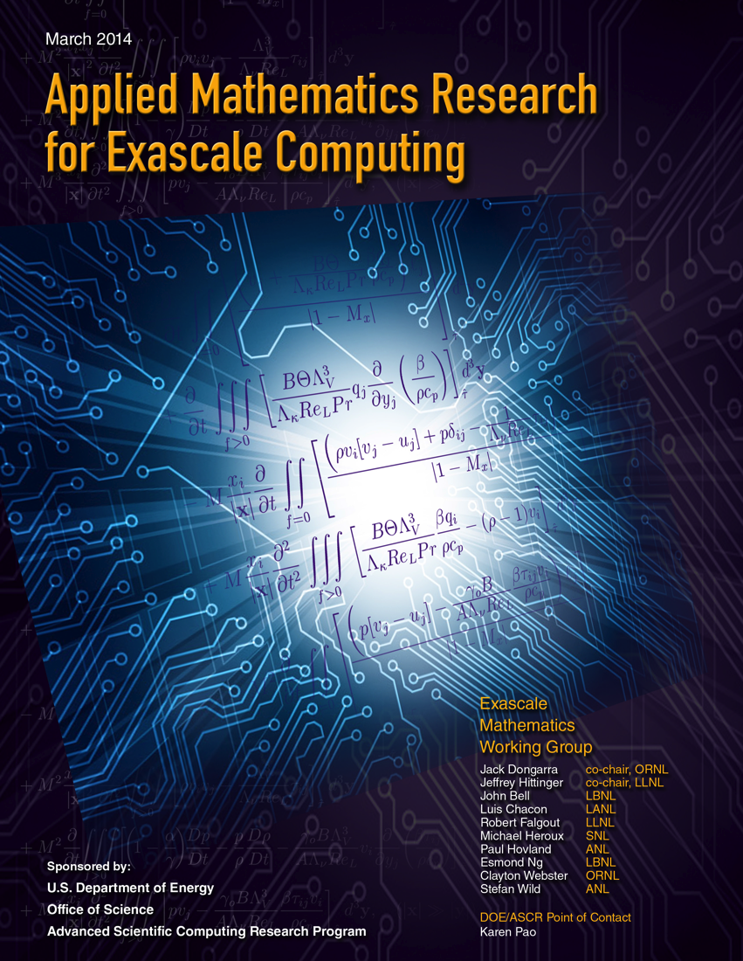
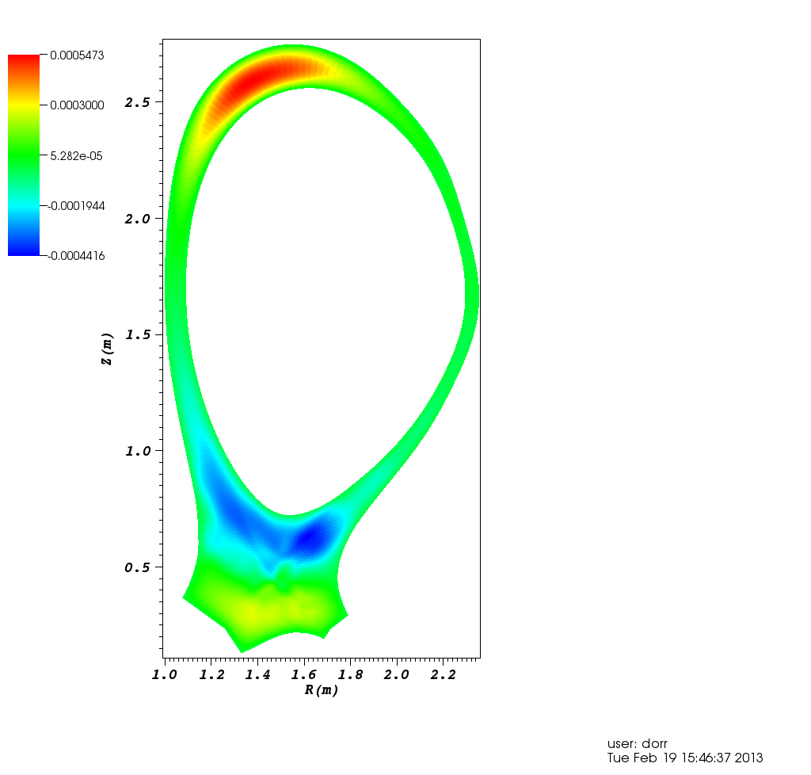

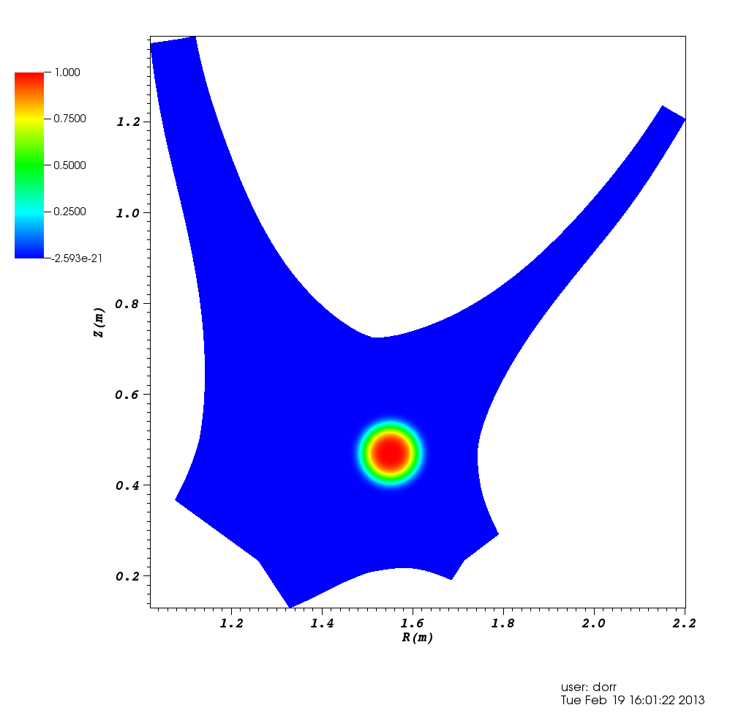
Jeff Hittinger(CSGF Fellow, 1996-2000)
Group Leader, Scientific Computing
Center for Applied Scientific Computing, LLNL
Practicum: LANL, 1997
PhD: U. Michigan, Aerospace Engineering and Scientific Computing
Postdoc: LLNL, 2000-2001
Research staff: LLNL, 2001-present
Practicum:
  Initiated his interest in working at a DOE lab
  Contacts from practicum directly led to his postdoctoral position
Program of Study:
  Allowed him to pursue advanced training in applied mathematics and computer science
  Breadth of training has made him a key contributor to several interdisciplinary projects
Current and Past Leadership:
  DOE ASCR Exascale Mathematics Working Group co-chair
  DOE ASCR Applied Mathematics Point-of-Contact, LLNL
  DOE OFES/ASCR Fusion Simulation Program planning team
  Has served on several ASCAC subcommittees
Poloidal
Core
Radial
SOL
SOL

Slide 32
Existing Workforce Training
Multiple reviews attest to success of CSGF program
  Contributes to lab, national workforce in Comp. Sciences
2011 ASCAC review of the program states that:
  “a large percentage of fellows spend a portion of their early career in the DOE laboratories and an even larger portion continue interaction with the DOE laboratories as they pursue their careers in academia and industry.”
2012 longitudinal study of CSGF program:
  155 respondents: 28% in government, 38% in education, 34% in industry; 89% had CS&E-related employment
FINDING: The exemplary DOE CSGF program, deemed highly effective in multiple reviews, is uniquely structured and positioned to provide the future workforce with the interdisciplinary knowledge, motivation, and experiences necessary for contributing to the DOE mission.

Slide 33
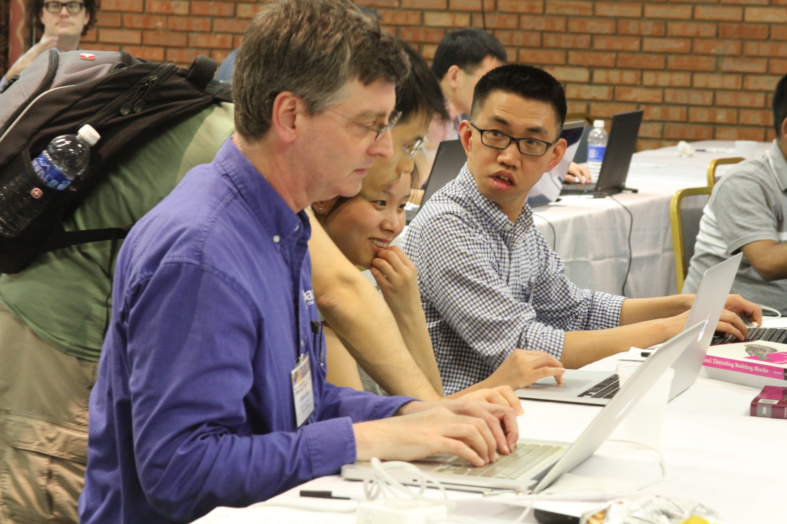
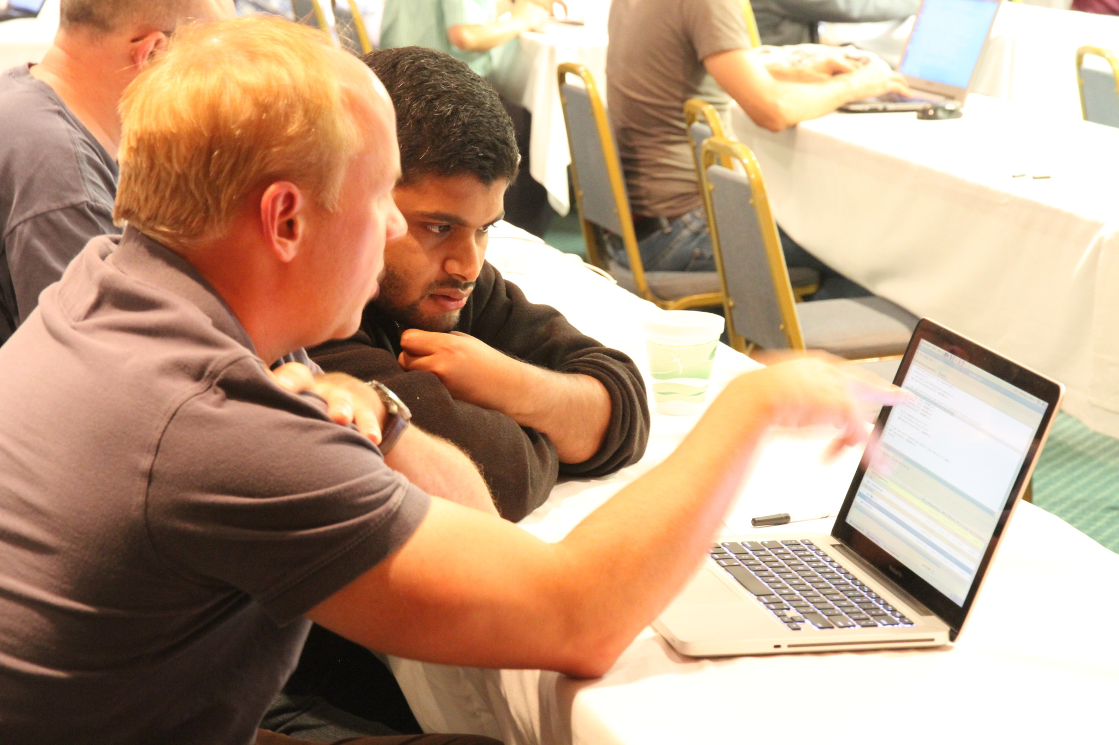
Lab Training and Outreach
Labs all put significant effort into attracting, training and retaining workers in Computing Sciences
Engage graduate students and postdocs through programs such as summer internships, university subcontracts
  Exposure to lab environment is key
  Postdoctoral fellowships such as ANL’s Wilkinson and ORNL’s Householder
  Programs where student is co-advised by lab staff
Many staff come from these programs
Notes:
Not coordinated
Programs with joint advising: Higher Ed research experiences at ORNL; Graduate Research Assistant program at LANL and others at ANL, LLNL, SNL
Recent SCGSR from DOE supports grad students who conduct part of thesis research at a lab

Slide 34
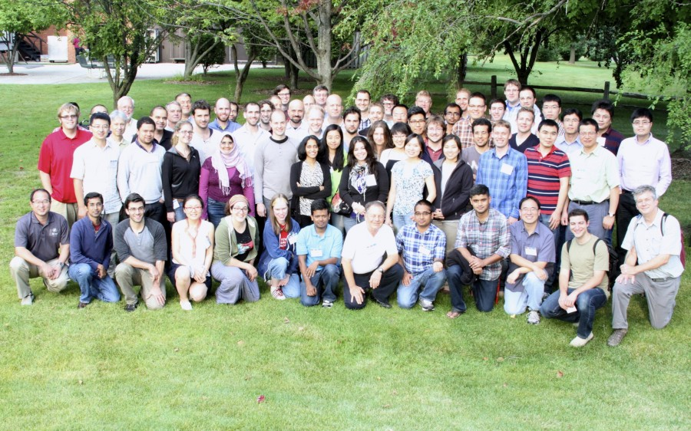
DOE Workforce Development
Office of Science
Placeholder for lab outreach slide
Stuff…
Stuff…
ANL’s ATPESC 2014: One of many lab initiatives in outreach and training
Notes:
ATPESC (ANL training program on extreme scale computing), summer 2014

Slide 35
Role of Labs: Workforce Retention
Labs face many challenges in maintaining workforce
Need to re-examine career paths to offer competitive choices, provide a more attractive workplace
  Current funding model makes it hard for young staff to establish themselves
  Consider how to give employees opportunities to grow professionally e.g. through new opportunities
  Provide resources to address work/life balance
  Adapt to shorter-term commitment that is becoming common
  Facilitate mid-career entry to labs
  Engage in education
FINDING: The DOE laboratories have individually developed measures to help recruitment and retention, yet more can be done at the national level to amplify and extend the effectiveness of local programs.

Slide 36
Summary of Findings
The multidisciplinary national labs face workforce recruiting and retention challenges in Computing Sciences
Insufficient educational opportunities are available at academic institutions in areas of the Computing Sciences most relevant to the DOE mission.
There is a growing demand for graduates in Computing Sciences that far exceeds the supply. A larger workforce gap and continued underrepresentation of minorities and females are expected.
The exemplary DOE CSGF program, deemed highly effective in multiple reviews, is uniquely structured and positioned to provide the future workforce with the interdisciplinary knowledge, motivation, and experiences necessary for contributing to the DOE mission.
The DOE laboratories have individually developed measures to help recruitment and retention, yet more can be done at the national level to amplify and extend the effectiveness of local programs.

Slide 37
Full Set of Recommendations (1)
Preserve and increase investment in the DOE CSGF program to opportunities for more high-quality students, particularly students from underrepresented populations and demographics.
Establish new fellowship programs, modeled after the CSGF program, for research opportunities in enabling technologies in the computing sciences, including computer science for HPC, large-scale data science, and computational mathematics.
Expand support for local laboratory programs and encourage greater inter-laboratory sharing of information about locally successful programs and workforce related data.

Slide 38
Full Set of Recommendations (2)
Establish a DOE-funded Computing Leadership graduate curriculum advisory group to spearhead participation in efforts within ACM, CRA and NSF to develop and annually publish competencies of DOE need at the graduate and undergraduate level.
Working with ACM SIGHPC, NSF and other organizations, provide a rich repository of DOE mission-oriented learning materials and engagement opportunities to attract and guide individuals towards careers in areas of DOE need.
Working with other agencies and organizations, establish certificate programs to address need for competency certification. Work with other agencies to fund implementation of curricular programs, particularly online programs, in the areas of DOE need.

Slide 39
Full Set of Recommendations (3)
Improve attractiveness of DOE opportunities with continued relocation assistance, ongoing professional development in DOE strategic areas and position rotation, and establish a sabbatical program for DOE employees.
Increase awareness of DOE opportunities by working with multiple universities to develop campus champions and increase support for DOE employees to visit campuses to promote opportunities within DOE.
Working with other agencies, develop a strategic plan with programs and incentives to pro-actively recruit, mentor and sustain the involvement of significantly more women, minorities, people with disabilities, and other underrepresented populations through the completion of their PhD program and their active participation in CS&E careers.

Slide 40
Summarized Recommendations
Leverage and strengthen the successful DOE CSGF program by doubling its funding and expanding its scope to include research in HPC-enabling sciences such as computational mathematics, computer science, and data analytics.
Establish a DOE-funded computing leadership graduate curriculum advisory group for establishing graduate level curricular competencies specifically to fulfill DOE’s Computing Sciences workforce needs.
Develop a recruiting and retention program that increases DOE’s visibility on university and college campuses and that provides relocation assistance, travel for recruiting, ongoing professional development, opportunities to take sabbaticals and other non-monetary career incentives.
Build a diverse workforce that spans demographics and universal accessibility for a broader awareness of career opportunities within DOE. This includes inter-agency coordination, targeted opportunities, and strategic development plans to expand and build a workforce to include non-traditional, underrepresented, and military veterans.
Expand support for local laboratory programs and encourage greater inter-laboratory sharing of information about locally successful programs as well as workforce related data.

