Slide 1

The State of U.S. Science & Engineering
Science and Engineering Indicators 2020
Julia M. Phillips, Chair
NSB Committee on National S&E Policy
Thursday, April 23, 2020

Slide 2
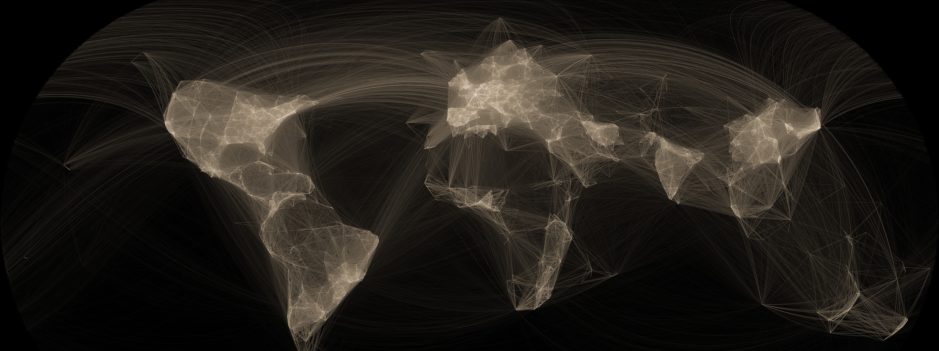
Science & Engineering:
A New Global Context
Image credit: Oliver H. Beauchesne and SCImago Lab
Data: Elsevier Scopus

Slide 3

Global Investment in Research & Development

Slide 4
R&D Definitions
Basic research – experimental or theoretical work undertaken primarily to acquire new knowledge of the underlying foundations of phenomena and observable facts, not directed toward any particular use.
Applied research – original investigation undertaken in order to acquire new knowledge, directed primarily towards a specific, practical aim or objective.
Fundamental research = basic + applied research
Experimental development – systematic effort, based on existing knowledge from research or practical experience, directed toward creating novel or improved materials, products, devices, processes, systems, or services.

Slide 5
Global Investment in Research & Development

Slide 6
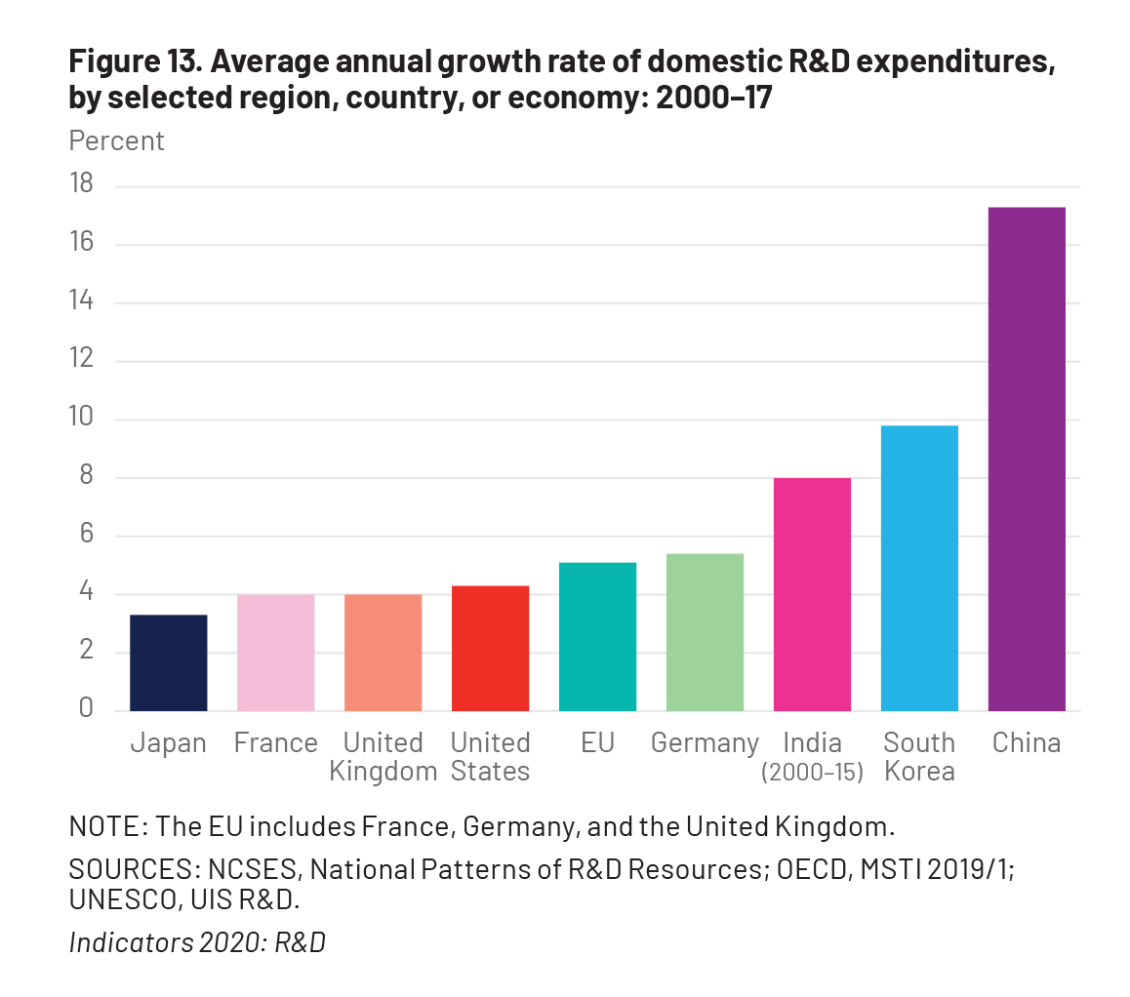
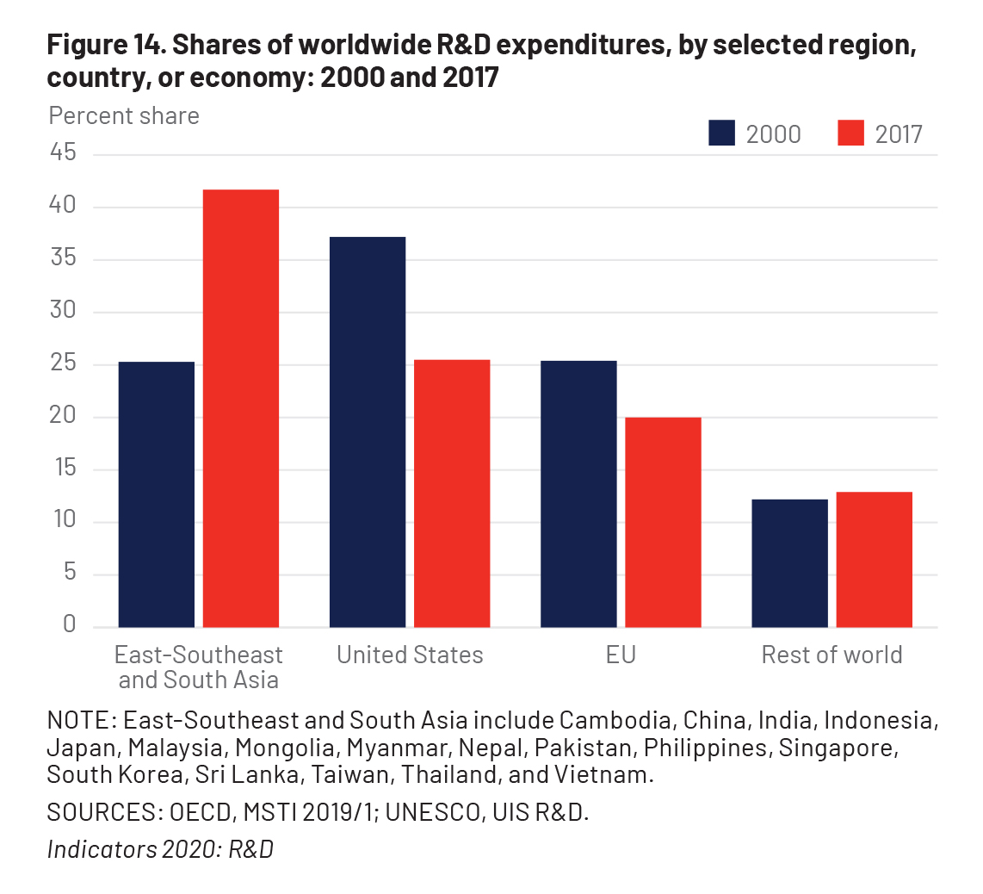
Shift in Global R&D Expenditures

Slide 7

Global High R&D Intensive Industry Output
Rest of world
Other selected Asia
China
Japan
EU
U.S.
21%
19%
32%
6%
25%
38%
Source: IHS Markit, Comparative Industry Service.

Slide 8
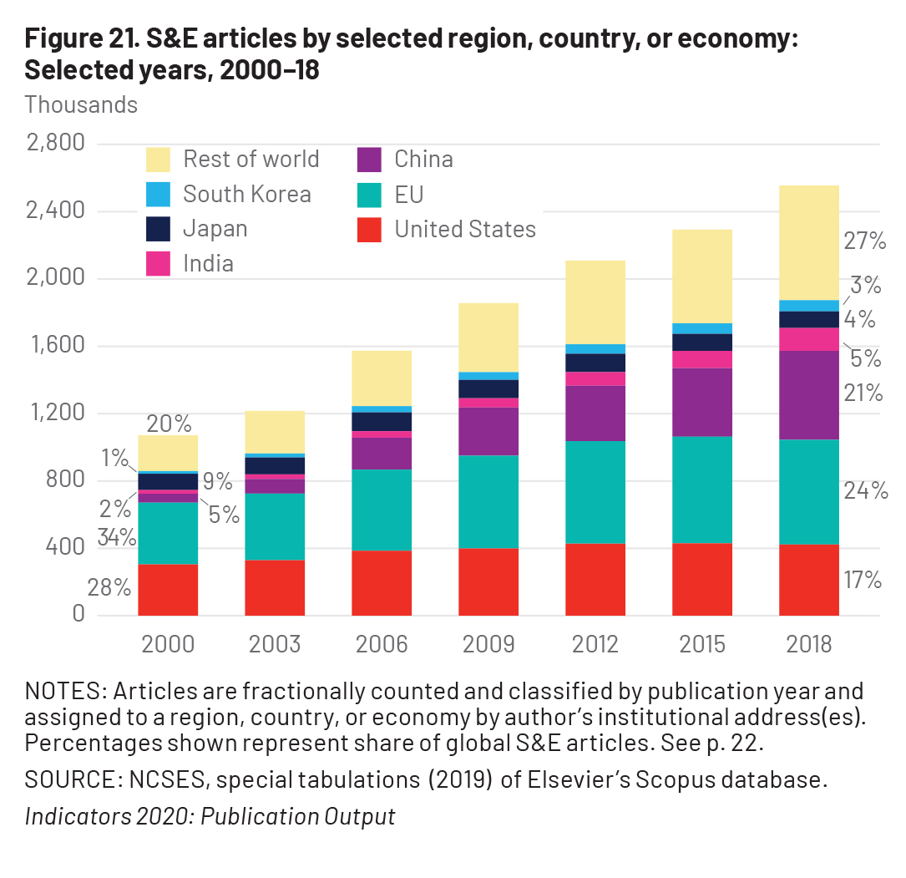
Global S&E Publications

Slide 9
International collaboration on S&E publications
Source: Elsevier, Scopus database.

Slide 10

International Student Enrollment
International students enrolled in U.S. higher education institutions: 2012-18
Source: U.S. Department of Homeland Security, U.S. Immigration and Customs Enforcement, special tabulations (2018) of the Student and Exchange Visitor Information System (SEVIS) database.

Slide 11
Stay rate: Foreign Recipients of U.S. S&E Doctorates
Note: The data source changed after 2011. Margin of error is shown for the 2017 estimates which are from a sample survey.

Slide 12
U.S.: We Need to Adapt

Slide 13
United States
China
NCSES InfoBrief 20-309

Slide 14
U.S. Investment in Research & Development

Slide 15

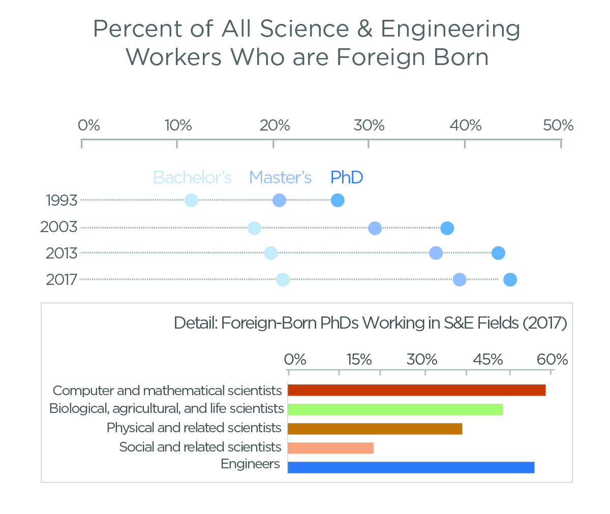
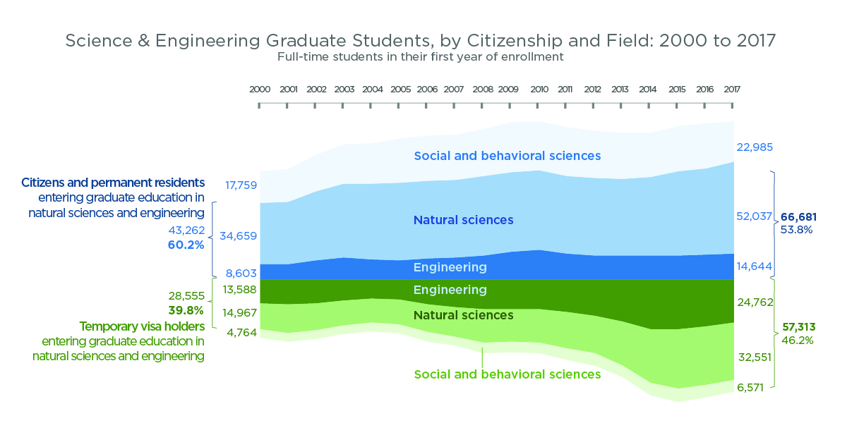
Foreign-born Students & Workers in U.S. S&E

Slide 16
Race & Ethnicity: U.S. S&E Degree Recipients

Slide 17
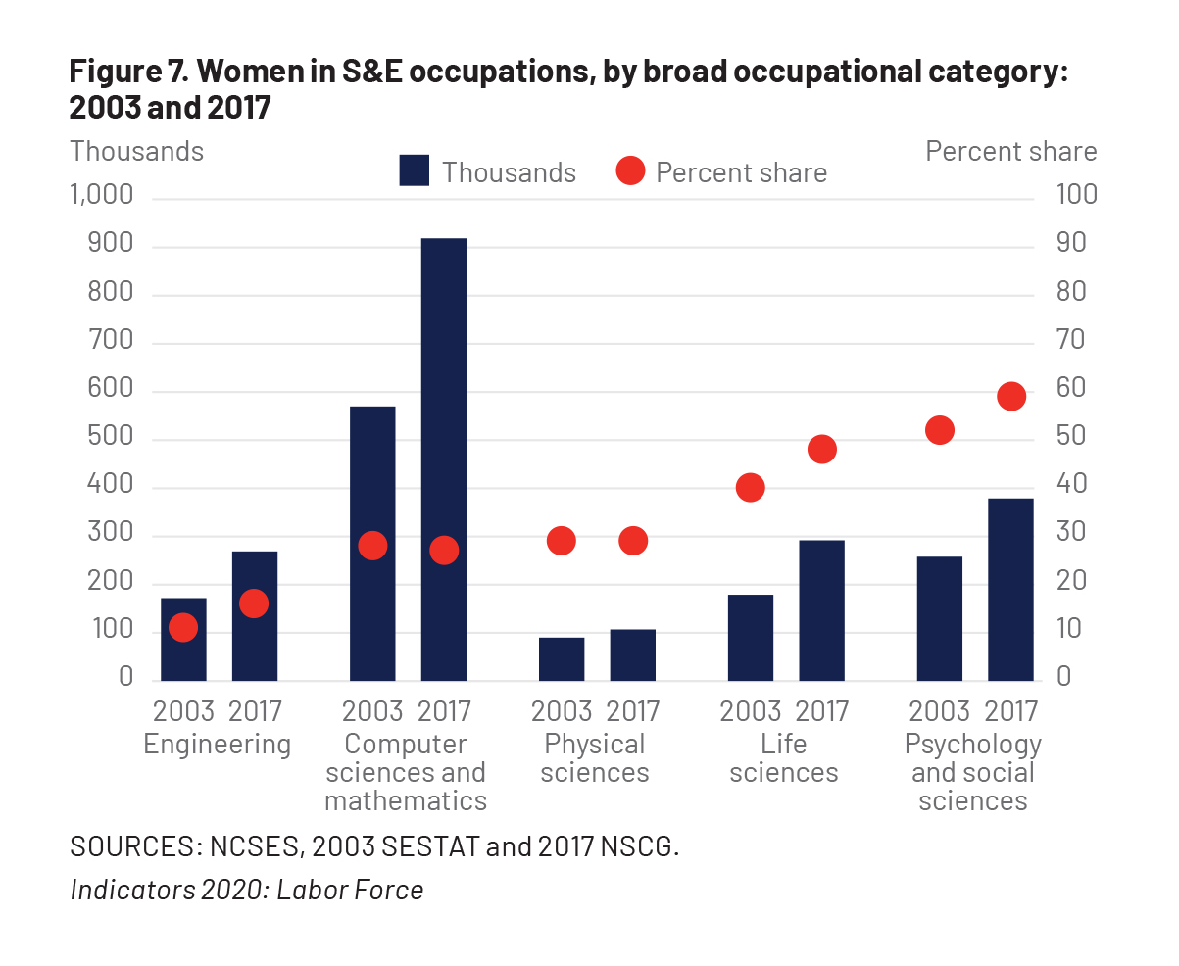
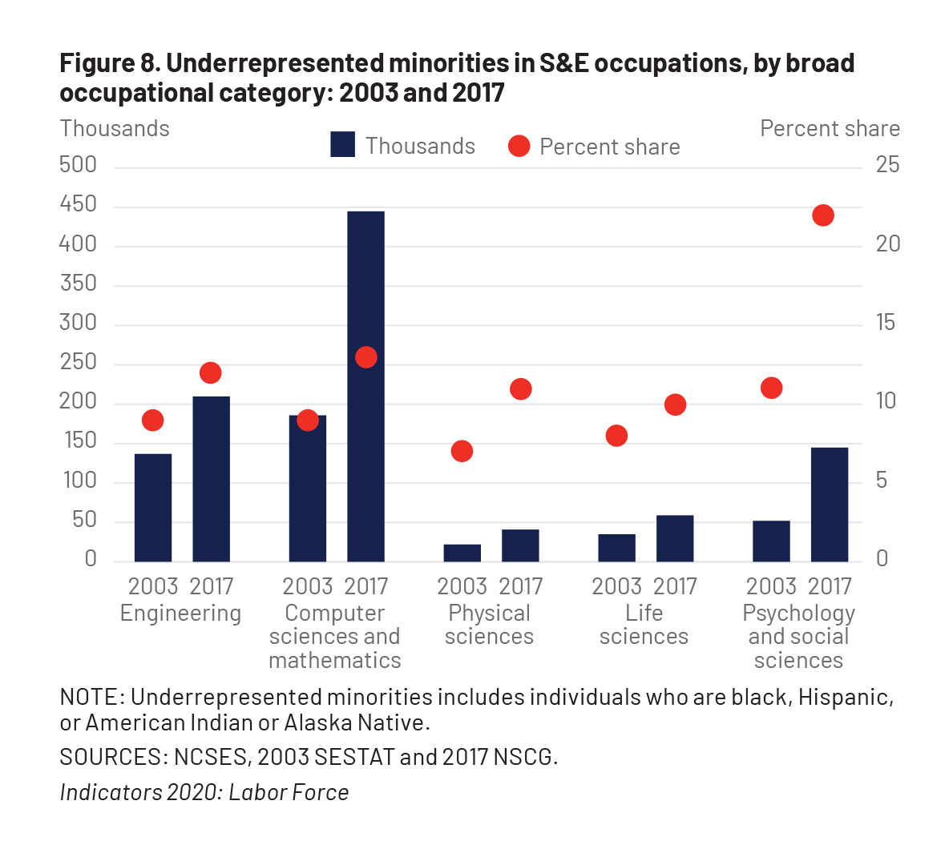
Women & Underrepresented Minorities in U.S. S&E

Slide 18

U.S. NAEP, Grade 8 Mean scores: 1990-2018
Mathematics
Science
Technology & Engineering Literacy
Note: Scores not comparable across subjects

Slide 19

Increase in Worldwide
S&E Knowledge
Total R&D expenditures
Total publications
Total doctoral degrees
Total patents
Total KTI production

Slide 20
Risks of Complacency
“There is…the risk a society runs when it falls into the habit of responding to long-term risks with short-term solutions….
It is the ceding of technical and scientific leadership to China. It is the innovation that never occurs, and the knowledge that is never created, because you have ceased to lay the groundwork for it. It is what you have never learned that might have saved you.”
- Michael Lewis, The Fifth Risk

Slide 21
A Vision for the Future:
US Prosperity & Security REQUIRES World-Leading S&E
We must:
Provide an example to the world in the conduct of science & engineering
Develop, attract, and retain world-leading talent by:
  Nurturing all U.S.-born STEM talent
  Welcoming international talent
Ensure accessible world-class S&E infrastructure throughout the U.S.
Partner:
  Across sectors
  Across agencies
  From discovery to market
  Across the globe

