Slide 1
ASCR OVERVIEW
October 7, 2011
BERAC
Daniel Hitchcock
Acting Associate Director
Advanced Scientific Computing Research

Slide 2
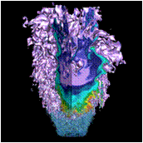
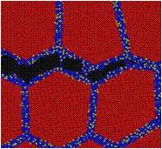
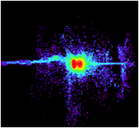
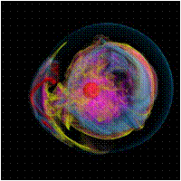
Advanced Scientific Computing Research
Delivering world leading computational and networking capabilities to extend the frontiers of science and technology
The Scientific Challenges:
Deliver next-generation scientific applications using today’s petascale computers.
Discover, develop and deploy tomorrow’s exascale computing and networking capabilities.
Develop, in partnership with U.S. industry, next generation computing hardware and tools for science.
Discover new applied mathematics and computer science for the ultra-low power, multicore-computing future.
Provide technological innovations for U.S. leadership in Information Technology to advance competitiveness.
FY 2012 Highlights:
Research in uncertainty quantification for drawing predictive results from simulation
Co-design centers to deliver next generation scientific applications by coupling application development with formulation of computer hardware architectures and system software.
Investments in U.S. industry to address critical challenges in hardware and technologies on the path to exascale
Installation of a 10 petaflop low-power IBM Blue Gene/Q at the Argonne Leadership Computing Facility and a hybrid, multi-core prototype computer at the Oak Ridge Leadership Computing Facility.

Slide 3
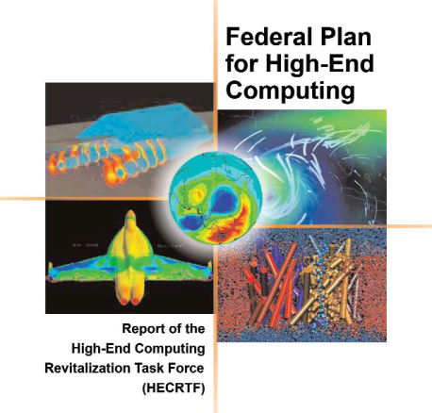





ASCR Facilities
Providing the Facility – High-End and Leadership Computing
Investing in the Future - Research and Evaluation Prototypes
Linking it all together – Energy Sciences Network (ESnet)
Notes:
3

Slide 4
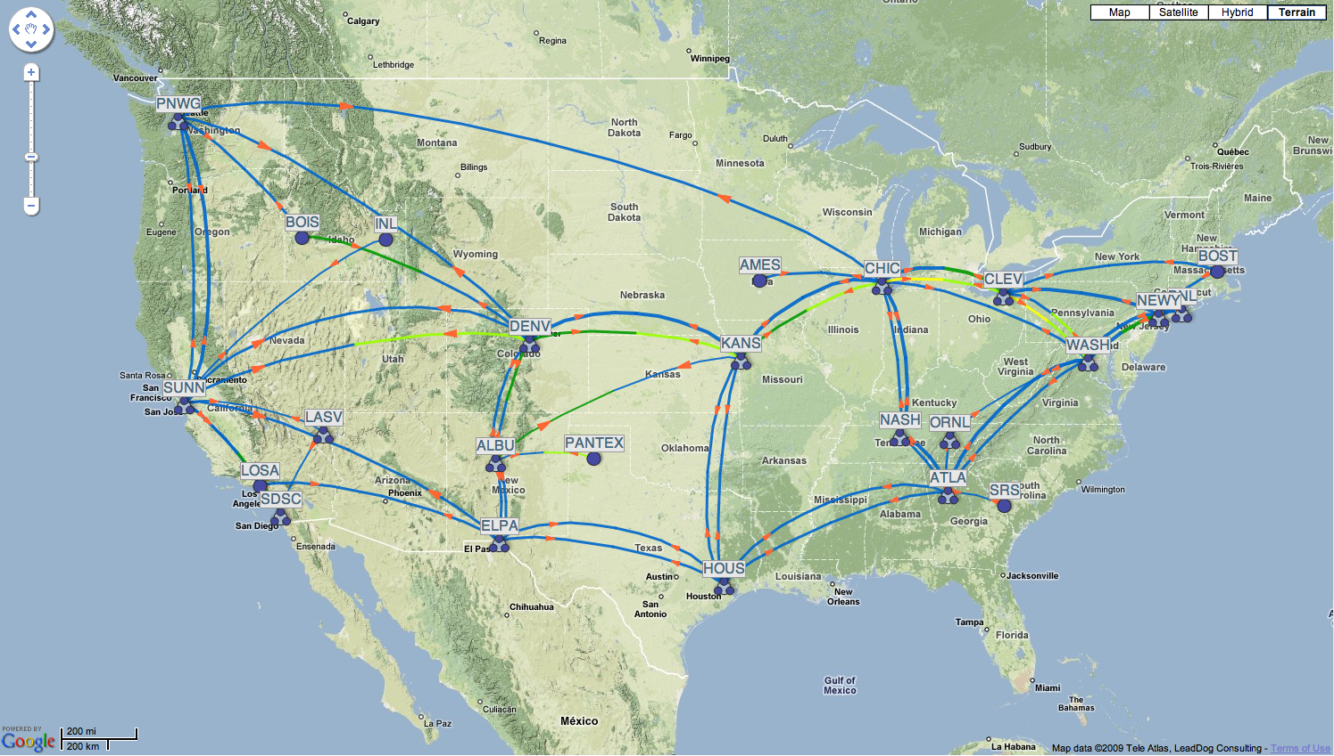

Energy Sciences Net
ALCF / ANL
Chicago
NERSC / LBNL
NYC
OLCF / ORNL
Nashville
Sunnyvale
100 G/l ANI Testbed (ARRA)
2009 Award

Slide 5

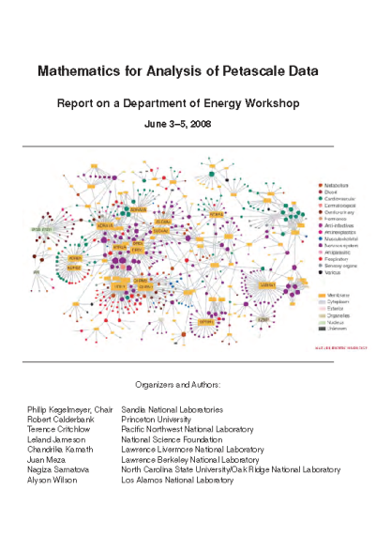
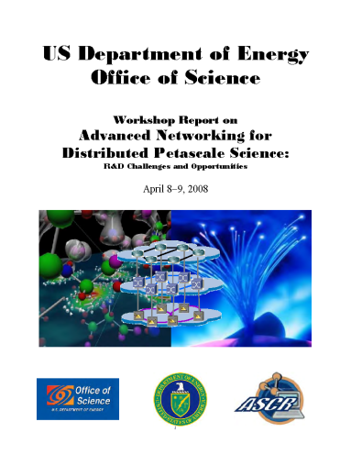
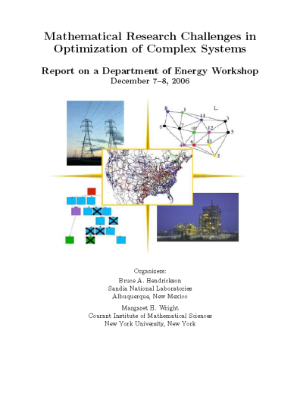
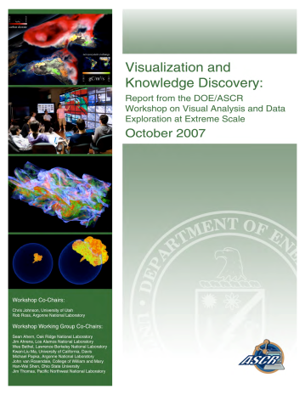

ASCR Research
Substantial innovation is needed to provide essential system and application functionality in a timeframe consistent with the anticipated availability of hardware
Provide forefront research knowledge and foundational tools:
  Applied Mathematics
  Computer Science
  SciDAC
  Next Generation Networking for Science
Notes:
Top: 3D fully implicit extended MHD simulations - Figure depicts temperature during the evolution of a helical perturbation in a 3D toroidal fusion device.
Bottom - Linear Scaling 3D Fragment (LS3DF). Density Functional Theory (DFT) calculation numerically equivalent to a more common algorithm, but scales with O(n) in number of atoms rather than O(n^3). PI: Wang, LBNL.
(Alternative definition) - Multiscale Mathematics: Develop multiscale models and algorithms for understanding complex system behavior that emerges across vastly different space and time scales.

Slide 6
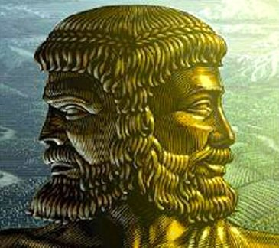
Looking Backward and Forward
Many Core
Energy Aware
X Stack
CoDesign
SciDAC Institutes
Strategic ASCR – SC Office Partnerships
Titan
Mira
???
SciDAC Centers for Enabling Technology and Institutes
Science Application Partnerships
Hopper
Jaguar
Intrepid

Slide 7
SciDAC Institutes
Goals & Objectives
  Deliver tools and resources to lower barriers to effectively use state-of-the-art computational systems;
  Create mechanisms to address computational grand challenges across different science application areas;
  Incorporate basic research results from Applied Mathematics and Computer Science into computational science challenge areas and demonstrate that value
  Grow the Nation’s computational science research community.
Awards- Up to $13M/year over 5 years available to support 1–5 Institutes
Eligible applicants- DOE National Laboratories, Universities, Industry and other organizations
Expected outcome- Institutes that cover a significant portion of DOE computational science needs on current and emerging computational systems.
Timeline
Solicitations opened- February 23, 2011
Letters of Intent- March 30, 2011
Solicitations closed- May 2, 2011
First awards- end of FY2011
Answers to Inquiries- http://science.doe.gov/ascr/research/scidac/SciDAC3InstitutesFAQ.html

Slide 8
Scientific Discovery through Advanced Computing (SciDAC) Institutes – FY11 Awards
FASTMath – Frameworks, Algorithms, and Scalable Technologies for Mathematics
Topic areas: Structured & unstructured mesh tools, linear & nonlinear solvers, eigensolvers, particle methods, time integration, differential variational inequalities
QUEST – Quantification of Uncertainty in Extreme Scale Computations
Topic areas: Forward uncertainty propagation, reduced stochastic representations, inverse problems, experimental design & model validation, fault tolerance
SUPER – Institute for Sustained Performance, Energy and Resilience
Topic areas: Performance engineering (including modeling & auto-tuning), energy efficiency, resilience & optimization
FASTMath Director – Lori Diachin, LLNL | QUEST Director – Habib N. Najm, SNL | SUPER Director – Robert F. Lucas, USC
Argonne National Laboratory | Los Alamos National Laboratory | Argonne National Laboratory
Lawrence Berkeley National Lab | Sandia National Laboratories* | Lawrence Berkeley National Lab
Lawrence Livermore National Lab* | Johns Hopkins University | Lawrence Livermore National Lab
Sandia National Laboratories | Massachusetts Institute of Technology | Oak Ridge National Laboratory
Rensselaer Polytechnic Institute | University of Southern California | University of California at San Diego
 | University of Texas at Austin | University of Maryland
 |  | University of North Carolina
 |  | University of Oregon
 |  | University of Southern California*
 |  | University of Tennessee at Knoxville
 |  | University of Utah
OMB Briefing -- 9.23.2011

Slide 9
Strategic ASCR – SC Program Partnerships
Goals and Objectives
  Partner with SC Programs to combine the best applied mathematics, computer science, and networking with SC program expertise to enable Strategic advances in program missions.
Five FOAs out before September 30, 2011:
  Fusion Energy Science: topics in Edge Plasma Physics, Multiscale Integrated Modeling, and Materials Science
  High Energy Physics: topics in Cosmological Frontier, Lattice Gauge Theory QCD, and Accelerator Modeling and Simulation
  Nuclear Physics: topics in Low- and Medium-Energy Nuclear Physics and Heavy Ion Collider Physics
  Biological and Environmental Research: topics in dynamics of atmospheres, oceans, and ice sheets that support Earth System Modeling
  Basic Energy Sciences: topics in theoretical chemistry and materials science, especially excited states of atoms and molecules, materials electron correlation.
Notes:
SC FOA# Pre-Apps Proposals Max Value
FES 571 Sep 9 Oct 26 $6.6M
HEP 580 none Jan 9 $4.0M
NP 581 Oct 30 Jan 5 $4.0M
BER 588 Oct 17 Dec 5 $6.5M
BES 593 Dec 9 Mar 12 $6.0M

Slide 10
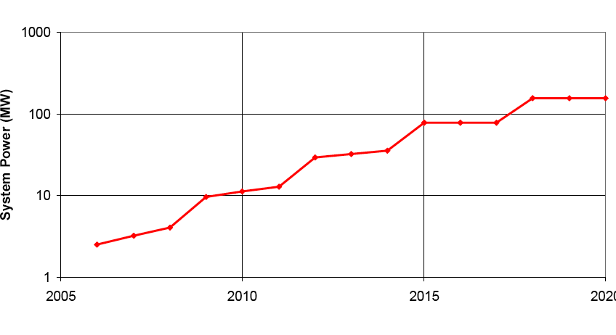
The Future is about Energy Efficient Computing
At $1M per MW, energy costs are substantial
1 petaflop in 2010 will use 3 MW
1 exaflop in 2018 at 200 MW with “usual” scaling
1 exaflop in 2018 at 20 MW is target
usual scaling
goal
2005 2010 2015 2020

Slide 11
The Fundamental Issue: Where does the Energy (and Time) Go?
Intranode/SMP
Communication
Intranode/MPI
Communication
On-chip / CMP
communication

Slide 12
Memory Technology: Bandwidth costs power

Slide 13
Approaches
Locality, Locality, Locality!
Billion Way Concurrency;
Uncertainty Quantification (UQ) including hardware variability;
Flops free data movement expensive so:
  Remap multi-physics to put as much work per location on same die;
  Include embedded UQ to increase concurrency;
  Include data analysis if you can for more concurrency
  Trigger output to only move important data off machine;
  Reformulate to trade flops for memory use.
Wise use of silicon area

Slide 14
Co-Design
Goals & Objectives
Understand how to allocate complexity between hardware, systems software, libraries, and applications;
Modify application designs at all levels;
Understand reformulating as well as reimplementing tradeoffs;
Explore uncertainty quantification, in line data analysis, and resilience in applications;
Co-adapt applications to new programming models and perhaps languages;
Impact of massive multithreaded nodes and new ultra-lightweight operating systems.
Awards- June 2011
Expected outcome- Understanding, Guidance for Future Applications, Application Readiness

Slide 15
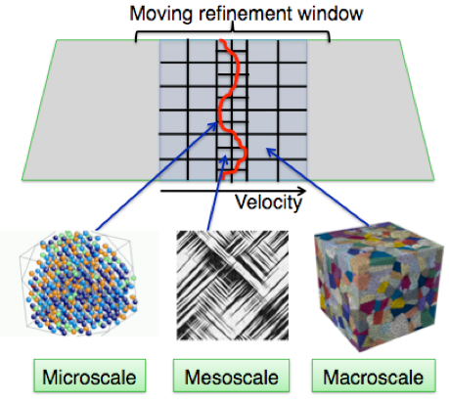
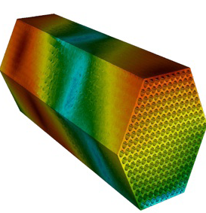
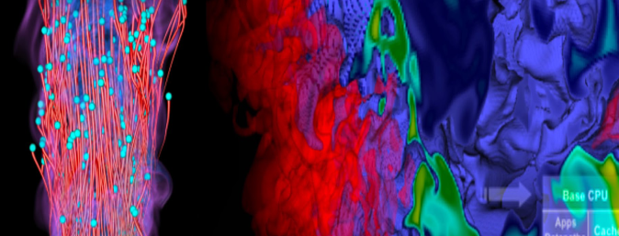
Three Exascale Co-Design Centers Awarded
 | ExMatEx (Germann) | CESAR (Rosner) | CECDC (Chen)
National Labs | LANL | ANL | SNL
 | LLNL | PNNL | LBNL
 | SNL | LANL | LANL
 | ORNL | ORNL | ORNL
 |  | LLNL | LLNL
 |  |  | NREL
University & Industry Partners | Stanford | Studsvik | Stanford
 | CalTech | TAMU | GA Tech
 |  | Rice | Rutgers
 |  | U Chicago | UT Austin
 |  | IBM | Utah
 |  | TerraPower
 |  | General Atomic
 |  | Areva
  Exascale Co-Design Center for Materials in Extreme Environments (ExMatEx)
  Director: Timothy Germann (LANL)
  Center for Exascale Simulation of Advanced Reactors (CESAR)
  Director: Robert Rosner (ANL)
Combustion Exascale Co-Design Center (CECDC)
Director: Jacqueline Chen (SNL)
Notes:
ExMatEx Goal: Develop algorithms, system software, and hardware that will enable pervasive embedding of microscopic behavior modeling and simulation into meso- and macro-scale materials simulations at the exascale, for the simulation and modeling of materials subjected to extreme mechanical environment.
CESAR Goal: Enable predictive modeling and simulation for advanced nuclear reactor design at the exascale by integrating three distinct software components -- weakly compressible hydrodynamics, particle transport, and structural mechanics -- into one code environment, TRIDENT, for detailed analysis of next-generation reactors
CECDC Goal: Simultaneously redesign all aspects of the combustion simulation process, from algorithms to programming models to hardware architecture, to enable detailed modeling and simulations at realistic operating conditions at the exascale for transportation and energy production applications.

Slide 16
Future of Data Driven Science
All of these hardware trends impact data driven science (in many cases more than compute intensive);
Data from instruments still on 18-24 month doubling because detectors on CMOS feature size path;
100 gigabit per second per lambda networks on horizon;
Disk read and write rates will fall further behind processors and memory;
Significant hardware infrastructure needed to support this which probably will not be replicated at users’ home institution (i.e. launching a petabyte file transfer at a users laptop is not friendly)

Slide 17
ASCR-BES Workshop on Data
“Data and Communications in Basic Energy Sciences: Creating a Pathway for Scientific Discovery”
October 24-25, 2011 Bethesda, MD
Goals & Objectives
  Identify and review the status, successes, and shortcomings of current data (including analysis and visualization) and communication pathways for scientific discovery in the basic energy sciences;
  Ascertain the knowledge, methods and tools needed to mitigate present and projected data and communication shortcomings;
  Consider opportunities and challenges related to data and communications with the combination of techniques (with different data streams) in single experiments;
  Identify research areas in data and communications needed to underpin advances in the basic energy sciences in the next ten years;
  Create the foundation for information exchanges and collaborations among ASCR and BES supported researchers, BES scientific user facilities and ASCR computing and networking facilities.
Co-Chairs
  Peter Nugent, NERSC
  J. Michael Simonson, SNS

Slide 18
ASCR at a Glance
Office of Advanced Scientific Computing Research
Associate Director – Daniel Hitchcock (acting)
Phone: 301-903-7486
E-mail: Daniel.Hitchcock@science.doe.gov
Research
Division Director – William Harrod
Phone: 301-903-5800
E-mail: William.Harrod@science.doe.gov
Facilities
Division Director – Daniel Hitchcock
Phone: 301-903-9958
E-mail: Daniel.Hitchcock@science.doe.gov
Relevant Websites
ASCR: science.energy.gov/ascr/
ASCR Workshops and Conferences:
science.energy.gov/ascr/news-and-resources/workshops-and-conferences/
SciDAC: www.scidac.gov
INCITE: science.energy.gov/ascr/facilities/incite/
Exascale Software: www.exascale.org
DOE Grants and Contracts info: science.doe.gov/grants/

Slide 19
Background

Slide 20
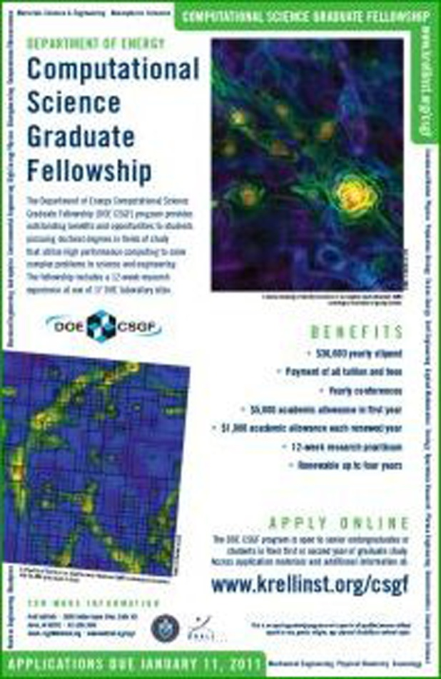

Computational Science Graduate Fellowship www.krellinst.org/csgf
Funded by the Department of Energy’s Office of Science and National Nuclear Security Administration, the DOE CSGF trains scientists to meet U.S. workforce needs and helps to create a nationwide interdisciplinary community.
Some Talks from 2011 Fellows Conference
  "The Materials Genome: An online database for the design of new materials for clean energy and beyond“
  "Understanding electromagnetic fluctuations in microstructured geometries“
  "Computational science meets materials chemistry: a bilingual investigation of surface effects in nanoscale systems“

Slide 21
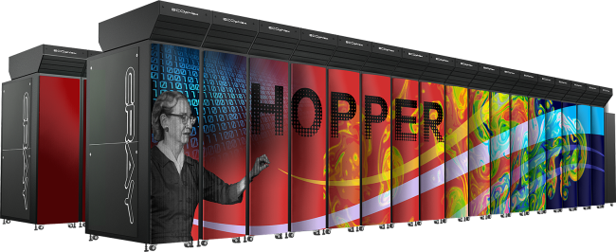
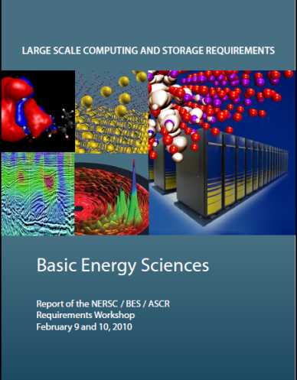
NERSC
Hopper in production April 2011
1.25 PFlop/s peak performance Cray XE6
Over a billion core-hours to science per year
Gemini high performance resilient interconnect
BES NERSC Requirements Workshop :
  www.nersc.gov/assets/HPC-Requirements-for-Science/NERSC-BES-WorkshopReport.pdf

Slide 22
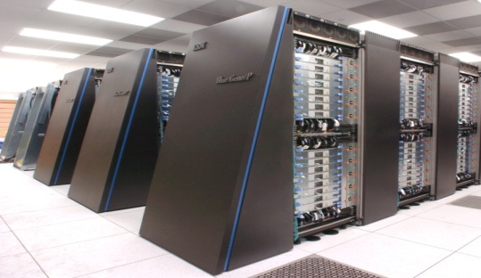
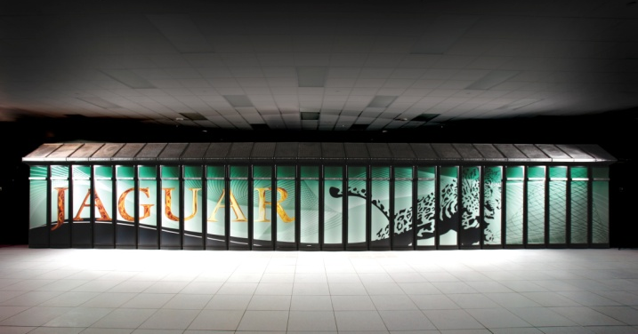
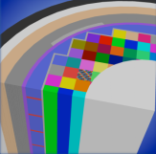
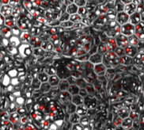


INCITE
The Cray XT5 ("Jaguar") at ORNL and the IBM Blue Gene/P ("Intrepid") at ANL will provide ~2.3 billion processor hours in FY12 to address science and engineering problems that defy traditional methods of theory and experiment and that require the most advanced computational power.
Peer reviewed projects are chosen to advance science, speed innovation, and strengthen industrial competitiveness.
Demand for these machines has grown each year, requiring upgrades of both.
Argonne Leadership Computing Facility
Oak Ridge Leadership Computing Facility
In FY 2012, the Argonne LCF will be upgraded with a
10 petaflop IBM Blue Gene/Q. The Oak Ridge LCF will continue site preparations for a system expected in FY 2013 that will be 5-10 times more capable than the Cray XT-5.
Nuclear Reactor Simulation
Energy Storage Materials
Turbulence

Slide 23
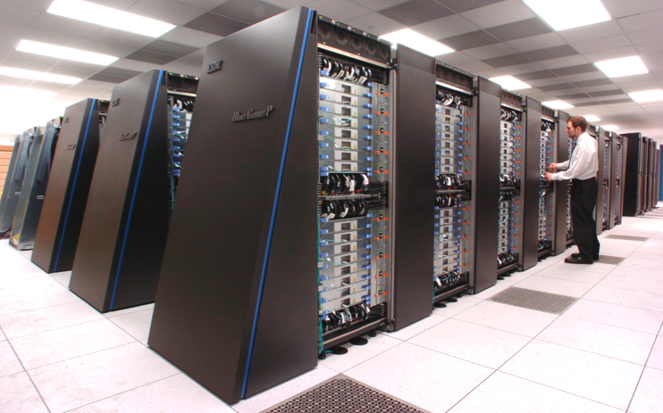
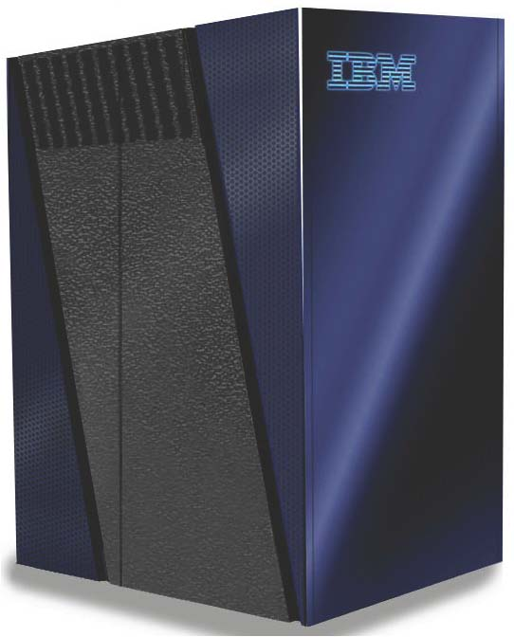

Argonne Leadership Computing Facility
ALCF - now
ALCF - 2013
more CPUs/node (x 4)
faster CPUs (x 60)
faster storage (x 2.7)
more storage (x 3.6)
more RAM/CPU (x 2)
48 racks
Intrepid
Blue Gene/P—peak 557 TF
40 racks
40,960 nodes (quad core)
163,840 processors (3.4 GF Peak)
80 TB RAM
8 PB storage capacity
88 GB/s storage rate
1.2 MW power
Air-cooled
Mira
Blue Gene/Q—peak 10 PF
48 racks -- just one row more than Intrepid
49,152 nodes (16 core)
786,432 processors (205 GF peak)
786 TB RAM
28.8 PB storage capacity
240 GB/s storage rate
Estimated 3-8 MW projected power
Water-cooled
~20 times the computing power in only 20% more space
Notes:
The current ALCF-1 system is in Steady State (Operations) and will continue in operation throughout the duration of the ALCF-2 Design, Modification & Enhancement (DME) Project.

Slide 24
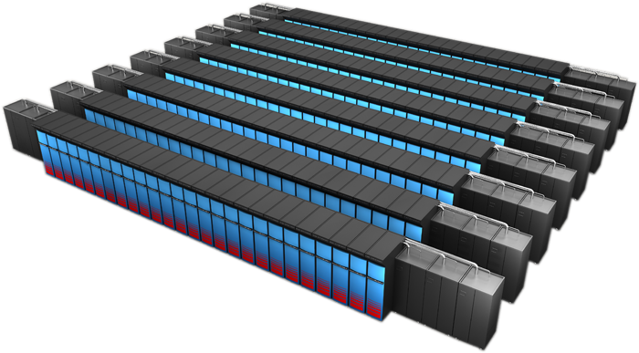
Oak Ridge Leadership Computing Facility
OLCF-3
  Builds on DARPA HPCS investment in Cray
  Prepare applications for path to Exascale computing
  CD-1 approved, December 2009
  Lehman CD2-3b Review scheduled for August, 2010
Science Application Readiness
Application Readiness Review August, 2010
Science Teams
Port, Optimize, New Modeling Approaches
Early Access to development machine
Cray-NVIDIA System
~10-20 Pflop/s peak
Hybrid x86/accelerator architecture
Liquid cooled
Highly power efficient

Slide 25
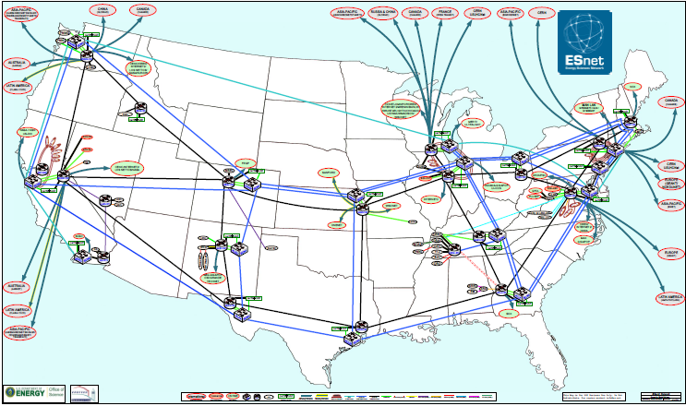
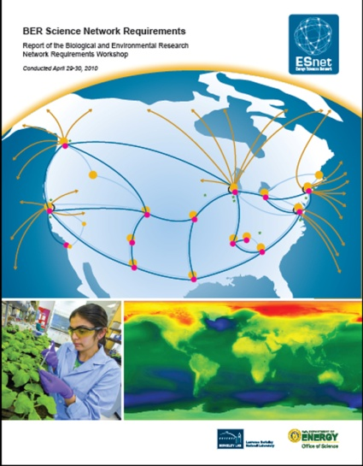
ESnet
BER 2010 Requirements Workshop
  www.es.net/assets/Papers-and-Publications/BER-Net-Req-Workshop-2010-Final-Report.pdf
Electronic Collaboration Tools
  www.ecs.es.net
Network Performance Tools
  fasterdata.es.net
Virtual Circuits
  www.es.net/services/virtual-circuits-oscars/

