Slide 1
The State of BER October 6, 2011
Sharlene Weatherwax Associate Director of Science Biological and Environmental Research

Slide 2
Biological Systems Science
 | (dollars in thousands)
 | FY 2011 CR | FY 2012 House | FY 2012 Senate Committee
Genomic Science | 176,855
Radiological Sciences | 41,467
Ethical, Legal, and Societal Issues | 1,000
Medical Applications | 4,000
Biological Systems Facilities & Infrastructure | 84,697
SBIR/STTR | 8,726
Total, Biological Systems Science | 316,745 | 296,945 | 326,744

Slide 3
Climate & Environmental Sciences
 | (dollars in thousands)
 | FY 2011 CR | FY 2012 House | FY 2012 Senate Committee
Atmospheric System Research | 27,821
Environmental System Science | 80,263
Climate and Earth System Modeling | 77,810
Climate and Environmental Facilities and Infrastructure | 101,333
SBIR/STTR | 7,851
Total, Climate and Environmental Sciences | 295,078 | 250,130 | 295,079

Slide 4
Personnel Recruitments and Changes

Slide 5
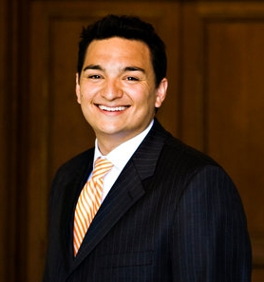
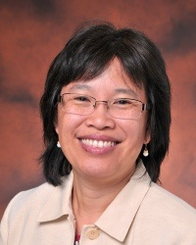
Welcome
Patrick Horan
Science Assistant, CESD
Sharlene Weatherwax No longer “Acting”

Slide 6
Future
Director, BSSD – Announcement closed September 9

Slide 7
Awards and Honors

Slide 8
Early Career Awards
Program purpose:
to support the development of individual research programs of outstanding scientists early in their careers
to stimulate research careers in DOE Office of Science areas
Early career is defined as no more than 10 years past Ph.D.
7 BER awards (3 laboratory, 4 university) in FY 2011
5 year awards, universities - $750,000, national labs - $2,500,000

Slide 9
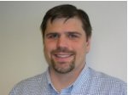
BER Early Career Scientists FY 2011
Matt Marshall
Pacific Northwest National Laboratory
Multi-System Analysis of Microbial Biofilms
Characterize the heterogeneous structure of hydrated biofilms including the distribution of metals and proteins and the reactivity of catalytic proteins within the biofilm. Results have the potential to aid in identifying mechanisms of redox transformations of metals within the biofilms and metal binding sites.

Slide 10
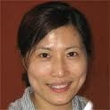
BER Early Career Scientists FY 2011
Yongqin Jiao
Lawrence Livermore National Laboratory
Systems Level Investigation of Uranium Resistance and Regulation by Caulobacter crescentus
Develop a conceptual model of uranium cycling under oxic conditions that could be used to understand processes occurring at DOE sites and inform potential remediation strategies.

Slide 11
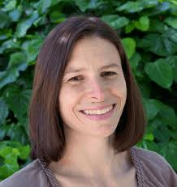
BER Early Career Scientists FY 2011
Susannah Tringe
Lawrence Berkeley National Laboratory
Microbial Communities in Biological Carbon Sequestration
Examine microbial community structure and functional properties in a restored wetland habitat, characterizing processes that result in increased biosequestration of organic carbon over time. Leverage JGI resources, using metagenomics, metatranscriptomics, and single cell genomics to assess overall community metabolic potential and correlate this information to measured biogeochemical processes.

Slide 12
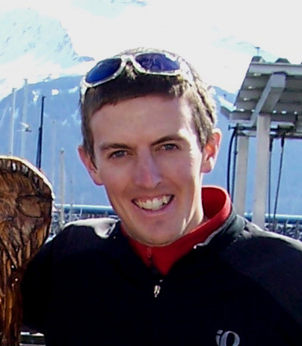
BER Early Career Scientists FY 2011
Tim Bertram
UC San Diego
In situ measurements of heterogeneous reactions on ambient aerosol particles: Impacts on atmospheric chemistry and climate
Incorporate advances into a particle reactor to study uptake kinetics for ammonia and dinitrogen pentoxide by complex, ambient aerosol particles, in contrast to current molecular level information on these processes determined in laboratory investigations on model aerosols.

Slide 13
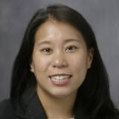
BER Early Career Scientists FY 2011
Heileen Hsu-Kim
Duke University
Nanoscale Mercury Sulfide-Organic Matter Interactions and Implications for Solubility and Biomethylation
Focus on understanding the formation, dissolution, aggregation, and bioavailability of nanoparticulate mercuric sulfides in the presence of natural organic matter, an important, but not well understood, aspect of the mercury biogeochemical cycle.

Slide 14
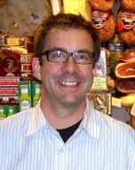
BER Early Career Scientists FY 2011
Samuel Hazen
University of Massachussetts, Amherst
Plant-Microbe Genomic Systems Optimization for Energy
Identify phenotypes and genes in Brachypodium that favor ethanol production. Combine a consolidated bioprocessing regime that employs Clostridium phytofermentans to produce ethanol and QTL analysis to identify critical genes in Brachypodium phenotypes that relate to increased ethanol when processed.

Slide 15
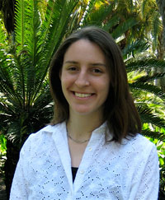
BER Early Career Scientists FY 2011
Mary Dunlop
University of Vermont
Engineering Robust Hosts for Microbial Biofuel Production
Understand and enhance microbial tolerance to the high levels of biofuel end product. 1) Identify efflux pumps and mechanisms for altering membrane fatty acid composition that may enhance tolerance; 2) build a synthetic feedback system to keep intracellular concentration of toxic products at non-toxic level; 3) combine tolerance traits to further increase tolerance.

Slide 16
2010 Presidential Early Career Award for Scientists and Engineers (PECASE)
DOE selects nominees from DOE 2010 Early Career Award winners
White House award ceremony on October 14
September 26, 2011 - 5:21pm
WASHINGTON, D.C. – President Obama named 13 U.S. Department of Energy (DOE) researchers as recipients of the Presidential Early Career Award for Scientists and Engineers (PECASE). This is the highest honor bestowed by the U.S. government on outstanding scientists and engineers who are early in their independent research careers. The DOE awardees are being recognized for their efforts in a variety of fields – from research to help our nation achieve energy independence and enhance national security to explorations of the elementary particles in the universe.
BER has two PECASE winners!

Slide 17

2010 Presidential Early Career Award for Scientists and Engineers (PECASE)
Victoria Orphan
California Institute of Technology
For developing new techniques to study interactions between microbes, relevant for understanding the role of methane in the biosphere, which is of urgent importance for addressing the global carbon cycle and climate change; and for emerging leadership in the microbiology research community.

Slide 18

2010 Presidential Early Career Award for Scientists and Engineers (PECASE)
Wei‐Jun Qian
Pacific Northwest National Laboratory
For developing and improving methods to identify proteins in key metabolic processes, profiling dynamic protein abundances at the subcellular level, providing information needed to make enzyme processing of biomass more efficient, and for impressive scientific independence and leadership in proteomics.

Slide 19
Biological and Environmental Research:
Trans-disciplinary science
Systems-based, data intensive and diverse research
World class, high impact user facilities
Scientific partnering to meet DOE mission needs

