Slide 1
Update from the Office of Science
Biological and Environmental Sciences
Advisory Committee
September 16, 2010
Dr. W. F. Brinkman
Director, Office of Science
U.S. Department of Energy
www.science.doe.gov

Slide 2
The Administration’s S&T Priorities for the FY 2011 Budget
“We double the budget of key agencies, including the National Science Foundation, a primary source of funding for academic research, and the National Institute of Standards and Technology, which supports a wide range of pursuits – from improving health information technology to measuring carbon pollution, from testing “smart grid” designs to developing advanced manufacturing processes. And my budget doubles funding for the Department of Energy’s Office of Science which builds and operates accelerators, colliders, supercomputers, high-energy light sources, and facilities for making nano-materials. Because we know that a nation’s potential for scientific discovery is defined by the tools it makes available to its researchers.”
President Barack Obama
April 27, 2009

Slide 3

Secretary
Steven Chu
Deputy Secretary
Daniel B. Poneman
Energy R&D Organizations
Under Secretary
for Energy
Kristina Johnson
Under Secretary
for Science
Steven E. Koonin
Under Secretary
for Nuclear Security
Thomas D’Agostino
Office of Science
William Brinkman
Patricia Dehmer
Energy Efficiency & Renewable Energy
Cathy Zoi
Advanced Research Projects Agency – Energy
Arun Majumdar
Basic Energy Sciences
Harriet Kung
High Energy Physics
Dennis Kovar
Fossil Energy
James Markowski
Advanced Scientific Computing Research
Michael Strayer
Nuclear Physics
Tim Hallman
Nuclear Energy
Pete Miller
Biological & Environmental Research
Anna Palmisano
Fusion Energy Sciences
Ed Synakowski
Electricity Delivery
and Energy Reliability
Pat Hoffman (A)
Workforce Development for Teachers & Scientists
Bill Valdez
Notes:
3

Slide 4
Status of FY 2011 Budget Request and Appropriations
(dollars in thousands)
FY 2010
FY 2011
Total
FY 2011
Current
Recovery
Request to
House
House Mark vs.
Senate
Senate Mark vs.
Approp.
Act
Congress
Mark
Request
Mark
Request
Office of Science
Advanced Scientific Computing Research…………………
383,199
+161,795
426,000
424,800
-1,200
-0.3%
418,000
-8,000
-1.9%
Basic Energy Sciences………………………………………
1,598,968
+555,406
1,835,000
1,670,618
-164,382
-9.0%
1,739,115
-95,885
-5.2%
Biological & Environmental Research………………………
588,031
+165,653
626,900
613,617
-13,283
-2.1%
614,500
-12,400
-2.0%
Fusion Energy Systems………………………………………
417,650
+91,023
380,000
380,000
——
——
384,000
+4,000
+1.1%
High Energy Physics…………………………………………
790,811
+232,390
829,000
816,500
-12,500
-1.5%
820,085
-8,915
-1.1%
Nuclear Physics………………………………………………
522,460
+154,800
562,000
552,500
-9,500
-1.7%
554,000
-8,000
-1.4%
Workforce Development for Teachers & Scientists…………
20,678
+12,500
35,600
22,678
-12,922
-36.3%
21,000
-14,600
-41.0%
Science Laboratories Infrastructure…………………………
127,600
+199,114
126,000
113,000
-13,000
-10.3%
126,000
——
——
Safeguards & Security………………………………………
83,000
——
86,500
86,500
——
——
86,500
——
——
Science Program Direction…………………………………
189,377
+4,600
214,437
201,437
-13,000
-6.1%
208,000
-6,437
-3.0%
Small Business Innovation Research/Tech.Transfer (SC)…
107,352
+18,719
——
——
——
——
——
——
——
Subtotal, Science…………………………………………
4,829,126
+1,596,000
5,121,437
4,881,650
-239,787
-4.7%
4,971,200
-150,237
-2.9%
Earmarks……………………………………………………
74,737
——
——
18,350
+18,350
——
40,800
+40,800
——
Small Business Innovation Research/Tech.Transfer (DOE)
60,177
+73,248
——
——
——
——
——
——
——
Subtotal, Science…………………………………………
4,964,040
+1,669,248
5,121,437
4,900,000
-221,437
-4.4%
5,012,000
-109,437
-2.1%
Use of PY Bal………………………………………………
-153
——
——
——
——
——
——
——
——
Total, Science………………………………………………
4,963,887
+1,669,248
5,121,437
4,900,000
-221,437
-4.3%
5,012,000
-109,437
-2.1%

Slide 5
FY 2011 House and Senate Markup Details for BER

Slide 6
DOE Office of Science Graduate Fellowships
The FY 2011 request doubles the number of graduate fellowships in basic science
$10 million is needed to FY 2011 to fund 150 additional fellowships
Purpose: To educate and train a skilled scientific and technical workforce in order to stay at the forefront of science and innovation and to meet our energy and environmental challenges and to couple the fellows into the Departments research
Eligibility:
    Candidates must be U.S. citizens and a senior undergraduate or first or second year graduate student to apply
  Candidates must be pursuing advanced degrees in areas of physics, chemistry, mathematics, biology, computational sciences, areas of climate and environmental sciences important to the Office of Science and DOE mission
Award Size:
  The three-year fellowship award, totaling $50,500 annually, provides support towards tuition, a stipend for living expenses, and support for expenses such as travel to conferences and to DOE user facilities.
FY 2010 Results:
    150 awards were announced this summer using FY 2010 and American Recovery and Reinvestment Act funds.
  FY 2011 Application Process:
    Funding Opportunity Announcement issued in Fall 2010
    Awards made in March 2011

Slide 7
Prospects for Solar Fuels Production
What We Can Do Today
Two Limits
Ultimate Goal
solar microcatalytic energy conversion
$12/kg H₂ @ $3/pW PV
(BRN on SEU 2005)
PV cell
High capital costs
Low capital costs
balance of system
current
liquid
electrolyzer
fuel storage
gas
We do not know how to produce solar fuels in a cost effective manner.
Chemists do not yet know how to photoproduce O₂, H₂, reduce CO₂, or oxidize H₂O on the scale we need.
gas
fuel storage
fuel storage
H₂ compression
compression
Notes:
Given that we now have an active FOA out on the Fuels from Sunlight topic, we have decided not to follow the other module example by giving specific research highlight examples. This is to avoid the “perception” of endorsing any specific groups’ efforts. Therefore, the solar fuels slides are essentially laying the case for why we would need a Hub and ending with a Hub FOA slide. Please let me know if you would like us to do something different for this module.

Slide 8
Award of the “Fuel From Sunlight” Hub
Winning team led by Cal Tech and LBNL
Other institutions involved:
  SLAC National Accelerator Laboratory
  Stanford University
  UC Berkeley
  UC Santa Barbara
  UC Irvine
  UC San Diego
Professor Nate Lewis leader
Looking for a factor of 10 over nature
Strong push to integrate processes to form a complete system

Slide 9
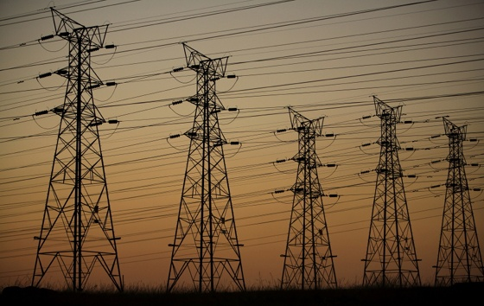
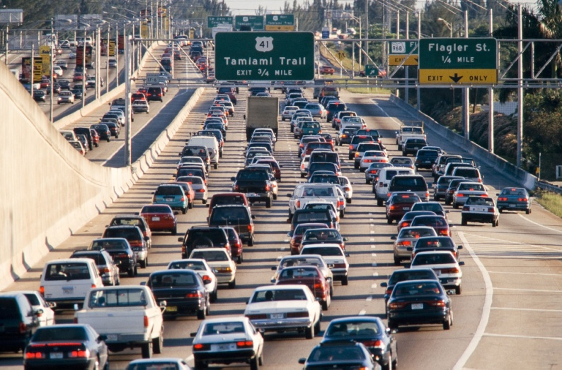
FY 2011 Energy Innovation Hub for Batteries and Energy Storage
Addressing science gaps for both grid and mobile energy storage applications
The Administration’s Energy Plan has two goals that require improvements in the science and technology of energy storage:
Solar and wind providing over 25% of electricity consumed in the U.S. by 2025
1 million all-electric/plug-in hybrid vehicles on the road by 2015
Grid stability and distributed power require innovative energy storage devices
  Grid integration of intermittent energy sources such as wind and solar
  Storage of large amounts of power
  Delivery of significant power rapidly
Enabling widespread utilization of hybrid vehicles requires:
  Substantially higher energy and power densities
  Lower costs
  Faster recharge times
Notes:
Electrical Energy Storage
The projected doubling of world energy consumption within the next 50 years, coupled with the growing demand for low- or even zero-emission sources of energy, has brought increasing awareness of the need for efficient, clean, and renewable energy sources. Energy based on electricity generated from renewable sources, such as solar or wind, offers enormous potential for meeting future energy demands. However, practical use of large scale solar- or wind-based electrical generation requires electrical energy storage (EES) systems to level their cyclic nature. In addition, greatly improved EES systems are needed to replace today’s hybrid electric vehicles with plug-in hybrids or all-electric vehicles.
Fundamental performance limitations of energy storage systems are rooted in the constituent materials making up an EES device, and novel approaches are needed to develop multifunctional EES materials that offer new self-healing, self-regulating, failure-tolerant, impurity-sequestering, and sustainable characteristics. The discovery of novel nanoscale materials with architectures tailored for specific performance offer particularly exciting possibilities for the development of revolutionary three-dimensional architectures that simultaneously optimize ion and electron transport and capacity. New capabilities are also needed to “observe” the dynamic composition and structure at an electrode surface, in real time, during charge transport and transfer processes. New in situ photon- and particle-based microscopic, spectroscopic and scattering techniques with time resolution down to the femtosecond range and spatial resolution spanning the atomic and mesoscopic scales are needed to meet this challenge. Research to formulate a predictive knowledge of structural and functional relationships based upon multiscale integrating theory-based methods at different time and length scales can effectively complement experimental efforts to provide insight into mechanisms, predict trends and identify new materials. With such underpinning knowledge, wholly new concepts in rational materials design can result in EES systems capable of storing higher energy densities with long cycle lifetimes.

Slide 10



World’s Most Powerful Computers for Open Science
#1
#9
#17
Rankings from June, 2010 Top 500 Supercomputing List
Notes:
10

Slide 11
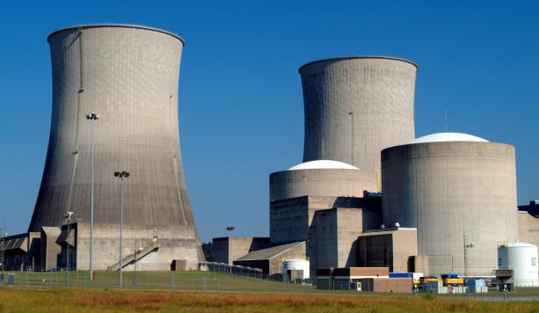
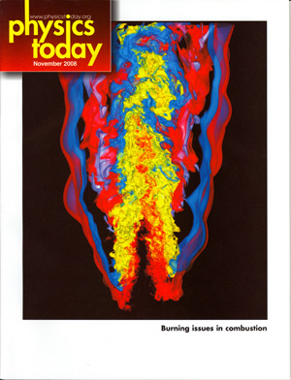
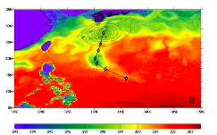
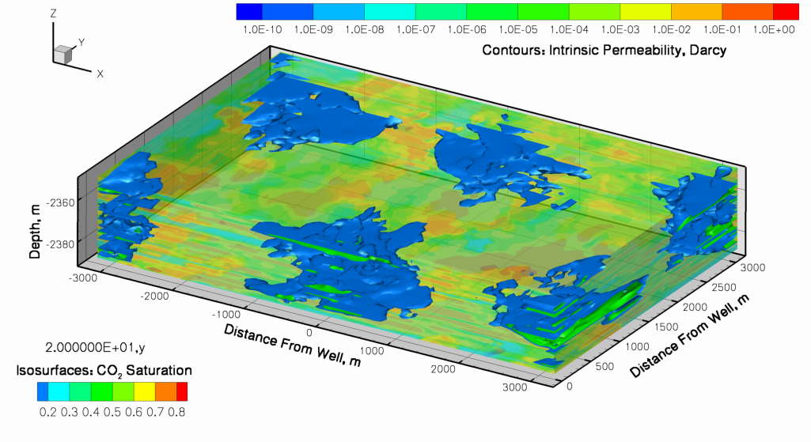
Exascale Initiative
The Goal: “Provide the United States with the next generation of extreme scale computing capability to solve problems of National importance in Energy, the Environment, National Security, and Science”
Why do Exascale?
  Environment
  Energy
  National Security
  Science and Innovation
  American Competitiveness
Geologic sequestration
Massive Earth System Model ensembles
(e.g. decadal forecasts, extreme weather )

Slide 12
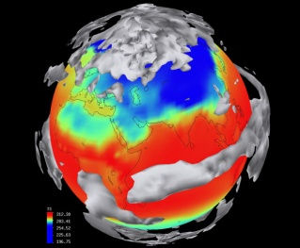
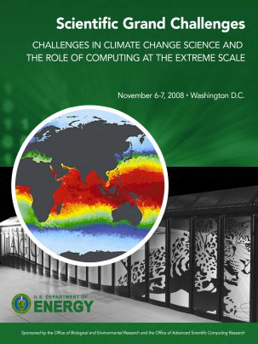
The Future: Exascale Computing and Climate Modeling
Exascale computing will enable:
  Simulation of clouds over their natural range of scales for global climate
  Modeling fully turbulent exchange of heat and gases between the atmosphere and ocean
  Robust climate models for early warning, adaptation, and mitigation
  Higher resolution
“Challenges in Climate Change Science and the Role of
Computing at the Extreme Scale.” DOE BER and ASCR, 2009.
Notes:
Top image source :http://www.vets.ucar.edu/vg/CSM/control.shtml
Control simulation of an older version of the Climate System Model (CSM), showing
surface temperature and clouds from a control simulation of present-day conditions.
Graph on right: The Green Flash Team, LBNL, http://www.lbl.gov/cs/html/greenflash.html
Graph shows the petaflop/second (realized sustained performance) required to simulate the atmosphere at various resolutions down to about 2 km. Given that the realized performance for climate models is about 10% of peak performance, and since pushing to 1 km would increase the cost by 2^3 (x 2^2 for resolution, and x2 for CFL), this graph shows that a 1-km atmosphere running in isolation would require ~100 Petaflop/peak system.
Cloud graphic on left: Taken from Khairoutdinov et al 2009 see 10.3894/JAMES.2009.1.15 . It shows a visualization of simulated cloud scene over the area of
205 x 205 km^2 from an atmospheric LES run at 100-m lateral resolution.
Ocean graphic on left: hurricane track from fully-coupled high-res simulation. This is intended
To illustrate Kerry Emanuel’s hypothesis that mixing of the upper ocean by tropical
Cyclones (which require ultra-high-resolution to resolve) may be a critical process
In the climate system that could be affected if tropical cyclones get stronger due
To global warming.
Source
ref: McClean, J. L., D. C. Bader, J. Dennis, F. Bryan, A. Mirin, P. Jones, M. Maltrud, M.
Vertenstein, D. Ivanova, N. Norton, T. Craig, J. Boyle, E. Hunke, S. Klein, B. Chan, P.
Worley, and R. Jacob, 2009a: Ultra-high-resolution coupled climate
simulations. 14th Annual CCSM Workshop, Breckenridge, CO, June 2009,
(http://www.cgd.ucar.edu/csm/events/ws.2009/Presentations/TenMile/OMWG/mcclean.pdf).

Slide 13
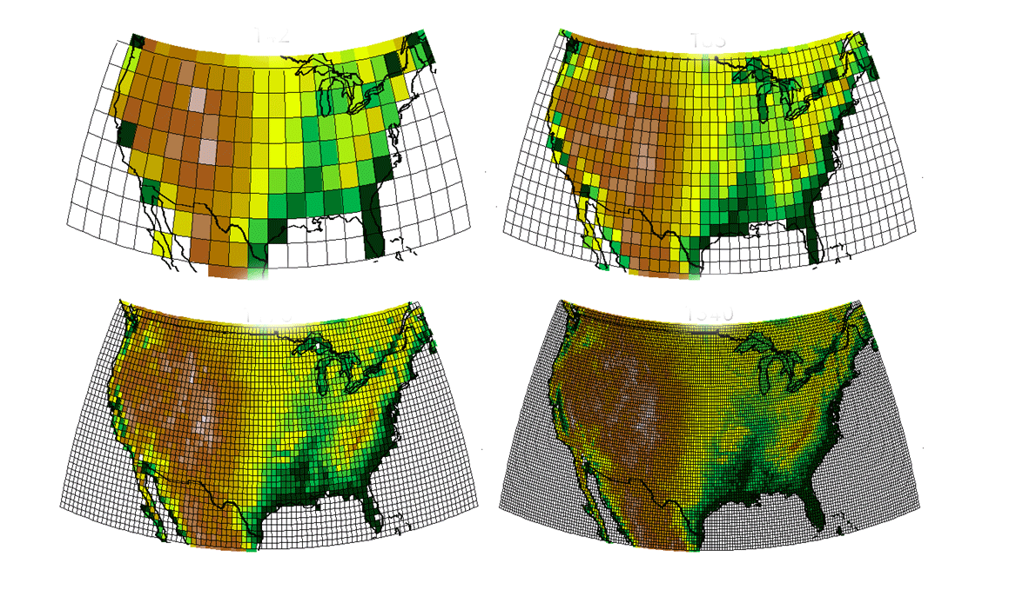
Spatial resolution of climate models is increasing
300 km
150 km
75 km
25 km

Slide 14
Exascale Initiative Major Components
Platform R&D
2 Vendor Tracks
Critical Technologies
(everyone benefits)
Software and Environments
Co-design
Platforms
Memory
Nonvolatile storage
Optics
Power
Integration
Risk Mitigation
Operating environment
Systems Software
System reliability
Programming model
Performance models
Simulators
Applications integration with vendors
Early prototypes to ensure component integration and usefulness
Risk mitigation for vendors – Non recoverable engineering cost
Physics Models
Applied Math
Exascale Initiative

Slide 15
Transitioning to Exascale
Applied Math and Computer Science
FY 2010: Focused on long lead time research for exascale:
  Applied Math
    Complex mathematics with uncertainty quantification
        Research that addresses the mathematical challenges involved in developing highly scalable approaches for uncertainty analysis in the modeling and simulation of complex natural and engineered systems.
  Computer Science
    X-Stack Software Research
      Emphasis on transformational computer science discoveries focused on the development of a scientific software stack that supports extreme scale scientific computing, from operating systems to development environments.
    Advanced Architectures and Critical Technologies for Exascale Computing
      Basic and applied research to address fundamental challenges in the design of energy-efficient, resilient hardware and software architectures and technology for high performance computing systems at exascale.
    Scientific Data Management and Analysis at the Extreme
      Innovative basic research in computer science for management and analysis of extreme-scale scientific data in the context of petascale computers and/or exascale computers with heterogeneous multi-core architectures.
Underpins Exascale
Notes:
These are the FOA topics put out in FY2010. Most projects have started only a short time ago so no significant accomplishments yet.
Uncertainty Quantification:
-- Embedded UQ in multiscale, multiphysics simulations to enable predictive science
X-stack:
-- New ways of designing software for mulitcore systems
-- Tools for transitioning the MPI legacy to the future
-- Tools to enable I/O and software testing at scale
Scientific Data Management and Analysis:
-- Integration of data management and file systems
-- New ways to represent scientific data to enable understanding
Advanced Architectures:
-- Understanding the interplay of memory architecture and applications on power and resilience
-- Providing simulation tools to enable application/hardware codesign

Slide 16
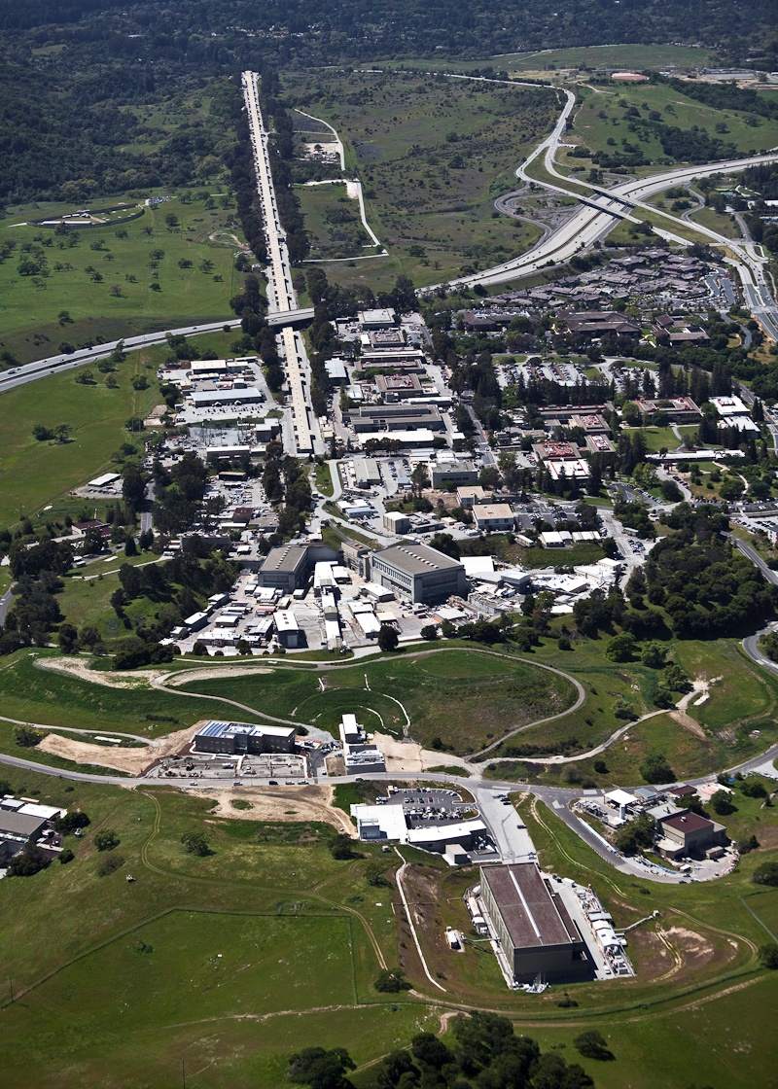
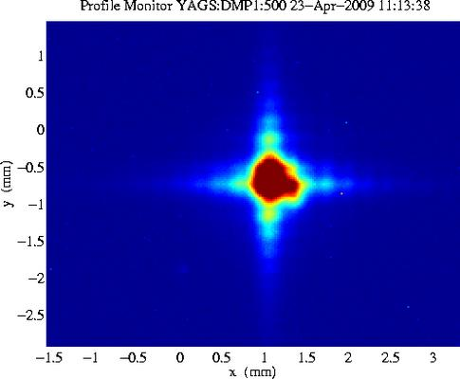
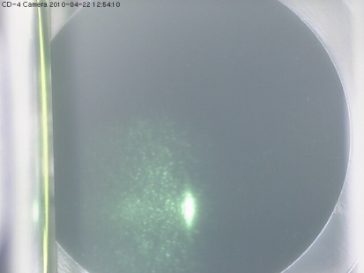
Linac Coherent Light Source or “LCLS” at SLAC
The World’s First X-ray Laser
LCLS uses 1/3 of linac
First X-rays:
~ 1 PM PDT
4/15/2009
electron beam
undulator hall
x-ray production
Detection of
X-ray at Far Hall ~ 1 PM PDT 4/22/2010
near hall
3 experiments
x-ray beam
far hall
3 experiments
Notes:
The LCLS constitutes a revolutionary advance in photon science. It combines the atomic resolution capability of x-rays with the ultrafast capability of conventional lasers. This capability became possible by employing frontier concepts in accelerator physics. High quality electron beams generated in a specially designed gun are accelerated to relativisitic speeds and then compressed to a small volume. When these ultra-small bunches of charge are sent through long precisely engineered magnetic structures called undulators, all electrons in the tiny bunch radiate complete in tune and the generated x-rays are more than a billion times brighter than those produced by the most powerful existing sources. The ultrafast x-ray pulses are used much like flashes from a high-speed strobe light, enabling scientists to take stop-motion pictures of atoms and molecules in motion, shedding light on the fundamental processes of chemistry, technology, and life itself. The first three months of LCLS user assisted commissioning have already shown that the LCLS pulses are intense enough and bright enough to capture images of atomic and electronic events with a “shutter speed” of less than 10 femtoseconds. Molecular movies, revealing the inner workings of the atomic world are now within our reach.
The purpose of the Linac Coherent Light Source (LCLS) Project is to provide laser-like radiation in the x-ray region of the spectrum that is 10 billion times greater in peak brightness than any existing coherent x-ray light source. The LCLS Project will provide the first demonstration of an x-ray Free Electron Laser (XFEL) in the 1.5 - 15 Ångstrom range and will apply these extraordinary, high-brightness x-rays to scientific problems.
Technical Objective: 13 GeV electron energy, 0.2 nano coulomb electron charge, Minimum of 10⁶ photons/(mm² *0.1%BW) X-ray flux density at the Front End Enclosure, ~100,000 ft² conventional facility, 1 instrument installed ready for commissioning.

Slide 17
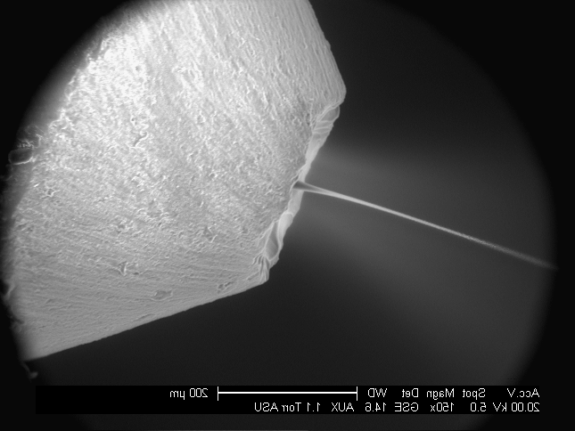
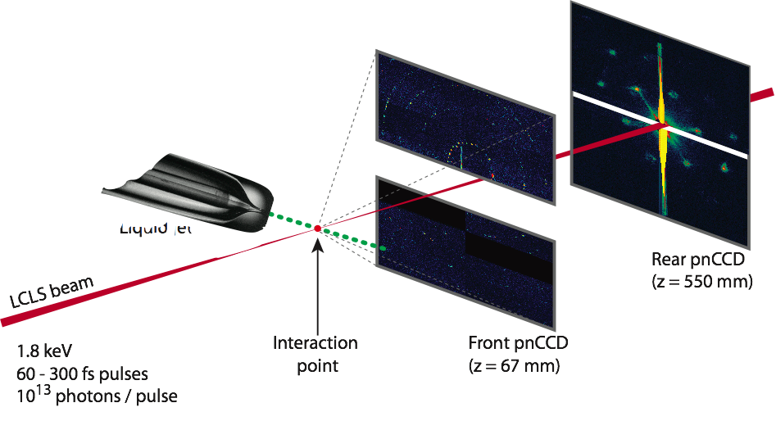
Early Studies at LCLS: Nanocrystals in Water Microjet
John Spence et al. ASU
Spokesperson: Henry Chapman et al.
collaboration of
Center for Free Electron Laser Science DESY
Arizona State University, Max Planck CFEL ASG, SLAC, LLNL, CBST, Uppsala University
Liquid jet
8 cm
Liquid jet
back
detector
at 55cm
x-rays: 7 μm
liquid jet: 4 μm
front
detector
at 7cm

Slide 18
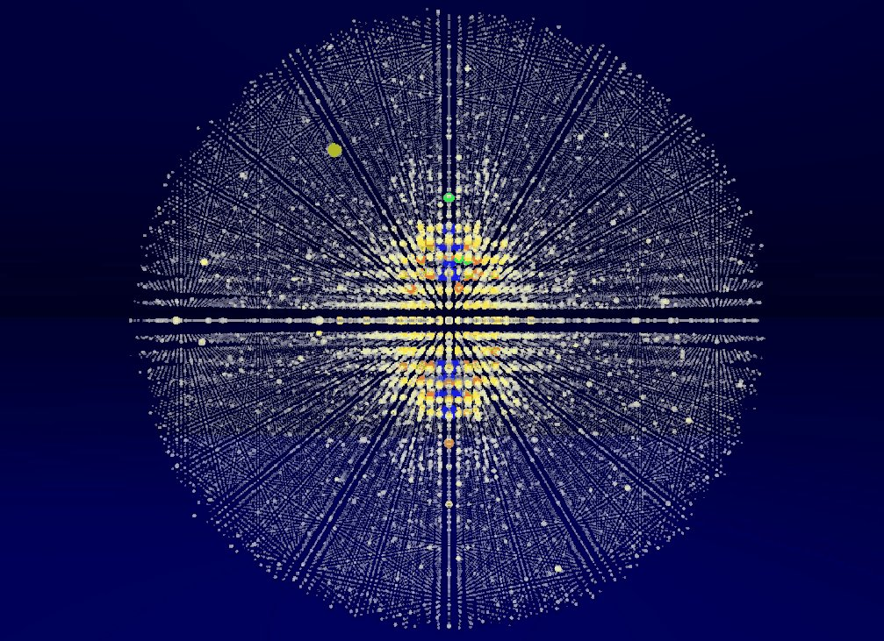
Notes:
Gateway to the Future

Slide 19

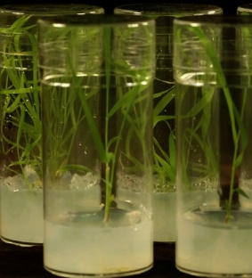

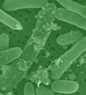

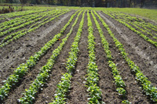
Bioenergy Research Centers: Recent Highlights
Identification of key lignin biosynthesis genes in switchgrass, providing potential targets for improving switchgrass as a bioenergy crop.
Used synthetic biology toolkit to construct the first microbes to produce an advanced biofuel directly from biomass.
Characterized soil microbial community structure to understand impacts of biomass crop growth on marginal lands
BERAC September 16, 2010
19
Notes:
The lignin part of plant cell walls makes plants difficult to breakdown and convert to biofuels. BESC researchers identified a key gene involved in lignin biosynthesis in switchgrass, a major perennial feedstock for lignocellulosic ethanol production. Their results provide a potential target for modification in the development of switchgrass as a bioenergy crop. Photo shows transgenic switchgrass in lab culture.
Reference: Escamilla-Treviño et al 2010. Switchgrass (Panicum virgatum) possesses a divergent family of cinnamoyl CoA reductases with distinct biochemical properties. New Phytologist 185: 143-155.
JBEI researchers (in collaboration with LS9) engineered several key changes into E. coli to take up hemicellulose, break it down and convert into biodiesel.
overproduce fatty acids that could then be metabolically converted into structurally tailored fatty esters (biodiesel), alcohols and waxes
produce hemicellulases.
Photo shows microbes producing oil droplets
Reference : Microbial production of fatty-acid-derived fuels and chemicals from plant biomass; Steen et al, Nature, Vol 463|28 January 2010
GLBRC uses high-capacity sequencing technology to characterize microbial rhizosphere communities of biofuel crops grown on agricultural vs. marginal lands. Found that soil environment and land management were key factors influencing community structure. Although more limited in plant diversity, greater bacterial diversity was observed in the biofuel crop samples than in the forest samples. Photo shows agricultural row cropland tested.
Reference: Jesus, E. C., et al., 2010, “Bacterial Communities in the Rhizosphere of Biofuel Crops Grown on Marginal Lands as Evaluated by 16S rRNA Gene Pyrosequences,” Bioenergy Research, 3: 20–27.

Slide 20
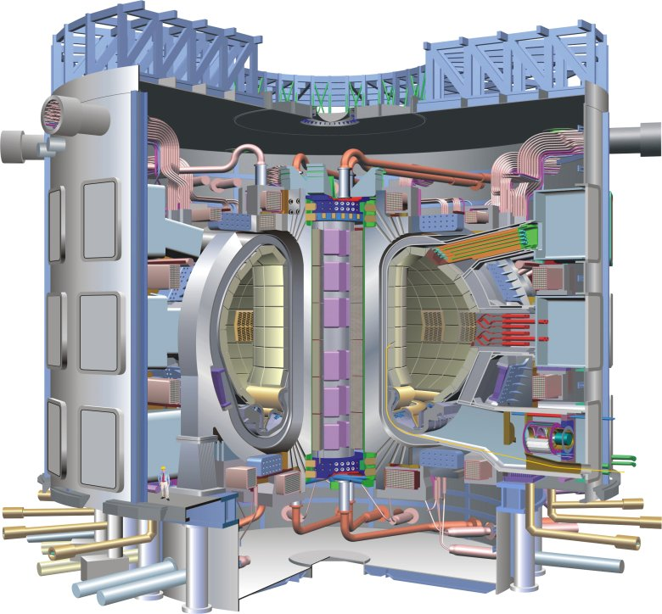
ITER
ITER (Latin for “the way”) is a first of a kind major international research collaboration on fusion energy.
U.S. is a 9.09% partner.
ITER Goals
  Designed to produce 500 MW
  of fusion power (Q > 10)
  for at least 300-500 seconds
  Burning plasma dynamics and control
    - U.S. emphasizes the value of ITER, its flexibility, and its diagnostics as a scientific instrument: develop a predictive capability of the burning plasma state
  Will optimize physics and integrate many of key technologies needed for future
  fusion power plants
The Agreement on the Establishment of the ITER International Fusion Energy Organization for the Joint Implementation of the ITER Project, entered into force in October 2007 for a period of 35 years.
ITER Tokamak – Cross Sectional View

Slide 21
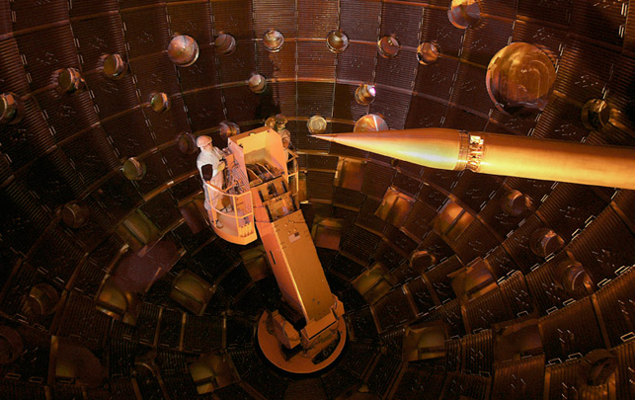
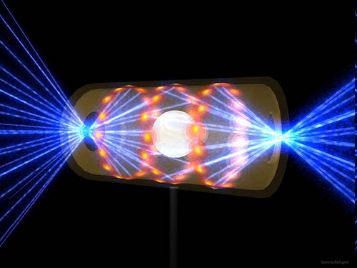
Inertial Fusion Energy: Nearing Ignition
The newly completed National Ignition Facility – the world’s most powerful laser system – recently began full operations
NIF is on track to achieve the first laboratory demonstration of “ignition” or net energy gain
Notes:
Edit down and broader context; add NIF ignition

Slide 22
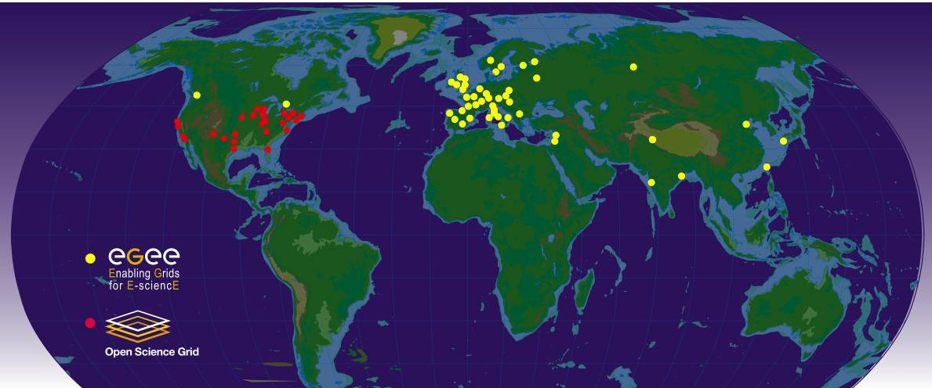
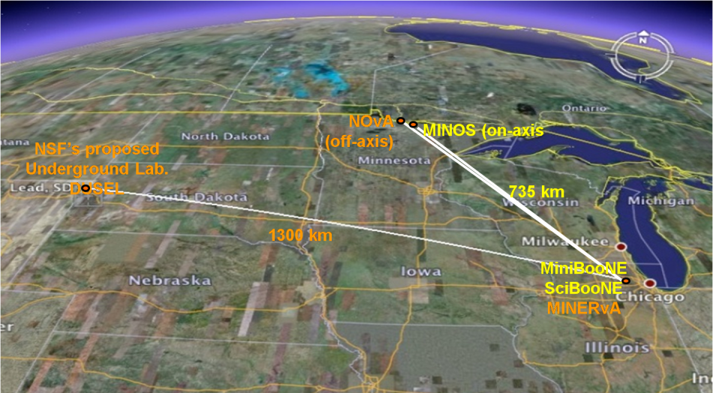
The U.S. High Energy Physics Program
The U.S. is uniquely positioned for a world-leading program in neutrino physics
The U.S. is a critical and strategic partner in global scientific collaborations that push the boundaries of High Energy Physics. The U.S. has developed components for the Large Hadron Collider at CERN and hosts centers for data analysis.
Network sites of the Open Science Grid and Enabling Grids for E-sciencE used for transmitting experimental data from the LHC to scientists worldwide.
At home, HEP builds on its investments in tools and facilities to capture the unique opportunities of neutrino science. These opportunities are fundamental to the science of particle physics.
At the heart of the DOE HEP program is the world’s most intense neutrino source at Fermilab, which serves MINERvA and MINOS and will support NOvA and the proposed LBNE (+$12,000K, HEP, initiated in FY 2011).
The NuMI beamline provides the world’s most intense neutrino beam for the MINOS experiment and proposed NOvA and LBNE experiments
Notes:
Global Map Image sources http://www.interactions.org/cms/?pid=2100&image_no=CE0227
Shows data center sites for LHC
“Google Map” showing trajectory of current and proposed neutrino beamlines from Fermilab, serving MINOS, NOVA, and LBNE

Slide 23
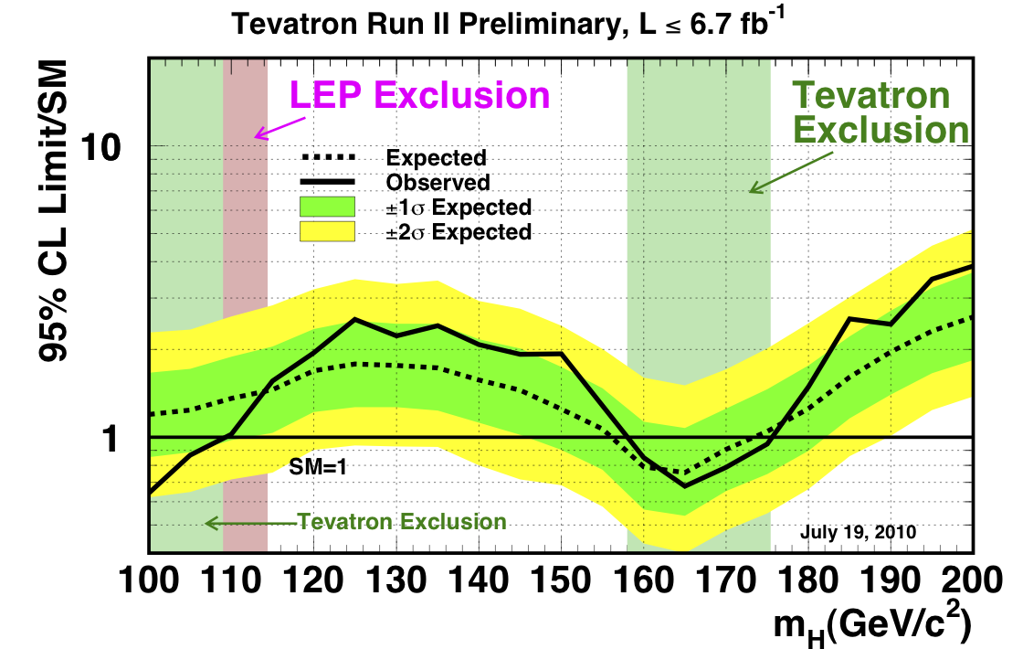
Progress Toward the Higgs Particle*
*D. Wright, LLNL, private communication
BERAC September 16, 2010

Slide 24
Accelerator Technology – Is it good enough?
Long term waste storage needs dominated by actinides
Fast Spectrum Reactors can burn actinides but require chemical processing
Accelerator Driven Systems would allow the reduction of the actinides and burning of the spent fuel without chemical processing
Question is can accelerators be built with ~50MW of power in the beam and can associated targets be constructed

Slide 25
SBIR and STTR
Continuous need for enhancing small businesses
DOE-wide SBIR and STTR programs are managed by SC
It is not a small program ~$150M/yr
Steps are being taken to strengthen program
Moved up to report to Deputy Director in SC
Enhancing office to make it more effective
Strengthening involvement of DOE executive management
http://www.science.doe.gov/sbir/

Slide 26

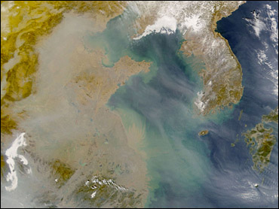
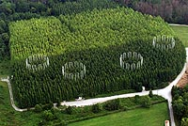
What are the major knowledge gaps in climate models?
Representation
of clouds in
climate models
Direct and indirect effects of aerosols
on climate
Interactions
of the carbon cycle
and climate
Notes:
The largest driver of uncertainty lies in how different models handle changes in the way clouds absorb or reflect radiative energy in a changing climate.
“radiative forcing,” the change in the atmosphere’s radiation balance due to alterations in the atmosphere.
The representation of aerosols in climate models is relatively crude, partly due to computational limitations and partly because there are aerosol processes we don’t understand well enough.
There are still many unknowns in the terrestrial carbon cycle; e.g., the missing carbon sink.

