Slide 1
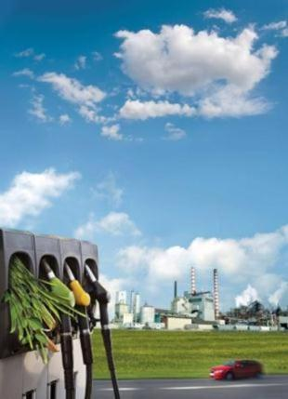


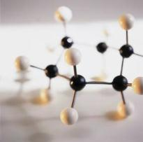
Activities in DOE’s Biomass Program
Paul F. Bryan,
Program Manager
DOE Biomass Program
Biological and Environmental Research Advisory Committee Meeting
March 9, 2011

Slide 2
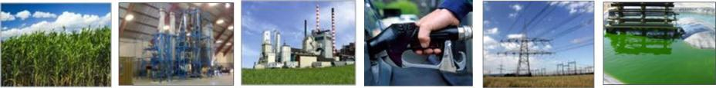
Sustainable Biofuels, Biopower,
and Bioproducts
The Biomass Program is working to advance biomass technologies in support of DOE’s mission to strengthen America’s energy security, environmental quality, and economic vitality through:
Feedstocks
Conversion technologies
Integrated biorefineries
Infrastructure
Biopower
Advanced biofuels
Developing lower cost feedstock logistics systems
Systematically validating and deploying technology at first-of-a-kind facilities
Improving conversion efficiencies and costs
Evaluating vehicle emissions, performance, and deployment options
Providing a clean,
domestic,
dispatchable
renewable
source of power
Expanding portfolio beyond cellulosic ethanol to hydrocarbon fuels
Notes:
2
For the last decade or more, U.S. national bioenergy policy has focused on the development of transportation fuels, with little attention has been given to biomass electric or thermal energy generation. I am happy to report that the political landscape is changing.
DOE Biomass Program Priorities
Developing cost-competitive, high-performance biofuels, biopower, and bioproducts by supporting research, development, and deployment projects in partnership with other government agencies, national labs, industry, and academia.
Accelerating deployment of advanced biofuels such as cellulosic ethanol and renewable gasoline, diesel, and jet fuel to facilitate meeting the nation’s Renewable Fuel Standard in order to significantly reduce greenhouse gas emissions, lower dependence on foreign oil, and encourage the development of a viable domestic bioindustry.
Promoting positive economic, social, and environmental effects and reducing the potential negative impacts of biofuels production activities.
Biofuels must eventually be affordable and profitable if they are to become truly sustainable for the long term – and thus, a major focus of our efforts has been to bring down the cost of conversion technologies.
BIOFUELS TARGETS
At a modeled cost for mature technology:
$1.76/gallon cellulosic ethanol by 2012
$2.85/gallon renewable gasoline by 2017
$2.84/gallon renewable diesel by 2017
$2.76/gallon renewable jet by 2017
Research and Development (R&D) Projects
About 100 R&D projects in feedstocks production and logistics, thermochemical and biochemical conversion technology, analysis, and sustainability. ¹
Additional new algal and advanced consortia-based R&D investments focused on renewable hydrocarbons – representing about 75 university, laboratory, and private industry partners. Hydrocarbon fuels can be transported and sold using existing infrastructure.
Integrated Biorefineries (IBR) Projects
DOE IBR investments = more than $1 billion for 27 IBRs at the pilot, demonstration, and commercial scale, of which 17 are Recovery Act-funded
Private industry cost-share investments = more than $2.5 billion
American Recovery and Reinvestment Act (ARRA) Projects
Biomass Program: $800 million appropriated²
More than 35 unique projects
At least 2,600 jobs estimated created or saved (2009 – 2014)
More than 20 recipient states
Other DOE Programs: about $130 million in 48C tax credits, SBIR/STTR, Energy Frontier Research Centers, ARPA-E, algae-related carbon capture and storage projects, and community renewable energy
Biopower: New Signature Initiative as of FY11
Story: Like cellulosic ethanol biorefinery projects, other advanced biofuel refineries can also transform local life and create new jobs, like in the town Park Falls, Wisconsin—a town with a population of less than 3,000 people. One of our partners, Flambeau, plans a biorefinery that aims to produce green diesel fuel and Fischer-Tropsch liquids. This will provide immediate employment for a two-year period, with additional longer term jobs. While still in its planning stages, the Flambeau River Papers mill project is expected to save or create up to 40 permanent new jobs as well as another 125 jobs in the regional logging and forestry industry.
Story: We’re excited about achievements made this past year in the area of fast pyrolysis. For example, DOE-funded researchers at Virginia Tech have made advancements in producing stable bio-oils that can be stored for more than six months without significant increases in viscosity—making it more suitable for processing at existing biorefineries. Steady progress might be more difficult as we near our ambitious cost-reduction targets. That’s why these final hurdles will require innovative approaches and significant investment. This is just one example; our other pyrolysis projects have also made important advancements.
Story: DOE has partnered with POET on a $200 million cost-shared commercial facility in Iowa to produce clean-burning cellulosic ethanol beginning in 2010. The company plans to turn a small-scale pilot project that currently produces around 20,000 gallons of ethanol a year into an operation capable of cranking out 25 million gallons annually. The company has been working with local farmers in Iowa to utilize innovative technology to convert waste products from the corn harvest such as corn cobs into renewable biofuels. Projects like this could help the U.S. produce billions of gallons of cellulosic biofuels over the coming decade, stimulate local economies, provide additional income for farmers, and reduce U.S. dependence on foreign oil.
U.S. Biofuel Industry Highlights
Ethanol refineries = 200³
Total U.S. ethanol production capacity = 14.5 bgy⁴
Estimated U.S. ethanol production in 2009 = 10.6 billion gallons⁵
Biodiesel refineries = 202⁶
Total biodiesel production capacity = around 3.12 billion bgy⁷
Estimated U.S. biodiesel production in 2009 = 545 million gallons⁸
¹This number excludes earmarks and international projects.
²Of these funds, $718 million were awarded to Biomass Program projects; $14.3 million to NREL to expand the integrated biorefinery research facility, and the remainder went to EERE-wide SBIR (non-Biomass) funding and departmental staffing, management, and oversight activities.
³Annual Ethanol Industry Outlook. Renewable Fuels Association, January 2010.
⁴This includes nameplate (13.03 bgy) plus planned capacity (1.43 bgy). Operating capacity is 11.88 gby. Annual Ethanol Industry Outlook. Renewable Fuels Association, January 2010.
⁵Annual Ethanol Industry Outlook. Renewable Fuels Association, January 2010.
⁶Includes producing and not producing plants. http://www.biodieselmagazine.com/plant-list.jsp
⁷This includes existing capacity (2.69 bgy) plus planned capacity (427.8 mgy). “Production Capacity.” National Biodiesel Board, June 2009.
⁸“Biodiesel Production Estimates CY2005 – current.” National Biodiesel Board.

Slide 3
Biomass Program Appropriations and Requests
}
Biopower ($21 M)
Feedstocks (6 M)
}
}
Algae ($10 M)
}
Thermochemical Conversion ($73 M)
}
Biochemical
Conversion ($44 M)

Slide 4
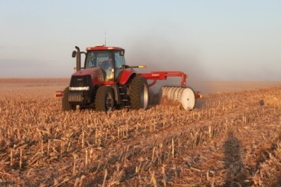
Feedstocks
(Terrestrial, Non-Algal)
Defining the Resource to Reach RFS
  “Billion Ton” Update
  Accessible via KDF
Unlocking the Resource
  Baseline productivity →Regional Feedstock Partnership trials
  Improve productivity →USDA & SC Collaboration
  Measure Sustainability →Watershed-scale assessments
  Supply a uniform, high-density, stable feedstock →INL Deployable
  Process Demonstration Unit
Future Direction
  Emphasis on Feedstock Productivity shifted to USDA, others
  Implementation of the Uniform Format Feedstock Supply Design
  Need for supportive policy – full implementation of BCAP
Notes:
4

Slide 5
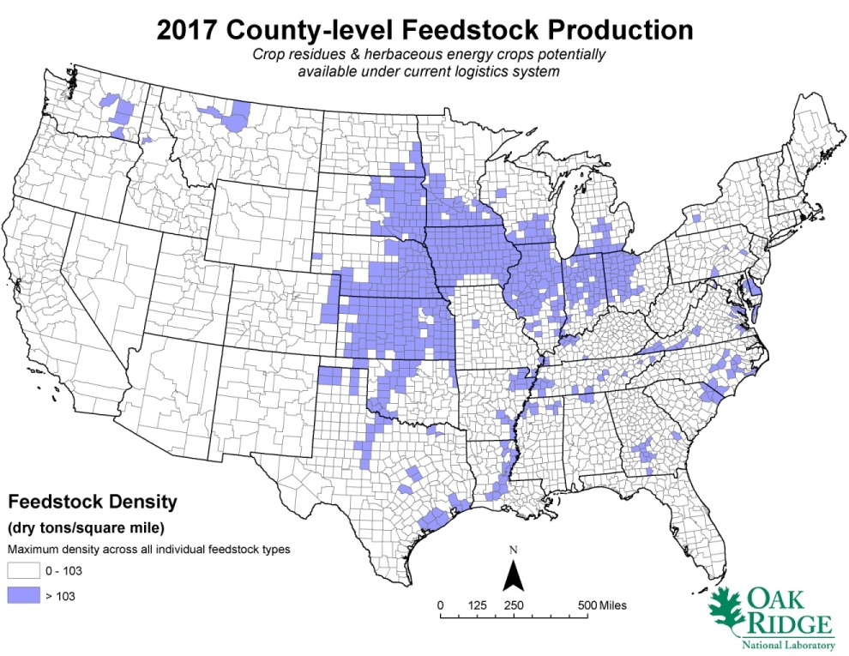
Unlocking the Resource –
An Illustrative Example
Number of counties that could potentially produce high-density biomass feedstock resources under existing production and logistics systems
Little to no improvement in feedstock yield
Existing harvesting, collection, storage, and transportation techniques
Sustainability considerations limited
Conversion specifications for feedstock not addressed
Supply risk due to price fluctuations, weather events, lack of year-round supply, etc.
Notes:
5

Slide 6
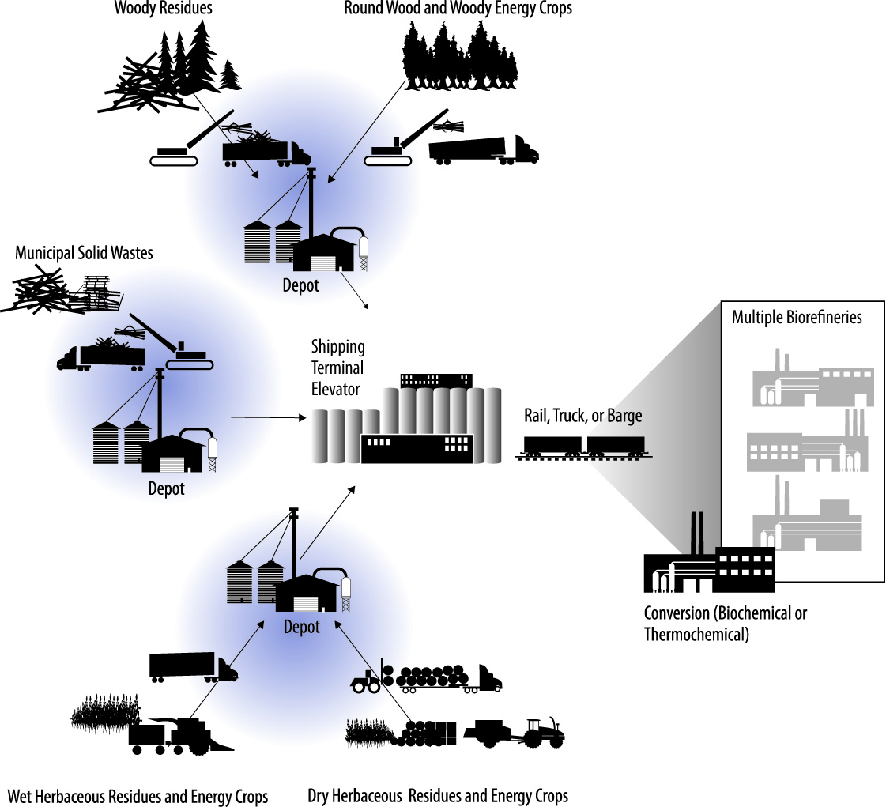
Unlocking the Resource
Feedstock resources with a depot supply system
5-20 miles
50-150 miles
150-300 miles
Notes:
By reducing the distance feedstock resources must travel (from within a 50 mile radius from farm/forest to biorefinery to within a 5 – 20 mile radius from farm/forest to depot), it becomes more economically viable to move feedstocks produced at a lower density. Feedstocks can then be combined at a depot site, densified through preprocessing operations, and transported greater distances to a shipping terminal elevator, and ultimately even greater distances to the biorefinery.
6

Slide 7
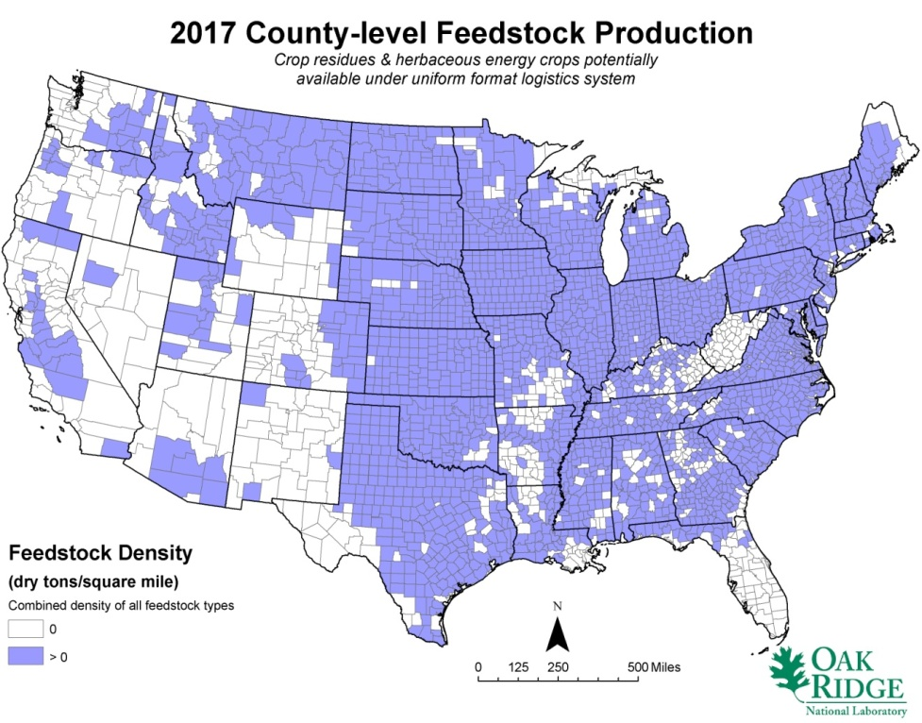
Unlocking the Resource –
An Illustrative Example
Number of counties that could potentially produce high-density biomass feedstock resources under existing production and logistics systems
Number of counties that could potentially produce high-density biomass feedstock resources under advanced production and logistics systems
Little to no improvement in feedstock yield
Existing harvesting, collection, storage, and transportation techniques
Sustainability considerations limited
Conversion specifications for feedstock not addressed
Supply risk due to price fluctuations, weather events, lack of year-round supply, etc.
Feedstock yield improved via genetics, genomics, breeding, improved production practices, etc.
Shift to a uniform-format feedstock preprocessing depot logistics supply system
Sustainability considerations expanded
Conversion specifications for feedstock addressed
Supply risk due to price fluctuations, weather events, lack of year-round supply, etc. decreased
Notes:
7

Slide 8
Exploring Multiple Routes to Biomass
Platforms
Feedstocks
Products
Cellulosic Sugar Platform
Co or By Products
Power
Enzymatic Hydrolysis
Sugars
Fermentation
Feedstock
Production
& Logistics
Pyrolysis Oil Platform
Ethanol
Butanol
Olefins
Aromatics
Gasoline
Diesel
Jet
Heat and Power
Energy crops
Waste Streams
Algae
Fast Pyrolysis
Liquid
Bio-oil
Upgrading
Syngas Platform
Gasification
Raw syngas
Filtration &
Clean-up
R E F I N I N G
Lipid (Oil) Platform
Algal and other Bio-Oils
Transesterification
Catalytic Upgrading
Research on multiple conversion pathways aims to improve the efficiency and economics of biofuels production.
Notes:
8
Biomass Conversion → Intermediate → Intermediate Process/Reaction → Products or Fuel

Slide 9
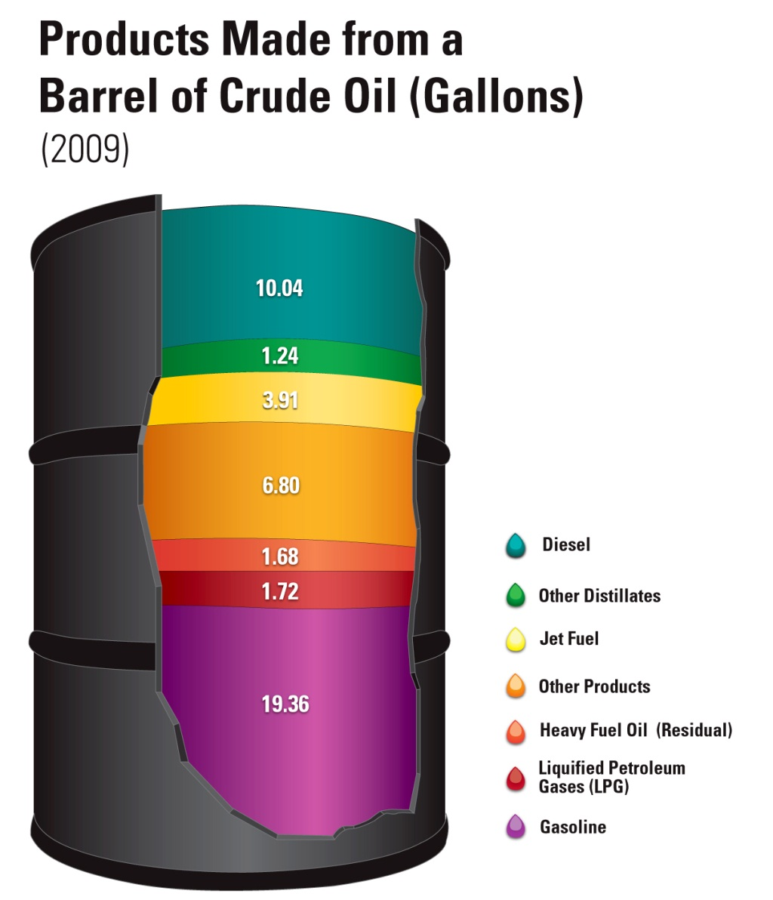
Replacing the Whole Barrel –
Ethanol, “Drop-ins,” and Market Balance
Below E10, refiners can adapt
Somewhere above E10, problems arise:
  Refiners shift gasoline to lower-value products
  Reduced crude runs reduce diesel / jet supply
  Refinery balance can be disrupted (aromatics, H2, light / heavy, heat / process integration, etc.)
Foreseeable capacity ~100% ethanol:
  Conv. RF will be ethanol (mostly corn)
  Adv. NCRF will be ethanol (mostly cane)
  Adv. CRF will initially be ethanol (cellulosic)
  Limited biodiesel & renewable diesel from veg oils and waste fats & oil
No single hydrocarbon is a panacea:
  Paraffin vs. aromatic
  Single component (volatility)
  Acceptability as “contaminant” in other fuels
  Combustion behavior
  Refinery adaptability
Source: Energy Information Administration, “Oil: Crude Oil and Petroleum Products Explained” and AEO2009, Updated February 2010, Reference Case.
Notes:
9

Slide 10
Department of Energy, Biomass Program
Integrated Biorefinery Capacity Timeline
DOE OBP has 26 IBR projects producing biofuels at various scales:
12 at pilot scale (min 1 dry tonne per day feedstock)*
8 at demonstration scale (min 50-70 dry tonnes per day feedstock)
6 at commercial scale (min 700 dry tonnes per day feedstock)
* Note, pilot projects would not sell biofuel in
commercial markets. This scale is for techno-economic validation.

Slide 11
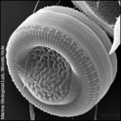

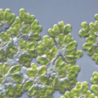
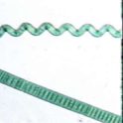
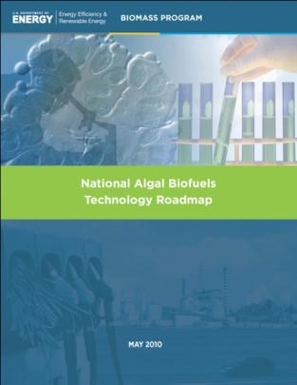
Algal Biofuels
Benefits of Algal Biofuels
• High productivity
• Minimizes competition with agriculture
• Can use waste and salt water
• Recycles carbon dioxide
• Integrated production of fuels and co-products
© MBL, Woods Hole
© NIES Japan
© U. Wisconsin
http://seaweed.ucg.ie
Challenges to commercializing Algal Biofuels
• Affordable and scalable algal biomass production
  • Feedstock production & crop protection
  • Energy efficient harvesting and drying
  • Extraction, conversion, and product purification
  • Siting and sustainability of resources
Notes:
The Biomass Program has initiated a comprehensive (across the supply chain from feedstock development to fuel testing) and strategic (closely integrated with existing activities and proactively addressing sustainability issues) investment in algal biofuels.
The National Algal Biofuels Technology Roadmap, released on June 28, 2010, identifies many of the key challenges and opportunity areas to commercializing algal biofuel technologies, and serves as a basis for R&D activities being pursued by the Program. These R&D thrust areas include:
1. Improving Productivity.
Quickly isolate and identify more productive strains (cell sorters, imaging using live-dyes)
Genetic engineering or breeding for beneficial traits (faster growth, more lipids, strain robustness to temperature, pH)
Enhanced crop protection (new biocides, pesticides and herbicides, manipulate culture conditions to selectively grow strain of choice, real-time pond monitoring and detection of pests and pathogens)
2. Decreasing Process Costs.
New harvesting/dewatering methods (new membrane technology, flocculation technology, acoustic focusing technology, promote high culture densities)
Efficient extraction/separation methods (microwaves, ionic liquids, supercritical processing, nanotechnologies)
Better conversion methods (hydrothermal liquefaction to deal with wet biomass, continuous production and secretion of oils and hydrocarbons)
11

Slide 12
Relationships Between Science and Technology in DOE
Office of Science (BER, BES)
Technology Offices (EERE, NE, FE, TD, EM, RW)
Discovery
Research
Applied Research
Technology Maturation & Deployment
Basic
Research
Basic research for fundamental new understanding, the grand science challenges
Development of new tools, techniques, and facilities, including those for advanced modeling and computation
Basic research for new understanding specifically to overcome short-term showstoppers on real-world materials in the DOE technology programs
Research with the goal of meeting technical targets, with emphasis on the development, performance, cost reduction, and durability of materials and components or on efficient processes
Proof of technology concept
Cost reduction
Scale-up research
Prototyping
Manufacturing R&D
Deployment support
Notes:
Adapted from Mark Downing, ORNL (http://www.wvcommerce.org/app_media/assets/pdf/energy/biofuels/Downing.pdf), which was adapted from an original by Patricia M. Dehmer, DOE Office of Basic Energy Sciences

Slide 13
Example: Lignocellulosic Conversion to Ethanol
Biological and Environmental Research
Energy Efficiency & Renewable Energy
Discovery Research
Basic
Research
Applied
Research
Technology Maturation & Deployment
Genomics
Transcriptomics
Proteomics
Interactomics
Metabolomics
Advanced computing
Broadened planting ranges for energy crops
Increases in yield per unit area
Decreased costs in dollars per unit area
Increased liquid fuels yield per unit of biomass
Technology Milestones:
Enzymatic fermentation
Gas/liquid fermentation
Acid hydrolysis
fermentation
Gasification
Pyrolysis
Combustion
Cofiring
Planning
Execution
Reviews and reporting
Validation
Analysis
Infrastructure
Market Development
Communication, education, and outreach
Notes:
Adapted from Mark Downing, ORNL (http://www.wvcommerce.org/app_media/assets/pdf/energy/biofuels/Downing.pdf), which was adapted from an original by Patricia M. Dehmer, DOE Office of Basic Energy Sciences

Slide 14
Cooperation and Joint Planning
  Regular coordination and participation in strategic planning
    Solicitations
    Joint Road Mapping—2005 DOE Biomass to Biofuels workshop
    Observers at Bioenergy Research Center annual reviews, biennial Biomass Program Peer Review, other reviews/selections
    Joint program and investigator meetings
      Biomass Program annual conferences
      Genomic Science (GTL) PI meetings
  Coordinate on projects funded through American Recovery and Reinvestment Act
    LBNL Process Demonstration Unit
    Sustainability activities
Notes:
BACK UP FOR COORDINATION/STRATEGIC PLANNING
Both quarterly, Board-related, and ad hoc coordination
Examples:
Interagency Metabolic Engineering Working Group
(5 joint solicitations)
JGI genome target selections
(Which Bugs and Community Sequencing Program)
Board Working Groups
BACK UP FOR BRC reviews
2007 Bioenergy Research Center (BRC) merit review panel
2007 BRC Lehman review
2007 and 2009 Biomass Program Peer Reviews
Initially “which bugs” meetings and now JGI Community Sequencing Program--selects plant and microbial sequencing targets supporting DOE's bioenergy mission
Next-generation biomass feedstocks
Deconstruction of plant biomass
Microbial conversion of lignocellulosic material to ethanol or other biofuels
Since 1999, OBP program staff have participated as observers or reviewers, ensuring mission coordination
B2B: Identify resources in Office of Biological and Environmental Research genomics research program relevant to goals in EERE Office of Biomass Program replacement of petroleum-derived transportation fuels.
Define common sets of science and technology opportunities and barriers.
Program Peer Reviews: External, independent review of OBP research portfolio and strategic direction, BER participated as observers or speakers
The Biomass Program hosted Biomass 2010 on March 30 and 31, 2010, in Arlington, Virginia to provide a high-level forum to better understand the set of challenges along the path to clean, renewable energy from biomass resources. BER helped organize and co-chair a session

Slide 15
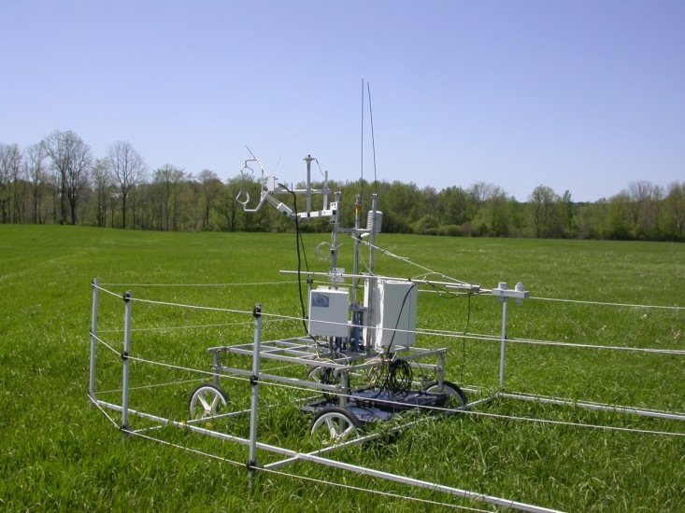

Great Lakes Bioenergy Research Center
DOE-OBP is leveraging existing GLBRC sustainability efforts through authorization via ARRA funding
  Novel production systems for perennial, native grassland systems, and integrated systems
  Biogeochemical, biodiversity, and socioeconomic responses to expansion and intensification of agriculture and silvicultural practices
  Empirical measurements of CO₂ release and gain from land use change and bioenergy production
  Spatially explicit land-use change forecast on crop area changes

Slide 16
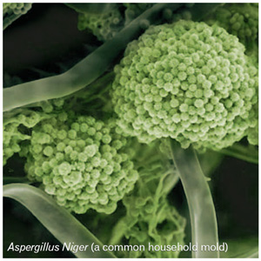
Fungal Genomics
  PNNL is working to better understand bioprocesses involved in biofuel, enzyme and chemical production
    Fungal Genomics
      Translating scientific knowledge into practice to accelerate fungal bioprocess and strain development
      Successfully collaborated with JGI and sequenced Aspergillus terreus ESTs from three key itaconic acid bioprocess stages (pre-production, production initiation, post initiation)
      Mapped the itaconic acid biosynthetic pathway to a gene cluster in the Aspergillus terreus genome
Notes:
Fungal Genomics. Use genomics information to better understand hyperproductivity in industrial organisms.
Rationale
*Fungi are the primary source of most enzymes involved in industrial biomass degradation and they are the cell factories that produce them
*Increased production host enzyme output leads to decreased cost of enzymes
*Fungi are the primary source of most enzymes involved in industrial biomass degradation and they are the cell factories that produce them
Future Work
[1] Identification of individual genes important for improving and lowering cost of enzyme production
[2] Express biosynthetic pathways in platform organism (Aspergillus niger) for production of hydrocarbon biofuels
[3] Develop foundational understanding of pentose utilization and carbon flow to enable increased carbon efficiency for hydrocarbon biofuel production
Image - PNNL: Scott Baker, Ph.D.; 2011 BC Peer Review

Slide 17
Clean Energy Initiative
Innovative biofabrication effort to standardize and scale up the fabrication of fundamental biological components
  Allows for rapid prototyping and testing for new approaches to synthesizing biofuels
  Will help America capture world leadership in the emerging field of biomanufacturing – through establishing this capability domestically
Possible Spending Plan | FY 2012
Energy Efficiency and Renewable Energy | $15M
Office of Science | $60M

Slide 18
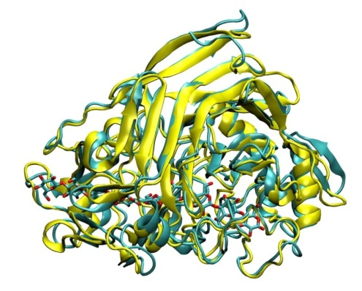
Protein and Cell Wall Characterization
  NREL is providing enzyme saccharification and pretreatment fundamentals required to increase xylan and glucan conversion performance
    Chemical Process Fundamentals
      Define cellulase interactions at the plant cell wall important for efficient hydrolysis
      Determine how pretreatment affects major plant cell wall features and their affect on cellulase activity
    Biological Process Fundamentals
      Determine how enzyme performance can be improved by modifying linker peptides
    Advanced Cell Wall Characterization
      Developing new methods for biomass characterization
      Imaging molecular structure of plant cell wall and single molecules (enzymes & domains)
Projects interface with EFRC-C3Bio, BRC-BESC, BRC-JBEI, and BRC-GLBRC
T. reesei xtal structure
P. funiculosum homology model
Notes:
Chemical Process Fundamentals (CPF). Develop sufficient understanding of key barrier related processing challenges to enable the reduction of pretreatment severity as well as maximization of xylose yields (e.g., > 90%).
Rationale
*Determine influence of particle size on the digestibility of dilute acid pretreated corn stover at different xylan removal levels.
*Determine effect of deacetylation on xylan hydrolysis kinetics.
*Improve understanding of competing of xylose dehydration and reversion pathways
Biological Process Fundamentals (BPF). A) To enable industry to achieve a 2x reduction (~$0.10/gallon ethanol) in enzyme cost and 90% glucose yield. B) To determine if non cellulase enzymes, such as xylanases, can be used to improve xylose yields and reduce costs associated pretreatment.
Advanced Cell Wall Characterization (ACWC). To acquire knowledge about the structure and chemistry of the energy plant cell wall that helps us overcome biomass recalcitrance. The considerable improvements in optimizing pretreatment conditions and enzyme performance must be achieved in the context of understanding the cell wall.
Rationale
*Mapping structural changes during pretreatments
*New labeling techniques for cellulases acting on cell wall
*Generating hypotheses for testing
* What do cellulose microfibrils really look like?
*Define the relationships between lignin redistribution and pretreatment
Image - NREL: Mike Himmel, Ph.D; 2011 BC Peer Review

