Slide 1
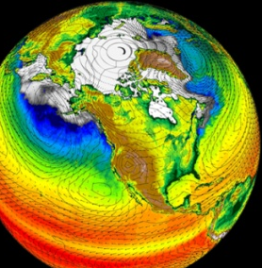
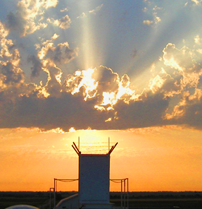
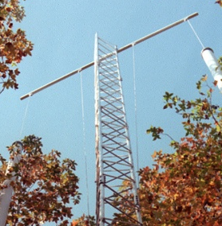
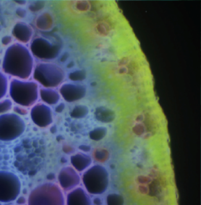
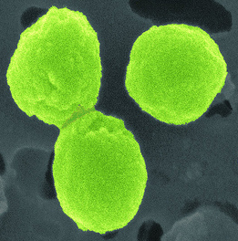

BERAC Meeting
Climate and Environmental Sciences Division Update
Gary Geernaert, Ph.D.
Director
Climate and Environmental Sciences Division
September 16, 2010
Office
of Science
Office
of Science
Office of Biological
and Environmental Research
Office of Biological
and Environmental Research

Slide 2
Outline
Philosophy and assimilation
Division updates
  Staffing
  Science
  Solicitations
  Strategy
Other
2 BERAC Sep 2010
Department of Energy • Office of Science • Biological and Environmental Research

Slide 3
Philosophy
Tenets
  Science centric: Evolutionary and revolutionary
  Science that matters
  Mission relevant, DOE unique
  Efficient steward of taxpayer investment
3 BERAC Sep 2010
Department of Energy • Office of Science • Biological and Environmental Research

Slide 4
Philosophy
Management/leadership priorities
  Shared vision
  CESD (and staff) prominence
  The “one culture” paradigm
  Strong multi-program teams
  Creating true multidisciplinary programs
  Creating BER-wide collaboration
4 BERAC Sep 2010
Department of Energy • Office of Science • Biological and Environmental Research

Slide 5
Assimilation
DOE culture
CESD and BER people
Collaborations with other agencies
USGCRP and OMB
Lab visits and reviews
5 BERAC Sep 2010
Department of Energy • Office of Science • Biological and Environmental Research

Slide 6
Science updates
Atmospheric science
ARM Climate Research Facility
Terrestrial ecosystems
Subsurface
EMSL
Climate modeling
Integrated Assessment
6 BERAC Sep 2010
Department of Energy • Office of Science • Biological and Environmental Research

Slide 7
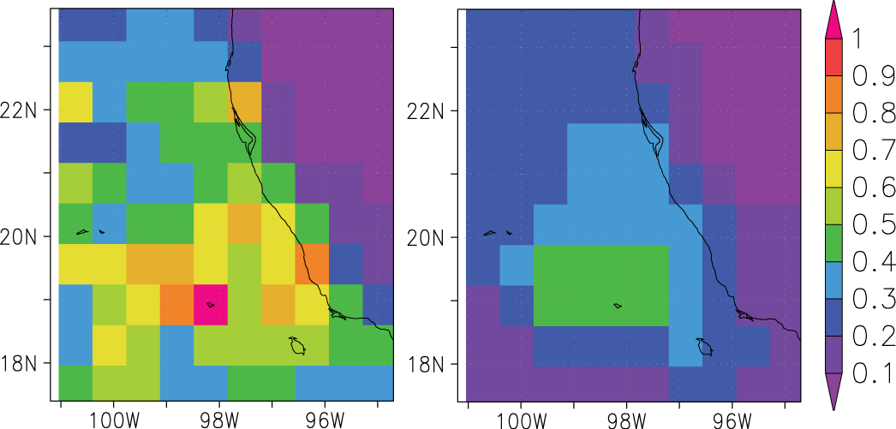

Atmospheric System Research
Improving Aerosols in GCMs
Existing GCMs ignore aerosol sub-grid variability (SGV) at local scales
Insights will drive improvements of aerosol-climate interactions in GCMs
Using the MILAGRO field campaign from March 2006 as a case study
SGV: Black Carbon (Primary)
SGV: SO₄+NH₄+NO₃ (Secondary)
Findings
SGV large for primary aerosols and strongly driven by emission SGV
Formation processes of secondary aerosols reduce their SGV but it is not negligible
Gulf of Mexico
SGV defined as standard dev. of a 3-km simulation within a GCM cell divided by the mean
75x75 km²
Mexico City
Qian, Y., W. I. Gustafson, and J. D. Fast, 2010: An investigation of the sub-grid variability of trace gases and aerosols for global climate modeling. Atmos. Chem. Phys., 10, 6917-6946, doi:10.5194/acp-10-6917-2010.
7 BERAC Sep 2010
Department of Energy • Office of Science • Biological and Environmental Research
Notes:
Yun Qian, William I. Gustafson Jr., & Jerome D. Fast
Atmospheric Sciences & Global Change Division, PNNL
Primary aerosols (Black Carbon) (left panel) shows greater spatial variability while secondary aerosols (e.g., sulphate) (Right Panel) shows weak variability. This information will help developing empirical formulations for each type of aerosol so that spatial heterogeneity can be included in GCM simulations for realistic representation of aerosol effects on climate. In otherwords, these secondary aerosols seem to be well represented in GCMs while primary aerosols are not.

Slide 8

ARM Climate Research Facility – SPARTICUS results
Preliminary Findings:
Extinction measured by Raman Lidar is in broad agreement with extinction derived from aircraft probe data with shattered particles removed.
If shattered particles were NOT removed, in situ extinction would be about a factor 5 higher.
A First: Direct comparisons of extinction remotely sensed and directly measured in cirrus
SPEC Learjet
Goal: determine in-situ size and number of ice crystals in cirrus
Data: Small Particles In Cirrus (SPARTICUS) field campaign at
Where: ARM SGP
When: Nov 2009 - Mar 2010
8 BERAC Sep 2010
Department of Energy • Office of Science • Biological and Environmental Research
8 BER BSSD
Department of Energy • Office of Science • Biological and Environmental Research
8 BER BSSD
Department of Energy • Office of Science • Biological and Environmental Research
Notes:
Jay Mace is PI
The approximately150 hours of concurrent data on cirrus clouds used a broad array of both ground-based and aerial measurements.

Slide 9
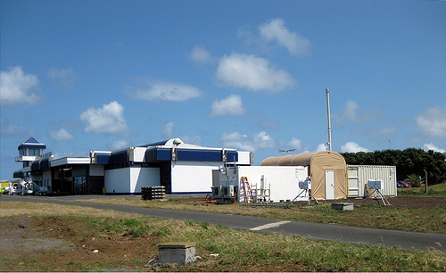
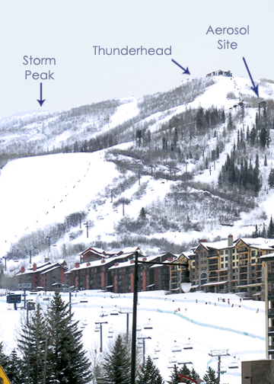
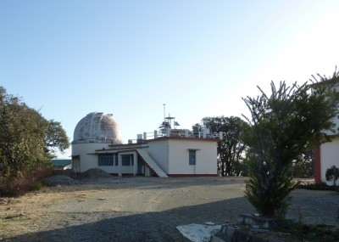
ARM Climate Research Facility
First mobile facility
  in the Azores to study marine clouds
  April 2011 deployment to India to study monsoon/aerosols
Second mobile facility
  will begin inaugural deployment at Storm Peak, CO (Nov. –March).
October 2011 to Maldives: aerosol impacts on monsoon. DYNAMO/CINDY
9 BERAC Sep 2010
Department of Energy • Office of Science • Biological and Environmental Research
9 BER BSSD
Department of Energy • Office of Science • Biological and Environmental Research
9 BER BSSD
Department of Energy • Office of Science • Biological and Environmental Research
Notes:
Azores mobile facility at airport
Jay Mace, BERAC member is the PI of Storm Peak
Nainital location for AMF in India

Slide 10
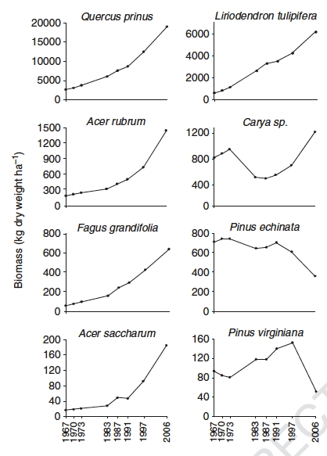
Terrestrial Ecosystem Science
Clarifies Climate Sensitivity of Eastern Forests
40-year record of tree diameter growth and survival (1967 through 2006) were used to evaluate the importance of species, succession, and climate on forest composition and biomass accumulation.
Demonstrating that direct effects on eastern hardwood forest biomass accumulation and composition attributable to current climate variability were small in comparison to changes resulting from natural succession or insect outbreaks.
Kardol P, Todd DE Jr., Hanson PJ, Mulholland PJ (2010) Long-term successional forest dynamics: species and community responses to climatic variability. Journal of Vegetation Science 21:627-642.
10 BERAC Sep 2010
Department of Energy • Office of Science • Biological and Environmental Research
Notes:
Annual variation in summer temperatures and drought impacted biomass accumulation of some species.
All forest stands accumulated biomass throughout the 40-year observation period, but drought years reduced the rate of accumulation during some measurement intervals
Question: Are trees sensitive to climatic variability, and do tree species differ in their responses to climatic variability? Does sensitivity of forest communities to climatic variability depend on stand composition?
Location: Mixed young forest at Walker Branch Watershed near Oak Ridge, East Tennessee, USA.
Methods: Using a long-term dataset (1967–2006), we analyzed temporal forest dynamics at the tree and species level, and community dynamics for forest stands that differed in initial species composition (i.e., chestnut oak, oak–hickory, pine, and yellow poplar stands). Using summer drought and growing season temperature as defined climate drivers, we evaluated relationships between forest dynamics and climate across levels of organization.
Results: Over the four-decade study period, forest communities underwent successional change and
substantially increased in biomass. Variation in summer drought and growing season temperature contributed to temporal biomass dynamics for some tree species, but not for others. Stand-level responses to climatic variability were related to the responses of component species, except in pine stands. Pinus echinata, the dominant species in pine stands, decreased over time due to periodic outbreaks of pine bark beetle (Dendroctonus frontalis). These outbreaks at Walker Branch could not be directly related to climatic conditions.
Conclusions: The results indicate that sensitivity of developing forests to climatic variability is stand
type-dependent, and hence is a function of species composition. However, in the long term, direct
effects of climatic variability on forest dynamics may be small relative to autogenic successional processes or climate-related insect outbreaks. Empirical studies testing for interactions between forest succession and climatic variability are needed.

Slide 11
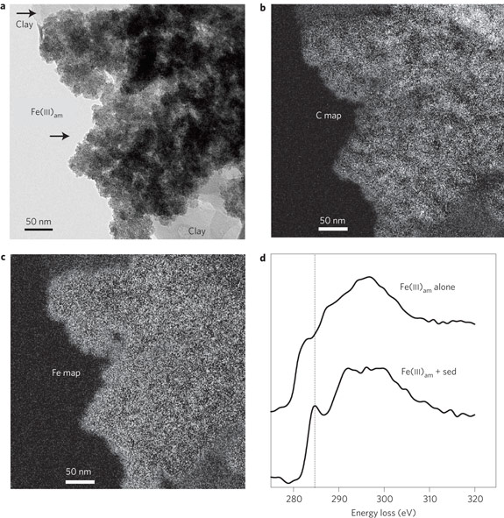
Subsurface Biogeochemical Research
Objective
Identify solid phase humic materials as electron acceptors for anaerobic microbial metabolism.
Approach
Humic particulates from wetland sediments were examined for evidence of microbial reduction.
Electron spin resonance studies indicated quinone moieties in the solid-phase humic materials were being reduced, as previously shown for soluble humic substances.
Reduced particulate humics transfer electrons to Fe(III)oxide minerals.
Impact
New form of microbial electron acceptor and “electron shuttling” mechanism.
Increased insight into the interplay between microorganisms, NOM and soil minerals.
A potential component of recently proposed microbial “electrical networks” in soils and sediments.
Roden et. al. (2010) Extracellular electron transfer through microbial reduction of solid-phase humic substances. Nature Geoscience, 3:417-421
11 BERAC Sep 2010
Department of Energy • Office of Science • Biological and Environmental Research
11 BER Overview
Department of Energy • Office of Science • Biological and Environmental Research
Notes:
An examination of humics materials as electron acceptors in anaerobic environments. This work published in Nature Geoscience this year represents a new form of microbial metabolism that may play a role in Fe cycling in soils and sediments and may also play a role in hypothesized microbial “electrical networks” in sediments. The work is important because iron mineral cycling has implications for contaminant transport processes in subsurface and hyporheic zones sediments.

Slide 12

Environmental Molecular Sciences Laboratory Scientists Discover Reactions that Create Climate-Changing Brown Carbon Aerosol
Objective
Examine processes governing brown carbon formation using desorption electrospray ionization mass spectrometry (DESI-MS)
Approach and Findings
Created “white” limonene/O3 secondary organic aerosol particles, deposited them on substrates, and exposed them to atmospherically-relevant concentrations of ammonia.
Gradual browning of particles and significant formation of nitrogen-containing molecules that absorbed visible light.
Understanding processes that lead to brown carbon formation are important for accurate climate model parameters.
Laskin et al. (2010) High-resolution Desorption Electrospray Ionization Mass Spectrometry for chemical Characterization of Organic Aerosols. Analytical Chemistry 82(5) 2048-2058.
12 BERAC Sep 2010
Department of Energy • Office of Science • Biological and Environmental Research

Slide 13
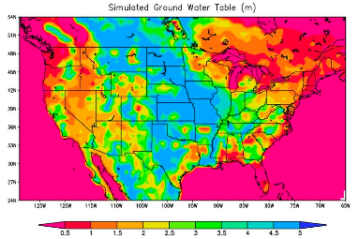
Regional and Global Climate Modeling
Objective
To examine how climate, soil, and vegetation control groundwater table and its feedbacks to climate
The groundwater table depth simulated by the coupled land-atmosphere model for North America. Although precipitation has a dominant influence on groundwater table depth, soil and vegetation also have important effects leading to regional differences in the groundwater table depth.
Approach
Developed a coupled land-atmosphere model that includes groundwater table dynamics for climate simulations
Evaluated the simulations using observation data
Analyzed how climate, soil, and vegetation control groundwater table dynamics
Impact
This study suggests that climate change, land use change, and groundwater withdrawal can affect regional precipitation through changes in groundwater table depth that provide feedback to the atmosphere
Leung, L.R., M. Huang, Y. Qian, and X. Liang, 2010: Climate-soil-vegetation control on groundwater table dynamics and its feedbacks in a climate model. Clim. Dyn., DOI 10.1007/s00382-010-0746-x.
13 BERAC Sep 2010
Department of Energy • Office of Science • Biological and Environmental Research
Notes:
Reported in BER/ASCR workshop report. Workshop led by Warren Washington and organized by Anjuli Bamzai and Lali Chatterjee
Multi-lab effort led by LLNL
The position of a self-generated Category 4 tropical cyclone over seven days from the Ultra-High Resolution CCSM Simulation (UHRCCS Team, 2009). The model uses 0.25-degree grid spacing for the atmosphere and 0.1- degree grid spacing for the ocean. The colors show sea-surface temperatures and the contour lines display surface pressure. At this resolution, the phenomenon of cold water upwelling produced by the storm's winds can be realistically simulated, and appears as a cold water "wake" behind the storm track.
The ability of climate models to simulate tropical cyclones and their climatic effects have been limited by the coarse resolution in climate models. Recent advances in horizontal resolution enabled by increases in computing resources permit some models to generate tropical cyclone events. Figure 9 shows a Category 4 Pacific storm simulated in the prototype CCSM4 high resolution coupled simulation
Uses a developmental version 4 of CCSM, and its components: the latest versions of the LANL Parallel Ocean Program (POP), and sea ice (CICE) codes and the NCAR Community Atmosphere Model (CAM), and Community Land Model (CLM), with improved physical parameterizations and computational enhancements
Ran on Atlas – 9000 processor, 44 tflop parallel computer at LLNL
Established the skill of a coupled land-atmosphere model to simulate groundwater table fluctuations
Demonstrated how groundwater table dynamics can influence regional climate

Slide 14
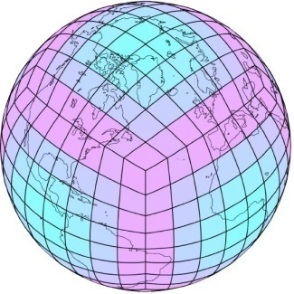
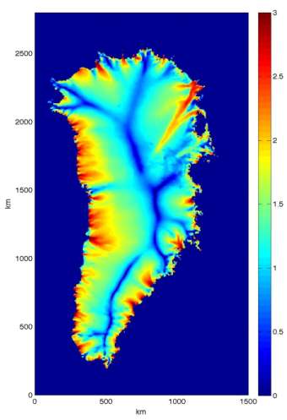
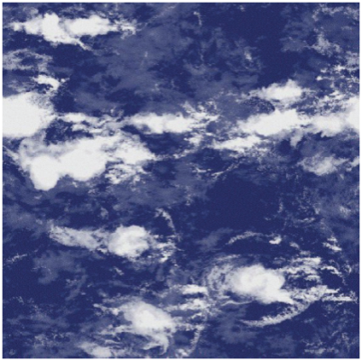
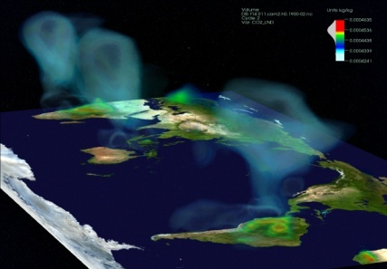
DOE funded scientists make extensive contributions to the New Version of the Community Earth System Model
DOE funded scientists from the Climate and Earth System Modeling, Atmospheric System Research and Terrestrial Ecosystem Science programs developed several improved components of the recently released CESM. These include a new sea ice sub-model, a land-ice model, several physical formulation improvements to the global ocean sub-model, a new chemistry model, a new radiation package, a new aerosol sub-model, two new cloud schemes for more accurate representation of near-surface layered clouds, and the community land model.
14 BERAC Sep 2010
Department of Energy • Office of Science • Biological and Environmental Research
Notes:
Objective
To develop, test, and exploit a first generation of Earth system model that will run efficiently on thousands of processors and include significant model enhancements
The new model’s advanced capabilities will help scientists shed light on some of the critical mysteries of global warming.
, including:
The impact warming temperatures have on the massive ice sheets in Greenland and Antarctica?
How will patterns in the ocean and atmosphere affect regional climate in coming decades?
How will climate change influence the severity and frequency of tropical cyclones, including hurricanes?

Slide 15
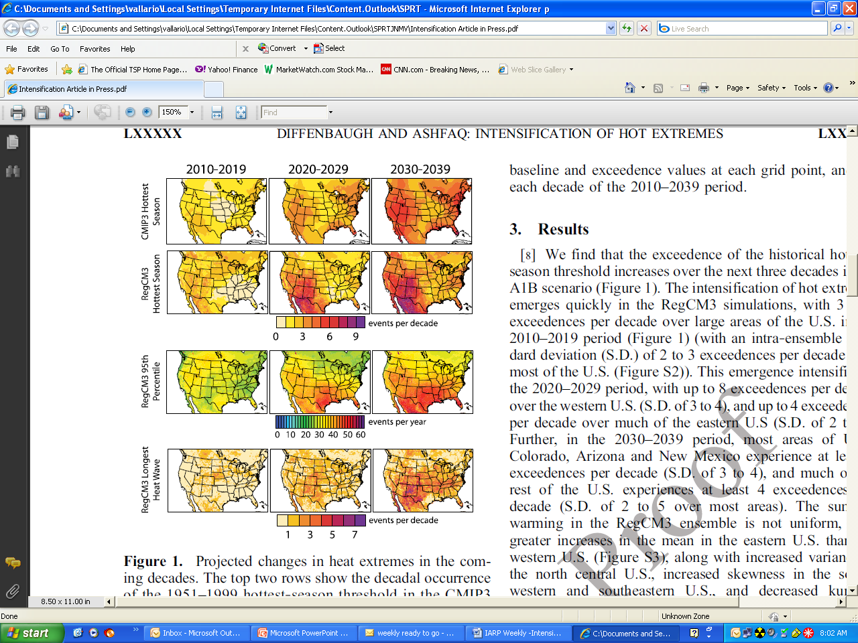
Integrated Assessment
Intensification of Hot Extremes Projected in U.S. that with projected future distributions of greenhouse gasses, substantial intensification of hot extremes could occur within the next 3 decades even at a 2 degree C global warming target.
By 2030, as many as nine occurrences of the highest seasonal temperature and seven longest heat waves compared to records of the second half of the 20th century.
  Diffenbaugh, et al, 2010: Geophysical Research Letters
15 BERAC Sep 2010
Department of Energy • Office of Science • Biological and Environmental Research
Notes:
Picked up by AP, Washington Post, Chicago Tribute, LA Times and featured in NY Times and NPRs On Point show.

Slide 16
Summary
Developing shared vision with science community, CESD staff, and BERAC
Broad program excellence
Multi-disciplinarity
Partnering across SC, DOE, and other agencies
16 BERAC Sep 2010
Department of Energy • Office of Science • Biological and Environmental Research

Slide 17
Thank you!
17 BERAC Sep 2010
Department of Energy • Office of Science • Biological and Environmental Research

