Slide 1
Climate Research Roadmapping Workshop
Mike Kuperberg
Presentation to BERAC
September 17, 2010

Slide 2

BER Climate Change Research:
The Energy-Climate Nexus
Greenhouse gases are emitted during energy production…
and
Climate change will impact energy production.
Understand the effects of GHG emissions on Earth’s climate and the biosphere
Provide foundational science to support effective energy and environmental decision making

Slide 3
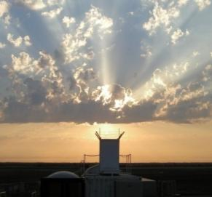
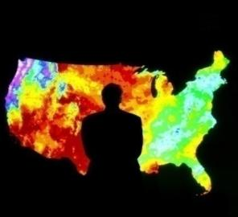
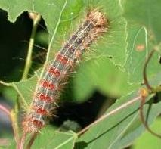
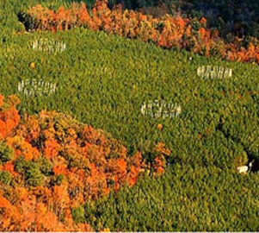
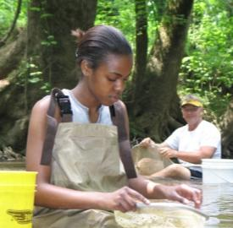
BER Climate Change Research
Strategic themes
Atmospheric System Research
Environmental System Science (Terrestrial Ecosystems)
Climate and Earth System Modeling
ARM Climate Research Facility

Slide 4
BER addresses key uncertainties in climate models:
Process Research
Clouds
Aerosols
Carbon cycle
Climate Modeling
Earth System
Regional/Global
Integrated Assessment
How can we better integrate process research and climate models?

Slide 5
May 2010 Climate Research Roadmapping Workshop
Objectives
  Create a forum for discussion of scientific opportunities and knowledge gaps
  Provide input in the framework of near, mid term, and long term goals (logic model approach) for next ten years
  Identify new approaches for integration of climate science and encourage a wide range of ideas!
Process:
  Led by the steering committee, develop white papers and blogs to spark discussion and promote debate
  Focus on areas of unique DOE strengths in atmospheric sciences, terrestrial ecosystems, climate modeling, and on latitudinal challenges

Slide 6
Steering committee members and program staff
Tony Janetos (PNNL), Ricky Rood (U Michigan), Peter Thornton (ORNL), Dave Turner (U Wisconsin-Madison)
Jerry Melillo (MBL) (keynote presentation)
Jeff Amthor, Wanda Ferrell, Joe Graber, Renu Joseph, Mike Kuperberg, Ashley Williamson
Over 50 participants, diverse scientific and institutional backgrounds

Slide 7
Outcomes
Following the workshop, BER staff compiled material from:
  Discussion papers
  Presentations
  Extensive notes
Compiled into the Workshop report (pre-print copies in BERAC handouts)
Hard copies to be available soon and electronic version will be posted on the BER website
BER identified seven overarching findings from the workshop

Slide 8
Overarching Findings (1)
Build upon BER Strengths in Integrated, Model-Inspired Science to Understand Complex Earth Systems
  Coupled Earth systems are among the most complex of systems
  Understanding complex systems requires a systems approach and closely integrated, multidisciplinary research
  Sensitivities identified by modeling results should be addressed by subsequent research
  Systems research results should be well suited to informing coupled models
  Current limitations in the ability of models to extrapolate understanding across spatial and temporal scales
  BER’s strengths are well suited to the above science needs

Slide 9
Overarching Findings (2)
Foster Balanced Program of Discovery and Use-Inspired Research
  The breadth of discovery to use-inspired science is quite wide in climate change research
  Discovery science involves long-term investments ranging from atmospheric science to soil biogeochemistry
  Use-inspired science is often driven by shorter-term needs where advances in discovery science inform decision makers
  While BER emphasizes discover science, there is a need to maintain balance between these two aspects of the program

Slide 10
Overarching Findings (3)
Develop and Support Targeted Scientific Research Campaigns
  Focus on tractable challenges
  Nature of the challenge could range from single disciplines to the representation of complex systems and challenges within climate models
  BER history is rich with such approaches (Intensive Operational Periods-IOPs, Free-Air CO2 Enrichment FACE experiments, tropical precipitation)
  Identify the challenge and focus the necessary resources and science to resolve the issue.

Slide 11
Overarching Findings (4)
Understand and Quantify Uncertainty in Climate Projections
  Lack of uncertainty quantification limits our ability to interpret climate projections
  Uncertainty quantification will improve model-process research and will inform decision making
  Three types of model uncertainty
    Internal – stochastic variability within a model
    Intermodel – resulting from ensemble runs
    Model-observations – where model projections diverge from recorded observations
  Challenging models with observations will require coordination between the modeling and process science communities

Slide 12
Overarching Findings (5)
Understand Sign (+ or –) of the Carbon Feedback and How It Changes over Time
  The feedback of ecosystems to a changing climate is represented in earth system models with extreme variability
  This is the result of a lack of understanding of these processes and their interactions with climate change
  DOE’s history in both carbon cycle science and earth system modeling is well positioned to resolve this challenge
  Need to couple process research with model development and evaluation

Slide 13
Overarching Findings (6)
Understand Role of Natural and Anthropogenic Disturbances in Earth Systems and Incorporate Information into Model Projections
  Disturbance can be the driving factor in the balance of Earth systems – often dominating long-term trends
  Disturbance can be both natural and anthropogenic
  Disturbance is neither well understood nor well incorporated in Earth system models
  Need to get disturbance incorporated appropriately into models
  Requires BER’s unique experience with process science and model development

Slide 14
Overarching Findings (7)
Understand and Incorporate the Complete Water Cycle into Regional, Climate, Earth System, and Integrated Assessment Models
  Water is the integrating factor with respect to Earth’s complex systems
  Precipitation, soil moisture, surface and subsurface water movement are critical to Earth systems
  The complete water cycle needs to be incorporated into all scales of models
  Global models are beginning to represent large scale water processes, but regional scale processes are difficult
  Water was recognized as an underappreciated aspect for the climate community

Slide 15
Next steps:
The Report on the Climate Research Roadmap Workshop provides vital input from the scientific community on key knowledge gaps, important scientific opportunities, and new science integration ideas.
The Climate and Environmental Sciences Division will use the findings from the Roadmap Workshop—along with other input from the scientific community*— to update its ten year Strategic Plan from 2008.
The Climate report will be posted electronically and available in hard copy.
*BERAC reports, National Academy, USGRCP, others

