Slide 1
The State of BER
BERAC Meeting
Sept. 1, 2009
Anna Palmisano, Ph.D.
Associate Director of Science
Biological and Environmental Research

Slide 2
Outline
Strategic Vision and FY 10 Budget Highlights
ARRA Update
Early Career Awards
Interagency Interactions
Strategic Planning Update
Personnel Changes in BER
BER Retreat
Looking Ahead…

Slide 3
BER Strategic Directions- 2010 & Beyond
Science for Discovery:
Understanding complex biological, climatic, and environmental systems across vast spatial and temporal scales
Revolutionize bioenergy production through transformational discoveries in biology
Integration of climate theory, observation, experiment & modeling
New capabilities for analyzing / managing data to predict & engineer biological systems
Environmental sustainability & stewardship from predictive understanding across scales
Notes:
3

Slide 4
BER Strategic Directions- 2010 & Beyond
National Scientific User Facilities – the 21st Century Tools of Science
New user resources at the Joint Genome Institute for analysis of complex genomic systems including microbial communities, plants, and ecosystems
Increase the diversity of climate systems represented by Atmospheric Radiation Measurement Climate User Facility fixed and mobile sites
New capabilities for studying dynamic processes of chemical reactions and in living systems
Notes:
4

Slide 5
BER Strategic Directions- 2010 & Beyond
Science to Meet the DOE mission and National Needs
Develop biofuels as a major secure national energy resource
Understanding the potential effects of greenhouse gas emissions on Earth’s climate and biosphere, and their implications for our energy future
Predict the fate and transport of DOE-relevant subsurface contaminants
Develop new tools to explore the interface of biological and physical sciences
Notes:
5

Slide 6
BER Budget Trends

Slide 7
Budget Highlights from FY10
President’s Budget Request: $604,182,000
Biological Systems Science: $318,476,000
Climate and Environmental Sciences: $285,706,000
House Mark:
Decreased Biological System Science by $2M
Decreased Climate and Environmental Sciences by $5M
Senate Mark:
Full funding, but moved nuclear medicine to the Office of Nuclear Physics; transfer is being appealed.
Conference?
Stay tuned!
Notes:
7

Slide 8
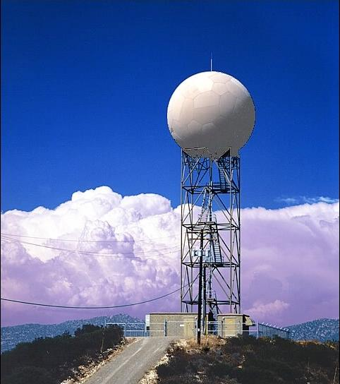
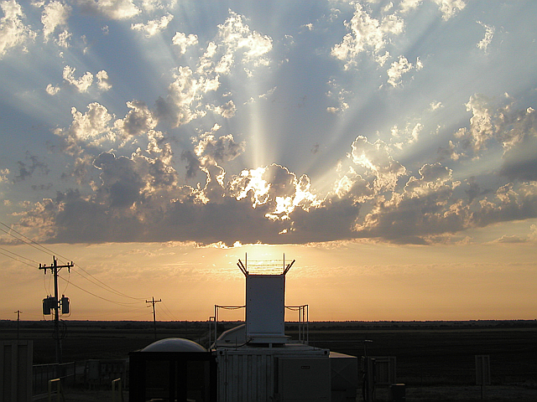
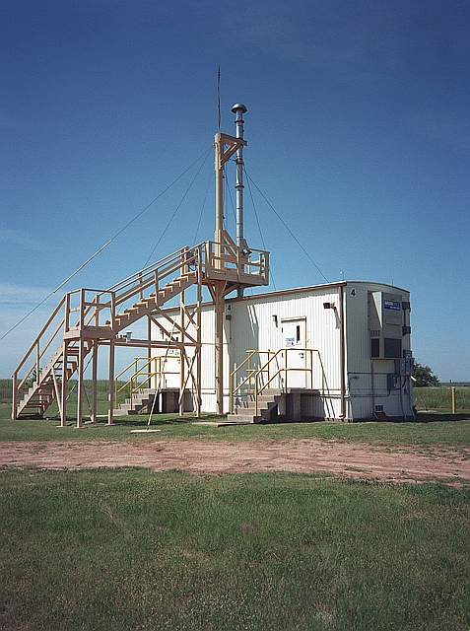
BER Recovery Act Projects:
Atmospheric Radiation Measurement (ARM) Climate Research Facility (ACRF)
Goal: To enhance the current ACRF measurement base to provide new knowledge and improve the predictive performance of climate models
Needed capabilities identified in climate science workshops
$60M for capital investments in instrumentation and research infrastructure for the fixed and mobile ARM facilities.
  Capabilities to provide 3-D measurements of cloud scale dynamics, microphysics and precipitation.
  Capabilities to provide enhanced measurements of atmospheric aerosol composition and chemistry.
8 BER Overview
Department of Energy • Office of Science • Biological and Environmental Research

Slide 9
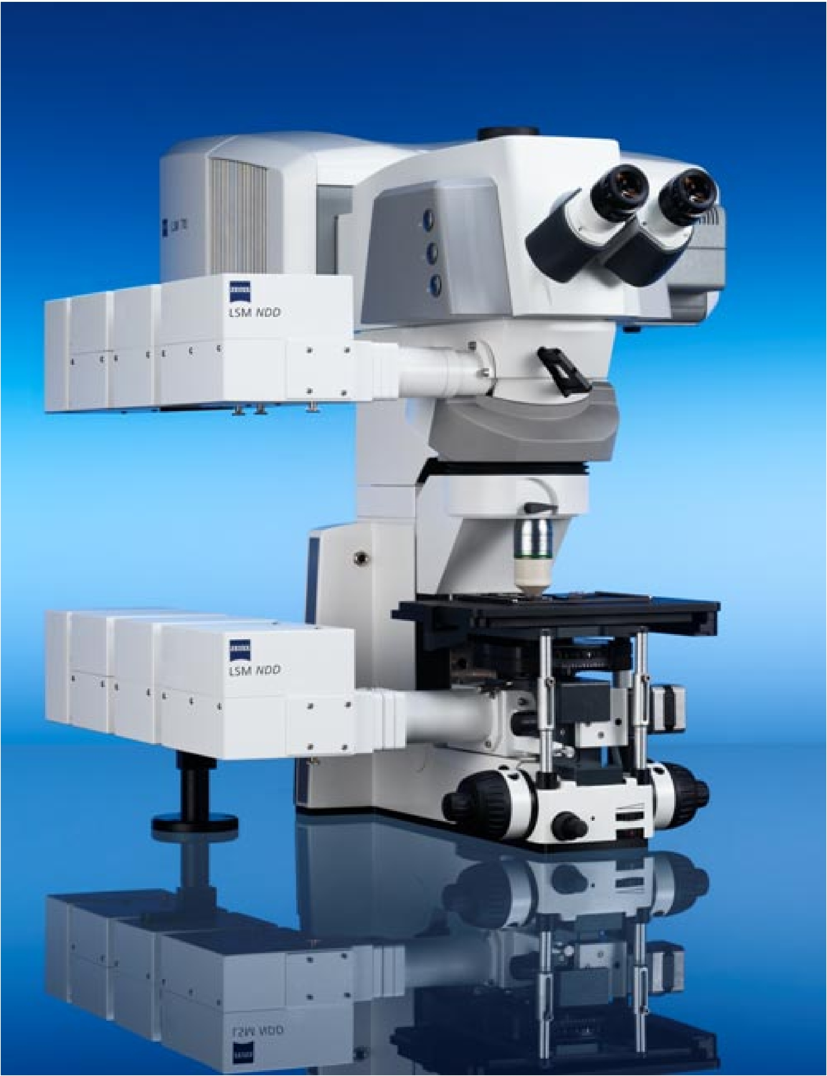
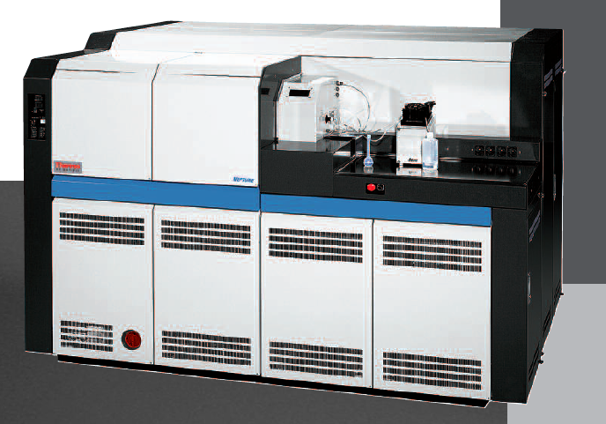
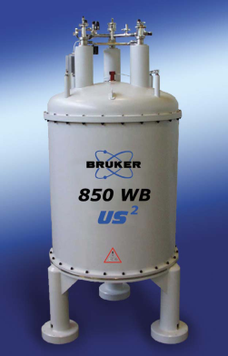
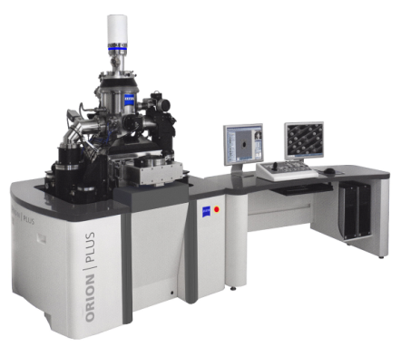
BER Recovery Act Projects:
Environmental Molecular Sciences Laboratory (EMSL)
Goal: To probe fundamental physical, chemical and biology processes underpinning DOE’s energy, science and environmental challenges.
Needed capabilities identified by the EMSL Recapitalization Plan, and aligned with EMSL’s three science themes
$60M for more than 25 leading-edge experimental capabilities.
  Nuclear magnetic resonance spectrometers; mass spectrometers; molecular/microscopy imaging capabilities; and nano- and molecular-level characterization instruments.
9 BER Overview
Department of Energy • Office of Science • Biological and Environmental Research

Slide 10
BER Recovery Act Projects: Other Investments
Bioenergy Research Centers Capital Equipment
  Bioenergy Science Center (BESC) at ORNL - $5.4M
  Great Lakes Bioenergy Research Center (GLBRC) at U. of Wisconsin - $4.1M
  Joint Bioenergy Institute (JBEI) - $4M
  Infrastructure for plant feedstock genome analysis and characterization
Integrated Assessment (IA) Research Program
  PNNL/Joint Global Change Research Institute - $4.9M for computational and data storage equipment
Joint Genome Institute (JGI)
  LBNL - $13.1M for infrastructure for genome sequencing, analysis and characterization for plant feedstocks.
Knowledgebase (Kbase) R&D
  ORNL - $3.2M for conceptual design and planning for a Systems Biology Knowledgebase.
10 BER Overview
Department of Energy • Office of Science • Biological and Environmental Research

Slide 11
Early Career Awards: Fast Facts
Goal: Train next generation of young scientists at universities and national labs
Largest effort of its kind in DOE history aimed at next generation of scientists
David Thomassen is overall lead for BER, with Marv Stodolsky for BSSD and Bob Vallario for CESD
Early career is defined as no more than 10 years past Ph.D.
BER will fund 8 awards in FY10
427 Letters of Intent!

Slide 12
Summary of Letters of Intent for BER Early Career Awards
Climate and Environmental Sciences Division: 183
Subsurface science 30
Carbon cycle and ecology 63
Atmospheric sciences 26
Modeling 40
Other 24
Biological Systems Science Division: 244
Genomics (microbes, plants, technologies) 120
Radiological sciences 12
Computational biosciences 20
Ethical, legal and societal Issues 25
Other 67

Slide 13
Interagency Interactions
U.S. Global Climate Change Research Program (13 agencies)
Ameriflux network (NSF, NOAA, NASA, and USDA)
Joint program with USDA on plant feedstock genomics
Metabolic Engineering Interagency Program (8 agencies)
Protein Data Bank (NIH, NSF)
Effects of Low Dose Radiation (NASA)
Structural Biology: NIH’s National Center for Research Resources – Dr. Barbara Alving will speak today!
US-European Commission Biotechnology Task Force

Slide 14
US-EC Biotechnology Task Force
Mission: “To promote information exchange and coordination between biotechnology research programs funded by the European Commission and the United States government.”
Participants: European Commission Research Directorate and U.S. agencies: NSF, USDA, DOE, DOD,NIH, EPA, FDA, NIST, OSTP, and others
Task Force will celebrate its 20th anniversary in June 2010
BER co-chairs:
  Working Group on Environmental Biotechnology
  Working Group on Working Group on Biobased Materials and Bioenergy
Activities include jointly funded workshops, short courses and fellowships.

Slide 15
BER Mission Priorities: Strategic Planning Update
Provide the foundational science to:
Develop biofuels as a major secure national energy resource (completed, on web site)
Understanding the potential effects of greenhouse gas emissions on Earth’s climate and biosphere, and their implications for our energy future (completed, on web site)
Predict the fate and transport of DOE-relevant subsurface contaminants (update in progress – workshop led by David Lesmes)
Develop new tools to explore the interface of biological and physical sciences (in progress, Dean Cole and Libby White, co-leads)

Slide 16
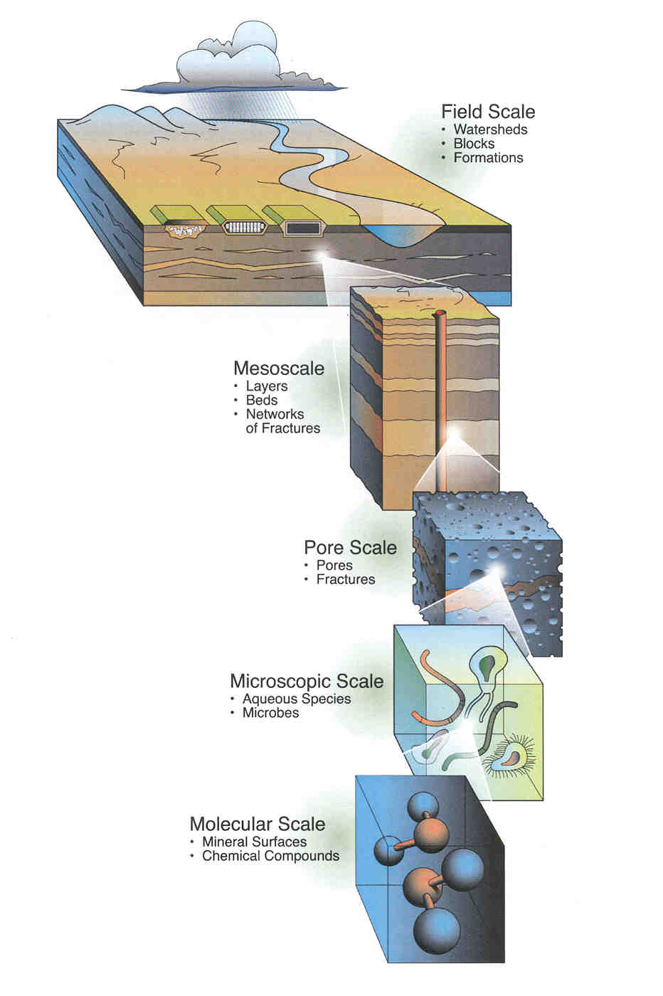
Subsurface Complex System Science
Relevant to Contaminant Fate and Transport
Workshop held Aug. 3-5, 2009
Goal – Identify knowledge gaps and science challenges that must be met to predict contaminant behavior in complex subsurface systems
Field Scale
>10³ m
Participants:
36 scientists with experience in three broad
observational scales of research:
Molecular to pore scale
Intermediate scale
Field scale
….and three broad disciplinary areas:
Microbiology
Geochemistry
Transport/Modeling
Mesoscale
10^{1.5}-10³ m
Pore scale
10⁻³-10^{1.5} m
Microscopic
10⁻⁷-10⁻³ m
Molecular/nano
10⁻¹⁰-10⁻⁸ m
Charting a path to a predictive understanding of subsurface processes
influencing contaminant transport across scales in the environment

Slide 17
BER Personnel Changes and Recruitments
Dr. Roger Dahlman retired after 32 years at DOE; recruiting an ecologist to backfill for Roger.
Dr. Renu Joseph has joined BER as an IPA in climate modeling
Dr. Cathy Ronning has joined BER as Program Manager in plant biology and genomics.
Dr. Peter Kirchner will complete his BER detail and retire on Sept. 30.
Leslie Runion was promoted from secretary to administrative specialist; recruiting a CESD secretary to backfill for Leslie.
Recruiting a Science Assistant for BSSD (over 100 applicants!)
Request for filling the SES Division Director slot for CESD has been signed by Dr. Brinkman, but needs even higher approval.
Notes:
17

Slide 18
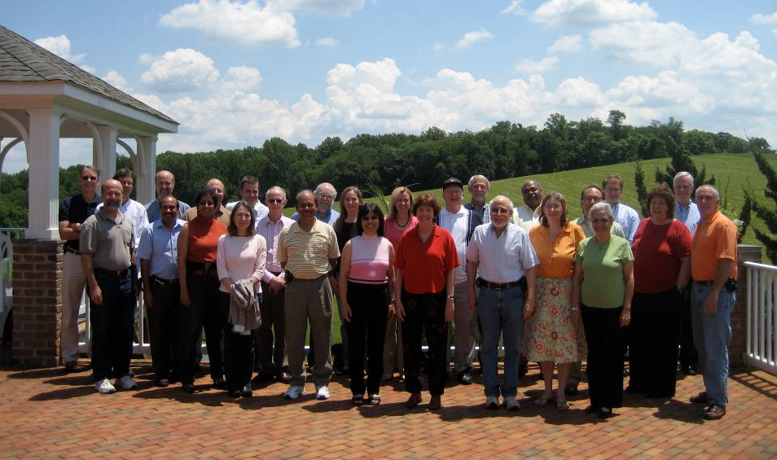
BER Science Retreat, June 2009
High Risk/High Reward Research
Science Integration

Slide 19
BERAC Activities:
Looking ahead….
Long Term Vision
Committee of Visitors for Climate and Environmental Sciences Division
Joint Genome Institute Strategic Planning
Engage Key Interagency Partners
  Dr. Tim Killeen – NSF Geosciences (last BERAC)
  Dr. Barbara Alving – NIH National Center for Research Resources (Today)
  Next meeting?
Notes:
19

Slide 20
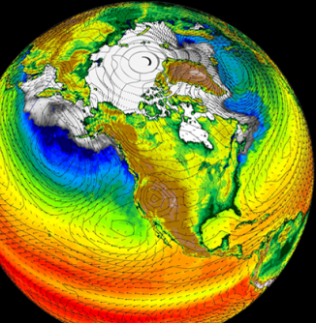
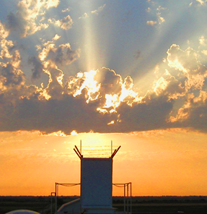
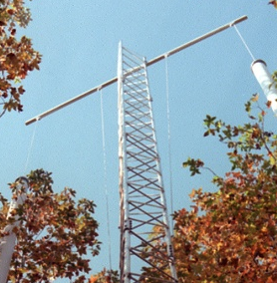
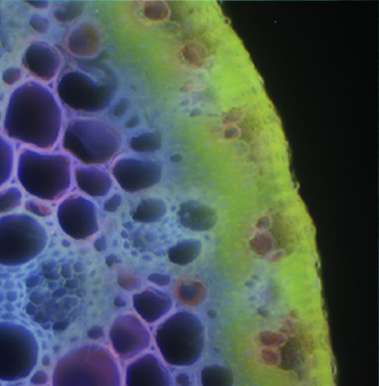
Thank you!

