Slide 1
The State of BER
September 16, 2010
Anna Palmisano
Associate Director of Science
Biological and Environmental Research

Slide 2
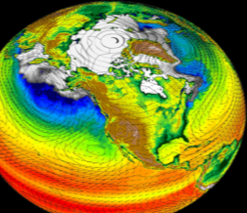
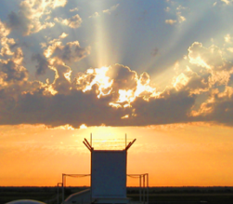
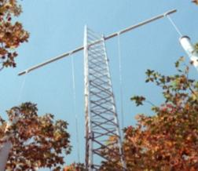
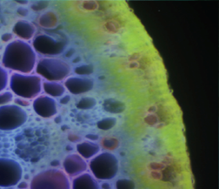
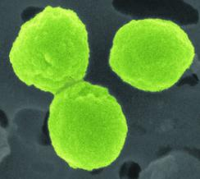
Biological and Environmental Research
Driven by fundamental scientific questions…..
What are the roles of the Earth systems in determining climate?
How is information stored in the genome translated into active microbes, plants, and ecosystems?
What are the biological and physical forces that govern the behavior of Earth’s subsurface environment?

Slide 3
Biological and Environmental Research
Serving DOE’s mission needs…
  Support the development of biofuels as major and sustainable national energy source
  Determine the potential effects of greenhouse gases on Earth’s climate and biosphere, and the impact on our energy future
  Predict the fate and transport of contaminants in the subsurface environment at DOE sites
  Develop new tools to explore the interface of biological and physical sciences

Slide 4
Scientific Opportunities within BER:
What makes us unique?
Trans-disciplinary science: BER science no longer fits neatly into disciplines.
BER science is systems-based, and therefore, extremely data intensive and data diverse.
Our user facilities enable scientists throughout the globe to contribute in unprecedented ways to rapidly advance biological, climatic and environmental research.
Our dedicated program staff excel at creating and nurturing partnerships to advance science.

Slide 5
Outline
Status of the President’s Budget Request for FY2011
BERAC Grand Challenges for BER Workshop
BERAC Committee of Visitors for Climate and Environmental Sciences
Personnel Changes and Recruitments
Highlights from BER
  Knowledgebase planning
  Upcoming BRC review
  Climate roadmap workshop
Update on the American Recovery and Reinvestment Act investments
Update on Early Career Awards and Graduate Research Fellowships
Interagency Interactions

Slide 6
Update on the Status of the President’s Budget for BER in FY2011

Slide 7
BER Funding Profile ($ in thousands)
 | FY 2010 | FY 2011 President's Request | FY 2011 Senate Mark
Biological Systems Science | 318,476 | 321,947 | 317,547
Climate and Environmental Sciences | 285,706 | 304,953 | 296,953
Total BER | 604,182* | 626,900 | 614,500
*prior to SBIR/STTR transfer
Notes:
EMSL -- Operations funding increases are offset by planned reductions in capital equipment funding.

Slide 8
BERAC Grand Challenge Workshop March 2-3, 2010

Slide 9
Charge from the Director of DOE’s Office of Science to BERAC:
What are the greatest scientific challenges in biology, climate and the environment that DOE will be facing in the long term (20 year horizon)?
How should we position BER to address those challenges? What fields of science are needed to achieve future mission challenges?
What new and innovative tools are needed to advance BER science?
How can should we train the workforce of the future in integrative system science?

Slide 10
BERAC Grand Challenges Workshop Steering Committee
Gary Stacey
Jim Ehleringer
Joyce Penner
Greg Petsko
David Randall
Peg Riley
Gary Sayler
Mavrik Zavarin

Slide 11
BERAC Grand Challenges Workshop: Creating a Long Term Vision for BER Science
Based on a highly successful model employed by BES to identify Basic Research Needs
Workshop engaged about 100 scientific leaders in biology, climate, environment, energy, sustainability, computation, and other fields
Discussions centered around Systems biology, Synthetic biology, Climate science, and Sustainability
Cross-cutting areas were computation, scaling, data management, education and training
Draft workshop report will be briefed by Gary Stacey to BERAC today!

Slide 12
Committee of Visitors (COV) for Climate and Environmental Sciences Division
July 2010

Slide 13
Committee of Visitors (COV) Review of the Climate and Environmental Sciences Division
Led by BERAC member, Dr. Judy Wall, on July 21-22, 2010
Charged by the Director of the Office of Science to assess:
    processes used to solicit, review, recommend and monitor
    proposals for research in Office of Science programs
    the breadth, depth and national/international standing of portfolios
    management and oversight of DOE national user facilities
Comprised of a broad range of experts encompassing the relevant programmatic areas
Reviewed all program and facility management activities over the past 3 years
COV findings presented today for BERAC review and will be submitted to Director, Office of Science
BER will be asked to respond to recommendations

Slide 14
Personnel Recruitments and Changes

Slide 15
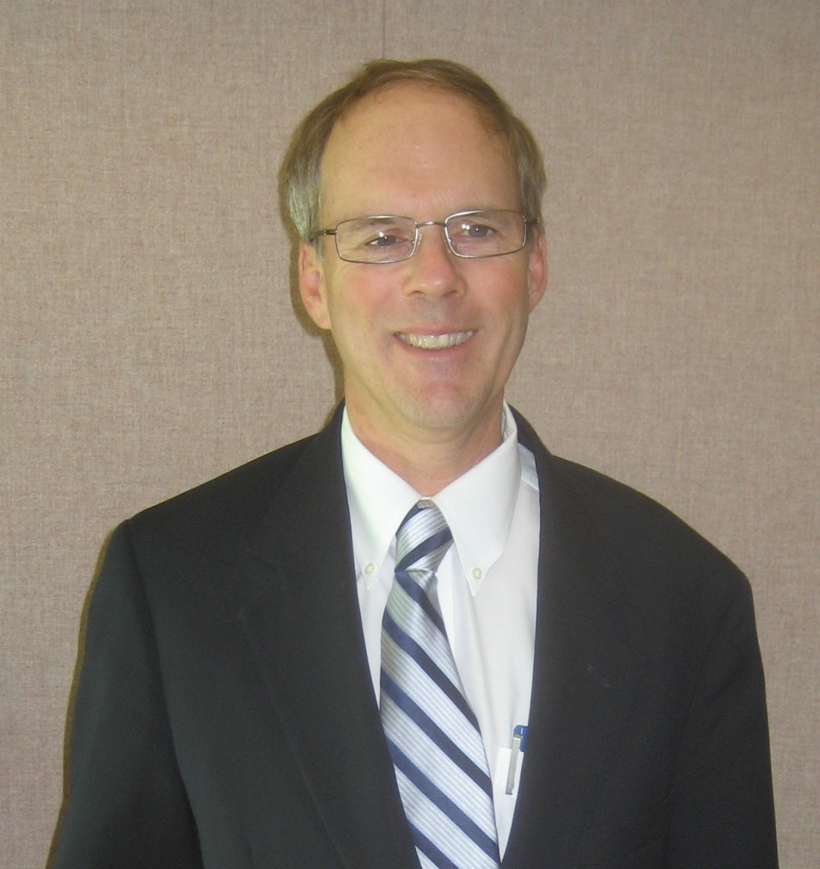
Welcome our New Division Director for Climate and Environmental Sciences: Gary Geernaert
Ph.D. in Atmospheric Sciences from U. of Washington
Scientist at Naval Research Lab and Program Manager at Office of Naval Research
Division Director for Dept. of Atmospheric Environment at National Environmental Research Institute, Denmark
Director of the Institute of Geophysics and Planetary Physics at Los Alamos National Lab

Slide 16
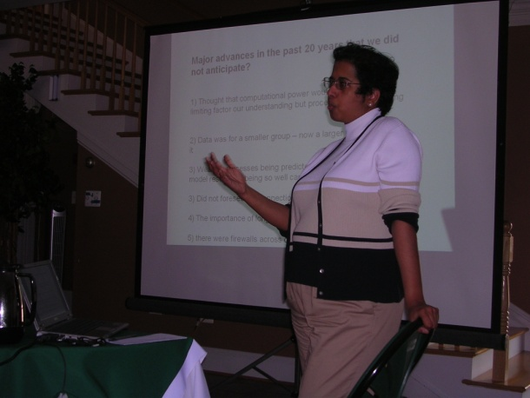

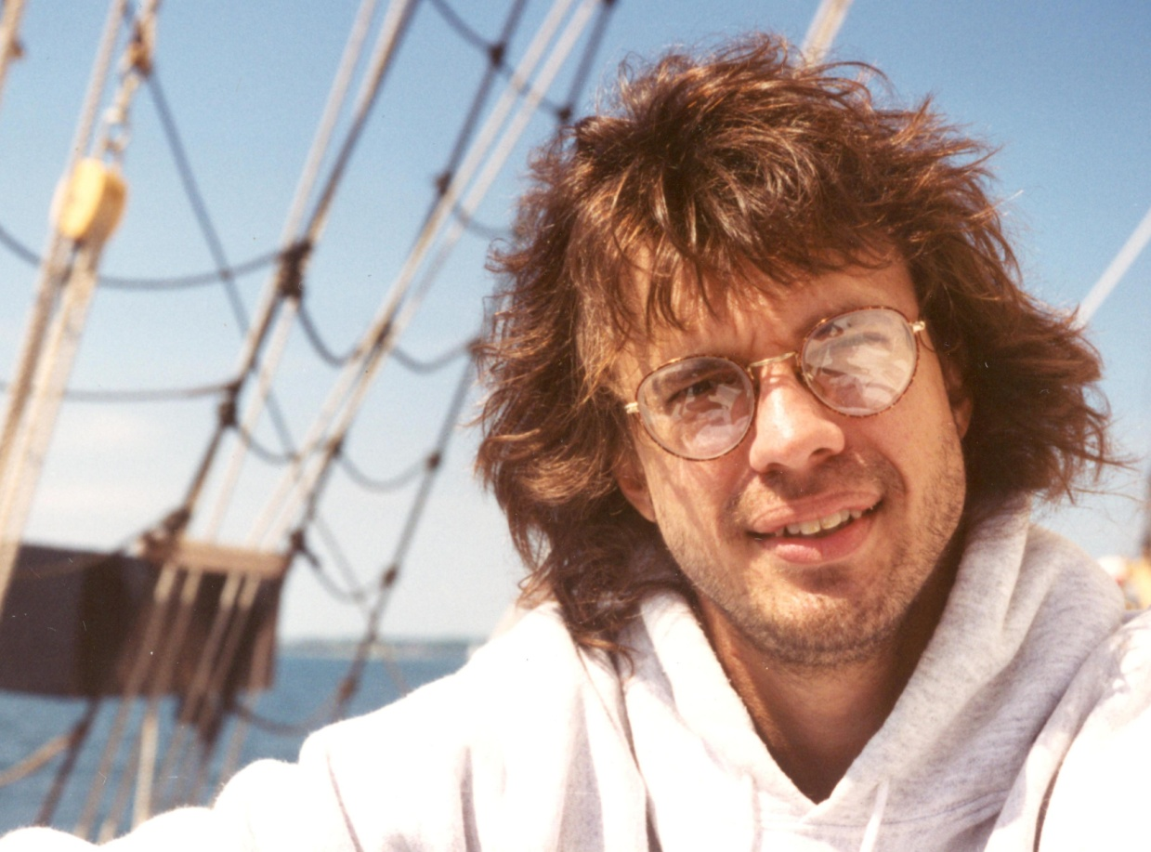
New Science Staff and Recruitments in Climate and Environmental Sciences
Two new program managers for climate modeling:
  Renu Joseph will lead Regional and Global Climate Modeling
  Dorothy Koch will lead Earth System Modeling
Lost Jeff Amthor – recruiting for Ecologist to backfill
Recruitment for Science Assistant for Climate and Environmental Sciences Division has been put on hold

Slide 17
Highlights for BER

Slide 18
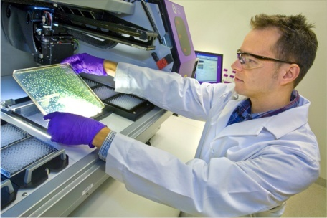

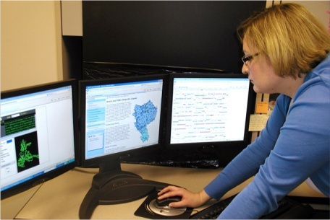
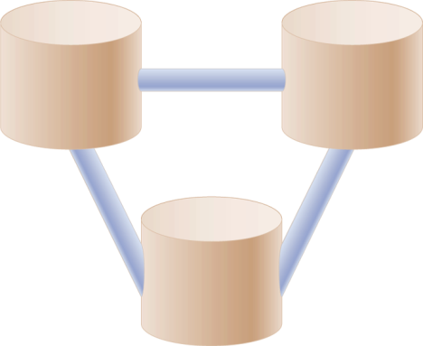
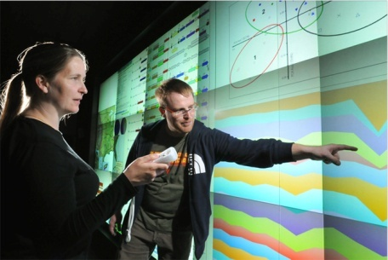
DOE Systems Biology Knowledgebase
Establishing a systems biology modeling framework
Data generators
Open-Access Data and Information Exchange
Flexible user interfaces
Easy data retrieval
Environment for in silico experimentation
Data
users
Seamless Submission and Incorporation of Diverse Data
Standards for data, metadata
Quality control and assurance
Automated data handling
DOE Systems Biology
Knowledgebase
Meta-
data
Community-Wide Stewardship
User, Standards, and Advisory committees
Value-added analysis
Training, tutorials, and support
Data
Software and tool developers
Tools
Open Development of Open-Source Software and Tools
Analysis and visualization
In silico experimentation
Tracking and evaluation of tool use

Slide 19
DOE Systems Biology Knowledgebase
Establishing a systems biology modeling framework—engaging the scientific community
March 2009: DOE Systems Biology Knowledgebase for a New Era in Biology Workshop Report articulates the mission and community need for a Knowledgebase
July 2009: Recovery Act supports the research and development of an implementation strategy for the Systems Biology Knowledgebase.
Community Workshops—engage specific research communities
  Supercomputing, Nov. 2009
  Plant and Animal Genome XVIII, Jan. 2010
  DOE Genomic Science Grantee Workshop, Feb. 2010
  Joint Genome Institute Users Meeting, March 2010
Synthesis Workshop. June, 2010
Pilot Projects- Develop bioinformatics software for cloud architecture and Infrastructure test bed for storing experimental data
Discussion included ASCR, iPlant, NCBI, NCI, Google and Amazon

Slide 20
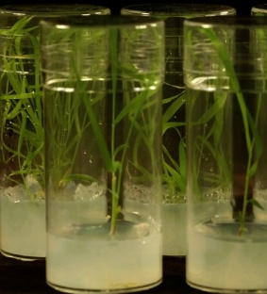
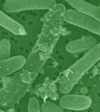
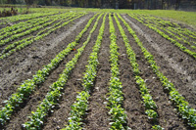
Bioenergy Research Centers – three year review
Reverse-site visit progress review in Bethesda
  BioEnergy Science Center—Sept. 27, 2010
  Great Lakes Bioenergy Research Center—September 28, 2010
  Joint BioEnergy Institute—September 29, 2010
Single external review team with diverse expertise will evaluate all Bioenergy Research Centers:
  Quality of the science
  Management
  Progress against stated milestones
Led by Sharlene Weatherwax and Biological Systems Science Division staff

Slide 21
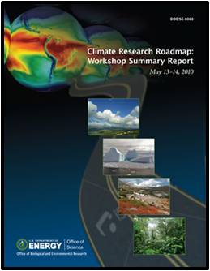
Climate Roadmap Workshop - May 2010
Goal – determine research challenges important for developing a predictive understanding of global climate
Over 50 scientists identified key science challenges and research opportunities for the next 10 years in:
  Atmospheric Systems Research
  Terrestrial Ecosystem Science
  Climate and Earth System Modeling
Opportunities for integration across disciplines and latitudes identified with a focus on crosscutting challenges and outcomes.
Organized by Mike Kuperberg and BER colleagues

Slide 22
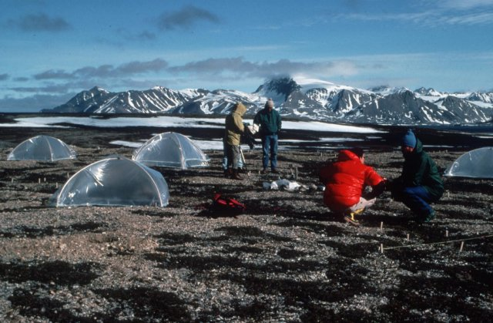
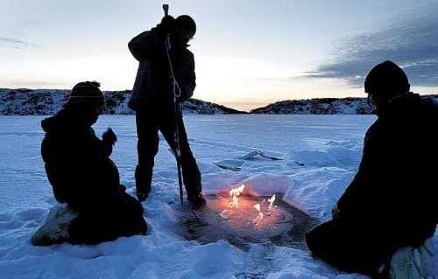
Arctic Climate Science: A Global Priority
The Arctic is vitally important to global climate:
  This globally sensitive region has vast reservoirs of carbon and ice.
  Melting Arctic permafrost will release massive amounts of carbon.
  Melting Arctic ice has major impacts on ocean circulation.
Major knowledge gaps limit global models:
  The Arctic is poorly represented in global climate models.
  Arctic processes needed by Earth System Models are under-studied and observations are limited.

Slide 23
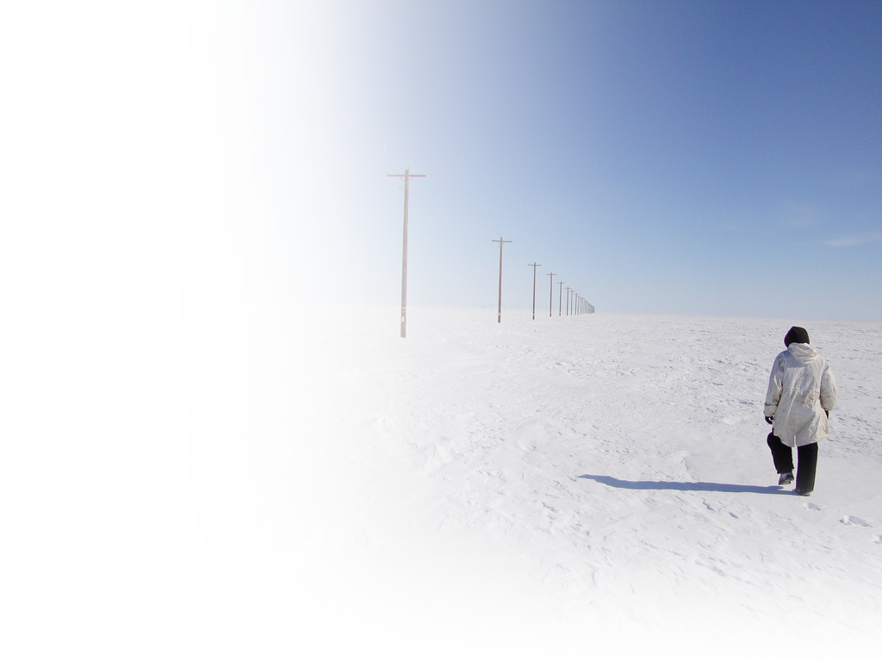
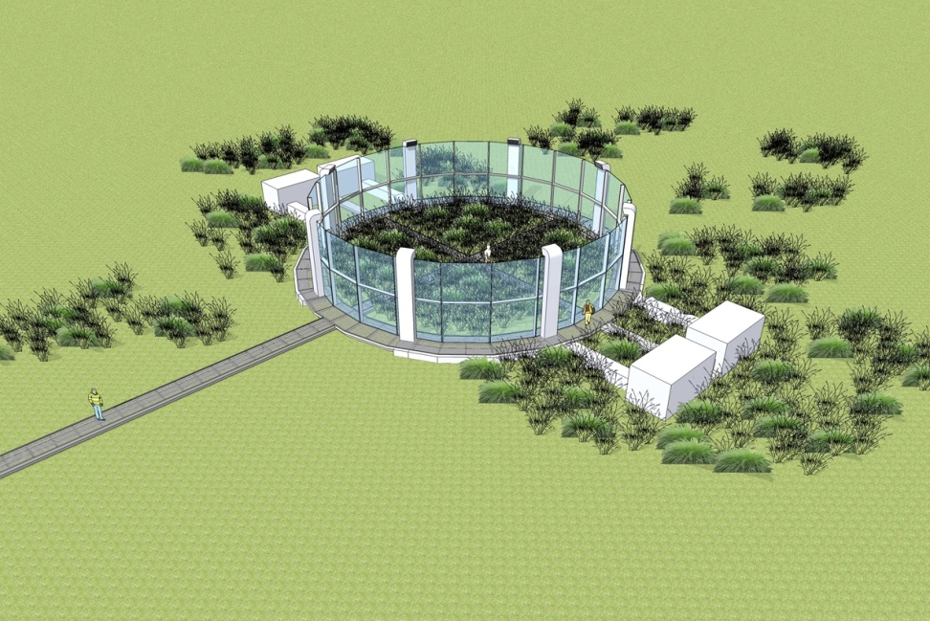
Next-generation ecosystem experiment: Arctic tundra
Targets a system that is globally important, climatically sensitive, understudied, feasible--tundra with underlying permafrost
Warming could cause a large net release of CO₂ and/or CH₄ to the atmosphere — a strong positive feedback to warming
Warming might also reduce albedo (surface reflectivity)
BER bring unique scientific expertise in:
  Large scale ecological experiments
  Ecogenomics and microbial ecology
  Atmospheric exchange
  Radiative forcing
Artist’s conception

Slide 24
American Recovery and Reinvestment Act – An Update

Slide 25
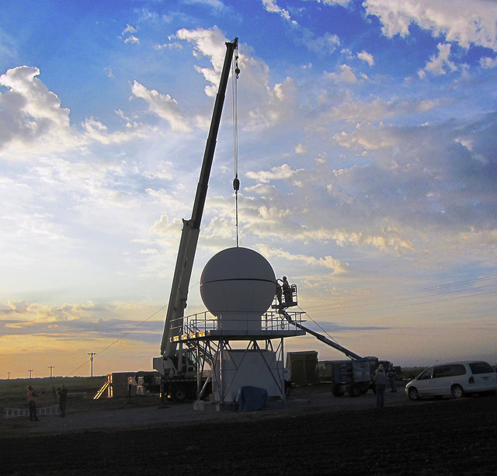
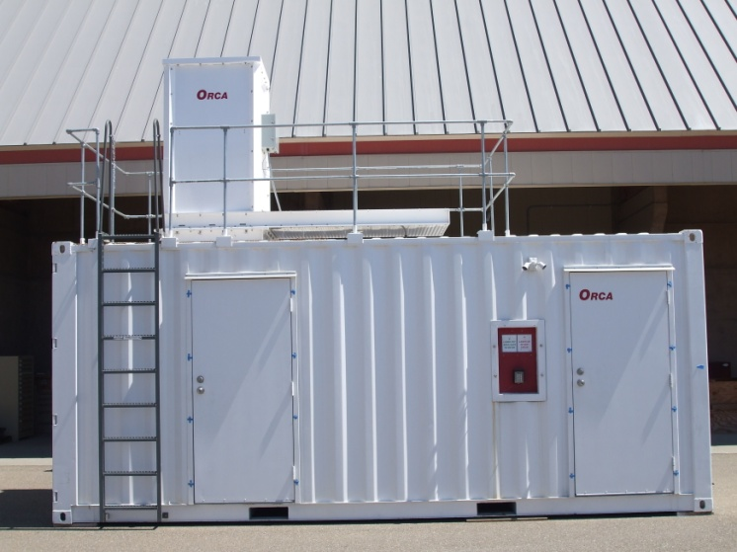
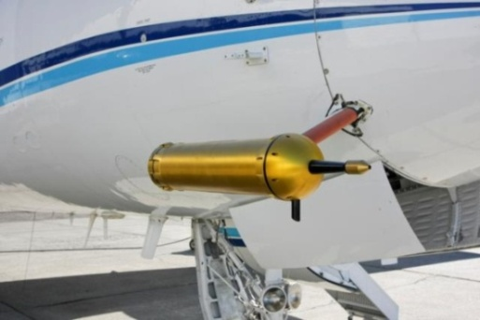
BER Recovery Act Projects:
Atmospheric Radiation Measurement (ARM) Climate Research Facility (ACRF)
$60M for capital investments in instrumentation and research infrastructure for the fixed and mobile ARM facilities.
Contracts are in place for 100% of the Recovery Act baseline instruments.
58.1% of the instrument systems have been received as of Sep. 1.
Precipitation radars installed at Southern Great Plains.
Raman lidar ready to ship to Darwin.
New instrument flew on G-1 in the recent CA campaign.
25 BER Overview
Department of Energy • Office of Science • Biological and Environmental Research
Notes:
Goal: To enhance the current ACRF measurement base to provide new knowledge and improve the predictive performance of climate models
Needed capabilities for 3-D measurements of cloud scale dynamics, microphysics and precipitation and enhanced measurements of atmospheric aerosol composition and chemistry identified in climate science workshops
Top is new precipitation radar being installed at SGP
New Raman lidar ready for shipping to Darwin.
ultra high sensitivity aerosol spectrometer flew in CARES

Slide 26
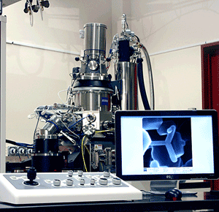
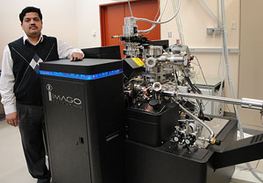
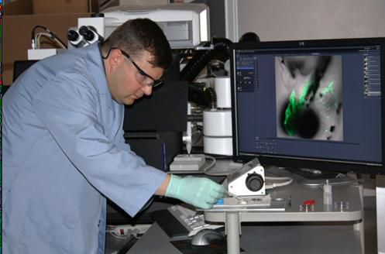
BER Recovery Act Projects:
Environmental Molecular Sciences Laboratory (EMSL)
$60M for capital investments in instrumentation for the Environmental Molecular Sciences Laboratory (EMSL).
Contracts are in place for 34 of the 35 new instruments.
  Nuclear magnetic resonance spectrometers, mass spectrometers, molecular/microscopy imaging capabilities; and nano- and molecular-level characterization instruments.
77% of the instrument systems have been received as of Sep. 1.
43% instruments installed and operating:
  Local Electrode Atom Probe (LEAP)
  Helium Ion Microscope
  Mulitphoton Confocal Microscope
Helium Ion Microscope
Local Electrode Atom Probe
Multiphoton Confocal Microscope
26 BER Overview
Department of Energy • Office of Science • Biological and Environmental Research
Notes:
Goal: To probe fundamental physical, chemical and biology processes underpinning DOE’s energy, science and environmental challenges.
Needed capabilities identified by the EMSL Recapitalization Plan, and aligned with EMSL’s three science themes.
90% of the $60M is out for bid, committed, or received.

Slide 27
Summary of Additional Recovery Act Funding
Bioenergy Research Centers ($13,500K capital equipment) – JBEI/LBNL ($4,000K); BESC/ORNL ($5,400K); GLBRC/U of WI ($4,100K). All equipment received. Green houses for JBEI delayed.
Joint Genome Institute ($13,100K) – data, networking systems & next generation DNA sequencing equipment all received.
Integrated Assessment research at PNNL ($4,900K) – advanced computing system and mass storage system for the research community. Advanced “Evergreen” computer system in place at U of MD.
Knowledgebase R&D ($3,200K) – 5 systems biology knowledgebase workshops held since Nov 2009. Software development projects nearing completion. Implementation plan under review.

Slide 28
Early Career Awards and Graduate Research Fellowships

Slide 29
Early Career Awards: Supporting the next generation of young scientists
Largest effort of its kind in DOE history aimed at next generation of scientists
David Thomassen is overall lead for BER, with Marv Stodolsky for BSSD and Bob Vallario for CESD
Early career is defined as no more than 10 years past Ph.D.
8 BER awards (3 laboratory, 5 university) in FY 2010; 5 year awards, universities - $750,000, national labs - $2,500,000
FY 2011 Solicitation –
  Required preapplications due August 13, 2010
  Proposals due November 9, 2010
  New awards – Spring 2011

Slide 30
DOE Office of Science Graduate Research Fellowships (Office of Workforce Development for Teachers and Scientists)
Support outstanding U.S. citizen graduate students in fields relevant to the Office of Science to encourage the development of the next generation U.S. scientific and technical talent.
150 students selected for 2010-2011 academic year. $50,500 per year for up to three years for tuition, living expenses, research materials and travel to research conferences or to Department of Energy scientific user facilities.
Support comes in part from $12.5 million from the American Recovery and Reinvestment Act.
A total of >3,200 applications received by SC; 1,155 binned as BER related; 909 BER relevant reviewed online; 600+ reviewed by panels.
Todd Anderson & Noelle Metting BER leads
FY 2011 application process pending.

Slide 31
Interagency Interactions

Slide 32



NSF-DOE-USDA Regional Climate Modeling
Five year interagency program to develop more powerful models that can help decision-makers develop adaptation strategies addressing climate change.
FY 2010 solicitation – NSF - ~$30 million; DOE ~$10 million; USDA ~$9 million.
Models will be designed to support planning for the management of food and water supplies, infrastructure construction, ecosystem maintenance, and other pressing societal issues at more localized levels and more immediate time periods than can existing models.
Renu Joseph – BER Program Manager

Slide 33
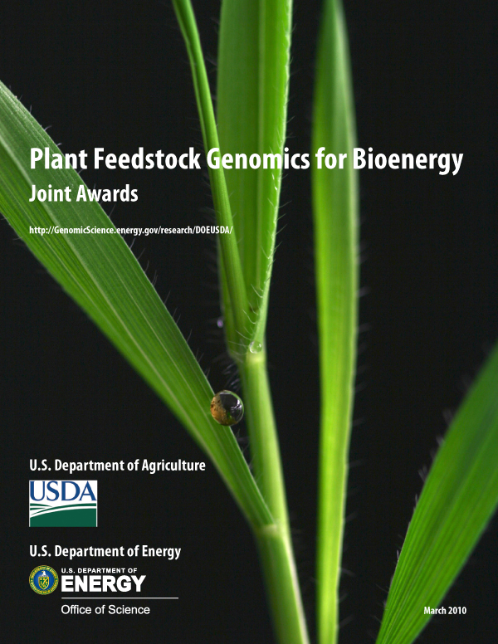
DOE-USDA Plant Feedstock Genomics for Bioenergy
5th year of joint effort to improve and accelerate genetic breeding programs to create plants better suited for bioenergy production.
Focus on biomass genomics to harness lignocellulosic materials for biofuels production. Emphasis on perennials, including trees and other nonfood plants as dedicated biofuel crops.
45 projects totaling $40.1 million.
Nine FY 2010 awards totaling $8.9 million ($6.9M DOE, $2M USDA).
Cathy Ronning BER Program Manager.

Slide 34
DOE-NIH Workshop on Interface of Biology & Physics
Secretary Chu and NIH Director Collins charged Anna Palmisano and Jeremy Berg (Director, National Institute of General Medical Sciences ) with organizing a workshop to identify opportunities to advance biology by leveraging advances in physics.
Early spring 2011. ~30 participants. ~50% physicists.
Driving questions:
  What are big questions in biology that cannot be addressed with existing technology?
  What are emerging ideas or technologies in physics that have potential applications in biology?
Organizers: Cathy Lewis (NIGMS) & David Thomassen (BER)

Slide 35
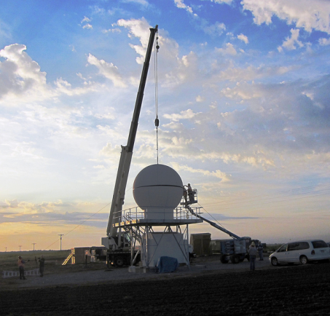
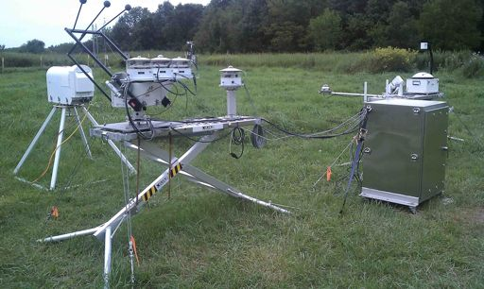
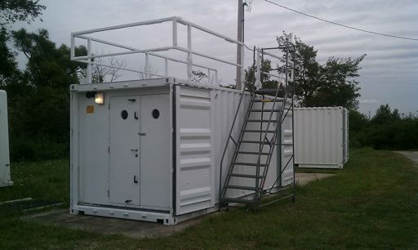
ARM Campaigns
Joint campaign with NASA at Southern Great Plains
  Goal is to provide the most complete characterization of convective cloud systems and their environment that has ever been obtained, providing constraints for model cumulus parameterizations that have never before been available.
DOE, NSF, NASA, Navy, and NOAA are supporting DYNAMO, the U.S. contribution to Cooperative Indian Ocean Experiment on Intraseasonal Variability in Year 2011 (CINDY2011)
  Second mobile facility will be used to test several current hypotheses regarding the mechanisms responsible for Madden-Julian Oscillation (MJO) initiation and propagation in the Indian Ocean area.
  BER also supporting a CINDY2011 experiment on Manus to examine the MJO in the Pacific.
Wanda Ferrell BER Program Manager
Notes:
The field campaign will take place between approximately April 15, 2011 and June 1, 2011. This late spring
transition period emphasizes the climatological maximum in monthly mean precipitation totals and heavy,
warm season convective rainfall events in the Oklahoma region as is observed from ARM SGP surface
meteorology observations.
The Recovery Act instruments will provide key measurements for the experiment.
NASA will provide additional ground measurements and two aircraft: the NASA ER-2 and University of North Dakota (UND) Citation. These aircraft are being deployed to provide coordinated high-altitude radar and radiometer
sampling of precipitation structure and in situ microphysics.
DYNAMO
The AMF deployment will start operations Oct 1, 2011 through March 31, 2012 on Gan
Island, Maldives.
The framework of DYNAMO/CINDY2011 includes two proposed islandbased
sites, and two ship-based locations forming a square pattern with sonde profiles and
scanning precipitation and cloud radars at both island and ship sites. These data will be used to
produce a Variational Analysis data set coinciding with the one produced for AMIE-Manus.
Many climate models do not show well-defined MJO signals, and those that do have
problems accurately simulating the initiation, amplitude, propagation speed, and seasonal
variations of the MJO signal. Since the MJO is the dominant mode of intra-seasonal variability
in the tropics and it interacts with both the monsoon and El Nino, improved simulations are
important for climate modeling.
From Wikipedia:
The Madden–Julian oscillation (MJO) is the largest element of the intraseasonal (30–90 days) variability in the tropical atmosphere. It is a large-scale coupling between atmospheric circulation and tropical deep convection [1] [2]. Rather than being a standing pattern (like ENSO) it is a traveling pattern, propagating eastwards at approximately 4 to 8 m/s, through the atmosphere above the warm parts of the Indian and Pacific oceans. This overall circulation pattern manifests itself in various ways, most clearly as anomalous rainfall.

Slide 36
Biological and Environmental Research:
Trans-disciplinary science
Systems-based, data intensive and diverse research
World class, high impact user facilities
Scientific partnering to meet DOE mission needs

