Slide 1
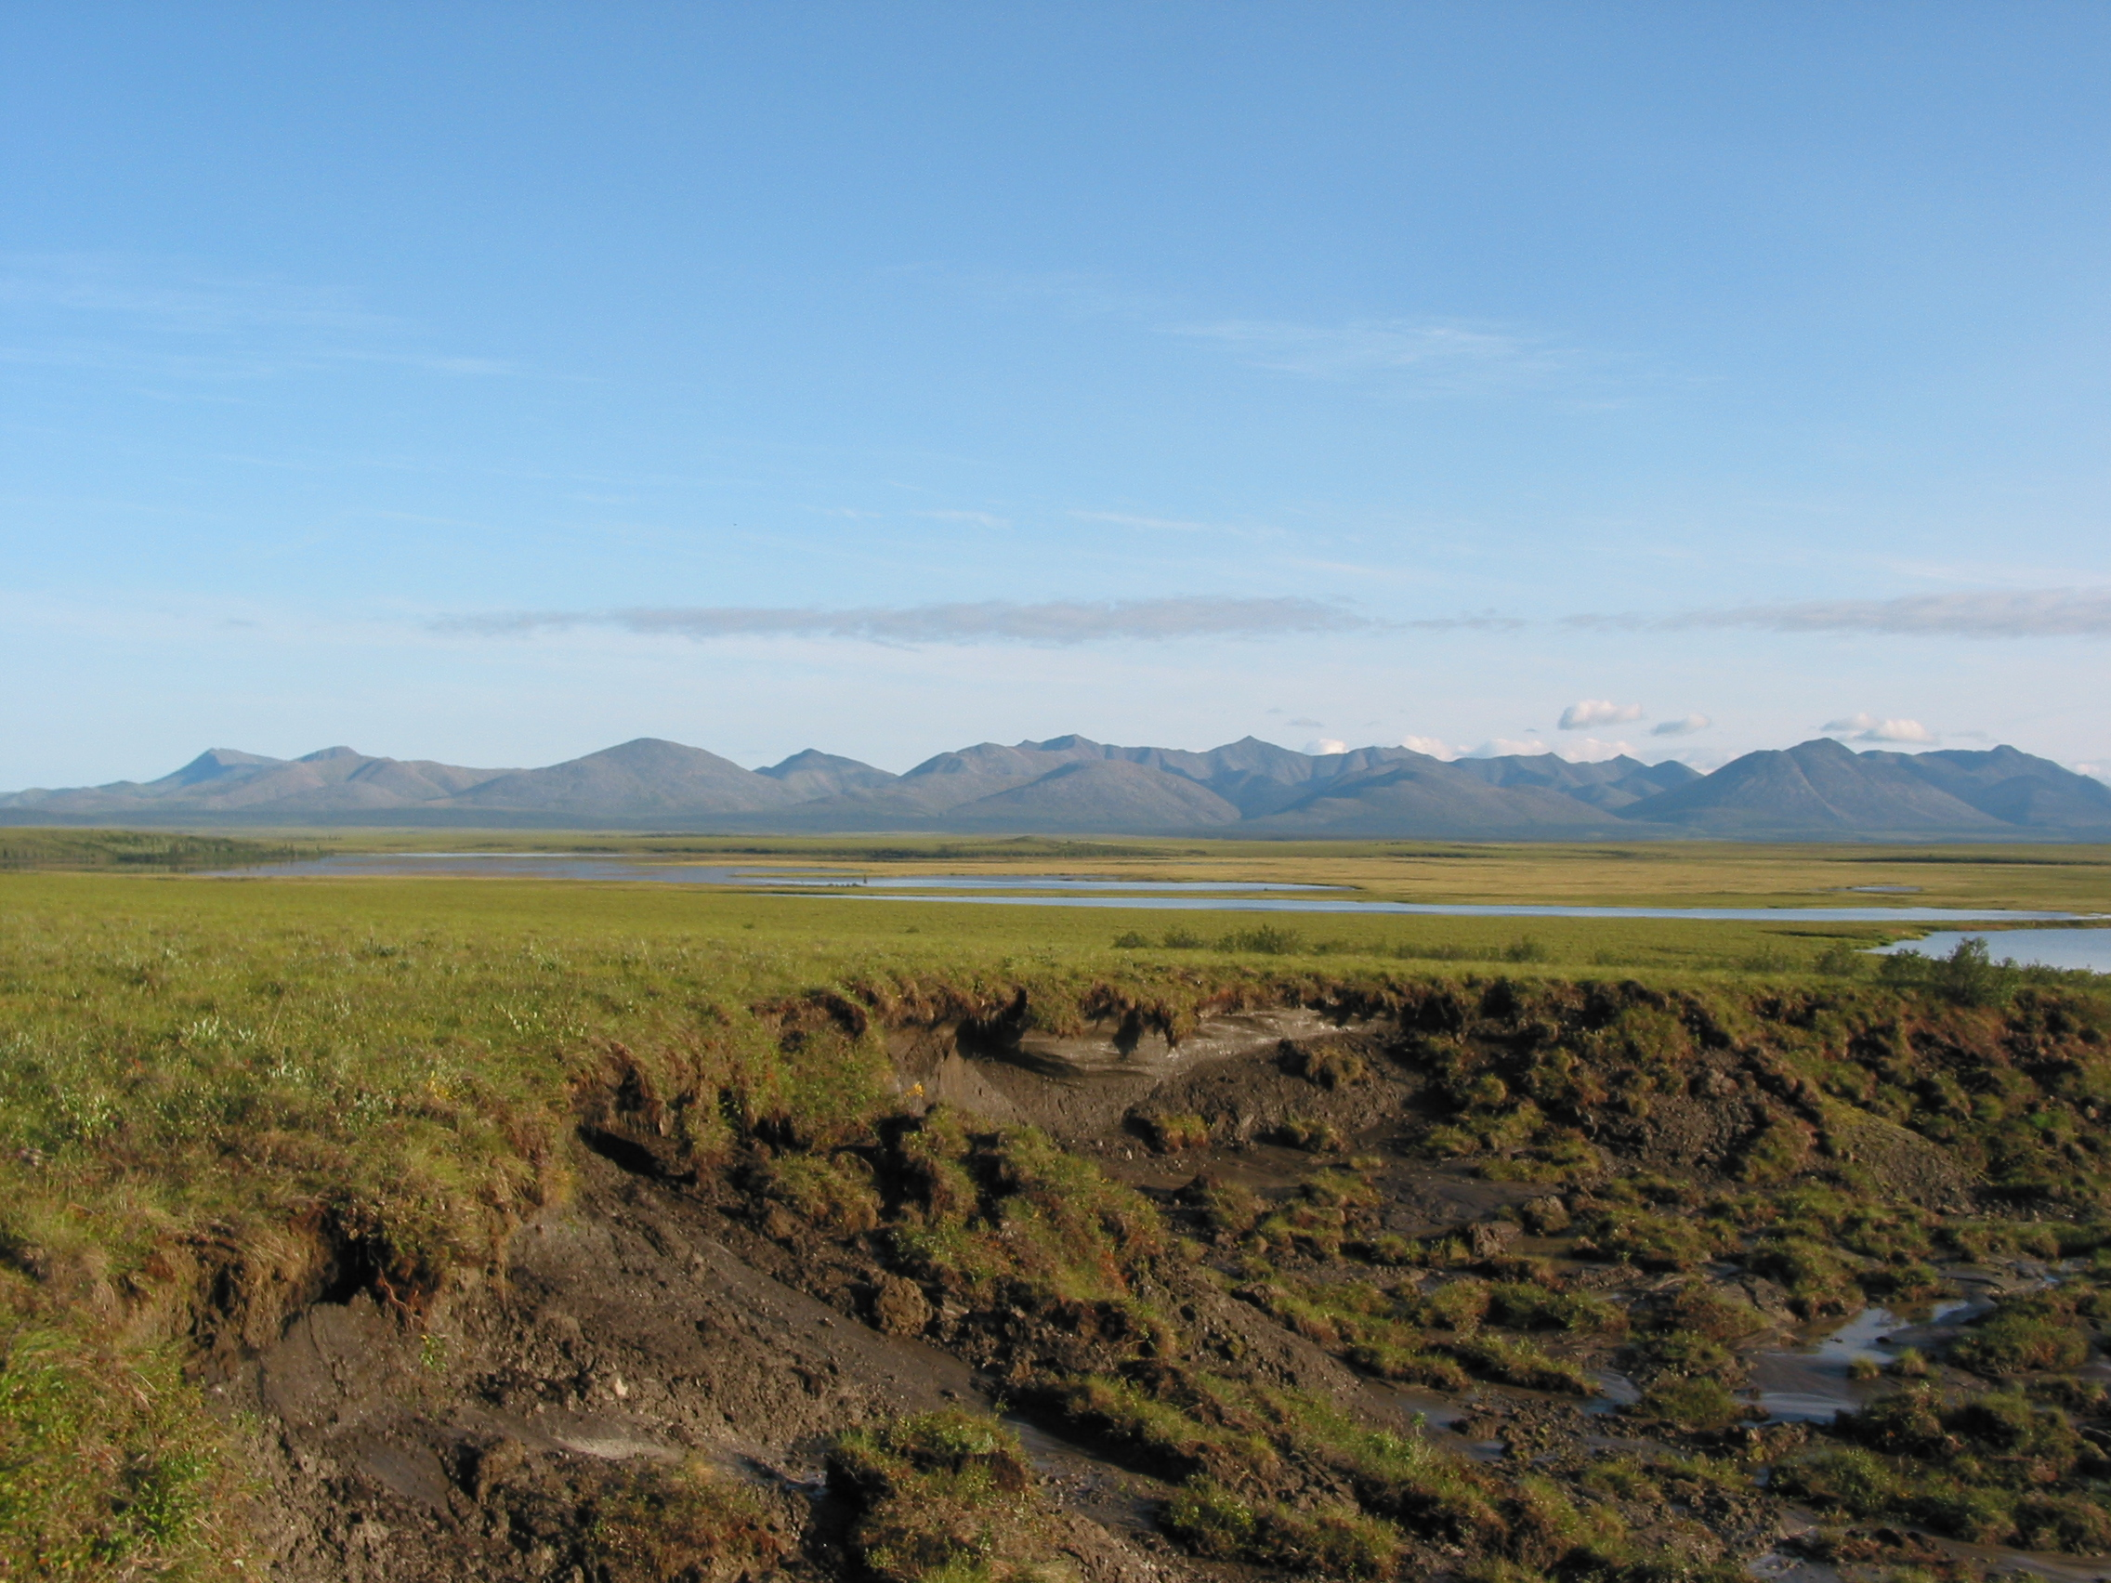
Permafrost Carbon and Climate Feedbacks in a Warmer World
Dr.Ted Schuur
Department of Biology
University of Florida
and
Institute of Arctic Biology
University of Alaska
Notes:
Thanks the advisory board for the invitation to present

Slide 2
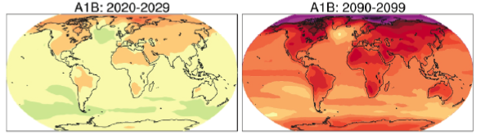

Future Climate Projections
2030
2100
deg C
[IPCC, 2007]
Notes:
By now, many of us acknowledge that the Earth’s climate in this century is likely to be substantially different from that of the past 100 years.
These graphs show IPCC temperature projections for the next couple decades, and the end of the century based on a particular economic development and GHG emission scenarios
We can see the familiar pattern of more warming over land than ocean, and most warming at high latitudes, from 2-3 deg C by 2030, to 5-7 deg C by 2100.
This amount of warming is for ‘optimistic’ scenarios of ~2deg global warming. Global warming of 4deg corresponds to ~13degC warmer at high latitudes.

Slide 3
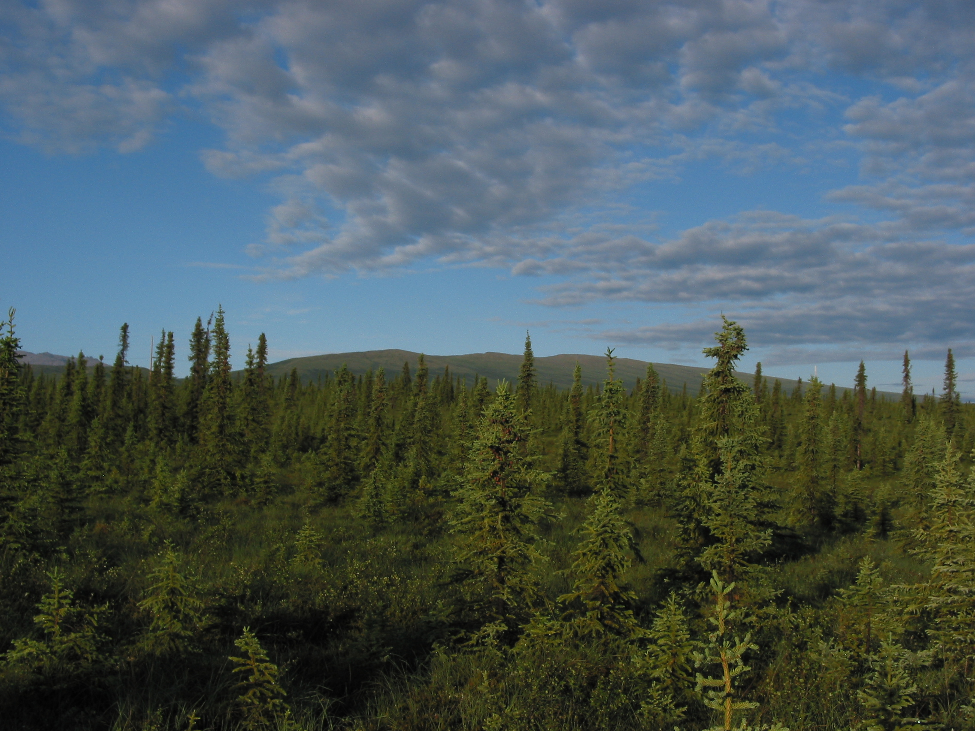
Climate
Terrestrial
Ecosystems
Notes:
Due to the projected changes in climate, there has been a great deal of important research examining the impacts on terrestrial ecosystems
Indeed, no ecosystem on Earth is remote enough to escape these effects.
Today’s focus is going to be on those systems whose response is large enough to influence the future trajectory of climate change.
I’m going to touch about this broadly in the next slide, before thinking more specifically about the feedback from permafrost carbon.

Slide 4
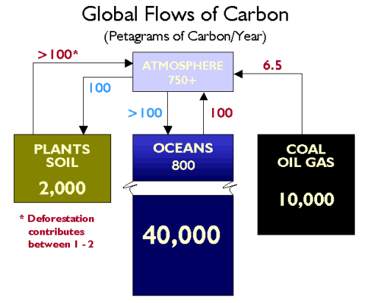
whrc.org/carbon/
Notes:
This is a good time to look at a broad overview of the global C cycle showing the major pools in the terrestrial biosphere, the ocean, as well as fossil C
The current increase in atmospheric C is driven by fossil C (now up around 8.5 Gt/year) and also deforestation, now around 1.2 Gt/yr
Changes in the Carbon Cycle, plus other greenhouse gases, are the main contribution to current climate change.
A major research question involves the natural flows of C. By what magnitude might these change in response to a future climate regime?

Slide 5
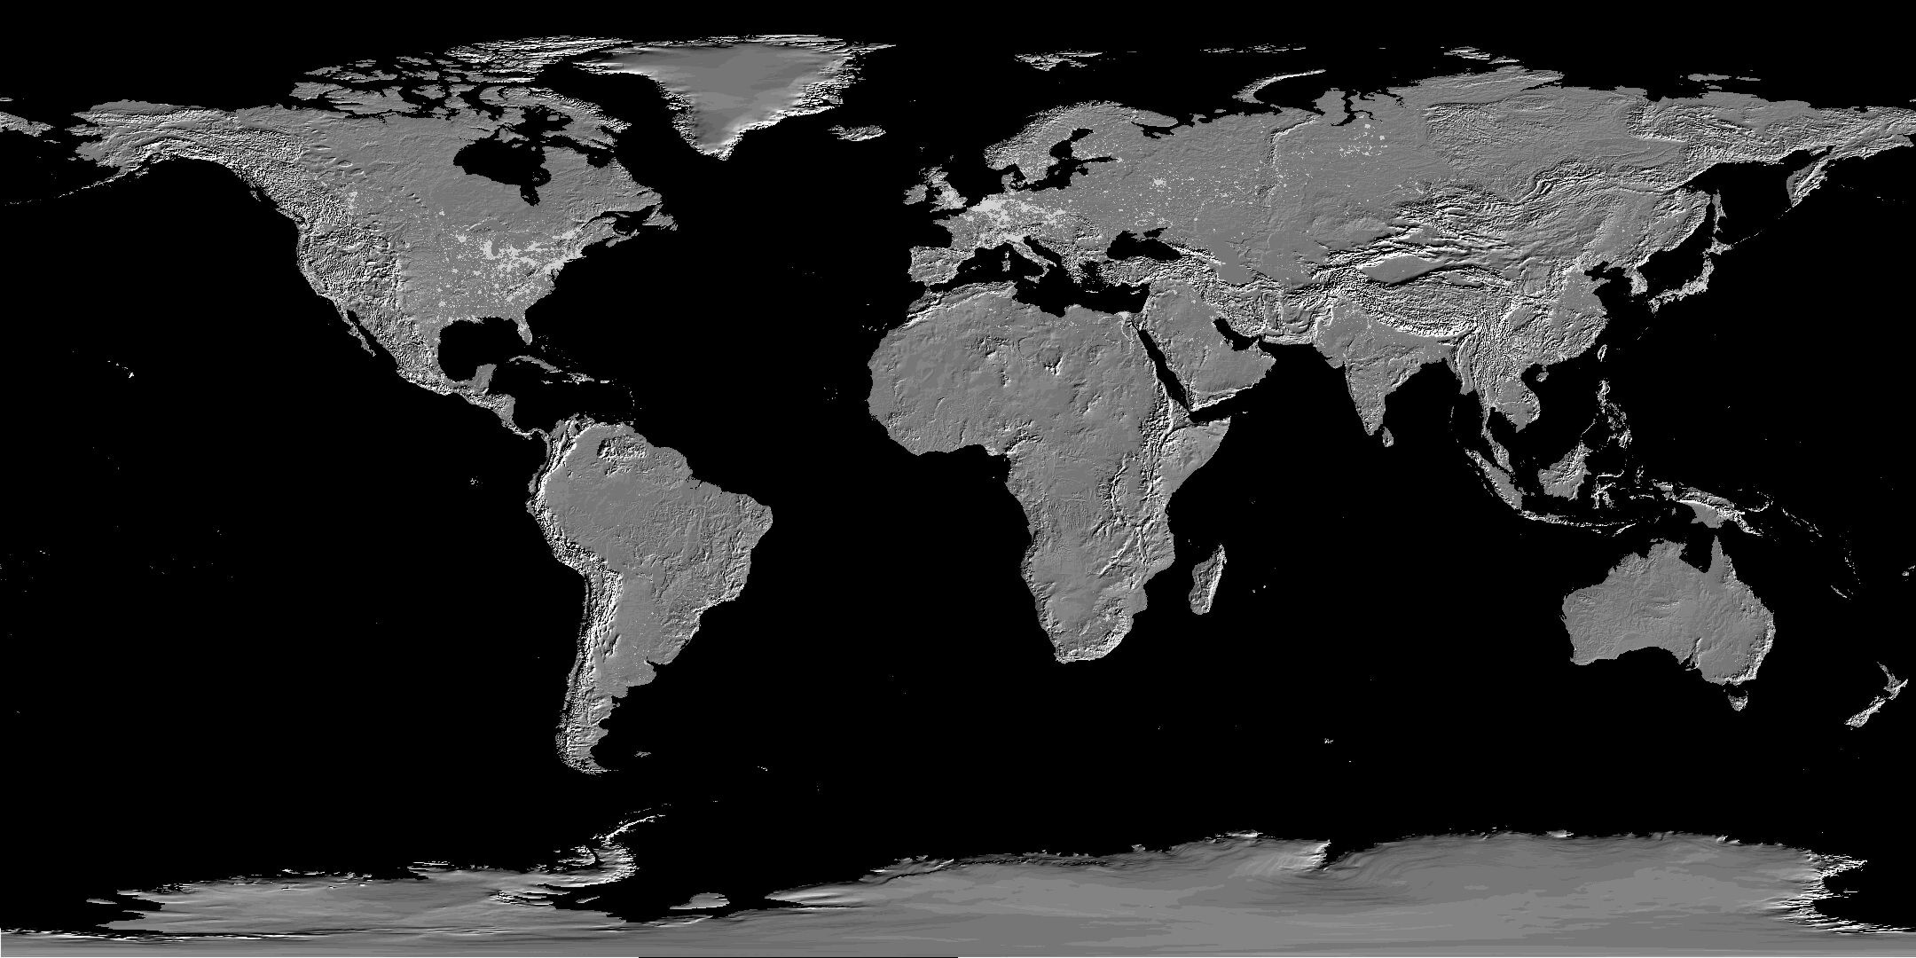
Vulnerability of the Carbon Cycle in the 21st Century
Land
Permafrost
Oceans
HL Peatlands
CH₄ Hydrates
Biological Pump
Solubility Pump
T Peatlands
Veg.-Fire/LUC
Many Pools and Processes not in GCMs
Field and Raupach 2004
Global Carbon Project 2005
Notes:
One of the primary ways that terrestrial ecosystems feedback to climate change is through the carbon cycle.
This is a slide shows most likely terrestrial ecosystems/processes that may have a feedback to climate change
This slide shows Fire in tropical & boreal, peatlands in tropics and high latitudes, and permafrost
These are so-called vulnerable terrestrial C pools that have a high likelyhood of being transferred to the atmosphere over the next decades to century.
But, they are not included in large scale climate models.
Focus today will be on high latitude systems, and in particular, C in permafrost

Slide 6
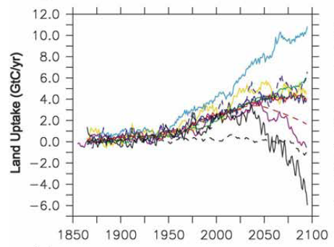
Net Terrestrial Carbon Uptake
2000-2008
Net Land Uptake
3.0 Gt C/yr
[Friedlingstein, 2006]
Notes:
Why do these Vulnerable C pools matter? They can have a large influence on how we expect the terrestrial biosphere will respond in a future climate.
This shows a model intercomparison with coupled C-climate models.
You can see that hindcasting the models have fairly good agreement with one another, and with current measurement shown with the red dot.
However, future projections vary wildly, due to our fundamental lack of understanding about mechanisms…

Slide 7
Permafrost Feedback to Climate Change
CO_{2,} CH₄
Organic matter
decomposition
°T
Permafrost
thaw
Notes:
Okay, focusing specifically on the feedback from permafrost carbon to climate…
I’ll start with this simplified feedback from permafrost thawing to climate that many of us have heard about from the literature or the popular press.
This positive feedback cycle goes like this. Human induced warming from fossil fuel emissions causes permafrost to thaw. Organic carbon that is frozen in permafrost soil then can decompose and be respired by soil fungi and bacteria as carbon dioxide and methane. This contributes to future warming and continues the cycle.
There’s been a lot of recent attention on this feedback cycle, and questions about the potential impact on climate.
The strength of this feedback depends on 2 things: the size of the permafrost C pool, and the dynamics of this pool when thawed.
There have been important findings about both of these recently, and I am going to structure my talk today by first discussing the permafrost C pool, and then the dynamics.

Slide 8
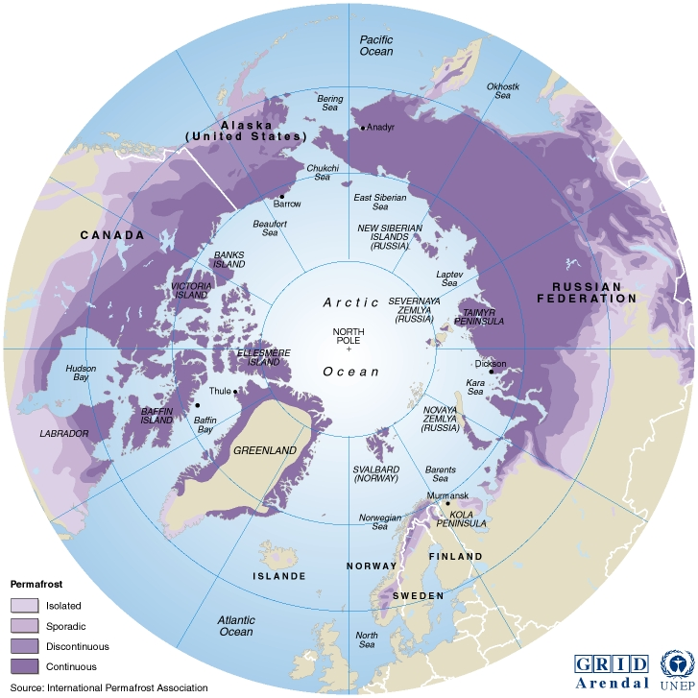
Permafrost Distribution
[from Brown
et al. 1998]
24% of NH Exposed Land Surface
Notes:
Permafrost is defined as earth materials below zero degrees for 2 consecutive years. Permafrost regions occupy 24% of Northern Hemisphere exposed land surface area.
This map shows the areal distribution of permafrost divided in the zones of continuous, discontinous, isolated, and sporadic permafrost that vary here on the map in shades of purple, and in the extent of permafrost.
Zones of continuous, discontinuous, sporadic, isolated -- differ based on spatial extent of frozen ground.
In the discussion of permafrost carbon, it is important to understand that budgets are presented for permafrost zones, whether or not there is actually permafrost present in any particular location.

Slide 9
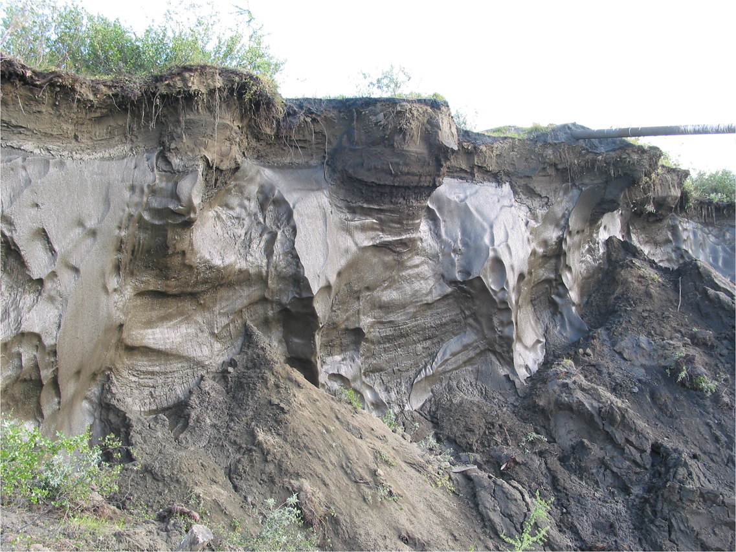
Permafrost Carbon: Mineral Soils
Active Layer
Ice Wedge
Permafrost Soil
Notes:
Permafrost C spans a wide range of soil types. Here are some examples: Siberian loess permfrost w/ ice wedges
This is a picture of permafrost soil from the continuous permafrost zone in NorthEast Siberia to give you an idea of what frozen ground can look like. This face is exposed by permafrost thaw and is about 10-15m in height.
Large massive ice wedges appear whitish, are regularly spaced, and are separated by frozen soils. These ice wedges have been frozen since the Pleistocene, and this is an example of permafrost with high ice content.
At this surface I have highlighted what is known as the active layer, which is the surface layer that thaws each summer and refreezes in winter. Here it is about 70 cm, and in general it can range between 30-150cm depending on location.

Slide 10
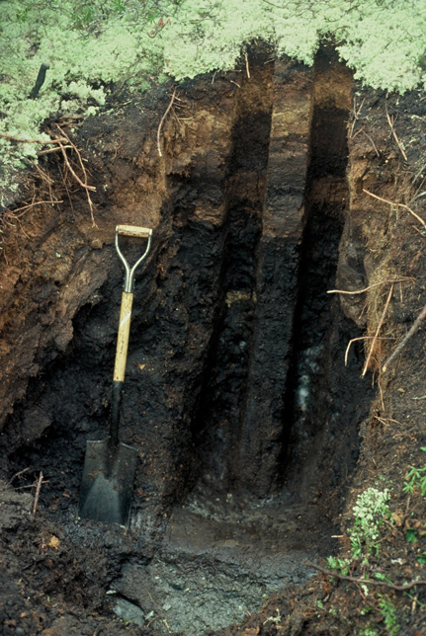
Permafrost Carbon: Peat Soils
Organic Soil
(>20% C)
Mineral Soil
Notes:
Canadian peat permafrost; Contrasting because of thick organic soil horizon.
This is a contrasting photo of a permafrost peat soil from Canada. This has a thick organic layer, which can be anywhere from 30cm to several meters, overlying permafrost. This accumulation of undecomposed organic material is promoted by cold and waterlogged conditions, and can insulate the permafrost below.
In the discussion of permafrost carbon, it is important to recognize that this includes a wide range of soil types.

Slide 11
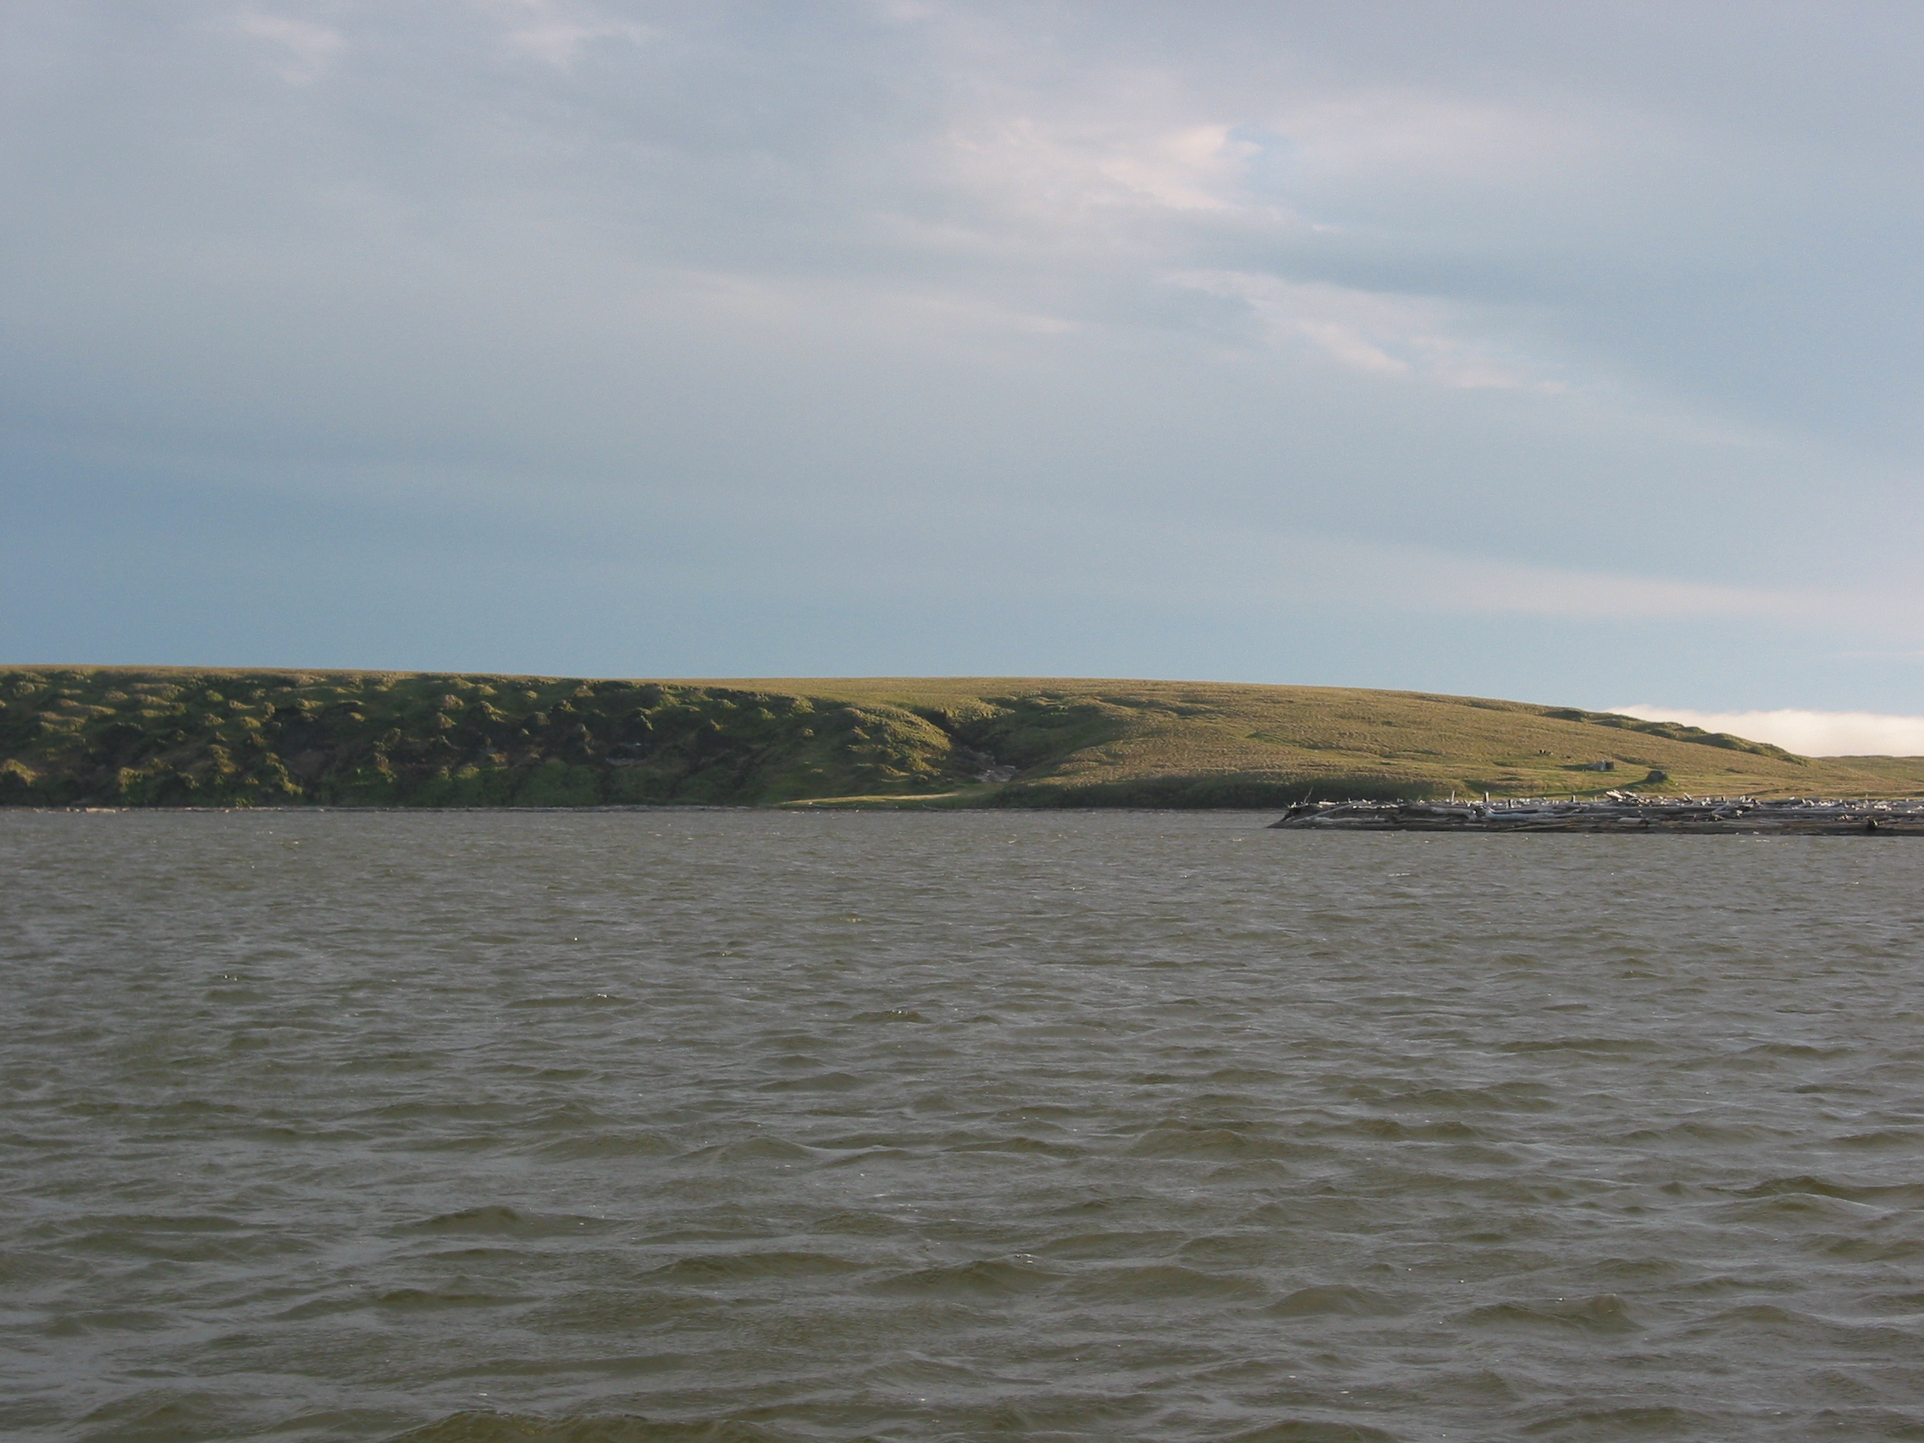
Global Carbon Pools
Global Vegetation C 650 Pg
Global Soil C (1m) 1500 Pg
Atmosphere 777+ Pg
Permafrost Zone Soil C
Peatlands (several m) 277 Pg
Mineral Soil (3m) 747 Pg
Siberian Deep C (~25m) 407 Pg
Alluvial Deep C (~25m) 241 Pg
1672 Pg
[Jobaggy 2000, Field et al. 2007, Zimov et al. 2006, Tarnocai et al. 2009, Schuur et al. 2008]
Notes:
This shows the size of different global C pools, and for comparison the new numbers for permafrost C
Units of Pg, billion tons, or gigatons
Peatlands -- others outside of permafrost zone
Deep C inventories are first order approximation, very rough at this time, but represent a best guess.
Bottom line is that permafrost C is a substantial reservior of C, and because of how it has become stored due to cold and waterlogged conditions, is likely to be sensitive to changes in climate.
New estimate for high latitude soils is roughly 3-4 larger when deep soils are included (450 Pg previous)

Slide 12
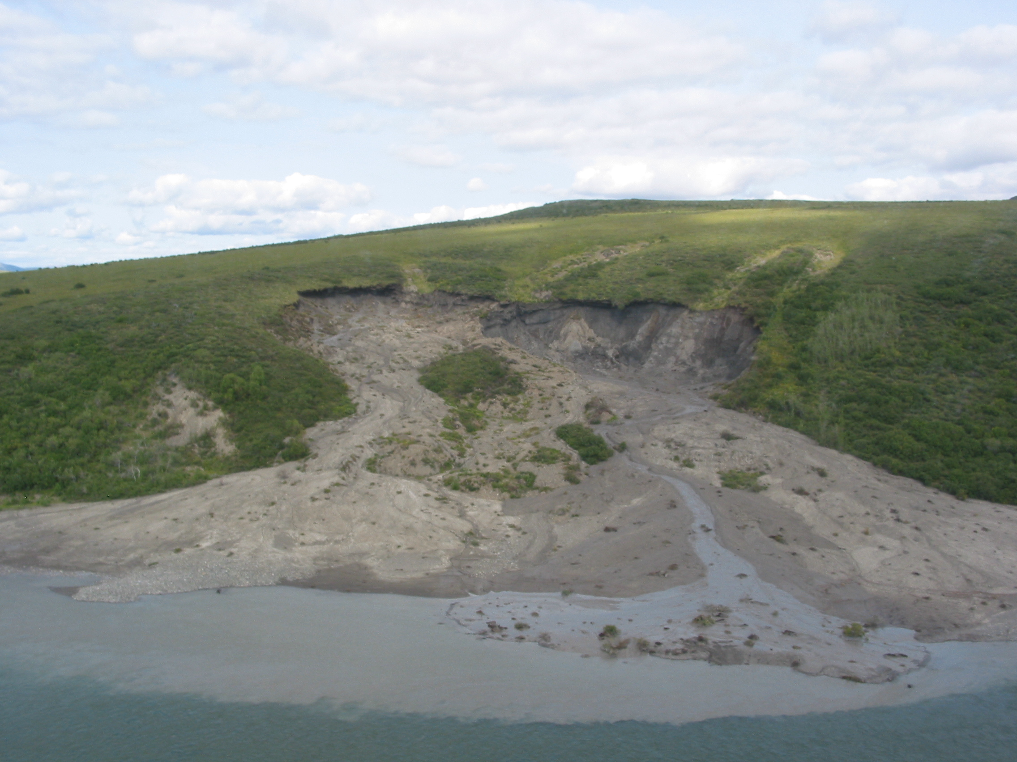
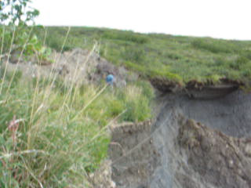
Permafrost Thaw: Threshold Dynamics
8
Biological
Threshold
Minimal Thaw
Moderate Thaw
6
Severe Thaw
Ecosystem Respiration
(umol CO₂ m⁻² sec⁻¹)
4
2
[Schuur et al. 2009]
0
-10
-5
0
5
10
Soil Temperature (ºC)
Physical
Threshold
Notes:
Now that we’ve covered the permafrost carbon pool size, Id like to turn to the dynamics of permafrost thaw since this will control how fast C can enter the atm
The interesting (and potentially maddening) thing about this problem is that the freezing point is an identifiable threshold point that affects biological and physical processes that ultimately control the release of permafrost C.
Top graph shows exponential relationship with temperature; both above and below zero, but one cannot predict the other.
Bottom figure shows physical threshold when ground ice melts, this can collapse the very structure of the ground leading to rapid thaw rates locally

Slide 13
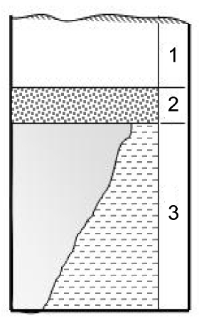
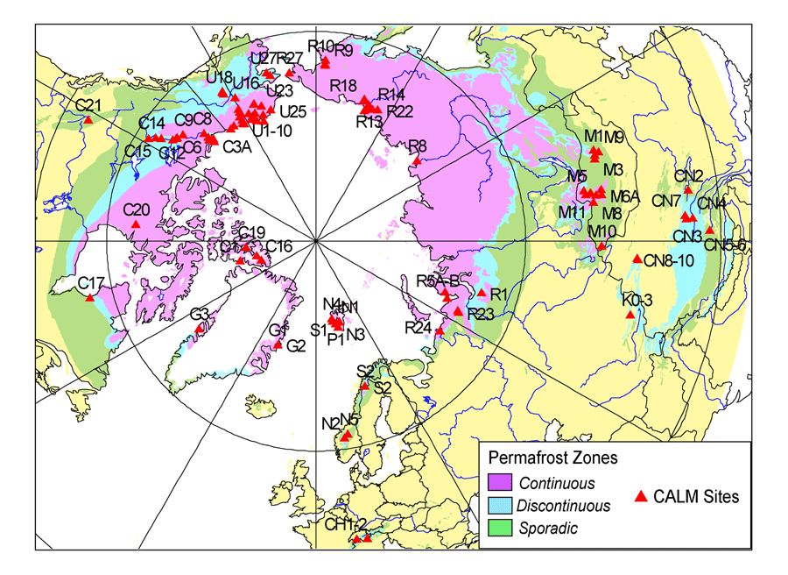
Permafrost Thaw: Active Layer Thickening
Projected Thaw (to 0°C):
Continuous Zone: 150 years
Discontinuous Zone: 60 years
Active
Layer
Transient
Layer
Permafrost
Soil
Circumpolar Active Layer
Network (CALM)
[Nelson et al. 2004, Oelke & Zhang 2004 ]
Notes:
For regional measurements of permafrost thaw, the simplest mechanism is to consider:
Permafrost thaw mechanisms: active layer thickening and the degradation of surface permafrost
Active layer is measured across the northern hemisphere with the CALM network. Simple projections using the rate past several decades of permafrost thaw project that permafrost will reach the thaw point sometime this century in the discontinuous zone and next century further north.

Slide 14
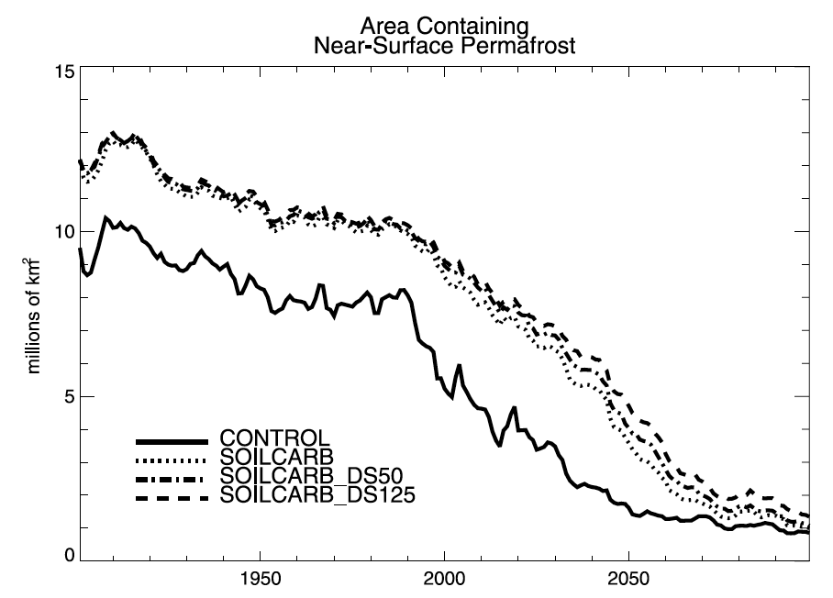
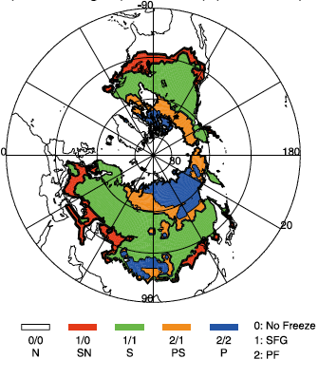
Permafrost Thaw: Model Projections
Degradation of Near Surface Permafrost:
85-90% reduction by 2100
[Lawrence et al. 2008, Lawrence et al. 2005]
60% reduction by 2100
[Saito et al. 2007]
66% reduction by 2100
[Euskirchen et al. 2006]
Notes:
This type of surface permafrost degradation has been projected by more sophisticated models that include future climate change.
Here I show a few regional or global scale model results – this is not the full range of warming scenarios, but instead represent a 7-8deg warming at high latitudes,
Which is consistent with a global average warming of 2 deg.
Different model scenarios predict slightly different trajectories of near-surface permafrost degradation, but many do show widespread thaw during this century

Slide 15
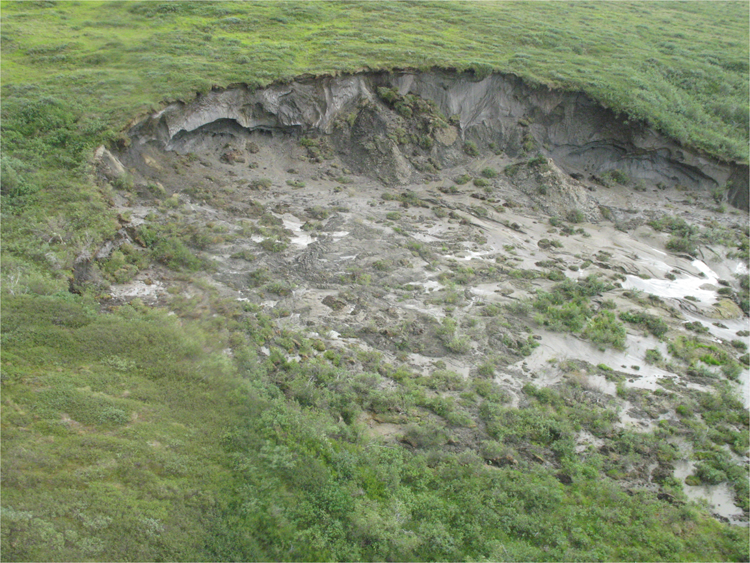
Permafrost Thaw: Thermokarst
Thermokarst Distribution (Alaska):
54% Continuous Zone
5% Discontinuous Zone
[Jorgenson
et al. 2006]
Thermokarst Change Over 5 Decades (Alaska):
0.6% → 4.4%; Continuous Zone
26% → 33%; Discontinuous Zone
[Jorgenson
2008]
Notes:
The story becomes more complicated considering these more abrupt form of permafrost thaw.
This headwall in this picture is ~20m, making this half the size of a football field; a feature like this can start to thaw and degrade in a single or few growing seasons
This is as result of internal thaw mechanisms that operate in a positive feedback to amplify initial permafrost thaw
Permafrost thaw mechanisms: thermokarst & distribution.
There is no global scale observation network to monitor these thermokarsts.
Here are a few statistics from Alaska, but I note that these rates may only be valid for these specific areas

Slide 16
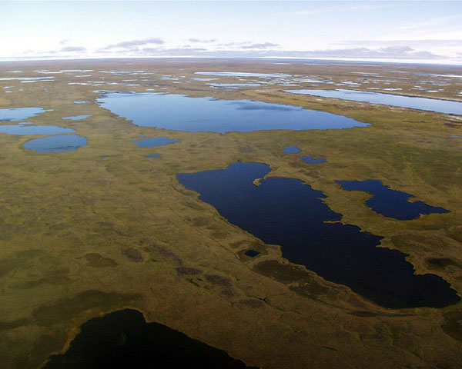
Thermokarst: Lowlands
Lake Area Changes
(Siberia; 1973-1998):
+12% Continuous Zone
-13% Discontinuous Zone
[Smith et al. 2005]
Notes:
The last picture was upland permafrost undergoing thermokarst. In the lowlands or other areas of low relief, thermokarst lakes can form as permafrost degrades
Thermokarst Lakes: drying and wetting

Slide 17
Feedbacks to the Carbon Cycle
CO_{2,} CH₄
positive
feedback
negative
feedback
°T
decomposition
production
nutrient
availability
Notes:
Lastly, I have been discussing mainly the release of C from permafrost to the atmosphere.
To fully evaluate terrestrial feedbacks at high latitude, need also to consider processes that can offset permafrost emissions
Basically, increasing temperatures stimulate 2 processes; decomposition, which feeds back positively to climate change,
and, plant growth, either directly or indirectly through nutrient cycling, which feeds back negatively to climate change.
The question in terms of climate change really is which process is stronger. Greening of the Arctic? or Decomposing permafrost C?

Slide 18
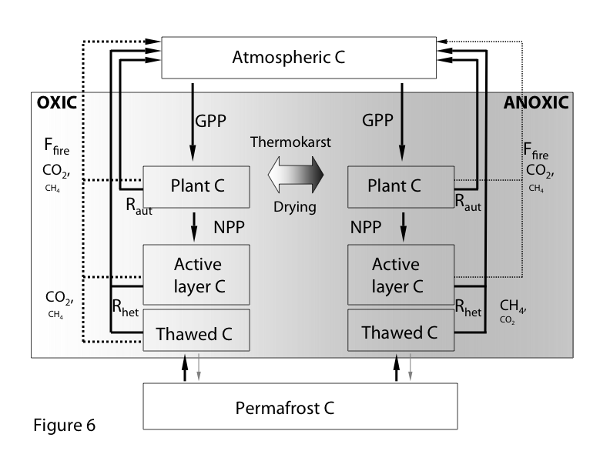
Permafrost Carbon Feedback to Climate
Schuur et al. 2008 BioScience
Schuur et al. 2009, Nature
Dorrepaal et al. 2009, Nature
Walter et al. 2006, Nature
Walter et al. 2007, Science
Notes:
All of these mechanisms are summarized in this conceptual figure, which represents a a landscape perspective of this carbon feedback to climate change.
Permafrost C, when thawed will either decompose in anaerobic or aerobic environment depending on landscape and site attributes. Each side of this graphic represents a rudimentary C cycle for a well drained or poorly drained ecosystem. Plants remove C from the atmosphere, and it is returned either through metabolism or fire.
In well drained landscapes, this is primarily through CO2, but in wetlands, there is CO2 and CH4 emissions.
On the landscape, these ecosystems are distributed across a gradient of drainage, and additionally, permafrost thaw can move systems along this gradient via phenomena such as thermokarst (ground subsidence) or drying as can happen when the permafrost surface, which perches water, recedes.
There’s been important work on this topic in both oxic and anoxic systems – I’m going to talk about some specific results from my own lab group; we’ve primarily been working in upland systems that are relatively well drained.

Slide 19
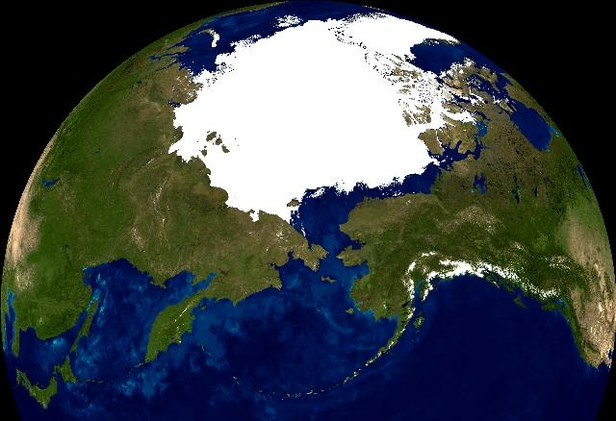
Eight Mile Lake Study Area
Healy
Notes:
Now I’m going to focus in on work that my research group has been doing located near the town of Healy Alaska, in Interior Alaska just outside of Denali National Park.
This is in the latitudinal band known as the zone of discontinuous permafrost, although there is is widespread permafrost in the location of the study site

Slide 20
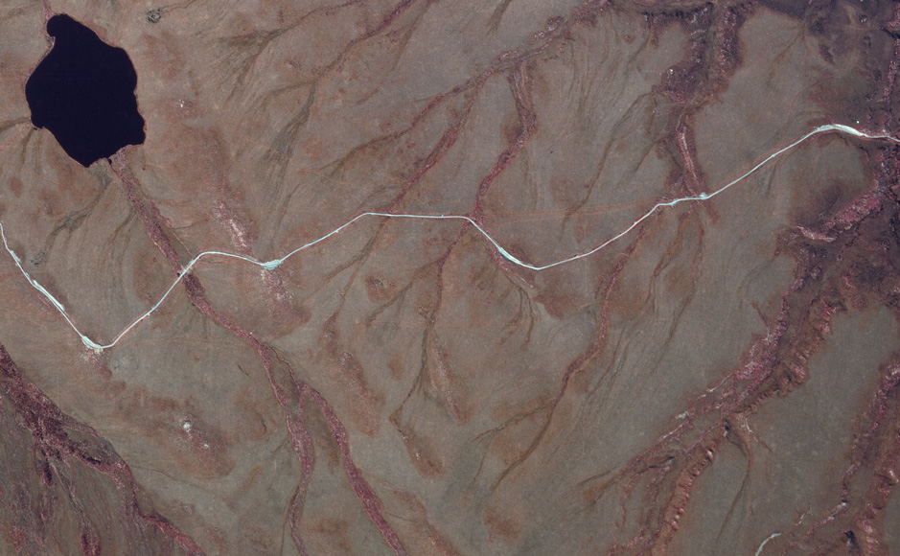
Eight Mile Lake Study Area
CiPEHR Project
Permafrost Thaw Gradient
Notes:
Im going to briefly show results from a couple of studies including a naturally occurring permafrost thaw gradient and a new experimental warming in tundra
What you can note in this picture is the tundra in tan/grey is striated with thermokarst terrain that has developed over the last few decades.
The first results I’ll show describe a series of sites that differ in the timing and the degree of permafrost thaw.

Slide 21
Old Carbon Loss
500
Minimal Thaw
Moderate Thaw
450
Extensive Thaw
400
Ecosystem Respiration
(g C m⁻² yr⁻¹)
350
300
250
R²=0.93
200
5
10
15
20
Old Carbon Loss
(%)
[Schuur et al. 2009 Nature]
Notes:
Here we show that as permafrost thaw increases from areas with little thaw to areas of increasing amounts of thaw, we see an increase in both the total respiration loss (C to the atmosphere), and also the loss of ‘old’ C measured with radiocarbon. This shows that this stored ancient C is now contributing increasing amounts to the modern C cycle.

Slide 22
Feedbacks to the Carbon Cycle
CO_{2,} CH₄
positive
feedback
negative
feedback
°T
decomposition
production
nutrient
availability
[Schuur et al. 2009 Nature]
Notes:
This study also showed an interesting dynamic with time. Within the first 15 years of thawing we found that plant growth appeared to be more sensitive to permafrost thaw in that the system took up C from the atmosphere.
Early with thawing, greening (increased plant growth) is the dominant feedback, but at the same time old C is already starting to be destabilized but it is masked by increased plant growth making this site a net sink of C.

Slide 23
Feedbacks to the Carbon Cycle
CO_{2,} CH₄
positive
feedback
negative
feedback
°T
decomposition
production
nutrient
availability
[Schuur et al. 2009 Nature]
Notes:
Later in the thaw process (Extensive site), Reco dominates. Here Old C loss continues to increase. Plant productivity is still higher than compared to the Minimal thaw site, but now the increased respiration makes this site a net source of C

Slide 24
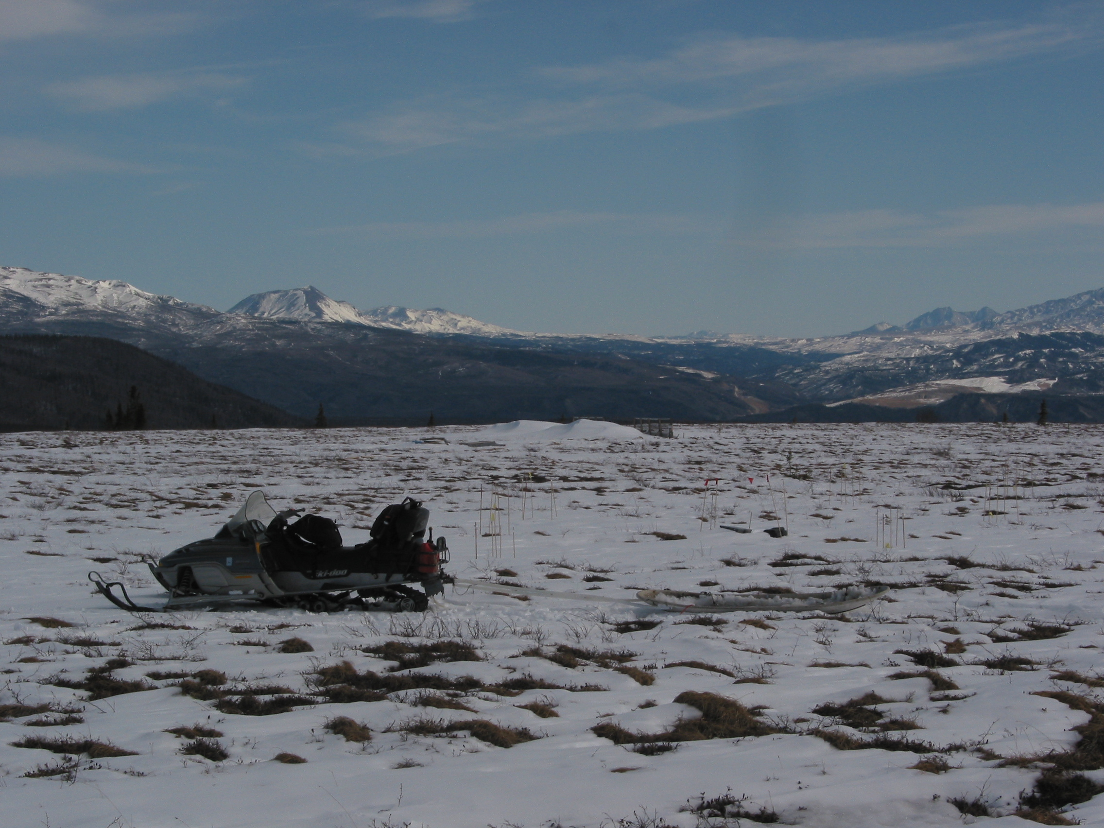
CiPEHR Project
(Carbon in Permafrost, Experimental Heating Research)
Two Treatments, Factorial
Winter Warming (Snow Fence + Snow Removal)
Summer Warming (Open Top Chamber)
Annual Warming (Combination)
Control (Ambient)
Replicated: 6 times w/ subreplicate plots
Established: Summer 2008
Next Step: Water Table Manipulation (2011)
Notes:
The permafrost thaw gradient was a great way to approach decadal scale response of permafrost thaw, but is also subject to other pre-existing conditions that we cannot control on a natural gradient.
To add to this knowledge, we recently started a warming manipulation that uses passive warming to warm in the summer, in the winter, and combined.
To warm in the winter, we established snow fences that accumulate a snow pack that you can see here in the background of this picture.
Snow fences are a common experiment, but the twist here is that instead of allowing the increased snow to persist in the spring, we remove the snowpack so that the manipulation is only of ground temperature, not of water or season length.
We combine this winter warming with summer open top chambers that increase air and soil surface warming
I will mention that this summer we have added plots in order to manipulate water table starting in 2011.

Slide 25
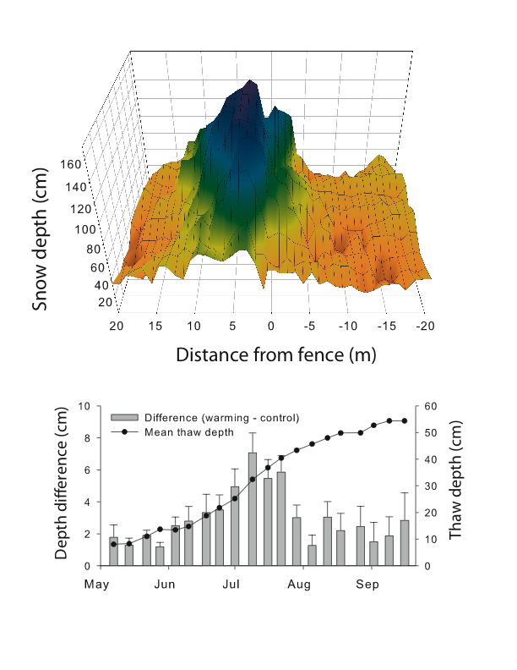
Winter Warming Causes Surface Permafrost Degradation
Natali et al. 2010,
Global Change Biology
Notes:
We’ve published the first year of these results and show that by increasing the snowpack (top), we increase the depth of thaw during the following summer growing season.
The black points show the seasonal depth of thaw with the grey bars representing the difference in thaw depth between the warming and control treatment.
In effect, this treatment was able to degrade the surface permafrost, which was a major limitation of past passive warming experiments that typically did not achieve this.

Slide 26
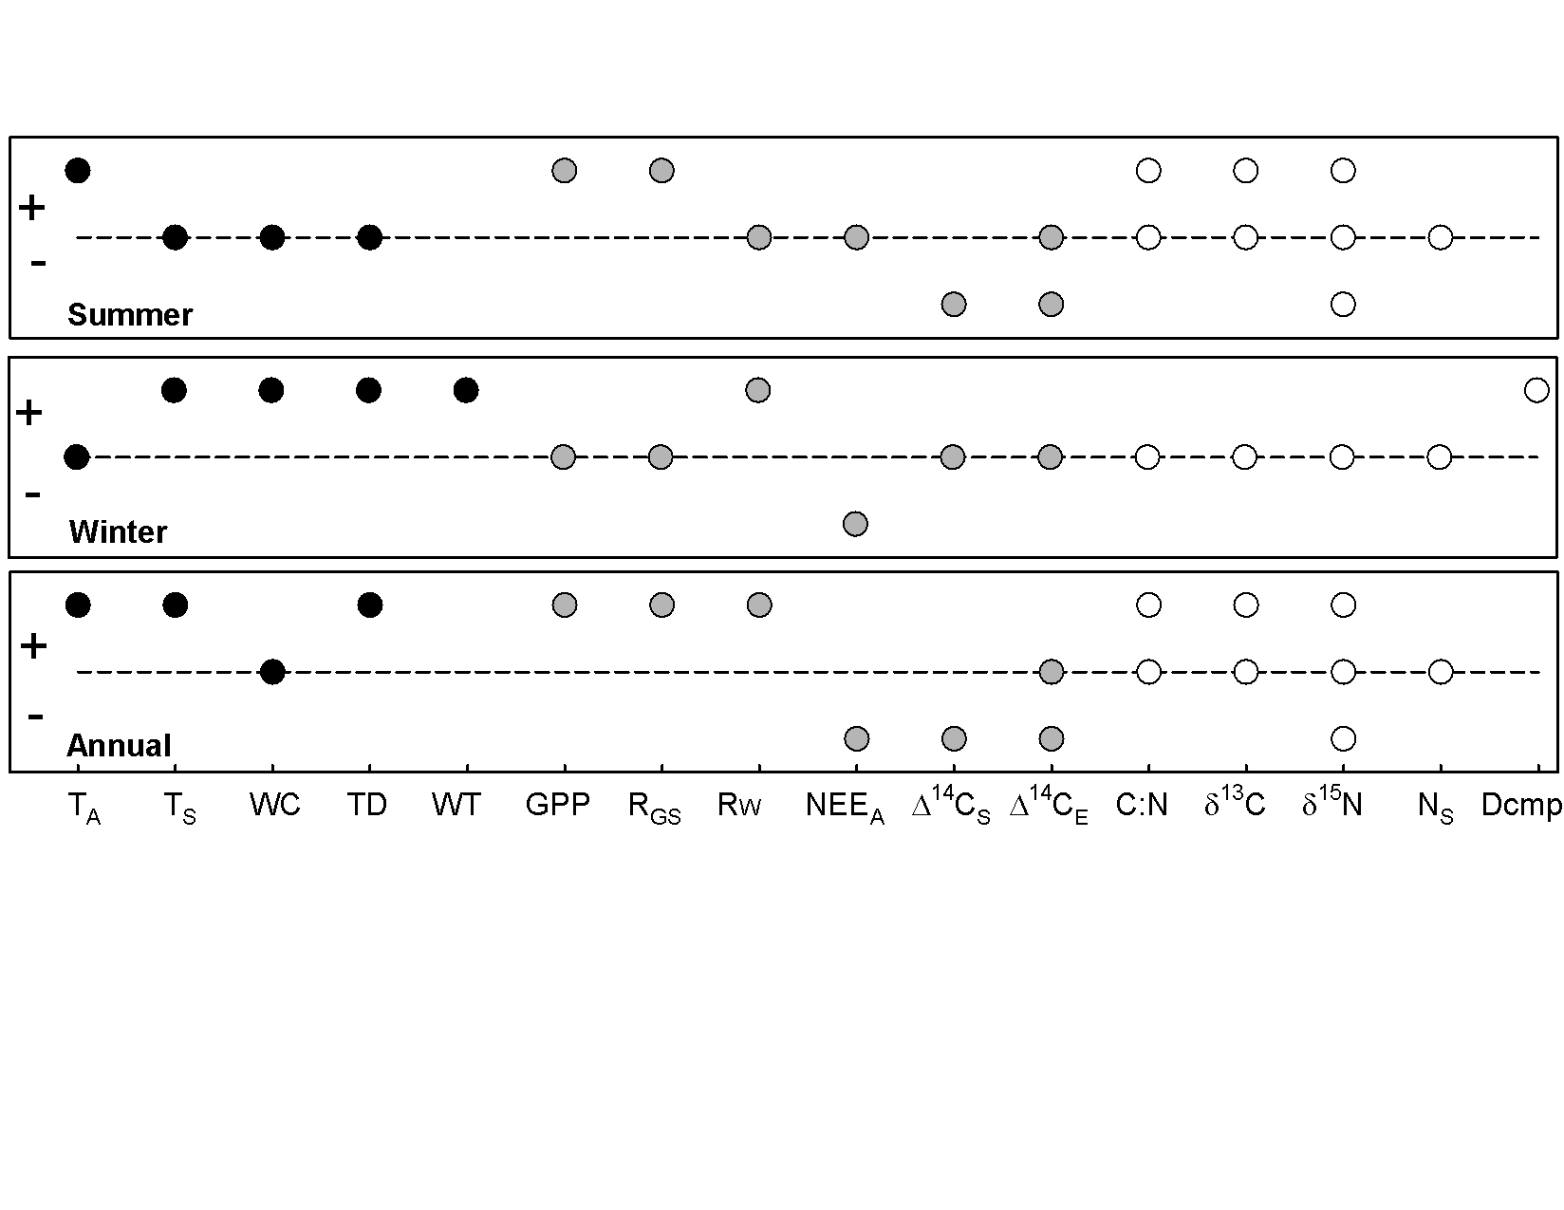
Ecosystem Response to Permafrost Thaw
Natali et al. 2010, Global Change Biology
Notes:
I’m not going to go in to great detail of this slide, but essentially it shows that for the 3 warming treaments (summer, winter, annual),
We are able to detect effects on the physical microclimate (black dots), the carbon cycle (grey dots) and various plant and soil metrics (white dots)
Dots above the line are a positive effect of warming, below a negative effect of warming.
While this experiment is a great first step for experimentally manipulating the permafrost thaw process, we are still limited by using passive warming – we cannot alter the magnitude of this warming response and must observe the effects of what the experiment gives us.

Slide 27
Permafrost Feedback to Climate Change
CO_{2,}CH₄
Organic matter
decomposition
°T
Permafrost
thaw
Notes:
Finally, I want to say a few words addressing the different C greenhouse gases that can be released by microbial activity: carbon dioxide and methane.
I’ve been talking about upland systems, where CO2 dominates as the feedback gas, but

Slide 28
Permafrost Feedback to Climate Change
CO_{2,}CH₄
Organic matter
decomposition
°T
Permafrost
thaw
Notes:
What about methane with its high greenhouse warming potential?

Slide 29
Permafrost Carbon Feedback to Climate
What is likely to be the relative importance of methane versus carbon dioxide release for future climate forcing?
Offsetting factors:
Global Warming Potential: ↑CH₄
C mineralization rate: ↑aerobic
Relative Climate Forcing
Aerobic CO₂ * GWP (1)
Anaerobic CO₂ * GWP (1)
+ Anaerobic CH₄ * GWP (25)
Schuur et al. 2008, BioScience
GWP = Global Warming Potential
Notes:
We can look at this question of:
Here we are looking at the relative climate forcing impact of permafrost carbon decomposing in an (largely) aerobic environment versus decomposing in a (largely) anaerobic environment.
To do this, for any single soil, I take the amount of C released as CO2 from the aerobic and multiply that by GWP.
Then, I divide that by the amount of C released both as CO2 and as CH4 from the anaerobic incubation, also multiplying those values by the respective GWP.
This compares the effect of a particular soil if it decomposed in an aerobic environment to if it decomposed in an anaerobic environment.

Slide 30
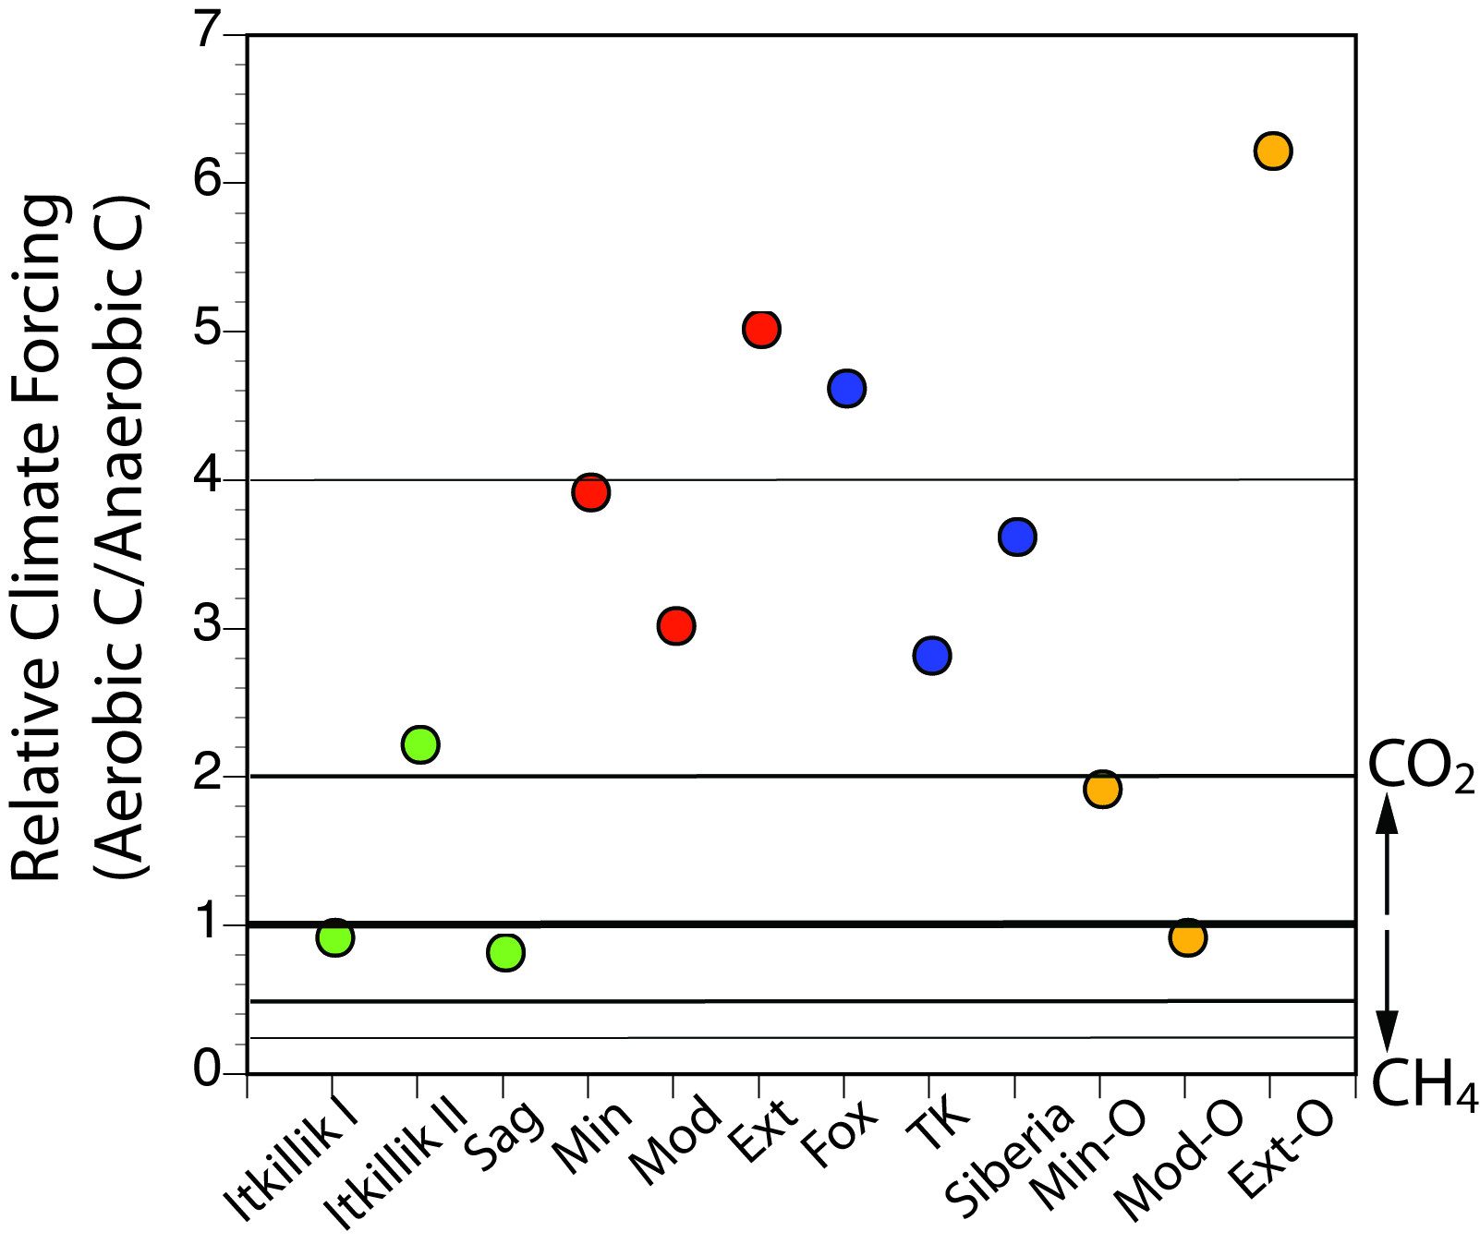
Relative Climate Forcing
Lee, Schuur, in prep
Notes:
Same incubation data shown as this ‘Relative Climate Forcing’ index.
The line at 1 is in bold. This is where the effect in aerobic is equal to that in anaerobic. I also put thinner lines to show 2:1 and 4:1 in favor of CO2 and the equivalent matching for methane down below. These lines are just to give you a sense of the possible scale.
Remember, this index takes into account GWP and the difference in C emission rate together. If the climate impact was driven only by GWP, the points would fall along the bottom at a value of 0.04.
There is variation among the soils in this relative climate forcing index.
From these data, we have a couple of points at the 1:1 line, 1 below, but 9 out of 10 points are above the line, showing that for each of these soils, it would have a greater climate impact were it to decompose in an aerobic environment and release only carbon dioxide.

Slide 31
Permafrost Thaw: Methane
Ebullution loss (CH₄) 95% of total
Siberian thaw lakes
1974-2000 ↑58%
Siberian thaw lakes
>Last Glacial Max. 33-87%
East Siberian Arctic Shelf Equal to global
Ocean CH₄ Venting total
Walter et al. 2006, Nature; Walter et al. 2007, Science; Shakova et al. 2010 Science
Notes:
These results do not downplay the importance of methane. Indeed there have been important discoveries about the methane cycle in recent years. I don’t have time to review the details of this work, but I highlight some recent findings here.
Thermokarst Lakes: drying and wettingSiberian Thaw Lakes developed after the LGM contributed 33-87% of the increase in atm methane that occurred at that transition (increase from 400-700ppb) 9-11kya
The take-home message is that in terms of the full climate feedback effect from permafrost thaw, both methane and carbon dioxide emissions are likely to play a significant role, and that we ignore either at our own risk.

Slide 32
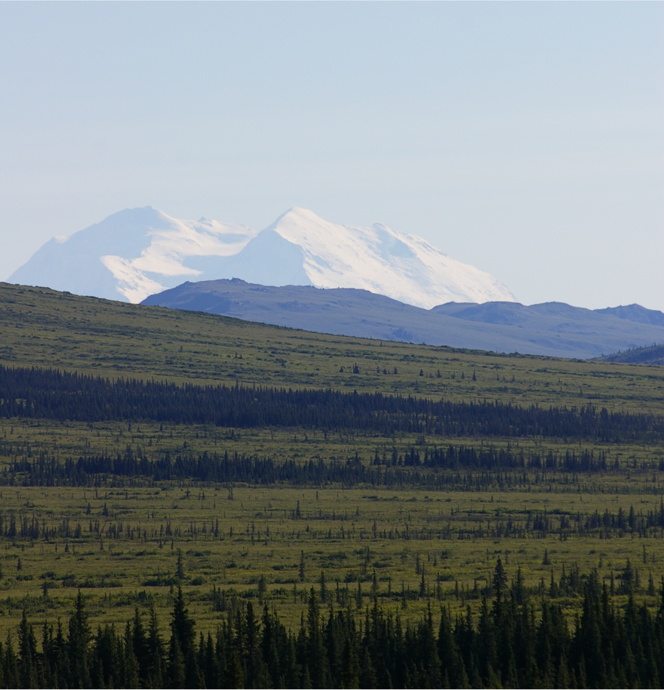
Permafrost Carbon Emissions
Permafrost Zone Soil C
Gelisol Soil Order (3m)* 818 Pg
x 9.4-12.9%
77-106 Pg**
Permafrost C Loss (0.8-1.1 Pg/yr)
Current Land Use Change*** (1.2±0.6 Pg/yr)
*Tarnocai et al. 2009, **Schuur et al. 2009, ***van der Werf et al. 2009
Notes:
Finally, I’d like to end with this calculation of permafrost C based on the field measurement from the thaw gradient I showed earlier.
This really is a back of the envelope calculation in CO2 equivalents.
If we take a conservative value for surface permafrost and multiply it by the net loss rate (this includes greater uptake by plants)
If we use the surface 3m permafrost C pool size, and extend this same net C loss assuming surface thawing, as some models have already predicted,, we expect that ~90Pg loss by the end of the next century.
To put this in perspective with other biospheric terms in the global C cycle
This land use term is currently about 1.2 Pg.
This data suggest that the contribution from permafrost thaw could be of similar magnitude with widespread thawing in the future, and important enough to include explicitly in global C balance calculations.
While I hope that I have convinced you of the potential importance of the permafrost C feedback to climate, I want to make the final point that this contribution from Permafrost C would likely continue over centuries time scales, releasing many hundreds of Pg of C.

Slide 33
Conclusions
Permafrost C pools are large and quite sensitive to changes in temperature
Rapid (decadal scale) destabilization of these pools is possible given threshold dynamics
Future annual contribution to the atmosphere could be similar in size to land use change, but is currently poorly constrained
Notes:
Summary

Slide 34
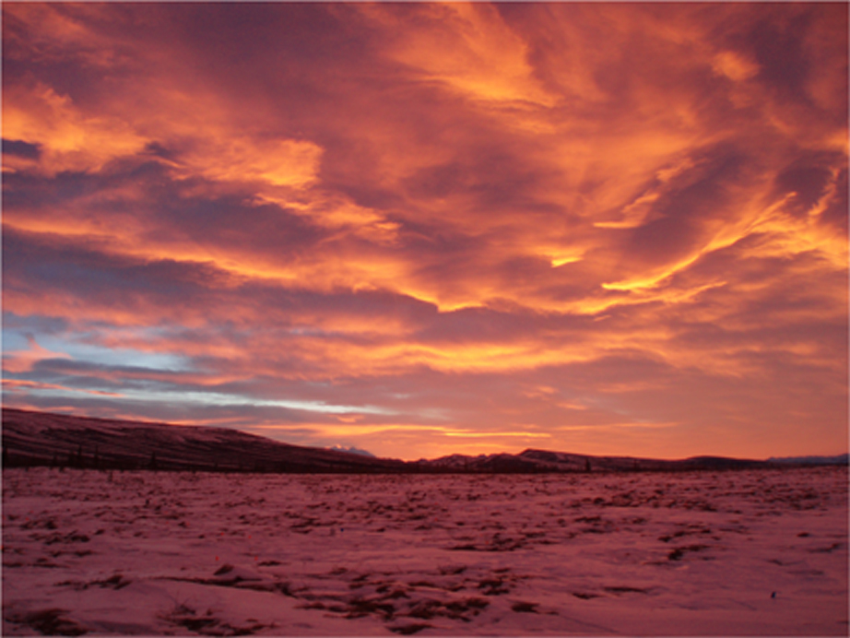
Acknowledgements
People: Florida Ecosystem Ecology Research Laboratory, NCEAS Vulnerability of Permafrost Thaw Working Group, Bonanza Creek LTER
Funding: NASA New Investigator Program, NSF Ecosystems, DOE NICCR, Andrew W. Mellon Foundation, Bonanza Creek LTER, Denali National Park and Preserve, NSF CAREER Program, NSF OPP

