Slide 1
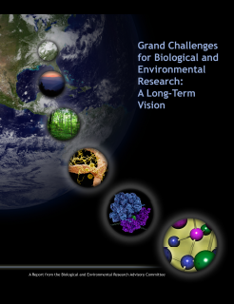
Grand Challenges for Biological and Environmental Research: A Long-Term Vision
DRAFT
Overview of the Report from the March 2010 Workshop
Gary Stacey BERAC Chair University of Missouri
BERAC Meeting September 16, 2010

Slide 2

Workshop Development and Planning

Slide 3
Workshop Development and Planning
Charge letter from William Brinkman, DOE Office of Science Director
Look beyond near- to mid-term time horizons to coming decades
Key workshop goals:
Identify greatest scientific challenges in biology, climate, and environment that DOE will be facing
Describe how BER should be positioned to address these challenges
Determine new and innovative tools needed to advance BER science
Suggest how to train the future workforce in integrative system science
Series of conference calls
4 white papers:
Grand Challenges for Systems Biology
Systems Integration Framework of Informational and Synthetic Biology
Twenty Year Vision for Climate Change
Systems Sustainability for Energy Options

Slide 4
Workshop Development and Planning
Workshop held March 3-4, 2010
Four disciplinary breakout discussion groups
Systems Biology
Information and Synthetic Biology Systems Integration Framework
Climate Change
Research Framework for Energy Sustainability
Four interdisciplinary breakout discussion groups
Understanding Systems Across Temporal and Spatial Scales
Meeting Workforce and Education Needs
Data Integration and Knowledgebase Development
Novel Tools, Techniques, and Probes

Slide 5
Workshop Results

Slide 6
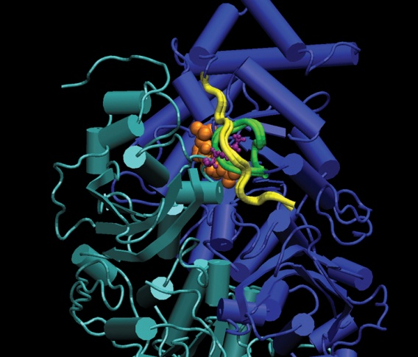
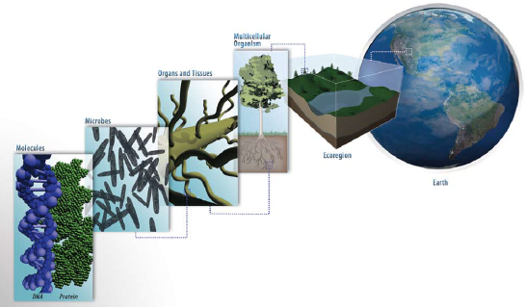
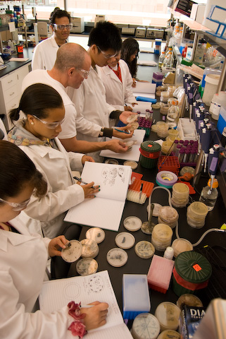
Workshop Results
Cross-Cutting Themes
Complexity
Scales
Multidisciplinary research
Computing and mathematics
Education
Human impacts

Slide 7
Grand Challenges
Workshop Results
Biological Systems
Systems biology provides the approaches needed to address biological complexity, while synthetic biology tests this understanding through application.
Computational Bioscience
Biology is becoming a data-intensive, informational science that requires new paradigms to deal with data management and complexity.
Climate Research
Issues of climate change and sustainability require that we develop a better understanding of earth system processes.
Energy Sustainability
An essential component of energy sustainability is fundamental knowledge of relevant natural and physical processes, their interactions and human influences.
Education and Workforce Training
The imperative need is to educate our future workforce to think about properties
of whole systems, which rarely can be explained as an accumulation of parts.

Slide 8



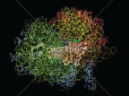
Grand Challenges in Biological Sciences
Workshop Results
Systems and synthetic biology for
Enabling predictive biology
Measuring and analyzing biological systems
Exploring ecosystem biogeochemistry and carbon cycling
to achieve DOE missions in energy production, carbon biosequestration, and environmental remediation

Slide 9
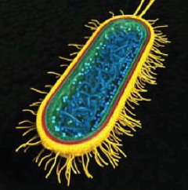
Grand Challenges in Biological Sciences
Workshop Results
Enabling Predictive Biology:
Develop a functionalized simulation model of a single cell for accurately predicting phenotype from genotype-environment interactions
Establish new model organisms for relevant ecological process understanding
Improve capabilities for imaging a single cell at a resolution of one molecule per cell
Use robust biochemical, functional, and experimental evidence to enhance genome and metagenome annotation
Develop the biological understanding for generalizing and applying models from simple systems to more complex systems
Identify and articulate general design principles that distill our understanding of biology

Slide 10
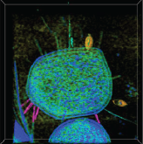
Grand Challenges in Biological Sciences
Workshop Results
Measuring and Analyzing Biological Systems:
Apply advanced computational and analytical capabilities to characterize the information molecules and network interactions used by biological systems
Measure microbial processes and interactions in the real world and in experimental simulations
Provide standardizable, reproducible sampling protocols and observations enabling functional characterizations of systems and synthetic design
Define the range of analytes, ligands, and fluxes of materials to be measured
Define scalability requirements for measurement technologies and develop capabilities for in situ and in vitro sensors

Slide 11
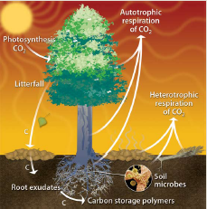
Grand Challenges in Biological Sciences
Workshop Results
Exploring Ecosystem Biogeochemistry and Carbon Cycling:
Understand, predict, and manipulate the types and rates of ecosystem responses and feedbacks that result from and influence climate change
Deploy synthetic (or nonsynthetic) biology to understand and manipulate ecosystem function
Determine the molecular basis of robustness, fitness, and selection
Develop a complete understanding of the biogeochemical cycles important to regulating carbon flux through biological systems
Apply functional metagenomics to enable mass balance closure for biogeochemical cycles and transfer this information to biosystem design

Slide 12
Grand Challenges in Biological Sciences
Workshop Results
Exploring Ecosystem Biogeochemistry and Carbon Cycling: -continued
Manage plant and microbe stress response to control carbon biosequestration and remediation of metals and radionuclides
Define the fundamental microbial basis for permafrost carbon-methane transformations
Develop designs for optimizing carbon flow for biomass production, carbon allocation, and biosequestration to reduce rates of atmospheric CO₂ accumulation and to increase terrestrial carbon storage by 50% in 20 years
Determine carbon and nutrient dynamics in natural systems

Slide 13
Grand Challenges in Computational Bioscience
Workshop Results
Establish a new data management paradigm
Create a new publishing paradigm
Develop a new computing paradigm
Standardize experimental protocols and methods to increase interoperability
Improve data quality
Ensure scientific productivity
Develop virtual laboratories

Slide 14
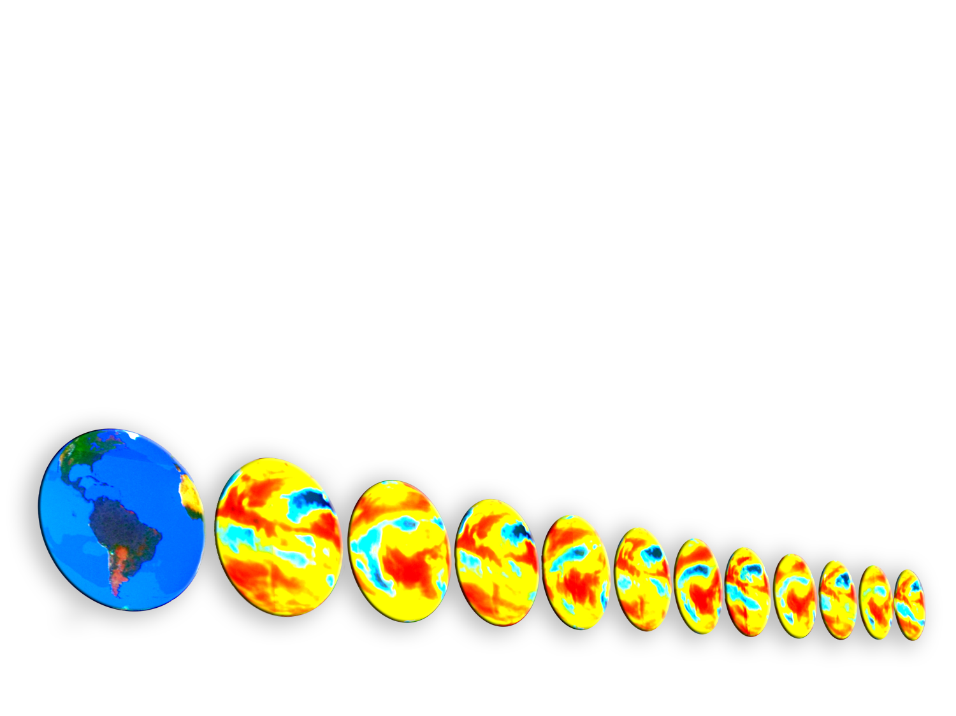
Grand Challenges in Climate Research
Workshop Results
Earth System Models
Develop higher-resolution models to integrate many more relevant processes than current models and to describe climate change over much longer time scales
Cloud and Aerosol Processes
Improve parameterizations for microphysics, radiative transfer, and turbulence processes to quantify indirect aerosol forcing and resulting precipitation changes
Ocean and Terrestrial Processes
Develop ecosystem-observing systems to monitor biogeochemical cycles in ocean and terrestrial biospheres, including subsurface soils

Slide 15
Grand Challenges in Climate Research -continued
Workshop Results
Biological Processes
Advance understanding of important biological interactions and feedbacks to identify potential tipping points and possible mitigation strategies such as carbon biosequestration
Human Interactions
Improve integration of anthropogenic climate forcings into ESMs and develop new techniques to evaluate these coupled models at both global and regional scales
Observing Systems
Establish new observational technologies to comprehensively compare ESM predictions with observations and to quantify model errors

Slide 16
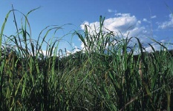
Grand Challenges in Energy Sustainability
Workshop Results
Analyze and compare potential approaches to organize land use, water use, and energy systems in ways that achieve sustainable energy, food, biodiversity, and ecosystem functioning
Identify and characterize potential Earth system drivers, feedbacks, and vulnerabilities to state changes so that their consequences and triggers might be avoided
Develop unifying models and frameworks capable of testing and evaluating the significance of potential global change issues, including energy, land use, and water. The impacts these issues have on both society and the environment also must be tested and assessed.

Slide 17
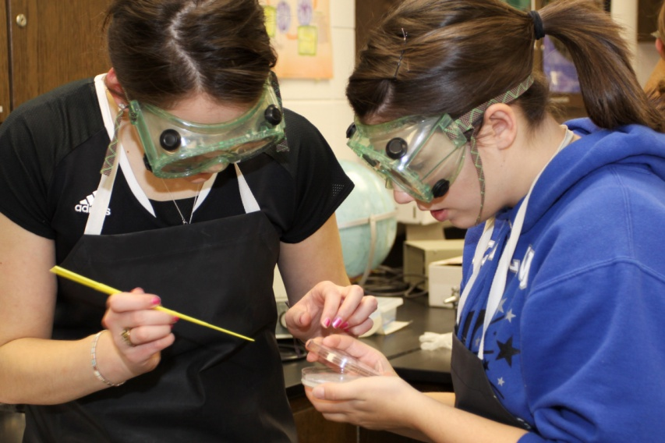
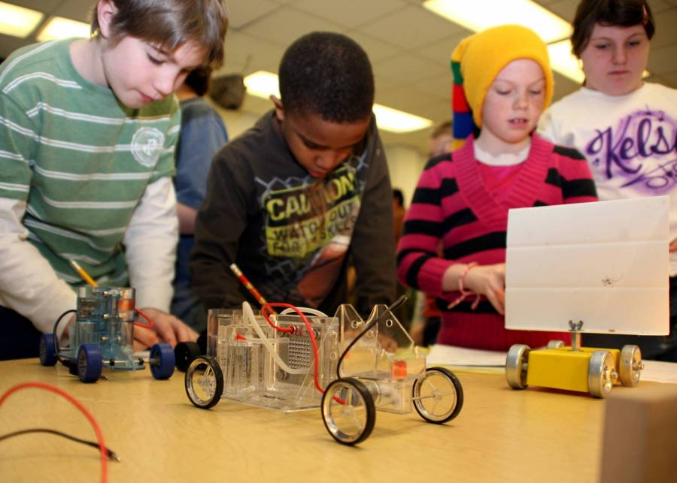
Grand Challenges in Education and Workforce Training
Workshop Results
Engage science educators
Develop a centralized education mission
Initiate interdisciplinary fellowships
Enhance career development programs
Support engineering education
Install education experts at the national laboratories
Develop collaborative teaching programs

Slide 18
Grand Challenges for Biological and Environmental Research: A Long-Term Vision
Thanks are due to many people…including
Workshop steering committee: James Ehleringer, Joyce Penner, Greg Pestko, David Randall, Peg Riley, Gary Sayler, and Mavrik Zavarin
All of the workshop attendees.
Workshop contributing authors…(listed p. v in the report)
DOE BER staff who ably assisted in the meeting planning
Betty Mansfield and her staff who put together such an attractive report
DOE BER for funding the effort
Dr. Brinkman and the Office of Science for initiating the process

