Slide 1

The Present and Future of
Climate Modeling
Warren M. Washington
National Center for Atmospheric Research
DOE/BERAC
March 2011

Slide 2
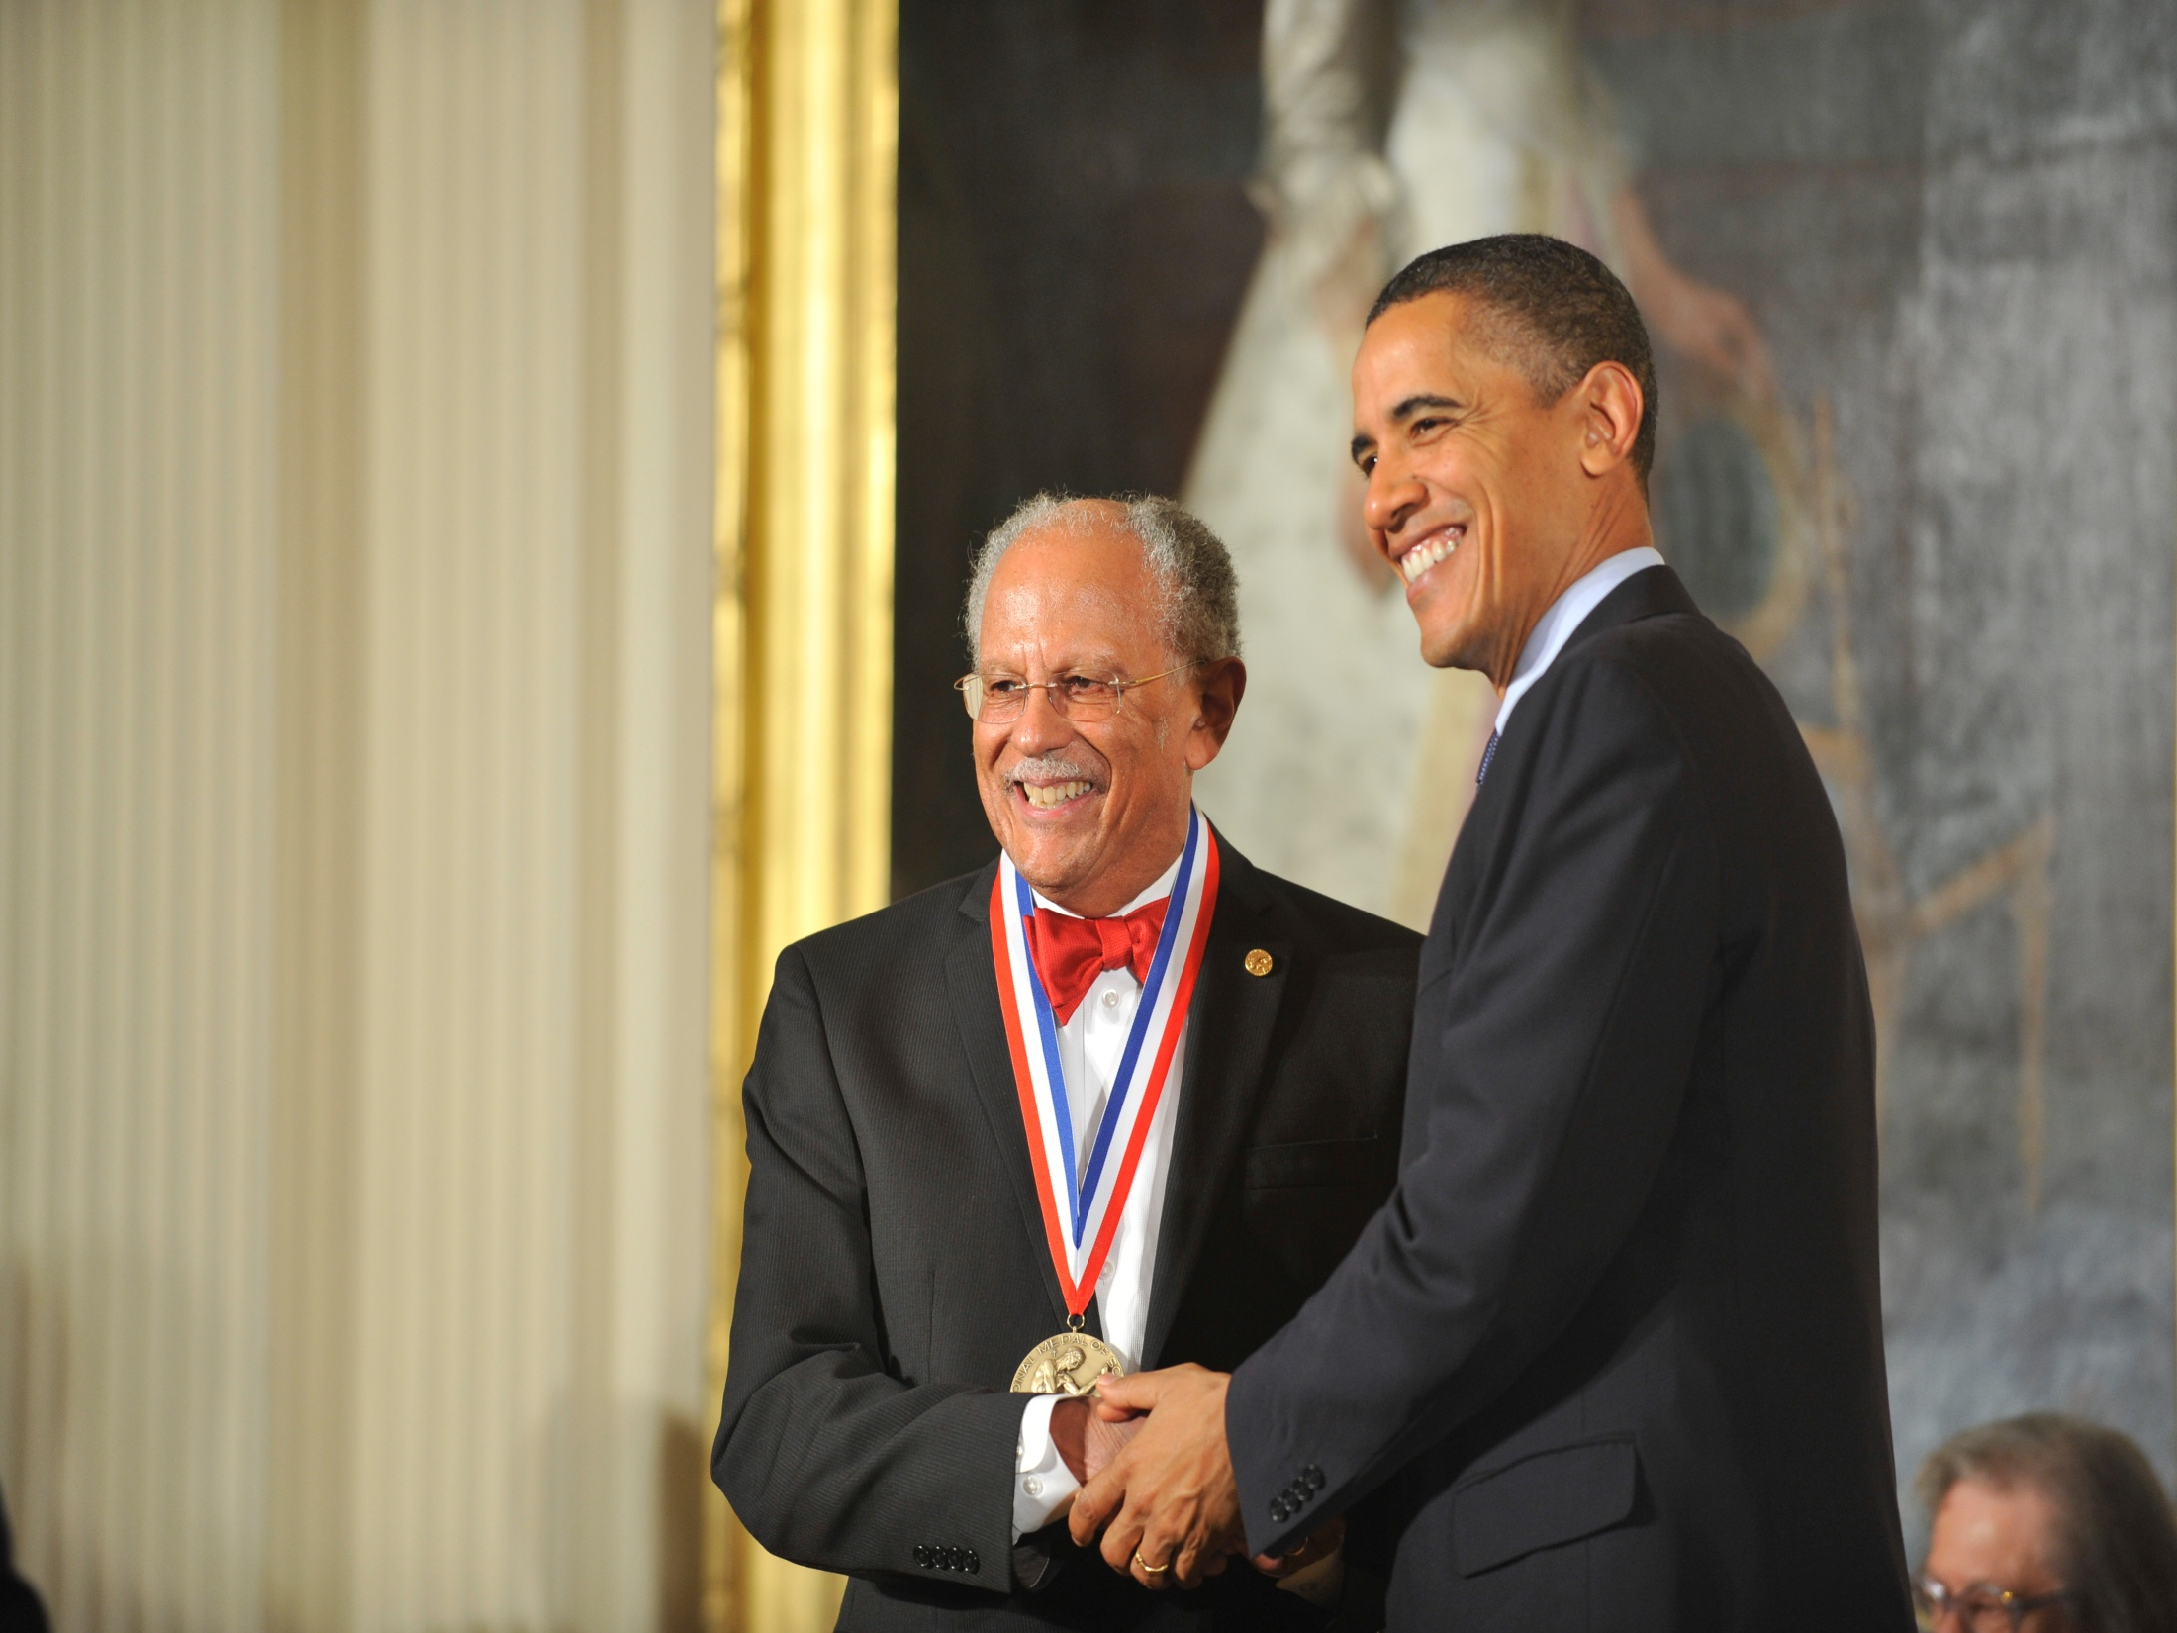

Slide 3
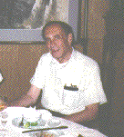
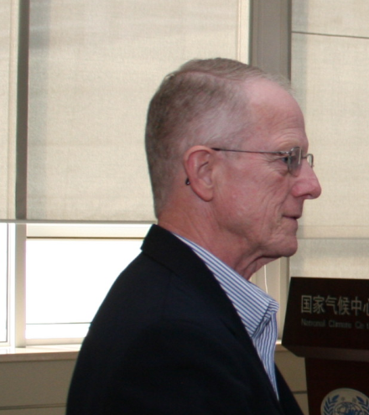
Early years working with DOE (1978)
Mike Riches
Fred Koomanoff

Slide 4
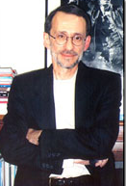
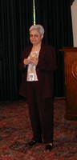
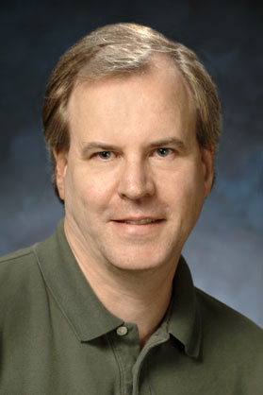



DOE Program Management
Ari Patrinos
(former Head of BER)
Jerry Elwood
Dave Bader
Anjuli Bamzai
Renu Joseph
Dorothy Koch

Slide 5
Overview
Brief history of climate change and modeling the climate system
Prediction of 20th , 21st, and beyond century climate change
Can we keep future global warming to a 2º degree goal?
Helping climate change policy formulation with trustworthy information on causation, mitigation, and adaptation.

Slide 6
The Observational Story

Slide 7
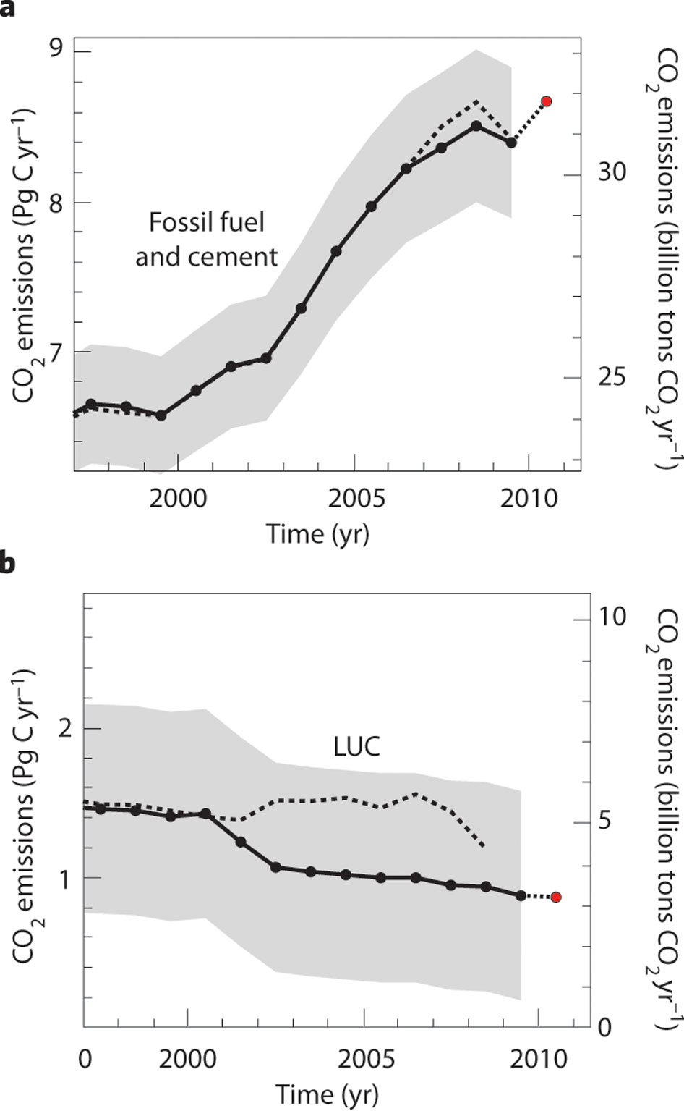
CO₂ Emissions
Fossil Fuel
and cement
Friedlingstein
et al. Nature
Geoscience, 2010
Land use
change (LUC)

Slide 8
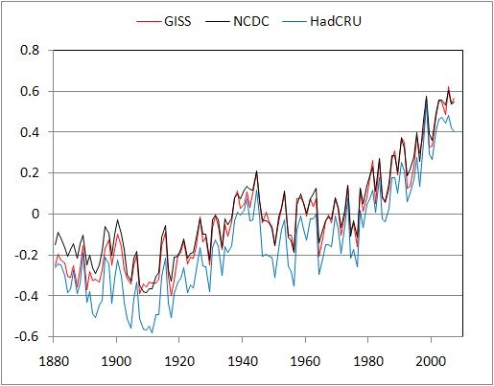
Global Temperature Trends

Slide 9
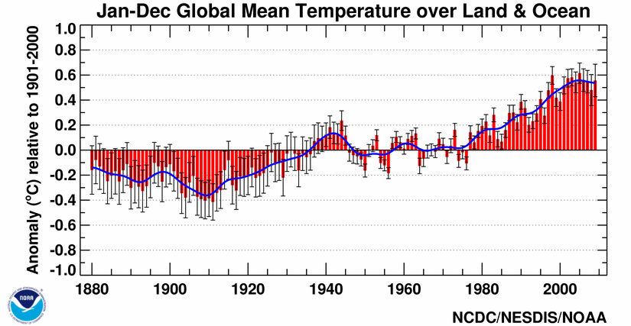
2010 was a record warm year

Slide 10
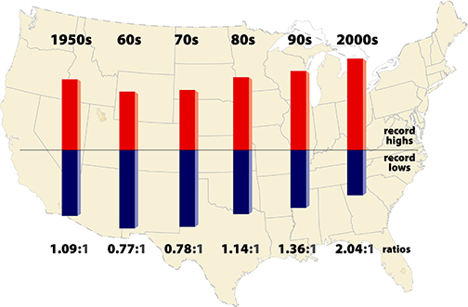
Changes in Extremes
This graph shows the warming story!
J. Meehl et al. 2010

Slide 11


Slide 12
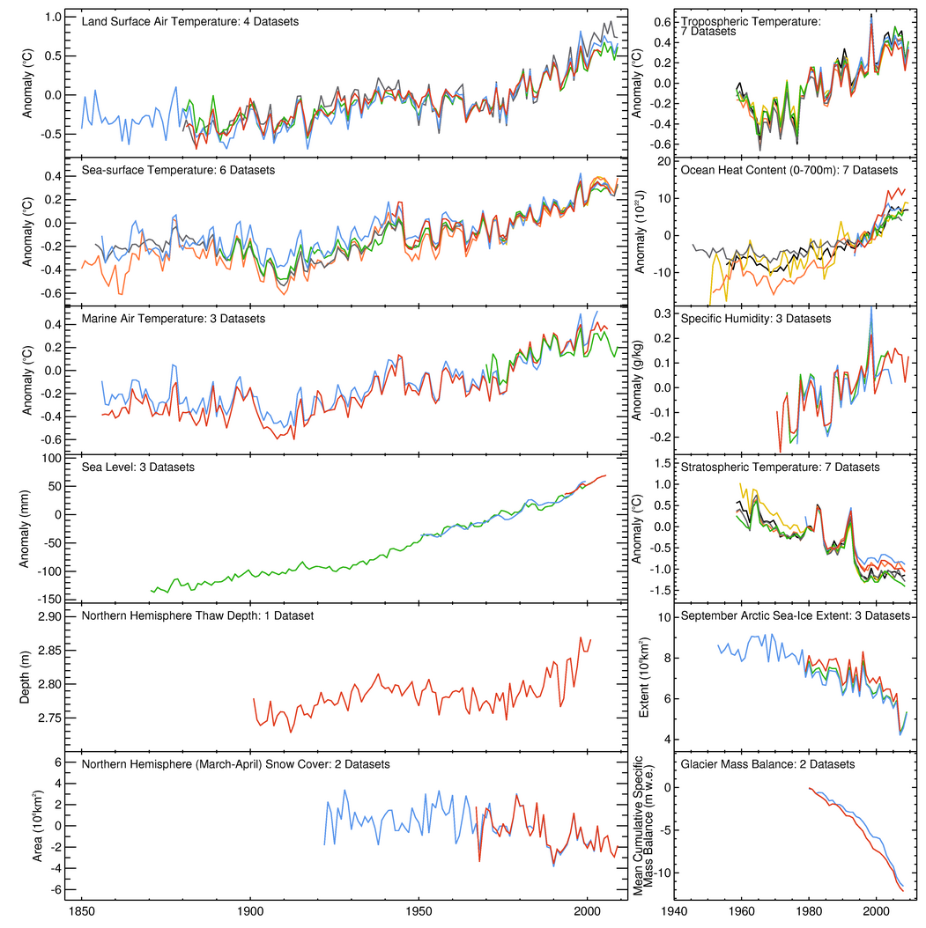
Land surface temperatures
Troposphere
temperature
Ocean surface temperatures
Upper ocean
heat content
Marine air temperatures
Humidity
Sea level rise
Stratospheric
temperature
N. H. thaw depth
Arctic sea ice
Glacier mass
balance
N. H. snow cover
1850
1900
1950
2000
1940
2000
From Hadley Center

Slide 13
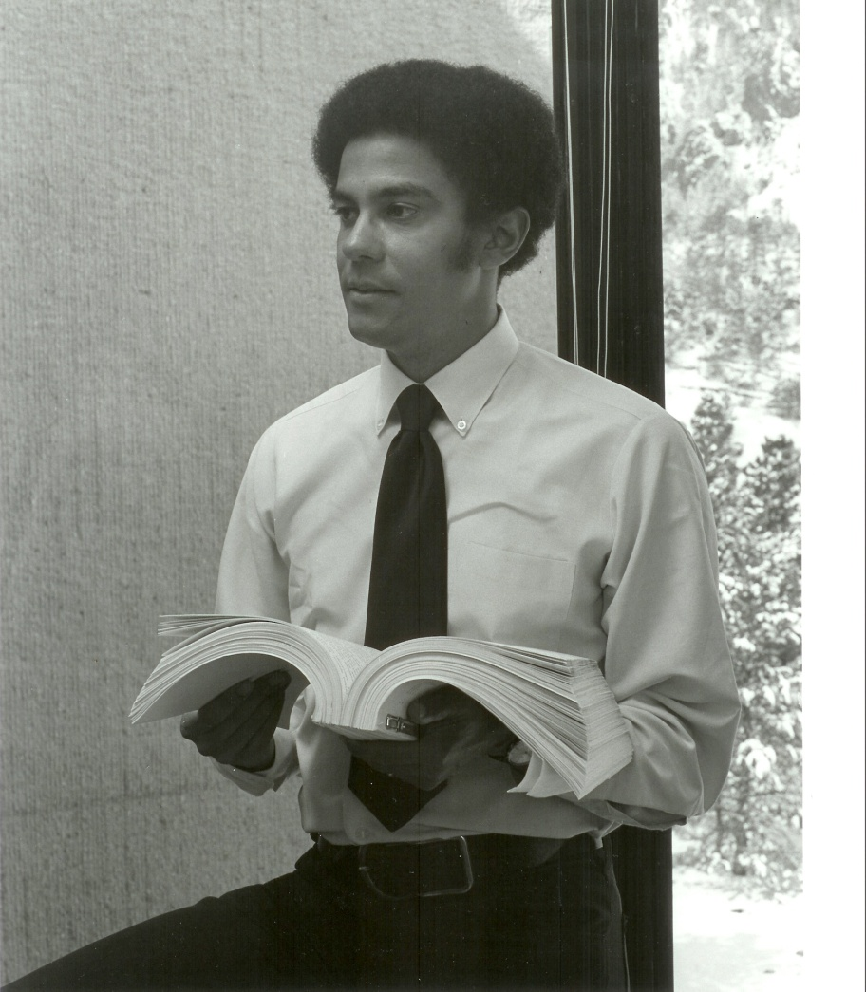
43 years ago

Slide 14
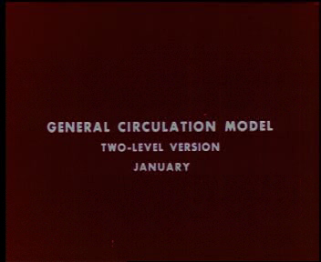

Slide 15
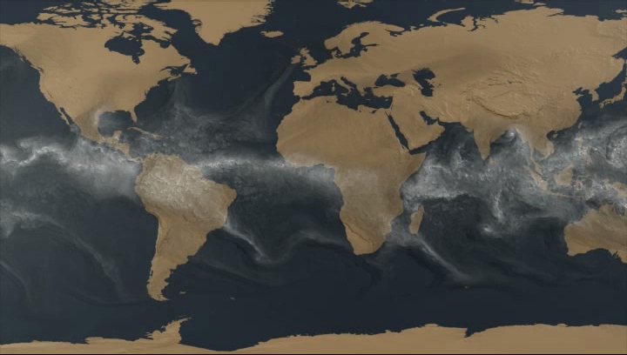
Water Vapor (12 Km resolution)
M.Taylor, Sandia

Slide 16
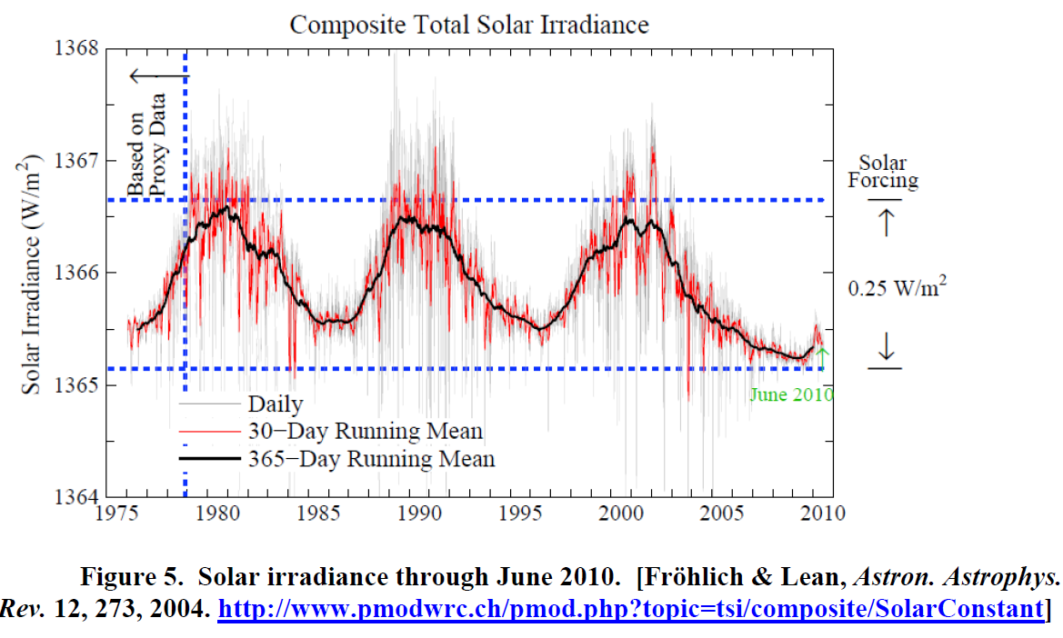

Slide 17
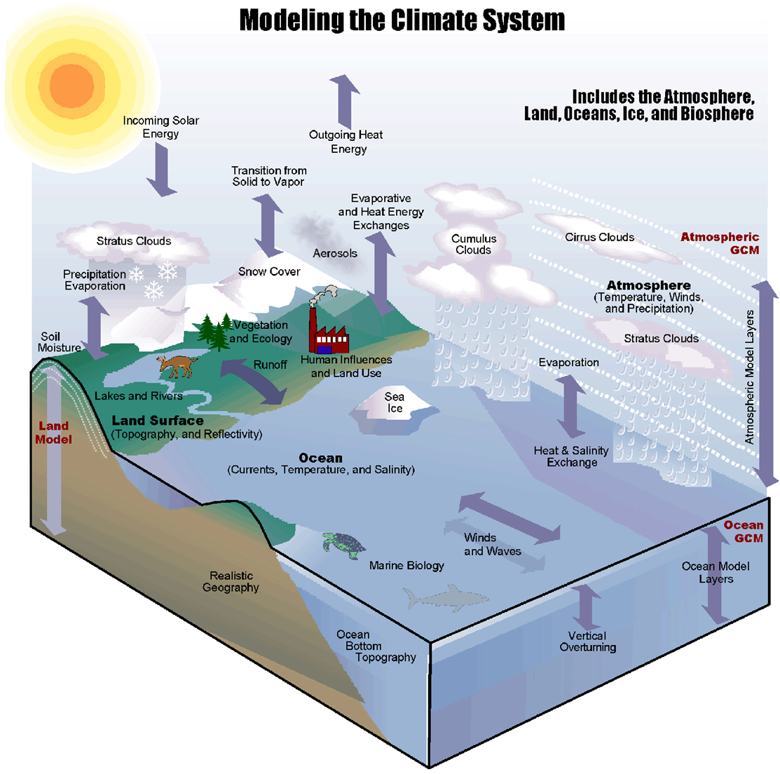
Climate and Earth System Models are
Becoming More Complete

Slide 18
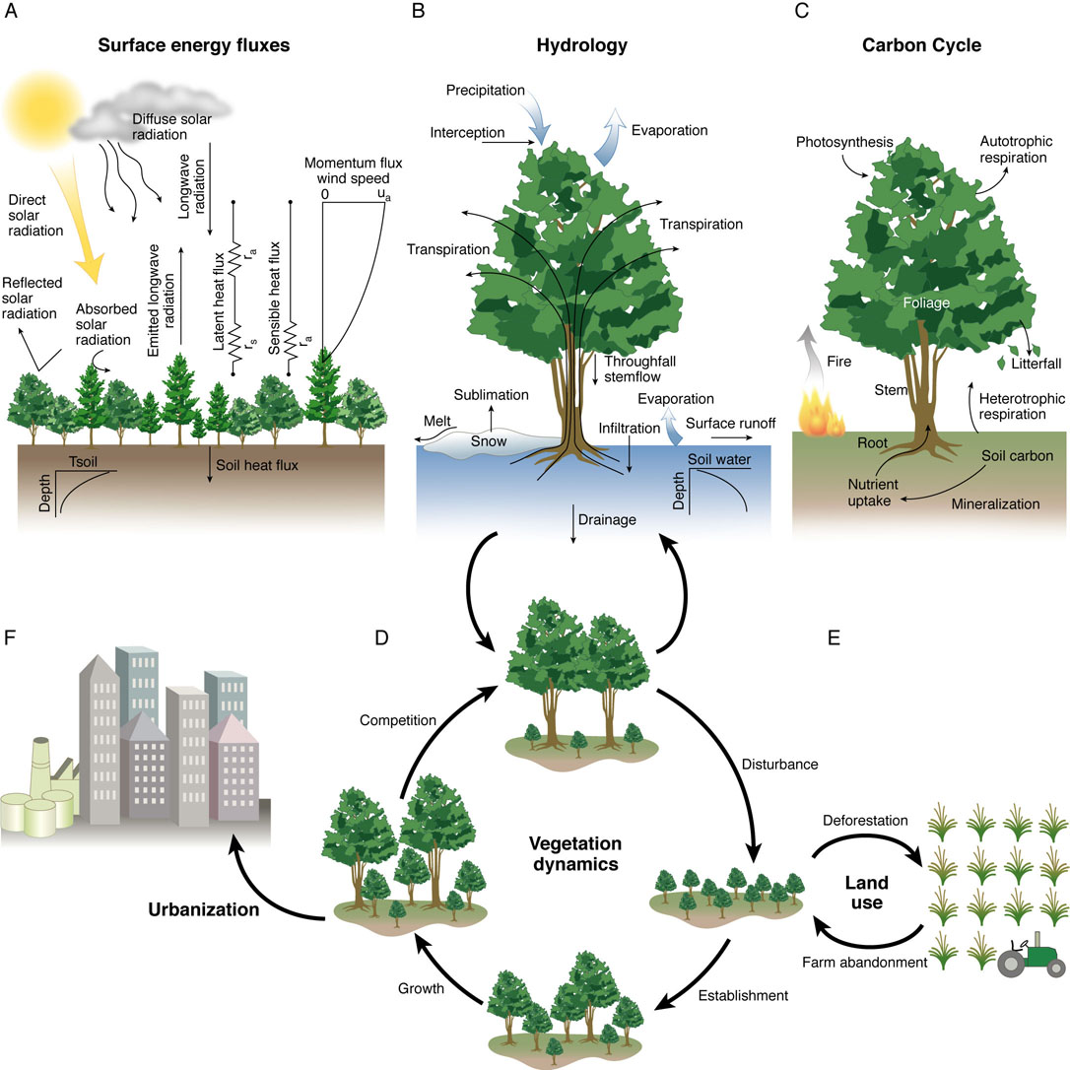
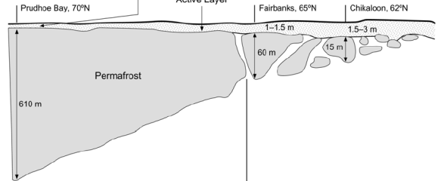
Community Land Model 4
Surface Energy Fluxes
Hydrology
Carbon/Nitrogen Cycling
Urbanization
CLM4
Vegetation Dynamics
Land Use & Change
Permafrost
Bonan (2009)
Notes:
Advances in model capabilities in CLM4
Terrestrial carbon and nitrogen cycle
Transient land cover/land use change including wood harvest (biophysical and biogeochemical impacts)
Effects of climate change on urban areas
Permafrost response to climate variability and change
Future plans
Methane emissions model and wetland dynamics
Crops and irrigation
Assess vulnerability of large soil carbon stores in permafrost and peatlands
Improved fire and new insect outbreak parameterizations
Advances in model capabilities in CLM4
Terrestrial carbon and nitrogen cycle
Transient land cover/land use change including wood harvest (biophysical and biogeochemical impacts)
Effects of climate change on urban areas
Permafrost response to climate variability and change
Future plans
Methane emissions model and wetland dynamics
Crops and irrigation
Assess vulnerability of large soil carbon stores in permafrost and peatlands
Improved fire and new insect outbreak parameterizations

Slide 19
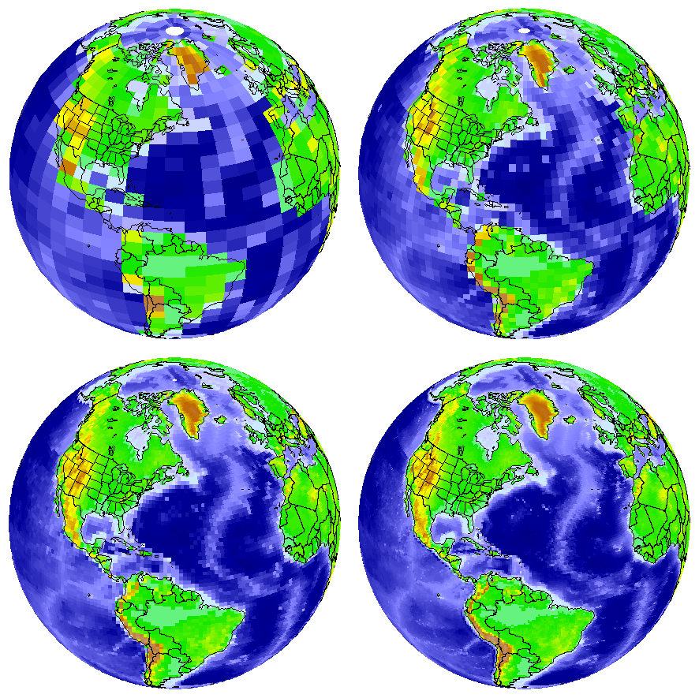
Atmospheric and Ocean Resolution
1º to
0.1º
100 km
to 10 km
Realistic
Hurricanes
and cyclones
Realistic
Ocean
eddies

Slide 20
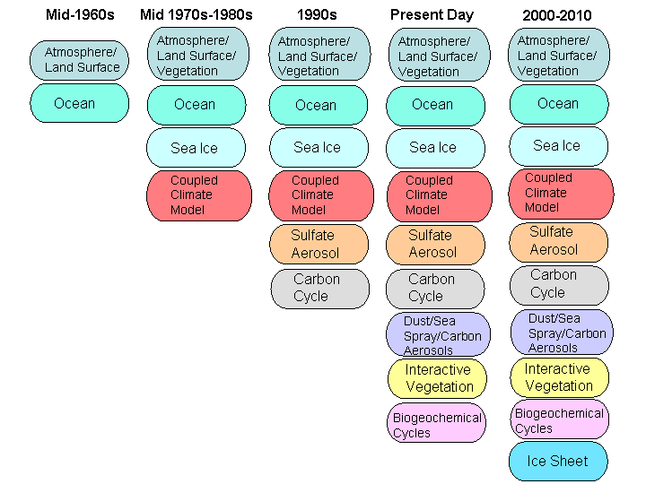
Timeline of Climate Model Development
Small
teams
Intermediate
size teams
Large teams made up
of several 10s to 100s

Slide 21
Example of new features found in high resolution climate models!
West Pacific Basin,
Sept 1 to Sept 17, 2005 CAM5a.
“Fujiwara effect”
Two cyclones rotate around each other for a few days and eventually merge, observed mostly in Pacific ocean region.
Julio Bacmeister, NCAR, 2010
Notes:
21

Slide 22
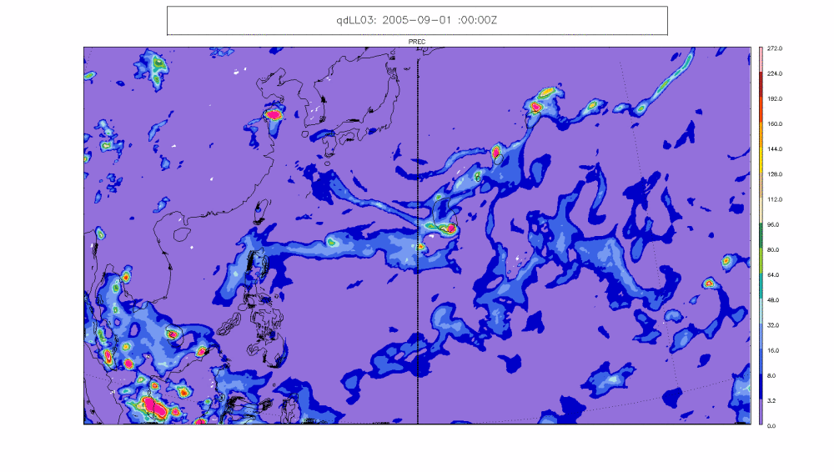

Slide 23
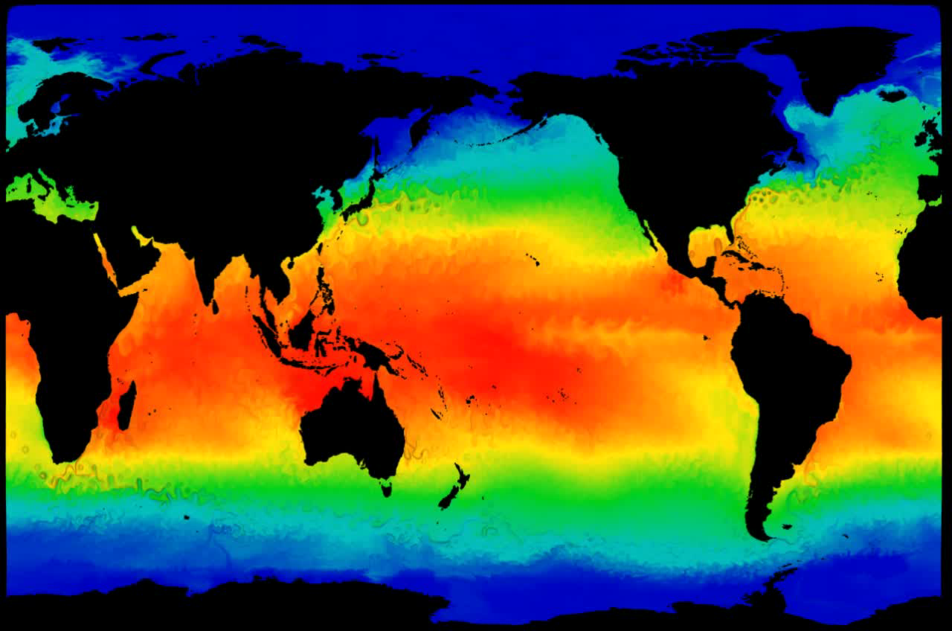

Slide 24
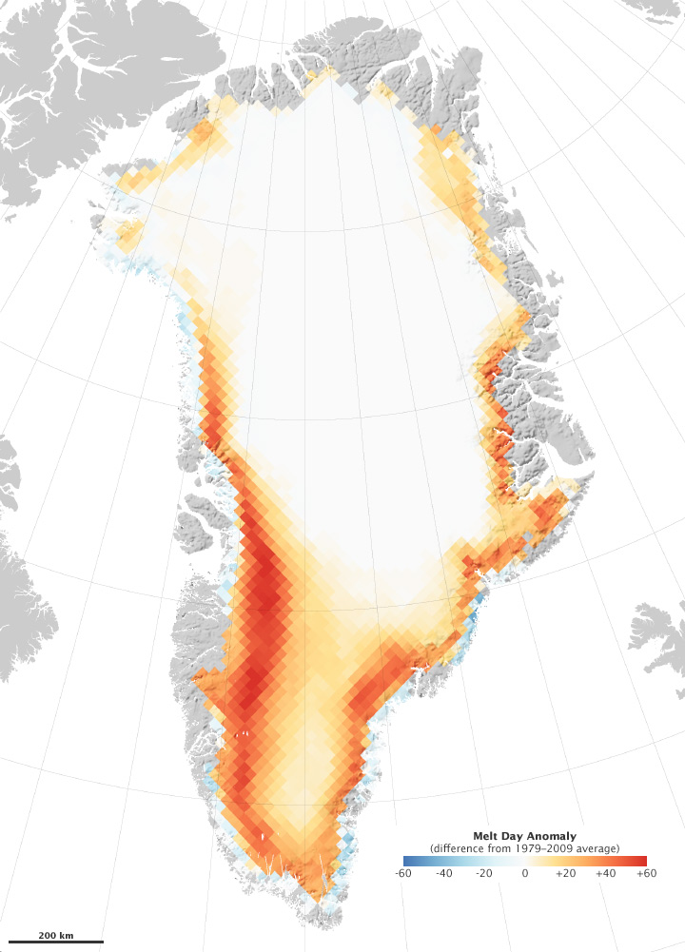
2010 was a record year for glacier melting on Greenland

Slide 25
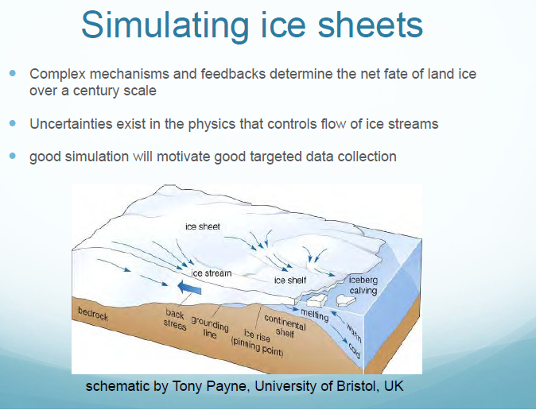

Slide 26
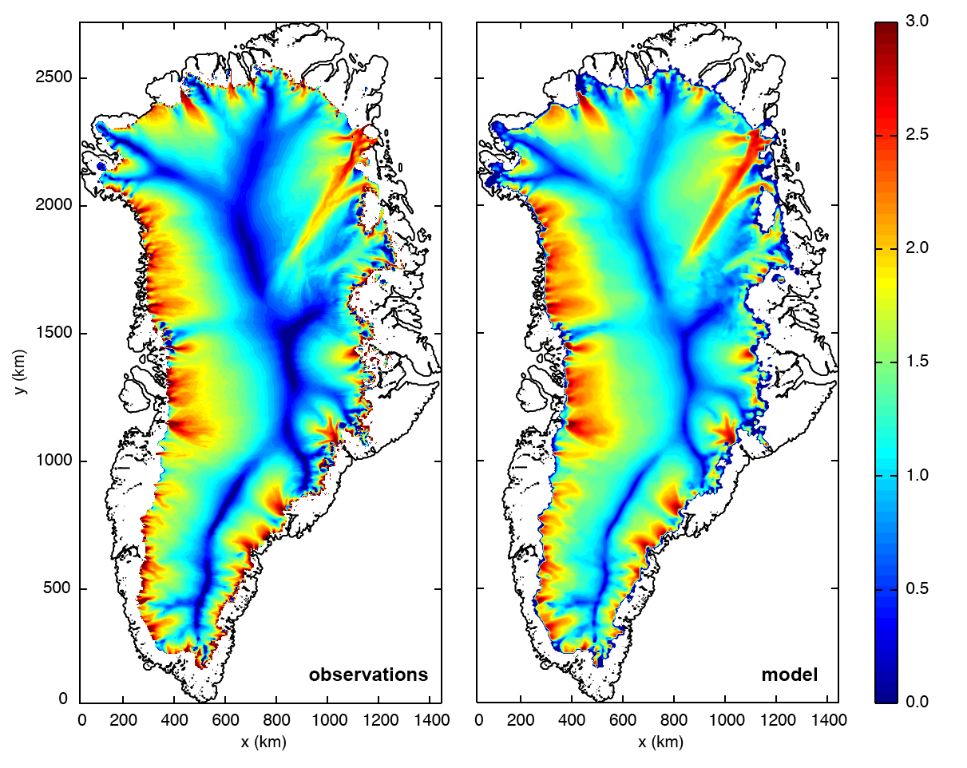
Velocities
m/year
Observations
5 km Resolution
model
Price, Lipscomb et al, Lanl,2010
Notes:
- Left panel shows balance velocities. (Velocities needed to maintain present-day geometry in steady state based on our best estimate of the surface mass balance).
Right panel shows results from the tuned higher-order model at 5 km resolution.
The match is quantifiable; route-mean square velocity difference for the whole is sheet is ~40 m/yr and for individual drainage basins of interest is as small as ~5-10 m/yr

Slide 27
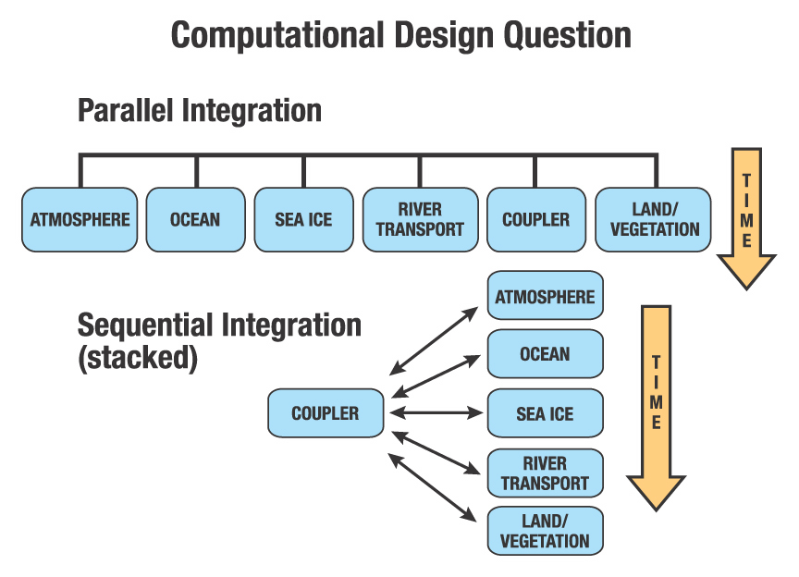
Parallel and Sequential Integration or Hybrid

Slide 28
The Pole Problem!

Slide 29
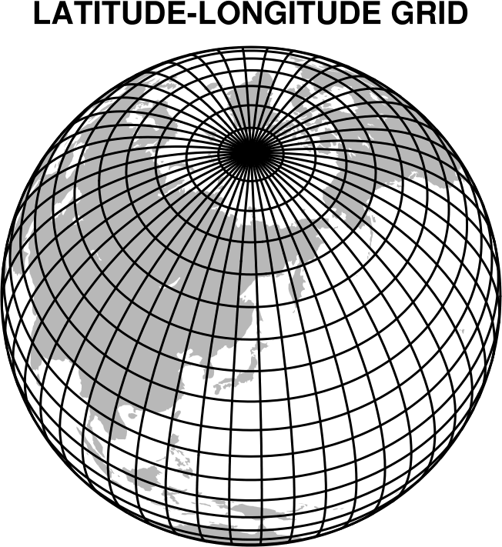
Atmospheric Grid Structure in the 1960s and 1970s
Problem near the poles
where longitudes
converge

Slide 30
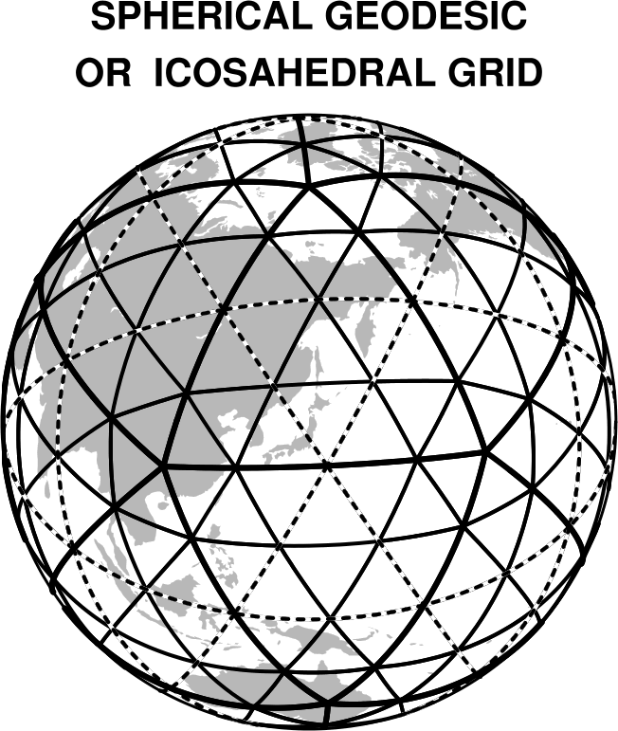
The Icosahedral Solution

Slide 31
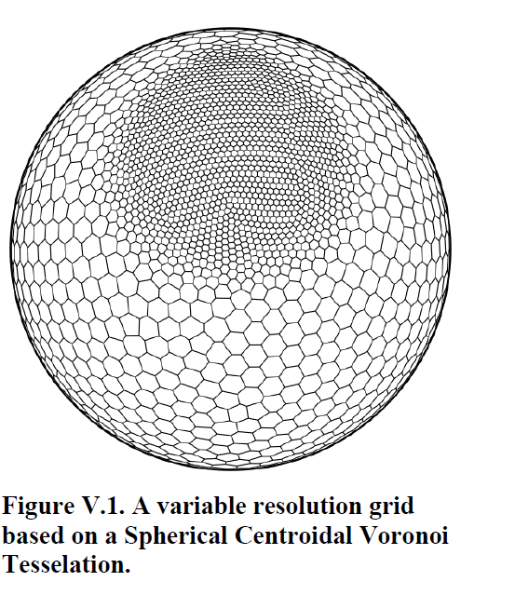
From T. Ringler, LANL
Regional focus
on a global grid system

Slide 32
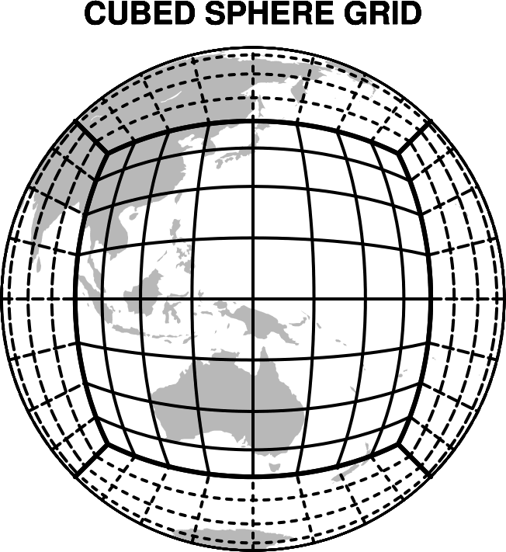
Novel Solution to the Pole Problem by Sadourny (1972)

Slide 33
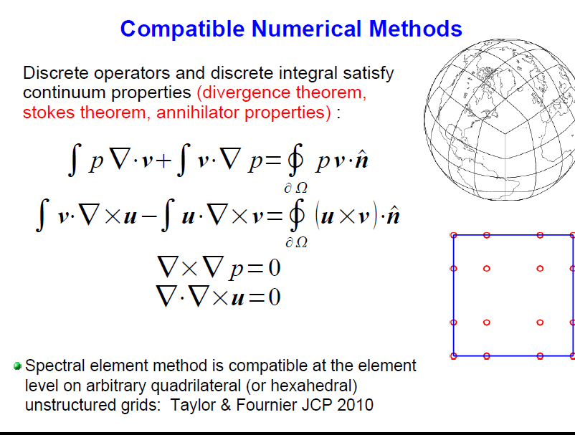

Slide 34
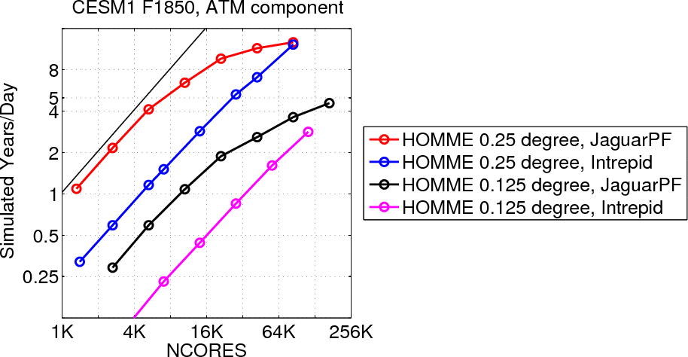
Scaling climate models to present and future computer systems…a breakthrough!
Clever use of finite
element methods
M. Taylor, Sandia

Slide 35
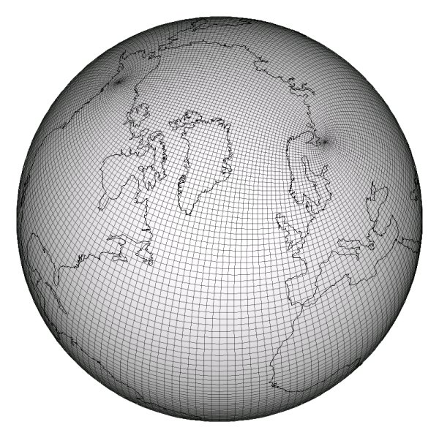
Ocean Parallel Ocean Program (POP) tripole system over land
Tripole pole points
Note the third pole point at South Pole

Slide 36
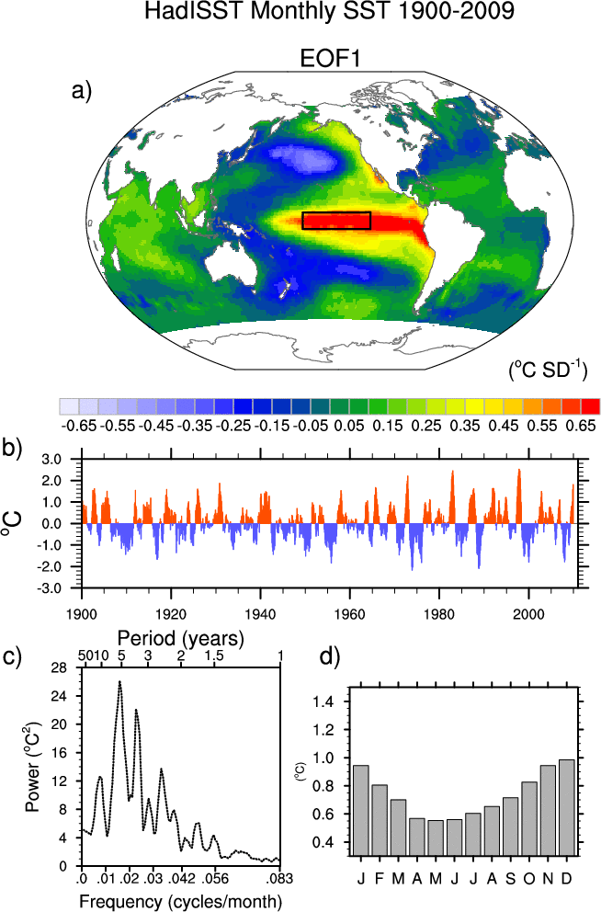
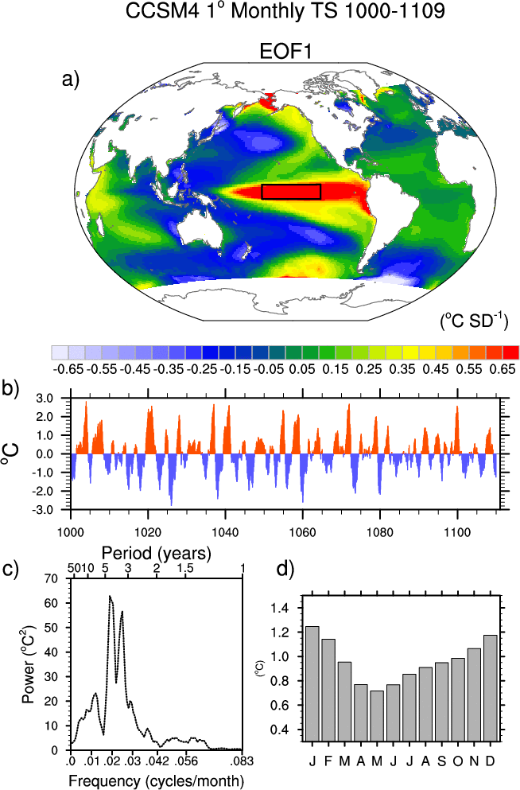
Leading Mode of Global SST Variability
Seasonal Capability (Neale, NCAR)
Observations
CCSM4

Slide 37
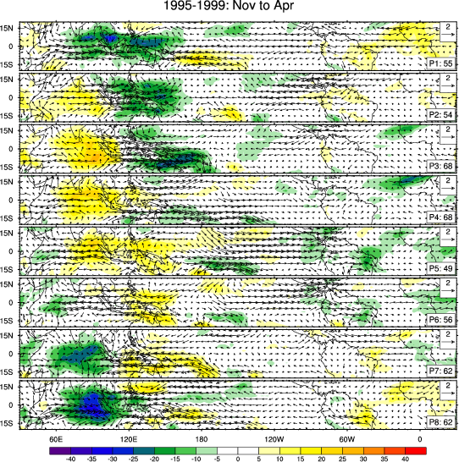
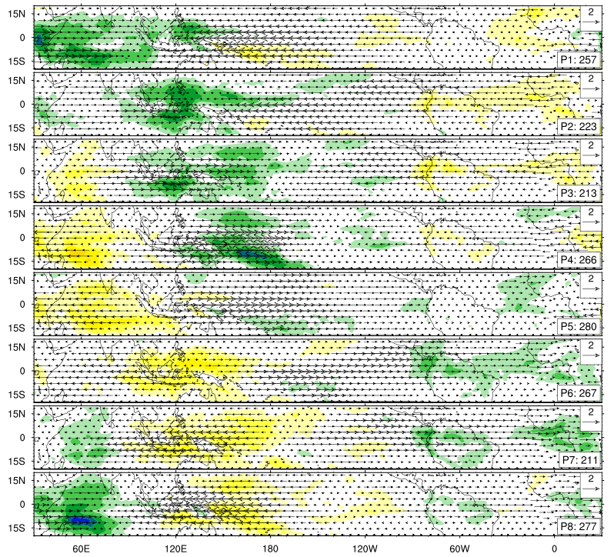
Composite Madden Julian Oscillation (MJO)
Medium Range Capability (Neale, NCAR)
CCSM4-1 deg)
Observed (NOAA,ERA40,1995-1999)
Eight phase composite of PC1 and PC2 from combined EOFs.
20th Century coupled experiments, Winter (OLR colors, low-level winds)

Slide 38
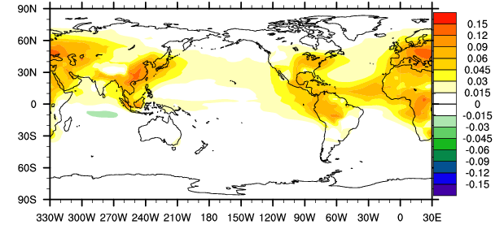
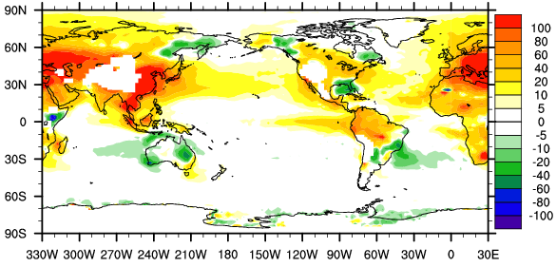
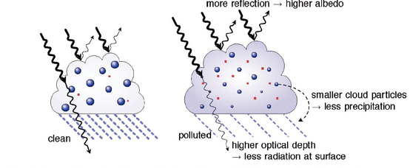
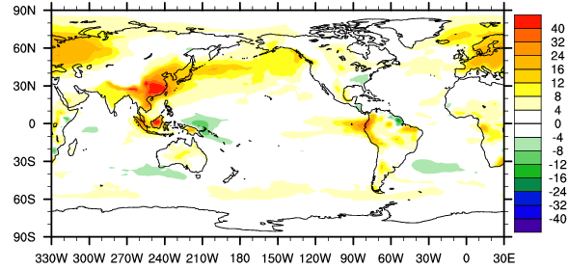
Total aerosol change (optical depth)
Anthropogenic aerosol affects on climate in CESM1-CAM5
(1970-1999) minus 1850 climate
Increased aerosol burdens in SE Asia, Europe, NE America
Increases cloud droplet number concentration; strongest over land
Increased droplet activation = increased numbers of smaller drops = brighter clouds with more liquid
Cloud water droplet number concentration (#/cc) at 850 mb
Liquid water path (g/m²)
Gettelman and Neale,NCAR
Net negative combined low-cloud affects over the 20th century
IPCC

Slide 39
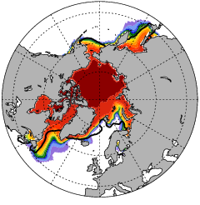
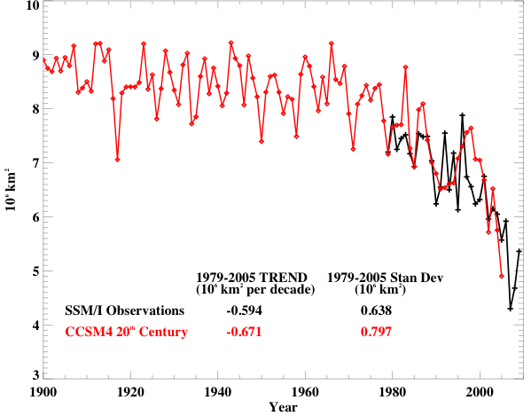
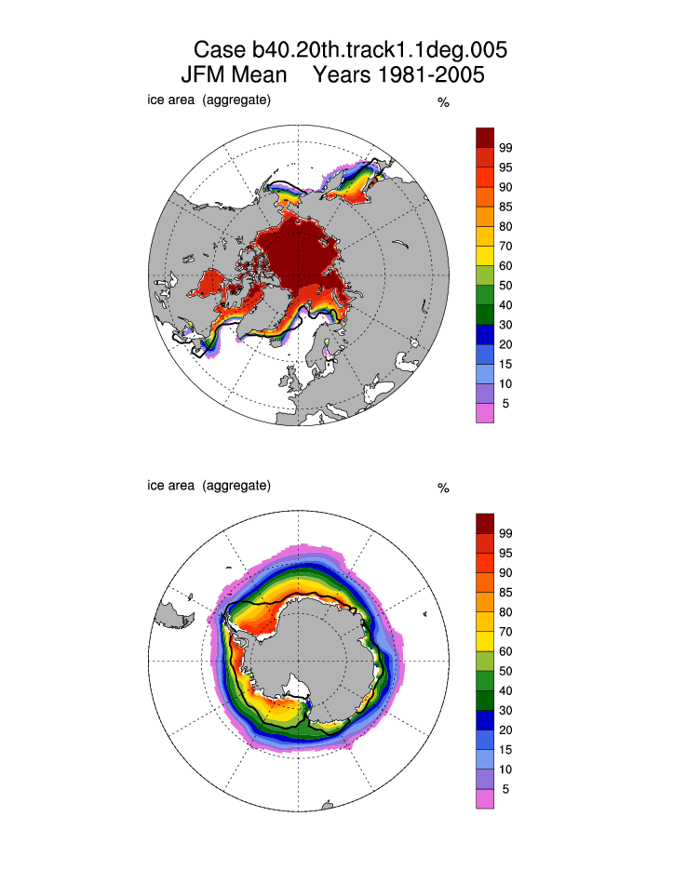
Arctic Sea Ice
(Late 20th Century)
climate change capability
CCSM3
September sea-ice extent loss
SSM/I
CCSM4
(%)
JFM Extent
NCAR
Notes:
The winter sea ice edge is considerably improved from CCSM3 with:
Less Labrador sea ice
Less Pacific sea ice
Modest increases in GIN sea ice cover
The summer ice edge (not shown) was well simulated in CCSM3 and remains well simulated in CCSM4

Slide 40
Modeling Future Climate

Slide 41
Entering into the Anthropocene
The Holocene epoch has ended and as Nobel Prize winner Paul Crutzen has suggested, we are entering into the Anthropocene epoch…mankind caused climate change.

Slide 42
Where are we with respect to cutting greenhouse gas emissions?
Mitigation versus adaptation…if we do nothing about greenhouse gas emissions then it is all adaptation.
If we go to a low emission mitigation scenario, what does this mean in terms of climate change and impacts.
Copenhagen and Cancun climate change conferences suggest we have not solved the major policy aspects of future climate change. Some small steps have been achieved.

Slide 43
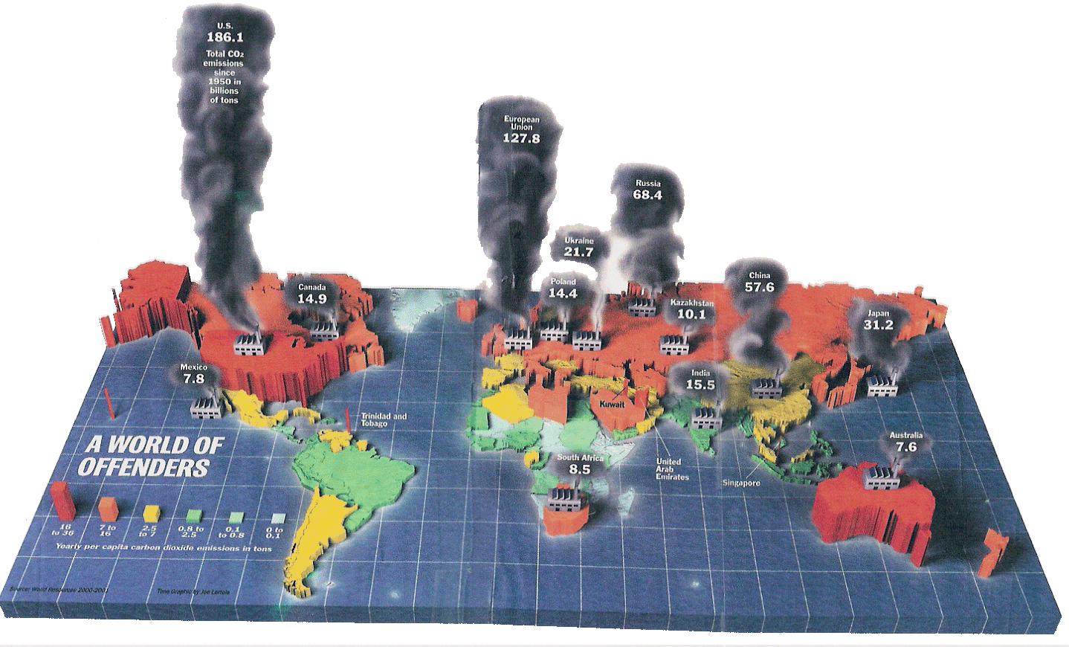
China exceeded U. S. emissions in 2009; they are
building a new coal power plant every week! However they are also aggressively moving to green energy.
Source: World Resources 2000-2001 Time Magazine – 9 April 2001

Slide 44
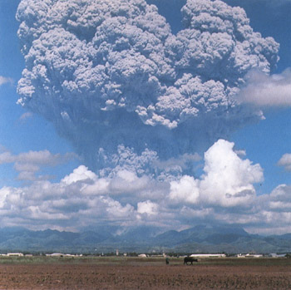
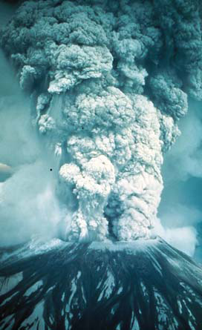
Title slide
Mt. St. Helens
Mt Pinatubo eruption in the Philippines, June 15, 1991. Gases and solids injected 20 km into the stratosphere.
From Church, White, & Arblaster

Slide 45
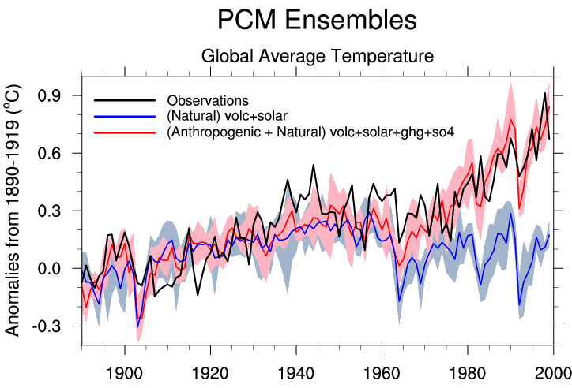
Natural Variations do not Explain Observed Climatic Change
Climate models with natural forcing (including volcanic and solar) do not reproduce warming
When increase in greenhouse gases is included, models do reproduce warming
Addition of increase in aerosols (cooling) improves agreement

Slide 46
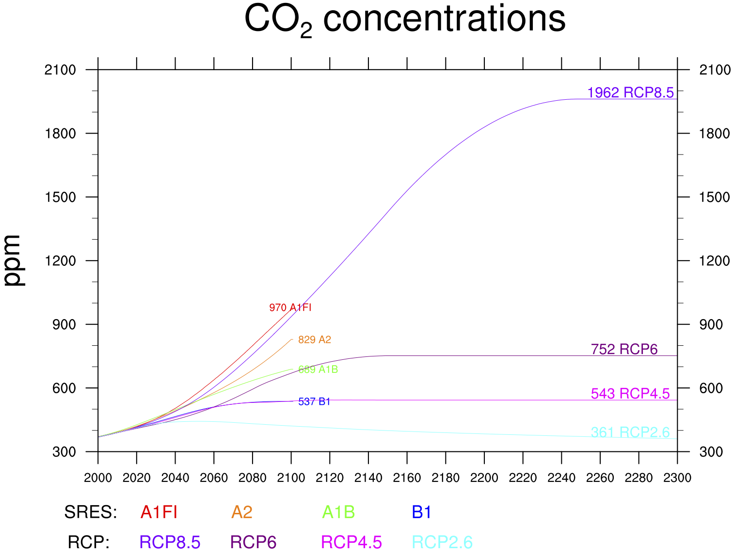
Old and New
Scenarios
RCP2.6 requires negative emission
We are here
G. Strand, NCAR
Gary Strand

Slide 47
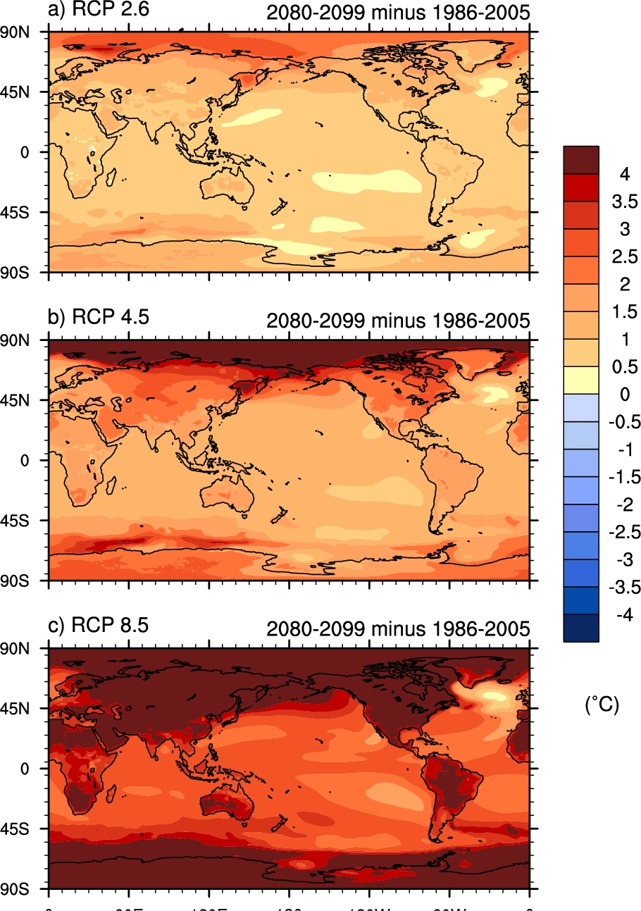
Close to the 2 degree
solution
Policy Choices
New RCP simulations
for next IPCC Assessment

Slide 48

Climate and Earth System models have and continue to contribute to understanding the climate system. They allow the science community to determine objectively the impacts of climate change on food production, flooding, drought, sea level rise, and health.
From Istockphoto.com

Slide 49
What is it so hard for policymakers and the public to understand climate change?
How infrared radiation works with different types of atmospheric gas molecules (diatomic, triatomic, polyatomic)
Climate feedbacks mechanisms like water vapor, albedo, clouds, etc.
The scientific method

Slide 50

clouds
albedo
Water vapor
Lapse rate

Slide 51
Future New Developments and Setbacks in Climate Modeling
Climate Science for Sustainable Energy Future (CSSEF)
Cloud resolving climate models
Community Earth system models
Loss of two major NASA satellites instruments (OCO and GLORY) Key measurements of CO₂, aerosols, and solar flux)…we still have space measurements of these quantities.

Slide 52
The path forward for
DOE and its
Partner Agencies and Departments

Slide 53
The End

Slide 54



Geoengineering Strategies
Space mirrors
High altitude sulphur injections
Seeding stratocumulus clouds to brighten clouds
Sequestration of CO₂
Iron Fertilization, ...
All these do not solve the ocean acidification problem!
Phil Rasch DOE PNL

Slide 55
Ways to Help Policy Development
Couple high resolution global climate models to regional climate and hydrological models
Couple Earth System models to various integrated assessment models
Continue to make internet friendly data archives (ESG works great!)
Work with policy communities obtain data that they can use!

