Slide 1
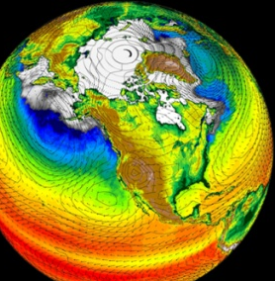
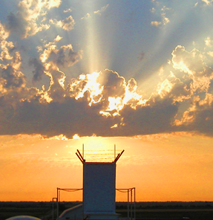
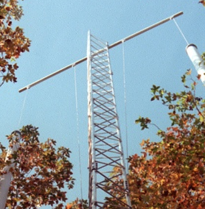
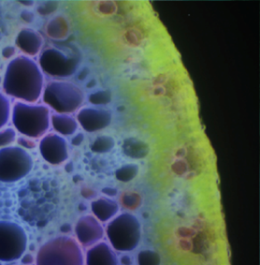
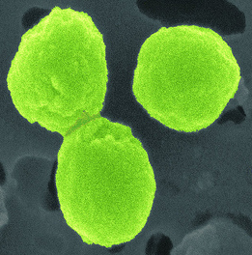


BERAC Meeting Biological Systems Science Division Update
Sharlene C. Weatherwax, Ph.D.
Director
Biological Systems Science Division
September 16, 2010
Office of Science
Office of Science
Office of Science
Office of Biological and Environmental Research
Office of Biological and Environmental Research
Office of Biological and Environmental Research

Slide 2
Updates on Division Solicitations
CURRENT SOLICITATIONS
FOA-0000368 Genomic Science and Technology for Energy and Environment
PLANS FOR FUTURE SOLICITATIONS
Joint USDA-DOE Plant Feedstock Genomics for Bioenergy
Systems Biology Knowledgebase
2 BERAC Sept2010
Department of Energy • Office of Science • Biological and Environmental Research
2 BER BSSD
Department of Energy • Office of Science • Biological and Environmental Research
2 BER BSSD
Department of Energy • Office of Science • Biological and Environmental Research

Slide 3
DOE BER Workshop: CAFAE—Critical Assessment of Functional Annotation Experiment
Held May 18-19, 2010, Crystal City, VA
Broad participation from universities, DOE national labs, nonprofit institutions. Observers from other Federal agencies and OSTP
Co-Chairs: Owen White, U Md; Nikos Kyrpides, JGI
Goal: Explore the feasibility of emulating a CASP (Critical Assessment of computational Structural Prediction) competition to improve annotation of genes and genomes.
Outcomes:
Recommend further discussion for organizing a competition to stimulate improved annotations
Requirements include clear goals and metrics for accomplishment, and a governance committee and mechanism that have the respect and confidence of the participating research communities.
Consider awarding a prize for defined specific goals.
3 BERAC Sept2010
Department of Energy • Office of Science • Biological and Environmental Research
3 BER BSSD
Department of Energy • Office of Science • Biological and Environmental Research
3 BER BSSD
Department of Energy • Office of Science • Biological and Environmental Research

Slide 4
Central DOE Institutional Review Board (CDOEIRB)
In 2001, DOE established its Central Beryllium IRB to review all DOE-funded and conducted human subjects research related to the diagnosis, treatment and prognosis of chronic beryllium disease (CBD) in beryllium-exposed workers.
In 2010, the scope of the Central Beryllium IRB was expanded to include non-beryllium-related multi-site health studies of the DOE workforce. The Central DOE IRB (CDOEIRB) held its first meeting in spring 2010.
The expansion has been well received by the DOE site IRBs, who also have a large representation on the CDOEIRB, and by PIs
The expansion resulted in streamlined approval process for PIs, who now do not have to submit protocols for multi-site studies to multiple DOE site IRBs for review.
The Institutional Official is Anna Palmisano, and the Chair is Jim Morris.
4 BERAC Sept2010
Department of Energy • Office of Science • Biological and Environmental Research
4 BER BSSD
Department of Energy • Office of Science • Biological and Environmental Research
4 BER BSSD
Department of Energy • Office of Science • Biological and Environmental Research

Slide 5
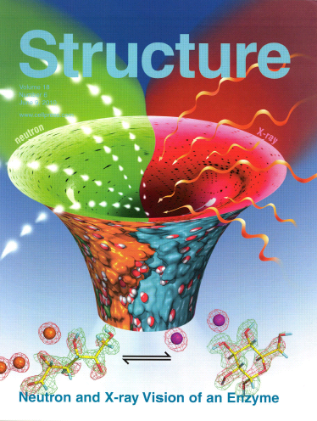
New Approaches for Visualization of Biofuel Catalytic Reactions
Objective:
Use neutron crystallography to understand the movement of hydrogen atoms as the enzyme D-xylose isomerase (XI) converts glucose to fructose
Approach:
Combine information from existing x-ray crystallography models of the enzyme with neutron crystallography studies to define the positions of hydrogen atoms at the active site as the catalytic reaction takes place
Results/Impact:
Experiments show how hydrogen atoms are moved in the isomerization process, including which amino acid residues are protonated in each step
Results provide a foundation for engineering improvements in the performance of the enzyme, with potential applications to biomass processing
A.Y. Kovalevsky, et al., Structure (2010) 18, 688-699.
5 BERAC Sept2010
Department of Energy • Office of Science • Biological and Environmental Research
5 BER BSSD
Department of Energy • Office of Science • Biological and Environmental Research
5 BER BSSD
Department of Energy • Office of Science • Biological and Environmental Research

Slide 6
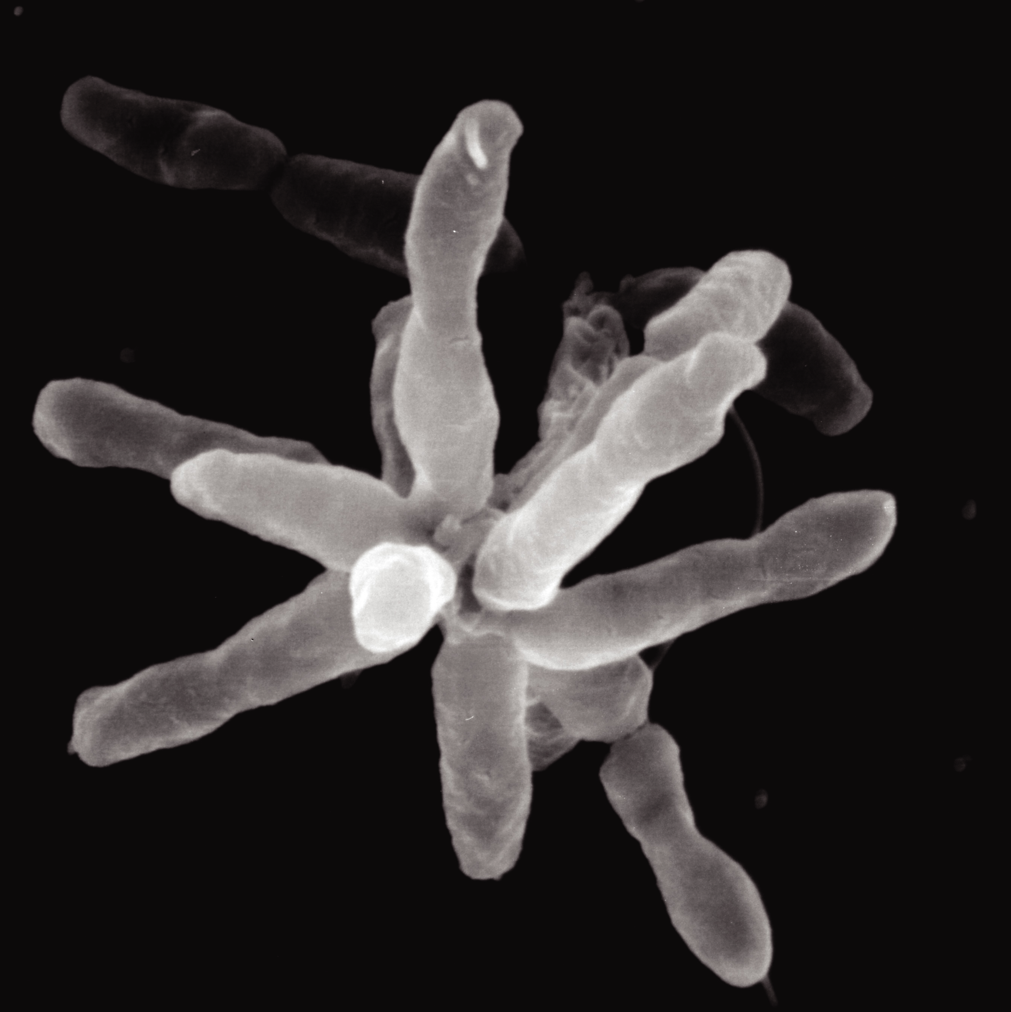
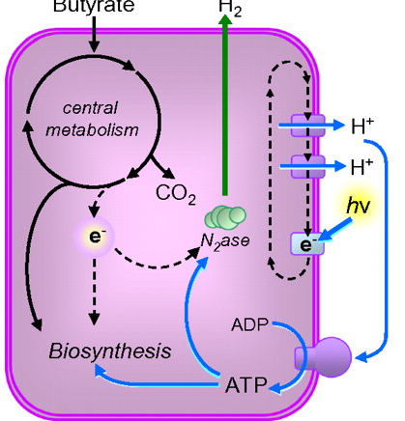
Flux Analysis Reveals New Metabolic Role
for CO₂ and N₂ Fixation
Objective:
Why do photoheterotrophic bacteria need to fix CO₂ while consuming organic acids as a carbon source?
Approach:
Use metabolic flux analysis and transcriptomics to examine flow of carbon and electrons during growth of R. palustris on acetate.
1 μm
Acetate
Results/Impact:
Biosynthesis only consumes 50% of reduced cofactor; extra electrons directed to fix CO₂, recharge cofactors, balance redox potential
During N₂ fixation, electron flow is partially re-directed towards H₂ production
Illustrates how cells can use core metabolic processes to perform multiple functions
McKinlay & Harwood, (2010) PNAS 107:11669-11675
6 BER BSSD
6 BERAC Sept2010
Department of Energy • Office of Science • Biological and Environmental Research
6 BER BSSD
Department of Energy • Office of Science • Biological and Environmental Research
6 BER Overview
6 BER BSSD
Department of Energy • Office of Science • Biological and Environmental Research

Slide 7
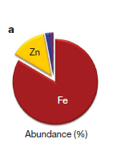
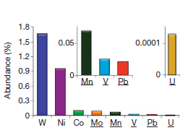
Broader Role of Metals in Microbial Processes
Objective:
To understand the true extent of metal- containing microbial proteins on a genome-wide scale using a new combination of techniques
Approach:
Chromatographic separation of cytoplasmic proteins and metal content analysis by Inductively Coupled Plasma Mass Spectrometry
Techniques tested on Pyrococcus furiosus, E.coli. and Sulfolobus
Results/Impact:
An unexpectedly high number of metal-containing proteins were identified , with broad diversity of metals
Points to a revised and broader role for metals in microbial processes and validation of a new discovery tool for biology
Cvetkovic et al., (2010 ) Nature doi:10.1038/nature09265.
7 BER BSSD
7 BERAC Sept2010
7 BERAC Sept2010
Department of Energy • Office of Science • Biological and Environmental Research
Department of Energy • Office of Science • Biological and Environmental Research
Department of Energy • Office of Science • Biological and Environmental Research
7 BER BSSD
Department of Energy • Office of Science • Biological and Environmental Research
7 BER Overview
7 BER BSSD
7 BER BSSD
7 BER BSSD
Department of Energy • Office of Science • Biological and Environmental Research
Department of Energy • Office of Science • Biological and Environmental Research

Slide 8
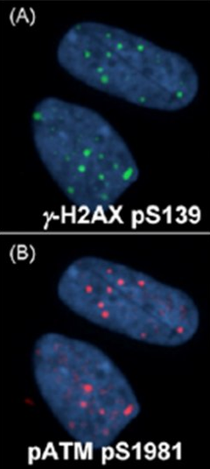
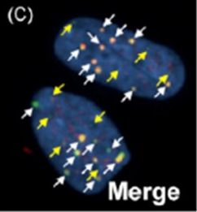
Inter-individual variation in human cells before and after exposure to low doses of ionizing radiation
Objective:
Study cellular inter-individual variation in DNA damage repair after exposure to low dose radiation
+
(Merged)
Approach:
Primary cells from 25 apparently normal and 10 DNA repair-deficient individuals were exposed to low doses of gamma-rays
Radiation-induced DNA damage and subsequent repair was quantified by measuring the kinetics of DNA repair protein complexes
Results/Impact:
Significantly slower focus formation was observed in seven normal strains, similar to most of the mutant strains
Genetic variants in DNA damage signaling and repair genes in apparently normal individuals may contribute to differential susceptibility to cancer induced by radiation exposures Wilson, et al., (2010) Mutation Research 683: 91-97
8 BER BSSD
8 BERAC Sept2010
Department of Energy • Office of Science • Biological and Environmental Research
8 BER BSSD
Department of Energy • Office of Science • Biological and Environmental Research
8 BER Overview
8 BER BSSD
Department of Energy • Office of Science • Biological and Environmental Research

Slide 9
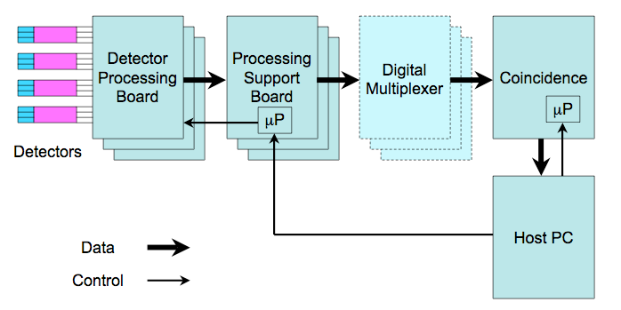
Flexible, High-Performance Electronics for Radiotracer Imaging
Objective:
Design flexible, high-performance electronics that can be used for a wide variety of radiotracer imaging cameras.
Approach:
Develop OpenPET, a powerful yet flexible electronics system, with software allowing customization.
Make the information needed to construct these electronics (schematics, circuit board layout, etc.) publicly available
Impact:
Open-source software and firmware allows multiple research groups to pool resources and speed development.
Useful for DOE mission needs and the radiation imaging instrumentation community.
WW Moses et al, IEEE Trans. Nucl. Sci. NS-57, (accepted for publication in the September issue), 2010.
9 BER BSSD
9 BERAC Sept2010
Department of Energy • Office of Science • Biological and Environmental Research
9 BER BSSD
Department of Energy • Office of Science • Biological and Environmental Research
9 BER Overview
9 BER BSSD
Department of Energy • Office of Science • Biological and Environmental Research

Slide 10
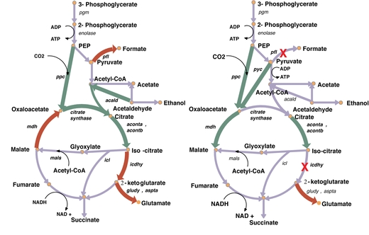
Optimizing genetic manipulations in microbes
Objective:
Identify all possible metabolic pathways, supported by existing experimental data, and optimize these pathways to achieve a target level of product
Approach:
Identify and Integrate data from existing databases
Use constraint optimization to identify necessary reactions in a network
Identify minimum set of engineering changes for overproduction of a product
Results/Impact:
Translate predictive metabolic pathways into quantifiable levels of products
Quickly identify novel pathways and intermediates that can be explored using experimental metabolic bioengineering techniques
S. Ranganathan et al, PLoS, Computational Biology 6: 1-11 (2010); S. Ranganathan and C. Maranas, Biotechnology Journal 5: 716-725 (2010)
10 BER BSSD
10 BERAC Sept2010
Department of Energy • Office of Science • Biological and Environmental Research
10 BER BSSD
Department of Energy • Office of Science • Biological and Environmental Research
10 BER Overview
10 BER BSSD
Department of Energy • Office of Science • Biological and Environmental Research

Slide 11
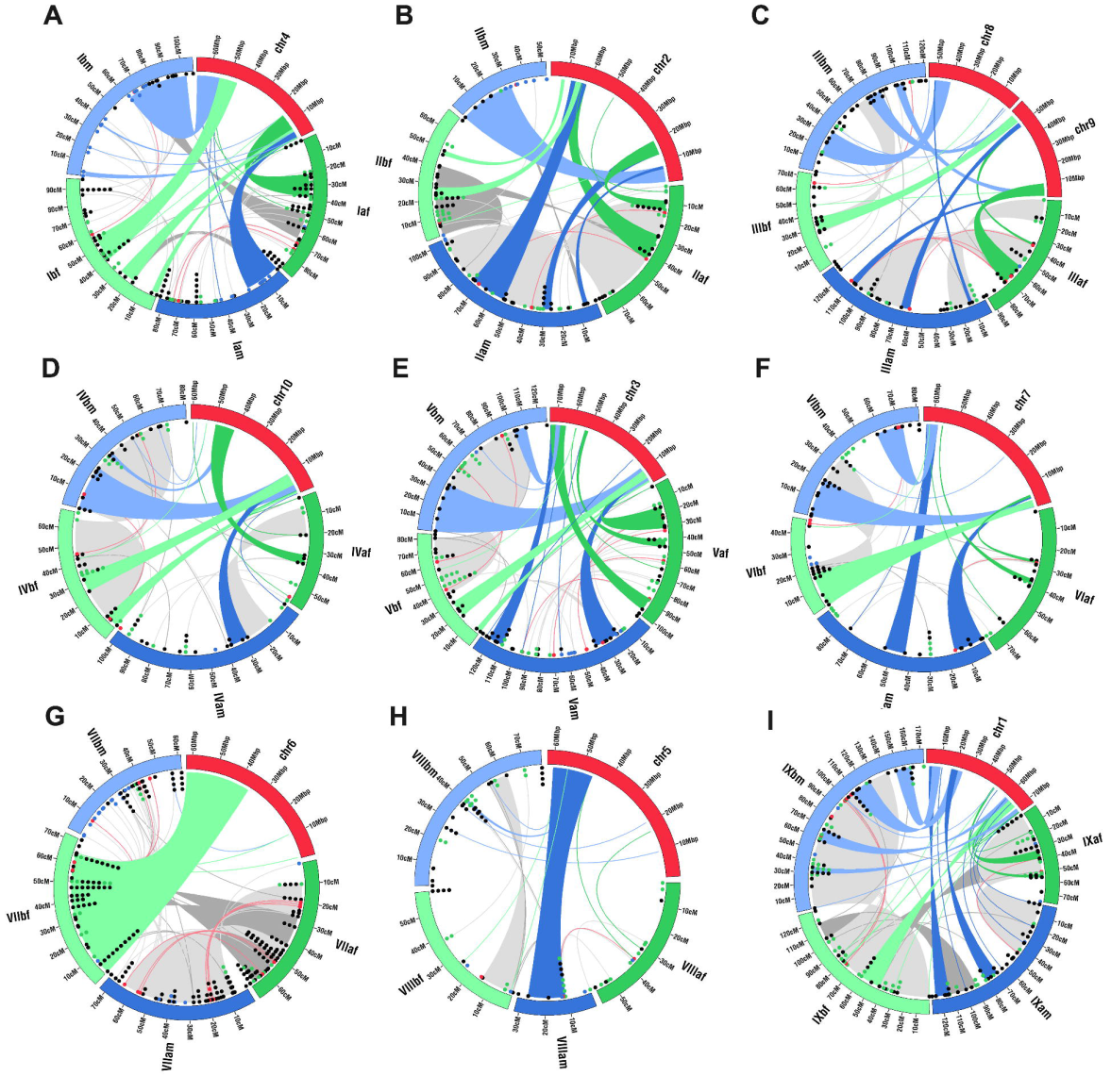
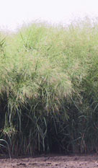
Switchgrass Genome Structure Revealed
Objective:
Elucidate the genome structure and inheritance of switchgrass to enable genetic improvement of the crop.
Approach:
Construct complete male and female parental linkage maps of two tetraploid switchgrass genotypes.
Compare to sorghum, foxtail millet.
Homology group VII linkage map
Results/Impact:
Will enable the development of marker assisted selection (MAS) strategies to improve switchgrass and other potential bioenergy grass species.
Okada et al. (2010) Genetics 185(3):745-760.
11 BER BSSD
11 BERAC Sept2010
Department of Energy • Office of Science • Biological and Environmental Research
11 BER BSSD
Department of Energy • Office of Science • Biological and Environmental Research
11 BER Overview
11 BER BSSD
Department of Energy • Office of Science • Biological and Environmental Research

Slide 12

DOE Bioenergy Research Centers
Third year reverse site progress reviews
BESC—September 27, 2010
GLBRC—September 28, 2010
JBEI—September 29, 2010
External review team to evaluate:
science and management
progress against stated milestones
12 BERAC Sept2010
Department of Energy • Office of Science • Biological and Environmental Research
12 BER Overview
Department of Energy • Office of Science • Biological and Environmental Research
12 BER BSSD
Department of Energy • Office of Science • Biological and Environmental Research

Slide 13

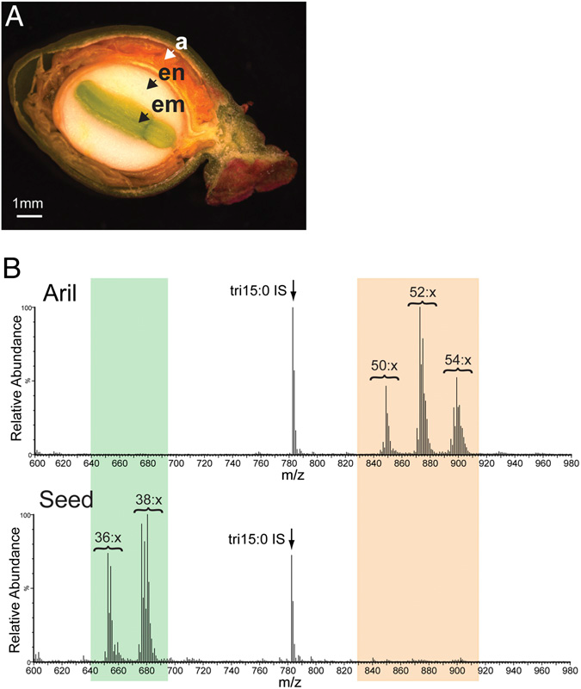
Gene Responsible for Synthesis of Low Viscosity Seed Oil Identified
Objective:
Enable discovery and engineering of novel oils in plants
Approach:
Target Euonymus alatus (Burning Bush) seed oil which is 30% less viscous than conventional vegetable oils, due to unusual triacylglycerol (TAG) content.
Isolate rare gene encoding the enzyme required for acTAG using JGI sequencing.
acTAGs lcTAGs
Results/Impact:
Arabidopsis transformed with this gene produced acTAGs
Identification of this gene suggests potential of engineering plant oils with specific desired properties for biofuels.
Durrett et al (2010) PNAS 107(20):9464-9469.
13 BERAC Sept2010
Department of Energy • Office of Science • Biological and Environmental Research
13 BER Overview
Department of Energy • Office of Science • Biological and Environmental Research
13 BER BSSD
Department of Energy • Office of Science • Biological and Environmental Research

Slide 14
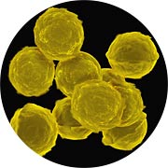

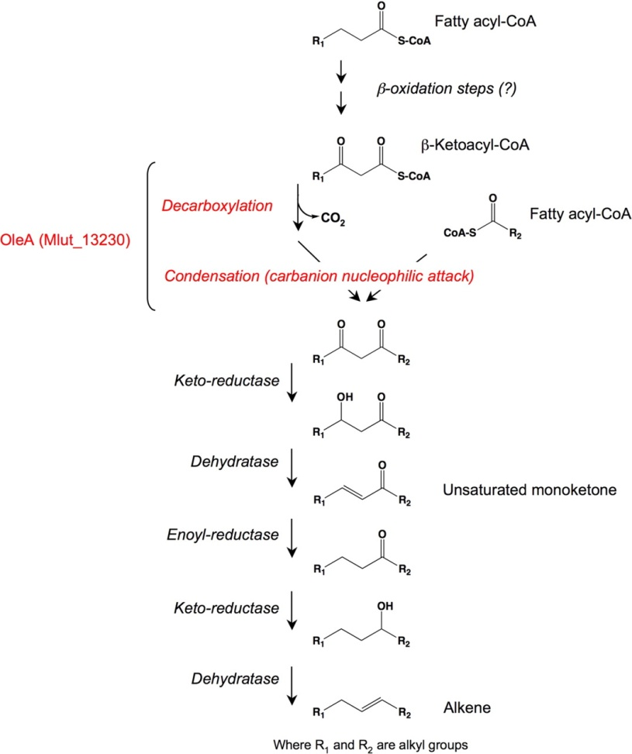
Identifying New Biofuel Synthesis Pathways in Microbes
Objective:
What genes are responsible for synthesis of long chain alkenes in Micrococcus luteus?
Approach:
Identify genes associated with decarboxylation and condensation of fatty acids in M. luteus genome, introduce and express in E. coli, and examine synthesized alkenes and monoketones.
Results/Impact:
Three genes were identified that resulted in synthesis of long chain alkenes when introduced into a fatty acid overproducing strain of E. coli.
Further engineering of the resulting strain is underway to produce alkenes tailored for optimal biofuel properties
Beller, H. R. et al. 2010. Appl. Environ. Microbiol. 76(4):1212-1223
14 BER BSSD
14 BERAC Sept2010
Department of Energy • Office of Science • Biological and Environmental Research
14 BER BSSD
Department of Energy • Office of Science • Biological and Environmental Research
14 BER Overview
14 BER BSSD
Department of Energy • Office of Science • Biological and Environmental Research

Slide 15

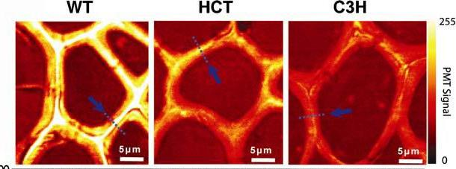
High spatial-resolution, chemical imaging of lignin supplies potential explanations for improvements in saccharification
Objective: Improve pretreatment processes by understanding the role of lignin in saccharification.
Approach: Image wild type and reduced-lignin alfalfa using coherent anti-Stokes Raman scattering (CARS) microscopy. CARS microscopy offers much greater sensitivity and faster acquisition time than many other microscopies.
Results: Lignin modification occurs preferentially in cell corners, perhaps providing larger pathways for the movement of enzymes.
Lignin concentration
Cell corners
Zeng et al., (2010) Bioenergy Res., DOI 10.1007/s12155-010-9079-1
15 BERAC Sept2010
Department of Energy • Office of Science • Biological and Environmental Research
15 BER Overview
Department of Energy • Office of Science • Biological and Environmental Research
15 BER BSSD
Department of Energy • Office of Science • Biological and Environmental Research

Slide 16
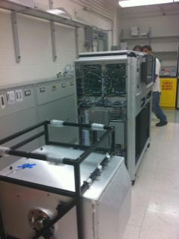
Joint Genome Institute Updates
Community Sequencing Program:
August review; decisions announced in October
User Community Activities:
5th annual User Meeting (March)
Finishing in the Future (June)
10th Cyanobacterial Workshop (June)
JGI Operations:
Outcome of the March 2010 Review
JGI is highly committed to improve operations and efficiency
JGI needs to identify critical workflow bottlenecks, establish key performance indicators, and implement workflow and tracking processes
JGI needs to augment senior IT operations management expertise
JGI Response
Victor Markowitz hired as CIO and Associate Director
Acquired LIMS designed for sequencers; currently adapting to improve project tracking and workflow
Initiated development of improved standard operating procedures
16 BERAC Sept2010
Department of Energy • Office of Science • Biological and Environmental Research
16 BER BSSD
Department of Energy • Office of Science • Biological and Environmental Research
16 BER BSSD
Department of Energy • Office of Science • Biological and Environmental Research

Slide 17
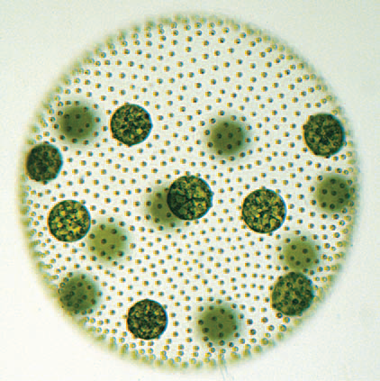
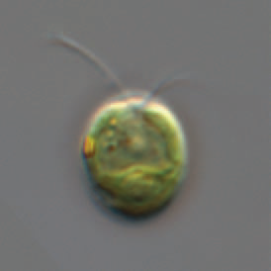
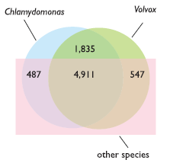
Genomic Clues into Multicellularity
Objective:
Understand the genetic basis for multicellularity
Approach:
Sequence the genome of the multicellular alga Volvox carteri, compare it to the sequence of the single-celled alga Chlamydomonas
Compare Volvox sequences with C. reinhardtii
Results/Impact:
138 Mb genome
14,500 predicted genes
Despite fundamental differences in organismal complexity and life history, the two species have very similar predicted protein families.
Preferential expansion of lineage-specific proteins in Volvox provided a key source of developmental innovation and adaptation.
Prochnik, et..al..Science, 329:223, 9 July, 2010
17 BERAC Sept2010
Department of Energy • Office of Science • Biological and Environmental Research
17 BER BSSD
Department of Energy • Office of Science • Biological and Environmental Research
17 BER BSSD
Department of Energy • Office of Science • Biological and Environmental Research

Slide 18
A look ahead for BSSD
Principal investigator meetings
Inter Agency Modeling and Analysis Group (IMAG): MSM2010 Meeting, October 27-28
Radiochemistry and Instrumentation Research
Genomic Sciences—moved!
Future workshops
Switchgrass
Low Dose strategic planning
18 BERAC Sept2010
Department of Energy • Office of Science • Biological and Environmental Research
18 BER BSSD
Department of Energy • Office of Science • Biological and Environmental Research
18 BER BSSD
Department of Energy • Office of Science • Biological and Environmental Research

