Slide 1
Report of the BERAC Panel on the Atmospheric Radiation Measurement (ARM) Climate Research Facility (ACRF)
Minghua Zhang Stony Brook University, SUNY

Slide 2
ACRF User Facility
Three fixed sites
Two mobile facilities (AMF)
An aerial facility
Data processing and data archive facilities
Engineering and operational infrastructure

Slide 3
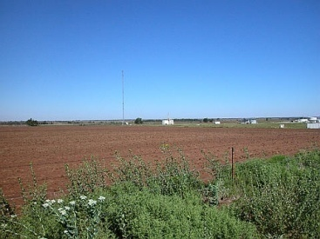
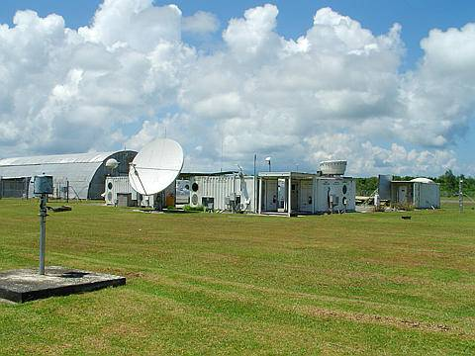
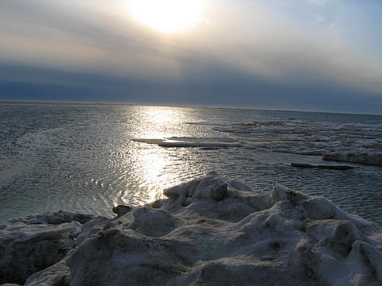
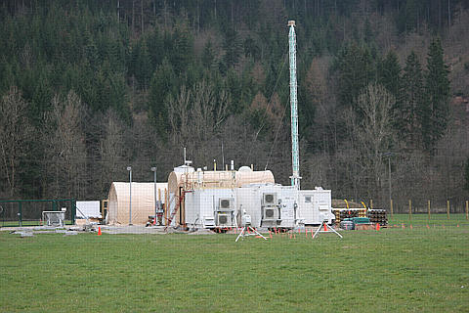
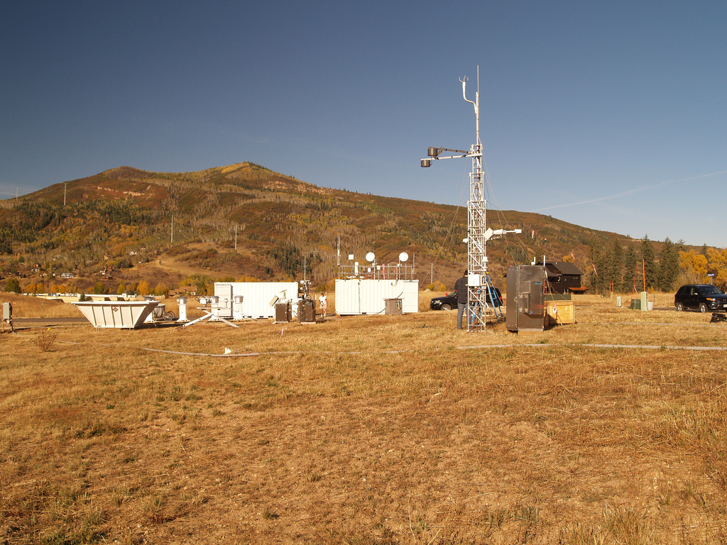
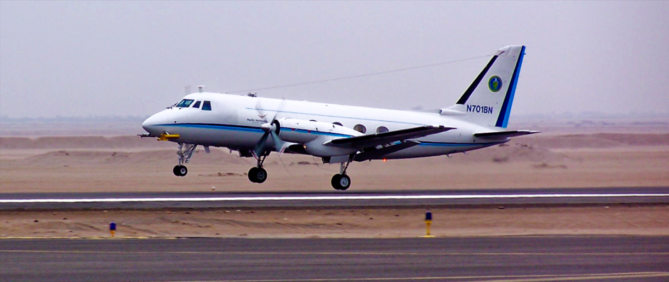
Field Campaign Capabilities Fixed Sites
Southern Great Plains
Tropical Western Pacific
North Slope of Alaska
Mobile Facility 1
Mobile Facility 2
Aerial Facility

Slide 4
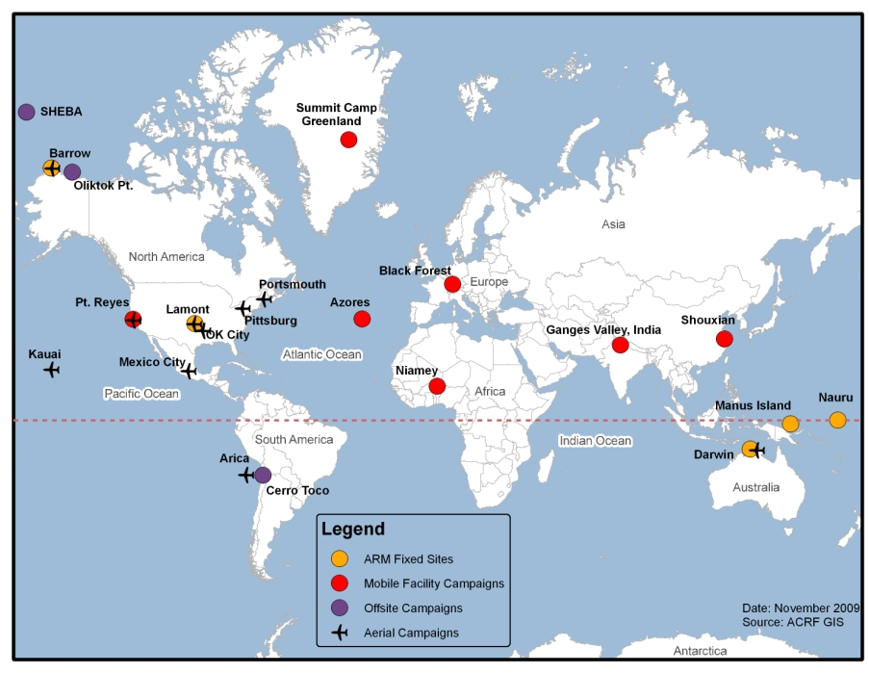
ACRF User Facility

Slide 5
ACRF Missions as a User Facility
Collect and develop datasets of radiation, aerosols, clouds with dynamics and thermodynamics at locations of various climate regimes.
Supplement the continuous data sets with laboratory studies and shorter-duration field campaigns
Enable research to understand and parameterize cloud and radiation processes.
Enable research to improve climate models.

Slide 6
Charge Letter Questions
Eight Questions, Four Groups:
Science impact and support
Management
Resources
Recommendations

Slide 7
Review Panel
Minghua Zhang (Chair), Stony Brook Univ.
Gerald Mace, Univ. of Utah
Robert Rauber, Univ. of Illinois at Urbana-Champaign
Qin-Hon Moeng, NCAR
Max Suarez, NASA GSFC
David Turner, Severe Storm Lab., NOAA
Site Visit and Review Meeting at Ponca City
Feb. 16-18, 2011

Slide 8
Review Questions: 1. Science Impact and Support
Is the use of ARM Climate Research Facility resources making a significant impact in climate change science?
Does ACRF adequately support the science objectives of DOE Atmospheric System Research program and the general scientific user community? If so, is it appropriate for a BER-supported user facility?

Slide 9
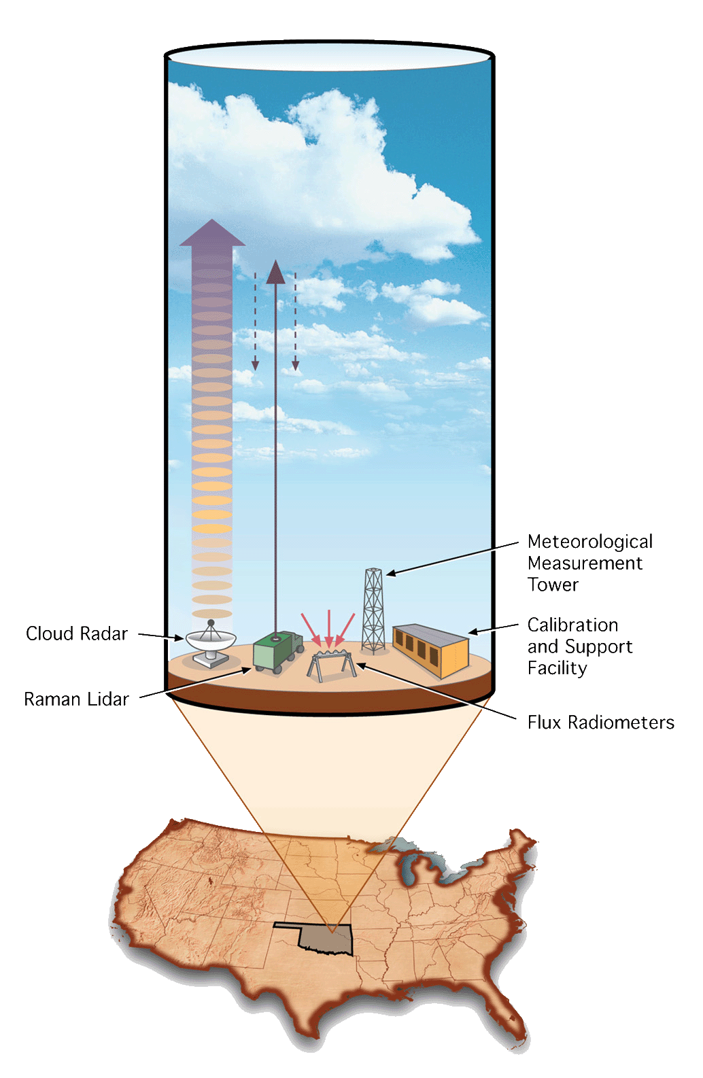
Findings: Science Impact by Providing Data and Measurements
Vertical profiling datasets of macro- and microphysical properties of clouds and radiation, at high temporal resolutions, along with atmospheric thermodynamics and dynamics, to enable evaluation of model parameterizations
Spectrally-resolved infrared radiance dataset, to reduce uncertainty of infrared radiative transfer models from about 10 W/m² before ACRF to 1-2 W/m².

Slide 10
Findings: Science Impact by Providing Data and Measurements
Improvement in the ability to measure atmospheric water vapor, reducing the uncertainty in column precipitable water vapor from 10-15% to 3-4%.
Statistically relevant, airborne observations of liquid, ice, and mixed-phase cloud properties, aerosol properties, and trace gases, to allow detailed process-level understanding of cloud-radiation-aerosol-precipitation interactions.

Slide 11
Findings: Impact on Science
Improved radiative transfer codes in GCMs, including the Community Atmospheric Model (CAM)
Improved parameterizations of clouds and convection in GCMs.
Incorporation of the improved aerosol indirect effects on climate in GCMs.
The development of a multi-scale modeling framework MMF, leading to an NSF STC
Improved weather prediction models (ECMWF).

Slide 12
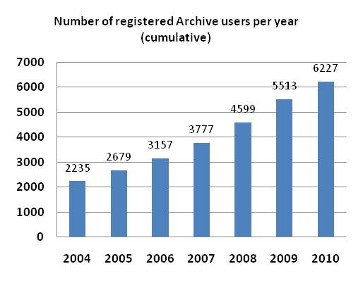
Findings: Science Impact from User Statistics
> 1000 peer-reviewed publications

Slide 13
Findings: Science Impact on ASR and Community
ACRF has provided the ASR science team and the larger science community with:
a suite of observations that allow for study of radiation, cloud, aerosol, precipitation and their interactions.
capability to propose new instruments, new measurements, and field campaigns.
high-level processed products, from raw measurements to integrated geophysical variables.

Slide 14
Conclusion 1: Science Impact
ACRF dataset collected has significantly impacted the climate science.
ACRF has supported the science objectives of the DOE ASR program and the general science user community.
It is appropriate and important for DOE BER to operate ACRF because of the critical needs of ACRF data in climate research, the complexities of the facilities, the scale of measurement operations, and the technical and science expertise required.

Slide 15
Review Questions: 2. Management
Is ACRF management effectively setting priorities, tracking progress, and resolving problems that impact facility operations?
Are the ACRF and participating laboratory management roles and responsibilities effectively carried out and coordinated?
Is there an ongoing program of self-assessment or external benchmarking aimed to continuously improving ACRF management and operations?

Slide 16
Findings: Setting Priorities
ACRF Sets Priorities based on input from:
ASR Science Team
ACRF Science and Infrastructure Steering Committee (SISC)
ACRF-initiated workshops
Community Input
Workshop in 2008 asked these questions:
What are the outstanding science questions for the next ten years?
What measurements, instruments, and data products are needed to address the science questions?

Slide 17
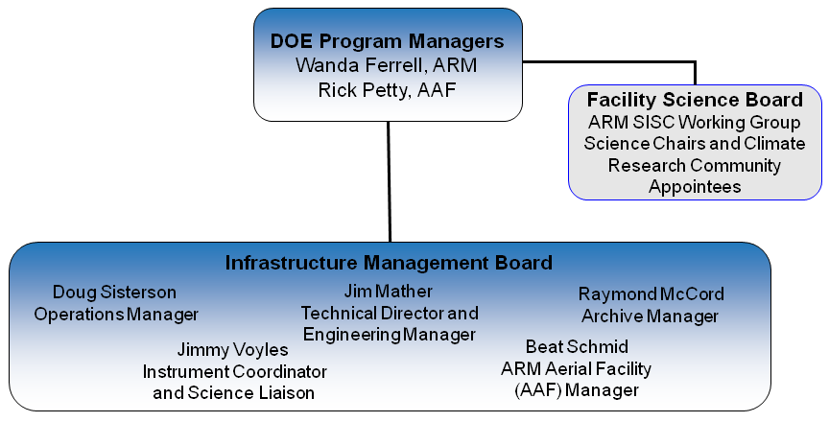
Findings: Tracking Progresses

Slide 18
Findings: Tracking Progresses
Monitoring of operational status of all ACRF instruments at all sites at PNNL
Usage of its datasets, segregated into various forms such as different instrument and data types and demographics of the users
Peer reviewed publications that use ACRF datasets
Research highlights that use ACRF datasets
Status report at regular meetings (ASR, SISC)

Slide 19
Findings: Resolving Problems
Weekly teleconferences of ACRF Problem Review Board and Engineering Review Board
Weekly teleconferences of the IMB (technical director, managers of operations, instruments, engineering, data archive, and aerial facility)
Bi-weekly teleconference of the data systems and data quality control personnel
Monthly reports, annual ASR meetings
Open mindedness of ACRF program managers to encourage and act on feedback at all levels.

Slide 20
Findings: Lab and Management Roles
PNNL: ACRF Technical Director, Engineering Manager, Instrument Coordinator, and Aerial Facility
ANL: Operations manager, SGP site manager, 2nd AMF site manager
ORNL: ACRF data archive
SNL: NSA site manager
LANL: TWP site manager, 1st AMF
BNL: high-level cloud data products
LLNL: high-level model data products
Responsibilities are clear; interactions seamless.

Slide 21
Findings: Self Assessment
IMB teleconference to conduct weekly review of status
Data coordination call for bi-weekly assessment of data issues
Monthly Science and IMB call.
User satisfaction survey after each aerial facility campaign, lessons learned for each AMF deployment
2007 Archive user workshop
2009 Facility User Survey

Slide 22
Findings: Self Assessment
Tracking progress of data and facility usage, and science impact
Annual Accomplishments Reports
Seeking comments through the web
ACRF carries self assessment at various levels regularly. ACRF Management reacts to assessment results quickly.
No formal protocol of self assessment is documented.

Slide 23
Conclusion 2: Management
ACRF actively solicits, and decisively acts upon, inputs from the science community in setting its priorities. Effective mechanisms are in place to track progress and resolve problems at all levels.
Coordination among the national laboratories is seamless; management carries out its responsibilities effectively.
ACRF assesses its operation and progress continuously for improvements, but no self-assessment protocol is formally documented.

Slide 24
Review Questions: 3. Resource
Is the user model for allocating resources for all ACRF capabilities appropriate? Does ACRF attract the best mix of users?
Are there adequate resources to accomplish the BER mission at ACRF in the current budget scenario? Are ACRF processes for allocating and managing BER resources (personnel and funds) appropriate?

Slide 25
Findings: User Model
Access ACRF data archive to download data directly
propose field campaigns through a peer-review process of proposals
Propose to add instruments or measurements to ACRF field campaigns
All data from the field campaign are available timely to the general user community

Slide 26
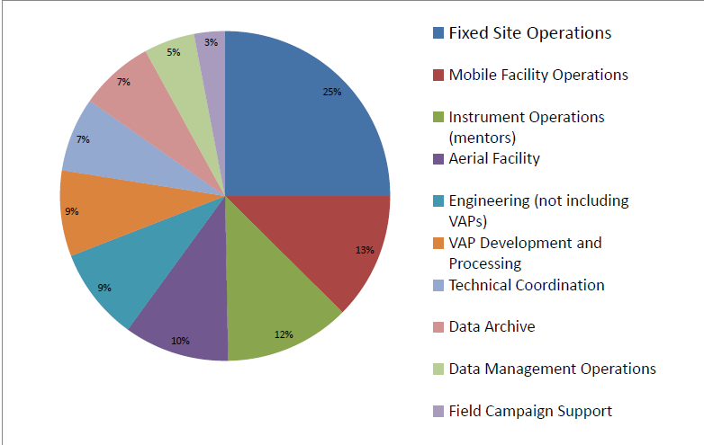
Findings: Resource Allocations

Slide 27
Findings: Appropriateness of resources and their management
ACRF is achieving end-to-end deployment and processing of its assets and data with current resources.
Allocations resources are balanced; their management well carried out.
ACRF made good use of the ARRA funds, acquiring and deploying new instrumentation, particularly the suite of new radars. The current level of resources must be maintained to fulfill the goals of the facilities.

Slide 28
Conclusion 3: Resources
The ACRF user model suits its missions, is compatible with resource allocations, which are appropriate.
ACRF has been functioning well under the present budget challenges with the newly acquired instruments.
Current level of funding must be maintained, needs to be implemented in future years to include operation, maintenance and production of data products from the full ACRF instrument suite.

Slide 29
Review Question: 4. Recommendations
Could changes be made to increase the impact of ACRF on DOE Science Goals?

Slide 30
Recommendation: 1. Data quality
ACRF carries data QC through:
the Data Quality Office (DQO) in which all data streams are visually inspected
(2) instrument mentors that provide additional expertise for each instrument data stream
(3) individual ASR PI investigations.
Recommendation: Establish QC protocol for the data QC office, instrument mentors, and the ASR site scientists to interact and operate in a well-defined process

Slide 31
Recommendation: 2. User base
ACRF currently reaches out to users through
Professional conferences
(2) Exhibits
(3) K-12 Education
(4) Web and publication
Recommendation: Conduct user tutorial workshops regularly to target undergraduate and graduate students as well as young scientists.

Slide 32
Recommendation: 3. High-level product
ACRF currently processes raw measurements to some high-level geophysical fields (VAP product), but many high-level fields remain undeveloped.
Recommendation: Establish VAP mentor program for critical high-level data products

Slide 33
Recommendation: 4. ACRF Showcase Datasets
ACRF currently produces a Climate Modeling Best Estimate (CMBE) product, which packages high-level integrated datasets.
Recommendation: Expand the ACRF showcase product, with an oversight board to define and implement the critically needed data and processing.

Slide 34
Final Words
ACRF has enabled research on critical questions in climate science.
ACRF management is effective and rigorous.
Current resources are adequate, but need to be maintained.
ACRF will benefit from more emphasis on data quality, user workshop, and high-level products.
We can be proud of how ACRF is being operated and its outcome.

