Slide 1
JCESR: One Year Later
George Crabtree
Director, JCESR
Argonne National Laboratory
University of Illinois at Chicago
Outline
Challenges: Transportation and Electricity Grid
Vision, Mission, Legacies
A New Paradigm
Highlights: trace water, solvation, Mg-ion battery
Directions: solvation, metal anodes, novel prototypes, reaction pathways
Basic Energy Sciences Advisory Committee (BESAC)
July 29, 2014
Bethesda, MD

Slide 2

Energy Storage Challenges
Two biggest energy uses poised
for transformational change
Transportation 28%
  Foreign oil → domestic electricity
  Reduce energy use
  Reduce carbon emissions
Electricity 39%
  Coal → Gas → Wind and Solar
  Greater reliability, resiliency, flexibility
  Replace “just in time” with inventory
Energy Demand
Residential & Commercial
Non-electric
11%
Transportation 28%
Electricity Grid
39%
Industrial
Non-electric
22%
2013
EIA Monthly Energy Review Table 2.1 (May 2014)
The bottleneck for both transitions is
inexpensive, high performance electrical energy storage

Slide 3
JCESR Has Transformative Goals
Vision
Transform transportation and the electricity grid
with high performance, low cost energy storage
Mission
Deliver electrical energy storage with five times the energy density and one-fifth the cost of today’s commercial batteries within five years
Legacies
A library of the fundamental science of the materials and phenomena of energy storage at atomic and molecular levels
Two prototypes, one for transportation and one for the electricity grid, that, when scaled up to manufacturing, have the potential to meet JCESR’s transformative goals
A new paradigm for battery R&D that integrates discovery science, battery design, research prototyping and manufacturing collaboration in a single highly interactive organization
$100/kWh
400 Wh/kg 400 Wh/L
800 W/kg 800 W/L
1000 cycles
80% DoD C/5
15 yr calendar life
EUCAR
Transportation
$100/kWh
95% round-trip efficiency at C/5 rate
7000 cycles C/5
20 yr calendar life
Safety equivalent to a natural gas turbine
GRID

Slide 4
Why So Aggressive?
Seek transformative outcome
Next generation energy technology demands next generation electricity storage
Bring the community to the rich potential of beyond lithium-ion
Lithium-ion – the best battery technology we have ever seen
  Increases energy density at 5%/yr
  Decreases cost at 8%/yr
. . . but cannot achieve transformative factors of five in cost and performance
JCESR → beyond Lithium-ion

Slide 5

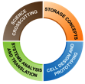


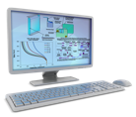
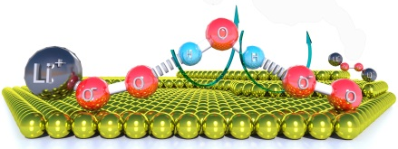
JCESR Creates a New Paradigm for Battery R&D
MATERIALS
PROJECT
TDTs
Multivalent Intercalation
CROSSCUTTING SCIENCE
Systems
Analysis and Translation
Cell Design
and Prototyping
Commercial Deployment
Chemical Transformation
Non-Aqueous Redox Flow
Discovery Science
Battery Design
Research Prototyping
Manufacturing Collaboration
++
ELECTROCHEMICAL DISCOVERY LAB
Wet and dry electrochemical interfaces
Model single crystals
Practical nanoparticles
TECHNO-ECONOMIC MODELING
“Building battery systems on the computer”

Slide 6

Lithium Ion Battery Technology

Slide 7
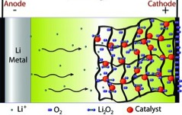
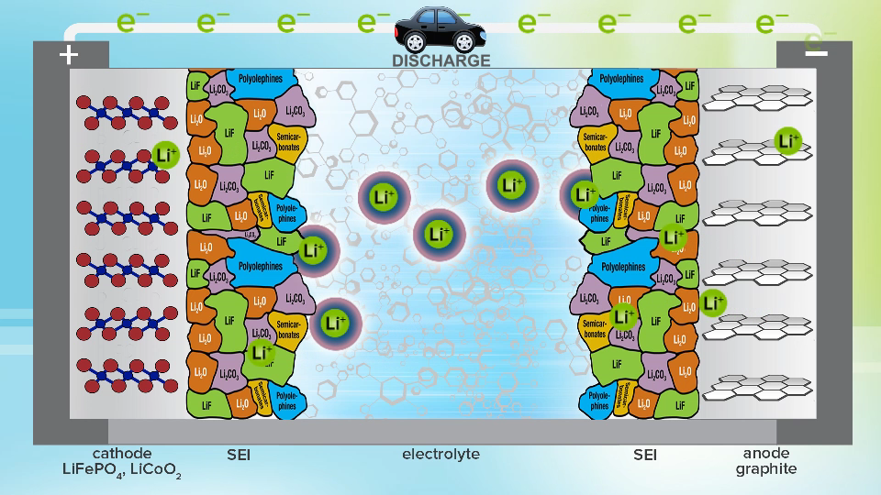
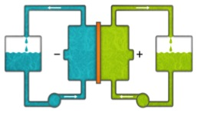
JCESR’s Beyond Lithium-ion Concepts
Black, Adams, Nazar, Adv. Energy Mater 2, 801 (2012)
Lithium-ion “Rocking Chair”
Chemical Transformation
Li⁺ cycles between anode and cathode, storing and releasing energy
Replace intercalation with high energy chemical reaction: Li-S, Li-O, Na-S, . . .
Mg⁺⁺
Yang, Zheng, Cui, Ener Env Sci 5, 1551 (2013)
Multivalent Intercalation
Non-aqueous Redox Flow
Replace monovalent Li+ with
di- or tri-valent ions: Mg⁺⁺, Al⁺⁺⁺, . . .
Double or triple capacity stored and released
Replace solid electrodes with liquid solutions or suspensions:
lower cost, higher capacity, greater flexibility

Slide 8




Beyond Lithium Ion Opportunity Space is Large, Unexplored and Rich
Catholyte
Chemical
Transformation
Intercalant
mostly
unknown
Solid
Systems
Liquid
Beyond
Li-ion
Anolyte
Intercalant/Alloy
transformational
advances
Metal
extensive knowledge
Intercalant electrodes
Li-ion
Li
Mg Al
Bi, Sn, Oxysulfides
Quinoxaline
Metal
Coordination Complexes
Triflate, Tetraborate
Oxide
Phosphate-based ceramics,
Block Co-polymer
Li-O
Li-S
Na-S
Quinoxoline Ferrocence
Polysulfides
clear pathways to advances
Spinel
Layered
Graphite, LiCoO₂
LiFePO₄, LiMnO₂
. . .
Materials

Slide 9
JCESR Approach to Big, Unexplored Beyond Lithium-ion Space
Partners that span the space
  Five national labs
  Five universities, plus faculty from four non-partner universities
  Four private sector companies
Affiliates that represent the community
  45 affiliates at launch
  65 affiliates as of July 2014
New tools define the landscape
  Materials Project / Electrolyte Genome
  Electrochemical Discovery Lab
  Techno-economic Modeling
Battery concepts with multiple implementations
  Multivalent Intercalation
  Chemical Transformation
  Non-aqueous Redox Flow
Parallel research across four functions + frequent communication
Fundamental science and engineering inform strategic directions

Slide 10
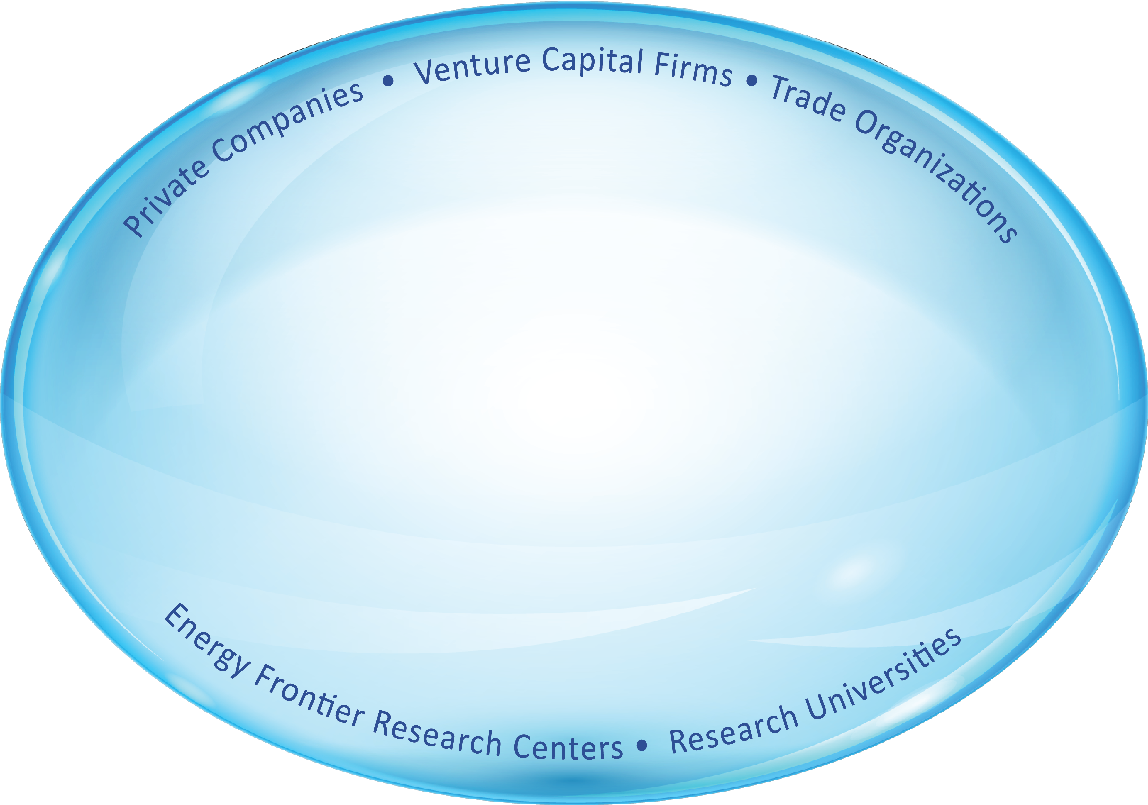


JCESR Team
and Affiliates
45 Affiliates at launch
65 Affiliates July 2014
Affiliates Day
March 19, 2014
Affiliates Newsletter
July 2014

Slide 11

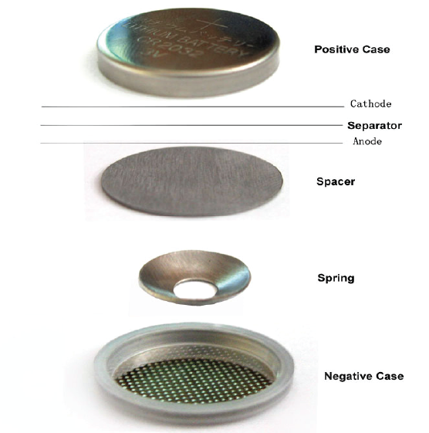
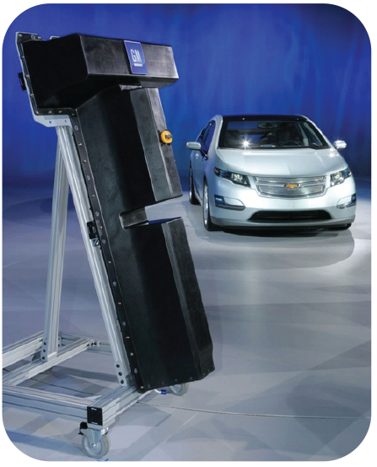

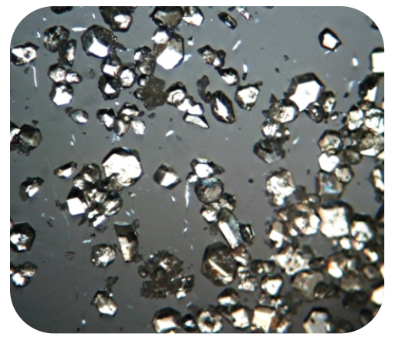
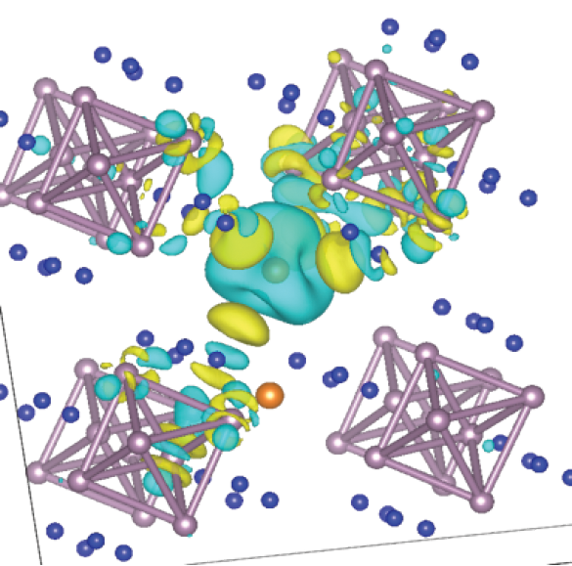
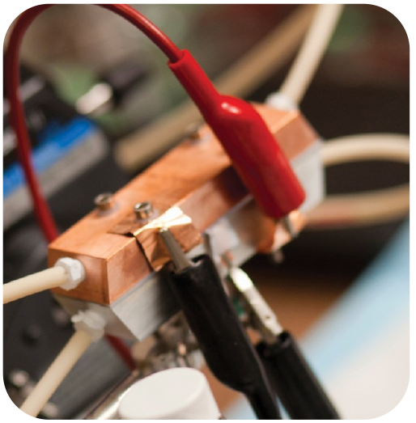

Battery Technology Readiness Level (BTRL)
BTRL - 1
BTRL - 2
BTRL - 3
BTRL - 3
BTRL – 5 - 6
1-2 YEARS
2-5 YEARS
2-5 YEARS
5-10 YEARS
Proof-of-concept prototype
Research prototype
Scientific Breakthrough
New class
of materials
synthesized
Proven
performance
in half cells
Proven
performance in
lab-scale full cells
Material scale-up,
cell testing and
scale-up to pack
Response to advice from
Governance Committee, ESAC and action item from Oct 1 Management Review
Developed collaboratively with
JCI, NASA-Glenn, TARDEC
JCESR
“sweet spot”

Slide 12


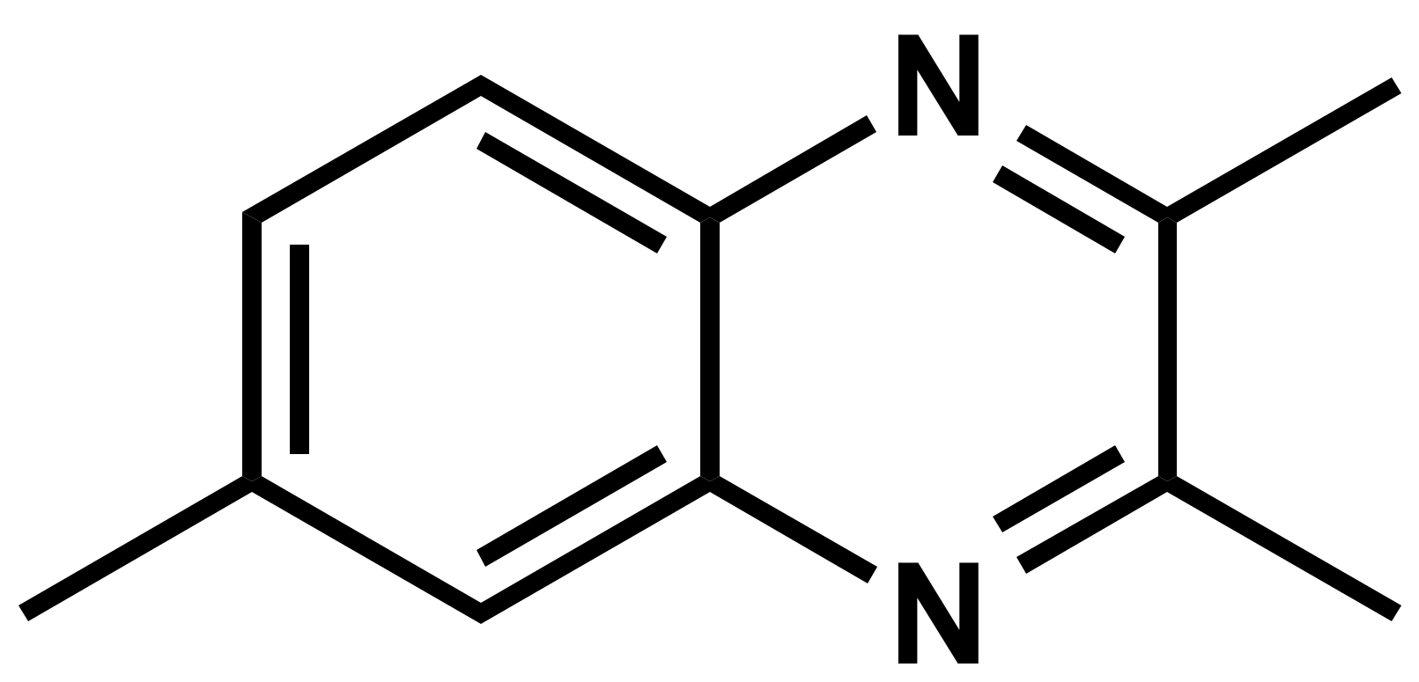
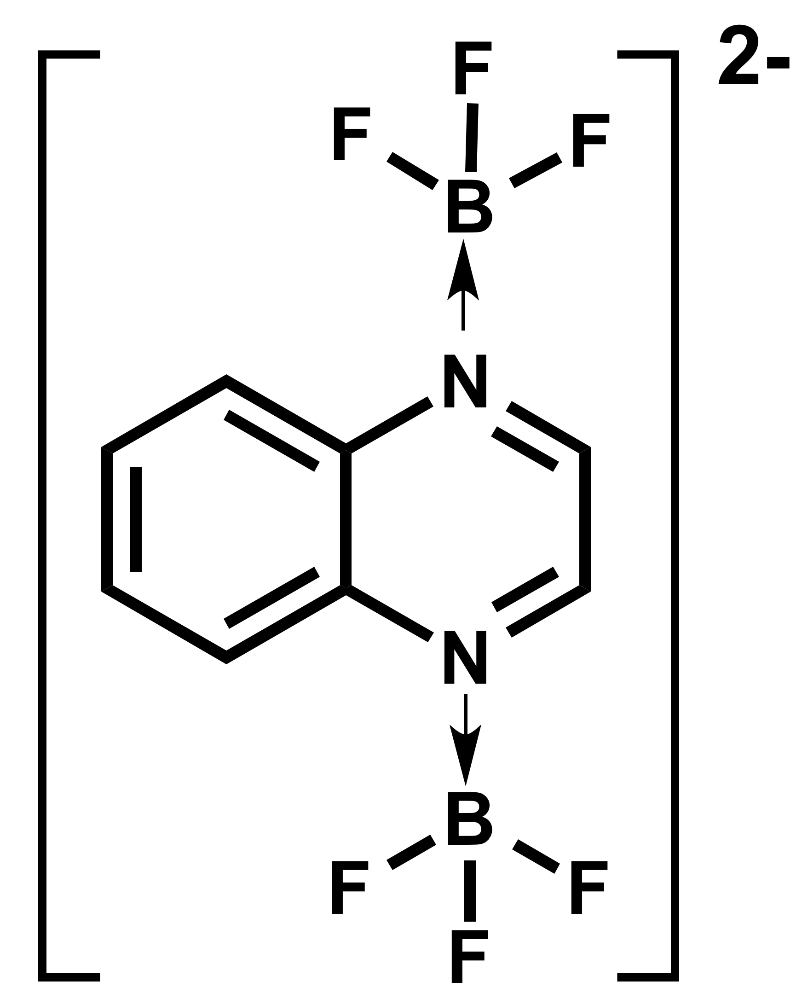
JCESR Achieves Across the Science-Manufacturing Spectrum
Link to Community
New IP
Infinite current collector
Industry-science collaboration
Six projects of interest to JCI
MOU with NASA-Glenn
Multivalent Intercalation
Systems
Analysis and Translation
Cell Design
and Prototyping
CROSSCUTTING SCIENCE
Chemical Transformation
Commercial Deployment
Non-Aqueous Redox Flow
Discovery Science
Battery Design
Research Prototyping
Manufacturing
Collaboration
System Mass for 100 kWh_{use} (kg)
2e⁻
2e⁻
2 DBBB
TMQ
Trimethylquinoxaline
Li/LMRNMC
2C⁺
V
Li/O₂ open
Si/LMRNMC
Li/O₂ closed
Gr/LMRNMC
charged
2 [DBBB⁺A⁻]
TMQ²⁻ [C⁺]₂
Gr/NMC333
discharged
Useable Energy Density (Wh_{use}/L)
System Volume for 100 kWh_{use} (L)
All Organic Redox Flow
Non-aqueous Redox Flow + Electrolyte Genome
Brushett, Zhang et al (MIT, ANL)
4
Li/O₂
Tesla Model S
85 kWh_{use}
3
Li/LMRNMC
Theoretical kWh/L
2
Gr/NMC333
Nissan Leaf
22 kWh_{use}
1
BF₄⁻
1
2
3
+
Theoretical kWh/kg
Trace water catalyzes lithium peroxide electrochemistry
EDL+Electrolyte Genome
Jirkovský et al, Science (submitted)
TMQ
BF₄⁻
Useable Specific Energy (Wh_{use}/kg)
Quantifying the promise of Li-air batteries (with GM)
Gallagher et al, Energy and Environmental Science (2014) DOI:10.1039/C3EE43870H
10x electrochemical activity
First year summary + more highlights
www.jcesr.org

Slide 13
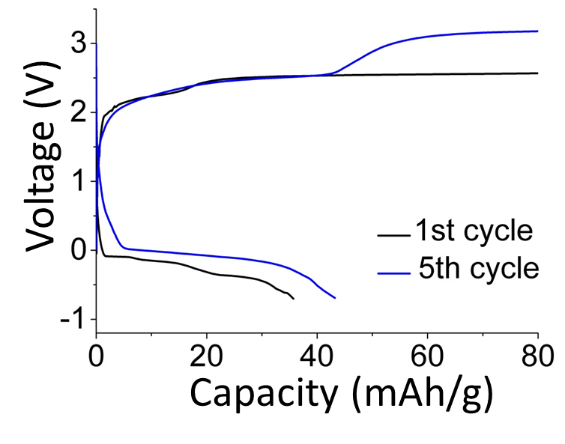
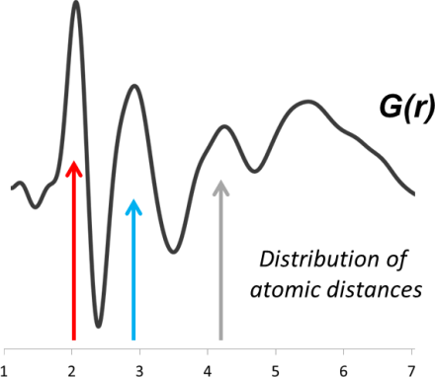

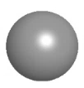
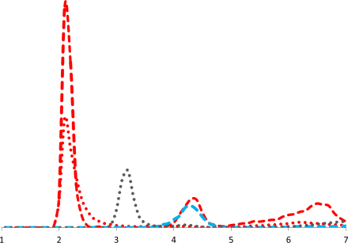


Toward a Multivalent Intercalation Battery
Challenges
Mobility of ++ ions in cathode
Solvation – desolvation
Stable electrolyte
Compatible anode, electrolyte, cathode
Only one demonstrated system
Mg-chloroaluminate-Mo₆S₈
(Aurbach 2000)
Mobility in Mn₂O₄ Cathode
Mg++ Solvation Shell
First Fully Functional Mg⁺⁺ Battery since 2000
Controls
• Chemical reactions in electrolyte
• Interfacial ion exchange
• Mobility in electrolyte
Experiment: APS x-ray diffraction
Simulation: Electrolyte Genome
Pair Distribution Function
Quantifies anion presence in solvation shell
Mg⁺⁺
Li⁺
Ca⁺⁺
Energy barriers for MV ion diffusion in Mn₂O₄ spinel
Materials Project
Distribution of
atomic distances
Early stage prototype
Compatible
anode-electrolyte-cathode
Mg metal anode
Diglyme electrolyte
V₂O₅ cathode
Mg⁰ → Mg²⁺ + 2e-
High Li⁺ diffusion ≠
high MV diffusion
Coordination environment controls diffusion barrier
Tetrahedral→ octahedral → tetrahedral
Ca⁺⁺ has surprisingly low mobility barrier
Experiment
Diglyme
Electrolyte
Mg⁺⁺
Metal
Anode
Intercalation Cathode
Computation
Diglyme
······ Mg-solvent
- - - Mg-anion
TFSI⁻
1
2
3
4
5
6
7
(r / Å)
Lapidus et al, submitted (PCCP)
First year summary + more highlights
www.jcesr.org

Slide 14
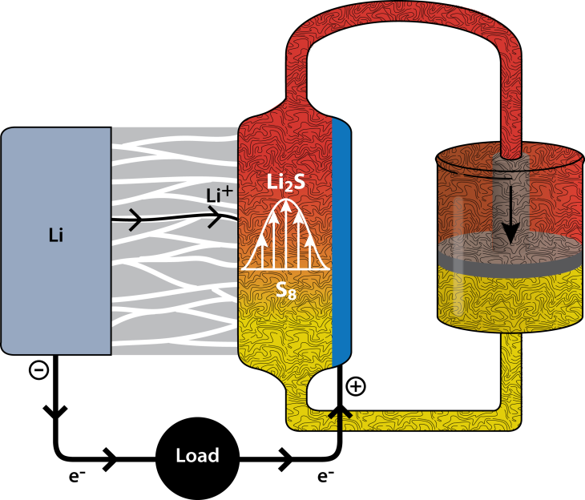
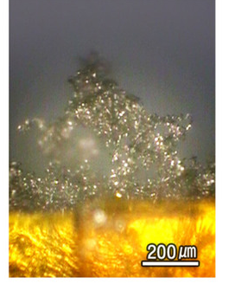
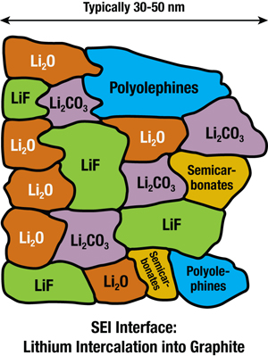
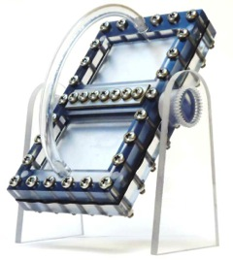
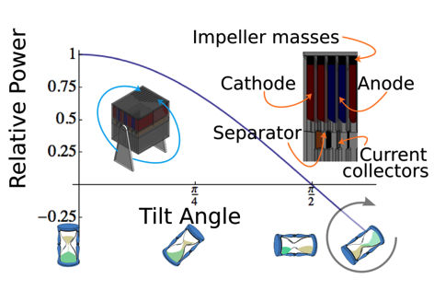
Priority Research Areas
Metal Anodes
Robust surfaces over
multiple solution/deposition cycles
Solvation/de-solvation structure and transfer dynamics
Li-polysulfide Semi-Flow
Concept
-
30-50 nm
Electrolyte
+
+
Electrode
+
+
+
+
+
Kang Xu ARL
Thackeray,ANL
Park et al, Nature Scientific Reports doi:10.1038/srep03815
Solid-Electrolyte Interphase
partially solvated ion at interface
Solution/deposition dynamics, surface degradation,
dendrite growth
fully solvated ion
In bulk electrolyte
Y. Yang, G. Zheng, and Y. Cui, Energy & Environmental Science, 6, 1552 (2013)
Novel Prototyping Concepts
Gravity Induced Flow Cell
Molecular Understanding
of Reaction Pathways and Energetics
Lithium-Sulfur Batteries
Electrolyte Genome / EDL
Critical to battery science and technology strategies
Rich opportunities for in situ, time-resolved, multi-modal characterization, predictive theory and multiscale modeling

Slide 15
Perspective
More on JCESR website
www.jcesr.org
Vision: Transform transportation and electricity grid with high performance, low cost energy storage
Mission: Deliver electrical energy storage with five times the energy density and one-fifth the cost
→ Beyond lithium ion
Legacies:
A library of the fundamental science of the materials and phenomena of energy storage at atomic and molecular levels
Two prototypes, one for transportation and one for the electricity grid, that, when scaled up to manufacturing, have the potential to meet JCESR’s performance and cost goals
A new paradigm for battery R&D that integrates discovery science, battery design, research prototyping and manufacturing collaboration in a single highly interactive organization
A bold new approach to battery R&D
Accelerate the pace of discovery and innovation
Bring the community to the beyond lithium-ion opportunity

