Slide 1
Comments from the
Office of Science
BESAC
29 July 2014
Patricia M. Dehmer
Acting Director, Office of Science
U.S. Department of Energy

Slide 2

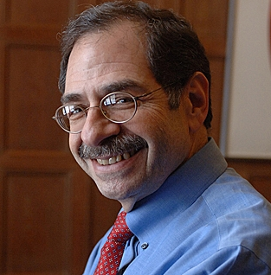
Still waiting for confirmation …
Professor Lynn Orr
Nominee for S-4
Professor Marc Kastner
Nominee for SC-1
2

Slide 3
Outline
SC FY 2015 Budget –
House and Senate Marks
Comments on the impacts FACA studies
Update on Data Management Plans
Update on STEM workforce needs studies
3

Slide 4
FY 2015 Office of Science Budget – House and Senate Marks

Slide 5
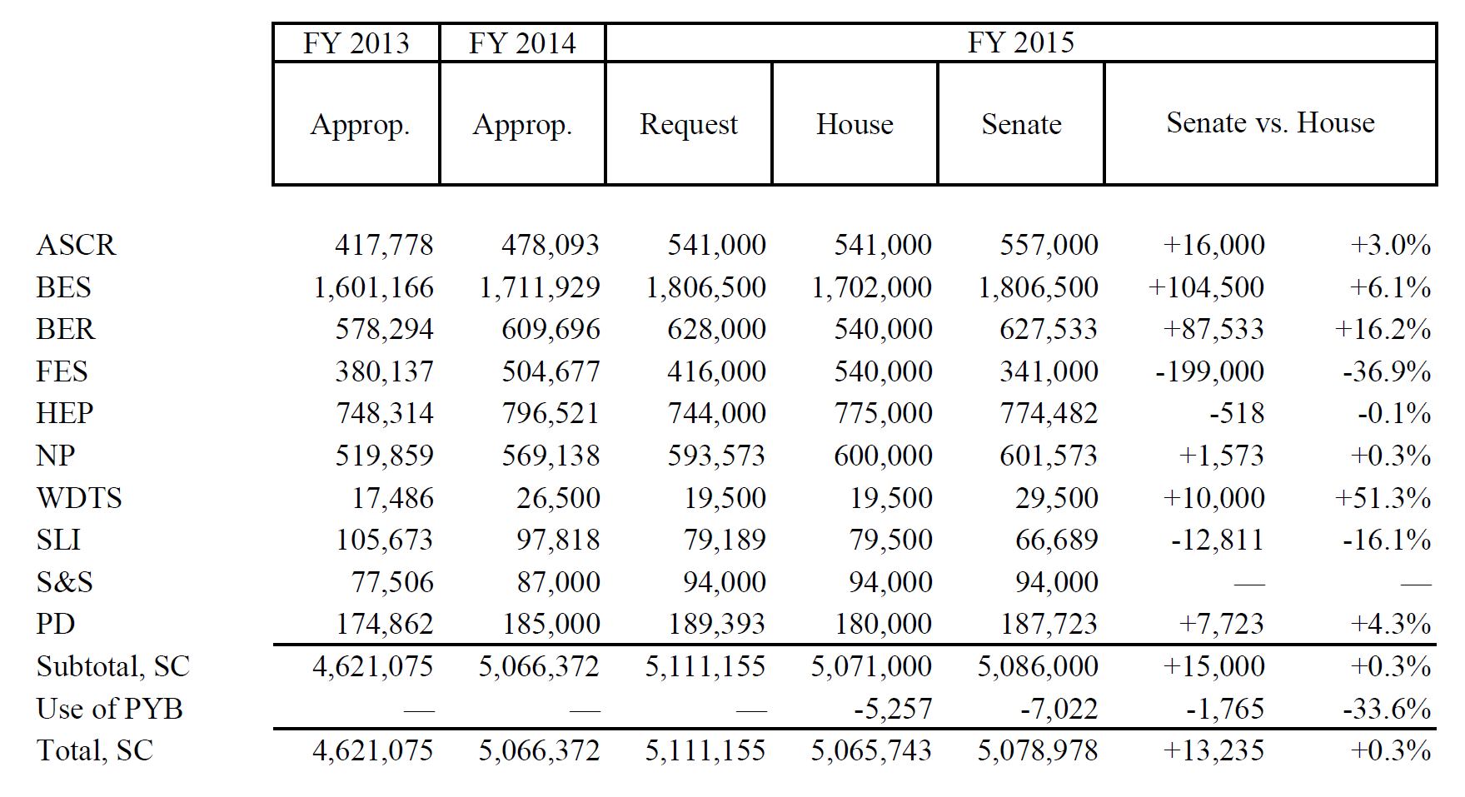
SC Funding Status
(budget authority in thousands of dollars)
5

Slide 6
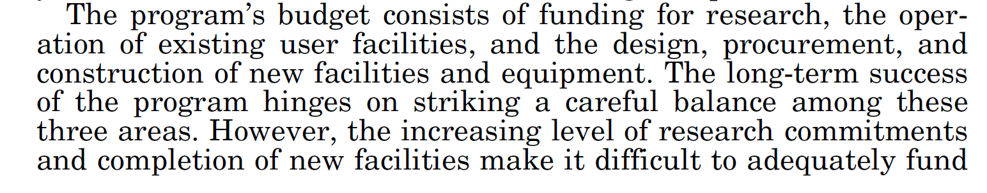
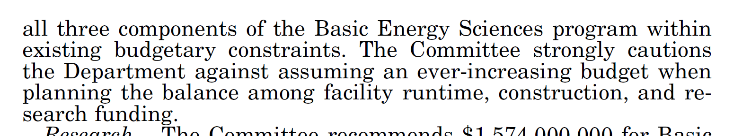
FY 2015 HEWD Guidance for BES
6

Slide 7
Impacts of FACA Studies

Slide 8
Synchrotron Radiation Light Sources
Briefing for SEAB
20 June 2014
Excerpt from:
Patricia M. Dehmer
Acting Director, Office of Science
U.S. Department of Energy
8

Slide 9
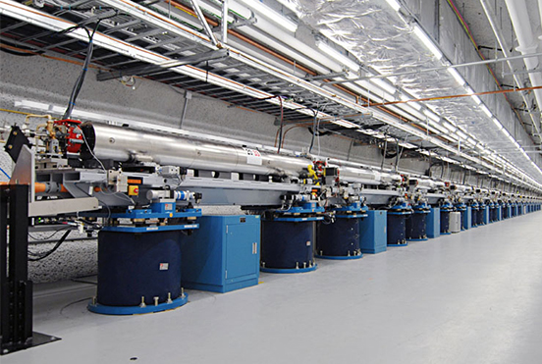
Plans: Past
BESAC Report: Novel Coherent Light Sources, January 1999
Given currently available knowledge and limited funding resources, the hard X-ray region (8-20 keV or higher) is identified as the most exciting potential area for innovative science. DOE should pursue the development of coherent light source technology in the hard X-ray region as a priority. This technology will most likely take the form of a linac-based free electron laser device using self-amplified stimulated emission or some form of seeded stimulated emission. The developers of such a source should seek to attain both temporal and spatial coherence, as well as precise timing with ultrashort pulsed lasers, which will be required for laser pump/X-ray probe experiments.
LCLS Commissioned, April 2009
aka the “Leone” Report

Slide 10
BESAC Report on
“Future X-Ray Light Sources” and the DOE Actions
Excerpt from:
Patricia Dehmer
Acting Director, Office of Science
Harriet Kung
Director, Office of Basic Energy Sciences
Jim Murphy
Director, BES Scientific User Facility Division
10

Slide 11
Plans: Present—Charge to BESAC on X-ray Light Sources
On January 2, 2013, Bill Brinkman issued a charge to the Basic Energy Sciences Advisory Committee (BESAC).
The charge requested:
  assessment of the grand science challenges
  evaluation of the effectiveness of the present light source portfolio
  enumeration of future light source performance specifications
  prioritized recommendations on future light source concepts
  prioritized research and development initiatives
John Hemminger, the Chair of BESAC, served as Chair of a 22 member Subcommittee, which used previous BESAC and BES reports and new input from the x-ray sciences communities to formulate findings and recommendations.
  The final report was accepted by BESAC on July 25, 2013.

Slide 12
Findings and Recommendations
At the present time, the U.S. enjoys a significant leadership role in the x-ray light source community. This is a direct result of the successes of the major facilities managed by BES … and the particularly stunning success of the first hard x-ray free electron laser, the Linac Coherent Light Source (LCLS).
However, it is abundantly clear that international activity in the construction of new diffraction limited storage rings and new free electron laser facilities will seriously challenge U.S. leadership in the decades to come.
The U.S. will no longer hold a leadership role in such facilities unless new unique facilities are developed …

Slide 13

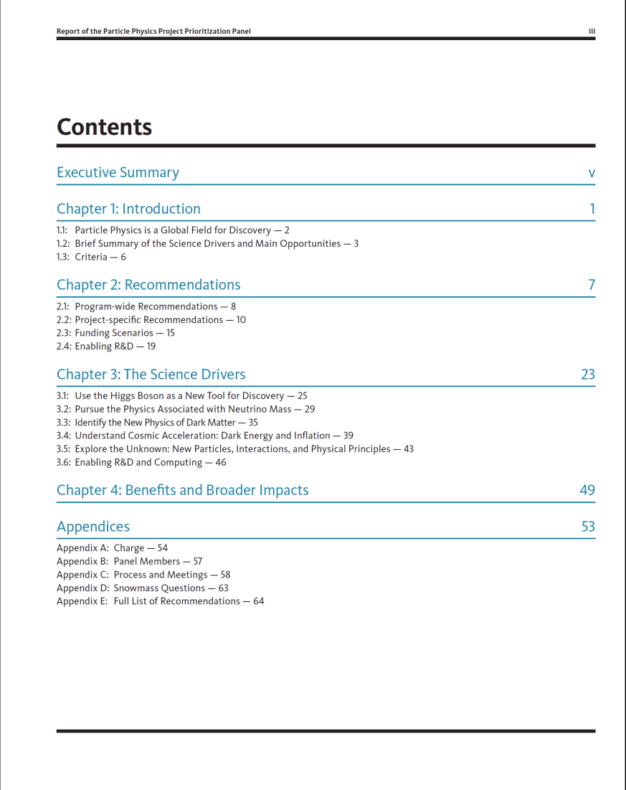
A Ten-year Strategic Plan for HEP in the U.S.

Slide 14
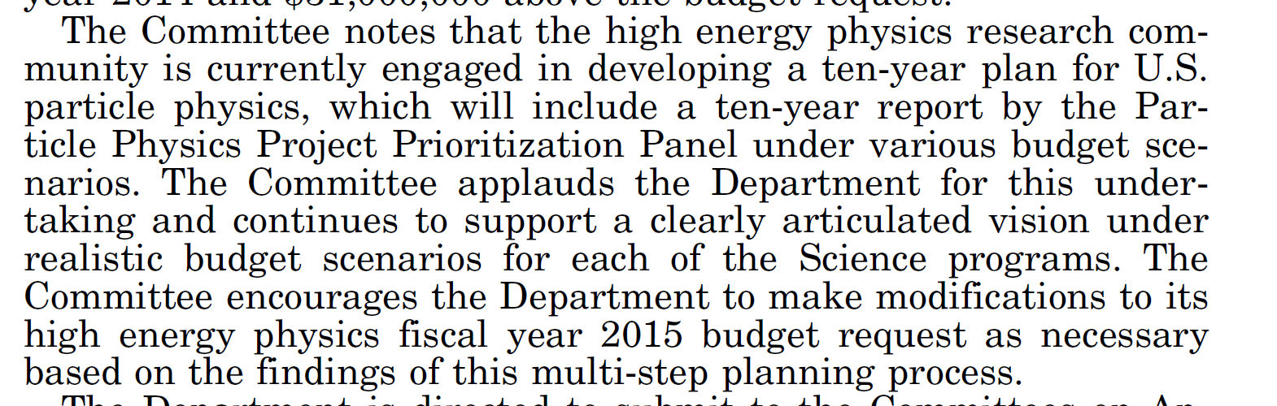
FY 2015 HEWD Guidance for HEP
14

Slide 15
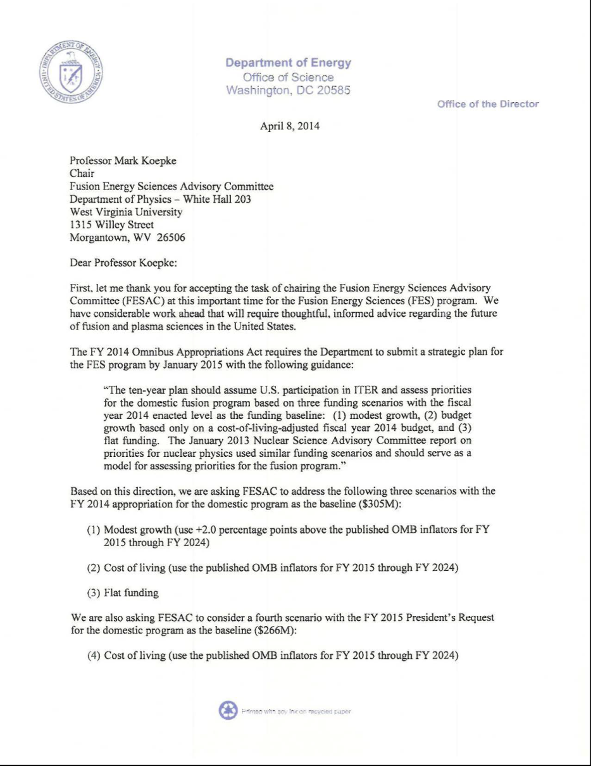
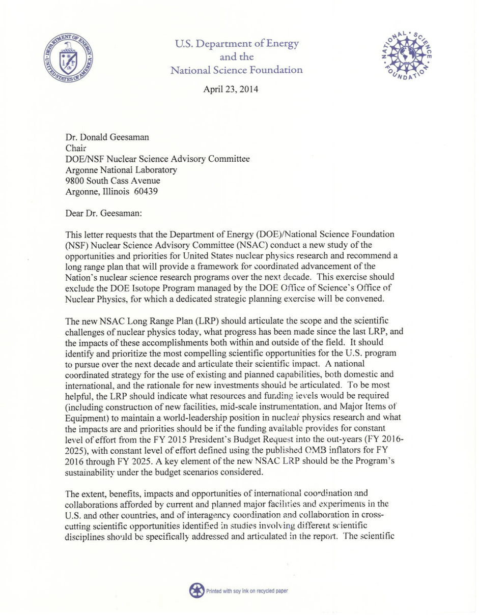
Other FACA Strategic Planning Charges
FESAC
NSAC

Slide 16
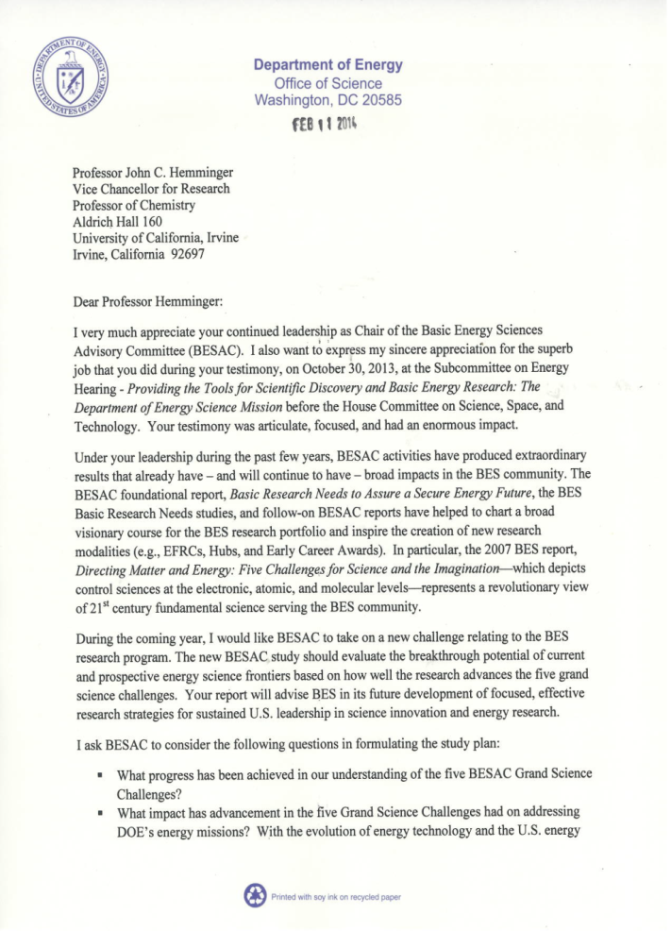

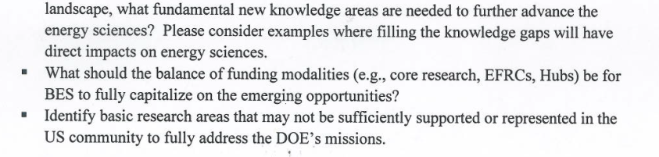

Current BESAC Charge

Slide 17
Full Funding of Financial Assistance Awards <$1Million

Slide 18
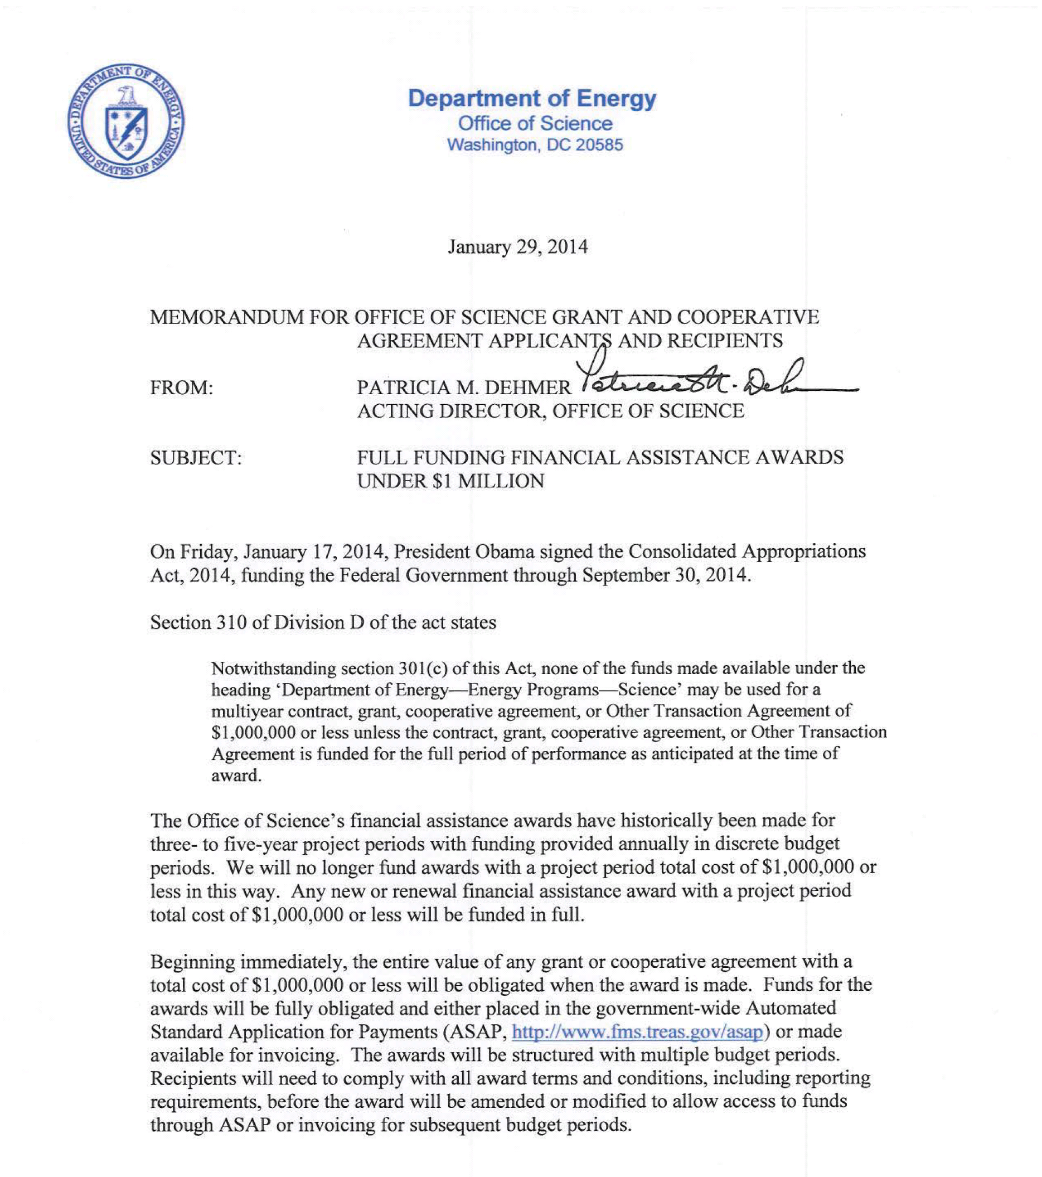
http://science.energy.gov/~/media/grants/pdf/FullFundingMemo.pdf

Slide 19
Digital Data Management

Slide 20
Office of Science Statement on Digital Data Management
All proposals submitted to SC for research funding
will be required to include a Data Management Plan
Requirements will be included in all solicitations for research funding starting Oct. 1st, 2014. This includes the Annual FOA.
Detailed requirements and further information on:
  Suggestions for what to include in a Data Management Plan
  Supplemental guidance and requirements from SC Program Offices
  Links to information about data management resources at SC user facilities
  Definitions of key terms
  FAQs
http://science.energy.gov/funding-opportunities/digital-data-management/
Now
Live!

Slide 21
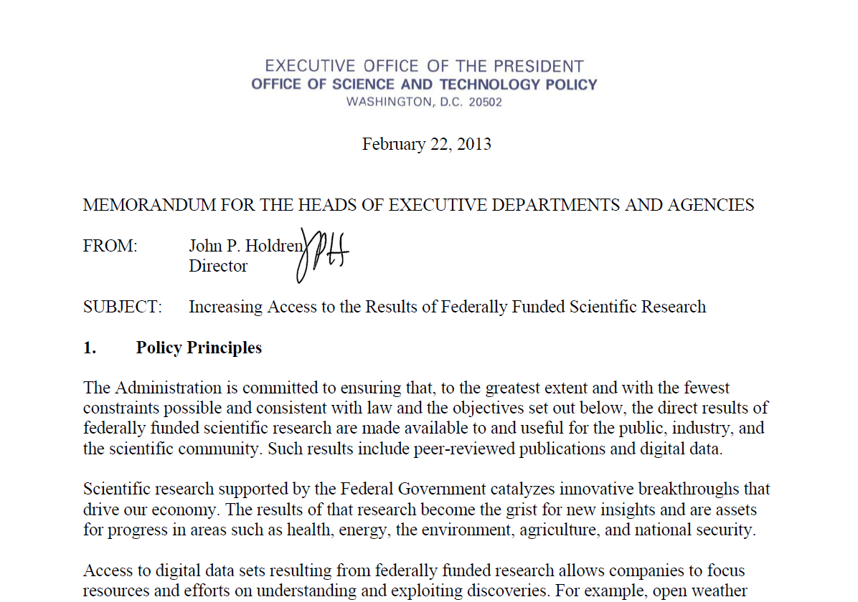
DOE Response to OSTP Memo
Increasing Access to the Results of Federally Funded
Scientific Research
DOE Public Access Plan
Data:
Data Management Plan requirements:
Office of Science – FY 2015
Other DOE Offices – FY 2016
Publications:
DOE Public Access Gateway for Energy and Science (PAGES^{Beta}) will be launched soon
All DOE-supported researchers will be required to submit metadata for peer-reviewed publications and full text or links to accepted manuscripts starting in FY 2015
Public Access Plan will be available on the DOE Open Government website

Slide 22
Administration consolidation
of STEM activities across
federal agencies

Slide 23
FY 2014 Administration Consolidation of STEM Ed. Activities
DOE Programs Terminated in the FY 2014 President’s Budget Request
Computational Sciences Graduate Fellowship (SC/ASCR)
Summer School in Nuclear Chemistry and Radiochemistry (SC/BES-NP)
Global Change Education Program (SC-BER) (phasing out)
QuarkNet (SC-HEP)
National Undergraduate Fellowship Program in Plasma Physics and Fusion Energy Sciences (SC-FES) (phasing out)
Plasma/Fusion Science Educator Programs (SC-FES) (phasing out)
Graduate Automotive Technology Education (EERE)
Wind for Schools (EERE)
Nuclear Scholarships/Integrated University Partnerships (NE)

Slide 24
FY 2015 Administration Position on STEM
The FY 2014 STEM education consolidation strategy continues in
FY 2015.
But, it is now acknowledged that DOE has mission-specific workforce needs in STEM fields and that the DOE laboratories are a unique resource for training workers in STEM research and development.
Proposed STEM workforce development activities in the Office of Science should include:
  an evidence-based statement of the workforce need;
  a statement of program goals;
  a diverse applicant pool and an unbiased selection procedure; and
  a mechanism for tracking program outcomes and evaluating success.

Slide 25
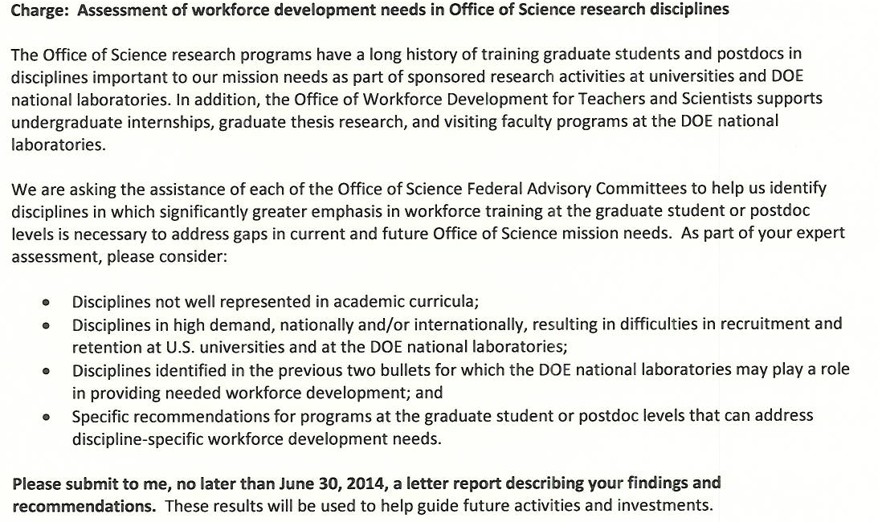
Charge to All Six Federal Advisory Committees

Slide 26
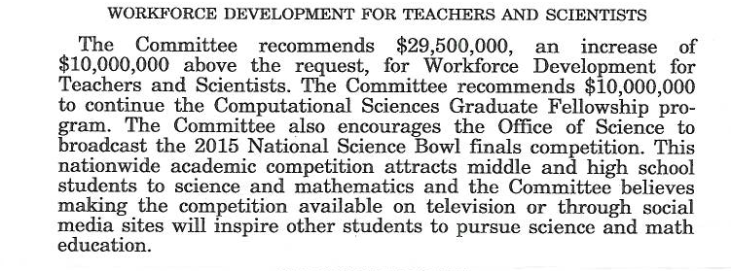
FY 2015 SEWD Guidance for WDTS
26

Slide 27
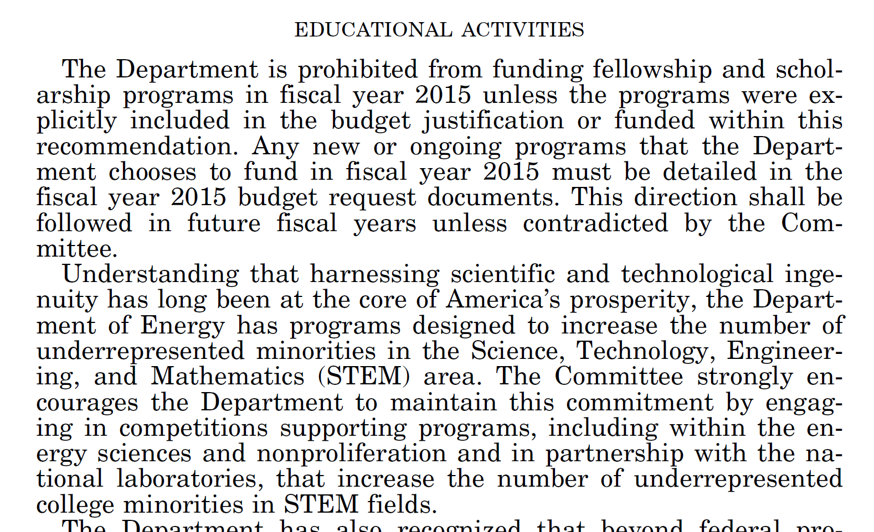
FY 2015 HEWD Guidance for STEM
27

