Slide 1

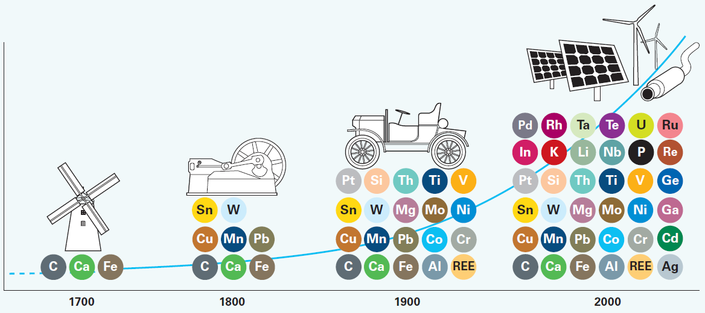
Evolution of the Energy Landscape
Ellen D. Williams
Senior Advisor, DOE
BESAC Advisory Council
July 30, 2014

Slide 2
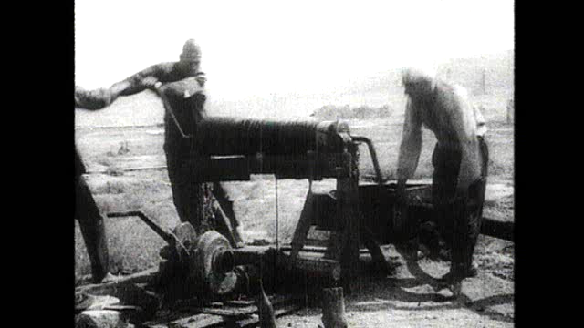
Evolution of Technology
14b
Notes:
Drilling has developed enormously over the last century as this film excerpt shows.
Film excerpt voice over: Oil wells were once literally that, wells and dug by hand. This extraordinary scene is from Baku in Azerbaijan, less than a century ago. Mechanisation saved men from the danger of well digging. This is a percussion drilling rig soon to be followed by the invention of rotary drilling. In the early shallow oil fields competition resulted in closely spaced wells as operators raced to reach the reservoirs. Modern rigs, placed in optimum locations by today’s explorers are capable of drilling thousands of feet and the development of directional drilling techniques and tools has allowed drillers to efficiently drill angled and horizontal wells that can follow the reservoir.
Offshore, progress has been equally dramatic. Guided by seismic, explorers moved offshore in the 1940s, here in the shallow waters of the Caspian where complete offshore complexes were built to exploit large reserves. The development of mobile offshore rigs followed, first with jack up rigs and then rigs that were completely free from the sea bed that enabled drilling in thousands of feet of water.

Slide 3
Transition in the energy supply
Atmospheric CO₂ concentration
1960: 320 ppm
2010: 390 ppm
Desired maximum by 2100: 450 ppm
Source: U.S. Energy Information Administration Annual Energy Review, Tables 1.3, 10.1, and E1
Notes:
‘Other Renewable Energy’ includes Geothermal, solar/PV, wind, waste, and biofuels.

Slide 4
Energy scales
2010 World Energy Use
~ 16 TW-year
~140000 TWh
~12 Gtoe
~ 88 Gboe
~ 480 x10⁹ MBTU
~ 500 million TJ
Thermodynamic Limits
Fuel | Heat of Combustion MJ/kg | Combustion CO₂ kg CO₂/MJ
Coal | 15-27 | 0.07 - 0.19
Oil | 42 | 0.074
Methane | 55 | 0.050
Butanol | 36 | 0.065
Ethanol | 30.5 | 0.063
Sucrose | 16.5 | 0.093
Glucose | 14.2 | 0.10
Natural Gas:
Natural gas is measured in normal cubic meters (for gas at 0ºC at 101.325 kPa)
or in standard cubic feet (for gas at 16ºC and 101.56 kPa).
World production of natural gas in 2011 was 3283 billion cubic meters
= 2955 million toe = 123 million TJ .
Notes:
How much energy we use, and what is the energy content of the various resource types
So how BP is meeting Energy demand?
Full year results will be announced shortly, but for the first nine months, the
BP oil and gas production 3, 4 mboe/d ( million of barrrels per day)
for the first nine months ~ 920 Mboe.
As for the low carbon production
Low Carbon
BP owns and operates 3 producing ethanol mills with a total crush capacity of 7.2 million tonnes.
–Crush capacity represents the maximum capacity to process biofuels feedstock per annum
Wind capacity is 1763 Gross and 1048 Net – this include 32MW in Netherlands.

Slide 5





Energy Resource Competition
The Energy Sustainability Challenge
What are the implications of natural resource (water, land and minerals) constraints on energy production and supply in the context of a growing world population, greenhouse gas emissions and climate change?
http://www.bp.com/energysustainabilitychallenge
Notes:
My third statement is that ‘Science gives us the evidence for change’.
In 2009, BP undertook a program to investigate concerns about sustainability of the world’s resources, as cogently described in the Beddington report. Issues of natural resources scarcities – including minerals, water and fertile land connect with the world’s energy production and US in complex ways. These include minerals needed in energy-critical technologies, the development of biofuels, and choices about the production of electricity. In addition, the demand and availability for these resources are also highly variable – dependent for instance on the geographic distribution of rainfall and evolving dietary choices as regions become wealthier.
Initial scope of the problem was extremely large – Needed to break it down into specific questions
Will the world’s natural resource base (water, land, minerals, ecosystems) be sufficient to sustain the expected world population of 2050?
Will natural resource constraints (water, land, minerals, ecosystems) cause changes in the relative importance of the different components of the future energy mix?
Will responding to the impacts of natural resource constraints (water, land, minerals, ecosystems) cause substantive changes in the total energy demand in the future?
How can BP foresee changes in business environments as a result of resource scarcities, and forestall negative consequences?
Can BP derive business advantage through ability to work in or help mitigate a resource-constrained environment?
Can BP use improved technical understanding on natural resource scarcity and its management to predict or guide governance and regulatory decisions?
Choice to carry out open research at Universities was made early in program – purpose to create a basis of knowledge for understanding and common discussion.. Breadth of University capabilities provides access to the wide spectrum of disciplinary expertise needed to address the problem.
Collaborative research among different Universities required by program – Structuring and managing the program has become a significant part of the learnings from the ESC in itself.

Slide 6
World Resource Connections
Materials
Carbon
capacity of
atmosphere
Source: BP/ McKinsey & Co analysis
Rare earths critical for refining / petrochemicals and used in wind turbines
~57% from fossil fuel use
GHG
emissions
Agriculture and land use drives
~28% of GHG emissions
~5% of steel used in oil and gas
Energy
Carbon abatement through
Afforestation
<5% of water withdrawals used in mining
>10% of energy used in metals and mining
Agriculture uses
~2% of energy
< 0.5% of withdrawals in fossil fuel extraction
~12 % in power generation
~0.5% in fuel refining and processing
Biofuels use ~2% of global cropland
~ 3% of global energy used for water supply and treatment
~0.5% of water withdrawals used in biofuels production
Water
Land
Irrigation
~70% of water withdrawals used in agriculture
Phosphates critical inputs into fertilizers
Notes:
*NOTE BUILD ON SLIDE*
What we immediately found was that there is a great deal of public misperception of these issues, and that reliable quantitative information is often not easy to find. This chart shows an overview of the results of our work to remedy that problem.
We’ve placed energy in the centre, and the weights of the arrows illustrate the quantitative relationships of energy with other parts of the resource system. The link to climate is the strongest, but most people would find the relatively small size of the other links surprising.
Here I’ll just focus on the water links: Humanity overall withdraws 10% of the world’s available renewable freshwater reserves every year - that comes to about 4000 cubic kilometres of water in volume. Of that 4000 cubic kilometres, less than 2% (about 80 cubic kilometres) is used in fossil fuel extraction (that is coal, gas and oil), and about 10% is withdrawn for cooling in power generation.
These are big numbers, but small in comparison with water for agriculture. But since WATER IS NOT FUNGIBLE, on a regional scale these volumes can still have a big impact.
SOURCE(S): McKinsey analysis with ESC updates

Slide 7
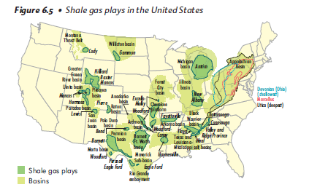
Overview
The Energy-Climate Context
Basis of energy projections
  Cost
  Availability
  Regulation
  Technology
Technology – all of the above and out of the box
Communicating Science

Slide 8
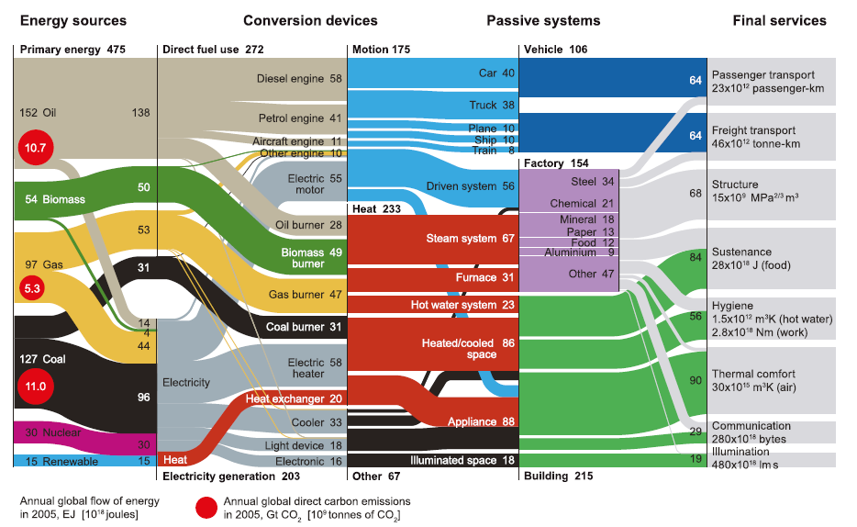
Energy use
University of Cambridge

Slide 9
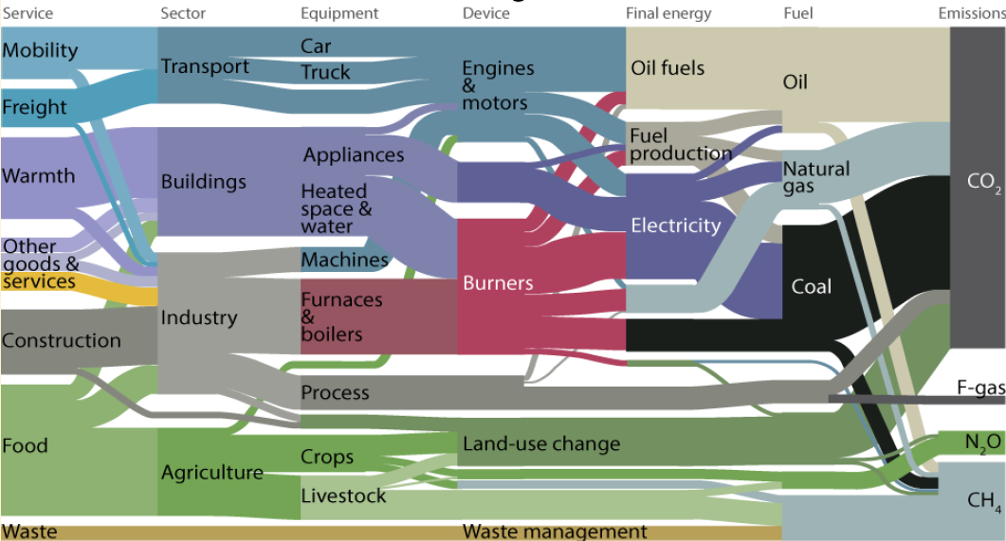
Greenhouse gas Sankey diagram - 2010
Gt CO₂e
8.9
Energy
~31
12.8
12.3
~12.3
Other
~20
Source: Cambridge U., B. Bajzeli, et al. Environmental S&T 2013
Notes:
(Select strand to talk through)

Slide 10
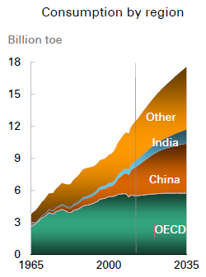
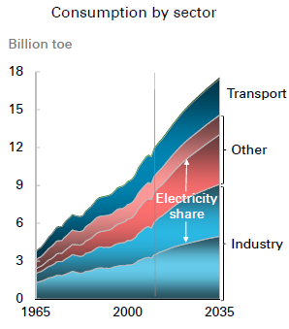
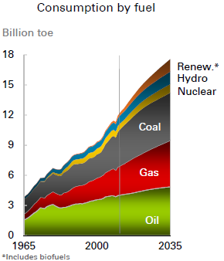
The energy future: insights from BP’s Energy Outlook 2035
Industrialisation and growing power demand increase the world’s appetite for primary energy:
http://www.bp.com/statisticalreview
Notes:
Speaker notes:
Almost all (93%) of the energy consumption growth is in non-OECD countries.
Non-OECD energy consumption in 2030 is 61% above the 2011 level, with growth averaging 2.5% p.a. (or 1.5% p.a. per capita), accounting for 65% of world consumption (compared to 53% in 2011).
OECD energy consumption in 2030 is just 6% higher than in 2011 (0.3% p.a.), and will decline in per capita terms (-0.2% p.a. 2011-30).
Energy used for power generation grows by 49% (2.1% p.a.) 2011-30, and accounts for 57% of global primary energy growth.
Primary energy used directly in industry grows by 31% (1.4% p.a.), accounting for 25% of the growth of primary energy consumption.
The fastest growing fuels are renewables (including biofuels) with growth averaging 7.6% p.a. 2011-30. Nuclear (2.6% p.a.) and hydro (2.0% p.a.) both grow faster than total energy. Among fossil fuels, gas grows the fastest (2.0% p.a.), followed by coal (1.2% p.a.), and oil (0.8% p.a.).

Slide 11
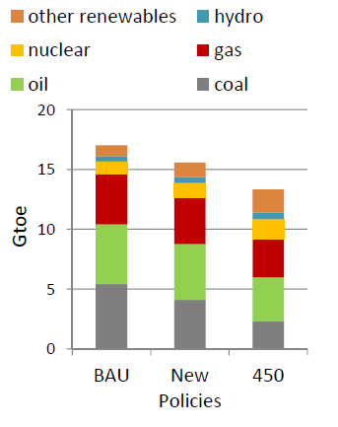
Context of climate change
Contributions to reductions in IEA scenarios:
Scenarios: energy mix in 2035
BAU
>800 ppm
by 2100
Additional 6DS emissions
New Policies
~600 ppm
by 2100
450 ppm
2⁰C
Source: IEA
World Energy Outlook 2011
Notes:
Energy use and CO2 emissions will almost double by 2050 if current trends persist. This would put the world on the path towards a 6°C rise in average global temperature. The energy technologies exist to stave off that threat. The current relationship between economic growth, energy demand and emissions is unsustainable.

Slide 12


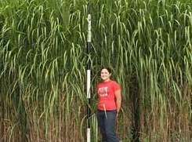
Overview
The energy-climate context
The basis for energy projections
  Cost
  Availability
  Regulation (U.S. illustration)
  Technology
Technology – all of the above and out of the box
Communicating Science

Slide 13
Levelized cost of electricity
New build base-load
New build superpeak
$(2012)/MWh
Combined Cycle Gas Turbine (CCGT)
CCGT with $40 per tonne CO₂ tax
CCGT with Carbon Capture & Storage
Coal
Coal with $40 per tonne CO₂ tax
Coal with Carbon Capture & Storage
Nuclear
Geo-thermal
Bio-Energy
On-Shore Wind
Off-Shore Wind
Solar PV
Solar - CSP
Simple Cycle Gas Turbine (SCGT)
Intermittent
Gas
Coal
Low-Carbon
Current price range
Source: AE Strategy 2012
Notes:
Notes from Ian Luciani: interim 2012 U.S. LCOE update (pending new GIAAP HH assumptions)
Compared to 2011, solar PV is the only significant mover, down nearly 25% due significantly to oversupply in the module production and supply chain
What LCOE includes / excludes
A levelised cost comparing power generating technologies on an apples to apples basis is fundamental [policy can always disappear]
No additional integration costs applied to variable products [under review during 2012]
Focused on new build only
New build requirements are a function incremental electricity or RPS demand growth and retirement of existing assets
Shown on a real basis

Slide 14
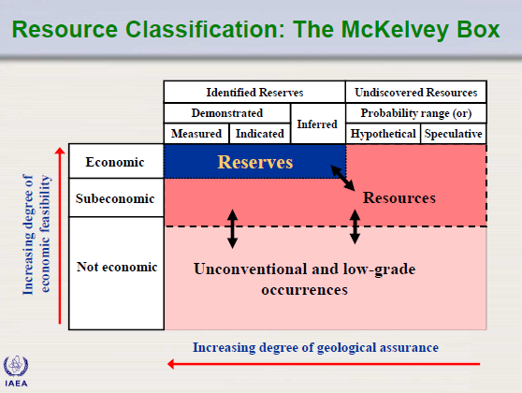
Reserves and resources

Slide 15
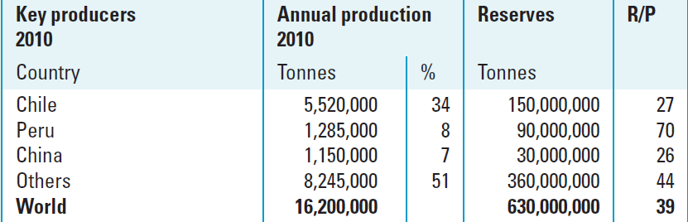
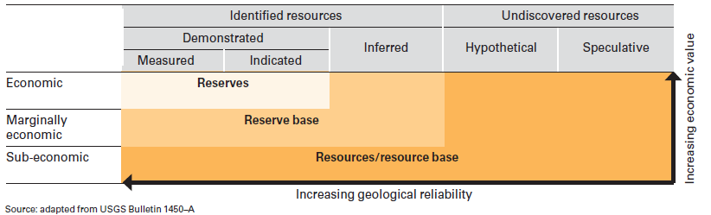
Reserves are dynamic
Example: Copper - in 1970, the global reserves of copper were 280 million tonnes. Between 1970 and 2010, over 400 million tonnes of copper were extracted, however the reserve figure rose to 630 million tonnes.
Relationship between resources and reserves

Slide 16
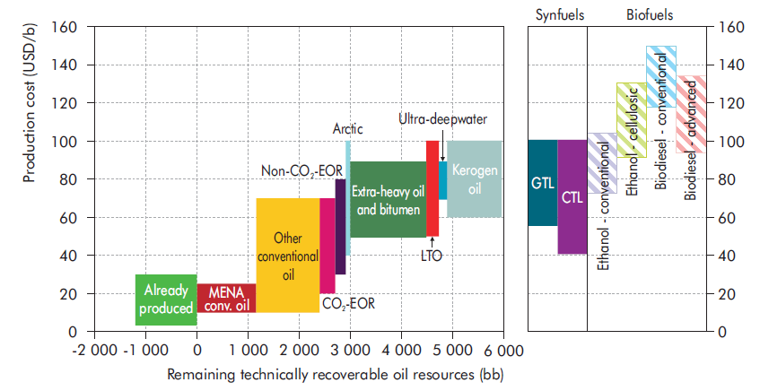
Long-term crude oil cost of supply curve
Resources to Reserves 2013 © OECD/IEA, 2013, fig. 8.3, p.
Notes:
world totals based on BP Stats Review 2013, except Biofuels (source = Joe Giljum)
Oil (thousand barrels per day)
World: 86,152; BP: 2056; BP share = 2.4%
Gas (million cubic feet per day)
World: 336,390; BP: 7393; BP share = 2.2%
Biofuels = 404 million litres ethanol equivalent for 2012 (source = Lee Chapman)
Wind = 2619 MegaWatts gross, 1558 MegaWatts net. (Wind figures confirmed with Dominic Emery)

Slide 17
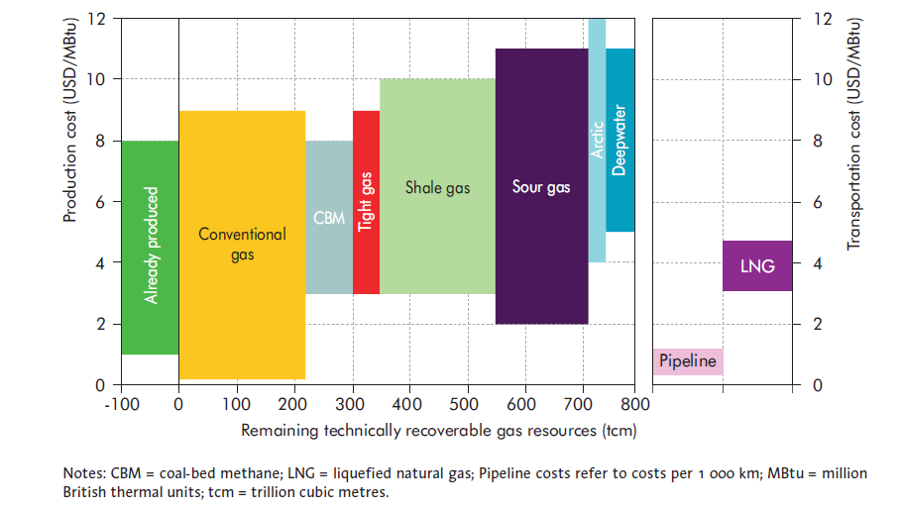
Long-term Natural gas cost of supply curve
Resources to Reserves 2013 © OECD/IEA, 2013, fig. 8.4, p. 231
Notes:
world totals based on BP Stats Review 2013, except Biofuels (source = Joe Giljum)
Oil (thousand barrels per day)
World: 86,152; BP: 2056; BP share = 2.4%
Gas (million cubic feet per day)
World: 336,390; BP: 7393; BP share = 2.2%
Biofuels = 404 million litres ethanol equivalent for 2012 (source = Lee Chapman)
Wind = 2619 MegaWatts gross, 1558 MegaWatts net. (Wind figures confirmed with Dominic Emery)

Slide 18
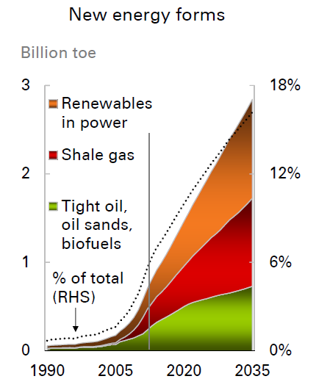
Projected supply growth to match demand
BP Energy Outlook 2035

Slide 19
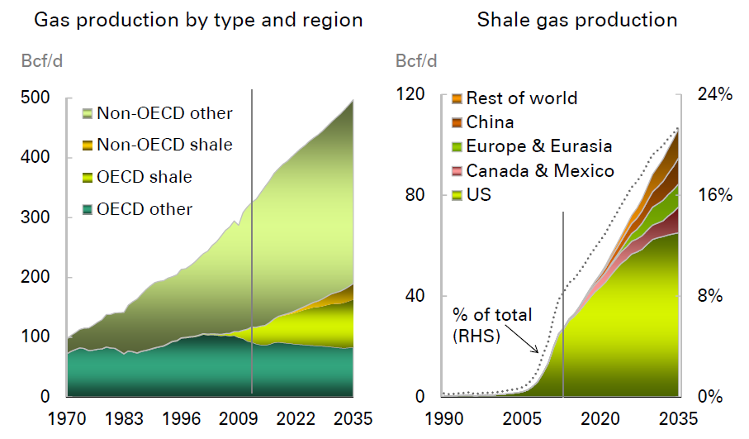
Evolution of supply
BP Energy Outlook 2035

Slide 20
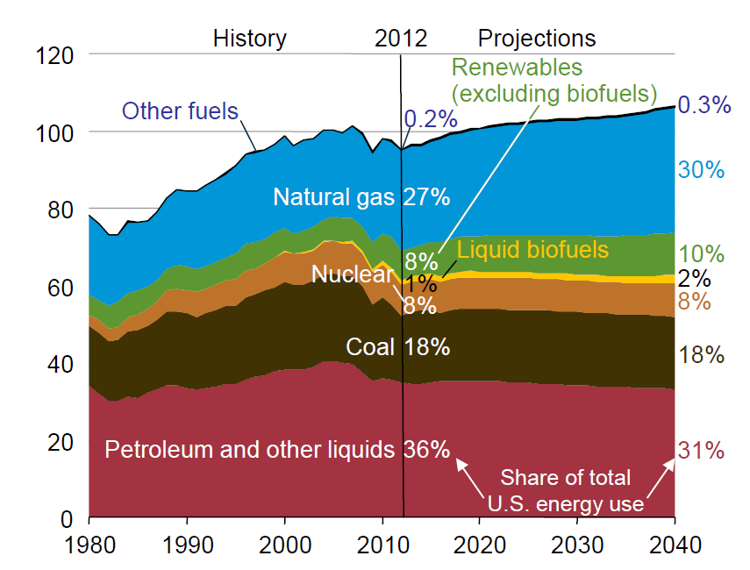
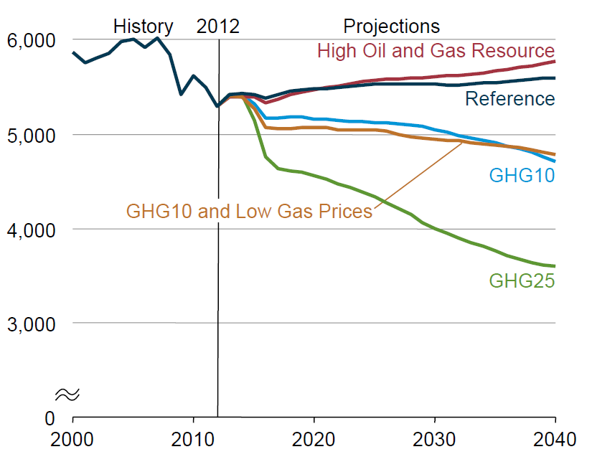
US Energy Evolution reference case and regulation
Energy Consumption by Source
Reference Case
Energy-related CO₂ emissions
(million metric tonnes)
Billion toe
3
2
1
0
EIA Annual Energy Outlook 2014
Notes:
Cases that place a fee on CO2 emissions throughout the energy
sector, starting at either $10 or $25/ton and rising at a rate of 5%/year thereafter (the GHG10 and GHG25 cases)
(1.05)^28 = 33

Slide 21
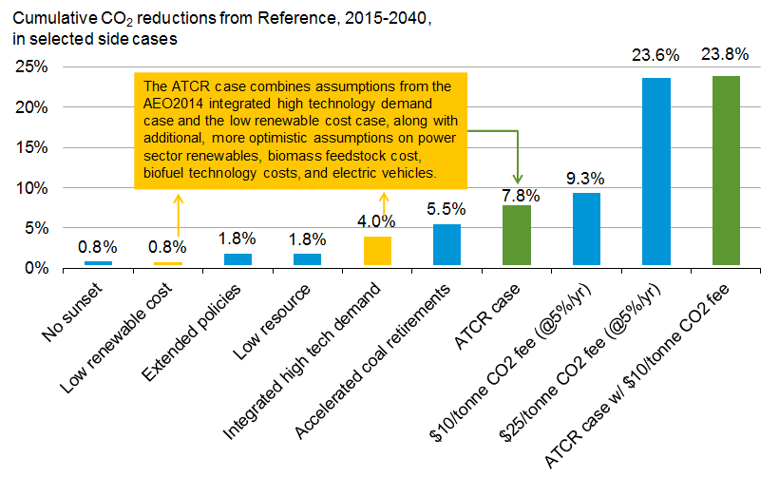
US Energy Evolution reference case and technology (ATCR)
Supplemental Case: Annual Energy Outlook 2014

Slide 22
US Energy Evolution reference case and technology (ATCR)
Advanced Technology Carbon Reduction (ATCR) case: Combines the AEO2014 assumptions for the High Demand Technology case and Low Renewables Technology Cost case, with extensions.
Extensions:
  Renewable generation: 30% capital cost reduction for renewable generating technologies, higher wind capacity factors, and 30% lower biomass feedstock cost
  Fossil and nuclear: 30% capital cost reduction for advanced combined cycle and gas turbines, IGCC, nuclear plants, fuel cells, and coal CCS retrofits
  Biofuels: reductions over 20% for biomass-to-liquids technologies
  Electric vehicles: reduced battery and electric drive system costs (EERE “EV Everywhere” goals)
  Industrial: increased secondary aluminum production; greater renewable fuel in cement kilns and more retirement of less efficient wet kiln process capacity
Supplemental Case: Annual Energy Outlook 2014
Notes:
The Low Renewable Technology Cost case includes the tax
credit through 2016, as in the Reference case, but assumes lower
installed costs than in the Reference case. Even in the Reference
case, installed costs for renewable technologies decline from
their present values. For example, solar PV installed costs
fall from around $5,400 per kilowatt (kW) in 2012 to around
$3,270 per kW in 2020 and around $2,900 per kW in 2040.
The Low Renewable Technology Cost case assumes an additional
20% reduction in installed costs after 2013, resulting in
increased adoption of both solar PV and wind technologies for
electricity generation, especially in locations with the combination
of high electricity prices and sufficient renewable resources.
By 2040, more than 25 GW of renewable capacity is installed,
10 GW more than in the Reference case.
In the 2013 Demand Technology case, which restricts equipment
and shell efficiencies to those available in 2013, energy
intensity is reduced by 2.7% from 2012 to 2040, averaging
0.1%/year as equipment is replaced over time and as new
buildings are constructed. In the High Demand Technology
case, which assumes lower costs and higher efficiencies for
commercial equipment and building shells and a 7% real discount
rate, commercial energy intensity falls by 0.6%/year, or
twice the rate in the Reference case. As a result, energy intensity
is 15.8% lower in 2040 than in 2012. The Best Available
Demand Technology case allows for even greater shell efficiency
improvements than the High Demand Technology case,
and also limits future technology choices to only the most efficient
models of equipment in each year. As a result, commercial
sector energy intensity declines by 0.7%/year on average,
to 18.5% below the 2012 level in 2040.

Slide 23
Overview
The Energy-Climate Context
Basis of energy projections
  Cost
  Availability
  Regulation
  Technology
Technology – all of the above and out of the box
Communicating Science

Slide 24
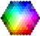
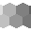
2012 BP Workshop on the technology status of Solar Fuels
Inputs
Energy Conversion
Reduction
Solar
Bio-photo-
electrochemical
Photons
Solar Energy
Electrons
Products
Oxidation
Heat
Photochemical
Alcohols
Feed stock collection
Work
H2O
Photo-electro-chemical
CO
Sea Water
Fuel synthesis
Heat
Desalination / purification
Fresh Water
H2
Thermochemical
CO2
Air capture
Concentration & sorbent regeneration
Key
Point source
In scope
Out of scope
Bio
Biomass
Feedstock recycling

Slide 25
Value metric 1: Land area required for energy capture
Method | Materials System | Reactant & Product | Best Present Efficiency | Aspirational Efficiency
Agriculture | Corn, sugar cane Lignocellulose (LC) | Water and CO₂ to ethanol | 0.2% ( corn/sugar-commercial) 1.5% (LC- laboratory) | 0.4% (corn,sugar) 2% (LC)
Photo-electrochemical (PEC) | Silicon/GaAs type semiconductor system | CO₂ / BuOH H₂O / H₂ | 2% (BuOH) <10% (H₂) (laboratory) | 10% (BuOH) 15% (H₂)
Photo-chemical (PC) | Transition metal molecular catalyst | CO₂ to MeOH | <1% (formate) (laboratory) | 5% (MeOH)
Solar thermal chemical | Metal oxide redox reactor | Water and CO₂ to Syngas (H₂ and CO) | <1% (pilot) | 15% (before FT)
Bio-PEC | Fe compound / bacteria | CO₂ / BuOH | 0.5% (BuOH) (laboratory) | 3%(BuOH)
Solar Photo-voltaic (PV) electrolysis | Photovoltaic solar collection with commercial electrolyzer | CO₂ / MeOH H₂O / H₂ | 8% (MeOH) (laboratory) 11% (H₂) (commercial) | 20% (MeOH) 25% (H₂)

Slide 26
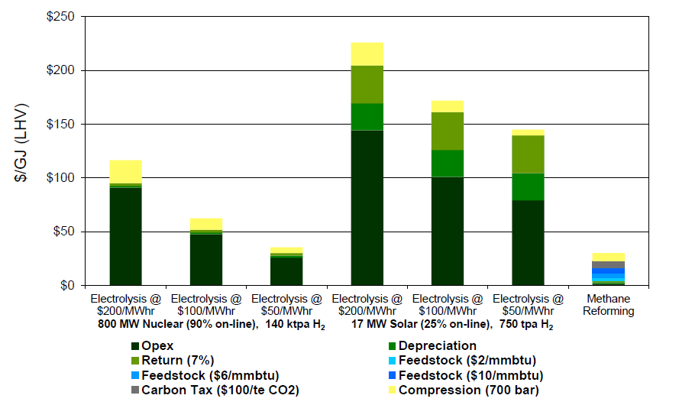
Value metric 2: Commercial costs for single plants
Hydrogen production
Example of Cost Dependences
800 MW base-load (90% on-line)

Slide 27
Integrated system vs. individual plants
    Use of a relatively simple all year round optimisation tool for semi-quantitative assessment
    It determines least-cost generation options to meet a given load increase on the grid (or an equivalent replacement of existing generating assets) by a combination of:
          a downsized natural gas combined cycle (NGCC) plant “running flat” all year round
          an H₂-based storage system, including electrolyser, H₂ turbine and H₂ tanks
          a large scale PV farm
        This is then compared to the case in which demand is met by an NGCC plant only, with size matched to the peak load
NGCC
(flat out)
PV
Electro-
lyser
Load
H2
tanks
H2
turbine

Slide 28
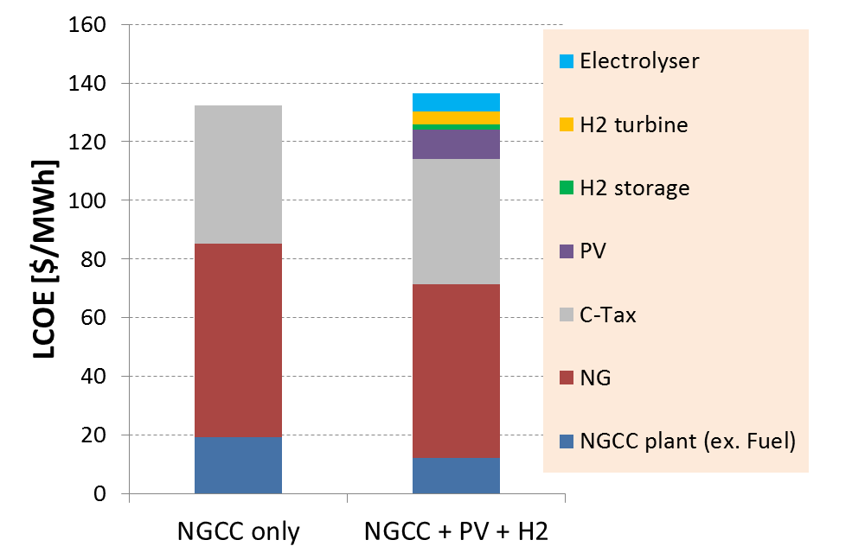


Example of systems costs
@ 100 $/tCO₂e
10 $/MMBtu
$1.⁸⁰/W PV
NGCC only system
NGCC 1000 MW
Combined system
NGCC 541 MW
PV farm 389 MW
Elec’lyser 182 MW
10% decrease in natural gas consumption
If PV cost decreases to $1/W, 24% decrease in natural gas consumption at same gas and CO₂ prices

Slide 29
Communicating Science
The world urgently needs to reduce CO₂ emissions, and major advances in every aspect of clean energy technology are needed to reduce the costs to do so. We need:
  Improvements in existing technologies
  New discoveries
  New approaches based on systems integration
We cannot afford to be naïve about the economic and regulatory context in which new technologies must compete, and the competing demands for resources needed for R&D.
We can expect to be challenged, and must be clear about how we draw on fundamental research to support economic value delivery to the U.S.
Fundamental Research
Use Inspired Research
Development
Demonstration
Deployment
Timeline:
years
decades
LoSal® EOR
Notes:
1) We have to have AND make publicly available sound technical information, or discussions and subsequent policy decisions may be counterproductive.
2) There’s not a silver bullet for water and land issues - regional variability make every case different
3) With good governance and good technology, it really can be possible to meet the world’s energy needs without destroying the rest of the resource base. However, getting to good governance and good technology requires us to communicate effectively!

