Slide 1
Future of Electron Scattering and Diffraction Workshop
(FESW)
Summary
Presented by Yimei Zhu (BNL)
On behalf of the organizers
BESAC Meeting
July 30, 2014

Slide 2

Outline
Workshop overview
Key breakthrough science opportunities and challenges
Critical enablers - major instrumentation needs
- Concluding remarks
http://science.energy.gov/bes/news-and-resources/reports/

Slide 3
Future of Electron Scattering and Diffraction Workshop
Feb 25-26, 2014, Rockville, MD USA
The goal:
To identify the opportunities in electron scattering and diffraction that address BES Grand Challenges.
The key question:
What are the scientific frontiers requiring advances in electron scattering and diffraction to address new science in chemistry, materials, physics & biology?
Attendees:
- about 60 invited world-leading experts
in experiment, theory, instrumentation development
- representatives from NSRCs and BES managers

Slide 4




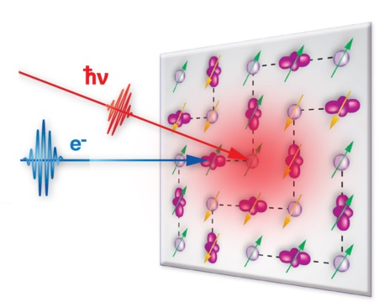
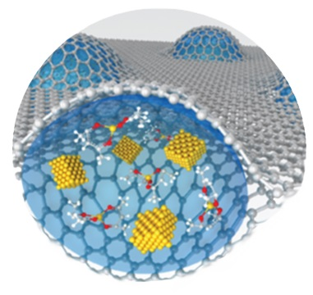
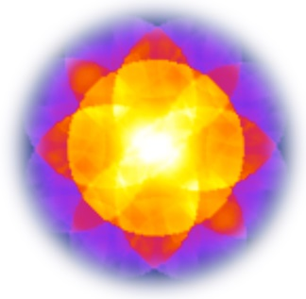
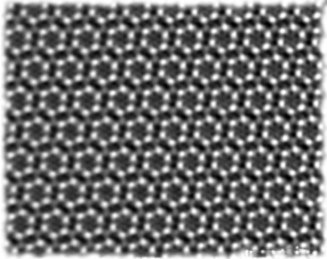
Four organizers for four topical sessions
Yimei Zhu
(BNL)
Ernie Hall
(GE)
Haimei Zheng
(LBNL)
Susanne Stemmer (UCSB)
Ultrafast
science
Advances in imaging
Sample environment
Measuring
functionality
FESW coordinator: George N. Maracas (DOE-BES)

Slide 5
Workshop Scope
New Science in
Chemistry, Materials Science, Physics, Biology
What new science could be enabled by advances in electron scattering and diffraction?
Overarching Theme
Revolutionary Advances in
Electron Scattering, Diffraction, Imaging and Spectroscopy
How can these advances be achieved in the next generations of instrumentation?
Implementation
Focus Areas
Ultra-Fast, Ultra-Small, Sample Environment, Measuring Functionality
Temporal
Resolution
Spatial Resolution
Energy Resolution
Sample Environment Capability
How can the optimum synergies be found to produce revolutionary breakthroughs?

Slide 6
A historical perspective
TEAM
- The BES sponsored TEAM project has advanced imaging to 0.5Å spatial resolution
- For the future, the scientific case for improving resolution alone is not compelling
- There is a strong scientific motivation for achieving molecular/atomic resolution measurements of functionality at short time scales and in real environments to address BES Grand Challenges
Aberration corrected electron microscope
0.1
1
LBL ARM
1
0
.
1
Electron microscope
Resolution (nm)
Marton
10
0
.
0
1
100
0
.
0
0
1
Ruska
Abbe
1000
Amiei
Light microscope
0
.
0
0
0
1
Ross
1800 1840 1880 1920 1960 2000 2040
Year

Slide 7
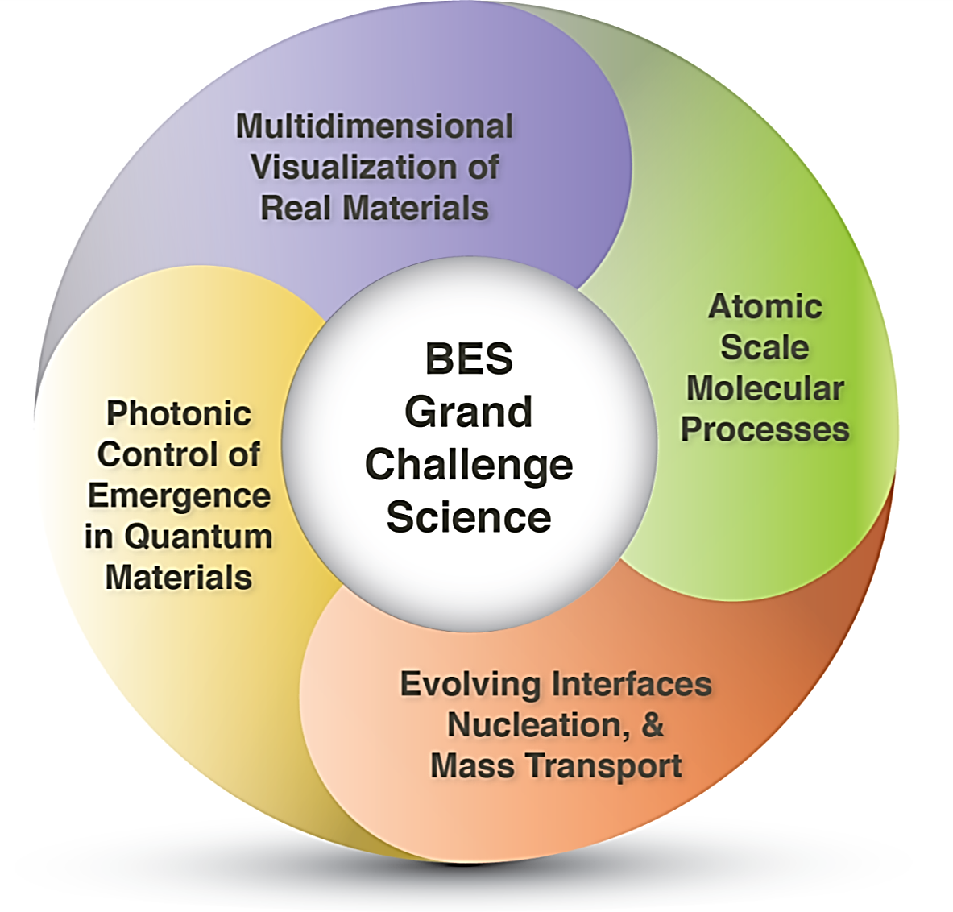
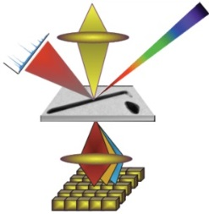
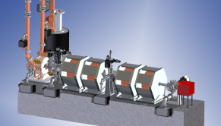
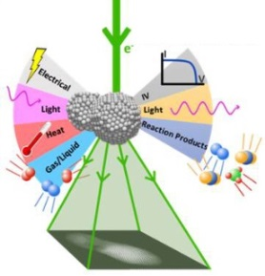
Four science areas and three instrument enablers were identified where electron probes can have major impacts on Grand Challenges
Science Areas
Instrument Enablers
A
[1] Multidimensional atomic resolution microscope
[2] Ultrafast electron diffraction and microscopy instrument
[3] ‘Lab-in-gap’ dynamic microscope
Enablers
[1, 2, 3]
B
C
Enablers
[2, 3]
Enablers
[2]
D
Enablers
[1, 2, 3]

Slide 8
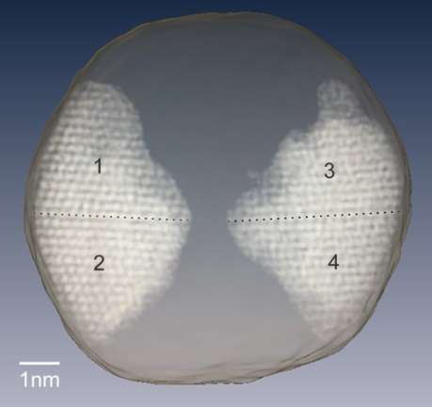
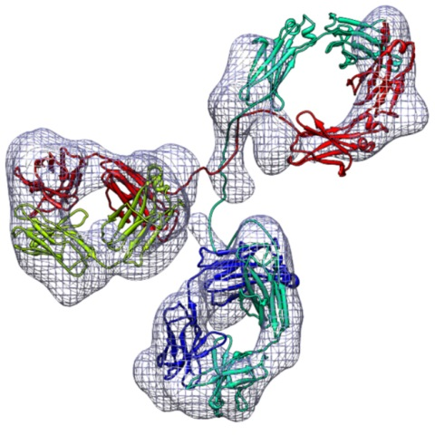
A. Multidimensional* Visualization of Real Materials
- Electronic and Atomic Structure:
imaging defects, dopants, impurities, vacancies in 3D
- Collective / Correlative Phenomena & Materials:
imaging atomic structure with spin, charge, and
electronic state under external stimuli
- Energy Transport at Nanoscale:
mapping phonon density of states, scattering process and correlating to atomic structure
imaging grains in a Au nanoparticle in 3D (see report)
- Mesoscale Materials and Phenomena:
imaging formation of mesoscale structures
μs – fs temporal resolution
protein tomography
*Muiltidimensional - three-dimensional atomic scale tomography and spectroscopy of atomic and electronic structures over real/momentum/energy space
Zhang, Ren, PLoS ONE,
7 30249 (2012)

Slide 9
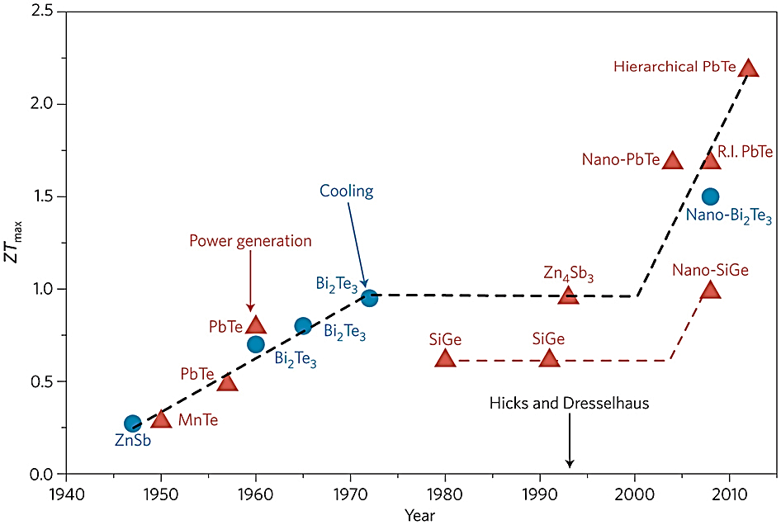
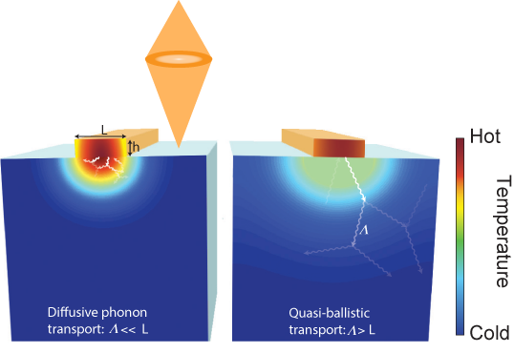
A. Multidimensional Visualization of Real Materials
Example: engineer phonon scattering at nanoscale to minimize heat transport
2.5
evolution of ZT_{max} over time
–importance of the ‘nanoscale’
2.0
Challenge: thermoelectric energy harvesting – design materials with low phononic heat transport and high electronic conductivity (optimize ZT)
1.5
ZT _{max}
1.0
0.5
0.0
1940
1950
1960
1970
1980
1990
2000
2010
Present: phonon imaging and transport measurements at nanoscale are not practical
Nat. Nanotech. 8, 471–473 (2013)
Future:
ultrafast electrons (sub-ps) can image nanoscale phonon scattering dynamics and heat propagation
high-energy resolution (sub-10meV) enables imaging phonon density of states at nanoscale
Siemens, et al Nat. Mat. (2009)

Slide 10
B. Atomic Scale Molecular Processes
Challenge: understand & ultimately control the selectivity and efficiency of photon energy conversion
Proton
transfer
Example: excited state charge transfer is an important photostabilizer - which path does the molecule take in the photoexcited state?
Present: x-rays have low sensitivity to nuclei (Thomson scattering ~1/mass²) not feasible for revealing proton transfer
Future: fs electron diffraction can measure in real time the full molecular structure with sub-0.1Å and 10 fs resolution while the molecule relaxes
Conical
intersection
Potential energy
Proton transfer coordinate
Paterson et al., J. Phys. Chem. A 109, 7527 (2005)

Slide 11
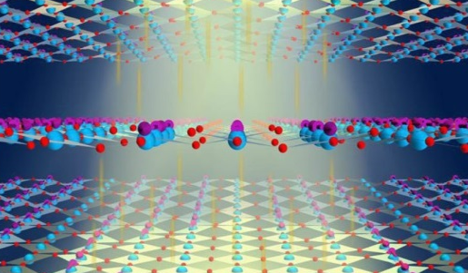
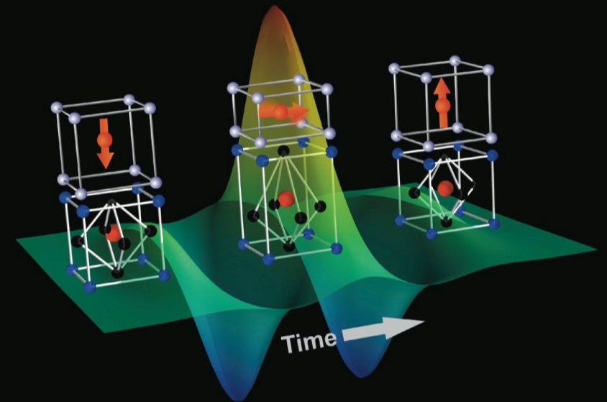
C. Photonic Control of Emergence in Quantum Materials
(i) superconducting gap (STM)
Challenge: disentangle and control competing lattice, charge, spin, orbital order
Present:
- equilibrium phase separation as seen by nanoprobes (i).
- light-induced superconductivity seen by spatially averaging fs x-rays & THz probes (ii).
10 nm
(ii) Light-induced superconductivity
Future:
- use tailored intense electric field pulses & tunable multicycle optical excitation to control superconductivity, metalicity, multiferroicity (iii) ….
- use ultrafast electron probes to disentangle locally competing order parameters
(iii) THz pulse coupling of multiferroicity
For figure details see report

Slide 12
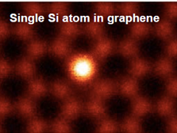
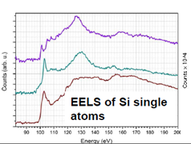
D. Evolving Interfaces, Nucleation, and Mass Transport
Challenge: imaging interface dynamics, mass transport and nucleation events at molecular and atomic level in-situ and in-operando.
Atomic imaging and spectroscopy in vacuum,
Lopez-Bezanilla et al , J. Chem. Phys. Lett. 5, 1711 (2014).
Present: atomic-resolution imaging and spectroscopy measurement only in vacuum and in steady state.
Future: molecular/atomic level imaging and spectroscopy in liquid, gas, during electrochemical deposition, in oxidation and corrosion in-situ and in-operando.
2nm
(A) Catalytic Au particles on CeO₂ under CO/air (see report).
(B) Pt-Fe particles growth in liquid solution (see report).

Slide 13



Enablers – Major New Instrumentation Needs
[1] Multidimensional atomic resolution microscope
[2] Ultrafast electron diffraction and microscopy instrument
[3] ‘Lab-in-gap’ dynamic microscope

Slide 14
[1] Multidimensional Atomic Resolution Electron Microscope
Accessing structural info over real/momentum/energy space @ low-temperatures
  - imaging dopants, interstitials, light elements
  - visualizing localized phonon modes and motion of charged particles/vacancies
  - correlating lattice, spin, orbital, and charge
  - accessing emergent electronic phases and radiation-sensitive materials
Uniquely suited to answer fundamental questions in condensed matter physics that require understanding of physical and electronic structure at the atomic scale.

Slide 15
[1] Multidimensional Atomic Resolution Electron Microscope
Present
spatial resolution: 0.5Å @ 300K
transmittance: 10meV @ 10mrad
stage drift rate: 15Å/min
Future
spatial resolution: <1.0Å @ 5K
transmittance: 5meV @ 20mrad
stage drift rate: 1.5Å/min
Key developments required
10x improvement in gun brightness, beam energy and energy spread
1eV resolution x-ray detector solid angle 4sr
stable cryogenic capabilities (stage stability 0.1Å)
high-speed, radiation resistant, energy-resolving active pixel detector: DQE 0.7
1 meV phonon resolution spectroscopy
DQE: Differential Quantum Efficiency
Technical challenge: developing revolutionary detectors and attaining system stability for atomic resolution at 5K

Slide 16
[2] Ultrafast Electron Diffraction and Microscopy Instrument
Imaging and controlling materials processes in real-time and real-space
  visualizing energy / mass transport over various length- and time-scales
  determining molecular pathways for photon energy conversion
  creating transient / emergent properties
  electric field control of metal-insulator transitions & multiferroic domain dynamics
  disentangling locally competing order parameters
  ps-nm imaging defect dynamics and evolution of order in non-crystalline materials
Complementary to XFEL, taking advantage of strong interaction of electrons with matter, enabling the understanding of dynamics of chemical reactions, mesoscopic systems and the photonic control of emergence in quantum materials

Slide 17
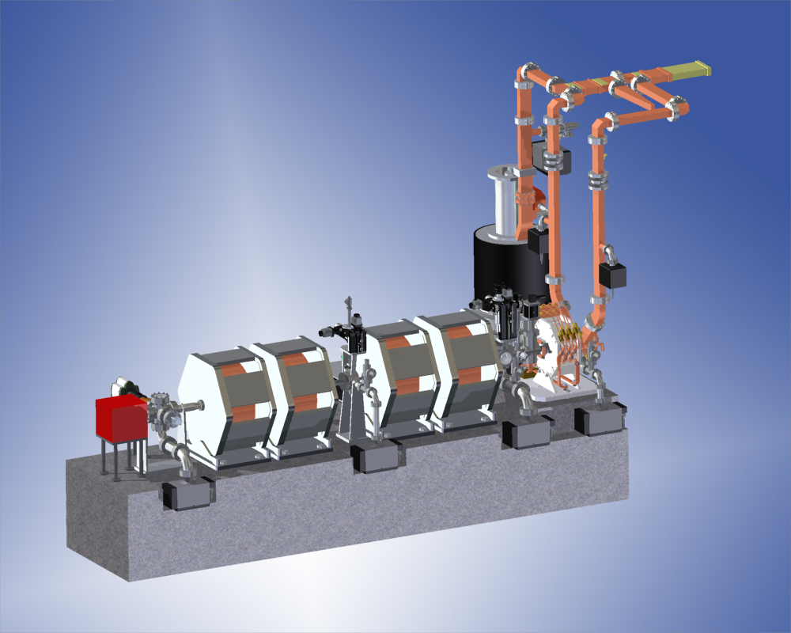
[2] Ultrafast Electron Diffraction and Microscopy Instrument
Achieving a 1000 x improvement in time resolution over current microscopes
Present resolution
Diffraction: 100μm probe, 300fs (stroboscopic /single shot, 10⁵ e⁻)
Imaging: 5nm, 15ns (single shot, 10⁷ e⁻)
Future resolution
Diffraction: 10μm probe, 10fs (stroboscopic), 100fs (single shot, 10⁵ e⁻)
Imaging: 1nm, 10ps (single shot, 10⁷ e⁻)
Key developments required
high brightness electron source
multipole lenses
novel detector
pump technology
including THz pulses
Technical challenge: getting sufficient electrons in the beam for single shot imaging in the presence of space charge

Slide 18
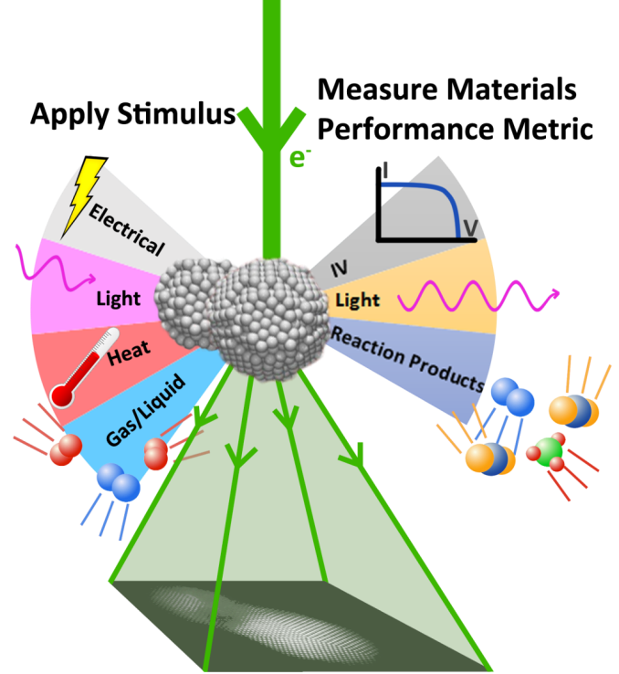
[3] ‘Lab-In-Gap’ Dynamic Microscope
Enabling quantitative measurements of materials structure, composition, and bonding evolution in working environment
  liquids, gases and plasmas; super-atmospheric pressure; biasing, cooling, heating stages; closed liquid/gas flow cells
  in-situ and in-operando experimentation of materials under real operating conditions at molecular and atomic resolution
  dynamic process and time resolved observations
Allows multi-modal (e.g., optical, thermal, mechanical, electrical, and electrochemical) probing of materials’ functionality in situ and in operando.

Slide 19
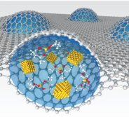
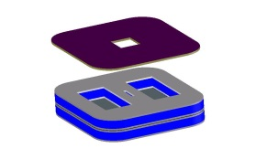
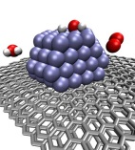
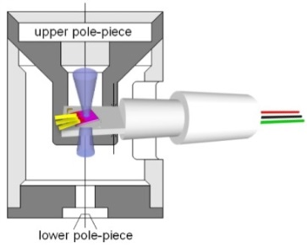
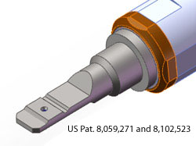
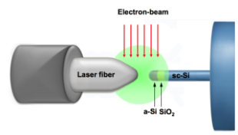
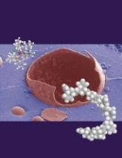
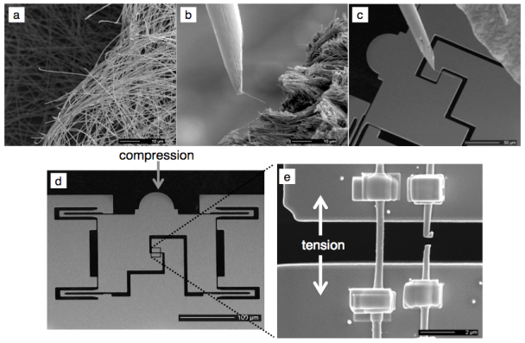
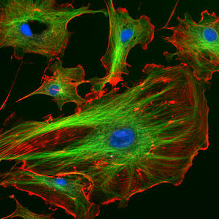
[3] ‘Lab-In-Gap’ Dynamic Microscope
Present resolution
5 mm gap @ 0.5 Å (TEAM)
gas @ 1 Torr: 1 Å − 1.4 Å, liquid drop: 2 Å
time resolution: 2.5 ms (TEAM)
Future resolution
10 mm gap @ 1 Å
gas @ 1 Torr: 1 Å, liquid: 1 Å
time resolution: 10 ns (pump/probe)
ETEM & gas cell
Key developments required
Graphene
encapsulant
SiN_{x}
liquid cell
Gas mixing reactions
upper pole piece
electron beam
laser
Electric
biasing
Flow channel
Light interaction
lower pole piece
synergistic development of optics, source, sample environment, and detectors
differentially pumped, corrected for spherical / chromatic aberrations
Molecular reactions
Imaging biological materials
Mechanics in extreme environment
Technical challenge: attaining molecular/atomic resolution in working environment

Slide 20
FESW Concluding Remarks
“To realize the proposed instruments in a timely fashion, BES should aggressively support research and development of complementary and enabling instruments, including
Advanced electron source, new detectors, optics, tunable pumps, stages
The proposed instruments would have transformative impact on physics, chemistry, materials science, engineering and technology, and other fields.”
Estimated development time for implementation
Near term (3 years): Ultrafast electron diffraction and microscopy instrument
Mid term (3-5 years): ‘Lab-in-gap’ dynamic microscope
Long term (5-10 years): Multidimensional atomic resolution electron microscope
BES is uniquely positioned to lead this effort and, with national lab resources, to provide technology breakthroughs in key development areas

Slide 21
Thank you !
Acknowledgement
E. Hall, S. Stemmer, H. Zheng (FESW co-organizers)
G. Maracas, J. B. Murphy (DOE/BES)
X. Wang, H. Durr, M. Guehr (SLAC)
D. Muller (Cornell)
E. Stach (BNL)
J. Spence (ASU)
And all the other workshop participants

