Slide 1
ASCR OVERVIEW
August 3, 2011
BESAC
Daniel Hitchcock
Acting Associate Director
Advanced Scientific Computing Research

Slide 2
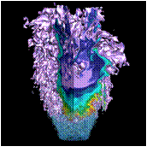
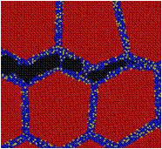
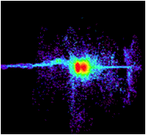
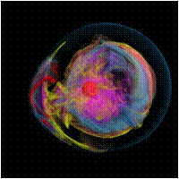
Advanced Scientific Computing Research
Delivering world leading computational and networking capabilities to extend the frontiers of science and technology
The Scientific Challenges:
Deliver next-generation scientific applications using today’s petascale computers.
Discover, develop and deploy tomorrow’s exascale computing and networking capabilities.
Develop, in partnership with U.S. industry, next generation computing hardware and tools for science.
Discover new applied mathematics and computer science for the ultra-low power, multicore-computing future.
Provide technological innovations for U.S. leadership in Information Technology to advance competitiveness.
FY 2012 Highlights:
Research in uncertainty quantification for drawing predictive results from simulation
Co-design centers to deliver next generation scientific applications by coupling application development with formulation of computer hardware architectures and system software.
Investments in U.S. industry to address critical challenges in hardware and technologies on the path to exascale
Installation of a 10 petaflop low-power IBM Blue Gene/Q at the Argonne Leadership Computing Facility and a hybrid, multi-core prototype computer at the Oak Ridge Leadership Computing Facility.

Slide 3
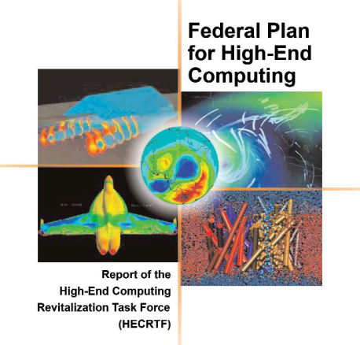
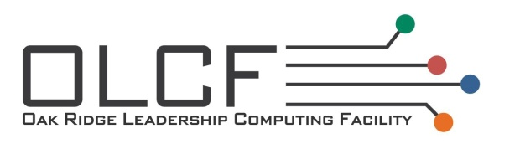




ASCR Facilities
Providing the Facility – High-End and Leadership Computing
Investing in the Future - Research and Evaluation Prototypes
Linking it all together – Energy Sciences Network (ESnet)
Notes:
3

Slide 4
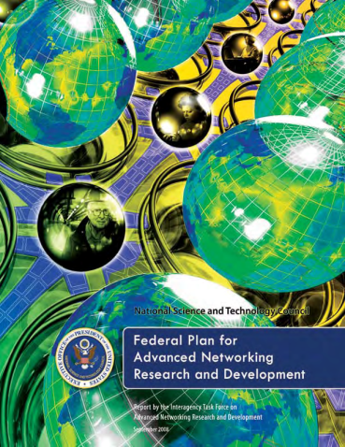
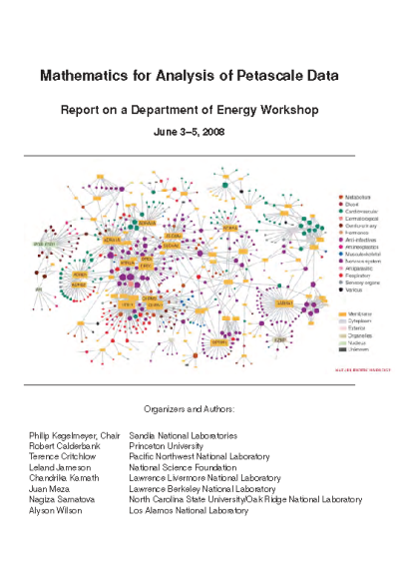
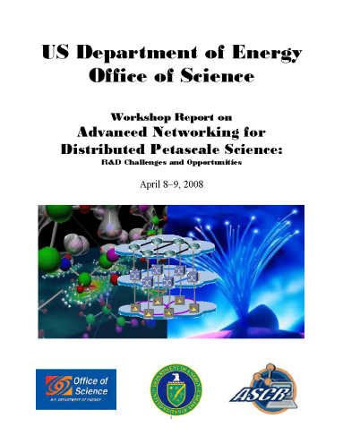
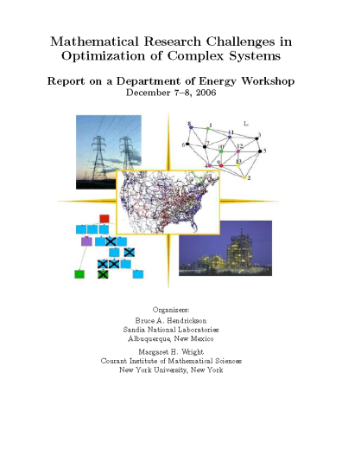
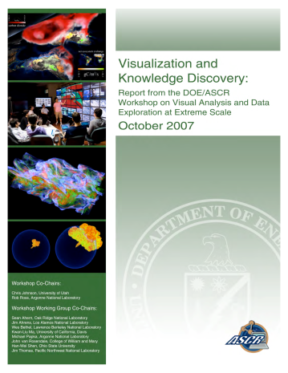
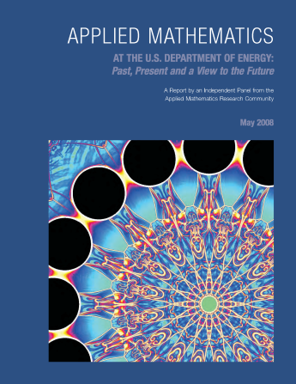
ASCR Research
Substantial innovation is needed to provide essential system and application functionality in a timeframe consistent with the anticipated availability of hardware
Provide forefront research knowledge and foundational tools:
  Applied Mathematics
  Computer Science
  SciDAC
  Next Generation Networking for Science
Notes:
Top: 3D fully implicit extended MHD simulations - Figure depicts temperature during the evolution of a helical perturbation in a 3D toroidal fusion device.
Bottom - Linear Scaling 3D Fragment (LS3DF). Density Functional Theory (DFT) calculation numerically equivalent to a more common algorithm, but scales with O(n) in number of atoms rather than O(n^3). PI: Wang, LBNL.
(Alternative definition) - Multiscale Mathematics: Develop multiscale models and algorithms for understanding complex system behavior that emerges across vastly different space and time scales.

Slide 5
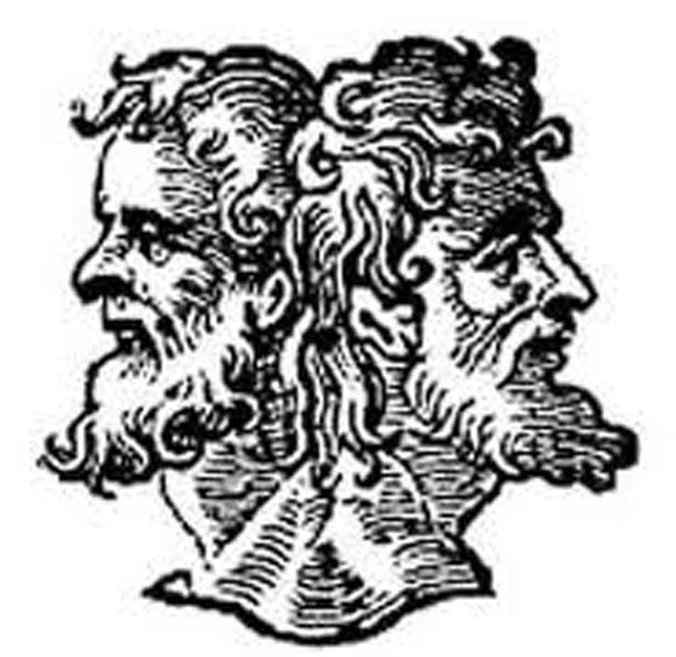
The Future of Computing and Data
SciDAC Institutes
Strategic ASCR – SC Office Partnerships
Hopper
Jaguar
Intrepid
Many Core
Energy Aware
CoDesign
X Stack
Titan
Mira
???

Slide 6
Why Computing is Changing
Top500
Concurrency Dominated
By 2020
  Typical server node chip ~400 cores
  1k node cluster ➔ 400,000 cores
  Laptop ~ 100 cores (low power)
Performance
SciDAC-3
Hubs
Co-Design
X-Stack
Advanced Architectures
Data Management and Analysis at Extreme Scale
Today
Typical server node chip ~ 8 cores
1k node cluster ➔ 8,000 cores
Laptop ~ 2 cores (low power)
Laptops
2015
Time

Slide 7
SciDAC Institutes
Goals & Objectives
  Deliver tools and resources to lower barriers to effectively use state-of-the-art computational systems;
  Create mechanisms to address computational grand challenges across different science application areas;
  Incorporate basic research results from Applied Mathematics and Computer Science into computational science challenge areas and demonstrate that value
  Grow the Nation’s computational science research community.
Awards- Up to $13M/year over 5 years available to support 1–5 Institutes
Eligible applicants- DOE National Laboratories, Universities, Industry and other organizations
Expected outcome- Institutes that cover a significant portion of DOE computational science needs on current and emerging computational systems.
Timeline
Solicitations opened- February 23, 2011
Letters of Intent- March 30, 2011
Solicitations closed- May 2, 2011
First awards- end of FY2011
Answers to Inquiries- http://science.doe.gov/ascr/research/scidac/SciDAC3InstitutesFAQ.html

Slide 8
Awards for Scientific Discovery through Advanced Computing (SciDAC) Institutes
SUPER – Institute for Sustained Performance, Energy and Resilience: Robert F. Lucas, University of Southern California
FASTMath – Frameworks, Algorithms, and Scalable Technologies for Mathematics: Lori Diachin, Lawrence Livermore National Laboratory
QUEST – Quantification of Uncertainty in Extreme Scale Computations: Habib N. Najm, Sandia National Laboratories
SUPER | FASTMath | QUEST
Argonne National Laboratory | Argonne National Laboratory | Los Alamos National Laboratory
Lawrence Berkeley National Lab | Lawrence Berkeley National Lab | Sandia National Laboratories
Lawrence Livermore National Lab | Lawrence Livermore National Lab | Johns Hopkins University
Oak Ridge National Laboratory | Sandia National Laboratories | Massachusetts Institute of Technology
University of California, San Diego | Rensselaer Polytechnic Institute | University of Southern California
University of Maryland |  | University of Texas at Austin
University of North Carolina
University of Oregon
University of Utah
University of Southern California
University of Tennessee, Knoxville

Slide 9
Strategic ASCR – SC Office Partnerships
Goals & Objectives
  Partner with SC Programs to Combine the best math, CS, and networking with SC program expertise to enable strategic advances in program missions
Awards- FOA’s in development with other SC Offices
Eligible applicants- DOE National Laboratories, Universities, Industry and other organizations
Expected outcome- New Science.
Timeline
Solicitations opened- August 2011
First awards- mid FY2012

Slide 10
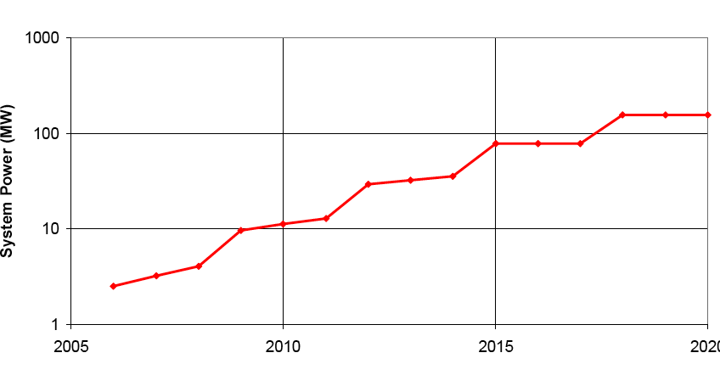
The Future is about Energy Efficient Computing
At $1M per MW, energy costs are substantial
1 petaflop in 2010 will use 3 MW
1 exaflop in 2018 at 200 MW with “usual” scaling
1 exaflop in 2018 at 20 MW is target
usual scaling
goal
2005 2010 2015 2020

Slide 11
The Fundamental Issue: Where does the Energy (and Time) Go?
Intranode/SMP
Communication
Intranode/MPI
Communication
On-chip / CMP
communication

Slide 12
Memory Technology: Bandwidth costs power

Slide 13
Approaches
Locality, Locality, Locality!
Billion Way Concurrency;
Uncertainty Quantification (UQ) including hardware variability;
Flops free data movement expensive so:
  Remap multi-physics to put as much work per location on same die;
  Include embedded UQ to increase concurrency;
  Include data analysis if you can for more concurrency
  Trigger output to only move important data off machine;
  Reformulate to trade flops for memory use.
Wise use of silicon area

Slide 14
Co-Design
Goals & Objectives
Understand how to allocate complexity between hardware, systems software, libraries, and applications;
Modify application designs at all levels;
Understand reformulating as well as reimplementing tradeoffs;
Explore uncertainty quantification, in line data analysis, and resilience in applications;
Co-adapt applications to new programming models and perhaps languages;
Impact of massive multithreaded nodes and new ultra-lightweight operating systems.
Awards- June 2011
Expected outcome- Understanding, Guidance for Future Applications, Application Readiness

Slide 15
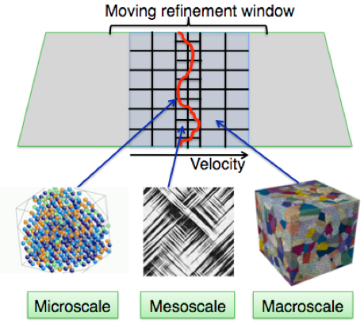
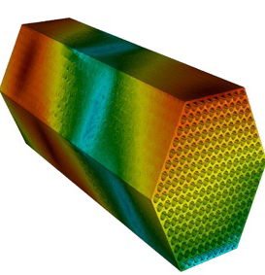
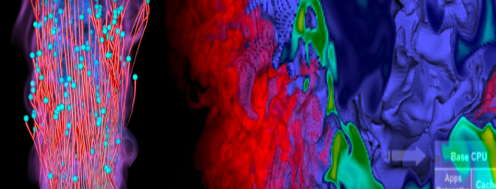
Three Exascale Co-Design Centers Awarded
 | ExMatEx (Germann) | CESAR (Rosner) | CECDC (Chen)
National Labs | LANL | ANL | SNL
 | LLNL | PNNL | LBNL
 | SNL | LANL | LANL
 | ORNL | ORNL | ORNL
 |  | LLNL | LLNL
 |  |  | NREL
University & Industry Partners | Stanford | Studsvik | Stanford
 | CalTech | TAMU | GA Tech
 |  | Rice | Rutgers
 |  | U Chicago | UT Austin
 |  | IBM | Utah
 |  | TerraPower
 |  | General Atomic
 |  | Areva
  Exascale Co-Design Center for Materials in Extreme Environments (ExMatEx)
  Director: Timothy Germann (LANL)
  Center for Exascale Simulation of Advanced Reactors (CESAR)
  Director: Robert Rosner (ANL)
Combustion Exascale Co-Design Center (CECDC)
Director: Jacqueline Chen (SNL)
Notes:
ExMatEx Goal: Develop algorithms, system software, and hardware that will enable pervasive embedding of microscopic behavior modeling and simulation into meso- and macro-scale materials simulations at the exascale, for the simulation and modeling of materials subjected to extreme mechanical environment.
CESAR Goal: Enable predictive modeling and simulation for advanced nuclear reactor design at the exascale by integrating three distinct software components -- weakly compressible hydrodynamics, particle transport, and structural mechanics -- into one code environment, TRIDENT, for detailed analysis of next-generation reactors
CECDC Goal: Simultaneously redesign all aspects of the combustion simulation process, from algorithms to programming models to hardware architecture, to enable detailed modeling and simulations at realistic operating conditions at the exascale for transportation and energy production applications.

Slide 16
Future of Data Driven Science
All of these hardware trends impact data driven science (in many cases more than compute intensive);
Data from instruments still on 18-24 month doubling because detectors on CMOS feature size path;
100 gigabit per second per lambda networks on horizon;
Disk read and write rates will fall further behind processors and memory;
Significant hardware infrastructure needed to support this which probably will not be replicated at users’ home institution (i.e. launching a petabyte file transfer at a users laptop is not friendly)

Slide 17
ASCR-BES Workshop on Data
“Data and Communications in Basic Energy Sciences: Creating a Pathway for Scientific Discovery”
October 24-25, 2011 Bethesda, MD
Goals & Objectives
  Identify and review the status, successes, and shortcomings of current data (including analysis and visualization) and communication pathways for scientific discovery in the basic energy sciences;
  Ascertain the knowledge, methods and tools needed to mitigate present and projected data and communication shortcomings;
  Consider opportunities and challenges related to data and communications with the combination of techniques (with different data streams) in single experiments;
  Identify research areas in data and communications needed to underpin advances in the basic energy sciences in the next ten years;
  Create the foundation for information exchanges and collaborations among ASCR and BES supported researchers, BES scientific user facilities and ASCR computing and networking facilities.
Co-Chairs
  Peter Nugent, NERSC
  J. Michael Simonson, SNS

Slide 18
ASCR at a Glance
Office of Advanced Scientific Computing Research
Associate Director – Daniel Hitchcock (acting)
Phone: 301-903-7486
E-mail: Daniel.Hitchcock@science.doe.gov
Research
Division Director – William Harrod
Phone: 301-903-5800
E-mail: William.Harrod@science.doe.gov
Facilities
Division Director – Daniel Hitchcock
Phone: 301-903-9958
E-mail: Daniel.Hitchcock@science.doe.gov
Relevant Websites
ASCR: science.energy.gov/ascr/
ASCR Workshops and Conferences:
science.energy.gov/ascr/news-and-resources/workshops-and-conferences/
SciDAC: www.scidac.gov
INCITE: science.energy.gov/ascr/facilities/incite/
Exascale Software: www.exascale.org
DOE Grants and Contracts info: science.doe.gov/grants/

Slide 19
Background

Slide 20
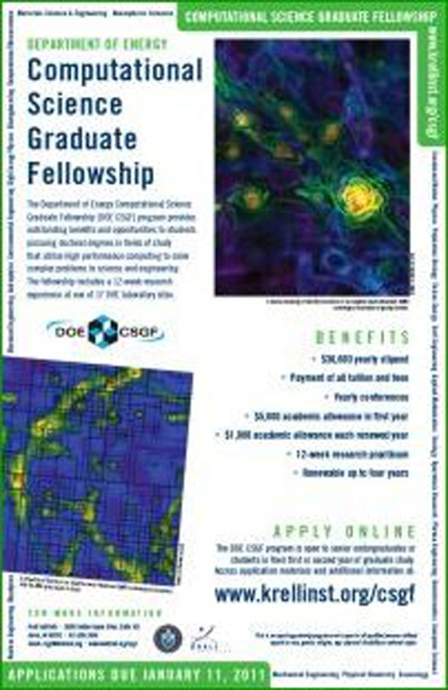

Computational Science Graduate Fellowship www.krellinst.org/csgf
Funded by the Department of Energy’s Office of Science and National Nuclear Security Administration, the DOE CSGF trains scientists to meet U.S. workforce needs and helps to create a nationwide interdisciplinary community.
Some Talks from 2011 Fellows Conference
  "The Materials Genome: An online database for the design of new materials for clean energy and beyond“
  "Understanding electromagnetic fluctuations in microstructured geometries“
  "Computational science meets materials chemistry: a bilingual investigation of surface effects in nanoscale systems“

Slide 21
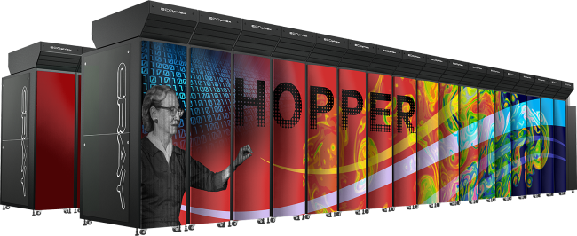
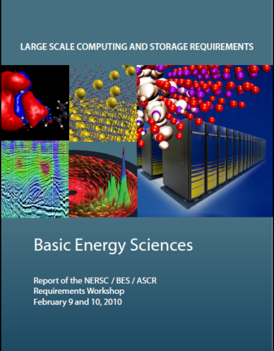
NERSC
Hopper in production April 2011
1.25 PFlop/s peak performance Cray XE6
Over a billion core-hours to science per year
Gemini high performance resilient interconnect
BES NERSC Requirements Workshop :
  www.nersc.gov/assets/HPC-Requirements-for-Science/NERSC-BES-WorkshopReport.pdf

Slide 22
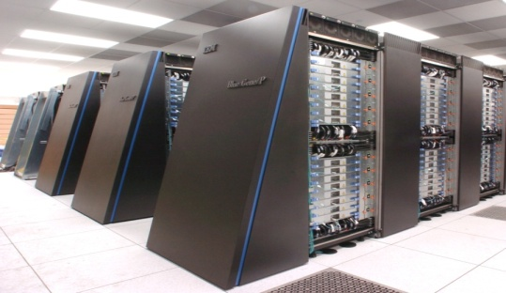
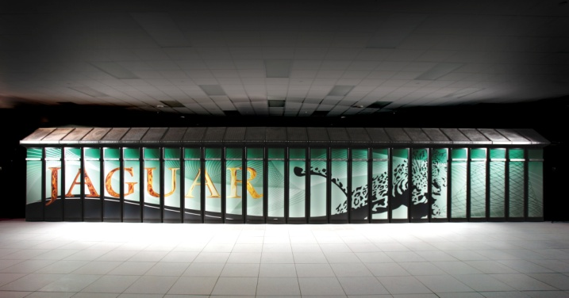
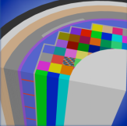
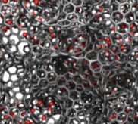
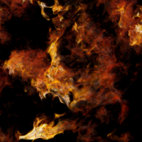

INCITE
The Cray XT5 ("Jaguar") at ORNL and the IBM Blue Gene/P ("Intrepid") at ANL will provide ~2.3 billion processor hours in FY12 to address science and engineering problems that defy traditional methods of theory and experiment and that require the most advanced computational power.
Peer reviewed projects are chosen to advance science, speed innovation, and strengthen industrial competitiveness.
Demand for these machines has grown each year, requiring upgrades of both.
Argonne Leadership Computing Facility
Oak Ridge Leadership Computing Facility
In FY 2012, the Argonne LCF will be upgraded with a
10 petaflop IBM Blue Gene/Q. The Oak Ridge LCF will continue site preparations for a system expected in FY 2013 that will be 5-10 times more capable than the Cray XT-5.
Nuclear Reactor Simulation
Energy Storage Materials
Turbulence

Slide 23
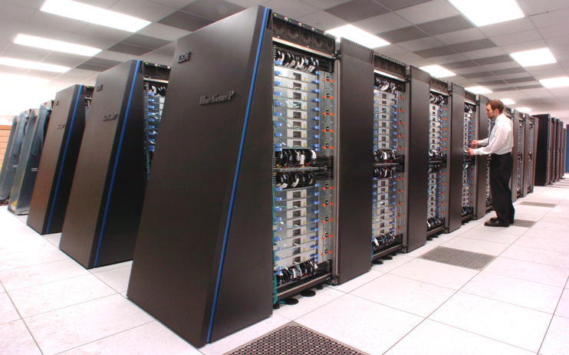
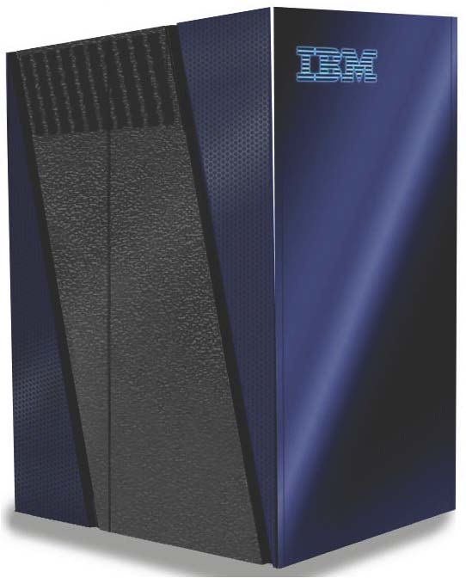
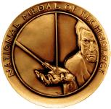
Argonne Leadership Computing Facility
ALCF - now
ALCF - 2013
more CPUs/node (x 4)
faster CPUs (x 60)
faster storage (x 2.7)
more storage (x 3.6)
more RAM/CPU (x 2)
48 racks
Intrepid
Blue Gene/P—peak 557 TF
40 racks
40,960 nodes (quad core)
163,840 processors (3.4 GF Peak)
80 TB RAM
8 PB storage capacity
88 GB/s storage rate
1.2 MW power
Air-cooled
Mira
Blue Gene/Q—peak 10 PF
48 racks -- just one row more than Intrepid
49,152 nodes (16 core)
786,432 processors (205 GF peak)
786 TB RAM
28.8 PB storage capacity
240 GB/s storage rate
Estimated 3-8 MW projected power
Water-cooled
~20 times the computing power in only 20% more space
Notes:
The current ALCF-1 system is in Steady State (Operations) and will continue in operation throughout the duration of the ALCF-2 Design, Modification & Enhancement (DME) Project.

Slide 24
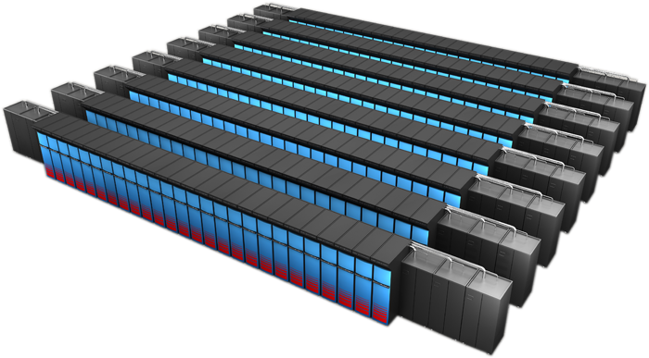
Oak Ridge Leadership Computing Facility
OLCF-3
  Builds on DARPA HPCS investment in Cray
  Prepare applications for path to Exascale computing
  CD-1 approved, December 2009
  Lehman CD2-3b Review scheduled for August, 2010
Science Application Readiness
Application Readiness Review August, 2010
Science Teams
Port, Optimize, New Modeling Approaches
Early Access to development machine
Cray-NVIDIA System
~10-20 Pflop/s peak
Hybrid x86/accelerator architecture
Liquid cooled
Highly power efficient

Slide 25
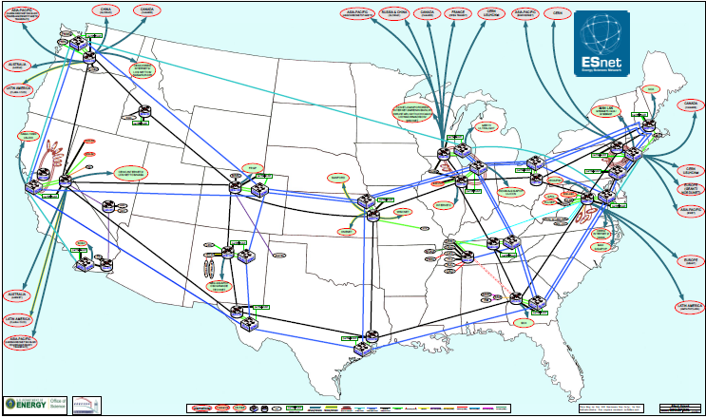
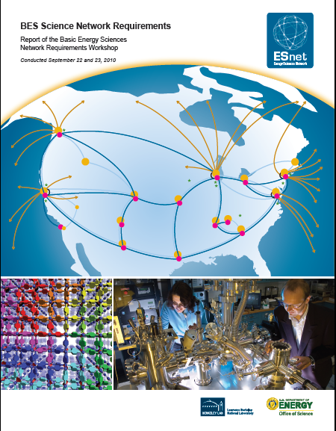
ESnet
BES 2010 Requirements Workshop
  www.es.net/assets/Uploads/BES-Net-Req-Workshop-2010-Final-Report.pdf
Electronic Collaboration Tools
  www.ecs.es.net
Network Performance Tools
  fasterdata.es.net
Virtual Circuits
  www.es.net/services/virtual-circuits-oscars/

Slide 26
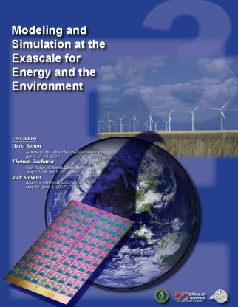
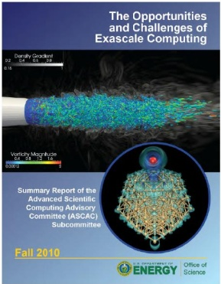
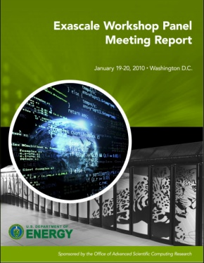
Why Exascale --
Exascale Applications and Technology
http://www.science.doe.gov/ascr/WorkshopsConferences/GrandChallenges.html
Town Hall Meetings April-June 2007
Scientific Grand Challenges Workshops November 2008 – October 2009
  Climate Science (11/08),
  High Energy Physics (12/08),
  Nuclear Physics (1/09),
  Fusion Energy (3/09),
  Nuclear Energy (5/09) (with NE)
  Biology (8/09),
  Material Science and Chemistry (8/09),
  National Security (10/09) (with NNSA)
Cross-cutting workshops
  Architecture and Technology (12/09)
  Architecture, Applied Mathematics and Computer Science (2/10)
Meetings with industry (8/09, 11/09)
External Panels
  Trivelpiece Panel (1/10)
  ASCAC Exascale Charge (FACA) (11/10)
MISSION IMPERATIVES
“Exascale computing will uniquely provide knowledge leading to transformative advances for our economy, security and society in general. A failure to proceed with appropriate speed risks losing competitiveness in information technology, in our industrial base writ large, and in leading-edge science.” - Advanced Scientific Computing Advisory Committee

Slide 27
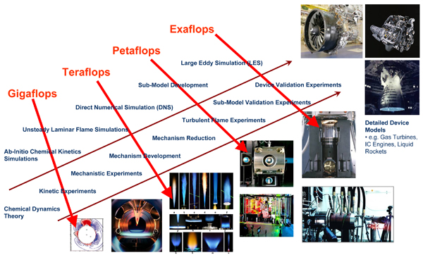
Progress Toward Simulating Combustion
Basic Research

Slide 28
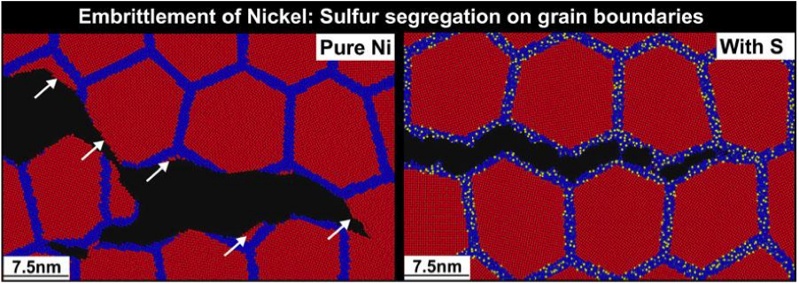
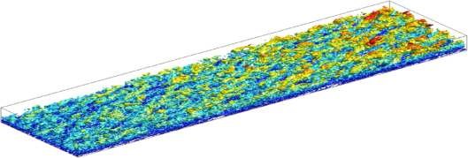
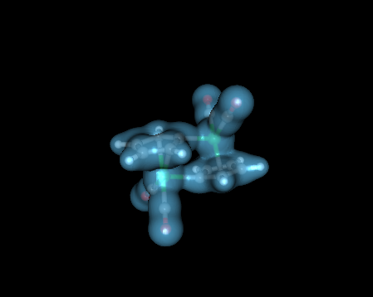
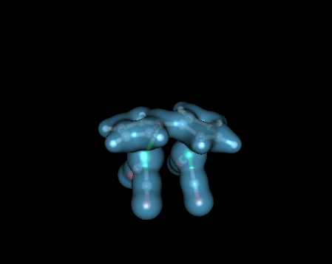
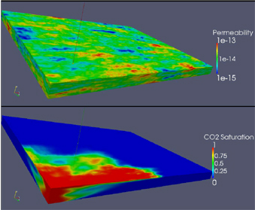

ASCR Computational Research Delivers Public Benefits – Saving Energy
Stress Corrosion Cracking - Priya Vashishta, USC
Annually, corrosion costs about $276 Billion (3% of GDP).
Performance and lifetime of materials in nuclear and advanced power generation are severely limited by corrosion from extreme conditions.
Simulations link sulfur impurities and embrittlement of Nickel.
Turbulence - Robert Moser, UT-Austin
20% of world energy consumption (100 quadrillion BTU) due to turbulence.
Virtual redesign reduces costly drag on piping, ducts, and vehicles.
Simulations show where viscous near-wall turbulence interacts with outer-layer resulting in energy losses in transport of fuels in pipes and flow past vehicles.
Storing Solar Energy - Jeffrey Grossman, MIT
Capturing solar energy in chemical form can make it storable and transportable.
Simulations reveal how fulvalene diruthenium molecules change configuration when they absorb heat from sunlight informing the search for similar, less expensive compounds
Subsurface – Mary Wheeler, University of Texas at Austin
High fidelity models of complex geosystems are key tools for groundwater remediation, sequestration of carbon in saline aquifers and enhanced petroleum production.
Simulations have been used to characterize the US Eagle Ford shale formations in collaboration with industrial partners Chevron, IBM, and ConocoPhillips.

Slide 29
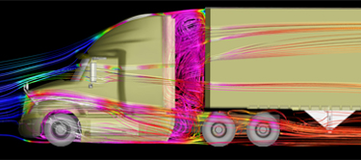
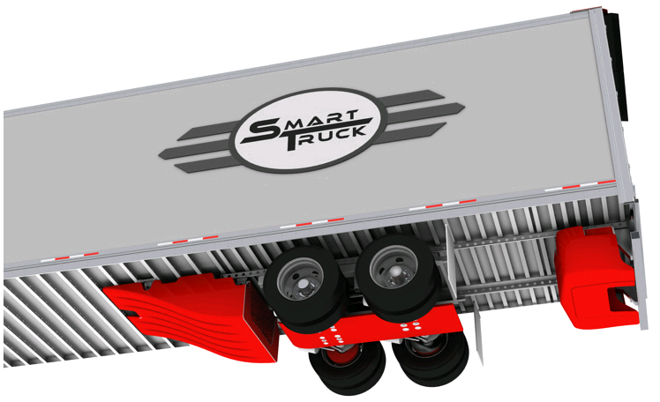
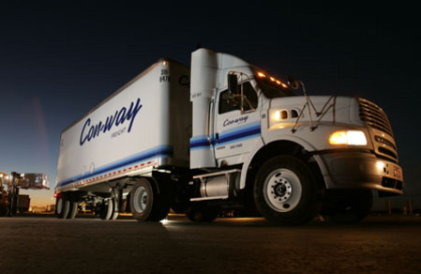
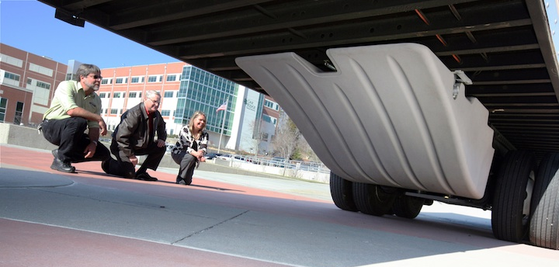






High Performance Computing: SmartTruck/DOE Partnership
Aerodynamic forces account for ~53% of long haul truck fuel use.
Class 8 semi trucks (300,000 sold annually) have average fuel efficiency of 6.7 MPG
Used ORNL’s Jaguar Cray XT-5 2.3 petaflop computer for complex fluid dynamics analysis – cutting in half the time needed to go from concept to production design
Outcome: SmartTruck UnderTray add-on accessories predict reduction of drag of 12% and yield EPA-certified 6.9% increase in fuel efficiency.
If the 1.3 million Class 8 trucks in the U.S. had these components, we would save 1.5 billion gallons of diesel fuel annually (~$4.4B in costs and 16.4M tons of CO₂)
Awarded as one of the “Top 20 products of 2010” from Heavy Duty Trucking magazine
Con-way Freight Inc. is the first corporation to install the SmartTruck UnderTray system.
Notes:
ORNL’s Jaguar helps BMI win award, nation save fuel (DOE press release)
OAK RIDGE, Tenn., Feb. 8, 2011 – A BMI Corp. SmartTruck technology that could save 1.5 billion gallons of diesel fuel and $5 billion in fuel costs per year has hit the road in record time in part because of simulations performed on the nation’s most powerful supercomputer at the Department of Energy’s Oak Ridge National Laboratory.
While South Carolina-based BMI Corp. has just won an industry award from Heavy Duty Trucking magazine, the real winners could be trucking companies and the environment. With installation of BMI’s SmartTruck UnderTray System to improve the aerodynamics of 18-wheeler (Class 8) long-haul trucks, the typical big rig can achieve fuel savings of between 7 and 12 percent, easily meeting the new California Air Resources Board mandate that calls for a minimum mileage improvement of 5 percent.
Those results, which earned BMI one of the publication’s top 20 products of the year awards, were made possible because of simulation work performed on ORNL’s Jaguar supercomputer.
“We were able to run simulations based on the most complex tractor and trailer models instead of simplified models, and we were able to run them faster,” said Mike Henderson, chief executive officer and founder of BMI, an engineering services firm based in Greenville, S.C.
The work on Jaguar shortened the computing turnaround time for BMI’s complex models from days to a few hours and eliminated the need for costly and time-consuming physical prototypes. In all, running simulations on Jaguar allowed BMI to go from concept to a design that could be turned over to a manufacturer in 18 months instead of the 3½ years they had anticipated, according to Henderson, who noted, however, that more work remains.
“Our first goal was to design add-on parts for existing trucks and trailers to make them more aerodynamic,” Henderson said. “By reducing drag we boost fuel efficiency and cut the amount of carbon that’s being dumped into the environment.”
In time, BMI plans to design trucks that are far more aerodynamic from the ground up.
“We hope to soon turn our attention to creating a brand new highly aerodynamic vehicle with optimum fuel efficiency,” Henderson said.
Until then, Henderson noted that if all of the nation’s 1.3 million Class 8 trucks were configured with just the minimum UnderTray package, the average fuel economy of 6 miles per gallon could increase to about 6.5 mpg or more, which is significant given the fact 18-wheelers collectively travel some 130 billion miles per year. And from an emissions standpoint, equipped with the aerodynamics package, those trucks would reduce their carbon dioxide emissions by 32.7 billion pounds (16.4 million tons).
BMI’s work with ORNL was made possible through the laboratory’s Industrial High-Performance Computing Partnerships Program, supported by the DOE Office of Science. Through this effort, BMI was able to access Jaguar, which boasts nearly 225,000 processing cores with a theoretical peak computational capability of 2.3 petaflops (2.3 quadrillion floating operations per second).
The UnderTray’s aerodynamic components are manufactured in Georgia by Cellofoam while various metal brackets, bolts and other hardware that attach the parts to the trailer are made by a number of companies in South Carolina. Several fleets, including Con-way Truckload and Frito-Lay, are already using the parts. The kit can be installed in the field by fleet owners and operators.
The award is to be presented today at the American Trucking Association’s 2011 Technology & Maintenance Council’s annual truck show in Tampa, Fla. UT-Battelle manages ORNL for DOE’s Office of Science.

