Slide 1
Office of Energy Efficiency and Renewable Energy (EERE) Activities and Collaborations with BES
Henry Kelly
Acting Assistant Secretary EERE
Basic Energy Sciences Advisory Committee
August 2-3, 2011

Slide 2
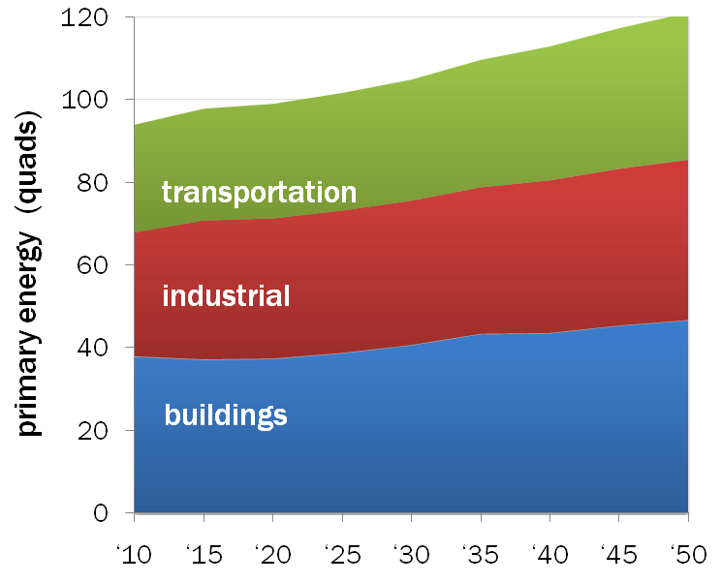
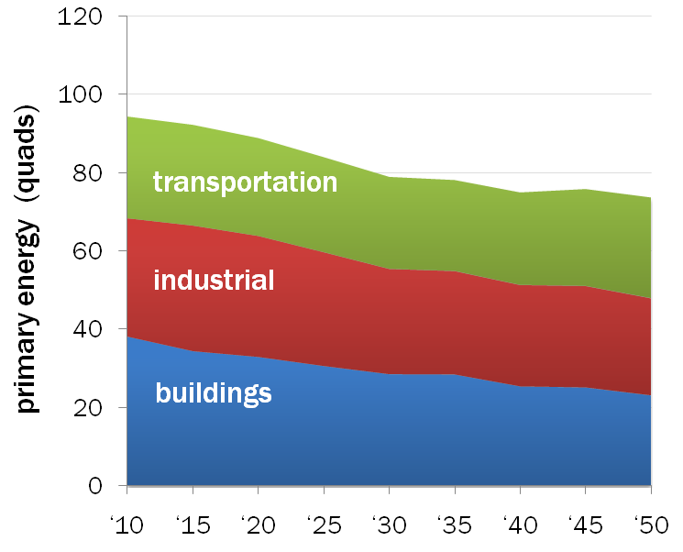
Total Primary Energy Use by Sector
Baseline
Aspirational

Slide 3
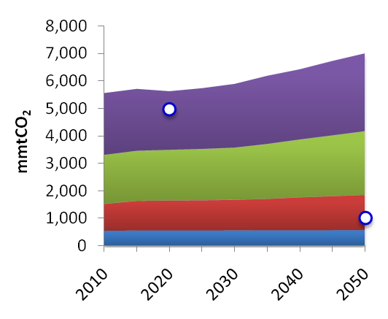
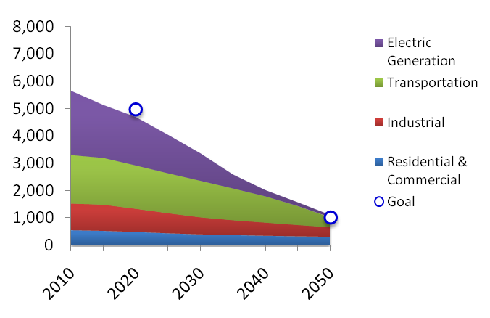
Total Emissions by Sector
Baseline
Aspirational

Slide 4
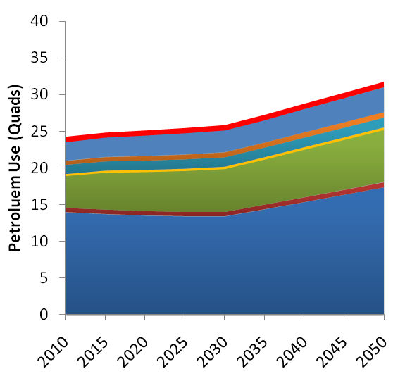
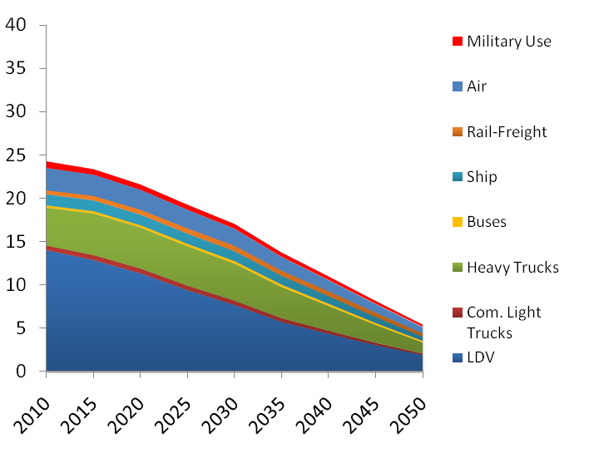
Petroleum Product Use by Mode
Baseline
Aspirational

Slide 5
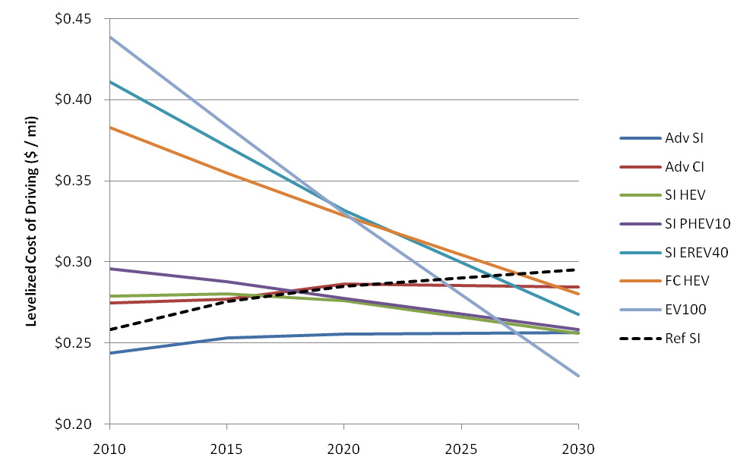
Light Duty Vehicle Costs ($/mile)
Vehicle costs are in the average risk case (50% likely) and are for a midsize vehicle. Gas price is AEO reference case ($3.64 in 2030), no carbon price assumed.

Slide 6
Battery R&D Advance the development of batteries.
Lithium/Sulfur/air; Non lithium
Theoretical Energy: 3000 Wh/kg, >3000 Wh/l
EERE and ARPA-E
EV Goals
$100-150/KWh
Lithium/High-Voltage cathode
Theoretical Energy: 990 Wh/kg ,3000 Wh/l
Energy
2014 DOE EERE
PHEV Goals
$300/KWh
Silicon/High-Voltage cathode
Theoretical Energy: 880 Wh/kg, 3700 Wh/l
Graphite/High-Voltage cathode
Theoretical Energy: 560 Wh/kg, 1700 Wh/l
Graphite/Layered cathode
Theoretical: 400 Wh/kg,1400 Wh/l
Practical Energy: 150 Wh/kg 250 Wh/l;
~300 Cells, ~$10,000
PHEV Battery
~200 Cells, ~$6,000
PHEV Battery
~100 Cells, ~$3,000
PHEV Battery
Low-cost
EV Battery
Current Technology
2015
2020
Notes:
6

Slide 7
Thermal processes dominate energy use across many energy-intensive industrial subsectors
Source: Analysis of energy use in select energy-intensive industries, based on Energy Information Administration 2006 Manufacturing Energy Consumption Survey data

Slide 8
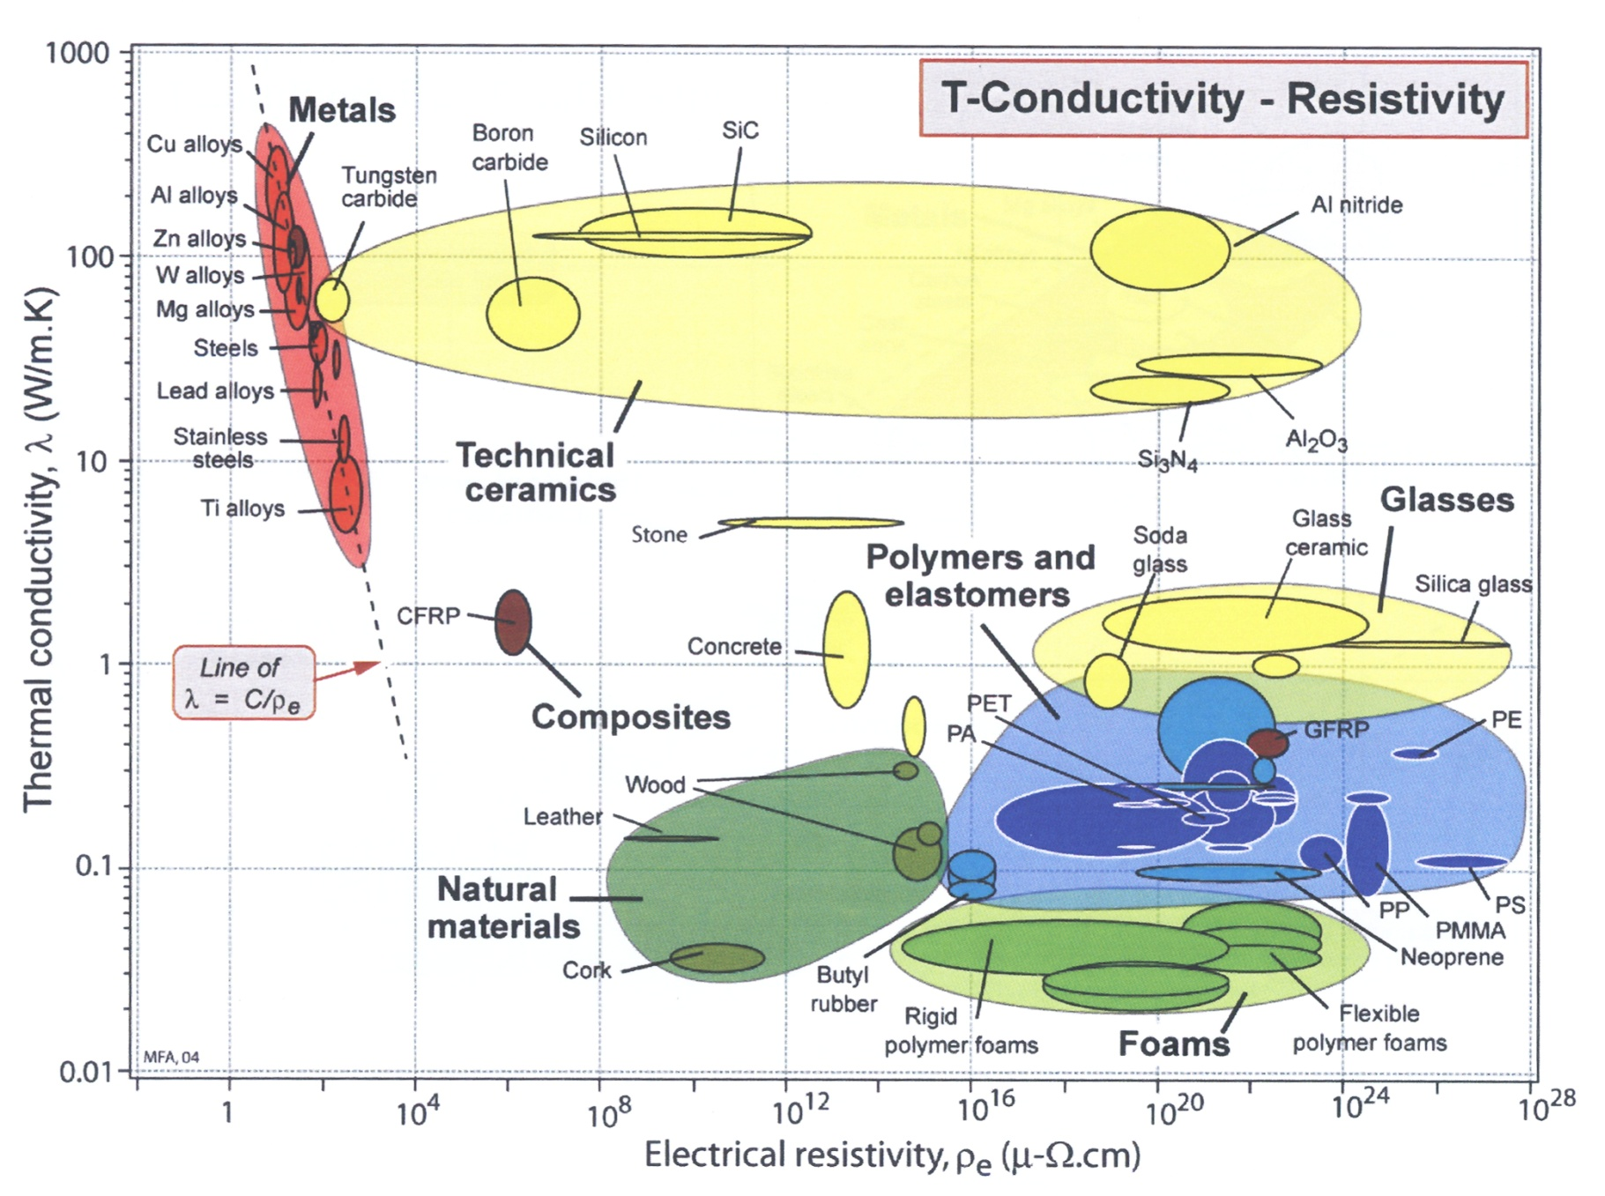
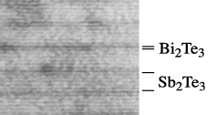
Thermoelectric Materials
Thermoelectric
Superlattice
Arrange atomic planes

Slide 9
Residential Energy Consumption

Slide 10
Commercial Energy Consumption

Slide 11
Aspirational goal for buildings:
Preliminary
48%
TBTUs Primary Energy in 2030

Slide 12
Renewables
Photovoltaics
Concentrating Solar Power
Wind
Geothermal
Hydroelectric
Biomass
Fuel Cells
Marine and Hydrokinetic

Slide 13
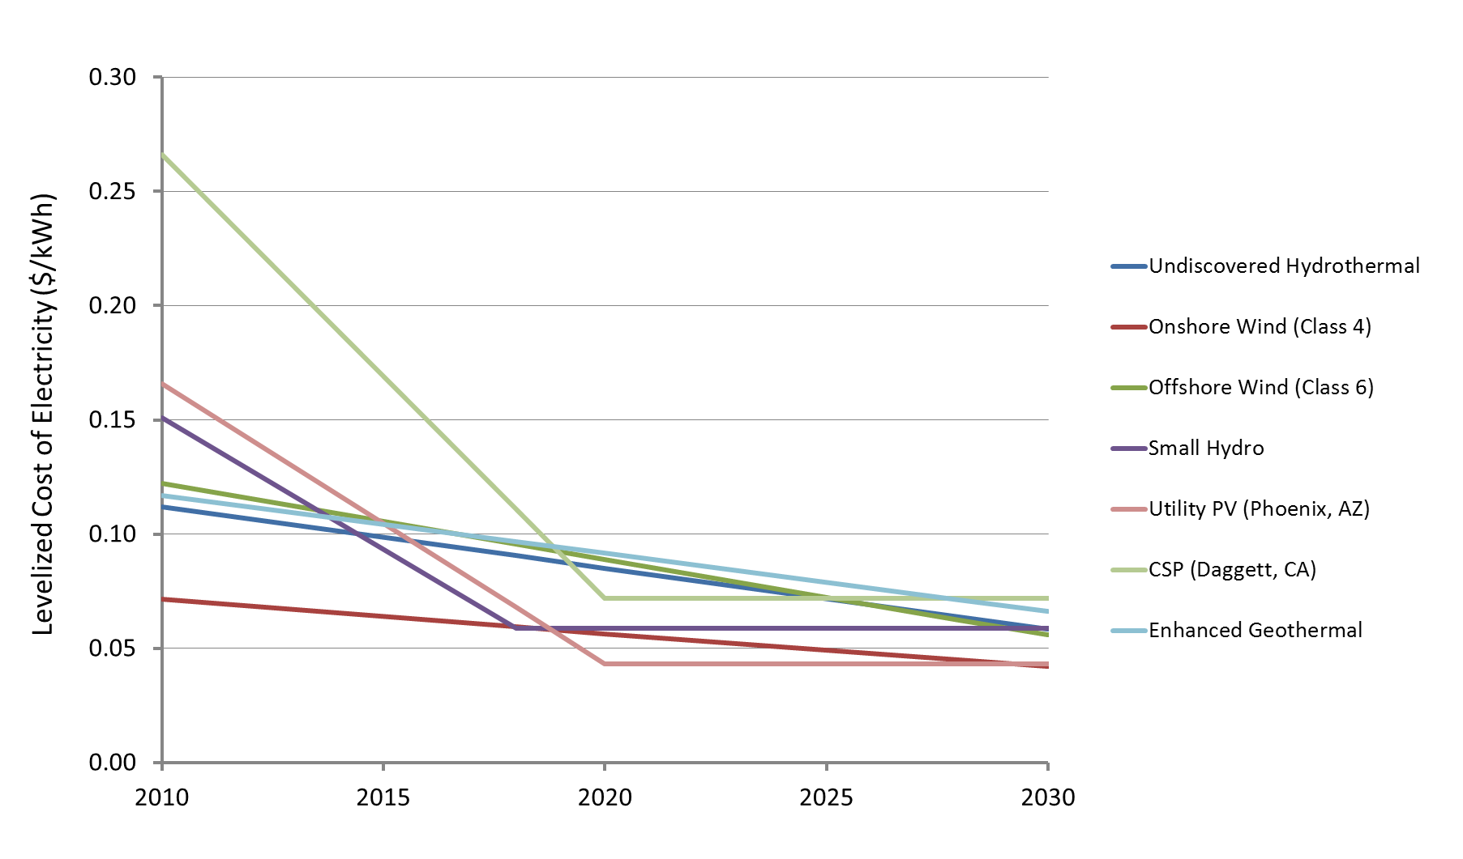
Levelized Cost of Electricity
Same as previous but utility scale technologies only.

Slide 14
SunShot
Power Electronics
Balance of Systems (BOS)
PV Module
$3.80/W
Installed Systems Price ($/W)
$1/W
$1/W Target
2004 Systems
Prices
2010 Systems
Prices
BOS Soft Costs Reductions
Power Electronics Cost Reductions
BOS Improvements
Module Efficiency Improvements
Manufacturing Cost Reductions
Notes:
$1/W is ~5-6 cents per kWh
PV becomes directly competitive with coal
Requires about a 4x cost reduction to make it there
14

Slide 15
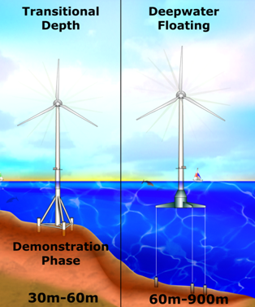
Wind Technology Challenges
Advanced turbine materials:
Inexpensive carbon fiber
Superconducting cables
Smart materials
Better permanent magnets
System Reliability
Inexpensive deepwater foundations for offshore wind

Slide 16
Advanced Biofuels
Sources: MTG -2009 PNNL Technical Report http://www.pnl.gov/main/publications/external/technical_reports/PNNL-18481.pdf;
Pyrolysis – PNNL Technical Report http://www.pnl.gov/main/publications/external/technical_reports/PNNL-18401.pdf;
FT - Swanson, et.al. 2010 (nth) FUEL Journal http://dx.doi.org/10.1016/j.fuel.2010.07.027;
Open Pond Algae - Davis, et.al. 2011 Applied Energy Journal http://dx.doi.org/10.1016/j.apenergy.2011.04.018;
PBR Algae - Davis, et.al. 2011 (PBR) Applied Energy Journal http://dx.doi.org/10.1016/j.apenergy.2011.04.018;
Notes:
Sources: MTG -2009 PNNL Technical Report http://www.pnl.gov/main/publications/external/technical_reports/PNNL-18481.pdf; Pyrolysis – PNNL Technical Report http://www.pnl.gov/main/publications/external/technical_reports/PNNL-18401.pdf; FT - Swanson, et.al. 2010 (nth) FUEL Journal http://dx.doi.org/10.1016/j.fuel.2010.07.027; Open Pond Algae - Davis, et.al. 2011 Applied Energy Journal http://dx.doi.org/10.1016/j.apenergy.2011.04.018; PBR Algae - Davis, et.al. 2011 (PBR) Applied Energy Journal http://dx.doi.org/10.1016/j.apenergy.2011.04.018;
Capital Cost includes return on investment.

Slide 17
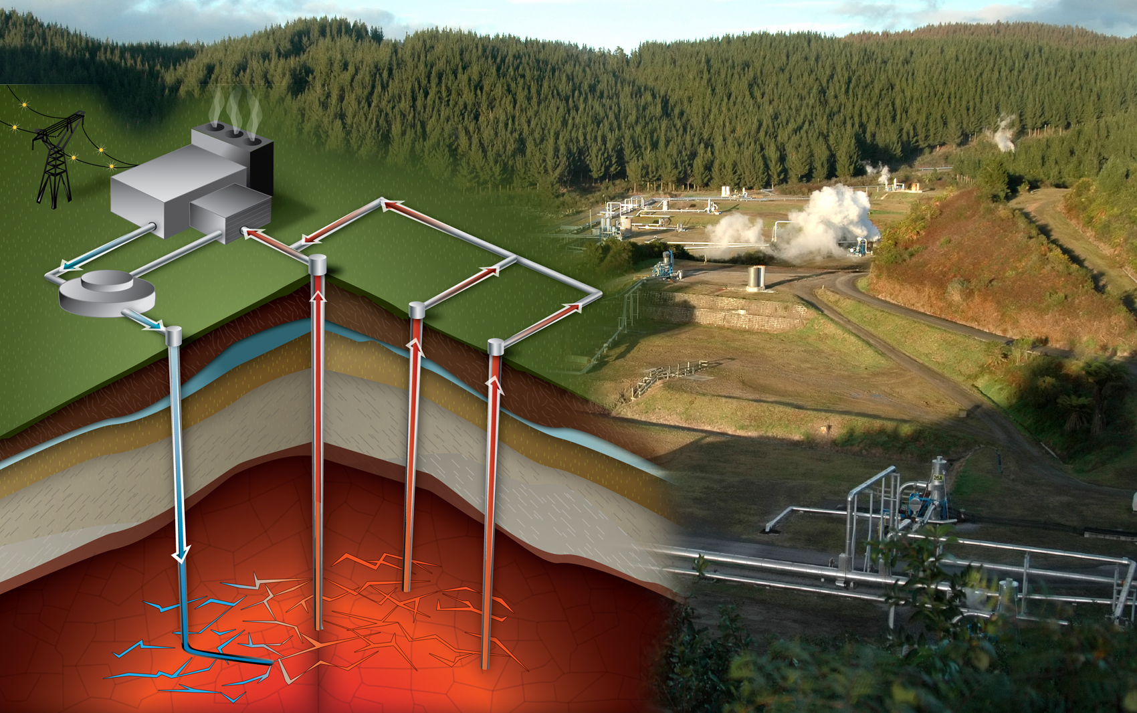
Enhanced Geothermal Systems
Jay Nathwani

Slide 18
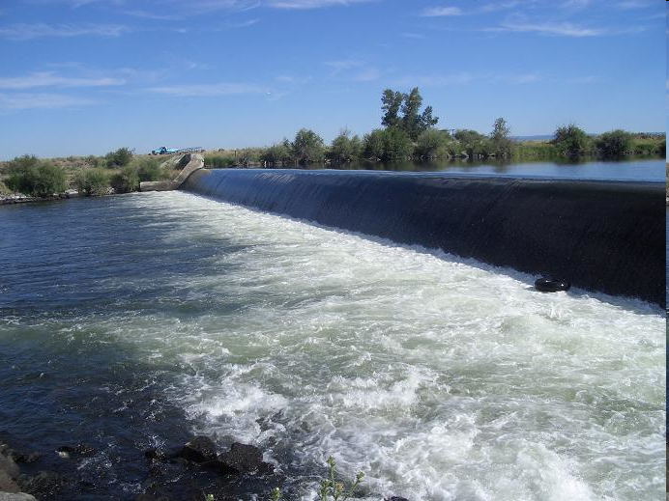
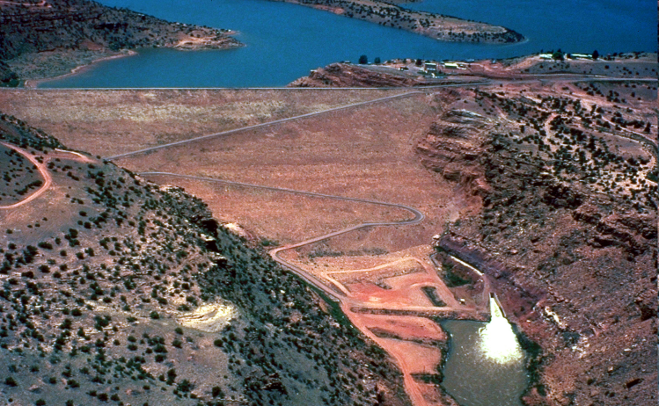
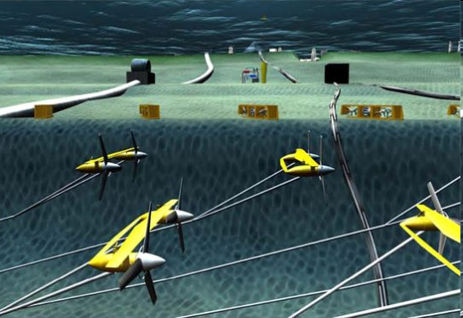
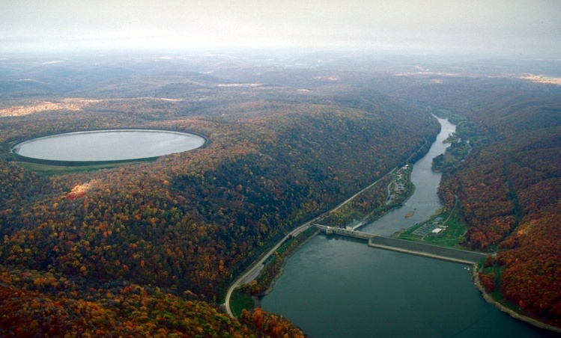
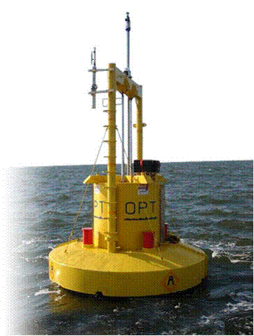
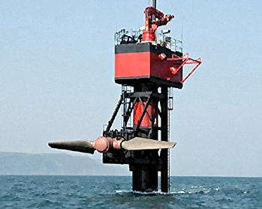
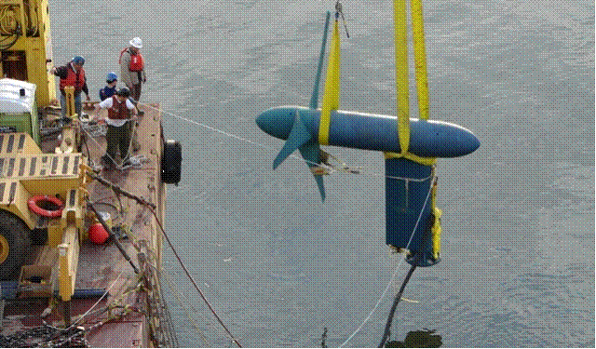
Water Power
Notes:
18
@ broad buckets, MHK and CH

Slide 19
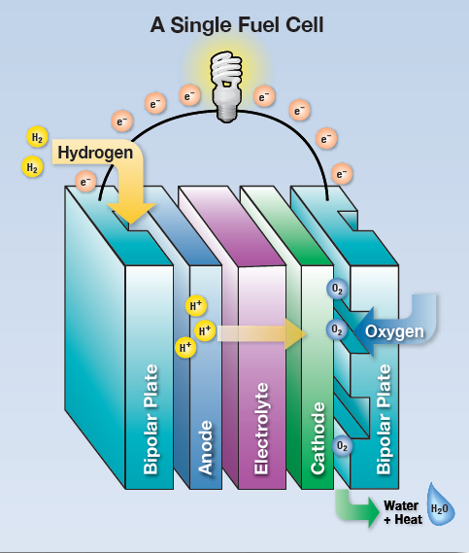
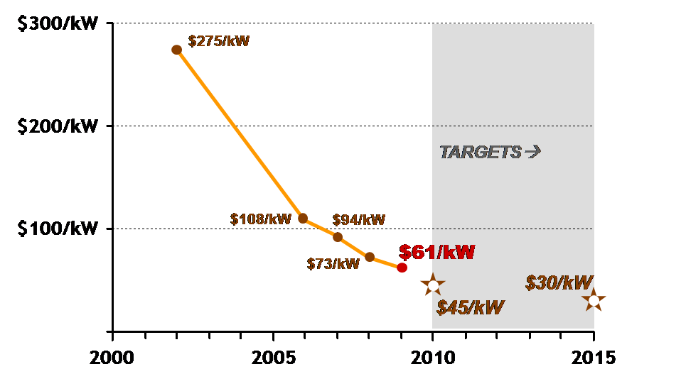
Fuel Cells
Innovation: Cheaper, effective catalysts – removing precious metals – the dominant cost driver for many fuel cells.
Los Alamos National Lab’s catalyst (Cyanamide-Iron-Carbon) shows the hghest reaction rate observed to date in a non-precious metal catalyst.
Potential: A nearly 10x improvement in the performance of catalysts that do not contain precious metals.
Projected Cost of Transportation Fuel Cells (at high volume—500,000 units/year)
Notes:
Innovative Fuel Cell Catalysts
LANL has achieved a nearly 10x improvement in the performance of catalysts that do not contain precious metals
Precious metal catalysts are a dominant cost-driver in automotive and other PEM (polymer electrolyte membrane) fuel cells
LANL’s catalyst (Cyanamide-Iron-Carbon) shows the highest reaction rate (oxygen-reduction reaction) observed to date in a non-precious metal catalyst
→ exhibits potential to exceed DOE’s 2010 target for non-precious metal catalyst activity (130 amps/cm3)
Graphic on bottom right shows Projected Cost of Transportation Fuel Cells (at high volume—500,000 units/year)
DOE has achieved more than 75% cost-reduction in PEM fuel cells in the last few years, largely due to advances in catalysts. The use of non-precious catalysts would drive costs even lower.
Graphic on top left shows A Single Fuel Cell
Catalysts at the anode and cathode are essential for the chemical reactions driving a fuel cell. LANL’s catalyst facilitates the reaction at the cathode, between H+ ions and oxygen, to form water.
DOE-funded work at Los Alamos National Lab (LANL) has led to major improvements in fuel cell catalysts, which are critical for performance and cost-reduction.
In spite of dramatic advances with Pt based fuel cell catalysts, catalyst cost is still dominant in polymer electrolyte membrane (PEM) fuel cell stack related costs.
Non-precious metal fuel cell catalysts present the ideal solution in terms of both abundance and cost.
Although performance is still relatively low compared to state of the art Pt catalysts, Los Alamos National Laboratory (LANL) has made a significant advance by exhibiting major improvement in oxygen reduction reaction (ORR) activity of non-precious metal catalysts.
These advances could be significant for automotive and other PEM fuel cells, but also for Anion-Exchange and Phosphoric Acid fuel cells.
Performance is still low compared to expensive Pt catalysts
These improvements, and resulting cost reductions, could help meet DOE’s cost target (of $30/kW) for automotive fuel cells which will enable fuel cells to be cost-competitive with internal combustion engines.

Slide 20



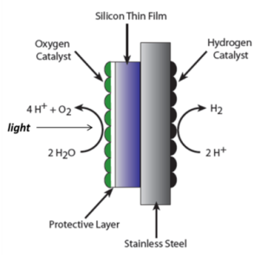
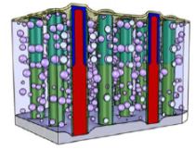
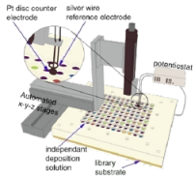
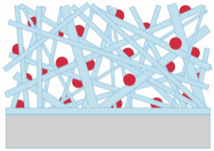


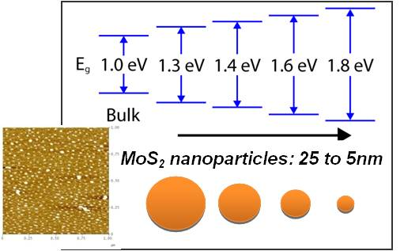

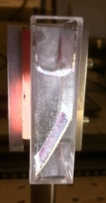

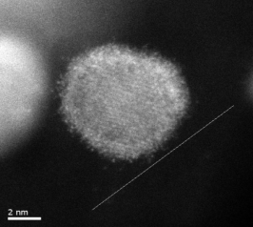
Collaborations:
Fuel Cell & H₂ Examples
Fuel Cell Examples of Cross-Office Collaborative Successes
Advancing fundamental science knowledge base
Applied RD&D of innovative technologies
High Throughput
Processes (UCSB)
Working Groups PEC, Biological, High T Membranes, Storage Systems
Using ARPA-E developed catalyst in water splitting device
Solar Fuels Hub
Nanowire based solar fuels generation (CalTech)
Standard protocols and benchmarking
Bandgap tailoring
(Stanford)
Nano-catalyst support scaffold
(Stanford)
ARPA-E: Focus on creative, high-risk transformational energy research
Mechanistic understanding of catalysts
Pt monolayer
Pd core
Alkaline Membranes
Developing novel catalysts (high risk/high impact)
Biological H₂ production
Materials-based H₂ storage

Slide 21
Top Ten Research Problems for EE (zeroth order draft)
Durable membranes that transport only H₂O (for cooling/ dehumidification)
Room temperature separations (replace distillation etc.)
Thermoelectric device with ZT>3
Magnets for motors and generators that operate at room temperature without rare earth materials
Glazing materials with controllable properties (transmissivity, reflectivity, emissivity)
Fast synthesis of Lithium-electrolyte interface layer formation
Low cost insulating materials with low conductivity/cm-thickness
Low cost sensor for measuring air quality (CO, CO₂, particulates, hydrocarbons, bacteria)
Low cost, low embedded energy substitute for concrete
Multi-photon phosphors

Slide 22
Top Ten Research Problems for RE (zeroth order draft)
Methods for accurate prediction of windspeeds on land and in the ocean (minute scale to monthly scale)
High-efficiency biological pathways for converting biomass to materials now made from petroleum (bacteria, enzymatic processes…)
High-efficiency non-biological or bio-mimetic pathways for converting biomass to materials now made from petroleum (electro-fuels, sunlight-to-fuels)
Low cost, durable materials with high optical transmissivity and high electrical conductivity
Inexpensive production methods for high-efficiency III-V photovoltaics
Low-cost, durable membranes that transport only H₂ and require little or no rare materials (flow batteries, fuel cells)
Inexpensive methods for locating geothermal resources
High band gap semiconductors (power conditioning/controls)
High growth rate algae or other materials that convert >80% of mass to lipids
New membranes and/or chemistries for utility-scale flow batteries

