Slide 1
BES Communications Plan
Basic Energy Sciences Advisory Committee Meeting
August 3, 2011
Eric A. Rohlfing
Director; Chemical Sciences, Geosciences, and Biosciences Division
Office of Basic Energy Sciences

Slide 2
Does BES have a communication problem?
Several comments from our stakeholders have suggested we might!
SC has recognized this issue and is confronting it aggressively – the “Discoveries and Innovation” series on the SC website, for example.
BES needs to communicate:
  Why we fund what we do.
  What we fund.
  How we do business.
  Impact of BES research.
Objective: Improve transparency through better communication with all our stakeholders - DOE, OMB, OSTP, Congress, the scientific community, the public.
Plan: Multiple “publications” that convey our messages in complementary ways.
Have we done better in the past? Maybe.

Slide 3
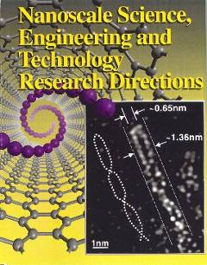
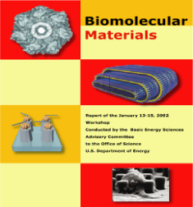
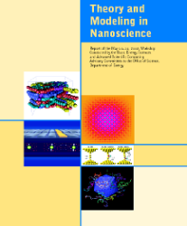
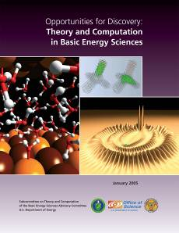
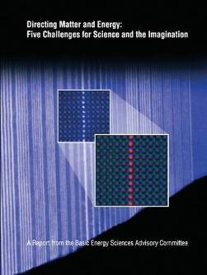
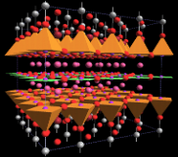
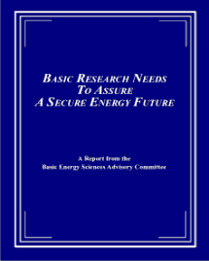
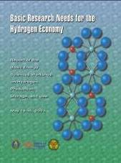
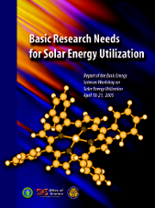
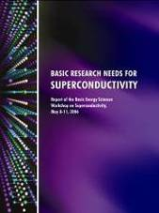

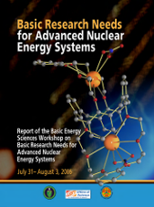
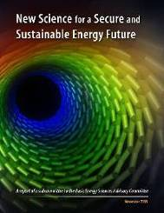
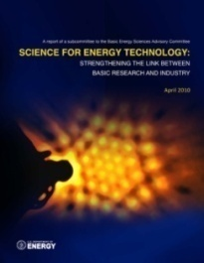
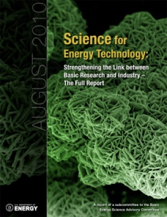
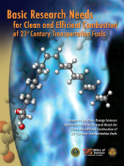
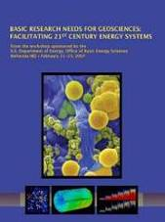
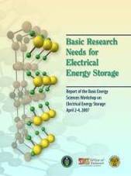
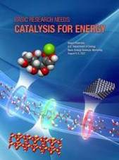
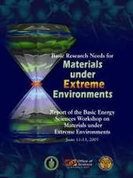
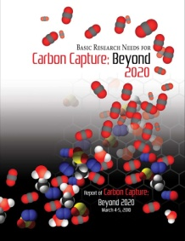
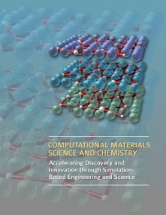

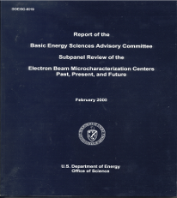
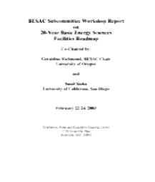
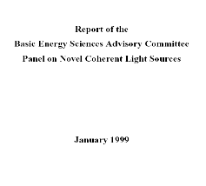
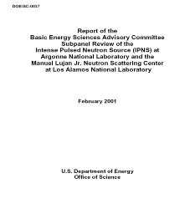
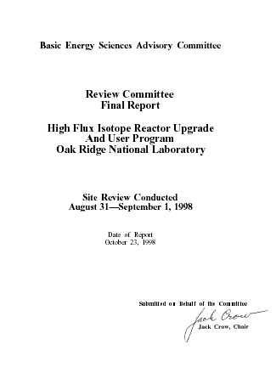
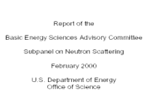
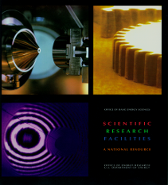
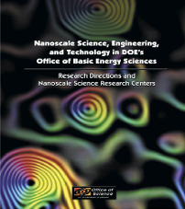
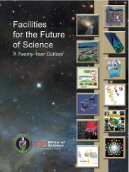
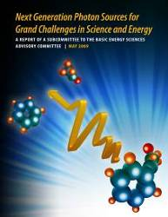

We answer the “Why?” question better than ever!
Science for Discovery
Complex
Systems
Science for National Needs
National Scientific User Facilities, the 21st century Tools of Science & Technology
Notes:
3
ERL, FEL, Ring, Cathode, novel sources, enabling technologies;

Slide 4
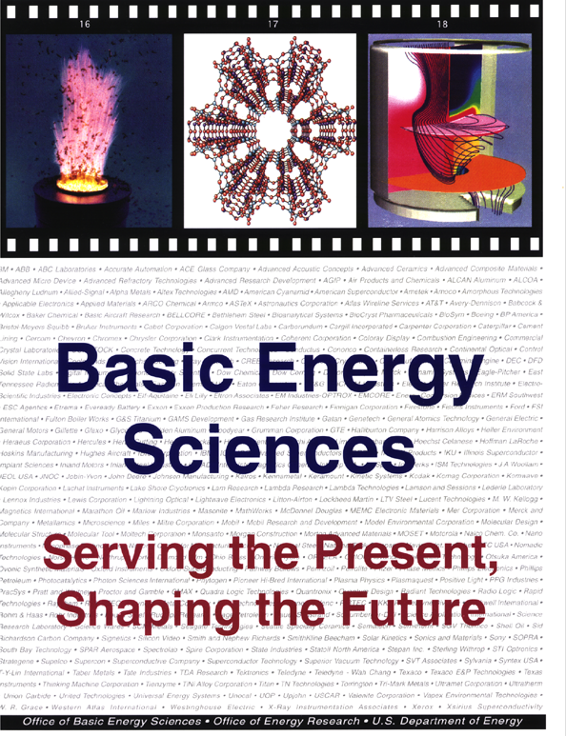
But perhaps we have done better on the “Impact” question
1996 report highlighted the formal and informal interactions between BES researchers and industry and featured specific success stories that demonstrated the impact of BES research investments on energy technologies.
Congressional staffers have pointed to this document as a good example of what BES should be doing to better communicate research impact.

Slide 5
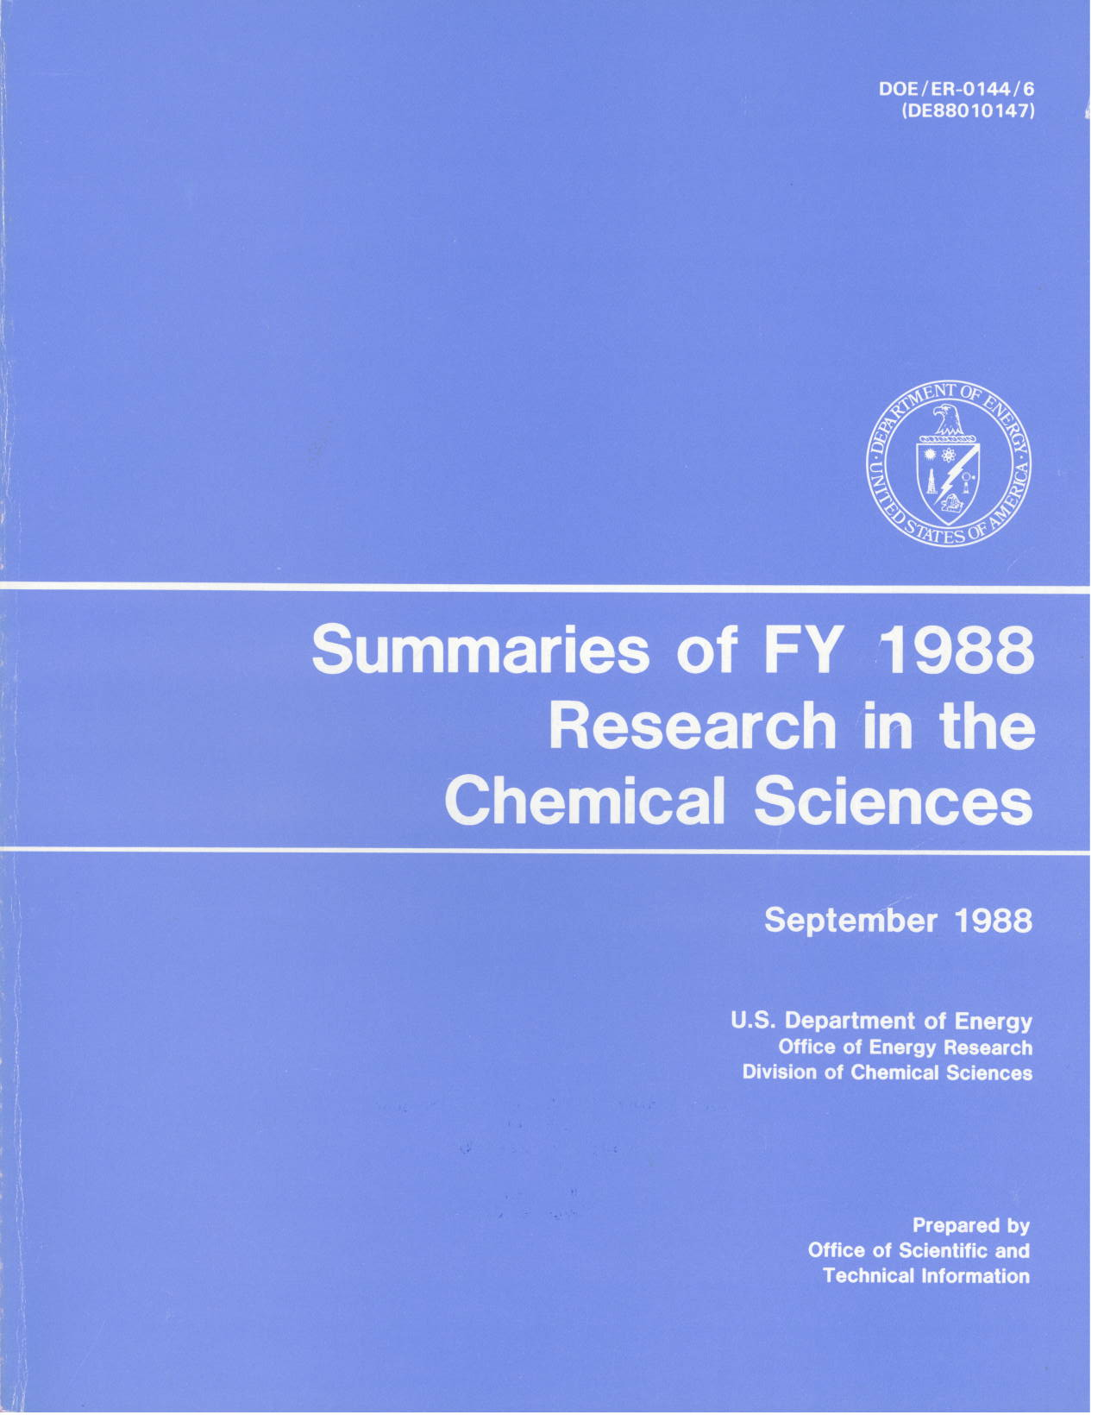
And we were more systematic on the “What?” question
In the past, BES produced “research summary books” that contained abstracts of BES research projects at universities and DOE labs.
Currently, the availability of this information is not uniform across BES.
  MSE maintains a “searchable” abstract database for grants and separate listings of lab projects.
  Both research divisions put the reports from Principal Investigator meetings online – these contain a wealth of information on grants and lab projects.

Slide 6
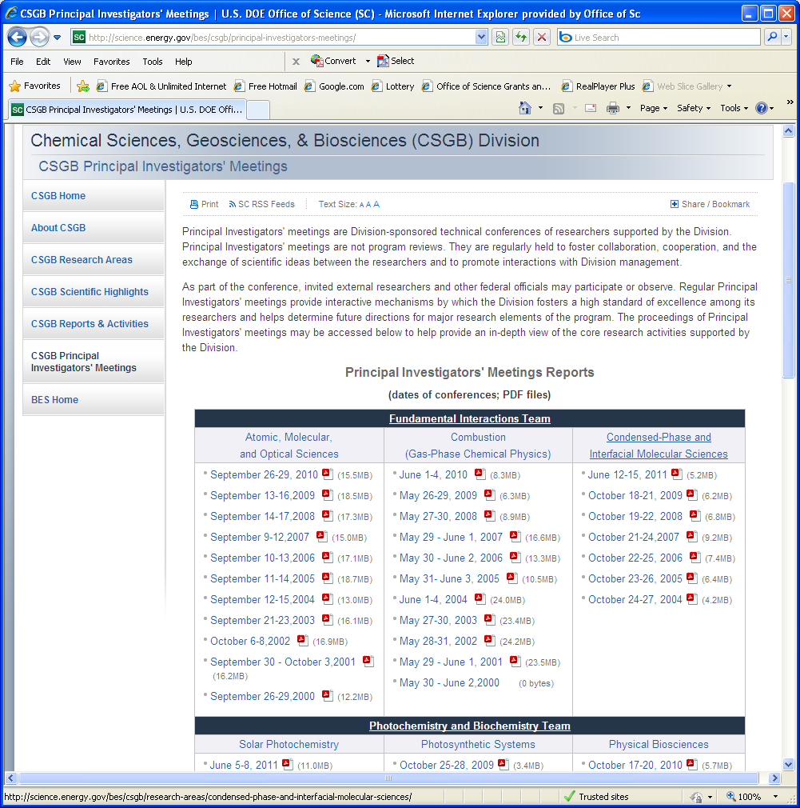
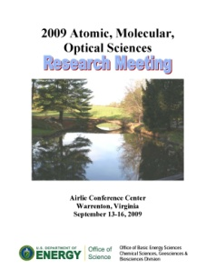
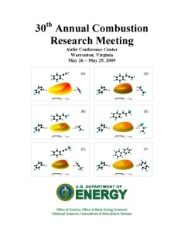
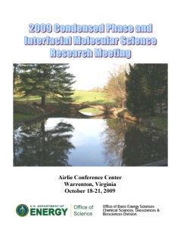
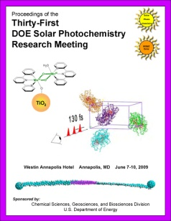
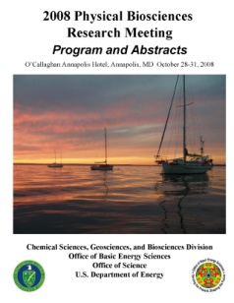
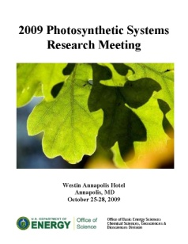
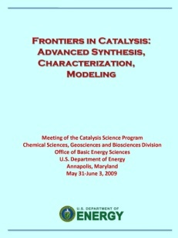
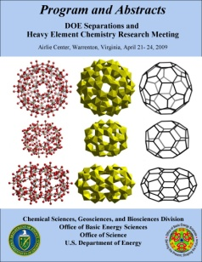
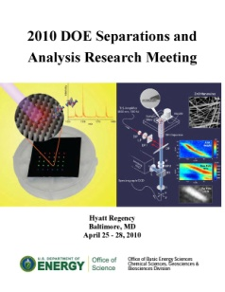

Slide 7
The BES Communications Plan
Produce three major publications:
  Science Serving the Nation Updated (online and hardcopy)
  BES Annual Report for FY 2011 (online and hardcopy)
  BES FY 2011 Project Summaries (online only)
All three will be published prior to the release of the FY 2013 budget request in early 2012.
Annual Report and Project Summaries will be updated annually.
Impact
What and How?

Slide 8
Science Serving the Nation Update
An update to the 1996 document to include impacts over the last 15 years, with emphasis on how BES basic research has translated into technological advances.
Foundation for updating:
  Recent “success stories” from labs and grants, which will include those recently featured on SC website.
  BESAC Workshop - Science for Energy Technology:
  Strengthening the Link between Basic Research and Industry
  BRNs
Collection of additional input:
  Broad email engagement of PIs requesting input
  Formation of a “Working Group” to select highlights, consolidate input, and draft individual sections
Contractor will provide technical editing, layout, and production.

Slide 9
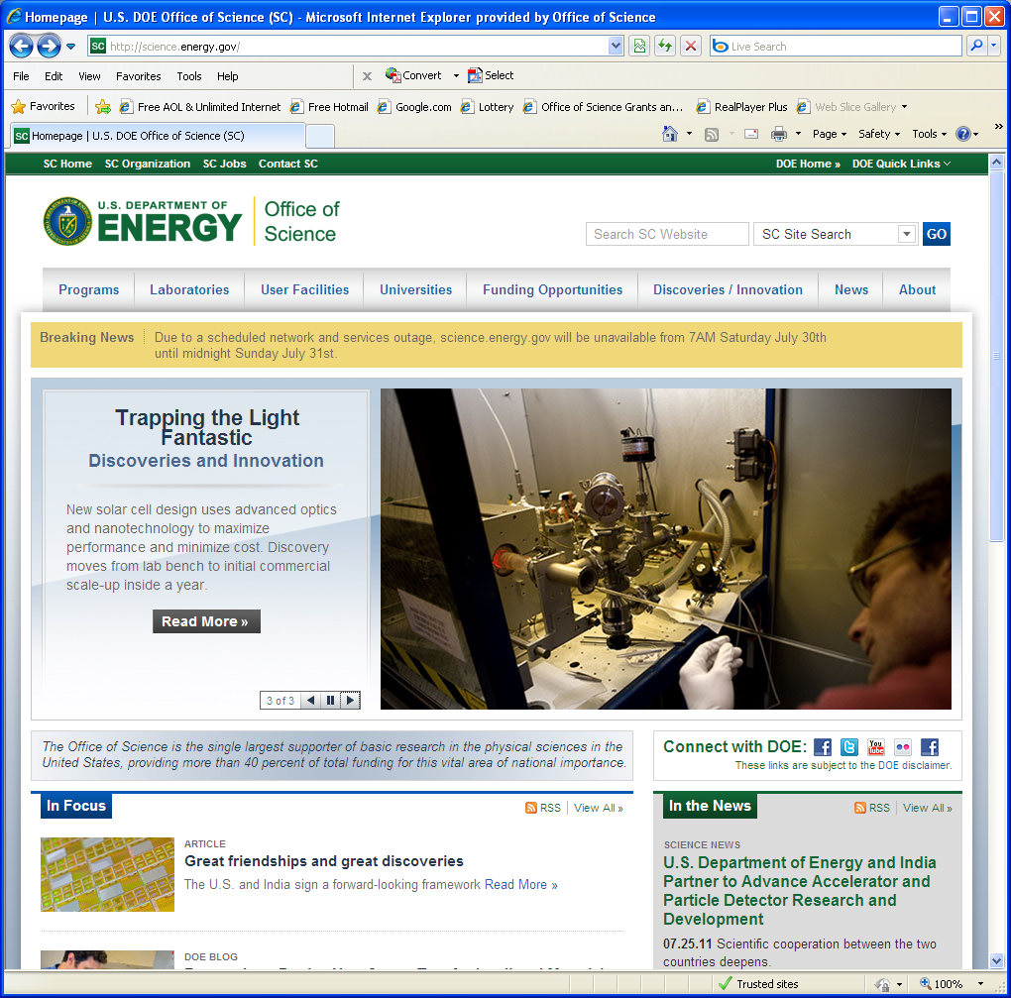

Slide 10
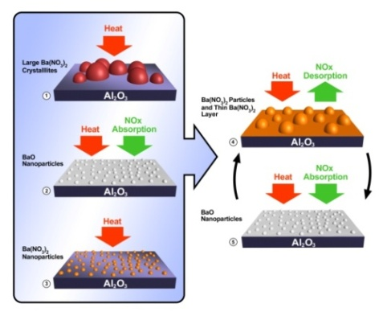
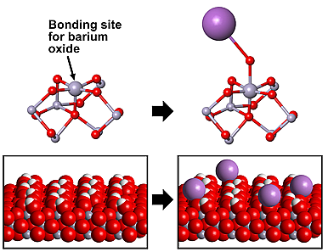



Catalytic Exhaust After Treatment:
From Molecular-Level Understanding to Emissions Reductions
Basic Science
Applied R&D
Manufacturing/
Commercialization
LNT technology used as after treatment on Cummins ISB diesel engine on Dodge Ram pickup in 2007, meeting 2010 emissions standards 3 years early.
More than 200,000 sold.
Studies of LNT deactivation identified large catalyst structure changes during cyclic operation.
Ultra-high field NMR spectroscopy in DOE’s user facility, EMSL, has provided fundamental information for understanding oxide-supported lean NOx trap (LNT) catalysts, including a γ-Al₂O₃ support for Ba and Pt catalytic phases
EERE-Funded Emission Control CRADAs at PNNL: Ford, GM, Dow, GE, Cummins, Johnson Matthey, Caterpillar, PACCAR
Work summarized in Journal of Catalysis 251, 189 (2007)
10

Slide 11
BES Annual Report for FY 2011
A layperson summary of BES in brochure format that includes:
  An overview of BES: mission, organization, type of research projects supported, and strategic planning.
  How BES does business: program management, receiving applications for funding, merit review (including peer review), funding decisions, and external reviews of BES programs (COVs).
  Descriptions of the BES research portfolio, including representative research highlights for FY 2011.
    MSE, CSGB, SUF (Accelerator and Detector R&D), EFRCs, and Fuels From Sunlight Energy Innovation Hub.
    Highlights will overlap with those in the FY 2013 budget request but will be more accessible in text and will include graphics.
Contractor will provide technical editing, layout, and production.
Serve as a gateway to more detailed information – project summaries, EFRCs, Hub, etc.

Slide 12
Example highlights from BES FY 2012 budget request
Smallest Superconductor Discovered. Scientists have found the world’s smallest superconductor, a chain of four pairs of organic molecules less than one nanometer wide and only 3.5 nanometers long. In normal metals, the resistance of a wire increases as the size of the wire decreases, making it very difficult to make nanoscale metal wires because the increased resistance causes the wires to heat up and eventually melt. However, superconducting materials have no electrical resistance and can carry large electrical currents without power dissipation or heat generation. In this research, the organic superconductor (BETS)₂GaCl₄ (where BETS is bis(ethylenedithio)tetraselenafulvalene) continued to be superconducting as the molecular chains decreased from 50 nm to the length of only four pairs of molecules. This finding provides the first evidence of successful fabrication of nanoscale superconducting wires, opening up a new regime for superconductivity research that could potentially impact nanoscale electronic devices and energy applications.
A Protein that Protects Photosynthetic Apparatus Critical to Algal Survival. Plants and algae use photosynthesis to capture solar energy and convert it into a chemical form that can be used by the cell. Too much sunlight, however, can harm photosynthetic organisms, causing severe oxidative damage and even cell death. To protect themselves, both plants and algae have evolved an energy-quenching mechanism that releases excess light energy as heat and protects the photosynthetic apparatus from damage. Researchers recently found that an evolutionarily ancient light harvesting protein, called LHSCR, was critical for survival of the green algae Chlamydomonas reinhardtii in a fluctuating light environment. The research suggests that this single protein in algae may play a role in both dissipating excess energy from chlorophyll and in sensing light to turn off the dissipation mechanism at the appropriate time. In higher plants, however, one protein in the light harvesting complex dissipates the energy while a different protein acts as the light sensor. The study of LHSCR in algae presents an alternative view of how nature controls solar energy harvesting and provides new insight for the effective use of algae as a biofuels feedstock and for the design of artificial light harvesting complexes.
High Brightness Beams Obtained with Low Charge Injection. Recent studies have demonstrated that high brightness photon beams can be produced by a free electron laser from electron bunches carrying small amounts of charge. These electron bunches have extremely low charge but are of very high quality, i.e., they are well collimated and packed in ultrashort intense bunches. The bunch duration is shorter than the time it takes for an atom to move a significant distance (less than 100 femtoseconds) and resulted in high brightness photon beam that can be used to take snapshots of the atomic structure of matter, opening new exciting possibilities in the understanding of novel materials. In addition, these beams alleviate the difficulties of transporting high charge electron bunches by producing high photon brightness with smaller amounts of charge. These results have contributed greatly to the successful operation of the Linac Coherent Light Source.

Slide 13
FY 2011 Project Summaries
Searchable PDF file(s) that summarize the 1400 research projects supported by the BES core programs. Each record will contain:
  Division and core program
  Project title and identifier (grant or FWP #)
  Institution
  PI or lab POC name and email
  Project abstract – one paragraph for single-PI grants; two for group awards
  Staff on project: senior PIs, postdocs, grad students, undergrads
  Annual funding
Most of the information will be collected from the PI or POC through a web-based system run by a contractor, who will create a database from which the PDFs can be produced.
Email notifications have gone out to all academic PIs and lab POCs from BES. Instructions on web-based data entry will go out during the week of Aug. 8 and data entry will be open for a month.
Annual update should be easy!

