Slide 1
Basic Energy Sciences Update
February 23, 2012
Harriet Kung
Director, Basic Energy Sciences
Office of Science
Department of Energy

Slide 2
Outline
FY 2012 Appropriation
Program Highlights
FY 2013 Budget Request
BES Staffing Update
Upcoming Activities

Slide 3
FY 2012 BES Budget Appropriation
Research programs
Energy Innovation Hubs
Battery and Energy Storage Hub (+$20M)
Energy Frontier Research Centers
Core Research
Plan to initiate new projects in materials and chemistry by design
Scientific user facilities operations
All facilities operate below optimum level
Synchrotron light sources
Neutron scattering facilities
Nanoscale Science Research Centers
FY 2012 Approp:
$ 1,688M
(+$10M from FY 2011)
SUF Research
25
SBIR/STTR & GPP
43
Hubs
44
Const, OPC, MIE
NSRCs 103
EFRC
100
233
Neutron Sources
249
Facilities
Ops
731
CSGB
Research
240
Light Sources
379
MSE
Research
274
Construction and instrumentation
National Synchrotron Light Source-II ($159M) and NEXT instrumentation ($12M)
Spallation Neutron Source instruments ($12M)
Advanced Photon Source upgrade ($20M)
Linac Coherent Light Source-II ($30M)

Slide 4
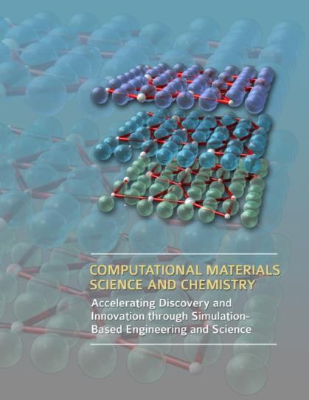
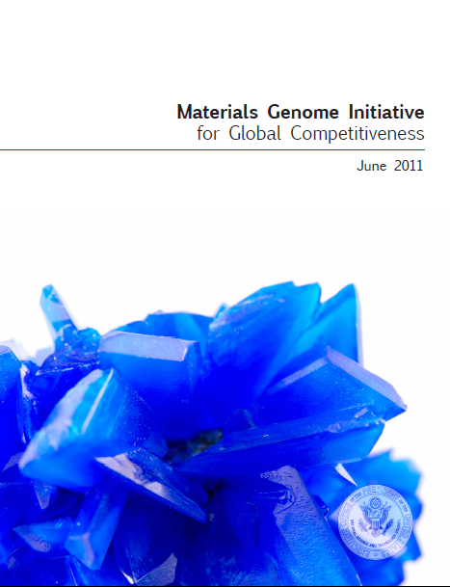
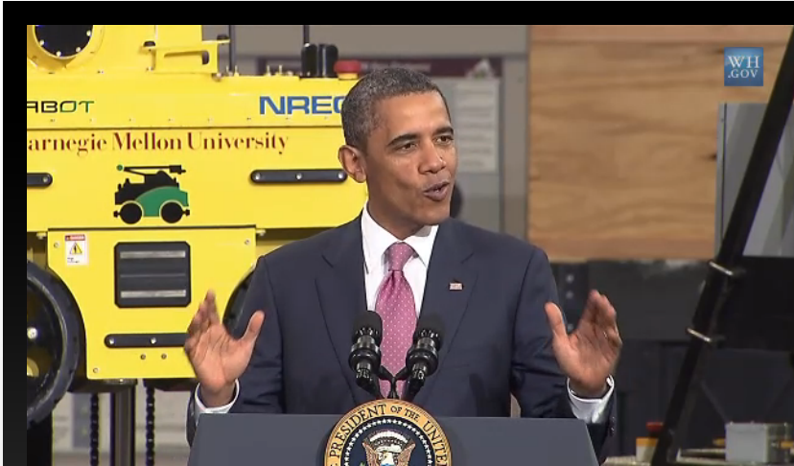
Materials & Chemistry by Design
Materials Genome Initiative
American Manufacturing
Joint BES-ASCR Workshop, July 2010
National Science and Technology Council,
Office of Science and Technology Policy
A Renaissance in American Manufacturing, President Obama Speech on June 24, 2011
“We are at the threshold of a new era where predictive modeling will transform our ability to design new materials and chemical processes, thereby enabling rational discovery strategies for systems that were not tractable a few years ago.”
The Materials Genome Initiative will create a new era of materials innovation that will serve as a foundation for strengthening domestic industries …and offers a unique opportunity for the United States to discover, develop, manufacture, and deploy advanced materials at least twice as fast as possible today, at a fraction of the cost.
President Obama kicks off the Advanced Manufacturing Partnership (AMP), a national collaboration between the government, industries, and universities to invest in cutting-edge technologies, create new jobs and bring about a renaissance in American manufacturing. As part of his new AMP, the President is announcing an ambitious plan, the Materials Genome Initiative, to double the speed with which we discover, develop, and manufacture new materials.
4

Slide 5
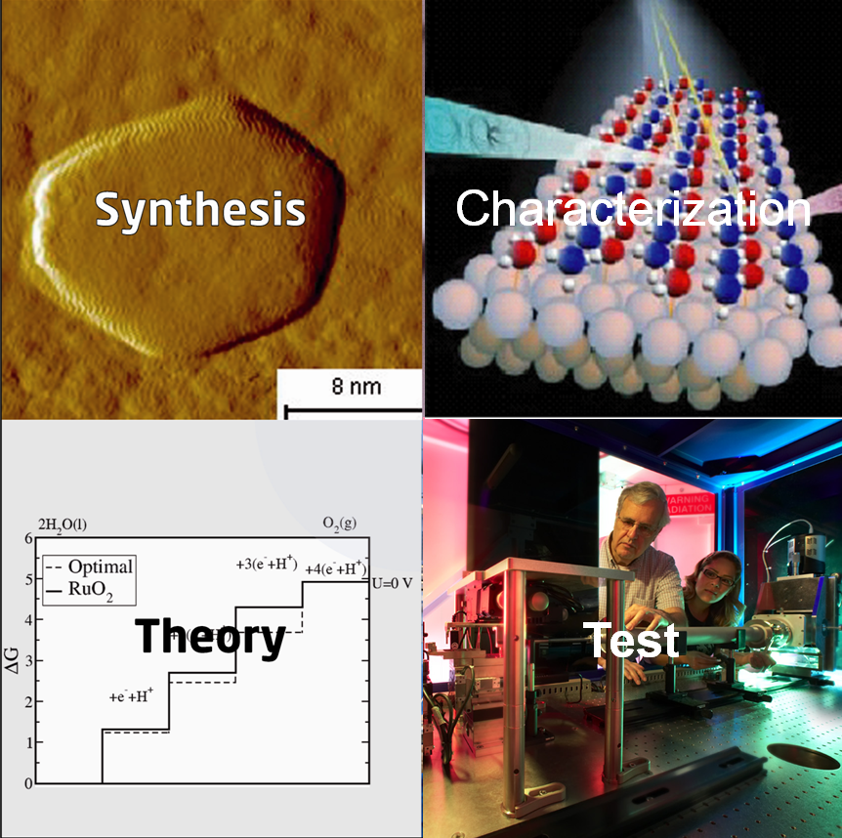
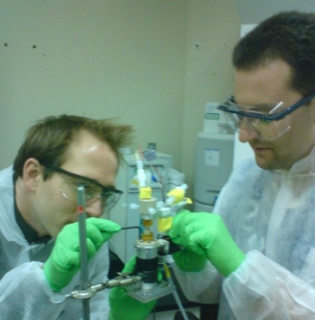
Expression of Interest Predictive Theory and Modeling for Materials and Chemical Sciences
Program Drivers
Experimentally validated theory & modeling paradigm for design
User-friendly software tools
Harness the power of modern experimental tools and techniques
Data standards, management and data-driven design strategies
Science Topics:
Excited states and dynamics
Electronic and ionic transport
Electron correlations
Multiple length and time scales
Novel approaches
Required preliminary applications are due on March 1
Funding Types:
Single investigator/Small group
Glue funding
Software innovation centers
http://science.energy.gov/bes/funding-opportunities/predictive-theory-and-modeling/

Slide 6
Outline
FY 2012 Appropriation
Program Highlights
FY 2013 Budget Request
BES Staffing
Upcoming Activities

Slide 7
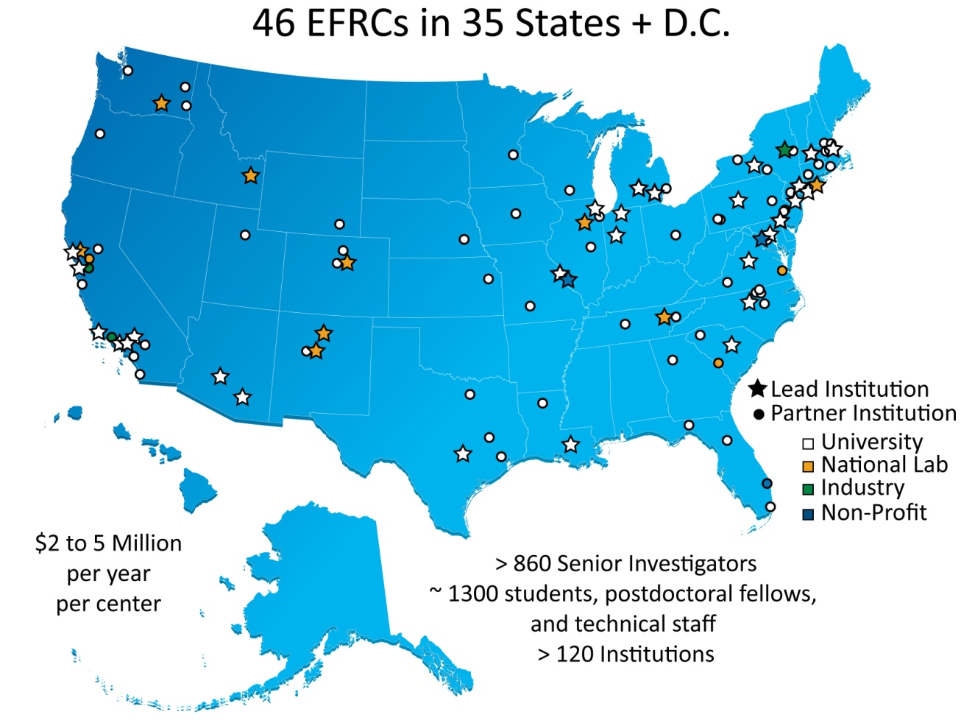
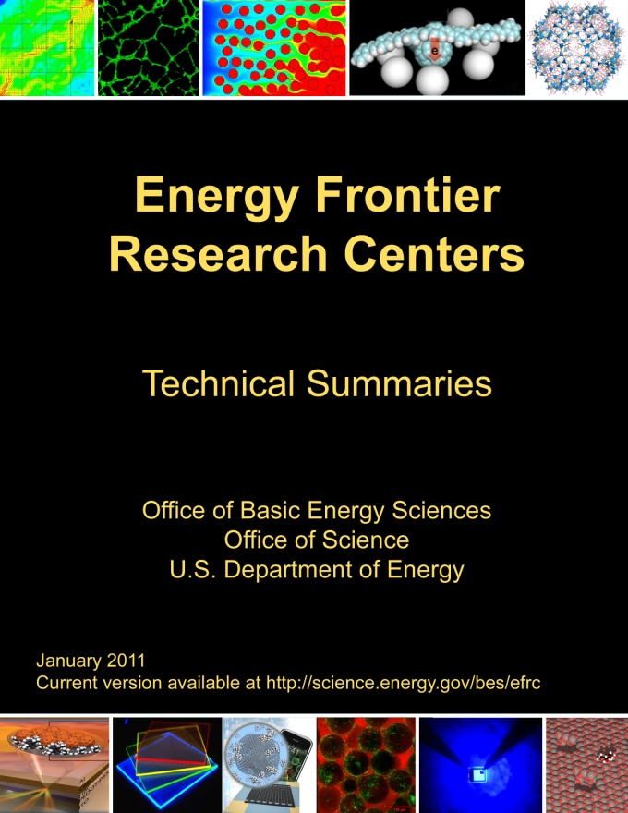
Energy Frontier Research Centers
46 EFRCs in 35 States were launched in Fall 2009
~860 senior investigators and ~2,000 students, postdoctoral fellows, and technical staff at ~115 institutions
> 250 scientific advisory board members from 12 countries and > 35 companies
Impact to date:
>1,000 peer-reviewed papers including more than 30 publications in Science and Nature.
> 40 patents applications and nearly 50 additional patent/invention disclosures by 28 of the EFRCs.
at least 3 start-up companies with EFRC contributions
Assessment of progress:
All EFRCs are undergoing mid-term peer review to assess progress towards goals and plans for the next 2 years of R&D.
http://science.energy.gov/bes/efrc/

Slide 8
FY 2012 EFRC Science Reviews
Dates and Location:
January – April 2012, the 3rd year of the 5-year award period
Off-site reviews clustered according to both topic and region
Science Review Process:
Comprehensive review addressing:
Strategic vision, scientific progress and plans, and technical accomplishments
Management—synergy that makes an EFRC “greater than the sum of its parts”
One full day of scientific presentations, posters, and small group discussions for each EFRC
Review by a panel of 3-4 expert peer reviewers with complementary email reviews if needed to ensure coverage of the technical breadth of the EFRC
EFRC participants: 12 to18 people including the EFRC Director(s), EFRC Leadership, and a mix of senior investigators, postdoctoral staff, and graduate students
Review feedback: verbatim reviewer comments and a guidance letter (BES comments, recommendations, and action items)
Review will be used by BES in making funding decisions.

Slide 9
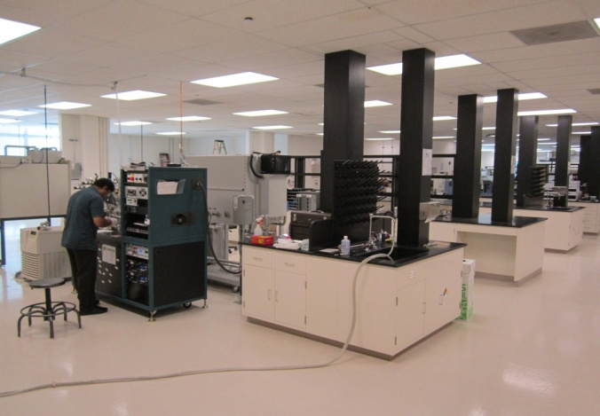
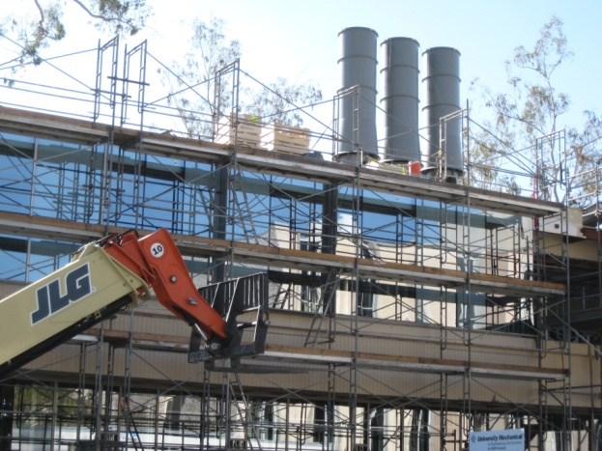
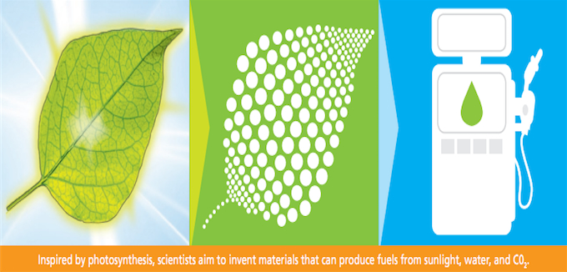

Fuels from Sunlight Hub: Project Update
Space:
The Joint Center for Artificial Photosynthesis (JCAP) North (LBNL) occupies 14,000 sq. ft. leased space.
JCAP South (Caltech) occupies temporary space; renovation of permanent space complete May 2012.
Staffing: Staffing ongoing at all levels (senior staff, postdocs, students).
Equipment: Equipment acquisitions on schedule.
Output: Several scientific publications and invention disclosures.
Oversight:
BES conducted a management/operations review of JCAP in April, 2011. JCAP on track with no major issues.
SC/BES will conduct an onsite scientific and technical review in spring 2012.
Collaboration:
JCAP hosted Artificial Photosynthesis Futures Meeting to formulate collaborations with EFRCs and demonstrate new lab capabilities at JCAP North.
JCAP North main lab
JCAP South (Jorgensen Hall) under renovation

Slide 10
Batteries and Energy Storage Energy Innovation Hub Transform the Grid and Electrify Transportation
$20M in FY 2012 funding was appropriated for the Batteries and Energy Storage Hub
$25M is requested in FY 2013 for the second year of funding
A 5-year award is anticipated in response to the Funding Opportunity Announcement that opened on February 1
Letters of Intent are due on March 1
Full proposals are due on May 31
Decision and award prior to the end of FY 2012
The Hub will develop electrochemical energy storage systems that safely approach theoretical energy and power densities with very high cycle life – and have the potential for economic and fundamentally new manufacturing
These are systemic challenges requiring new materials, systems, innovative engineering, and enhanced scientific knowledge
The Hub will link fundamental science, technology, and end-users, and it will collaborate with relevant BES, Energy Frontier Research Centers, ARPA-E EERE, and OE activities
10

Slide 11


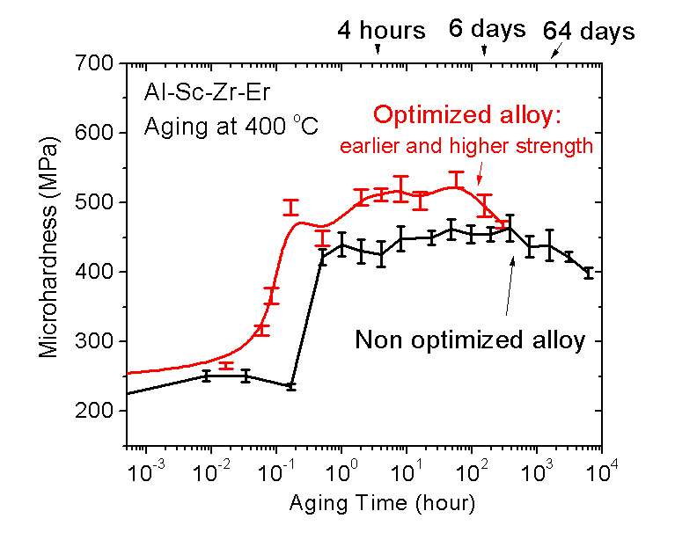
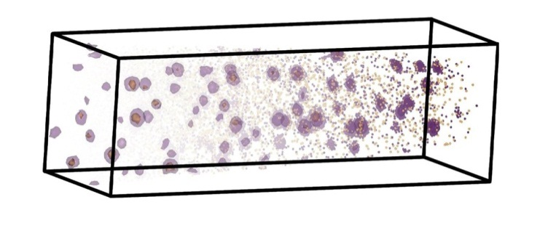


New Aluminum Alloys for Energy-Efficient Transportation: from Fundamental Research to Cars and Planes
Basic Science
Applied R&D
Manufacturing/
Commercialization
Ford and Boeing jointly sponsored applied research at NU to optimize the alloys for energy-efficient airplanes and cars, building on DOE-BES funding.
Properties optimized include strength and resistance to aging at high temperature, manufacturability, and cost. The new alloys can operate at twice the temperature of commercial alloys.
New aluminum alloy will be cast into brake rotors and replace much heavier cast-iron rotors, helping Ford improve mileage of its cars.
Northwestern University (NU) developed nano-scale precipitates in aluminum, using trace amounts of highly potent, exotic alloying elements: scandium, zirconium, lithium and rare earths (RE).
Information from atomic tomography allows tailoring of precipitate size, spacing, composition and structure, optimizing their strengthening effect and aging resistance.
Al
matrix
New aluminum alloy may be used to replace titanium in elevated temperature applications, such as heat shields.
RE core
Sc shell
300 nm

Slide 12
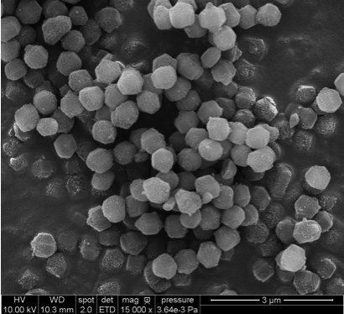
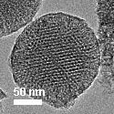
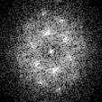

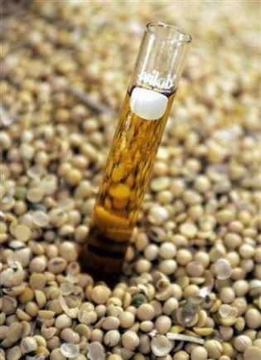
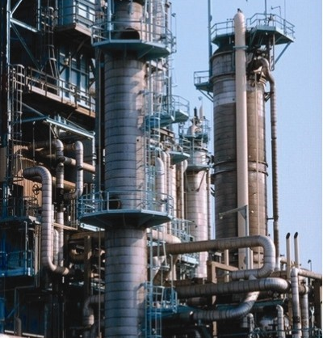
Rational Catalyst Design for Cost Effective Biodiesel Production
Basic Science
Applied R&D
Manufacturing/
Commercialization
Biodiesel is produced from vegetable and algal oils via transesterification, which is commercially catalyzed by a strong base.
In 2007 the technology’s commercial value attracted investor capital and Catilin, Inc. was born. Scale-up synthesis and pilot-plant demonstration was funded by EERE. In May 2011, Albemarle Corp. acquired Catilin, making the catalyst available as GoBio^{tm} T300.
Discovery that co-locating catalysts and substrates in confined spaces greatly increases reaction rates leads to a new series of bi-functional mixed metal oxide materials for cooperative catalysis. One was identified as having both basic and acidic sites making it ideal for biodiesel production.
Current catalysts require pure feedstocks, and high temperature and pressure, making them unsuitable. EERE-supported work demonstrated that the new catalyst can make biodiesel from broader spectrum feedstocks and works even in the presence of impurities, such as acids and metals.
12

Slide 13
BES User Facilities Hosted Over 14,000 Users in FY 2011
More than 300 companies from various sectors of the manufacturing, chemical, and pharmaceutical industries conducted research at BES scientific user facilities. Over 30 companies were Fortune 500 companies.

Slide 14




DOE Light Sources Spur New Small Companies
The technologies and know-how developed at DOE light sources serve as the seeds for new companies located across the U.S.
Research and development activities at DOE light sources create a great variety of opportunities for commercial ventures, including the foundation of new start-up companies. These start-ups create thousands of jobs and give advanced technologies a foothold in the commercial market.
Such spin-off companies include Xradia (imaging products), InSync (custom high-tech mirrors), ADSC (CCD detectors) and XIA (detector electronics).
Impact: DOE light sources give rise to small businesses, create jobs.

Slide 15
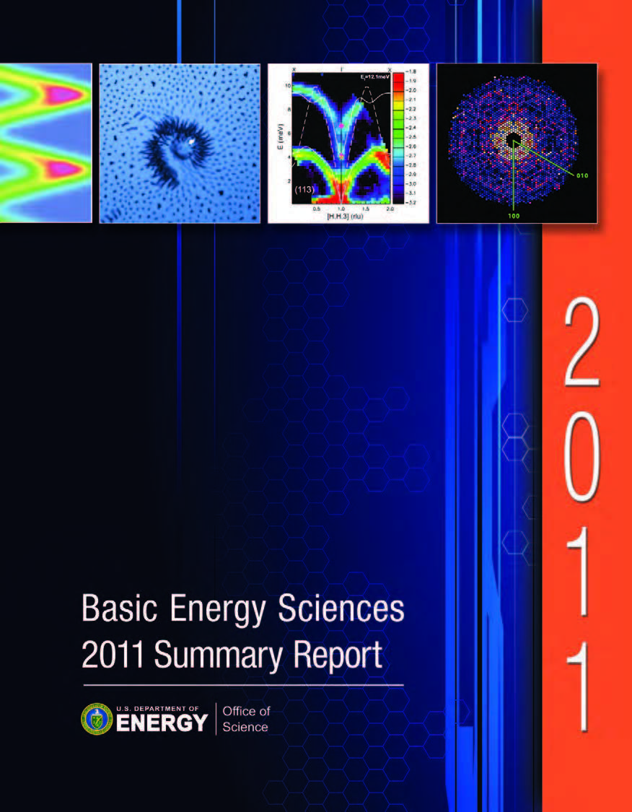
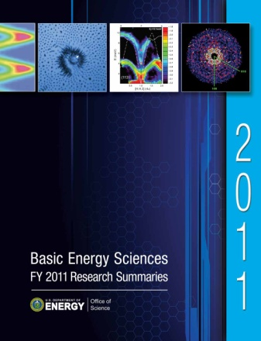
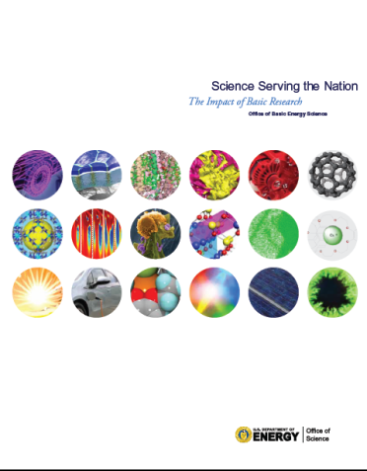
BES Publications for Improved Communication
BES 2011 Summary Report
http://science.energy.gov/bes/research/
Overview of BES
How BES does business
Descriptions and representative research highlights for 3 BES divisions, EFRCs, and Energy Innovation Hubs
BES FY 2011 Research Summaries
http://science.energy.gov/bes/research/
Summaries of more than 1300 research projects across 3 BES divisions, including senior investigators, postdocs, graduate and undergraduate students, and a brief project description
Science Serving the Nation (brochure)
Coming soon!
Brief vignettes describing the impact of BES funded research on scientific innovation and its impact on end-use technology
Draft

Slide 16
Outline
FY 2012 Appropriation
Program Highlights
FY 2013 Budget Request
BES Staffing
Upcoming Activities

Slide 17
FY 2013 BES Budget Request
Research programs
Energy Innovation Hubs (+$5M)
Energy Frontier Research Centers
Joint EERE R&D (+$20M)
Core Research
Materials and Chemistry by Design (+$20M)
Science for Clean Energy (+$42M)
Scientific user facilities operations
Near optimum operations of all facilities (+$42M)
Synchrotron light sources
Neutron scattering facilities
Nanoscale Science Research Centers
Instrumentation for clean energy, joint with EERE (+$15M)
NSLS-II Early Operations (+$22M)
FY 2013 Request: $1,799.6M, +$111M
SUF Research
27
SBIR/STTR & GPP
51
Hubs 48
Const, OPC, MIE
NSRCs 114
EFRC
120
167
Neutron Sources
258
Facilities
Ops
810
CSGB
Research
260
Light Sources
439
MSE
Research
316
Construction and instrumentation
National Synchrotron Light Source-II
NSLS-II instrumentation (NEXT) ($12M)
Advanced Photon Source upgrade ($20M)
Linac Coherent Light Source-II ($64M)
17

Slide 18
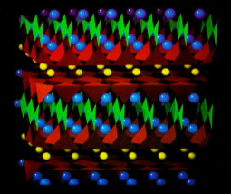
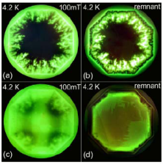
Science for Clean Energy: Nanoscale to Mesoscale Sciences
Developing the next generation of materials, chemicals, and game-changing processes—understanding structure, properties, and function from atoms and molecules, through the nanoscale, and to the mesoscale (+$42M).
Research will enable science-based chemical and materials design and manufacturing in, for example:
direct conversion of solar energy to fuels
generation of electricity from clean energy sources
storage and transmission of electrical energy
carbon capture, utilization, and sequestration
the efficient use of energy
Collaboration with the Office of Energy Efficiency and Renewable Energy will accelerate the transition of scientific discoveries into prototype clean energy technologies (+$20M).
First determination of the structure of the high Tc super-conductor YBa₂Cu₃O_{7-x} determined using neutron scattering.
Magneto-optical images of superconducting films
Fabricated industrial wires of MgB₂ superconductors used in MRIs and commercial magnets.

Slide 19
Jointly Funded R&D for Clean Energy
R&D jointly funded by the Office of Science (SC) and the Office of Energy Efficiency and Renewable Energy (EERE) will focus on a clean energy agenda (+$35M in each program).
EERE Strategic Programs. +$25M for R&D to accelerate the transition of novel scientific discoveries into innovative, clean energy technologies. This funding is to be prioritized for university, laboratory, and small business competitive R&D awards to study underlying physical challenges related to clean energy technologies and to design and test next-generation clean energy devices. A further +$10M for joint solicitations is within individual program allocations in EERE for improved coordination of energy-related research across the Department.
SC Basic Energy Sciences. Equivalent levels of funding will support the fundamental science portions of the joint R&D to enable discoveries for innovative clean energy technologies. The SC effort will leverage existing investments in clean energy sciences at Energy Frontier Research Centers (+$20M) and at SC user facilities (+$15M), such as light sources and Nanoscale Science Research Centers.

Slide 20
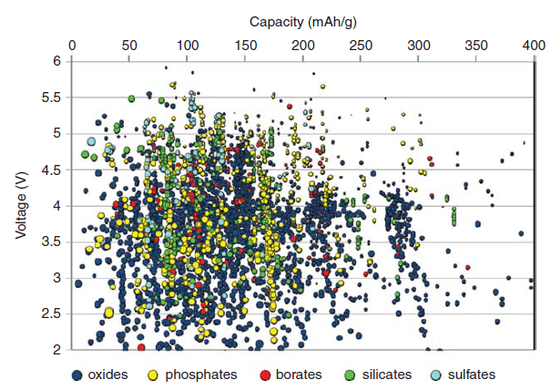
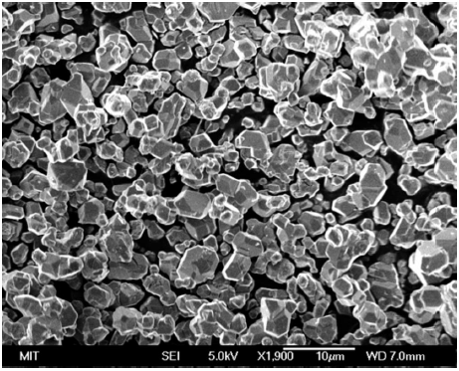

Materials and Chemistry by Design Accelerating Discovery for Global Competitiveness
Prediction: New battery materials starting from first principles theory
Research to establish design rules to launch an era of predictive modeling, changing the paradigm of materials discovery to rational design (+$20M).
New software tools and data standards to catalyze a fully integrated approach from material discovery to applications
Discovery of new materials has been the engine driving science frontiers and fueling technology innovations. Research would utilize the powerful suite of tools for materials synthesis, characterization, and simulation at DOE’s world-leading user facilities
Integrated teams to focus on key scientific knowledge gaps to develop new theoretical models
Long-term: realization in reusable and broadly-disseminated software
Collection of validated experimental and modeling data for broader community use
Validation:
Materials fabrication
Test
http://materialsproject.org/
End Use: Software on-line for general community use

Slide 21
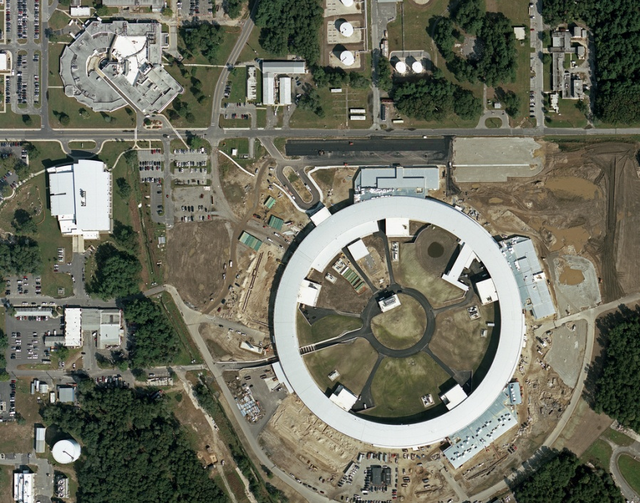
Maintaining World Leadership in Light Sources
National Synchrotron Light Source-II, 67% Complete
Highly optimized x-ray synchrotron:
exceptional brightness and beam stability
suite of advanced instruments, optics, and detectors that capitalize on these capabilities
Capabilities:
~ 1 nm spatial resolution
~ 0.1 meV energy resolution
single atom sensitivity
FY 2012 $159M, FY 2013 Request $72M
NSLS
NSLS-II
Aug 2005 CD-0, Approve Mission Need (Complete)
Jul 2007 CD-1, Approve Alternative Selection and Cost Range (Complete)
Jan 2008 CD-2, Approve Performance Baseline (Complete)
Jan 2009 CD-3, Approve Start of Construction (Complete)
Feb 2009 Contract Award for Ring Building (Complete)
Aug 2009 Contract Award for Storage Ring Magnets (Complete)
May 2010 Contract Award for Booster System (Complete)
Mar 2011 1st Pentant Bldg Beneficial Occ; Start Accel Installation (Complete)
Feb 2012 Beneficial Occupancy of Experimental Floor
Apr 2012 Start LINAC Commissioning
Oct 2012 Start Booster Commissioning
May 2013 Start Storage Ring Commissioning
Jun 2015 CD-4, Approve Start of Operations
21

Slide 22
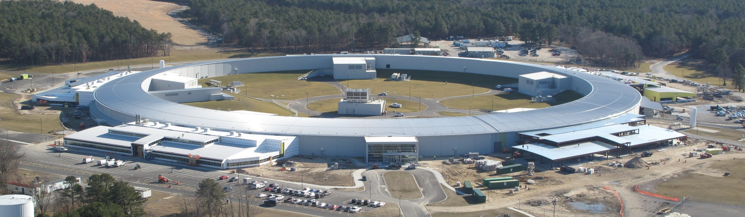
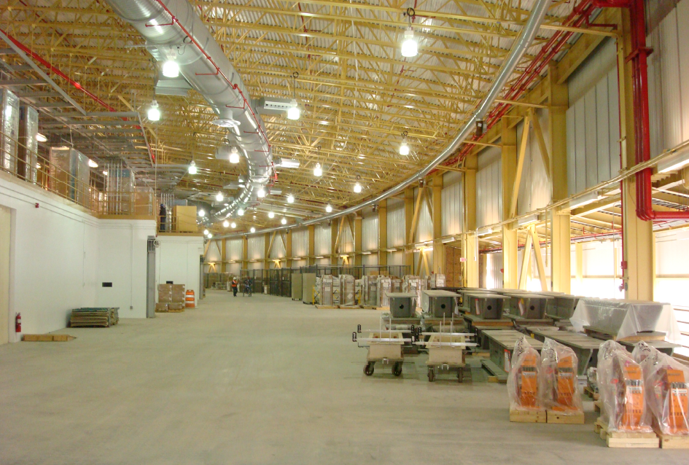
Conventional Facilities Status
Photo From 2-3-12
Ring Bldg essentially complete
Expect BO of final pentant week of Feb 13
Ring Bldg paving complete
Ring Bldg site grading & seeding nearly complete (needs touch-up in spring)
LOB concrete & steel complete
LOB envelope & interior fit-out underway
On-track to complete LOBs 1-3 by July and LOBs 4-5 by Dec
Pentant 3
Girders & Components ready for Integration

Slide 23
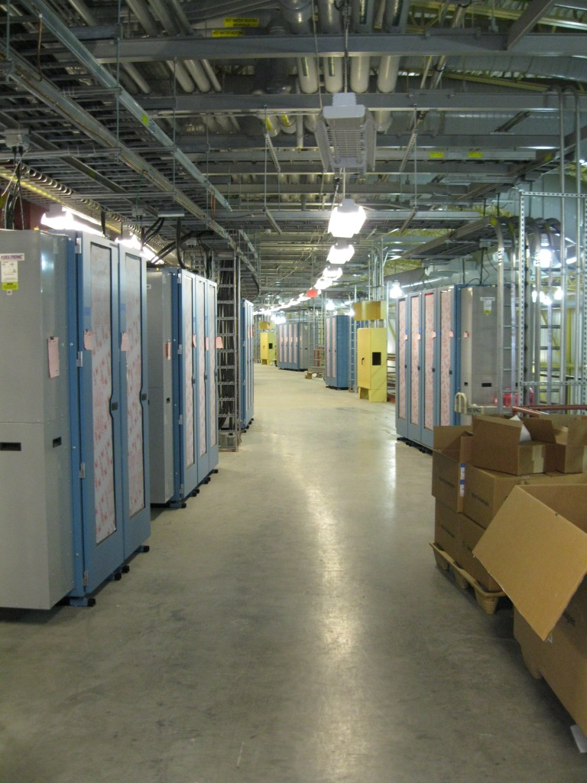
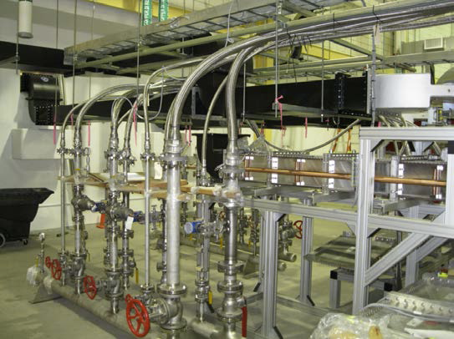
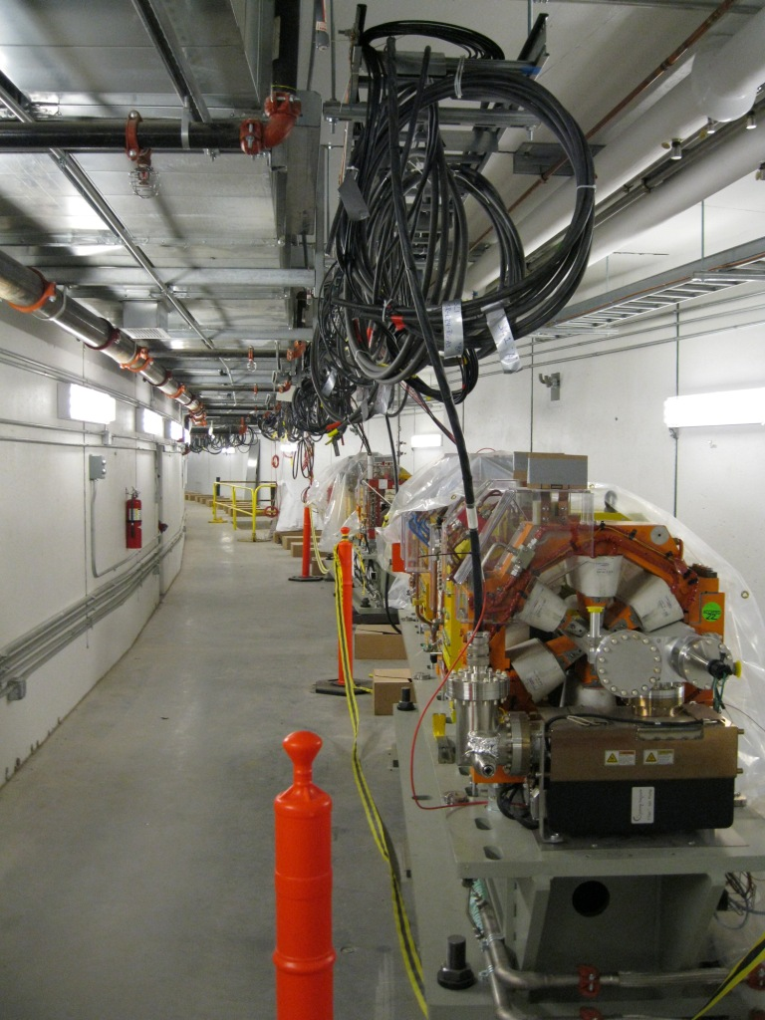
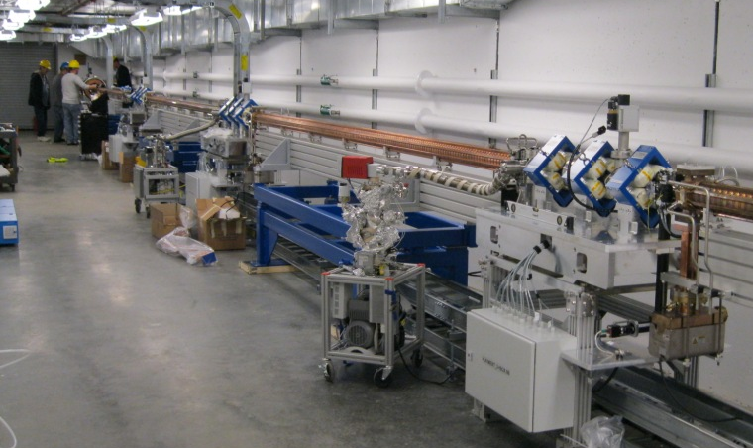
Accelerator Systems Installation Progress
RF
Electrical Mezzanine in Pentant 1
Storage Ring in Pentant 1
LINAC
23

Slide 24
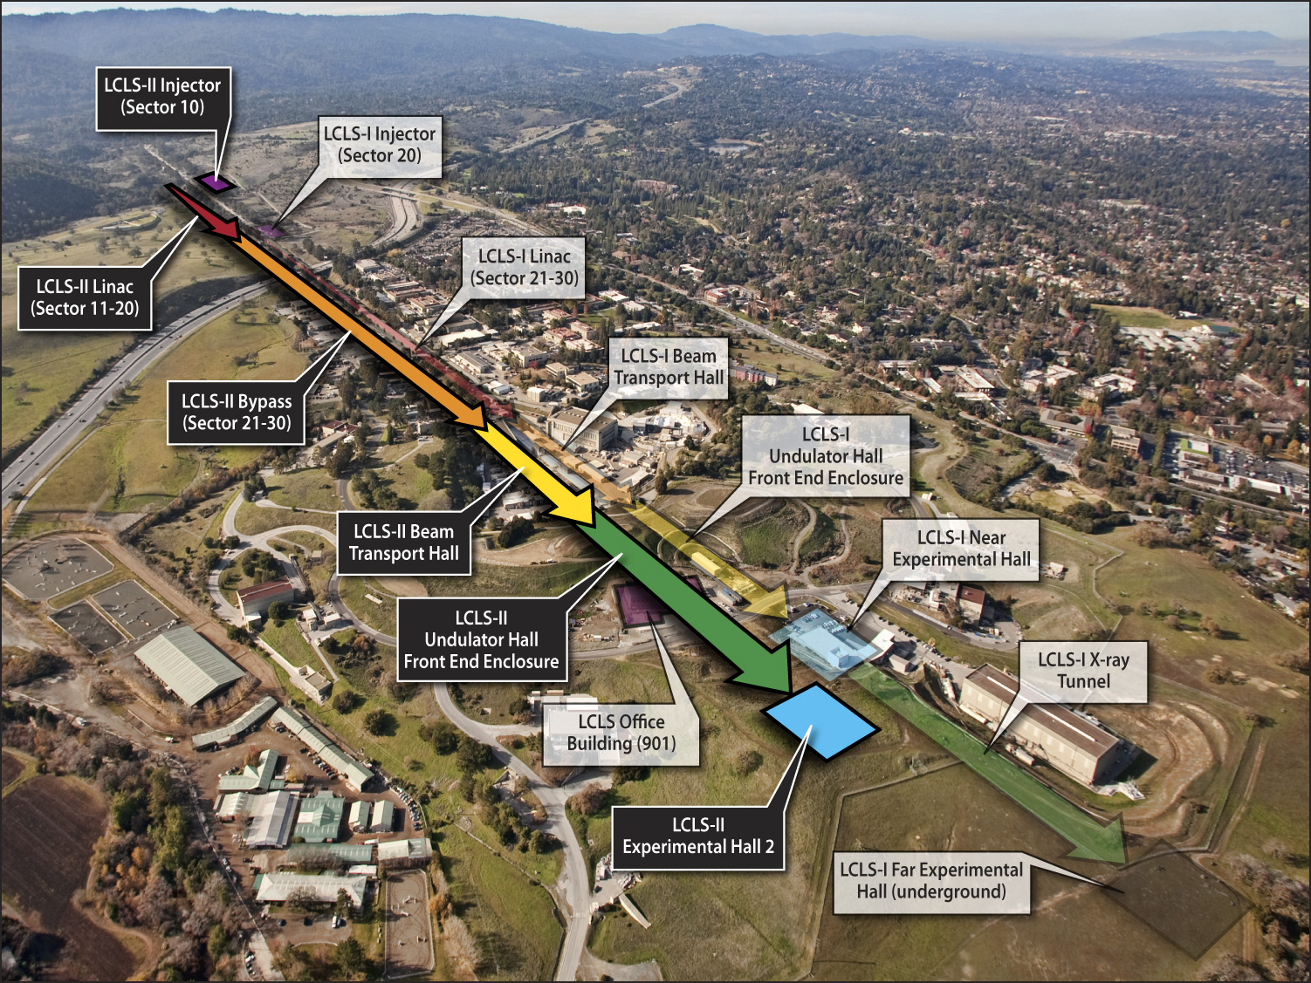
Linac Coherent Light Source-II
Expansion of Highly Successful LCLS:
New experimental hall with room for 4 experimental stations, nearly doubling capacity
Simultaneous operation of experimental stations
Enables US to remain at international forefront for XFEL science
Capabilities:
Expanded x-ray energy range (250eV – 13keV)
X-ray polarization control
Control pulse length down to ~1 femtosecond
Multiple, independently controlled x-ray beams
Factor of 20 increase in intensity
CD-1 Cost Range: $350M - $500M (Line Item Construction); FY 2012 $30M, FY 2013 Request $64M for R&D, design, long lead procurement, and construction
Apr 2010 CD-0, Approve Mission Need (Complete)
Oct 2011 CD-1, Approve Alternative Selection and Cost Range (Complete)
Mar 2012 CD-3a, Approve Long Lead Procurements
Jan 2013 CD-2, Approve Performance Baseline
Jun 2013 CD-3b, Approve Start of Construction
Sep 2019 CD-4, Approve Start of Operations
24

Slide 25
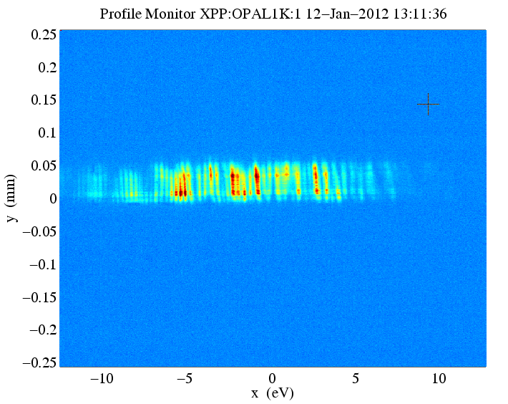
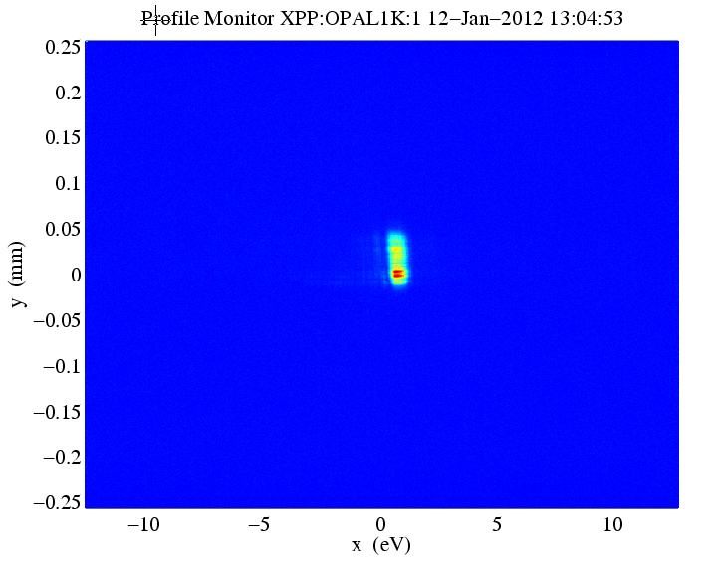
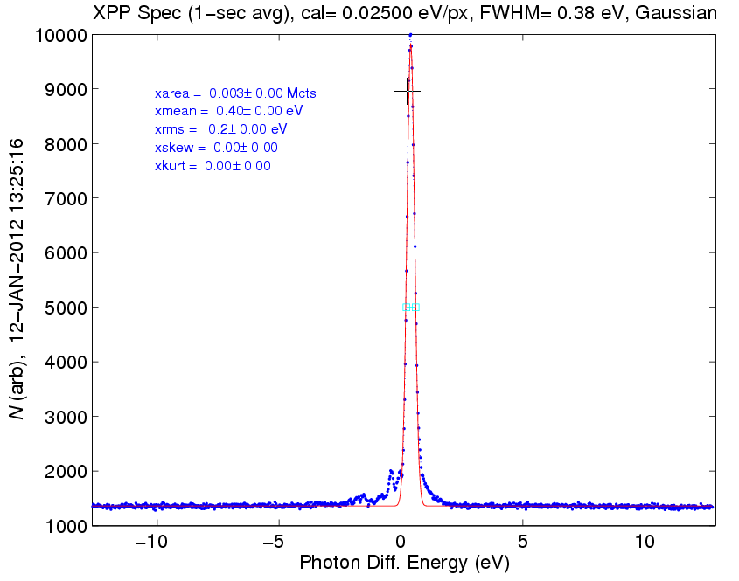
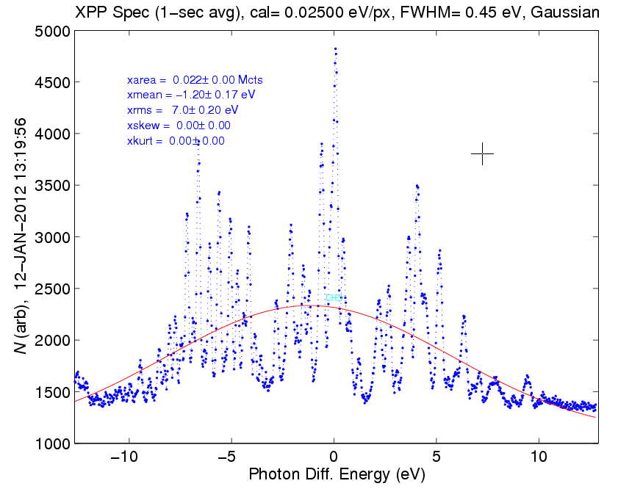



First Demonstration of Hard X-ray Self Seeding at LCLS: Enhanced Coherence
Concept developed by Geloni, Kocharyan and Saldin, DESY 10-053 (2010).
The mean seeded FEL power is 8 GW with a 2.5 GW SASE background at 8 keV for 40 pC bunch charge.
Peak seeded power is in excess of 15 GW, comparable to SASE but with a spectral bandwidth reduction by the factor of 40.
Next steps include system optimization of the LCLS undulator beamline including additional undulators which should increase seeded power and reduce intensity fluctuation.
SASE FEL spectrum
Seeded FEL spectrum
~ 20 eV
~ 0.5 eV
Near Fourier Transform limit
SASE and Seeded spectra recorded on single shots. The left panels are SASE with 150 pC, 3kA peak current, un-seeded. The FWHM of the SASE spectrum is 0.2 % Bandwidth. The right panels are the seeded beam with the same electron beam parameters. The FWHM of the seeded beam is 0.5 eV (5x10⁻⁵ bandwidth)
SLAC-Argonne-TISNCM Collaboration

Slide 26
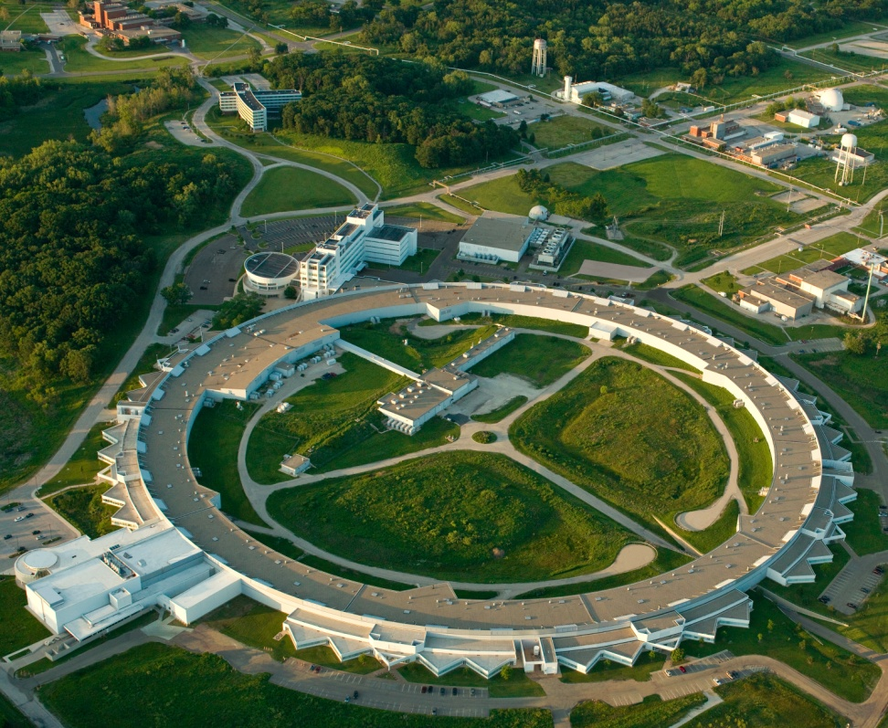
Advanced Photon Source Upgrade (APS-U)
3rd Generation Hard X-ray Light Source:
Provides an unprecedented combination of high-energy, high-average-brilliance, and short-pulse x-rays together with state of the art x-ray beamline instrumentation
Capabilities:
Temporal resolution to 1 picosecond
Spatial resolution to <1 nm above 25keV
Conceptual Scope:
Accelerator and x-ray source upgrades
New and upgraded beamlines
Enabling technical capabilities
CD-1 Cost Range: $310M - $450M (Major Item of Equipment)
FY 2012 $20M, FY 2013 Request $20M for R&D, design, and long lead procurement
Apr 2010 CD-0, Approve Mission Need (Complete)
Sep 2011 CD-1, Approve Alternative Selection and Cost Range (Complete) Dec 2012 CD-2, Approve Performance Baseline
Dec 2012 CD-3a, Approve Long Lead Procurements
Dec 2014 CD-3b, Approve Start of Construction
Sep 2019 CD-4, Approve Start of Operations

Slide 27
NSLS-II Experimental Tools (NEXT)
Provide scientific instruments for NSLS-II:
Enhance NSLS-II with 4 to 6 best-in-class beamlines
Beamlines chosen from peer reviewed proposals
Beamlines will support 300-400 users per year
Capabilities:
Electron SpectroMicroscopy (ESM)
Full-field X-ray Imaging (FXI)
Integrated In-Situ and Resonant X-ray Studies (ISR)
Inner Shell Spectroscopy (ISS)
Soft Inelastic X-ray Scattering (SIX)
Soft Matter Interfaces (SMI)
CD-1 Cost Range: $83M - $90M (Major Item of Equipment)
FY 2012 $12M, FY 2013 Request $12M for R&D, design, long lead procurement, and construction
May 2010 CD-0, Approve Mission Need (Complete)
Dec 2011 CD-1, Approve Alternative Selection and Cost Range (Complete)
Jun 2012 CD-2, Approve Performance Baseline
Jun 2012 CD-3a, Approve Long Lead Procurements
Jan 2013 CD-3b, Approve Start of Construction
Jun 2016 CD-4, Approve Start of Operations

Slide 28
History of BES Request vs. Appropriation

Slide 29
Outline
FY 2012 Appropriation
Program Highlights
FY 2013 Budget Request
BES Staffing Update
Upcoming Activities

Slide 30
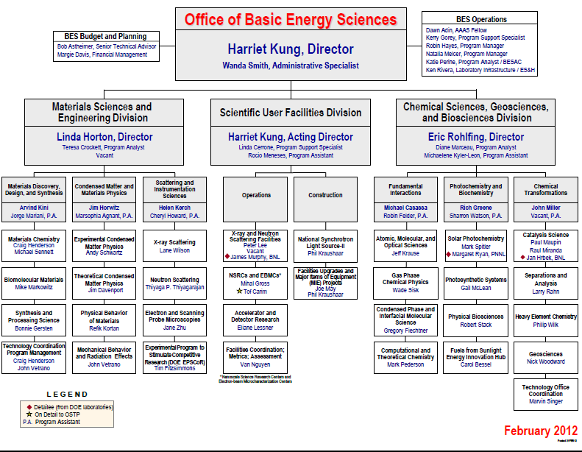
New
Vacancy

Slide 31
Outline
FY 2012 Appropriation
Program Highlights
FY 2013 Budget Request
BES Staffing
Upcoming Activities

Slide 32
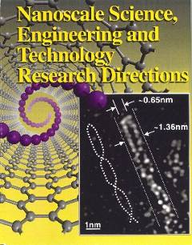
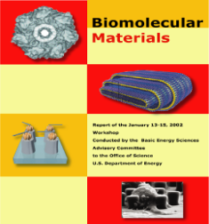

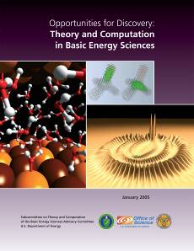
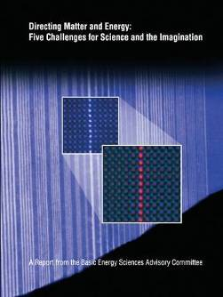
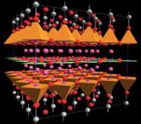

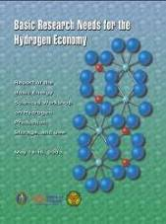



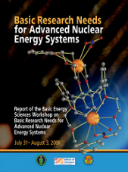

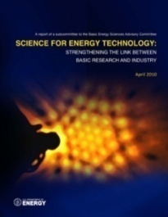
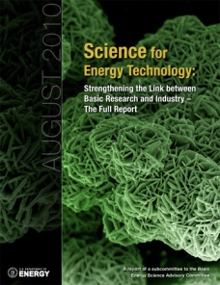
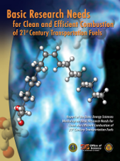
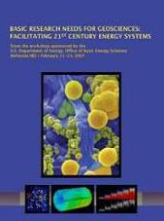

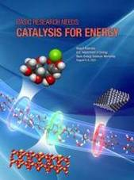















BES Strategic Planning Activities
Science for Discovery
Mesoscale Science
Complex
Systems
Science for National Needs
National Scientific User Facilities, the 21st century tools of science
Detector R&D
Notes:
32

