Slide 1
Takeaways from yesterday
Quantum to the continuum is the key theme
Mesoscale is a frontier for control science
Emphasize what is new/why now
Lead by specific examples through the community

Slide 2
Quantum to the Continuum:
Opportunities for Mesoscale Science
George Crabtree
ANL/UIC
John Sarrao
LANL

Slide 3


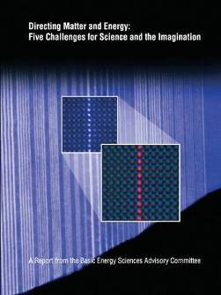
Background
Why: the need for innovation, as articulated in Science for Energy Technology
Why now: the insights and tools we’ve gained (and are still gaining) from nanoscience, as articulated in New Science for a Secure and Sustainable Energy Future
What: build on basic science challenges, as articulated in Directing Matter and Energy: Five Challenges for Science and the Imagination
3

Slide 4
What is Meso?

Slide 5
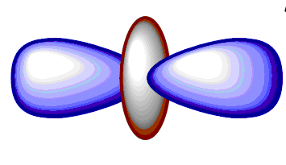
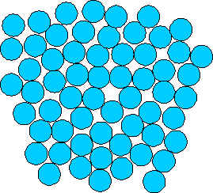

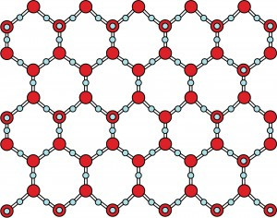
What is Meso?
from the Greek
In between, intermediate, middle
Relative, not absolute
meso
classical
quantum
isolated
interacting
simple
complex
Focus on structure, dynamics, and function

Slide 6
What is Meso? An Opportunity Space
Multiple degrees of freedom interact constructively
  Complexity enables new phenomena and functionality
  Consilience of systems and architectures
  Biology: an inspiration and proof of principle
    Biological complexity with inorganic materials
Multiple spatial, temporal and energy scales meet
  Quantum meets classical
  Top-down meets bottom-up
  Multi-scale dynamics essential for functionality
At the meso scale, new organizing principles are needed
  Meso embraces emergent as well as reductionist science
    What laws govern deterministic assembly?

Slide 7
Key Themes: Quantum to the Continuum
Defect Evolution and Damage Accumulation
Functional Mesoscale Systems
Reactive Transport in Mesoporous Media
Bio-inspired Assembly and Transduction
Notes:
This is long report, short report has only list of GC/PRDs and CrossCutting Tools, no Implementing/enabling mesoscience, as in SciTech

Slide 8
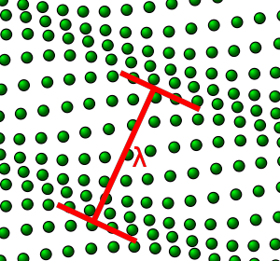
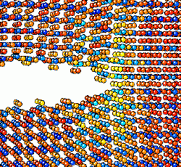
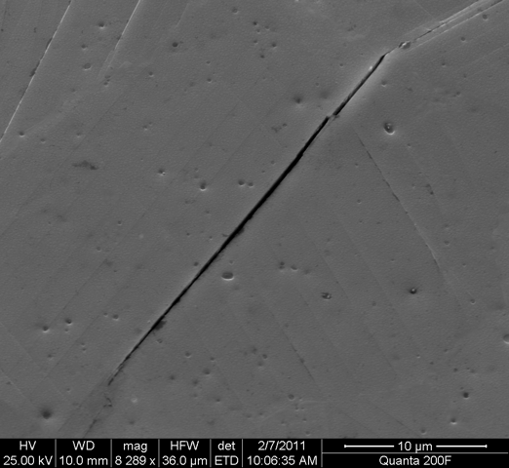
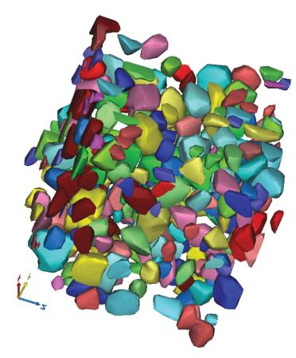

Defect Evolution and Damage Accumulation
Crack
Propagation
Deformation
3D Coherent
Imaging
Crack
Initiation
Failure
x-ray tomography

Slide 9
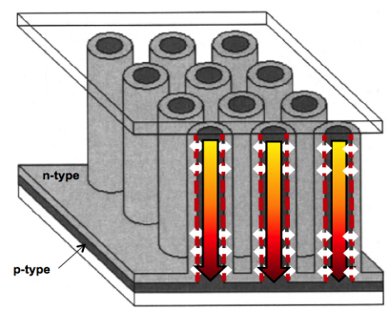
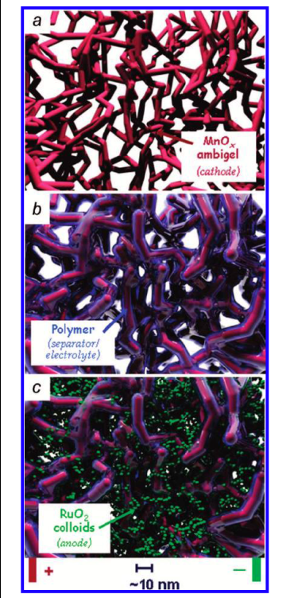
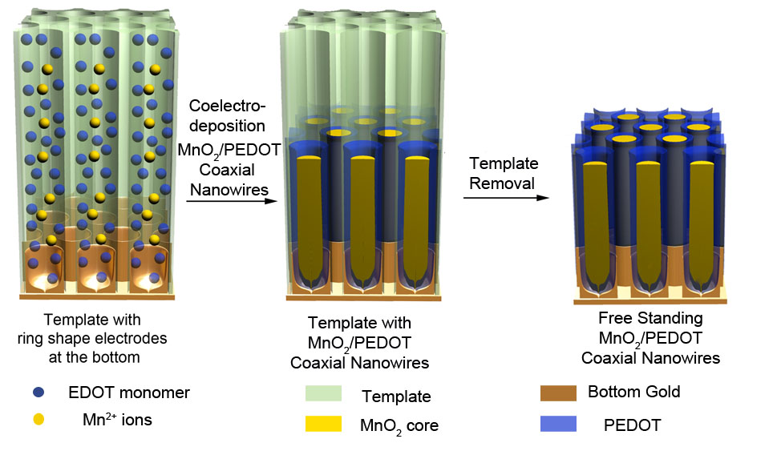
Functional Mesoscale Systems
Solar cell
Battery
Super capacitor
Phenomena
Ionization
Ion insertion/extraction
Electronic / ionic conduction
Volume expansion/contraction
Meso
Functionality
Energy storage
Energy delivery
Reversibility on demand
Degrees of freedom
Electronic
Ionic
Chemical
Mechanical

Slide 10
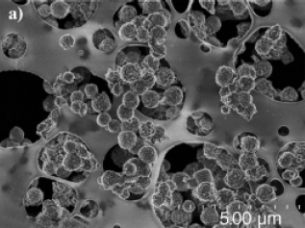
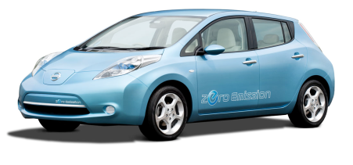
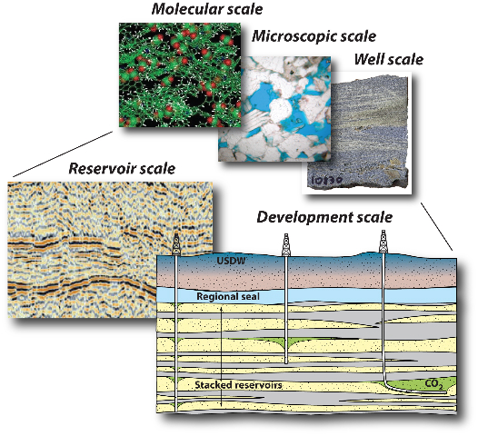
Reactive Transport in Mesoporous Systems
electrons
solid-electrolyte-interface
solid-electrolyte-interface
Li⁺ ions
cathode
electrolyte
anode
Li ion battery
CO₂ sequestration

Slide 11

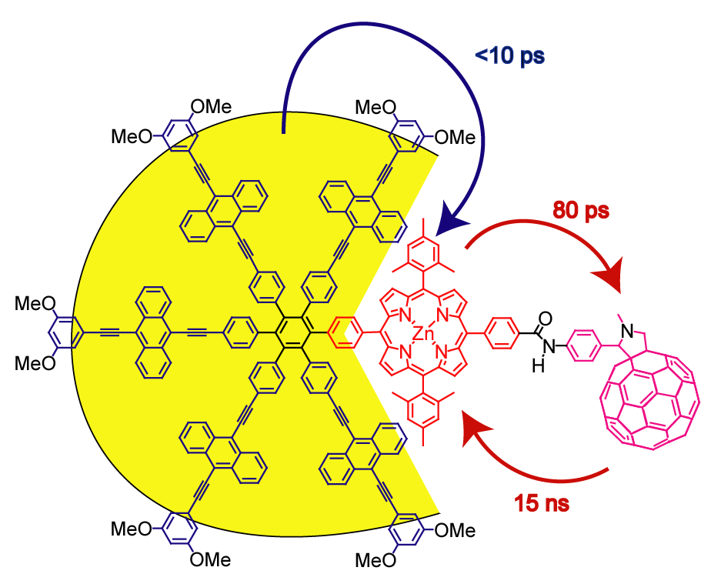
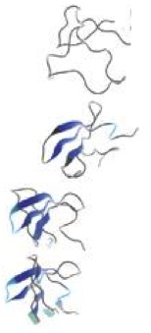
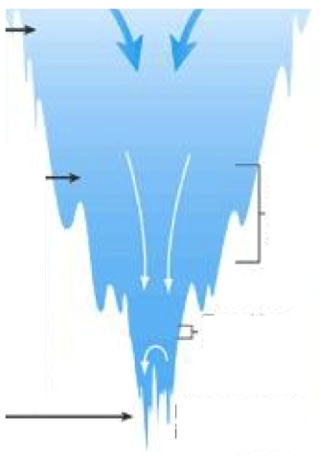
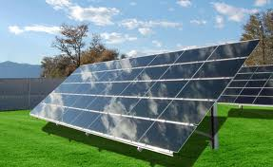
Bio-inspired Assembly and Transduction
Elements of Assembly
compositional
structural
functional unit
energy
connecting
functional units
architectural
light
electron
temporal
connecting
sequential steps
many interacting degrees of freedom
Unfolded
Intermediate
Native structure
Protein folding

Slide 12
Realizing the Meso Opportunity: Tools and Instruments
Mesoscale
Physics, Materials
and Chemistry
Synthesis
Theory
Simulation
Characterization
Notes:
integrates across synthesis, characterization, theory/simulation: new opportunities at the boundaries not previously emphasized
multiscale in time, space and interacting degrees of freedom ("complexity")
for characterization: multimodal, several simultaneous or sequential measurements needed to see interacting phenomena and scales
for synthesis: more complex systems with more interacting degrees of freedom (more elements, more complex architectures, more heterogeneity, more interfaces)
for theory/simulation: multiscale, more atoms, more architecture, more self-assembly, more dynamics

Slide 13
Mesoscale Tools and Instruments
Synthesis / Assembly
Directed synthesis of complex inorganic materials
Multi-step, multi-component assembly processes
Computational synthesis / assembly
Characterization
In situ, real time dynamic measurements:
4D materials science
Multi-modal experiments, e.g. structure + excitation + energy transfer
Multi-scale energy, time and space
Theory / Simulation
Far from equilibrium behavior
Heterogeneous/disordered systems
Dynamic functionality of composite systems
Cross-cutting Challenges
Co-design/integration of Synthesis ←→ Characterization ←→ Theory/Simulation
Directed Multi-step, multi-component assembly processes that scale
Multi-modal simultaneous and sequential measurements
  spanning energy, length & time scales
Predictive theories and simulation of dynamic functionality
13

Slide 14
Venues for Community Input: Town Halls and Website
APS Boston Wed Feb 29
Marc Kastner and William Barletta (MIT), hosts
ACS San Diego Tues Mar 27
John Hemminger, Douglas Tobias (UCI), hosts
MRS San Francisco Mon Apr 9
Cynthia Friend, Gordon Brown (Stanford/SLAC)
Don DePaolo, Paul Alivisatos (Berkeley/LBNL), hosts
ACS Webinar Thu April 12
John Hemminger, Douglas Tobias (UCI), hosts
Meso2012.com

