Slide 1
Meso Outreach and Community Input:
A status report
John Sarrao
LANL
George Crabtree
ANL/UIC
Meso2012.com
Priority Research Directions
Realizing the Meso Opportunity

Slide 2
Venues for Community Input: Town Halls and Website
APS Boston Wed Feb 29
Marc Kastner and William Barletta (MIT), hosts
MRS San Francisco Mon Apr 9
Cynthia Friend, Gordon Brown (Stanford/SLAC)
Don DePaolo, Paul Alivisatos (Berkeley/LBNL), hosts
ACS Webinar Thu April 12
John Hemminger, Douglas Tobias (UCI), hosts
Chicago middle May
Meso2012.com

Slide 3
Priority Directions/Key Themes*
Damage Accumulation and Materials Lifetime
Functional Mesoscale Systems
Catalysis at the Mesoscale
Reactive Transport Through Mesoporous Media
Self and Guided Assembly in Biology
Role of Fluctuations in Formulating Organizing Principles in Mesoscale Systems
*Representative input to date
Notes:
This is long report, short report has only list of GC/PRDs and CrossCutting Tools, no Implementing/enabling mesoscience, as in SciTech

Slide 4
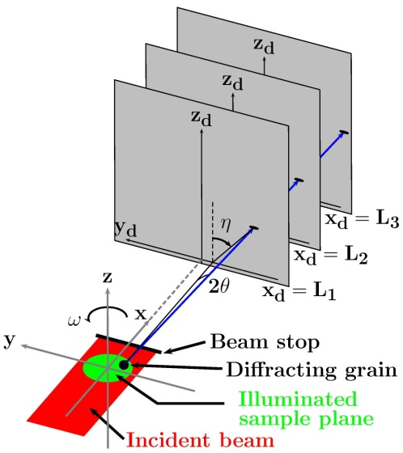
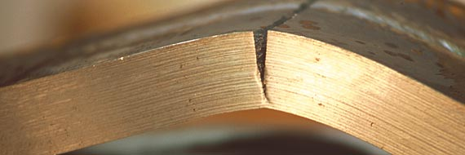
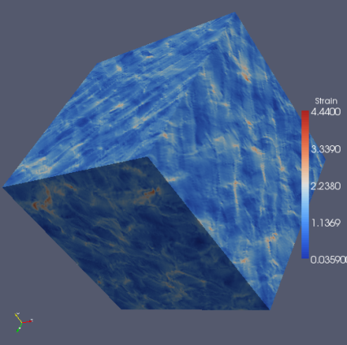
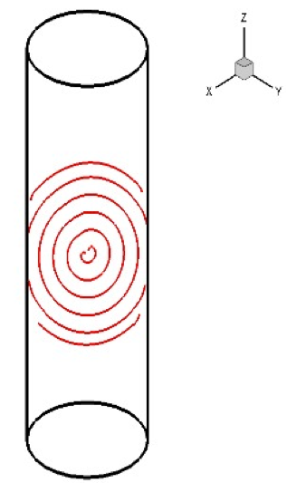
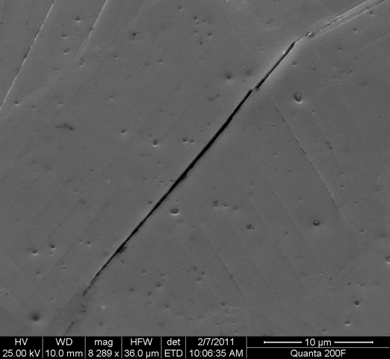
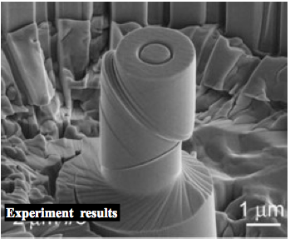
Damage Accumulation and Materials Lifetime
Continuum Models ➡
Hot Spots
Adv. Photon Source
Damage
Mesoscale Crack
Dislocation flow, aggregation

Slide 5
Damage Accumulation and Materials Lifetime
Opportunity
Approach
Most structural materials are limited by damage accumulation
  Examples: gas turbine engines, bridges, automobiles, planes, medical devices
The key defect is the dislocation
Collective behavior of dislocations is key to crack or void formation
Difficult to identify and understand mechanisms
Defects can evolve dynamically
  Predict the performance of new materials & structures at the mesoscale
New 3-D mesoscale microscopies
  Synchrotron orientation mapping, computed tomography ...
Large-scale computation at multiple levels, e.g. dislocation dynamics, microstructurally accurate deformation simulations
New science for models of collective behavior of defects, e.g. stat. mech. of dislocations, relationship to mechanical behavior
Exploit statistical approaches to understand large data sets while exploiting our knowledge of mechanisms
Meso Challenge
Impact
Systems are typically dynamic and aggregated (often massively)
“Functional” defects and their evolution (reliability) limit value of nano/meso scale systems
How can we identify, locate, and characterize the collective behavior of defects?
How can we correlate and recognize mechanisms (process, structure) that cause the damage initiation?
Can we optimize materials to postpone damage initiation?
Defects are the prime limitation on lifetime for both established and new materials
Identifying and understanding defects in mesosystems drives advances in instrumentation and facilities
Stimulate a focus on defects-process-structure-properties paradigm
Improved materials, new materials for transportation, energy, medical applications
Rollett

Slide 6
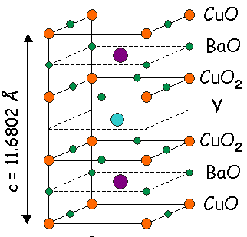
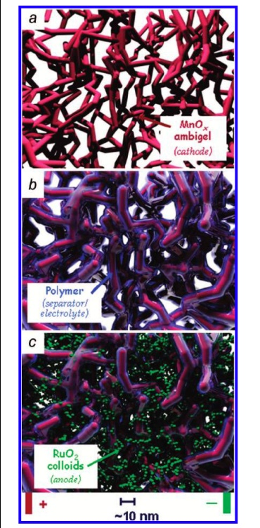
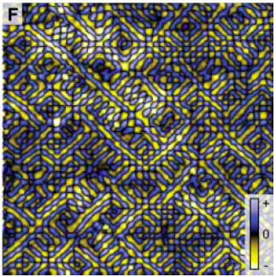
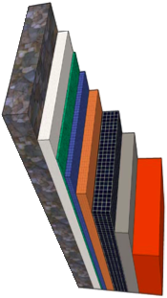

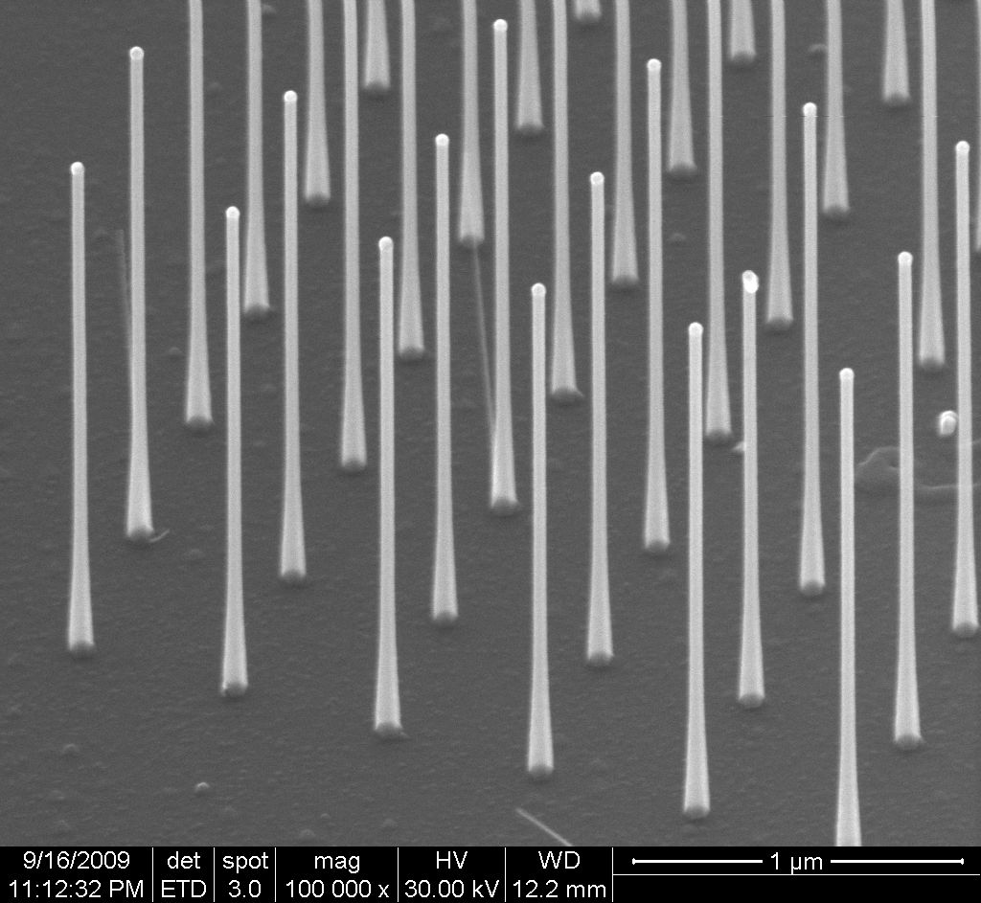
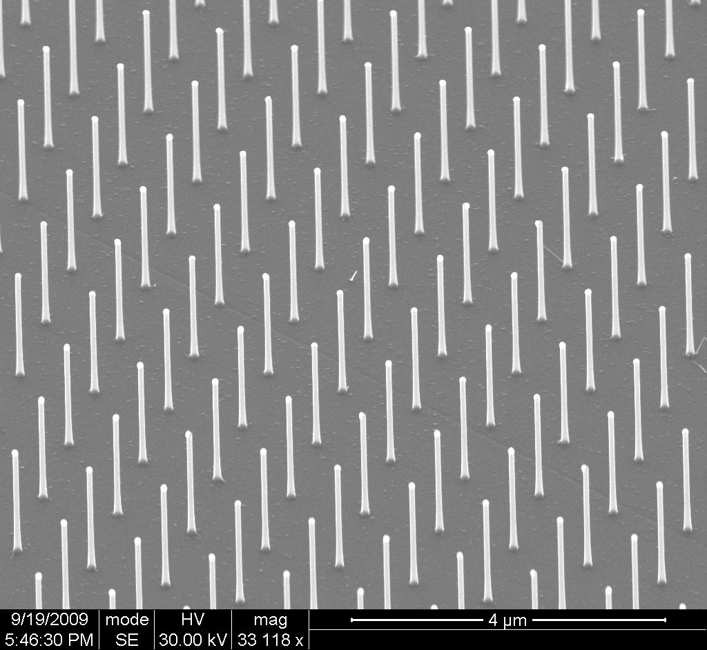
Functional Mesoscale Systems
Cu shunt layer
Ag cap layer
Imaging of electronic modulations in a cuprate high-temperature superconductor from
Kohsaka et al., Science 315, 1380 (2007)
YBCO
superconductor
LaMnO₃ buffer
MgO template
Al₂O₃ / Y₂O₃ Ni barrier
Ni alloy substrate
Aperiodic nanostructured battery
J. W. Long, D. R. Rolison, Acc Chem Res 40 (9), 854-862 (2007)
Massively parallel nanostructures

Slide 7
Functional Mesoscale Systems
Opportunity
Approach
Mesoscale systems can be self-organized and designed to provide scientific and applications value if they are understood and controlled.
“Self-organized”: e.g., high-temperature superconductors or multiferroics.
  “Designed”: e.g., nanostructured photovoltaics or batteries.
  “Self-organized and designed”: e.g., vortex pinning in superconductors or giant magneto resistance.
Highly controlled synthesis of crystalline, thin-film, and complex structures (e.g. designed and self-organized systems)
Development of new measurement techniques to detect emergent functional behavior and spontaneous inhomogeneity dynamically, and at multiple length scales.
Development of new computational techniques that incorporate and merge ab-initio and continuum and are cognizant of structural complexity and hierarchy.
Meso Challenge
Create and exploit materials with electronic or structural complexity that exhibit collective behavior with useful functionality.
Understand how these collective phenomena emerge from the nanoscale and predict their behavior and functionality.
Develop means to control mesoscale systems for applications of their functionality.
Impact
Create the knowledge base for next generation high performance materials and systems for energy applications.
This multiple-scale and multiple-view approach of computation, synthesis, and measurement will provide a new platform for materials research.
Rubloff, Greene, Tranquada

Slide 8
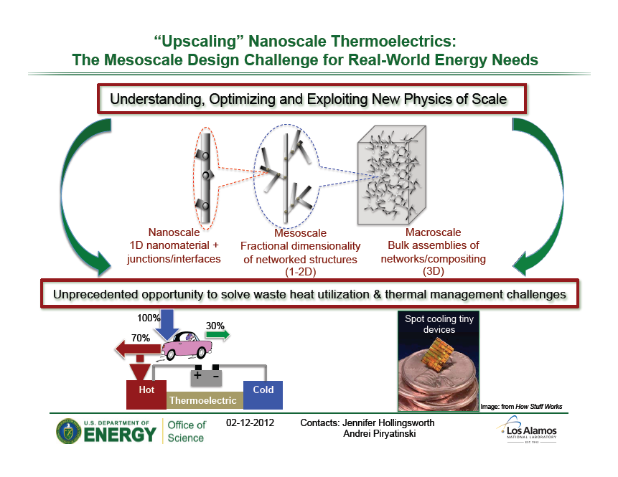

Slide 9
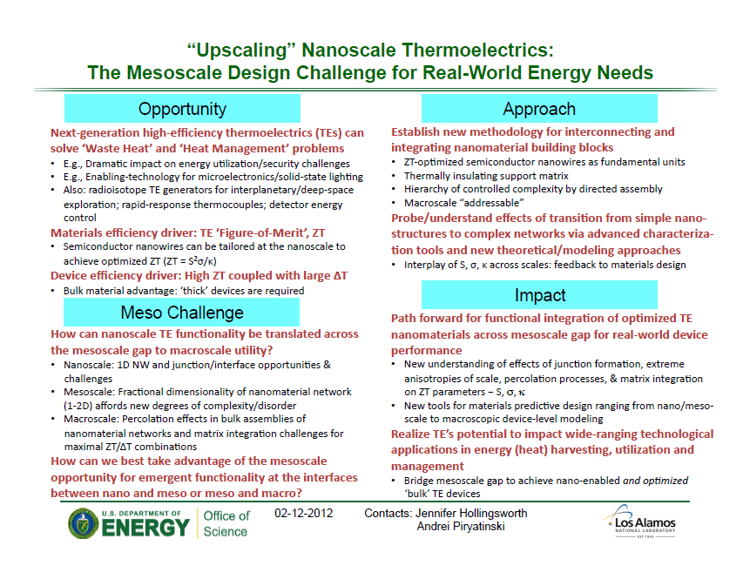

Slide 10
Measure Quantum Effects in Nanostructures
Opportunity
Approach
Need: higher resolution lithographic methods to bridge this dimensional gap. Investment should be made in facilities that can achieve smaller dimensions
Need: control over contacts between leads and nanostructures and between different nanostructures. Investment should be made in techniques for controlling the chemistry of interfaces between metals and nanostructures or between nanostructures
Phenomena that result from size effects can be controlled by adjusting the size through chemical synthesis and/or self assembly. An example is the quantum size effect in quantum dots, which may be useful for solar cells.
Meso Challenge
Nano structures can be chemically synthesized or self assembled with dimensions less than ~10 nm. Electron transport, however, requires metallic leads that must be fabricated using lithographic tools, typically limited to dimensions greater than 10 nm. While we have exquisite control of contacts in electrostatically confined nanostructures in GaAs, contacts between metallic leads and nanostructures or between different nanostructures are not well controlled.
Impact
Improved lithography would allow control over tunneling into and out of nanostructures.
Such control could lead to a quantum computer that would allow the solution of many quantum chemical problems that are currently beyond the reach of computation. It could also lead to solar cells exploiting the tunable band gap of quantum dots.
Kastner

Slide 11
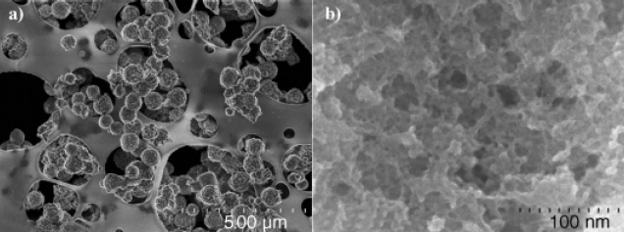
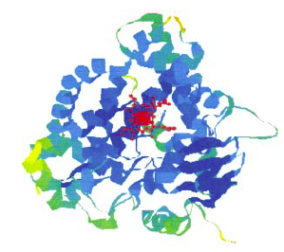
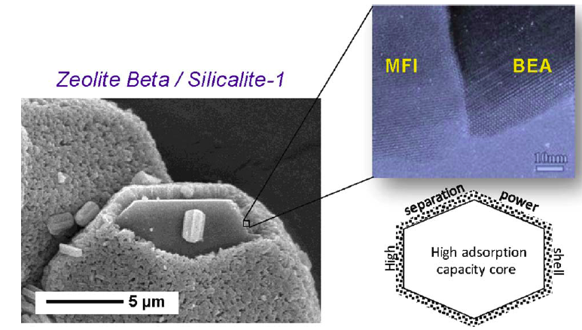
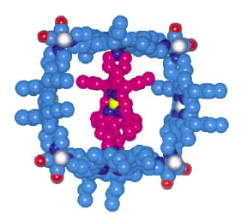
Catalysis at the Mesoscale
Hierarchical Mesoporous zeolites
Artificial Enzymes
Alkylation of benzene with propan-2-ol
cytochrome P450
Xiao et al., Ang. Chem. Int. Ed. 45 (2006) 3090
Molecular sieves
supramolecular encapsulated catalyst
Bouizi et al., Adv. Funct. Mater. 15 (2005) 1955
Centi, Perathoner., Coord. Chem. Rev. 255 (2011) 1480
Merlau et al., Ang. Chem. Int. Ed. 40 (2001) 4239

Slide 12
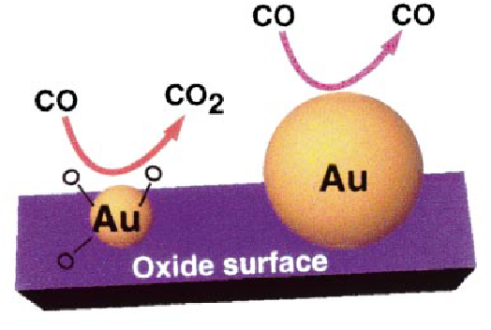
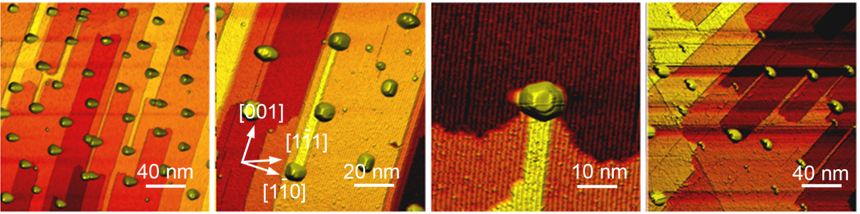
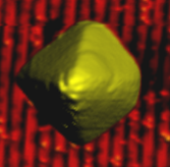
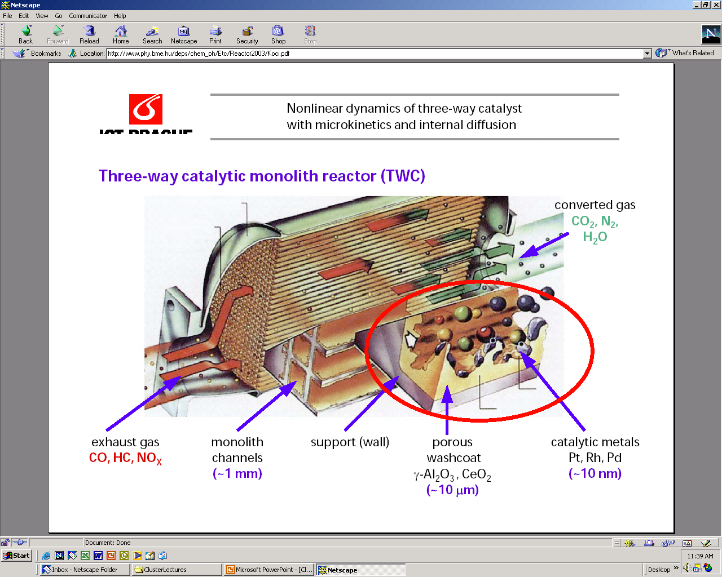
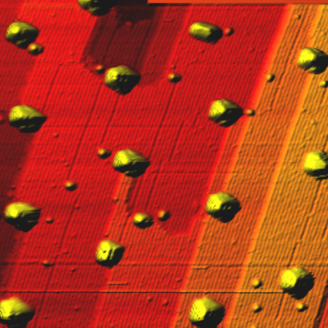
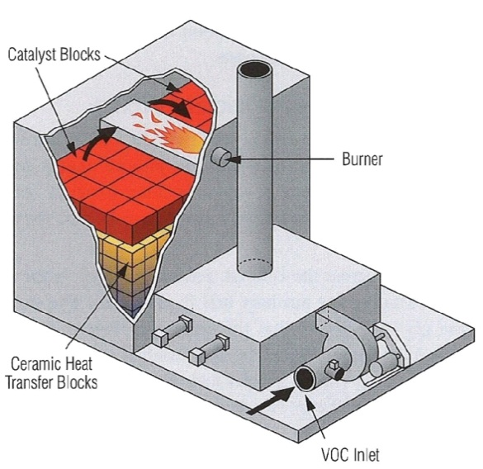
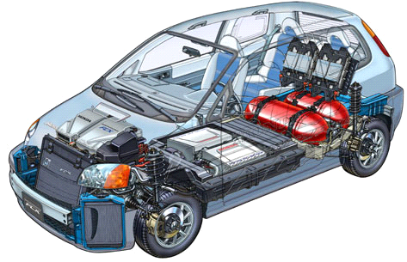
Nano
Pt
Catalysis
2 nm
Rao et al., Chem. Eur. J. 8. (2002) 28
Behafarid, Roldan, Phys. Chem. Lett. (2012); Nano Lett. 11 (2011) 5290
Meso
Pt/TiO₂
Pt/γ-Al₂O₃
10 nm
Naitabdi et al. Appl. Phys. Lett. 94 (2009) 083102;
Roldan et al., JACS 132 (2010) 8747
www.phy.bme.hu/deps/chem_ph/Etc/Reactor2003/Koci.pdf
Macro
Beatriz Roldan Cuenya

Slide 13
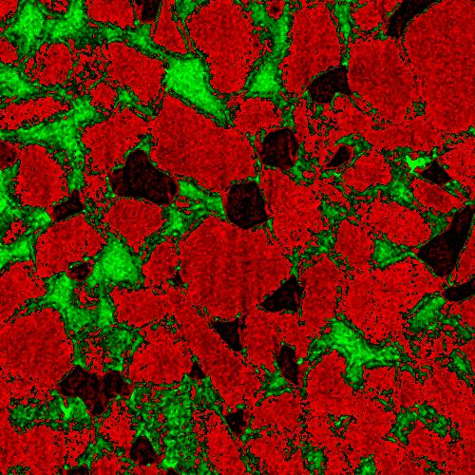
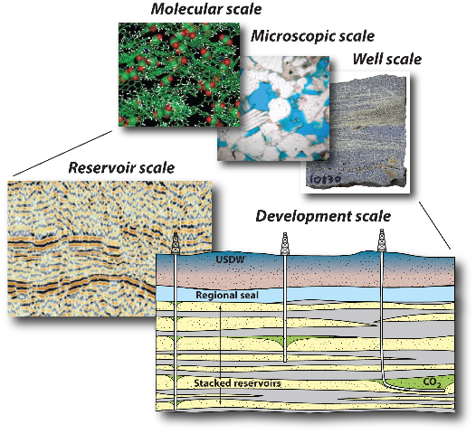
Reactive transport through mesoporous media
The Challenge:
Multiscale, multiphase modeling
of sequestration sites for
capacity, injectivity, containment
The Opportunity:
Sequestering carbon dioxide allows
clean use of fossil fuels
CO₂
Water
Mineral
grain
2 mm
Pore scale

Slide 14
Reactive transport through mesoporous media
Opportunity
Approach
One of the major challenges facing mankind is the capture and long-term storage of CO₂ from the burning of fossil fuels. We don’t understand how to do this on a scale large enough to sequester the billion metric tons produced annually. Physical and chemical trapping of CO₂ are the two most promising options, but they are not fully developed.
Element-sensitive mesoscale imaging of multiphase fluid flow through porous rocks and of reaction products (and their location) from mineral carbonation reactions are a major challenge that can be addressed using high-energy x-ray CT scanning at synchrotron light sources. New beamlines at the APS dedicated to this problem are needed.
Meso Challenge
Impact
What makes it meso? Physical trapping of CO₂ involves injecting it into saline aquifers, depleted oil/gas reservoirs, gas shale, and coal deposits. Understanding multi-scale fluid flow in porous rocks at the mesoscale is required. Achieving large-scale chemical trapping requires enhanced kinetics of mineral carbonation and how this process can increase the porosity and permeability of rocks at the mesoscale.
Successful physical and/or chemical trapping of CO₂ will help solve one of the major environmental problems facing mankind.
Gordon Brown

Slide 15
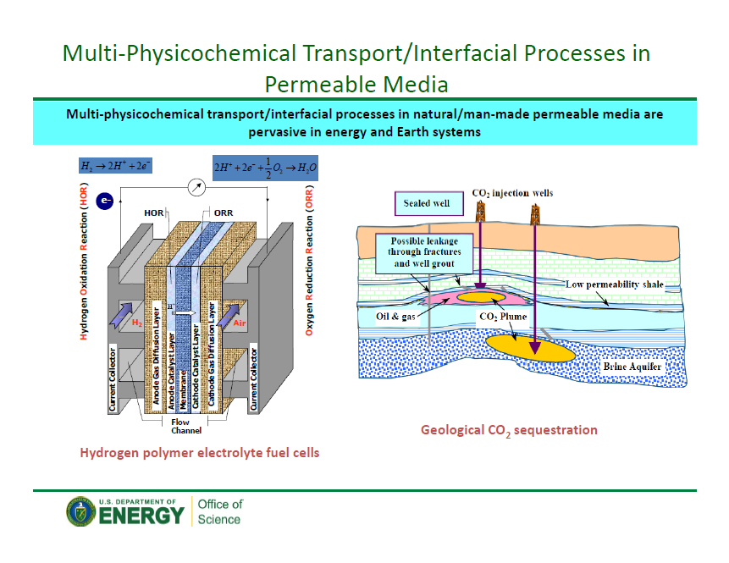

Slide 16
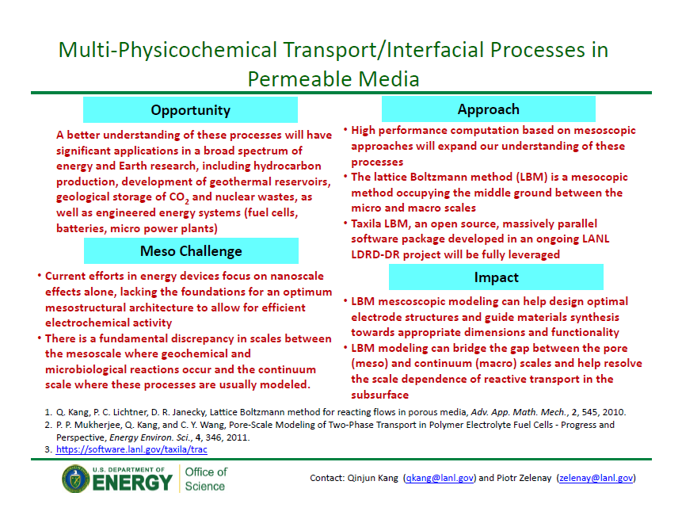

Slide 17

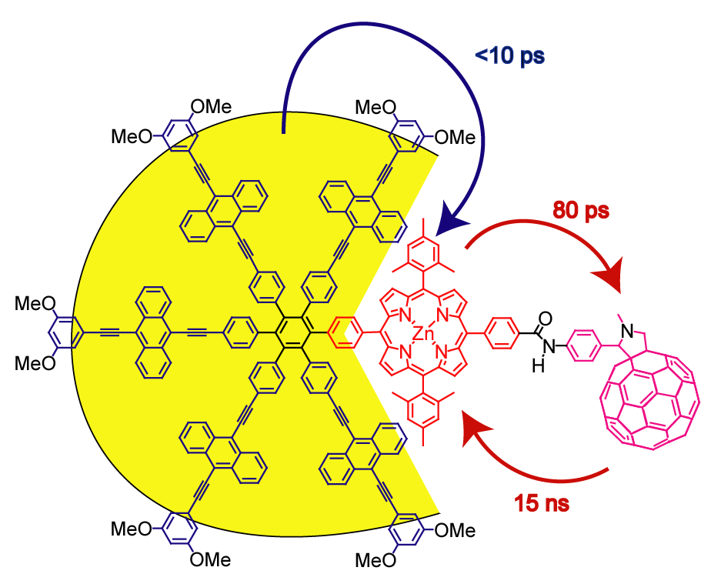

Self and Guided Assembly Inspired by Biology
Levels of Complexity
compositional
structural
functional unit
energy
connecting
functional units
architectural
light
electron
temporal
connecting
sequential steps
many interacting degrees of freedom
First steps being made
Meso challenges remain

Slide 18
Self and guided assembly in biology
Opportunity
Approach
Numerous examples in biology of taking nanoscopic building blocks and assembling them into functional entities with remarkable properties/capabilities
E.g., shapes changes via membrane-cytoskeleton coupling, biomineral (organic/inorganic) materials, protein synthesis/trafficking, viral capsids and carboxysomes, rosettasomes
Understanding how nature does it will advance capabilities to develop biomimetic materials, e.g., sensors, biofilm attachment, nanobots
Need: better in situ methods (imaging, elemental sensitivity, spectroscopy, nm spatial resolution); coarse grained/phenomenological models, enhanced sampling techniques; measurements and modeling of the same systems under the same conditions essential for validating models, defining “organizing principles”
Impact
Biomedical
New biomimetic materials
Biosynthetic materials
Sequestration/transformation of environmental contaminants, e.g., arsenic, radionuclides
Meso Challenge
Length and time scales
Function vs. misfunction at the mesoscale, how and why? E.g., amyloid formation
Must study in situ!
Kay and Tobias

Slide 19
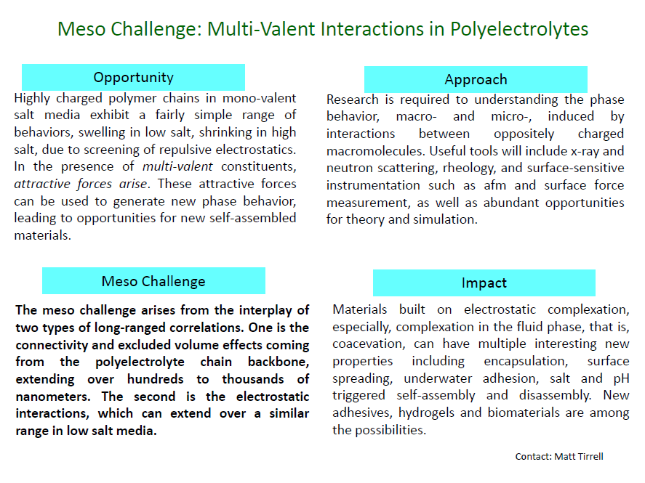

Slide 20
Role of fluctuations in formulating organizing principles in meso-scale systems
Opportunity
Approach
Understanding the mean behavior of meso objects, and their fluctuations in behavior
Many mesoscale materials are metastable.
Metastability arises from kinetic arrest
Self assembly/organization of large systems
Statistical issues in meso-scale science
Develop experimental & theoretical tools for complex systems and microstates or fluctuations
Tools to study populations of meso systems and their evolution over time
Time resolved structural/chemical probes
Time dependent studies of fluctuation
Coarse graining approaches
Accurate descriptions of dynamics in coarse grains models
Statistical studies of molecular populations
Meso Challenge
Impact
Systems of high complexity, composed of a large number of atoms (100 nm object >10⁷ atoms).
They have many degrees of freedom with a rugged energy landscape.
Their evolution over time, (spanning time scales) . Why are they metastable.
What determines the evolution between the possible structural motifs.
Fundamental understanding will lead to rational design of new materials with tailored functionality
Understanding fluctuations will enable improved materials with lower degradation and longer lifetimes.
French

Slide 21
Realizing the Meso Opportunity: Tools and Instruments
Mesoscale
Physics, Materials
and Chemistry
Synthesis
Theory
Simulation
Characterization
Notes:
integrates across synthesis, characterization, theory/simulation: new opportunities at the boundaries not previously emphasized
multiscale in time, space and interacting degrees of freedom ("complexity")
for characterization: multimodal, several simultaneous or sequential measurements needed to see interacting phenomena and scales
for synthesis: more complex systems with more interacting degrees of freedom (more elements, more complex architectures, more heterogeneity, more interfaces)
for theory/simulation: multiscale, more atoms, more architecture, more self-assembly, more dynamics

Slide 22
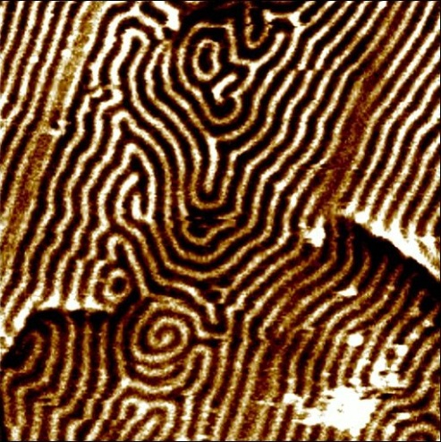
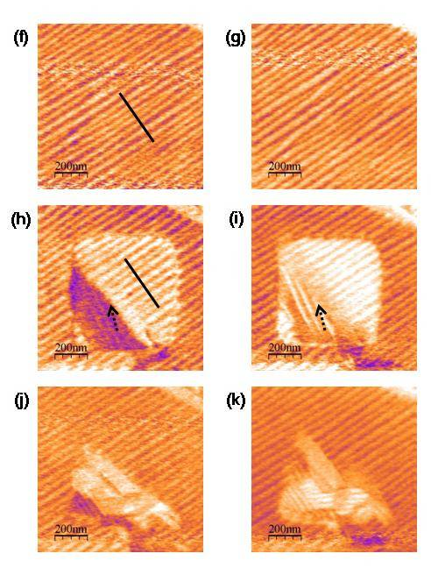
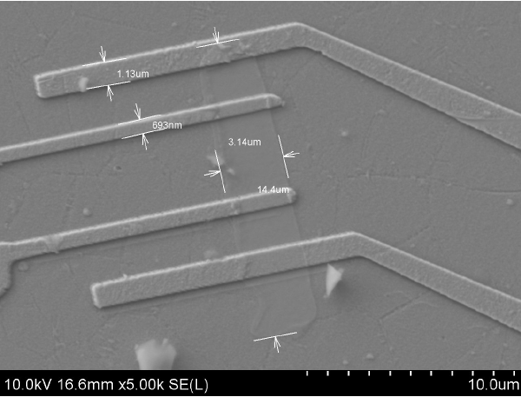
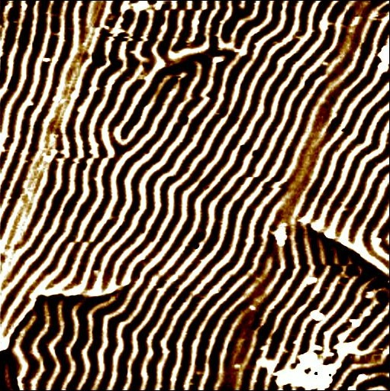
Controlling coupled ferroic domains at meso-scopic length scale
(Varatharajan et al., Advanced Materials 21, 3497 (2009))
10 μm
1μm
Patterned
permalloy/PZT
heterostructure
-5V
-5V
14 μm
+5V
Switchable
ferroelastic domains
E-field tunable
spintronic device
Switchable
ferromagnetic domains
Ichiro Takeuchi
Notes:
Engineered piezoelectric layer shows E-field reversible ferroelastic domains at submicron level (left)
Ferromagnetic layer deposited on top shows E-field switchable ferromagnetic domains at micron level (center)
This serves as the basis for a novel multiferroic spintronic device (right)

Slide 23
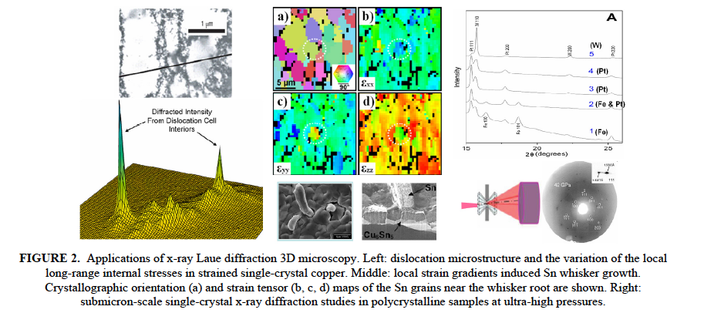
Studies of Materials on Mesoscopic Length-Scales
Studies of materials on mesoscopic length-scales require a penetrating structural probe with submicron point-to-point spatial resolution.
Three-dimensional scanning Laue diffraction microscopy provides detailed local structural information of crystalline materials such as crystallographic orientation, orientation gradients, and strain tensors.
“X-ray Laue Diffraction Microscopy in 3D at the Advanced Photon Source,”
W. Liu, P. Zschack, J. Tischler, G. Ice, and B. Larson, AIP Conf. Proc. 1365, 108 (2011)
Denny Mills

Slide 24
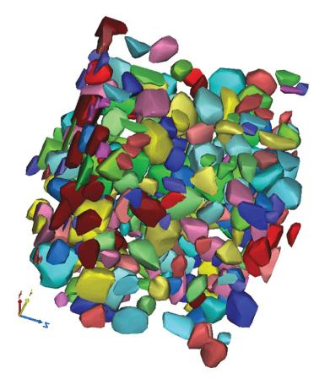
Why Materials Fail: Characterizing Damage in Aluminum Matrix Composites
The properties of materials can be improved by studying how, why they fail.
Techniques to investigate microstructures in metal matrix composites (MMCs, lightweight, high-stiffness materials of interest in automotive and aerospace applications, primarily from a fuel efficiency point of view) are limited to surface images that cannot yield information about the composite's 3-D structure; or (3-D imaging) are time consuming, destructive to the sample.
X-ray tomography at the U.S. Department of Energy’s Advanced Photon Source at Argonne National Laboratory examined the microstructure of an SiC MMC before and after tensile damage, captured high-resolution 3-D images of MMC samples.
Technique is non-destructive, requires minimal time for sample preparation.
Study produced several important findings, added to our knowledge about damage evolution in MMCs.
J.J. Williams, Z. Flom, A.A. Amell, N. Chawla, X. Xiao, and F. De Carlo, “Damage evolution in SiC particle reinforced Al alloy matrix composites by X-ray synchrotron tomography,” Acta Mater. 58, 6194 (2010).
Denny Mills

Slide 25
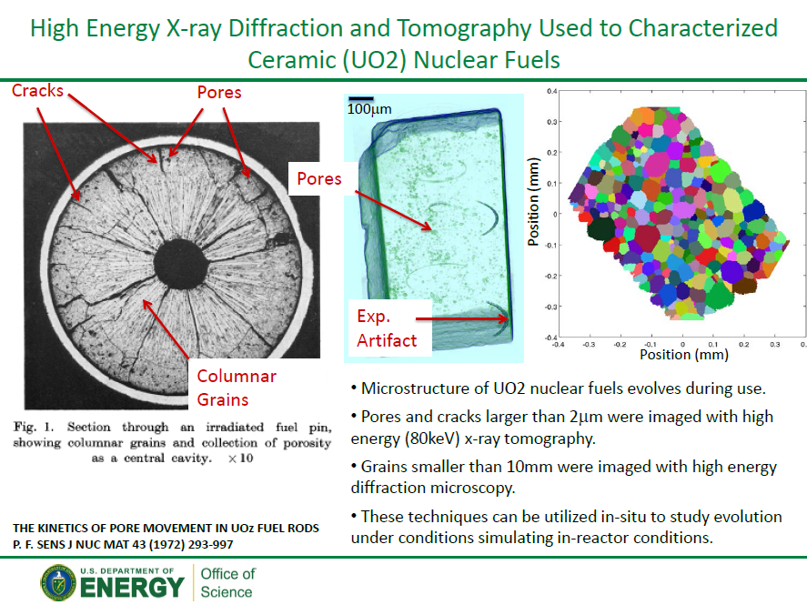

Slide 26
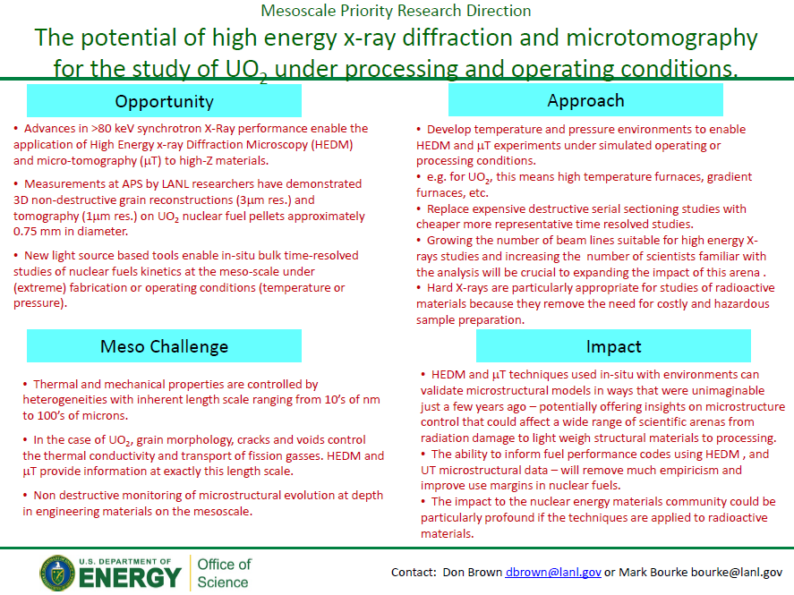

Slide 27
3D imaging inside mesoscopic objects is becoming possible
While atomic-resolution imaging in 3D advances
rapidly by several methods, "seeing inside" mesoscopic
micron-sized objects at nm resolution has proven more
difficult.
Lens-less hard X-ray imaging now makes this possible.
This coherent phase-contrast Ptychography
technique is expected to impact many fields, from
semiconductor devices to imaging foams,
percolation media, bone, porous media, catalysts
porous polymers, composite materials – anywhere
where the internal organization of matter on the
mesoscale is important. The recent invention
of the Free-electron X-ray laser will allow lens-less
time-dependent X-ray imaging, while TEM methods
are now being extended to tomography for
inorganic materials..
Mouse femur bone, imaged in three dimensions at 100nm resolution, by quantitative hard X-ray phase-contrast tomography (Ptychography). Diefolf et al . Nature 436, 467 (2010).
Spence

Slide 28
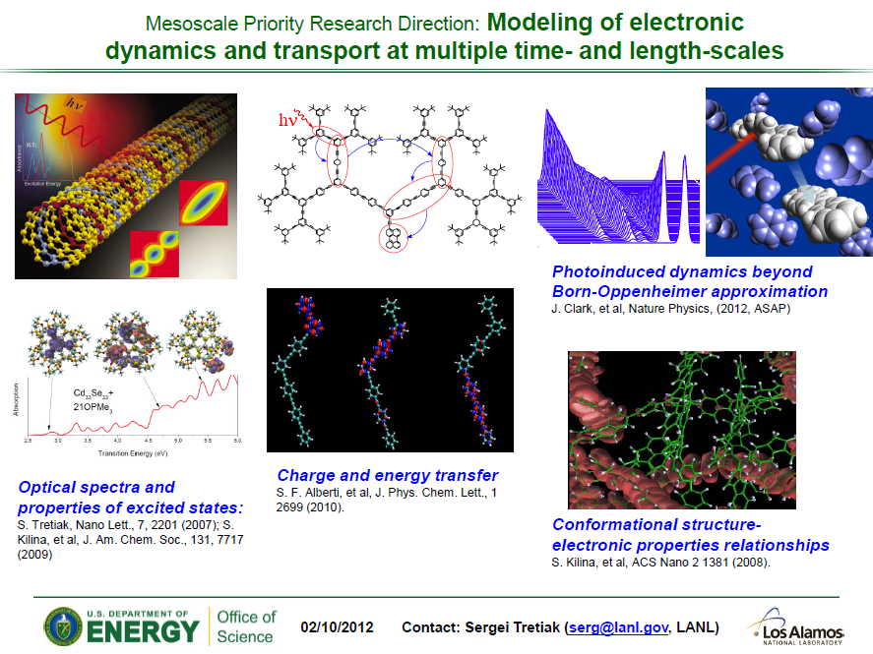

Slide 29
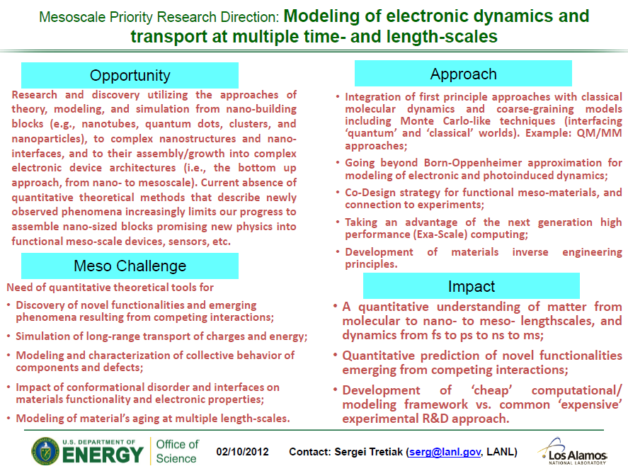

Slide 30
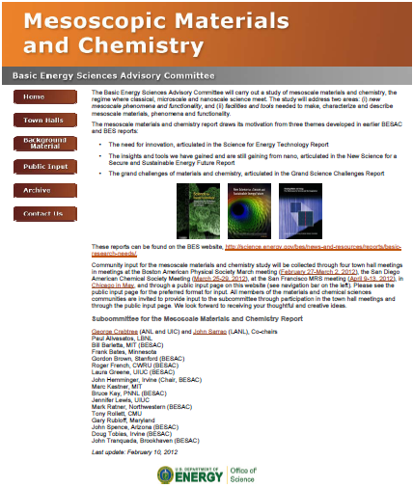
http://www.meso2012.com
Input wanted! – 25 contributions as of 2/20/12

