Slide 1
DOE Software Innovation Center for Integrated Multi-Scale Modeling of Structural Metals
(PRISMS – PRedictive Integrated Structural Materials Science)
John Allison
The University of Michigan
--
DOE-BES Advisory Committee
July 27, 2012

Slide 2
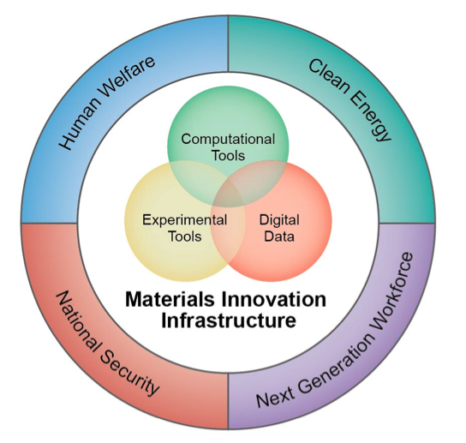
Materials Genome Initiative
. . . This initiative offers a unique opportunity for the United States to discover, develop, manufacture, and deploy advanced materials at least twice as fast as possible today, at a fraction of the cost.
President Barack Obama, 24 June 2011
Announcing the Materials Genome Initiative
“(In this context) genome connotes a fundamental building block toward a larger purpose” NSTC MGI White Paper, 2011

Slide 3


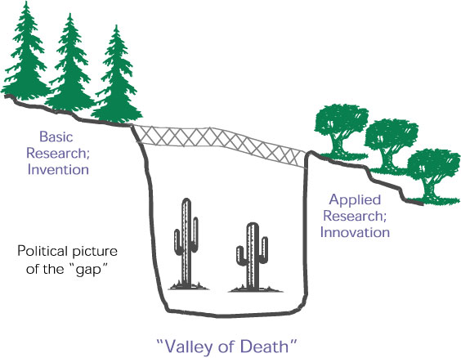




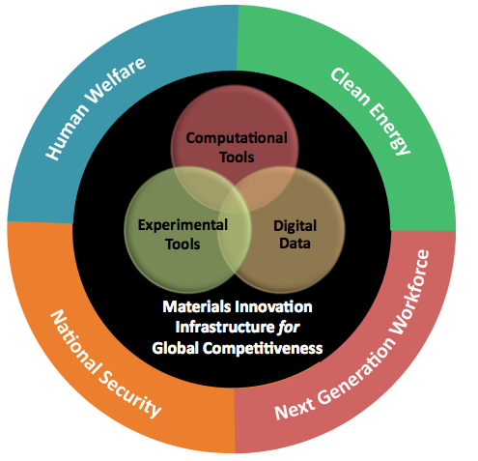
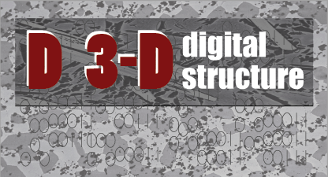

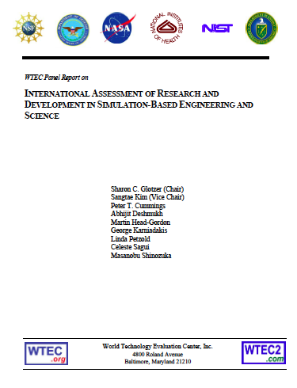
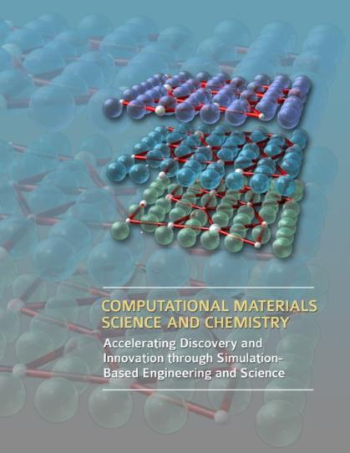
Historical Highlights
1989
1995
DOE: Advanced Strategic Computing Initiative
NRC: The Valley of Death
NRC: Materials Science & Eng for the 1990s
2001
European Union
1999
AFOSR-MEANS
DARPA-AIM
Virtual Aluminum Castings
ONR-D3D
NRC-ICME
WTEC-SBES
BES-ASCR
2004
2008
2009
2010
2011
We are at a tipping point!

Slide 4
US National Materials Advisory Board - Committee on Integrated Computational Materials Engineering (ICME)
Tresa Pollock, Chair
John Allison,Vice Chair
Notes:
4

Slide 5
The Vision
Computationally-driven materials development is a core activity of materials professionals in the upcoming decades, uniting materials science with materials engineering and integrating materials more holistically and computationally with product development.
5
Notes:
5

Slide 6
Integrated Computational Materials Engineering (ICME) is the integration of materials information, captured in computational tools, with engineering product performance analysis and manufacturing-process simulation.*
What is ICME?
Chemistry
Thermodynamics
Diffusion
Quantitative
Processing-Structure Relations
Quantitative
Structure-Property Relations
Engineering Product Performance Analysis
Process & product optimization
Innovation
Manufacturing
Process
Simulation
Constitutive Models

Slide 7
NMAB Committee Selected Findings
ICME is an emerging and potentially transformational discipline, but in its infancy.
Where applied in industry, return-on-investments of 3:1 to 9:1 have been realized.
Integration of knowledge domains is essential.
Curated knowledge bases are essential for capturing, archiving and disseminating information
ICME requires a cultural shift.
For ICME to succeed, it must be embraced as a discipline by the materials science and engineering community

Slide 8
ICME/ICMSE – The Next Big Thing in
Structural Materials
Well established knowledge base upon which we can build
Government initiatives
  US: Materials Genome Initiative !
  European Commmission: Through Process Modeling
  China: 集成计算材料工程
Growing industrial activity
      Internal developments
      Aerospace Consortia (USAF/Materials Affordability Initiative)
      Automotive Consortia (USCAR/DOE – Magnesium)
Growing academic activity
      University Materials Council Initiative
      NSF / Univ. of Michigan – Summer School
      Centers proposed (US and China)
Growing professional society activity: TMS, ASM, ASME, AIAA, MRS……

Slide 9
DOE Software Innovation Center for Integrated Multi-Scale Modeling of Structural Metals
(PRISMS Center)
(PRISMS – PRedictive Integrated Structural Materials Science)

Slide 10
DOE Software Innovation Center for Integrated Multi-Scale Modeling of Structural Metals
(PRISMS Center)
- Our Goals -
Establish an Integrated Multi-Scale Modeling Framework and Open Source Software (PRISMS)
Develop Advanced Open Source Computational Methods
Tightly Couple Experiments and Models
Application and Validation – PRISMS Demonstrator: Magnesium, Fatigue & Ductility
Establish the Materials Commons: An Open Source Knowledge Repository and Virtual Collaboration Platform for the PRISMS Community

Slide 11
DOE Software Innovation Center for
Integrated Multi-Scale Modeling of
Structural Metals
- Our Vision -
Provide the capability for rapid insertion of the latest science into the engineering process
PRISMS – will be an extensible scientific core for ICMSE & MBD for structural metals
Chemistry
Thermodynamics
Diffusion
Quantitative
Processing-Structure Relations
Quantitative
Structure-Property Relations
Engineering Product Performance Analysis
Process & product optimization
Innovation
Manufacturing
Process
Simulation
Constitutive Models

Slide 12
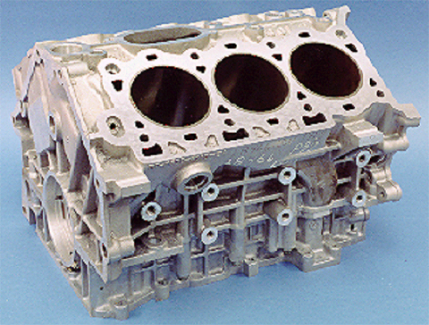
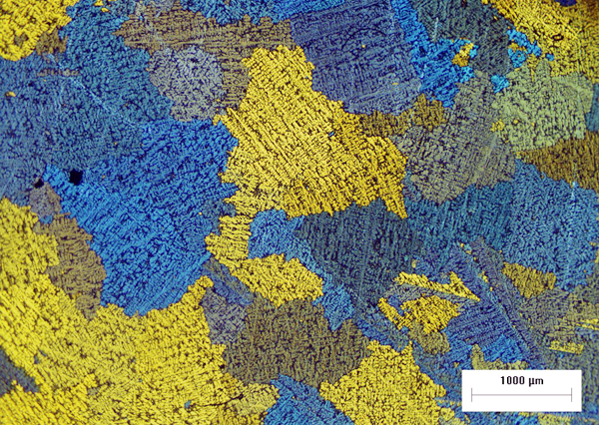
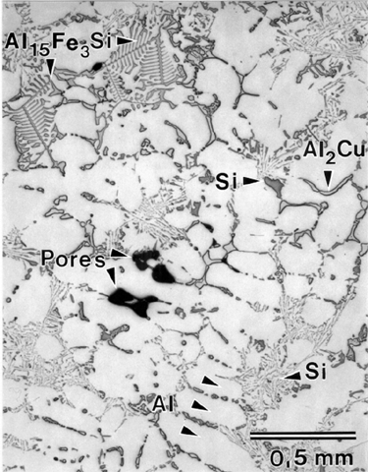
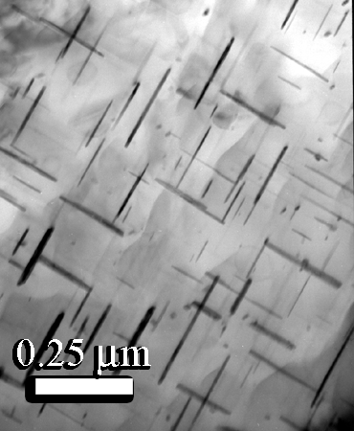
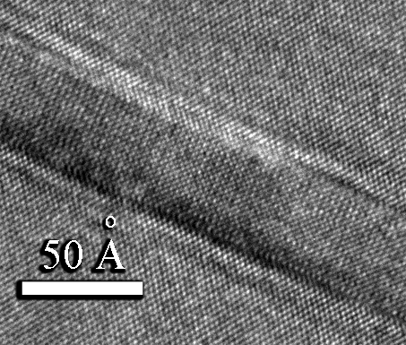
From Atoms to Components: Dealing with the Meso-Scale is Essential !
Ford Virtual Aluminum Castings
had to treat all these scales
1 m
Engine Block
1 – 10 mm
Macrostructure
Grains
Macroporosity
Properties
• High cycle fatigue
• Ductility
10 – 500um
Microstructure
Eutectic Phases
Dendrites
Microporosity
Intermetallics
Properties
• Yield strength
• Tensile strength
• High cycle fatigue
• Low cycle fatigue
Thermal Growth
• Ductility
1-100 nm
Nanostructure
Precipitates
Properties
• Yield strength
Thermal Growth
• Tensile strength
• Low cycle fatigue
• Ductility
Key materials processes occur at many length scales – and all can be influenced by manufacturing history
0.1-1 nm
Atomic Structure
Crystal Structure
Interface Structure
Properties
• Thermal Growth
Yield Strength

Slide 13

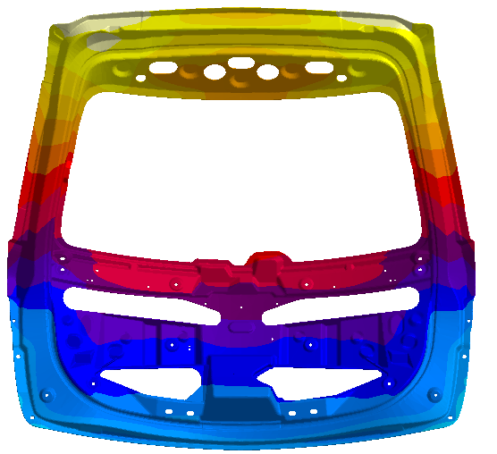
Why Magnesium, Fatigue & Ductility ?
Magnesium alloy development is at a very immature stage – and property improvements are required.
Fatigue and ductility (fracture) behavior of materials are important engineering properties – but the science is largely phenomenological
These problems are ripe for an integrated predictive approach
Magnesium alloys are an important alternative for lightweighting vehicles
250
Al-4Cu
200°C
Al-4Cu-0.05Sn
Al-4Cu-0.3Mg
Al-4Cu-0.3Mg-0.5Si
Al-4Cu-0.3Mg-0.4Ag
1989
200
Al-4Cu-0.3Mg-0.4Ag-1Li
150
Hardness (VHN)
Traditional alloy development processes aren’t responsive to the need
100
1906
50
0
1
10
100
Ageing Time (h)

Slide 14
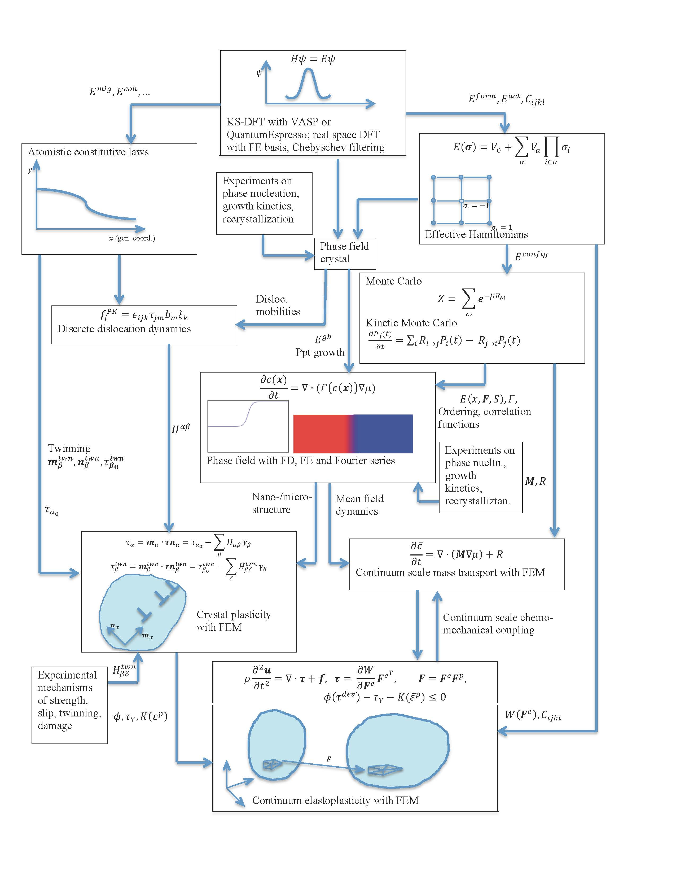
PRISMS – Integrating Length Scales and Scientific Domains
Integrated, Open Source Toolset
Primarily hierarchical
Mathematical descriptions appropriate for the scale
Parameter passing to higher scales

Slide 15

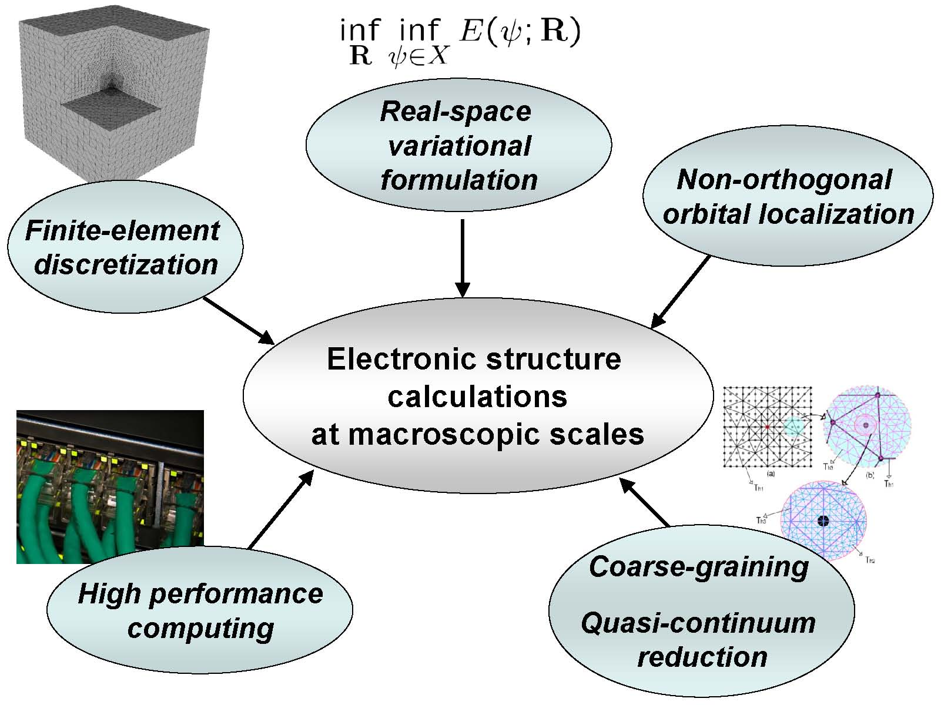
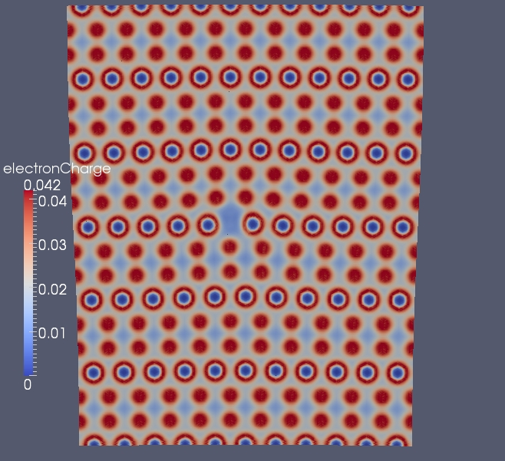
DFT-FE
Real-space formulation of DFT with a finite-element basis for large-scale electronic-structure calculations
Vikram Gavini
Overview of main aspects
Key features of DFT-FE:
Complex geometries and boundary conditions
Pseudopotential and all-electron calculations
Scalability on parallel computing platforms
Innovations:
Development of a linear scaling method
Quasi-continuum coarse-graining techniques that enable electronic structure calculations on multi-million atom systems.
PRISMS Demonstrators:
Energetics of defects
Inform atomistic constitutive laws
Electronic structure of an edge dislocation in aluminum

Slide 16

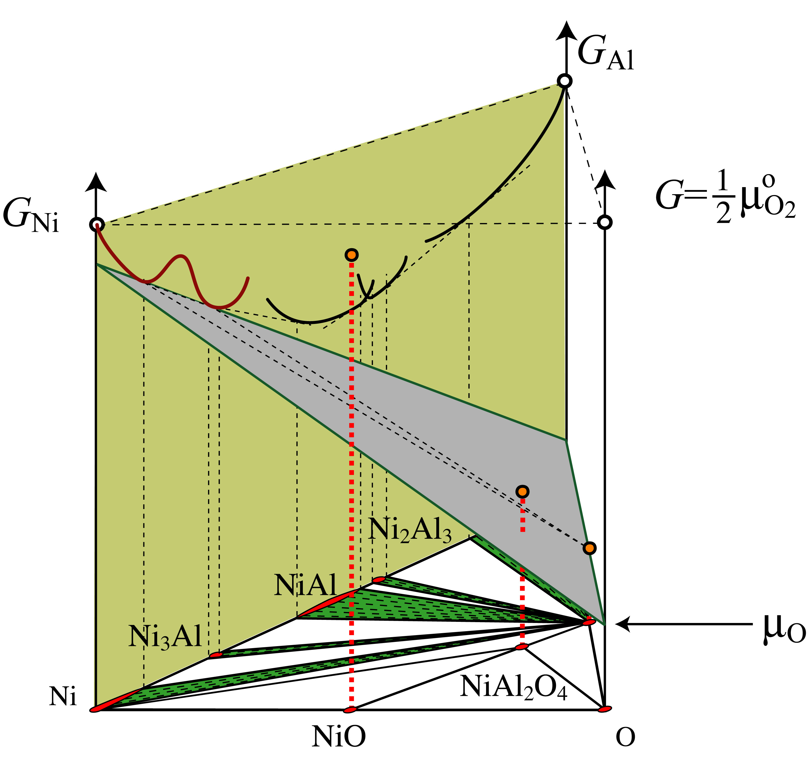
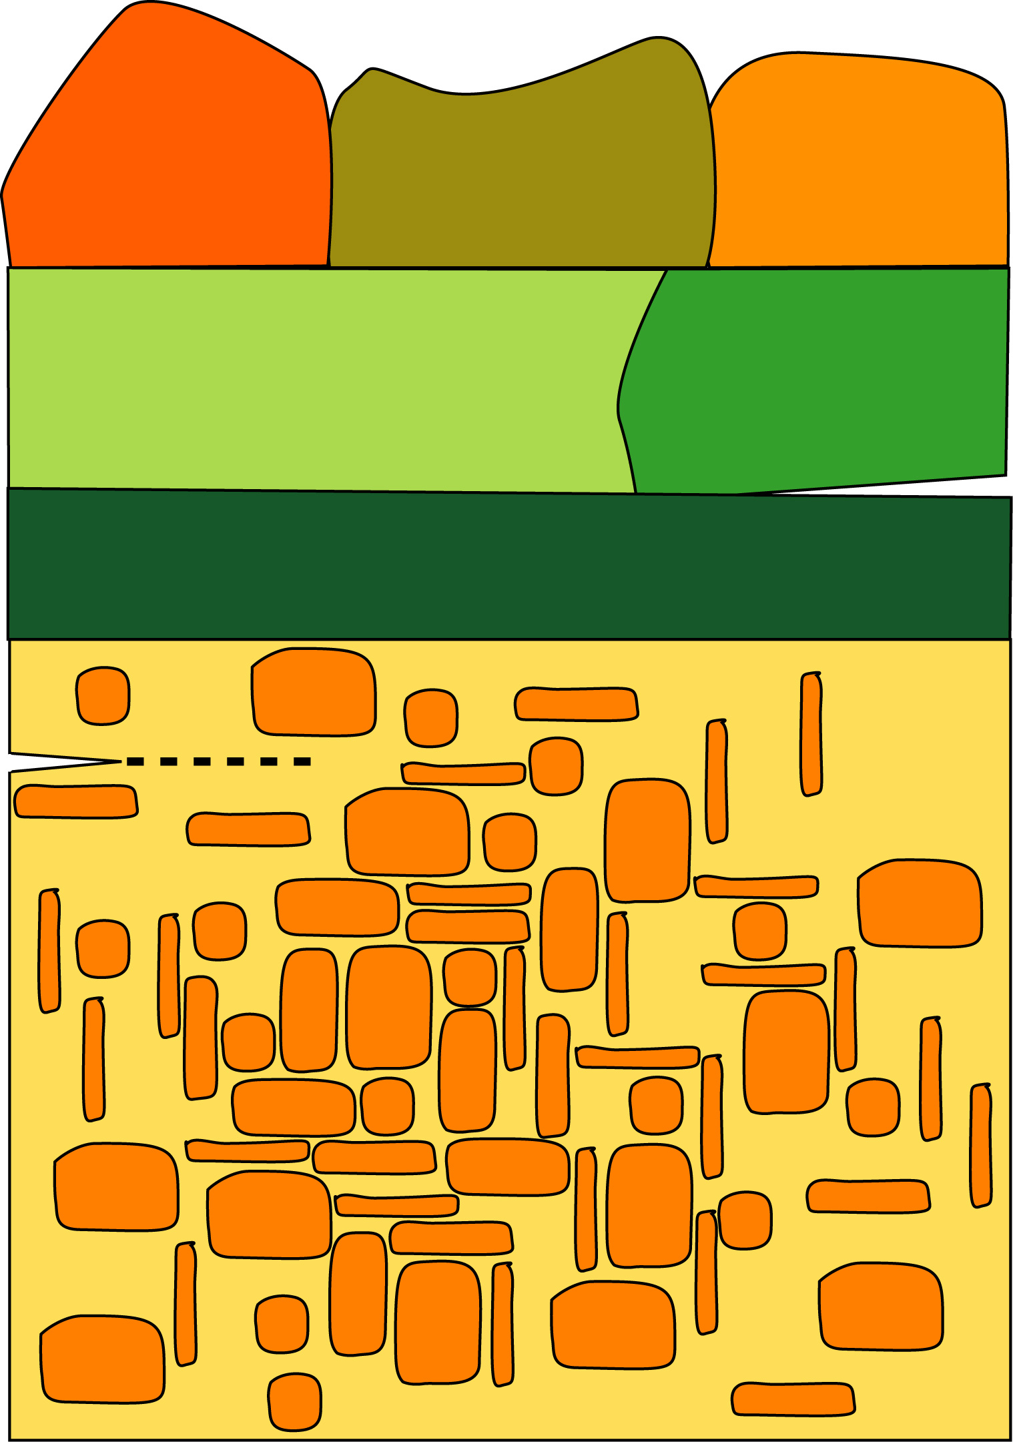
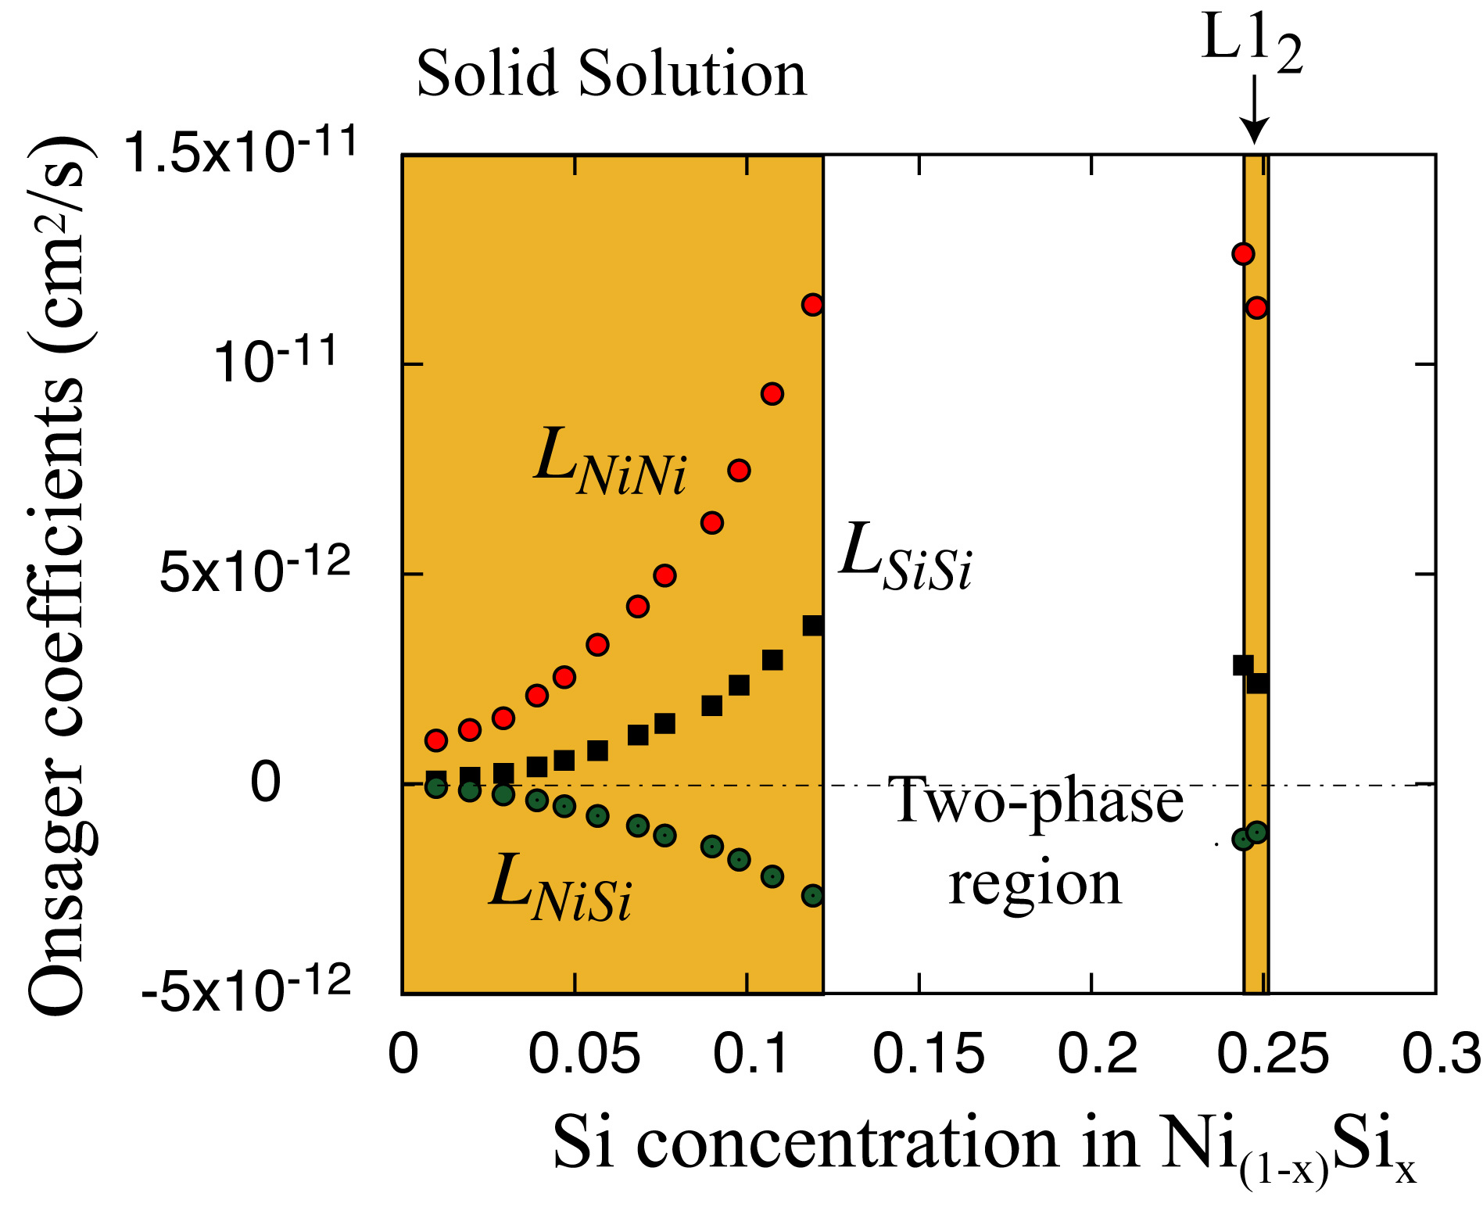
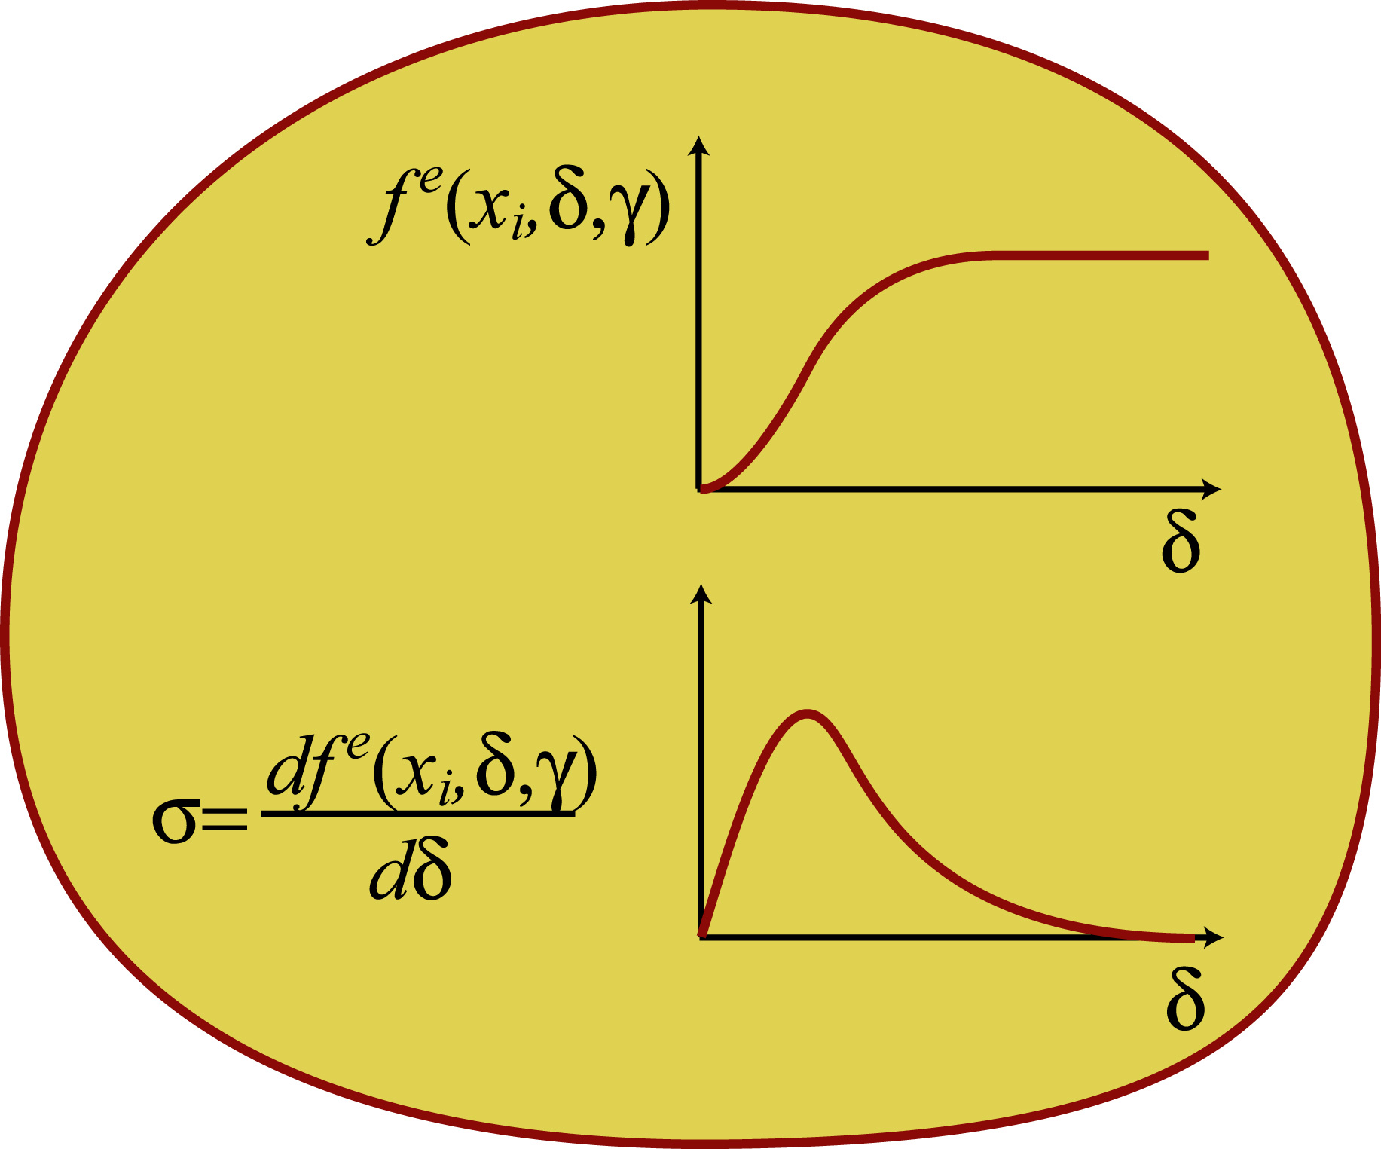
First-Principles Statistical Mechanics
Predicting thermodynamic, kinetic and mechano-chemical properties of the solid state
Anton Van der Ven
First-Principles Statistical Mechanics
Predict free energies (of bulk, interfaces, grain boundaries), atomic mobilities, and mechanical constitutive laws to be used in continuum simulations of microstructure evolution and mechanical deformation
Innovations:
CASM: Highly automated statistical mechanical software package to calculate:
  Phase diagrams
  Multi-component diffusion coefficients
  (Kinetic Monte Carlo Simulation)
  Mechano-chemical constitutive laws
PRISMS Demonstrators:
Phase stability in new Mg-alloys
Diffusion coefficients in new Mg alloys
Chemically informed grain boundary
and interface traction curves
for decohesion

Slide 17

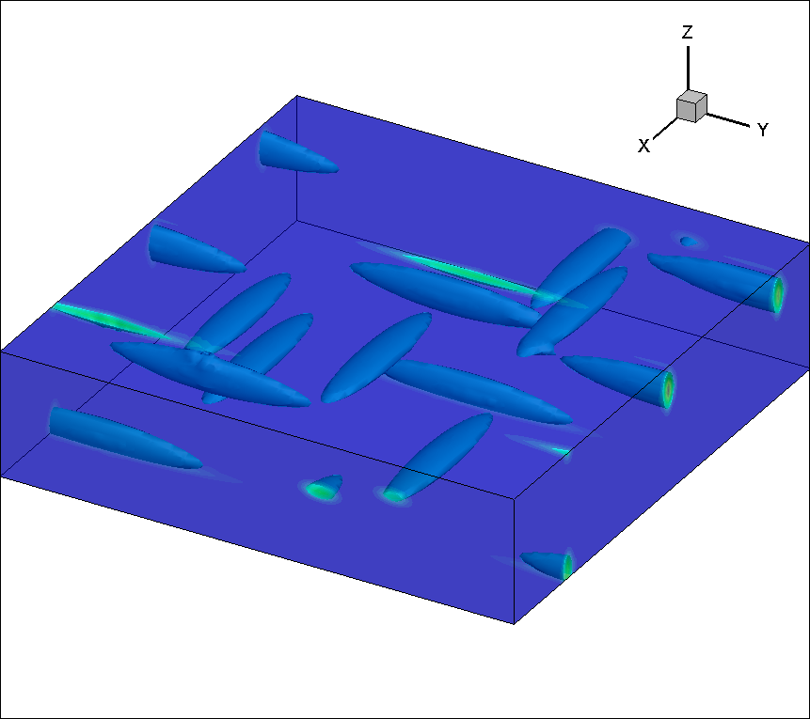
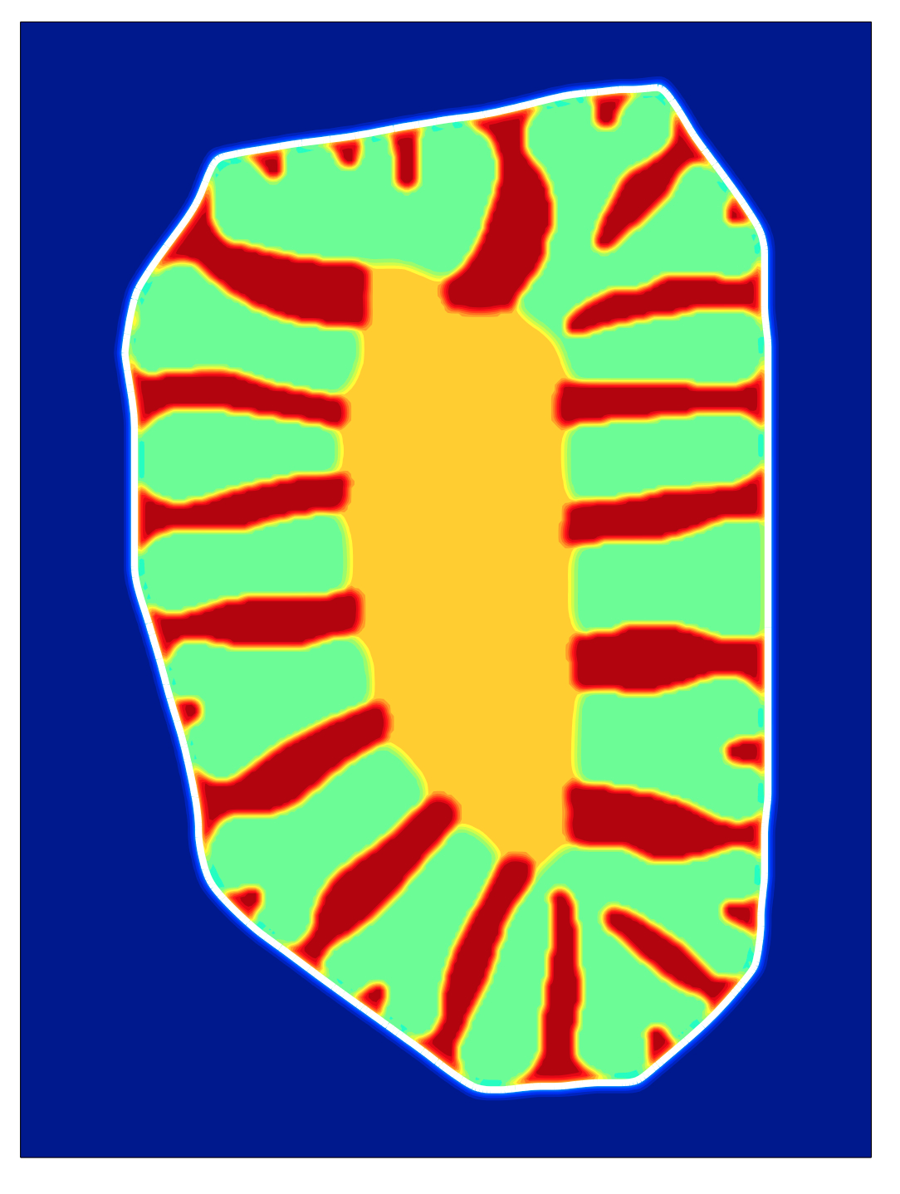
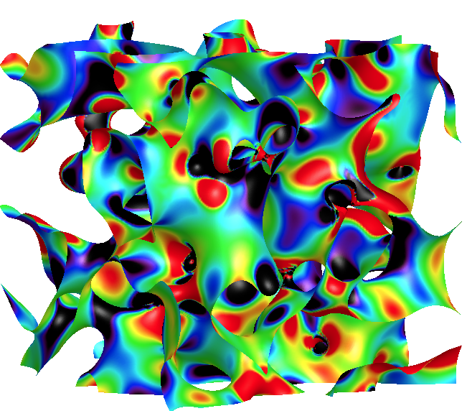
Phase Field Method
An essential technique for predicting microstructural evolution
Katsuyo Thornton
Precipitate evolution in Mg alloy
Ref: Li, Chen and Allison, 2011
What phase field is & is used for:
A model for dynamic evolution of microstructures based on the thermodynamic driving force
Grain growth, precipitate evolution, etc.
Applications to many systems (metals, semiconductors, ceramics, composites)
Innovations:
Large-scale simulations via parallelization
Linking to models at other length scales
PRISMS Demonstrators:
Recrystallization and grain growth
Growth and coarsening kinetics of strengthening precipitates (with a nucleation model)
Phase field modeling applied to battery material (left) and coarsening (right)

Slide 18
Phase-Field Crystal Method
An atomistic model capable of simulating evolution of microstructures
Katsuyo Thornton
What phase field crystal is & is used for:
A model for nano/microstructure evolution with atomistic resolution and diffusive time scale
Grain growth, precipitate evolution with crystalline anisotropy naturally incorporated
Innovations:
Model development for improved prediction accuracy
PRISMS Demonstrators:
Recrystallization and grain growth
Effects of crystalline anisotropy on interfacial energy and other input to the phase field model
Growth and coarsening of crystallites simulated with PFC

Slide 19

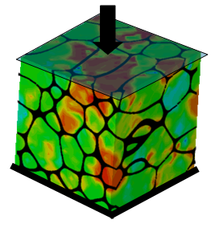
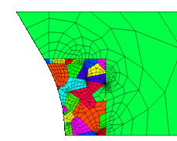
Crystal Plasticity Finite Element (CPFE) for prediction of microstructure deformation and failure
Microstructure deformation and failure
Veera Sundararaghavan
What CPFE is & is used for:
Simulate microstructural (polycrystal) response to an applied stress
Innovations:
Model parameters from first principles (DFT/DD) computations
Tight integration with experiments (Robomet, DIC) for inputs & validation
Parallel, open source codes for multiscaling, modeling failure
PRISMS Demonstrators:
Prediction of mechanical properties of Mg alloys
Code integration with phase field to model recrystallization, with VMM to model shear bands, cracks
Multi-scaling

Slide 20

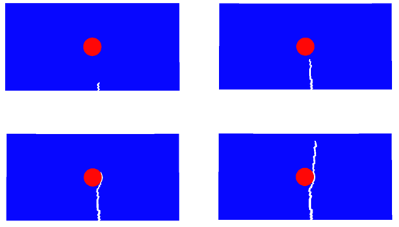
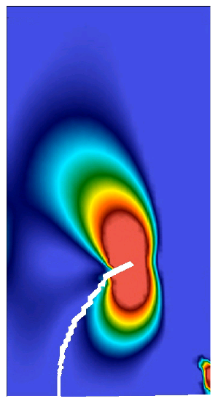
Variational multiscale method
Embedding fine scale interface mechanics in internal state variable models
Krishna Garikipati
What the variational multiscale method is used for
FE method for localized deformation such as shear bands and cracks (discontinuities)
Embed traction-separation laws in internal state variable models, which are themselves obtained by coarse-graining
Innovations
Arbitrary topologies of shear bands and cracks
Evolving path of discontinuity
PRISMS demonstrators
Use in CPFE to first obtain continuum ISV models
Fatigue crack initiation & growth

Slide 21
PRISMS – Tight Coupling of Experiments and Models
Experiments are key for:
- Mechanisms
- Filling gaps in theory
- Quantitative inputs
- Validation

Slide 22


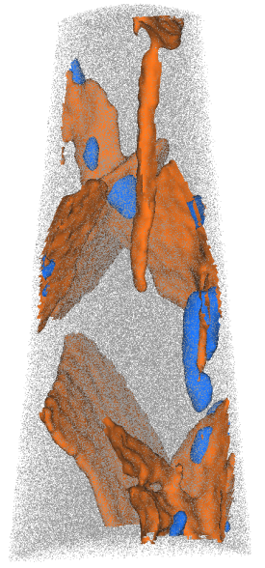

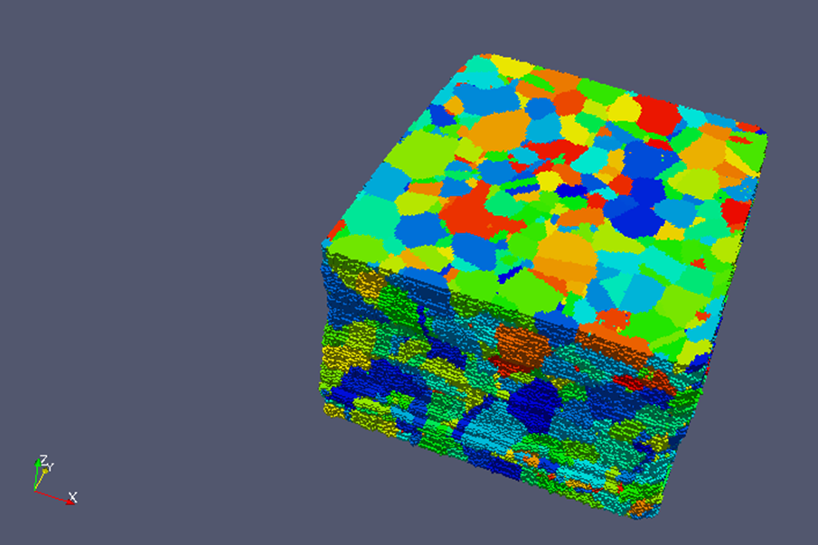
3D Microstructural Characterization
An essential technique for developing and validating microstructural models
Emmanuelle Marquis
John Allison
Combined APT – TEM of precipitates (Nano level)
Techniques for 3D :
Atom Probe Tomography
Quantitative 3D TEM
3D Electron backscatter diffraction
Serial sectioning
Innovations:
Linkage from nano- to micro-scale
Overlaying structure & chemistry information
Quantitative techniques
RoboMet for micron-scale microstructure (Newly acquired)
PRISMS Demonstrators:
Recrystallization and grain growth
Strengthening precipitate structures and kinetics
Cu
Al
Li
Model Inputs & Validation
3D Grain Structure (Micron level)
Ref: Groebber, AFRL

Slide 23

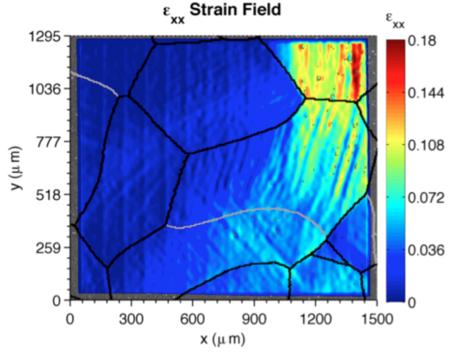
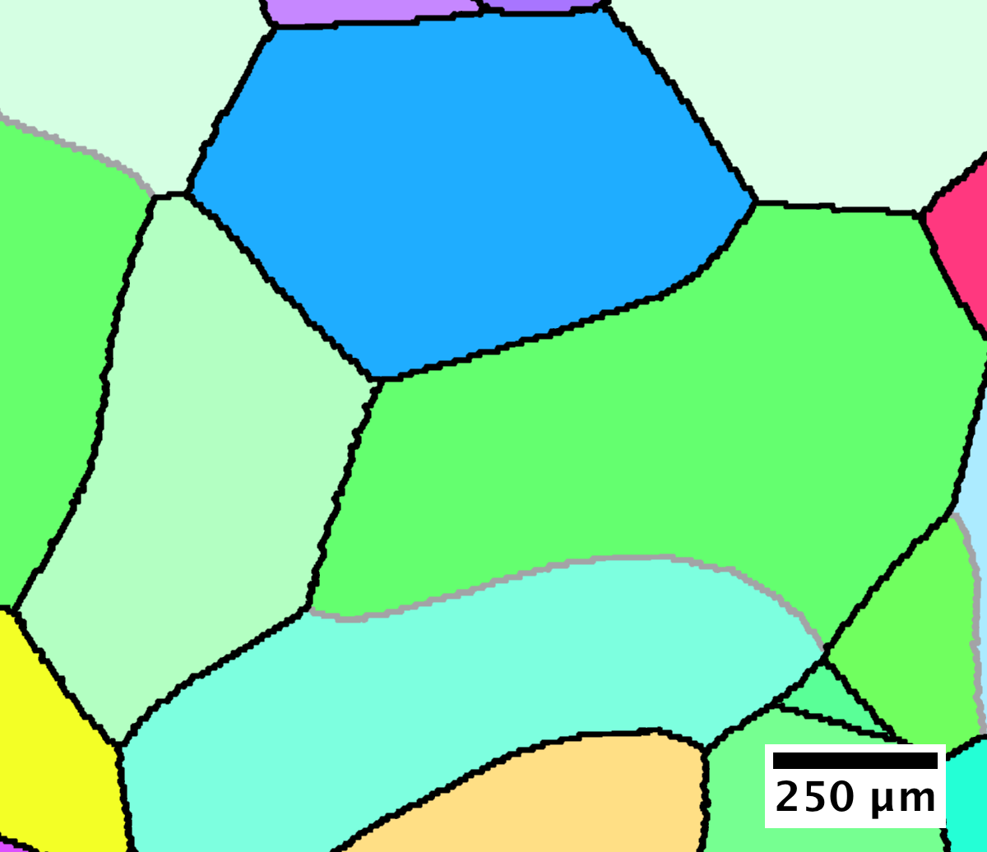
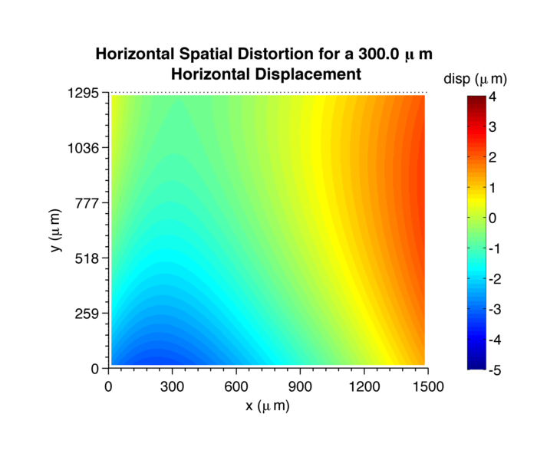
Full Field Mapping at the Microstructural Length Scale: Strain and Crystallography
Experimental input and validation for computational efforts
Sam Daly
Techniques
In-SEM full-field deformation mapping (Digital Image Correlation)
In-SEM thermo-mechanical testing (max 5 kN; 850°C)
Electron backscatter diffraction
Innovations:
SEM-Digital Image Correlation
  Custom in-house software
  Custom-built hardware
  Nanoparticle deposition techniques
PRISMS Demonstrators:
Microstructure-dependent local deformation mechanisms.
Effect of microstructural evolution on fatigue and ductility.
Strain Field in 99.99% Al under mechanical load (SEM-DIC) with corresponding crystallographic information (EBSD)
Custom in-house code accounts for complex spatial and temporal distortions
Notes:
SEM-DIC to map deformations
Patterning through NPs and e-beam
FIB deposition is to align DIC strains with EBSD data
EBSD for crystallography
Confocal microscopy for z-diplacement

Slide 24

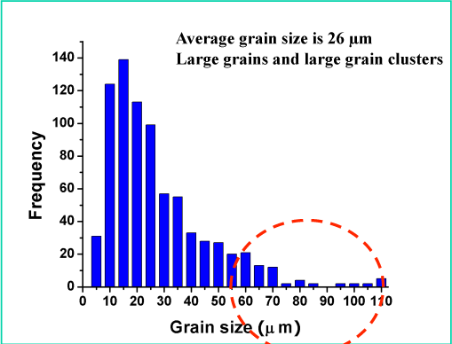
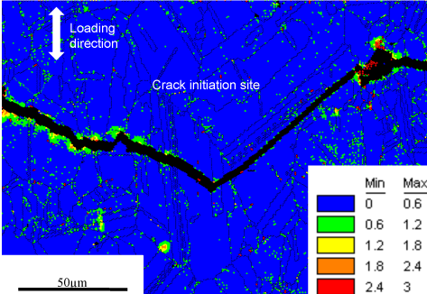
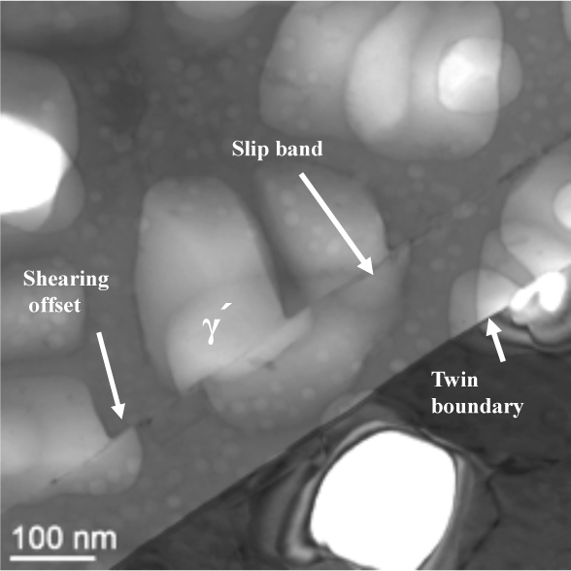
Ultrasonic Fatigue
Identifying the role of critical microstructure features on fatigue damage and life
J. Wayne Jones
John Allison
Critical microstructure neighborhoods control fatigue life for structural materials
Techniques for UF :
20 kHz cycling => VHCF (N_{f} ~10⁸ -10⁹ )
Real-time nonlinear ultrasonics diagnostics
Innovations:
In situ UF: APS
UF/DIC for strain localization studies
UF/SEM for high resolution crack initiation
Coupled with 3D for model development
PRISMS Demonstrators:
Quantification of cyclic strain localization
Microstructure/crack initiation in Mg Alloys
Necessary to characterize extremes of microstructure to model fatigue behavior

Slide 25
PRISMS – Integrating Length Scales and Scientific Domains

Slide 26


The Materials Commons
---
An Open Source Knowledge
Repository & Virtual Collaboration Platform
H.V. Jagadish
Margaret Hedstrom
Curating, archiving and dissemination of “Information”
Information: Digital data (experiment and simulation results) & PRISMS Tools
Workflow processes, standards, sharing practices & policies
“Fusion” of experiments and simulation – knowledge creation
Develop the Open Source PRISMS Community (Collaboration, Annual Workshop, Glue Grants, etc.)
Federation (Materials societies, other repositories)

Slide 27
Summary
We are at a tipping point with Materials by Design/ICME/ICMSE - Materials Genome Initiative is an important opportunity
The DOE Software Innovation Center for Integrated Multi-Scale Modeling of Structural Metals has been designed to:
  Provide an integrated suite of professional, open-source computational tools
  Develop advanced computational tools
  Closely couple models with unique experimental capabilities for model development, inputs and validation
  Establish the Materials Commons
  Build a PRISMS collaborative community
Our Vision: PRISMS – will be an extensible scientific core for ICMSE & Materials By Design for structural materials

Slide 28
Materials Genome Initiative
Thank you for this opportunity !!
“(In this context) genome connotes a fundamental building block toward a larger purpose” NSTC MGI White Paper, 2011

Slide 31
PRISMS –Tight Coupling of Experiments and Models
Experiments are key for:
- Mechanisms
- Quantitative inputs
- Filling gaps in theory
- Validation

Slide 32
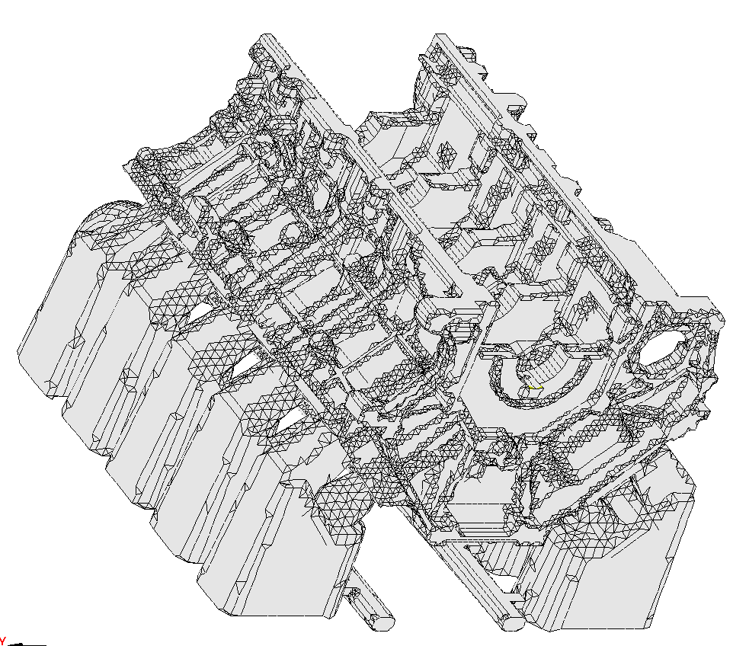
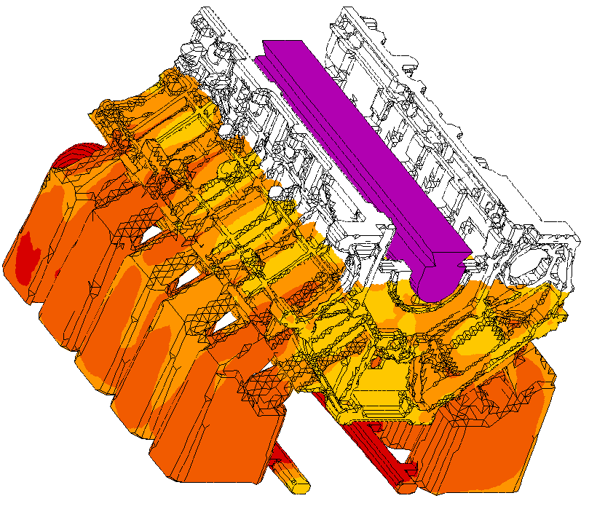
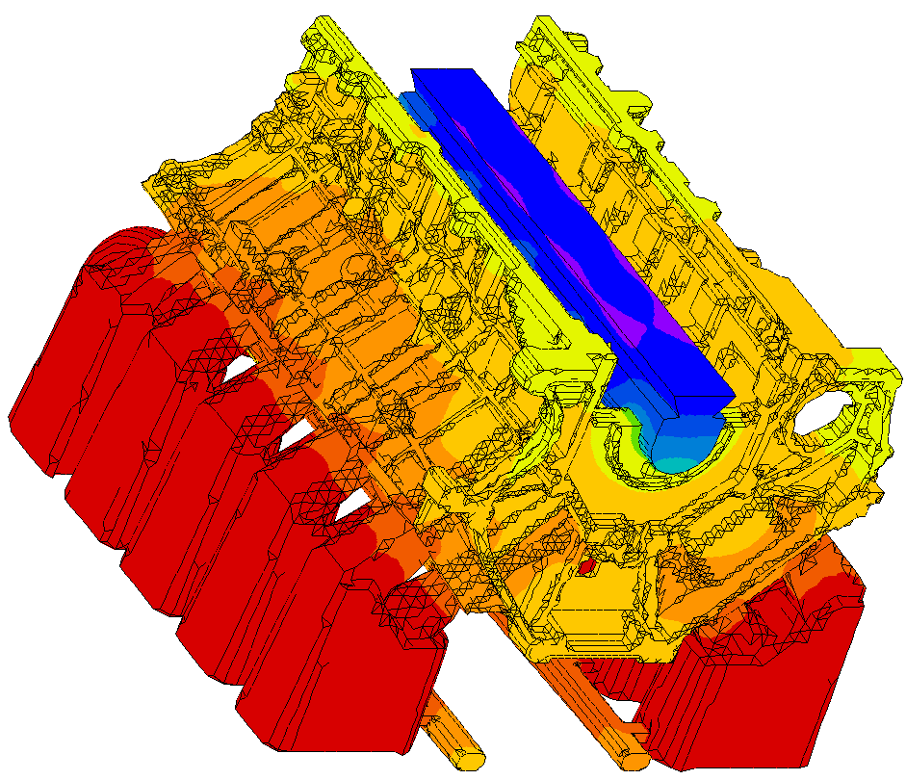
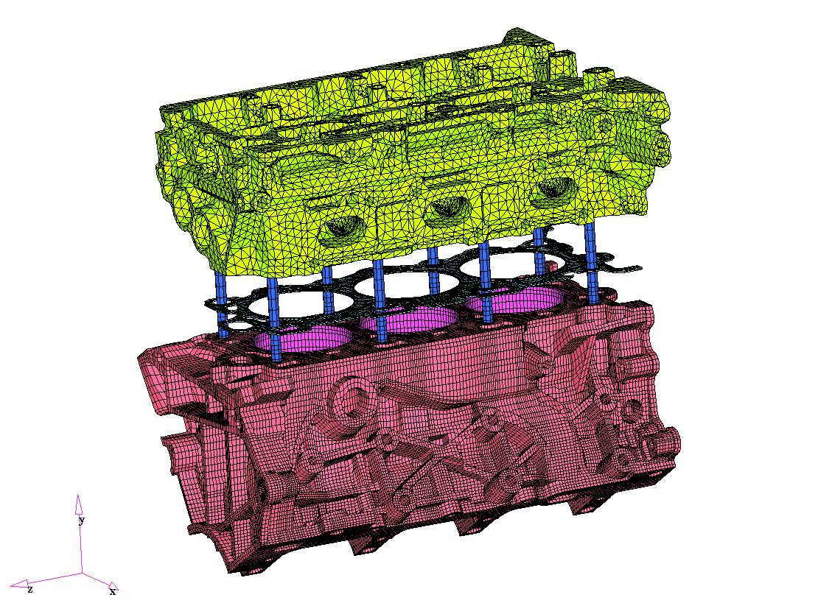
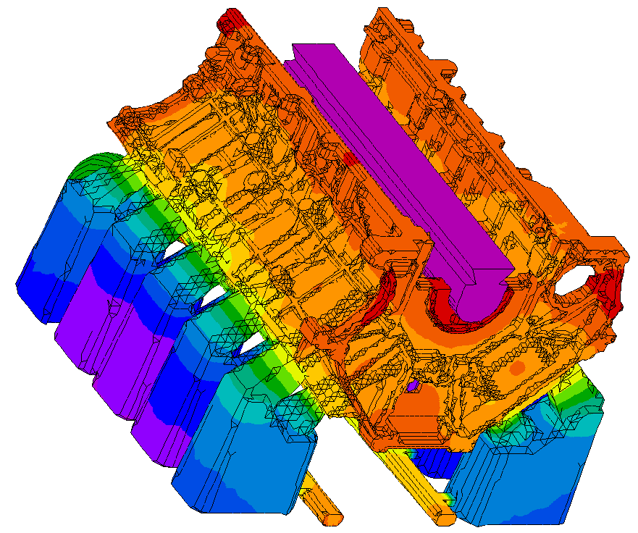
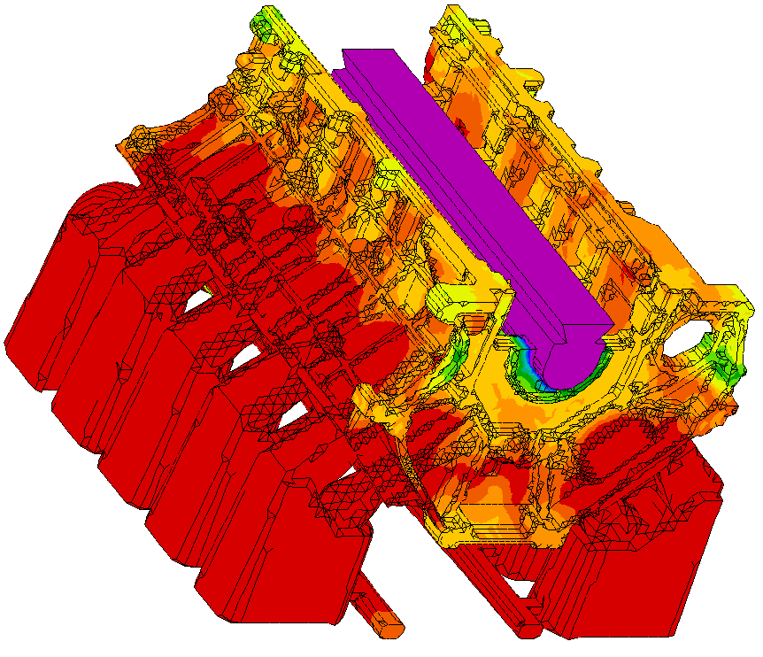
Ford Virtual Aluminum Castings (VAC) Process Flow
Initial Geometry
Casting Filling
Casting Thermal History
Local Strength
Local Microstructure
Product Performance Analysis

Slide 33
VAC Processing-Structure-Property Linkages
Casting
Heat Treatment
Processing
Solution Treatment
Aging
n
Chemistry
Thermodynamics
Microstructure
Micro porosity
Eutectic Phases
Precipitation
Properties
High Cycle Fatigue
Low Cycle Fatigue
Yield Strength
Thermal Growth

Slide 34
PRISMS – Integrating Experiments and Models
Experiments are key for:
- Mechanisms
- Quantitative inputs
- Filling gaps in theory
- Validation

Slide 35
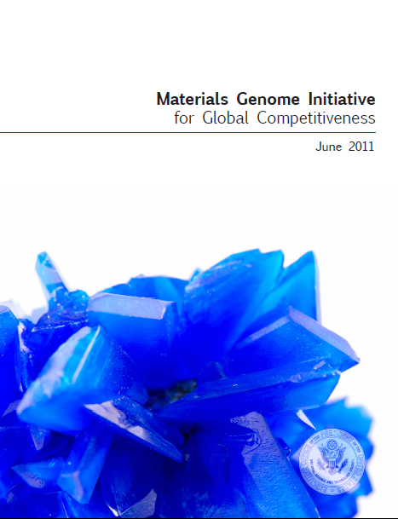
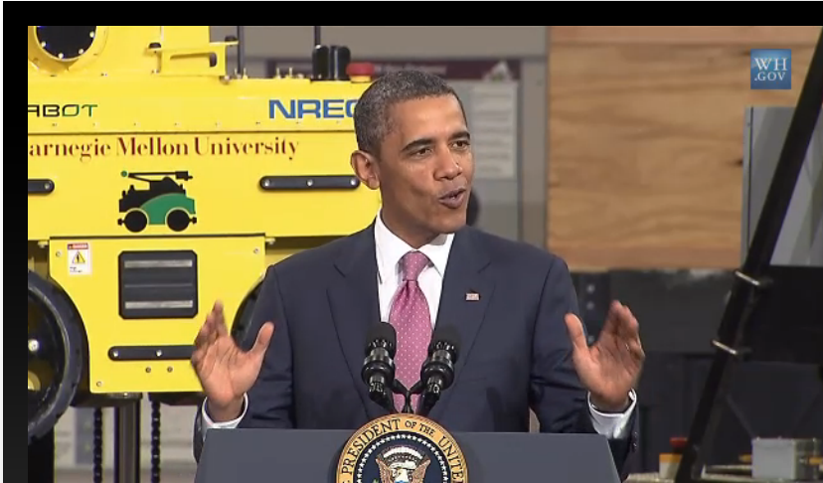
Materials & Chemistry by Design
Materials Genome Initiative
American Manufacturing
Joint BES-ASCR Workshop, July 2010
National Science and Technology Council,
Office of Science and Technology Policy
A Renaissance in American Manufacturing, President Obama Speech on June 24, 2011
“We are at the threshold of a new era where predictive modeling will transform our ability to design new materials and chemical processes, thereby enabling rational discovery strategies for systems that were not tractable a few years ago.”
The Materials Genome Initiative will create a new era of materials innovation that will serve as a foundation for strengthening domestic industries …and offers a unique opportunity for the United States to discover, develop, manufacture, and deploy advanced materials at least twice as fast as possible today, at a fraction of the cost.
President Obama kicks off the Advanced Manufacturing Partnership (AMP), a national collaboration between the government, industries, and universities to invest in cutting-edge technologies, create new jobs and bring about a renaissance in American manufacturing. As part of his new AMP, the President is announcing an ambitious plan, the Materials Genome Initiative, to double the speed with which we discover, develop, and manufacture new materials.
35

Slide 36
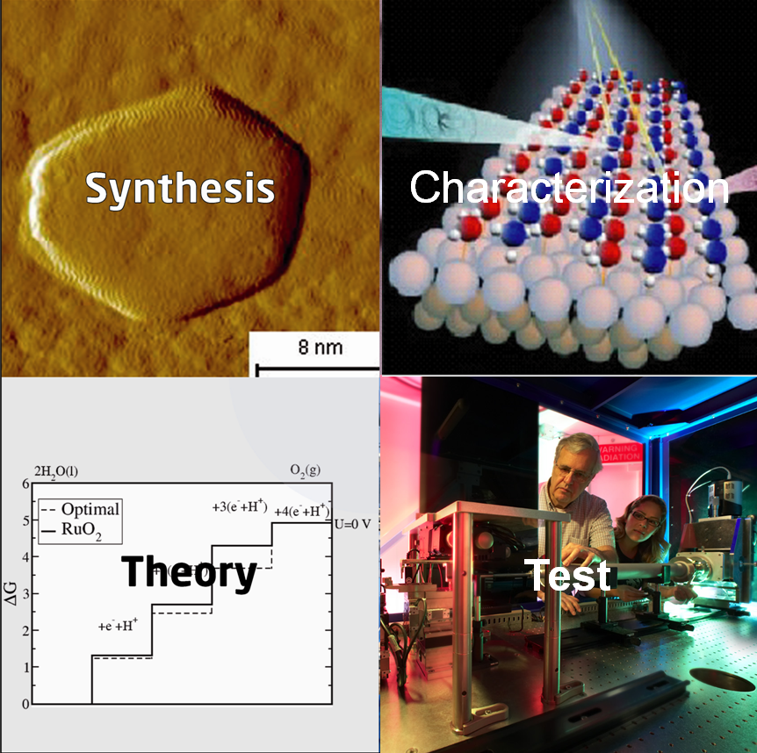
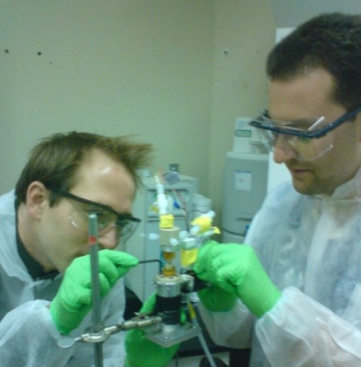
Expression of Interest
Predictive Theory and Modeling for Materials and Chemical Sciences
Program Drivers
Experimentally validated theory & modeling paradigm for design
User-friendly software tools
Harness the power of modern experimental tools and techniques
Data standards, management and data-driven design strategies
Science Topics:
Excited states and dynamics
Electronic and ionic transport
Electron correlations
Multiple length and time scales
Novel approaches
Required preliminary applications are due on March 1
Funding Types:
Single investigator/Small group
Glue funding
Software innovation centers
http://science.energy.gov/bes/funding-opportunities/predictive-theory-and-modeling/

