Slide 1




















Slide 2
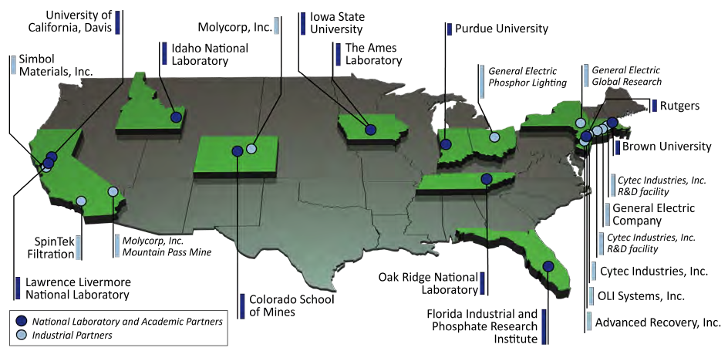
The CMI Partnership

Slide 3
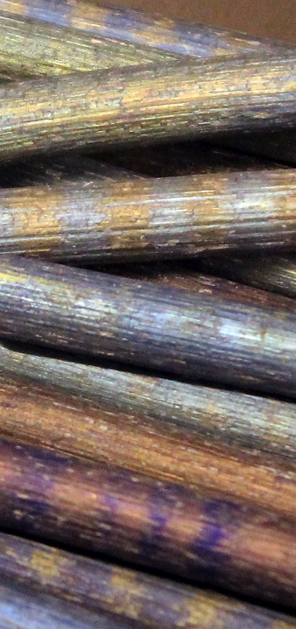
What is a “Critical Material?”
Any substance used in technology that is subject to supply risks, and for which there are no easy substitutes.
Or, in plain English – stuff you really need but can’t always get.
The list of materials that are considered critical depends on who, where and when you ask.
CMI focuses on clean energy technologies, in the US, over the next 10 to 15 years.

Slide 4
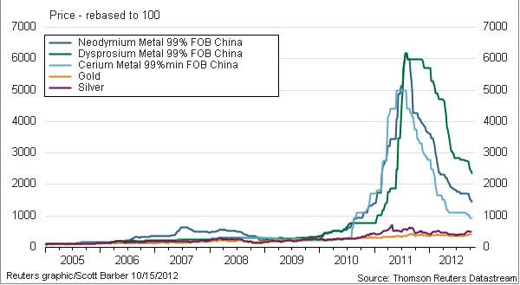
Rare Earth Prices compared to Gold & Silver

Slide 5
Annual Average Cobalt Prices
Notes:
Those who fail to learn the lessons of history are condemned forever to repeat them.
The cobalt crisis arose in 1978 as a result of a revolution in Zaire.
Prices returned substantially to their historic levels by 1982.
What happened subsequently is typical of “materials crises”….
We are trying to take the long term view of what needs to be done…

Slide 6

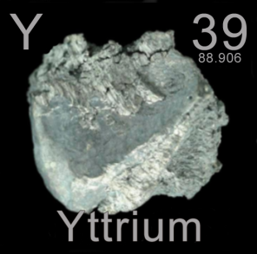
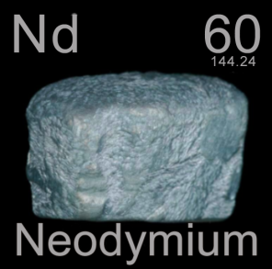
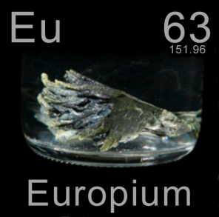
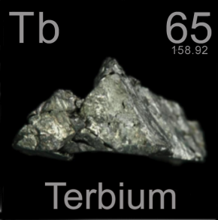
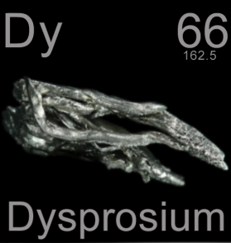
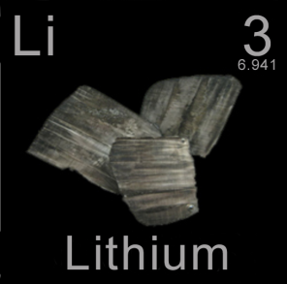
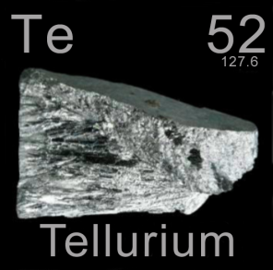
The Mission of CMI
  Eliminate materials criticality
  as an impediment to the commercialization
  of clean energy technologies
  for today and tomorrow.

Slide 7
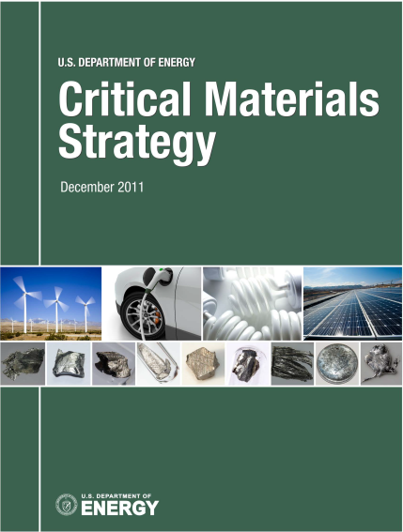
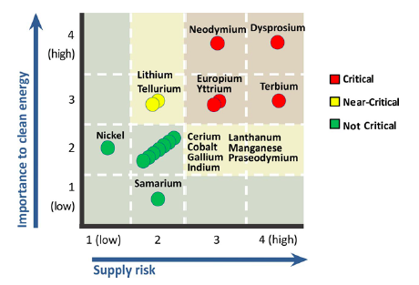
Implementing DOE’s Critical Materials Strategy
Medium Term: 2015 – 2025

Slide 8
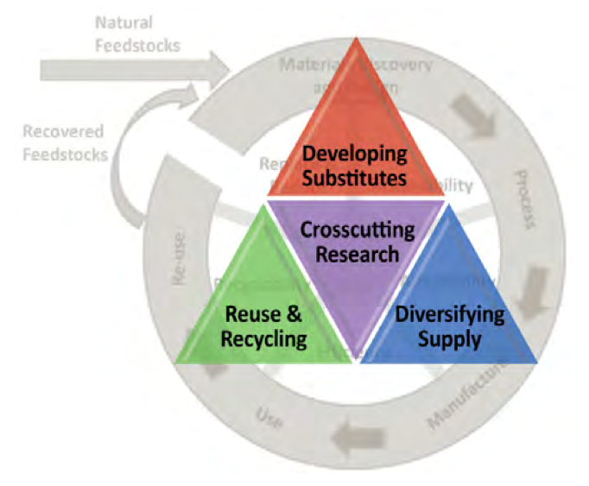
The Three Pillars of DOE’s Strategy
Diversify global supply chains,
Develop substitute materials,
Enhance recycling, reuse and efficient use of materials,
            …but not ALL of these in EVERY case!

Slide 9
CMI Project Selection and Design
CMI addresses 7 critical or near-critical chemical elements.
36 initial projects, selected for several criteria
  Potential for impact at a key point in the materials lifecycle, in a realistic timeframe.
  Integration of strengths and capabilities across the Hub. (No project is carried out by a single partner institution.)
  Clear path to deployment. Commercialization plan in place on day one.
  Annual evaluation addresses continued adherence to the timeline and each of the above criteria.
As the world changes, we expect to terminate projects and start new ones.

Slide 10
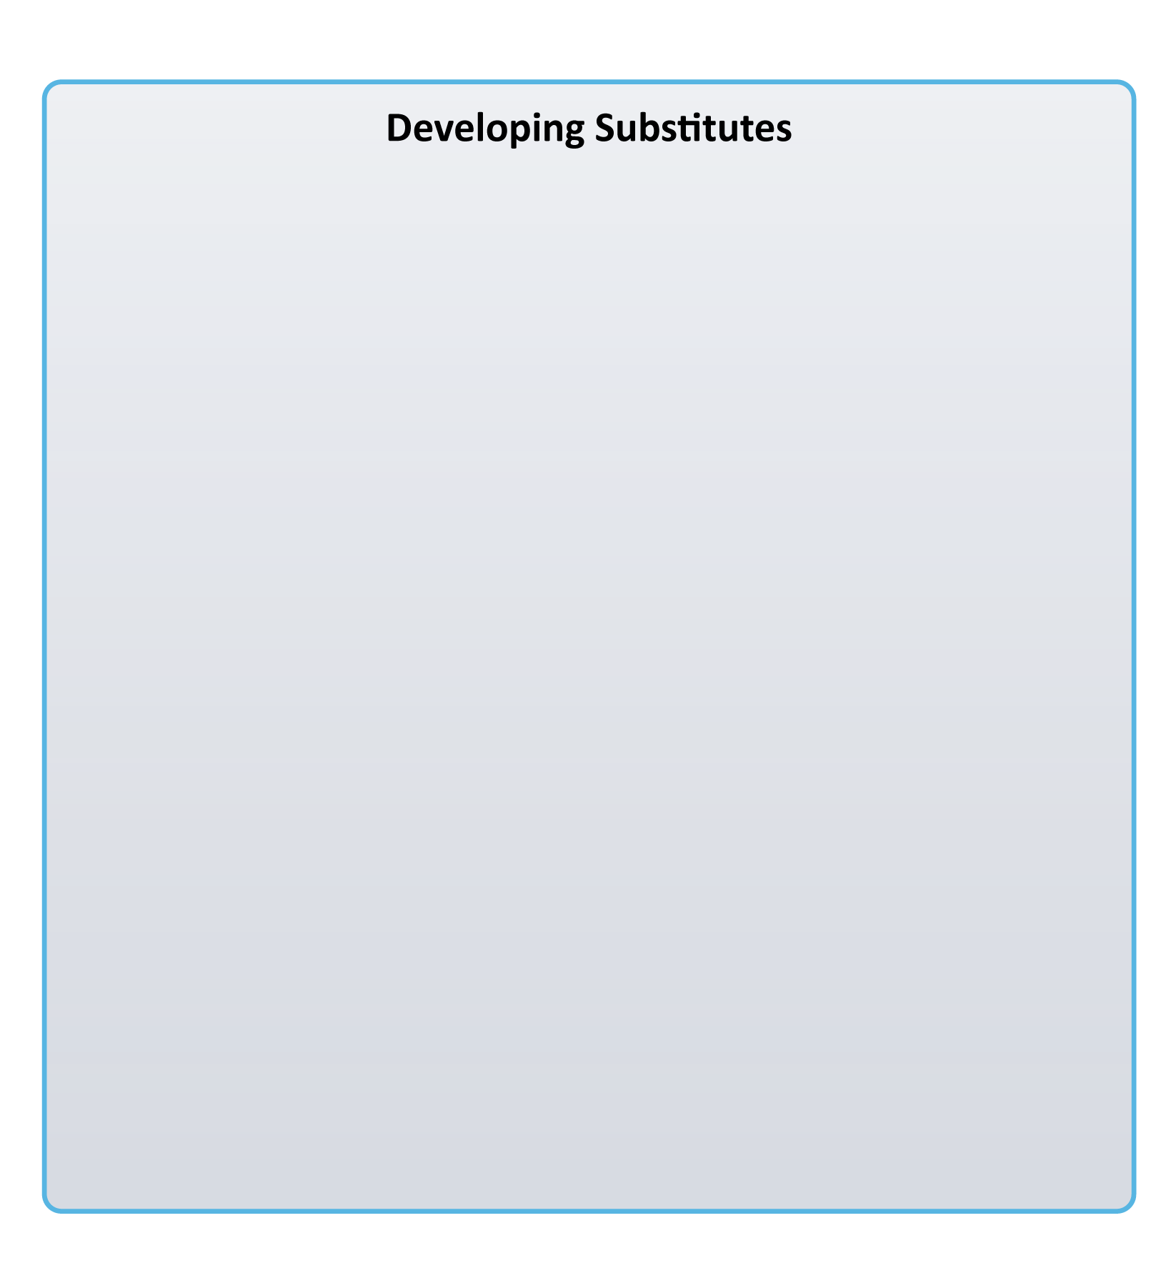
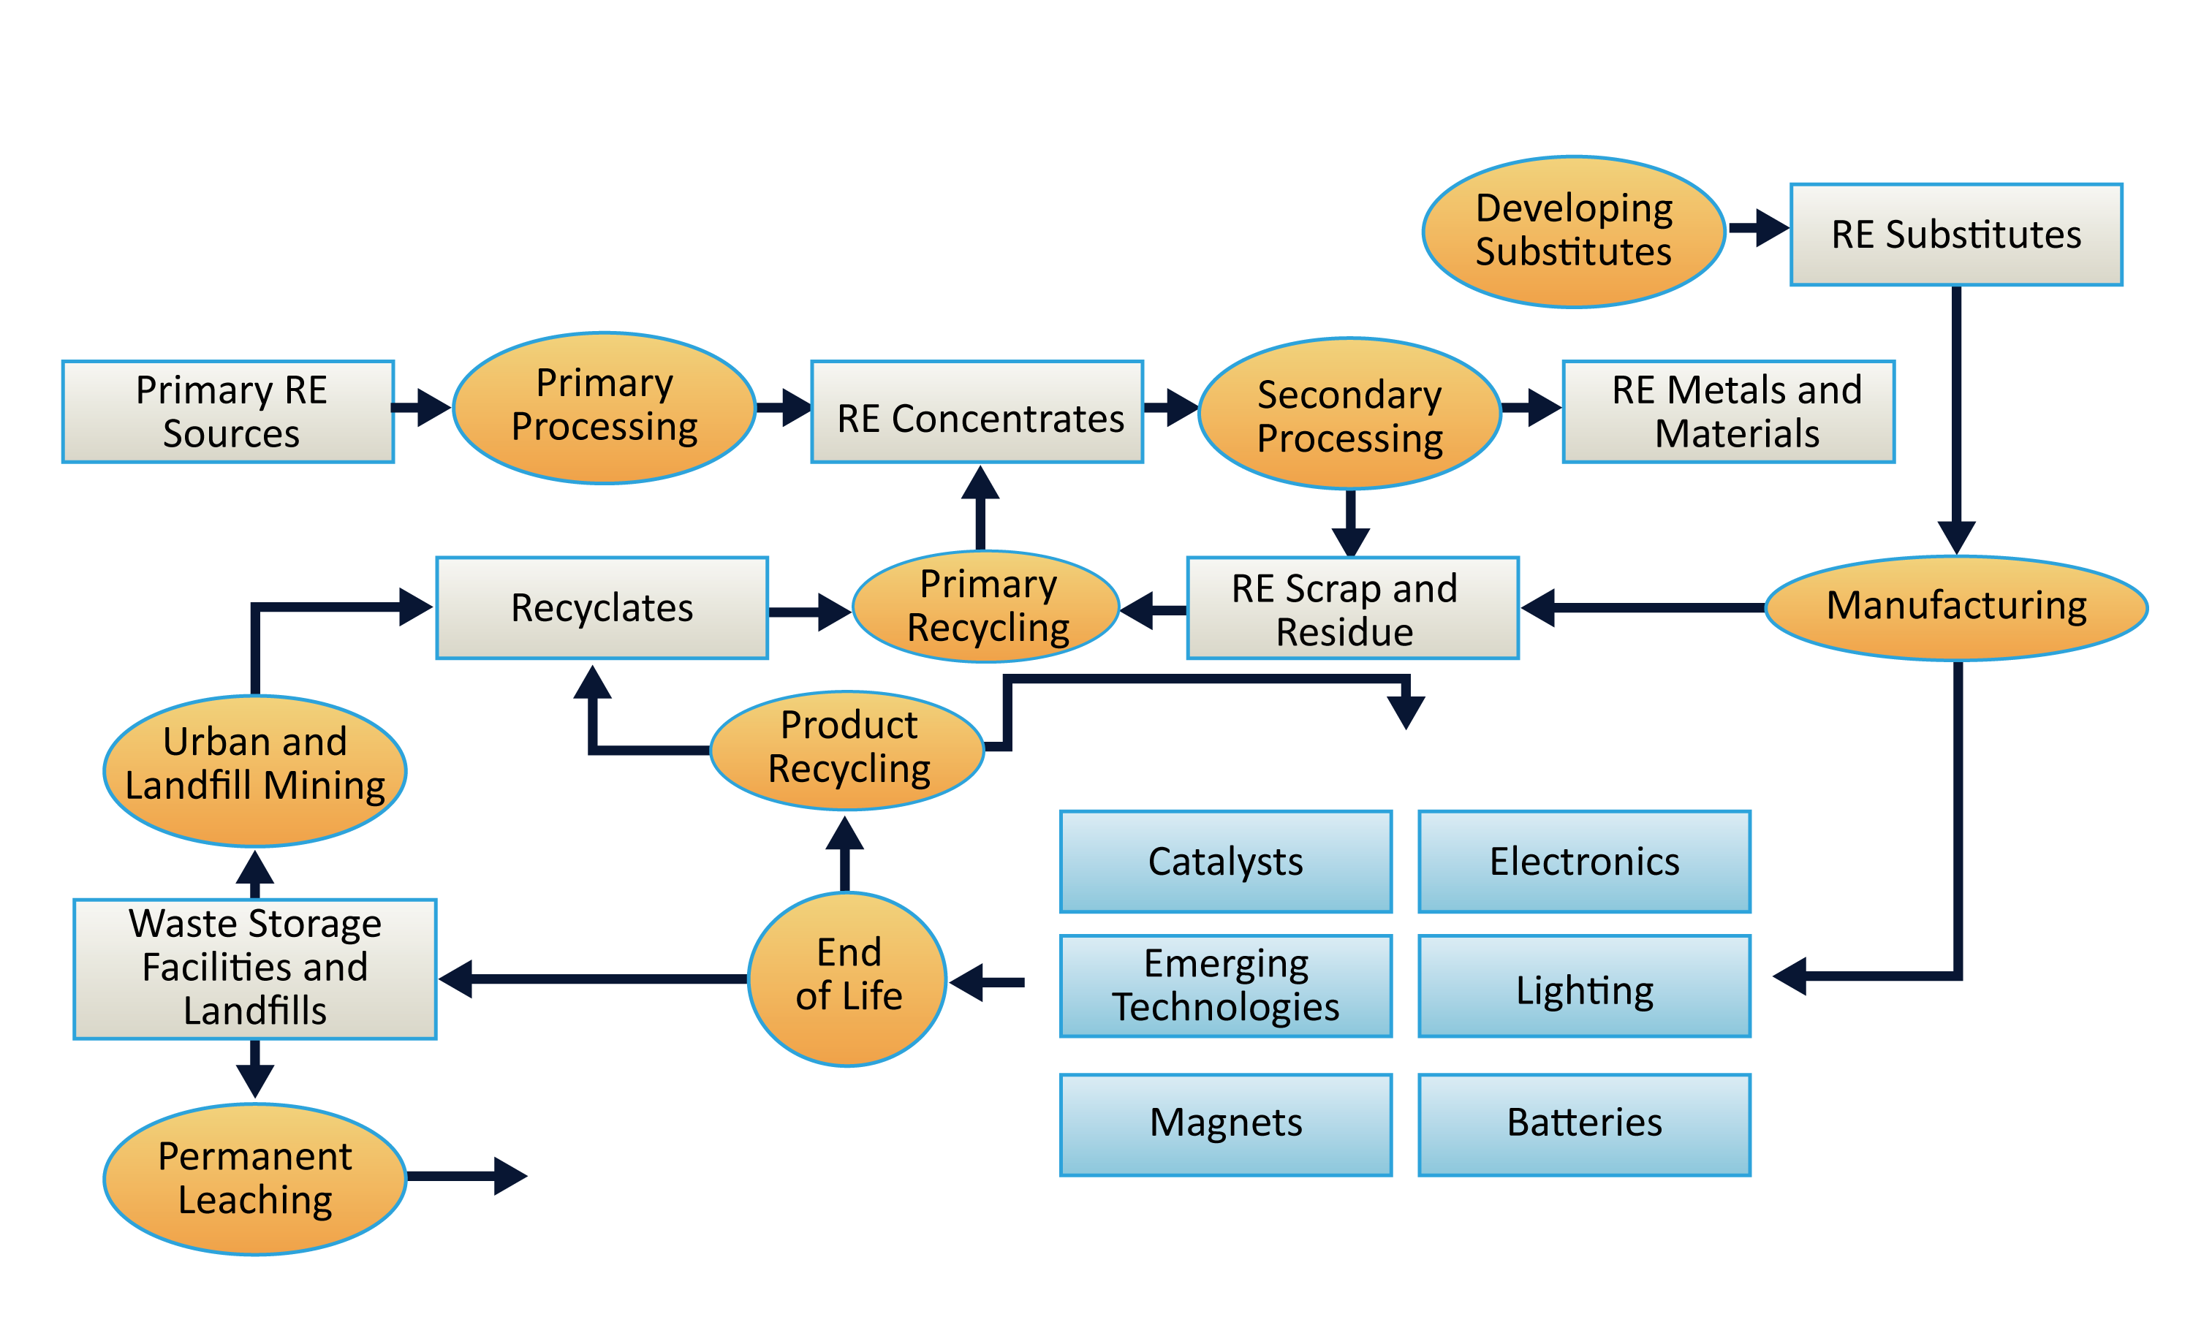
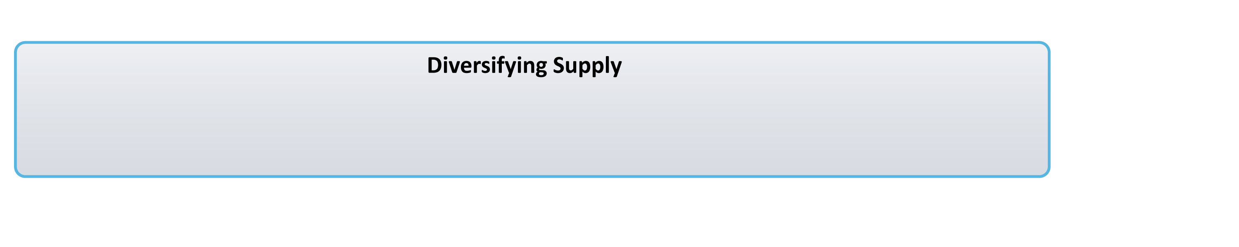
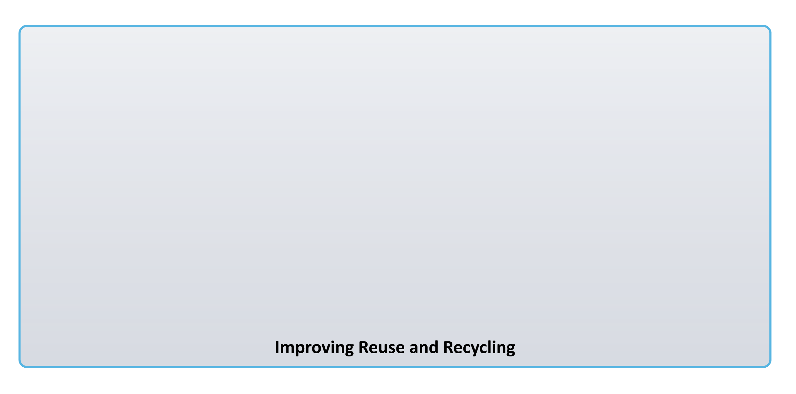
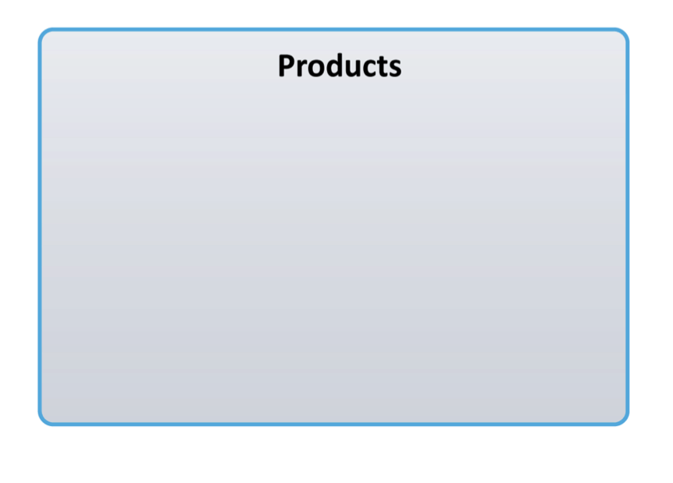
Supply Chain and Economic Analysis

Slide 11
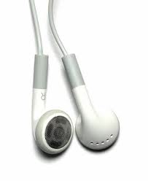
Neodymium
Used for high-performance magnets
Traditional uses:
  Hard disk drive spindle motors
  Portable electronics - loudspeakers & microphones
  Small motors in vehicles
Emerging uses:
  Traction motors in electric vehicles
  Wind turbine generators
Notes:
Cannot recycle to meet emerging needs. Must develop new sources or substitutes. Timescale issues.

Slide 12
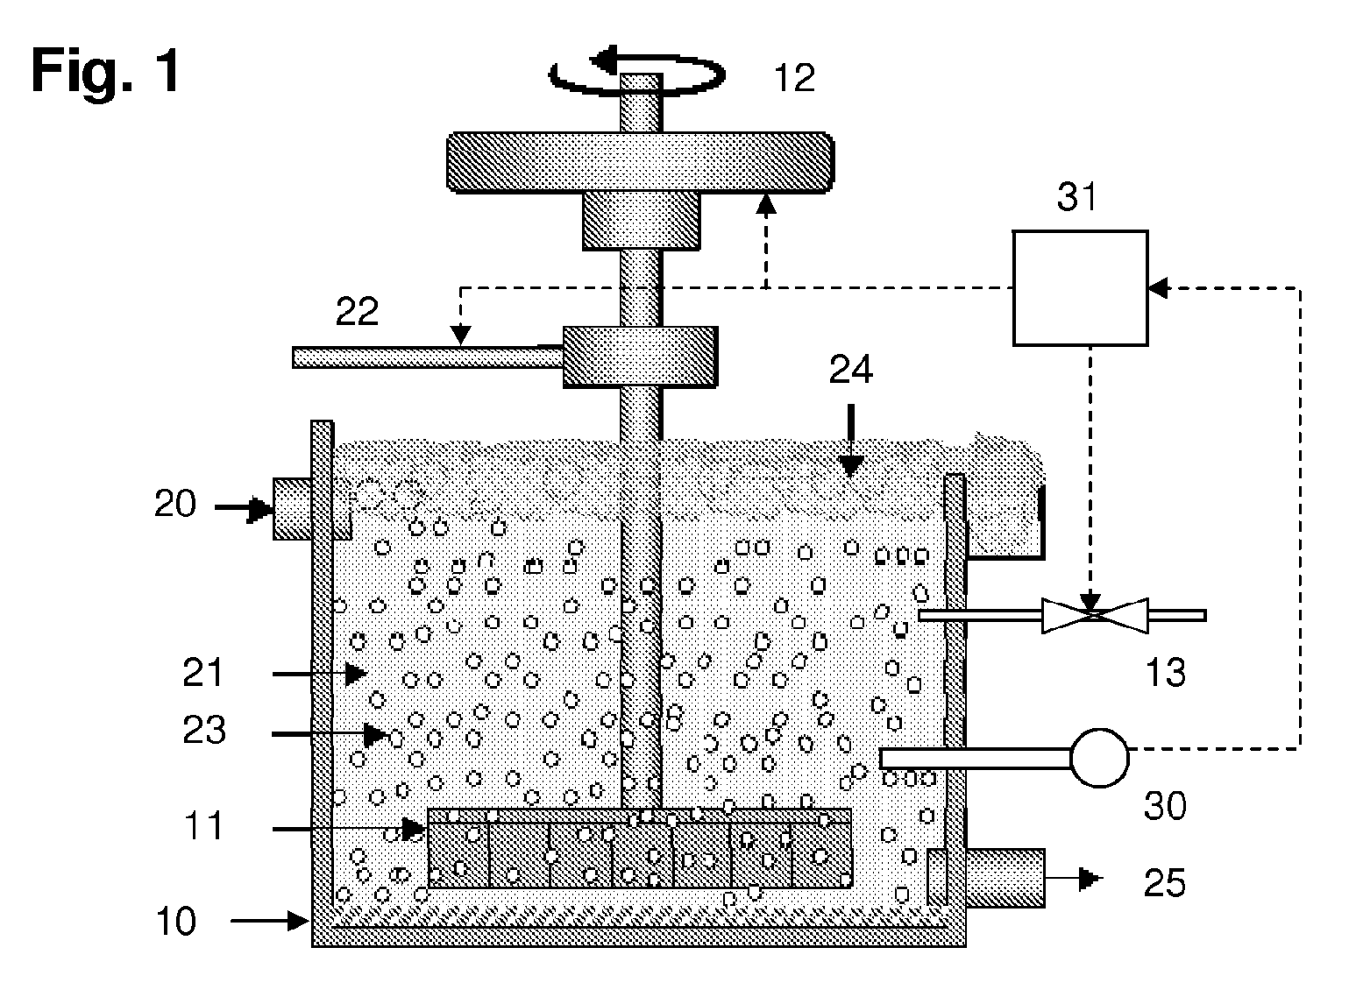
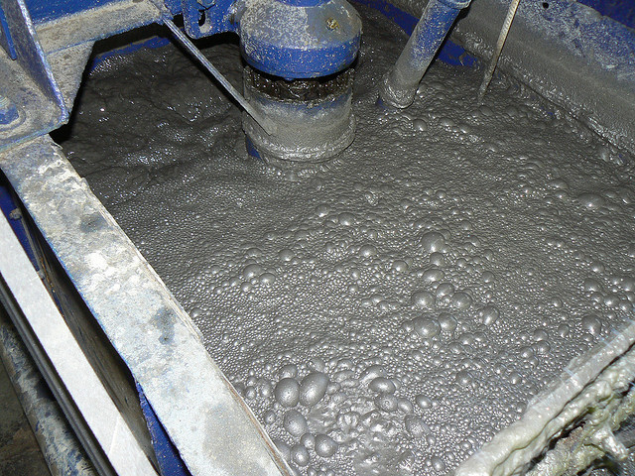
Classical Froth Flotation
Separates valuable ore from the associated gangue.
Concentrates bastnaesite, but not monazite.
Monazite contains more of the higher-value heavy rare earths, but currently goes to the tailings heap.

Slide 13
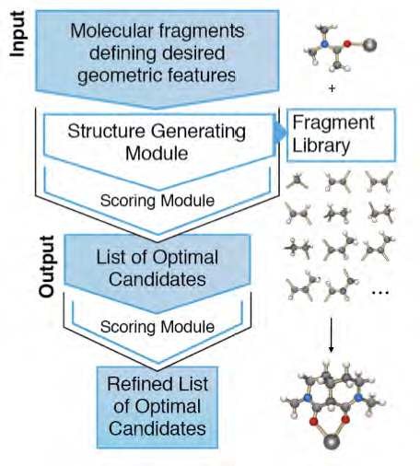
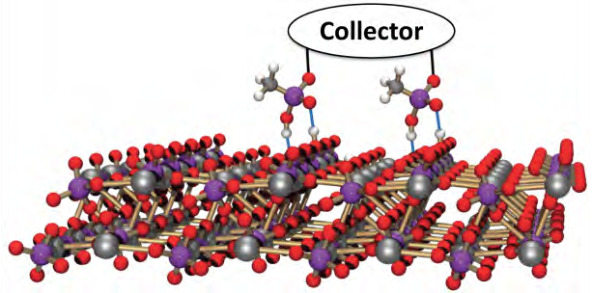
Quantum Froth Flotation
Solution: find collector molecules that bind monazite to air bubbles.
Quantum chemistry computations at Ames and Oak Ridge.
Pilot-scale testing at Idaho.
US-based chemical manufacturers.
Deployment to US mines.
Notes:
Note – tech transfer path is built in from the beginning.

Slide 14
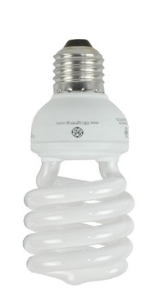
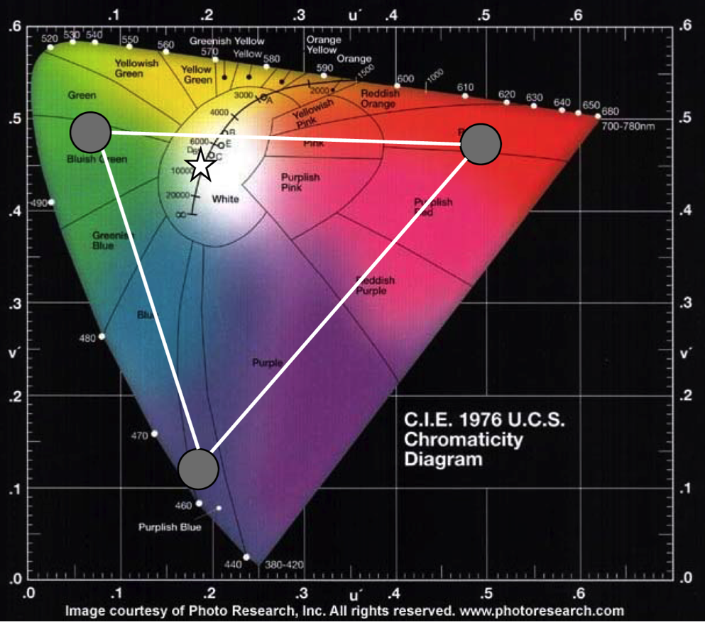
Terbium & Europium
Provide green and red light emission
Traditional uses:
  CRTs
  Long-tube fluorescent lamps
  Flat panel color displays and TVs
Current uses:
  Compact fluorescent lamps
  Personal electronics
Future uses:
  LED lighting
  OLED displays

Slide 15
Projected Annual Production of Emerging Mines tonnes of REO
Separating these elements is costly, time-consuming and potentially highly polluting.
Some ore bodies also contain radioactive elements.
Not all of the elements can be absorbed by the market.
Data extracted from US Department of Energy: Critical Materials Strategy, 2011.

Slide 16
Potential Annual Revenue, USk$/yr at April 2008 prices
Not all of this revenue is realizable, because some elements are overproduced relative to demand – notably Ce.
If we succeed in inventing a substitute for Nd, then its price will drop. This will reduce mine revenues and challenge the sustainability of supply for other rare earths.

Slide 17
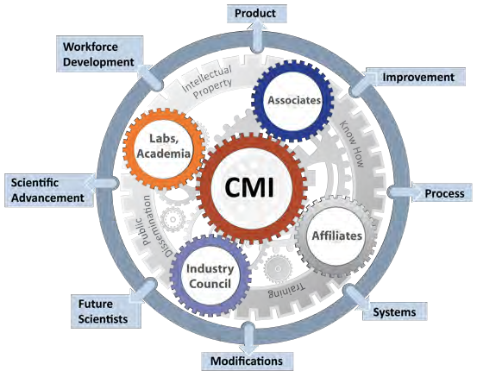
CMI’s Integrated Approach
Think-tank function determines technology-driven needs and timescales, which lead to focused research objectives most likely to produce impact.
Research capacity to address all aspects of the materials lifecycle as needed: cradle to grave… to resurrection.
Deployment strategy built into every project at the beginning.
Close connectivity with industrial, academic and government efforts.
  Industrial Associates program
  Critical Materials Information Center
  Federal Critical Materials Coordination Council
  Annual collaborative research workshop

Slide 18
Progressing Toward Deployment:
Budget Distribution by Technology Readiness Levels
Dollars in Thousands

Slide 19
CMI Today and Tomorrow
CMI has the team, management, and technical plan to assure the supply of materials for current and future clean energy technologies.
We will make scientific breakthroughs and drive innovation to market.
We will develop and deploy the technologies that lead to:
  Diversification of sources
  Development of substitute materials
  Improvements in usage, efficiency and recycling
  Improvements to economic analysis and forecasting
We will develop the next generation of scientists and technical experts.
We will anticipate rather than respond to materials supply crises.

Slide 20
Thank You!
Questions?

