Slide 1
Joint Center for Energy Storage Research: an Overview
George Crabtree | JCESR Director

Slide 2
Electricity and transportation – ready for transformation
→ electricity storage
JCESR challenge: 5-5-5
5x energy density, 1/5 cost, in 5 years
Beyond lithium ion – three storage concepts
Innovative tools for atomic and molecular level understanding
Design batteries from the bottom up
Prototypes ready for scale up to manufacturing
for the grid and transportation
A new paradigm for battery development
Integrate discovery science → prototypes in one organization
2

Slide 3
The Battery Development Challenge
Energy Demand
Two biggest energy uses poised
for transformational change
Transportation 29%
  Oil → Electricity
  Reduce foreign oil dependence
  Reduce carbon emissions
Electricity 40%
  Coal → Gas → Wind and Solar
  Reduce carbon emissions
  Sustainable energy supply
Industrial
Non-electric
20%
Electricity
Industrial
10%
Transportation 29%
Electricity
Commercial
15%
Residential & Commercial
Non-electric 11%
Electricity
Residential
15%
EIA Annual Energy Review 2009
The bottleneck for both transitions is
inexpensive, high density electrical energy storage
Notes:
Biggest energy users: Transportation and Electricity
Also biggest Carbon emitters, transportation (41%) and electricity (27%) in 2010
Electricity storage is critical enabling feature for both transitions

Slide 4
JCESR Targeted Outcomes
Achieving Goals For Lasting Legacies
Transformational goals: 5-5-5
  5 times greater energy density
  1/5 cost
  within 5 years
$100/kWh
400 Wh/kg 400 Wh/L
800 W/kg 800 W/L
1000 cycles
80% DoD C/5
15 yr calendar life
EUCAR
Transportation
Legacies
  Library of fundamental knowledge
    Atomic and molecular understanding of battery phenomena
  Pre-commercial prototypes for grid and transportation
  New paradigm of battery development
    Build the battery from the bottom up
    Systems-centric
    End-to-end integration
$100/kWh
95% round-trip efficiency at C/5 rate
7000 cycles C/5
20 yr calendar life
Safety equivalent to a natural gas turbine
GRID
Notes:
5x energy density: driving range Volt=38 mi/full charge, Leaf=73 mi/full charge, gas car=300 mi/full tank
(Tesla is 265 mi/full charge, simply by using bigger, more expensive battery. Tesla S retail $80K/265 mi, volt $39K/38 mi, Leaf $35.2K/73 mi.)
For grid, main drive is cost: compete against hydroelectric where geologically suitable, and gas turbines as back up for variability of wind and solar.
Community recognizes these as aggressive goals. In response:
On the back of an envelope, the most improvement you can get with the “best case scenario” (assuming all phenomena operate at high efficiency) is 10x. On this scale, 5x is well within reach
5-5-5 are the goals needed to transform transportation and the grid; lesser outcomes will not succeed in pushing transportation and the grid beyond the tipping point. JCESR wants to face the challenge of transforming the grid and transportation; lesser goals will not be transformative.

Slide 5

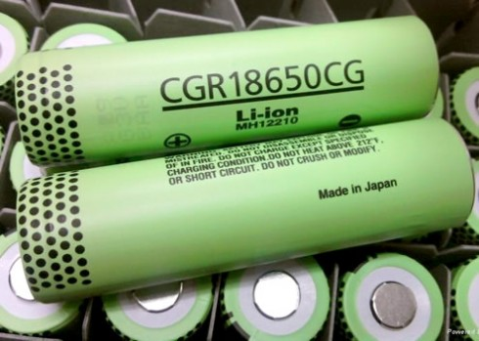
Conventional Battery R&D
Science
Journal Articles/Patents
Science Community
Isolated
Isolated
Engineering Community
Technology
5% Improvement per year
• Component-centric • Sequentially organized •
• Hunt-and-try approach • Incremental improvement •
5
Notes:
Science and Engineering communities
Science focuses on phenomena and materials, produces knowledge published in peer reviewed journals and discussed at scientific meeting
Engineering focuses on performance, produces devices, publishes in peer-reviewed literature and discusses at technical meetings. Li ion battery technology improves at 5%/yr (energy density), a champion performer among battery technologies. Cost decline at 8%/yr. This is an extraordinary record in the battery community, but still incremental and not transformational.
The science and engineering communities do not talk enough to each other, a traditional barrier that impedes rapid progress

Slide 6
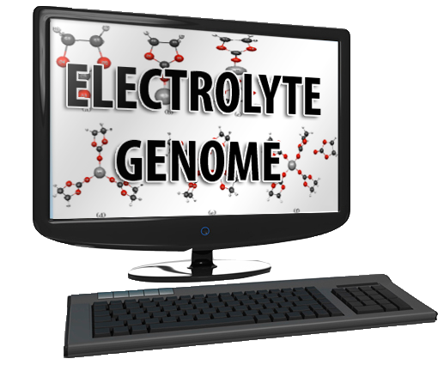
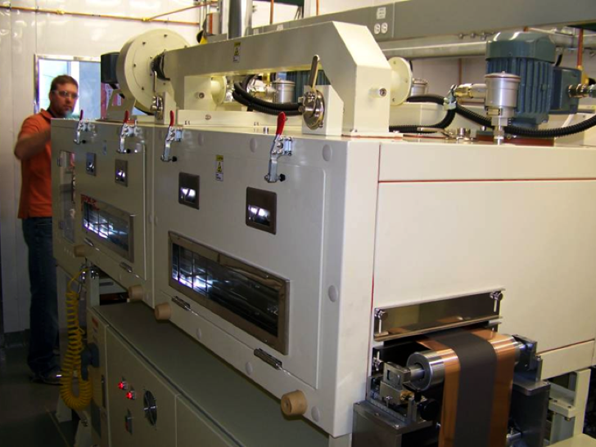
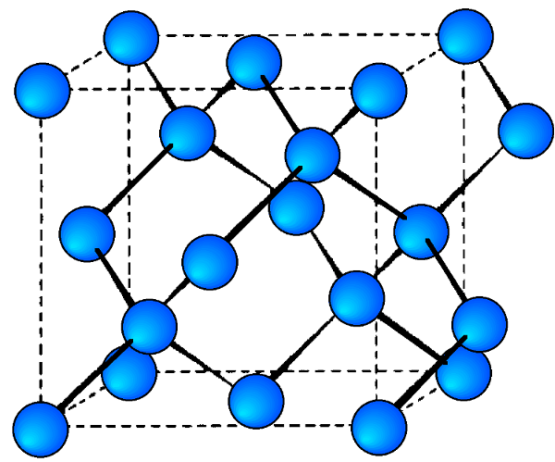
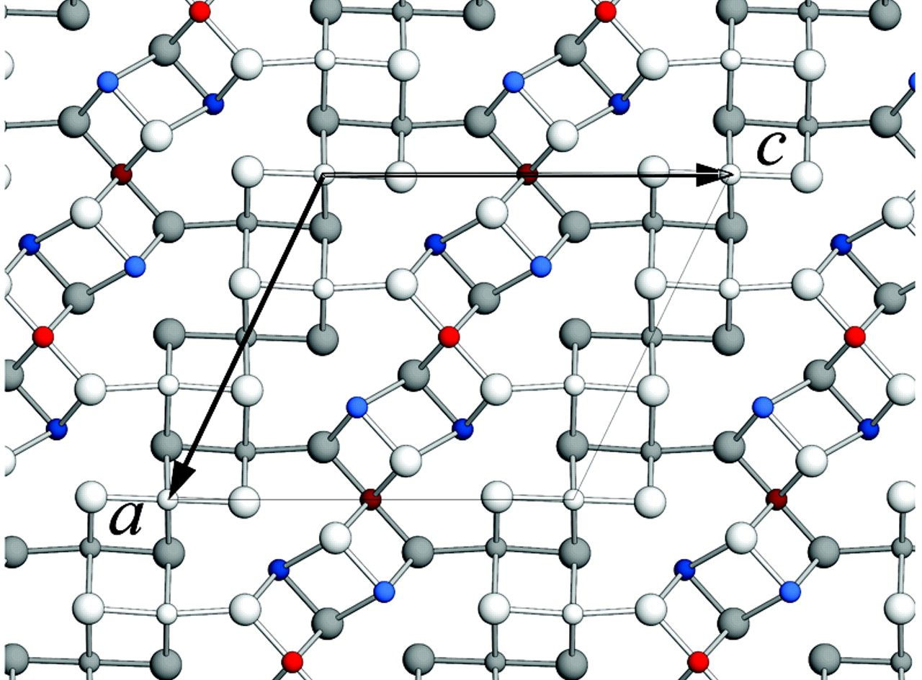
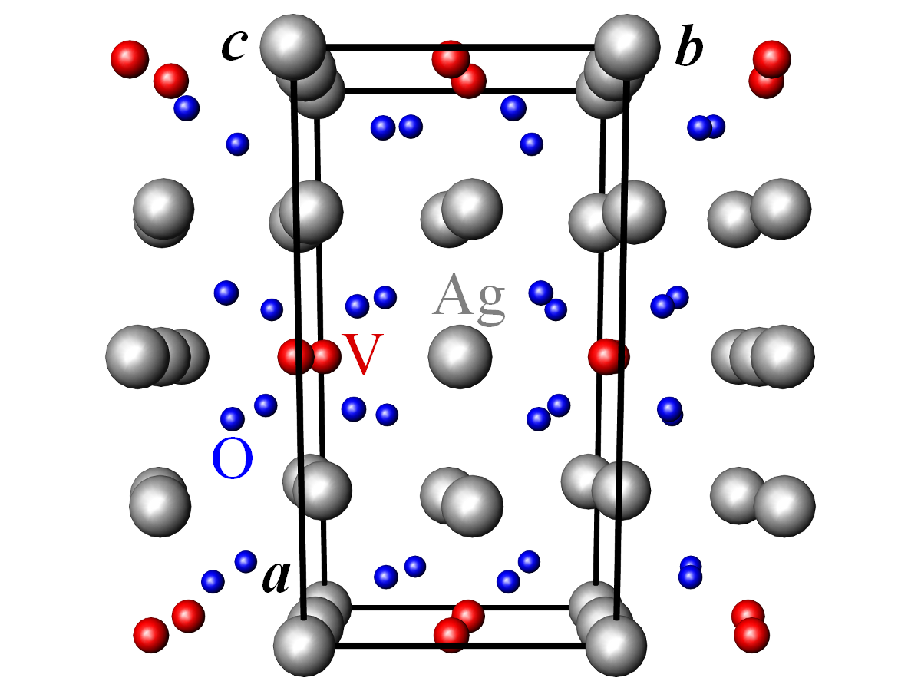
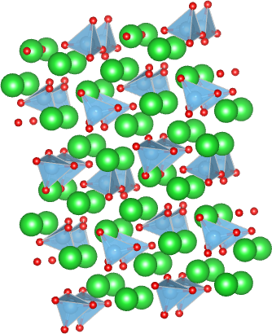

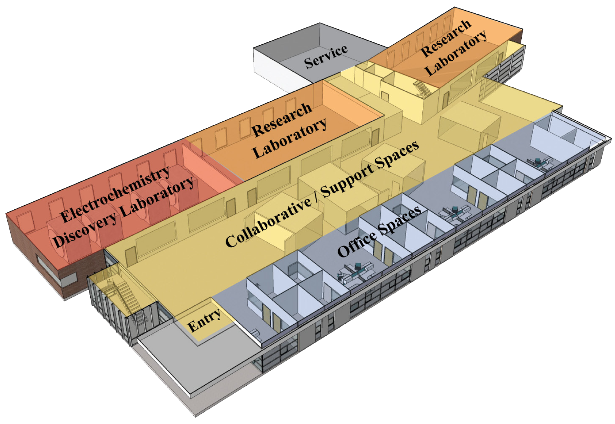
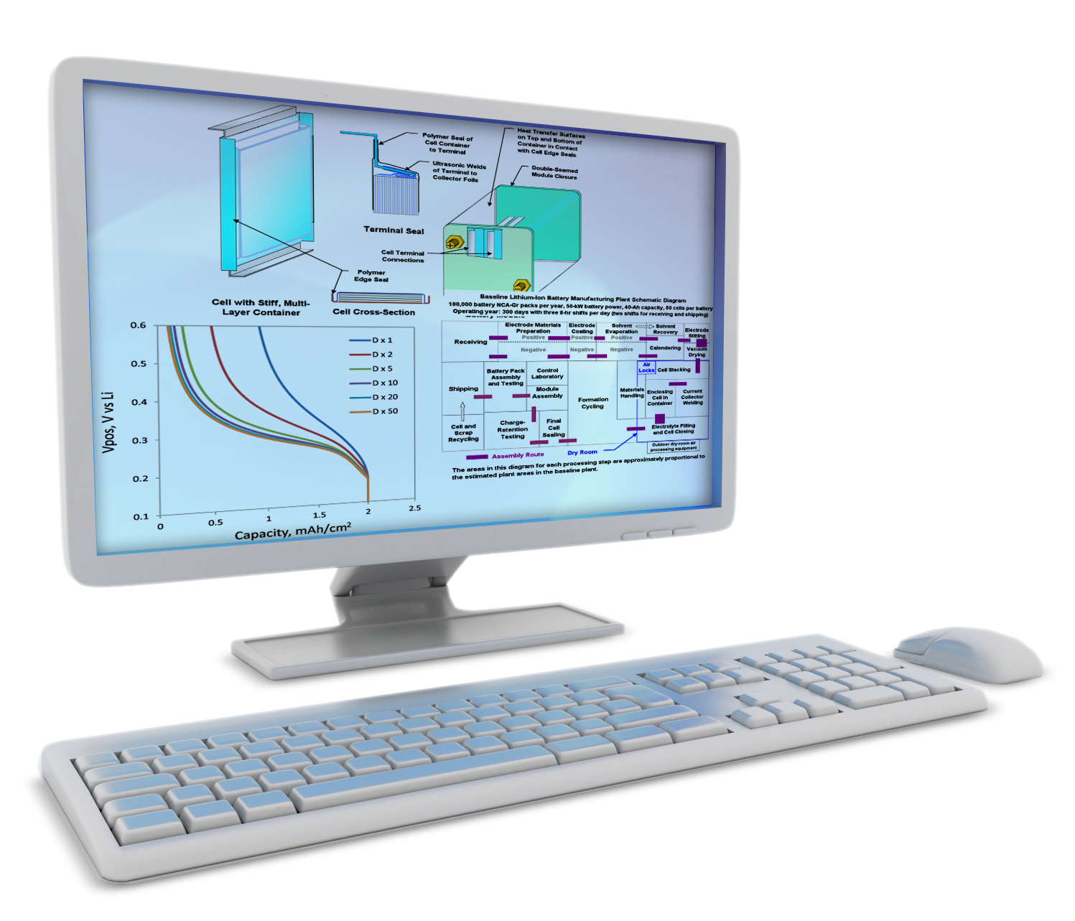
The JCESR Paradigm: Beyond Lithium Ion
MATERIALS
GENOME
Multivalent Intercalation
CROSSCUTING SCIENCE
Systems
Analysis
and Translation
Cell Design
and Prototyping
Commercial Deployment
Chemical Transformation
Non-Aqueous Redox Flow
TECHNO-ECONOMIC MODELING
EDL
Distinguishing tools
END-TO-END INTEGRATION
Notes:
The 5x goal of JCESR cannot be achieved with 5%/yr improvement of Li ion
JCESR looks exclusively beyond Li ion
Bring innovative set of ideas, tools and people together spanning discovery science of the materials and phenomena of electrical energy storage, integration, modeling and evaluation of materials and phenomena into a battery system, making and breaking prototypes that can be scaled to manufacturing level, and transferring prototypes to industry for manufacturing.
Three concepts for Beyond Li ion: multivalent intercalation, chemical transformation, non-aqueous redox flow
JCESR wants to understand these phenomena at the fundamental atomic and molecular level, to enable controlling the phenomena to design a battery from the bottom up. Conventional approach is “top down”: keep trying materials as battery components without considering atomic and molecular phenomena.

Slide 7









The JCESR Team
5
National Laboratories
Argonne
Lawrence Berkeley
Sandia
Pacific Northwest
SLAC
4
Private Sector Partners
Dow
JCI
Applied Materials
Clean Energy Trust
5
Universities
University of Illinois at Chicago
University of Chicago
Northwestern University
University of Illinois at Urbana-Champaign
University of Michigan
Notes:
Partners chosen for strategic contribution
Dow: materials and high throughput techniques
JCI=Johnson Controls, largest battery manufacturer in the world, mostly lead acid, they understand that lead acid will be overtaken by new technology and want to be on the forefront
Applied Materials (AMAT): leading makers of manufacturing equipment, focused on semiconductor industry, techniques are similar for battery manufacturing
Clean Energy Trust: a private non-profit in Chicago that promotes entrepreneurship, a key feature of Beyond Li Ion.

Slide 8
The JCESR Team
206 R&D 100 awards, 15 for batteries
142 startups in last decade, 12 battery startups
$1.3B in licensing revenues, 320 companies licensed
3 U.S. plants built from battery licenses
2 of 3 America’s “Top Energy Innovator” Award recipients (ANL, PNNL)
25,000+ patents teamwide; 718 battery patents
38 “Award of Excellence in Technology Transfer” by Federal Laboratory Consortium
Notes:
Achievements of the JCESR Team, most over the last decade
JCESR knows the battery community, know how to transfer technology

Slide 9
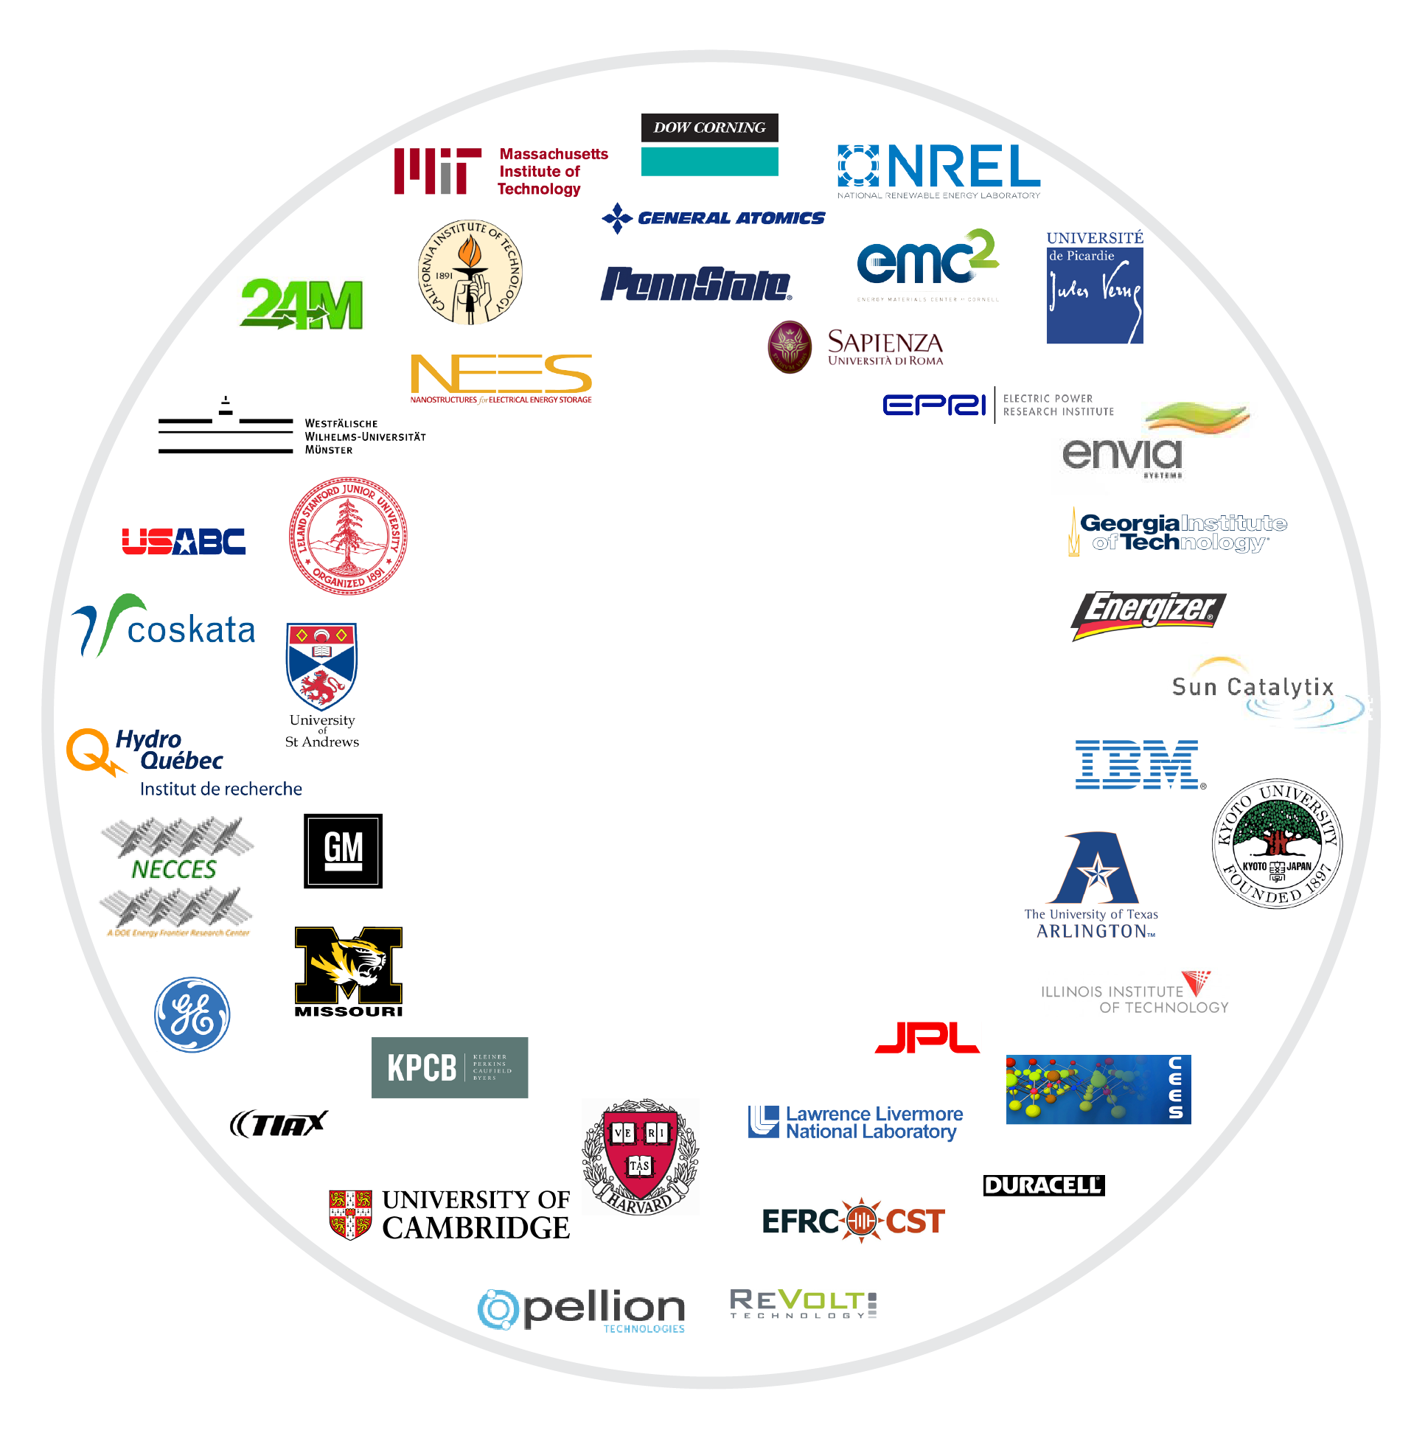






JCESR Affiliates
Centralizing force for battery field
40 organizations
Communicating
and
collaborating
with the
energy storage
community
Private
Companies
Venture Capital
Firms
Research Universities
Trade
Organizations
Energy Frontier
Research Centers
9
9
9

Slide 10

Beyond Lithium Ion
Storage Concepts
not
Battery Technologies
CROSSCUTING SCIENCE
Multivalent Intercalation
Chemical Transformation
Non-Aqueous Redox Flow
Multivalent Intercalation
Chemical Transformation
Non-Aqueous Redox Flow
TEN FUNDAMENTAL SCIENCE CHALLENGES
Multivalent Intercalation
Mobility in host structures
Mobility across interfaces
Stable and selective interfaces
Chemical Transformation
Phase transformation and juxtaposition
Functional electrolytes
Stable and selective interfaces
Non-Aqueous Redox Flow
Novel redox species
Ionic mobility
Interfacial transport
Stable and selective membranes
Notes:
Basic research goal is to understand the three concepts at the atomic and molecular level, not to use them as three distinct approaches to a beyond Li ion battery; ultimate battery may combine elements of each concept (see example near end of talk).
As part of proposal, asked why do we not have batteries based on these concepts today? Where are the “grand challenges”?
Identified ten fundamental science challenges, 3 or 4 for each concept, that must be overcome to enable battery technology. These ten challenges drive our research program.

Slide 11
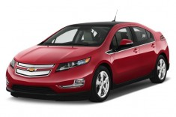
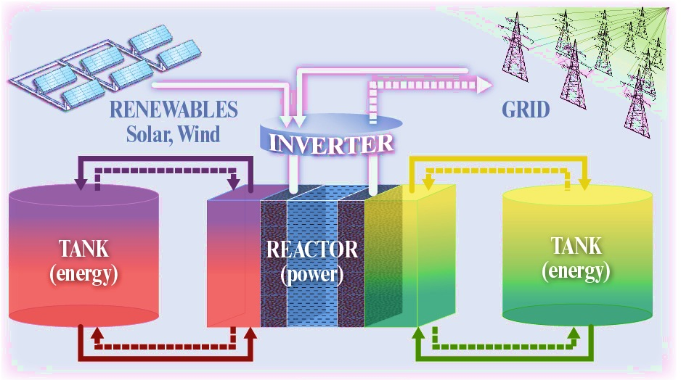
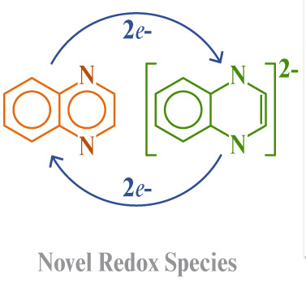
Beyond Li-ion Storage Concepts
CROSSCUTING SCIENCE
Multivalent Intercalation
Chemical Transformation
Non-Aqueous Redox Flow
electrons
ions
Non-aqueous redox flow
Flowable electrodes
solutions or suspensions
no structural constraints
rich horizon of unexplored redox couples
Low cost / high capacity
Multivalent intercalation
  Li⁺ → Mg⁺⁺, Y⁺⁺⁺, . . .
Double or triple energy stored and released
Chemical transformation
intercalation → chemical reaction
Li-O₂, Li-S, Na-S, . .
All atoms store and release energy
Highest potential, least understood opportunities
Notes:
The three concepts
Multivalent intercalation: replace monovalent Li with divalent Mg or trivalent Y, double or triple the energy stored per ion
Chemical Transformation: replace intercalation between layers (as in graphite anode) with formation of a chemical bond. Chemical bond stores more energy that intercalation, and allow all atoms in the cathode to participate in storing energy. Li-air is example of this concept.
Non-aqueous redox flow: Replace solid material anode and cathode with flowable electrodes, either as a solution of single ions or as a suspension of nm size colloidal particles. Flowable electrodes can be pumped to a remote location and stored in large tanks, enabling high capacity energy storage for the grid.
Figure of merit: solubility of active ion, to minimize volume and weight of battery, boost energy density and lower cost (right image on lower right – high solubility not only raises energy density, it lowers cost of energy, allowing more expensive active materials to be used).
Opportunity: rich space of redox active species, many more organics than conventional metals (left image in lower right)
Need a genome-like computational approach: JCESR introduced a new concept, the Electrolyte Genome, to address this opportunity

Slide 12
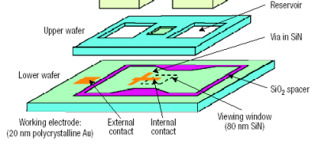
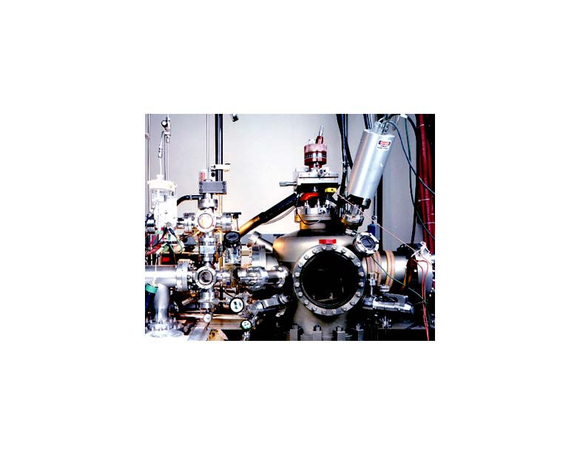
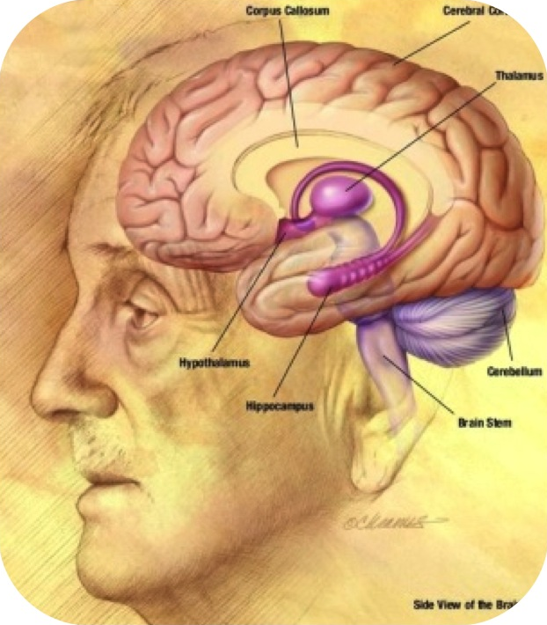
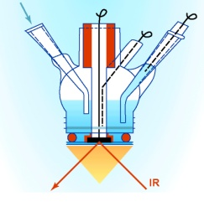
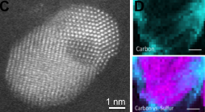
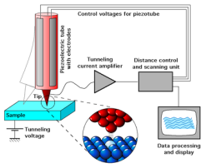

JCESR Integrated Approach
Resolving challenges
CROSSCUTING SCIENCE
Multivalent Intercalation
Chemical Transformation
Non-Aqueous Redox Flow
Understand battery phenomena
at atomic and molecular levels
→ Design the battery from the bottom up
Trends in activity,
stability and selectivity
Solve the ten fundamental
science challenges
  → Science-based design rules
UHV
TEM
Computation
FTIR
ALS, APS, SNS, EMSL, MRL
INDUSTRY PARTNERS AND AFFILIATES
STM
SXS

Slide 13
What’s the Science in JCESR?
CROSSCUTING SCIENCE
Multivalent Intercalation
Chemical Transformation
Non-Aqueous Redox Flow
Observe
Examples
Electrochemical Discovery Lab (EDL)
In-situ TEM
In-situ NMR
On top of x-ray and neutron scattering…
Control
Examples
Surfaces
Bulk structures
Soft material
Spanning the three storage concepts
Translate
Examples
Techno-economic models
Prototype batteries
Industrial engagement
Translation occurs in two directions
Electrolyte
Genome

Slide 14
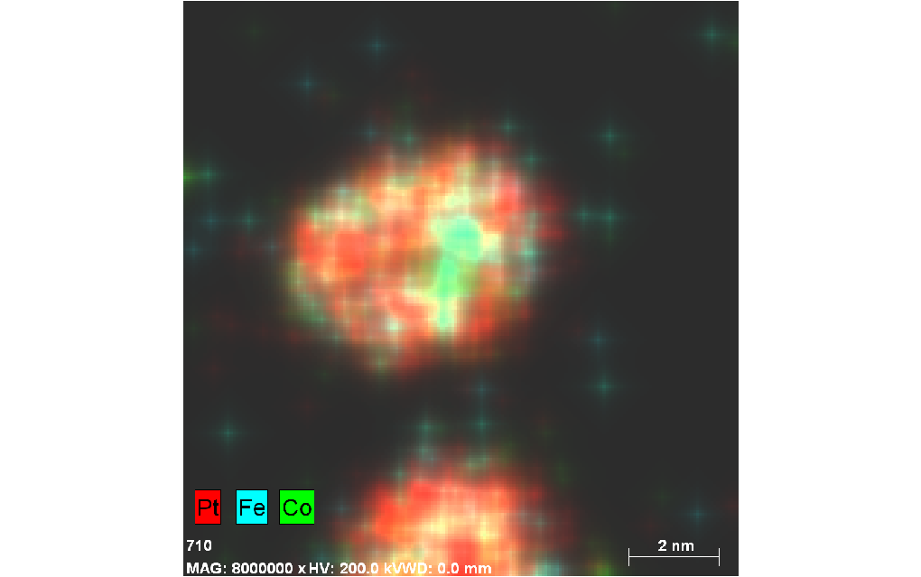
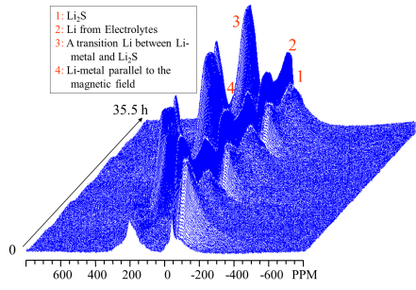
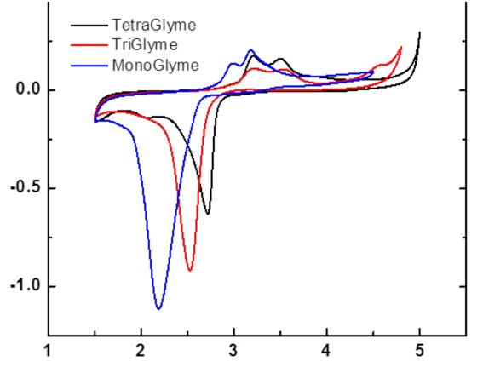
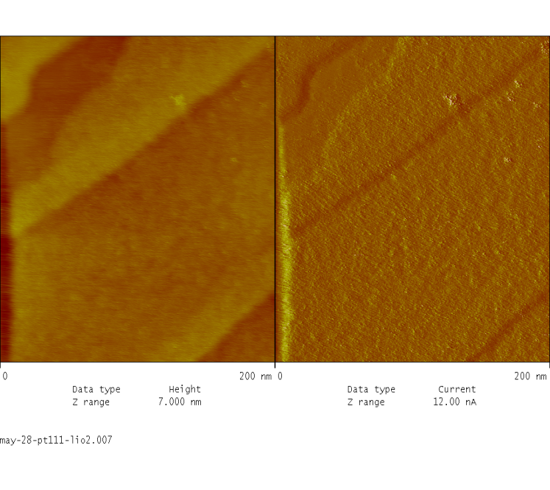
The Electrochemical Discovery Laboratory
The Hub of the Hub
CROSSCUTING SCIENCE
Multivalent Intercalation
Chemical Transformation
Non-Aqueous Redox Flow
EDL
Cell Design and Prototyping
Techno-economic
Modeling
MATERIALS
GENOME
COMPOSITE SYSTEMS
Synthesis
UHV Spectroscopy
ELECTROCHEMISTRY
SURFACES•INTERFACES
1 ML of Li_{X}O_{x}
Current
Au(100)
Au(100)
Thin Film
Single Crystal
MBE•CVD•PVD
XPS•Leed•FTIR•UPS•AES•Raman•SFG•nmr
Potential (V vs. Li)
STM•AFM
RDE•RRDE
Notes:
Fed by the two genomes: materials and electrolyte
Combines state of art tools in one laboratory: synthesis (single crystal and thin films), characterization by structure, spectroscopy, imaging, transport, and electrochemistry, all without removing the sample from its protected environment, vacuum or inert atmosphere.
The output of the EDL will be input for Techno-economic modeling and Cell Design and Prototyping.
The materials and electrolyte genome, the EDL, Techno-economic modeling, and cell design and prototyping form an innovation loop of new ideas.

Slide 15
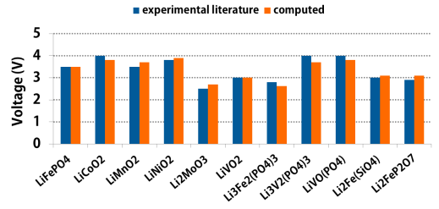
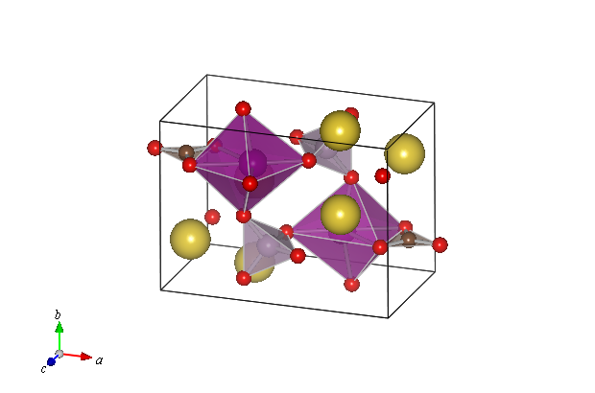
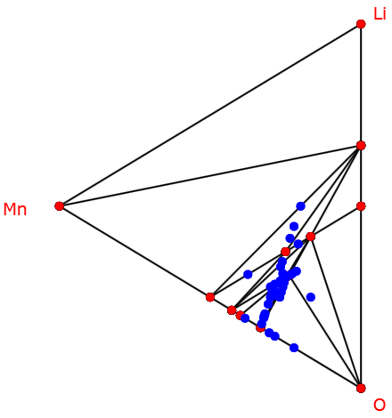
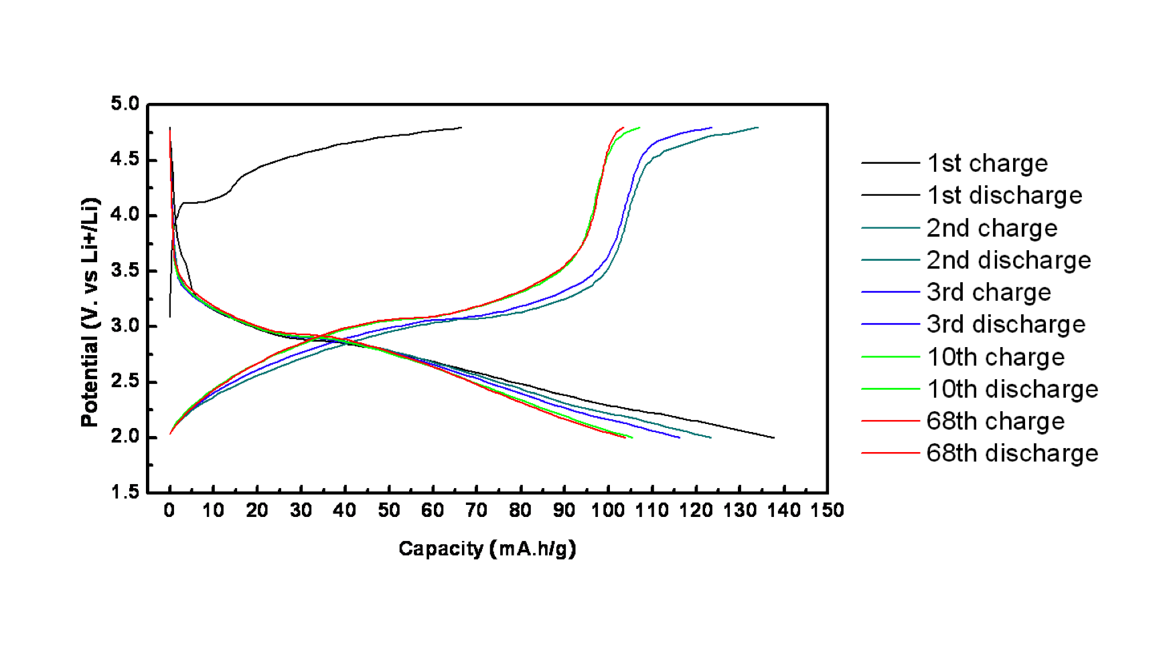
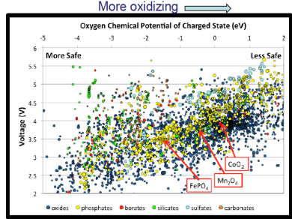
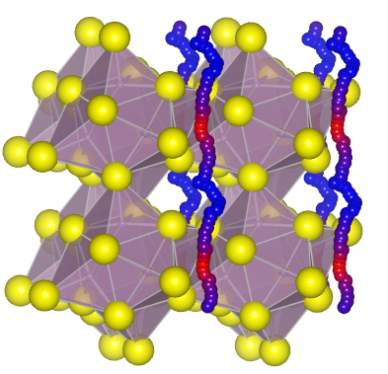
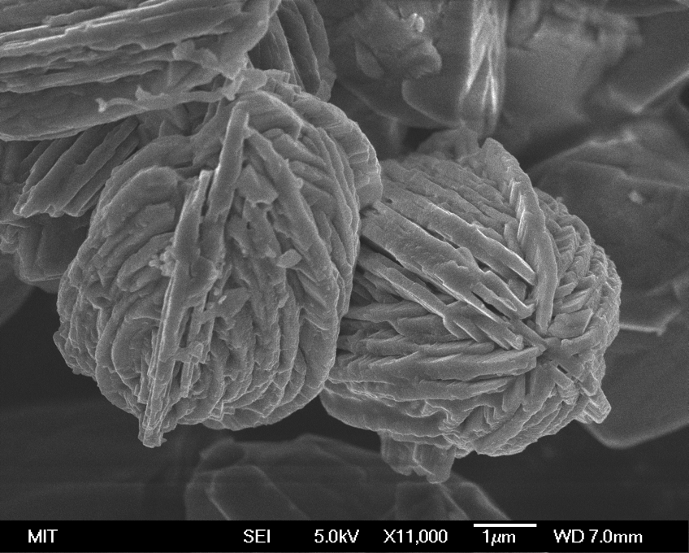
The Materials Genome Approach
High-throughput calculations and datamining of structure-property relationships for 10⁵ of materials
Multivalent Intercalation
CROSSCUTING SCIENCE
Chemical Transformation
Non-Aqueous Redox Flow
Voltage
“Sidorenkites”: Li₃M(CO₃)(PO₄)
(M = Fe, Mn, Ni, Co)
Structural Stability
MATERIALS
GENOME
O₂ release: safety
Ionic mobility
Discovery of New Classes of Functional Materials
Notes:
Materials Genome approach
Concept and implementation approximately 5 years old.
Basic version: simulate 1000 materials for specific figures of merit (e.g, for batteries, operating voltage, structural stability etc shown on left) and find 5 that look promising; then synthesize and explore those 5 in the laboratory. Saves enormous time over making all 1000 in the laboratory, streamlines the discovery process.
Sophisticated version: look for trends in properties among a library of tens of thousands of materials, and design the target material for specific properties.
Example: new cathode, Sidorenkites (upper right), discovered for Li ion batteries, would not have been thought of by traditional intuition.

Slide 16
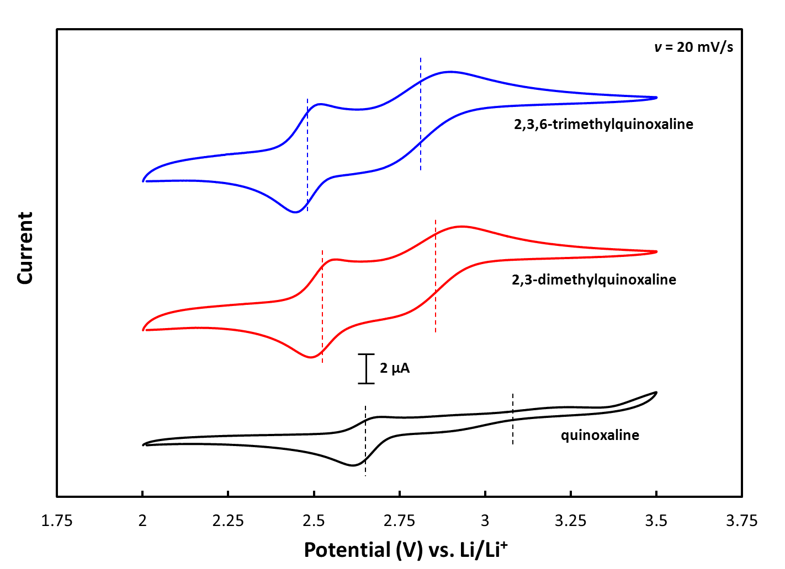
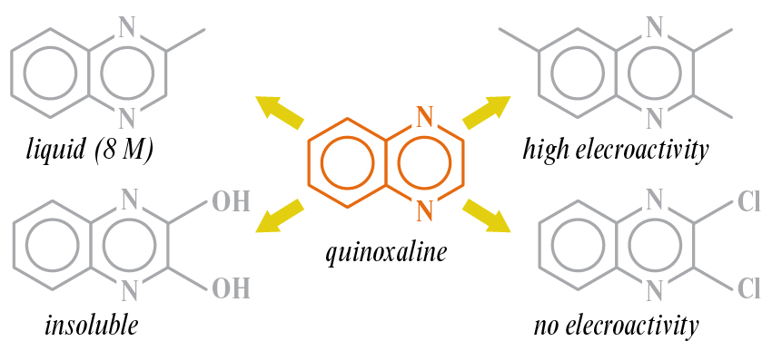
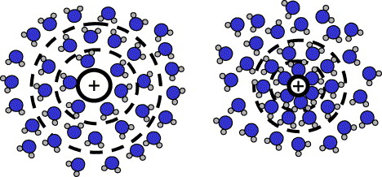
Building an Electrolyte Genome
CROSSCUTING SCIENCE
Multivalent Intercalation
Chemical Transformation
A new horizon for designing novel electrolytes and redox-active molecules
Non-Aqueous Redox Flow
0.2 M LiBF₄ in PC, Pt/Li/Li cell, 20 ms⁻¹
Computational structure/composition/property platform
10⁴-10⁵ solvents, salts, and redox molecules;
organized for interactive searching and design
Redox activity
Stability against cathode / anode
Solvation structure and mobility
Solvation / desolvation dynamics
Solubility
Energy storage capacity
++
++
Notes:
Electrolyte genome
Electrolytes are a central component of batteries, but only a few are known and used.
New electrolytes are needed for all three concepts, must be compatible with working ion and with electrodes
The opportunities are rich, e.g., quinoxiline can be tailored to be highly soluble or insoluble, highly electroactive or inactive, by adding simple structural elements (upper right)
The electroreactivity of quinoxaline (upper left) can be tailored to release one or two electrons, and the position of the reaction peaks can be controlled by adding ligands.
Genomic approaches were developed for solids with crystal structures, not yet applied to polar liquid solvents containing dissolved salts
JCESR will build the first electrolyte genome, a computational approach to simulating and evaluating the performance of liquid electrolytes
The electrolyte genome will evaluate many relevant properties, such as the ones on the lower left
The electrochemical dynamics is complex: the working ion must shed its solvation shell, penetrate a barrier at the solid-electrolyte interphase, then intercalate into the cathode or anode as a single ion.

Slide 17
The JCESR Paradigm: Beyond Lithium Ion
MATERIALS
GENOME
Multivalent Intercalation
CROSSCUTING SCIENCE
Systems
Analysis
and Translation
Cell Design
and Prototyping
Commercial Deployment
Chemical Transformation
Non-Aqueous Redox Flow
TECHNO-ECONOMIC MODELING
EDL
Distinguishing tools
END-TO-END INTEGRATION
Notes:
We have talked about the discovery science component of JCESR (left side). The materials and phenomena discovered in the Concepts and Crosscutting Science teams will be integrated into battery systems on the computer using techno-economic modeling, in the Systems Analysis and Translation component of the Hub, and the best of the battery systems will be promoted to Cell Design and Prototyping.

Slide 18
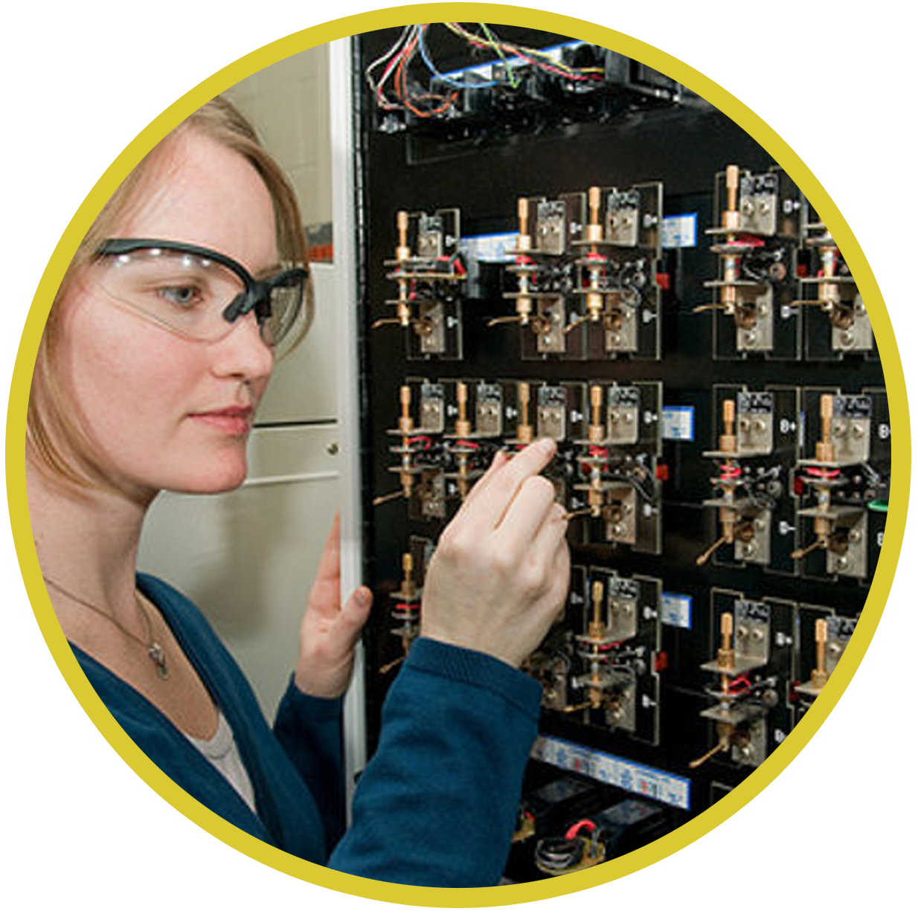
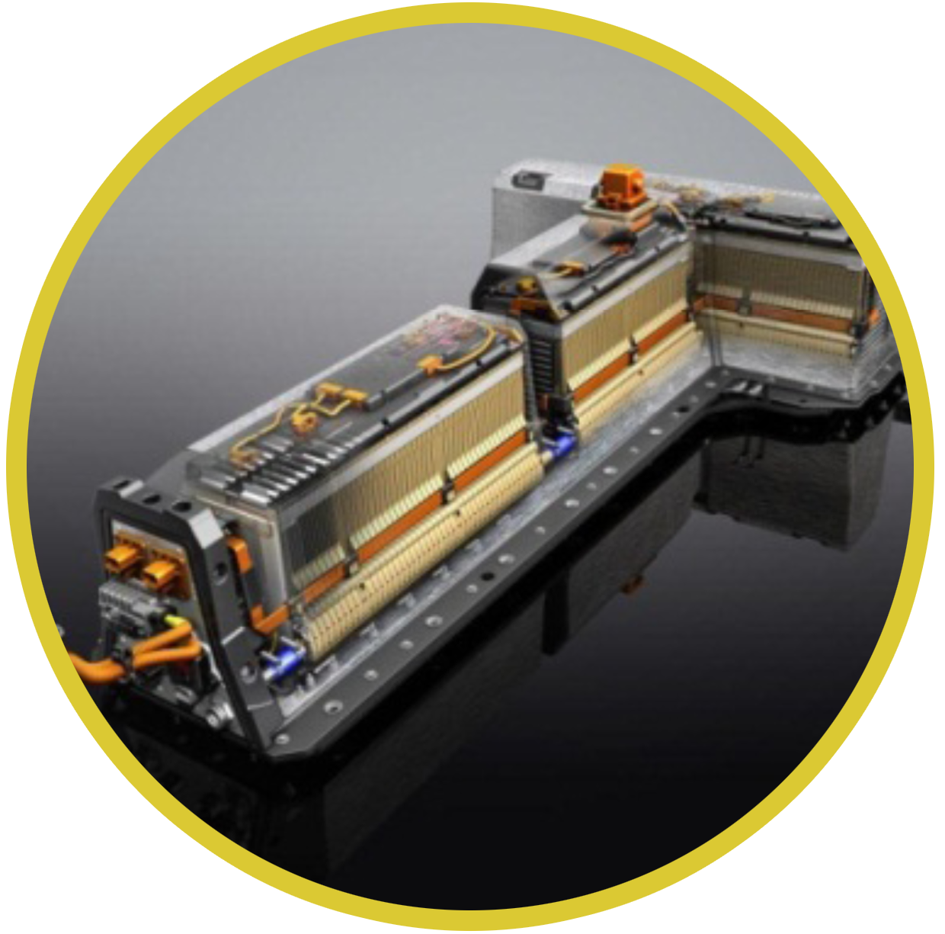
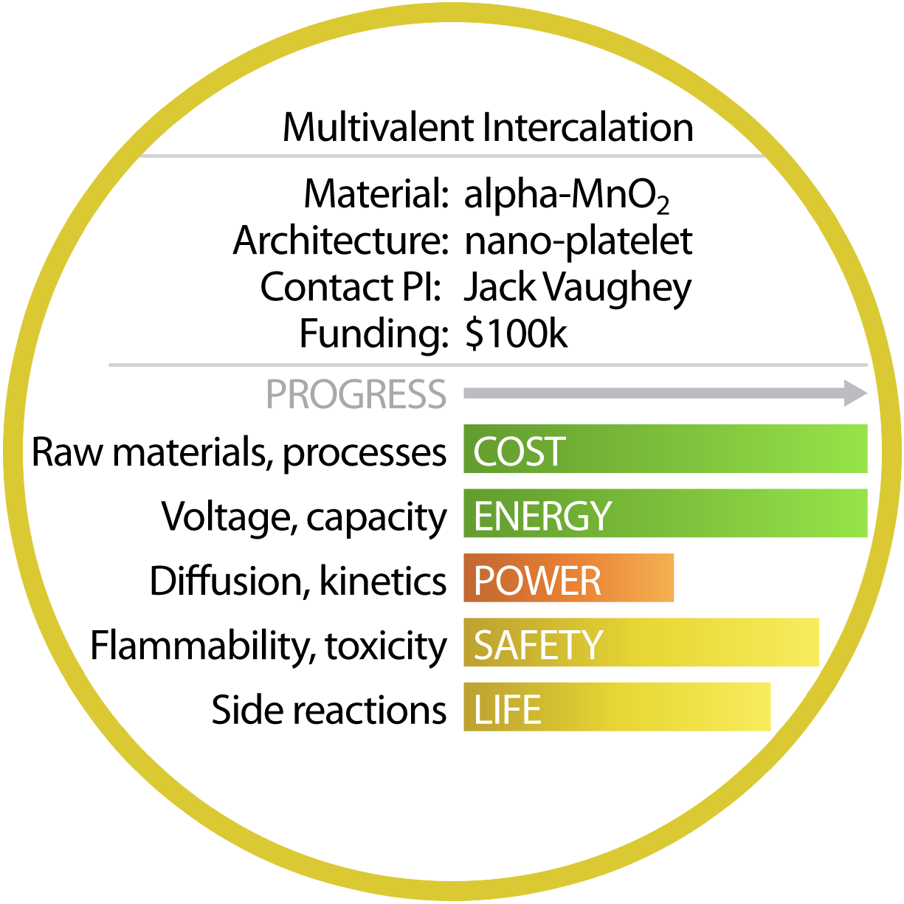
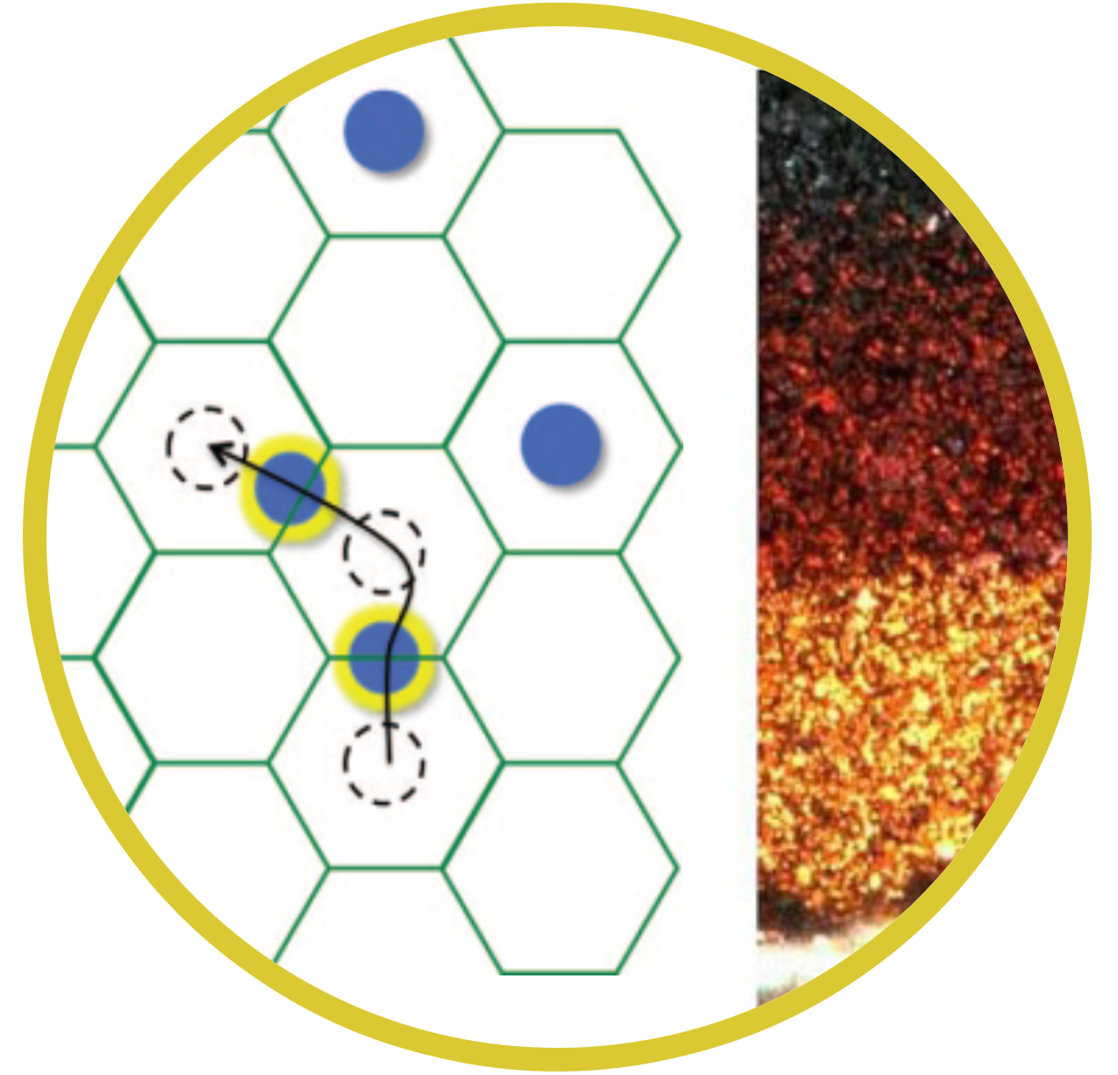
Techno-Economic Modeling
Building a Battery on the Computer
Systems
Analysis
and Translation
Linking system level goals to materials level values
    What cell voltage, capacity, diffusion coefficient, ...etc… do I need to meet JCESR goals?
Directing research dollars to most promising approaches
    Informing JCESR leadership, assessing most promising candidates, creating new Translational Development Teams
Understanding the barriers to transformational advances
    Across all levels – materials, electrodes, cells, pack/stacks
5-5-5
Technical performance
Manufacturing cost
Diffusion coefficient rate constant
practical capacity voltage
Notes:
Techno-economic modelling
The materials and phenomena discovered in the Concepts and Crosscutting Science will be integrated into battery systems using techno-economic modelling. This model treats the battery as a system made of components such as anode, electrolyte and cathode, all working together to produce the energy storage and release function. It simulates two of the key targeted outcomes of JCESR, performance (such as energy density, charge time, round trip efficiency and cycle life) and manufacturing cost. Technoeconomic modelling works in both directions. It may take 20 candidate battery systems using the materials and phenomena from discovery science, and find that four of them are worthy of promoting to cell design and prototyping. It will also show which components of the battery limit its performance, and what performance level is needed for the weak link to bring battery system performance up to acceptable standards. This challenge will then be fed back to the discovery science teams, charging them to understand the reasons for the underperformance and correct them.

Slide 19
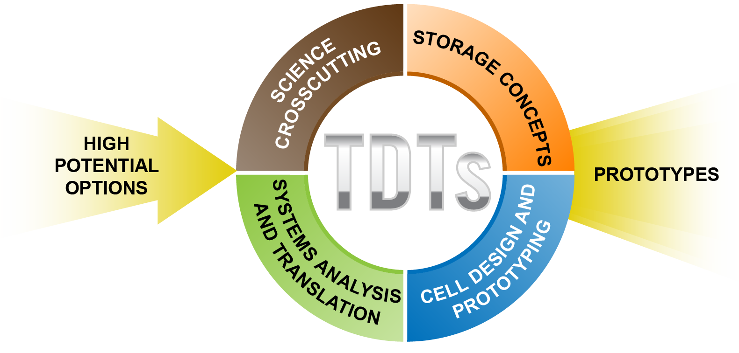

Translational Development Teams
Integrating Science with Engineering
Cell Design
and Prototyping
We kickoff two TDTs on Day 1 to design and prototype cells
• Transportation – Mg Intercalation
• Grid – Non-aqueous redox flow
Notes:
Prototyping will be done by a team composed of representatives from each of the four JCESR components – discovery science, techno-economic modelling, cell design and prototyping, and commercial deployment, represented by the four colors in the circle. These teams are called Translational Development Teams and will apply the full range of JCESR’s knowledge and capabilities, and example of the end-to-end integration that is a hallmark of JCESR.
We not only want to make prototypes, we want to break them. Why to they fail? Failure modes will be passed back to the discovery science teams, to understand the cause of the failure and correct it.
We start prototyping on Day 1 to learn how the candidate battery systems work, discovery failure modes, stimulate the discovery science teams, and begin the communication and integration processes.

Slide 20
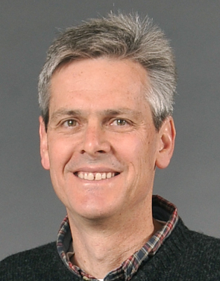

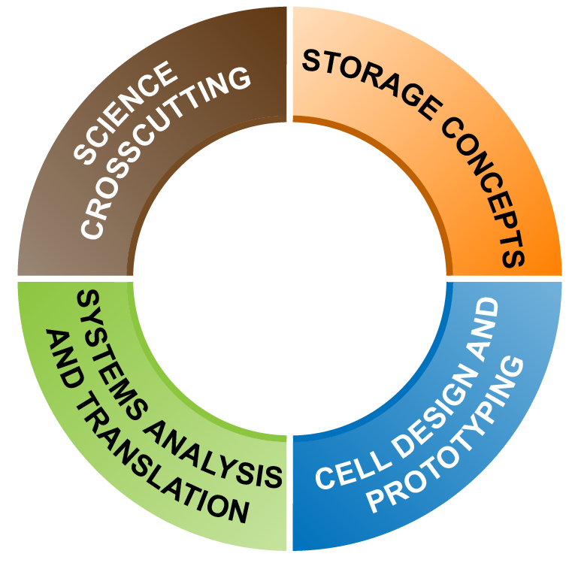
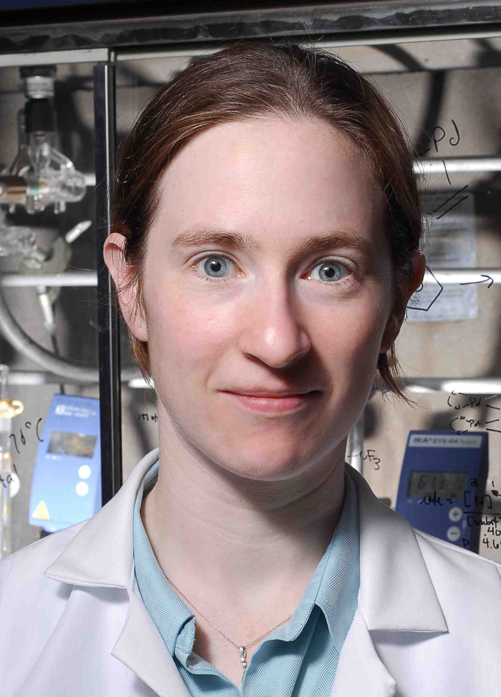

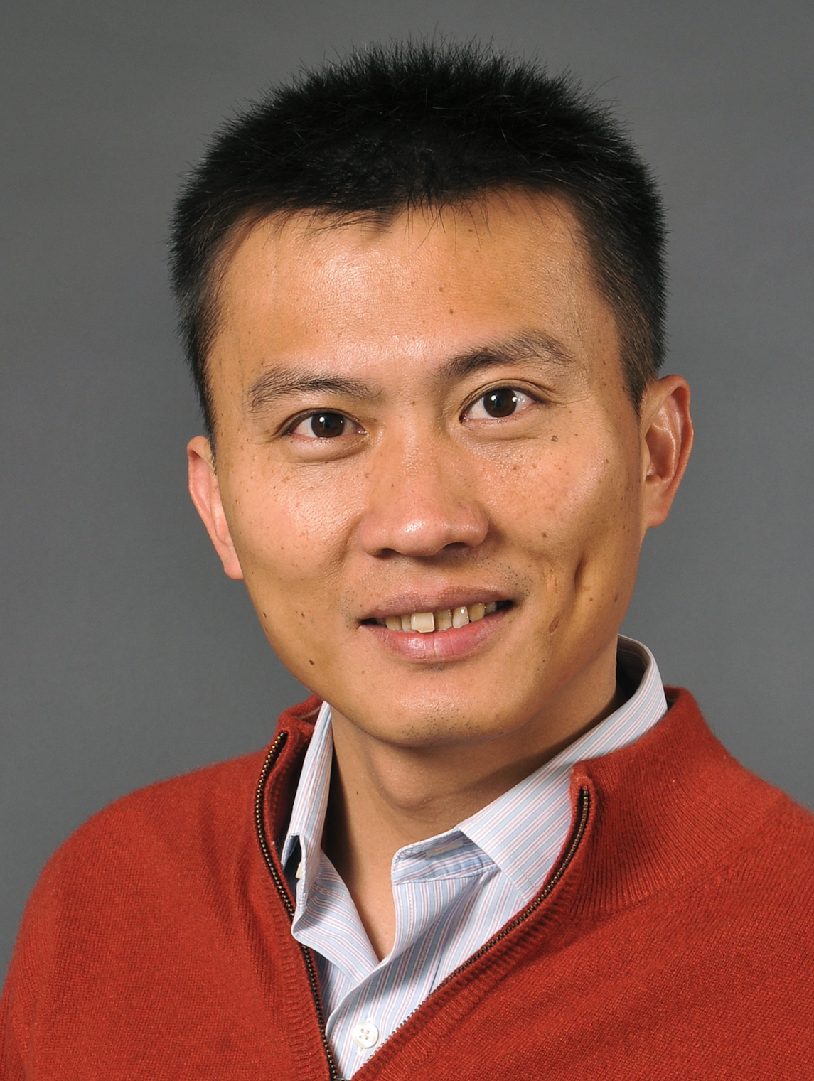
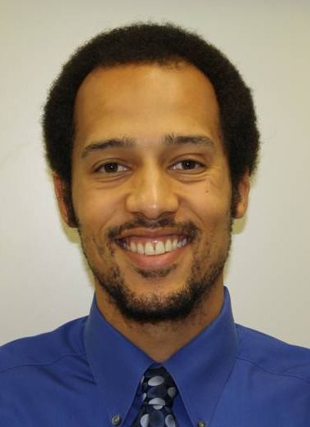



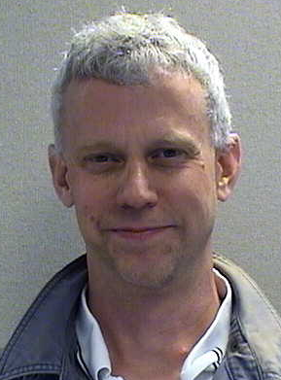
TDT 2
Mg intercalation
$100/kWh, 400 Wh/kg and 400 Wh/L
Cell Design
and Prototyping
TDT 1
Non-aqueous Redox Flow
$100/kWh, 95% efficiency at C/5
Kevin Zavadil, SNL
Jun Liu
PNNL
Melanie Sanford
U-M
Jack Vaughey
ANL
Yi Cui SLAC
Fik Brushett
MIT
Nitash Balsara,
LBNL
Chris Apblett
SNL
Andy Jansen
ANL
Pat Hurley
JCI
Our Multi-Disciplinary Teams
Notes:
Engineering examples: Intercalation (Transportation Batteries – Nitash Balsara) graphic: segment of the org chart, and/or segment of unifying graphic
Mg alpha MnO2 – study a specific system to intercalate Mg in order to develop a new architecture with good ionic conductivity graphic: SEM of alpha MnO2 (Peter Bruce SEM)
As we identify that new architecture, Dow will collaborate with us to discover the new material and design a cost-effective manufacturing pathway; AMAT will collaborate to develop new methods to assemble the film
Simultaneous discovery of electrolyte (Genome, etc.) – system-level development
Large-scale prototyping of cells – JCI prototyping facility – capitalizing on existing infrastructure (e.g. laying down a film on a current collector) Graphic for JCI facility – AND, cell sent to SNL for abuse testing, where unfoerseen side reactions are identified and sent on back to science.

Slide 21
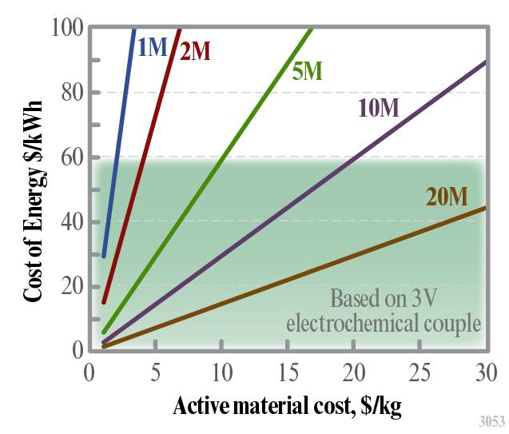
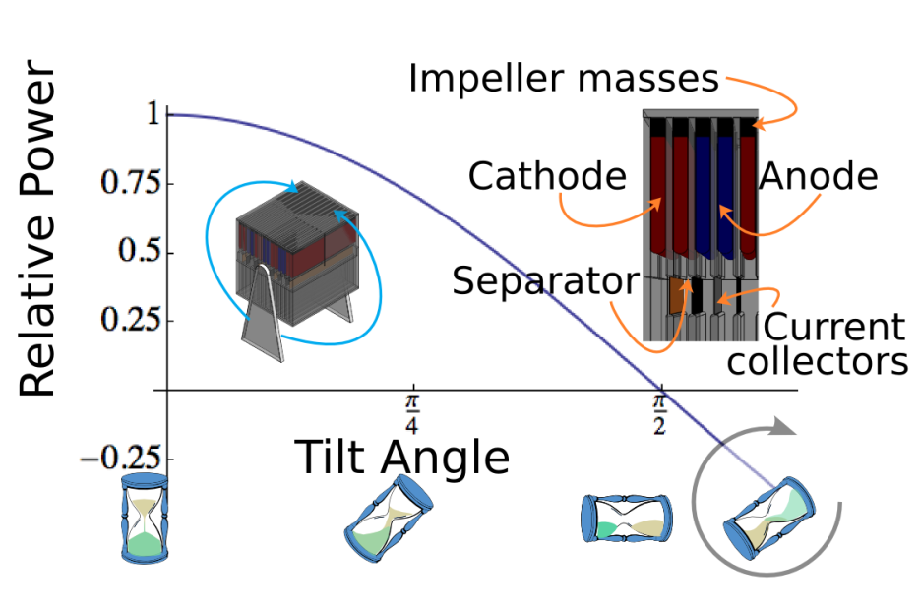
Unveiling New Challenges through
Cell Design and Prototyping
Example: flowable electrodes
10x energy density,1/5 cost of benchmark flow batteries
Low cost materials
Simplified system architecture
Scalable low-cost manufacturing
New chemistry plus new architecture presents enormous opportunity…

Slide 22
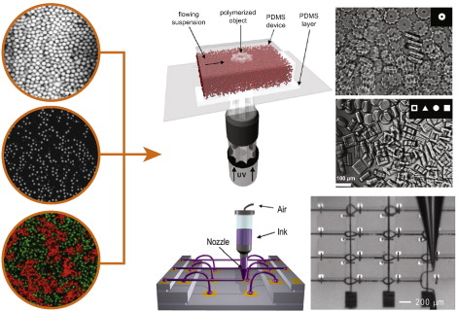
Unveiling New Challenges through
Cell Design and Prototyping
Example: flowable electrodes
… we need early prototypes to validate and explore materials behavior
Jamming flow in non-Newtonian fluids can result in unplanned bulk effects and undesirable side-reactions at colloid surfaces.
Early testing of prototypes will unveil challenges not necessarily predicted in the nanoscale efforts
Lewis et al., Colloid and Interface Science, 2011

Slide 23

Intellectual Property Plan
Facilitates Open Collaboration
Commercial Deployment
  Agreement signed and in place to operate under single IP
  Management Plan
  All foreground IP pooled,
  with centralized licensing
  Allows industrial concerns to
  see a clear path to
  commercialization
  One stop shopping
  Some Background IP pooled
  Portion of IP revenues reinvested in JCESR
Notes:
Before our proposal was submitted, JCESR had a fully signed and executed IP plan. A notable feature of the plan is that no company may receive and exclusive license, a requirement of the government role in JCESR. IP developed by partners with no JCESR role are owned by the partner. More commonly, IP developed under collaboration is jointly owned. A collaborating partner may have better terms non-collaborating partners, but not exclusivity.
Partners have made their foreground IP available to create a one-stop shopping for licensees.

Slide 24
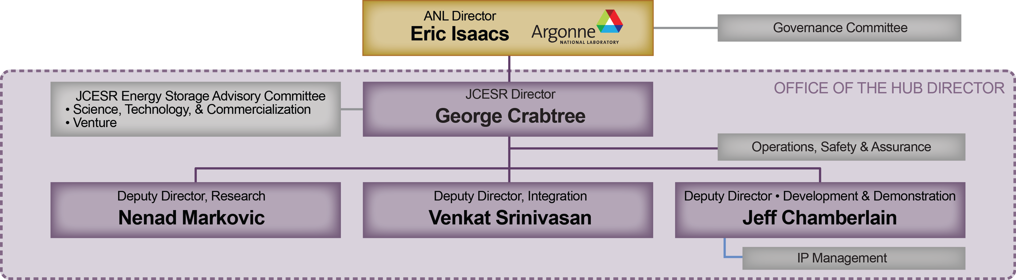
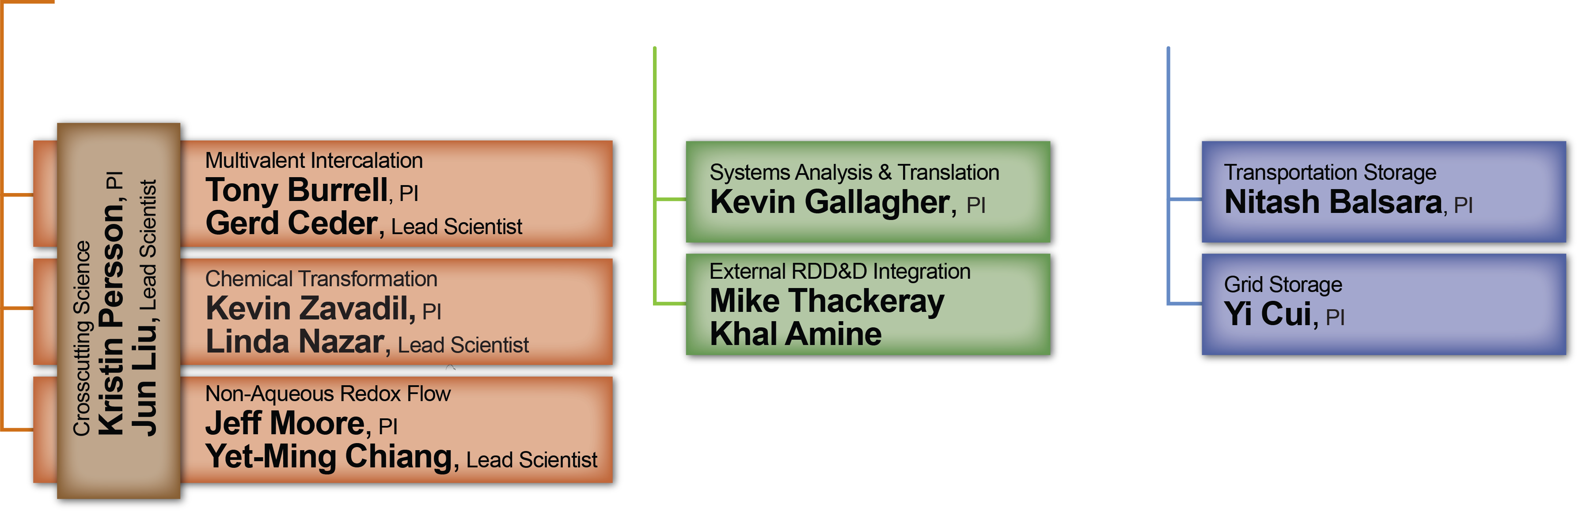
JCESR Organizational Structure
Synergistic, Integrated, Mission-Focused
Outcome Driven, Constant Communication,
Formal and Informal Evaluations, Rapid Reconfiguration
Notes:
Pis and Lead Scientists head each team, they are repsonsible for programs, communication among team members, reporting technical results up, down and sideways, and setting the program annually.

Slide 25
Communication – Enabling the Operation
Informal communications
  Constant, using all tools at our disposal (cell phones, adobe connect, Skype, travel, etc.)
  Within working teams
  Across working teams, via specific cross-cutting working groups
  This is where the action is! Remember graduate school…
Formal communications
  Twice monthly conference calls between team leads and PI
  Twice monthly conference calls between PIs and ExCom
  Once/month Quad chart reports
  Once/quarter Quad chart + written reports
  Once/quarter Directorate meeting
  Annual all-hands meeting, minimum
  Regular calls between JCESR ExCom and DOE, as well as Governance Committee
  Quarterly reports to DOE
  Annual review by DOE

Slide 26
JCESR Launch and Operation:
Enabling Three Legacies, Outcomes-Driven Program, Communication Excellence
Launching and operating JCESR is a multi-dimensional effort
Core idea: liberate the scientists and engineers to perform the research
However, we need excellence in reporting and communication across the Hub
Working groups include:
  ESH&QA
  R&D
  Project Management
  HR
  Procurement
  Communications
  IT
  Education
  Advocacy
  Institutional Leadership

Slide 27
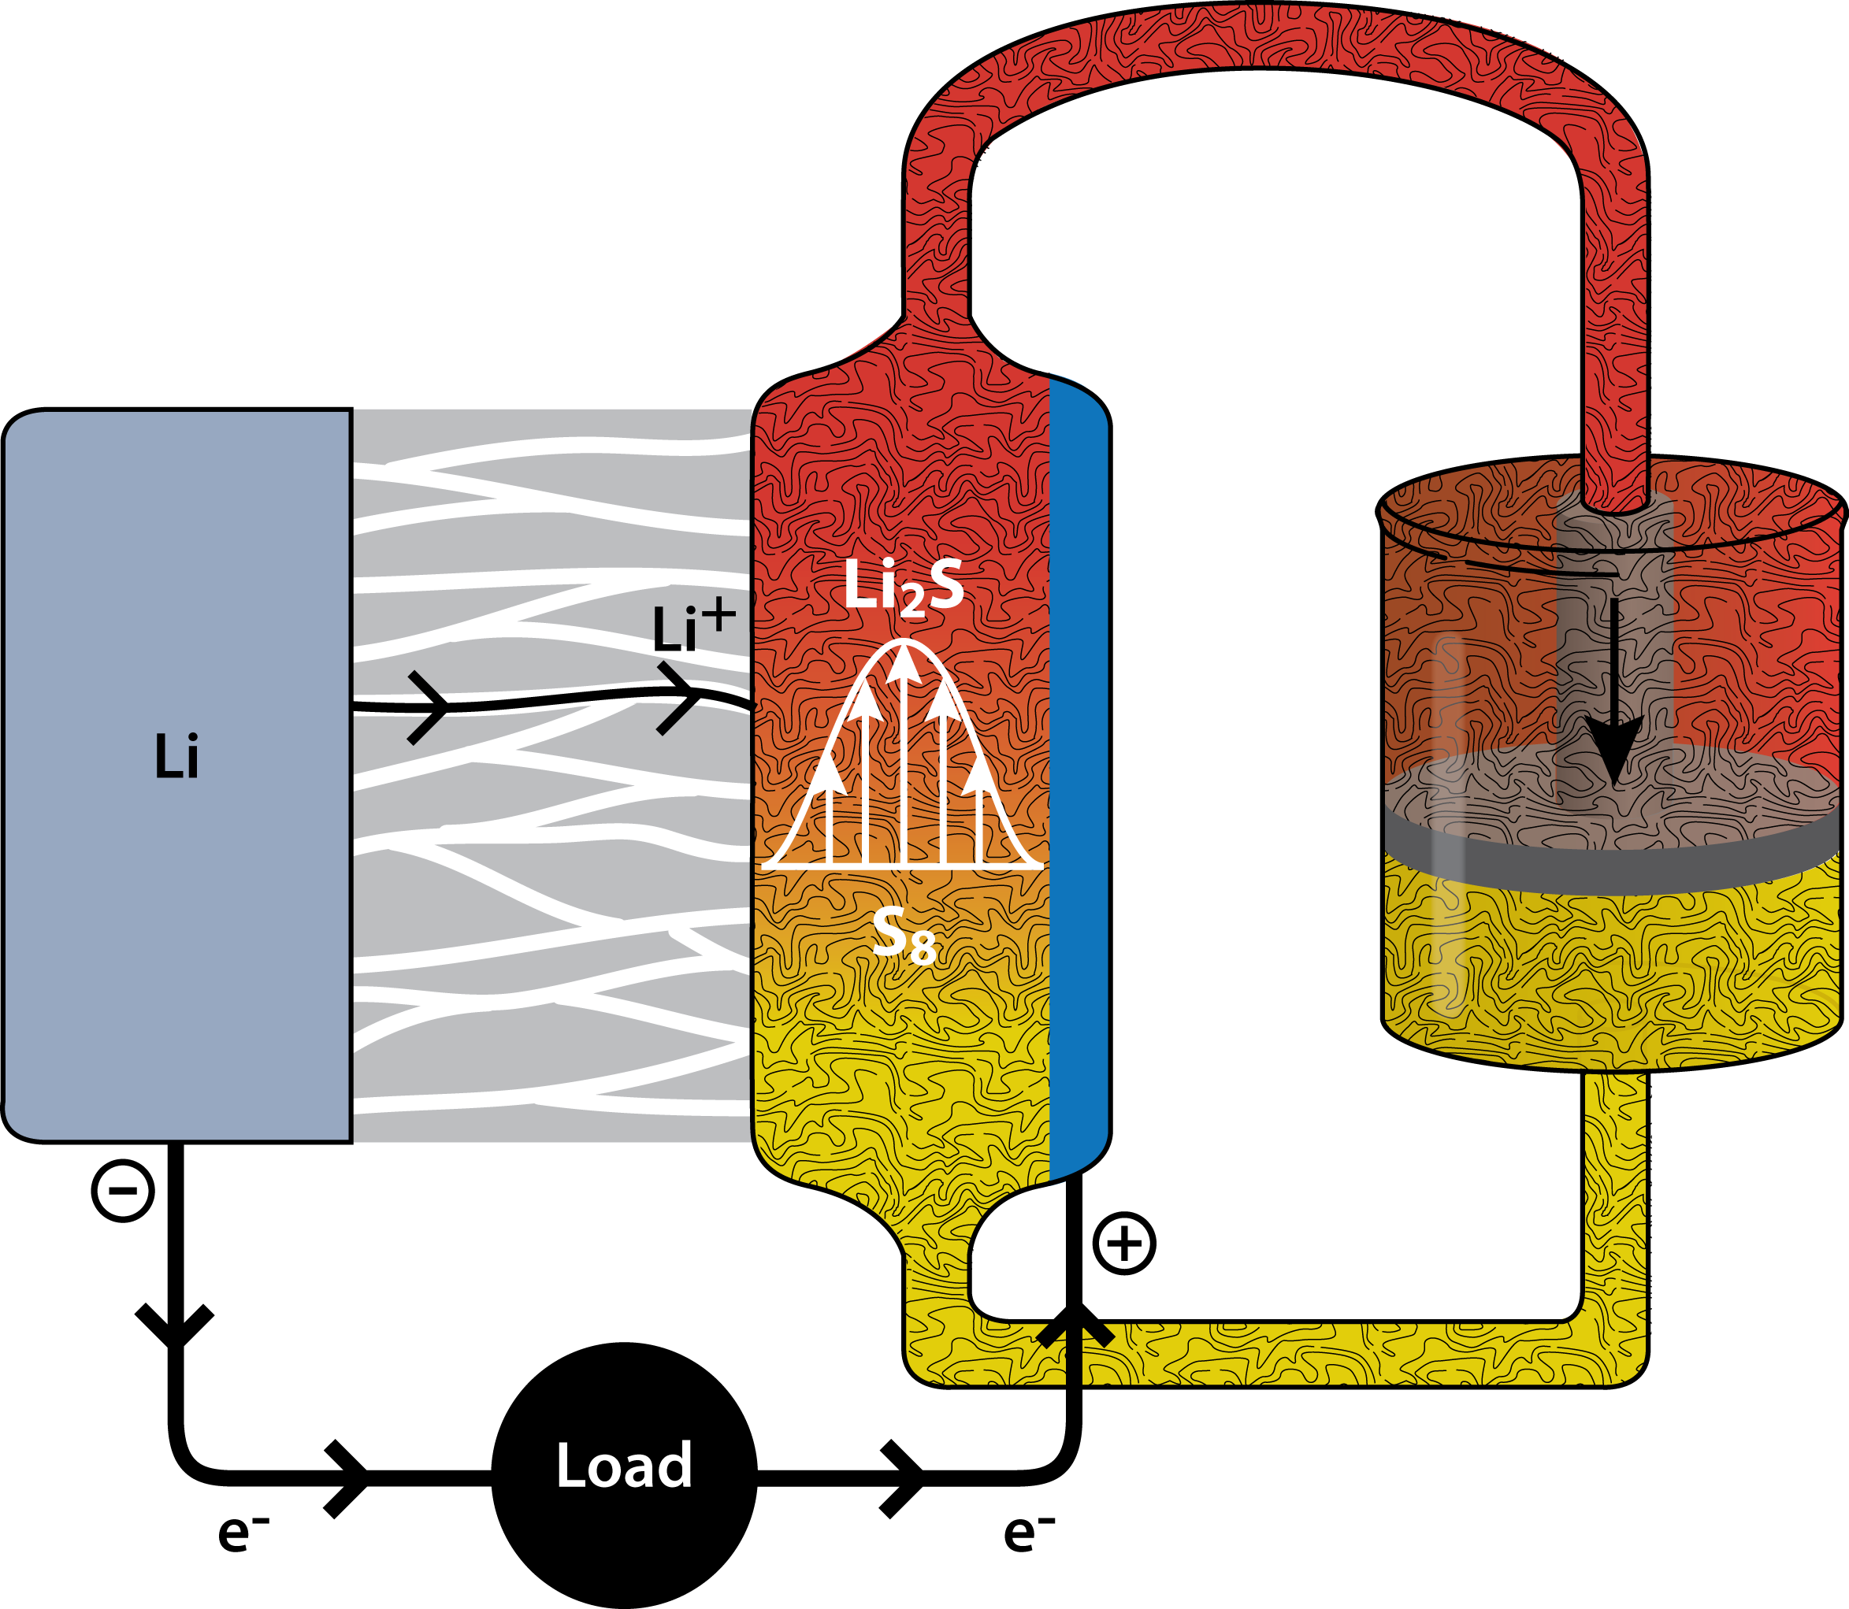


Ultimate Battery May Combine Storage Concepts
Multivalent metal anode
High mobility in stable electrolyte
Chemical reaction with flowable cathode
Multivalent metal
Flowable electrode
Notes:
Battery systems may combine Storage Concepts. This shows a battery with a metal anode, mono- or multivalent, a compatible and stable electrolyte, and a flowable cathode composed of sulfide compounds and carbon fibers to provide electrical conductivity. This example shows the power and the flexibility of the three storage concepts, and drives home the message that they are not battery technologies but fundamental phenomena that may be mixed and matched to suit the needs of the targeted application.

Slide 28
JCESR Maps onto DOE’s RDD&D Spectrum
Multivalent Intercalation
CROSSCUTING SCIENCE
Systems
Analysis
and Translation
Cell Design
and Prototyping
Commercial Deployment
Chemical Transformation
Non-Aqueous Redox Flow
Research
Development
Demonstration
Deployment
Grand Challenges
Discovery Science
Use-inspired Basic Research
Applied Research
Technology Maturation and Deployment
Matches DOEs Discovery Deployment Spectrum
28
Notes:
JCESR is a fully integrated energy storage development machine that maps onto DOE’s spectrum of research, development, demonstration and deployment functions. DOE often describes itself in the terms of the bottom line. Grand challenges represent the compelling fundamental scientific questions of how nature works, driven by curiosity rather than specific applications outcomes; JCESR does not do this kind of research but makes use of its fruits as soon as they are known. Discovery science seeks to understand the materials and phenomena of electrical energy storage at the atomic and molecular level; use-inspired basic research seeks fundamental understanding of specific practical outcomes such as anode, electrolyte or cathode functionality. Grand challenges, discovery science and use-inspired basic research seek to understand phenomena and materials; applied research seeks to understand performance, and technology maturation and deployment seeks to maximize performance at thel lowest cost. DOE has basic and applied offices that specialize in these functions. JCESR and the other Hubs are the first DOE-funded projects that span this basic-applied spectrum and integrate discovery science with product development. This is a bold new paradigm for DOE with the potential to rapidly accelerate progress on the most difficult energy challenges of the future.

