Slide 1
Basic Energy Sciences Update
February 28, 2013
Harriet Kung
Director, Basic Energy Sciences
Office of Science
Department of Energy

Slide 2
Outline
BES Staffing Update
Program Highlights
FY 2014 Budget Request
(~ late March, see BES website for update)
FY 2013 Appropriation (??)
BESAC Activities

Slide 3
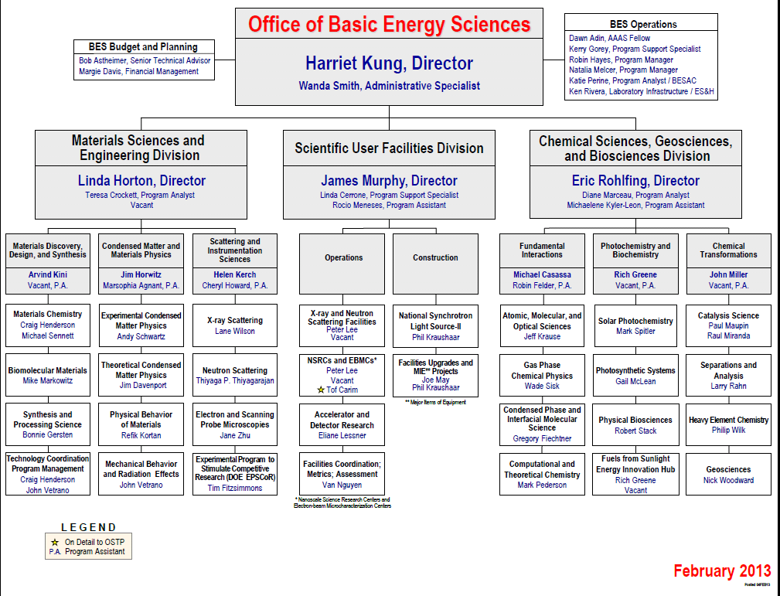
John Miller, Director (Acting)
Jim Rhyne
New
New
Vacant
Vacancy

Slide 4
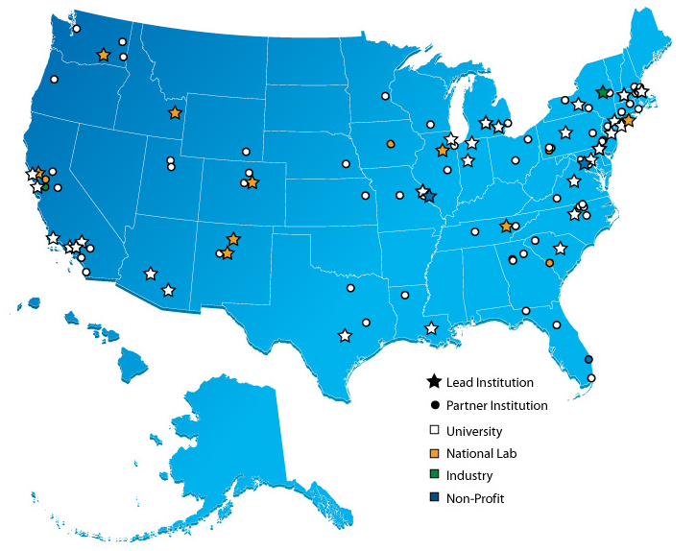
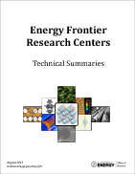
Energy Frontier Research Centers
46 EFRCs were launched in late FY 2009; $777M for 5 Years
Participants:
    46 EFRCs in 35 States + Washington D.C.
    ~850 senior investigators and
    ~2,000 students, postdoctoral fellows, and
    technical staff at ~115 institutions
    > 250 scientific advisory board members
    from 13 countries and > 40 companies
Progress to-date (~3.5 years funding):
    >3,400 peer-reviewed papers including
    >110 publications in Science and Nature
    19 PECASE and 11 DOE Early Career Awards
    over 200 patent applications, over 60 patent/invention disclosures, and at least 30 licenses by 34 of the EFRCs
    at least 60 companies have benefited from EFRC research
    EFRC students and staff now work in : > 195 university faculty and staff positions; > 290 industrial positions;
    > 115 national labs, government, and non-profit positions
http://science.energy.gov/bes/efrc/

Slide 5
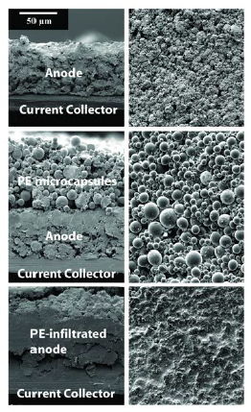




Autonomic Shutdown of Overheated Li-ion Batteries
Scientific Achievement
Thermally-triggered shutdown of lithium-ion batteries was achieved through design and integration of thermoresponsive microcapsules.
Significance and Impact
First demonstration that adding engineered microcapsules does not harm performance, but does prevent fires through autonomous shutdown of overheated lithium ion batteries.
Research Details
  Developed novel fabrication of ca. 4 μm thermoresponsive poly(ethylene) core-shell microspheres, which were deposited onto battery anodes or separators of coin cell type batteries with no impact on normal operation.
  Coin cells were cycled at 110 °C to activate microspheres, which promptly and safely terminated cell operation.
Cross section (left) and top-down (right) views of:
Top: a graphite (MCMB) anode.
Middle: an MCMB anode coated with thermoresponsive PE microspheres.
Bottom: a coated MCMB anode that has undergone autonomic shutdown (110°C).
M. Baginska, B.J. Blaiszik, R.J. Merriman, N.R. Sottos, J.S. Moore, and S.R. White, Advanced Energy Materials 2(5), 583–590 (2012)
Work was performed at the University of Illinois, Urbana-Champaign.

Slide 6
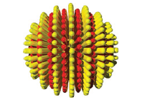

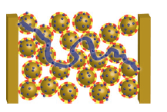



Nanoparticles Enable Ultrasensitive Detection of Toxic Metals
Scientific Achievement
Discovery that the surface of a gold nanoparticle (NP) can be decorated with specific organic molecules to produce a film that recognizes and selectively binds metals such as mercury (Hg⁺) or cadmium (Cd²⁺) .
  Significance and Impact
  The binding of metal ions by the NPs can be designed to result in electrical conductivity in the NP film, providing an inexpensive and ultrasensitive way to detect the presence of toxic metals.
  Research Details
  The ratio of NP film conductivity after binding to the conductivity before binding can be used to detect very low concentrations of specific metal ions.
  Solid-state sensors with unmatched sensitivity include NP films with detection limit of ~10⁻¹⁸ moles/liter for methyl Hg⁺ or ~10⁻¹² moles/liter for Cd²⁺.
a.
Hexanethiol (HT)
Ethylene glycol-terminated thiol (EG)_{n}
b.
Gold nanoparticle (Au NP) coated with alternating stripes of ligands (HT and EG_{n}) via a self-assembly process;
On binding of metal cations (blue spheres), such as Cd²⁺, conductive paths (blue line) percolate the film and connect two electrodes.
E. S. Cho, J. Kim, D. Tejerina, T. M. Hermans, H. Jiang, H. Nakanishi, M. Yu, A. Patashinski, S. C. Glotzer, F. Stellacci, and B. A. Grzybowski, Nat. Mater., 2012, online 10.1038/NMAT3406.
Work supported by the Non-Equilibrium Energy Research Center (NERC) at NERC institutions Northwestern University and University of Michigan

Slide 7
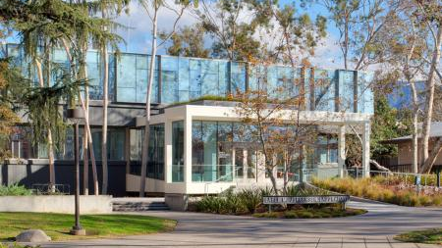
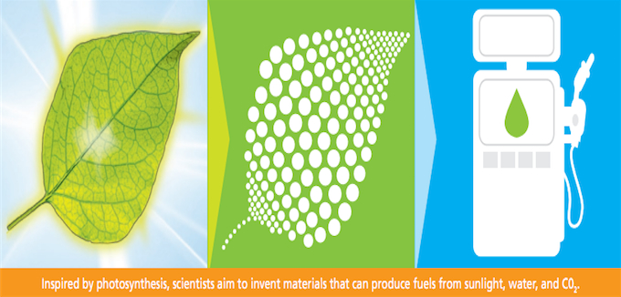

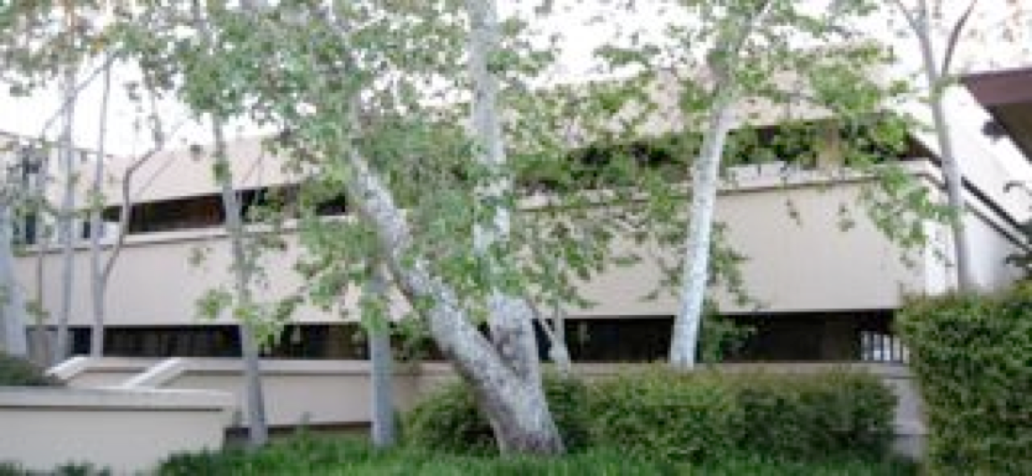
Fuels from Sunlight Hub: Project Update
Space:
The Joint Center for Artificial Photosynthesis (JCAP) North (LBNL) occupies 14,000 sq. ft. leased space.
  Future occupancy planned for Solar Energy Research Center (Oct. 2012 groundbreaking) and General Purpose Laboratory (under construction).
JCAP South (Caltech) occupies 18,500 sq. ft. in newly renovated Jorgensen Laboratory Building.
  Renovation resulted in LEED Platinum Certification.
Equipment: Major equipment acquired; project year 3 purchases on schedule.
Jan. 2013 Staffing Update:
About 150 total staff; approaching steady state level.
New directorate established. Includes: Fulltime Director, Founding Director/Chief Scientist, and two Assistant Directors.
Oversight: SC/BES will conduct an on-site scientific review April 2013; both sites will be visited.
Output: Scientific productivity (publications, invention disclosures, etc) accelerating as JCAP enters 3rd year of operations.
Renovation of Jorgensen Laboratory Building
Before
After
Notes:
Leadership in Energy and Environmental Design (LEED) U.S. Green Building Council
Jorgensen Laboratory Building renovation total cost was $19.5 million; DOE contribution was $8 million from FY10 funds. The remainder came from the Resnick Sustainability Institute, private donors, and Caltech. JCAP South occupies over 2/3 of building. The renovation resulted in the Jorgensen Laboratory being awarded the Leadership in Energy and Environmental Design (LEED) Platinum Certification….a prestigious honor.
Staff breakdown: 41 senior staff; 24 research staff; 30 post-docs; 26 grad students; 15 administrative staff.
As JCAP transitions into a fully operational phase, it has evolved into a large, complex research enterprise….requiring a full-time director. Accordingly, a new directorate was recently formed. Carl Koval becomes the full-time Director. Nate Lewis - who always was and remains at 50% time on JCAP – moves into the role of Chief Scientist, which better utilizes his world-class technical expertise.
After “Output” section, you could segue into next slide by stating, “The next slide is one example of the ever-increasing productivity of JCAP as it becomes fully operational”.

Slide 8
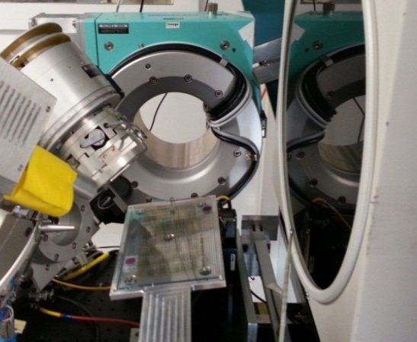
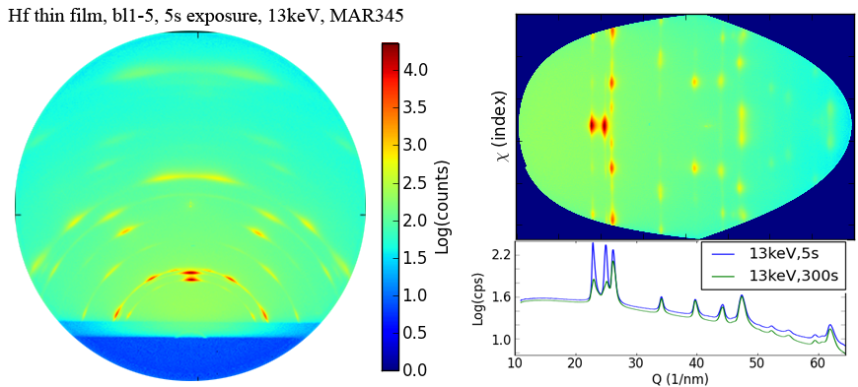






JCAP-HTE/SSRL High Throughput X-Ray Diffraction
Scientific Achievement
  Collaborating with the Stanford Synchrotron Radiation Facility (SSRL), the JCAP-HTE group has developed a new high throughput x-ray diffraction (HT-XRD) experiment. Using the bright x-ray source and automated scanning, XRD measurements can be acquired for material libraries at a throughput of 30s per 1mm x 1mm x 200nm sample. The 2,000 catalysts on the plate shown below can be measured in approximately 1 day.
Significance and Impact
  A prevalent objective in materials science research is the establishment of structure-property relationships. For JCAP-HTE, the “property” could be photocurrent or water splitting catalytic activity. The “structure” is the crystallographic arrangement of atoms in the sample and is most readily measured by XRD. JCAP-HTE and SSRL have prototyped a state of the art high throughput XRD experiment that will impact the entire combinatorial materials science community.
Research Details
  A carefully tailored geometry maximizes the information content of each XRD image, especially for textured films.
  Future generations of this experiment will exceed 10,000 samples per day, enabling rapid determination of phase diagrams.
  The 1mm² measurement area is well suited for many combinatorial efforts, enabling rapid leverage of this technology.
An HTE library is shown in the XRD experiment at SSRL
Examples of XRD measurement and processing of a Hafnium thin film

Slide 9
Batteries and Energy Storage Energy Innovation Hub
Transform the Grid and Electrify Transportation
Funding Opportunity Announcement that opened on February 1
  Letters of Intent due on March 1
  Full proposals due on May 31
  Award announced on November 30
The Joint Center for Energy Storage Research (JCESR) is a multi-partner team led by Argonne National Laboratory that combines the R&D firepower of five DOE national laboratories, five universities, and four private firms with the aim to achieve revolutionary advances in battery performance.
The Department of Energy awarded the Hub up to $120 million over five years, and the State of Illinois is providing $5 million through its Jobs Now! capital construction plan to help build the state-of-the-art JCESR facility. Additionally, the Governor Quinn has committed to working with the Illinois General Assembly to provide additional capital funding for the building in the future.
The new Hub will integrate efforts at several successful independent research programs into a larger, coordinated effort designed to push the limits on battery advances. It will coordinate with relevant BES (including the EFRCs), ARPA-E, EERE, and OE activities.
9

Slide 10
BES User Facilities Hosted Over 15,000 Users in FY 2012
More than 300 companies from various sectors of the manufacturing, chemical, and pharmaceutical industries conducted research at BES scientific user facilities. Over 30 companies were Fortune 500 companies.

Slide 11
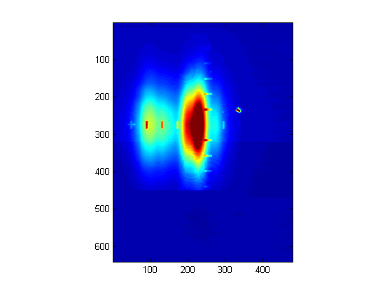
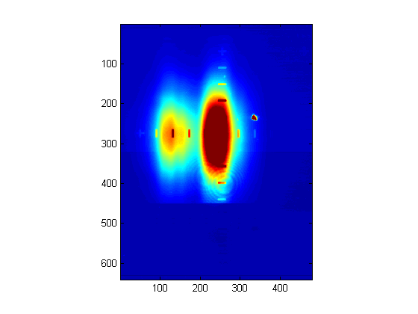



Simultaneous Hard X-ray Experiments at LCLS
  Previously, LCLS has performed one experiment at a time due to the difficulty of splitting the beam
  A novel beam splitting scheme now allows two experiments to be performed simultaneously
  A thin diamond crystal transmits 70% of the incident broad bandpass beam and the transmitted beam is used for nano-crystallography experiments at the CXI station
  The thin diamond crystal also reflects a monochromatic slice out of the incident beam and this is redirected by a second diamond crystal into the XPP station for pump-probe studies
  The data for both CXI and XPP is of the same quality as when the experiments are performed one at a time
XPP
CXI
Two diamond(111) crystals
Mono In
Mono out
X-ray beam profiles in CXI showing minimal effects of the thin diamond crystal

Slide 12
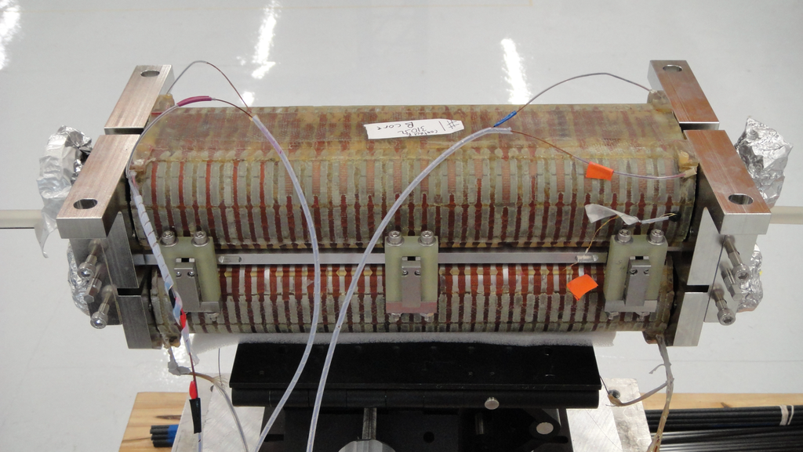
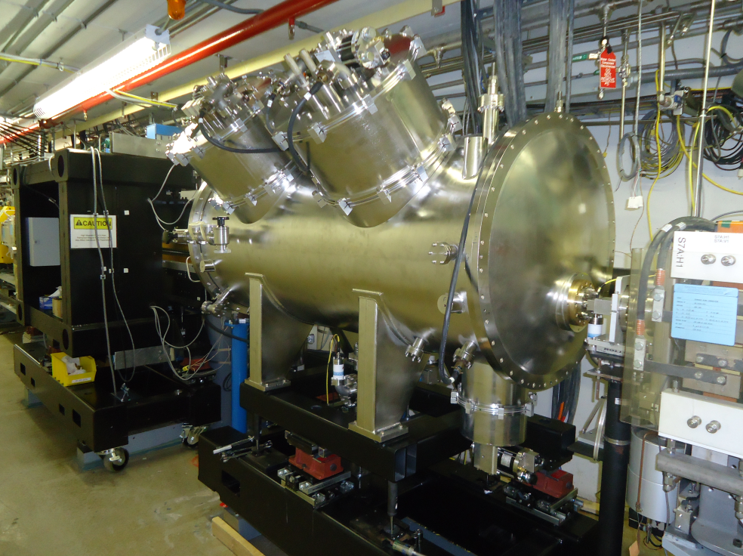
First High-Energy Superconducting Undulator Installed at APS
Completed magnet assembly
FEATURES
First hard x-ray superconducting undulator
Designed at the APS (except cryostat)
Successfully installed in APS ring
Undulator A,3rd harmonic
3.3cm, 70periods
Measured data
SCU0, 1st harmonic
1.6cm, 20 periods
Magnet in a cryostat installed at the APS
First x-rays detected on January 21, 2013 during machine studies
Initial measurements agree with a theoretical prediction
12
Notes:
First Light from the First High-Energy Superconducting Undulator
More than eight years of effort by Advanced Photon Source (APS) physicists, engineers, and technicians culminated on January 21, 2013, with the production of the first x-rays from the prototype of a novel superconducting undulator (SCU), which has been installed in the APS electron accelerator and storage ring at Argonne National Laboratory. It is the first such SCU operated at a third-generation synchrotron x-ray facility.
Superconducting technology has been utilized before at synchrotron radiation facilities for building powerful wigglers or bending magnets, which are other types of synchrotron-x-ray-producing devices. But making small-period, strong-magnetic-field undulators that meet stringent field quality requirements has been a long-standing objective for accelerator science.
Original designs and technological solutions implemented in collaboration with the Budker Institute of Nuclear Physics in Russia led to the compact and efficient SCU device that has been installed and tested at Sector 6 of the APS. This device, approximately 0.35 m long, serves as the prototype for future 1-m- and 2-m-long SCUs that will be fabricated as critical components of the APS Upgrade project, which is supported by the U.S. Department of Energy Office of Science.
The immediate goal of developing novel SCUs is to significantly boost the brightness of high-energy x-ray beams that will be one of the important features of enhanced capabilities of the upgraded APS source. The deployment of innovative superconducting materials and technology will allow the APS to deliver unsurpassed x-ray brightness at energies between 50 and100 keV.
The new superconducting device was tested in a laboratory prior to installation in the APS accelerator. Its performance as a superconducting magnet exceeded design parameters in several areas. For example, the magnet delivers a field that is 20% stronger than the specification, which translates into a significantly wider tuning range and higher x-ray flux. After successful installation and operation in the APS ring, measurements of x-rays produced by the superconducting undulator had begun.
"This result makes me very excited about the future impact of superconducting undulators on research using hard x-rays," said APS Director Brian Stephenson. "The success of this novel device is a testimony to the ingenuity and dedication of the APS staff in developing new technology to enable the frontier science carried out by our users."
The APS is the premier high-energy synchrotron x-ray facility in U.S. The implementation of superconducting undulator technology, together with other aspects of the revolutionary APS Upgrade project, will ensure that the facility maintains its leadership in the future. The APS Upgrade will support the scientific breakthroughs needed to meet present and future challenges in energy, the environment, health, and our national security.

Slide 13
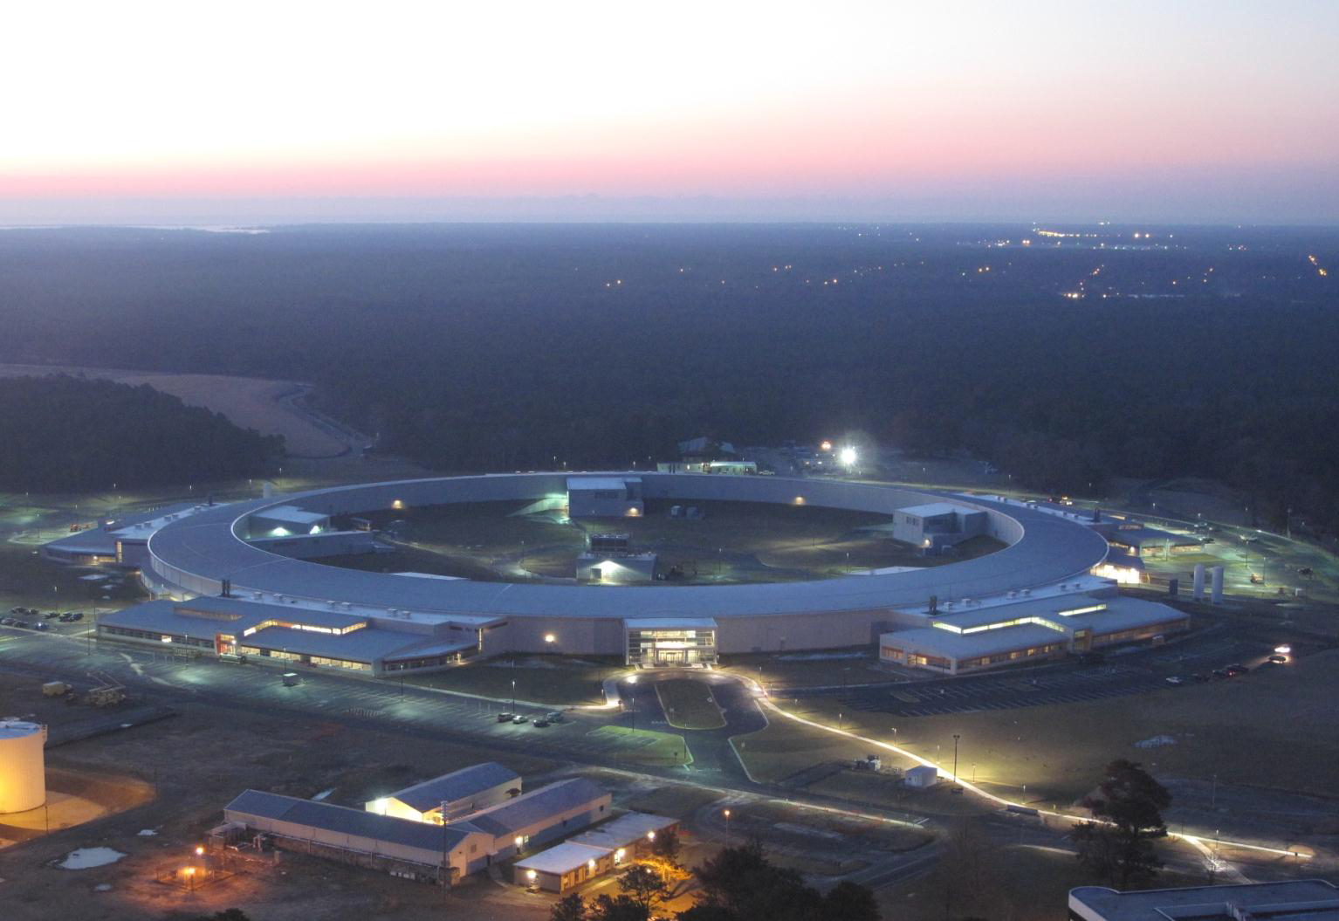
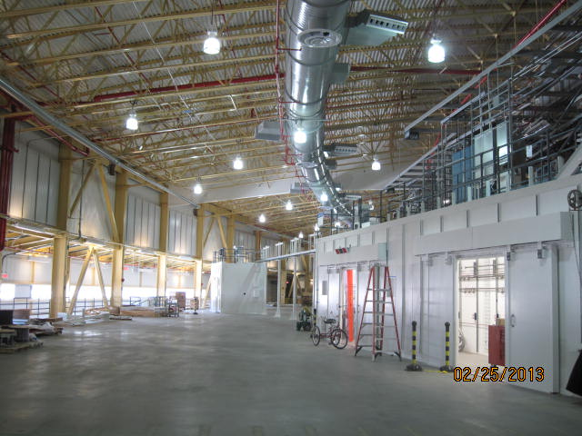
National Synchrotron Light Source-II
85% Complete
Photo From 2-18-13
Ring Bldg complete
LOB 1-5 complete
LOB 3 occupied
LOB 4-5 fit-out underway
LOB 4-5 occupancy by April
Contract closeout May
Experimental Floor
HXN Hutch Installation

Slide 14
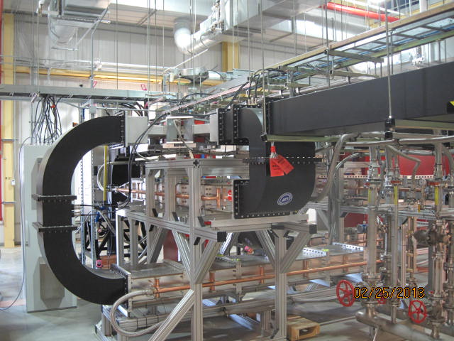
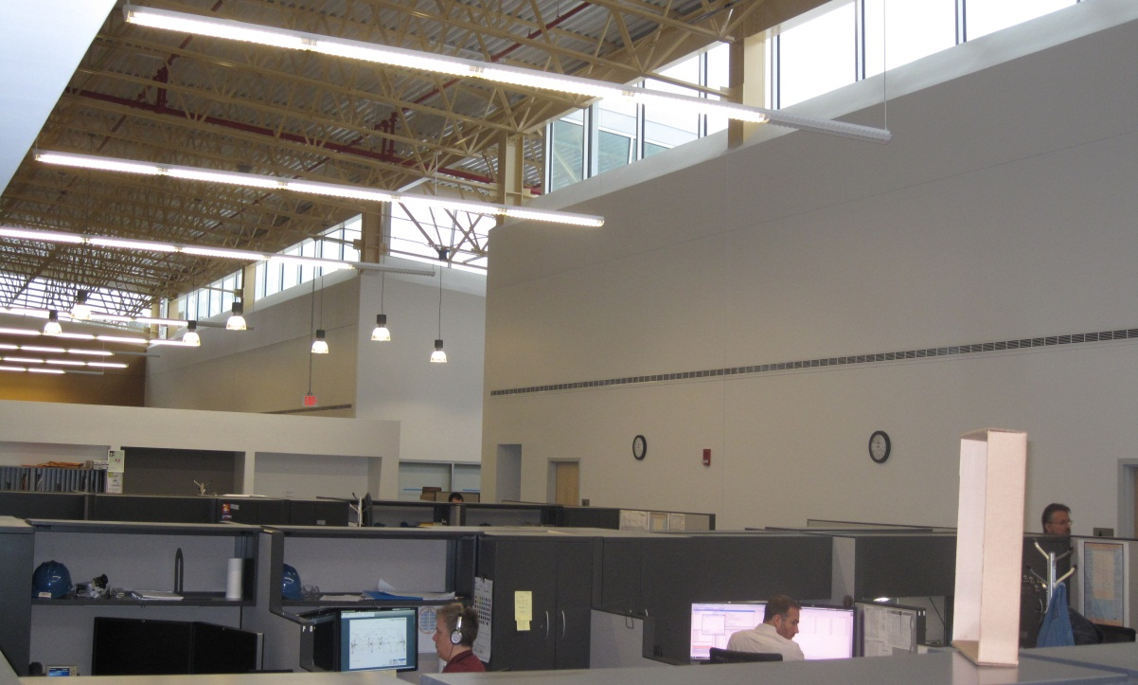
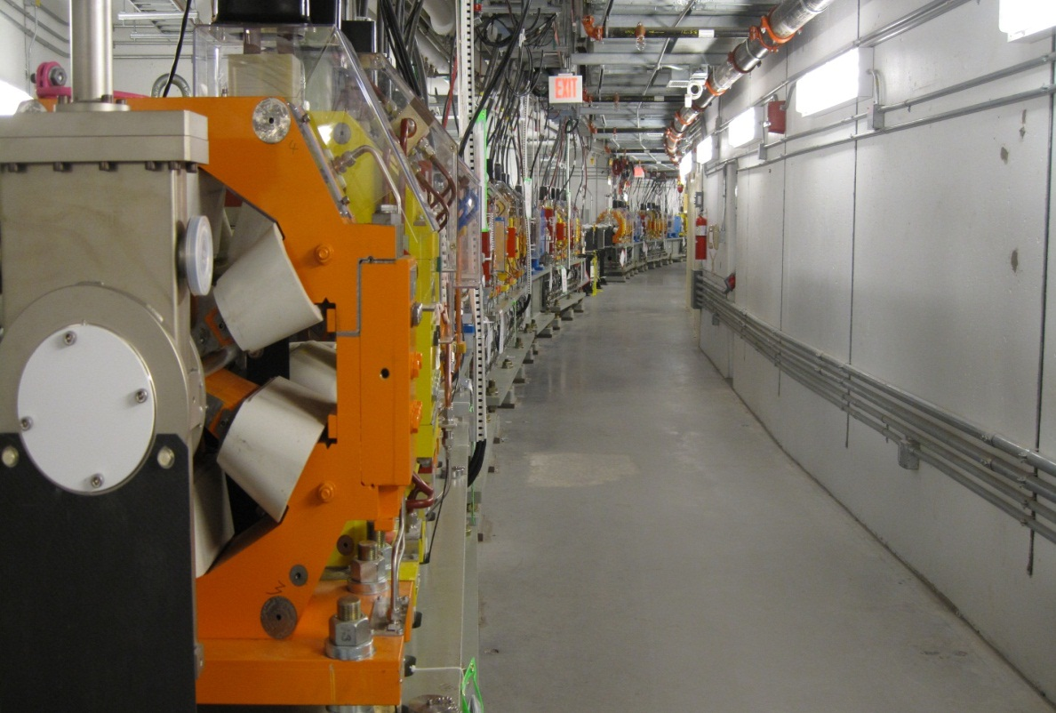
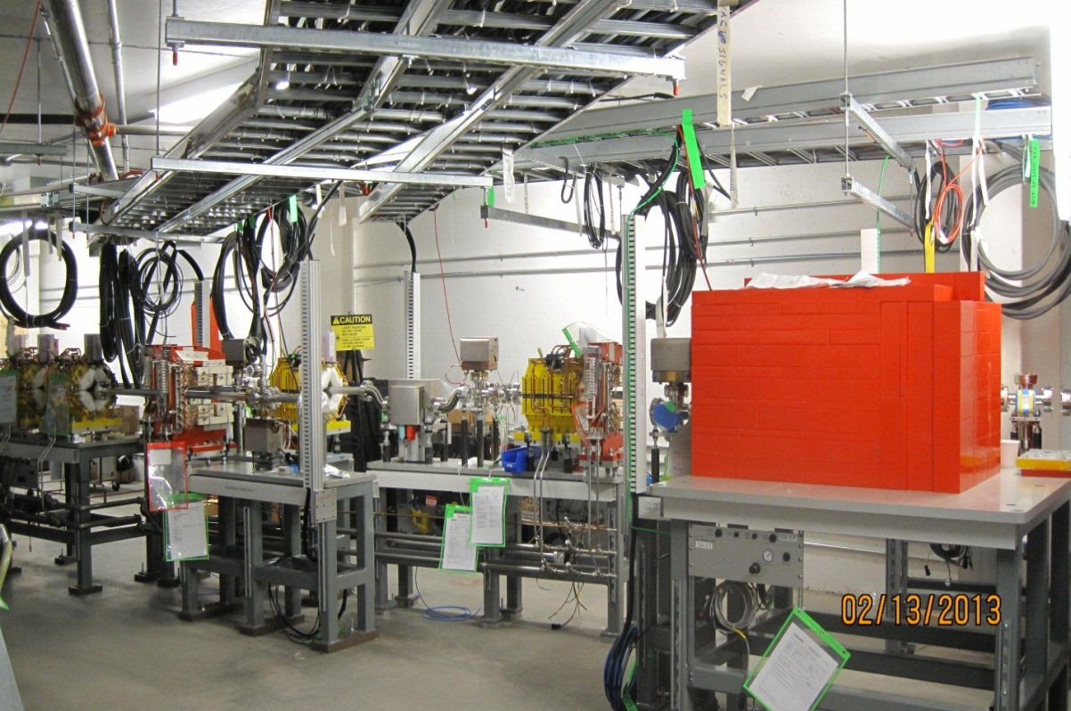
NSLS-II Accelerator Systems Installation Progress
RF
Experimental Floor
t
RF
LOB 3
Storage Ring in Pt 1
Pentant 1
LINAC
Booster Transfer Lines
14

Slide 15
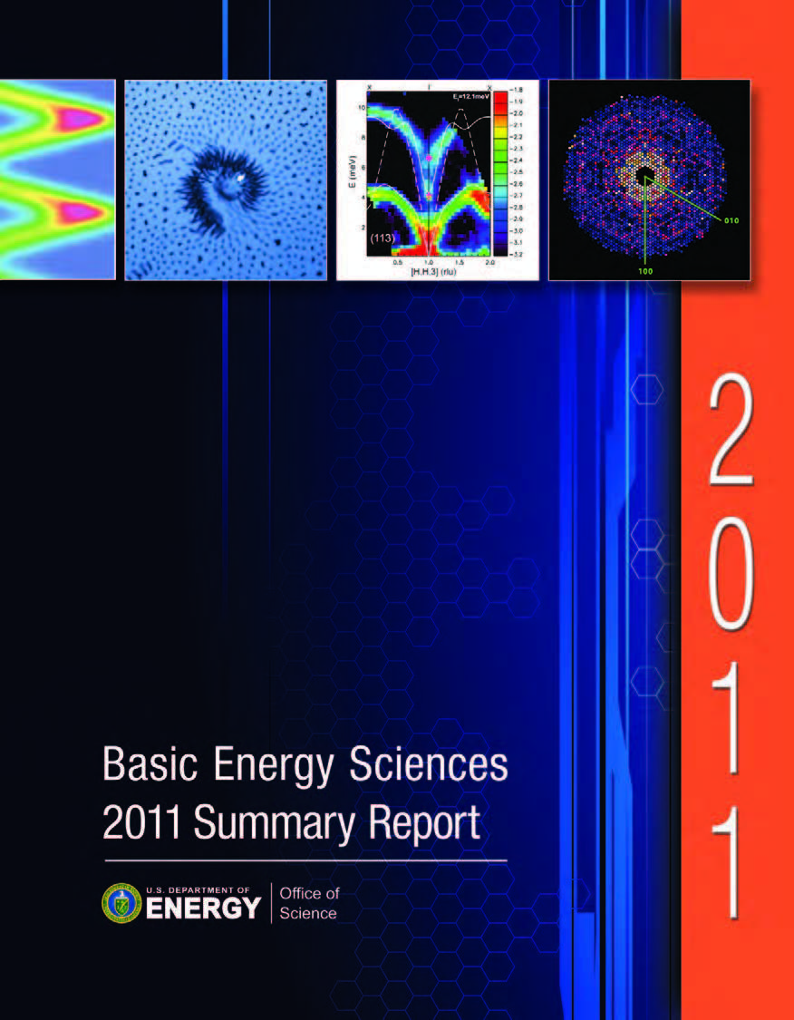
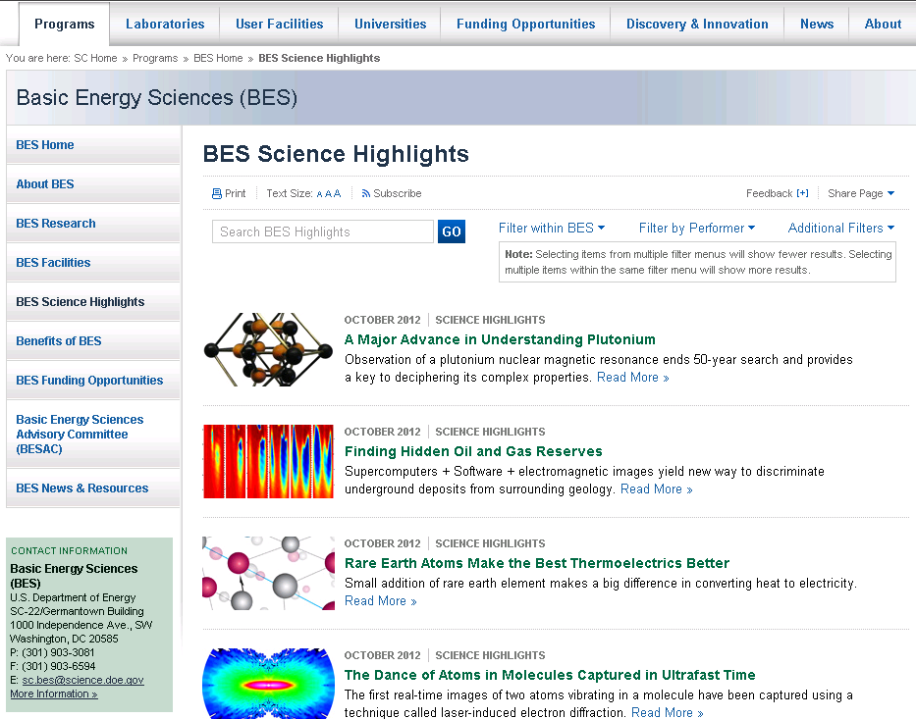
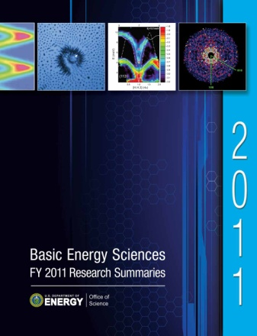
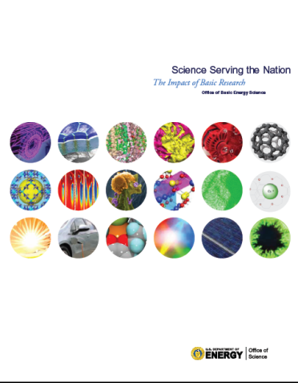
BES Publications for Improved Communication
http://science.energy.gov/bes/highlights/
  http://science.energy.gov/bes/research/

Slide 16
FY 2013 – An Unusual Year of Budget Planning and Execution
 | FY 2012 |  |  |  |  |  |  |  |  |  |  |  | FY 2013
 | O | N | D | J | F | M | A | M | J | J | A | S | O | N | D | J | F | M | A | M | J | J | A | S
FY 2013 Budget Release |  |  |  |  | ◊
Congressional Hearings |  |  |  |  |  | ◊ | ◊ | ◊ | ◊ | ◊ | ◊
Congressional Appropriation |  |  |  |  |  |  |  |  |  |  | ◊ | ◊
Initial Financial Plan |  |  |  |  |  |  |  |  |  |  | ◊ | ◊
Monthly AFP Changes |  |  |  |  |  |  |  |  |  |  |  |  | ◊ | ◊ | ◊ | ◊ | ◊
February 13, 2012 – FY 2013 Budget Release
September 28, 2012 – 6 months CR (P.L. 112-175) passed through March 27, 2013
October 1, 2012 – BES Initial Fin Plan set operating at ~47% of FY12 level
March 1, 2013 – Sequestration set to occur (intense scenario planning on-going)
March 27, 2013 – a CR for the partial/full year or an omnibus bill??

Slide 17
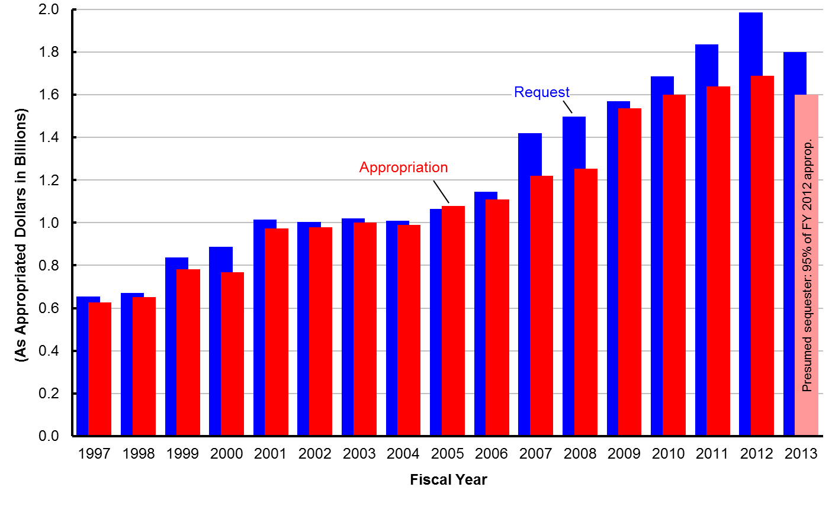
History of BES Request vs. Appropriation

Slide 18
BESAC FACA Charge
December 20, 2012 – Bill Brinkman charged each Office of Science Federal Advisory Committee to help with the prioritization of proposed scientific user facilities with the goal to ensure optimal benefit from Federal investments.
This charge is derived from the administration efforts to improve the efficiency, effectiveness, and accountability of government programs and will provide input to SC to formulate a 10-year prioritization of scientific facilities across SC.
BES has assembled a list and developed material that described the nature of existing and proposed new scientific user facilities or major upgrades that could contribute to world leading science in their respective programs from 2014 – 2024.
This BESAC Subcommittee is formed in January 2013 in response to the charge. A final report is due by March 22, 2013 to Office of Science, which by September 30, 2013 will formulate a 10-year prioritization of scientific facilities.

Slide 19
Included in the BES list are 18 Existing/New/Upgraded Facilities
14 Existing Facilities
4 Proposed Upgrades/New Facilities
Light Source Facilities
  ALS (LBNL)
  APS (ANL)
  NSLS (BNL)
  NSLS-II (BNL)
  LCLS (SLAC)
  SSRL (SLAC)
Neutron Source Facilities
  HFIR (ORNL)
  SNS (ORNL)
  Lujan (LANL)
Nanoscale Science Research Centers
  CNM (ANL)
  CFN (BNL)
  Foundry (LBNL)
  CNMS (ORNL)
  CINT (SNL/LANL)
Light Source Facilities
  APS Upgrade (ANL)
  LCLS-II (SLAC)
  NGLS (LBNL)
Neutron Source Facilities
  SNS Second Target Station (ORNL)

Slide 20
The Charge to This Panel
Although there are other criteria, such as expected funding levels, important when considering a possible portfolio of future facilities, the subcommittee report should focus on the two criteria listed in the charge letter.
The ability of the facility to contribute to world-leading science in the next decade (2014 – 2024).
  Include both existing and proposed facilities/upgrades and consider, for example, the extent to which the proposed or exiting facility or upgrade would answer the most important scientific questions;
  Whether there are other ways or other facilities that would be able to answer these questions;
  Whether the facility would contribute to many or few areas of research and especially whether the facility will address needs of the broad community of users including those supported by other Federal agencies;
  Whether construction of the facility will create new synergies within a field or among fields of research; and what level of demand exists within the (sometimes many) scientific communities that use the facility.
  Place each facility or upgrade in one of four categories:
  (a) absolutely central; (b) important; (c) lower priority; and (d) don’t know enough yet.

Slide 21
The Charge to This Panel
( -- Continued --)
The readiness of the facility for construction. For proposed facilities and major upgrades, please consider:
  Whether the concept of the facility has been formally studied;
  The level of confidence that the technical challenges involved in building the facility can be met;
  The sufficiency of R&D performed to-date to assure technical feasibility of the facility;
  The extent to which the cost to build and operate the facility is understood.
  Place each facility or upgrade in one of three categories:
  (a) ready to initiate construction; (b) significant scientific/engineering challenges to resolve before imitating construction; and (c) mission and technical requirements not yet fully defined.

Slide 22
How We Will Address the Charge
Each set of presenters has provided a white paper and a copy of the presentation material. Presenters have been asked to address the points in the charge letter.
Evaluators (you) must be sensitive to the overall sense of the criteria in the charge letter.
    An evaluation matrix has been developed that maps the charge questions onto the table form.
    Evaluators are asked to “grade” each project using this matrix, and also, to write a narrative giving any other information you may wish to provide.
    You may also add any overall summary comments you wish to provide.

Slide 23
BESAC Light Sources Charge
January 2, 2013– Bill Brinkman charged BESAC to provide advice on the future of photon sources and science, which will require formation of a panel of experts and a workshop and will consider both new science opportunities and new photon source technologies in parallel. The specific charge includes:
  Assessment of the grand science challenges that could best be explored with the current and possible future SC light sources.
  Evaluate effectiveness of the present SC light source portfolio to meet these grand science challenges.
  Enumerate future light source performance specifications that maximize the impact on grand science challenges.
  Prioritized recommendations on which future light source concepts and the technology behind them are best suited to achieve these performance specifications.
  Identify prioritized R&D initiatives to accelerate the realization of these future light sources in a cost effective manner.
This BESAC report should be delivered by July 15, 2013.

Slide 24
International Landscape of Free Electron Laser
FEL Facility | LCLS/LUSI | LCLS-II | NGLS | FLASH | FLASH-II | XFEL | SACLA | SWISS FEL | PAL FEL
Laboratory, Country | SLAC, USA | SLAC, USA | LBNL, USA | DESY, FRG | DESY, FRG | DESY, FRG | SPring8, JPN | PSI, CH | PAL, ROK
First Operation | Sep 2009 | ~2018 |  | Jun 2006 | ~2014 | ~2015 | Jun 2011 | ~2016 | ~2015
Status | Operating | Construction | Design | Operating | Construction | Construction | Operating | Construction | Construction
E-Beam Energy [GeV] | 2.2-15 | 7-13.5 | 2.4 | 0.5-1.25 | 0.5-1.25 | 17.5 | 8.5 | 2.1-5.8 | 3, 10
Peak Brightness | 1.0E+33 | 1.9E+33 | 3.0E+32 | 2.0E+30 | 1.0E+31 | 8.7E+33 |  | 2.0E+32 | 5.0E+31
Average Brightness | 3.00E+21 | 5.80E+21 | 8.00E+24 |  |  | 3E+24 |  | 2.00E+21
Wavelength Range [Å] | 1.3-50 | 0.7-50 | 10-120 | 41-450 | 40-800 | 0.5-10 | 0.63-2 | 7-70, 1-7 | 10-100, 0.6-7
Photon Energy Emphasis | Hard X-Ray | Hard X-Ray | Soft X-Ray | Soft X-Ray | Soft X-Ray | Hard X-Ray | Hard X-Ray | Hard X-Ray | Hard X-Ray
Peak Power [GW] | 90 | 190 | 0.3-3 | 1-3 | 1-5 | 37 | 40 | 3
Pulse Energy [mJ] | 0.1-6 | 0.1-12 | 0.002-1 | 0.4 | 0.5 | 3.7 | 0.5 | 0.005-0.2
Pulse Duration FWHM [fs] | 1-500 | 1-500 | 1-300 | 50-200 | 10-200 |  | <20 | 5-50
Linac Type, Freq [GHz] | NC, 2.856 | NC, 2.856 | SC, 1.3 | SC, 1.3 | SC, 1.3 | SC, 1.3 | NC, 5.7 | NC, 5.7 | NC, 2.856
Rep Rate [Hz] | 120 | 120 | ≥1E6 | 10 | 10 | 10 | 10-60 | 100 | 60
Bunches per Cycle | 1 now, 2 later | 1 now, 2 later | CW | 500 | 4000 | 2700 |  | 2 | 1 or 2
Number of Undulators | 1 | 2 | 3 now, 10 later | 1 | 1 | 3 | 1 now, 5 later | 2 | 2
Number of Instruments per Undulator | 6 | 3 | ≥2 | 5 | 5 | 2 |  | 3 | 1-2, 2-4

Slide 25
International Landscape of Storage Ring Light Sources
Storage Ring Facility | ALS | NSLS XRAY | NSLS-II w/DW | SSRL | APS | APS-U | SLS | MAX IV | SIRIUS | ESRF | SPring-8 | PETRA-III | ESRF Phase I&II | Spring-6 Upgrade
Laboratory, Country | LBNL, USA | BNL, USA | BNL, USA | SLAC, USA | ANL, USA | ANL, USA | PSI, CH | MAX, SWE | LNLS, FRB | ESRF, FRA | SPring8, JPN | DESY, FRG | ESRF, FRA | SPring8, JPN
First Operation | 1993 | 1984 | 2014 | 1974(2004) | 1996 | ~2018 | 2001 | 2015 | ~2016 | 1992 | 1997 | 2010 | ~2019 | ~2019
Status | Oper | Oper | Const | Oper | Oper | Const | Oper | Const | Const | Oper | Oper | Oper | Design | Design
E-Beam Energy [GeV] | 1.9 | 2.8 | 3 | 3 | 7 | 7 | 2.4 | 3 | 3 | 6 | 8 | 6 | 6 | 6
Emittance [nm] | 2.2 | 59 | 0.5 | 9.6 | 3.1 | 3.1 | 5.5 | 0.33 | 0.28 | 4 | 3.4 | 1 | 0.13 | 0.0675
Average Brightness | 4E19@1 keV | 2E+17@3keV | 3E+21@3keV | 1.1E19@12keV | 1.4E20@8keV | 4E20@8keV | 4E19@1keV | 4E21@10keV | 2E21@10keV | 3E20@8keV | 8E20@10keV | 1E21@10keV | 1E22@8keV | 4E22@10keV
Circumference [m] | 197 | 170 | 792 | 234 | 1104 | 1104 | 288 | 528 | 518.2 | 844 | 1436 | 2304 | 844 | 1436
Photon Energy Emphasis | Soft X-Ray | Hard X-Ray | Hard X-Ray | Hard X-Ray | Very Hard X-ray | Very Hard X-ray | Soft X-Ray | Hard X-Ray | Hard X-Ray | Very Hard X-ray | Very Hard X-ray | Very Hard X-ray | Very Hard X-ray | Very Hard X-ray
Beam Current [ma] | 500 | 300 | 500 | 450 | 100 | 150 | 400 | 500 | 500 | 200 | 100 | 100 | 200 | 100
RMS Pulse Duration [ps] | 30 | 145 | 15 | 3-21 | 33 | 0.9 | 0.1-35
# of Straights | 12 | 8 | 30 | 18 | 40 | 40 | 12 | 20 | 20 | 32 | 48 |  | 32 | 48

