Slide 1
International Light Sources Survey presented to the
BESAC Meeting
28 February 2013
James B. Murphy, Director
BES Scientific User Facilities Division

Slide 2
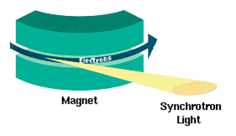
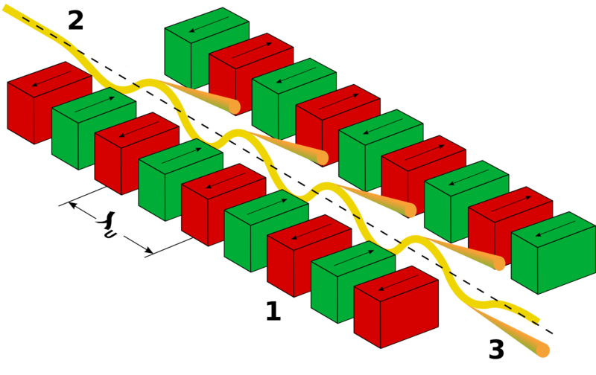
How to Produce Photons?: Accelerate Electrons in a Magnetic Field
To Maximize X-ray Production:
Low mass, e⁻
Highly Relativistic
Strong
Acceleration
Synchrotron Radiation (1st & 2nd Gen)
Undulator Radiation (2nd-4th Gen)
B-Field with
N_{u} Periods
e⁻
Uniform
B-Field
Broad Band
Intensity
Intensity
Narrow Band, Δω/ω ~ 1/N_{u}
Relativistic Angles Ψ_{v} ~ 1/γ, Ψ_{h} ~ K/γ; Undulator: Δω/ω ~ 1/N_{u} & I ~ N_{u}²

Slide 3
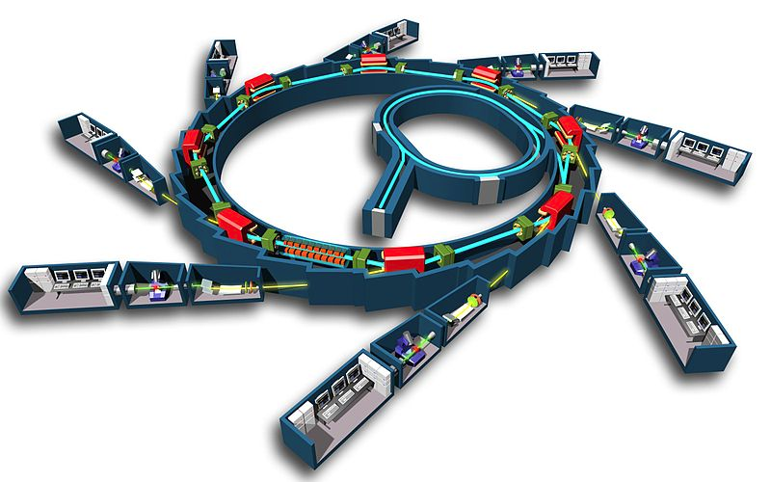
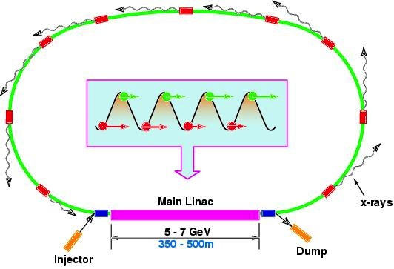
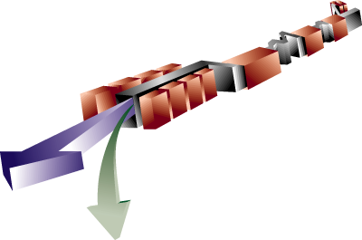
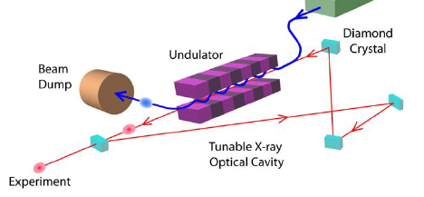
Light Sources: ERL, FEL & Storage Ring
Storage Ring
ERL
Spontaneous Emission
BES
Today
approx. 500m
FEL Amplifier
FEL Oscillator
Stimulated Emission
LCLS

Slide 4
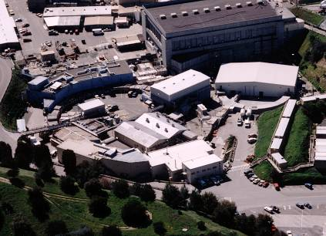
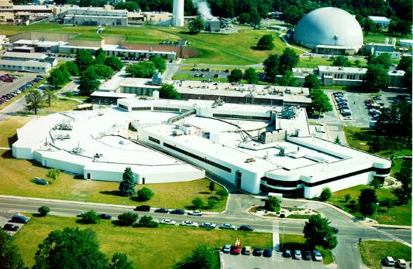
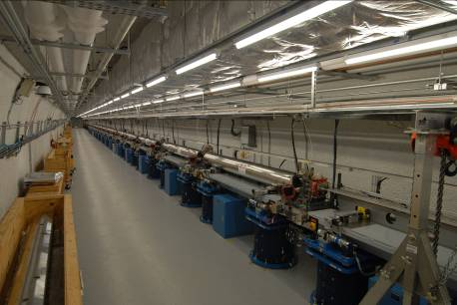
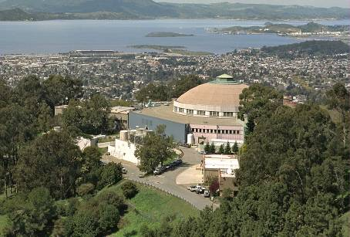
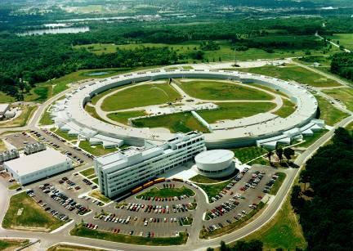
Five Operating BES Synchrotron Light Sources
SSRL 1974 & 2004
NSLS 1982
LCLS 2009
4 Rings
1 FEL
Users
~ 11K
1st & 3rd Gen
2nd Gen
4th Gen
ALS 1993
APS 1996
3rd Gen
3rd Gen
BES Light Sources (LS) have been an SC success story in S&T impact and as key national resources for innovation and competitiveness
Challenge: Maintain U.S. leadership in LS amidst fierce world-wide competition

Slide 5
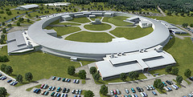
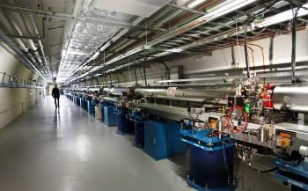
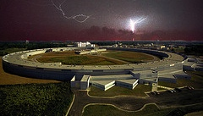
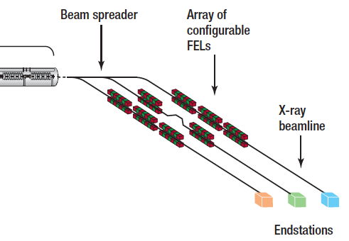
Future: BES Light Source Construction & MIE Projects
BNL NSLS-II: 3 GeV ring with ε < 1 nm with damping wigglers; ~10⁴ boost in brightness over NSLS; goal of 1 nm spatial & 0.1 meV energy resolution; at CD3
SLAC LCLS-II: New Injector + 1 km linac, two new undulators (SX & HX) to give extended spectral range (250 eV to 18 keV) together with expanded capacity; self seeding & TW operation; near CD2
ANL APS-U: Brightness boost with 150 ma, ~15 new/upgraded beamlines & IDs (SCUs) to optimize hard x-rays; Short Pulse X-rays (SPX) adds new timing capability to rings, τ_{FWHM} ~ 2 ps; near CD2
LBNL NGLS: MHz rep rate Soft X-ray FELs based on 2.4 GeV SC linac & 3 undulators (10 in the future); SASE, seeded & two color FELs; at CD0
2015
2018
2018
>2020

Slide 6
DOE Light Sources & Key Worldwide Competitors
Circa 2013
MAX IV
PSI SLS
PETRA III
PAL XFEL
SWISSFEL
XFEL
ALS
ESRF,U
FLASH-I,II
NGLS
NSLS-I,II
APS,U
SPRING8,U
SSRL
LCLS-I,II
SACLA XFEL
SIRIUS
Storage Rings in Blue
FELs in Red
There are many more UV/X-ray rings, IR/UV FELs & a few ERLs

Slide 7
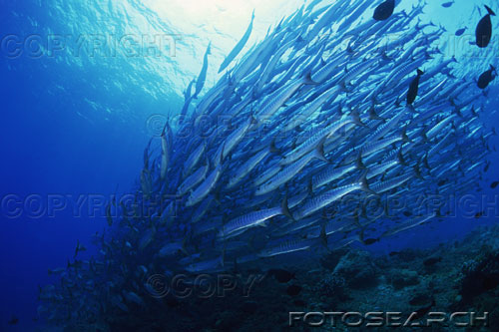
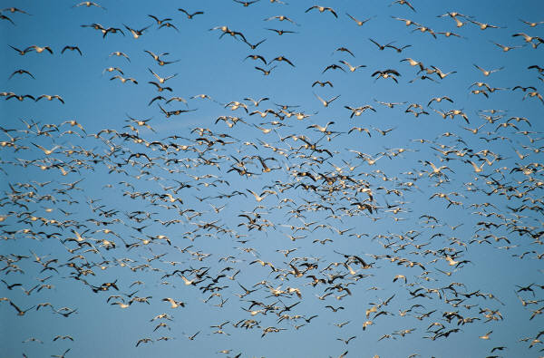
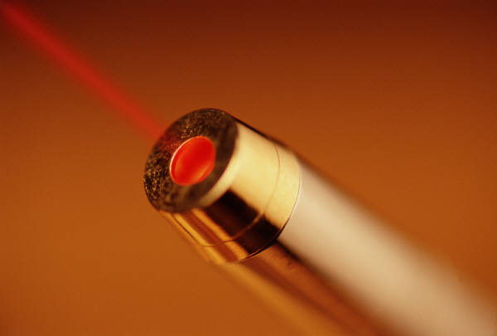
Light Source Metrics: Photons Inherit Electron Properties
Electrons
  Emittance
  Pulse Length
  Energy Spread
  Peak Current
Photons
  Ave & Peak Brightness
  Photons/Pulse, Flux
  Coherence
  Pulse length
Low Brightness Beam
Low Brightness Beam
High Brightness Beam
Diffraction Limit: ε_{e} ~ λ/4π

Slide 8
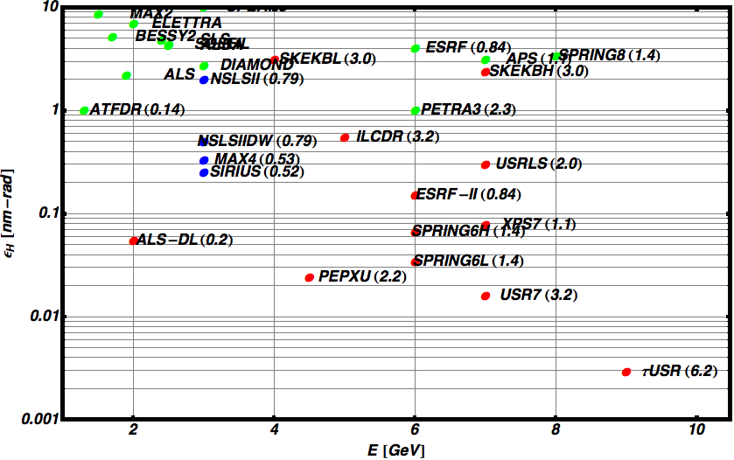
Ring Horizontal Emittance vs Ring Energy
Ring Name (Circumference in km)
Achieved
Construction
Design
Diffraction Limit @1Å
ε ~ λ/4π ~ 8 pm
DW

Slide 9

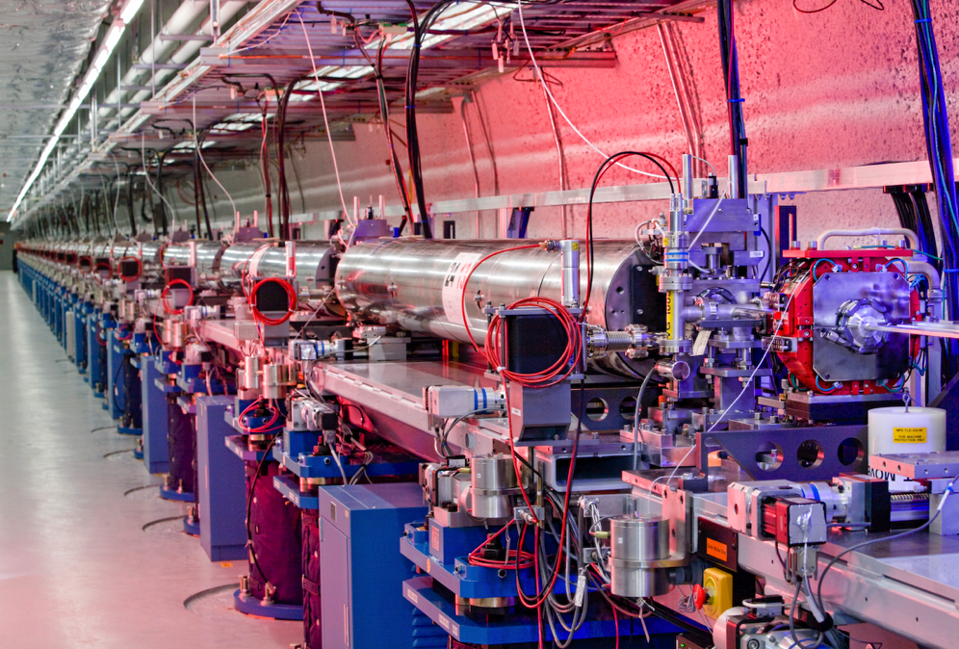

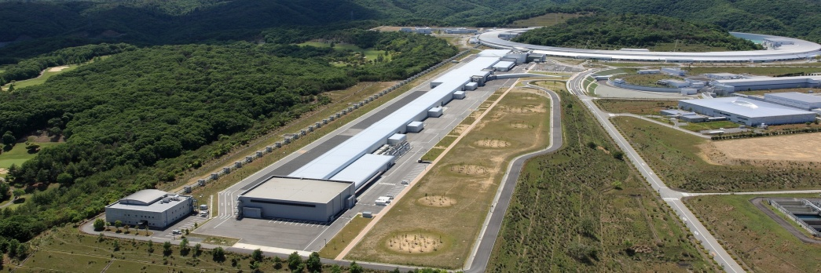
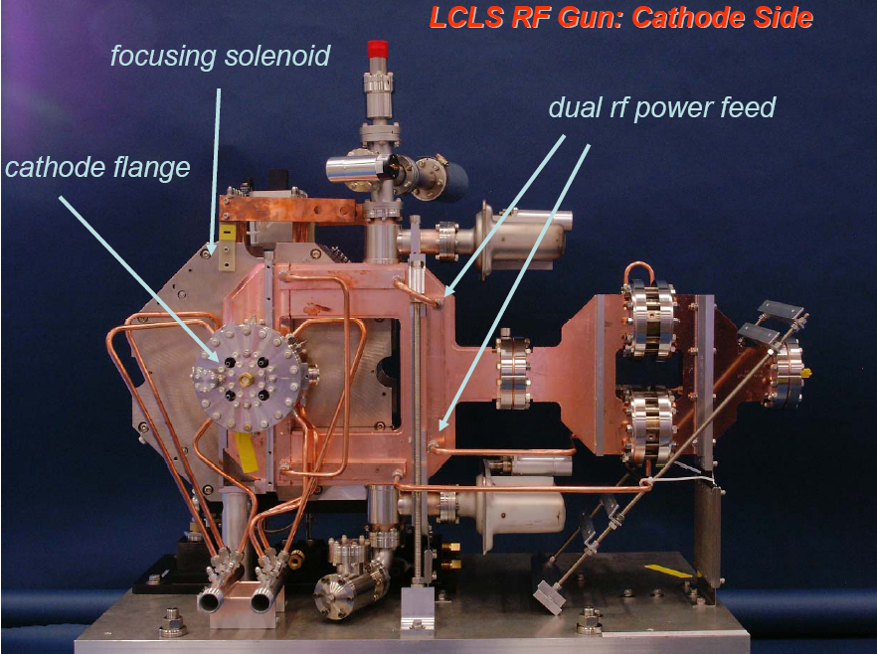
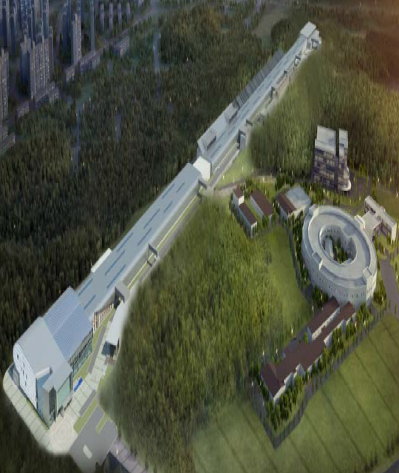

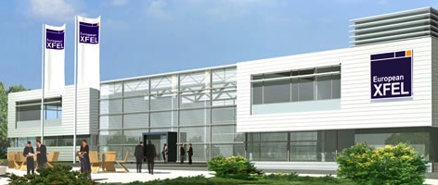

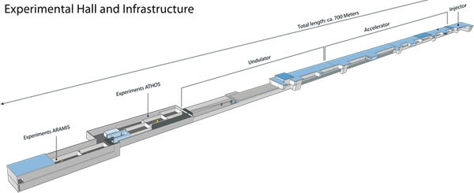

Hard X-Ray FELs in Operation & Under Construction
LCLS-I, II 2009, 2018
14.5 GeV, 120 Hz NC
SACLA 2011
8.5 GeV, 60 Hz NC
XFEL 2015
17.5 GeV, 3000 x 10 Hz SC
PAL XFEL 2015
10 GeV, 100 Hz NC
SWISS FEL 2017
5.8 GeV, 100 Hz NC
Four normal conducting (NC) linacs
One pulsed superconducting (SC) linac
How low can E_{e} & $ go without dashing performance?

Slide 10
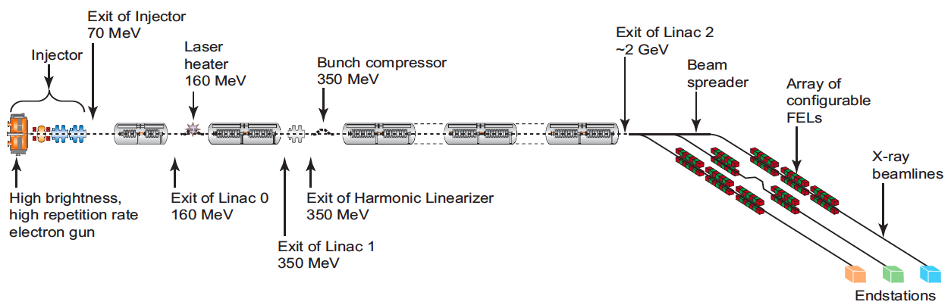
Gazing Beyond LCLS-I & II: High Rep Rate FELs
NGLS: Soft X-Ray FEL Amplifier @ 1MHz
E_{e}~ 2.4 Gev CW SC Linac
CD0 Document
λ ~ 10 Å
XFEL-Oscillator ERL
Electron
Injector
E_{e} ~ 6-10 Gev ERL
Store an X-ray pulse in a Bragg cavity→ multi-pass gain & spectral cleaning
Provide meV bandwidth (Δω/ω ~ 10⁻⁷)
MHz pulse rep rate→ high average brightness
Needs R&D on diamond cavity & ERL
λ ~ 1 Å

Slide 11
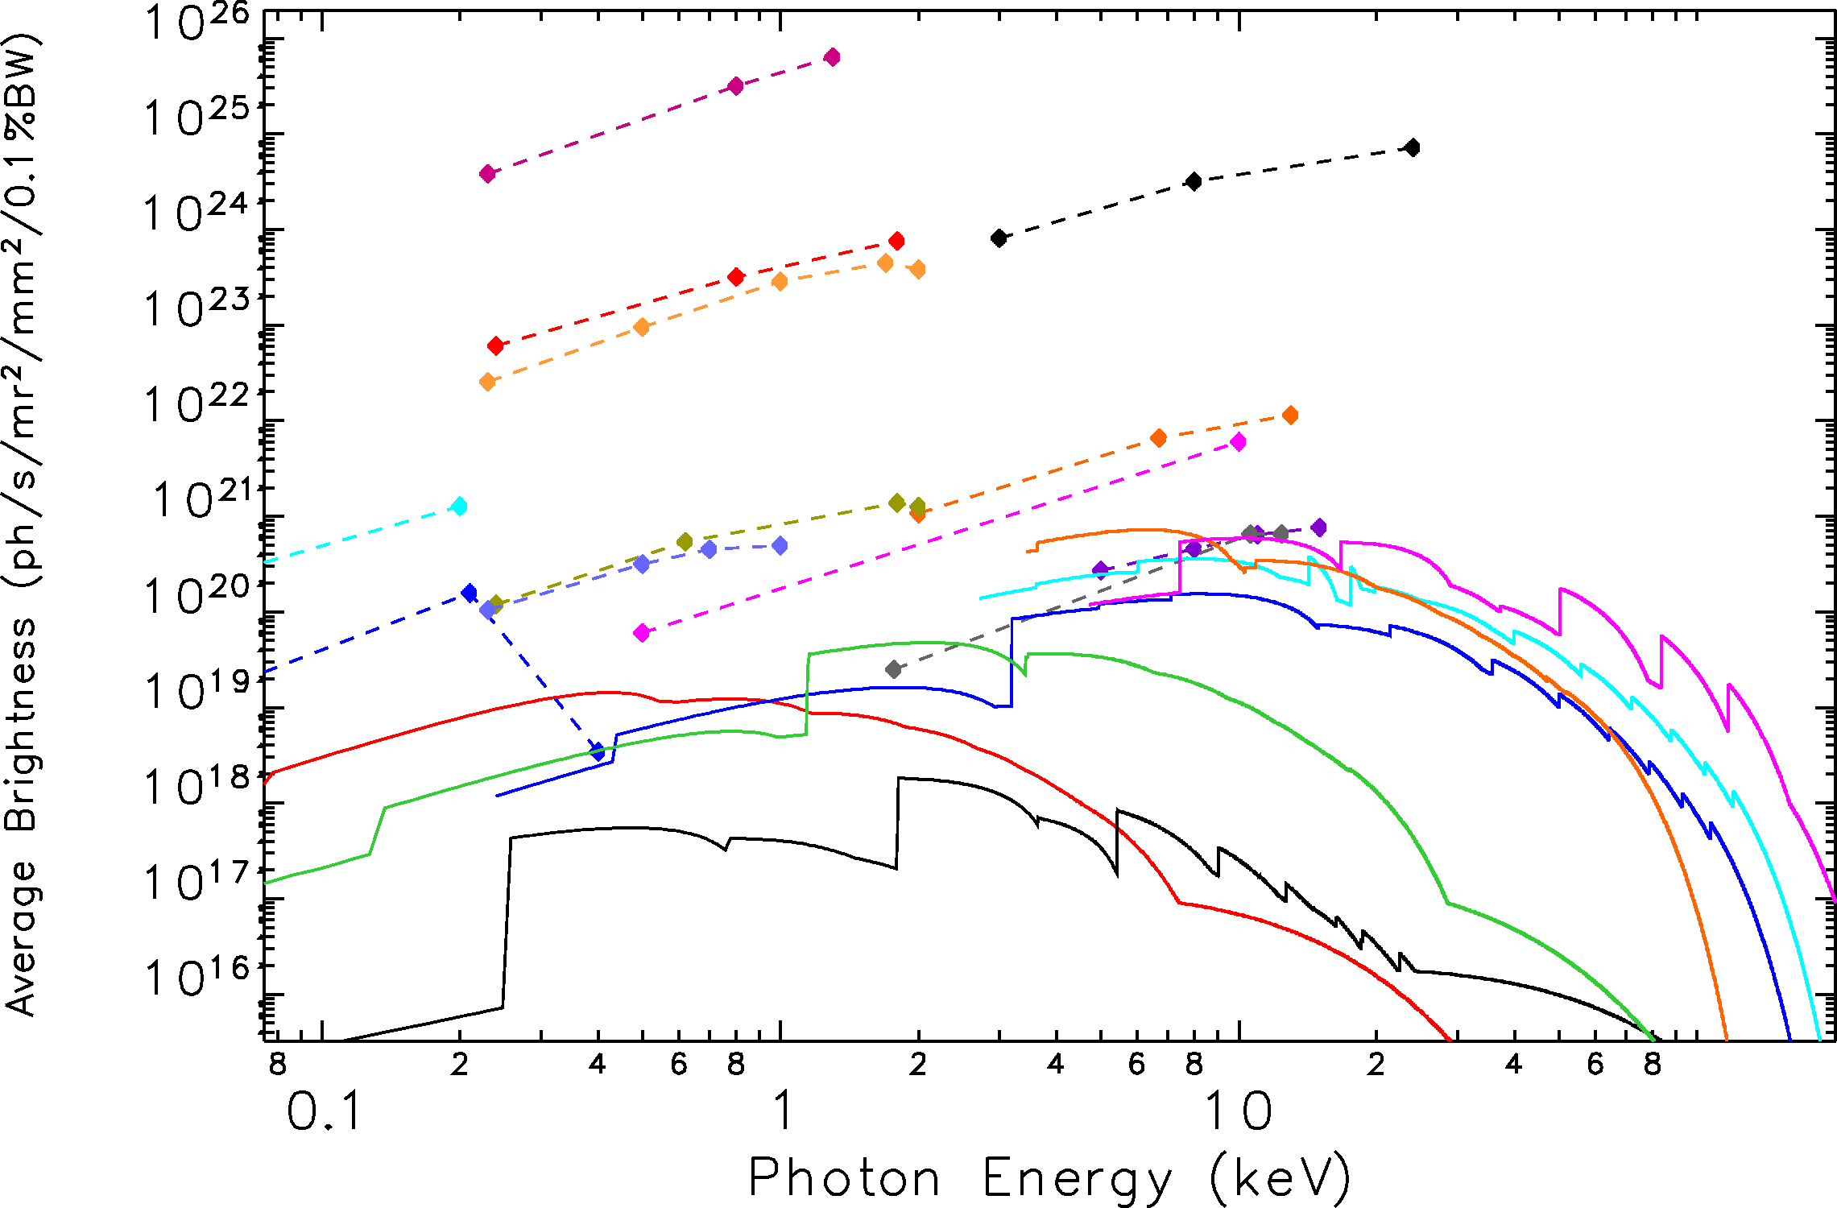
Average Brightness: SASE FELs & Existing Rings
Seeding can boost
Brightness by ~ 10²
M. Borland
R. Hettel
Feb 2013
NGLS FEL1
Seeded
EU XFEL 1, 2
EU XFEL 3
NGLS
FEL1
LCLS2 HXR
NGLS FEL 3
Chirp SASE
LCLS2
SXR
SACLA
FLASH
LCLS1
PETRA3
Spring8
Fermi 2
ESRF
APS
ALS
SSRL
SWISSFEL
NSLS1
Fermi 1

Slide 12
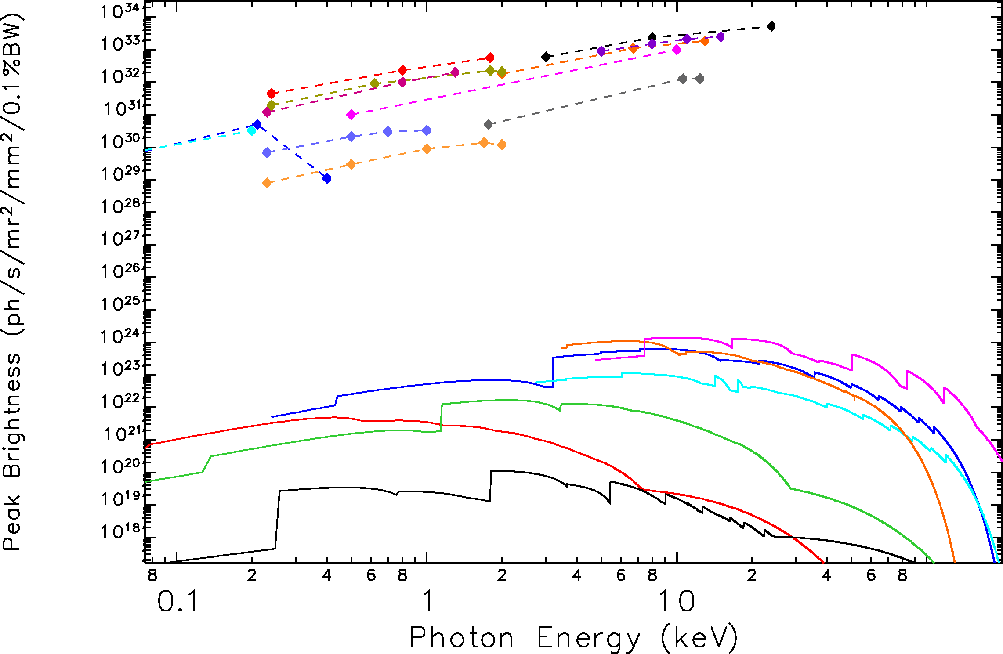
Peak Brightness: SASE FELs & Existing Rings
EU XFEL 1, 2
M. Borland
R. Hettel
Feb 2013
LCLS2
HXR
EU XFEL 3
SACLA
LCLS1
Fermi 2
SWISSFEL
LCLS2
SXR
FLASH
NGLS
FEL1
NGLS FEL 3
Chirp SASE
NGLS FEL1
Seeded
PETRA3
Spring8
APS
ESRF
ALS
SSRL
NSLS1
Fermi 1

Slide 13
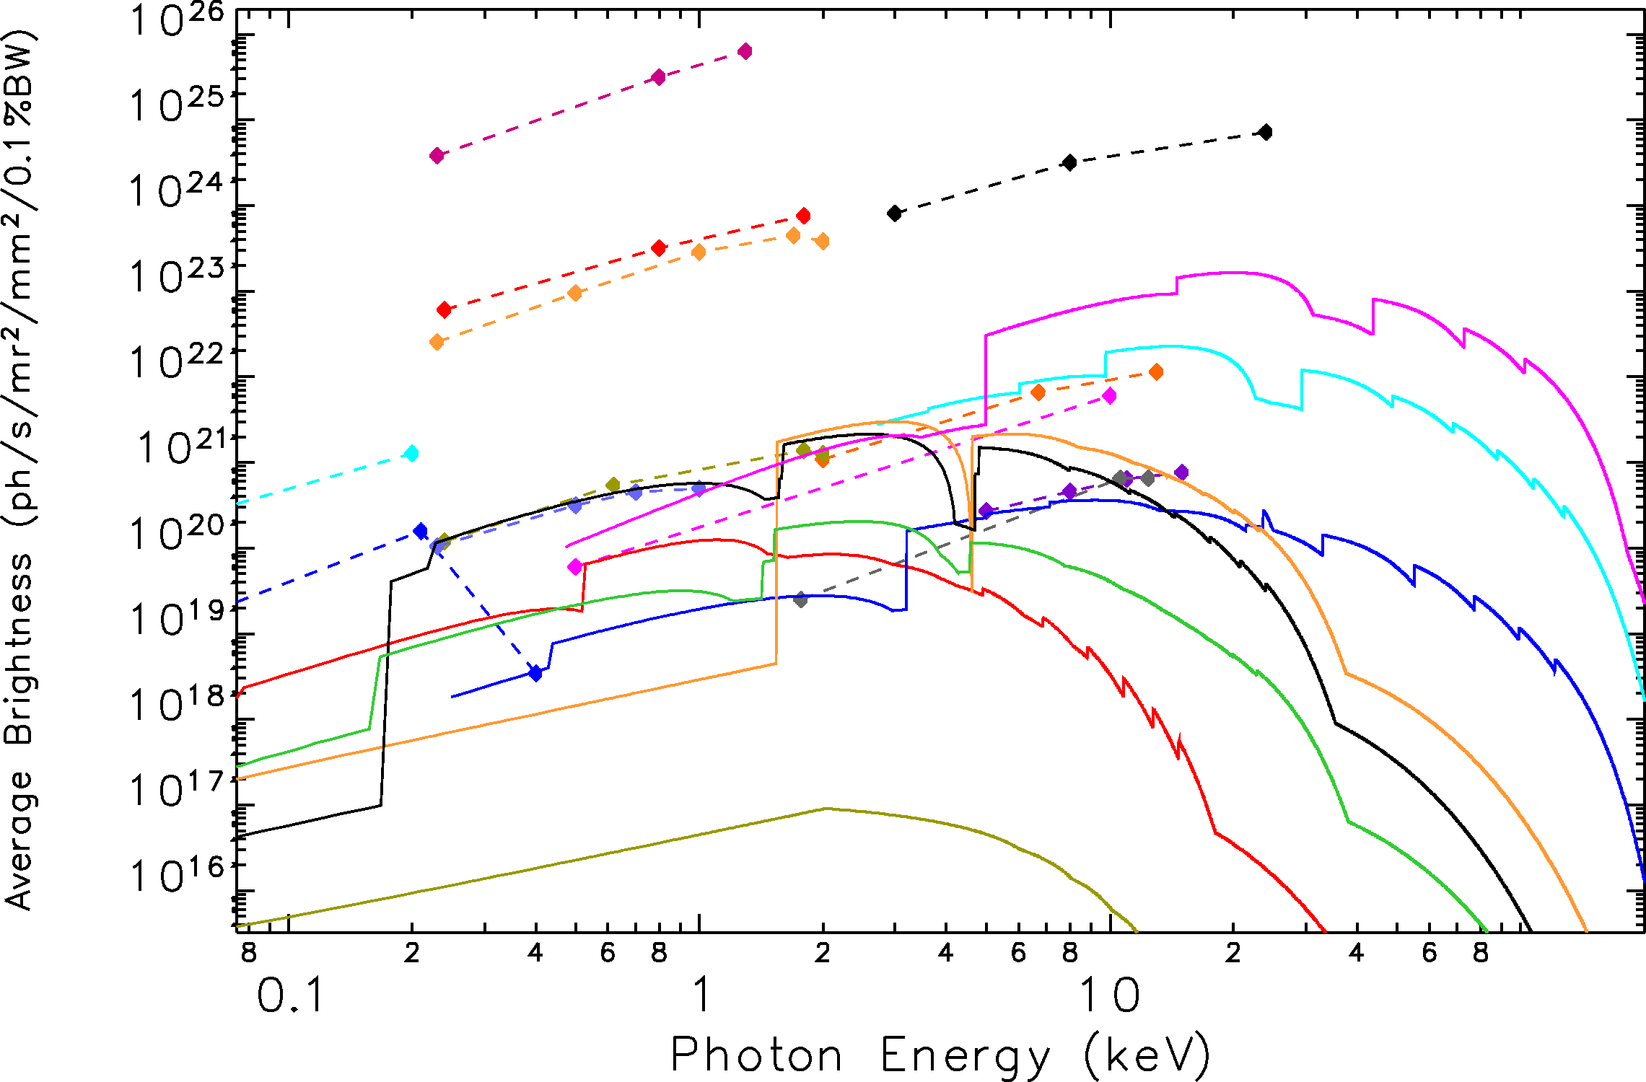
Ave Brightness: SASE FELs & Upgraded Rings
NGLS FEL1
Seeded
M. Borland
R. Hettel
Feb 2013
EU XFEL 1, 2
EU XFEL 3
Spring8
NGLS
FEL1
LCLS2 HXR
NGLS FEL 3
Chirp SASE
LCLS2
SXR
ESRF
FLASH
LCLS1
SACLA
MAX4
Fermi 2
NSLS2
APS
ALS
SWISSFEL
SSRL
MAX1.5
Fermi 1

Slide 14
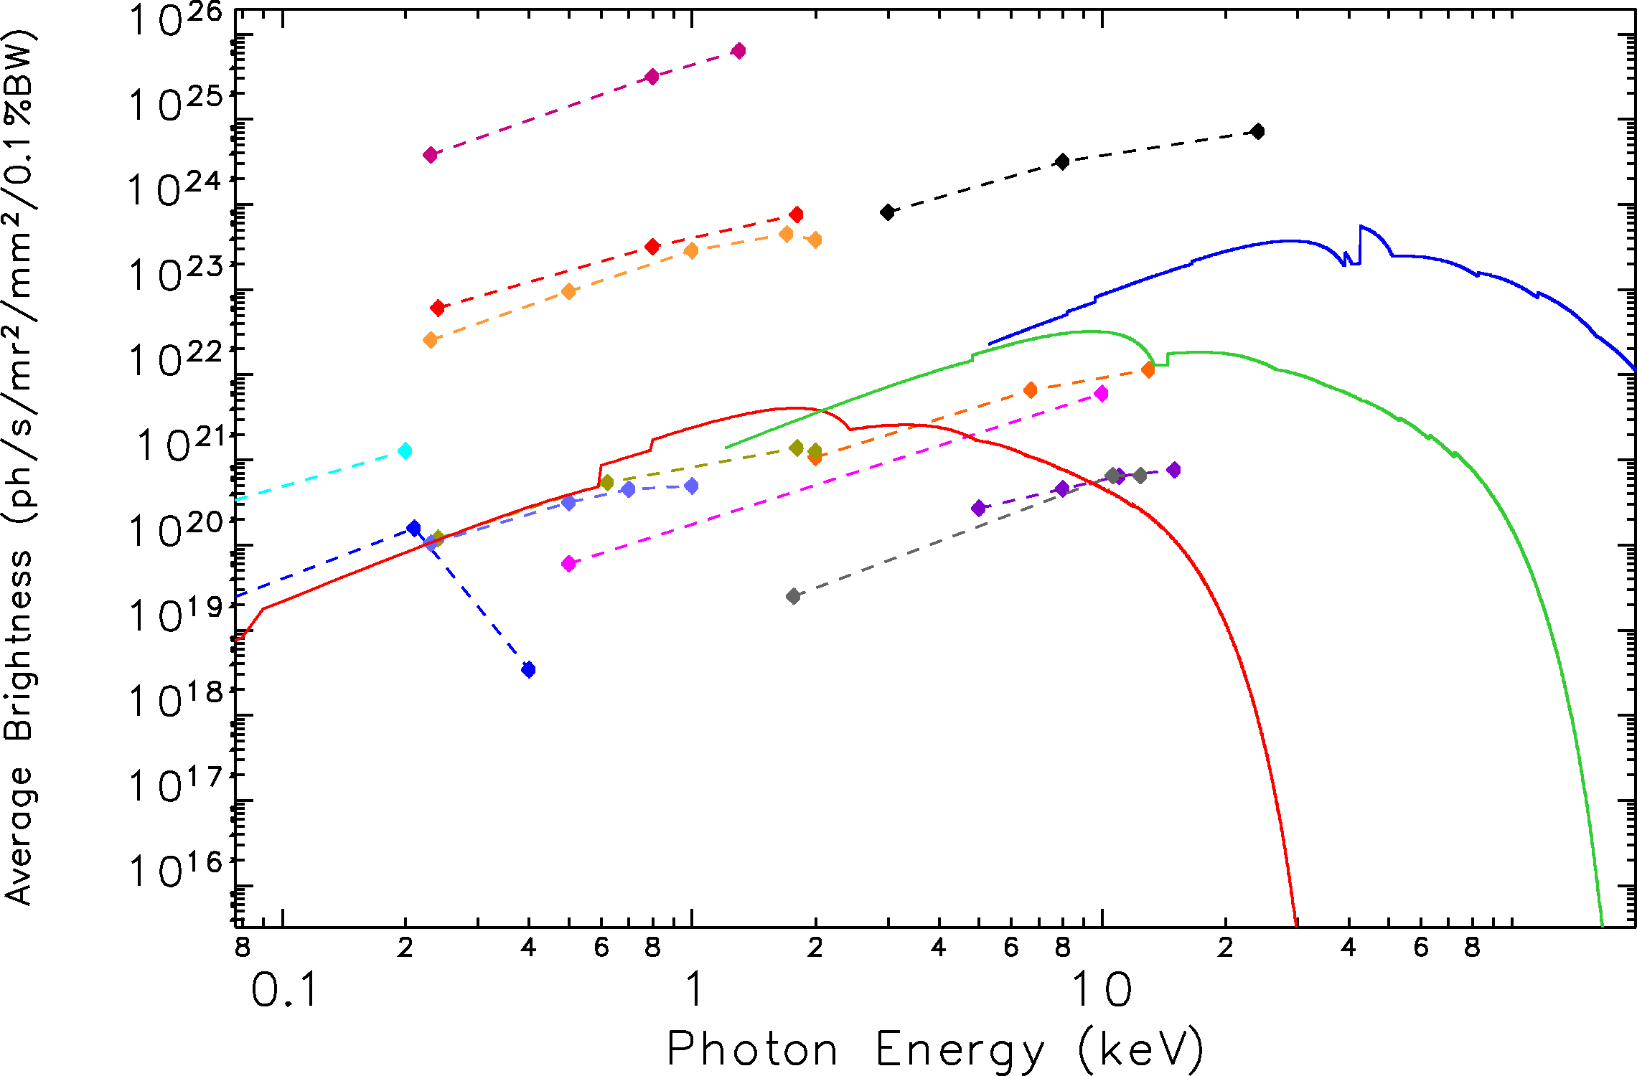
Average Brightness: SASE FELs & USRLS Rings
NGLS FEL1
Seeded
M. Borland
R. Hettel
Feb 2013
EU XFEL 1, 2
EU XFEL 3
TauUSR
NGLS
FEL1
LCLS2 HXR
NGLS FEL 3
Chirp SASE
LCLS2
SXR
LCLS1
PEP-X
FLASH
PETRA3
SACLA
Fermi 2
ALS-DL
SWISSFEL
Fermi 1

Slide 15
Photons/Pulse vs Pulse Duration
At 6.5 MHz ~10¹³-10¹⁴ ph/sec
LCLS 1.5 Å, 2 x 10¹² ph/pulse
SPX
ANL-08/39
BNL-81895-2008
LBNL-1090E-2009
SLAC-R-917

Slide 16
Summary Remarks
BES SUFD is the steward of the facilities which enable the expansion of the frontiers of bio, chem, geo & physical sciences
There are BES facilities in their infancy, and some poised for rebirth, all with strong track records of performance; the goal is to sustain their preeminence & maximize science productivity (grand challenges, discovery, basic, applied….)
Worldwide competition in light source development is fierce, competitors compromise on capacity but less so on performance
As the quantitative performance gap between sources narrows, the quality of the science performed at the BES user facilities will have to set the USA apart from the pack
BES strives to deliver revolutionary new sources, while ensuring an evolutionary path, with robust R&D programs on accelerators, detectors, optics & technology

Slide 17
EXTRAS

Slide 18
FELs: Coherent Emission in a Cooperation Length
Spontaneous Emission from a Random Beam
λ = λ_{u} (1+K²/2)/2γ²
λ_{u}
Stimulated Emission from a Self Bunched Beam
N_{c} ~ 10⁵

Slide 19
Storage Ring Data for Brightness Plots
Facility | Location | Energy (GeV) | Effective emittance (nm) | Circumference (m)
ALS (Present) | US (LBNL) | 1.9 | 6.3 | 196.8
ALS (Upgrade) | US (LBNL) | 1.9 | 2.2 | 196.8
APS (Present) | US (ANL) | 7.0 | 3.1 | 1104
APS (Upgrade) | US (ANL) | 7.0 | 3.5 | 1104
ESRF (Present) | France | 6.04 | 4.1 | 844.4
ESRF (Upgrade) | France | 6.04 | 0.15 | 844.4
MAX-IV 1.5 GeV | Sweden | 1.5 | 6.0 | 96
MAX-IV 3.0 GeV | Sweden | 3.0 | 0.3 | 528
NSLS-I | US (BNL) | 2.8 | 66 | 170
NSLS-II | US (BNL) | 3.0 | 0.5 | 792
Spring-8 (Present) | Japan | 8.0 | 3.8 | 1436
Spring 8-II (Upgrade) | Japan | 6.0 | 0.034 | 1436
SSRL (Present) | US (SLAC) | 3.0 | 10 | 234
SSRL (Upgrade) | US (SLAC) | 3.0 | 5.0 | 234
ALS-DL | US (LBNL) | 2.0 | 0.055 | 196.8
PEP-X | US (SLAC) | 4.5 | 0.012 | 2199
tauUSR | US | 9.0 | 0.003 | 6210

Slide 20
FEL Data for Brightness Plots
FEL Facility | Location | Electron Energy (GeV max) | Photon Energy Range (keV) | Rep Rate | Linac Technology (NC or SC)
EXFEL | DESY, FRG | 20 | 0.5-20 | 10 Hz, 2700 pulse burst | SC
FERMI | Trieste, IT |  | 0.01-0.4 | 50 Hz | NC
FLASH | DESY, FRG | 1.25 | 0.01-0.2 | 10 Hz, 800 pulse burst | SC
LCLS-I | SLAC, USA | 13.6 | 0.5-10 | 120 Hz | NC
LCLS-II | SLAC, USA | 13.6 | 0.24-12 | 120 Hz | NC
NGLS | LBNL, USA | 2.4 | 0.23-2 | 1 MHz | SC
PALXFEL | PAL, Korea | 10 | 0.28-20 | 60 Hz | NC
SACLA | Spring-8, Japan | 8 | 5-15 | 60 Hz | NC
SwissFEL | PSI | 6 | 1.8-12 | 100 Hz | NC

Slide 21
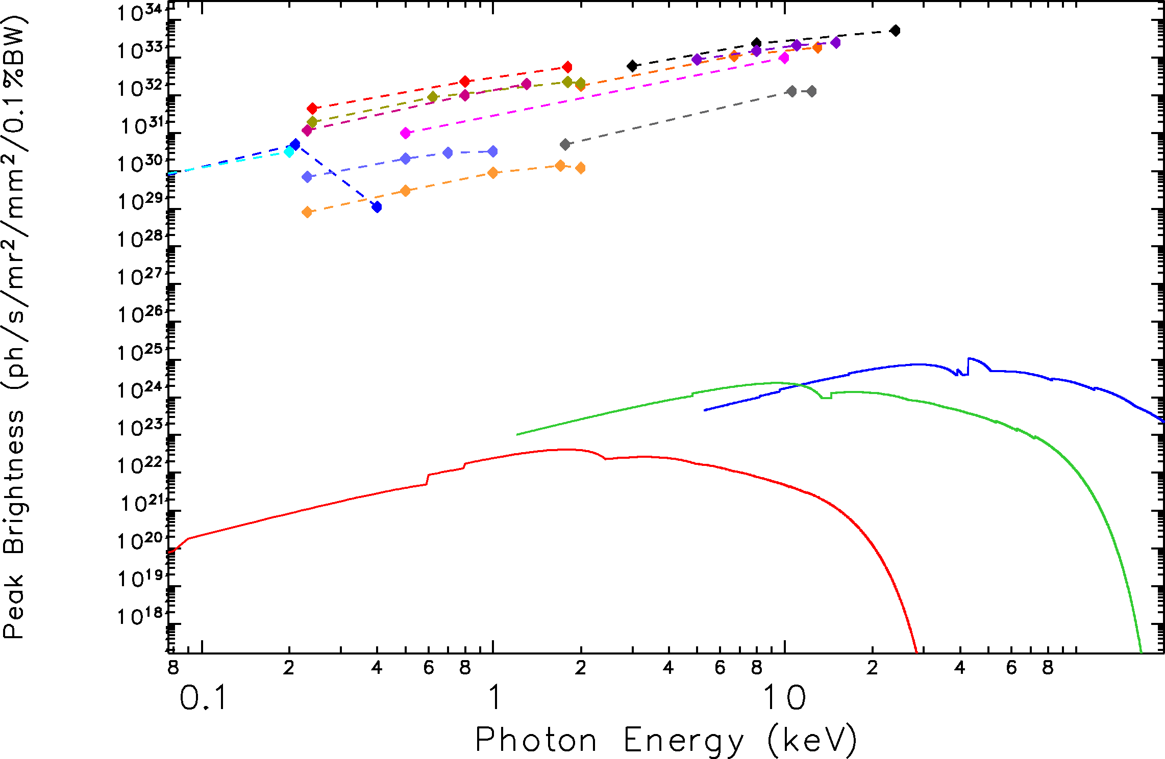
Peak Brightness: SASE FELs & USRLS Rings
EU XFEL 1, 2
M. Borland
R. Hettel
Feb 2013
LCLS2
HXR
EU XFEL 3
SACLA
LCLS1
Fermi 2
SWISSFEL
LCLS2
SXR
FLASH
NGLS
FEL1
NGLS FEL 3
Chirp SASE
NGLS FEL1
Seeded
TauUSR
PEP-X
ALS-DL
Fermi 1

Slide 22
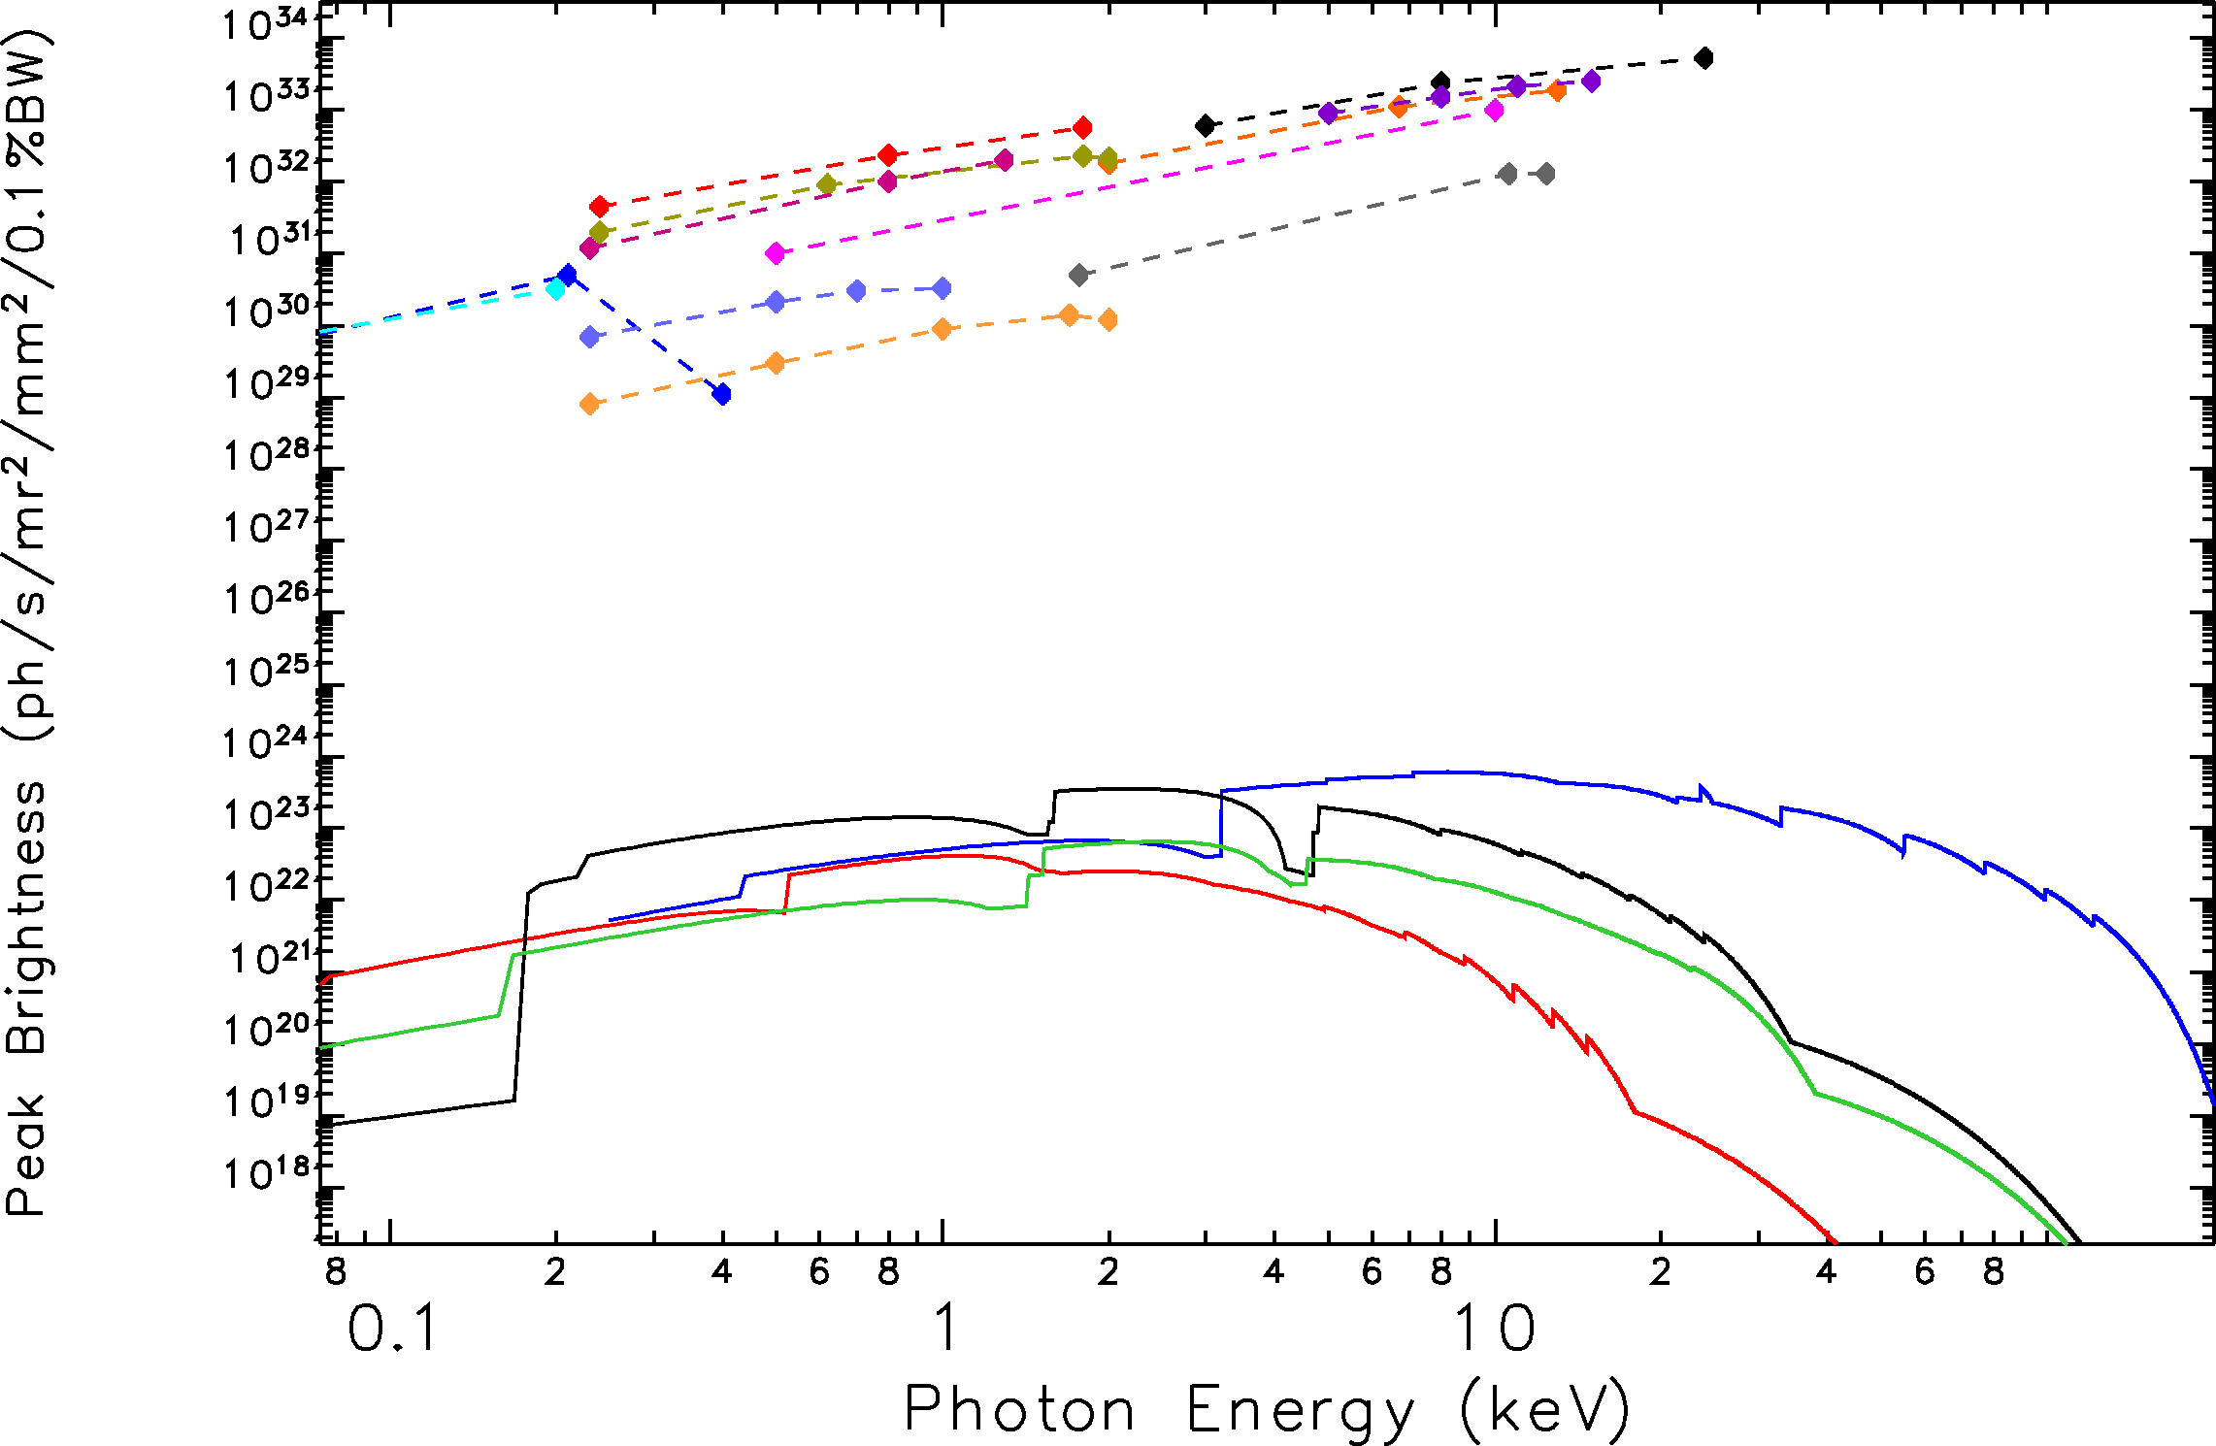
Peak Brightness: SASE FELs & Upgraded Rings
EU XFEL 1, 2
M. Borland
R. Hettel
Feb 2013
LCLS2
HXR
EU XFEL 3
SACLA
LCLS1
Fermi 2
SWISSFEL
LCLS2
SXR
FLASH
NGLS
FEL1
Spring8
NGLS FEL 3
Chirp SASE
NGLS FEL1
Seeded
PETRA3
ESRF
APS
NSLS2
ALS
SSRL
Fermi 1

