Slide 1
Report of the Committee of Visitors
Energy Frontier Research Centers
and
Joint Center for Artificial Photosynthesis
Energy Innovation Hub
Office of Basic Energy Sciences
U.S. Department of Energy
to the
Basic Energy Sciences Advisory Committee
Review since Initiation of EFRCs (2009) and JCAP (2010) through Fiscal Year 2012
Germantown, Maryland
May 29-31, 2013
Persis S. Drell
July 26, 2013

Slide 2
Process
A Committee of Visitors (COV), under the guidance of the Basic Energy Sciences Advisory Committee (BESAC), reviewed the programs of the Energy Frontier Research Centers (EFRCs) and the Joint Center for Artificial Photosynthesis (JCAP), an Energy Innovation Hub.
The EFRCs and JCAP are supported by the Basic Energy Sciences (BES) program within the DOE Office of Science.
The EFRC funding opportunity announcement, issued on April 4, 2008, resulted in awards to 46 EFRCs for five years starting on August 1, 2009, at $2-$5 million per year per award for a total award commitment of $777 million over five years.
The Fuels from Sunlight Hub funding opportunity announcement, issued on December 22, 2009, culminated in a $122 million over five-year award to JCAP on September 29, 2010.
This report covers the initiation and management of the EFRC (2009) and JCAP (2010) programs through fiscal year 2012.

Slide 3
Process (Cont.)
The COV was chaired by Dr. Persis Drell.
The charge to the COV, from Dr. John Hemminger, the chair of BESAC, was to:
Assess the efficacy and quality of the processes used to solicit, review, recommend, and document proposal actions and monitor active projects.
Within the boundaries defined by the DOE missions and available funding, comment on how the award process has affected the breadth and depth of portfolio elements, and the national and international standing of the portfolio elements.
This was the first COV for both the EFRCs and JCAP.

Slide 4
Committee Membership
A balance was achieved between
Researchers who were involved in an EFRC or Hub application or are EFRC participants (8) and those who were not (11)
Between academic (14) and national laboratory (5) staff
Between those who have previously served on a COV (11) and those that have not (8).
Given the size of the EFRC and JCAP programs and the breadth of programmatic areas, a sizable committee was assembled.
19 members, including the chair.
EFRC (12) and a JCAP (6) panel.
EFRC panel was further divided into two subpanels on award selection (6) and operations (6).
Each panel/subpanel had a first and second “read,” that is, a first and second reading by different reviewers.

Slide 5
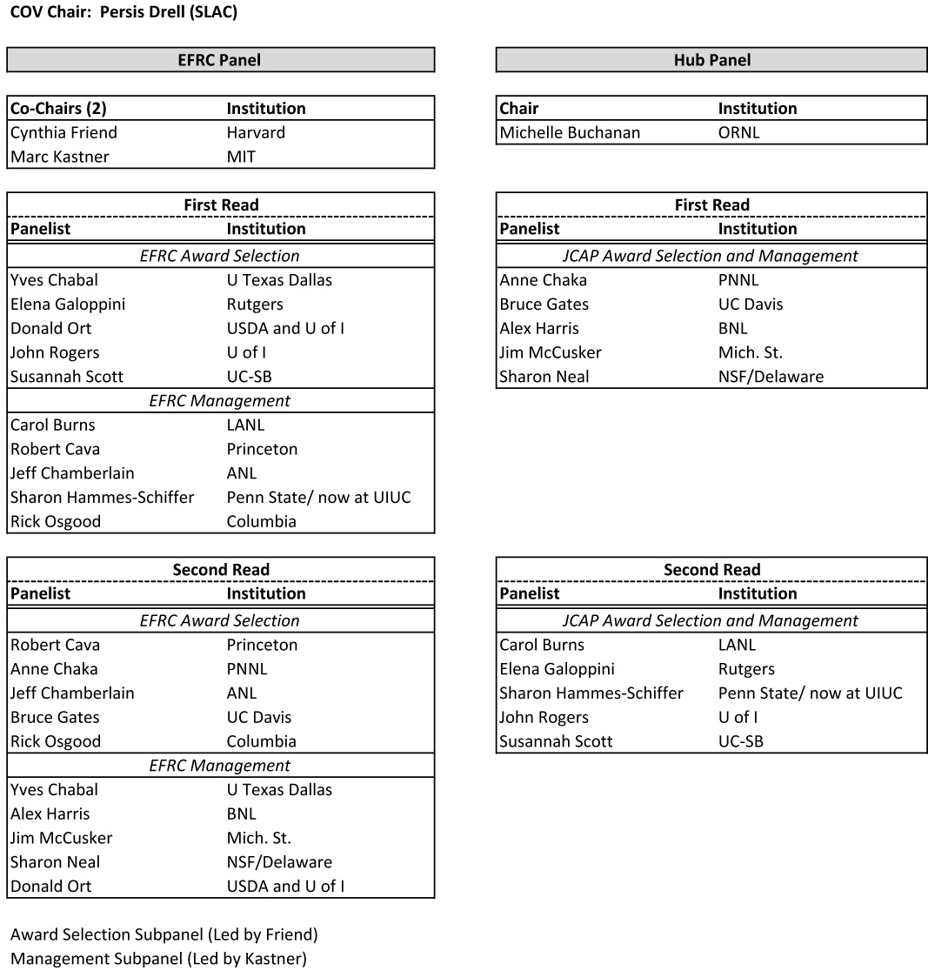
Review Panel
COV Membership and Reading Assignments

Slide 6
COV Membership and Second Reading Assignments

Slide 7
Major Findings of COV
The unanimous judgment of this COV is that the outcome of the EFRC and JCAP procurement processes resulted in the funding of research with high potential for scientific impact in areas relevant to the DOE BES mission and led by highly recognized and accomplished scientists. The high scientific quality of the review and selection process reflects very favorably on the good judgment and competence of the BES staff and program managers.
The review of the EFRC proposals was a formidable task that was generally well managed by the BES staff. The challenges were the consequence of the need to review and act on a large number of proposals on a short time scale. The reviewers were of high quality overall. Given the constraints of time and potential for conflict of interest, the BES staff did a good job of recruiting from international scientists, industry and some non-DOE government labs. However, there was a striking lack of diversity (gender and ethnic) in the reviewer pool.

Slide 8
Major Findings (Cont.)
The BES management processes for the EFRCs are very well implemented and effective. A number of well thought out mechanisms are in place and have been actively used to identify issues and resolve them. A number of the communication mechanisms between the EFRCs and the science community and the public are excellent, and, overall, the EFRCs have told an inspiring story to the general scientific community concerning the value of fundamental research that supports energy sustainability.

Slide 9
Major Findings (Cont.)
The solicitation and review process for the Hub was a very substantial task that was well managed by the BES staff. The panels selected for the reviews were judged to be excellent. The merit review process was thorough and well documented, and the award to the Joint Center for Artificial Photosynthesis (JCAP) was consistent with its ranking by reviewers as being the clear leader in both the first and second review panels.
While both EFRCs and the Hub present new management challenges, the size and unique focus of the Hub makes it absolutely critical for success that an effective Hub management structure is established. Continued BES oversight for the JCAP Hub will be required to achieve the stated goals.

Slide 10
Major Recommendations of COV
Although EFRC award documents provided a clear rationale for why a given project was funded, the documentation for the proposals declined was limited to the reviewers’ comments and the total average score. We recommend that BES document the reasons for declining proposals that were reviewed well enough to be fundable.
For the promise of the Hub to realize its full potential with significant impact, the COV recommends that BES take steps to ensure full integration and synergy of activities within the Hub to achieve the appropriate focus on the singular goal to be achieved for the funded project period (5 years).

Slide 11
Many Thanks!
Terrific hard working COV!
Outstanding BES staff!
The availability of information relevant for the review well in advance of the review greatly assisted the COV in being well prepared and organized to assess a large amount of material very efficiently

