Slide 1
Basic Energy Sciences Update
BES Advisory Committee Meeting
July 25, 2013
Harriet Kung
Director, Basic Energy Sciences
Office of Science, U.S. Department of Energy

Slide 2
Outline
What’s New – organization and BES staffing update
FY 2013 Budget & Program Highlights
FY 2014 Request and Appropriation Status

Slide 3
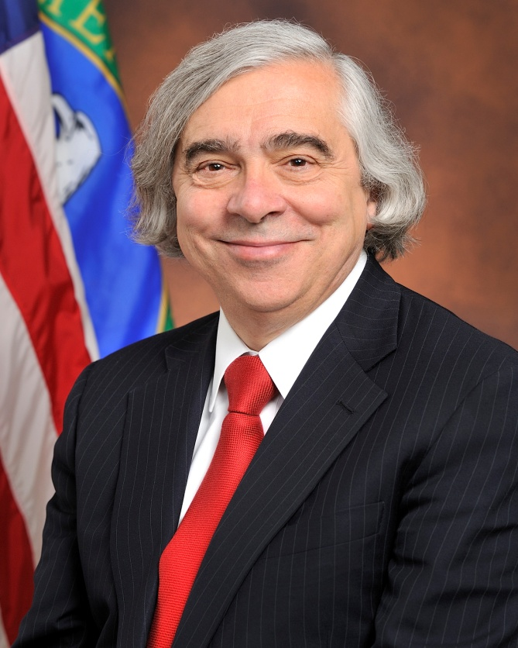
Secretary of Energy, Dr. Ernest Moniz confirmed on May 16, 2013
Professor of Physics and Engineering Systems at MIT and founding Director of the MIT Energy Initiative and of the MIT Laboratory for Energy and the Environment
Under Secretary of the Department of Energy (1997 to 2001)
Associate Director for Science in the Office of Science and Technology Policy in the Executive Office of the President (1995-1997)
Served on the President Obama’s Council of Advisors on Science and Technology; the Department of Defense Threat Reduction Advisory Committee; the Blue Ribbon Commission on America’s Nuclear Future; and the Council on Foreign Relations
Fellow of the American Association for the Advancement of Science, the Humboldt Foundation, and the American Physical Society.
Bachelor of Science degree summa cum laude in Physics from Boston College, Doctorate in Theoretical Physics from Stanford University
3

Slide 4
Secretary Moniz on Science
House Committee on Science, Space, and Technology June 18, 2013
“Competing in the new energy economy will require us to harness the expertise of our scientists, engineers, and entrepreneurs. As the President said, ―the world is shifting to an innovation economy, and nobody does innovation better than America. The President believes in a robust scientific research infrastructure, strong support for research, and a buildup in human capacity.”
“Energy Frontier Research Centers (EFRCs) provide an important example of the Department’s focus on supporting new and emerging research areas. These centers support scientists and engineers as they work to solve specific scientific problems to help unleash new clean energy technology development.”
“Earlier this month, I made my first trip as Secretary to Oak Ridge, Tennessee to visit the Oak Ridge National Lab (ORNL) and the Y-12 National Security Complex. During my visit, I toured the Spallation Neutron Source, a facility that is helping us better understand the properties of the advanced materials needed to harness and store energy, and which is just one example of the cutting edge facilities across our national labs that are critical for our economic competitiveness and our national security.”

Slide 5
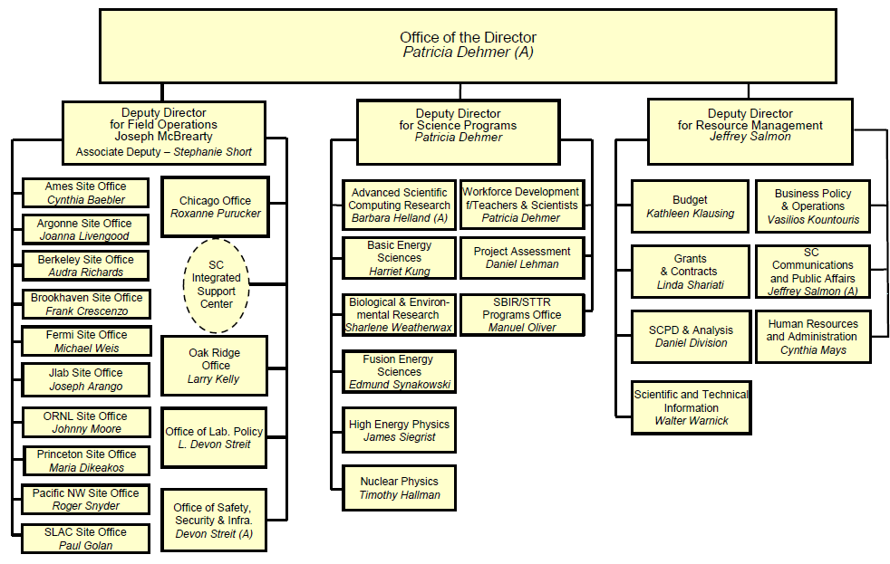
Effective 4/13/2013

Slide 6
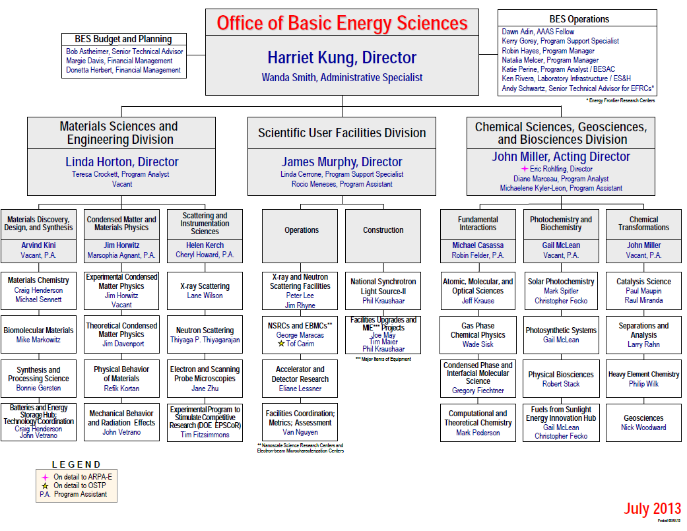
Vacant
New
Vacancy

Slide 7
FY 2013 BES Budget Appropriation
Research programs
  Energy Innovation Hubs (+$4.8M)
  Energy Frontier Research Centers
  Core Research (- $5.5M)
Scientific user facilities
    Synchrotron light sources (-$6.8M)
    Neutron scattering facilities (-$3M)
    Nanoscale Science Research Centers (-$2.3M)
    NSLS-II early ops (+$22M)
FY 2013 Approp:
$ 1,596M
(- $92M from FY 2012)
SBIR/STTR & GPP
50
SUF Research
27
Const, OPC, MIE
NSRCs 100
EFRCs + Hubs
148
126
Neutron Sources
246
CSGB
Research
236
Facilities
Ops 743
Light Sources
396
MSE
Research
266
Construction and instrumentation
  National Synchrotron Light Source-II (-$87.5M) and NEXT instrumentation
  Spallation Neutron Source instruments (-$11.5M)
  Advanced Photon Source upgrade
  Linac Coherent Light Source-II (+$15M*)
*Includes $22.5M of prior year carryover

Slide 8
BES Budget Request vs. Appropriation (1997 – 2013)

Slide 9
Appropriations of BES Major Program Components
FY 2013 vs. FY 2012 (-$92M)
9

Slide 10
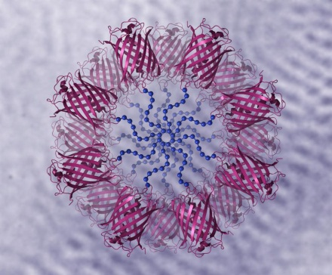
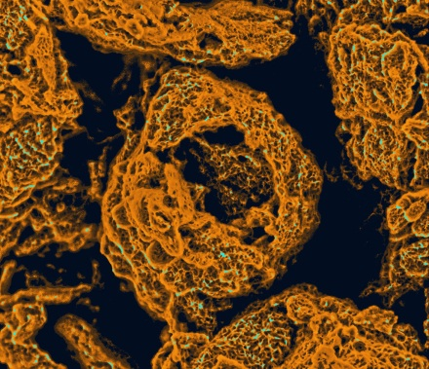
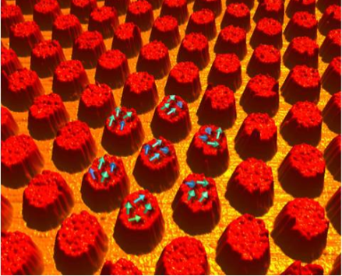
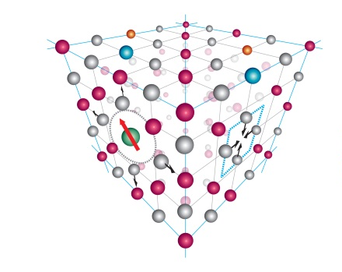
Materials Science and Engineering Research
Moving towards “Materials by Design
Design principles for functional biomaterials
  Enhanced control of self-assembly of polymers based on understanding the role of water – and its concentration during synthesis via neutron scattering (Olsen, MIT)
Nanosized pores and tunnels for improved battery performance
  Nanostructures in air electrodes based on self-assembly of graphene enhance interactions of air with lithium while connecting tunnels promote air flow (Liu, PNNL)
Spacing of arrays of niobium islands allows tuning of superconducting properties
  Island geometry, spacing, and disorder impact superconducing properties in ways that are not explained by current theory (Mason, U of I)
Improved thermoelectric properties by additions of dysprosium atoms
  1-2% dysprosium improves thermoelectric properties by 15%, increasing ZT from 1.3 to 1.5 (Levin, Ames Laboratory)
Dy
Vacancy
10

Slide 11
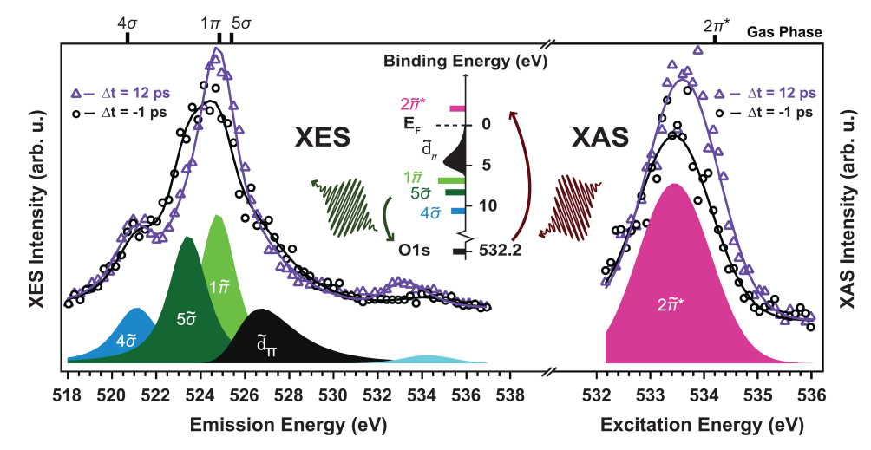
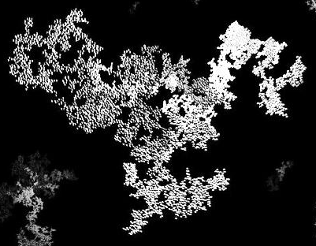
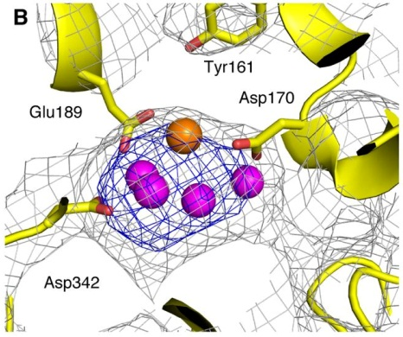
Chemical Sciences, Geosciences and Biosciences Research
Ultrafast X-Ray Science of Chemical Transformations
Ultrafast Visualization of Surface Catalytic Species
  Transient states with picosecond lifetimes were detected and analyzed in real time with the LCLS and quantum chemical models, proving the existence of CO/Ru precursor species in surface catalytic reactions. (Dell’Angela et al, SLAC)
Coherent X-ray Diffraction Reveals Structures of Individual Aerosol Particles
  Intense ultrafast pulses from the LCLS enable examination of individual soot particles, airborne and in their natural state, revealed surprising diversity and complexity. (Bogan et al., SLAC)
Snapshots of Photosynthetic Water Splitting
  Simultaneous atomic and electronic structural images of PSII, a key photosynthetic complex that converts light into chemical energy, were obtained using ultrafast X-ray pulses from the LCLS. Such dynamical measurements provides critical insight for development of artificial and biohybrid photosynthetic components for efficient fuel production from solar energy (Kern et al., LBNL)
11

Slide 12
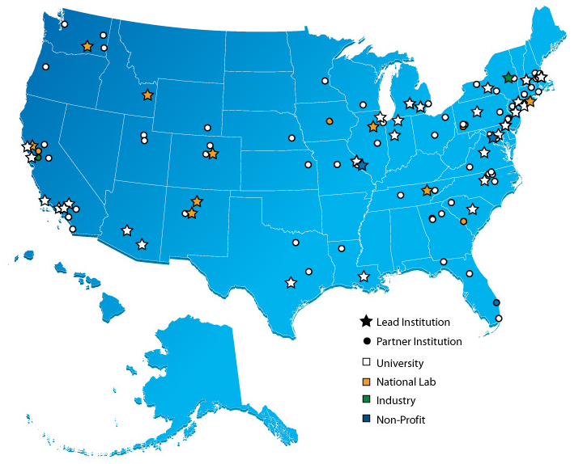
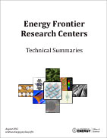
Energy Frontier Research Centers
46 EFRCs were launched in late FY 2009; $777M for 5 Years
Participants:
    46 EFRCs in 35 States + Washington D.C.
    ~850 senior investigators and
    ~2,000 students, postdoctoral fellows, and
    technical staff at ~115 institutions
    > 260 scientific advisory board members
    from 13 countries and > 40 companies
Progress to-date (~3.75 years funding):
    >3,800 peer-reviewed papers including
    >135 publications in Science and Nature
    19 PECASE and 13 DOE Early Career Awards
    over 200 patent applications, over 60 patent/invention disclosures, and at least 30 licenses by 34 of the EFRCs
    at least 60 companies have benefited from EFRC research
    EFRC students and staff now work in : > 215 university faculty and staff positions; > 340 industrial positions;
    > 130 national labs, government, and non-profit positions
http://science.energy.gov/bes/efrc/
12

Slide 13























































Companies that Benefit from EFRC Research

Slide 14
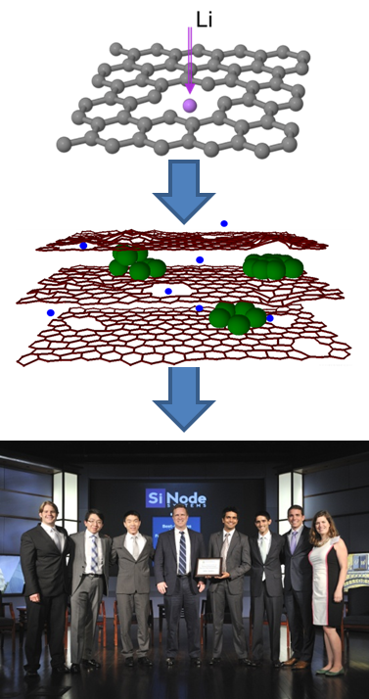

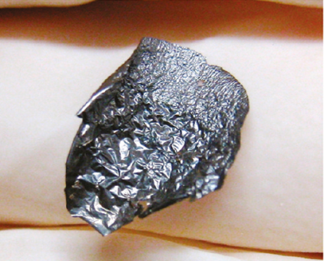




Architectural Design of Graphene Electrodes:
From Theory to New Materials and Technology
Basic Science
Energy Frontier Research Center
Breakthrough Award from Popular Mechanics in 2010.
Manufacturing/
Commercialization
  Theory inspired the development of a ‘holey’ graphene composite where vacancy defects enable facile Li diffusion in electrodes.
EFRC student-led start up (Cary Hayner is Chief Technology Officer)
Won >$1M in start up capital
Winner of the 2013 DOE National Clean Energy Business Plan Competition
Winner of the 2013 Rice Business Plan Competition
Predicted behavior was realized with the encapsulation of silicon nanoparticles (green spheres) in graphene papers leading to near-theoretical capacity with excellent rate capabilities and improved cycling.
Zhao, et al. ACS Nano, 2011, 5(11), 8739.
http://www.youtube.com/watch?v=OnMKuXjkj2o
Technology shown to be compatible in a full cell configuration of a Li ion battery (coin cell-sized anode material shown)
Center for Electrical Energy Storage (CEES)

Slide 15
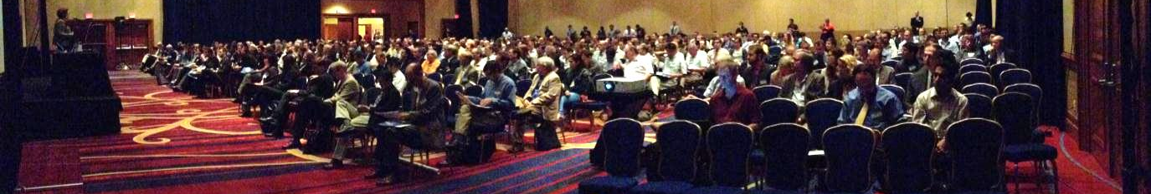
EFRC Principal Investigators’ Meeting
(July 18-19, 2013)
Nearly 500 participants, ~85% from EFRCs
Plenary Session (George Crabtree, Arun Majumdar)
Technology talks from other DOE Offices (EERE, NE, ARPA-E)
Parallel Scientific Sessions (114 Talks, 229 Posters)
  Solar fuels and biomass – Catalysis
  Energy conservation and conversion – Photovoltaics
  Predictive theory and modeling – Energy storage
  Materials and chemistry for nuclear
  energy applications
  Carbon capture and sequestration

Slide 16
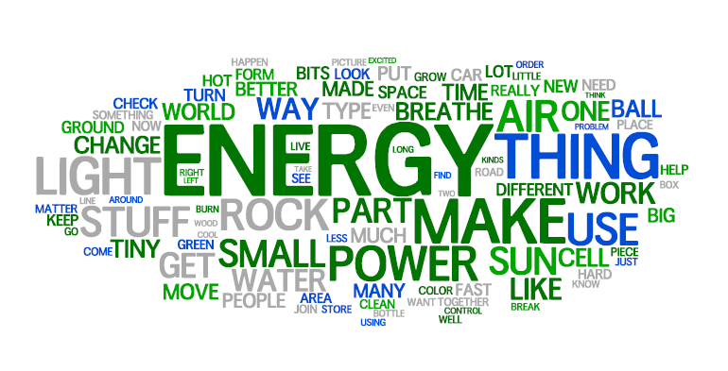
EFRC Ten-Hundred and One Word Challenge
16

Slide 17
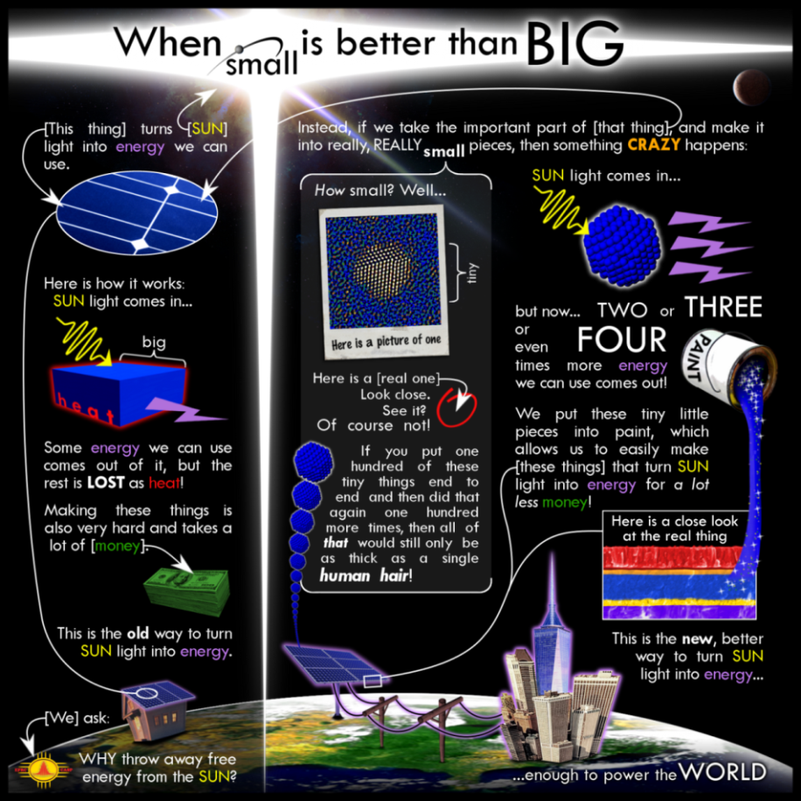
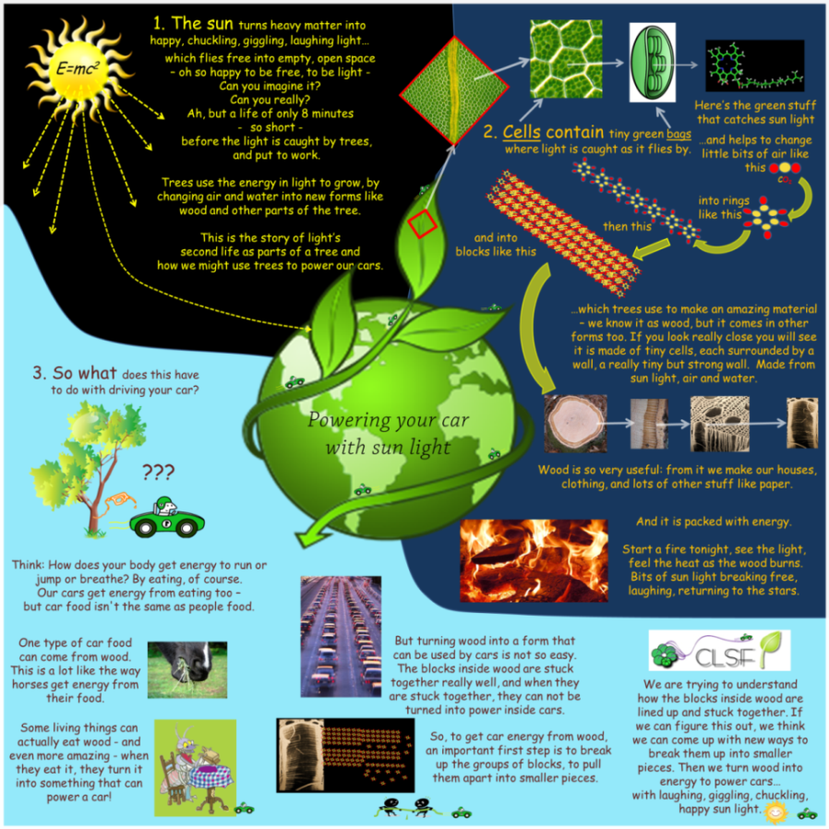
Ten-Hundred and One Word Challenge Winners
Overall Winner:
Powering your car with sun light
Center for Lignocellulose Structure and Formation (CLSF) at Penn State
People’s Choice:
When small is better than BIG
Center for Advanced Solar Photophysics (CASP) at LANL
All entries: http://www.energyfrontier.us/posters
17

Slide 18
EFRC Graduate Student and Postdoc Competition
Each EFRC was invited to nominate one graduate student and one postdoctoral researcher to present a talk at the 2013 EFRC PI Meeting.
The DOE EFRC management team selected 22 finalists.
Selection criteria:
  How well the research exemplifies the opportunities provided by the EFRC funding modality;
  Scientific excellence.
Graduate Student Awards:
Abishek Kashinath, MIT [CMIME]
  “Preventing helium-induced damage through interface engineering”
Maria N. Luckyanova, MIT [S3TEC]
  “Coherent Phonon Heat Conduction in Superlattices”
Brett M. Savoie, Northwestern [ANSER]
  “Concerted Processes in Organic Photovoltaics: The Related Challenges of Generating and Collecting Charge in a Disorder Environment”
Postdoctoral Researcher Awards:
Michelle Liberton, Washington U. [PARC]
  “Probing Light Harvesting and Photosynthetic Productivity in Cyanobacteria”
Gareth S. Parkinson, Vienna U. Tech. [CALCD]
  “Adsorbate Induced Adatom Mobility in a Model Catalyst: Pd/Fe₃O₄”
Xavier Roy, Columbia [RPEMSC]
  “Nanoscale Atoms in Solid-State Chemistry”
Notes:
.

Slide 19
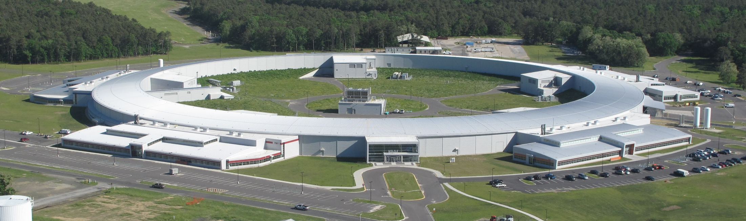
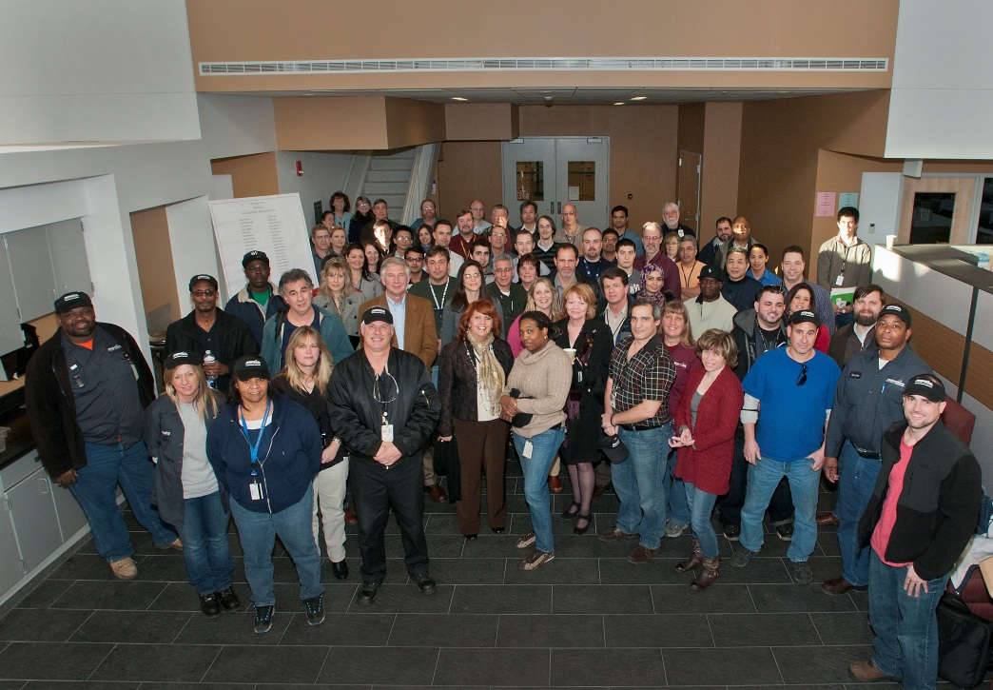
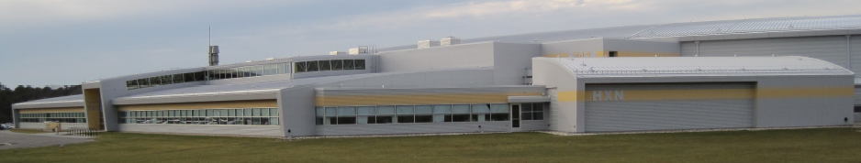
NSLS-II Conventional Facilities Status
Ring building complete
HXN satellite building complete
All 5 LOBs complete
  Occupied LOB3 in Jan
  LOBs 4 & 5 in March
Celebrating moving into LOB3

Slide 20
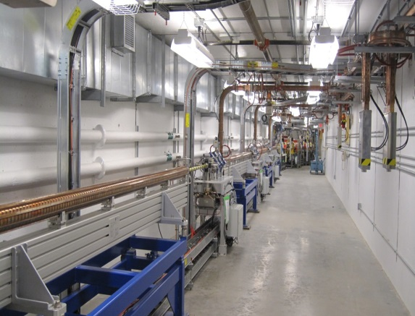
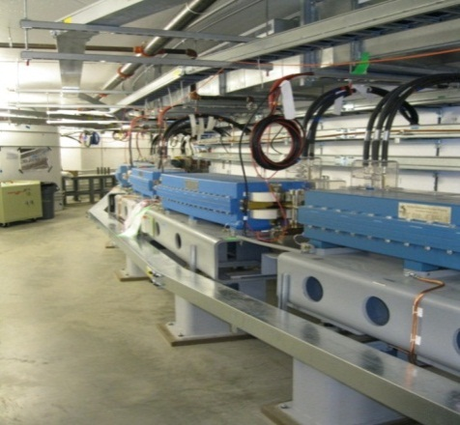
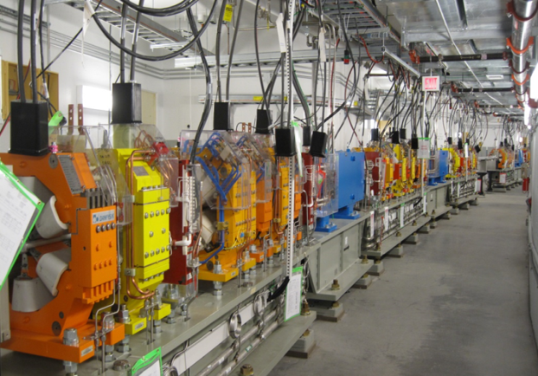
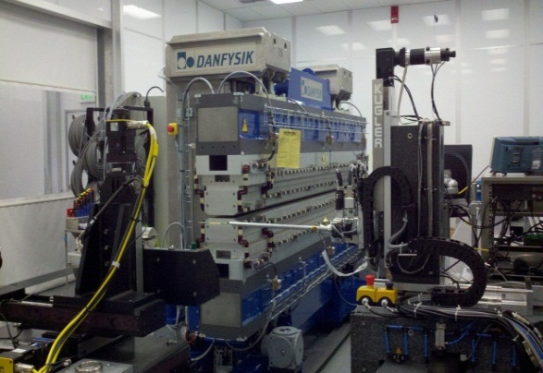
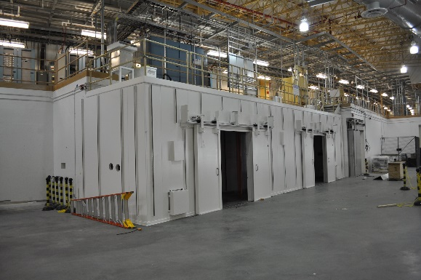
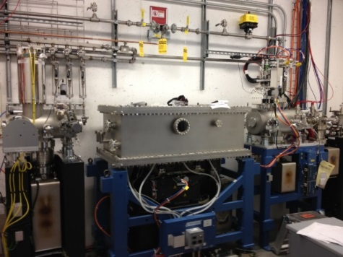
NSLS-II Accelerator Systems and Beamlines Status
LINAC Installed & Commissioned
Storage Ring Installation 88%, commissioning Dec 13
Booster commissioning Oct ‘13
Horizontal collimating mirror (HCM) enclosure installed at HXN hutch
Damping Wiggler in test
Project hutch installation complete
20

Slide 21
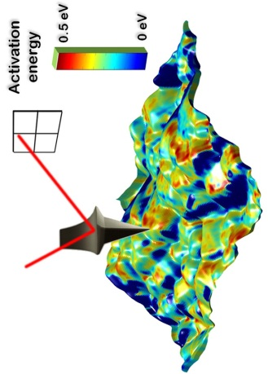
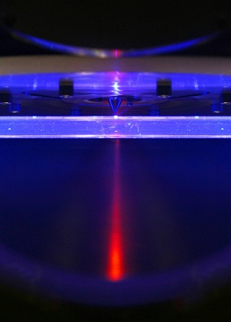
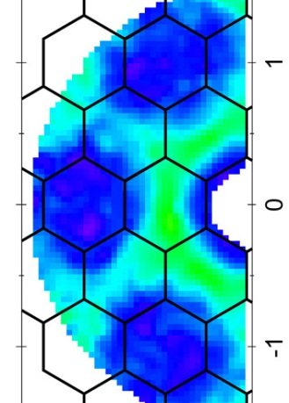
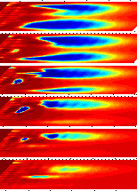
FY 2014 Budget Highlights
Energy Frontier Research Centers (EFRCs) are recompeted (both existing and new)
Energy Innovation Hubs
      Fuels from Sunlight Hub: Joint Center for Artificial Photosynthesis (JCAP) will be in its fourth project year.
      Batteries and Energy Storage: Joint Center for Energy Storage Research (JCESR) will be in its second year.
Core research
      Research, approximately flat at the FY 2012 level, increases work at the mesocale (2012 BESAC report From Quanta to the Continuum: Opportunities for Mesoscale Science).
Scientific user facilities are funded at optimum operations
Construction projects
  National Synchrotron Light Source-II
  Linac Coherent Light Source-II
Major Items of Equipment
  Advanced Photon Source Upgrade
  NSLS-II Experimental Tools

Slide 22
FY 2014 BES Budget Request
FY 2014 Request: $1,862M
Research programs
  Energy Innovation Hubs
  Energy Frontier Research Centers
    One-time $68.7M
  Core Research
Scientific user facilities
Optimum operations of facilities
  Synchrotron light sources
  Neutron scattering facilities
  Nanoscale Science Research Centers
NSLS-II Early Operations ($69M)
SBIR/STTR & GPP
53
SUF Research
37
Const, OPC, MIE
NSRCs 107
EFRCs
+ Hubs
217
214
Neutron Sources
261
Facilities
Ops
832
CSGB
Research
240
Light Sources
464
MSE
Research
269
Construction and instrumentation
  National Synchrotron Light Source-II
  NSLS-II instrumentation (NEXT)
  Advanced Photon Source upgrade
  Linac Coherent Light Source-II
22

Slide 23
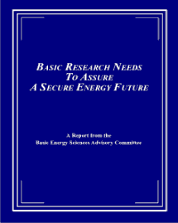
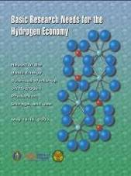

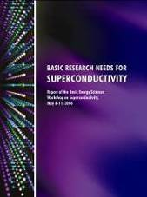
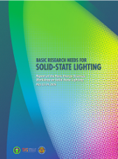
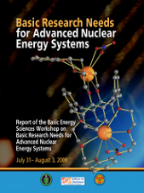

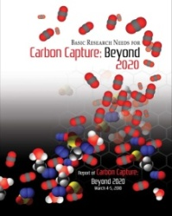

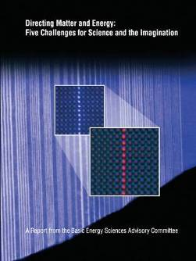
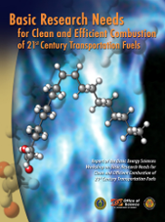
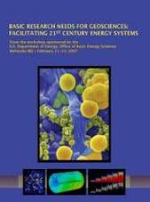
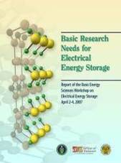
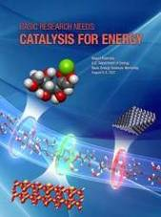
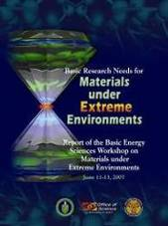
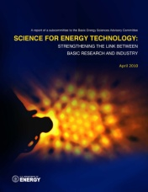
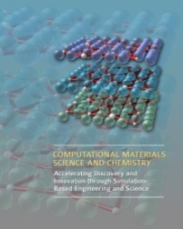
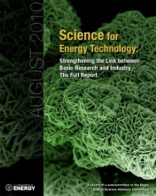
Energy Frontier Research Centers
Recompetition in FY2014
  The initial 46 EFRCs were funded for 5-years beginning in FY 2009: 30 EFRCs were funded annually at about $100M; 16 were fully funded by Recovery Act support
  For FY 2014, funding continues at $100M plus one-time funding of $68.7M
Solicitation will request both renewal and new EFRC applications including:
  Areas of energy-relevant research identified by recent BES and BESAC workshops
  Research to advance the rate of materials and chemical discovery
  Mesoscale science
Selection of awards will be based on rigorous peer review of applications of the proposed research
  Renewal awards will include assessment of the progress during the first 5-year award
Renewal and new awards will maintain a balanced EFRC portfolio for grand challenge and use-inspired energy research
23

Slide 24
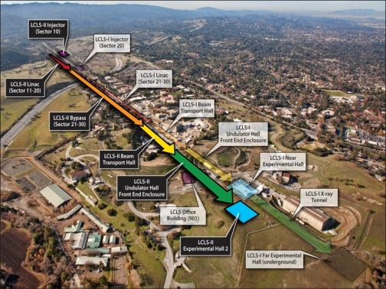
Linac Coherent Light Source – II
Linac Coherent Light Source-II (LCLS-II)
LCLS-II will provide a second, independently
controlled free electron laser with expanded
x-ray energy range (250eV - 13keV), polarization
control, pulse length down to ~1 femtosecond
Conversion to a Line Item Construction Project
Project continues as an MIE under the FY 2013 CR;
heavy civil construction does not proceed.
Impacts include increased TPC and lengthened
schedule.
FY 2013 $45M for design, in-house fabrication,
long lead procurements, and preparations for
CD-2/CD-3b approval. Project is nearly ready to
initiate construction and is managing work to minimize impacts in FY 2013.
FY 2014 Request of $95M for continuation of engineering design, procurements, technical systems, and civil and conventional construction
CD-0 | CD-1 | CD-2 | CD-3a | CD-3b | CD-4 | FY 2013 | FY 2014 Request
April 2010 | October 2011 | 4Q FY13 | March 2012 | 4Q FY13 | 4Q FY19 | $45M | $95M

Slide 25
FY14 BES HEWD Mark
The Committee recommends $1,583,099,000 for Basic Energy Sciences, $106,396,000 below fiscal year 2013 and $279,312,000 below the request.
The Committee recognizes the critical contribution that the program’s light sources, neutron sources, and other user facilities make to scientific discovery and American industry. The United States is currently host to the world’s most advanced and productive basic energy science user facilities, and the Department is urged to develop a plan for the next generation of light sources and other user facilities in order to maintain American leadership through the next decade.
$1,509,299,000 for Research within Basic Energy Sciences, $29,199,000 below fiscal year 2013 and $231,812,000 below the request. The recommendation includes $24,237,000 for the fifth year of the Fuels from Sunlight Energy Innovation Hub and $24,237,000 for the second year of the Batteries and Energy Storage Energy Innovation Hub, the same as the request; and $60,000,000 for Energy Frontier Research Centers (EFRC’s), $40,000,000 below the request. The recommendation does not provide $68,729,000 for the requested one-time funding for additional EFRCs. The Committee provides no funds, $8,520,000 below fiscal year 2013 and the request, for the Experimental Program to Stimulate Competitive Research.
MIE: $64,200,000 for two major items of equipment, the same as the request: $39,200,000 for the Advanced Photon Source Upgrade and $25,000,000 for NSLS-II Experimental Tools.
Facilities: $775,003,000 for facility operations, which includes funding for individual scientific user facilities at their finalized fiscal year 2013 operating levels and $50,000,000 for NSLS-II early operations, $29,053,000 above fiscal year 2013 and $19,000,000 below the budget request.
Construction.—$73,800,000 for Basic Energy Sciences construction projects, $77,197,000 below fiscal year 2013 and $47,500,000 below the request. The recommendation includes the first year of construction funding for the LINAC Coherent Light Source II two-tunnel upgrade project.
The bill includes a provision prohibiting the Office of Science from entering into multi-year funding agreements with a value of less than $1,500,000.
25

Slide 26
FY14 BES SEWD Mark
The Committee recommends $1,805,162,000, a decrease of $57,249,000 below the budget request, for Basic Energy Sciences.
Of these funds, the Committee recommends up to $100,000,000 for Energy Frontier Research Centers and $24,237,000 each for the Fuels from Sunlight and Batteries and Energy Storage Hubs.
Within these funds, the Committee also recommends $20,000,000 for the Experimental Program to Stimulate Competitive Research [EPSCoR] program, which was created by Congress over concerns about the uneven distribution of Federal research and development grants.
MIE: $64,200,000 for two major items of equipment, the same as the request: $39,200,000 for the Advanced Photon Source Upgrade and $25,000,000 for NSLS-II Experimental Tools.
Construction—$121,300,000 is provided for construction activities as requested, which includes $26,300,000 for the National Synchrotron Light Source-II at Brookhaven National Laboratory and $95,000,000 for the Linac Coherent Light Source-II at SLAC.
26

Slide 27
FY14 BES Appropriations: HEWD vs. SEWD
HEWD Mark
SEWD Mark
 | FY 13 Approp. | FY 14 Request | FY 14 House | FY 14 House vs. FY 13 Approp. |  | FY 14 House vs. FY 14 Request
BES Total | 1,596,166 | 1,862,411 | 1,583,099 | -13,067 | -0.8% | -279,312 | -15.0%
MSE & CSGB | 676,248 | 750,921 | 610,342 | -65,905 | -9.7% | -140,579 | -18.7%
SUFD | 872,715 | 990,190 | 898,957 | +26,242 | +3.0% | -91,233 | -9.2%
Construction | 47,203 | 121,300 | 73,800 | +26,597 | 56.3% | -47,500 | -39.2%
 | FY 13 Approp. | FY 14 Request | FY 14 Senate | FY 14 Senate vs. FY 13 Approp. |  | FY 14 Senate vs. FY 14 Request
BES Total | 1,596,166 | 1,862,411 | 1,805,162 | +208,996 | +13.1% | -57,249 | -3.1%
MSE & CSGB | 676,248 | 750,921 | 693,673 | +17,424 | +2.6% | -57,249 | -7.6 %
SUFD | 872,715 | 990,190 | 990,190 | +117,475 | +13.5% | —— | ——
Construction | 47,203 | 121,300 | 121,300 | +74,097 | +157% | —— | ——
  The House EWD FY 2014 mark for BES continues most of the activities that are funded in FY 2013, including support of the EFRCs—but at a 60% reduced level from the FY 2013 level, two Energy Innovation Hubs, NSLS-II construction, and the operations of BES user facilities below the FY 2013 funding levels, reducing their operations to below optimum.
  The House mark allows for the continuation of the APS upgrade and NSLS-II instruments MIEs per planned schedules.
  The House mark reduces the core research by $17 million from the FY 2013 level, the support for LCLS-II construction below the request, NSLS-II early operations below the request, and eliminates funding for the DOE EPSCoR program.
  The Senate EWD FY 2014 mark for BES provides funding for all of the activities requested in FY 2014, except for the $68,729,000 requested one-time funding for additional EFRCs.
  The Senate mark will permit the facilities to perform needed maintenance and upgrades—much of which has been deferred— and will improve support to users in order to return facilities operations to optimum levels in FY 2014.
  All construction and MIE projects are funded at the requested levels.
  The Senate mark funds the Experimental Program to Stimulate Competitive Research [EPSCoR] program at $20,000,000, which is $11,480,000 above the FY 2014 request.
27

Slide 28
FY14 SC Appropriations: HEWD vs. SEWD
HEWD Mark
 | FY 13 Approp. | FY 14 Request | FY 14 HEWD | FY 14 HEWD vs. FY 13 |  | FY 14 HEWD vs. FY 14 Req.
SC Total | 4,621,075 | 5,152,752 | 4,653,000 | +31,925 | +0.7% | -499,752 | -9.7%
ASCR | 417,778 | 465,593 | 432,365 | +14,587 | +3.5% | -33,228 | -7.1%
BES | 1,596,166 | 1,862,411 | 1,583,099 | -13,067 | -0.8% | -279,312 | -15.0%
BER | 578,294 | 625,347 | 494,106 | -84,188 | -14.6% | -131,241 | -21.0%
FES | 385,137 | 458,324 | 506,076 | +120,939 | +31.4% | +47,752 | +10.4%
HEP | 748,314 | 776,521 | 772,521 | +24,207 | +3.2% | -4,000 | -0.5%
NP | 519,859 | 569,938 | 551,913 | +32,054 | +6.2% | -18,025 | -3.2%
SEWD Mark
 | FY 13 Approp. | FY 14 Request | FY 14 SEWD | FY 14 SEWD vs. FY 13 |  | FY 14 SEWD vs. FY 14 Req.
SC Total | 4,621,075 | 5,152,752 | 5,158,752 | +537,677 | 11.6% | +6,000 | +0.1%
ASCR | 417,778 | 465,593 | 499,773 | +81,995 | 19.6% | +34,180 | +7.3%
BES | 1,596,166 | 1,862,411 | 1,805,162 | +208,996 | 13.1% | -57,249 | -3.1%
BER | 578,294 | 625,347 | 625,347 | +47,053 | 8.1% | —— | ——
FES | 385,137 | 458,324 | 458,324 | +73,187 | 19.0% | —— | ——
HEP | 748,314 | 776,521 | 806,590 | +58,276 | 7.8% | +30,069 | +3.9%
NP | 519,859 | 569,938 | 569,938 | +50,079 | 9.6% | —— | ——
28

Slide 29
The worst of times and the best of times…
  Budget uncertainty and constraints will be the new normal.
  Balancing grand challenge science with mission-driven science while maintaining world leadership in all BES-supported research will be key and the ONLY way to position BES for potential future growth.
BES needs to fully support the operations of the critical facilities to provide the best services to our users in order to maximize the benefits to our society. At the same time, we cannot retreat from investing in large-scale research infrastructures. Standing still without assertive and timely investments will ultimately cede the U.S. leadership to international competitors.
We need to choose wisely and strategically!
29

Slide 30
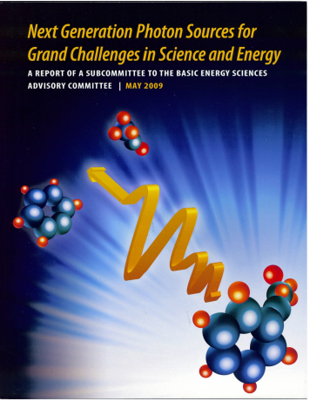
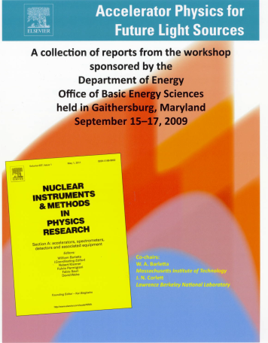
Specifying the Next U.S. Light Source
BESAC Study (4Q 2008): Next Generation Photon Sources for grand Challenges in Science and Energy
  Described important connections between science challenges and photon source characteristics
  Two most important source requirements
    Femtosecond time resolution
    Nanometer spatial resolution
BES Workshop (3Q 2009): Accelerator Physics for Future Light Sources
  Defined the state of the art in accelerator physics & technology for future light sources
BESAC Study (1Q 2013): SC “Priority Goal”
  Rated existing & planned facilities based on their impact on science in the next decade and their readiness to proceed to construction (for “planned”)
  Endorsed a new light source to maintain world leadership
BESAC Study (3Q 2013): Future science & light source facility assessment
  Will evaluate science grand challenges requiring new light sources
  Will evaluate future light source tech specs and concepts that would maximize the impact on science grand challenges
  Will identify R&D initiatives

