Slide 1
Committee of Visitors Review of the
BES Chemical Sciences, Geosciences, and Biosciences Division
Update for BESAC
February 28, 2014
Michael Casassa
Acting Director, Chemical Sciences, Geosciences
and Biosciences Division

Slide 2
A Brief History of COVs in SC/BES
The very first COV in SC was the review of the chemical sciences portion of the CSGB division in 2002.
This is will be the fifth review for CSGB and the fourteenth COV review in BES.
All previous COV reports and BES responses are archived on the SC/BES website for public view at http://science.energy.gov/bes/about/bes-cov/
COVs are now a standard part of BES practice and culture, and have been embraced by all offices in SC.
COV recommendations are taken very seriously by BES and have resulted in substantive changes.

Slide 3
Committee of Visitor Charge (Standard)
1. For both the DOE laboratory projects and the university projects, assess the efficacy and quality of the processes used to:
  (a) solicit, review, recommend, and document proposal actions and
  (b) monitor active projects and programs.
2. Within the boundaries defined by DOE missions and available funding, comment on how the award process has affected:
  (a) the breadth and depth of portfolio elements, and
  (b) the national and international standing of the portfolio elements.

Slide 4
COV Coverage: FY 2011-2013
Covered
  Core research programs, including:
  Base program awards to universities and DOE labs
  The base program has incorporated renewals of awards made in earlier BES solicitations and expressions of interest: Hydrogen Fuel Initiative (HFI), Solar Energy Utilization (SEU), Nanoscale science (NSET), Chemical Imaging (CI), Single-Investigator and Small-Group Research (SISGR).
  New awards resulting from the FY2012 Expression of Interest (EOI) in Research Leading to Predictive Theory and Modeling for Materials and Chemical Sciences and from the FY2012 SciDAC Funding Opportunity Announcement (FOA).
Not covered
  Energy Frontier Research Centers
  SC Early Career Awards
  SC Graduate Fellowship Program
  BES Equipment Supplement Program
  Fuels from Sunlight Energy Innovation Hub

Slide 5
Team Structure in CSGB
Molecular mechanisms of light capture and its conversion to chemical and electrical energy via chemical and biochemical pathways
Application of physical science tools to biochemical systems
Photo- and Biochemistry
Biomimetic catalytic systems
Structural and dynamical studies of atoms, molecules, and nanostructures; description of their interactions with external stimuli (photons, electrons) at full quantum detail
Fundamental
Interactions
Chemical
Transformations
Characterization, control, and optimization of chemical transformations, from catalysis to geochemistry
Interfacial nanoscale chemistry
Division-wide themes: chemical imaging; ultrafast chemical sciences; nanoscale science; interfacial science; theory, modeling, & simulation (including computation); synthesis

Slide 6
FY 2014 Committee of Visitors
Sharon Hammes-Schiffer, University of Illinois, Chair
April 30 – May 2, 2014 at DOE Germantown
17 COV panelists organized into 3 panels
Panelist statistics:
  Academia: 12 Funded by CSGB: 10
  DOE Lab: 4 Not funded: 7
  Industry: 1
  International: 1 Male: 9
  Female: 8
  Chaka, Francisco, Winograd served on prior CSGB COVs
  Hammes-Schiffer, Kay are BESAC members

Slide 7
Panel Structure and Membership
Panel 1: Fundamental Interactions
Bruce Kay, PNNL, (Lead and BESAC)
  Heather Lewandowski - JILA/CU
  Joe Francisco – Purdue University
  Gilbert Nathanson – University of Wisconsin
  Rigoberto Hernandez – Georgia Tech
Panel 2: Photochemistry and Biochemistry
Jim McCusker, Michigan State University (Lead)
  Greg Scholes – University of Toronto
  Claudia Turro – Ohio State University
  Lisa Utschig – ANL
  Joan Broderick – Montana State University
Panel 3: Chemical Transformations
Nick Winograd, Michigan State University (Lead)
  Giulia Galli – University of Chicago
  Jim Rustad – Corning
  Nicholas Delgass – Purdue University
  Emily Smith – Iowa State University
  Jackie Kipplinger – LANL
  Anne Chaka – PNNL (2008 COV Panelist)

Slide 8
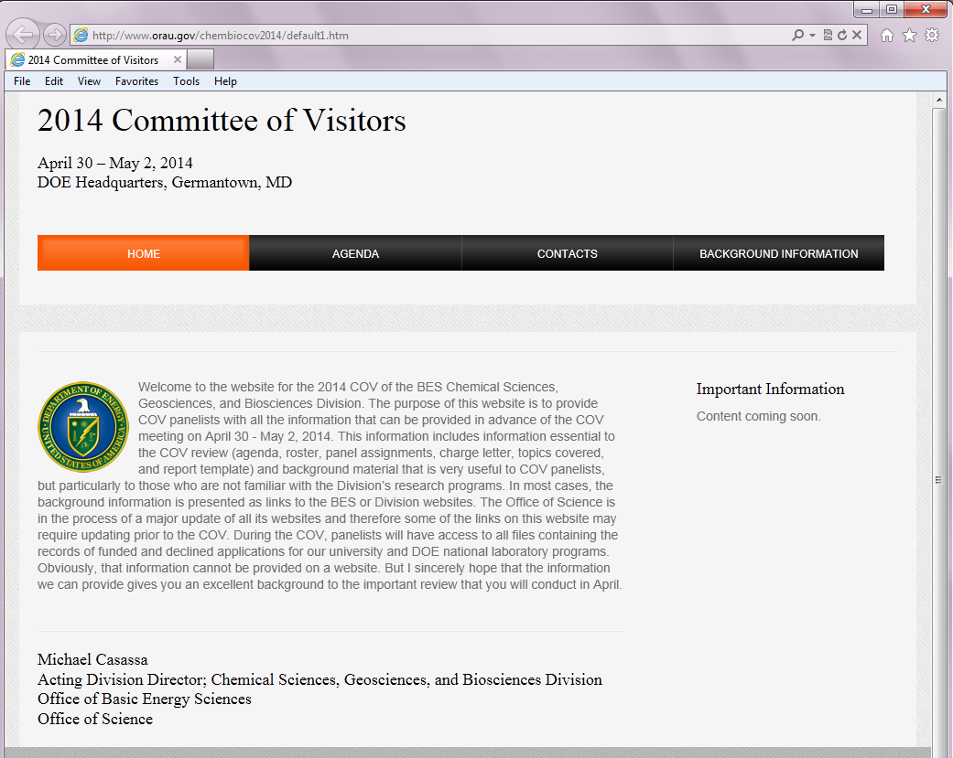
Committee of Visitors Preparations
Chair visited with the division on December 20, 2013
  Met with division director, team leads, program managers
  Informed chair of division’s programs
  Discussed process for COV
Conference calls – chair, panel leads, division director, and team leads
Prior to COV to go over agenda, discuss process, and address concerns
COV Website:
  Provides read ahead materials for COV panelists

Slide 9
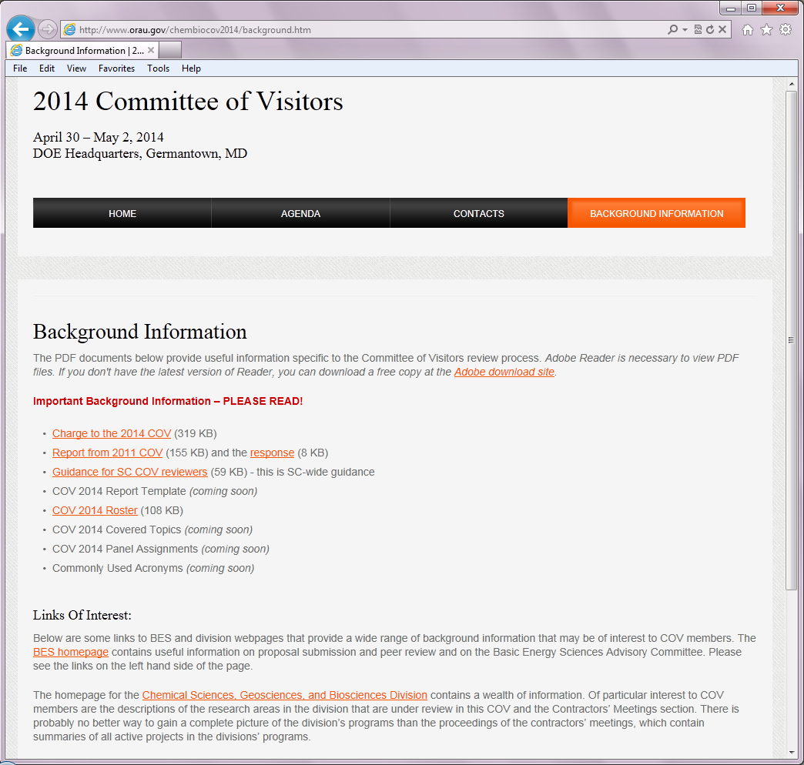
COV Website – Background Information

Slide 10
COV Agenda
Wednesday, April 30, 2014
Time | Activity | Committee Members | Division Staff | Location
7:30 AM | Travel from Fairfield Inn to DOE | All | Drivers with cars | Inn Lobby
8:00 AM | Continental Breakfast Available | All |  | A-410
8:30 AM | Welcome and Charge to the Committee | All | John Hemminger, Chair Basic Energy Sciences Advisory Committee | A-410
8:40 AM | Overview of Basic Energy Sciences | All | Harriet Kung, Director Office of Basic Energy Sciences | A-410
9:00 AM | Overview of the Chemical Sciences, Geosciences, and Biosciences Division | All | Michael Casassa, Acting Director Chemical Sciences, Geosciences, and Biosciences Division | A-410
9:30 AM | Update on the SC Portfolio Analysis and Management System (PAMS) | All | TBD, Office of Science | A-410
9:50 AM | Review Procedures | All | TBD, Team Lead | A-410
10:15 AM | Instructions and Schedule | All | Sharon Hammes-Schiffer, Chair Committee of Visitors | A-410
10:30 AM | Break and disperse to panel rooms
10:45 AM | First Read Panel 1-3 | First-Read Panel Members | CSGB Team Lead and Program Managers | E-401, E-301, TBD
 | Working Lunch | All | All | A-410
 | Resume First Read Panels | Panels |  | Panel Rooms
4:00 PM | Preliminary Report Drafting – Key Elements and Gaps | Panels |  | Panel Rooms
5:00 PM | Meeting between Panel Leads and Chair | Panel Leads and Chair |  | TBD
5:30 PM | Meeting with Chair and BES Senior Management | Chair | Harriet Kung, Michael Casassa | TBD
6:00 PM | Dinner for COV and BES Staff | All | All | Nick’s Chophouse

Slide 11
COV Agenda, cont’d.
Thursday, May 1, 2014
Time | Activity | Committee Members | Division Staff | Location
7:45 AM | Travel from Fairfield Inn to DOE | All | Drivers with cars | Inn Lobby
8:00 AM | Continental Breakfast Available | All |  | TBD
8:30 AM | Fundamental Interactions Team Session | Panel 1 | Jeff Krause, Acting Team Lead Greg Fiechtner, Mark Pederson, Wade Sisk | E-401
8:30 AM | Photo- and Biochemistry Team Session | Panel 2 | Gail McLean, Team Lead Chris Fecko, Mark Spitler, Bob Stack, Nada Dimitrijevic (detailee) | TBD
8:30 AM | Chemical Transformations Team Session | Panel 3 | John Miller, Team Lead Raul Miranda, Paul Maupin, Larry Rahn, Philip Wilk | E-301
9:15 AM | Complete First Read Panel Reports | Panels |  | Panel Rooms
 | COV Executive Session Reports from Panel Leads on First Read Reports | All |  | A-410
12:30 PM | Lunch | All |  | A-410
1:30 PM | Second Read Panel 1 Fundamental Interactions Team | Panel 1 Second Read Members | Jeff Krause, Acting Team Lead Greg Fiechtner, Mark Pederson, Wade Sisk | E-401
1:30 PM | Second Read Panel 2 Photochemistry and Biochemistry | Panel 2 Second Read Members | Gail McLean, Team Lead Chris Fecko, Mark Spitler, Bob Stack, Nada Dimitrijevic (detailee) | TBD
1:30 PM | Second Read Panel 3 Chemical Transformations | Panel 3 Second Read Members | John Miller, Team Lead Raul Miranda, Paul Maupin, Larry Rahn, Philip Wilk | E-301
4:00 PM | Merge First and Second Read Input Finalize Draft Panel Reports | First Read Panels |  | Panel Rooms
 | Dinner on your own | All | None | On your own

Slide 12
COV Agenda, cont’d.
Friday, May 2, 2014
Time | Activity | Committee Members | Division Staff | Location
7:45 AM | Travel from Fairfield Inn to DOE Germantown | All | Drivers with cars | Fairfield Inn Lobby
8:00 AM | Continental Breakfast Available | All |  | A-410
8:30 AM | COV Executive Session | All |  | A-410
9:15 AM | Closeout Session with COV and BES Senior Management | All | Harriet Kung, Michael Casassa | A-410
10:00 AM | Closeout Session with COV and BES Staff | All | All | A-410
10:45 AM | COV Chair meets with Panel Leads to begin drafting report | COV Chair Panel Leads |  | A-410
12:30 PM | Lunch | COV Chair Panel Leads |  | A-410
2:00 PM | Leave for airport from Germantown | COV Chair Panel Leads

Slide 13
Back-Up Slides

Slide 14
Recommendations from past COVs
The 2008 COV had a single recommendation:
“The COV recommends, in the strongest terms, the rigorous collection of data on all aspects of proposal solicitation, review, funding recommendation, proposed action and all metrics associated with progress that can assist in the evaluation of the impact of funded work.” BES concurred and the response has been the development of a new system for SC: Portfolio Analysis and Management System (PAMS).
This recommendation appeared in one form or another in every BES COV prior to 2008 in BES, and most in SC.
As of November 2013, PAMS is now being used to manage solicitations, reviews, selections, and initiation of procurement requests. It is significantly changing how BES conducts its work.
The 2014 CSGB COV will be the last “paper” COV.

Slide 15
Recommendations from past COVs
The 2011 COV had three recommendations:
“Program Managers are encouraged to attend more national and international conferences and to make more visits to groups of researchers in their programs—to spread the message of BES programs, to encourage wider participation, and to keep
abreast of forefront research in their fields.” BES concurred and has increased outreach, but travel has been increasingly restricted by appropriations.
“The COV recommends continued use of the procedures applied in the program to consider short preliminary statements of research ideas (white papers) and to provide rapid evaluations either encouraging researchers to submit full research proposals or consider modifying their plans.” BES concurred.
“The COV recommends that BES provide web sites that are more accessible and encouraging than those currently available to those who might be interested in participating in the program and obtaining funding.” BES concurred and has a new web presence as part of the revamping of the SC website. The website’s continued evolution includes accessible information about BES programs and funding opportunities.

Slide 16
EOI and SCiDAC Awards
  Research Leading to Predictive Theory and Modeling for Materials and Chemical Sciences - Expression of Interest and Awards
  Materials and Chemistry by Design
  A total of $13M in new funding was provided in FY2012 ($3M one-time) to support 5 centers and 10 smaller grants in BES (2 centers and 6 smaller grants in CSGB)
  SciDAC Partnerships in Computational Materials and Chemical Sciences - Funding Opportunity Announcement and Awards
  First-principles treatments of excited states and excited states processes; electron correlation in finite and extended systems; applications in solar energy, chemical reactions, magnetism and superconductivity, materials under extreme environments, separations, and energy storage
  A total of $6.4M in new funding was provided in FY2012 for 7 BES-ASCR partnerships. CSGB, MSE, and ASCR are about equally invested in these partnerships. CSGB participates in 4.
(10 )
(57)

