Slide 1
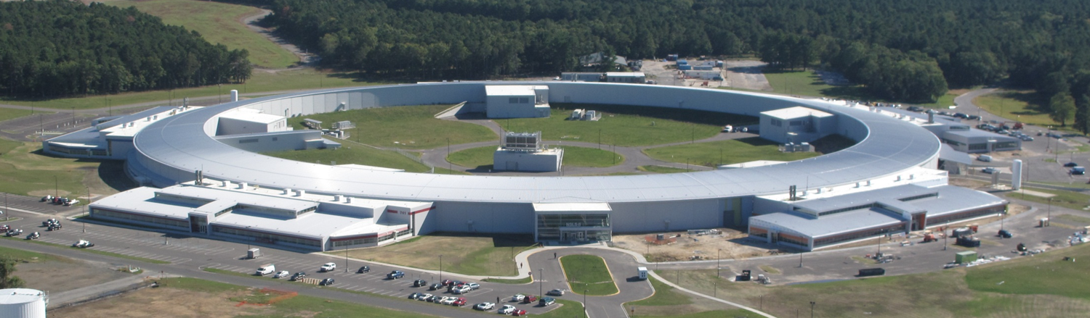
NSLS-II Update
Steve Dierker
Associate Laboratory Director for Photon Sciences
Brookhaven National Laboratory
February 27, 2014

Slide 2

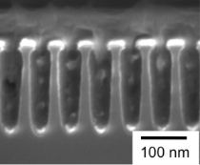
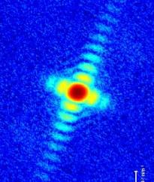
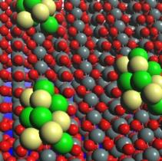
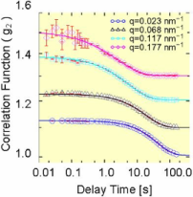
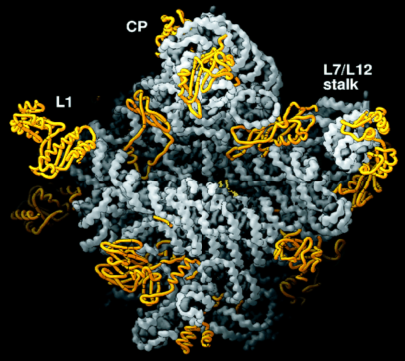
NSLS-II: A Powerful New Photon Microscope
Highly optimized x-ray synchrotron delivering:
  extremely high brightness and flux
  exceptional beam stability
  advanced instruments, optics, and detectors
Providing best-in-class capabilities for:
  imaging systems with nanoscale resolution
  determining chemical reactivity in-situ in real time
  Enabling studies of:
  interfaces and nanostructures
  electronic excitations and chemical reactivity
  in-situ chemical, magnetic, and biological imaging
  materials synthesis, catalytic reactions, superconductors, and magnets at extremes of temperature, pressure, and magnetic field
Resulting in scientific advances in:
  clean, renewable, and affordable energy
  molecular electronics
  high temperature superconductors
  structure-based drug design
New Capabilities
New Science
Nanoprobes
Nanoscience
Diffraction Imaging
Nanocatalysis
Coherent Dynamics
Life Science

Slide 3
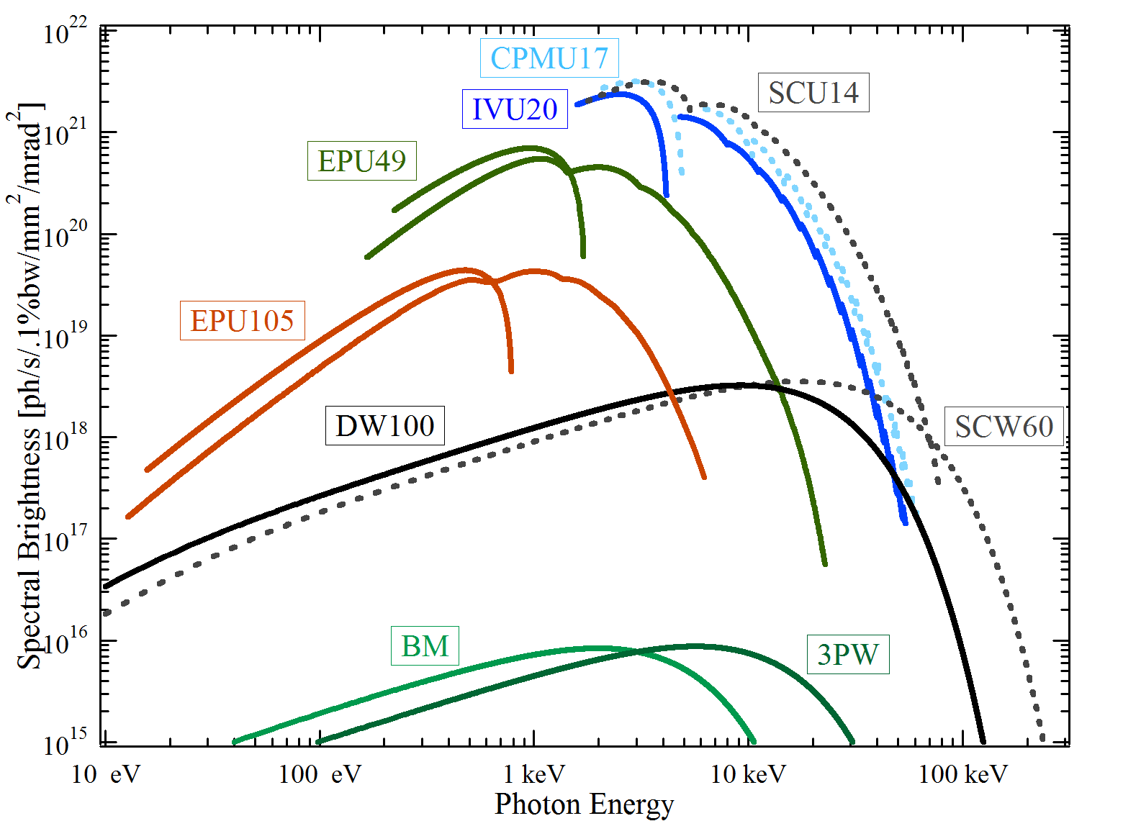
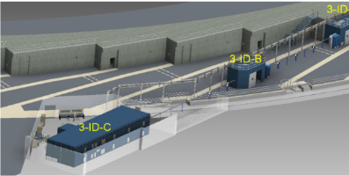
NSLS-II Design Features
Best-in-class brightness & flux from far infrared to hard x-rays
Design Parameters
  3 GeV, 500 mA, top-off injection
  Circumference 791.5 m
  30 cell, Double Bend Achromat
      15 high-β straights (9.3 m)
      15 low-β straights (6.6 m)
Novel design features:
  Damping wigglers
  Soft bend magnets
  Three pole wigglers
Ultra-low emittance for high brightness and small source size
  ε_{x}, ε_{y} = 0.6, 0.008 nm-rad
  Diffraction limited in vertical at 12 keV
  Small beam size: σ_{y} = 2.6 μm, σ_{x} = 28 μm, σ’_{y} = 3.2 μrad, σ’_{x} = 19 μrad
Pulse Length (rms) ~ 15 psec
  Large gap IR dipoles
  Long beamlines
  Ultra-high stability

Slide 4
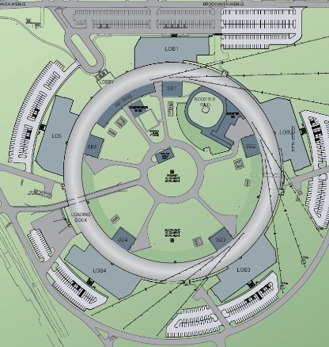
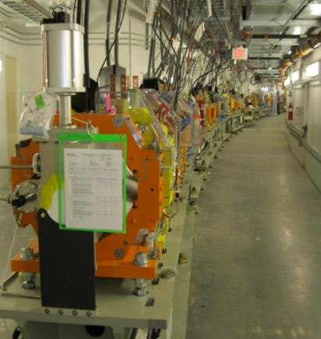
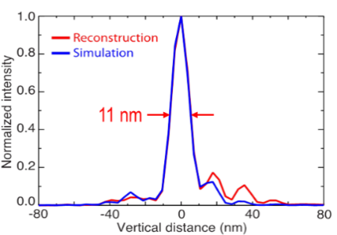
NSLS-II Project Scope
Accelerator Systems
  Storage Ring (~ ½ mile in circumference)
  Linac and Booster Injection System
Conventional Facilities
  Ring Building and Service Bldgs (400,000 gsf)
  5 Laboratory/Office Bldgs designed to promote interaction & collaboration among staff & users (190,000 gsf)
Experimental Facilities
  Initial suite of seven insertion device beamlines
  Capable of hosting at least 58 beamlines
Research & Development
  Advanced optics & accelerator components
  Total Project Cost $912M

Slide 5
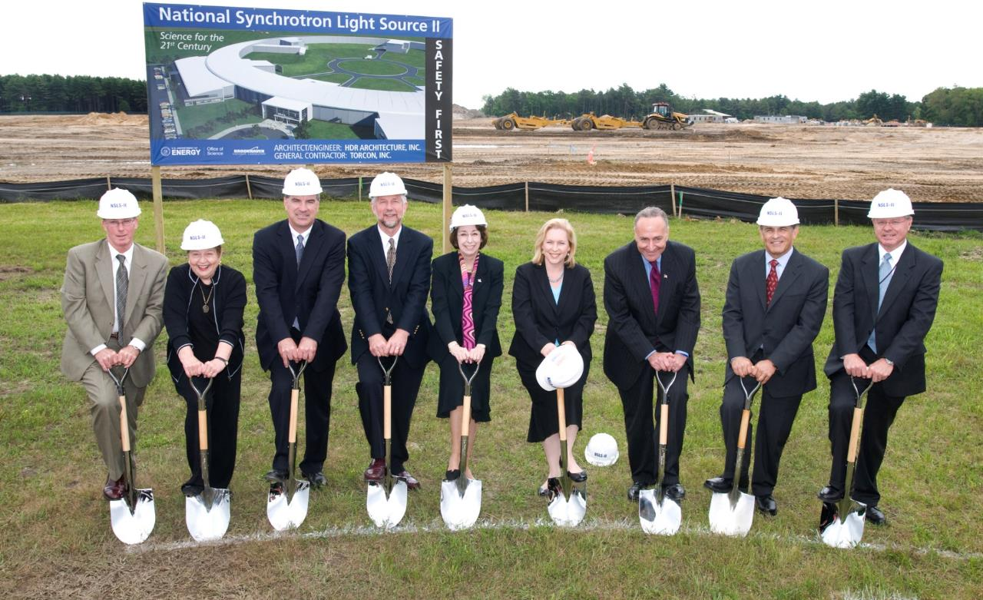
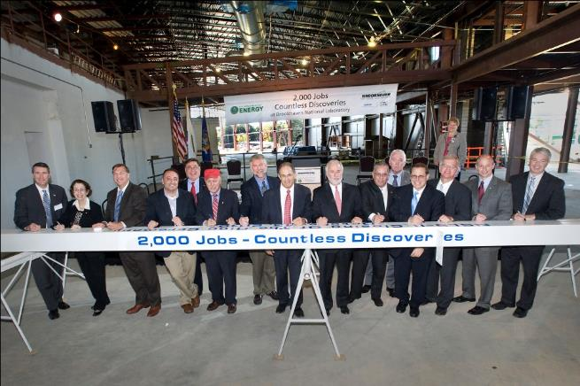
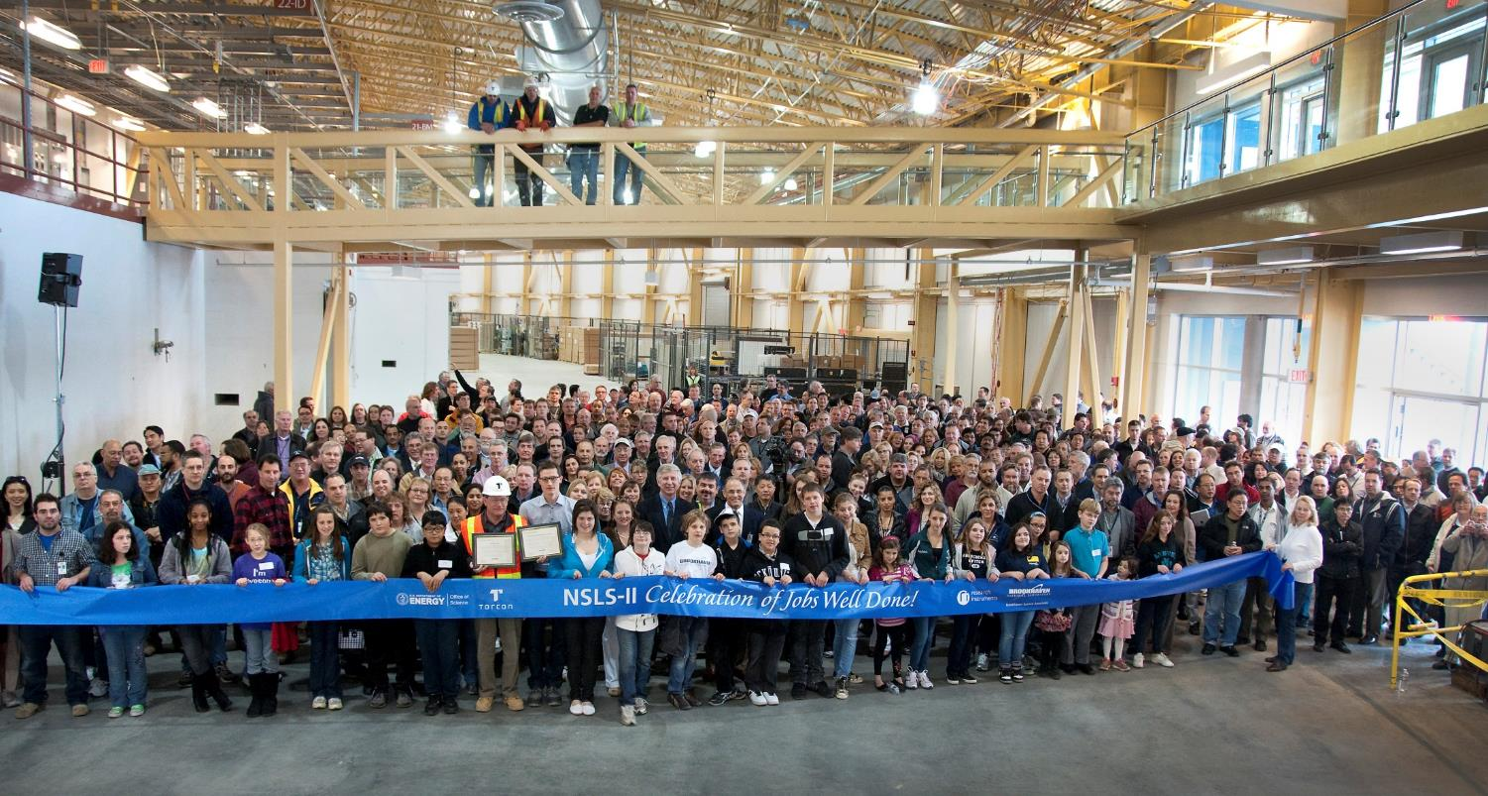
Key Project Milestones
Aug 2005 CD-0, Approve Mission Need (Complete)
Jul 2007 CD-1, Approve Alternative Selection and Cost Range (Complete)
Jan 2008 CD-2, Approve Performance Baseline (Complete)
Jan 2009 CD-3, Approve Start of Construction (Complete)
Feb 2009 Contract Award for Ring Building (Complete)
Aug 2009 Contract Award for Storage Ring Magnets (Complete)
May 2010 Contract Award for Booster System (Complete)
Feb 2011 1st Pentant Ring Building Beneficial Occupancy (Complete)
Feb 2011 Begin Accelerator Installation (Complete)
Feb 2012 Beneficial Occupancy of Experimental Floor (Complete)
Mar 2012 Start LINAC Commissioning (Complete)
Nov 2013 Start Booster Commissioning (Complete)
Mar 2014 Start Storage Ring Commissioning
Aug 2014 Early Project Completion; Ring Available to Beamlines
Jun 2015 CD-4, Approve Start of Operations
June 15, 2009
October 13, 2010
April 26, 2012

Slide 6
Status of NSLS-II Project
Excellent progress
Project is 94% complete as of end of January 2014
  current baseline % complete
  Conventional Facilities $310M 99%
  Accelerator Systems $293M 96%
  Experimental Facilities $85M 80%
  Pre-Ops $58M 69%
  Project Management $68M 99%
  R&D $61M 100%
On schedule for early completion in August, 2014
On budget with substantial scope added to maximize science

Slide 7
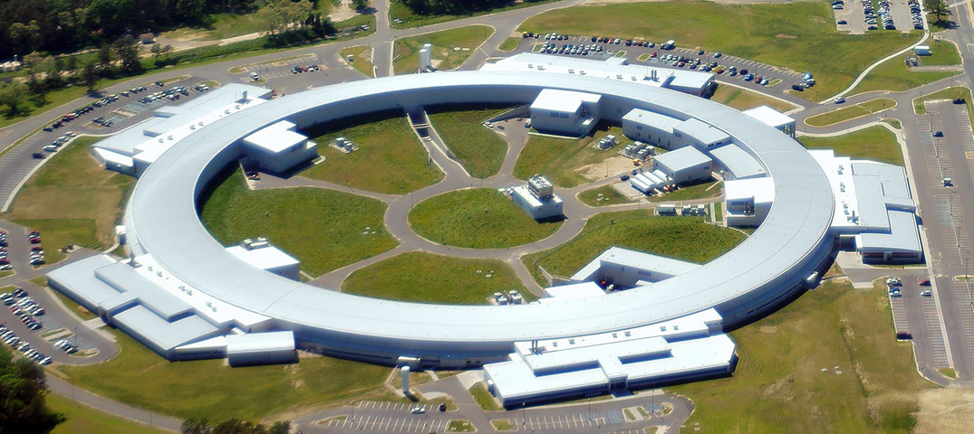

NSLS-II Buildings – LEED Gold & Awards
LEED: Leadership in Energy and Environmental Design
Certified
Silver
Gold
Platinum
American Council of Engineering Companies 2013 Engineering Excellence Awards:
  “Diamond” award from NYS chapter
  “Grand” Award from National chapter
Building Project of the Year Award from NY Chapter of the American Society of Civil Engineers (ASCE)
Owner Managed Project of the Year Award from NY-NJ Chapter of the Construction Management Association of America
Cost – less than 2% of construction
Benefits –
~30% reduction in energy use
More $$ for science
Gold for Ring Building January 2013
Gold for LOBs December 2013
  Kudos to HDR Architects, Torcon, EW Howell and the NSLS-II Conventional Facilities Team

Slide 8
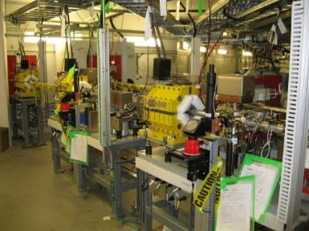
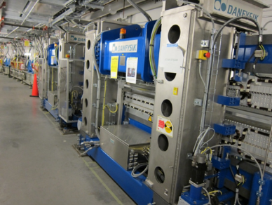
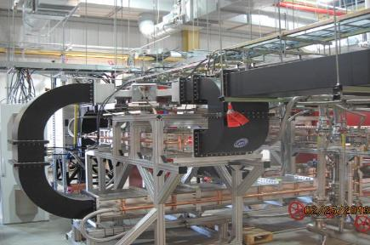
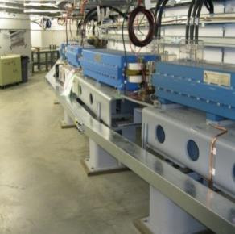
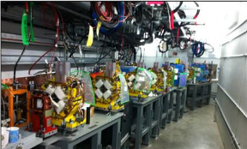

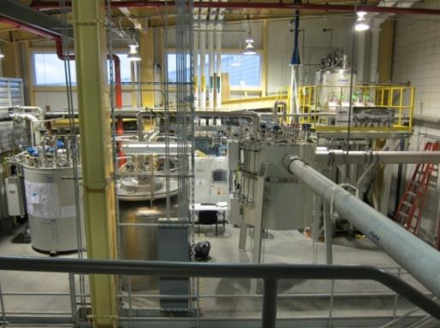
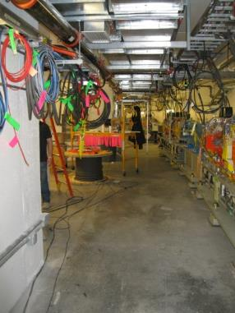
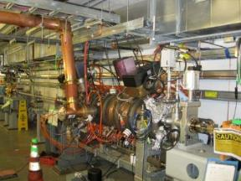
Accelerator Systems
Accelerator Systems are 96% complete
Injector commissioning is complete
Start of storage ring commissioning: Mar 21, 2014
Completion of accelerator systems: Aug 2014

Slide 9
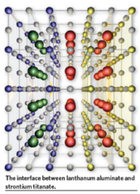
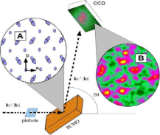
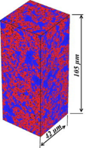
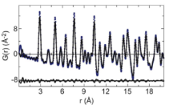
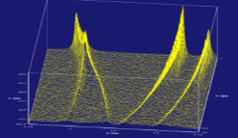
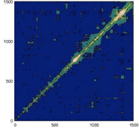
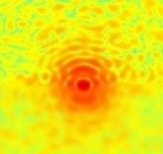
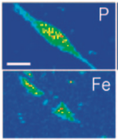
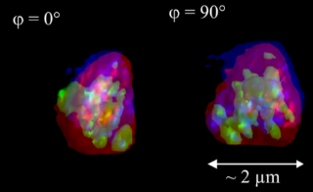
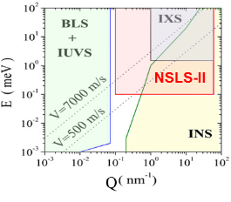
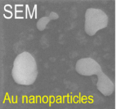
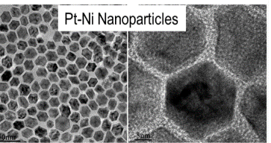
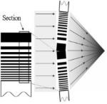
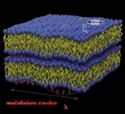
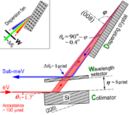
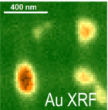
NSLS-II Project Beamlines
Coherent Soft X-ray Scattering (CSX-1)
Fast Switching Polarization
(CSX-2)
X-ray Powder Diffraction (XPD-1)
PDF (XPD-2)
World-leading coherent flux
XPCS, CDI
Resonant magnetic scattering, spectroscopy, XMCD
Powder diffraction, scattering, PDF 30-80 keV
Imaging & dynamics in strongly correlated and magnetic materials
Time-resolved in-situ in-operando extreme conditions Understanding complex nanostructured materials
Coherent Hard X-ray Scattering (CHX)
Sub-um Resolution X-ray Spectroscopy (SRX)
Non-equilibrium and heterogeneous dynamics in soft matter, at buried interfaces, biomaterials, glasses, driven systems
World-leading spectroscopy in sub-100 nm spot
3D chemical imaging and speciation at the nanoscale
100x greater time resolution in XPCS studies of dynamics
Hard X-ray Nanoprobe (HXN)
Inelastic X-ray Scattering (IXS)
THz dynamics in liquid, glassy, and crystalline materials with nanoscale inhomogeneities
100m long beamline
~10 nm baseline
~1 nm ultimate goal
~1 meV baseline
~0.1 meV ultimate goal
Nanoscale imaging with fluorescence and diffraction

Slide 10
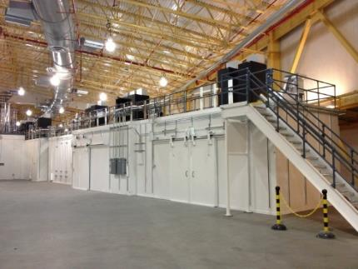
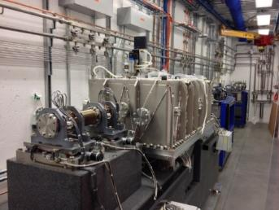
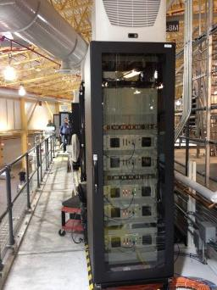
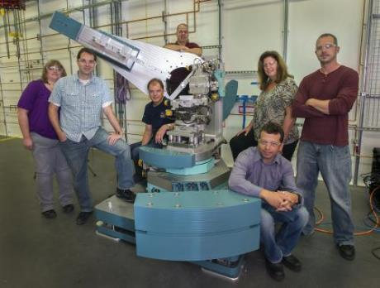
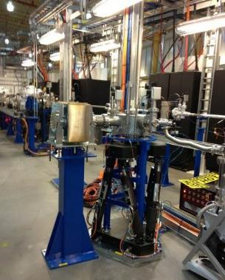
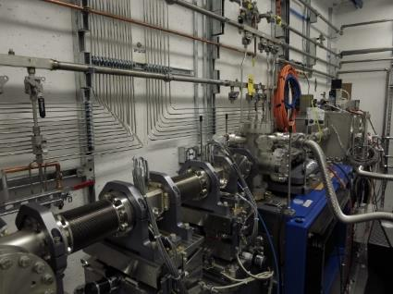
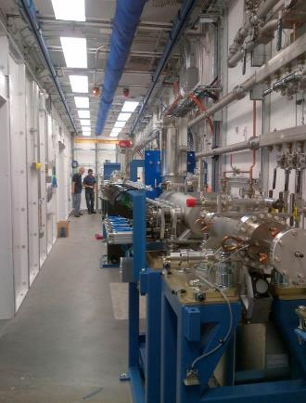
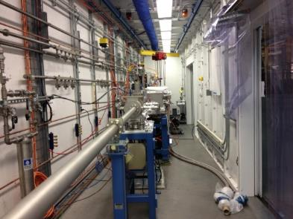
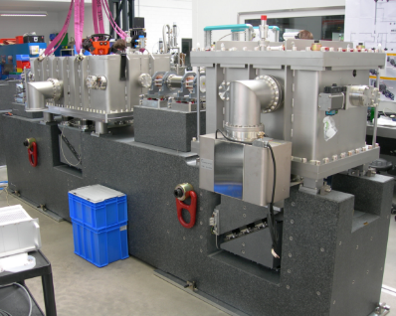
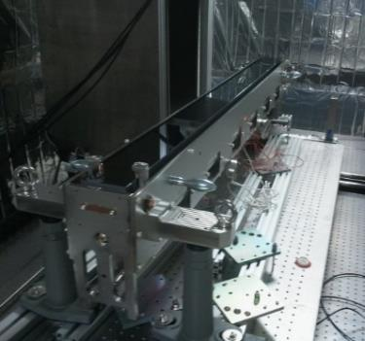
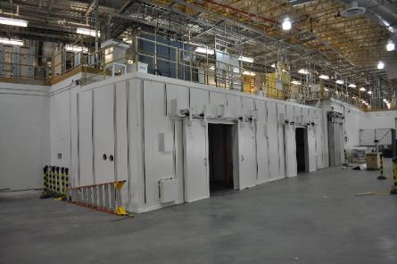
NSLS-II Project Beamline Status
18 Hutch Structures Erected at NSLS-II
Utility installations 95% complete
Beamline optics installation underway
Last optics due in March 2014
80% complete overall
On track for early finish

Slide 11
Early Storage Ring Operations
Challenge: Significant time will be required in FY15 & FY16 to install and commission insertion devices, front ends, and beamlines
Mitigation: Optimize installation schedule and coordinate with beamline operations

Slide 12
Phased Ramp-up of Science Capabilities
Construction and Testing
Technical
Commissioning w/ X-rays
User Assisted
Science
Commissioning
Start of Regular User Science Operation

Slide 13


First Experiments Workshop
August 12-13, 2013
  Update community about NSLS-II, operations ramp-up, and anticipated beam parameters
  Identify key research projects and first experiments for NSLS-II project beamlines, emphasizing those that need NSLS-II properties
  Facilitate formation of teams and identify key additional members needed to achieve science goals (e.g., theory and analysis, ancillary measurements, specimen preparation, etc)
  Excellent turnout
    305 registered attendees (incl IXS session on Oct 1, 2013
    >75% of attendees from outside of BNL-PS
    ~58% of attendees from outside of BNL
  A dozen other user workshops also held in FY13

Slide 14

Outcome of the First Round Call for Proposals
    First Light Experiment Proposals
        61 proposals received
        324 proposers from 129 institutions from around the world
        Science commissioning beamtime significantly oversubscribed
    Partner User Proposals
        21 proposals for partnerships on 14 beamlines received
        73 proposers from 22 institutions
NSLS-II Proposal Review Panel (PRP) was formed, consisting of 24 scientists from the international scientific community, distributed among 7 sub-panels
PRP meeting was held on Feb 4, 2014 to review First Experiment and Partner User proposals
    We are working with the user community to develop first experiments to ensure their success
Distribution of the 82 Proposals in the 7 PRP Sub-panels

Slide 15




1st Light Experiment:
Electronic Texture in High-Tc Cuprates
DOE-Grand Challenge: How do remarkable properties of matter emerge from complex correlations of atomic and electronic constituents?
  NSLS-II: real space images with nm resolution of charge stripe domains
  Real-space organization
  Origin of pinning of domain walls
  Dopant role
  Project Beamline: CSX-1
Impact: Improved critical properties of high-temperature superconductors could revolutionize energy generation, storage, and transmission
Samples are ready - G. Gu (BNL)
Endstation is commissioned and ready
Initial experiments at NSLS prove feasibility
High flux of NSLS-II needed
Beamline and experiment will be science ready by December 2014

Slide 16







HXN Early Science Experiments
Nano electronics
(C. Murray, IBM)
Ionic Membranes
(K. Brinkman, SRNL)
Oxidation of PtNi nanoparticles
Core-shell NP
(R. Nuzzo, UIUC)
sample grid
Electrochemically active bimetallic cathode materials, E. Takeuchi, Stony Brook University
Solid-Oxide Fuel Cells (W. Chiu, U of Conn.)
In-situ X-ray microscopy study of charged cathode
materials for electrochemical energy storage devices
K. Nam, BNL

Slide 17













Community Engagement
  NSLS-II development has been informed by many years of community engagement during the conceptualization and construction phases of NSLS-II, including:
  Community input from a large number of scientific workshops for strategic planning, beamline development, first experiments, & other topical forums
  Advice and input from Science Advisory Committee, beamline development review panels, Beamline Advisory Teams, and others
  Scientific grand challenges identified by DOE-BES, Priority Research Directions in Basic Research Needs series, and grand challenges in other areas of science (DOE-BER, NIH, NAS, …)
NSLS-II First Experiments Workshop, Aug 12-13, 2013

Slide 18




Priority Research Areas for NSLS-II
  Emergent Behavior from Complexity – understanding and control of emergent properties and dynamics in materials with complex quantum, molecular, and nanoparticle interactions that impact technologically important areas such as superconductivity and microelectronics
  Mastering Materials Synthesis & Properties – to achieve materials properties and functions by design through understanding and control of molecular self-assembly, and control of material environments and failure mechanisms
  Energy Systems and Materials – to understand and control the chemistry of energy conversion in support of DOE clean energy initiatives via efficient catalytic and photovoltaic materials, and better understanding and design of critical materials interfaces in energy storage and other energy systems
  Environment and the Earth Ecosystem – to understand and control the complex geochemical and biogeochemical processes in the Earth environment – transport of nutrients and toxins, element sequestration, biofuels, and impact of aerosol particles on environment and health
  Structure and Functions of Life – to understand how life functions at the molecular, cellular, systems, and evolution levels through protein structure discovery, structure to function correlation, and biological imaging

Slide 19




Cross-Cutting Science Themes
Complexity and Dynamics: NSLS-II world-class coherence, nano-imaging, and inelastic scattering capabilities will be ideally suited for studies on intrinsic self-organized & emergent heterogeneities and associated naturally-occurring processes – ‘unclocked’ dynamics
Functional Systems: NSLS-II in-situ and in-operando capabilities will enable correlated time-resolved in-situ diffraction, spectroscopy, and imaging studies in variety of functional systems
Multiscale & Mesoscale Science: NSLS-II advanced structural and chemical imaging tools will span multiple length and time scales, with the potential of matching experimental gauge volumes with those directly accessible by theory/modeling
Velocity field of 2D particle ensemble
Nanoparticles in functional systems
Mesoscale Science
In-situ & in-operando experiments

Slide 20
Science Needs Drive the
Development of NSLS-II Beamlines
NSLS-II will give researchers tools to characterize and ultimately control systems and to advance grand challenge science
NSLS-II Initial and Near-Term Suite of Beamlines:
Nanoscale and Mesoscale Imaging
Coherent Scattering and Imaging
Inelastic Scattering
Photoelectron and Soft X-ray Spectroscopy
In-situ and In-operando X-ray Diffraction & Spectroscopy
X-ray Scattering for Soft Matter
Structural Biology
Infrared
NSLS-II Beamline
Development Process
Call for Beamline Development Proposals (BDPs)
Information Meetings and Workshops
SAC Study Panel Reviews of BDPs
Full SAC Review and Recommendations
Approval of Proposed Beamlines (CD-0 equivalent)
Seeking Funding for Development of Specific Approved Beamlines
Organization, Properties, Function
Structure/function relationship of novel systems, synthesized or self-assembled, with emergent properties or enhanced performance
Dynamic and collective behavior
In-situ dynamics of systems during processing, in operation, under extreme conditions, or when driven far from equilibrium

Slide 21

NSLS-II Beamline Portfolio
30 Beamlines Under Development
8 NSLS-II Project Beamlines
Inelastic X-ray Scattering (IXS)
Hard X-ray Nanoprobe (HXN)
Coherent Hard X-ray Scattering (CHX)
Coherent Soft X-ray Scat & Pol (CSX1, CSX2)
Sub-micron Res X-ray Spec (SRX)
X-ray Powder Diffraction (XPD1, XPD2)
6 NEXT Beamlines (DOE MIE)
Photoemission-Microscopy Facility (ESM)
Full-field X-ray Imaging (FXI)
In-Situ & Resonant X-Ray Studies (ISR)
Inner Shell Spectroscopy (ISS)
Soft Inelastic X-ray Scattering (SIX)
Soft Matter Interfaces (SMI)
3 ABBIX Beamlines (NIH)
Frontier Macromolecular Cryst (FMX)
Flexible Access Macromolecular Cryst (AMX)
X-ray Scattering for Biology (LIX)
5 Partner Beamlines
Spectroscopy Soft and Tender (SST1, SST2)
Beamline for Mater. Measurements (BMM)
Microdiffraction Beamline (NYX)
X-ray Footprinting (XFP)
8 NxtGen Beamlines
Complex Materials Scattering (CMS)
Magneto, Ellipso, High Pressure IR (MET/FIS)
Metrology & Instrum Development (MID)
In-situ X-ray Diffraction Studies (IXD)
Materials Physics & Processing (MPP)
Quick X-ray Absorption and Scattering (QAS)
Tender X-ray Absorption Spectroscopy (TES)
X-ray Fluorescence Microscopy (XFM)
MID
ESM
Outline = ID
Solid = BM / 3PW / IR
NSLS-II Project, NEXT, ABBIX, and Partner Beamlines deliver world-leading capabilities
  All together, ~ 60% of the straight sections will be built out within first few years of NSLS-II operations
NxtGen beamlines will balance the beamline portfolio with complementary, often high throughput, capabilities and add significant capacity
NxtGen will build out ~ 33% of BM/3PW/IR ports
XFP

Slide 22











NSLS-II Experimental Tools (NEXT) Beamlines
DOE-BES funded $90M MIE project - Operations to begin 1QFY17
Inner Shell Spectroscopy (ISS)
Soft Inelastic X-ray Scattering (SIX)
In-situ, time-resolved, element specific studies of nanocatalysts, mettalloenzymes, environmental contaminants, batteries, and fuel cells
Elementary excitations (magnons, phonons and orbitons) in nanoscale samples (100 nm)³ w/ applications to
superconductivity, nanocatalysts, energy storage materials
Time resolved XAS with high E-resolution and at ultra-dilute concentrations
Sr₂CuO₃
World-leading soft x-ray energy resolution
Full-field X-ray Imaging (FXI)
Soft Matter Interfaces (SMI)
Real-time 3D imaging of natural and man-made materials in working environments
Understanding self-assembly of nanomaterials in order to create new hierarchical materials with tailored functionality
In-situ real-time studies of solid/liquid/vapor interfaces of complex materials
semiconductor failures
CaCO₃ drilling
High speed TXM w/ 30 nm resolution
In-Situ & Resonant X-Ray Studies (ISR)
Electron Spectro-Microscopy (ESM)
Powerful capabilities for in-situ, real-time growth, atomic structure of surface and interfaces, magnetic/orbital scattering, domain imaging, high magnetic fields
Advancing photoemission to characterize electronic structure of functional materials w/ high spatial resolution
Sub-meV nano-ARPES
LEEM/PEEM
Integrated materials physics studies

Slide 23

Advanced Beamlines for Biological Investigations with X-rays
ABBIX Project - NIH funded $45M - Operations to begin 1QFY16
Frontier Macromolecular Crystallography (FMX)
Highly Automated Beamline for
Macromolecular Crystallography (AMX)
Studies of enzymatic pathways of cellular
and microbiological processes
Studies of drug-target interactions of new
and improved pharmacologically effective compounds
Tunable 1µm beam of high intensity for
micro-crystallographic studies of small crystals and large unit cells
Atomic structure of large protein and nucleic acid complexes, including membrane proteins
Highly automated to support remote access and extensive experimental searches
Precise structure determinations with unprecedented throughput
High Brightness X-ray Scattering for Life Sciences (LIX)
Grazing incidence scattering from 2D solutions of
proteins embedded in near-native membranes
1μm beam scanning probe imaging and
tomography of biological tissues
Time-resolved solution scattering down to 10μs

Slide 24




Partner Beamlines
Operations to begin FY16
Spectroscopy Soft & Tender (SST-1, SST-2) - NIST
NYSBC Microdiffraction Beamline (NYX) - NYSBC
Nanoscale imaging of the structure and chemistry of buried layers and interfaces of real device architectures
Membrane proteins relevant to neurobiology and metabolic disorders, and protein-protein interactions in signaling complexes and protein-nucleic acid complexes in transcription or replication
6 unique world class NEXAFS/XPS stations (2 full field microscopes, 2 automated high-throughput, and 2 in-situ high pressure) with two undulators covering soft (100 eV – 2.2 keV) and tender (1 – 7.5 keV) x-rays
Diffraction from micron sized crystals and optimized for anomalous scattering with high energy resolution at low energies (3.5 – 17.5 keV)
New X-ray Photoelectron Spectroscopy Microscope being developed for SST
Beamline for Materials Measurements (BMM) - NIST
X-ray Footprinting (XFP) - CWRU
Strain engineering studies of electronic thin films, high throughput XAFS studies of chemical reactions and catalysts, phase transitions under controlled environmental conditions
High-throughput, high-quality hard x-ray absorption and diffraction
Steady state and time-resolved X-ray hydroxyl-radical mediated Protein and Nucleic Acid Footprinting

Slide 25




NSLS-II: The Next 10 Years
  Vision: Enable and conduct broad range of high-impact science programs at NSLS-II
World Class Science
Create a vibrant environment
Develop breakthrough capabilities
Identify new research areas
Attract world class scientists
High Impact Technologies
Identify pre-competitive industrial R&D
Match problems with expertise
Develop experiments/instruments
Provide solutions
Discovery Research Use-inspired Basic Research
Applied Research
Technology Maturation
& Deployment
Strategy
    World class scientists pioneering new research areas
    Develop and operate world-class photon sciences beamlines with breakthrough capabilities
    Advance enabling technology in optics, detectors, instrumentation, engineering, methodologies, and analyses
  Leverage BNL facilities & core programs and external groups to increase impact and better serve user community
  Catalyze innovation by facilitating university-industry-government collaborations via focused workshops with topical communities identifying needs and opportunities
Organizing communities in Consortia to achieve greater productivity and impact
  Facilitate formation of cross-cutting science consortia (e.g. Synchrotron Catalysis Consortium) to integrate science across beamlines, provide specialized instrumentation, and expand user community through outreach
NSLS-II
CFN / Nanoscience
New York Blue
Long Island Solar Farm

Slide 26
Developing Partnerships and Consortia
Several successful consortia and partnerships at existing synchrotron facilities provide models to build on: SCC, COMPRES, HP-Sync, etc.
  Provide dedicated instrumentation, such as sample cells, as well as scientific expertise in their specific field to help users at specific beamlines and help promote the science
  Very successful in delivering productive high-impact science
  We are working with the community to identify & develop targeted programmatic initiatives where we can play an active role in developing integrated research partnerships and consortia
  To engage and develop the research community through workshops, seminars, and other outreach activities
  To drive and coordinate the development of special equipment at beamlines and support laboratories such as sample environment, ancillary instruments, and analysis software
Partnering with Community
NSLS-II will continue to partner with the scientific community and leverage their interests, expertise & investments, including
Synchrotron Catalysis Consortium (SCC)
Consortium for Materials Properties Research in Earth Sciences (COMPRES)
Center for Emergent Superconductivity (CES)
National Institute of Science & Technology (NIST)
NY Structural Biology Center (NYSBC)
Case Center for Synchrotron Biosciences (CSB)
BNL Core Research Programs
BNL Center for Functional Nanomaterials
Industry (GE, IBM, others…)
DOE/BES supported X-ray Scattering groups

Slide 27



NSLS-II: A Bright Future
  NSLS-II continues to make excellent progress
    On track for early completion, on budget, substantial added scope
    30 beamlines under development
    Commissioning proceeding well & early operations plans well developed
    Development of first experiments underway & user community engaged
    Looking forward to fast ramp up to an exciting science program

