Slide 1
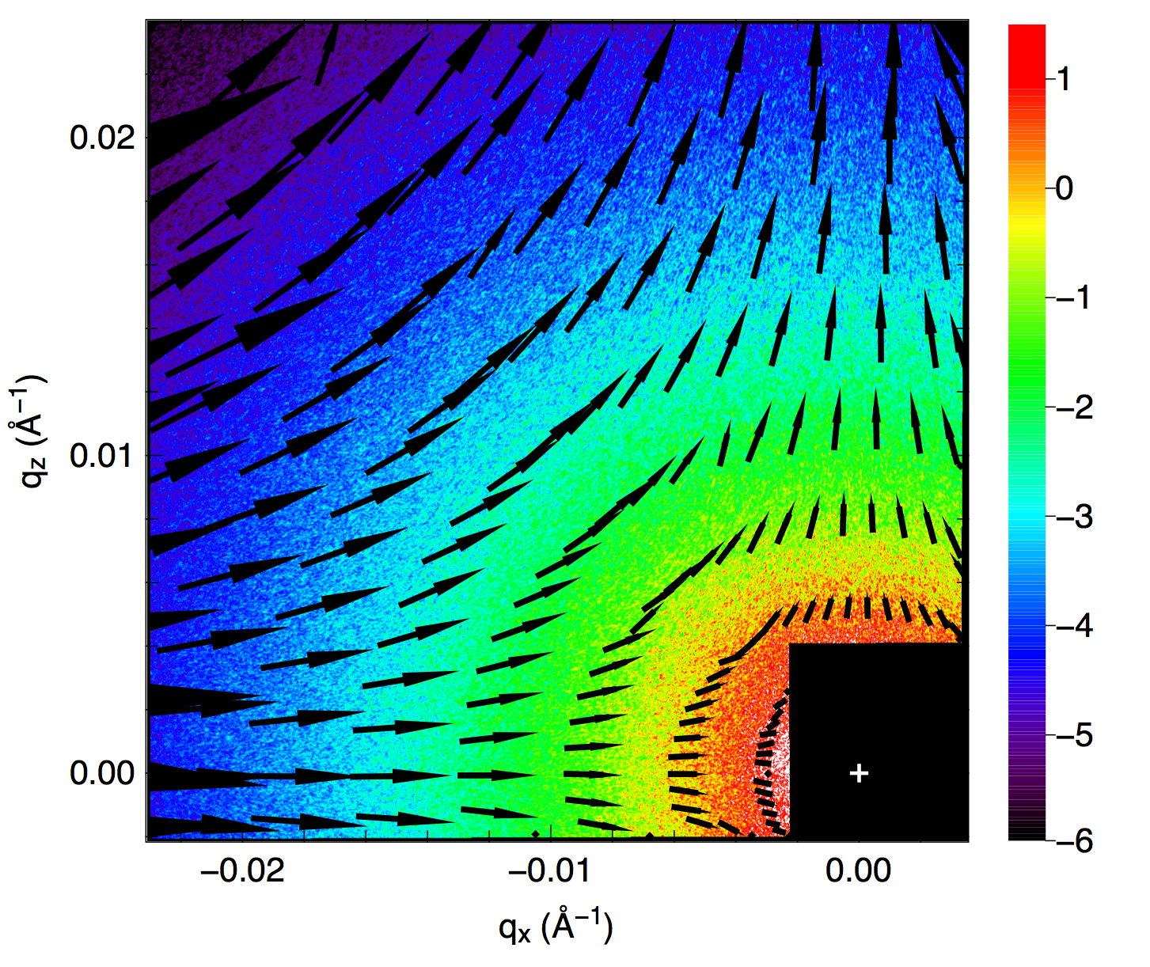
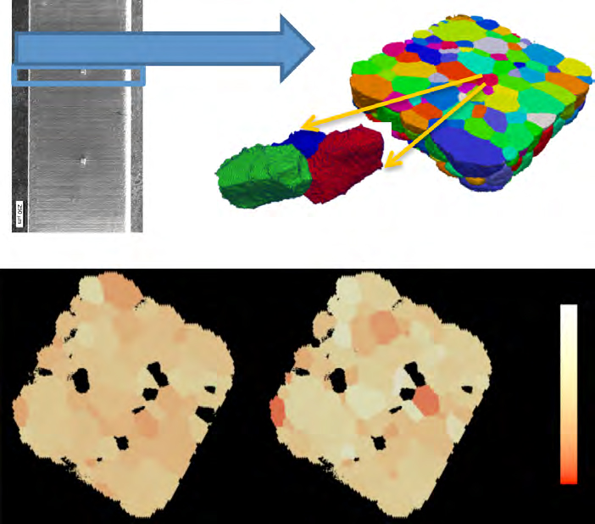
APS Upgrade:
The Next Generation of Synchrotron Science
Eric D. Isaacs
Director
Argonne National Laboratory
February 27, 2014

Slide 2
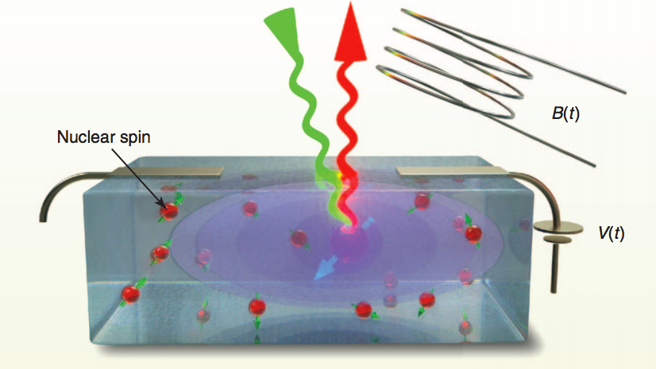
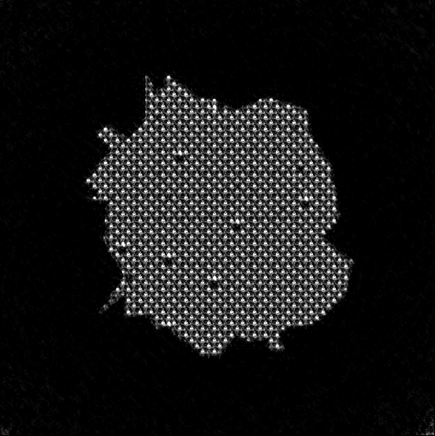
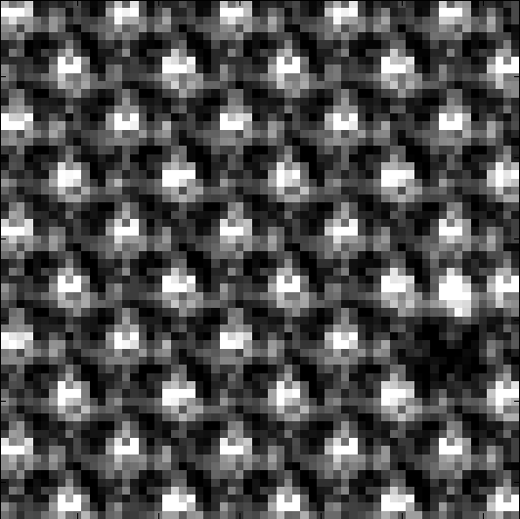
Can we understand and control quantum coherence in real materials?
Entangled spin states of single dopants in wide-bandgap semiconductors
Simulated reconstruction of nanocrystal with atomic vacancies, using
Bragg coherent diffraction imaging
Missing atom
is resolved
D. D. Awschalom et al., Science 339, 1174, 2013
Imaging a single point defect –
achieving the ultimate structural resolution
Notes:
this reconstruction is performed using an incident flux that is representative of what can be achieved with the APS-U over approximately one to two 8-hr shifts.
Other kinds of microscopy that have been done – bottom – things people are looking at now – right – visible light fluorescence from single atoms – all different, no one know why – different strain fields and structures – individual atoms producing that light –
Deposited in a region – just a few atoms –

Slide 3
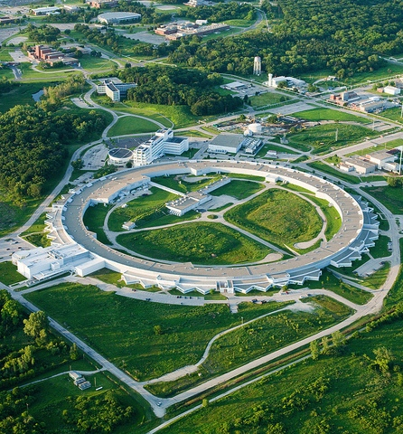

Positioning U.S. lightsources
for 21st century leadership
Advanced Photon Source:
The nation’s high-energy,
high-brightness lightsource
MBA Lattice yields 100x to 1,000x increased brightness
Creates transformational opportunities in science and technology
Maintains and extends APS strengths for >5,000 users
66 simultaneous experiments
Improved stability
Flexible bunch structure

Slide 4
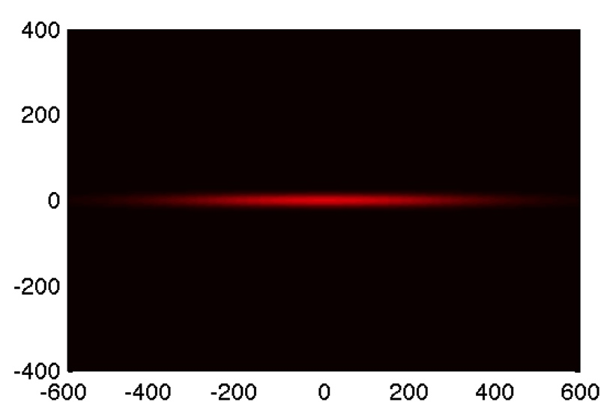
The APS today
microns
microns

Slide 5
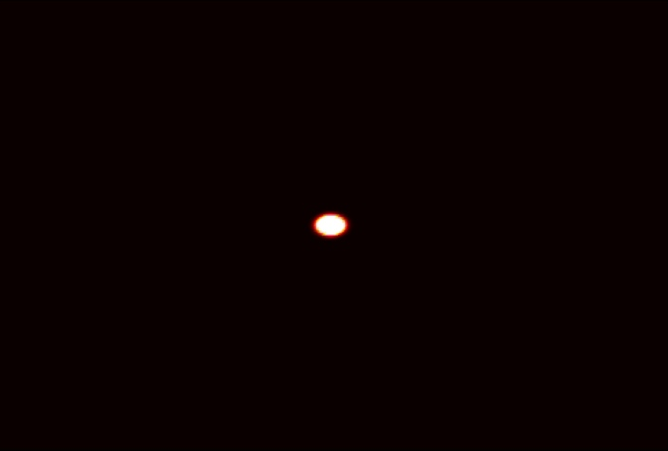
The MBA Lattice: Transforming the APS with coherence and brightness
microns
microns

Slide 6
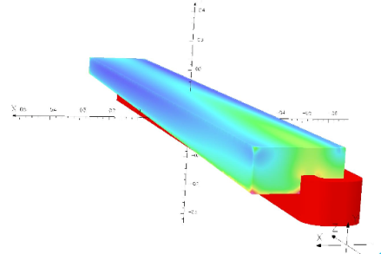
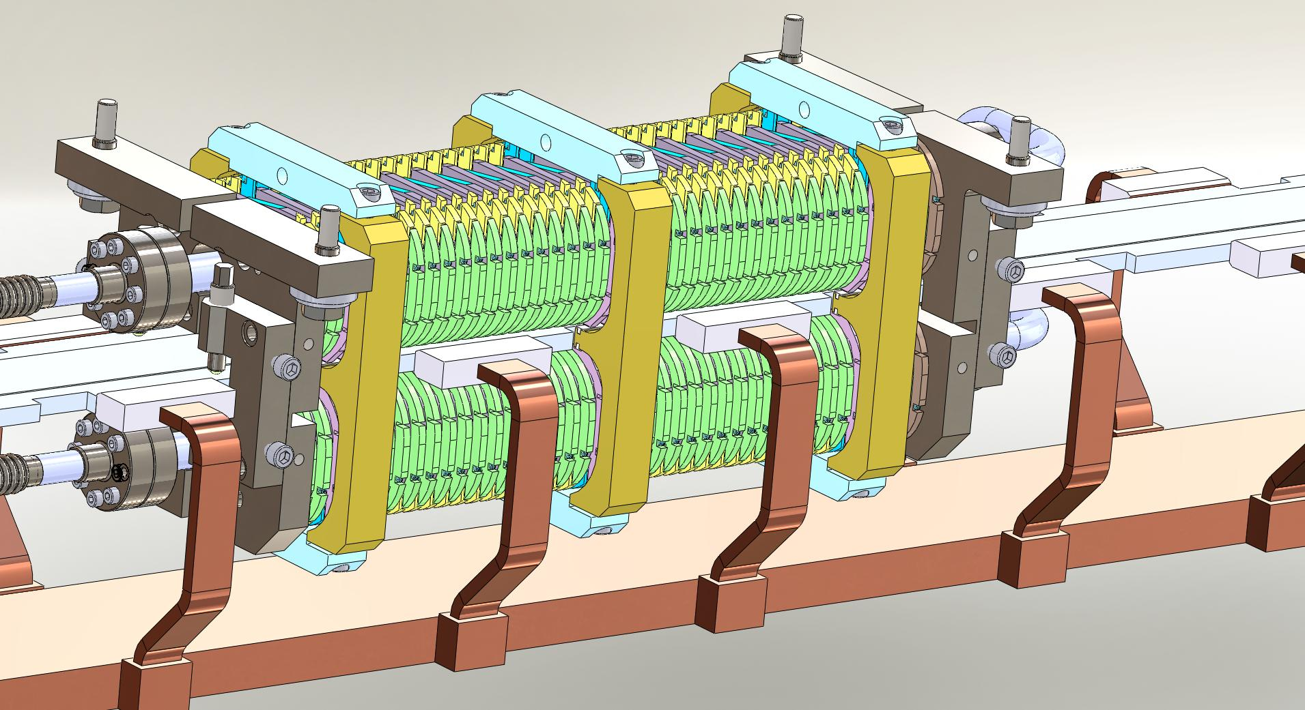
Dramatic improvements in technology
enable a powerful new scientific tool
Aggressive improvements in machine design made possible by:
Advances in accelerator modeling capabilities
Maturity of multibend achromat lattices
  Improvements in magnet, vacuum technology
  Innovation in electron injection scheme
  Breakthrough in fill pattern flexibility – up to 4 mA/bunch
  New possibilities for high-performance undulators (synergistic with LCLS-II)
➔ International consensus on MBA lattice design for next-generation ultra-bright storage rings
Longitudinal-gradient dipole
Superconducting undulator
Notes:
Dlsr talk from paul evans – what’s new
Why now?
Innovations – timing –
Machine 100-1000x brighter
In many ways – delivers everyinh aps with 1000x brightness – aps on steroids

Slide 7
APS-U: Unprecedented brightness and coherence up to high energies
Future APS w/ MBA
NSLS-II
Brightness vs. x-ray energy at top beamlines among BES synchrotron facilities
Notes:
This is what the future suite of x-ray facilities could look like
The black curve is the beautiful new facility at Brookhaven, NSLS-II, that will be coming on next year and provide high brightness x-rays in the low and medium energy range.
The blue curve is what an MBA lattice would provide at APS.
The brightness increases by 100x to 1000x compared to brightest devices in APS today.
This is a major leap to a new generation, with unprecedented brightness in the medium and high energy range.

Slide 8
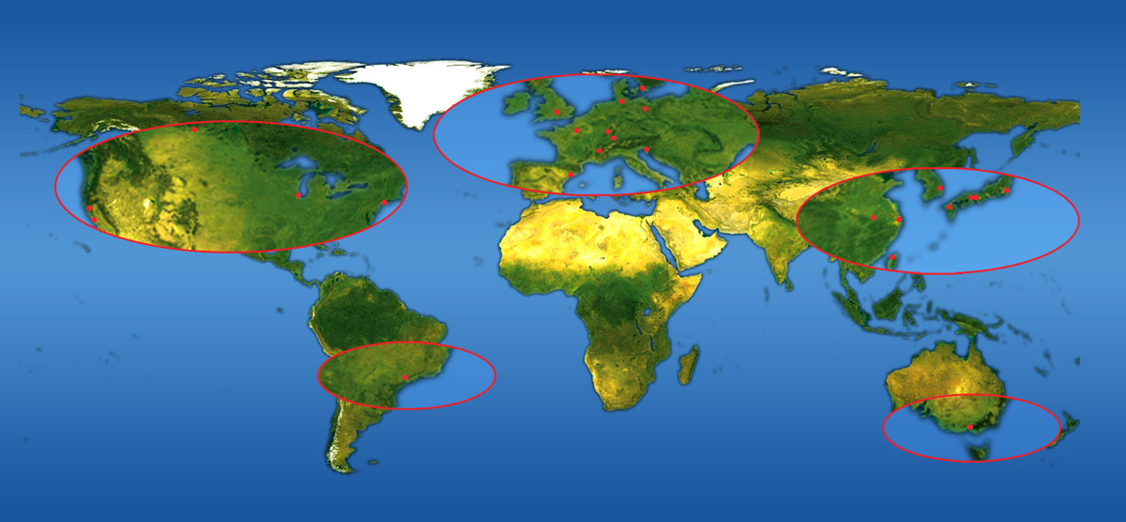
The international lightsource community is growing, collaborative – but also highly competitive
Notes:
Map of the twenty-five synchrotron light sources around the world which entered operation in the past 15 years (view larger image).
Stars show synchrotrons actively pursuing MBA lattice technology. To stay competitive, we must pursue at the APS.
Collaborators:
Fermi – magnets, measurement
Brookhaven – measurements, beam physics
LBNL, SLAC – undulator design
ESRF – lattice, everything
MAX IV – integration, engineering
IHEP Beijing – HV power supplies
Sirius, Sao Paolo, Beam physics
CERN - vacuum

Slide 9
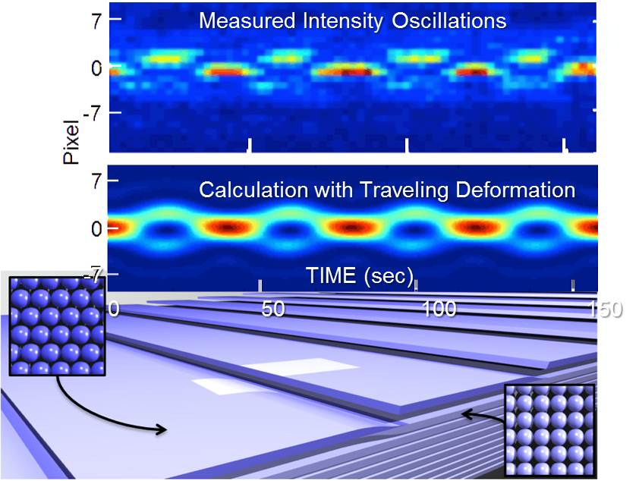
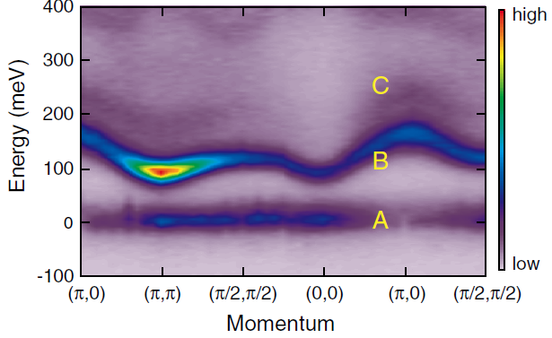
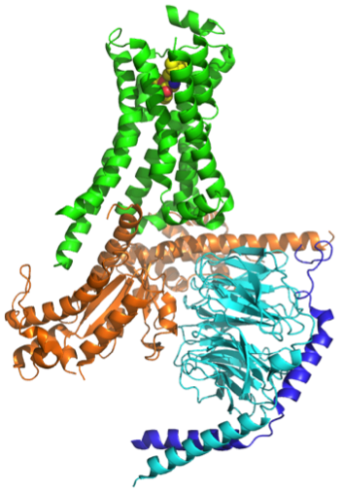
The next generation of lightsources promises to transform our understanding of matter
Scientific opportunities
APS MBA lattice upgrade will provide the microscope to image nanometer-scale heterogeneity and fluctuations
Breakthroughs in nanobeams and coherence techniques
Transverse coherence at high energies enables imaging and spectroscopy of local structure and dynamics in real environments
Integrating theory & simulation
Rapid advances are merging length & time scales of experiment and theory through computation
Atomic-to-Nanoscale Control in Materials Synthesis and Functionality
Nanometer imaging and nanosecond dynamics via coherent scattering in challenging environments
Intrinsic Heterogeneity and Quantum Coherence in Correlated Electron Materials:
Coherent control requires
nanoscale engineering
Sr₃Ir₂O₇
Electronic, magnetic, and phonon structure with sub 10-nm spatial resolution
Structure and Dynamics of Biological Materials
β₂ adrenergic receptor-Gs protein complex
Cellular Machinery: Structure and dynamics in non-periodic systems
Notes:
Workshop report --

Slide 10
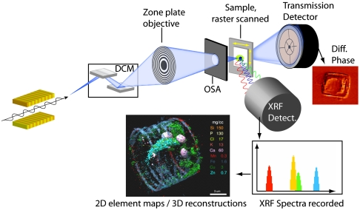
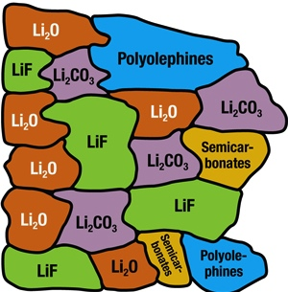


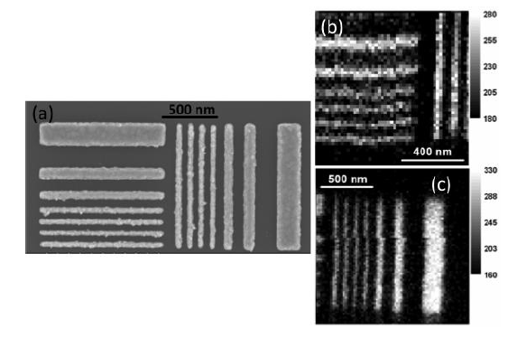
Achieving a new regime of scattering and spectroscopy with nanobeams
APS with MBA lattice will vastly expand the capability and capacity of scanned x-ray probes: High flux at resolution approaching 1 nm
30-50 nm
Electrolyte
Solvated
Ions
Electrode
Adsorbed
Ion
X-ray fluorescence and nano-tomography
NanoXRD
Sr₃Ir₂O₇
Energy (meV
Momentum
NanoRIXS
Continued optics development
Notes:
Bring to bear the full array of powerful x-ray techniques at nanometer dimensions – every probe a nanoprobe
X-ray fluorescence nano-tomography
3D elemental mapping of functional mesostructures
Fig. 1 de Jonge, et. al., PNAS 107, 15676 (2010).
nanoDiffraction
Identifying nanoscale multiphase structures and transformation mechanisms inside batteries during charging and discharging
nanoRIXS and nanoXRF
Understanding excitations and chemistry in heterogeneous materials and nanostructures

Slide 11
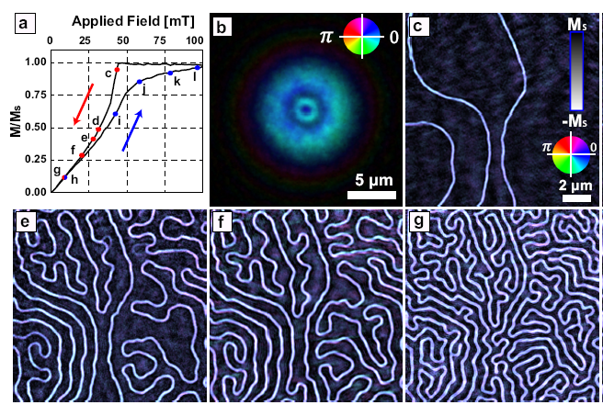
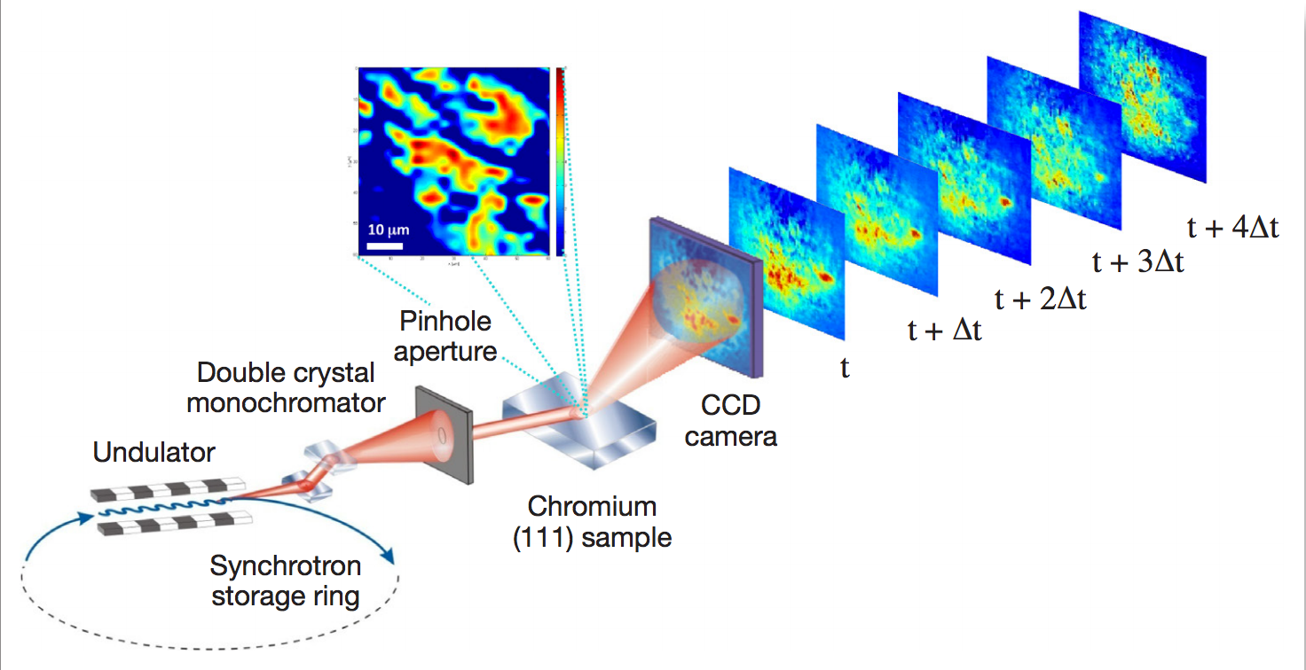
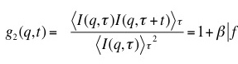
Coherence enables in operando imaging approaching atomic resolution
APS with MBA lattice will enable coherent diffraction imaging and ptychography with unprecedented resolution
Fast fluctuations with X-ray Photon Correlation Spectroscopy
    100x increase in brightness
    10,000x improvement in time resolution
Magnetic Domains in GdFe, Shpyrko, et al
Today
‘Disordered’ beam
Ordered sample
With
APS-U
“Ordered” coherent beams
Disordered samples
Notes:
Coherent Diffraction Imaging
Resolution limited by wavelength and sample stability – not optics
Recover real and imaginary parts of refractive index, magnetization, or
Required coherent x-ray flux scales as ~1/ R⁴ (R=resolution)
Wavelength-Resolution Ptychography
Scanned-beam ptychography adapts CDI to continuous samples, resolution far better than focused x-ray spot size
Improved coherence of DLSRs will allow coherent imaging techniques to reach wavelength resolution

Slide 12
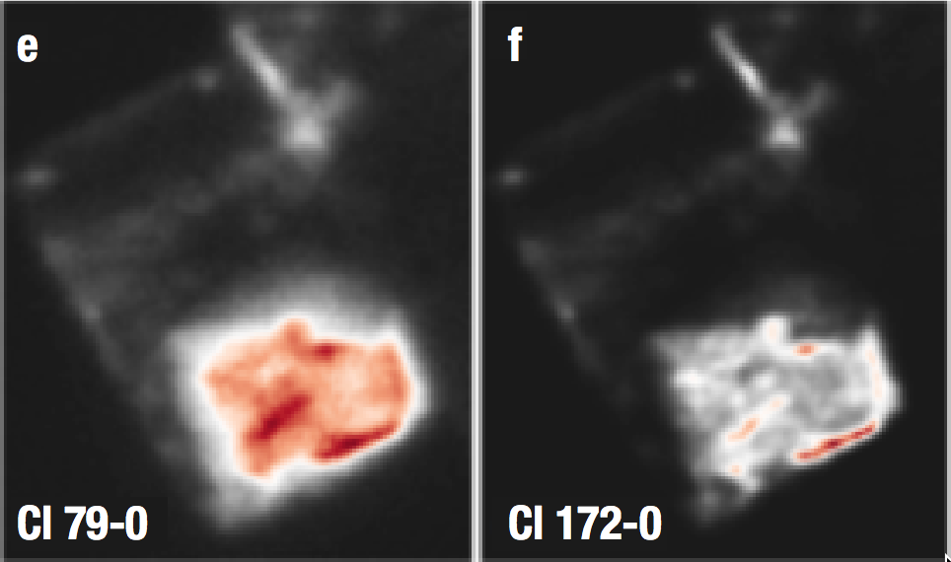
Nanobeam imaging
1 µm
Notes:
Combining ptychography with scanning probe. Nanobeam imaging synergistic with coherence. Left – raw nanobeam imaging, right has been sharpened up by using knowledge of shape of beam obtained from simultaneous ptychography

Slide 13
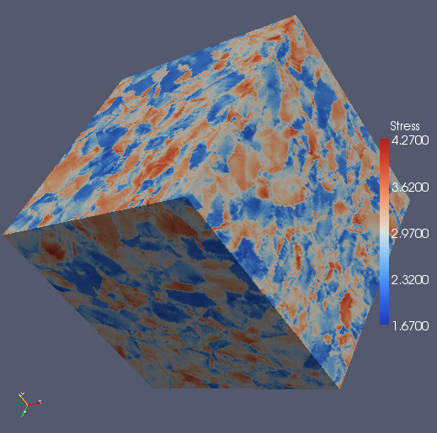
Materials science: In situ microstructural and strain mapping in real environments
Can we understand and create robust structural materials – from the atomic scale on up – for use in challenging conditions?
160 μm x 1mm x 1mm
APS with MBA lattice will enable:
  Higher spatiotemporal resolution to reveal the earliest stages of deformation, in complex materials – simultaneous orientation, strain mapping of >1,000 grains in mm-sized samples
  Environments:
    Thermo-mechanical loading
    Irradiated materials; high fields; high pressures
New capabilities at high energy (>50 keV)
    Sub-μm resolution
    10x higher strain resolution
    In-situ studies
Grains in turbine disc materials (J. Schuren, AFRL)
Near elastic limit
After 24 hours of creep strain
  Validation of models
Computational model of elastic response inside a polycrystalline metal
A.D. Rollett et al., Modeling Simul. Mater. Sci. Eng. 18, 074005 (2010)

Slide 14
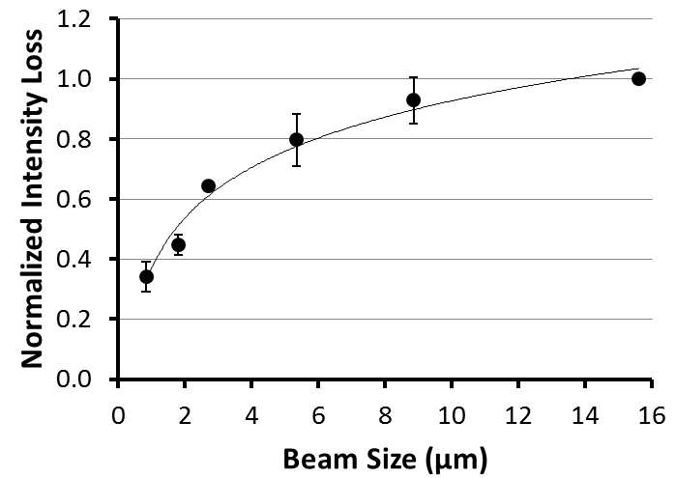
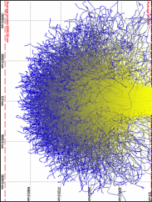
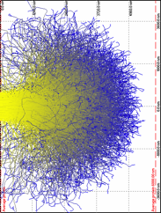
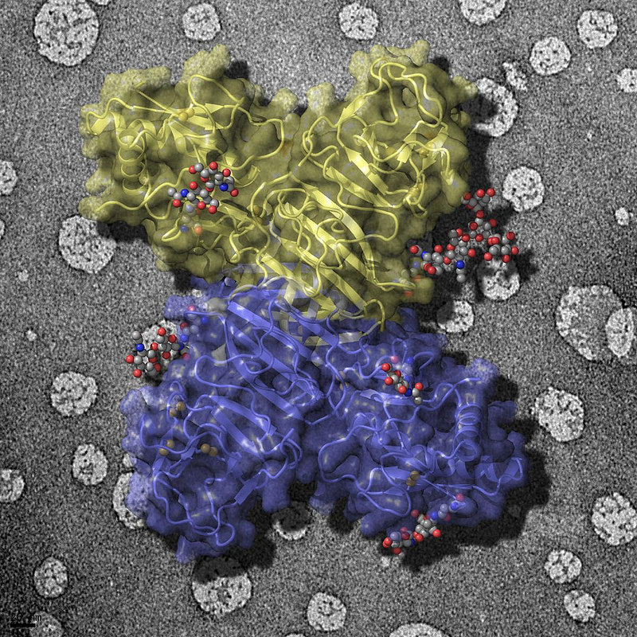
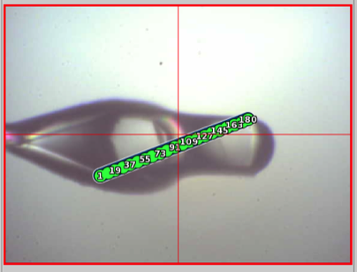
Micro-crystallography of biological macromolecules
Can we unravel the molecular mechanisms of living organisms?
APS with MBA lattice will enable determination of 3-D structures of high-impact proteins & protein complexes
MBA lattice will significantly expand MX horizon:
Nano/microcrystals – currently inaccessible
Improved S/N and resolution for small (0.5 – 5 µm), inhomogenous and/or weakly scattering crystals
Reduced radiation damage – photoelectron escape, short exposure times (~100 msec) at room temperature
Reduced radiation damage
Normalized intensity loss
Beam size (µm)
100x60 µm
β₂ adrenergic receptor-Gs protein complex (Kobilka labs)
Flavivirus NS1 protein (Akey & Dutta, U. Mich.)
Scanning across loop-mounted crystal
Notes:
Bottom Left:
The ribbon representation of the β2 adrenergic receptor-Gs protein complex. The integral membrane receptor is shown in green with an agonist bound (yellow), and the trimeric Gs protein components (Gα - orange, Gβ - cyan, and Gγ – purple). The increased brightness and stability provided by an MBA lattice holds promise for routine determination of 3-D structures of proteins and protein complexes, even from crystals as small as 0.5 microns.
Bottom Middle:
Notes refer to it as - -mm scale (Have call into George for more info) I think this is the origin; http://www.gmca.anl.gov/userprogram/jbluice-epics.html
Bottom Right:
The external face of the flavivirus NS1 protein (sugars in grey balls) is exposed on infected cell surfaces where it can interact with the immune system. This face is also exposed in secreted NS1 particles present in patient sera. The background image shows artificial membranes coated with the NS1 protein. Flaviviruses cause West Nile encephalitis, Dengue fever, yellow fever and several other forms of encephalitis.
Nobel Prize in 2012 was for understanding a very important membrane protein complex
This field has been growing exponentially, with many structures solved at APS using crystallography with ~10 micron beams
MBA will extend this state of the art to 1 micron and below, allowing studies of smaller or imperfect crystals, reduced radiation damage, and advanced rastering techniquesHigh energies at APS reduce rad damage, provide access to all elements

Slide 15
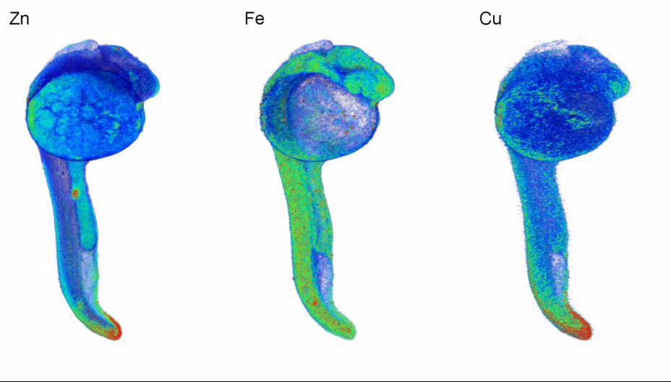
Life Sciences: Determining structure and dynamics from molecules to cells to organisms
Can we unravel the molecular mechanisms of living organisms?
APS with MBA lattice upgrade enables:
8,000x better 3D resolution, higher sensitivity (100nm lateral resolution, 1,200 projections)
Cellular imaging:
~20 nm resolution, few-atom sensitivity for fluorescence microscopy
Imaging sub-cellular structures approaching macromolecular scale
Whole-organism phase contrast imaging:
Centimeter fields, sub-micron resolution, higher penetration
200 µm
Zebra-fish: Metalloprotein cofactor metal distributions correlated with characteristic anatomical features of embryonic development
D. Bourassa et al, submitted
Notes:
Current dataset largely limited by data acquisition speed, which in turn is limited by available flux.
MBA source upgrade will bring 200x higher brightness, optics upgrades another factor of 2x => improve lateral resolution to 100 nm (again, just speed limited).
Detector improvements (larger subtended solid angle from 5% today to ~30%) give another factor of 6: Note a detector like the MAIA (BNL/CSIRO) with very fast readout and large subtended solid angle will be crucial.
Methods development (dose fractionation as in electron tomography) allow for further reduction of data acquisition time needed for each projection: easily a factor of 5 or more.
Red = milimole to sub milimole concentrations
Synchrotron X-ray fluorescence (SXRF) microtomography has emerged as a powerful technique for the 3D visualization of the elemental distribution in biological samples. Compared to 2D SXRF elemental imaging, microtomography poses significant additional challenges with regard to specimen preparation, data acquisition, and volumetric reconstruction. The mechanical stability, both of the instrument and the specimen, is paramount when acquiring tomographic projection series. By combining the progressive lowering of temperature method (PLT) with femto­second-based two-photon laser sectioning, we were able to embed, excise, and preserve a zebrafish embryo at 24 hours post fertilization in an x-ray compatible, transparent resin for tomographic elemental imaging. Based on a data set comprised of 60 projections, which were acquired at 2 μm resolution during 100 hours of beam time, we reconstructed the 3D distribution of zinc, iron, and copper using the iterative maximum likelihood expectation maximization (MLEM) backprojection algorithm. The volumetric elemental maps, which entail over 124 million individual voxels for each transition metal, revealed distinct elemental distributions that could be correlated with characteristic anatomical features at this stage of embryonic development.
Zebrafish embryo as a test model. Applicable to developmental biology, cancer research, metal associated diseases, etc . Today we can resolve cells, with the MBA upgrade we will be able to resolve subcellular structures inside w whole organism, etc.
Field of view 800x1500um, 2um step size, 60 projections, dwell:10 ms/pixel: 4 days beamtime

Slide 16
Coherence
Simulated coherent scattering from single vacancy in Si, using APS-U MBA beam parameters
S. Hruszkewycz, unpublished

Slide 17
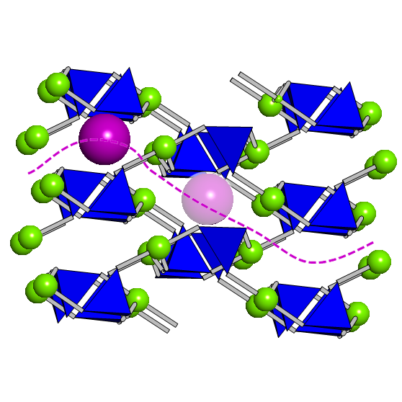
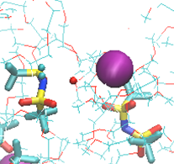
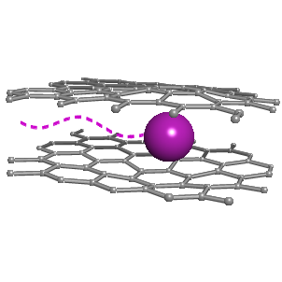
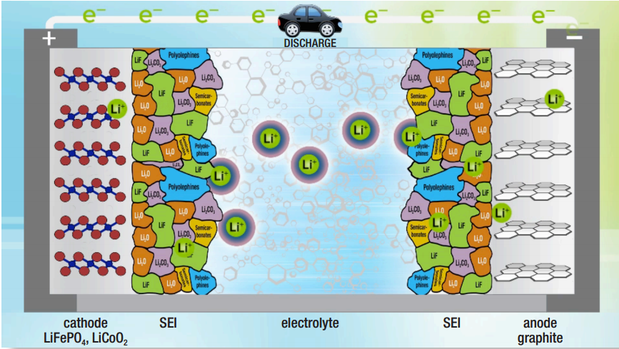
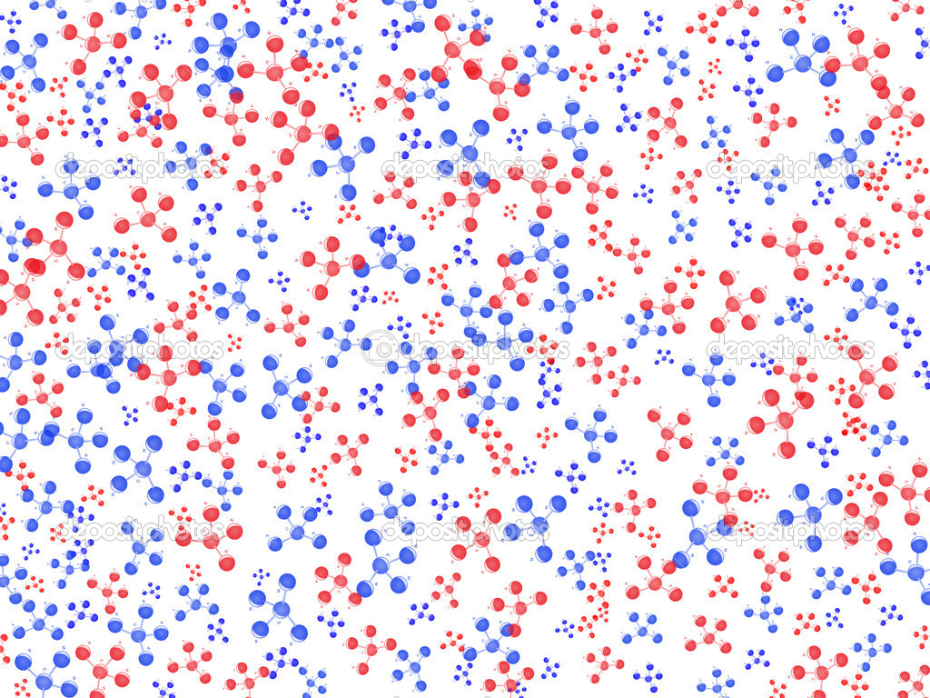
Electrochemistry across many length scales
How can we image – and ultimately control – interacting mesoscale phenomena in electrochemical systems?
Interfacial transfer dynamics
Solvation dynamics in the bulk electrolyte
Ionic and electronic mobility in solids
Phase transformation and morphology evolution
Discovering new chemistries and molecules
Mg²⁺
Mg²⁺
Mg²⁺
Mg²⁺
Mg²⁺
Mg²⁺
Mg²⁺
Mg²⁺
The APS with MBA lattice upgrade will enable exploration of these phenomena in real, heterogeneous systems
Notes:
Reduce beam with focusing optics – what capability we’re invoking? Reduce beam size with intensity
Solvation, desolvation --

Slide 18
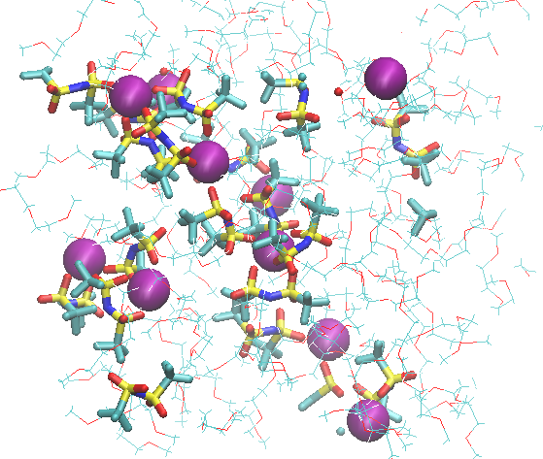
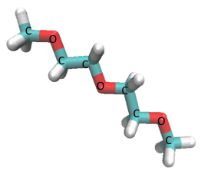
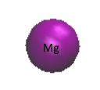
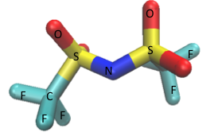
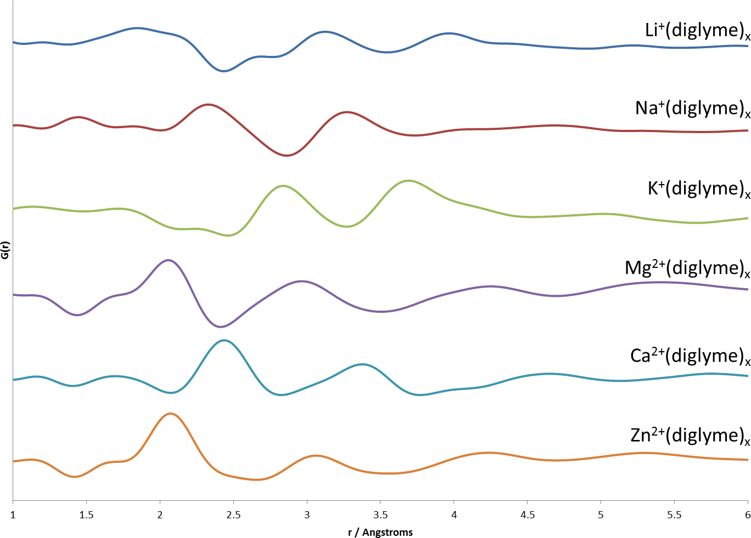

Multivalent solvation structure in electrolytes
Mg²⁺-O_{TFSI}
Coupled QM-MD calculations
0.4 Mg-TFSI/di-glyme
Mg²⁺-O_{di-glyme}
Mg²⁺-N_{TFSI}
Radial distribution function
Mg²⁺-C_{di-glyme}
Persson
PDF + Principal Component / Differential Analysis
0.4 M A^{n+}-TFSI/di-glyme
Mg²⁺-C
Chapman and Chupas
Mg²⁺-O
The MBA lattice will enable 1,000x smaller gauge volumes containing as little as a few multivalent ions – critical to ‘electrolyte genome’ project.
Will we be able to use the coherent scattering to recover 3-D structure?

Slide 19
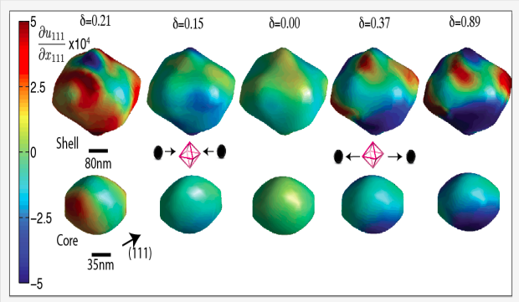
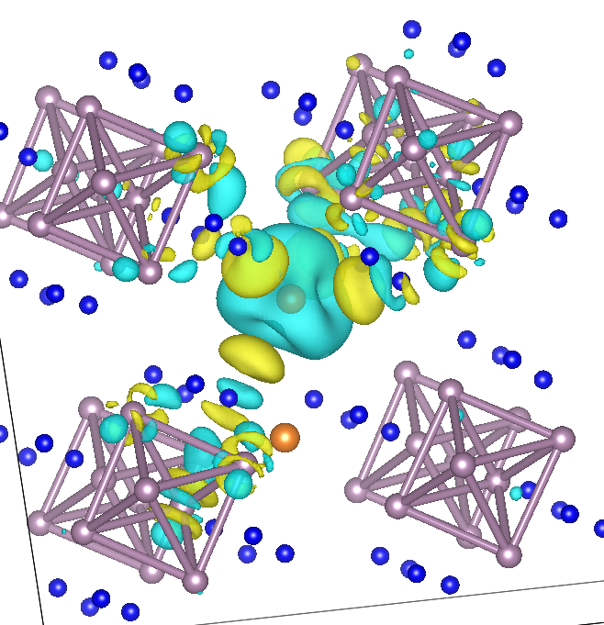
In operando coherent diffraction imaging will allow strain mapping at the nanometer scale
LiMnNiO strain map at APS with 50 nm resolution
Computational materials science: intercalated Mg++ strongly screened
The APS with MBA lattice will enable in operando imaging of single electrode particles approaching a few nm’s resolution
Notes:
Imaging of lithium diffusion within a single grain of LiNiMnO cathode during cycling

Slide 20
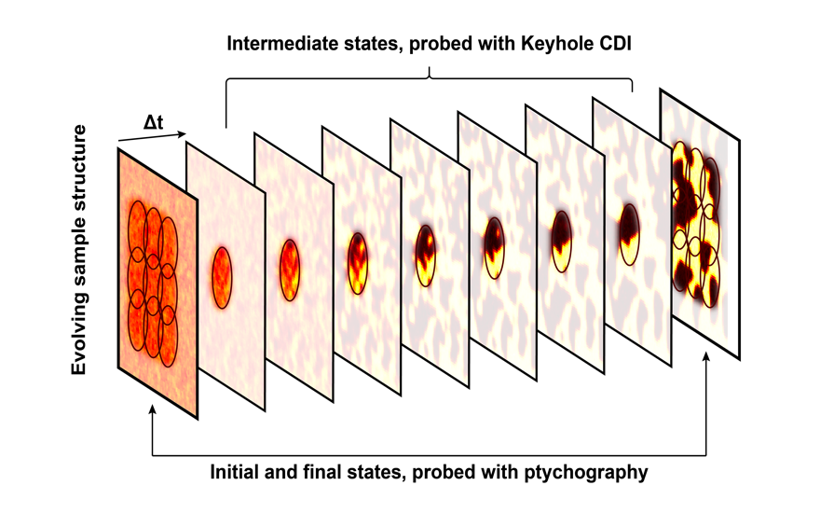
Achieving integrated views of complex processes through time domain ptychography
Intermediate states, probed with keyhole CDI
Evolving sample structure
Initial and final states, probed with ptychography
Notes:
Surprising phenomena occur in seemingly simple processes
For example, imaging structure evolution by constraining the solution with a sequence of x-ray patterns and high performance modeling incorporating basic physical processes such as diffusion would allow the simultaneous development and validation of theory and computational models.

Slide 21
Going beyond the pair correlation function
Can we understand the time evolution of deformation and flow in condensed matter?
The APS with MBA lattice upgrade will allow:
Molecular-scale motion in fluids and glasses mapped on sub-micron scale (e.g., transition to turbulent flow)
3-D strain tensor mapping in real-time of materials evolving under loading conditions
  ~I(t,q)I(t+τ, q+δq)
10²x-10³x brightness yields 10⁴ to 10⁶ increase in dynamic range
Nanosecond time scale, nanometer spatial resolution
Model system: spatiotemporal correlations in colloidal-decorated elastomer
Speckle shifts superimposed on scattering from a 20 micron region of a rubber sample undergoing flow in a stress-strain cell. Shifts are scaled by 200.
M. Sutton and Julien Lhermitte, unpublished
Notes:
What systems are worth studying? Cannot do with liquids, applicable materials – more from mark
Pick a problem- transition to turbulent flow – phase contrast photo – workshop – cartoon – xpcs –
Dynamic speckle to look at stuff - -identify the best possible problem
Lcls ii – cartoon – souresh – needs a real problem
This example – model system studied recently – see the dynamics – see strain fields locally – space=time cross correlations
Coolest thing about this – with these coherent beams – scattering from systems – see all this speckle – new techniques emerging – higher order correlations and cross correlations –
p. 30 worskhop – interesting things that happen in real fluids figure 4.2.2 – add as science

Slide 22
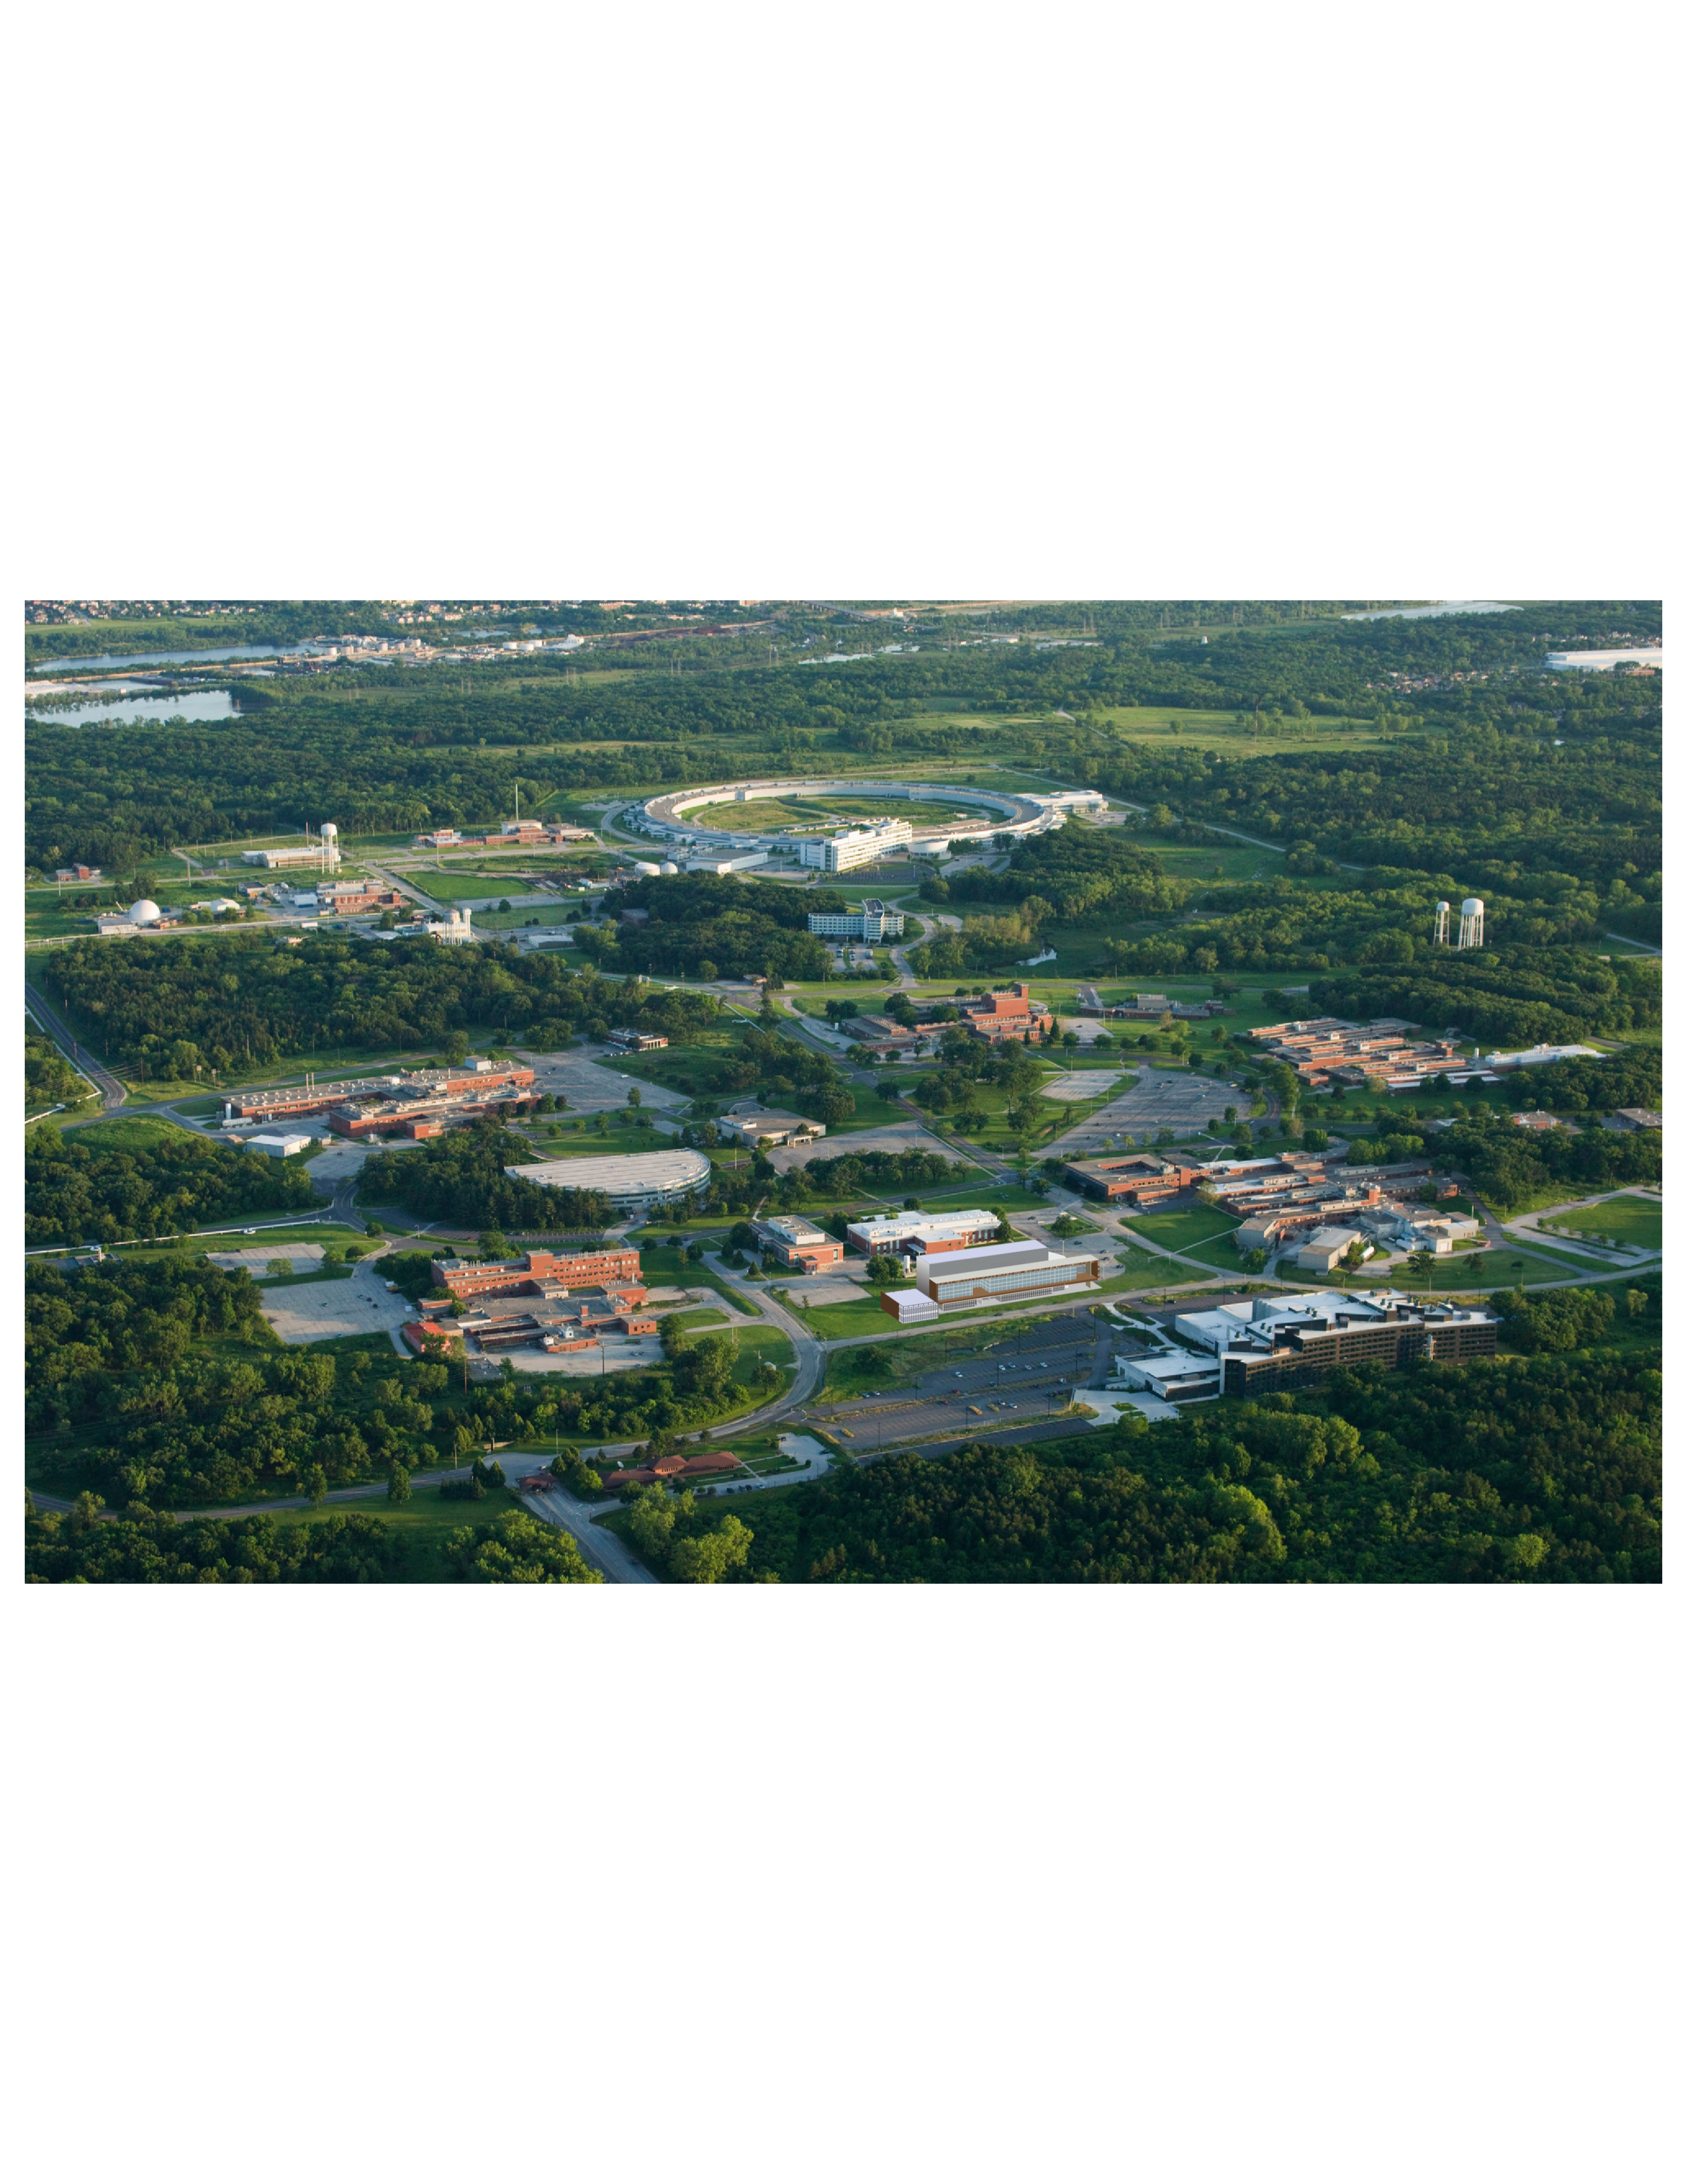
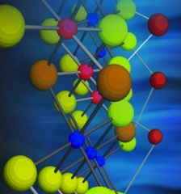
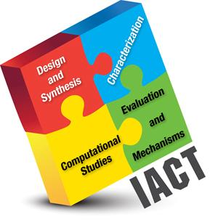
National Labs provide vital ecosystems for major DOE scientific user facilities
Protein facility
Transportation research
Nanoscience
Chemical engineering
Chemistry
Accelerator physics
CEES
Materials and energy sciences; molecular engineering
Biology
High performance computing & data
Notes:
Discovery Science and Innovation Impacts
Better position to win and grow the lab strategically
Building strong partnerships and external relationships
Modernization Advances
Different way of doing business
Serious progress –
How we compete
How we address safety
How we reduce legacy waste/nuclear foot print
How we modernize and improve infrastructure
How we collaborate
Results
Progress in science and user facilities
Energy Frontier Research Centers ($50M+++)
Joint Center for Energy Storage Research ($125M)
Advanced Photon Source Upgrade ($550M)
MIRA - Blue Gene/Q ($100M)
Institute for Molecular Engineering ($7M/yr)
Progress in lab modernization
Energy Science Building ($90M, DOE/SC)
Advanced Protein Crystallization Facility ($35M, IL)
Radiological Footprint Reduction ($107M, DOE/EM)
Developed program capture capabilities
Increased rigor in the process
Made some really good hires
Hi Eric,
I did talk with Paul regarding the footprints reductions and infrastructure improvements. He is going to give it more thought and send us some summary information later today. The designer working to add MDL to the ESB rendering for the Argonne aerial view and will send that along later today as well.
In the meantime, I spoke with Karen Hellman and here are the stats related to ESB and APCF:
ESB
Capacity for 253
Moved approximately 160 – waiting on space re-allocation for the final occupants – but all planned moves have been completed
Focus now is on finishing equipment hook-ups and completing lab space
APCF
Capacity for 80
Moves started on 2/3, will be done in 4 phases, each phase is two weeks long and will be complete by end of March
All structural biology will be relocated to APCF
Let me know if there is anything else you need.

Slide 23
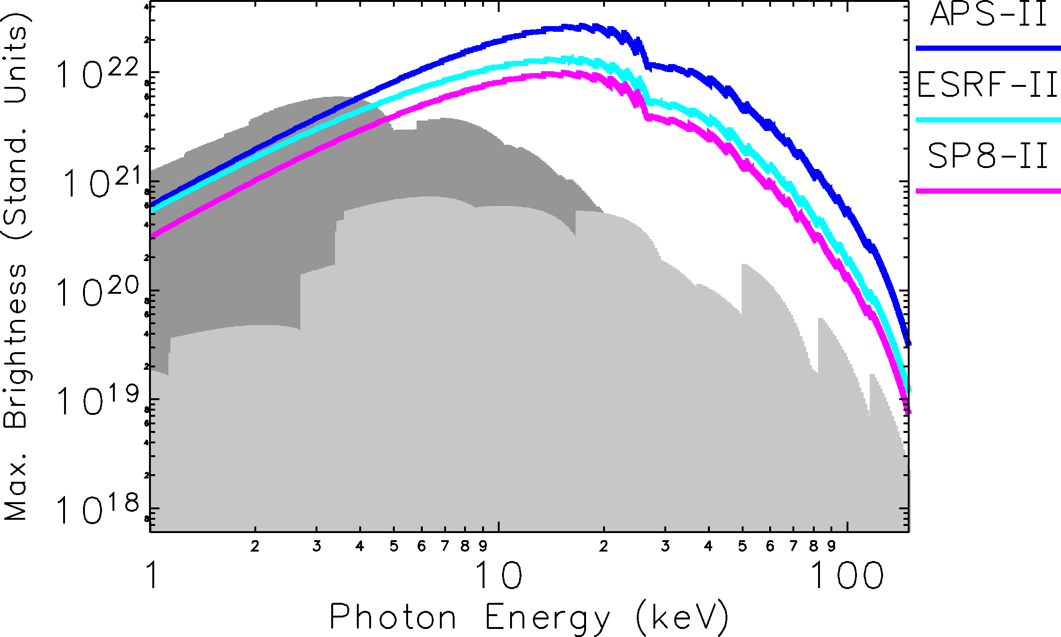
APS MBA compared to present and future machines
Near future
Present day
23
Notes:
11/01/13
Go to "View | Header and Footer" to add your organization, sponsor, meeting name here; then, click "Apply to All"
23
01/27/14
Go to "View | Header and Footer" to add your organization, sponsor, meeting name here; then, click "Apply to All"
23

Slide 24
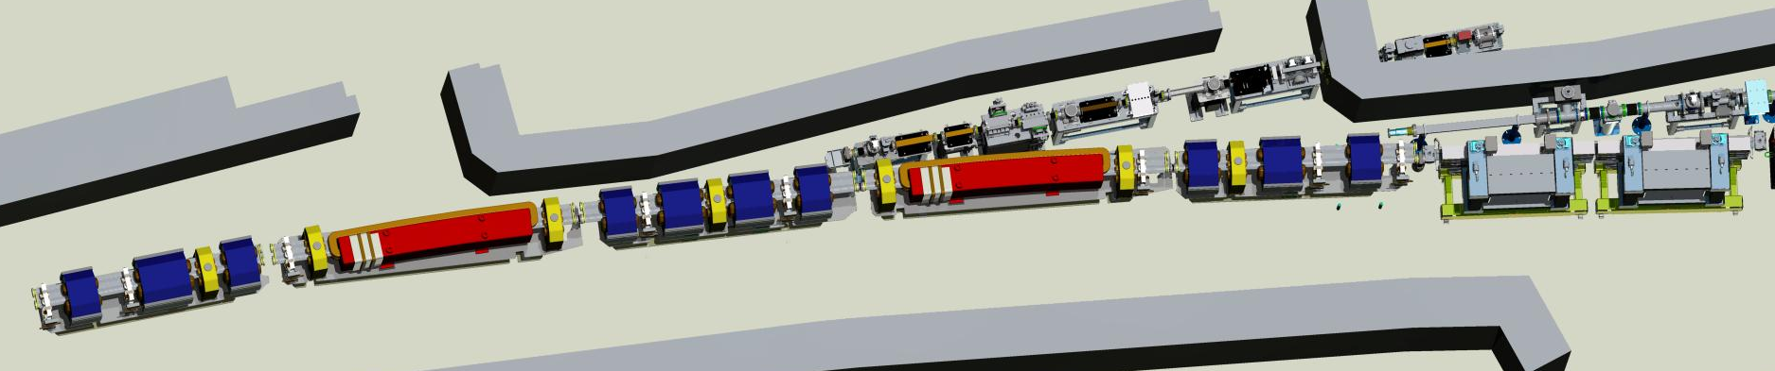
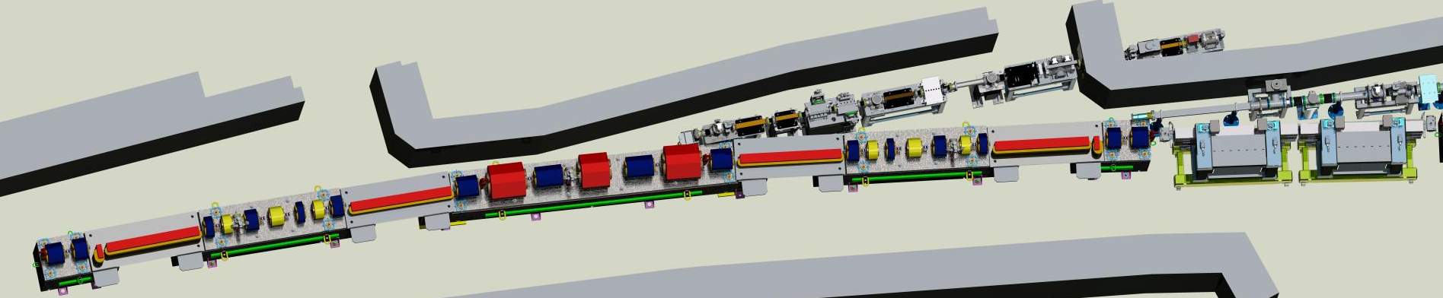
Lattice design evolution to multibend achromats
APS today
APS w/MBA lattice
Notes:
the red objects are the bending magnets,
Full sector is 25 meters, including insertion devices. – 40 around the ring
1,200 magnets being replaced.
Circular beam creates flexibility in undulator design

Slide 25
Parameters comparisons: APS today vs APS MBA Upgrade
Quantity | Symbol | Units | APS Now | APS MBA Timing Mode | APS MBA Bright. Mode
Beam Energy | E | GeV | 7 | 6 | 6
Beam current | I | mA | 100 | 200 | 200
Number of bunches | N_{b} |  | 24 | 48 | 324
Bunch duration | Ơ_{t} | ps | 34 | 70 | 18
Bunch spacing | T_{b} | ns | 153 | 77 | 11
Bunch rep. rate | f_{b} | MHz | 6.5 | 13 | 88
Emittance ratio | Ƙ = Є_{y} / Єₓ |  | 0.013 | 1.0 | 0.1
Horizontal emittance | Єₓ | pm | 3100 | 48 | 66
Horizontal beam size | Ơₓ | µm | 275 | 18.2 | 21.4
Horizontal beam divergence | Ơₓʹ | µrad | 11 | 2.7 | 3.1
Vertical emittance | Єy | pm | 40 | 48 | 7
Vertical beam size | Ơy | µm | 10 | 10.2 | 3.9
Vertical beam divergence | Ơyʹ | µrad | 3.5 | 4.7 | 1.8

Slide 26
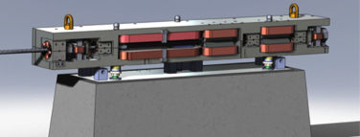
Challenges and progress in APS MBA-lattice upgrade
Injection systems: swap-out mode
  Benefits from on-axis injection
  tradeoff with dynamic aperture
Integration of engineering design
  1320 magnets
  Vacuum systems and power supplies
  Installation schedule
Optimization of injection system layout
Quads
Quads
Thick Septum
Thin Septum
Stripline kickers
Stored Beam
Injected Beam
Stripline Blade
Septum Wall
Multi-Magnet Concept (MAX-IV)
Beam physics review (Feb 13-14, 2014)
  ‘The team has made outstanding progress in a short time period towards the conceptual design’
Notes:
Removing 1885 tons of stuff from ring
MBA: Replacing with 3300 tons of stuff in ring – will settle
Vibrationally quiet.

Slide 27
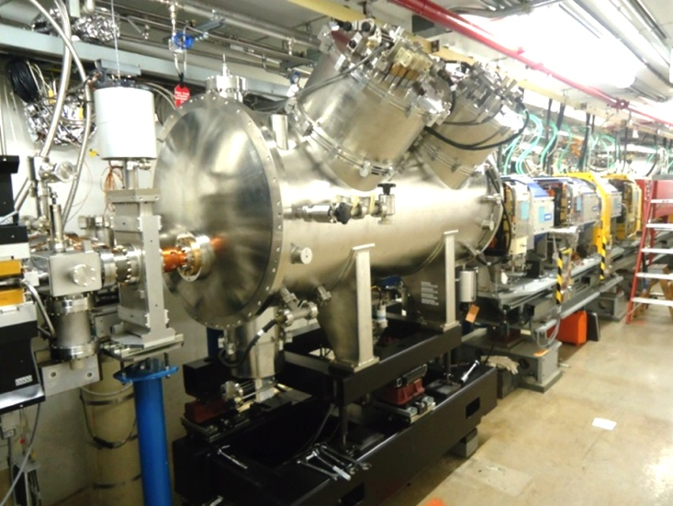
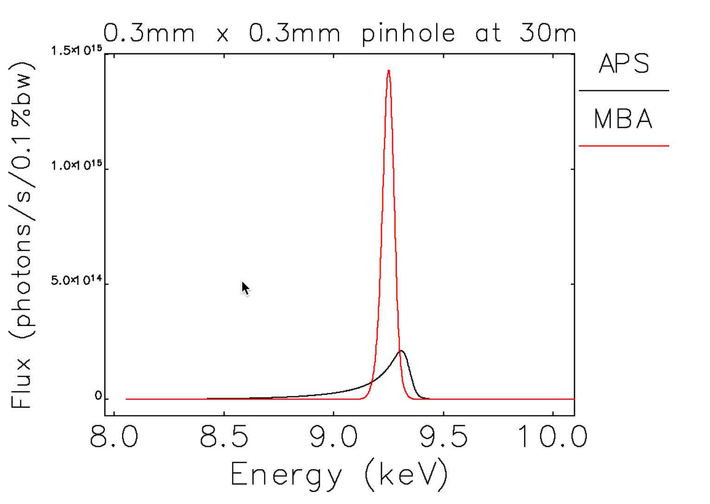


APS MBA upgrade enables advanced high-brightness undulators
Round beam created by MBA lattice enables great flexibility in undulators for high brightness
Advanced undulators synergistic with FELs
  Collaborative development programs with SLAC, LBNL
Notes:
Not only do we get beautiful improved electron beam, but it is easier to convert into beautiful x-ray beams with undulators
So when we mention that the round beam of our MBA machine will open new possibilities for high performance undulators, that is very synergistic
with the undulators needed for the FEL.
We are working together with SLAC and LBNL to develop new types that will benefit both machines. SLAC
has contracted with us to develop a horizontal gap prototype, and SLAC is the primary supporter of a 3-way collaboration on superconducting prototypes for LCLS-II. (For the superconducting, we are making a
prototype with the proven NbTi wire and LBNL is trying potentially higher performance Nb3Sn wire.) And we have an Argonne LDRD program to
develop a helical superconducting undulator, and another one on using YBCO wire, which could be even higher performance (when used at Lhe temperatures).
Attached are images of the horizontal gap design and prototype, the current superconducting undulator we have already installed, and a plot
comparing the peak fields of the permanent magnet and superconducting varieties vs. period at a fixed gap. Also a slide with diagrams of the
magnet inside the cryostat, which maybe be more informative than the picture of the outside of the cryostat.
So, I think the undulators deserve a full slide someplace towards the
end, showing the three new designs (horizontal gap, superconducting
planar and superconducting helical). We can explain that our brightness
plots are based on the proven planar NbTi superconducting device, but
that we expect further improvements as R&D progresses, and this will
benefit the FEL as well.
Small gaps
High-field superconducting undulators
Horizontal gap in helical designs
Better harmonic spectra

Slide 28


Detectors and data: Key to success of APS Upgrade
  Area detectors
  High-dynamic-range detectors with small pixels for coherence-based science
  MHz-frame-rate detectors for time-resolved science
Experimental
scattering
Computational science and data
New science enabled by:
  Real-time coupling of experimental data and modeling & simulation
  Real-time reconstructions (CDI, XPCS and movies, tomography)
New facilities required for real-time data and computational services – ~5 petabytes/month
Exploring multi-lab initiative with ASCR
Structure
Simulated
scattering
Notes:
Need some graphics for the interposer? Should we leave table in?

Slide 29


APS Upgrade with MBA Lattice:
The next generation of synchrotron science
E = 40keV
20 nm
Q ~ 10 Å⁻¹
Compelling science and technology
Design concept is well under way
MBA Lattice: The path to transformational understanding of matter
Notes:
APS Today:
Pair correlation functions are possible on bulk samples, providing average atomic structure
APS MBA:
Pair and many body correlations are accessible with coherent hard X-rays providing a more unique structural solution
This image is adapted from a small angle scattering coherent analysis at 2-ID-B
Coherence of the incident high energy x-ray beam will provide additional information on the relative arrangement of structures on the sub nanometer lengthscale.
Many-body correlations
Control of coherence and PDF can be combined to provide information on the multi-body atomic correlations (compared to the two-body atomic pair correlations provided by conventional PDF analysis). This would be a new paradigm for probing atomic scale structure leading to breakthroughs in the characterization of amorphous materials (e.g. pharmaceuticals, glasses,…artificial leaf)/

Slide 30
Questions?

Slide 31



Science of synthesis – at the heart of materials discovery
Can we build new materials from the atomic scale up?
In situ x-ray scattering during MOCVD growth of InGaN on top of a GaN template shows average epitaxial strain relaxation as growth progresses
APS with MBA lattice upgrade enables
ptychography to image formation of individual dislocations and associated strain fields
Theory of non-equilibrium strained-alloy growth instability
Spencer, Voorhees, and Tersoff, PRB 64, 235318 (2001)
Growth chamber mounted on surface diffractometer at beamline 12-ID-D of APS
Notes:
Growth and function of epitaxial films depends on substrate orientation.
Single crystals of desired substrate may be unavailable, difficult to grow with desired orientation, etc. Also by using solid solutions one can dial-in lattice mismatch (e.g. Rabe/Fennie strain engineering, MGI surveys) in ways not practical with single xtal substrates.
Left Fig: Schematic of process, textured polyxtalline aggregate with film deposited (PLD). Kikuchi patterns identify orientations of substrate and film pairs to evaluate epitaxial relationships on a grain-by-grain basis.
Right Fig: Rutile/anatase phase boundary vs. substrate orientation – collection to get map ~ 5 mins/pt (analysis is only partially automated at this point, but clearly could be fully automated)
Need sanity check on APS capabilities here.

