Slide 1
FY 2016 Budget Request to Congress for DOE’s Office of Science
February 2015
Dr. Patricia M. Dehmer
Acting Director, Office of Science
http://science.energy.gov/sc-2/presentations-and-testimony/

Slide 2
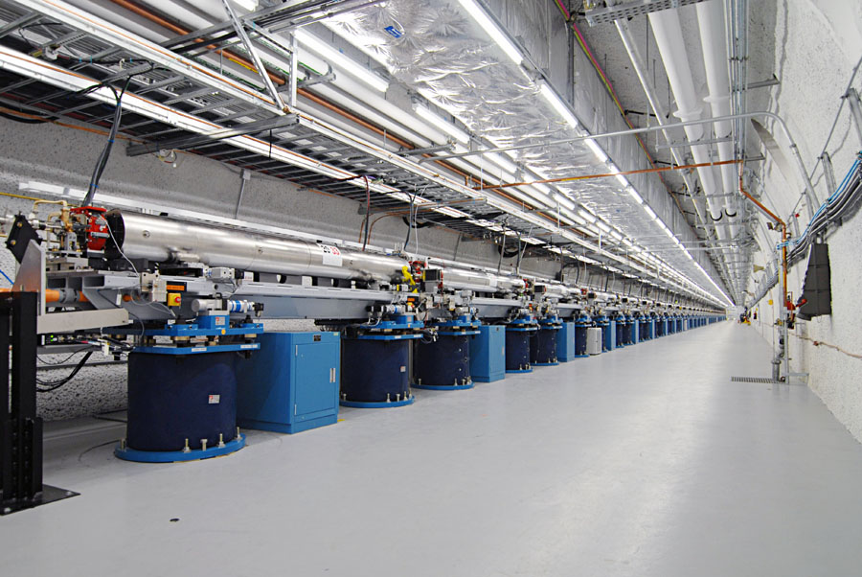
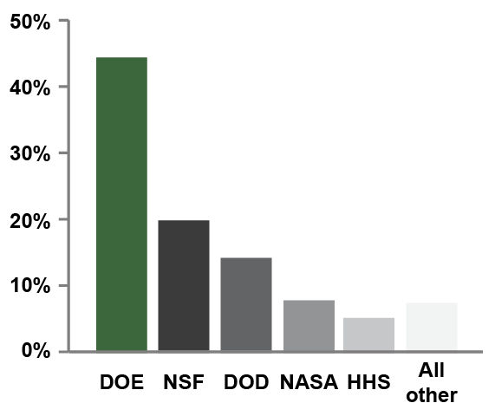
Office of Science
By the numbers
  SC delivers scientific discoveries and tools to transform our understanding of nature and advance the energy, economic, and national security of the U.S.
  Research
  Support for 47% of the U.S. Federal support of basic research in the physical sciences;
  ~22,000 Ph.D. scientists, grad students, engineers, and support staff at >300 institutions, including all 17 DOE labs;
  U.S. and world leadership in high-performance computing and computational sciences;
  Major U.S. supporter of physics, chemistry, materials sciences, and biology for discovery and for energy sciences.
Scientific User Facilities
  The world’s largest collection of scientific user facilities (aka research infrastructure) operated by a single organization in the world, used by 31,000 researchers each year.
Support for basic research in the physical sciences by agency.
Source: NSF Science and Engineering Indicators 2012
Shown is a portion of SLAC's two-mile-long linear accelerator (or linac), which provides the electron beam for the new Linac Coherent Light Source (LCLS) – the world’s first hard x-ray, free-electron laser. For nearly 50 years, SLAC's linac had produced high-energy electrons for physics experiments. Now researchers use the very intense X-ray pulses (more than a billion times brighter than the most powerful existing sources) much like a high-speed camera to take stop-motion pictures of atoms and molecules in motion, examining fundamental processes on femtosecond timescales.

Slide 3
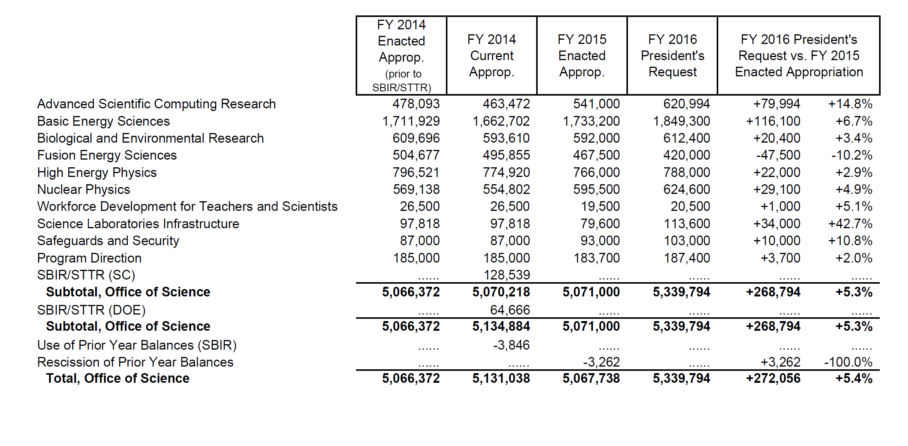
Office of Science FY 2016 Budget Request to Congress
(Dollars in thousands)

Slide 4
FY 2016 SC Budget Request by Category
Dollars in Thousands
Construction
BES: Linac Coherent Light Source-II continues and is in its peak funding year ($200,300K).
FES: ITER – support for the USIPO, IO, and hardware fabrication continues ($150,000K).
HEP: Long Baseline Neutrino Facility ($20,000K for PED); Muon to Electron Conversion ($40,100K).
NP: FRIB continues and is at the peak of its funding profile ($100,000K); accelerator commissioning and detector construction of the CEBAF 12 GeV upgrade continue ($12,000K).
SLI: Materials Design Lab at ANL ($23,910K); Photon Science Lab Building at SLAC ($25,000K); Integrative Genomics Building at LBNL ($20,000K).
Also in SLI: “Infrastructure Support” increases by $31,100K for top priorities identified as part of the Campus Strategy discussions, for electrical upgrades at ANL and SLAC and for facility improvements at FNAL.
Major Items of Equipment
BES: Advanced Photon Source Upgrade (APS-U) ($20,000K) and NSLS-II Experimental Tools (NEXT) (15,500K).
HEP: LHC Detector Upgrades (ATLAS and CMS) ($9,500K each); Large Synoptic Survey Telescope camera (LSSTcam) ($40,800K); Muon g-2 ($10,200K); LUX-ZEPLIN ($9,000K); SuperCDMS-SNOLab ($2,000K); Dark Energy Spectroscopic Instrument (DESI) ($5,300K).
Research
ASCR: There is a significant increase for the exascale initiative to support for HPC vendors to design and develop exascale node technologies and systems. (Δ = +$86,895K).
Also in ASCR: The Computational Science Graduate Fellowship is restored at $10,000K to fully fund a new cohort!
BES: Increases for EFRCs (Δ = +$10,000K), Computational Materials Sciences (Δ = +$4,000K), and mid-scale instrumentation for ultrafast electron scattering (Δ = +$5,000K).
BER: Increases for Climate and Earth System Modeling with largest increase for Climate Model Development & Validation and Integrated Assessment. (Δ = +$18,730K). Some decreases offset the increases.
FES: Research continues in all areas. Increase for GPP for PPPL in support of NSTX-U operations. HEDLP is reduced, but the Matter in Extreme Conditions end station at LCLS remains fully funded.
HEP: Research funding is nearly flat with FY 2015 and supports scientific results from operating experiments and R&D for future projects.
NP: Research increases by more than 8% to support high-priority work.
Facility Operations
ASCR, BER, BES, HEP: Facilities operate at or near to optimal, >98%.
FES: NSTX resumes operations for 14 weeks; DIII-D operates for 12 weeks until shutdown for installation of upgrades; Alcator C-Mod operates for 5 weeks prior to final shutdown at the end of FY 2016.
NP: RHIC operates 22 weeks, same as in FY 2015 and has funding for capital equipment and spares; ATLAS operates 37 weeks; CEBAF is supported for continued machine development and commissioning of beam to Halls B and C.

Slide 5
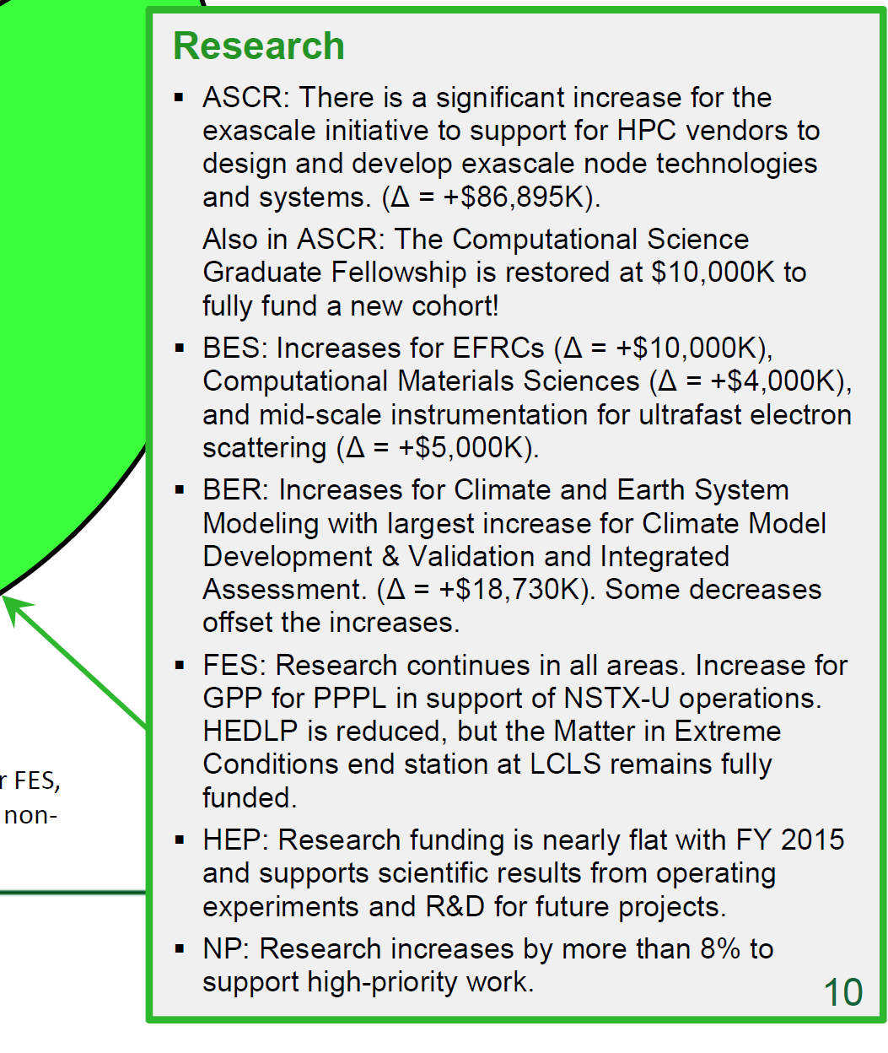

Slide 6
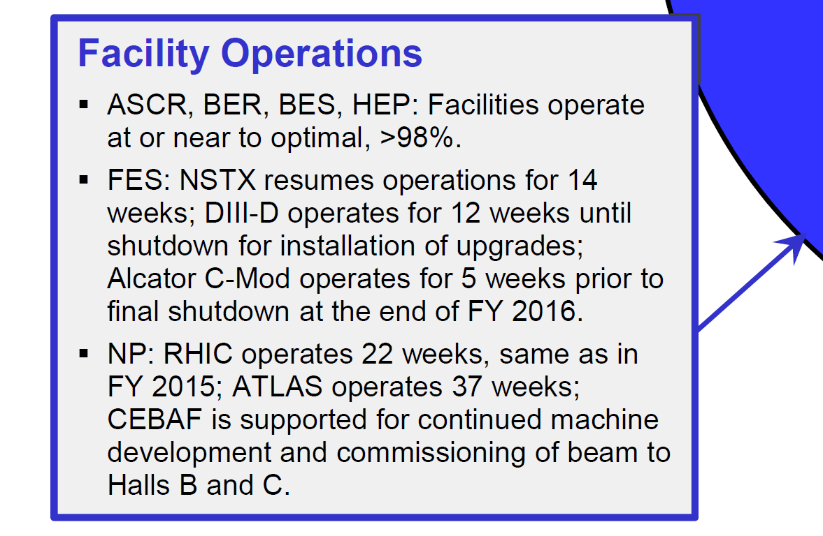
FY 2016 SC Budget Request by Category
Dollars in Thousands

Slide 7
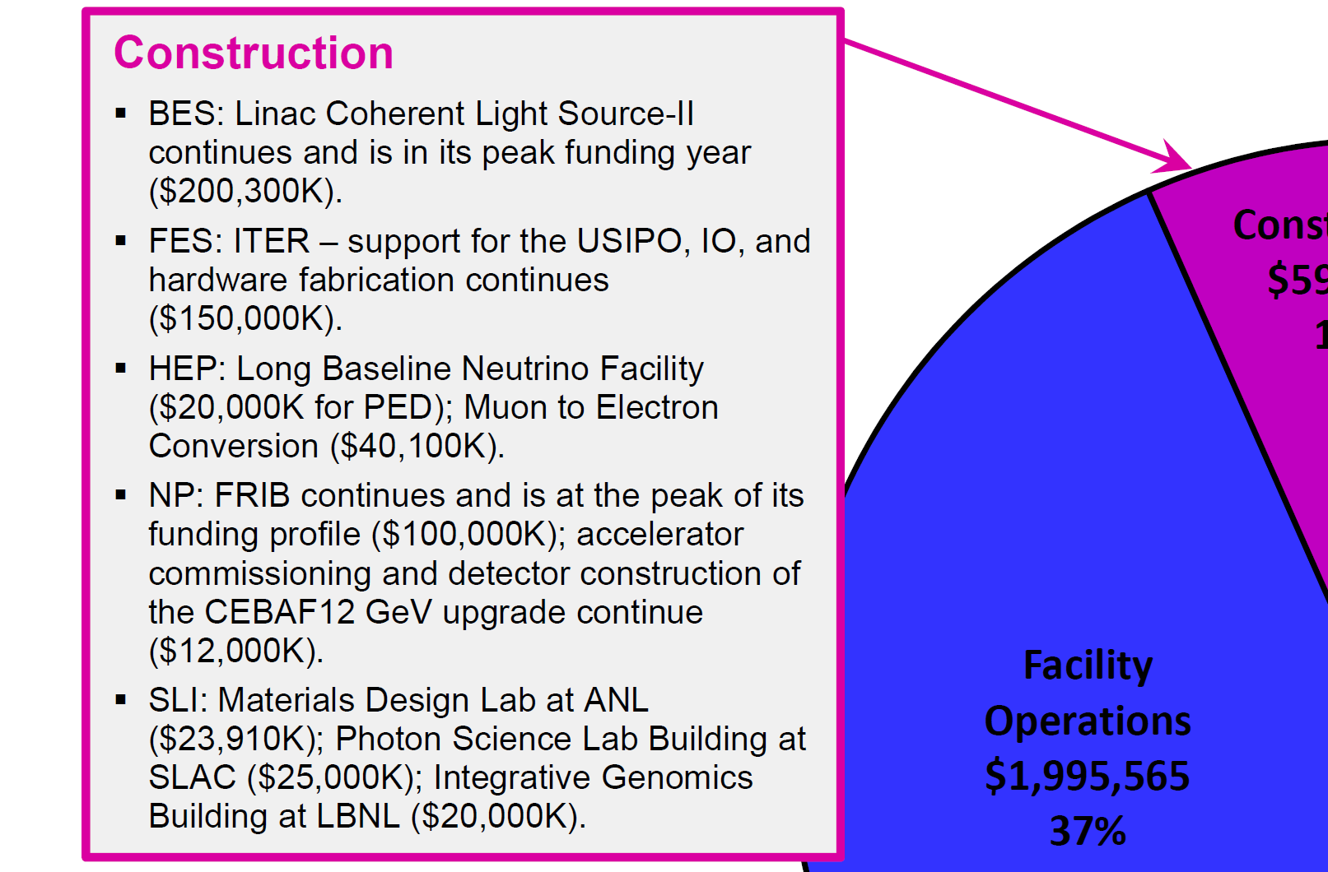
FY 2016 SC Budget Request by Category
Dollars in Thousands

Slide 8
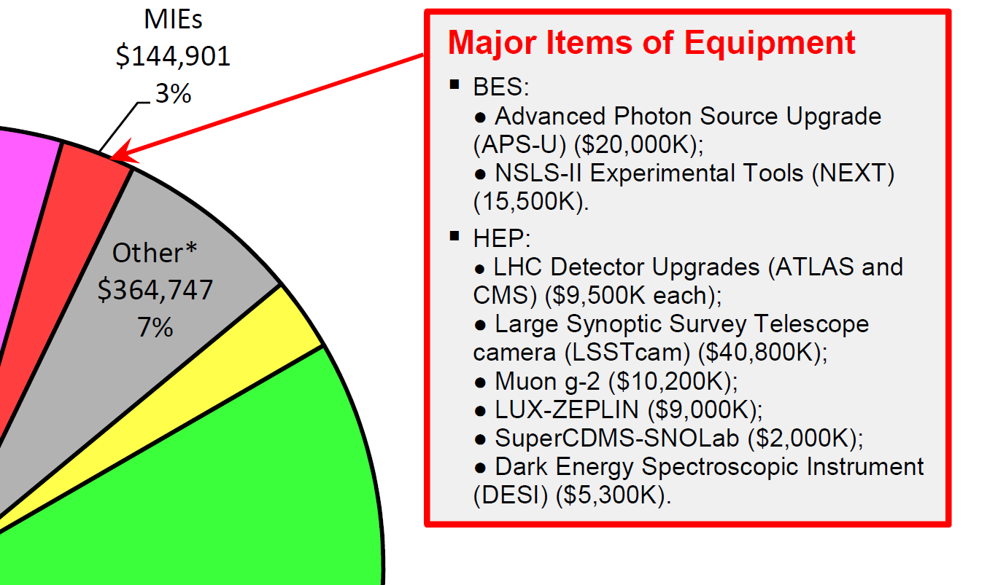
FY 2016 SC Budget Request by Category
Dollars in Thousands

Slide 9
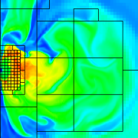
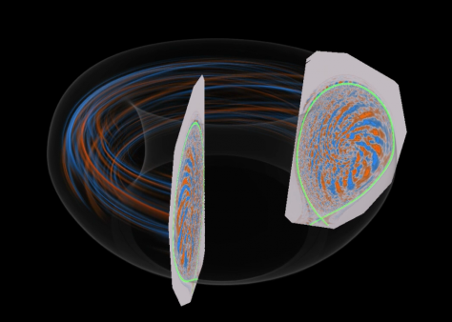
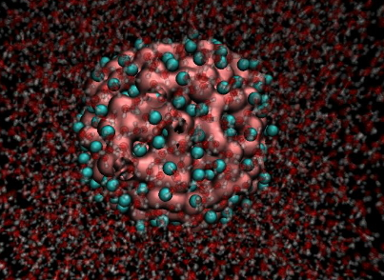
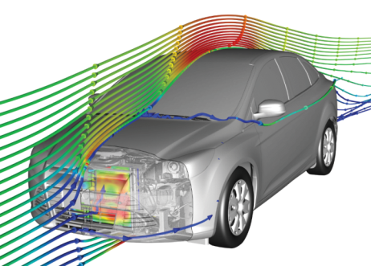
Advanced Scientific Computing Research
Computational and networking capabilities to extend the frontiers of science and technology
Exascale computing – (Exascale Crosscut: FY 2015 = $91,000K; FY 2016 = $177,894K; Δ = +$86,894K) Exascale crosscut includes engagement with HPC vendors to design and develop exascale node technologies and exascale hardware and software computer designs at the system level (Δ = +$69,000K); hardware architectures and system software; programming for energy-efficient, data-intensive applications.
Facilities operate optimally and with >90% availability; deployment of 10-40 petaflop upgrade at NERSC and continued preparations for 75-200 petaflop upgrades at the Leadership Computing Facilities.
SciDAC partnerships continue to accelerate progress in scientific computing.
The Computational Science Graduate Fellowship is restored at $10,000K to fully fund a new cohort.
Mathematics research addresses challenges of increasing complexity and Computer science research addresses productivity and integrity of HPC systems and simulations, and supports data management, analysis, and visualization techniques.

Slide 10
Path Toward Exascale in FY 2016
High Performance Computing and Network Facilities
  Next Generation Computing Platforms: Initiate integrated design efforts for computing environments, ranging from application workflow to hardware architecture and system software; establish partnerships with high-performance computer vendors, to design and develop exascale node and system architectures that will achieve the exascale computing initiative goals.
Mathematical, Computational, and Computer Sciences Research
  Applied Mathematics: Initiate research addressing predictive simulation for DOE mission applications, in exascale computing environments. This research aims to produce scalable, resilient models, algorithms and numerical libraries for analysis and uncertainty quantification.
  Exascale Software Environment: Initiate research addressing programming environments that encompass languages, compilers, runtime systems, and libraries, and serve as a bridge from high-level algorithms to lower-level hardware and operating-system platforms.
  Co-Design: Continue Co-design efforts, which provide the over-arching framework used to evaluate exascale options. Co-design efforts investigate a diverse set of technical areas, including architecture aware algorithms, programming models, system software, hardware architectures, resiliency, and power management.

Slide 11
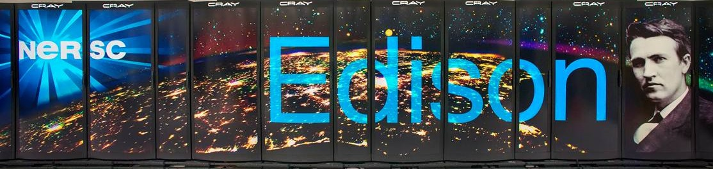
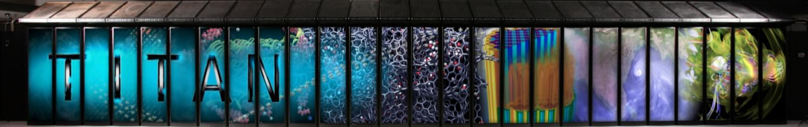
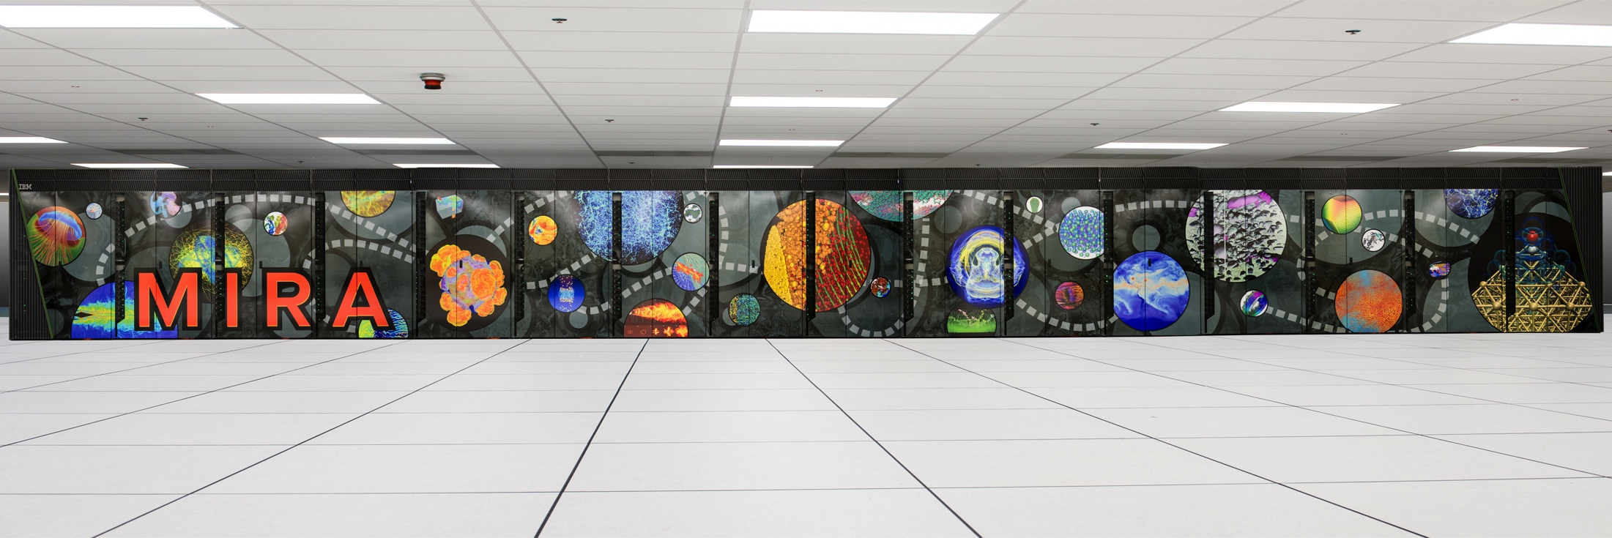
ASCR Production and Leadership Computing Facilities
Edison XC30: Peak performance 2.4 Pf
Titan: Peak performance 27.1 Pf
Mira: Peak performance 10 Pf

Slide 12
ASCR Computing Upgrades at a Glance
System attributes | NERSC Now | OLCF Now | ALCF Now | NERSC Upgrade | OLCF Upgrade | ALCF Upgrade
Name/Planned Installation | Edison | TITAN | MIRA | Cori 2016 | Summit 2017-2018 | Aurora 2018-2019
System peak (PF) | 2.4 | 27 | 10 | >30 | 150 | >150
Peak Power (MW) | 3 | 8.2 | 4.8 | <3.7 | 10 | ~13
System memory per node | 64 GB | 38 GB | 16 GB | 64-128 GB DDR4 16 GB High Bandwidth | > 512 GB (High Bandwidth memory and DDR4) | TBA
Node performance (TF) | 0.460 | 1.452 | 0.204 | >3 | >40 | >15 times Mira
Node processors | Intel Ivy Bridge | AMD Opteron Nvidia Kepler | 64-bit PowerPC A2 | Intel Knights Landing many core CPUs Intel Haswell CPU in data partition | Multiple IBM Power9 CPUs & mulitple Nvidia Voltas GPUS | TBA
System size (nodes) | 5,200 nodes | 18,688 nodes | 49,152 | 9,300 nodes 1,900 nodes in data partition | ~3,500 nodes | ~50,000 nodes
System Interconnect | Aries | Gemini | 5D Torus | Aries | Dual Rail EDR-IB | TBA
File System | 17.6 PB, 168 GBs, Lustre® | 32 PB, 1 TB/s, Lustre® | GPFS™ | 28 PB, 744 GB/sec , Lustre® | 120 PB, 1 TB/s, GPFS™ | TBA

Slide 13

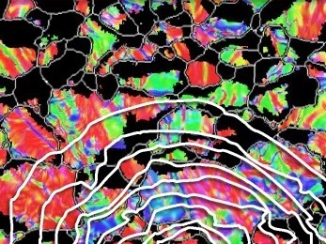
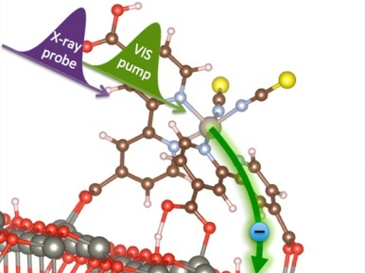
Basic Energy Sciences
Understanding, predicting, and controlling matter and energy at the electronic, atomic, and molecular levels
Increased funding for additional Energy Frontier Research Centers (EFRCs) (Δ = +$10,000K)
Increased funding for computational materials sciences research to expand technical breadth of code development for design of functional materials (Δ = +$4,000K)
New funding for mid-scale instrumentation for ultrafast electron scattering (Δ = +$5,000K)
Energy Innovation Hubs:
      Joint Center for Energy Storage Research (JCESR) will be in its 4th year.
      (FY 15 = $24,175K; FY 2016 = $24,137K)
      Joint Center for Artificial Photosynthesis (JCAP) is under review for renewal starting in September 2015. (FY 2015 = $15,000K; FY 2016 = $15,000K)
National Synchrotron Light Source-II (NSLS-II) begins its 1st full year of operations.
Linac Coherent Light Source-II (LCLS-II) construction continues.
BES user facilities operate at near optimum levels (~99% of optimal).
Two major items of equipment: NSLS-II Experimental Tools (NEXT) and Advanced Photon Source Upgrade (APS-U) are underway.

Slide 14
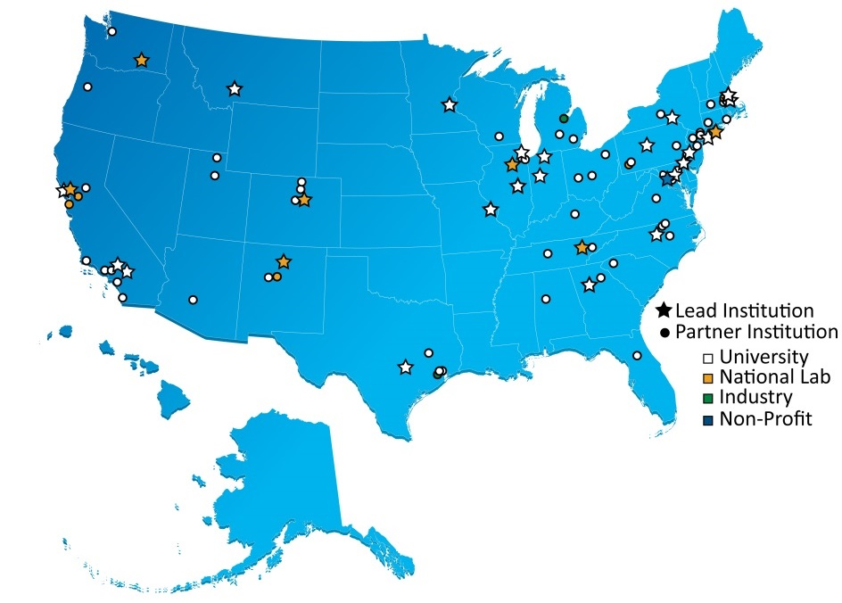
Energy Frontier Research Centers, 2009 - present
FY 2009 46 EFRCs were launched
$777M for 5 years, $100M/year base + $277M ARRA
FY 2014 Recompetition Results
    $100M/year base
    32 EFRCs in 32 States + Washington D.C.
      (22 renewals+ 10 new)
    Each $2-4M/yr for up to 4 years
    Led by 23 Universities, 8 DOE Labs, and 1 non-profit
    ~525 senior investigators and ~900 students,
    postdoctoral fellows, and technical staff at ~100 institutions
  FY 2015 – FY 2016 Review and Management Plan
    Management review of new centers in FY 2015.
    Full mid-term progress review for all centers in FY 2016, with funding for final two years contingent upon review outcome.
    FY 2016 Funding and New Solicitation
    Funding for EFRCs increases $10,000K (FY 2015 = $100,000K; FY 2016 = $110,000K).
    Call for new EFRC proposals with topical areas that complement current portfolio and that are informed by new community workshops.
    The EFRC program will transition to a biennial solicitation cycle starting in FY 2016.

Slide 15

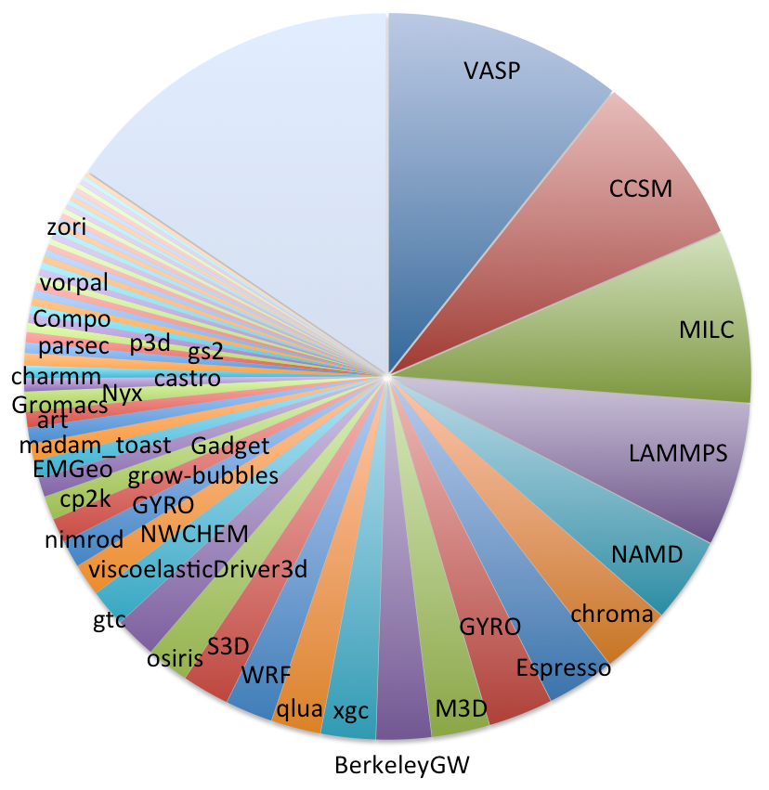


Increase for Computational Materials Sciences
  Funding
  FY 2015 included $8,000K for new awards. FOA announced January 26, 2015, for proposals to study functional materials; 4-year awards to be funded at $2,000-4,000K per year.
  FY 2016 Request of $12,000K will continue support for the FY 2015 awards and will fund additional awards to broaden the technical scope of the research.
Why computational materials sciences? The U.S. trails competitors in computational codes for materials discovery and engineering
At NERSC, the most used code is VASP, a commercial Austrian atomic scale materials modeling code requiring purchase of license.
(Quantum) Espresso, a popular materials modeling code, was developed by Italy.
Top codes for other fields used at NERSC were developed in the U.S. and are all free, community codes.
Atomic Scale Materials Modeling
Climate
QCD Physics
Molecular Dynamics
Biophysics
QCD Physics
Plasma Physics
Atomic Scale Materials
Modeling
Atomic Scale Materials Modeling
2013 Top Application Codes at NERSC
15

Slide 16
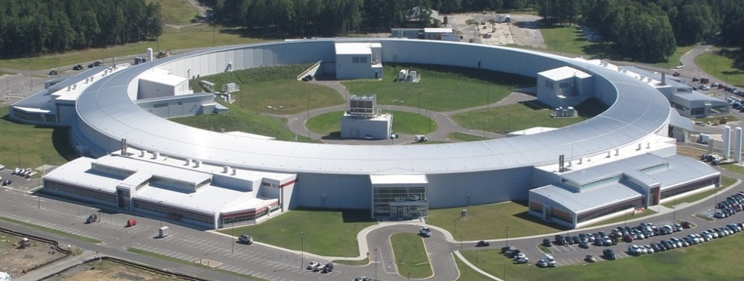
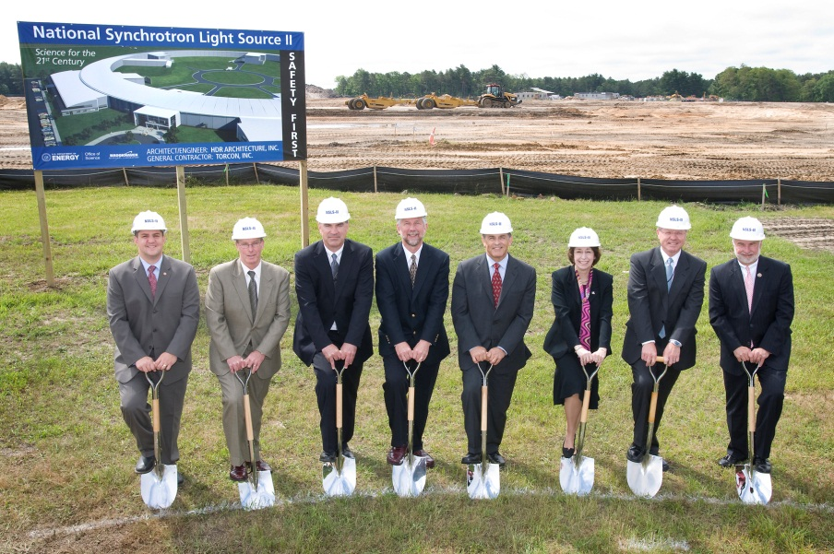
National Synchrotron Light Source II
Successfully completed on time and within budget
June 15, 2009
National Synchrotron Light Source-II (NSLS-II)
First light was achieved on Oct 23, 2014. Six project beamlines were approved for commissioning by Oct 31, 2014. All key performance parameters and project scope were delivered by December 2014.
NSLS-II provides over 600k square feet of space to house the 3 GeV storage ring and
5 lab and office buildings. The ring will be capable of 500 mA operation.
NSLS operations ceased September 30, 2014, and it will transition to safe storage in
FY 2015. NSLS-II FY 2015 operations is $90.4M. FY 2016 request includes operations funding of $110,000K.
16

Slide 17
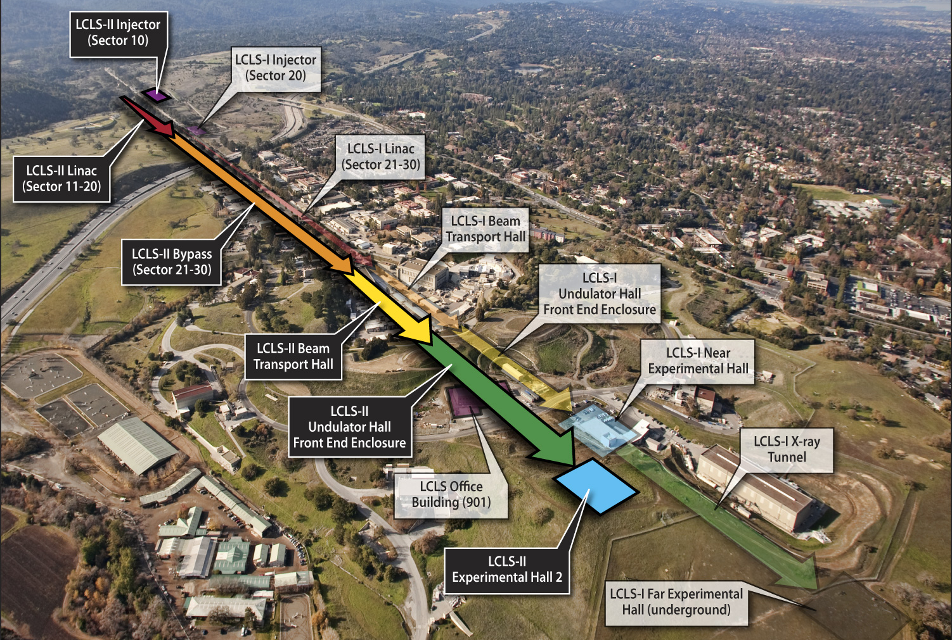
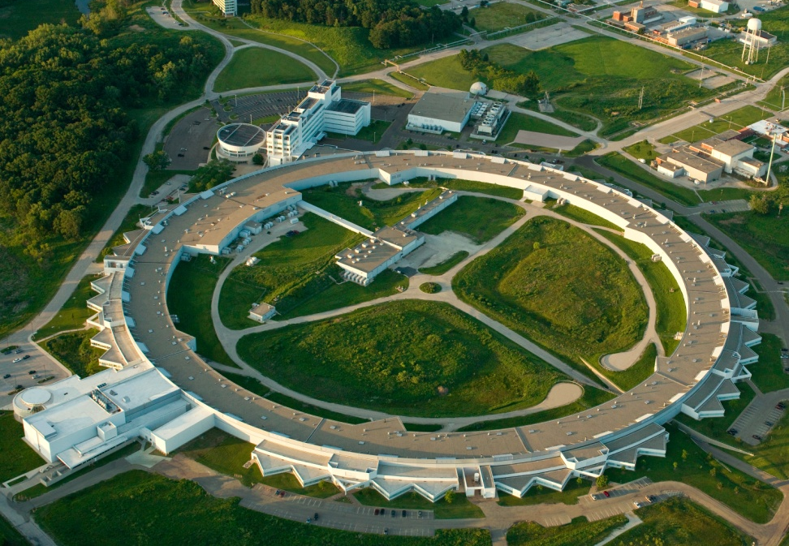
LCLS-II and APS-U Underway
Linac Coherent Light Source-II (LCLS-II)
FY 2015 = $148,000K; FY 2016 = $200,300K for R&D, design, prototyping, long lead procurement, and construction of technical systems.
LCLS-II will provide high-repetition-rate, ultra-bright, transform-limited, femtosecond x-ray pulses with polarization control and pulse length control to ~1 femtosecond. The hard x-ray range will be expanded to 25 keV.
Added are a 4 GeV superconducting linac; an electron injector; and two undulators to provide x-rays in the 0.2–5 keV energy range.
Advanced Photon Source Upgrade (APS-U)
FY 2015 = $20,000K; FY 2016 = $20,000K for R&D, design, and limited prototyping.
APS-U will provide a multi-bend achromat lattice to provide extreme transverse coherence and extreme brightness.
Initial conceptual design for the new lattice completed; conducting R&D and key component prototyping in support of the new design. Key performance parameters are being defined for the project and the new storage ring.
17

Slide 18
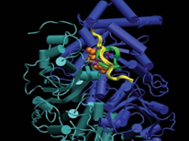
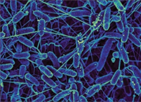

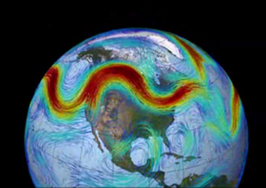
Biological and Environmental Research
Understanding complex biological, climatic, and environmental systems
Genomic sciences supports the Bioenergy Research Centers and increases efforts in biosystems design for bioenergy and renewable bioproducts (Δ = +$2,145K).
Mesoscale-to-molecules research supports the development of enabling technology to visualize key metabolic processes in plant and microbial cells at the subcellular and mesoscale.
Climate and Earth System Modeling develops physical, chemical, and biological model components to simulate climate variability and change at regional and global scales. (Δ = +$11,763K).
A new activity in Climate Model Development and Validation combines code development and numerical methods with ARM data to design an Earth system model with sub-10 km resolution for use on next generation and exascale computers. (Δ = +$18,730K).
Atmospheric System Research (ASR) addresses major uncertainties in climate change models: the role of clouds and the effects of aerosols on precipitation, and the atmospheric radiation balance.
Environmental System Science supports research to provide a robust, predictive understanding of terrestrial surface and subsurface ecosystems. Includes Next Generation Ecosystem Experiments targeting climatically sensitive terrestrial ecosystems not well represented in models.
Climate and Environmental Data Analysis and Visualization employs server side analysis to simplify analysis of large scale observations with model-generated data. (Δ = +$2,066K).
User facilities operate at optimal levels: ARM continues measurements at fixed sites, and mobile facilities deploy to the Arctic, Antarctic, and the Pacific Ocean. JGI provides genome sequence data, synthesis, and analysis. EMSL initiates work using the High Resolution and Mass Accuracy Capability.
18

Slide 19
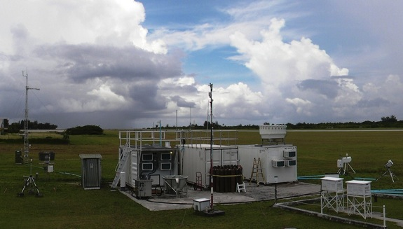
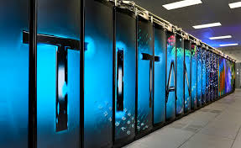
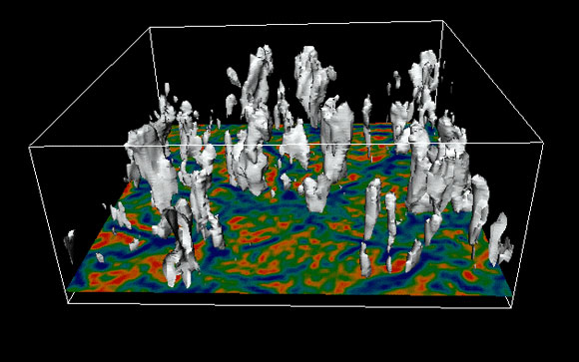
Climate Model Development and Validation
Model capabilities today
Global and regional simulations to 50 km resolution in full integration mode; to 25 km with limited integration. Unable to adequately represent extreme events, important to DOE and energy infrastructure.
No standard uncertainty quantification methodology applied to climate predictions. Improved confidence in predictions is needed by scientists and stakeholders.
No common software infrastructure strategy in climate modeling community. Current climate models will be unable to exploit DOE’s next generation exascale computer architectures.
FY 2016 Research Efforts
Combine major upgrades in advanced software code development, downscaling methodologies, and validation against testbeds for sites in U.S. (Oklahoma, Alaska) using the Atmospheric Radiation Measurement Climate User Facility (ARM)
Develop scale-aware physics appropriate for very high resolution phenomena extending 10 km to below 1 km.
Integrate scale-aware physics into improved climate modeling codes for use on next generation and exascale computers.
ARM Oklahoma
Best-in-class software and hardware
First modeling of high-res extreme phenomena with Uncertainty Quantification methodologies
19

Slide 20
DOE’s Role in Climate Science Research
SC relies on unique facilities and long term observing capabilities, most hosted or managed by DOE national laboratories, to collect and analyze data to understand climate processes. These facilities are:
  The Atmospheric Radiation Measurement (ARM) Climate Research Facility, to understand cloud-aerosol-precipitation interactions with the earth’s radiant energy balance
  Next Generation Ecosystem Experiments (NGEE), to explore ecological, biogeochemical, and soil process interactions
  Ameriflux, to measure ecosystem carbon, water, and energy fluxes to support environmental research
  Data from ARM, NGEE, and Ameriflux are coordinated under a DOE data informatics capability, enabling efficient use and integration by the scientific community
  The petascale Leadership Computing Facilities at ORNL and ANL, to understand earth and environmental system process interactions based on synthesis of complex data sets
SC grand science challenges that frame priorities include:
  Atmospheric and terrestrial process level interactions, in particular cloud, aerosol, ecological, hydrological, and biological processes that affect the earth’s energy balance at various scales
  Understanding processes that control internal climate variability and extremes
  Understanding uncertainty of the climate system
  DOE is a leader in climate science and has been since the 1950s, when the AEC was charged with understanding atmospheric transport for national security and, later, the impacts of CO₂. Today, DOE coordinates with other agencies through collaborative partnerships and through the U.S. Global Change Research Program.
20

Slide 21
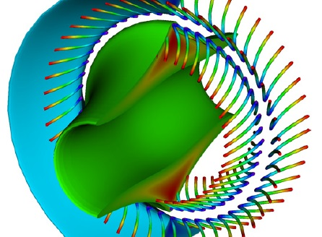
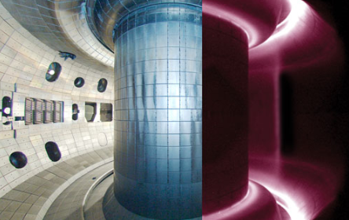
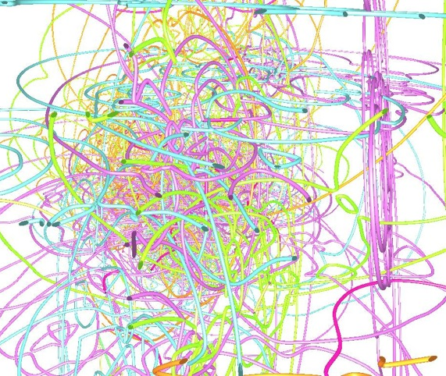
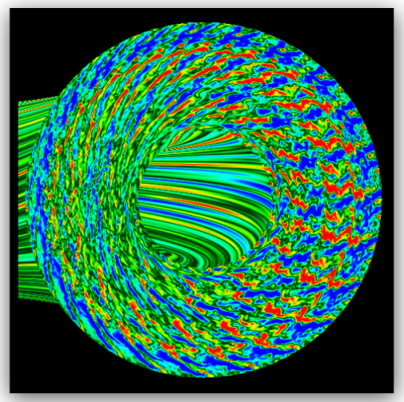
Fusion Energy Sciences
Matter at very high temperatures and densities and the scientific foundations for fusion
Research is supported for the DIII-D and NSTX-U national programs.
NSTX-U operates for 14 weeks; DIII-D operates for 12 weeks; and Alcator C-Mod operates for 5 weeks prior to facility close-out at the end of FY 2016.
Support continues for U.S. research involvement on international machines EAST (China), KSTAR (Korea), and W7-X (Germany).
HEDLP research is focused on the MEC instrument at LCLS.
General plasma science activities continue, including the partnership with NSF.
U.S. contributions to ITER support U.S. ITER Project Office; the US direct contribution; and progress on hardware contributions, including fabrication of the central solenoid magnet modules and structures and the toroidal field magnet conductor.
Gyrokinetic simulation of turbulent transport in
tokamak plasma
Magnetic reconnection on
Swarthmore spheromak
Interior of DIII-D tokamak
Dislocation loops forming and moving inside fusion materials
21

Slide 22
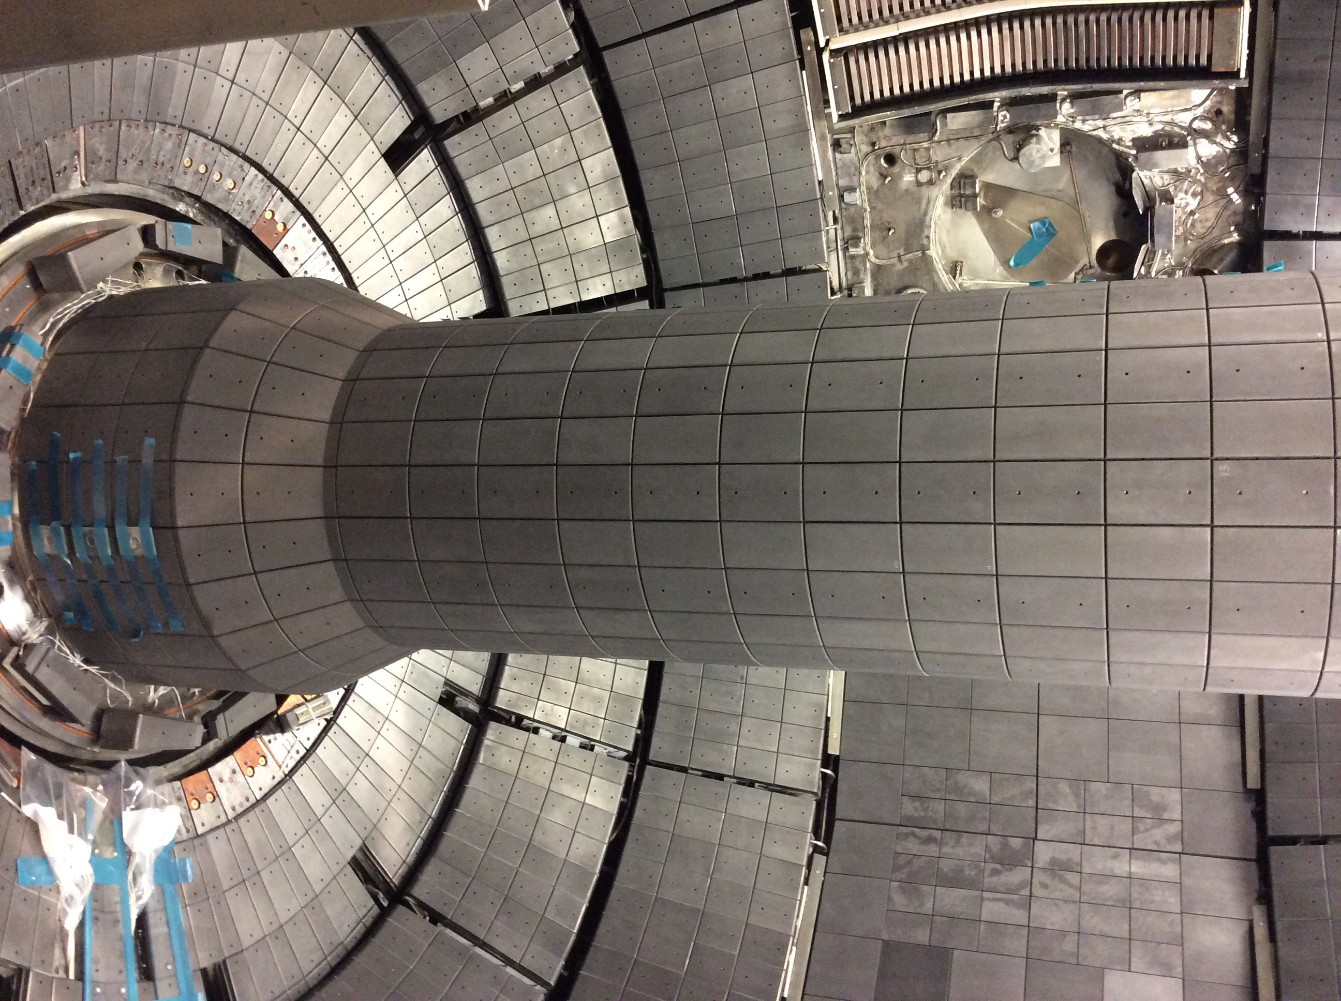
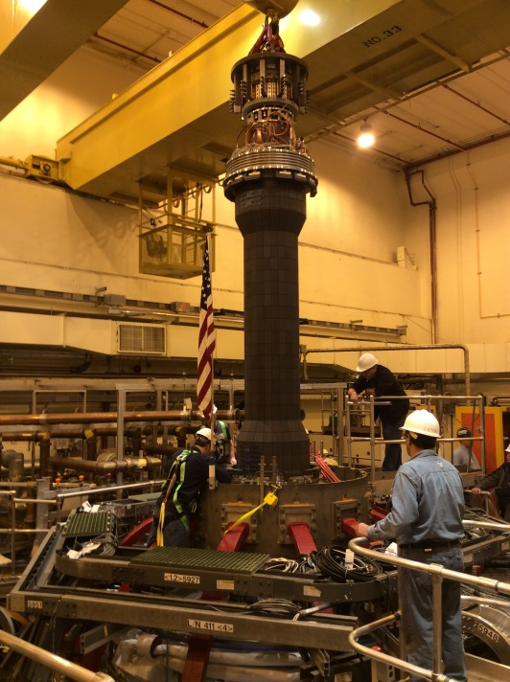
NSTX Upgrade at PPPL
FY 2016 is the first full year of operation of NSTX-U after completion of the multi-year upgrade construction project in mid-FY 2015.
Funding will allow 14 weeks of run time (up 4 weeks from the FY 2015 Enacted level).
NSTX-U will extend its performance to the new full field and current values (both double what had been achieved prior to the upgrade) and address divertor heat flux mitigation, enhanced plasma confinement, and non-inductive discharge sustainment.
In mid-FY 2016, a shutdown is planned for installation of a cryopump in the lower divertor and a row of tungsten tiles on the cryo-baffle.

Slide 23
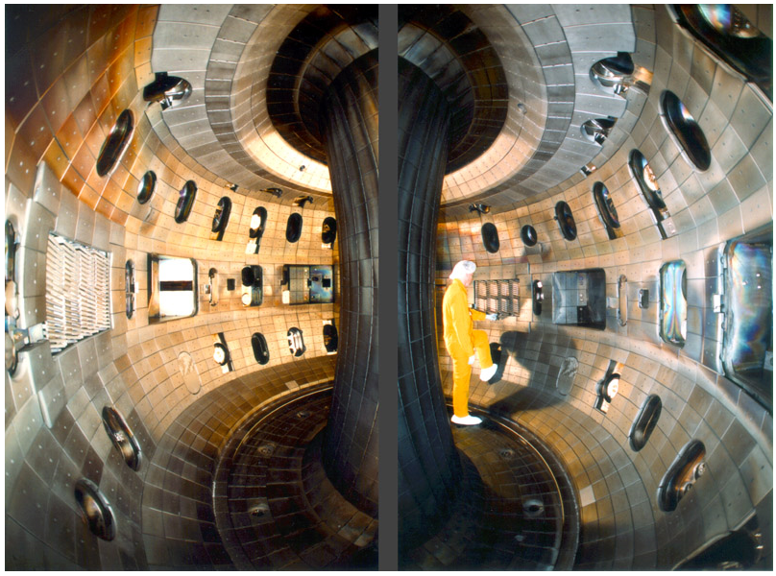
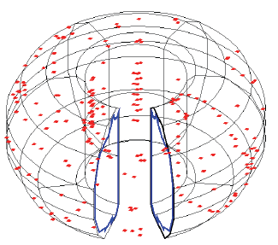
DIII-D and its Upgrades at General Atomics
Red dots are sensors on DIII-D tokamak
for three-dimensional magnetic field
structure measurements
Interior of DIII-D vacuum vessel
DIII-D will continue high-priority studies of transport, disruption physics and mitigation systems, methods to exploit three-dimensional magnetic field control for improved performance, and high plasma pressure operation.
After 12 run weeks, DIII-D will have a planned outage for installation of upgrades, including an additional high-power microwave heating system, new magnet power supplies for the 3D coils and shaping coils, and improvements to the neutral beam heating control system. Also, design modifications necessary for a second off-axis neutral beam will begin.

Slide 24
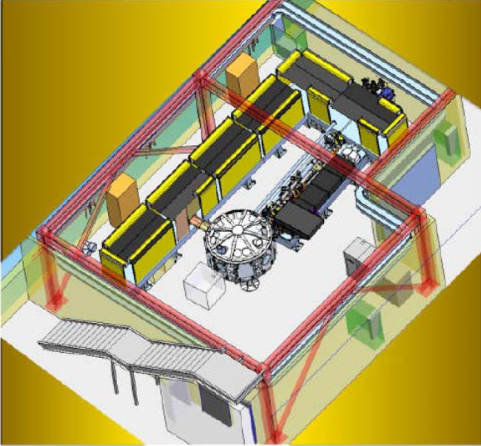
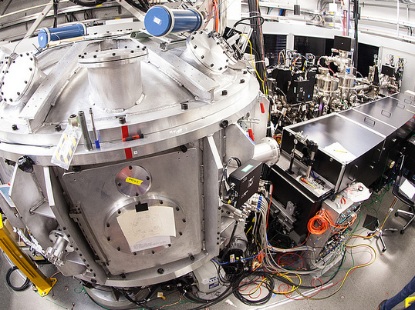
Matter at Extreme Conditions (MEC) End Station at LCLS
MEC provides access to high-energy-density regimes, uniquely coupled with the LCLS high-brightness x-ray source.
This enables experiments at the frontier of high energy density physics, laboratory astrophysics, laser-particle acceleration, and nonlinear optical science.
The MEC instrument combines the LCLS beam with high power optical laser beams and a suite of dedicated diagnostics (including an X-ray Thomson scattering spectrometer, an XUV spectrometer, a Fourier domain interferometer, and a VISAR system).
The large vacuum target chamber provides a versatile environment for key scientific areas including Warm Dense Matter physics, high pressure studies, shock physics, and high energy density physics.

Slide 25
Community Engagement Workshops
Following the Fusion Energy Sciences Advisory Committee (FESAC) Strategic Planning and Priorities Report (2014), FES will undertake a series of four technical workshops in May-June 2015. Workshop topics address the main recommendations of the FESAC report.
  Workshop on Integrated Simulations for Magnetic Fusion Energy Sciences
  Workshop on Transients
  Workshop on Plasma Science Frontiers
  Workshop on Plasma-Materials Interaction
Each workshop will deliver a written report prepared by its steering committee (a group of community scientists selected for topical expertise who will lead/participate in the workshop). The reports will address scientific challenges and potential implementation options.

Slide 26
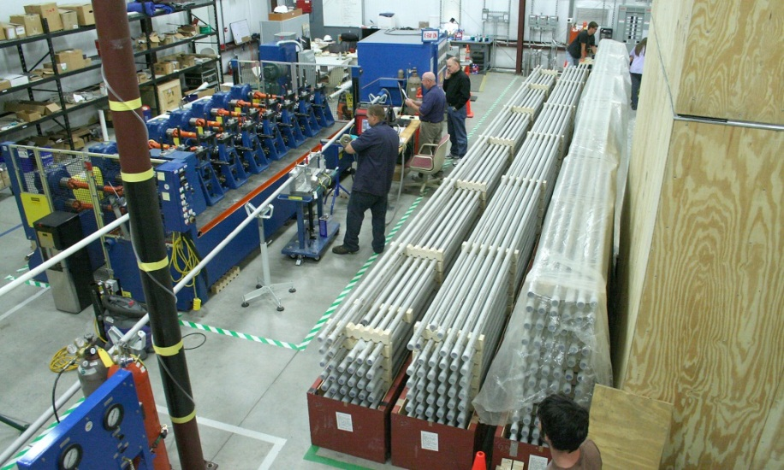
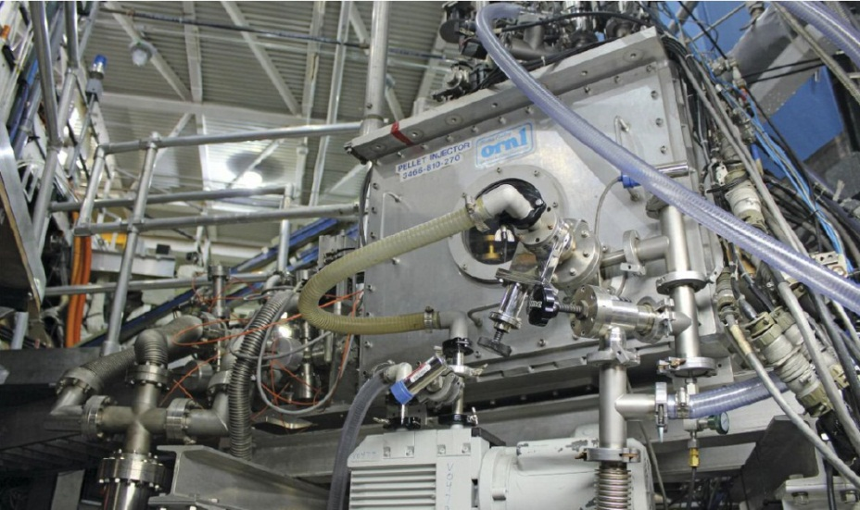
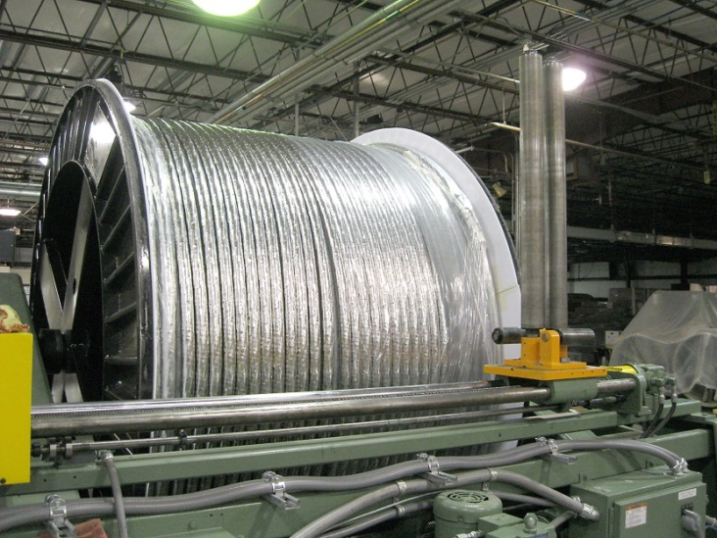
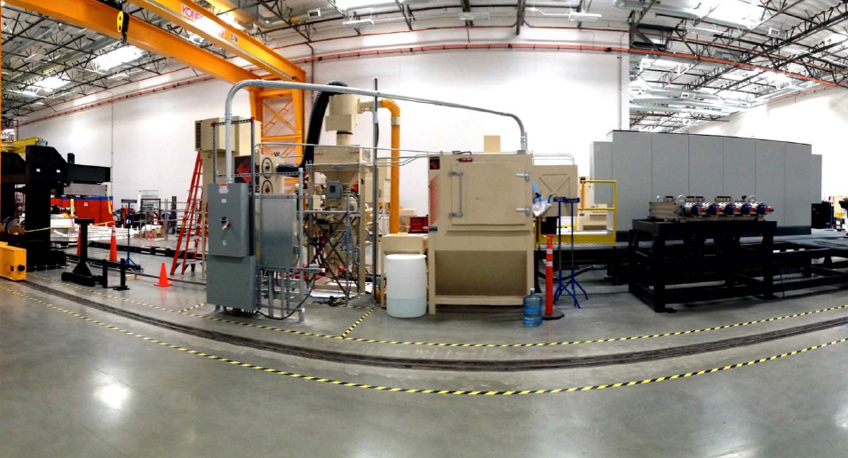
U.S. Fabrication of ITER Hardware Progressing
Toroidal field conductor jacketing at High
Performance Magnetics (Tallahassee, FL)
Pellet injector to feed ITER with frozen fuel pellets,
developed by ORNL (Oak Ridge, TN)
Toroidal field cable produced at New England Wire Technologies (Lisbon, NH)
Installation of the first winding station for the central solenoid at General Atomics (San Diego, CA)

Slide 27
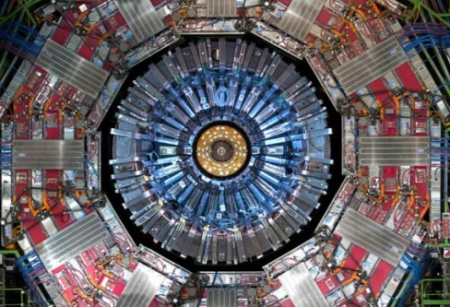
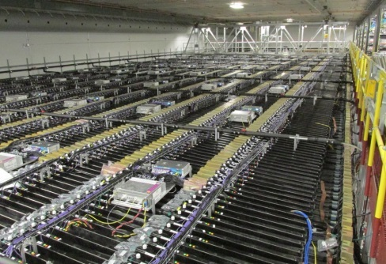
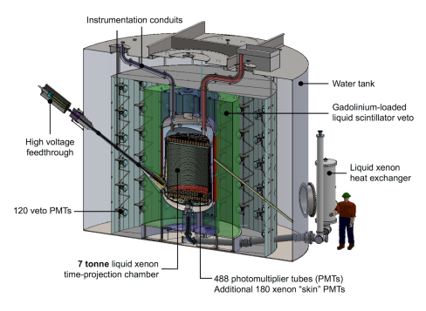
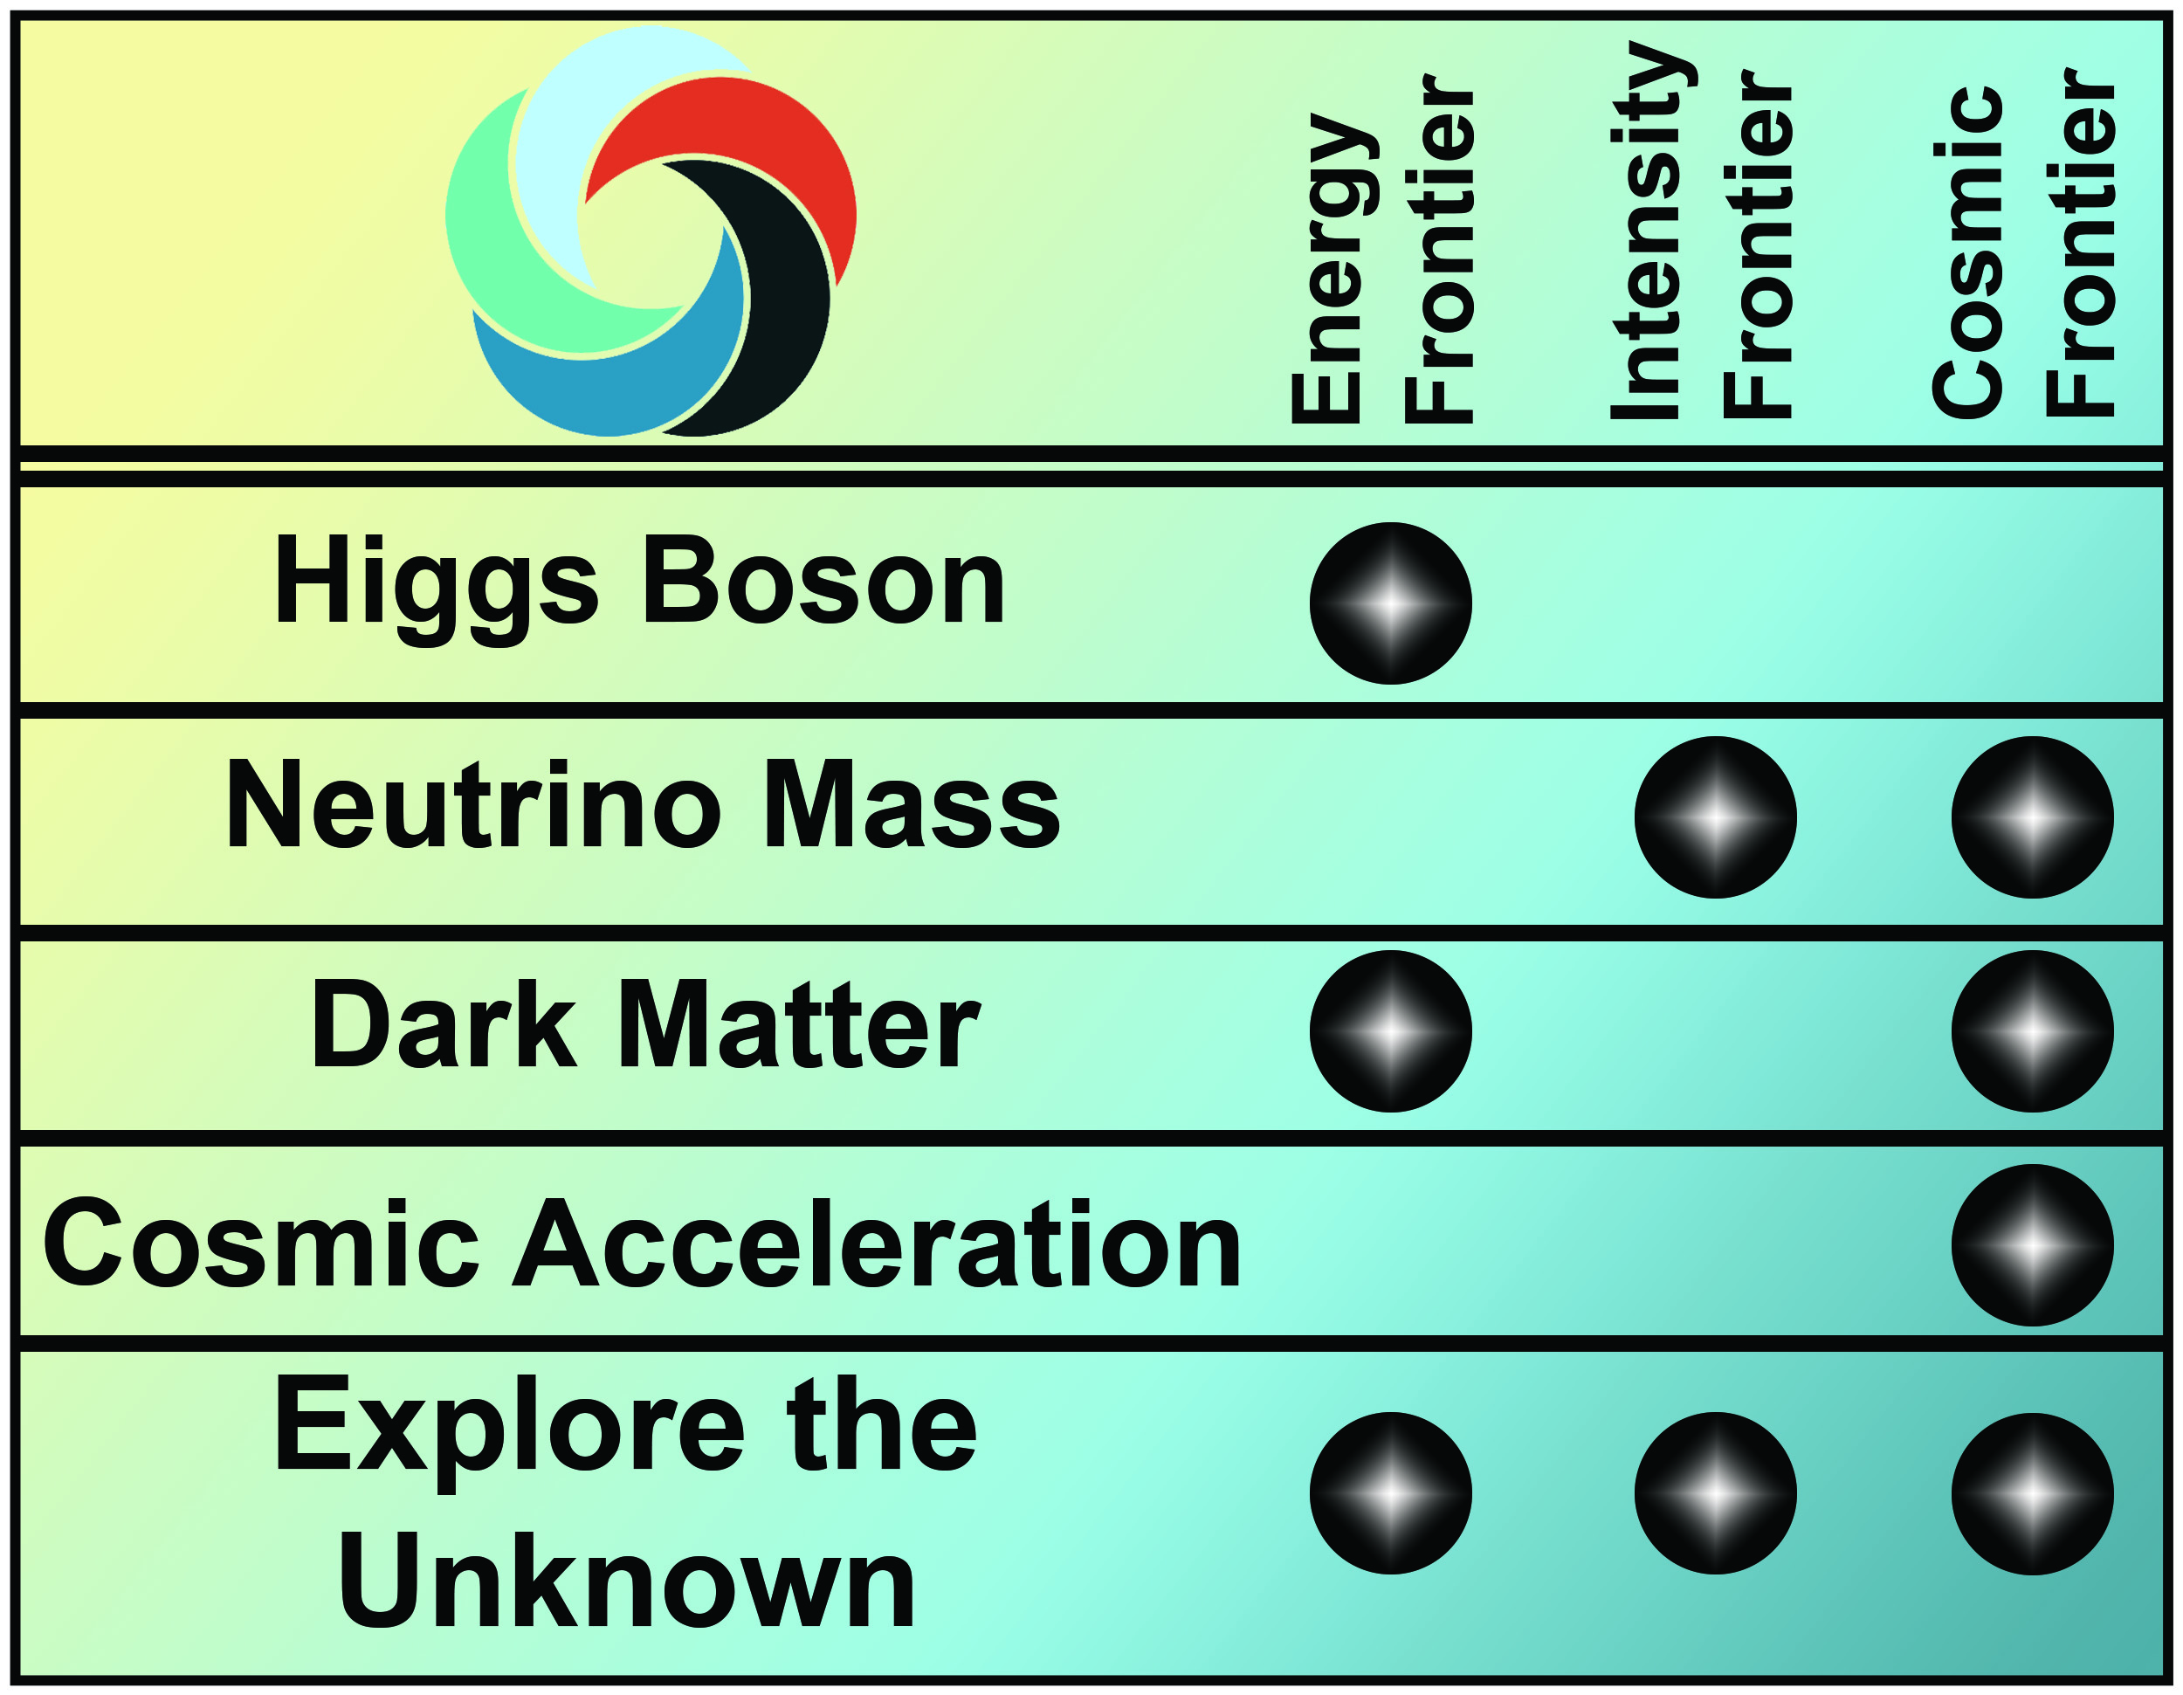

High Energy Physics
Understanding how the universe works at its most fundamental level
HEP is implementing the strategy detailed in the May 2014 report of the Particle Physics Project Prioritization Panel (P5), formulated in the context of a global vision for the field
  HEP Addresses the five compelling science drivers with research in three frontiers and related efforts in theory, computing and advanced technology R&D
  Increasing emphasis on international partnerships (such as LHC) to achieve critical physics goals
Energy Frontier: Continue LHC program with higher collision energy (13+ TeV)
  The U.S. will continue to play a leadership role in LHC discoveries by remaining actively engaged in LHC data analysis and the initial upgrades to the ATLAS and CMS detectors
Intensity Frontier: Develop a world-class U.S.-hosted Long Baseline Neutrino Facility
  Continue the design process for an internationalized LBNF and development of a short baseline neutrino program that will support the science and R&D required to ensure LBNF success
  Fermilab will continue to send world’s highest intensity neutrino beam to NOvA, 500 miles away
Cosmic Frontier: Advance our understanding of dark matter and dark energy
  Immediate development of new capabilities continue in dark matter detection with baselining of 2nd-generation experiments; and in dark energy exploration with baselining of DESI and fabrication of LSST camera.
Energy Frontier
CMS
Intensity Frontier
NOvA
Cosmic Frontier
LZ

Slide 28
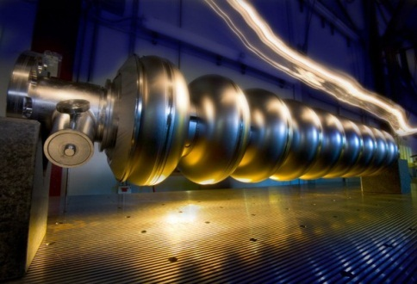
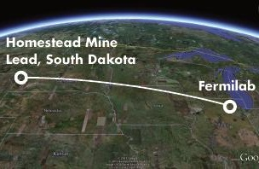
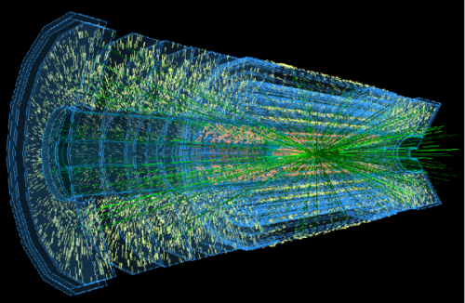
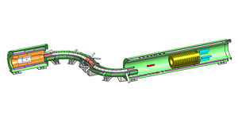
High Energy Physics
Understanding how the universe works at its most fundamental level
Accelerator Stewardship
  This subprogram focuses on the broader applications of accelerator technologies, including major thrusts in technology to enable ion-beam cancer therapy and R&D for high-power ultrafast lasers
  The FY 2016 Budget Request provides support for a new research thrust in energy and environmental applications of accelerators and expands the open test facilities effort
  The main facility supporting this subprogram, the Brookhaven Accelerator Test Facility (ATF), will undergo relocation at BNL and expansion in FY 2016 to accommodate more users
Construction/Major Items of Equipment (MIEs) reflect P5 priorities:
  The Long Baseline Neutrino Facility (LBNF) continues its design phase as the project baseline cost and technical scope are revised while incorporating international in-kind contributions
  The LHC ATLAS and CMS Detector Upgrade projects continue fabrication
  Muon g-2 continues accelerator modifications and fabrication of the beamline and detectors
  LSSTcam fabrication support increases according to planned profile
  Dark Energy Spectroscopic Instrument (DESI) will be baselined in 2016
  Fabrication proceeds on the dark matter experiment MIEs: SuperCDMS-SNOLab and LZ
  Construction continues for the Muon to Electron Conversion Experiment (Mu2e)
Accelerator
Stewardship
Mu2e
LBNF
LHC Upgrades

Slide 29



LHC – a Central Component of the Energy Frontier Program
U.S. investments enable leading roles in the global LHC physics collaborations
P5 report identified LHC upgrades as the highest priority near-term large project and specifically recommends:
  Complete in 2018 modest upgrades of ATLAS and CMS experiments to maintain performance.
  Continue collaborations with the High-Luminosity LHC (HL-LHC) upgrades of the accelerator and the ATLAS and CMS experiments (2023-25)
    HL-LHC upgrades will increase LHC luminosity by a factor of 10 beyond its design value and significantly extend discovery potential
U.S. leadership in superconducting magnet technology in general, and with Nb₃Sn in particular, is widely recognized and acknowledged
  U.S. LHC Accelerator Research Program (LARP) aims to leverage this expertise to serve needs of HEP community
ATLAS
CMS
Nb₃Sn Quadrupole Magnet

Slide 30



Short- and Long-baseline Neutrino Experiments at Fermilab
NOvA taking data using the world’s most powerful neutrino beam and the world’s longest baseline
  World’s highest intensity neutrino beam sent 500 miles from Fermilab to Ash River, MN
  Project completed on time and under budget in September 2014
  Currently operating as part of the planned six-year run
MicroBooNE, a key first step in the Fermilab short baseline neutrino program, begins three year run in 2015
  Largest liquid argon based neutrino detector built in the U.S., at 170 tons of total liquid argon mass
  Important step in development of large-scale liquid argon technology for future Long Baseline Neutrino Facility detector

Slide 31



Long Baseline Neutrino Facility
800 mile LBNF Beamline
U.S.-hosted, world-class Long Baseline Neutrino Facility identified by P5 as “the highest-priority large project in its timeframe.”
Community, led by Fermilab, is continuing the design process for an internationalized LBNF, with current design featuring:
  New neutrino beam at Fermilab with over 1 megawatt of initial beam power
  800 mile distant large Liquid Argon Time Projection Chamber (LArTPC) detector deep underground at Homestake mine in Lead, SD
Neutrino production at Fermilab
LArTPC Detector

Slide 32




Investments in Dark Matter and Dark Energy
P5 recommended strong immediate investments into the second generation dark matter direct detection program
  FY 2015 MIEs, FY 2016 baselining for LUX-Zeplin (LZ) and SuperCDMS–SNOLab to collectively provide sensitivity to both low- and high-mass WIMPs
  Small-scale ADMX-Gen2 supported to perform complementary search for axions
  Program includes broad, coordinated R&D for future experiments
P5 encouraged support for the Dark Energy Spectroscopic
Instrument (DESI) as part of the dark energy program
  DESI has MIE start in 2015 and will be baselined in 2016
  Will provide spectroscopic complement to imaging-based LSST
SuperCDMS-SNOLab
Neutrino production at Fermilab
LZ
ADMX-Gen2
DESI

Slide 33




Nuclear Physics
Discovering, exploring, and understanding all forms of nuclear matter
      Funding for research increases in every NP subprogram to support high priority research areas, e.g., in nuclear structure, nuclear astrophysics, the study of matter at extreme conditions, hadronic physics, fundamental properties of the neutron, and neutrinoless double beta decay. (Increase = +$13,483K or 8.1%)
Research at RHIC capitalizes on record luminosity and new capabilities to probe the perfect Quark-Gluon liquid. The FY 2014 run commissioned the Heavy Flavor Tracker, (new microvertex detector); the FY 2015 run will generate baseline data from proton+proton and proton+Au collisions; the FY 2016 run will generate the definitive Au+Au data to inform our understanding of the perfect liquid, discovered at RHIC in 2005.
The 12 GeV CEBAF Upgrade continues beam development and commissioning activities in preparation for project completion and the full start of the 12 GeV physics program in 2017.
Construction continues on the Facility for Rare Isotope Beams to provide unparalleled opportunity for research on nuclear structure and nuclear astrophysics.
Upgrades of the ATLAS ion source and Booster Cryomodule provide new scientific capability for understanding nuclear structure and the origin of the elements in the cosmos.
      Research, development, and production of stable and radioactive isotopes is provided for science, medicine, industry, and national security.

Slide 34


Relativistic Heavy Ion Collider
Record RHIC Luminosity Achieved
RHIC operates for 22 weeks, the same as FY 2015.
The FY 2016 run (Run-16) is essential to understand results on heavy quark propagation in the quark-gluon plasma discovered at RHIC.
The high statistics data planned for Run-16 will address these phenomena and are required for researchers to interpret the data acquired from the last two years.
Funds for experimental equipment, accelerator R&D, and materials and supplies are provided to optimize operations, maintenance, and support critical staff.
2014
Au + Au integrated luminosity from Run 14 exceeded all previous Au+ Au runs combined
New micro-vertex detector (Heavy Flavor Tracker) will detect particles containing charm and bottom quarks to characterize the quark-gluon plasma
34

Slide 35


The 12 GeV Upgrade at CEBAF
FY 2016 funding supports continued machine development and associated incremental power costs to support the 12 GeV research program, including engineering operations to Hall D and commissioning of newly installed hall equipment for physics running starting in FY 2017.
Major activities in FY 2016 will be developing beams for Halls B and C for commissioning activities.
Increased funding for commissioning the upgraded CEBAF facility is provided for operations and experimental support for staff, incremental power costs, and experimental equipment for Halls B, C, and D as the 12 GeV CEBAF experimental program is initiated.
35

Slide 36


Argonne Tandem Linac Accelerator System
FY 2016 funding supports 37 weeks of beam time and a program of upgrades for work in nuclear structure and astrophysics.
Continued operation of ATLAS in a 7 day per week mode is a high priority as demand for ATLAS beam time continues to far exceed availability.
Funding increases support of key personnel required to provide robust operations, implement new capabilities of the accelerator and support the increasing demand from the user community for a wider variety of beams.

Slide 37

Facility for Rare Isotope Beams
FRIB will increase the number of isotopes with known properties from ~2,000 observed over the last
century to ~5,000 and will provide
world-leading capabilities for
research on:
Nuclear Structure
  The limits of existence for nuclei
  Nuclei that have neutron skins
  Synthesis of super heavy elements
Nuclear Astrophysics
  The origin of the heavy elements and explosive nucleo-synthesis
  Composition of neutron star crusts
Fundamental Symmetries
  Tests of fundamental symmetries,
  Atomic EDMs, Weak Charge
  This research will provide the basis for a model of nuclei and how they interact.
Concrete for the floor of the target area was placed December 1-2. It took around 30 hours and 300 concrete trucks to place the 2,700 cubic yards of concrete. FRIB received Critical Decision 3B, Approval to Start Technical Construction, on August 26, 2014.

Slide 38

The DOE Isotope Program Managed by NP
Support continues for R&D competitive awards to universities and laboratories, as well as support to laboratory research groups at LANL, BNL, and ORNL.
Development of production techniques for alpha-emitting radionuclides for medical therapy continues to be a priority, implemented through collaborative R&D at the national laboratories, particularly at BNL, LANL, and ORNL.
Research at universities and national laboratories is supported for new isotope production technologies. Funding increases to enhance core research capabilities at the national laboratories and universities, and the program of competitive R&D, in order to address the high priorities especially with regard to the research to produce Ac-225, an isotope that shows great promise in the treatment of diffuse cancers and infections.
Maintains the infrastructure required to produce and supply isotope products and related services.
More than 225 customer orders and 470 shipments in FY 2013.

Slide 39




Workforce Development for Teachers and Scientists
Ensuring a pipeline of STEM workers to support the DOE mission
  At DOE labs and facilities, WDTS will support ~1,000 students and faculty
      750 Science Undergraduate Laboratory Interns (SULI) placed at one of 17 DOE labs or facilities
      70 Community College Interns (CCI)
      ~100 graduate students engaged in Ph.D. thesis research for 3-12 months at a DOE laboratory
      60 faculty and 25 students in the Visiting Faculty Program (VFP)
  Support for the National Science Bowl
    More than 20,000 students, coaches, and volunteers participate in the regional and final competitions.
    In FY 2015, there are 118 regional events, involving 14,000 students from all fifty states, the District of Columbia, Puerto Rico, and the U.S. Virgin Islands. WDTS brings the regional winners, the top 4% of the teams, to Washington, D.C. for the final competitions.
  Support for 6 Albert Einstein Distinguished Educator Fellows
  Support for on-line business systems modernization
  This activity modernizes on-line systems that are used to manage applications and their review, data collection, and evaluation for all WDTS programs.
  Support for program evaluation and assessment
  This activity will assess whether programs meet established goals using collection and analysis of data and other materials, such as pre- and post-participation questionnaires, participant deliverables, notable outcomes, and longitudinal participant tracking.

Slide 40

Visiting Faculty Participant (VFP) helps enable
new STEM programs at Alabama A&M University
Professor Egarievwe is a 3-time VFP participant at BNL, where he explored room temperature semiconductor nuclear detectors.
Based on this experience, he established the Nuclear Engineering and Radiological Science Center at Alabama A&M; graduate students have since completed M.S. and Ph.D. research projects.
He also developed research proposals, including a 5-year, $2 million grant from the Applied Research Initiative Program at the DHS’s Domestic Nuclear Detection Office.
In addition, the VFP program and collaboration with BNL helped the Electrical Engineering Technology and Mechanical Engineering Technology programs at Alabama A&M achieve full ABET accreditation. These efforts also led to the development and establishment of "Nuclear Systems" as a new concentration in Electrical Engineering and Mechanical Engineering programs at Alabama A&M.
Professor Stephen Egarievwe, Alabama A&M University, at BNL with his VFP student, Ariel Dowdy

Slide 41



Science Laboratories Infrastructure (SLI)
More than $600 million of line item investments on time, within budget since 2006
FY 2016 provides continued funding for:
Materials Design Laboratory (ANL) to house research in materials science and related disciplines.
Photon Science Laboratory Building (SLAC) to provide modern lab and office space for the expansion of SLAC’s photon science programs, using SSRL and LCLS-II.
Integrative Genomics Building (LBNL) to begin the consolidation of a significant fraction of the biosciences research currently now located in widely distributed commercially leased space.
Funding is also provided for:
General purpose infrastructure: electrical upgrades at SLAC and ANL and facility improvements at FNAL.
Continued funding of the New Brunswick Laboratory for infrastructure support and for transfer and shipment of material.
Nuclear operations support at ORNL.

Slide 42
Safeguards and Security
Supporting protection against unauthorized access, theft, or destruction of assets
The FY 2016 Request includes support for:
Maintaining adequate security for the special nuclear material housed in Building 3019 at the Oak Ridge National Laboratory.
Increasing cyber security investments to ensure the Cyber Security Program has the funds needed to defend against cyber security compromises, minimize future losses of protected information, and detect repeated attempts to access information technology assets critical to support the SC mission.
The CyberOne strategy—DOE’s solution for managing enterprise-wide cyber-security for incident response and identity management to mitigate the risk of intrusion.

Slide 43

Program Direction
The FY 2016 PD budget supports 945 FTEs
During the past 15 years, the ratio of the Program Direction budget to the SC appropriation has decreased from 4.4% to about 3.5% -- now the lowest ratio in DOE. This decrease has been accomplished through detailed analyses and execution of optimum staffing levels in both the SC Site Offices and the SC Headquarters program offices.
3.5%
4.4%
Ratio of SCPD funding to Total SC funding
Support for:
  Management of the Office of Science programs, facilities, and projects;
Business operations associated with portfolio management;
Office of Science Information Technology Modernization Plan (ITMP) – the consolidation of data centers, IT support service contracts, and more efficient technologies;
Federal travel for scientific program and laboratory operations oversight; and
President's Council of Advisors on Science and Technology (PCAST).

Slide 44


