Slide 1
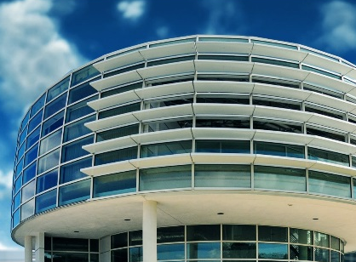
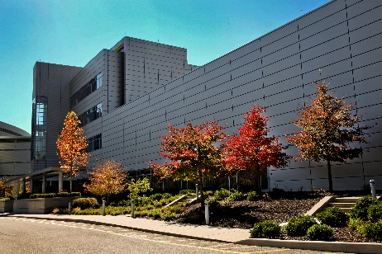
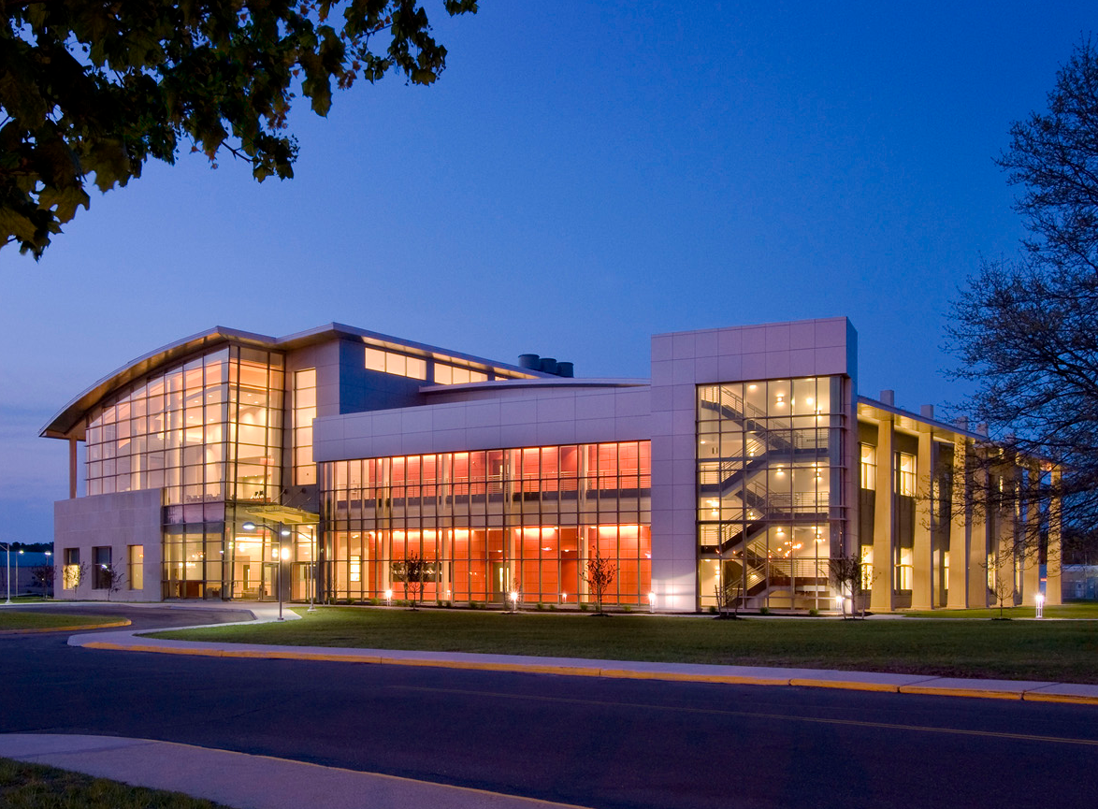
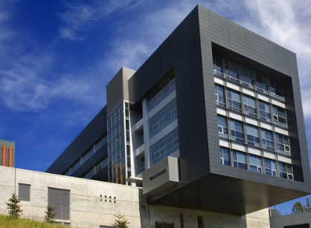
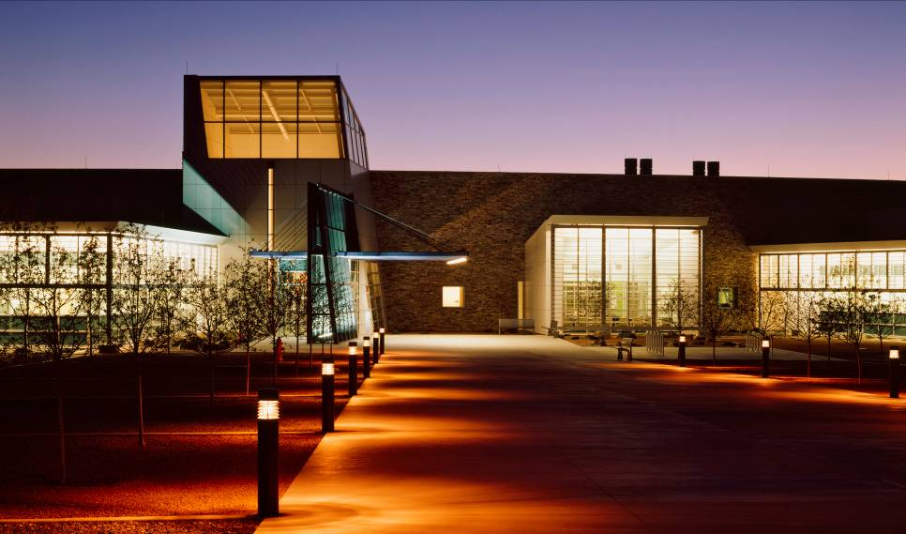
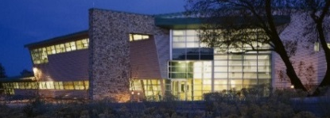



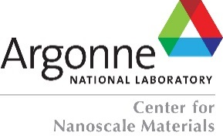




Update on the BES Nanoscale Science Research Centers
Jeffrey B. Neaton
  Director, Molecular Foundry
  BESAC Meeting
  February 27, 2015

Slide 2
The NSRC Program
National User Facilities for Nanoscale Science created by the Department of Energy through the NNI
Knowledge-based user facilities that provide state-of-the-art expertise, methods, and instrumentation in nanoscale science in a safe environment free of charge
Multidisciplinary research centers at the forefront of nanoscale science co-located with major DOE user facilities

Slide 3
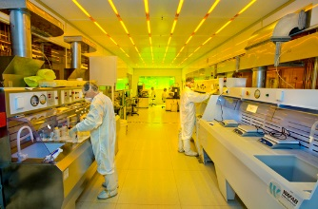
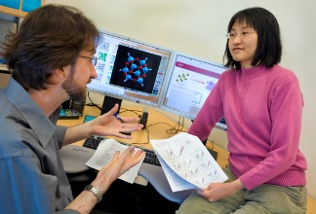
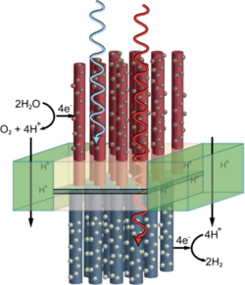
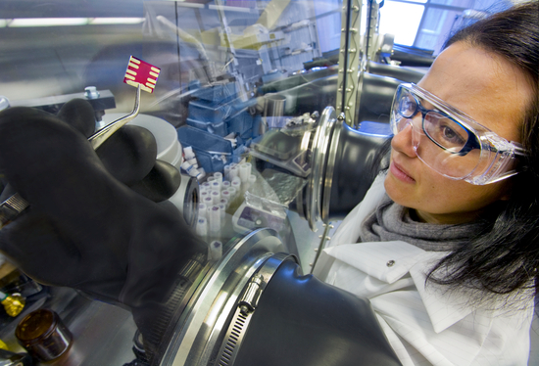
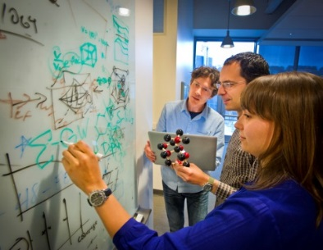
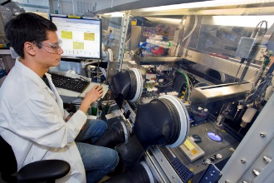
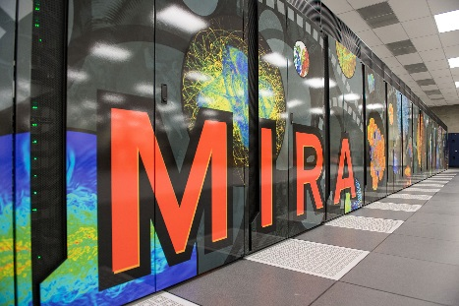


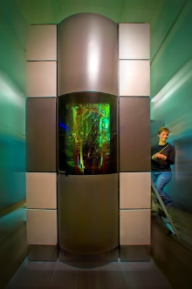
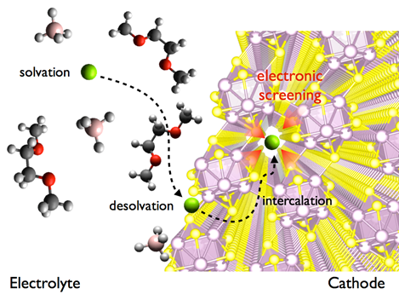
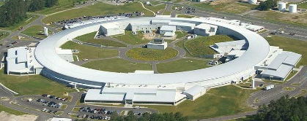
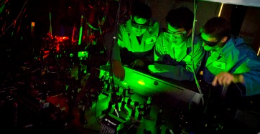
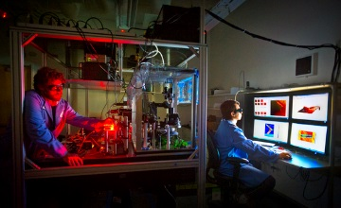
NSRCs: Multidisciplinary Science at the Nanoscale
Broad access to co-located, collaborative expertise & instrumentation across disciplines free of charge
Theory
Electronic structure and quantum dynamics
Statistical mechanics
Multiscale/multiphysics
Computation, algorithms, data
Fabrication
Nanolithography
Nanoimprint
Photoresist development
Solar energy conversion
Subsurface imaging
Synthesis &
Fabrication
Theory
Synthesis
Organic polymers
Inorganic nanostructures
Biomimetic nanomaterials
Hybrid assemblies/composites
Co-located supercomputers
Multidisciplinary science at
native length scales
Batteries
Characterization
Imaging and Spectroscopy
High-resolution electron microscopy
Near-field optical probes, STM, AFM
Novel materials for imaging
Electron microscopy
Co-located synchrotron or neutron source

Slide 4

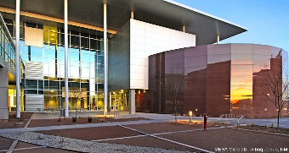
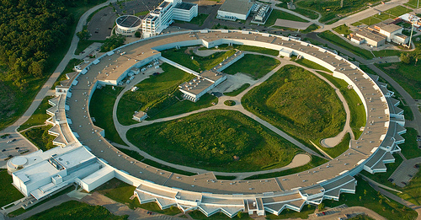

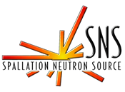


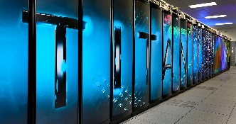


The Five NSRCs
Co-Located Facilities
MESA
APS
NSLS II
OLCF
ALCF
Expertise and Capabilities
Peptoids, TEAM 0.5, 1, Combi robots for q-dots, Near-field probes, X-ray simulation, nanoimprint, etc…
Operando characterization, DNA-mediated nanoassemblies, Large area nanofab, NSLS-II Beamlines, etc…
Near-field probes, deep data, large scale computation, microfluidics, functional mapping, etc…
Discovery platforms, metamaterials, in situ TEM, multiscale theory, etc…
Hybrid nanomaterials, STM, multi-modal end-stations, hierarchical nanofabrication, ACAT, etc…

Slide 5
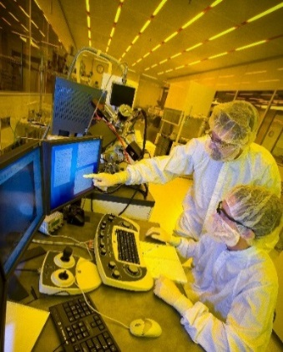
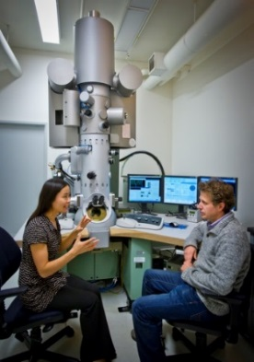
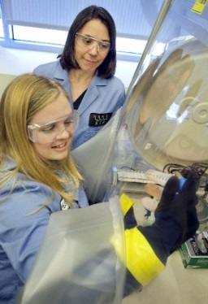
NSRC Scientific Staff
Offering broad expertise, fostering collaborative research
Highly talented research staff commit at least 50% of their time to users; the other 50% is devoted to research leading to capabilities – knowledge, tools and methods – that will attract the next generation of users
This innovative model fosters a uniquely collaborative environment that others are trying to replicate
Notes:
The PIs in our center, the staff scientists (25-30/center), operate on the so-called 50/50 model. 50% of their time is committed to working with users, who are selected by an external panel. MULTI-LINGUAL. The other half of their time is devoted to internal research that leads to new capabilities – knowledge, tools, and methods – that will attract the next generation of users.
This innovative model has been important in recruiting new talent into the Labs, and many of the staff operating under this model have been highly successful and become well recognized leaders, winning EC awards, PECASE, society fellowships, etc.
This model incentivizes multidisciplinary collaboration and leads to a very unique user experience where PIs can be very close collaborators, hence knowledge-based piece.
Other centers are trying to replicate us: recently toured with Dr. XXX from Yonsei University. Other examples include NSF’s recent call.
Several examples of shared user facilities. Many seem to have a recharge model if they have open access at all. Some have shared staff but they are technical staff. I think the statement is correct that people are trying to replicate our collaborative, shared lab model from a technical standpoint. Some include outside users. However, it is unclear if anyone has replicated that to include the expertise part of what we offer.
Jinwoo Cheon
H. G. Underwood Professor
Director, National Creative Research Initiative
Center for Evolutionary Nanoparticles
Senior Editor, Accounts of Chemical Research (ACS)
Department of Chemistry
Yonsei University
http://www.cheongroup.co.kr/common/main.asp
Stefano
In Europe a cluster of high profile institutes try to propose a copy of our NSRC and they came to visit us in 2008 and 2009. The proposal was not accepted at that time but I know they are going to try it again. it is called nffa: http://www.nffa.eu/
bb-seems like a collective. Hard to determine cost model but I think it’s a recharge rate situation. Doesn’t appear to have staff funded by collective. Goal appears to be to work together and share best practices and resources.
As well as the Australian National Fabrication Facility came to visit us and sent one of their technician here for few months to copy our stile
http://www.anff.org.au/
bb- seems like a network of open access centers located around the country. Hard to determine cost model. Mentions something about staff at each location funded through this network.
Jeff Urban
I visited this one in China - free, user model: http://english.nanoctr.cas.cn/au/bi/
bb-seems correct. Not positive it is free but appears so.
In addition to the China Nano center I mentioned, and Stefano's great example, the Stanford Microfluidics Foundry is similar as well. It does fee for service and it is linked to Steve Quake, but it has a full time staff that also does a lot of free training on microfluidics and consulting on projects. http://web.stanford.edu/group/foundry/index.html So, while not "free", they do have a training and educational component and work directly with users.
bb-seems correct.
Neal
- Instituto de Microelectronica de Barcelona, Barcelona, Spain (http://www.imb-cnm.csic.es/index.php/en)
bb-seems like shared facility with a strong training component
- Waterloo Institute for Nanotechnology, Waterloo, Ontario (https://uwaterloo.ca/institute-nanotechnology/)
bb-don’t know how this place is similar to us
- International Center for Nanotechnology Network, AIST – Tsukuba, Japan (http://www.aist.go.jp/aist_e/aist_laboratories/3nanotech/ or? http://tia-nano.jp/en/index.html)
bb-not convinced there is a website for this. Sounds like there’s a collaborativbe network of fabs but isn’t apparent that there’s a user component
- Melbourne Centre for Nanofabrication, Melbourne, Australia (http://nanomelbourne.com/)
bb-part of the network mentioned above. They say something about free consulting but that’s not exactly the same thing.
Eric
Daresbury SuperSTEM (http://www.superstem.com/)
bb-Free to some people; open to all
Diamond Light Source (http://www.diamond.ac.uk/Home.html)
bb-UK light source, seems analogous to ours
Emilio says that there is a major (5 country) initiative planned in Europe to replicate NSRC model (but no funds due to austerity)

Slide 6
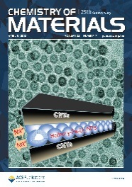
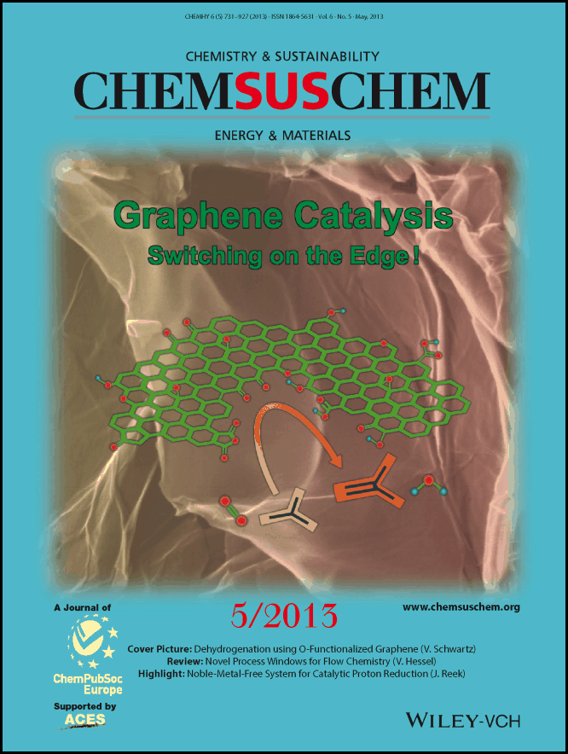
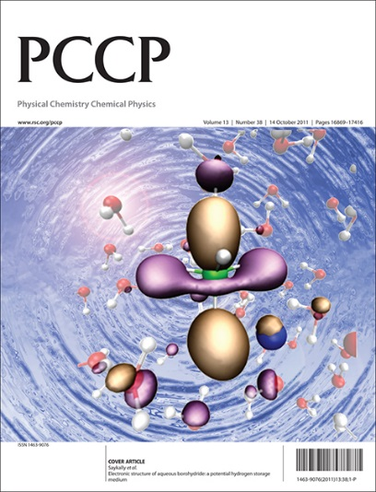
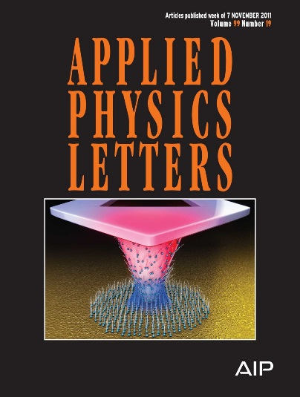
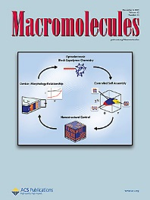
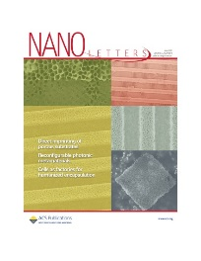
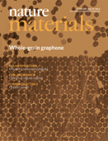
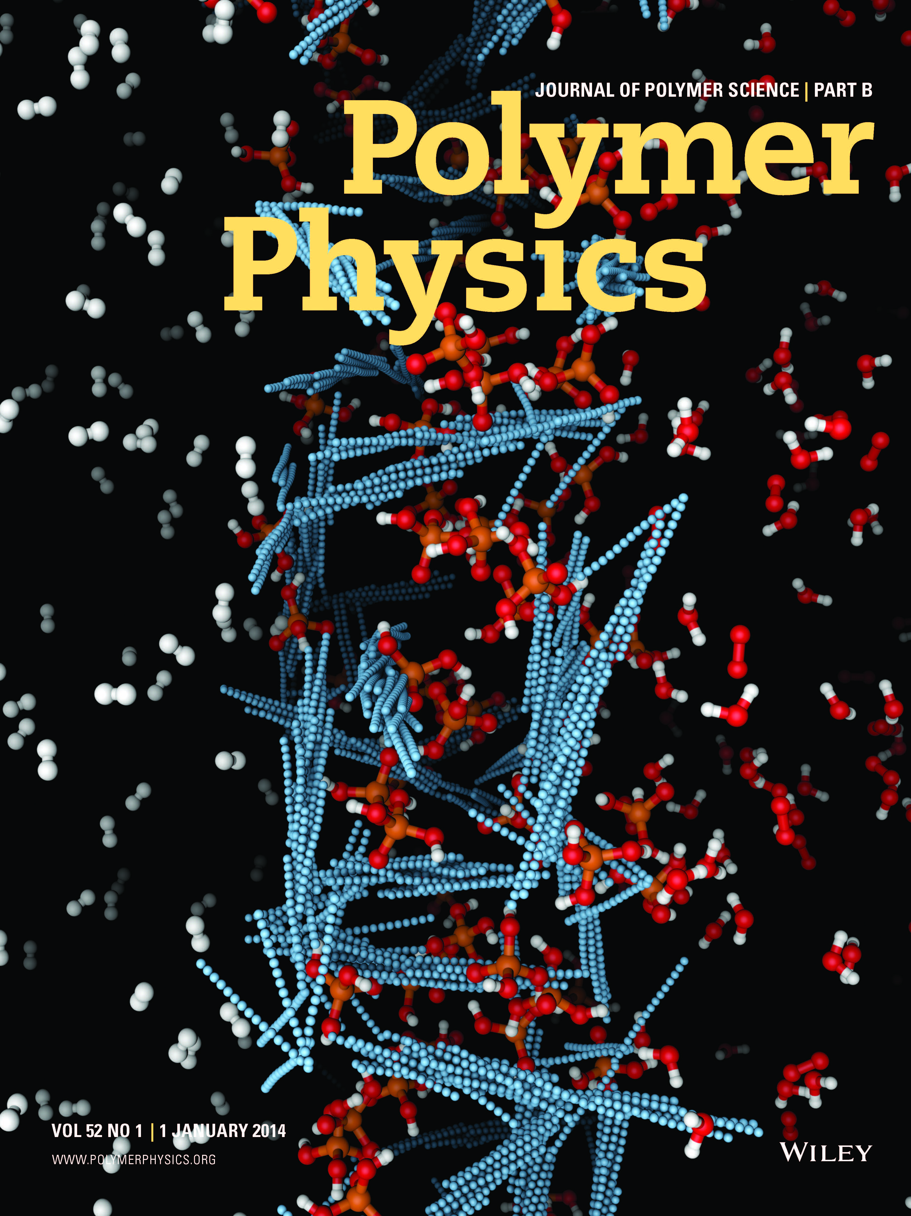
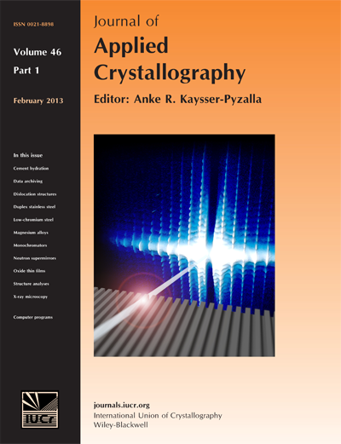
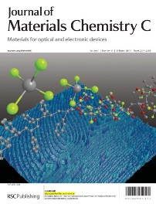
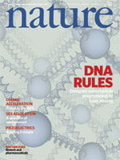
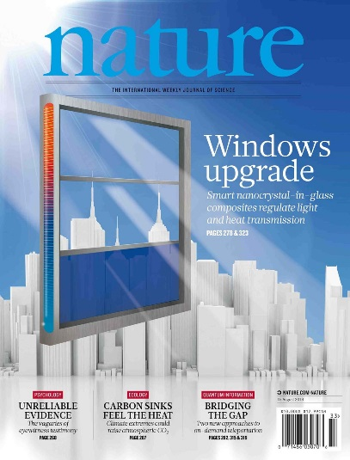
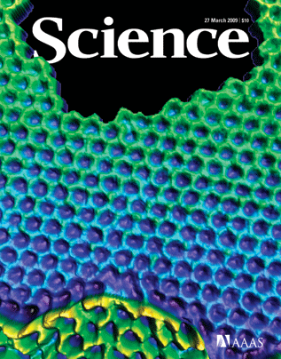
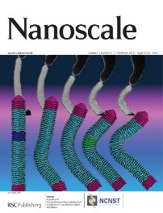
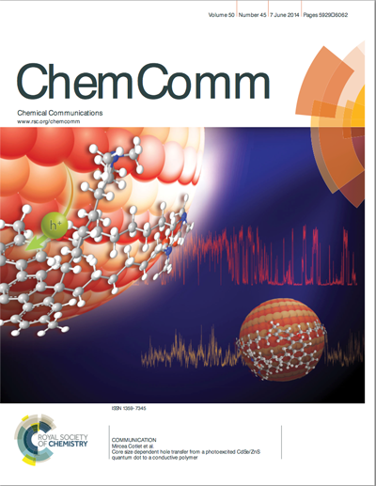
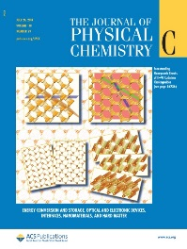
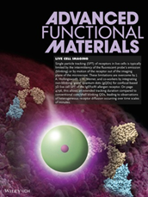
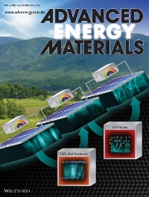
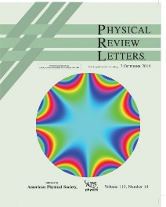
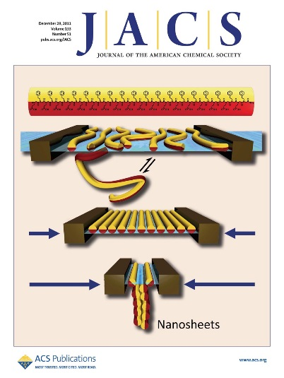
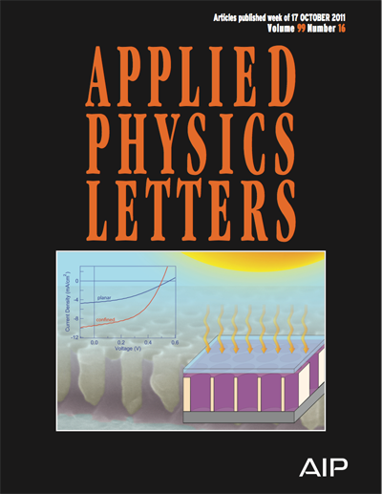
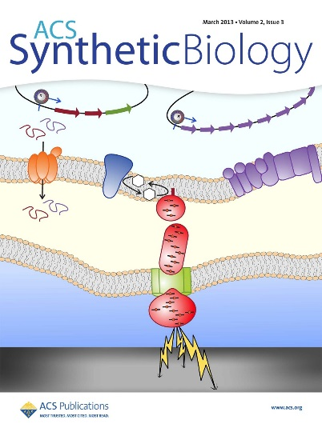
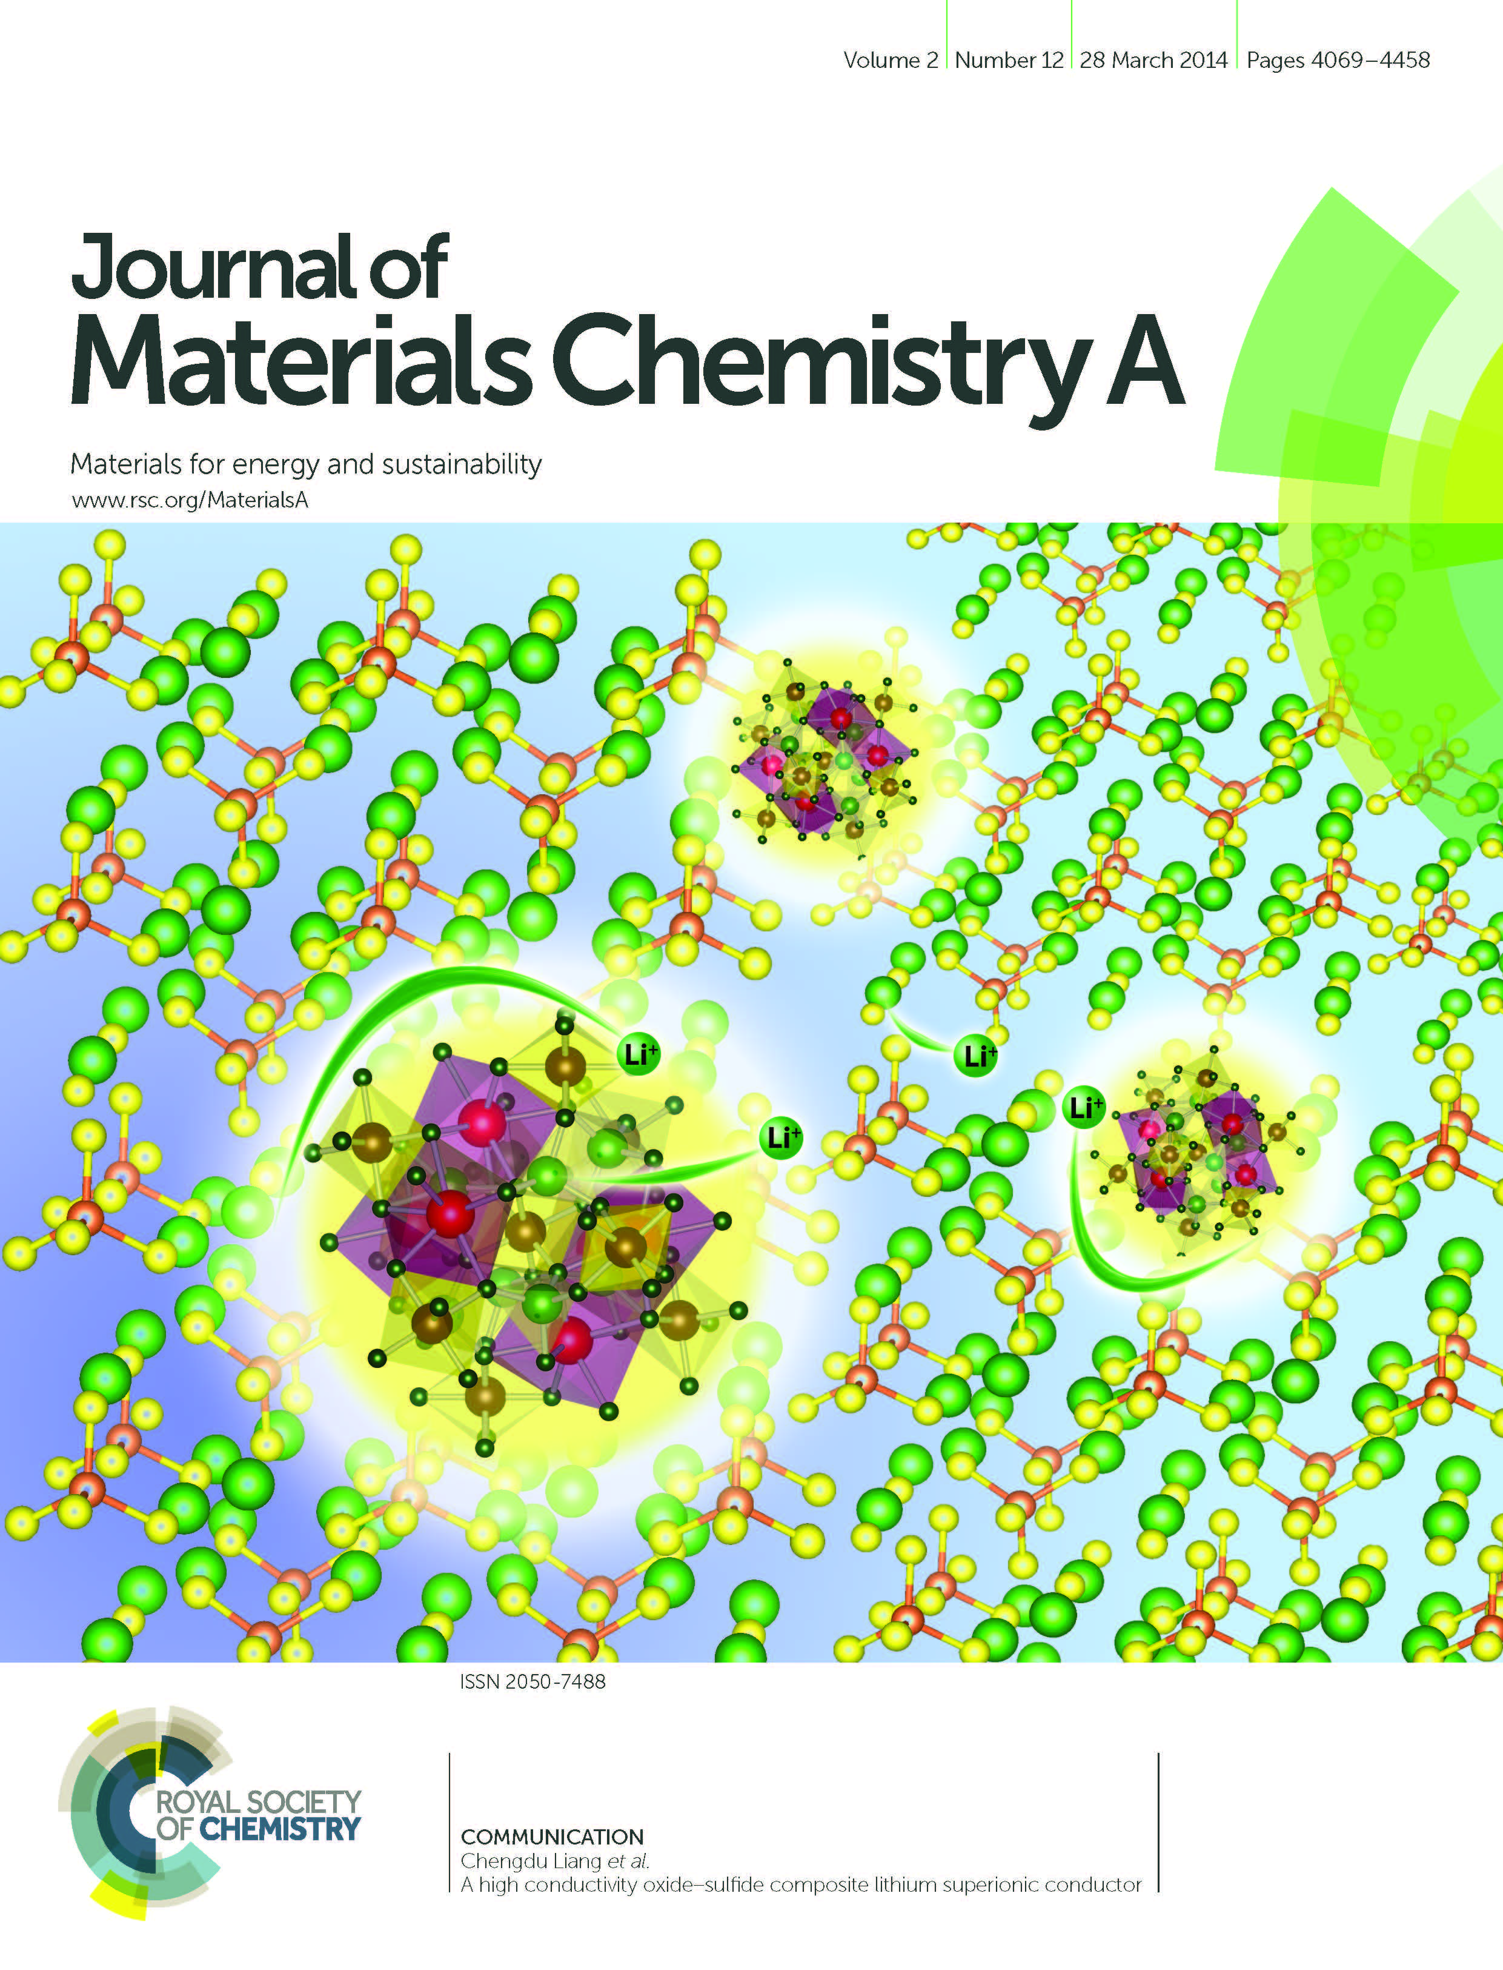
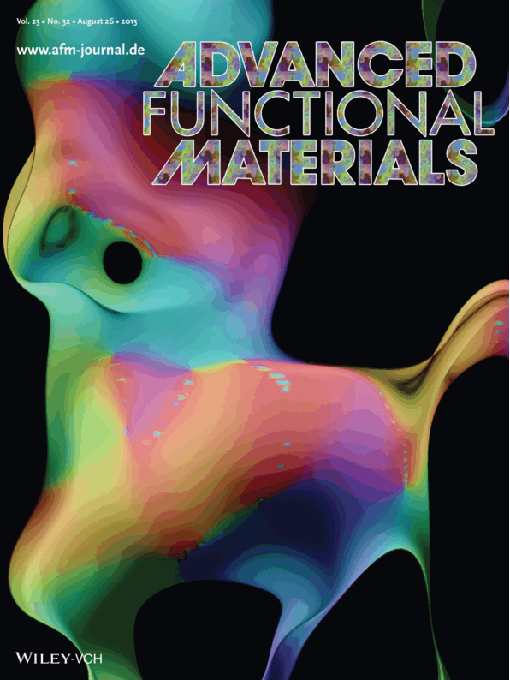






Scientific Productivity and User Demand
FY14 Submitted Proposals | 1600
FY14 Users | 2243
CY14 Publications | 1256
Up to 25% of 2014 publications per facility acknowledge co-located synchrotron and neutron source facilities (34% if EMBC and national supercomputer facilities are included)

Slide 7

User Demographics
Serving diverse scientific communities
FY 2014: 2243 Users from 45 US States and 34 Countries
User Affiliation
User Type

Slide 8

PCAST Assessment of NNI
Issued in 2005, 2008, 2010, 2012, 2014
Nanotechnology Success Story #1:
Light‐ and Heat‐ Shielding Nano‐Coating for “Smart Glass” Developed at the Lawrence Berkeley National Lab
A. Llordés, G. Garcia, J. Gazquez & D. J. Milliron. Nature 2013 500, 323.

Slide 9


















High-Impact Science at the NSRCs
31% of NSRC papers in high impact journals in FY14
1 um
A. Rahman, et al., Nature Comm. (2015)
J. R. Wilson,
et al., Nature Mater. (2006)
D. J. Gargas, et al. Nature Nanotechnol. (2014)
P. Strasser, et al., Nature Chemistry (2010)
Z. Liu, et. al., JACS (2013)
Seidel, et al., Nature Mater. (2009)
2 μm
Y. Zhang, et al., Nature Nanotechnol. (2013)
X. Li, et al, Angew. Chem. Int’l Ed. (2015)
D. Talapin et al., Nature (2009)
H. G. Liao, et al. Science (2012)
N. Balke, et al., Nature Nanotechnol. (2010)
D. B. Burckel, et al., Adv. Mater. (2010)
P. W. Sutter, et al., Nature Mater. (2008)
L. Trahey, et al., Adv. Energy Mater. (2013)
A.D. Christianson et al., Nature (2008)
N. P. Wells, et al., Nano Lett. (2010)
B. Kiraly, et al., Nature Comm. (2013)

Slide 10













New Classes of Nanomaterials Reaching and Impacting Diverse User Communities
Sequence-specific peptoid polymers for energy, water, human health, and sensing
Automated synthesis robots
K. T. Nam, et al., Nature Mater. (2010)
E. J. Robertson, et al., Proc Natl Acad Sci. (2014)
Antimicrobial peptoids:
Mimic the structure, function and mechanism of helical antimicrobial peptides
Mineralization peptoids:
Modulators of inorganic crystal growth
Sequence-defined peptoid polymers:
Study of fundamentals of nanoscale phase separation
Peptoid diagnostics:
Industry using to identify misfiled proteins in blood
N. P. Chongsiriwatana, et al.,
Proc. Natl. Acad. Sci. (2008)
C. L. Chen, et al., J. Am. Chem. Soc. (2011)
C. L. Chen, et al., Sci. Reports (2014)
10+ papers in last 5 years
J. Am. Chem. Soc., ACS Macro Lett., Soft Matter, Macromolecules
A. Y. Yam, et al., Biochem. (2011)

Slide 11







Novel Scanning Probe Approaches with Nanoscale Resolution for Broad Dissemination
Band excitation spectroscopy: Hyperspectral AFM Characterization
Time Domain
Fourier Domain
Single Frequency
On-Resonance BE
LiCoO₂
100 nm
Jesse, Kalinin, Nanotechnol. 18, 435503 (2007)
e.g. Balke et al., Nature Nano. 5, 749 (2010)
Mapping nanoscale variations in piezoelectric response (PZT)
Electrochemical Strain Microscopy:
Pt Nanoparticles on ZrO₂
New User Communities
125+ CNMS publications since 2007 use this approach
Bintachitt et al, PNAS (2010)
300x300nm
A. Kumar et al, Nature Chem. 3, 707 (2011).
R&D 100 award 2008, 2010
Spinoff founded in 2014

Slide 12

Discovery of New Functional Materials via NSRC and Synchrotron Imaging Capabilities
New structural form of porous carbon with extraordinary supercapacitor performance
2 nm
With CFN, NSLS, and NCEM-MF Staff, user at UT-Austin discovered a novel form of carbon through the activation of exfoliated graphene oxide with a storage capacity nearing that of a lead-acid battery
Structural determination performed at CFN and MF-NCEM with host of unique tools: HR-STEM, EELS, TEAM 1, and X-ray diffraction at NSLS.
New material is a conductive (100% sp²), densely porous structure comprised of positive and negative curvature carbon
Y. Zhu et al., Science 332, 1537 (2011)
>1000 citations thus far
Patent Application filed

Slide 13







Strong Synergies with Co-Located User Facilities
Coordinated 2-way access proposal process
Shared FTE
Joint instrumentation investments
For a typical NSRC, 1 in 6 papers acknowledge co-located user facilities
Multimodal Local-Probe Characterization @ APS, CNM
Neutron Diffraction @ CNMS, SNS
M. Shao et al., Nature Commun. (2014)
In operando NEXAFS @ ALS, NERSC, MF
N. Shirato et al., Nano Lett. (2014)
ARPES @ NSLS-II, CFN
Discovery Platforms @ CINT
TEM Liquid Electrochemistry
J. J. Velasco-Velez, et al., Science (2014)
J. Y. Huang, et al., Science (2010)
W. Jin, et al., Phys. Rev. Lett. (2013)

Slide 14




Expanding NSRC Capabilities with Leading-Edge Electron Microscopy
New in FY15: Electron Microscopy Centers (EMBCs) Merge with NSRCs
New scientific opportunities and operational efficiencies
        Soft, hybrid materials; in situ; dynamics
        Ultrafast electron scattering
        Solid-state direct electron detectors
        Environmental and in operando
        Atom probe and electron tomography
        Theory, computation, and data
Electron
Microscopy Center

Slide 15

NNI Strategic Plan
Issued in 2004, 2007, 2011, 2014
User Facility-Specific Goals
2.3 Promote broader accessibility and utilization of user facilities, cooperative research centers, and regional initiatives to accelerate the transfer of nanoscale science from lab to market.
3.3 Provide, facilitate the sharing of, and sustain the physical R&D infrastructure, notably user facilities and cooperative research centers.

Slide 16
















Strong and Growing Engagement with Industry
More than 45 companies used the NSRCs in 2014
Mapping nanoscale compositional variations in 3D for commercial TiAl alloy design
Nanoscale Polymers for Ultra-high Density Magnetic Storage
Tackling Cancer with Nanoparticles
R. Ruiz, et al., Journal of Vacuum Science and Technology B (2012).
H. J. Hathaway, et al, Breast Cancer Research (2011)
Controlling Heat with Hypersonic Crystals
Chemically Amplified Molecular Photoresist for High-Resolution Lithography
Enhancing Thermal Transport of Carbon Nanotubes
Probing carrier dynamics below the surface of solar cells
G. Zhu, et al., Appl. Phys. Lett. (2014).
DED
Growth of atomically abrupt nanowire heterostructures
AgAu catalyst
Silicon
S. Kaur, et al., Nat. Commun. (2013)
Silicon
Germanium
P. K. Kulshreshtha, et al., Nanotechnology (2014)
Silicon
E. S. Barnard, et al., Scientific Reports (2013)
Y.-C. Chou, et al., ACS Nano (2012)
Best DED reference?

Slide 17
NNI Strategic Plan
Issued in 2004, 2007, 2011, 2014
User Facility-Specific Goals
2.3 Promote broader accessibility and utilization of user facilities, cooperative research centers, and regional initiatives to accelerate the transfer of nanoscale science from lab to market.
3.3 Provide, facilitate the sharing of, and sustain the physical R&D infrastructure, notably user facilities and cooperative research centers.

Slide 18





NSRC Strategic & Budget Planning
Five-Year Strategic Plans
      Publically available and online 8/2014
      Priorities developed using broad input from staff, users, and other leaders in the community
      Equipment and personnel plans developed maximally-leveraging co-located facilities
BES budget and operations reviews for each NSRC nearly complete
NSRC portal: https://nsrcportal.sandia.gov

Slide 19
NSRC Equipment Status
Key instrumentation aging or soon no longer at forefront
NSRC investment strategies:
  Annual operating funds
  Team with co-located facilities
  External grants
  Partner users
  Additional resources from DOE

Slide 20








Reinvestment in Major Equipment to Maintain World-Leading Capabilities
Advanced Multibeam
Lithography
Focused Ion Beam
Compute Cluster
Semiconductor Molecular Beam Epitaxy
Atomic Layer Deposition
Nanoscale Energy Materials
X-ray Imaging Station (NEMXIS)
Next generation TEM

Slide 21











New Capabilities for FY15
Molecular Foundry
High-throughput materials discovery: automated synthesis for nanocrystals & polymers: Robots + ALS SAXS/WAXS beamline
Center for Functional Nanomaterials
Operando STEM: In partnership with NSLS-II, developing four beamlines for operando characterization and complex materials scattering
Center for Nanophase Materials Sciences
Direct-write nanofabrication using He-ion microscope
Center for Integrated Nanotechnologies
Electrochemistry Discovery Platform for in situ TEM
Center for Nanoscale Materials
Electron paramagnetic resonance and low-temperature scanning tunneling microscope

Slide 22


Questions?
Novel Materials
Increase Industry Engagement
Expand User Base
New Enabling Capabilities
Develop Disruptive Technologies
Promote Multidisciplinary Research
Leverage
Co-Located Facilities
Educate and Train Next Generation
High-impact science

