Slide 1
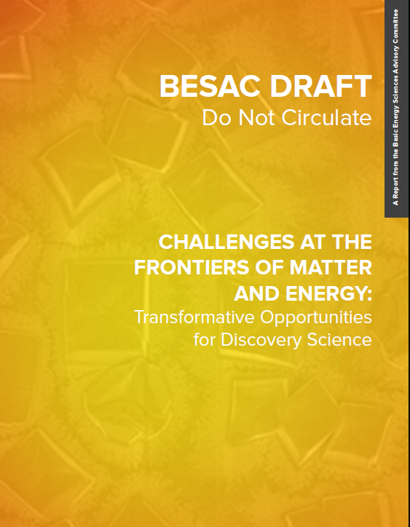
Challenges at the Frontiers of Matter and Energy:
Transformative Opportunities for Discovery Science
BESAC
02/26/15
http://www.besac2014.com/

Slide 2
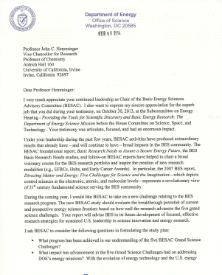

BESAC New Charge on Strategic Planning for BES Research
From: Dr. Pat Dehmer (Acting Director of Office of Science)
The new BESAC study should evaluate the breakthrough potential of current and prospective energy science frontiers based on how well the research advances the five grand science challenges. Your report will advise BES in its future development of focused, effective research strategies for sustained U.S. leadership in science innovation and energy research.
I ask BESAC to consider the following questions in formulating the study plan:
What progress has been achieved in our understanding of the five BESAC Grand Science Challenges?
What impact has advancement in the five Grand Science Challenges had on addressing DOE’s energy missions? With evolving energy technology and U.S. energy landscape, what fundamental new knowledge areas are needed to further advance the energy sciences? Please consider examples where filling the knowledge gaps will have direct impacts on energy sciences.
What should the balance of funding modalities (e.g., core research, EFRCs, Hubs) be for BES to fully capitalize on the emerging opportunities?
Identify research areas that may not be sufficiently supported or represented in the US community to fully address the DOE’s missions.

Slide 3
BESAC Subcommittee on Challenges at the Frontiers of Matter and Energy
Subcommittee
Nora Berrah (University of Connecticut)
Gordon Brown (Stanford University)**
Susan Coppersmith (University of Wisconsin-Madison)
Don DePaolo (LBNL and University of California-Berkeley)
Roger French (Case Western Reserve University)**
Cynthia Friend (Harvard University)
Ian Foster (ANL and University of Chicago)
Sharon Glotzer (University of Michigan)
Bruce Kay (Pacific Northwest National Laboratory)**
Jennifer Lewis (Harvard University)
Emilio Mendez (Brookhaven National Laboratory)
Margaret Murnane (University of Colorado-Boulder)
Monica Olvera de la Cruz (Northwestern University)**
Juan de Pablo (University of Chicago)
Tijana Rajh (Argonne National Laboratory)
Anthony Rollett (Carnegie Mellon University)**
Maria Santore (University of Massachusetts)**
Jamie Sethian (LBNL and University of California-Berkeley)
Matthew Tirrell (University of Chicago)**
William Tumas (National Renewable Energy Laboratory)
Executive Committee
John Sarrao, Chair (LANL)
George Crabtree (ANL & Univ. of Ill. at Chicago)
Mark Ratner (Northwestern)**
Graham Fleming (UC Berkeley)
John Hemminger, ex-officio (UC-Irvine)*
Thanks to
Lynn Yarris, Science Writer, LBNL
Natalia Melcer, BES
ANL Editorial & Production Team
*BESAC Chair
**BESAC Member

Slide 4
The Subcommittee gathered broad input from the community
Subcommittee meetings
  Bethesda, 7/31 & 8/1; kick-off workshop
  Berkeley, 8/28 & 8/29; focus on computing and correlated matter
  Evanston, 10/21 & 10/22; focus on synthesis and soft matter
  Cambridge, 12/4 & 12/5; focus on gas phase chemistry
  Germantown, 1/14 & 1/15; initial red team review of message/report
Community input at www.besac2014.com
  Targeted appeal to EFRC Directors and Early Career Awardees
We’re continuing to listen
  Townhall: APS March Meeting, March 4, 2015

Slide 5

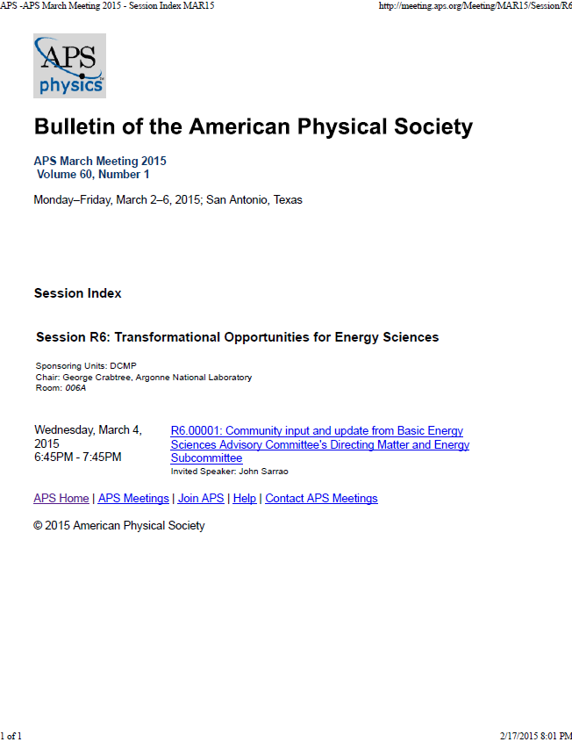
If you believe the message, help us spread the word

Slide 6
Why are the chapters out of order?
Table of Contents
Executive Summary
Chapter 1: Introduction: Standing on the Shoulders of Giants–Five New Transformational Opportunities for Energy Science
Chapter 2: Mastering hierarchical architectures and beyond-equilibrium matter
Chapter 3: Beyond Ideal Materials and Systems: Understanding the Critical Roles of Heterogeneity, Interfaces, and Disorder
Chapter 4: Harnessing Coherence in Light and Matter
Chapter 5: Grand Challenges Then and Now
Chapter 6: Revolutionary Advances in Models, Mathematics, Algorithms, Data, and Computing
Chapter 7: Exploiting transformative advances in imaging capabilities across multiple scales
Chapter 8: Enabling Success
Grand Challenges Then and Now is meant to be an “insert”
– can be read as a stand alone progress report; will also benefit from the advances of Ch. 6-8
-- in production, will have a distinct look and feel

Slide 7
Remember 2007…
At least some of us were much younger
We were actively working Basic Research Needs for xxx
EFRCs did not exist
SC Early Career Awards did not exist
Lots of compelling research had not yet occurred

Slide 8
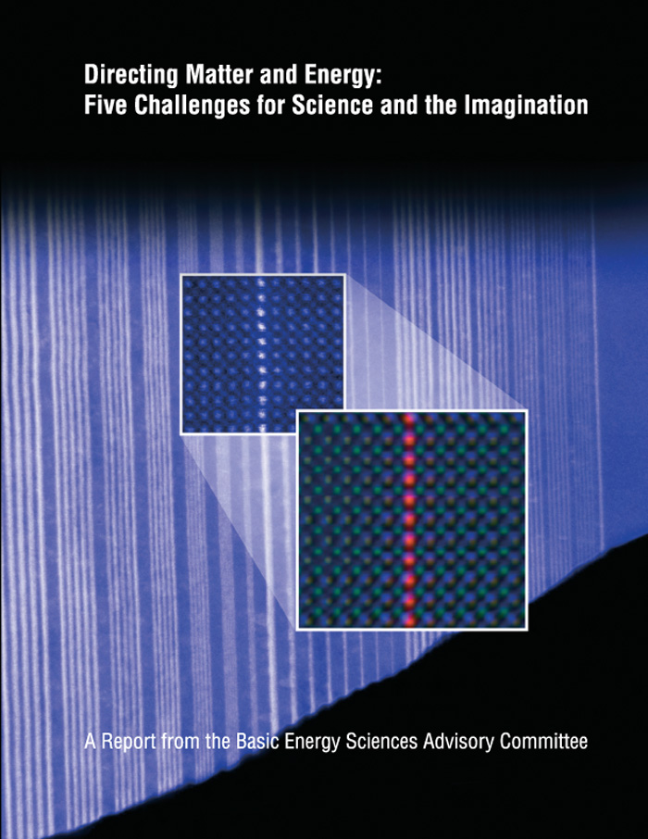
The 2007 Grand Challenges are still compelling AND the landscape has changed as a result of our progress
How Do We Control Material Processes at the Level of Electrons?
How do we design and perfect atom- and energy-efficient synthesis of revolutionary new forms of matter with tailored properties?
How do remarkable properties of matter emerge from complex correlations of the atomic or electronic constituents and how can we control these properties?
How can we master energy and information on the nanoscale to create new technologies with capabilities rivaling those of living things?
How do we characterize and control matter away - especially very far away - from equilibrium?

Slide 9
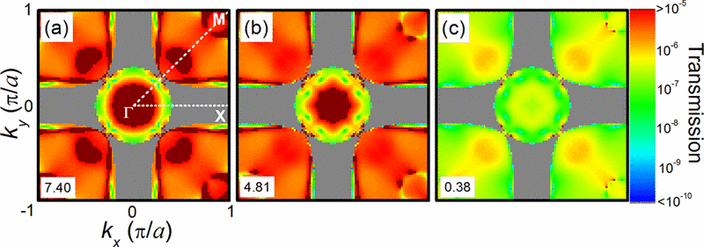
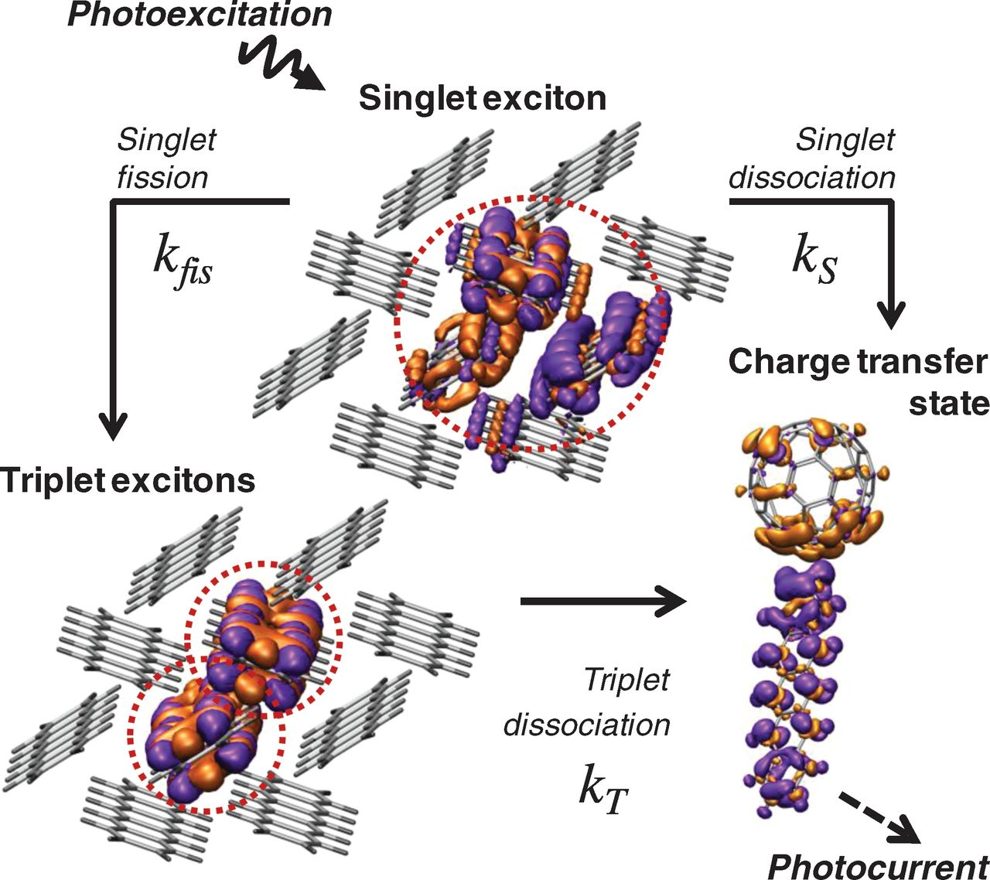
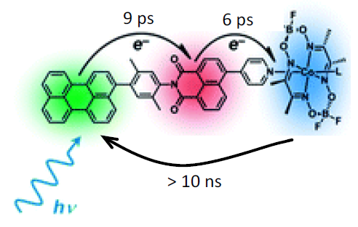
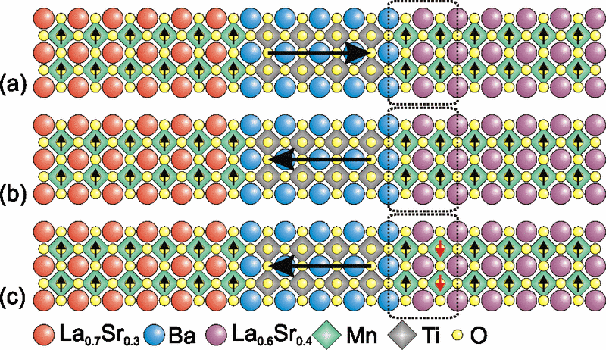
How Do We Control Material Processes at the Level of Electrons?
Much of the last century has focused on understanding how electrons in matter – their charge, their spin, and their dynamics – determine the properties of materials and how they direct chemical, electrical, or physical processes in materials. We are now on the verge of a new science of quantum control where our tools will go beyond probing what is there, towards the goal of controlling these processes and properties through direct manipulation of the electrons.
1 Photon
Ultrafast Multi-step Catalysis
Pentacene molecules
singlet exciton
2 triplet excitons
2 Electrons
Multiferroic Spin Valves
Exciton Fission
Controlling materials processes at the level of electrons has an enormously wide horizon. The
broader challenges in single layer, soft, amorphous and heterogeneous materials that enable the
remarkable functionality of biology and promise to bring similar complexity and functionality to
artificial energy materials remain to be explored.

Slide 10
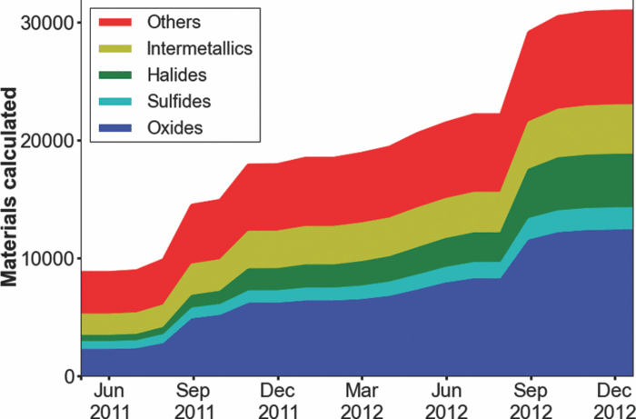
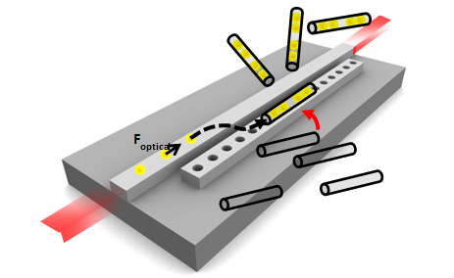
How do we design and perfect atom- and energy-efficient synthesis of revolutionary new forms of matter with tailored properties?
The periodic table contains more than 110 elements, but only a tiny fraction of all possible chemical compounds has yet been prepared and their properties characterized. Moving beyond trial-and-error searching, science is in favorable cases now approaching the threshold of ‘directed’ synthesis guided by predictive design, based on first-principles, of materials with properties that we desire
Directed Self-Assembly
Materials Genome
In situ characterization
Innovation and resources are needed for synthesis and characterization to reach a
level commensurate with predictive materials by design, allowing all three activities—discovery, synthesis and characterization—to work collaboratively to advance our collective materials wisdom.

Slide 11
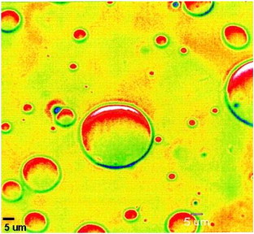
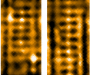
How do remarkable properties of matter emerge from complex correlations of the atomic or electronic constituents and how can we control these properties?
Emergent phenomena, in which the correlated behavior of many atomic or electronic constituents leads to an unexpected collective outcome, are of great significance across the sciences and engineering. Uncovering the fundamental rules of correlations and emergence is the first part of the challenge. The second is to achieve control over these correlations, a prospect that can only now be reasonably contemplated with the advent of tools to probe and affect particles and their correlations on the nanoscale. By understanding and controlling correlations, we can put emergences to work for us.
Bi₂Sr₂CaCu₂O_{8+x}
Ca_{2−x} Na_{x}CuO₂Cl₂
Predictive Vortex Simulation
Electronic Liquid Crystals
Charged Polymers
Correlation and the emergence of the new phenomena it drives are wellsprings of scientific discovery and innovation, ripe for the harnessing of new functionalities and applications.

Slide 12
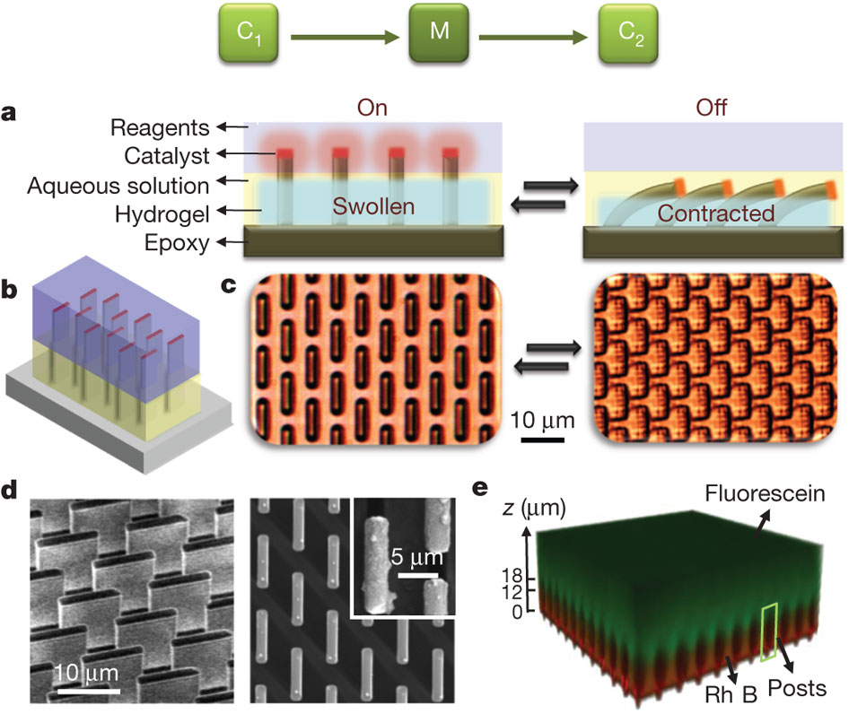
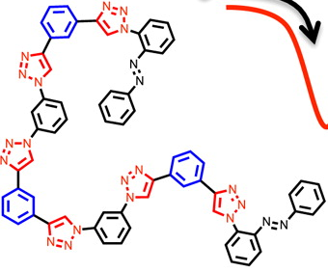

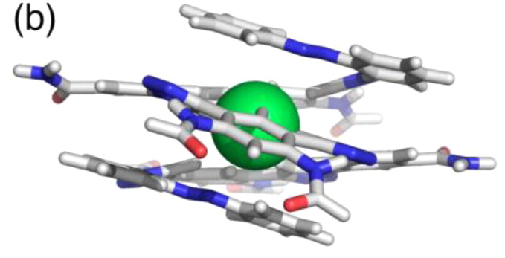
How can we master energy and information on the nanoscale to create new technologies with capabilities rivaling those of living things?
Implementation and utilization of complex nanotechnologies with capabilities approaching those found within the biological world remains beyond our reach at present. The ways in which energy, entropy, and information are manipulated within living nanosystems provide us with lessons on what humans must learn to do in order to develop similarly sophisticated technologies.
Folding Polymers
Cl ⁻
Molecular Motors
Self-Regulation
As we develop the tools to unravel biology’s most important secrets and remarkable successes in harnessing complexity for functionality, we can look forward to equally rich and expansive achievements in applying biology’s lessons to artificial energy materials, and even ultimately exceeding biology’s capabilities.

Slide 13
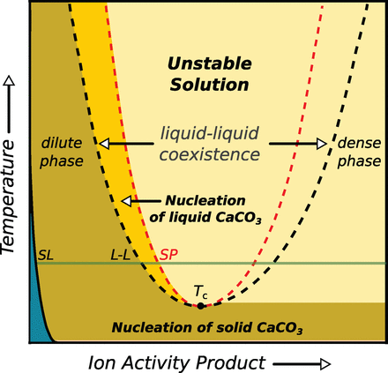
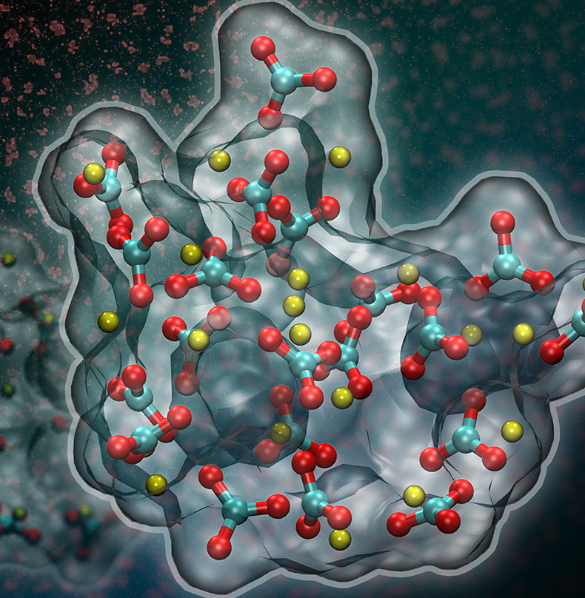

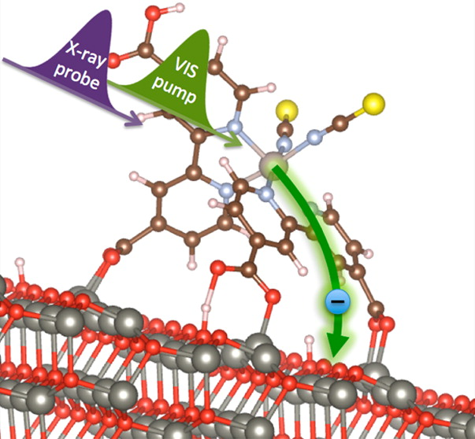
How do we characterize and control matter away - especially very far away - from equilibrium?
At equilibrium, we can make many significant statements about what can happen, about the states of matter and of energy, and about the structures that occur. The same is not true when we consider systems out of equilibrium, a state in which much of Nature finds itself much of the time. Understanding non-equilibrium processes and systems requires addressing the major difficulties associated with bridging theories across many length and time scales in order to construct meaningful statements and organizing principles to describe Nature most completely over the many relevant scales of time and of size.
Charge Transfer Dynamics
Capsules
Molten capsules
Coated Anode
Anode
Hot Anode
Unconventional Precipitation
Arresting Thermal Runaway
Critical universal questions remain:
By what mechanisms and how fast do far-from-equilibrium systems evolve?
Are there barriers to reaching equilibrium, or metastable states in which to trap the system?
How can we harness or manipulate transformations driven by disequilibrium?

Slide 14
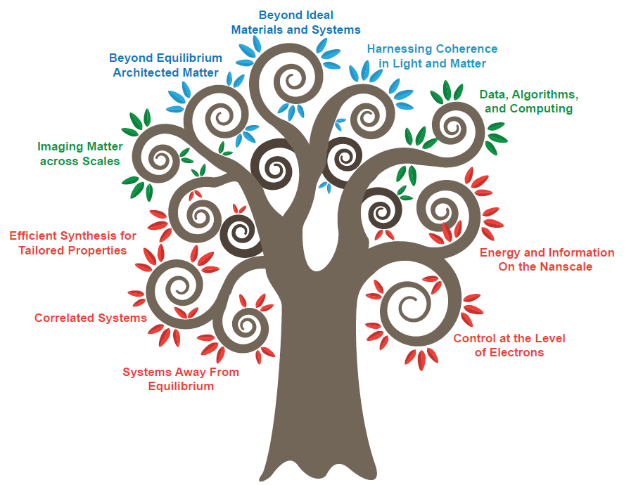
Challenges at the Frontiers of Matter and Energy:
Transformative Opportunities for Discovery Science
Beyond Ideal Materials and Systems
Beyond Equilibrium Architected Matter
Harnessing Coherence in Light and Matter
Imaging Matter across Scales
Data, Algorithms and Computing
Efficient Synthesis for Tailored Properties
Energy and Information on the Nanoscale
Correlated Systems
Systems Away from Equilibrium
Control at the Level of Electrons
Instrumentation, Synthesis, People, Resources

Slide 15
New Transformational Opportunities have emerged that have their foundations in the Grand Challenges
“The most exciting phrase to hear in science, the one that heralds new discoveries, is not ‘Eureka!’ but ‘That's funny...’” ―Isaac Asimov
Mastering Hierarchical Architectures and Beyond-Equilibrium Matter
Beyond Ideal Materials and Systems: Understanding the Critical Roles of Heterogeneity, Interfaces and Disorder
Harnessing Coherence in Light and Matter
Crosscutting Opportunities
Revolutionary Advances in Models, Mathematics, Algorithms, Data, and Computing
Exploiting Transformative Advances in Imaging Capabilities Across Multiple Scales

Slide 16
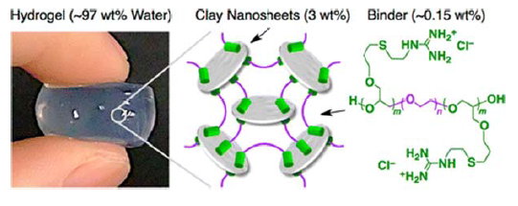
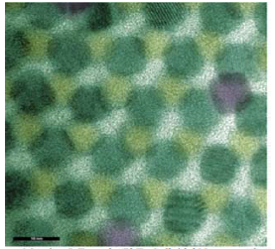
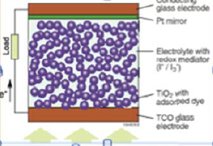
Mastering Hierarchical Architectures and Beyond-Equilibrium Matter
The transformational opportunity is to realize targeted functionality in materials by controlling the synthesis and assembly of hierarchical architectures and beyond‐equilibrium matter.
To realize this opportunity, several major advances are required:
1) predictive models, including the incorporation of metastability, to guide the creation of beyond equilibrium matter
2) Mastering synthesis and assembly of hierarchical structures for multi-dimensional hybrid matter
3) in situ characterization of spatial and temporal evolution during their synthesis and assembly

Slide 17
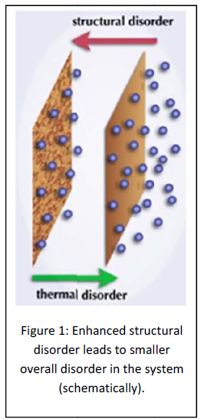
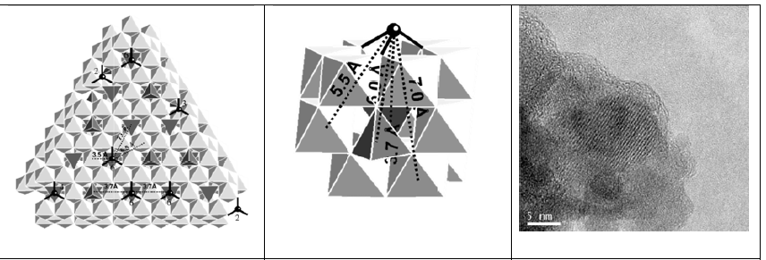
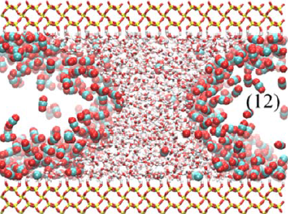
Beyond Ideal Materials and Systems: Understanding the Critical Roles of Heterogeneity, Interfaces and Disorder
Developing a fundamental understanding of the roles of heterogeneities, interfacial processes, and disorder in materials behavior represents a transformational opportunity to move from ideal systems to the complexity of real systems under realistic conditions.
Science of scale
Slow and statistically rare events
“epidemiological” studies of heterogeneous populations
Science of degradation and lifetime prediction
Notes:
geosciences

Slide 18
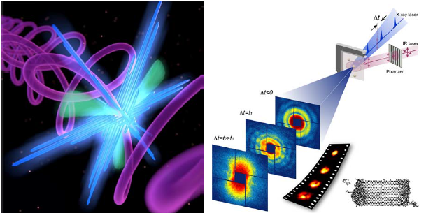
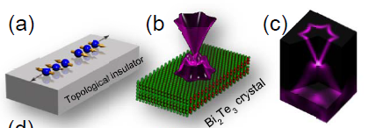
Harnessing Coherence in Light and Matter
The ability to realize full control of large‐scale quantum‐coherent systems has the potential to revolutionize fields as diverse as information processing, sensor technology, and energy generation.
new real‐time quantum microscopes that can visualize and control quantum matter
Long-lived temporally coherent states of quantum wavefunction
Ability to suppress decoherence effects of the environment
Role of symmetry protected states in coherent matter

Slide 19
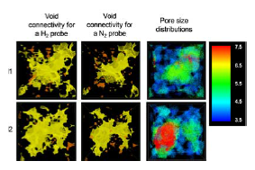
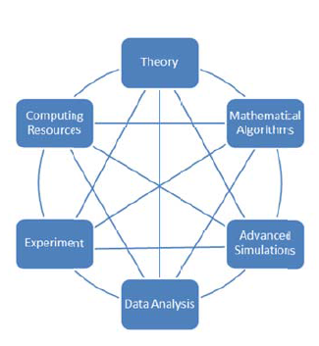
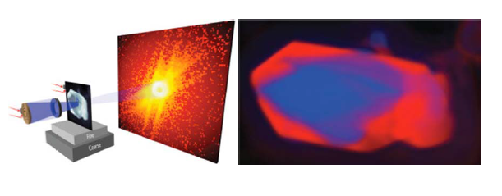
Revolutionary Advances in Models, Mathematics, Algorithms, Data, and Computing
A “perfect storm” of theoretical, mathematical, computational, and experimental capabilities are poised to greatly accelerate our ability to find, predict, and control new materials, understand complex matter across a range of scales, and steer experiments towards illuminating deep scientific insights.

Slide 20
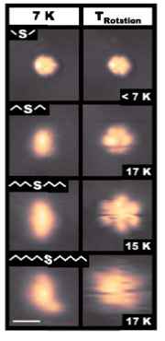
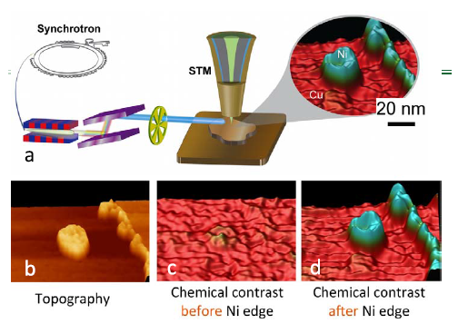
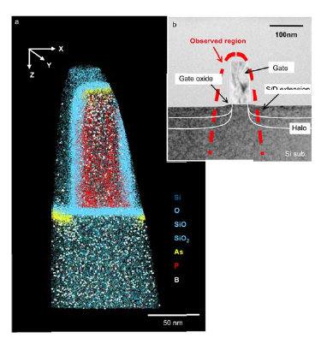
Exploiting Transformative Advances in Imaging Capabilities Across Multiple Scales
Making and exploiting advances in imaging capabilities emerge as national priorities because of their transformative impacts on materials discovery. These impacts include accelerating the introduction of new materials, the understanding of combustion, and progress in materials synthesis; and solving longstanding challenges in the relationship between the structure of inhomogeneous matter and its behavior.
Attosecond measurements
High resolution, chemically resolved multiscale mapping
4D characterization
Advanced, spatially & temporally resolved spectroscopy

Slide 21
Enabling Success
From the 2007 report: “In particular, the following needs were identified:
A highly trained, diverse, and empowered scientific workforce whose members possess depth in one or two areas and are able to collaborate across a breadth of scientific and technical fields;
A group of theorists, concentrating on the very difficult and demanding fundamental questions that arise in such problems as systems far away from equilibrium, nanoscale communications, or strong correlations; and
Appropriate new experimental and computational facilities and a balance of funding mechanisms that permit development of new instruments, tools and materials capabilities for single PIs, team science, and major user facilities.”
Action by BES led to : EFRCs, SC Early Career Awards, SISGRs,
Nevertheless, compelling needs remain
Instrumentation and Tools
Synthesis
Human Capital
Resources

Slide 22
Instrumentation & Tools
New eyes yield new insights. There needs to be a strong commitment to investigators skilled in instrument development and technique creation.
  The community needs to develop mathematical and computational capabilities to advance the frontiers of discovery science tightly coupled to experiment
Multi-modal and in situ measurements are required to observe and exploit the complex functionality we seek to control.
  We should seize the opportunity to build intimate connections among previously isolated approaches in synthesis, characterization and theory/modeling.
Notes:
New eyes = new instruments
New techniques open new horizons, STM is historical example

Slide 23
Synthesis
Predicting functionality
A central element of control science is the ability to predict functionality in complex, non-equilibrium, and dynamic materials. This will require embracing computational materials science, materials genomics, and inverse design as initiatives.
Making functional materials
The science of synthesis includes not only knowing what one wants to make but also knowing how to make it. We need to grow a synthesis capability consistent with the magnitude and sophistication of our characterization and computational resources.

Slide 24
Human Capital
Over the last decade, the seeds of a new generation of early career scientists have been planted. We should commit to their full-cycle career cultivation and development.
Networks of scientists spanning synthesis, characterization, theory and simulation are necessary for effectively meeting the grand challenges. BES should strengthen the connections and continue to foster the next generation of multi-lingual scientists who can span disciplines through collaboration.

Slide 25
Resources
A diverse array of funding modalities has been created in pursuit of Grand Challenge science. Especially in times of fiscal constraint, BES should ensure a balanced portfolio of investments.
.

Slide 26
Challenges at the Frontiers of Matter and Energy:
Transformative Opportunities for Discovery Science
Beyond Ideal Materials and Systems
Beyond Equilibrium Architected Matter
Harnessing Coherence in Light and Matter
Imaging Matter across Scales
Data, Algorithms and Computing
Efficient Synthesis for Tailored Properties
Energy and Information on the Nanoscale
Correlated Systems
Systems Away from Equilibrium
Control at the Level of Electrons
Instrumentation, Synthesis, People, Resources

