Slide 1
Basic Energy Sciences Update
BES Advisory Committee Meeting
July 7, 2015
Harriet Kung
Director, Basic Energy Sciences
Office of Science, U.S. Department of Energy

Slide 2
Outline
BES Staffing Update
Program Highlights
  Early Career Research Program Awards
  NSLS-II & Light Sources Update
  A Retrospective View of Three Case Studies
FY 2016 Budget Request & Appropriation Status
Upcoming Activities

Slide 3
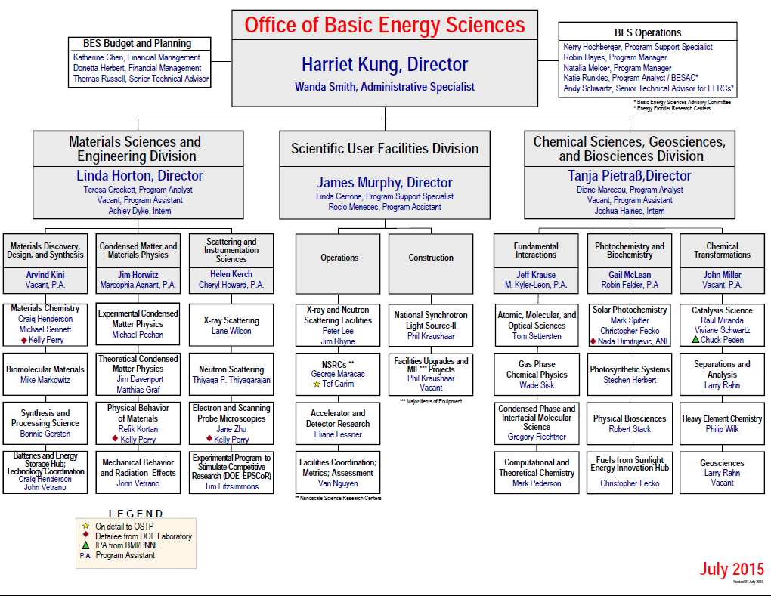
New
Retiring
Vacancy

Slide 4
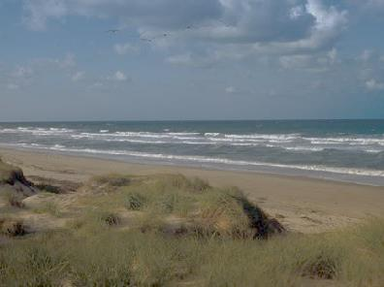
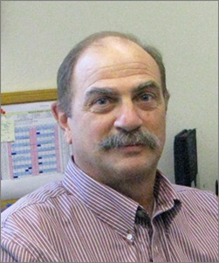

We got the Blues,
We got the Blues so bad.
John Miller is leavin’
And we’re all so sad!
But it’s time for John
To have some fun,
Lazin’ and dreamin’
In the Chesapeake sun!
Please join us in celebrating John’s 14 glorious years at DOE
as well as his 23 years of prior employment at ORNL
Thursday July 23, 2015 from 12:00-2:00 at
The Thai Farm Restaurant
800 King Farm Blvd #125
Rockville, MD 20850

Slide 5
Office of Science Early Career Research Program
Office of Science Early Career Research Program – Started in FY10
Purpose: To support individual research programs of outstanding scientists early in their careers and to stimulate research careers in the disciplines supported by the Office of Science
Eligibility: Within 10 years of receiving a Ph.D., either untenured academic assistant or associate professors on the tenure track or full-time DOE national lab employees
5-Yr Awards: University grants $150,000/yr, National lab awards $500,000/yr min
FY15 Program
609 Office of Science proposals received, 25 Basic Energy Sciences (17 universities, 8 Labs) awards out of a total of 50 awards for the Office of Science
Over 6 years, BES has made 158 awards out of a total of 356 awards for the Office of Science.
Overall demographics of BES Awards:
  30% female and 70% male
  73% university and 27% DOE lab awards
  Average 5.5 years post Ph.D.
  Average success rate of 4.8%
More Information: http://science.energy.gov/early-career/

Slide 6
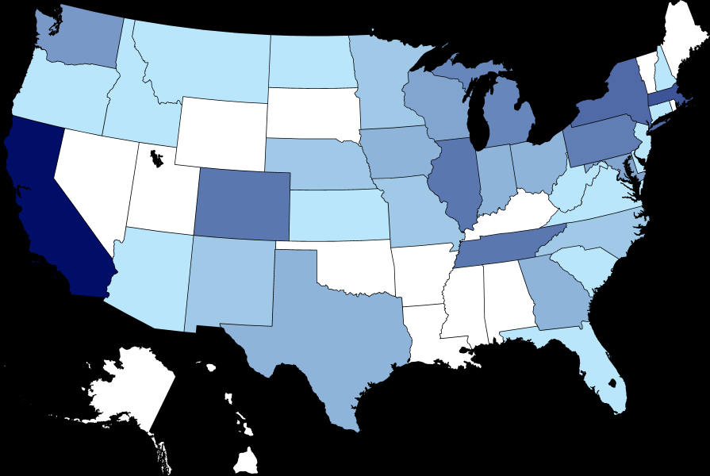
Snapshot of BES Early Career Research Program Awards
158 Awards in 35 States, 12 National Laboratories, and 64 Universities
4.8% success rate
5
1
1
2
1
Rotate Topics
1
4
11
15
Forward Funding
Started
1
7
1
3
8
1
2
9
3
3
4
1
9
1
1
38
1
2
2
9
1
2
3
1
3
1

Slide 7
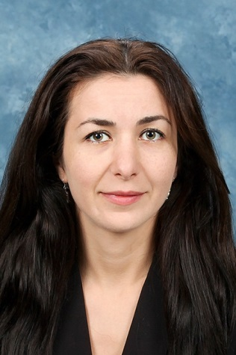
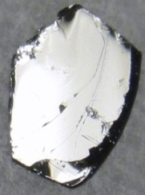
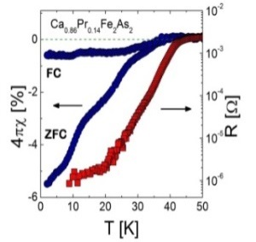
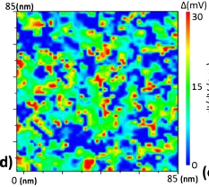
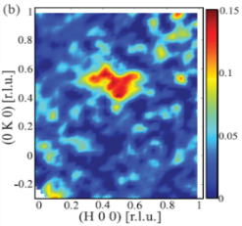
Early Career Research: Materials Sciences and Engineering
Athena Safa-Sefat, Oak Ridge National Laboratory
2010 Early Career Research Program Award: Origin of Superconductivity in Structurally Layered Materials.
Thomson Reuters Highly Cited Researcher (top 1%, 2002-2012).
> 175 publications, > 5800 citations, 38 h-index
> 93 publications during Early Career Award
2014 Science Highlights:
Cu dopants in FeAs planes of BaFe₂As₂ crystal create local lattice distortions and spin fluctuations, preventing superconductivity [PRL 113, 1170013.]
Fermi surface features explain lack of magnetism in a phase of CaFe₂As₂ crystal [PRL 112, 186401.]
  Spatial variation of Pr atoms and local density of states explain non-uniform superconductivity in Ca_{0.86}Pr_{0.14}Fe₂As₂ crystal [PRL 112, 047005.]
Research combines materials discovery & synthesis with theory and advanced characterization (neutrons, microscopy, and x-rays) to connect superconducting behavior on multiple length scales
High profile papers include:
Sefat, A.S. “Bulk synthesis of iron-based superconductors,” Current Opinion in Solid State & Materials Science 17, 59 (2013, invited).
Sefat, A.S. “Pressure effects on two superconducting iron-based families”, Reports on Progress in Physics 74, 124502 (2011, invited).
Sefat, A.S. & Singh, D.J., “Chemistry and electronic structure of iron-based superconductors,” Materials Research Bulletin 36, 614 (2011, invited).

Slide 8
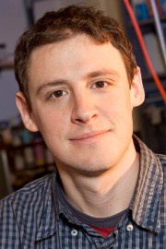
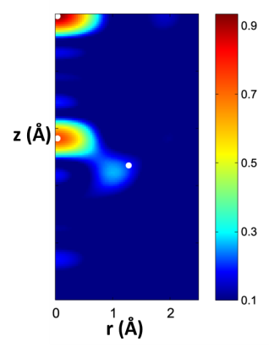
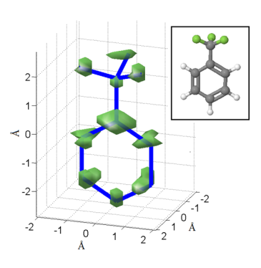



Early Career Research: Chemical Sciences (CSGB)
Martin Centurion, University of Nebraska, Lincoln
2010 Early Career Research program Award: Ultrafast Electron Diffraction from Aligned Molecules
Leader in experimental/algorithmic developments enabling 3D imaging of transient gas-phase structures
Key contributor in development of and first images using SLAC’s MeV ultrafast gas-phase electron diffraction capability
Science Highlights :
Femtosecond-timescale electron diffraction images of transient molecular structures with sub-Å resolution
Ultrafast laser alignment breaks random molecular orientations, enabling gas-phase measurements
Difference diffraction algorithm retrieves 3D structural information
Research uses ultrafast electron pulses to acquire atomically resolved 3D molecular images. Transient states with femtosecond lifetimes have been imaged in addition to static structures.
High profile papers include:
Hensley, C. J., Yang, J., Centurion, M., “Imaging of isolated molecules with ultrafast electron pulses ”, Physical Review Letters 109, 133202 (2012).
Centurion, et al., “Reconstruction of three-dimensional molecular structure from diffraction of laser-aligned molecules,” Structural Dynamics 1, 044101 (2014).

Slide 9
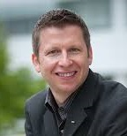
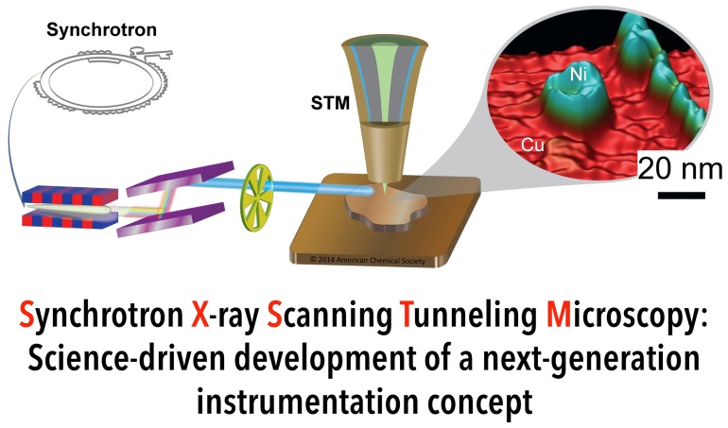
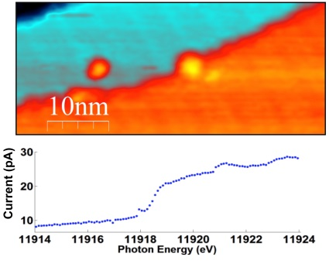

Early Career Research: X-ray & Neutron Scattering Facilities Volker Rose, Argonne National Laboratory
2012 Early Career Research Program Award: Combining Scanning Probe Microscopy and Synchrotron Radiation for Nanoscale Imaging with Chemical, Electronic, and Magnetic Contrast.
2009 R&D 100 Award;
2015 U Chicago Pinnacle of Education Award.
Science Highlights :
Invented way to simultaneously determine physical structure and chemical makeup of materials close to atomic level (U.S. Patent 8,850,611).
Achieved elemental contrast of nanoscale Ni islands on Cu(111) with record-breaking resolution.
Developed world’s first cryogenic SX-STM.
Research enables fundamentally new method of materials characterization by combining exquisite chemical and magnetic sensitivity of x-rays with high spatial resolution of scanning tunneling microscopy .
High profile publications include:
N. Shirato, M. Cummings, H. Kersell, Y. Li, B. Stripe, D. Rosenmann, S.-W. Hla, and V. Rose, Nano Letters 14, 6499-6504 (2014).
V. Rose, K. Wang, T.Y. Chien, J. Hiller, D. Rosenmann, J.W. Freeland, C. Preissner, S.-W. Hla, Adv. Funct. Mater. 23, 2646 (2013).

Slide 10
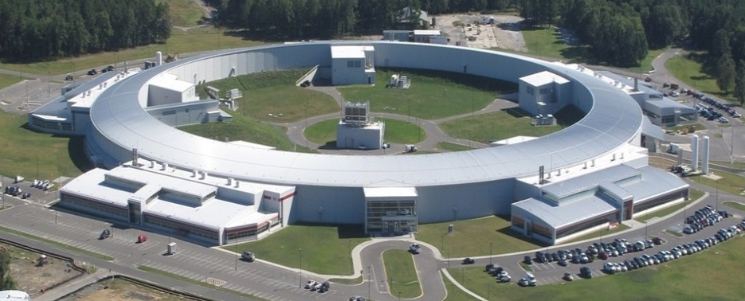
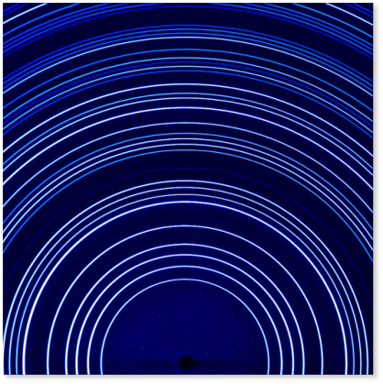
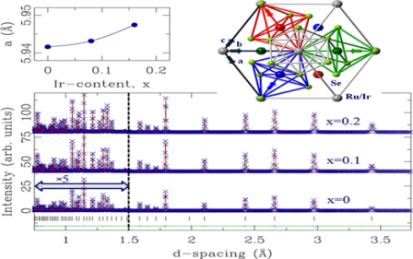
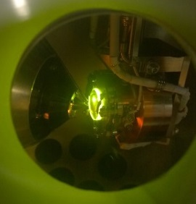
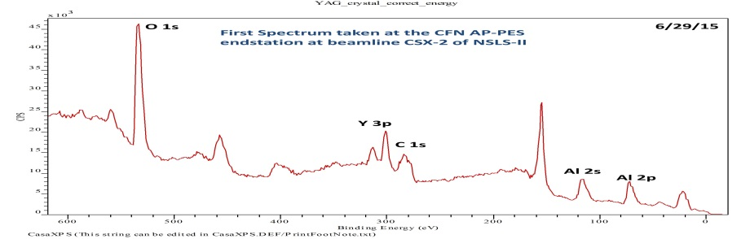
National Synchrotron Light Source-II
Six Project Beamlines in Commissioning and Taking Data
First light achieved on Oct 23, 2014; CD-4 approved on Mar 19, 2015
NSLS-II Accelerator Systems have provided >1500 hours of SR operations in FY15
All project BL IDs commissioned and front-ends are conditioned and certified for 75 mA operations, and currently providing user operation at 50 mA
Successfully stored 250 mA in the storage ring on June 15, 2015
First Publication (data measured at XPD): “Enhanced thermoelectric power and electronic correlations in RuSe2”, Kefeng Wang, et. al., Apl. Phys Lett. Mat. Feb. (2015)
First light and first spectrum taken at CFN AP-PES end-station at beamline CXS-2 of NSLS-II
10

Slide 11
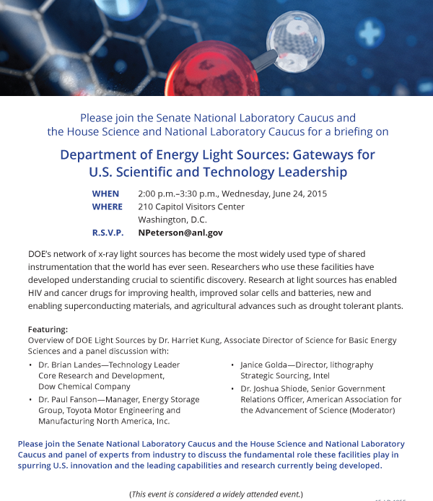
DOE Light Sources:
Gateways for U.S. Scientific and Technology Leadership
A briefing to highlight the contributions of light sources to scientific discoveries and technological advancements was held at the Capitol Visitors Center on June 25, 2015
The event was co-sponsored by the Senate National Laboratory Caucus and the House Science and National Laboratory Caucus.
A panel of industry representatives offered testimonies:
  Brian Landes, Dow Chemical
  Paul Fanson, Toyota North America
  Janice Golda, Intel
  Vincent Stoll, Abbvie
  Moderator: Joshua Shiode (AAAS)

Slide 12
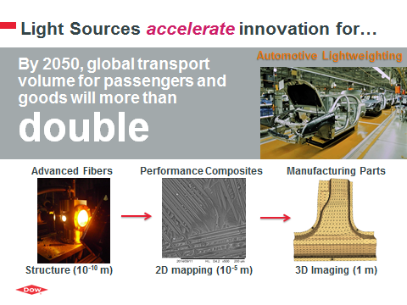
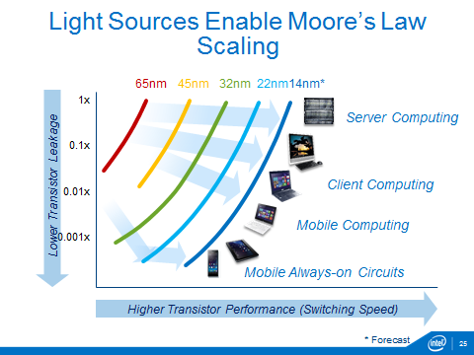
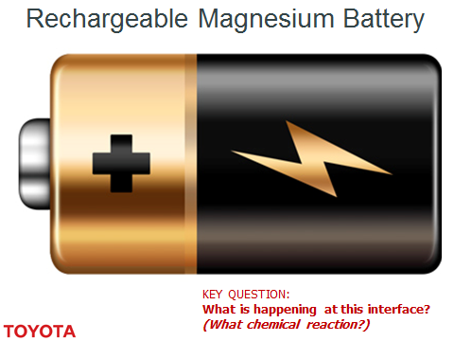
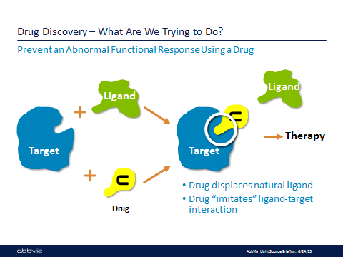

Slide 13
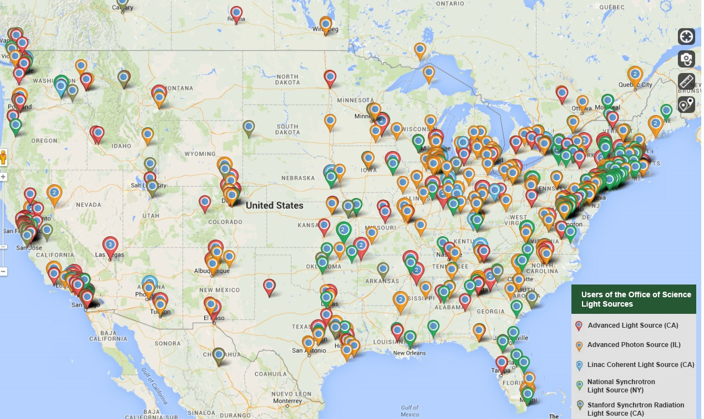

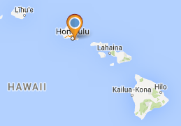
Where Do the U.S. Light Source Users Come From?
http://science.energy.gov/user-facilities/user-statistics/
Alaska
Hawaii

Slide 14
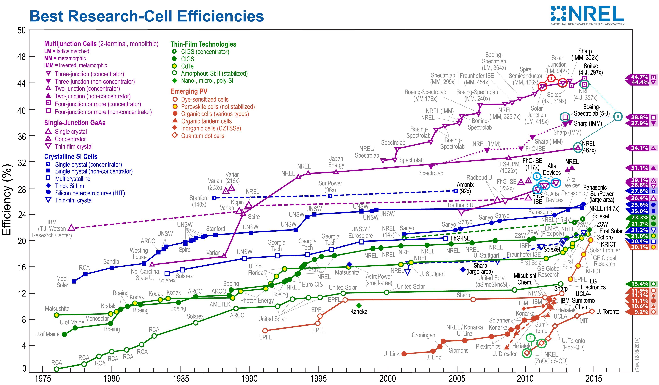
Evolution of Solar Research Cell Efficiencies
Plot courtesy of the National Renewable Energy Laboratory, Golden, CO

Slide 15
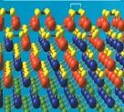
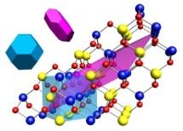
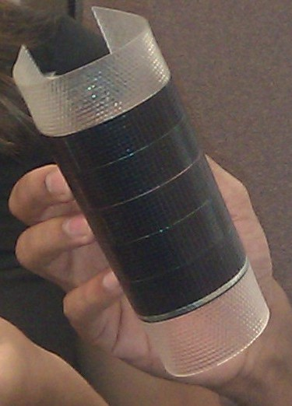
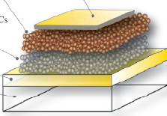
Recent BES Impacts on PV Technologies
III-V multi-junction solar cells based on semiconductors that have been extensively investigated by BES core programs at NREL and elsewhere
Bottom cell of Solar Junction three-junction device based on GaAsN
Top cell for 3 and 4- junction cells is GaInP
Light-Material Interactions in Energy Conversion EFRC
Optimized photon recycling for increased light absorption for epitaxial liftoff GaAs cells
IEEE Journal of Photovoltaics 2, 303 (2012)
Center for Advanced Solar Photophysics EFRC
First quantum dot solar cells
Advanced Materials, 22, 3704 (2010)
Nano Lett., 11, 3263 (2011)
Demonstration of MEG
Science 334, 1530 (2011)
Plot courtesy of the National Renewable Energy Laboratory, Golden, CO

Slide 16
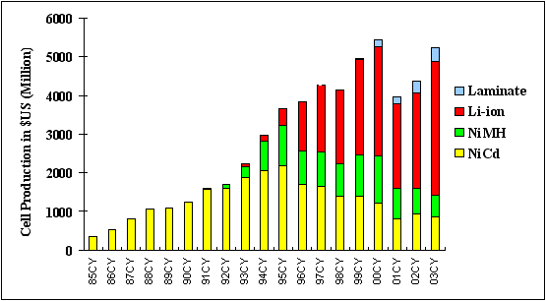
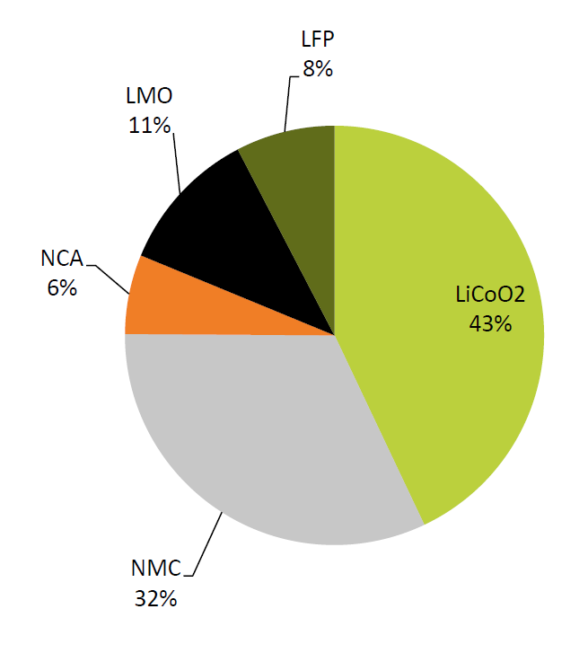
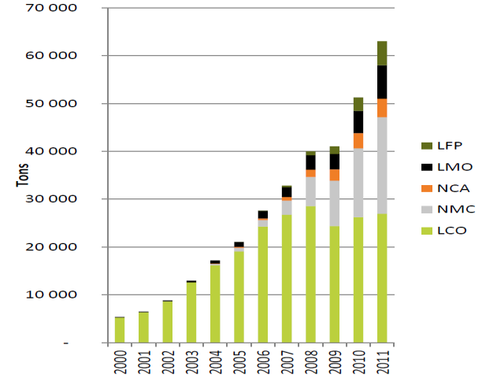
Trends in Lithium-Ion Batteries:
Increased Energy Density, Decreased Cost
Source: www.batteryuniversity.com
Significant growth in the production of Li-ion batteries starting in the mid-90s (red); trends have continued. In that same timeframe, energy density increased by a factor of ~2.5 an cost decreased by a factor of 10.
Li-Fe-P-O Cathode developed at MIT under BES funding
Cathode active materials
Li-Ni-Mn-Co-O Cathode developed at ANL under BES
Cathode active materials for LIB in 2011
Source: The Freedonia Group

Slide 17
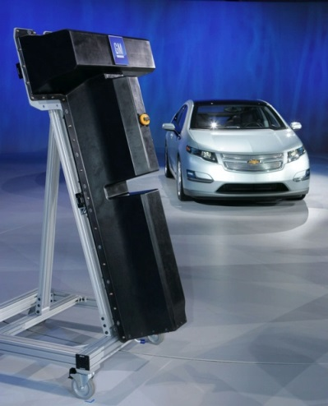
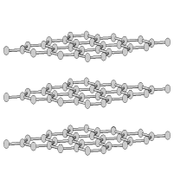
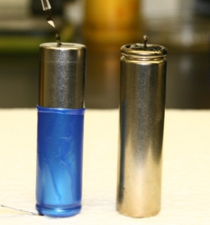






High-Energy Lithium Batteries:
From Fundamental Research to Cars on the Road
BES Basic Science
EERE Applied R&D
Manufacturing/
Commercialization
Discovered new nanostructured composite cathode materials and interfaces
Used advanced composite cathode materials to create high energy lithium ion cells with improved performance
Patents for new cathodes from the basic and applied research are licensed to materials and cell manufacturers and automobile companies
MO₂
Li_{x}C₆
(Anode)
xLi₂MnO₃•(1-x)LiMO₂
(Cathode)
Li₂M’O₃
LiMO₂
e⁻
Path of electrochemical
lithiation
M = Mn, Ni, Co
M’ = Mn, Ti, Zr
Li₂MO₂
Li⁺
Used the Advanced Photon Source
to characterize and understand composite cathode structures
High energy Li-ion cells…
…with increased cathode capacity, enhanced stability
Fourier-transformed X-ray absorption data of a composite cathode structure

Slide 18
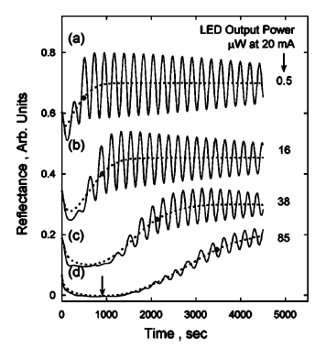
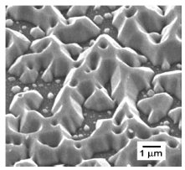
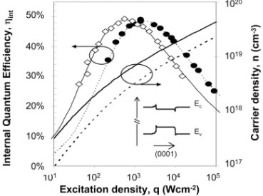

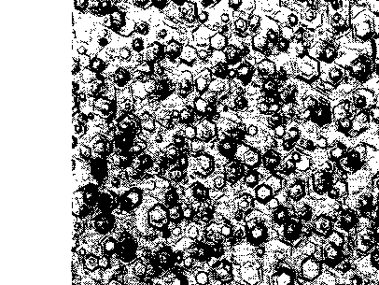
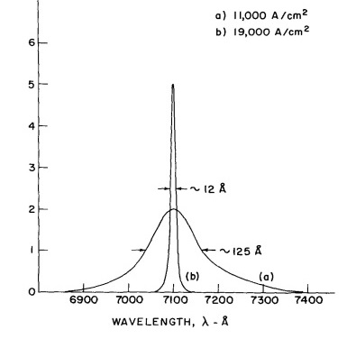
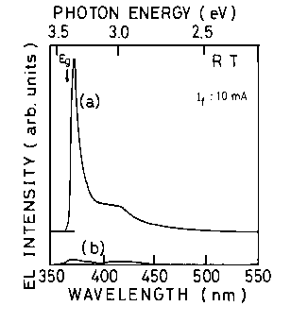
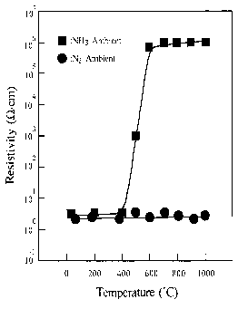
Science Underpinnings of Solid-State Lighting Technologies
1
Since 1995: Fundamental Physics of Epitaxy and Devices ➔ Efficiency Gains
GaAlInP
10⁻¹
DH:GaAlAs
InGaN
PC-White
GaN growth modes
Han (1997),
Koleske (2001)
InGaN
Wall-plug Efficiency
GaAlAs
ZnSe
10⁻²
GaP:Zn,O
GaAsP:N
10⁻³
GaAsP
SiC
10⁻⁴
Piezoelectric effects on band structure – e.g., Takeuchi (1997), Chichibu (1998)
Origins of “Droop”
e.g., Krames (2007), Weisbuch (2013)
Prior to 1995: LED-Based Lighting Technology is Born
First visible (deep red) LED Holonyak (1962)
Annealing for p-doping of GaN
Amano, Akasaki, Nakamura
(1989,1992)
Buffer layers for high-quality GaN
Amano, Akasaki, Nakamura
(1986, 1991)
Candela-class blue LED
Nakamura (1994)

Slide 19


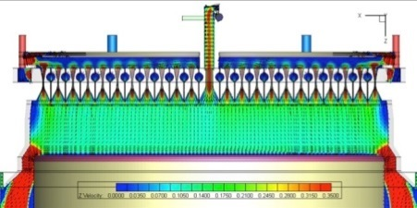
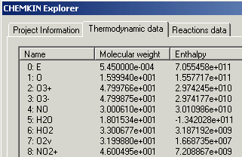
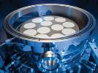
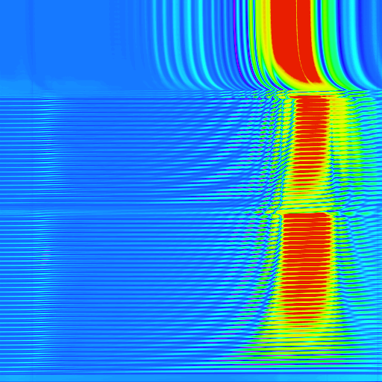
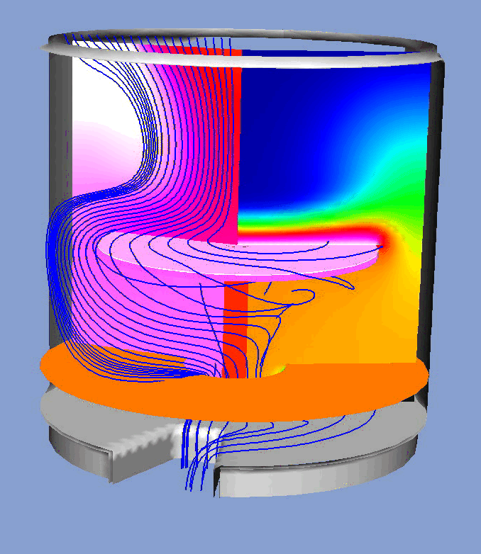




Solid-State Lighting:
Basic Research in Film Growth and In-situ Diagnostics
BES Basic Science
Applied R&D
Manufacturing (EERE)
Detailed mechanistic research on semiconductor deposition
Software and in-situ diagnostic tools licensed & commercialized
New MOCVD systems and models of the growth process enable improved manufacturing and material properties
In-situ diagnostics of growth chemistry
Reaction Design license for sales & support of Chemkin
Sandia transferred modeling and in situ monitoring expertise to Veeco
UHV surface studies
New reactor design
improved throughput
and reproducibility.
First detailed model of coupled gas-phase / surface chemistry and transport in CVD (Chemkin software)
In-situ monitor
licenses: Filmetrics, LayTec, K-Space, and Emcore
R&D 100
Award
Silicon CVD chemistry research (~4,800 citations)
Veeco new 465i reactor enables~70% reduction in epi-materials growth cost.

Slide 20










A Brighter Light, 50 Atoms Wide
Quantum Dots Impact Display and Medical Technologies
BES Basic Science
Applied R&D
Manufacturing/
Commercialization
Research on synthesis of quantum dots (QDs): semiconductor crystals 50 atoms wide, emit light when excited by electricity
Research on how to manipulate nanocrystals to improve optical properties for specific applications
Commercialization by Nanosys and Life Technologies, each of whom licensed QD patent portfolio in specific fields of use
Fabricated QDs and developed method
for tuning color output in QD film
Discovered how to reliably control QDs size, and how size controls emission of multiple colors of light
QD technology enhances color, brightness and energy performance in LCD screens
Discovered how to manipulate QD shape, and how shape controls electrical/optical properties
Developed method to simultaneously label several biological markers using QDs
Supported by industry partners Nanosys
and Quantum Dot Corporation
QDs used as fluorescence probes ‘Qdot probes’ for biomedical assays

Slide 21
FY 2016 BES Budget Request
Research programs
  Energy Frontier Research Centers ($110M; Δ = +$10M)
  Mid-scale Instrumentation for ultrafast electron scattering ($5M)
  Computational Materials Sciences ($12M; Δ = +$4M)
  Core Research & Energy Innovation Hubs at ~FY 2015 level ($550.5M)
Scientific user facilities
    All full operating facilities at near optimal (~99%) operations ($850.9M)
      NSLS-II 1st year of full operations ($110M; Δ = +$19.6M )
FY 2016 Request:
$1,849.3M
(+$116.1M from FY 2015)
SUF Research 22.2
SBIR/STTR, LTSM & GPP
67.9
Construction
MIE
NSRCs 118.8
235.8
Neutron Sources
255
EFRCs, Hubs, CMS
161.1
Facilities
Ops 850.9
CSGB
Research
241
Light Sources
477.1
MSE
Research
270.4
Construction and instrumentation
  NSLS-II instrumentation (NEXT) ($15.5M)
  Advanced Photon Source upgrade ($20M)
  Linac Coherent Light Source-II ($200.3M; Δ = +$52.3M )

Slide 22
FY 2016 SC Appropriations: HEWD vs. SEWD
HEWD Mark
$ in K | FY 15 Approp. | FY 16 Request | FY 16 HEWD | FY 16 HEWD vs. FY 15 |  | FY 16 HEWD vs. FY 16 Req.
SC Total | 5,140,438 | 5,339,794 | 5,095,283 | -45,155 | -0.9% | -244,511 | -4.6%
ASCR | 541,000 | 620,994 | 537,539 | -3,461 | -0.6% | -83,455 | -13.4%
BES | 1,733,200 | 1,849,300 | 1,770,306 | +37,106 | +2.1% | -78,994 | -4.3%
BER | 612,400 | 612,400 | 538,000 | -74,400 | -12.1% | -74,400 | -12.1%
FES | 420,000 | 420,000 | 467,600 | +47,600 | +11.3% | +47,600 | +11.3%
HEP | 788,000 | 788,000 | 776,000 | -12,000 | -1.5% | -12,000 | -1.5%
NP | 624,600 | 624,600 | 616,165 | -8,435 | -1.4% | -8,435 | -1.4%
SEWD Mark
$ in K | FY 15 Approp. | FY 16 Request | FY 16 SEWD | FY 16 SEWD vs. FY 15 |  | FY 16 SEWD vs. FY 16 Req.
SC Total | 5,140,438 | 5,339,794 | 5,139,160 | -1,278 | -0.02% | -200,634 | -3.8%
ASCR | 541,000 | 620,994 | 620,994 | +79,994 | +14.8% | —— | ——
BES | 1,733,200 | 1,849,300 | 1,844,300 | +111,100 | +6.4% | -5,000 | -0.3%
BER | 612,400 | 612,400 | 610,000 | -2,400 | -0.4% | -2,400 | -0.4%
FES | 420,000 | 420,000 | 270,168 | -149,832 | -35.7% | -149,832 | -35.7%
HEP | 788,000 | 788,000 | 788,100 | +100 | +0.01% | +100 | +0.01%
NP | 624,600 | 624,600 | 591,500 | -33,100 | -5.3% | -33,100 | -5.3%
22

Slide 23
FY 2016 BES HEWD Mark
The Committee recommends $1,770,306,000 for Basic Energy Sciences, $37,106,000 above fiscal year 2015 and $78,994,000 below the budget request.
Research
  Within available funds, the recommendation provides $97,800,000 for Energy Frontier Research Centers.
  For materials science and engineering research, the recommendation includes $377,085,000, of which $14,355,000 is for the Experimental Program to Stimulate Competitive Research (EPSCoR) and $8,000,000 is for Computational Materials Sciences. All other activities within this subprogram are funded at the requested level, including $24,137,000 for the fourth year of the Batteries and Energy Storage Innovation Hub.
  For chemical sciences, geosciences, and biosciences, the recommendation includes $305,974,000. The recommendation includes the requested level of $15,000,000 for the Fuels from Sunlight Innovation Hub, which begins the first year of its second five-year term in fiscal year 2016.
For scientific user facilities, the recommendation includes $895,381,000, of which $32,168,000 is for research; and $35,500,000 is for major items of equipment, same as the request (APS-U, NEXT). The recommendation includes $797,049,000 for facilities operations of the nation’s synchrotron radiation light sources, high flux neutron sources, and nanoscale science research centers, of which $245,419,000 is for the High-Flux Neutron Sources and $443,150,000 is for the Synchrotron Radiation Light Sources.
Construction.—The Committee recommends $191,866,000 for Basic Energy Sciences construction (LCLS-II), $53,166,000 above fiscal year 2015 and $8,434,000 below the budget request.
23

Slide 24
FY 2016 BES SEWD Mark
The Committee recommends $1,844,300,000 for Basic Energy Sciences, $111,100,000 above fiscal year 2015 and $5,000,000 below the budget request. Of these funds, $1,644,000,000 is for research. Within available funds for operations and maintenance of scientific user facilities, the Committee recommends $254,990,000 for high-flux neutron sources and $477,079,000 for near-optimal operations for the five BES light sources, including $125,500,000 the first full year of operations for the newly constructed NSLS-II.
An additional $10,000,000 is provided to accelerate completion of the Conceptual Design Report for the Second Target Station at the Spallation Neutron Source. Further, $5,000,000 is provided for research and development for the Advanced Light Source Upgrade. $20,000,000 is provided for the Advanced Photon Source Upgrade project, the same as the budget request. To better plan for costs of these upgrades and major construction projects, the Committee requests the Basic Energy Sciences Advisory Committee to provide a list prioritizing the order of the next five projects not later than 90 days after enactment of this act.
The Committee also recommends $12,000,000 for exascale systems (Computational Materials Sciences), the same as the request. The Committee recommends within the funds provided $3,000,000 for a competitive solicitation for universities to perform fundamental research toward the development of a new generation of nanostructured catalysts that can be used to synthesize fertilizer and ammonia without any secondary greenhouse gases.
The Committee recommends $24,137,000 for the Batteries and Energy Storage Hub, the Joint Center for Energy Storage Research [JCESR]. The Committee recommends $15,000,000 for the Fuels from Sunlight Hub, the Joint Center for Artificial Photosynthesis [JCAP].
The Committee also recommends $20,000,000 for the Experimental Program to Stimulate Competitive Research [EPSCoR].
24

Slide 25
FY 2016 Appropriations Marks: HEWD vs. SEWD
HEWD Mark
SEWD Mark
 | FY 2015 Approp. | FY 2016 Request | FY 2016 House | FY 16 House vs. FY 15 Approp. |  | FY 16 House vs. FY 16 Request
BES Total | 1,733,200 | 1,849,300 | 1,770,306 | +37,106 | +2.1% | -78,994 | -4.3%
MSE & CSGB | 678,121 | 697,151 | 683,059 | +4,938 | +0.7% | -14,092 | -2.0%
SUFD | 916,379 | 951,849 | 895,381 | -20,998 | -2.3% | -56,468 | -5.9%
Construction | 138,700 | 200,300 | 191,866 | +53,166 | +38.3% | -8,434 | -4.2%
 | FY 2015 Approp. | FY 2016 Request | FY 2016 Senate | FY 16 Senate vs. FY 15 Approp. |  | FY 16 Senate vs. FY 16 Request
BES Total | 1,733,200 | 1,849,300 | 1,844,300 | +111,100 | +6.4% | -5,000 | -0.3%
MSE & CSGB | 678,121 | 697,151 | 692,971 | +14,850 | +2.2% | -4,180 | -0.6%
SUFD | 916,379 | 951,849 | 951,029 | +34,650 | +3.8% | -820 | -0.1%
Construction | 138,700 | 200,300 | 200,300 | +61,600 | +44.4% | — | —
  BES DMSE core research is held approximately flat with FY 2015, while CSGB is reduced $1.1M below FY 2015.
  EFRCs are reduced to $97.8M, likely preventing a planned solicitation in FY 2016.
  $8M for computational materials sciences, $4M below the request.
  The LCLS-II construction project is funded at $191.9M, $8.4M below the request.
  MIEs (NEXT and APS-U) are funded at the request.
  Facilities operations are funded at $797M, $54M below the request. For the last three fiscal years, the scientific user facilities have been funded below the President’s Request. The compounding effect of these suboptimal budgets for operations can no longer be absorbed by further delaying maintenance, upgrades, or procurement activities. RIFs and reduction in hours are likely at this funding level.
  $14.4M for DOE EPSCoR, $5.8M above the request.
  The overall funding for core research is largely flat, providing no new funds for midscale instrumentation ($5M in the request).
  A directed investment of $3M for ammonia synthesis will likely divert funding from existing catalysis projects.
  $100M for EFRCs, $10M below the request and likely preventing a planned solicitation in FY 2016.
  $12M is provided for computational materials sciences, same as the request.
  All construction and MIE projects (LCLS-II, NEXT, APS-U) and the neutron scattering facilities are funded at the requested levels.
  NSLS-II is funded at $125.5M, $15.5M above the request. The operations at the remaining light sources must be reduced by $15.5M to offset the increase.
  NSRCs are funded at $106M, $12.7M below the request significantly impacting operations. RIFs are likely at this level.
  New funds provided for STS ($10M) and ALS-U ($5M).
  $20M for DOE EPSCoR, $11.5 M above the request.
25

Slide 26


BESAC New Charge on Strategic Planning for BES Research
From: Dr. Pat Dehmer (Acting Director of Office of Science)
The new BESAC study should evaluate the breakthrough potential of current and prospective energy science frontiers based on how well the research advances the five grand science challenges. Your report will advise BES in its future development of focused, effective research strategies for sustained U.S. leadership in science innovation and energy research.
I ask BESAC to consider the following questions in formulating the study plan:
What progress has been achieved in our understanding of the five BESAC Grand Science Challenges?
What impact has advancement in the five Grand Science Challenges had on addressing DOE’s energy missions? With evolving energy technology and U.S. energy landscape, what fundamental new knowledge areas are needed to further advance the energy sciences? Please consider examples where filling the knowledge gaps will have direct impacts on energy sciences.
What should the balance of funding modalities (e.g., core research, EFRCs, Hubs) be for BES to fully capitalize on the emerging opportunities?
Identify research areas that may not be sufficiently supported or represented in the US community to fully address the DOE’s missions.

Slide 27
























BES Strategic Planning and Program Development
1999
2000
2002
2004
2006
2008
2010
2012
2015
NNI
HFI
EFRCs
Early Career Research
Batteries Hub
Solar Fuels Hub
CMS
BESAC
BES
27
http://science.energy.gov/bes/news-and-resources/reports/

Slide 28




Basic Research Needs for Environmental Management Workshop
Co-sponsored by ASCR, BER, BES; July 8–10, 2015
Workshop Chair: Sue Clark (PNNL/WSU)
Associate Chairs: Michelle Buchanan (ORNL)
Bill Wilmarth (SRNL)
SC Technical Lead: Andy Schwartz (BES)
CHARGE: To conduct a thorough assessment of the scientific issues associated with the environmental management stewardship responsibility of DOE, and to identify scientific challenges, fundamental research opportunities, and priority research directions in the following areas:
  Waste stream characterization, transformation, and separations
  Waste form
  Contaminant fate and transport in geological environments
Breakout Sessions and Chairs:
Waste Stream Characterization, Transformation, and Separations: Jen Braley (CSM), Mark Antonio (ANL)
Waste Form: Jerry Frankel (OSU), Jim Marra (SRNL)
Contaminant Fate and Transport in Geological Environments: David Cole (OSU), Susan Hubbard (LBNL)
Crosscutting Research: Aurora Clark (WSU) & Todd Allen (INL)
Factual Document:
“Assessment of Technologies
for the DOE EM Mission”
Pre-Workshop Webinars:
EM Overview: June 25, 2015
SC Overview: June 30, 2015
Plenary Session Speakers:
  Pat Dehmer, DOE-SC
  Monica Regalbuto, DOE-EM
  Richard Meserve, Covington & Burling LLP
  Andrew Felmy, PNNL
  Bill Weber, UTK
  Carl Steefel, LBNL

Slide 29

Nano Placemat
http://science.energy.gov/bes/news-and-resources/nano-energy/
http://science.energy.gov/bes/news-and-resources/

