Slide 1
Quadrennial Technology Review
Presentation to the Basic Energy Sciences Advisory Committee
Lynn Orr
Under Secretary for Science and Energy
July 7, 2015

Slide 2
Rapidly evolving energy sector
The last five years have been defined by dramatic changes across the energy industry:
  Unconventional fossil fuel production
  Renewables cost reduction and market penetration
  New nuclear power construction
  Increased transportation electrification
  Increased efficiency in buildings and industry
  Advances in manufacturing and competitiveness
  Increasing use of digital technologies in the energy sector – Power, Vehicles, and Buildings
The grand challenges, policies, and dramatic changes in industry and technology require new approaches that better configure our programs, capabilities, and infrastructure for success.

Slide 3
Administration priorities
President Obama set forth the Administration’s Climate Action Plan in June 2013 with three key thrusts:
  Cutting carbon emissions in the United States
  Preparing the United States for the impacts of climate change
  Leading international efforts to address global climate change
In November 2014, the US made a historic commitment to reduce greenhouse gas emissions by 26-28% below 2005 levels by 2025.
The US’s commitment and demonstrated ability to meet our goals are key to climate negotiations at COP21 taking place in Paris in December 2015.

Slide 4
Quadrennial Reviews Underway
Quadrennial Energy Review: Called for by the President to analyze government-wide energy policy, particularly focused on energy infrastructure.
Quadrennial Technology Review: Secretary Moniz requested the second volume be published in parallel with the QER to provide analysis of the most promising RDD&D opportunities across energy technologies in working towards a clean energy economy.
  The resulting analysis and recommendations of the QTR 2015 will inform the national energy enterprise and will guide the Department of Energy’s programs and capabilities, budgetary priorities, industry interactions, and National Laboratory activities.

Slide 5
QTR 2015 Chapter Outline
National Energy System Strategic Objectives and Challenges
Energy Sectors and Systems
Enabling the Modernization of Electric Power Systems
Advancing Clean Electric Power Technologies
Increasing Efficiency of Building Systems and Technologies
Innovating Clean Energy Technologies in Advanced Manufacturing
Advancing Systems and Technologies to Produce Cleaner Fuels
Advancing Clean Transportation and Vehicle Systems and Technologies
Enabling Capabilities for Science and Energy RDD&D
Concepts in Integrated Analysis
Conclusions
Web Appendices
Introduction
Technology Assessments
Integrated Analysis

Slide 6
Process
Numerous experts from academia, industry, and the National Laboratories have been engaged through workshops, webinars, and peer review to inform and help shape the report.
The technology chapters of the QTR are informed by a number of in-depth technology assessments that analyze the current status and opportunities of individual energy technologies by sector.
Briefings have been provided to Secretary Moniz and the Office of Management and Budget.

Slide 7
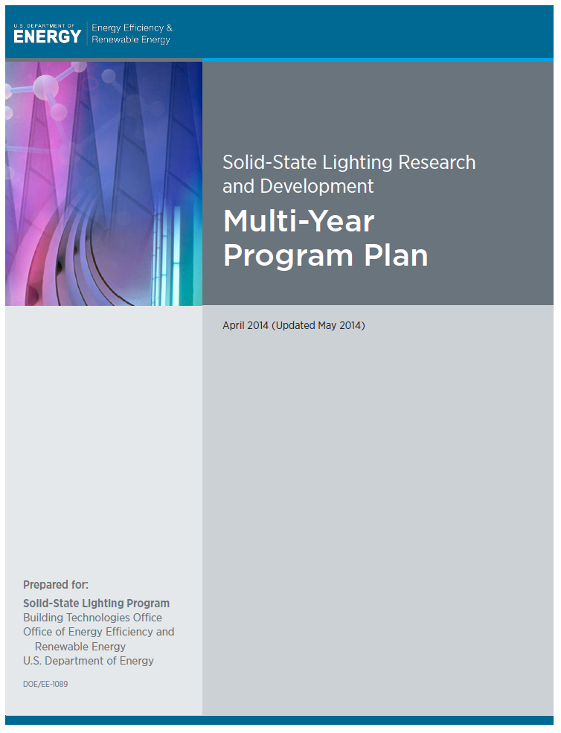
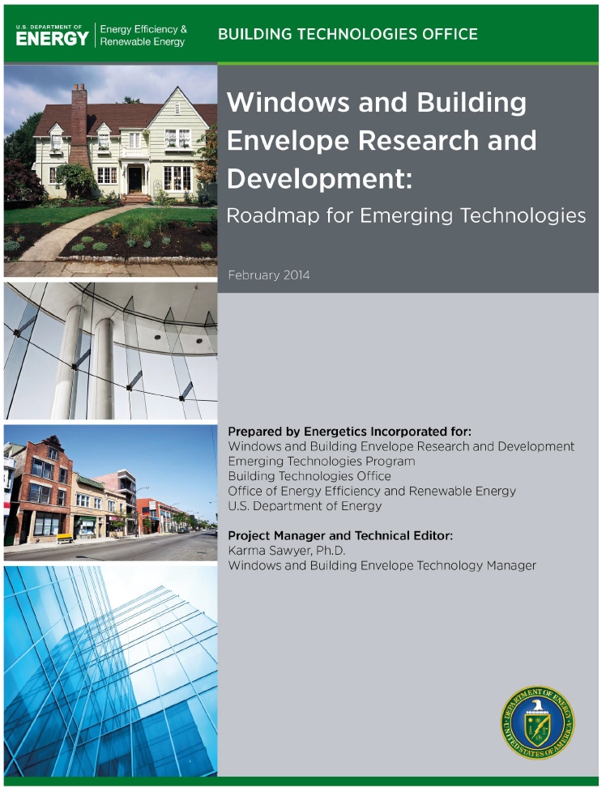
Extensive Outreach to Industry, Universities, Stakeholders
Builds on program activities: workshops, reviews,
road mapping (e.g., The Office of Electricity held 50+ workshops in two years).
Satellite Events: at major conferences and workshops to engage leading experts.
Dedicated Workshops:
  Sector specific: e.g. Nuclear, Transportation
  Cornerstone, with ~150 participants with industry/ university/stakeholder thought-leaders
  Capstone, with ~150 participants, with industry/ university/stakeholder thought-leaders
Expert and Public Outreach: Webinars to engage public and expert community: e.g., Grid, Manufacturing, others.
External Peer Review: ~200+ reviewers for chapters and related Technical Assessments, including 40 hours of VTC and Webinars.

Slide 8
Systems Analyses and
Technology Assessments
Designs, Architectures, Concepts
Measurement, Comm., Control
Flexible & Distributed Resources
Cyber Security
T&D Components
Electric Energy Storage
  A new level of systems analyses and technology assessments are being completed.
  Increased science, energy, and cross-technology integration involving a large community of national laboratory participants working with DOE Staff.
Carbon Capture
Carbon Storage
CCS for Industry
Fossil Advanced Energy Systems
CCS Cross-cutting Technologies
BioPower – CCS
Stationary Fuel Cells
Geothermal Power
Hydropower
Nuclear Fast-Spectrum Reactors
Nuclear Fuel Cycle
Nuclear Light Water Reactors
Nuclear Hybrids
Nuclear High Temp. Reactor
Solar CSP and PV Power
Marine Hydrokinetic Power
Wind Power
Sectors/Systems Analyses | Technology Assessments
Clean Fuels | 7
Grid Modernization | 6
Clean Electric Power | 17
Buildings | 4 roadmaps
Industry & Manufacturing | 14
Clean Transportation & Vehicles | 5
Additive Manufacturing
Combined Heat and Power
Composite Materials & Manufact
Critical Materials
Materials Flow Through Industry
Process Heating
Process Intensification
Roll-to-roll Processing
Smart Manufacturing
………

Slide 9
Preliminary Findings by Technology Chapter

Slide 10
  Enabling Modernization of Electric Power Systems
The modern grid needs enhanced observability, controllability and interoperability to adapt to increasing complexities of generation and end use.
Research, development, demonstration and deployment (RDD&D) opportunities in seven high impact areas to build the fundamental capabilities required for a modern electric power grid:
  Grid Design and Interoperability
  Control Systems for Transmission and Distribution
  Transmission and Distribution Components
  Distributed Energy Resources
  Electrical Energy Storage
  Planning Tools
  Physical and Cyber Security
Notes:
Overarching Challenge: Increasing complexities and demands for a modern grid:
On the supply side, there is a shift from coal generators to gas-fired generators and growing adoption of centralized and distributed variable resources (renewables).
On the demand side, there is a rapidly growing use of distributed generation and a shift from induction motor loads to greater use of electronic converters in buildings, industrial equipment, and consumer equipment.
Growing adoption of digital communications and control systems which increase data collection points and engage consumers.

Slide 11
  Advancing Clean Electric Power Technologies
Advancements in technologies both being deployed today such as solar, wind and CCS, as well as those on the horizon such as fuel cells and marine hydrokinetic power will be important to a clean energy future.
RDD&D opportunities in clean electric power technology development include:
  Carbon Capture and Storage – Second generation pilot demonstrations, retrofits, natural gas
  Nuclear Power – Novel fuels with enhanced safety characteristics, fast reactors, SMRs, fuel cycle technology, high temperature reactors and hybrid systems
  Hydropower - Materials and turbine designs, modularization, footprint reduction
  Wind Power - atmospheric flow models, offshore development, grid integration
  Biopower – BECCS, biomass gasification
  Solar (PV & CSP) – manufacturing and capital costs, integration with storage solutions
  Geothermal Energy – characterization, control of fracturing, subsurface access, hybrid systems
  Fuel Cells – durability, component and system costs, gas cleanup
  Marine Hydrokinetic Power – advanced controls, compact generators, corrosion and biofouling
Notes:
Overarching challenge:
The current portfolio of electric production includes a combination of reliable, but aging, base-load generation, evolving renewable resources, and new natural gas resources.
As the industry evolves to meet growing electrification and GHG reduction goals, challenges arise in optimizing the system, minimizing risks, and maintaining reasonable cost.

Slide 12
  Increasing Efficiency of Building Systems and Technologies
R&D opportunities in the buildings sector emphasize both cost reductions as well as efficiency improvements.
Key RDD&D opportunities include:
  Building thermal comfort and appliances – for example materials that facilitate deep retrofits of existing buildings (thin insulating materials), improved low-GWP heat pumping systems, and improved tools for diagnosing heat flows and measuring performance
  Lighting – further advancing LED and OLED technologies to include high efficiency green LEDs, reducing costs of OLEDs, and development of test procedures for determining the product lifetimes
  Electronics and Miscellaneous Building Energy Loads – for example more efficient circuitry, and more flexible power management, standardized communications protocols, and development of wide-band-gap semiconductors for power supplies
  Systems-Level Opportunities -- Developing energy harvesting systems to provide power for wireless sensors and controls, developing algorithms that allow building sensor and control systems to automatically optimize, and developing components and system designs that allow building devices to share waste heat
Notes:
Overarching Challenge:
Buildings account for 40% of total U.S. energy consumption.
The biggest consumers of energy within buildings are heating, ventilation, and air conditioning (HVAC) systems, lighting, water heating, refrigeration, and electronic devices.
The most energy intensive of this is HVAC.

Slide 13
  Innovating Clean Energy Technologies in Advanced Manufacturing
Improved manufacturing technologies can drive economy-wide energy impacts at three levels:
  Manufacturing unit operation systems
  Production/facility systems
  Supply-chain systems
Using this systems framework, RDD&D opportunities for consideration include:
Process heating systems
Motor-driven systems
Process intensification
Roll-to-roll processing
Additive manufacturing
Combined heat and power
Waste heat recovery
Advanced sensors, controls, platforms, and modeling for manufacturing
  Industrial demand-side management
  Advanced materials manufacturing
  Critical materials
  Sustainable manufacturing
  Direct thermal energy conversion materials, devices, and systems
  Materials for harsh service conditions
  Wide bandgap semiconductors
  Composite materials
Notes:
Overarching challenge:
The manufacturing sector consumes 79% of total industrial energy use.
However, the energy impacts are much broader, as manufactured goods affect the production, delivery, and use of energy.

Slide 14
  Advancing Systems and Technologies to Produce Cleaner Fuels
  Fuels supply 99.8% of the energy needed by our national transportation system, and a strong understanding of the technological options in the fuels sector can support an informed R&D strategy going forward.
Technology RDD&D opportunities and areas to be addressed include:
  Oil and gas:
    Minimizing the safety and environmental impacts of unconventional oil and gas development
    Protecting groundwater, increasing water availability and protecting air quality
    Understanding induced seismicity
  Bioenergy for Fuels:
    Costs of feedstock production, logistics, and conversion.
    Produce and manage a consistent suite of lignocellulosic feedstocks.
    Improving enzymes and micro-organisms for biochemical pathways and improving catalysts and processes for thermochemical pathways.
    High-value bioproducts and bio-based inputs to chemicals.
  Hydrogen
    Continued RDD&D of materials and systems innovations to improve efficiencies, performance, durability, cost, and address safety across all hydrogen production, delivery, storage, and dispensing options.
Notes:
Overarching challenge:
Fuels supply 99.8% of the energy needed by our national transportation system and 70% of that needed to generate our electricity.
Fossil fuels account for 83% of total energy use in the U.S.
The fuels sector is rapidly changing, with shale gas and oil sharply increasing over the past few years and commercial production of cellulosic biomass fuels posted to begin in 2015.

Slide 15
  Advancing Clean Transportation and Vehicle Systems and Technologies
The transportation technology portfolio requires complementary approaches that together shape an integrated R&D strategy for greenhouse gas emissions reduction including efficiency improvement, electric drivetrains, renewable fuels, and transportation system efficiencies.
Key considerations and areas to be addressed include:
  Fuel economy improvement
  Fuel-vehicle co-optimization
  Lightweighting of vehicles
  Electric drivetrain vehicles
  Battery cost, weight, and reliability improvements
  Power electronics, traction motor(s), and controls research to reduce cost
  On-board hydrogen storage
  Other transportation modes with significant efficiency improvement potential—including aviation, marine, rail, and off-road equipment
  A systems perspective on transportation and technologies that will enable future investment in smarter transportation systems and technologies.
Notes:
Overarching challenge:
Currently, light- medium-, and heavy-duty vehicles account for approximately three quarters of transportation energy use and emissions.
To greatly reduce greenhouse gas emissions, a larger share of vehicles must more efficiently use fuels and/or use lower carbon energy as it is not currently possible to capture and store carbon dioxide emissions from small, mobile sources.

Slide 16
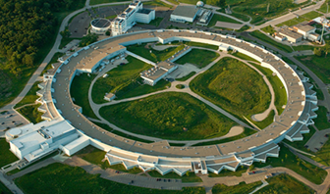
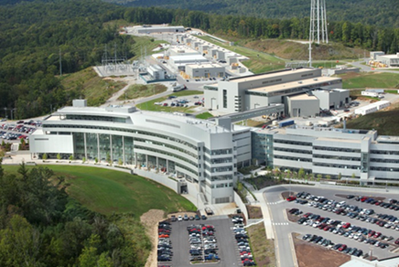
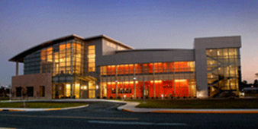
Understanding and Controlling Matter at the Atomic Scale
Unique, cutting-edge experimental tools for characterization, discovery, and synthesis of novel materials and energy systems.
X-ray light sources provide a range of wavelengths capable of probing structures as small as atoms to whole cells and beyond.
  LCLS-II and APS-U will provide higher energy and brighter beams.
  Instrument development brings NSLS-II’s world-leading beam brightness to more experiments.
Neutron sources are uniquely suited to non-destructive 3D structure determination of real systems.
  The SNS Second Target Station would enable new science in condensed matter, structural biology, and energy materials.
Nanoscale Science Research Centers integrate theory, synthesis, fabrication, and characterization of novel nanomaterials
    New capabilities in in operando electron microscopy and accelerator-based nanoscience.
    Novel fabrication techniques in combinatorics and self-assembly.
On-going research, development, and upgrades for facilities opens new frontiers in materials characterization (real systems in real time).
Notes:
Overview and motivation:
The Office of Basic Energy Science provides researchers with tools to probe fundamental materials properties and manipulate those properties through nano- and mesoscale synthesis techniques, creating tailored functionalities (towards systems by design - the main theme of the chapter). Pictures: APS (ANL); SNS (ORNL); CFN (BNL)
Each subsection is devoted to a class of facility: x-ray light sources; neutron scattering; and nanoscale science research centers.
The description of each class of facility provides readers with a description of the breadth of the facilities (5 x-ray light sources; 2 neutron scattering facilities; etc.), a general description of the unique opportunities afforded by each type of facility (with links to more detailed technical information), selected applications in science and technology R&D; and snapshot of how the facilities will be developed in the 5-10 year time frame (e.g. LCLS-II, the proposed STS). This approach is used throughout the four sections surveying the capabilities.
Light sources:
Each source has unique strengths, from hard x-ray imaging at the APS to ultrafast dynamics at LCLS.
Upgrades to LCLS and APS will open more systems to in situ and in operando studies.
NSLS-II is currently operating, and new end stations continue to be developed, expanding the application space for this cutting-edge light source.
Neutron sources:
The sensitivity to light atoms is invaluable to the study of soft matter and biological systems.
Neutrons have been used in the study of stress in turbine blades and additively manufactured materials, for example.
Nanoscale Science Research Centers:
Distinct but complimentary science themes.
NSRCs leverage co-located user facilities and unique, in-house tools for basic and applied nanoscience projects.
Grouping the BES-supported facilities and presenting them in this manner shows how the capabilities of the five NSRCs are supported by the other Science-supported capabilities (including computing, which is addressed in section 6).

Slide 17
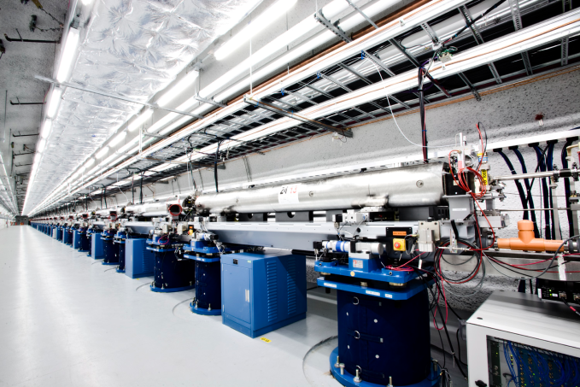
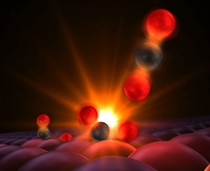
Understanding and Controlling Matter at the Atomic Scale
Traversing a Catalytic Reaction Pathway in Femtosecond Steps
SLAC researchers revealed details of a catalytic mechanism (CO oxidation at a ruthenium catalyst) by combining ultra-fast optical and x-ray laser pulses.
Ultra-bright femtosecond x-ray pulses from LCLS allowed researchers to directly characterize catalytic reaction intermediates.
The detailed understanding of elementary reaction steps enabled by LCLS opens the door for new catalysts that are both more reactive and more robust, leading to greater efficiency and reduced energy costs.
The 132 m LCLS undulator hall.
Reference: Ӧstrӧm et al. “Probing the Transition State Region in Catalytic CO Oxidation on Ru”, Science 347(6225), 978-982 (2015)
The stages of photoinitiated carbon monoxide oxidation at a ruthenium catalyst surface.
Notes:
Motivation:
Science examples in the four sections surveying capabilities have been chosen to represent some of the cutting edge research at each class of facility.
In nearly all cases, these examples have clear implications for development of the energy technologies surveyed throughout the QTR.
The science examples are providing specific examples that complement the more general descriptions of how each class of facility can support energy technology R&D that we provide in the main chapter content.
Science example:
Our x-ray light source example puts a spotlight on one of a growing number of new results that are made possible by the one-of-a-kind LCLS, the worlds first hard x-ray FEL.
This example describes direct experimental evidence of reaction intermediates obtained for CO oxidation on a Ru catalyst surface.
The example serves to highlight the unique capabilities of the LCLS, as well as what these capabilities enable for the research communities that leverage this tool.
Similarly, our examples describing imaging stress in additively manufactured turbine blades using neutron scattering or novel nanoscale synthesis techniques that enable improved optical and thermal control in window coatings serve to highlight unique ways in which BES-supported capabilities are contributing to energy technology.
Other Examples:
“New Approaches to Turbien Blade Manufacturing” – Leveraging neutron scattering techniques to understand the physical properties in turbine blades manufactured using additive techniques.
““Smarter” Smart Windows Enabled by Nanoscience” – Applications of novel nanoscale synthesis techniques is enabling development of new window glazings that can meet the need for tunable optical and thermal transparency.
“Growing Nano “Hair” for Electrodes” – Controlling 3D structure of nanomaterials using external stimulus to design novel electrodes for energy storage and conversion.

Slide 18
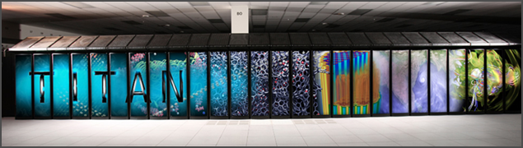
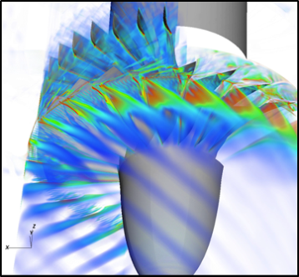
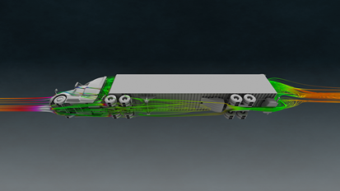
Modeling and Simulation of Complex Phenomenon
Accelerating discovery through modeling and simulation of real systems.
DOE and SC supported supercomputers enable simulation of complex real-world phenomena, putting true “systems-by-design” in reach.
The Office of Advanced Scientific Computing Research supports this push to modeling and simulation of real systems through parallel development of hardware, software, and skilled personnel.
  Leadership-class computers
  Production-class computers
  Energy Sciences Network
DOE computers - enabled through dedicated outreach from the laboratories - have an enormous impact across the engineering and manufacturing space.
The development needs of exascale computing – hardware, software, and efficiency – are being supported through co-design centers.
Name | Performance (pflops/s) | Laboratory
Titan | 17.6 | Oak Ridge
Mira | 8.60 | Argonne
Cascade | 2.53 | Pacific Northwest
Edison | 1.65 | Lawrence Berkeley (NERSC)
Hopper | 1.05 | Lawrence Berkeley (NERSC)
Red Sky | 0.43 | Sandia/NREL
Notes:
Motivation:
The developments described in the previous two sections are increasingly being enabled by advances in computational science.
Computer-based design of new materials can accelerate discovery and development of new materials for science and energy applications.
Advanced computing is helping to reveal all the interconnections in complex biological systems that dictate dynamics and determine product outputs such as biofuels.
Accurate climate prediction requires models that can integrate all the contributing physical, chemical, and biological processes that influence climate at a high level of fidelity within a realistic period of time.
Computing for engineering and manufacturing is providing a competitive advantage and accelerating product development.
Capabilities:
Leadership-class computing facilities
Dedicated to solving science and engineering problems too expensive for less powerful computers.
Computing time is allocated to problems addressing grand challenge and/or mission-critical science.
These two machines rank 2 and 5 on the top 500 supercomputer list.
Production-class computing facilities
Used for simulations that don’t require leadership computing power and/or to prepare codes for eventually use on LCFs.
List includes the computers at NERSC (LBNL), PNNL, NREL, Argonne, etc.
Energy Sciences Network
Provides 100 Gbit/s bandwidth to computing users across the national laboratory system.
It is increasingly finding application to large-scale experimental science (e.g. experiments conducted at LCLS, LHC), enabling near real time analysis of experimental results.
Applied R&D and Engineering:
The ACCEL program at ORNL, the Industry Engagement Team at ANL, and the Private Sector Partnership at NERSC, are examples of laboratory initiatives focused on supporting industrial users of DOE high performance computers.
Exascale:
The transition to exascale computing will enable, for the first time, true simulation of real world systems, which are characterized by interacting physical processes (multi-physics) occurring over a range of temporal and spatial scales.
Co-design - where the requirements of the scientific problem are considered when designing the computer system hardware and software – will ensure these machines are used effectively once built. There are three co-design centers current – ExaCT (combustion), ExMatEx (materials in extreme conditions), and CESAR (nuclear energy).
Picture credits: optimization of gas compression system for CCS (Titan); SmartTruck (Titan)

Slide 19
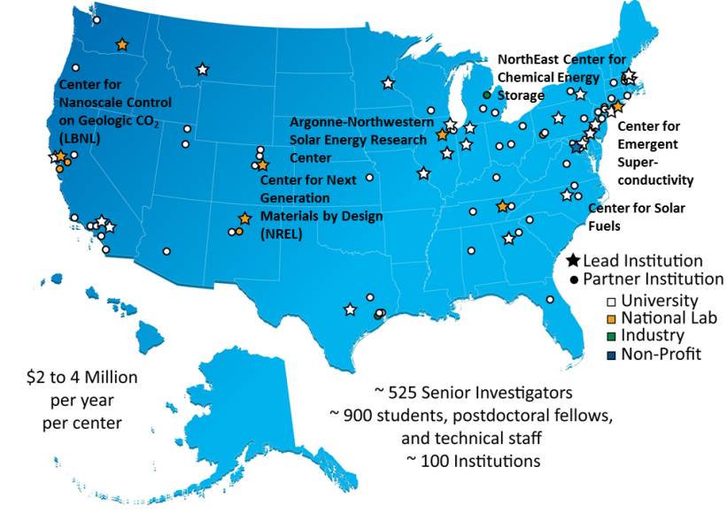
Multi-disciplinary, Multi-scale Research
Novel funding modalities foster collaborative, multi-disciplinary energy science research.
  Energy Frontier Research Centers accelerate high-risk, high-reward fundamental research for energy technology.
  Energy Innovation Hubs integrate basic and applied research and technology development for complete energy systems with transformative potential.
  Bioenergy Research Centers accelerate transformational breakthroughs in the basic science necessary for cost-effective, large scale biofuels production.
Current EFRC locations and partnering institutions. Selected EFRCs are highlighted to show relationships to technologies surveyed in the QTR.
The Centers are a strong link between basic and applied research for the energy technologies surveyed in the QTR.
Notes:
Motivation:
The DOE and Office of Science support three different research center modalities that foster cross-disciplinary collaboration to tackle the most challenging science problems for transformative energy technologies.
The talent from which these centers draw has been developed through years of funding support by Science to universities and national laboratories.
The Centers are the embodiment of the way in which the Office of Science workshop approach to portfolio development can have transformative impacts on entire programs.
EFRC (32):
Addresses one or more Grand Challenges (see report Directing Matter and Energy) and a priority research direction identified by the Basic Research Needs workshops.
Bring together universities, national labs, private sector, and non-profit researchers.
Centers are often based at or closely partnered with national laboratories, allowing researchers to leverage large-scale experimental and computational tools.
The EFRCs are a key bridge between the basic and applied research communities.
Centers called out in the map are representative of the close connection between Center research and the science needs articulated throughout the QTR.
EIH (4):
Designed to integrate basic and applied research and technology development in order to realize a complete energy system with transformative potential.
Each Hub is unique in how it approaches it’s goals, dictated by the current state of technology and its associated industry.
BRC (3):
The BRCs are integrated like EFRCs but funded like Hubs, focusing on the entire pathway from crop to fuel production.
BRCs are focused on basic research, but uniquely committed to fostering collaboration and technology transfer with the private sector.

Slide 20
Efforts at DOE HQ to Increase Collaboration
We’re also fostering increased collaboration and cross fertilization at DOE HQ and the National Laboratories through:
  Budget crosscutting initiatives
    Energy-water nexus
    Grid modernization
    Subsurface technology and engineering R&D
    Exascale computing
    Supercritical CO2
    Materials
    Cybersecurity
  Technology Teams
    Clean energy manufacturing
    Grid
    Subsurface technology and engineering R&D
    Advanced computing
    Supercritical CO2
    Water-energy
    Energy storage

Slide 21
Conclusion
The QTR will help identify key research and development opportunities, which we hope will not only guide DOE investment but investment across the national energy enterprise.
The final report is nearing completion and will be available in print and online, with the technology assessments fully accessible online.

