Slide 1
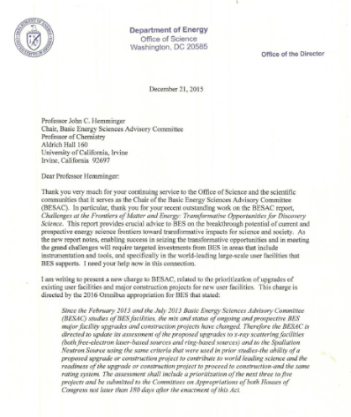
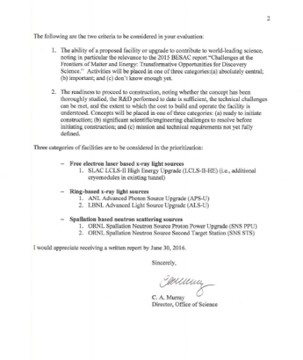
BESAC New Charge on Prioritization of Facility Upgrades
From: Dr. Cherry A. Murray (Director, Office of Science)
I am writing to present a new charge to BESAC, related to the prioritization of upgrades of existing user facilities and major construction projects for new user facilities.
The following are the two criteria to be considered in your evaluation:
The ability of a proposed facility or upgrade to contribute to world-leading science, noting in particular the relevance to the 2015 BESAC report “Challenges at the Frontiers of Matter and Energy: Transformative Opportunities for Discovery Science.” Activities will be placed in one of three categories:(a) absolutely central; (b) important; and (c) don’t know enough yet.
2. The readiness to proceed to construction, noting whether the concept has been thoroughly studied, the R&D performed to date is sufficient, the technical challenges can be met, and the extent to which the cost to build and operate the facility is understood. Concepts will be placed in one of three categories: (a) ready to initiate construction; (b) significant scientific/engineering challenges to resolve before initiating construction; and (c) mission and technical requirements not yet fully defined.

Slide 2
BESAC New Charge on Prioritization of Facility Upgrades
Three categories of facilities are to be considered in the prioritization:
  Free electron laser based x-ray light sources
    SLAC LCLS-II High Energy Upgrade (LCLS-II-HE) (i.e., additional cryomodules in existing tunnel)
  Ring-based x-ray light sources
    ANL Advanced Photon Source Upgrade (APS-U)
    LBNL Advanced Light Source Upgrade (ALS-U)
  Spallation based neutron scattering sources
    ORNL Spallation Neutron Source Proton Power Upgrade (SNS PPU)
    ORNL Spallation Neutron Source Second Target Station (SNS STS)

