Slide 1
LCLS-II High Energy (LCLS-II-HE)
A proposal to maintain US leadership in X-Ray FEL-based science
Chi-Chang Kao
Director
February 2016

Slide 2
Outline: A high energy upgrade to LCLS-II provides a straightforward solution for sustained world-leadership
Context: LCLS and LCLS-II
Scope of LCLS-II-HE
Science opportunities and requirements
Readiness to proceed

Slide 3
SC’s bold investment in LCLS has opened new directions of research in tackling grand challenge problems in multiple disciplines
Revealing coupled electronic & nuclear dynamics
Tracking ultrafast non-radiative decay
“Simple” isolated gas-phase molecules
First glimpse of chemical bond formation
Capturing elusive transition states
Chemical reaction on “ideal” metal surface
Momentum dependent collective modes in solids
Non-equilibrium electron-phonon coupling
Dynamics in “ideal” bulk materials
“Molecular movies” of systems operando
Transient atomic structure of complex systems
Initial frames via nano-crystallography
Work over the past 6 years has highlighted the key areas where coherence,
fs time-resolution, and high pulse energy can have a revolutionary impact

Slide 4
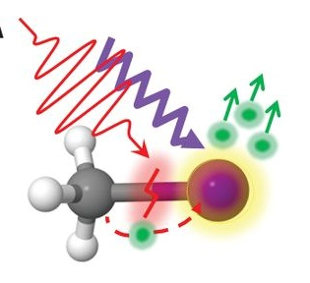
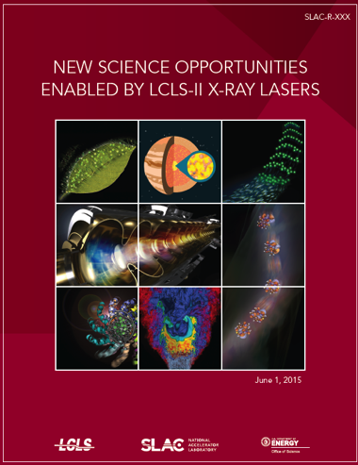
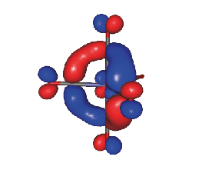
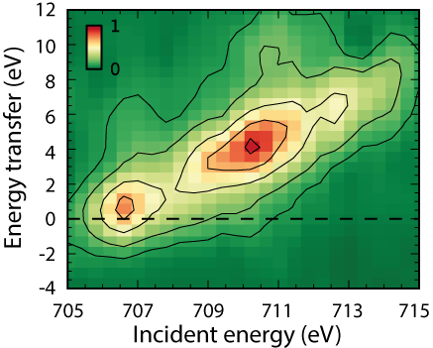
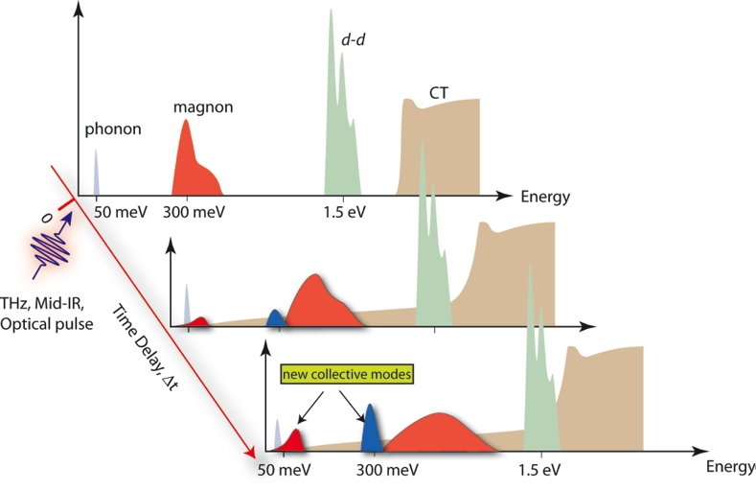
LCLS-II provides a major step forward, and a foundation for the future, satisfying the 2013 BESAC recommendation
Science Enabled by LCLS-II High Repetition Rate
Entanglement and correlation dynamics in isolated molecules
Δt = 350 fs
Local chemical structure and bonding:
Element specific maps of frontier
molecular orbitals and their evolution
Understand and control emergent phenomena in quantum systems with interacting degrees of freedom
>200 contributors, 2015
LCLS-II enables the study of element-specific electronic structure and excitations

Slide 5
Project Scope:
Extending High Rep Rate
To High Energy

Slide 6
This scope delivers photon energies beyond 12 keV (< 1Å) in a continuous pulse train up to 1 MHz repetition rate
Electronic dynamics
Atomic-scale structure
10
26
LCLS-II-HE
10
25
LCLS-II
Eu-XFEL
10
24
23
Average Brightness
(ph/s/mm²/mrad²/0.1%BW)
10
10
22
DLSR
limit
LCLS
10
21
10
20
Photon Energy (eV)
10
19
2000
4000
6000
8000
10000
12000
14000
LCLS-II-HE provides a substantial advance over any existing
or proposed X-ray capability anywhere in the world

Slide 7
LCLS-II-HE scope
Double the electron energy of the accelerator (4 ➔ 8 GeV)
  Extends X-ray energy limit from 5 keV to 12 keV
Install a second bypass line to provide a dual source
  Delivers simultaneous soft X-ray and hard X-ray beams at high rep-rate
Provide specialized instruments for unique new source
  Delivers optimized measurement capabilities
This provides a qualitatively new capability, unique in the world,
delivering ultrafast, Ångström performance at high average power

Slide 8
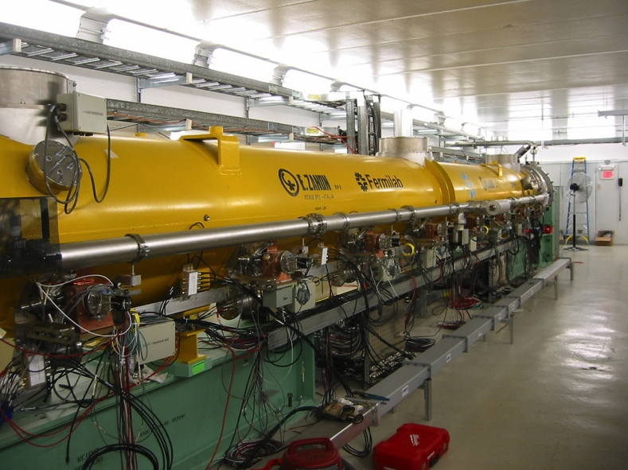
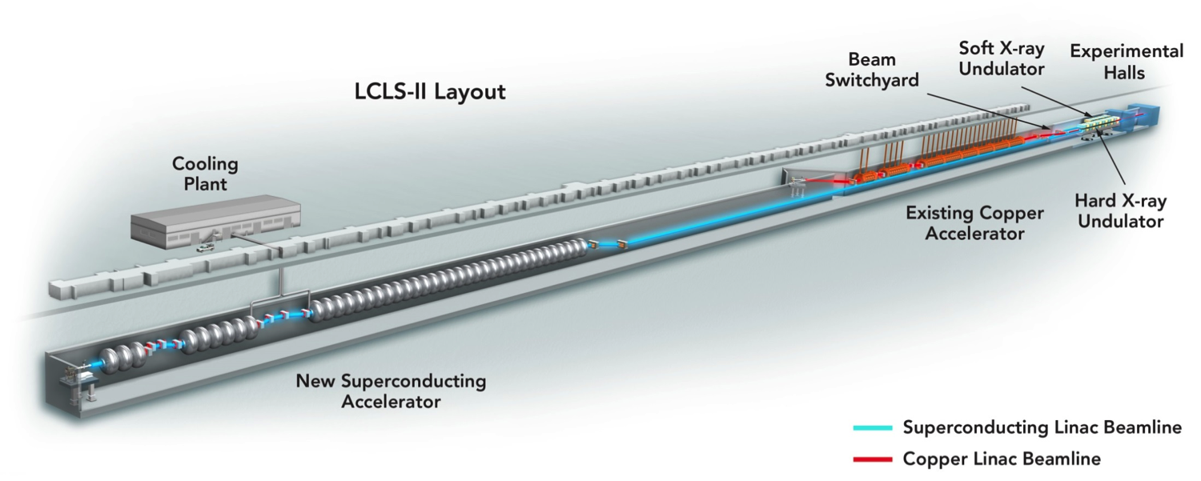
The scope includes the addition of cryomodules to extend the accelerator’s performance to 8 GeV
Doubles electron energy (4 ➔ 8 GeV)
  Add 19 more RF cryomodules
  Increase acceleration gradient
+19
We will make use of the existing tunnel, cryomodule design, and the cryogenic cooling capacity already being installed by the LCLS-II Project
Notes:
)

Slide 9
The bypass line enables a dual electron-beam capability
  2 energies available simultaneously at high repetition rate
  Add bypass for the existing 4 GeV beamline
  Optimize soft X-ray and hard X-ray undulators simultaneously
Plus, existing Cu-linac can deliver high pulse energy at 120 Hz (to 25 keV)
LCLS-II-HE Layout
3-8 GeV
8 GeV CW-SCRF Linac
(54 cryomodules)
3-8 GeV bypass
SXU
3-15 GeV Cu-Linac: LCLS
L2
SCRF L3
SCRF L4
Sec. 11-20 Linac
Sec. 21-30 Linac
HXU
3-4 GeV (LCLS-II bypass)
3-8 GeV,
3-15 GeV
This allows parallel, or combined beam experiments – offering flexibility to develop and exploit new techniques in this rapidly evolving field

Slide 10
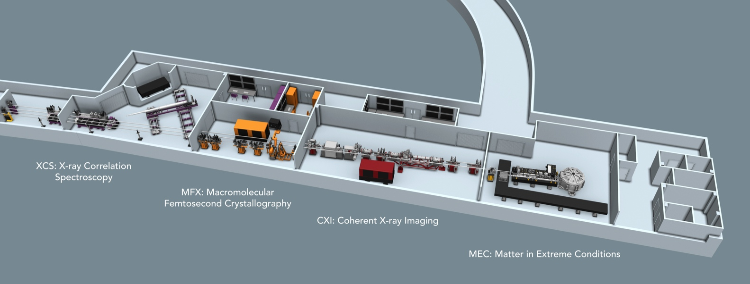
The scope includes instrumentation to take full advantage of the transformative nature of the new source
Combined sources for simultaneous atomic and electronic structure
Instrumentation for
  high resolution (~1 meV) spectroscopy
  atomic-scale imaging of fluctuating systems
The existing, multi-laboratory detector development roadmap provides a step-wise approach to exploiting this source on the required timescale
LCLS Far Experimental Hall
These extensions will be implemented within the existing infrastructure,
with installation of new designs and modifications to existing instruments

Slide 11
Scientific Opportunities

Slide 12
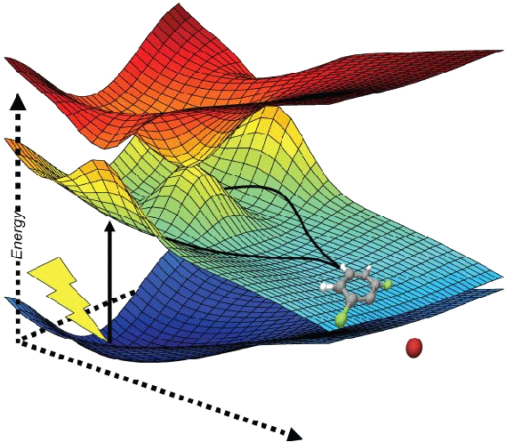
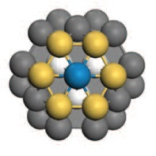
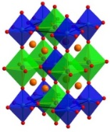
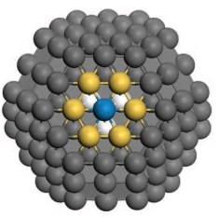
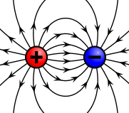
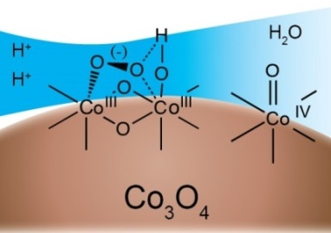
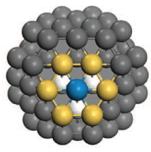
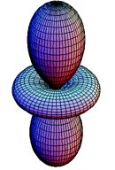
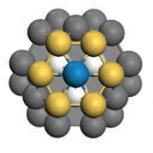
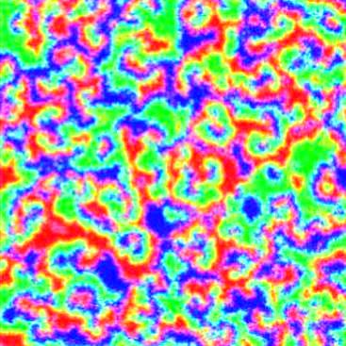
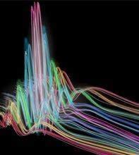

Understanding structural dynamics at the atomic scale is a key aspect of the Transformative Opportunities identified by BESAC
lattice
spin
charge
orbital
Electronic & nuclear coupling
Emergent properties
Materials heterogeneity
Heterogeneity
structural complexity
ground & excited states
Dynamics
excited state structure
non-equilibrium
transient structures
Fluctuations
in the ground state
spontaneous evolution
The ability to study non-equilibrium phenomena, and move beyond idealized materials and systems, will have major impact

Slide 13

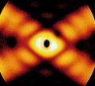
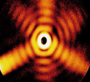
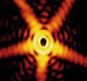
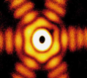
Coupled electronic & nuclear dynamics are fundamental to heterogeneous catalysis and interfacial chemistry
Scientific Opportunity
Correlate catalytic reactivity and structure
nanoparticle-by-nanoparticle
Characterize evolving heterogeneous catalyst
in real-time & operando with chemical specificity & atomic resolution
Significance and Impact
Critical input for theory for directed design & synthesis of efficient, selective and robust systems based on earth-abundant elements
LCLS-II-HE Approach
Coherent scattering and spectroscopy measured simultaneously provides shape, electronic and atomic structure of each nanoparticle
The collection of ∼10⁸-10¹⁰ independent measurements/day enables the characterization of heterogeneous ensembles
CXI
hν
hν
e⁻
Coherent X-ray imaging of
heterogeneous nanoparticles in situ
Möller et al., Nature Comm. (2014)
Requires tunable ultrafast hard X-rays at high repetition rate
to sample large ensembles

Slide 14
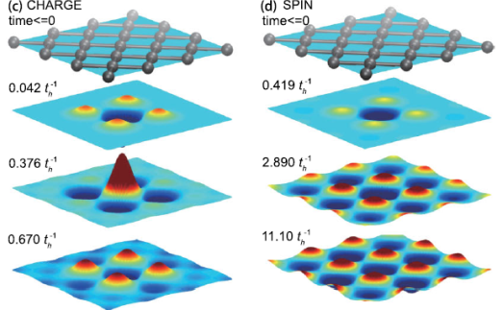

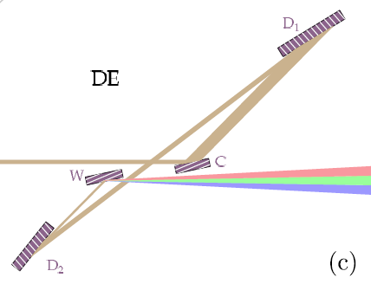
The uniquely high spectral brightness opens a long-sought window into emergent phenomena in complex materials
Scientific Opportunity
Characterize collective modes, including phonons, valence charge modes, Higgs modes in superconductors, and dynamical fluctuation modes near critical points in strongly correlated materials. Investigate low lying excitations in glassy materials
Significance and Impact
Measurement of S(q,w) provides a detailed and fundamental description of material response and a direct link to theoretical predictions of important collective modes.
LCLS-II-HE Approach
  X-ray Raman Spectroscopy (IXS) at ~1 meV scale
    Hard X-rays span entire Brillouin zone to study k-dependent coupling
    High repetition rate enables the observation of weak signals in complex materials with high-Z
    Tailored excitations can be employed (control) and measurements made under operating conditions (synthesis)
  X-ray Raman Spectroscopy (RIXS between 5-12 keV)
    Physics of the 4d and 5d materials – strong spin orbit coupling
prediction:
Modes in a metal-oxide Mott Insulator
charge
spin
“Ultimate” Resolution
designs for ~0.1 meV
Shvyd’ko, PRA (2015)
Requires average spectral brightness ~1000x beyond existing X-ray sources
to achieve full spectral resolution

Slide 15
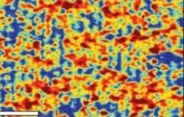

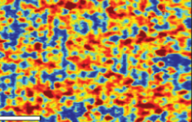
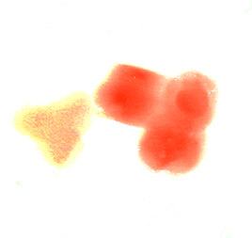

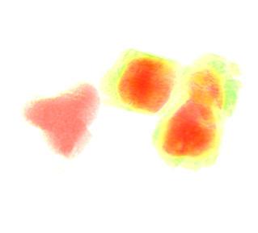
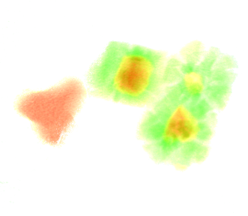
Imaging of diffusion and fluctuating material structures
Scientific Opportunity
Characterize, at fundamental length and time scales the local (atomic) distortions and long-range strain fields resulting from defect and impurity migration and ion diffusion in real materials under operating conditions
Significance and Impact
Inform directed design and synthesis modeling of energy conversion and storage materials
LCLS-II-HE Approach
Use dynamic X-ray scattering methods that span
many decades in time and space, down to fs in time and Å in space
Characterize statistically dynamic systems without long-range order, measuring S(q,t)
delay Δt
t₃
t₁
t₂
3d metal-oxide
electrode
ion
100 fs ∼1 Å/V_{sound}
discharge
5 µm
LiCoO₂
Co
Understanding ion diffusion at atomic level is central to performance improvements in electro-chemical energy storage materials
Requires hard X-rays at high repetition rate & programmable pulse structure
to capture dynamics of local changes in structure

Slide 16
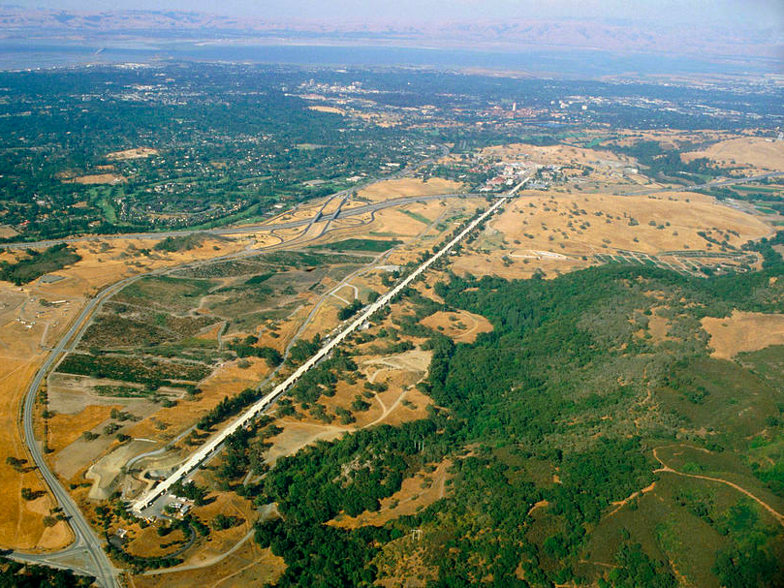
Readiness to Proceed

Slide 17
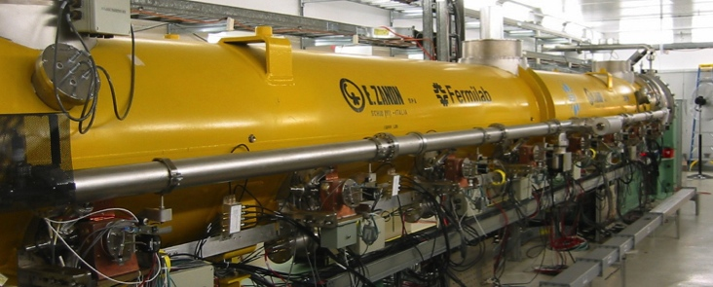
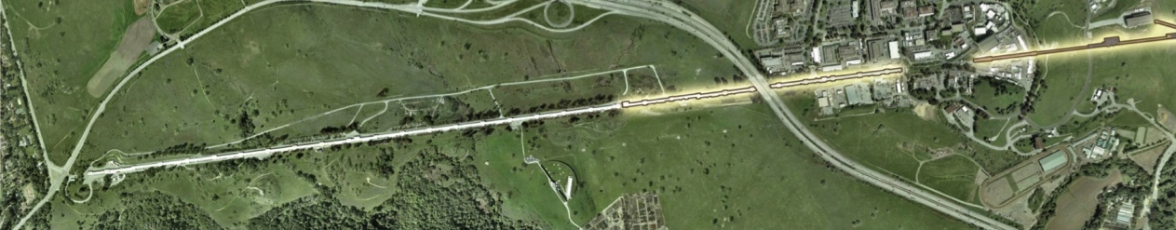
LCLS-II-HE leverages proven technology and benefits significantly from existing infrastructure at SLAC
  LCLS-II-HE requires 19 cryomodules, using proven technology and an established supply chain
    EuXFEL just built 100 almost identical cryomodules
    LCLS-II is delivering 36 cryomodules, currently in
    production by Fermi Lab and Jefferson Lab
  Installation will be in the newly refurbished available space in the existing tunnel
    No civil construction needed
  Sufficient cryogenic cooling capacity is already available at SLAC
    LCLS-II is installing 2 cryoplants as part of its risk mitigation plan
  New instruments based on the highly successful developments to date
LCLS-II-HE
LCLS-II
LCLS-II-HE is cost effective, low technical risk and ready to proceed

Slide 18




SLAC, Stanford and the DOE Site Office have an experienced team and proven management systems to proceed
Staff with the required expertise are in place at SLAC, SSO and at partner labs
Proven integrated management systems delivering cost effective solutions
Experienced and integrated team at SLAC, DOE and Stanford
We have all we need to successfully deliver LCLS-II-HE

Slide 19
Conclusions
LCLS-II-HE represents a timely, simple, and extraordinarily high impact opportunity to build on current success and maintain robust world leadership.
This project is a natural extension to LCLS-II, adding known technology, and using existing infrastructure.
It uniquely enables structural dynamics at the atomic scale, for ultrafast and high spectral resolution measurements.
The project is well defined and represents low risk to DOE.
SLAC is fully prepared and staffed to take on this challenge.
LCLS-II-HE provides DOE with a globally unique, low risk opportunity
to make a dramatic impact on the scientific priorities identified by BESAC

