Slide 1
Basic Energy Sciences Update
BES Advisory Committee Meeting
Feb. 11, 2016
Harriet Kung
Director, Basic Energy Sciences
Office of Science, U.S. Department of Energy

Slide 2
Outline
BES Staffing Update
FY 2016 Appropriation & Program Activities
FY 2017 President’s Request
Follow-on Activities

Slide 3
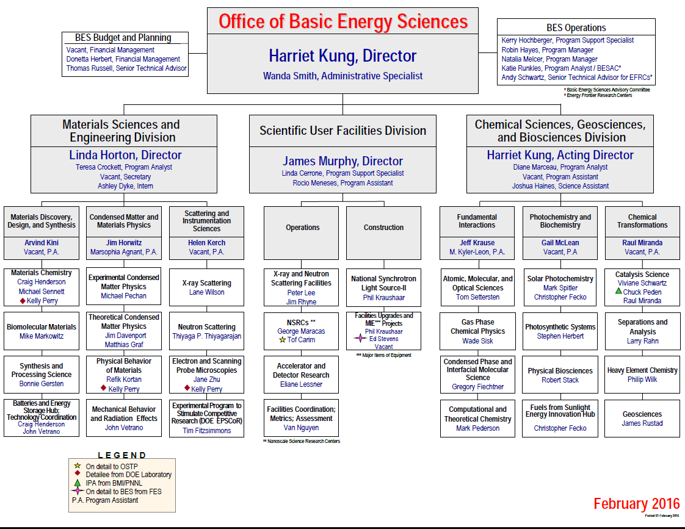
New
Vacancy

Slide 4
FY 2016 Consolidated Appropriations Act
Basic Energy Sciences
“BESAC is directed to update its assessment of the proposed upgrades to x-ray scattering facilities and to the Spallation Neutron Source using the same criteria that were used in prior studies…”
“In lieu of previous direction for materials science and engineering research, the agreement provides $15,000,000 for the Experimental Program to Stimulate Competitive Research; $12,000,000 for exascale systems (computational materials science), and $24,137,000 for the fourth year of the Batteries and Energy Storage Innovation Hub. In lieu of previous direction for chemical sciences, geosciences, and biosciences, the agreement provides $15,000,000 for the Fuels from Sunlight Innovation Hub.”
“In lieu of previous direction for scientific user facilities, the agreement provides $966,849,000, of which $35,500,000 is for major items of equipment, including $20,000,000 for the Advanced Photon Source Upgrade and $15,500,000 for the NSLS-II Experimental Tools. Within available funds for facilities operations, the agreement provides $10,000,000 to accelerate the process to critical decision-1 for the Second Target Station, $110,000,000 for the first full year of operations for NSLS-II, and $5,000,000 for research and development for the Advanced Light Source Upgrade.”
“The agreement provides $3,000,000 for a competitive solicitation for universities to perform fundamental research toward the development of a new generation of nanostructured catalysts that can be used to synthesize fertilizer and ammonia without any secondary greenhouse gases.”

Slide 5
FY 2016 BES Budget Appropriation
Research programs
  Energy Frontier Research Centers ($110M; Δ = +$10M)
  Computational Materials Sciences ($12M; Δ = +$4M)
  Core Research & Hubs at ~FY 2015 level ($558.5M)
Scientific user facilities
    All full operating facilities at near optimal operations ($865.3M)
    NSLS-II 1st year of full operations ($110M)
FY 2016 Appropriation:
$1,849 M
(+$115.8M from FY 2015)
Core Research Lab
285.9
Core Research
Univ
232.7
Facilities
Ops
865.3
EFRCs, Hubs, CMS
161.1
Construction and instrumentation
  NSLS-II instrumentation (NEXT) ($15.5M)
  Advanced Photon Source Upgrade ($20M)
  Linac Coherent Light Source-II ($200.3M; Δ = +$52.3M )
Construction
MIE
Others
235.8
68.3

Slide 6
History of BES Request vs. Appropriation*
Appropriation
Request
*Excludes SBIR/STTR

Slide 7
BES User Facilities Hosted Over 14,000 Users in FY 2015
The newly constructed NSLS-II started early operations in FY 2015 (hosted 110 users).
The three electron beam microcharacterization centers were merged administratively with their respective neighboring NSRCs in FY 2015.
The BES operations at the Lujan Neutron Scattering Center ceased operations in FY 2014.

Slide 8
FY 2015 Computational Materials Sciences Awards ($8M)
  Begun in FY 2015, Computational Materials Sciences supports research by integrated, multidisciplinary teams to develop validated software and databases for predictive design of functional materials.
  Part of DOE’s contribution to the Materials Genome Initiative for Global Competitiveness (MGI)
  Software will be usable by a broad community in universities, government and the private sector
  Midwest Integrated Center for Computational Materials, $3M/yr for 4 years
    PI, Giulia Galli, Argonne National Lab. University partners: Chicago, Michigan, Northwestern, Notre Dame, and California-Davis
    Nano-particle assemblies leading to artificial meta-materials with potential application to solar cells
    Validation at Advanced Photon Source. Leadership computing and data capabilities at Argonne
  Center for Computational Design of Functional Strongly Correlated Materials & Theoretical Spectroscopy, $3M/yr for 4 years
    PI, Gabriel Kotliar, Brookhaven National Lab. Partners: Rutgers Univ., Univ. Tennessee, Ames Laboratory
    New generation of software to accurately describe electronic correlations in oxides and complex materials where current theory fails. Application to thermoelectric materials. Validation at National Synchrotron Light Source. Codes to run at NERSC and Oak Ridge Leadership Computing Facility
  Computational Synthesis of Materials Project, $2M/year for 4 years
    PI, Priya Vashishta. U Southern California. Partners: California Institute of Technology, Lawrence Berkeley National Lab, Univ. Missouri, Rice Univ., SLAC National Accelerator Lab
    Studies of synthesis of 2-D layered structures. Application to electronics and catalysis. Confirmation includes ultrafast free electron laser experiments at LCLS. Data (Materials Project) and computing at NERSC and Argonne Leadership Computing Facility.

Slide 9
FY 2016 Computational Materials Sciences FOA ($4M)
Focus on materials and software not supported by 2015 awards
Applications from integrated teams (materials theory, modeling, computation, synthesis, characterization) must:
  Address a specific class of functional materials
    Explicitly excluded are structural, thermoelectric, and energy storage materials; structural properties; and synthesis of 2-D layered materials, assemblies of nanoparticles, isolated molecules, liquids (including ionic liquids), and homogeneous catalysts
  Support basic research that will deliver experimentally validated research codes and the associated experimental and theoretically derived data for the design of functional materials
    Explicitly excluded are proposals that emphasize density functional methods as currently implemented or semi-empirical approaches, dynamical mean field theory, and classical and first principles molecular dynamics.
  Provide a detailed plan for the full utilization of today’s petascale and tomorrow’s exascale leadership computing facilities
Funding level per Application: $1.5M to $2.5M per year for 4 years
  $4M appropriated for FY 2016
Only one Letter of Intent/Application will be accepted from any institution and from any lead PI/Director
Important dates: Required Letter of Intent Due: 3/7/2016 at 5:00 PM ET
  Application Due: 4/25/2016 at 5:00 PM ET

Slide 10
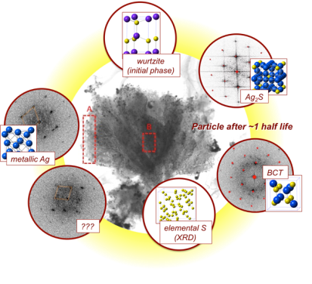
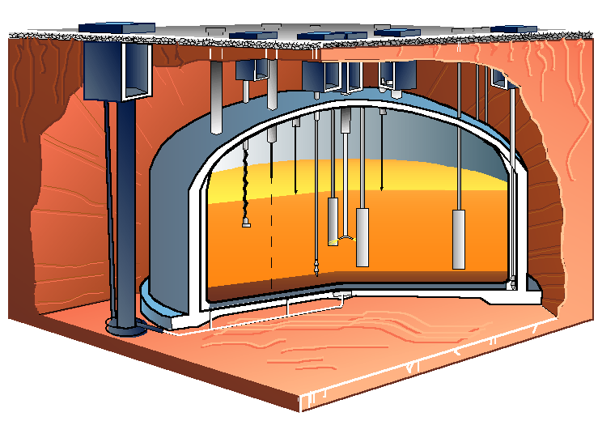
Energy Frontier Research Centers FOA ($10M)
Intent of the FOA is to support multi-disciplinary basic research teams in two topical areas of relevance to the DOE environmental management mission:
  Novel and innovative methods for characterization, transformation, and separation of nuclear waste
  New materials for long-term storage of nuclear waste, including waste forms
Applications must:
  Address relevant Priority Research Directions identified in the Basic Research Needs for Environmental Management report
  Address BESAC “grand challenges” and embody “transformative opportunities”
Funding level per Award: $2M to $4M per year for 4 years
One Letter of Intent/Application per institution and per lead PI/Director
Important dates:
  Required Letter of Intent Due: 3/9/2016
  Application Due: 4/19/2016

Slide 11

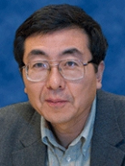
Sustainable Ammonia Synthesis Roundtable
February 18, 2016
Workshop Chairs: Jens Nørskov, SLAC/Stanford University
Jingguang Chen, BNL/Columbia University
BES Technical Leads: Raul Miranda, Tim Fitzsimmons, Bob Stack
The roundtable will convene national laboratory and university experts in catalytic, enzymatic, electrochemical and photochemical reduction of nitrogen in order to brainstorm new approaches to renewable ammonia synthesis.
  Focus: Grand challenges associated with the synthesis of ammonia without generating CO2 in an energy efficient and long-term sustainable manner.
Output: Report summarizing representative research on low-pressure ammonia synthesis and the priority research directions and crosscut capabilities needed to accelerate progress towards renewable carbon-free ammonia synthesis pathways.
Participants: Morris Bullock (PNNL ), Paul Chirik (Princeton), Ib Chorkendorff (DTU), Thomas Jaramillo (Stanford), Anne Jones (Arizona State), Peter Pfromm (Kansas State), Richard Schrock (MIT), Lance Seefeldt (Utah State), Dion Vlachos (Delaware), James Spivey (LSU), Jonas Peters (Caltech)

Slide 12
FY 2017 BES Budget Request
Research programs (w/SBIR/STTR)
  Energy Frontier Research Centers (Δ = +$33.8M)
  Computational Chemical Sciences (new, $14M)
  Core Research* with increase for Mission Innovation and other new opportunities, including quantum materials, synthesis science, and subsurface science (Δ = +$52M)
  Energy Innovation Hubs & Computational Materials Sciences
FY 2017 Request:
$1,936.7M
(+$87.7M from FY 2016)
SUF Research 26.9
SBIR/STTR, LTSM & GPP
73.7
Construction
MIE
210
NSRCs 122.3
EFRCs, Hubs, CM&CS
207.3
Neutron Sources
261.1
Facilities
Ops 872.5
CSGB
Research
256.8
Light Sources
489.1
MSE
Research
289.5
  Scientific user facilities (w/SBIR/STTR)
    All full operating facilities at optimal operations (Δ = +$7.5M)
    Accelerator and Detector Research (Δ = +$4.8M)
Construction and instrumentation
  Advanced Photon Source Upgrade
  Linac Coherent Light Source-II (Δ = -$10.3M)
*Includes EPSCoR

Slide 13
Strategic Balance of Major Program Components
FY 2017 President’s Request
Research (42%); Facility Operations (47%); Construction and MIEs (11%)

Slide 14
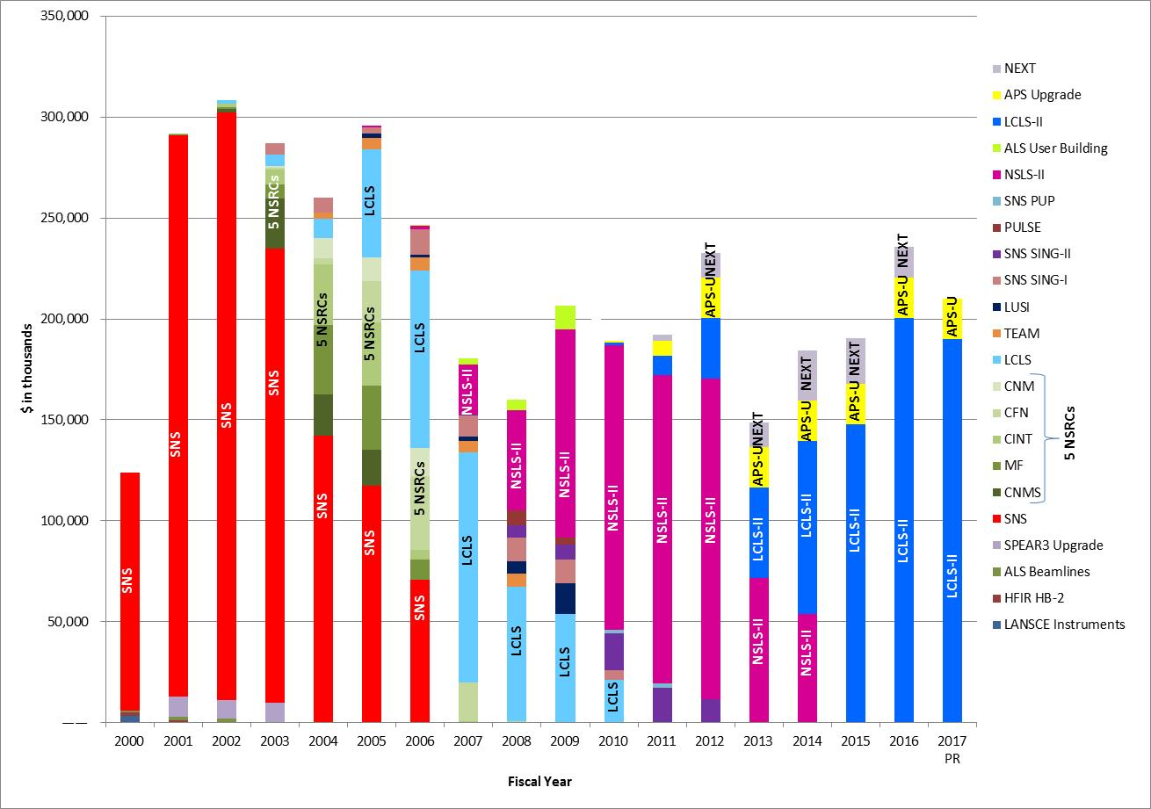
BES Construction/MIE Funding Profile 2000 – 2017

Slide 15
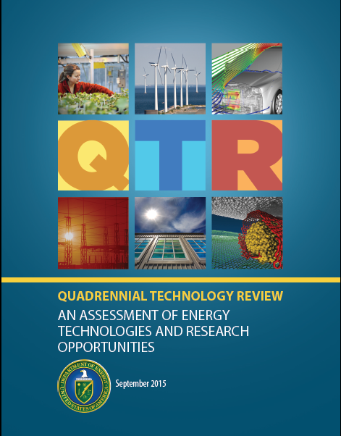

Key Documents Informing BES FY 2017 Budget Request
http://energy.gov/quadrennial-technology-review-2015
http://science.energy.gov/~/media/bes/besac/pdf/Reports/CFME_rpt_print.pdf
DOE Crosscuts:
Advanced Materials
Exascale Computing Initiative
Subsurface Science, Technology, and Engineering
Transformative Opportunities:
Hierarchical architectures
Non-equilibrium matter, non-ideal systems
Coherence in light and matter
Modeling and computation
Imaging across multiple scales

Slide 16
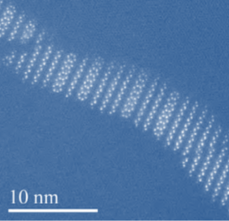
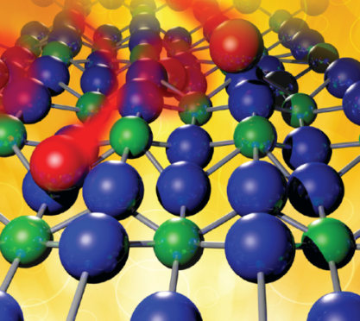
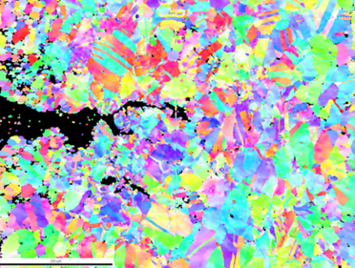
BES Core Research Contributes to Mission Innovation
Energy efficiency
  Catalysts based on enzymes that can operate under lower temperatures and ambient conditions
  Lightweight materials – hierarchical architectures and non-equilibrium structures beyond aluminum
  Thermocaloric materials – understanding and predicting properties of new materials for energy-efficient energy applications
Extreme environments
  Next generation materials for corrosive and high radiation environments, including self-healing materials that exploit reactivity induced by the nuclear environment
  Corrosion research for the electrochemical reactions in energy storage and utilization
  Interfacial chemistry leading to new separation methods, new materials for waste forms, and new control of subsurface contamination
Structure of advanced lightweight alloy
Diffusion of oxygen atoms (red) into uranium dioxide
Analysis of cracks at the nanoscale

Slide 17
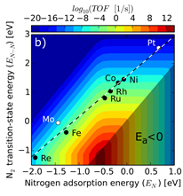
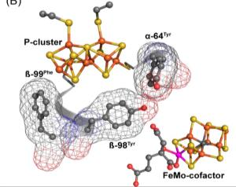
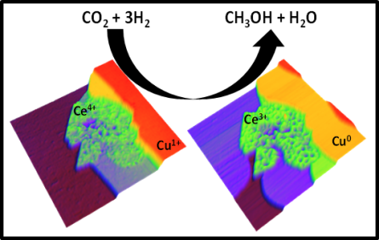
Energy Efficiency through Improved Catalysis
Advances in catalysis can make possible the production of fuels and chemicals with optimum energy efficiency and minimum environmental impact. Efficiency can be improved by:
Increased activity of catalytic sites combined with decreased temperature and pressure conditions
Higher specificity (selectivity) towards pathways that make only the desired products, and convert or prevent the undesired subproducts
Prolonged stability and recyclability
Enhanced versatility leading towards single-pot or tandem reactions
For FY 2017, proposed research will combine experiment and modeling to design novel efficient catalysts and reaction pathways.
  Efforts will focus on minimizing energy intensity by understanding and controlling the energetics of individual steps in the reaction pathway
  Multifunctional catalysts inspired by Nature’s catalysts, enzymes, or devised de novo will be synthesized to operate in water at ambient conditions
  Multidisciplinary approaches will combine principles of thermal, biological, electro-, and photoelectro- catalysis along with separations and reaction theory to develop next generation catalysts and to create new methods for conversion of renewable resources
Ammonia synthesis rate
Nitrogenase substrate reduction
Direct conversion of CO2 to methanol

Slide 18
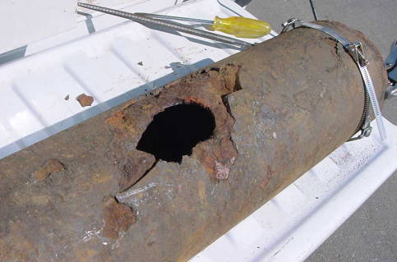
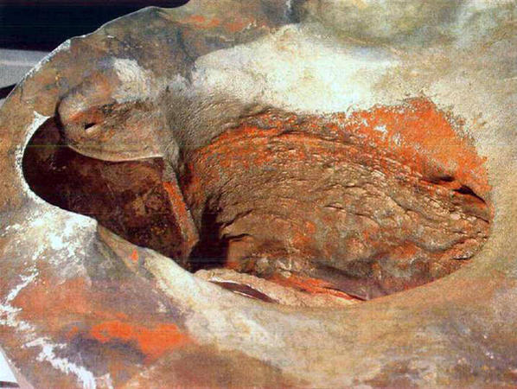
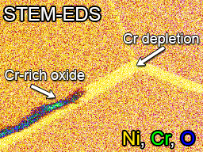
Corrosion and Materials under Extremes
Corrosion and stress corrosion cracking is a destructive electrochemical attack of a material that can substantially reduce the lifetime and performance. It is often exacerbated by other factors such as temperature, stress, radiation, and aggressive chemicals
Identified by the QER as a challenge for energy infrastructure – transmission, generation, and storage
Field is on the threshold of important breakthroughs, building on emerging advances across many fields of science and technology, especially well suited to combined experiment/theory approaches
For FY 2017, proposed research will combine experiment and modeling to develop a fundamental understanding of corrosion and degradation processes that can be applied to improve materials for energy technologies:
Use advanced modeling and characterization tools to assess the evolution of material structure and properties in multiple extreme environments with emphasis on critical regions including interfaces
High-fidelity, multiscale modeling (nano to meso) (BES), that can be integrated into predictions of corrosion degradation in actual service environments (technology offices)
Cast iron pipe failure
Stress Corrosion Cracking:
Davis-Besse Reactor Vessel
Cracking at the nanoscale

Slide 19

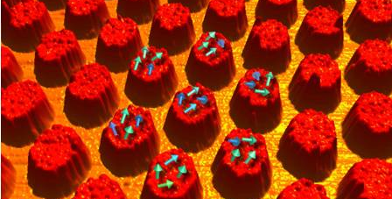
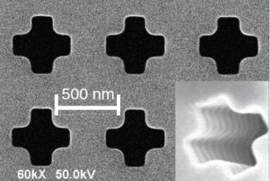
Quantum Materials
New materials are needed for next generation semiconductors, energy efficient electronics, and technological advances ranging from new magnets to superconductors to support energy technologies.
Emerging quantum materials -- materials whose properties result from strong and coherent interactions of the constituent electrons with each other, the atomic lattice, or light.
In FY 2017, additional research to discover new materials with unprecedented properties is proposed to take advantage of these phenomena and recent advances in the ability to manipulate and exploit coherence in light and matter.
Discovery of entirely new materials and properties through atomic-level control of synthesis and design of materials to enable high quality, tailored interfaces, controlled heterogeneity, and coherent manipulation of charge, spin, strain, and lattice dynamics
Application of combined characterization tools to understand diffusion at interfaces, control of spin, and correlation with structure and chemistry – including ultrafast timescales and near-atomic spatial resolution
Predictive theory and modeling coupled with experiments to evaluate new phenomena
Semiconductor
Superconducting Islands
Atomic diffusion across layers
Metamaterials

Slide 20
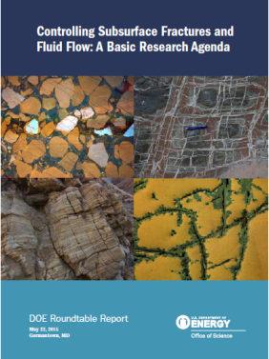
Subsurface Grand Challenge: Advanced Imaging of Geophysical and
Geochemical Signals in the Subsurface
Predicting and controlling geological response to perturbations from energy production and storage depends crucially on the arrangements of faults and fractures with respect to ambient subsurface stress.
Key Challenges
Stress, which governs the overall repository/reservoir response, is obtained only indirectly from strain and rock plasticity
Rocks have multi-scale fracture network structure - fractures cannot be individually resolved at all relevant scales
Rock mechanics is strongly influenced by chemical-mechanical coupling via precipitation/dissolution in fractures and pores
Requires tightly integrated field, laboratory, and computational approaches
Implementation Plan
$33.8M to fully fund up to 5 Energy Frontier Research Centers (EFRCs) for three years
EFRCs will engage the grand challenge through development and use of new geophysical/geochemical imaging approaches and computational methods
  Coupling with cross-cutting activities (computational/data analysis methods, new laboratory studies on imaging and chemical analysis)
  Coupling with field-based projects (supported by DOE technology programs)
http://energy.gov/subsurface-technology-and-engineering-rdd-crosscut

Slide 21

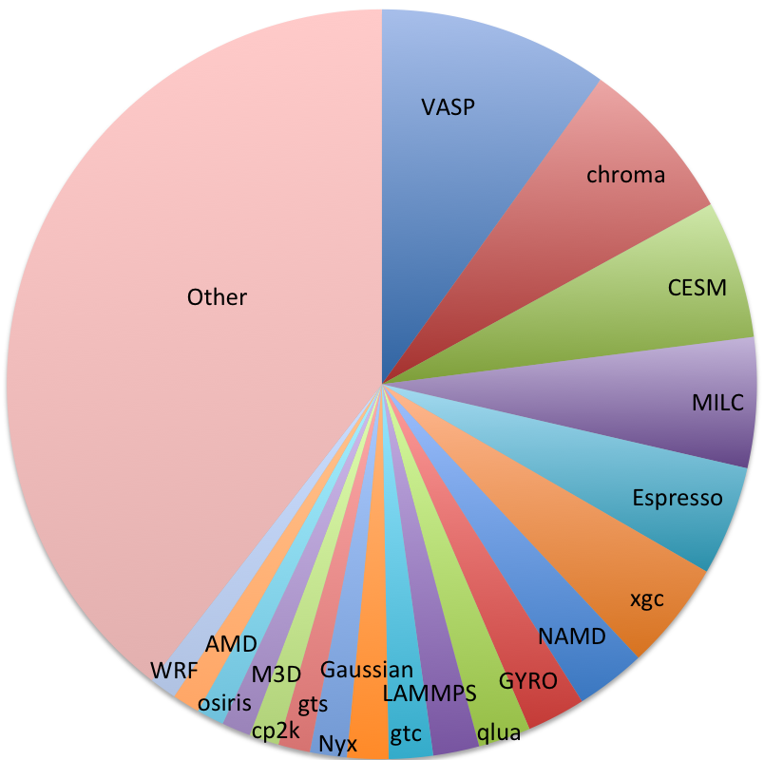



Increase for Computational Materials and Chemical Sciences
High-accuracy software is needed to understand how the behavior of atoms and molecules (or quantum effects) impacts energy conversion and materials synthesis.
Open-source, experimentally validated software, based on advanced quantum mechanical methods, is needed for accelerated prediction of functional materials and molecular assemblies..
At NERSC, the most used code is VASP, a commercial Austrian atomic scale modeling code requiring purchase of license. Development of Espresso, a materials sciences code, is led by Italy.
Top codes used at NERSC for other fields were developed in the U.S. and are all free, open-source community codes.
In FY 2017, a new effort in computational chemical sciences is proposed ($14M).
2015 Top Application Codes at NERSC
Atomic Scale
Modeling
High Energy Physics
Climate
High Energy
Physics
Atomic Scale Modeling
Plasma Physics
Biophysics
Plasma Physics
The U.S. trails other countries in development of computational codes in chemistry and materials sciences.
21

Slide 22
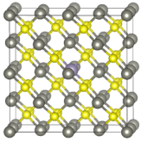
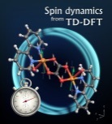
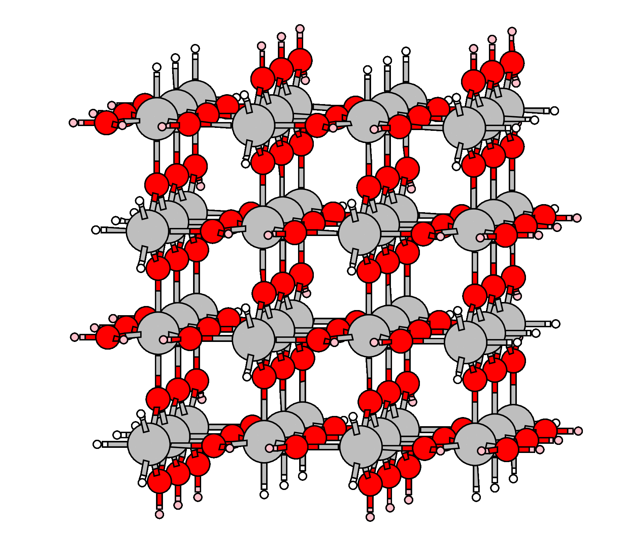
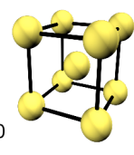
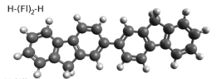
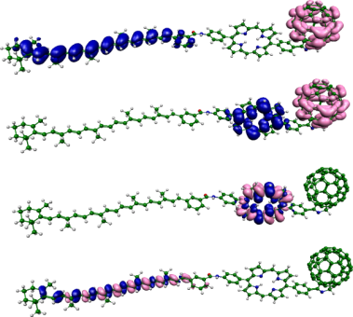
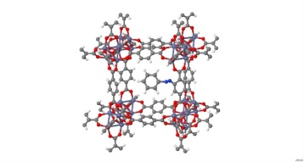
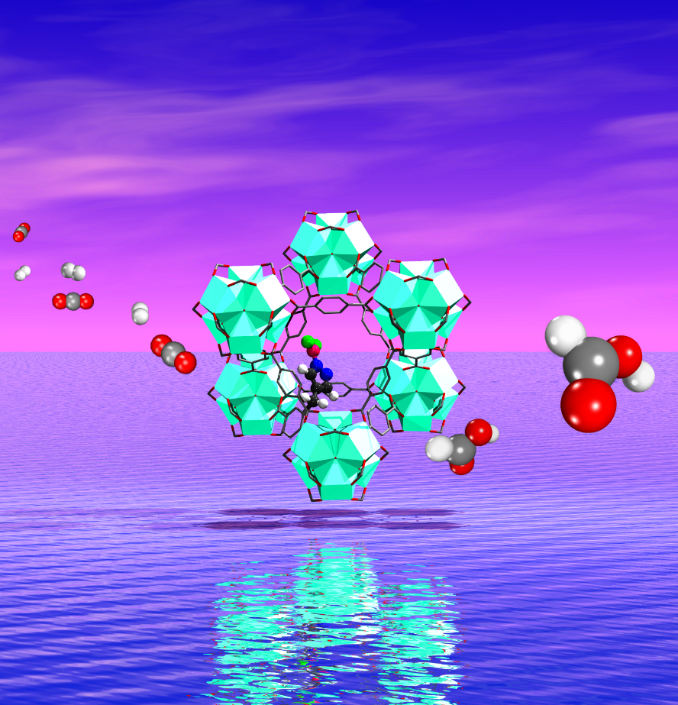
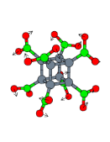
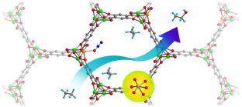
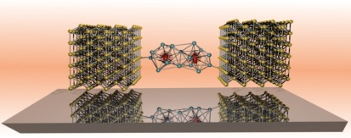
Computational Chemical Science:
Software is Key to US Scientific Leadership
1K Processors
  Open-source modular chemistry codes and software packages that are automated, account for quantum/relativistic effects, and with sufficient accuracies for d- and f- electron systems
8-50 Processors
50-100 Processors
1M Processors?
Valence Only!
All Electrons
Molecular Chemistry & Interfaces
Small molecules & simple solids
GAUSSIAN
GAMESS
VASP
ESPRESSO
BigDFT
AbInit
QCHEM
NWCHEM
??
System Energy
Energy Transfer
Charge/ Spin Transfer
Sunlight to Energy
CO₂ to Energy
Past
Today
2020-2025
Quantum effects at surfaces, interfaces, solutions, and vacuum govern chemical energy conversion, & electron transport in molecular-scale devices. Spin-dependent effects must be included for
  Artificial photosynthesis
  Gas separation and conversion
  Molecular catalysts
  Next generation computing chips
US must continue to lead development of high-accuracy chemical software that …
Is compatible with low memory peta-to-exascale computing architectures
Achieve efficient scaling of quantum methods with the number of atoms
Accounts for relativistic effects in f-electrons
Improves on DFT methods (self-interaction corrections, accuracy, new basis sets)

Slide 23
BES Contributions to DOE Crosscuts and Mission Innovation
($K) | FY 2017 Request | FY 2017 vs FY 2016 | Exascale | Adv. Materials | SubTER | MI: Efficiency | MI: Extremes
Materials Sciences and Engineering
Scattering and Instrumentation Sciences | 70,318 | +8,058 |  | ✓ |  | ✓ | ✓
Condensed Matter and Materials Physics | 133,800 | +15,751 |  | ✓ |  | ✓ | ✓
Materials Discovery, Design, and Synthesis | 76,871 | +6,861 |  | ✓ |  | ✓
Computational Materials Sciences | 12,000 | 0 | ✓
Chemical Sciences, Geosciences, and Biosciences
Fundamental Interactions | 79,233 | +4,634 |  |  |  | ✓
Chemical Transformations | 106,423 | +14,082 |  |  | ✓ | ✓ | ✓
Photochemistry and Biochemistry Research | 71,197 | +7,008 |  |  |  | ✓
Energy Frontier Research Centers | 86,766 | +32,566 |  |  | ✓
Computational Chemical Sciences | 13,635 | +13,635 | ✓

Slide 24

BES Communications
BES Program Update
  12-page brochure describing changes in the BES program in FY 2015 and accessible research highlights
  FY 2015 program updates include: completion of NSLS-II, Computational Materials Sciences awards, and the recent BESAC report, Challenges at the Frontiers of Matter and Energy: Transformative Opportunities for Discovery Science
  Research highlights illustrate BES advances in:
    Understanding and Controlling Matter
    Harnessing Material and Chemical Processes to Create Matter
    Modeling and Simulation of Complex Phenomena
  Plan to update annually
http://science.energy.gov/bes/

Slide 25

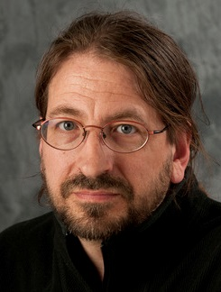
Neuromorphic Computing Roundtable: From Materials to Systems Architecture
October 29-30, 2015
Workshop Chairs: Ivan K. Schuller, UC-San Diego
Rick Stevens, ANL/University of Chicago
Co-Sponsored by BES and ASCR
SC Technical Leads: Mick Pechan (BES) and Robinson Pino (ASCR)
In response to OSTP Nanotechnology-Inspired Grand Challenges and National Strategic Computing Initiative
  Focus: Can brain-like (“neuromorphic”) computing devices based on new material concepts and systems be developed to dramatically outperform conventional technology? What are the basic research challenges for materials science and computing?
Main Conclusions:
  Creating a new computational system will require multidisciplinary teams, new computing architectures, and novel nano and meso structured materials
  Materials require fundamental understanding of formation and migration of ions, defects and clusters, developing novel spin based devices, and/or discovering new quantum functionalities
  Requires designing systems and materials that exhibit self- and external-healing, 3-D reconstruction, distributed power delivery, fault tolerance, & co-location of multistate memory and processors
http://science.energy.gov/ascr/community-resources/program-documents/

Slide 26
Follow-up Basic Research Needs Workshops
February 8 – 10, 2016
Basic Research Needs for Quantum Materials for Energy Relevant Technology
May 2016
Basic Research Needs for Synthesis Science
June 2016
Basic Research Needs for Innovation and Discovery of Transformative Experimental Tools
Fall 2016
Basic Research Needs for Efficient Energy Conversion and Use (TBD)

Slide 27
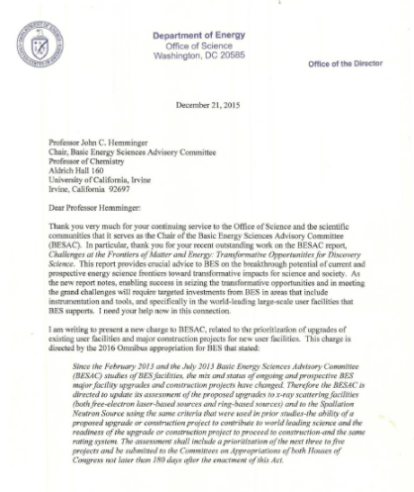
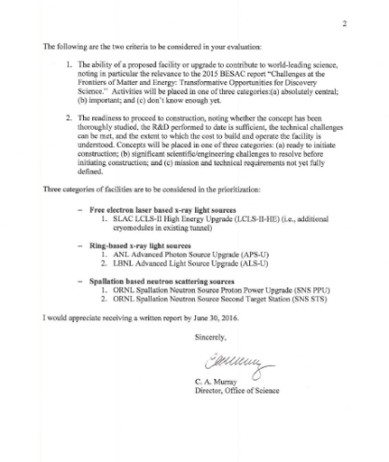
BESAC New Charge on Prioritization of Facility Upgrades
From: Dr. Cherry A. Murray (Director, Office of Science)
I am writing to present a new charge to BESAC, related to the prioritization of upgrades of existing user facilities and major construction projects for new user facilities.
The following are the two criteria to be considered in your evaluation:
The ability of a proposed facility or upgrade to contribute to world-leading science, noting in particular the relevance to the 2015 BESAC report “Challenges at the Frontiers of Matter and Energy: Transformative Opportunities for Discovery Science.” Activities will be placed in one of three categories:(a) absolutely central; (b) important; and (c) don’t know enough yet.
2. The readiness to proceed to construction, noting whether the concept has been thoroughly studied, the R&D performed to date is sufficient, the technical challenges can be met, and the extent to which the cost to build and operate the facility is understood. Concepts will be placed in one of three categories: (a) ready to initiate construction; (b) significant scientific/engineering challenges to resolve before initiating construction; and (c) mission and technical requirements not yet fully defined.

